Slide 1


“The growing role of
immune checkpoint inhibithors
in NSCLC treatment”
Michele De Tursi
Pietro Di Marino

Slide 2
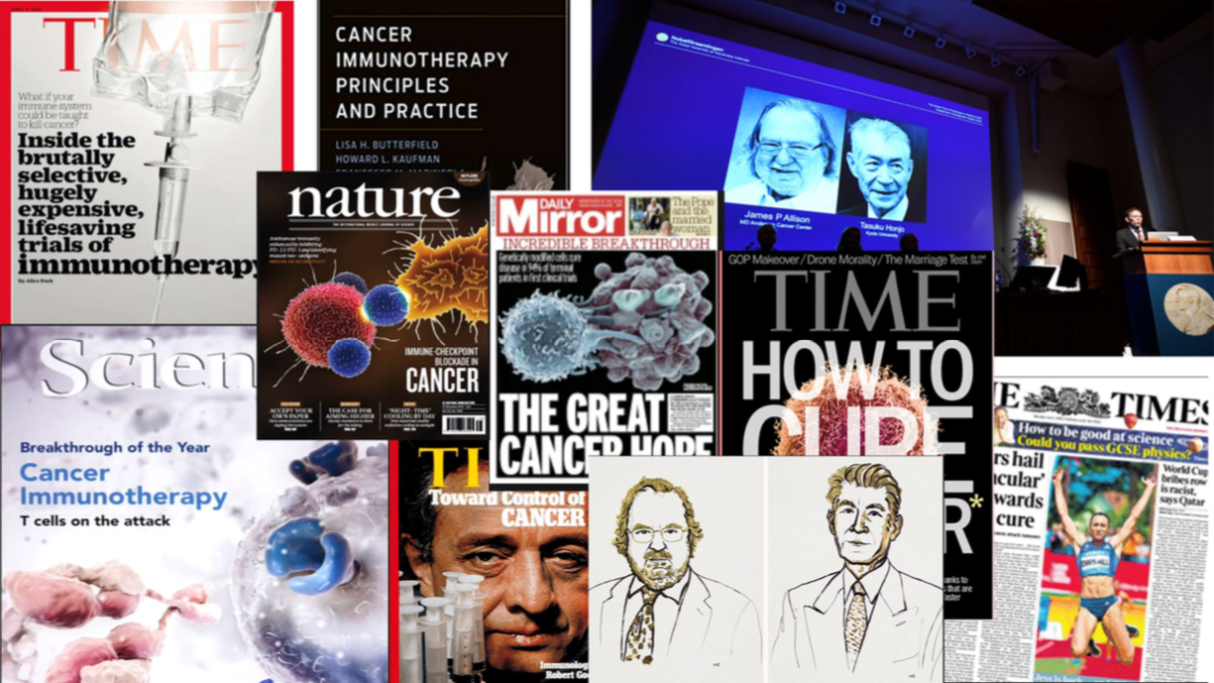

Slide 3
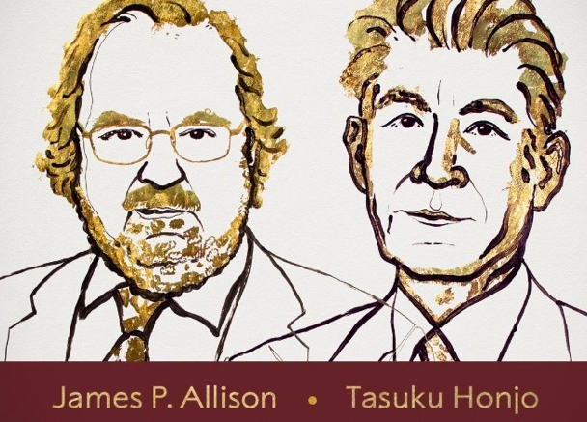
Premio Nobel per la Medicina 2018
Mr CTLA 4
Mr PD1

Slide 4
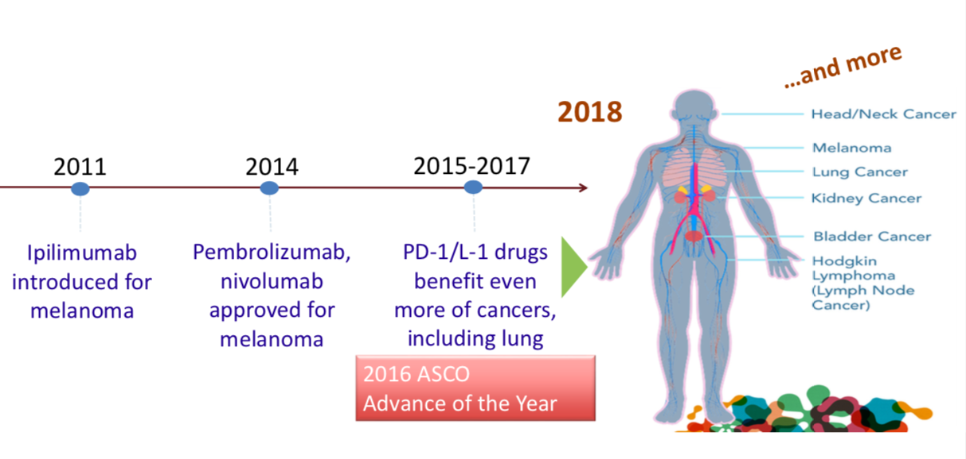
Premio Nobel per la Medicina 2018

Slide 5
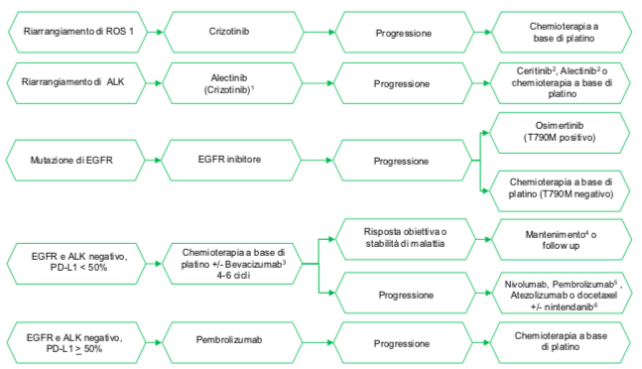
mNSCLC: oggi in Italia…
Linee Guida AIOM 2018

Slide 6
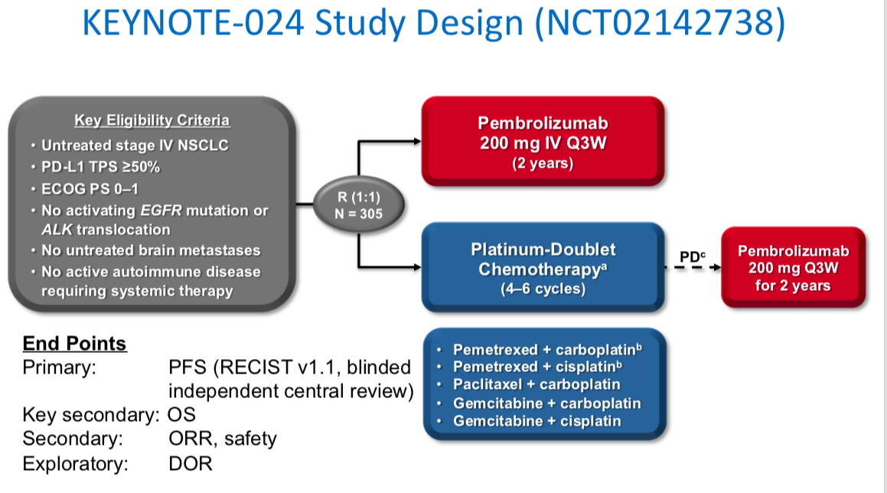
mNSCLC: in 1 linea- KEYNOTE 024

Slide 7
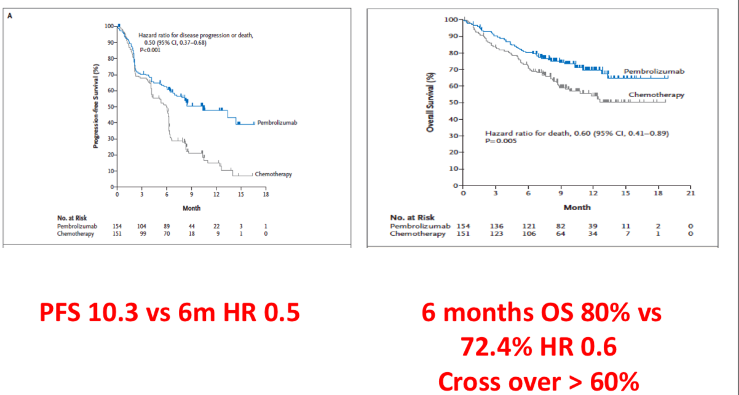
mNSCLC: in 1 linea- KEYNOTE 024
Reck M, et al. NEJM 2016

Slide 8
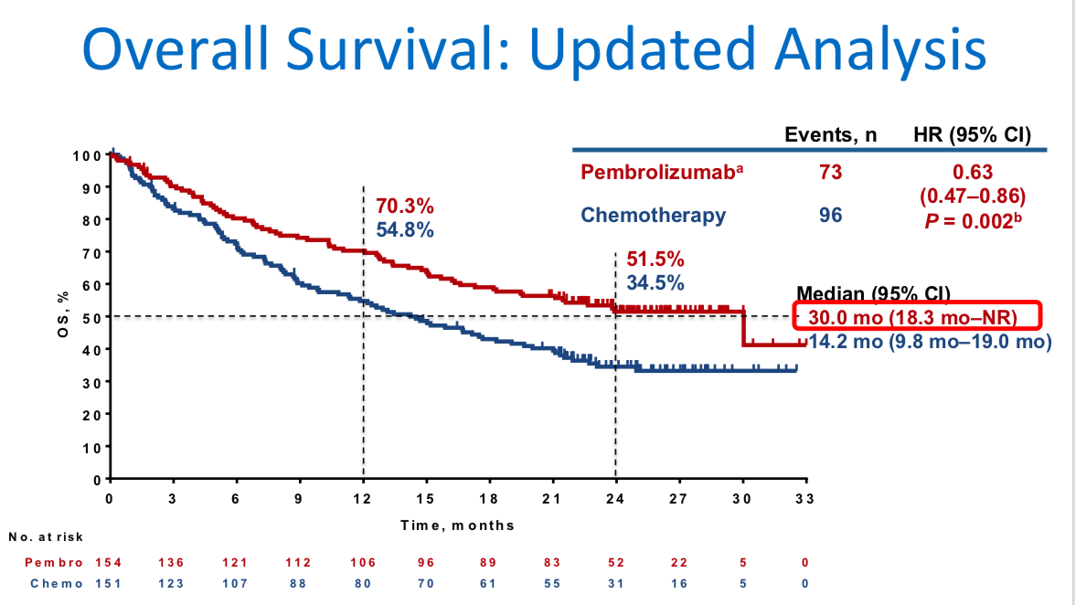
mNSCLC: in 1 linea- KEYNOTE 024
Reck M, et al. JCO 2019

Slide 9
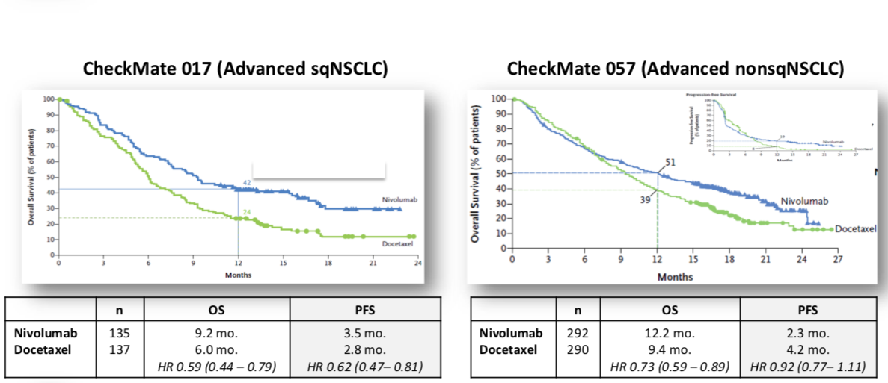
mNSCLC in 2 linea: Nivolumab

Slide 10
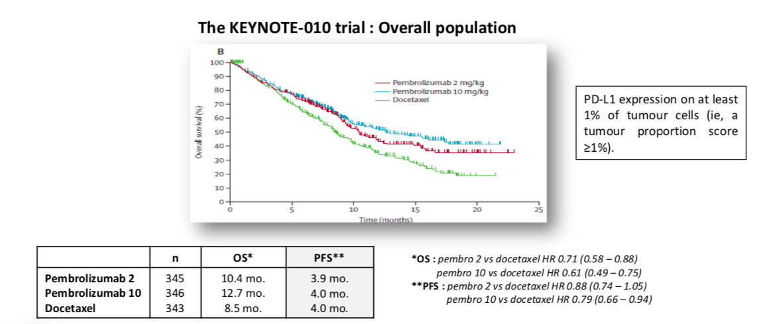
mNSCLC in 2 linea: Pembrolizumab

Slide 11
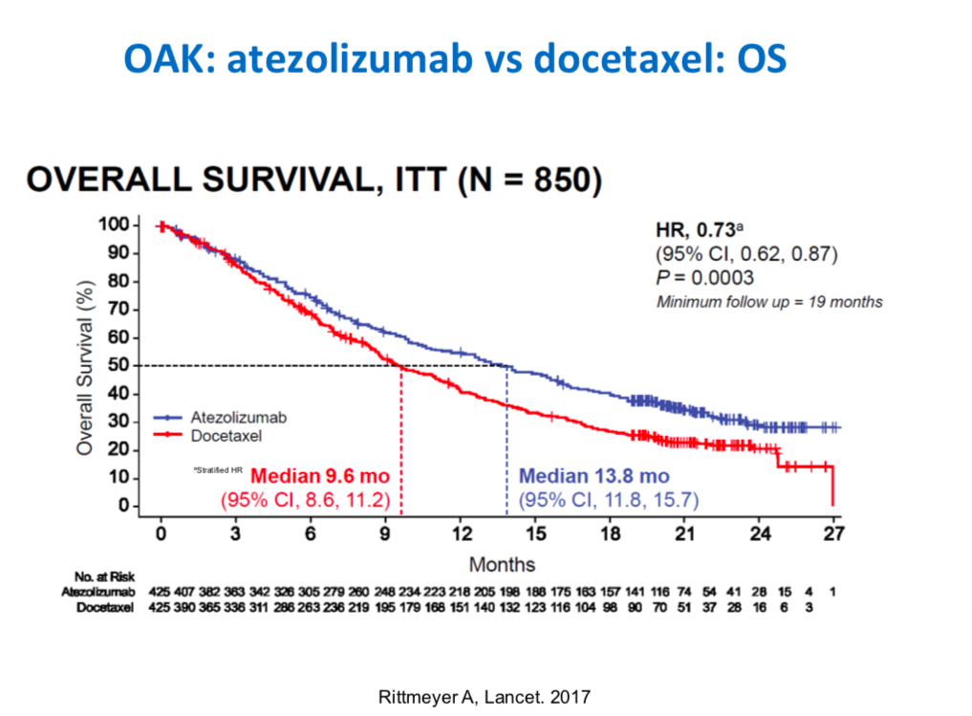
mNSCLC in 2 linea: Atezolizumab

Slide 12
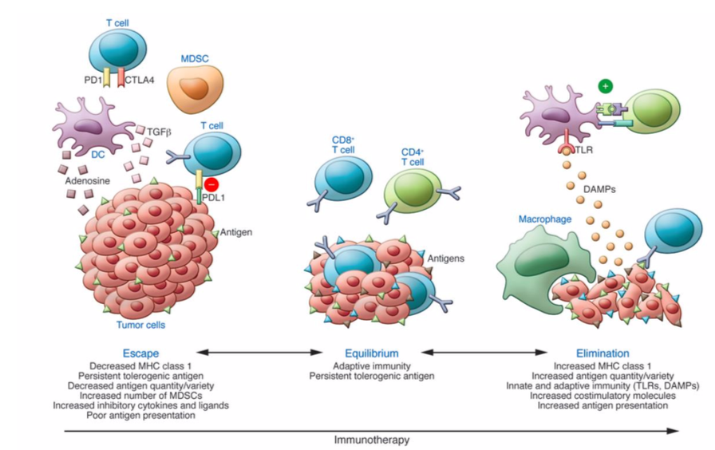
Response to cancer immunotherapy
Kalbasi, et al. J Clin Invest 2013

Slide 13
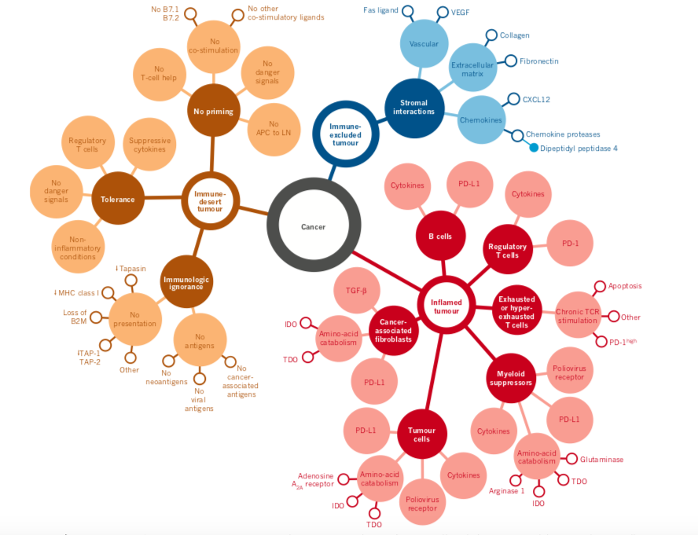
Uno dei problemi del cancro: differenti fenotipi
Chen D.S, et al. Nature 2017

Slide 14
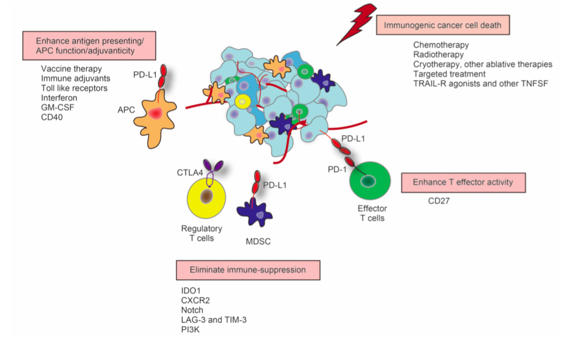
Combination strategies with checkpoint inhibition
Harris JS, et al.Cancer Biol Med 2016

Slide 15
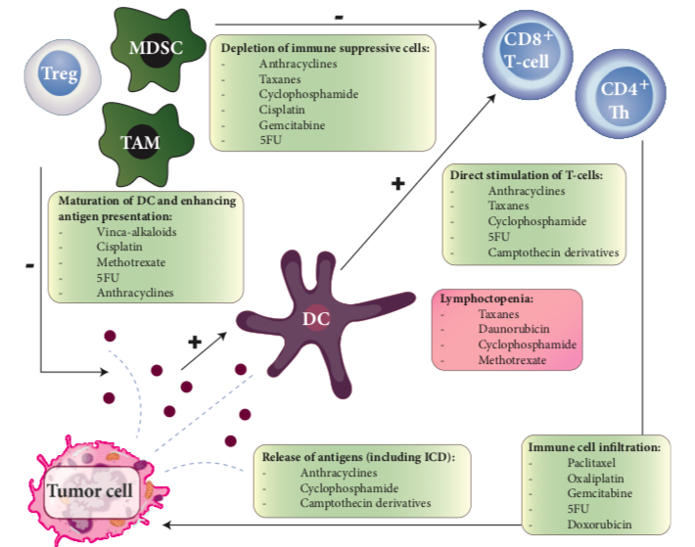
Immunomodulatory effects of chemotherapy
Heinhus K M, et al. Ann Oncol 2019

Slide 16
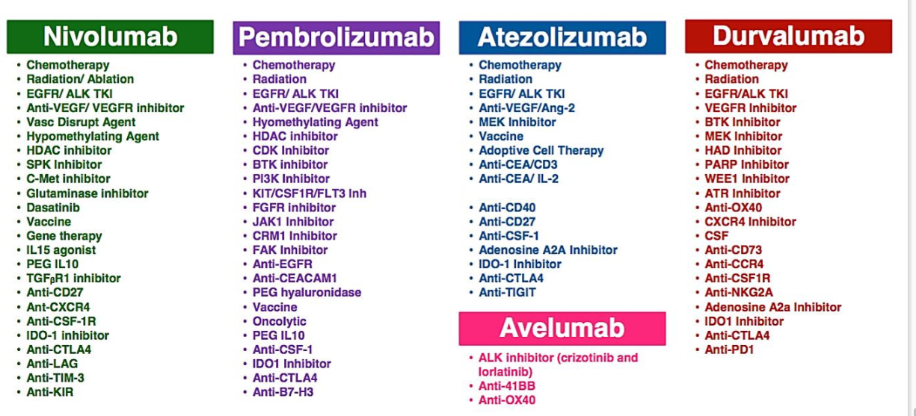
Un po’ di combinazioni…

Slide 17
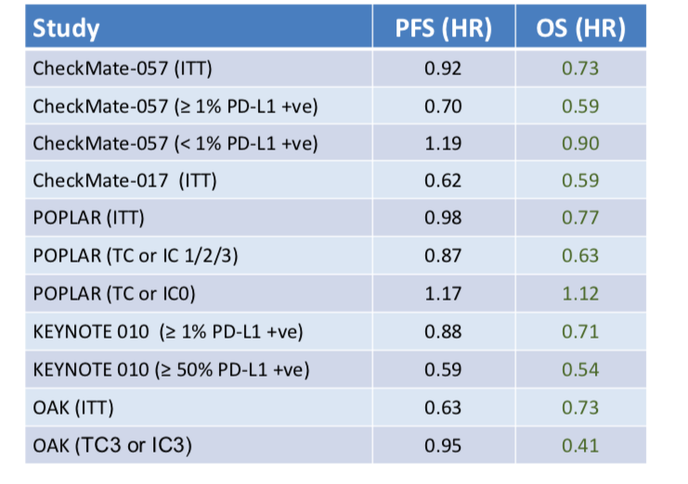
OS è più forte della PFS!

Slide 18
KEYNOTE 042

Slide 19
KEYNOTE 042

Slide 20
KEYNOTE 042

Slide 21
KEYNOTE 042

Slide 22
KEYNOTE 042

Slide 23
ImmunoCombo in 1 linea: CheckMate 227

Slide 24
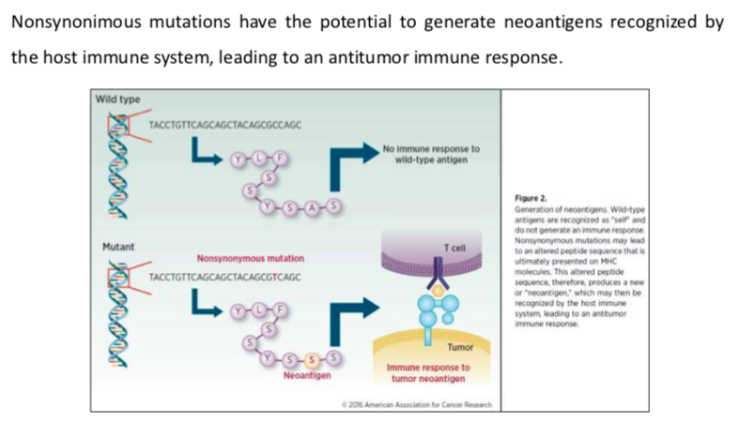
TMB and neoantigen formation
TMB: total number of somatic/acquired mutations per coding area of a tumor genome (Mut/Mb)
Braun D, et al. Clin Cancer Res 2016

Slide 25
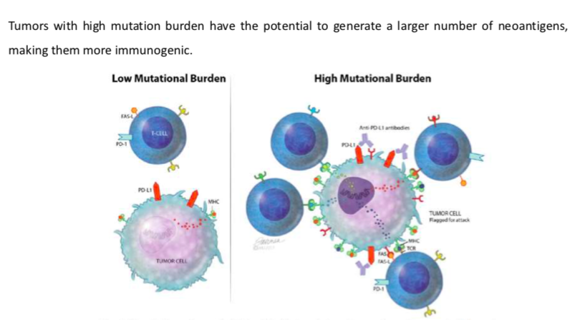
High vs Low TMB
Sharabi et al. The Oncologist 2017

Slide 26
CheckMate 227

Slide 27
CheckMate 227

Slide 28
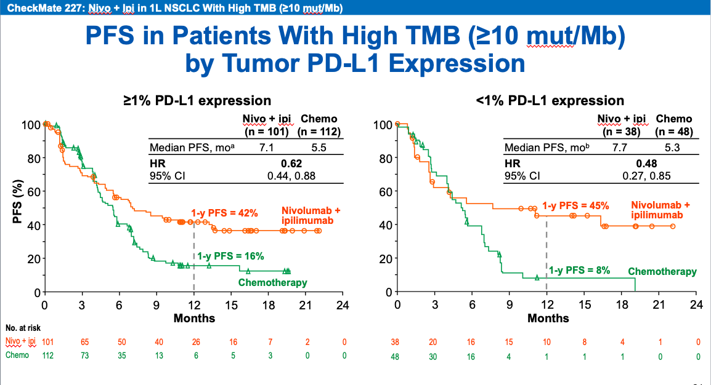
CheckMate 227

Slide 29
CheckMate 227

Slide 30
News in I linea
CheckMate 227
KEYNOTE-189
IMpower 150
IMpower 132
KEYNOTE -407
IMpower-131
Non-squamous NSCLC
Squamous NSCLC

Slide 31
CheckMate-227

Slide 32
CheckMate-227

Slide 33
CheckMate-227

Slide 34
KEYNOTE-189
Primary endpoints: OS e PFS

Slide 35
KEYNOTE-189

Slide 36
KEYNOTE-189

Slide 37
KEYNOTE-189

Slide 38
KEYNOTE-189

Slide 39
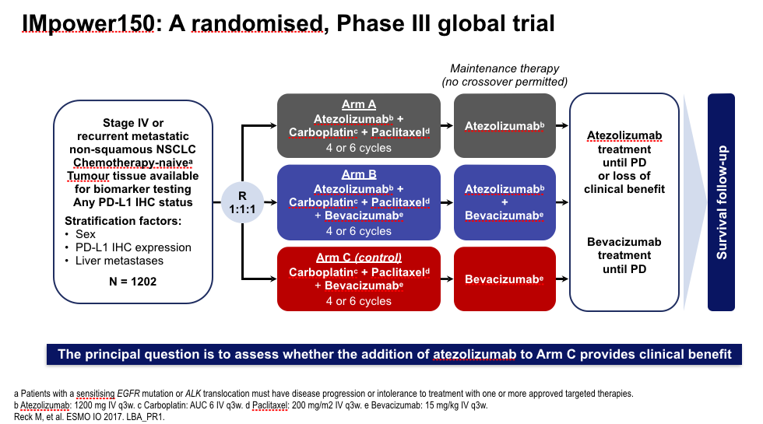
IMpower 150

Slide 40
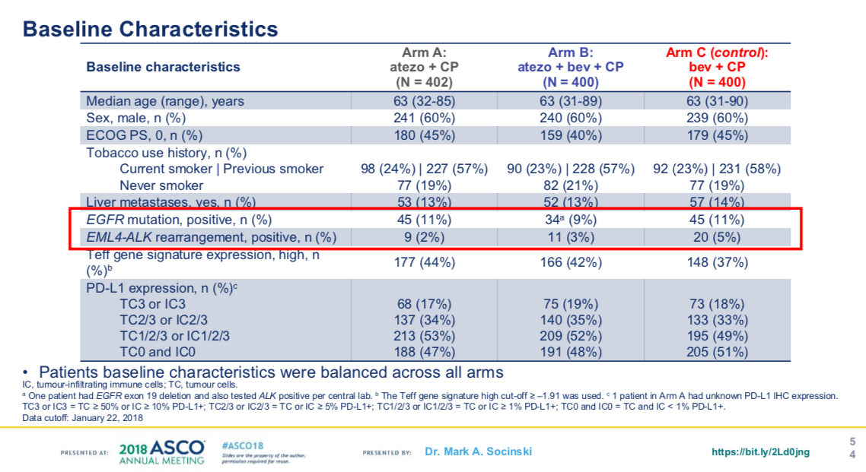
IMpower 150

Slide 41
IMpower 150

Slide 42
IMpower 150

Slide 43
IMpower 150

Slide 44
IMpower 150

Slide 45
IMpower 150

Slide 46
IMpower 132

Slide 47
IMpower 132

Slide 48
IMpower 132

Slide 49
KEYNOTE-407

Slide 50
IMpower 132

Slide 51
KEYNOTE-407

Slide 52
IMpower 131

Slide 53
IMpower 131

Slide 54
IMpower 131

Slide 55
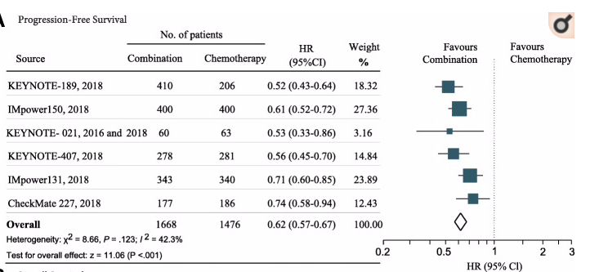
Immune-checkpoint inhibitor plus chemotherapy versus conventional chemotherapy
C
C
Zhou Y, et al. J ImmunCanc 2018

Slide 56
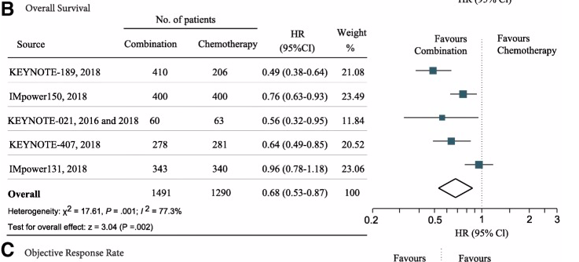
Immune-checkpoint inhibitor plus chemotherapy versus conventional chemotherapy
C
C
Zhou Y, et al. J ImmunCanc 2018

Slide 57
Checkpoint Inhibitors in Metastatic EGFR-Mutated NSCLC
Lee C K et al, J Thorac Oncol 2017

Slide 58
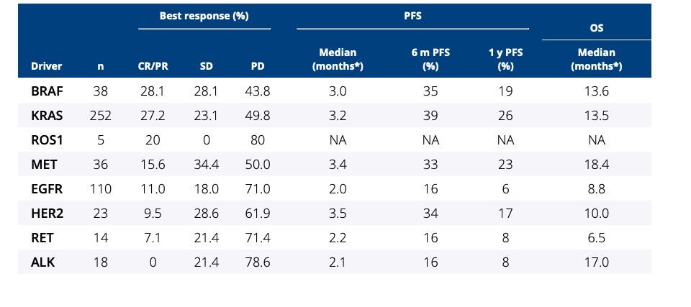
Efficacy of immune-checkpoint inhibitors (ICI) in non-small cell lung cancer (NSCLC) patients harboring activating molecular alterations (ImmunoTarget).
…ICI has inconstant efficacy in NSCLC harboring activating mutation….!”
Mazieres J, et al.Asco 2018

Slide 59
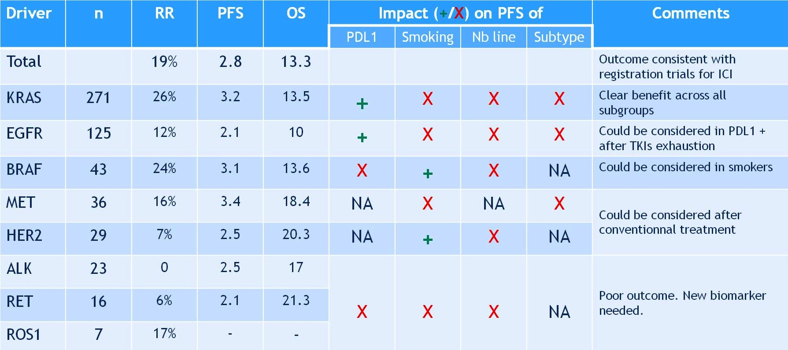
Efficacy of immune-checkpoint inhibitors (ICI) in non-small cell lung cancer (NSCLC) patients harboring activating molecular alterations (ImmunoTarget).
Mazieres J, et al. Asco 2018

Slide 60
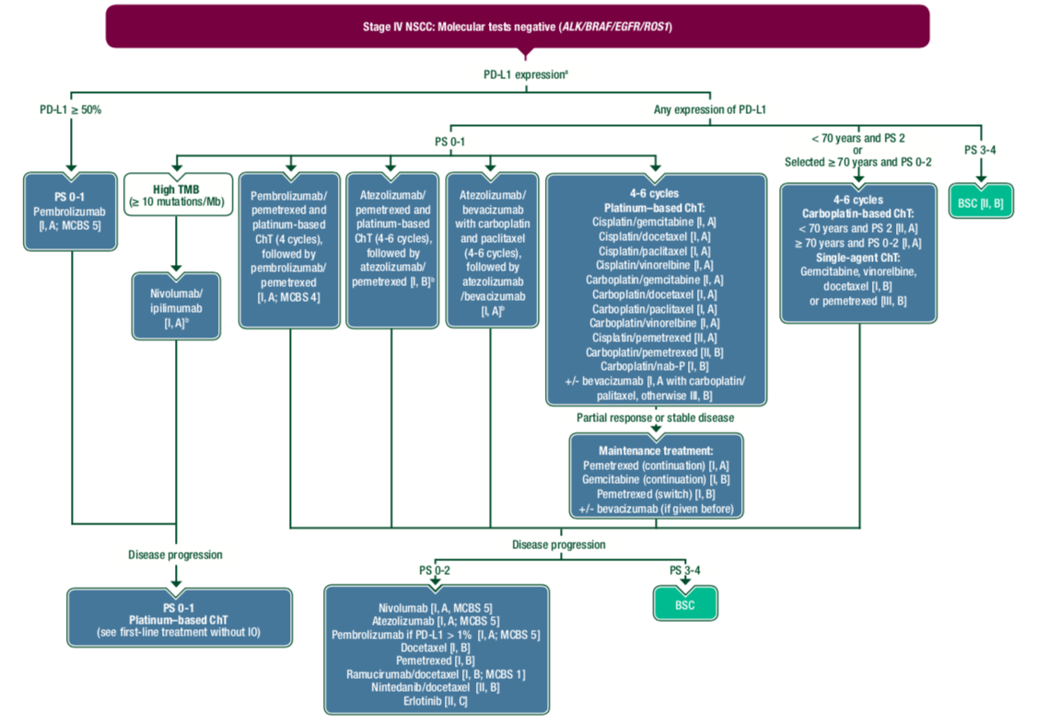
…il domani sarà presto oggi!...

Slide 61
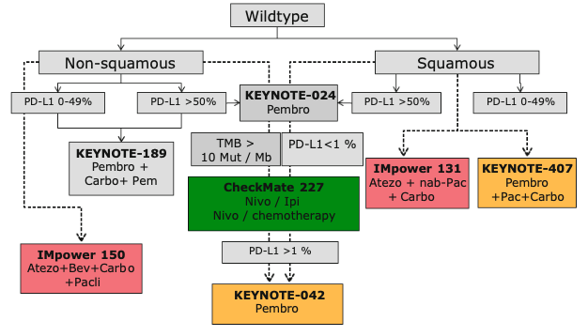
…il domani sarà presto oggi!...

Slide 62
PACIFIC

Slide 63
PACIFIC

Slide 64
PACIFIC

Slide 65
PACIFIC

Slide 66
PACIFIC

Slide 67
PACIFIC

Slide 68
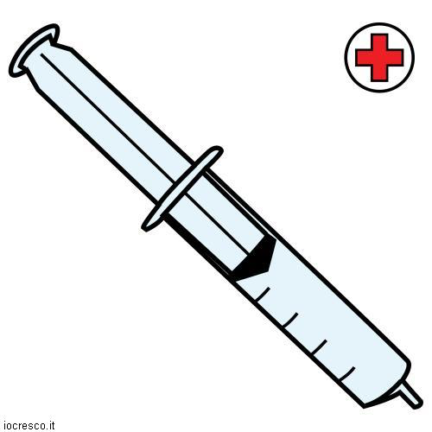

Takehome messages
L’immunoterapia sta cambiando la storia naturale del tumore del polmone
CHEMIO+IMMUNO > CHEMIO
STADIO III non operabili: durvalumab post chemio-radioterapia
Quali biomarcatori???
Combinazioni a chi???
Immunoterapia nella malattia oncogene addicted???
Cosa faremo dopo la 1 linea???
Grazie a tutti per l’attenzione!

