Slide 1
Laura Pizzuti
Oncologia Medica 2

Slide 2
Metastatic TNBC: still a very poor outcome

Slide 4
Cardoso F et al. Ann Oncol 2017

Slide 5
Current Treatment Options for Met TNBC
Sequential single-agent chemotherapy is the preferred approach for most pts with metastatic TNBC
Combination chemotherapy can be used for pts requiring more rapid response but does not improve OS
Pts should generally remain on a regimen until best response, disease progression, or significant toxicity
Taxanes
Paclitaxel
Docetaxel
Anthracyclines
Doxorubicin
Pegylated liposomal doxorubicin
Antimetabolites
Capecitabine
Other Microtubule Inhibitors
Nab-paclitaxel
Epirubicin
Gemcitabine
Vinorelbine
Eribulin
Platinum Agents
Carboplatin
Cisplatin
Zeichner SB, et al. Breast Cancer (Auckl). 2016;10:25-36.
Wahba HA, et al. Cancer Biol Med. 2015;12:106-116.
Notes:
TNBC, triple-negative breast cancer.

Slide 6
PDL1 +
PDL1 inhibition + chemo
NabPacli + Atezo

Slide 7
PD1/PDL1 inhibitors as single agent therapy, TNBC

Slide 8
Impassion130 trial

Slide 9
Impassion130: primary results

Slide 10
Impassion130 update: OS in PD-L1+ subgroup*

Slide 11
PDL1 +
gBRCA+
PDL1 inhibition + chemo
NabPacli + Atezo
PARP inh
(or Platinum if PARPi unavailable)

Slide 12
Phase III trials of PARPi in gBRCA HER2-MBC

Slide 13
OlympiAD: OS with olaparib vs chemo TPC

Slide 14
Toxicities – All grades

Slide 15
QoL in the OlympAD trial

Slide 16
PDL1 +
gBRCA+
Both+
PDL1 inhibition + chemo
NabPacli + Atezo
PARP inh
(or Platinum if PARPi unavailable)
PDL1 inhibition + PARPi 1st?

Slide 17
Combinig PARPi and IO?

Slide 18
Other HRD alteration
PDL1 +
gBRCA+
Both+
PDL1 inhibition + chemo
NabPacli + Atezo
PARP inh
(or Platinum if PARPi unavailable)
Consider Platinum?
(or clinical trial)
PDL1 inhibition + PARPi 1st?

Slide 19
gBRCA MBC: 1st line platinum vs docetaxel TNT phase III study
Tutt et al. Nature Med 2018

Slide 20
Other HRD alteration
PI3K/AKT
pathway altered
PDL1 +
gBRCA+
Both+
PDL1 inhibition + chemo
NabPacli + Atezo
PARP inh
(or Platinum if PARPi unavailable)
Consider Platinum?
(or clinical trial)
Chemo +/- AKT inh
(or clinical trial)
PDL1 inhibition + PARPi 1st?

Slide 21
Breast cancer and PI3K/AKT pathway

Slide 22
What can AKT inhibitors offer patients with PI3K/AKT/PTEN-altered metastatic TNBC?
Phase III trials ongoing

Slide 23
Other HRD alteration
PI3K/AKT
pathway altered
AR+
PDL1 +
gBRCA+
Both+
PDL1 inhibition+ chemo
NabPacli + Atezo
PARP inh
(or Platinum if PARPi unavailable)
Consider Platinum?
(or clinical trial)
Chemo +/- AKT inh
(or clinical trial)
Consider AR inhibition
(or clinical trial)
PDL1 inhibition + PARPi 1st?

Slide 24
Targeting the Androgen Receptor (AR): phase II data

Slide 25
Other HRD alteration
PI3K/AKT
pathway altered
AR+
PDL1 +
gBRCA+
Both+
PDL1 inhibition+ chemo
NabPacli + Atezo
PARP inh
(or Platinum if PARPi unavailable)
Consider Platinum?
(or clinical trial)
Chemo +/- AKT inh
(or clinical trial)
Consider AR inhibition
(or clinical trial)
PDL1 inhibition + PARPi 1st?
Other solutions?

Slide 26
ADCs: E.g. Sacituzumab Govitecan (IMMU-132)

Slide 27
ADCs: Sacituzumab Govitecan (IMMU-132)

Slide 28
Sacituzumab Govitecan: ASCENT Phase III Trial

Slide 29
TRILACICLIB (G1T28), a highly potent, transient CDK4/6 inhibitor

Slide 30
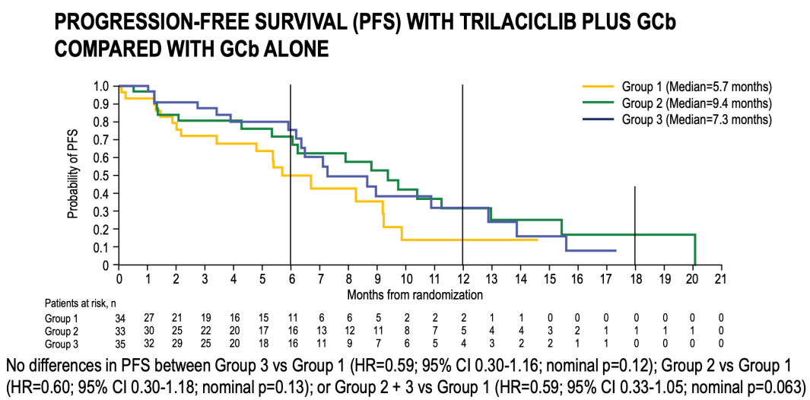
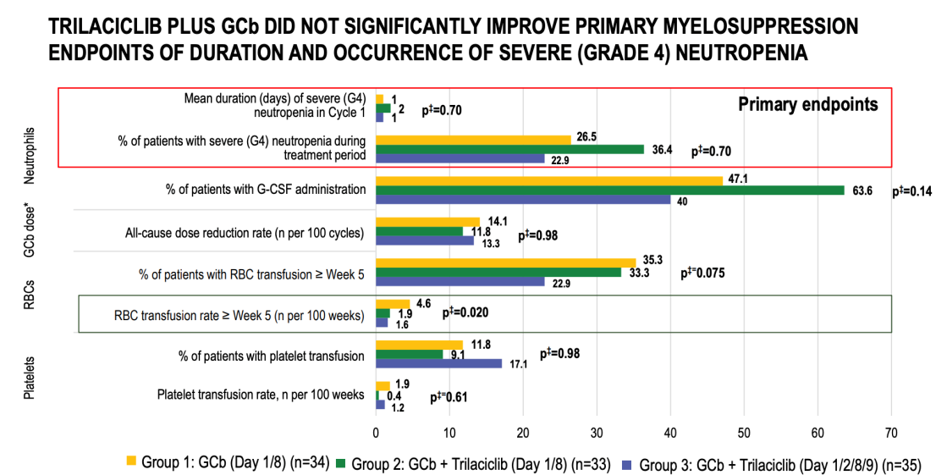
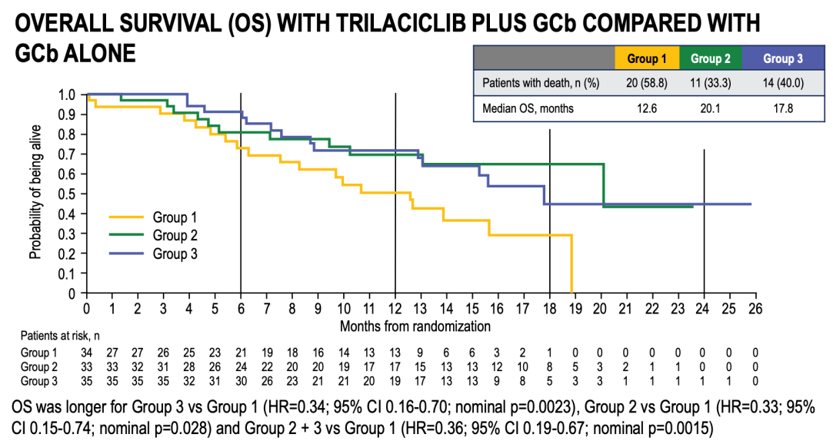
TRILACICLIB + GCb in pts with mTNBC, randomized phase II study (G1T28-04; NCT02978716)

Slide 31
Open questions

Slide 32
Quando smetteremo di chiamarlo triplo negativo?
About 40% of TNBC have PD-L1+

Slide 33
laura.pizzuti@ifo.gov.it

