Slide 1


Department of Dermatology
University of L’Aquila
Genetics of skin cancer
Cristina Pellegrini, PhD
University of L’Aquila
Chieti, 19 June 2019

Slide 2
Agenda
Skin cancers can be inherited: clinical impact of susceptibility genes on patient management
Impact of somatic genetic mutations for new target therapies
Melanoma
Non-melanoma Skin Cancer

Slide 3
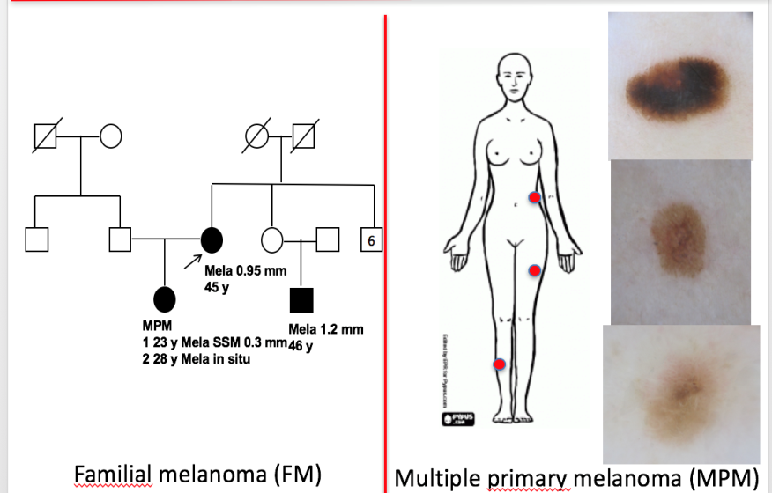
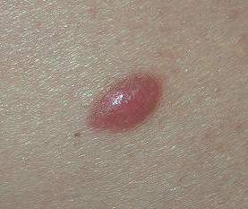
How do the new melanoma genetics impact
the clinical practice?
SUSCEPTIBILITY
DIAGNOSIS
THERAPY
BRAFi
MEKi
Notes:
We now have strong evidence to support molecular testing in patients with melanoma, as part of routine clinical prac tice and standard of care.
Molecular testing of melanoma tumor tissue for the presence of targetable oncogenic mutations is part of routine practice. BRAF and MEK inhibitors for melanoma with BRAF V600E

Slide 4
Germline genetic alterations in melanoma
Notes:
We now have strong evidence to support molecular testing in patients with melanoma, as part of routine clinical prac tice and standard of care.
Molecular testing of melanoma tumor tissue for the presence of targetable oncogenic mutations is part of routine practice. BRAF and MEK inhibitors for melanoma with BRAF V600E

Slide 5
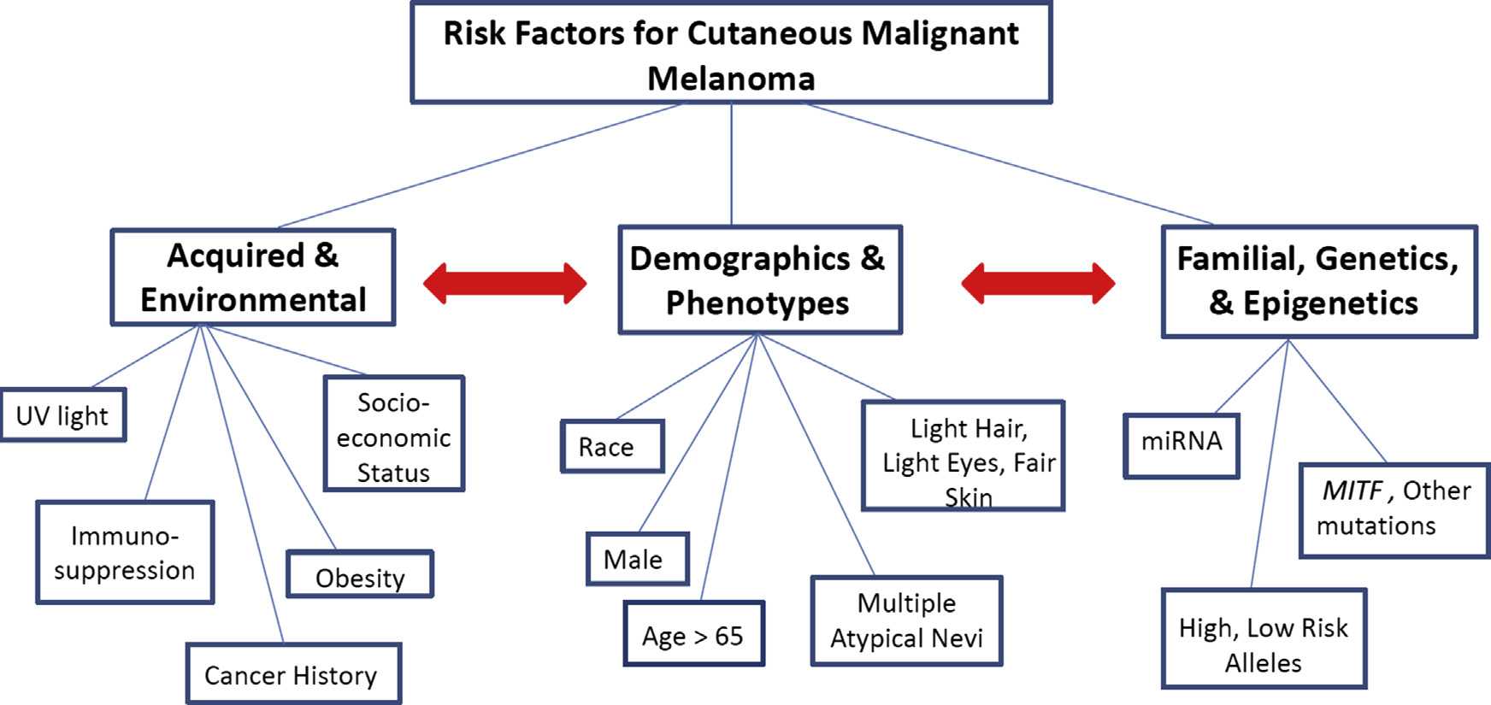
Is the melanoma heritable?
Azoury SC,et al. Surg Clin North Am. 2014. 94(5):945-62
Notes:
Melanoma causation and risk association is complex, with genetic and environmental
factors affecting individual risk
genetic susceptibility is another major MM risk factor
Susceptibility to CM is likely determined by an interaction of environmental risk factors including excessive exposure to ultraviolet radiation and genetically rolled phenotypic traits such as nevus propensity, red or blonde hair, light-colored eyes, fair skin, and limited tanning ability
Autosomica dominante o Multigenica/multifattoriale
In addition to environmental exposures and phenotypic traits, such as nevus count, red hair, and freckling, heritable genetic risk factors can contribute significantly to MM risk in affected individuals.2 An estimated 5% to 12% of all worldwide melanomas are estimated to be caused by inherited, high-penetrance, germline mutations, each with distinct clinical hallmarks
Hereditary melanoma is an autosomal dominant group of disorders

Slide 6
Features of
true “hereditary” melanoma
Bowel ca
Melanoma 85y
*
Clusters of relatives with melanoma
Unilateral lineage
Multigenerational
Multiple primary tumors
Young age of onset
Pancreatic ca
68 yo
Brain ca
27 yo
Melanoma
80 yo
Melanoma
54 yo
*
Ovarian ca
Melanoma
47 yo
Melanoma 45 y
Gastric ca
Multiple melanoma
1. SSM 48 yo
2. SSM 56 yo
3. LM 60 yo

Slide 7
Familial melanoma
Familial melanoma accounts for 5-12% of all melanoma cases
Family history of melanoma is associated with an increased melanoma risk
Individuals with affected first-degree relatives have 2-fold higher risk of melanoma
6
Mela 0.95 mm
45 y
MPM
23 y Mela SSM 0.3 mm
28 y Mela in situ
Mela 1.2 mm
46 y
Begg et al Cancer Causes Control 2004; Fallah M et al, Eur J Cancer 2014;
Ransohoff KJ et al. JAAD 2016
Notes:
A significant family history was reported in up to 12% of cases
People with first-degree relatives affected with melanoma are at higher risk for melanoma (.
The risk for melanoma almost doubles in people with a family history of the same disease, versus in people without any such family history.
Fallah et al. in their Nordic Registries Cohort study reported that this risk is higher if the affected relative has been aged under 30 at diagnosis, or if more than one first-degree relatives were affected.
In a study from the GEM group, Begg et al reported a cumulative risk of melanoma rising to 6.9% (6.1%) at age 80 in male (female) first-degree relatives of cases, and to 10.8% (9.5%) in relatives of cases diagnosed before age 50. In a registry based study in Utah melanoma risk was shown to have a significant familial component. Increased risk to relatives may occur as a result of shared genes and/or shared environment. Furthemore there are likely to be gene/gene interactions and gene/environmental interactions.
FAMMM (familial atypical multiple mole melanoma) syndrome: multiple nevi (some atypical), melanoma and pancreatic cancer.

Slide 8
Hereditary melanoma can appear as part of a familial melanoma syndrome or a mixed cancer syndrome
Notes:
Hereditary melanoma can appear as part of a familial melanoma syndrome or a mixed cancer syndrome
Genetic syndromes that increase the risk of cutaneous melanoma.
Melanoma is also observed at higher-than-expected rates in other hereditary cancer syndromes arising from germline mutations in tumor susceptibility genes (melanoma-subordinate syndromes).

Slide 9
Update on familial melanoma context
Family with melanoma-predominant syndromes
Family with melanoma-including syndromes (Mixed cancer syndromes)
Implications for:
Clinical management
Genetic counseling
Genetic testing
Leachman SA, et al. Cancer Metastasis Rev 2017
Notes:
Nuova interpretazione:
Syndromes in which melanoma is a predominant cancer type are considered “melanoma dominant”, although other cancers (mesothelioma, pancreatic ca) maybe observed.
Melanoma “subordinate syndromes” have an increased but lower risk of melanoma than that of other cancer(s) seen in the syndrome, such as breast and ovarian cancer or Cowden syndrome (Leachman 2017).
Families with an hereditary pattern of cancer that includes melanoma
Mixed cancer syndromes: familial conditions for which there is a high incidence of various cancers in general, includign melanoma
Melanoma genes can be associated with other cancer types and other cancer predisposition genes can increase the risk of melanoma. This overlap has major implications for genetics testing strategies.

Slide 10
Melanoma-predominant syndromes - Associated genes
Gene | Gene penetrance | Year | Melanoma | Associated cancers
CDKN2A | High-penetrance | 1994 | Cutaneous | Pancreatic carcinoma breast, lung and upper digestive cancer
 |  |  | Cutaneous | Neural system tumors
CDK4 | High-penetrance | 1996 | Cutaneous | Neural system tumors
TERT | High-penetrance | 2013 | Cutaneous | Ovarian, renal, bladder, breast, lung cancer
POT1 | High-penetrance | 2014 | Cutaneous | Gliomas
MITF | Intermediate penetrance | 2011 | Cutaneous | Renal carcinoma
Hereditary melanoma
(Familial melanoma)
Susceptibility to melanoma and renal cell carcinoma
Notes:
Si distinguono 3 condizioni: hereditary melanoma, BAP syndrome and MITF, caratterizzate da alterazioni genetiche diverse.
Syndromes in which melanoma is a predominant cancer type are considered melanoma dominant, although other cancers, such as mesothelioma or pancreatic cancers, may also be observed. These syndromes are associated with defects in CDKN2A, CDK4, BAP1, MITF, and POT1.
Melanoma subordinate syndromes have an increased but lower risk of melanoma than that of other cancer(s) seen in the syndrome, such as breast and ovarian cancer or Cowden syndrome. Many of these melanoma-subordinate syndromes are associated with well-established predisposition genes (e.g., BRCA1/2, PTEN). It is likely that these predisposition genes are responsible for the increased susceptibility to melanoma as well but with lower penetrance than that observed for the dominant cancer(s) in those syndromes.
Individuals with hereditary melanoma may have an increased risk of internal cancer, such as pancreatic carcinoma and central nervous system tumors.
Pathogenic germline mutations at CDKN2A have been associated with malignancies other than melanoma, including breast and pancreatic cancers (Borg et al., 2000; de Snoo et al., 2008; Ghiorzo et al., 2012; Goldstein et al., 2006; Potrony et al., 2014), smoking-related cancers of the head and neck, lung cancer, and gastroesophageal carcinomas (Helgadottir et al., 2014; Potjer et al., 2015), as well as central nervous system tumors (Pasmant et al., 2007; Petronzelli et al., 2001, Sargen et al, 2016). Moreover, there is recent evidence to suggest that familial melanoma cases who are wild type for CDKN2A are not at increased risk for non-melanoma cancers in contrast to pathogenic mutation carriers (Helgadottir et al., 2015).
Distinguishing familial melanoma cases with and without pathogenic CDKN2A mutations may serve to heighten awareness of increased risk for other cancers among carriers in melanoma families.
An increased risk of breast cancer was observed in CDKN2A.mutated pedigrees (Borg JNCI 2000).
Potrony et al.: The Authors observed an increased prevalence of pancreatic, lung and breast cancer in CDKN2A mutated melanoma families. The effects of cigarette smoking on lung cancer risk is well documented, but also pancreatic cancer and breast cancer have been associated with this risk factor. Furthermore, it has been reported that pancreatic cancer penetrance is higher in smoking CDKN2A mutation carriers than in nonsmoker carriers. Our results indicated that the increased prevalence of these cancers observed in CDKN2A -mutated families could be explained by genetic factors, when they are exposed to the same environmental factors as the general population.
Helgadottir et al: CDKN2A p.Arg112dup founder mutation carriers from melanoma-prone families (Sweden) and their First DRs and Second DRs have elevated risk for pancreatic, respiratory and upper digestive cancers. The risk for these cancers was significantly elevated among carriers that has ever smoked cigarettes compared with non-smokers. Germline CDKN2A mutations may confer an increased sensitivity to carcinogens in tobacco smoke. CDKN2A mutation carriers should be counselled to abstain from smoking.
Sargen: This article highlights the importance of considering CDKN2A mutations in patients with dysplastic naevi, melanoma and multiple nerve sheath tumours, specifically those with histological features of both neurofibromas and schwannomas.
In addition to conferring a risk of cutaneous melanoma, some melanoma susceptibility genes have been linked to risk of other cancers, with occurrence of specific cancers in melanoma families at greater rates than expected.
The most extensively reported association is between CDKN2A and pancreatic cancer¹² although an increased prevalence of other tobacco-associated cancers, in particular respiratory and upper digestive cancers, has been recently reported in CDKN2A-mutated families.¹⁷⁻³⁶
Several evidences have suggested that p14^{ARF} mutations predispose to neural system tumors.^{37,38}
A cancer syndrome including atypical melanocytic lesions, cutaneous/uveal melanoma and mesothelioma has been initially described in BAP1-mutated families, although additional cancers such as renal cell carcinoma and basal cell carcinoma are now considered as part of the BAP1 spectrum.²²⁻²⁵
An association with renal cell carcinoma has been observed also for MITF^{34,35} and more recently the POT1 gene has been implicated in the development of glioma.³⁹

Slide 11
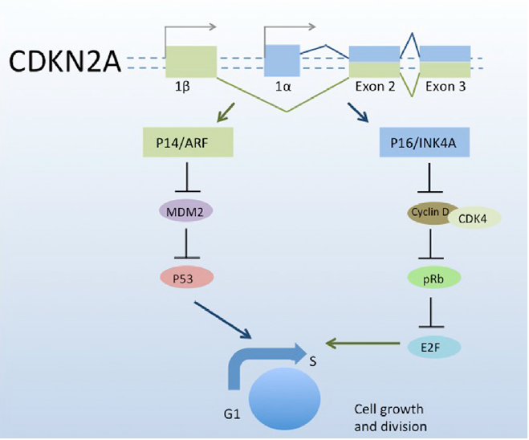
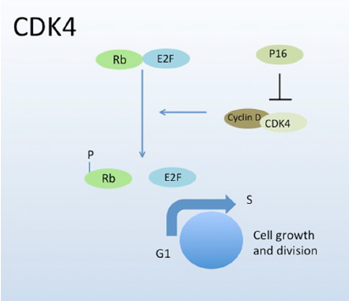
Familial melanoma: CDKN2A and CDK4 genes
Ransohoff et al, J Am Acad Dermatol, 2016
Notes:
The dominant molecular pathway involved in familial melanoma is:
CDKN2A pathway. CDKN2A encodes 2 proteins that are translated from alternate reading frames:
p16INK4A (P16), encoded by the alfa transcript, and p14ARF (P14), encoded by the beta transcript. Both P16 and P14 proteins are tumor suppressors important for cell cycle inhibition, specifically acting at the G1 to S transition.
CDKN2A/p16 regulates function of the Rb pathway – CDKN2A/p14 regulates function of the p53 pathway
Loss of such cell cycle suppressors allow cells with damaged DNA to proliferate and divide, leading to oncogenesis.
CDKN2A mutations impair the inhibitory functions of p16 and/or p14.
CDK4 pathway. Mutations in CDK4 change an arginine residue such that p16 can no longer bind. Subsequently, there is increased phosphorylation retinoblastoma-bound E2F promotes the G1 to S phase transition, promoting cell growth and proliferation.
CDKN2A encodes two different proteins p16INK4a and p14ARF. p16INK4a is an inhibitor of the cyclinD1/CDK4 complex and induces the arrest of the cell cycle in G1. When p16INK4a can perform its function correctly, if a cell is damaged it can induce senescence.
However when CDKN2A is mutated, the cyclinD1/CDK4 complex is not inhibited and phosphorylated pRb, releasing E2F transcription factor that can induce a cell cycle progression. If a cell is damaged the release of E2F can favor an aberrant proliferation that can lead to tumor development.
In the same way, when CDK4 is mutated, p16INK4a cannot interact with it and cannot inhibit the release of E2F.
p14ARF in front of a damaged cell induces apoptosis through the p53 pathway. If p14ARF is mutated, MDM2 can promote p53 ubiquitination and p53 is degraded in the proteasome. Thus when a cell is damaged, the lack of activation of p53 can allow that cell to avoid apoptosis
CDK4 was the second high risk melanoma susceptibility gene identified. CDK4 is an oncogene located within the 12q14 chromosomal region and encodes a protein that controls cell cycle progression through the G1 phase. To date mutations in this gene have been described in 17 melanoma-prone families and in all of them the mutation affects the same amino acid (Arginine 42). This amino acid is located in the p16INK4A binding domain of the CDK4 protein. Thus, when CDK4 is mutated, p16INK4A cannot inhibit the CDK4 kinase activity resulting in the progression of the cell cycle. CDK4 mutation carriers phenotypically behave similarly to p16INK4A mutation carriers.
This is consistent with the functional impact that mutations in both genes have at the cellular level, which results in the activation of the same pathway.

Slide 12
CDKN2A and CDK4 in familial melanoma risk
CDKN2A is the main high-risk gene involved in melanoma susceptibility
CDKN2A mutations identified in 20% of families (range 5-72%) but increase with the number of cases in the family (10% 2 cases; 30-40% ≥ 3 cases)
Lifetime melanoma risk in CDKN2A carriers varies by geography (30-91% in Australia, 50-76% in North America, 13-58% in Europe by age 50 and 80)
Increased risk (13/22-fold) of pancreatic cancer for CDKN2A/p16 mutation carriers and of NST tumors for CDKN2A/p14 mutation carriers
CDK4 melanoma families (≈ 20 families worldwide) are phenotypically similar to CDKN2A families (atypical nevi, early age, MPM)
Lifetime risk estimate for CDK4 mutation carriers has not been established
Notes:
To date, CDKN2A is the main high risk gene involved in melanoma susceptibility.
Mutations in that gene are found in around 20% of melanoma-prone families but the CDKN2A mutation frequency can range from 5% to 72% depending on the selection criteria used and the geographical areas.
The CDKN2A mutation detection rate increases with the number of cases in the family.
Mutations in CDKN2A are also detected in sporadic multiple primary melanoma patients (SMP). The CDKN2A mutation frequency in SMP with at least two primary melanoma is around 9%.
As in familial studies, the probability to detect mutations in SMP increases with the number of total primaries.
On the other hand, the probability to have CDKN2A mutations in sporadic melanoma patients with neither a family history nor multiple primaries is about 1%.
Harland et al, 2014: There is a low probability of detecting a germline mutation in people with melanoma except for those with a strong family history (>= 2 affected relatives, 25%), 3 or more primaries (29%) or more than one primary who also have other affected relatives (27%).
In 2009, international guidelines were published suggesting that individuals with an estimated 10% or greater pre-test probability of carrying a mutation in CDKN2A should be referred for genetic counseling
CDKN2A mutation penetrance (or the likelihood of developing melanoma over time -) also varies by geography. The estimated penetrance rates are 30–91%, 50–76%, and 13–58% among patients ages 50–80 in Australia, the United States, and Europe, respectively.
Australia and North America: areas of high levels of UV exposure – Europe: areas of low levels of UV exposure
These differences could be attributed to different sun exposure patterns or other risk factors in the families
28% of CDKN2A mutated families develop PC vs 6% of wild type (Goldstein). Mean age of onset 65-71 yrs.
CDK4 mutation carriers phenotypically behave similarly to CDKN2A mutation carriers. Mutations on both genes result in the activation of the same pathway

Slide 13
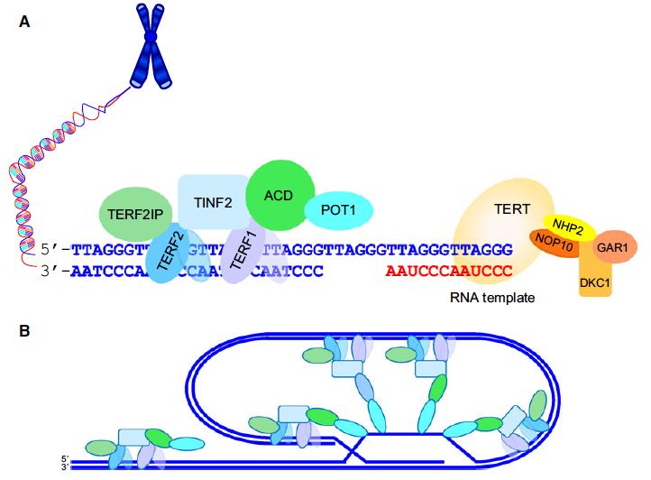
Familial melanoma - Telomere dysregulation pathway
Shelterin complex
Telomerase complex
Aoude et al. Pigment Cell Melanoma Res 2014; Shi et al, Nat Genet 2014
Notes:
After CDKN2A, the next most common mutated genes (9%) are those involved in telomere maintenance. 1% of familial melanoma.
Mutations in telomere-related genes, such as POT1, shelterin complex genes and TERT promoter have also been identified in classic appearing hereditary melanoma families.
POT1 founder mutations were identified in Italian families. POT1 helps to protect chromosomal ends form damage, degradation or inappropriate processing by DNA repair mechanisms.
Mutations in other shelterin complex components, ACD–TERF2IP, were also recently identified in familial cutaneous melanoma
Telomeres consist of tandem repeats of the 6 nucleotide unit sequence (TTAGGGlocated at the ends of chromosomes. After a certain number of cell divisions, the telomeres become so short that they trigger the cell to stop dividing or to self-destruct (undergo apoptosis).
Telomeres shorten both with age and following exposures associated with cancer risk, such as smoking and ultraviolet (UV) irradiation (68,69). Thus,telomere maintenance processes are natural candidates for explaining carcinogenesis.
The telomerase enzyme, the shelterin protein complex and many other accessory proteins are also comprised in the telomeres. They maintain genomic stability and chromosomal integrity by protecting chromosome ends from degradation, end-to-end fusion, and atypical recombination
Horn and colleagues identified a germline mutation in the promoter of telomerase reverse transcriptase (TERT) in a melanoma-prone family using multipoint linkage analyses and target enriched high-throughput sequencing. TERT is located in 5p15 and encodes the catalytic subunit of the telomerase (the other TERC, RNA template for telomere addition), which is the ribonucleoprotein complex that maintains telomere length
Telomerase protects telomere by elongating them via a strict cell cycle-regulated process.
Several studies have identified UV signature mutations at various positions in the TERT promoter. These alterations may increase the transcription of TERT by creating novel Ets transcription factor binding sites. Melanomas with TERT promoter mutations are more likely to be nodular or SSM, increased thickness, high mitotic rate and frequent BRAFV600 mutations. It is uncertain whether these characteristics also apply to familial cases, but they do imply a more aggressive course for these CMMs.

Slide 14
Telomere-related genes in familial melanoma risk
Mutations in the shelterin complex (POT1, ACD and TERF2IP) and TERT promoter are detected in 10% of CDKN2A-negative melanoma kindreds
POT1 mutations carriers have an increased risk for glioma
TERT mutations carriers have an increased risk for ovarian, renal, bladder, breast, lung cancer
Lifetime melanoma risk for POT1 and TERT has not yet been established

Slide 15
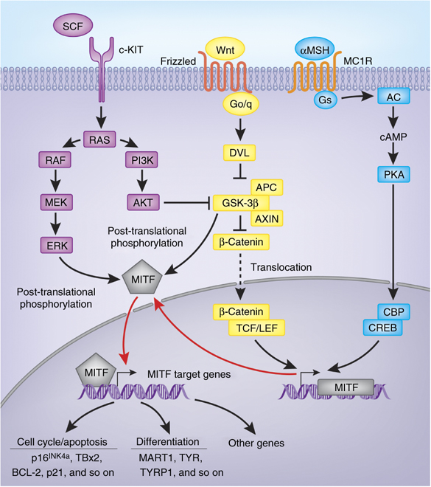
Melanoma-predominant syndromes
Susceptibility to melanoma and renal cell carcinoma
MITF gene
Hocker JID 2008
Notes:
a-MSH binds to melanocortin 1 receptor (MC1R), which induces the activation of adenylyl cyclase, followed by cAMP production. cAMP leads to phosphorylation of CREB transcription factors, which in turn stimulate MITF-M promoter activation [9].
Based on estimates of the burden of MITF mutations in the general white population, approximately 1% of all melanomas are estimated to be caused by MITF mutations
15

Slide 16
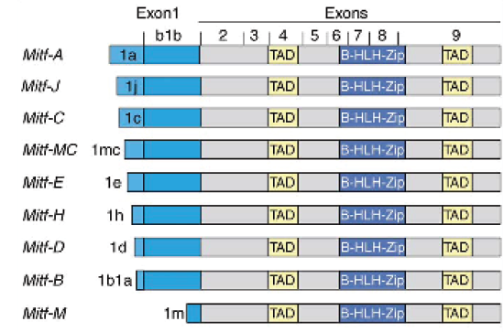
Germline MITF E318K mutation in melanoma-predominant syndromes
E318K
Ch 3p14
FUNCTIONAL ANALYSIS: impaired sumoylation and dysregulated transcription of specific MITF target genes
E318K is a rare variant which confers susceptibility to both familial and sporadic melanoma and/or renal cell carcinoma and/or pancreatic carcinoma
INTERMEDIATE RISK VARIANT (OR ≈ 2, range: 1.7-4.8)
Similar prevalence in CDKN2A-mutant patients as in CDKN2A-wt patients
Bertolotto et al: Nature 2011; Yokoyama et al. Nature 2011; Ghiorzo et al Pigment Cell Melanoma Res 2013; Berwick et al, Pigment Cell Melanoma Res 2014; Potrony et al, JAMA Dermatol 2015
Notes:
Microphthalmia-associated transcription factor (MITF) is also considered a moderate risk gene. Two independent groups identified the rare functional variant in MITF p.E318K (rs149617956) that increases melanoma risk and also predisposes to RCC.
A Germline mutation E318K leading to a substitution of glutamic acid 318 with lysine (E318K) in MITF. It is located in a small-ubiquitin-like modifier (SUMO) consensus site and the missense variant impairs the SUMOylation of MITF leading to binding of MITF and the transcriptional regulation of MITF’s target genes
FUNCTIONAL ANALYSIS: impaired sumoylation and dysregulated transcription of specific MITF target genes
The E318K severely impairs SUMO conjugation to MITF and increased MITF transcriptional activity. The mutant protein enhances melanocytic and renal cell clonogenicity, migration and invasion. Furthermore, this variant promotes invasive and tumorigenic behaviors in melanoma and RCC cells and might favor a phenotypic switch of melanoma cells towards a tumor-initiating cell phenotype.
We next sought to evaluate whether the E318Kmutation alters MITF function. The E318K variant is located within one of two IKXE consensus sites on MITF previously shown to be post-translationally modified by the addition of the small ubiquitin-like-modifier SUMO.
The prevalence of p.E318K in melanoma patients ranges from 1.6% to 2.8%, whilst in a control population prevalence of this variant is 0.6% in French and Italian populations and 0.8% in UK and Australian populations (83,84,86). Furthermore, this variant has been associated with phenotypic features such as high nevi count, fair skin and non-blue eye color.
16

Slide 17
Genetic testing for melanoma-predominant syndromes
Single-gene testing
Other cancers suggest a CDKN2A mutation or BAP1 mutation
Relative request to determine carrier status if a mutation has been identified in a cancer susceptibility gene
Melanoma multi-gene panel
CDKN2A, CDK4, BAP1, MITF, POT1
ACD, TERT (promoter), TERF2IP, MC1R, BRCA1, BRCA2, PTEN, RB1, TP53
Leachman SA, et al. Cancer Metastasis Rev 2017
Notes:
Especially in an era when reasonably priced multi-gene panel tests are available, it no longer seems appropriate to offer genetic testing to high-risk melanoma patients for only CDKN2A when other genes are known to cause melanoma-dominant syndromes.
This melanoma panel should include BAP1, CDK4, and CDKN2A. Genes for which risk has not been established but for which studies suggest an elevated risk include MITF and POT1 and we recommend including these in the melanoma panel.
Genes with a preliminary clinical association include ACD, BRCA1, BRCA2, MC1R, PTEN, RB1, TERT (with promoter), TERF2IP, and TP53 which may be included for research purposes

Slide 18
Melanoma-including syndromes - Associated genes
Gene | Gene penetrance | Melanoma | Associated cancers
BRCA1 BRCA2 | AD | Cutaneous and Uveal | Breast and ovarian
TP53 | AD | Cutaneous and Uveal | Breast, bone and soft tissue, central nervous system, leukemia
XPC XPD XPA | AR | Cutaneous | NMSC
PTEN | AD | Cutaneous | Breast, colorectal, thyroid, kidney and endometrial
Hereditary breast and ovarian cancer syndrome
Li-Fraumeni syndrome
Xeroderma pigmentosum
PTEN tumor syndromes
Ransohoff et al, JAAD 2016
Notes:
Melanoma is also observed at higher-than-expected rates in other hereditary cancer syndromes arising from germline mutations in tumor susceptibility genes (melanoma-subordinate syndromes). They have poorly defined but elevated risk of melanoma. These are the genes associated with these other types of cancer syndromes.
More specifically, increased risk for melanoma is seen in:
BRCA1 and BRCA2 are DNA repair involved genes that accumulate near DNA strand breaks.
Individuals with BRCA1 or BRCA2 mutations have increased risk of breast, ovarian, prostate and pancreatic cancers
Mutations in BRCA1 or BRCA2 decrease ability to repair DNA damage, leading to increased susceptibility to DNA mutagens, particularly those that cause double-stranded breaks
Li-Fraumeni syndrome (LFS) is an autosomal dominant cancer syndrome defined clinically by early onset soft tissue and bone sarcomas, leukemia, breast cancer, nervous system tumors, often occurring before age 30. Germline mutations in TP53 are present in 50-70% of LFS families.
TP53 is a tumor suppressor involved in ensuring genome integrity and disruption of its activity allows unchecked progression through the cell cycle and increased genome instability. TP53 mutations increase genome instability.
Xeroderma pigmentosum (XP) refers to a spectrum of autosomal recessive diseases caused by mutations in DNA repair genes (XPA-XPG ) that encode proteins that repair UV-induced DNA damage (nucleotide excision repair [NER]). Of all of the NER genes, mutations in XPC and XPD have the strongest association with increased MM risk.
Cutaneous findings. Patients with XP have extreme photosensitivity and freckling (at 1-2 years of age), a predisposition to the development of keratitis, iritis, and choroid melanoma, and basal cell carcinoma, squamous cell carcinoma, and MM at an early age. Other noncutaneous findings include hyporeflexia or areflexia, deafness, and intellectual disability.
Phosphatase and tensin homolog hamartoma tumor syndromes
Germline mutations in phosphatase and tensin homolog (PTEN ), a tumor suppressor gene, lead to a group of clinical syndromes in the umbrella category of PTEN hamartoma tumor syndromes. These syndromes include Cowden syndrome, which presentsin adulthood, and Bannayan-Riley-Ruvalcaba syndrome, which presents in children
A recent large study of individuals with genetically proven Cowden syndrome found an increased risk of numerous cancers, including melanoma (standardized incidence ratio, 8.5 [95% CI, 4.1-15.6]) and breast, thyroid, endometrial, kidney, and colorectal cancer.76 Other studies have also found an even greater magnitude of increased melanoma risk (standardized incidence ratio, 28.3 [95% CI, 7.6-35.4]). Because individuals with Cowden syndrome are at high risk for numerous cancers, including melanoma, they should be aggressively screened with annual skin examinations.

Slide 19
Melanoma-including syndromes
Subjects with BRCA2 mutations have 2.6-fold increased risk of melanoma. Data on BRCA1 are sparser (standardized incidence ratio, SIR: 3.31)
Case reports of multiple cutaneous MM or clustering of MM have been reported in Li-Fraumeni syndrome families
Individuals with XP have an estimated 600- to 8000-fold increased risk of melanoma
Individuals with Cowden syndrome have an increased melanoma risk (SIR: 8.5-28.3)
Ransohoff et al, JAAD 2016
Notes:
The breast cancer linkage consortium reported a relative risk of MM of 2.6 in BRCA2 carriers. Data on BRCA1 and MM are sparser. One
large recent prospective study reported a trend in BRCA1 mutation carriers toward increased MM risk (standardized incidence ratio, 3.31; P = .004). In addition, melanoma and breast cancer have been reported to co-occur in numerous pedigrees.
Current recommendations for MM screening for BRCA carriers include annual clinical examinations of the skin and eyes
More recently, case reports of multiple cutaneous MM or clustering of MM in LFS families have been reported.
Melanoma is considered rare and controversial component of LFS
Genetic counseling is difﬁcult because of the uncertainty in morphology-, site-, age-, and sex-speciﬁc cancer incidence
The clinical beneﬁt of presymptomatic genetic testing for germline TP53 is debated
NCCN guidelines recommend yearly skin examination in LFS patients, along with self-skin exam and photoprotection.
Individuals with XP have an estimated 600- to 8000-fold increased risk of MM. The median age of skin cancer diagnosis is 8 years. The lifetime risk of MM in patients with XP ranges from 5% to 20%. The incidence of XP is only 1 in 250,000 live births.70
These patients have an estimated 10,000-fold increased risk of nonmelanoma skin cancer by 20 years of age.
Regular dermatologic follow-up for skin examination is essential, along with an eye examination by an ophthalmologist.

Slide 20
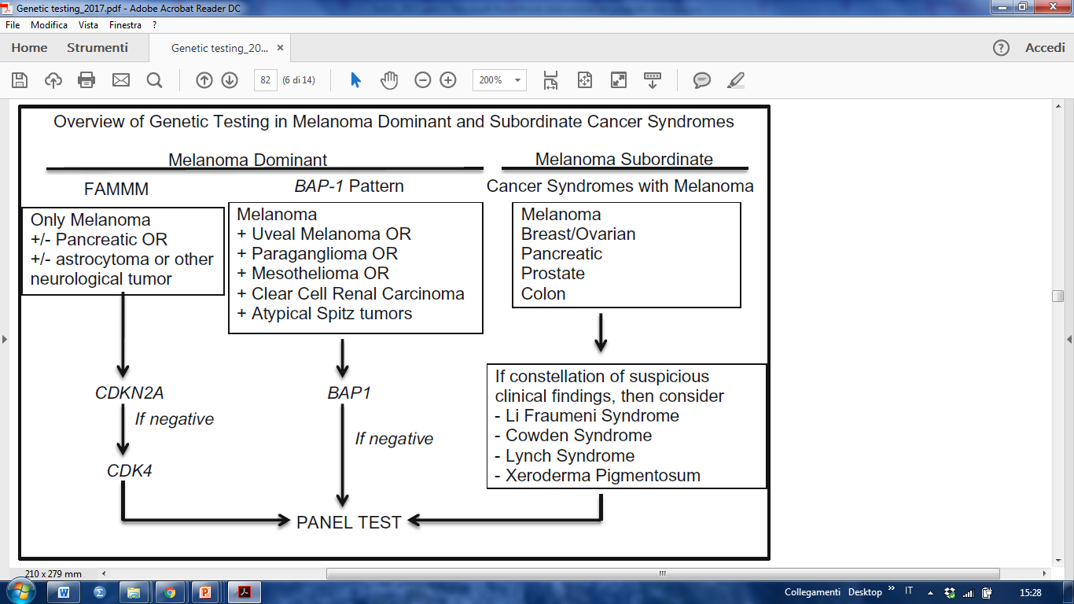
Genetic testing for melanoma-including syndromes
Guidelines for melanoma screening are unclear
Tailored genetic testing approach with multi-gene panels based on the cancer profile observed in the family
Leachman SA, et al. Cancer Metastasis Rev 2017
Notes:
There should likely be special consideration given to families that fail to meet the genetic testing criteria for a melanoma-dominant syndrome yet also have other cancers suggestive of a “melanoma-subordinate” cancer syndrome.
Leachman 2017: The authors updated the “rule of twos and threes” that takes other non-melanoma cancer types into consideration. To accomplish this task, we have created a simplified scoring system that identifies individuals or families that have a pattern of cancer development suspicious for germline inheritance of a pathogenic mutation
The authors detail how their institutions design a personalized genetic panel based on the personal and family history of a suspected hereditary cancer syndrome. This algorithmic approach is summarized in Fig. 1. Once an individual or family has met criteria for genetic testing and has received genetic counseling with informed consent, our centers create a tailored panel test that includes the genes that are most likely to be mutated, based on the other cancer types observed in the pedigree.
Costs associated with genetic testing and heightened surveillance (increased number of biopsies and other procedures)
Follow-up and management recommendations for some gene mutations are not well developed

Slide 21
Somatic genetic alterations in melanoma and clinical impact
Notes:
Now I would show our resent projects investigating the moelcuar genetics of melanoma at somatic level.

Slide 22

How do the new melanoma genetics impact
the clinical practice?
SUSCEPTIBILITY
DIAGNOSIS
THERAPY
BRAFi
MEKi
Notes:
We now have strong evidence to support molecular testing in patients with melanoma, as part of routine clinical prac tice and standard of care.
Molecular testing of melanoma tumor tissue for the presence of targetable oncogenic mutations is part of routine practice. BRAF and MEK inhibitors for melanoma with BRAF V600E

Slide 23
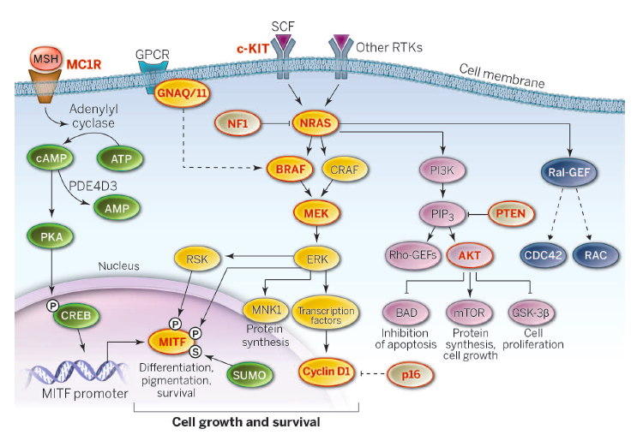
Signaling pathways in melanoma
Lo and Fisher, Science 2014
Lo and Fisher, Science 2014
Notes:
Multiple signaling pathways are implicated in melanoma pathogenesis. A key advance in the understanding and treatment of this disease was the discovery of…
Early events in the development of melanocytic tumors are often hotspot mutations in genes involved in the MAPK pathway, which is one of the most important pathways involved in melanocytic tumor development (Figure 1).
Important oncogenes in this pathway are BRAF (7q34), NRAS (1p13), HRAS (11p15), GNAQ (9p21),GNA11 (19p13), and KIT (4q12) (2–5). Mutations in these genes are mostly mutually exclusive, by themselves do not cause malignant progression, stay present with malignant progression, and activate the MAPK pathway.
BRAF is a serine/threonine protein kinase, encoded on chromosome 7q34 (18 esoni), that activates the MAP kinase/ERKsignaling pathway.
Of particular importance in melanoma is the mitogen-activated protein kinase (MAPK) pathway, which normally regulates cell growth, proliferation and differentiation
Includes the cascade of BRAF, NRAS, MEK1/2, and ERK1/2 gene products, also plays a major role in the development and progression of melanoma
MAPK signaling is initiated at the cell membrane, either by receptor tyrosine kinases (RTKs) binding ligand or integrin adhesion to extracellular matrix, which transmits activation signals via the RAS GTPase on the cell membrane inner surface.
BRAF agisce in forma dimerica con altri membri della famiglia RAF

Slide 24
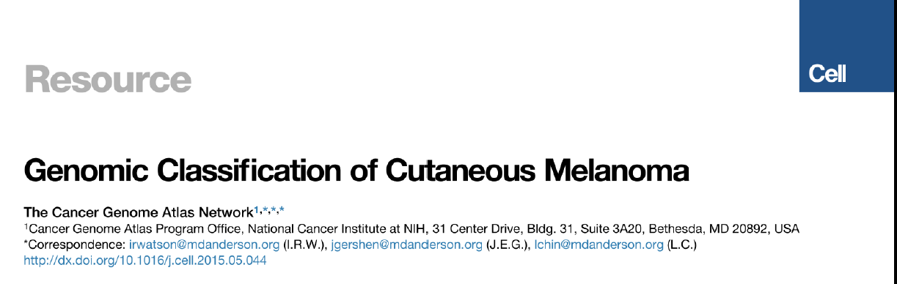
Somatic genetic classification
333 melanomas (20% thick primaries and 80% mets, regional > skin > distant)
The highest mutation rate than any other cancer analyzed
BRAF | N/H/K RAS | NF1 | Triple wild-type
52% tumors V600 > K601 Younger pts 90% UV-signature Mutually exclusive with NRAS | 28% tumors NRAS Q61, less G12-G13 Fewer HRAS and KRAS mut 93% UV-signature Mutually exclusive with BRAF | 14% tumors 39% wt BRAF/NRAS mela Mutation rate 92% UV-signature | Heterogenous group Older patients 30% UV- signature Copy number and complex rearrangement KIT mutations
Notes:
Recent genomic analyses have established the molecular classification of melanoma based on the most frequent driver oncogenic mutations (BRAF, NRAS, NF1) and have also revealed a long list of rare events, including mutations and amplifications as well as genetic microheterogeneity
Largest integrative analysis of cutaneous melanoma through DNA, RNA and protein-based analysis of 333 melanomas (primary 20% or metastatic 80%, mostly in then skin then distant sites) from 331 pts (with matched peripheral blood) to create a catalog of somatic alterations and describe their potential biological and clinical significance.
Mean mutation rate (16.8 mut/Mb), the highest than other cancer analyzed by TCGA. High fraction of UV-signature mutations C to and CC to TT: 76% primary and 84% mets
Four subtypes based on the pattern of the most prevalent significantly mutated genes: mutant BRAF, mutant RAS, mutant NF1, triple wild-type.
BRAF subtype: 52% tumors, V600, less frequent K601; anti-correlated with NRAS; younger pts, 90% with UV signature
RAS subtype (N/H/K): in all 3 RAS family members, 28% NRAD Q61, G12 and G13, less frequently HRAS and KRAS, anti-correlated with BRAF mut melanomas, 93% UV signature
NF1 subtype: 14% samples, highest mutation prevalence than other subtypes, 38.7% of non hot spot BRAF/NRAS melanomas, 92% with UV signature mutations
Triple WT: heterogeneous group, older pts, KIT mutations, 30% UV signature, enrichment of focal amplifications (copy number alterations) of known oncogens and complex structural rearrangements (fusion events). Other mutational processes involving structural rearrangement of the genome as compared to other subtypes
No significant outcome correlation with subtypes
Transcriptomic subclass enriched for immune gene expression associate with lymphocyte infiltrate and high LCK protein expression, a T cell marker, were associated with improved survival. Prognosis of melanoma patients with regional mets is influenced by tumor stroma biology.

Slide 25
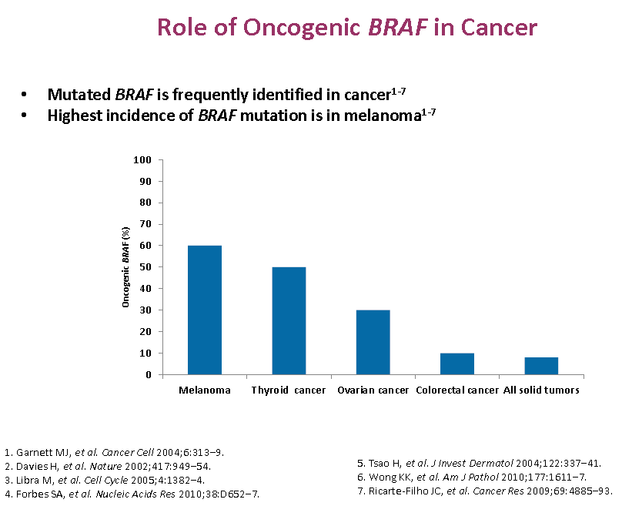
Somatic BRAF mutation in melanoma
Activating BRAF mutations (40-60%)
Lo and Fisher, Science 2014
Notes:
Activating mutations of the proto-oncogene BRAF occur in many human cancers, including malignant melanoma, colorectal cancer, ovarian cancer, and thyroid cancer with the highest frequency in melanoma.
Constitutively activating somatic missense mutations in BRAF were discovered to be present in a wide variety of human cancers, including papillary thyroid cancer (39–69%), cholangiocarcinoma (22%), colorectal cancer (5–12%) and borderline ovarian cancer (30%)
Marchetti: Tiroide (40-50%); ovarico (2-33%); polmone 3-5%; colon-retto (5-10%); hairy cell leukemia (100%?)
Melanoma primario: 36-59% - metastatico 42-66% 20% oscillazione: popolazioni diverse o problemi tecnici

Slide 26
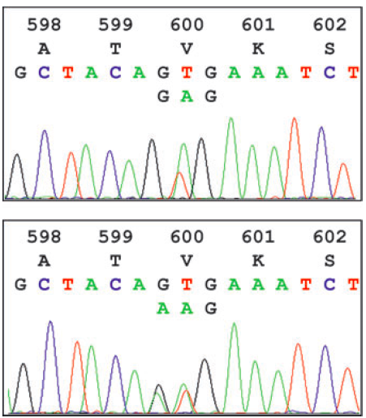
Somatic BRAF mutation in melanoma
BRAF mutations V600 (>90%) | % Mutations
V600E Val → Glu GTG>GAG | 70 - 75%
V600K Val → Lys GTG>AAG | 17-20%
V600D Val → Asp GTG>GAT | 4.5%
V600R Val → Arg GTG>AGG
V600E2 Val → Glu GTG>GAA
V600E
V600K
Garnett et al, 2004; Pritchard et al, 2007; Forbes et al, 2010; Arkenau et al, 2011; Schlaak et al, 2013
Notes:
The most common mutation in melanoma affects the BRAF gene.
The most frequently tested genes in melanoma at present are BRAF and NRAS, especially in those arising from the skin.
One hypothesis for the mechanism of uncontrolled activation is the increased exposure of the activation segment for interaction when a small hydrophobic amino acid at 600 (Valine) is switched to a hydrophilic residue. Normally, the RAF kinase domain in the inactive conformation is hidden in a hydrophobic pocket (Wan et al, 2004). La mutazione blocca la chinasi in una conformazione attiva
Among V600 mutations, over 90% are a single nucleotide mutation resulting in substitution of glutamic acid for valine (BRAFV600E: nucleotide 1799 T>A; codon GTG>GAG). The second most common mutation is BRAFV600K substituting lysine for valine, that represents 5-6 % (GTG>AAG), followed by BRAFV600R (GTG>AGG), an infrequent two-nucleotide variation of the predominant mutation, BRAF V600 ′E2′ (GTG>GAA), and BRAF V600D (GTG>GAT) [6]. The prevalence of BRAFV600K has been reported as higher in some populations (Long JCO 2011).
Long JCO 2012: 197 metastatic melanoma, Australia, 20% V600K. Implicazioni for clinical practice
Other mutations (G464E, G466V, D594V) decrease the catalyctic activity but promote dimerization with CRAF proteins and thus still increase activation of MEK and ERK.

Slide 27
Constitutive activation of BRAF in melanoma
Notes:
The most frequent BRAF mutation, BRAFV600E, causes constitutive activation of the kinase as well as insensitivity to negative feedback mechanisms. Distruzione interazioni idrofobica tra il pLoop e il segmento attivatore del domincio chinasico → destabilizzazione della conformazione inattiva di BRAF e sua attivazione costitutiva → aumentata fosforilazione di ERK
A major advance of the past few years was the discovery that RAF kinases can homo- and heterodimerize, and that, in fact, the structure of an active RAF kinase is that of a side-to-side dimer in which only one partner must have catalytic activity. Dimerization is enhanced by Ras and is subject to negative feedback regulation by ERK. Mutated BRAF signals as a monomer, independent of upstream growth stimuli.
BRAF mutato: attività fosforilante 700 volte maggiore del wt.
Vemurafenib is a potent inhibitor of the kinase domain of mutant BRAF, and leads to decreased proliferation through reductions of phosphorylated ERK and cyclin D1
Dabrafenib is a reversible, ATP-competitive inhibitor that selectively inhibits BRAF Val600Glu. Dabrafenib has shorter half-life than does vemurafenib (5.2 h vs 50 h), but is otherwise similar to vemurafenib in mode of action and pharmacodynamic effects
Trametinib is an orally available, small-molecule, selective inhibitor of MEK1 and MEK2.

Slide 28
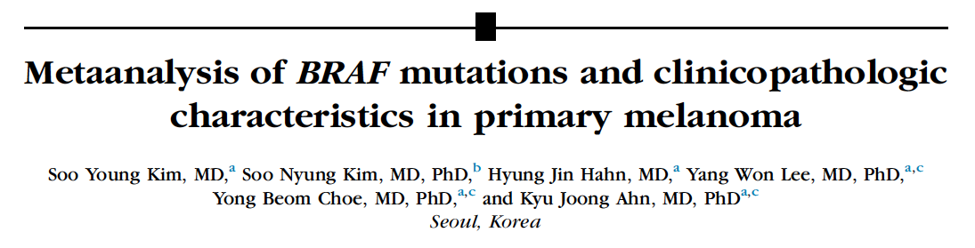
45 studies (5744 pts) – BRAF mutation: 40.3% white pts and 19.5% Asian pts - 36.4% overall
Clinico-pathologic characteristic | OR (95% CI) | p
Age ≤ 50 yrs | 1.734 (1.288-2.335) | <.001
Sex | 0.879 (0.770-1.003) | .055
Site – Trunk | 2.272 (1.918-2.691) | <,001
Non-Chronic Sun Damage (non-CSD) | 2.833 (1.947-4.122) | <.001
SSM | 2.081 (1.772-2.445) | <.001
NM | 1.039 (0.858-1,257) | .696
Ulceration | 1.174 (0.950-1.451) | .138
Tumor thickness | 1.508 (0.923-2.465) | .101
Advanced stage melanoma (stage III-IV) | 1.551 (1.166-2.064) | .003
JAAD 2015;72:1036-46
Notes:
BRAF mutation is one of the best defined molecular alterations contributing to the pathogenesis of melanoma. Mutations of BRAF induced hyperactivity of MAPK signaling pathway, which promotes the proliferation of tumor cells. The most prevalent mutation is a T1799A transversion in exon 15 (V600E, Val600Glu) aa substitution.
The Authors performed a metaanalysis (up to Nov 2013, 45 studies met eligibility criteria including 8 articles on Asians) of BRAF mutations and their association with clinico-pathologic characteristics of primary melanoma, with a subgroup analysis to compare Asian (few studies of Asian patients) and white patients.
BRAF mutations are associated with distinct clinico-pathologic characteristics
BRAF mutations: 40.3% white pts and 19.5% Asian pts. 36.4% overall.
BRAF mutation was associated with younger age (OR = 1.734; P <.001), trunk location (intermittently exposed) (OR = 2.272; P < .001), non-chronically sun damaged skin at the primary site, evaluated histologically (OR = 2.833; P < .001), superficial spreading melanoma (OR = 2.081; P<.001), and advanced melanoma stage (OR = 1.551; P = .003) but not with ulceration or tumor thickness (< and > 1 mm).
Trunk is commonly considered non-CSD

Slide 29
Somatic genetic classification
333 melanomas (20% thick primaries and 80% mets, regional > skin > distant)
The highest mutation rate than any other cancer analyzed
BRAF | N/H/K RAS | NF1 | Triple wild-type
52% tumors V600 > K601 Younger pts 90% UV-signature Mutually exclusive with NRAS | 28% tumors NRAS Q61, less G12-G13 Fewer HRAS and KRAS mut 93% UV-signature Mutually exclusive with BRAF | 14% tumors 39% wt BRAF/NRAS mela Mutation rate 92% UV-signature | Heterogenous group Older patients 30% UV- signature Copy number and complex rearrangement KIT mutations
Notes:
Recent genomic analyses have established the molecular classification of melanoma based on the most frequent driver oncogenic mutations (BRAF, NRAS, NF1) and have also revealed a long list of rare events, including mutations and amplifications as well as genetic microheterogeneity
Largest integrative analysis of cutaneous melanoma through DNA, RNA and protein-based analysis of 333 melanomas (primary 20% or metastatic 80%, mostly in then skin then distant sites) from 331 pts (with matched peripheral blood) to create a catalog of somatic alterations and describe their potential biological and clinical significance.
Mean mutation rate (16.8 mut/Mb), the highest than other cancer analyzed by TCGA. High fraction of UV-signature mutations C to and CC to TT: 76% primary and 84% mets
Four subtypes based on the pattern of the most prevalent significantly mutated genes: mutant BRAF, mutant RAS, mutant NF1, triple wild-type.
BRAF subtype: 52% tumors, V600, less frequent K601; anti-correlated with NRAS; younger pts, 90% with UV signature
RAS subtype (N/H/K): in all 3 RAS family members, 28% NRAD Q61, G12 and G13, less frequently HRAS and KRAS, anti-correlated with BRAF mut melanomas, 93% UV signature
NF1 subtype: 14% samples, highest mutation prevalence than other subtypes, 38.7% of non hot spot BRAF/NRAS melanomas, 92% with UV signature mutations
Triple WT: heterogeneous group, older pts, KIT mutations, 30% UV signature, enrichment of focal amplifications (copy number alterations) of known oncogens and complex structural rearrangements (fusion events). Other mutational processes involving structural rearrangement of the genome as compared to other subtypes
No significant outcome correlation with subtypes
Transcriptomic subclass enriched for immune gene expression associate with lymphocyte infiltrate and high LCK protein expression, a T cell marker, were associated with improved survival. Prognosis of melanoma patients with regional mets is influenced by tumor stroma biology.

Slide 30
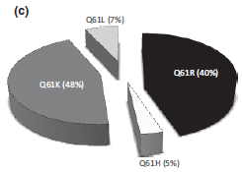
NRAS mutations in melanoma
Activating NRAS mutations (15-20%)
Mutually exclusive with BRAF mutations
 | NRAS mutations | % Mutations
Exon 1 | G12 G13 | 10-20%
Exon 2 | Q61 | 80-90%
Edlundh-Rose et al, Melanoma Res 2006; Goel et al, JID 2006; Poynter et al, Melanoma Res 2006
Notes:
The second most prevalent mutation in melanoma is in the NRAS gene, which account for approximately 20-30% of mutations driving melanoma. Mutations target aa residues 12, 13 and 61. The most prevalent mutation occurs in position 61 and results in the substitution of glutamine to arginine Q61R, and glutamine to lysine Q61K with less frequent alterations leading to glutamine to leucine Q61L.
In normal cells, RAS proteins switch between active GTP-bound forms and inactive GDP-bound forms. The transition between the active and inactive state is mediated by GTPase-activating proteins (GAPs). When examining the types of mutations within NRAS in melanoma patients, approximately 80–90% occur at the Q61 locus and less frequently at the G12 or G13 loci [10]. Oncogenic NRAS mutations of Q61 impair the GTP hydrolysis reaction.
Thus, the outcome of these substitutions is the persistence of the GTP-bound state of NRAS that drives melanoma by promoting cell growth, survival and invasion [55].
Model of NRAS signaling in melanoma: Wild type NRAS (top left) cycles between an inactive GDP-bound and active GTP-bound state, whereas mutations in G12, G13 and Q61 prevent hydrolysis of GTP, locking mutant NRAS in its GTP-bound, active state (top right) which results in permanent, stimulus independent downstream signaling. NRAS-GTP activates downstream effectors of the MAPK and PI3K/mTOR pathway (dark blue boxes). Schematic of the cell cycle pathway (light blue) and interaction sites of the specific inhibitors in the different cascades (red lines). (RTK: receptor tyrosine kinases, GAP: GAPase activating protein, GEF: guanosine exchange factor, MEKi: MEK inhibitor, PI3K/mTORi: PI3K/mTOR inhibitor, CDKi_{4,6}: CDK_{4,6} inhibitor)
Woodman S.E, et al, 2012: The RAS–RAF–MEK–ERK pathway is also activated in melanoma by point mutations in NRAS (Fig. 1). NRAS mutations are most prevalent in cutaneous tumors without CSD, and they are not detected in uveal melanomas (Table 1). The majority of mutations affect residues Q60 and Q61 in exon 2 (80%), with most other mutations affecting G12 and G13 in exon 1 [20% (4, 6)].
Activating mutations in NRAS are generally mutually exclusive with activating BRAF V600 mutations, with co-occurrence observed in less than 1% of treatment-naïve cutaneous melanomas (6).
In 2 independent series of more than 200 consecutive melanoma patients, NRAS mutations were associated with an increased Breslow thickness of primary melanomas (11, 25). One series also reported significantly shorter relapse-free survival and overall survival from primary melanoma diagnosis among patients with an NRAS mutation (25). A retrospective study of metastatic melanoma patients
also identified shorter overall survival from stage IV diagnosis for patients with NRAS melanomas compared with patients with wild-type BRAF and NRAS genes, with similar outcomes in patients with BRAF mutations who were not treated with BRAF inhibitors (6).
Somatic RAS mutations typically occur at codons 12, 13, or 61 (glutamine Q to Arginine R; Glutamine to Lysine K, Glutamine to leucine L) and maintain RAS in a constitutively active state. Although K-RAS mutants are the most frequent in human malignancies, mutations of RAS isoforms other than N-RAS are rare in melanomas. Although MAPK activation is characteristic of melanomas, RAS mutations are present in only 15% of cutaneous melanomas.
Therapeutic approaches targeting mutant NRAS directly have not been successful. Combination treatments targeting the downstream effectors of NRAS remain a viable option

Slide 31
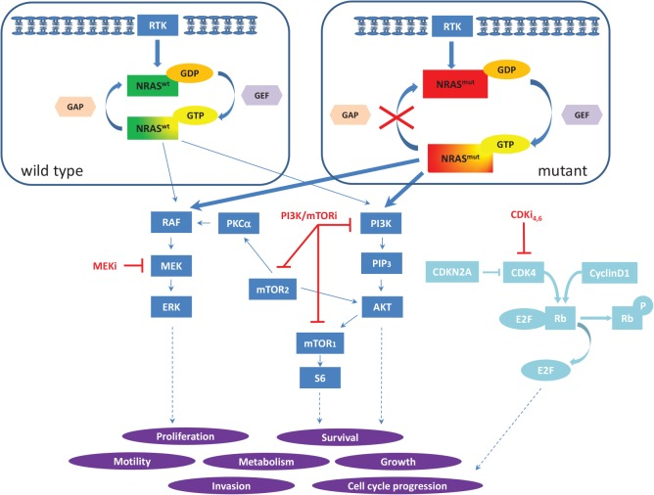
NRAS signaling in melanoma
NRAS mutations lock mutant NRAS in its GTP-bound active state
Oncotarget 2013 Apr;4(4):494-5

Slide 32
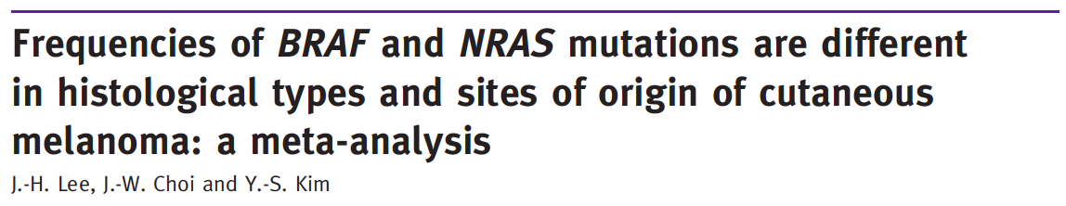
Somatic NRAS mutations
NRAS mutations – 18% (31 studies- 1972 pts)
Clinico-pathologic characteristic | OR (95% CI) | p
NM | 1.894 (1.336-2.687) | <.001
Site – Extremities | 1.561 (1.059-2.301) | .025
Chronic Sun Damage (CSD) | 1.887 (1.114-3.197) | .018
Notes:
Activating mutations in NRAS, KRAS and HRAS leading to constitutive Ras signaling have been reported in a variety of human malignancies.
The most common NRAS codon 61 mutations in cutaneous melanoma are G61R and Q61K, which lead to substitution of glutamine to arginine or to lysine. In contrast activating mutations of KRAS or HRAS in melanoma are very rare events.
Metaanalysis Lee et al, BJD 2011- BRAF (36 studies, 2521 pts) and NRAS (31 studies, 1972 pts) – Primary melanomas
BRAF mutations: 41%; NRAS mutations 18%.
Histological type
BRAF was closely associated with SSM OR 2.021 (1.440-2.835), p<.001). NM was not associated with BRAF mutations.
NRAS mutation was significantly related to NM OR 1.894 (1.336-2.687), p<.001. NRAS was not associated with SSM, ALM, LMM.
Tumor location
BRAF mutations were significantly related to the tumor site. OR for the trunk was 2.113 (1.674-2.667), p<.001. and with non-CSD OR: 2.043 (1.353-3.085), p=0.001. NRAS codon 61 has a UV hot spot and BRAF codon 600 does not.
NRAS mutations was significantly associated with extremities. OR 1.561 (1.059-2.301), p=0.025. and with CSD OR: 1.887 (1.114-3.197), p=0.018.
NO relationship between BRAF and NRAS mutations and sex and age (< 50 and > 50).
Schlaak et al, BJD 2013: NRAS mutations in pts aged > 60 yrs. Also Thomas et al 2007.
BRAF mutations were associated with tumor depth < 1mm and was rarely detected > 4 mm. NRAS was not associated with tumor depth. BRAF and NRAS mutations were not associated with T1, T2 vs T3 and T4.
Jacob 2012: patients with advanced stage (IV). BRAF or NRAS mutations were more likely than WT to have CNS mets. Shorter median survival for NRAS mutant pts from stage IV diagnosis.

Slide 33
333 melanomas (20% thick primaries and 80% mets, regional > skin > distant)
BRAF | N/H/K RAS | NF1 | Triple wild-type
52% tumors V600 > K601 Younger pts 90% UV-signature Mutually exclusive with NRAS | 28% tumors NRAS Q61, less G12-G13 Fewer HRAS and KRAS mut 93% UV-signature Mutually exclusive with BRAF | 14% tumors 39% wt BRAF/NRAS mela Mutation rate 92% UV-signature | Heterogenous group Older patients 30% UV- signature Copy number and complex rearrangement KIT mutations
Notes:
Largest integrative analysis of cutaneous melanoma through DNA, RNA and protein-based analysis of 333 melanomas (primary 20% or metastatic 80%, mostly in then skin then distant sites) from 331 pts (with matched peripheral blood) to create a catalog of somatic alterations and describe their potential biological and clinical significance.
Mean mutation rate (16.8 mut/Mb), the highest than other cancer analyzed by TCGA. High fraction of UV-signature mutations C to and CC to TT: 76% primary and 84% mets
Four subtypes based on the pattern of the most prevalent significantly mutated genes: mutant BRAF, mutant RAS, mutant NF1, triple wild-type.
NF1 subtype: 14% samples, highest mutation prevalence than other subtypes, 38.7% of non hot spot BRAF/NRAS melanomas, 92% with UV signature mutations
Triple WT: heterogeneous group, older pts, KIT mutations, 30% UV signature, enrichment of focal amplifications (copy number alterations) of known oncogens and complex structural rearrangements (fusion events). Other mutational processes involving structural rearrangement of the genome as compared to other subtypes
No significant outcome correlation with subtypes
Transcriptomic subclass enriched for immune gene expression associate with lymphocyte infiltrate and high LCK protein expression, a T cell marker, were associated with improved survival. Prognosis of melanoma patients with regional mets is influenced by tumor stroma biology.

Slide 34
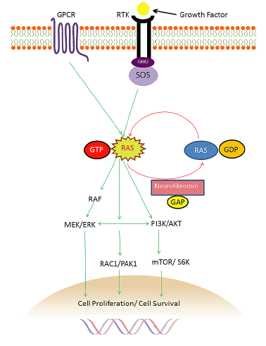
Role of NF1 and neurofibromin in tumor suppression
Tumor suppressor gene
Negative regulator of the Ras cellular proliferation pathway
NF1 aberrations in several sporadic tumors (brain, lung, ovarian, leukemia and melanoma)
Identification of NF1 aberrations is challenging
Clinical trials limited to preclinical studies
Unlikely to respond to BRAFi, benefit from anti-MEK and anti-PI3K
Yap et al. Oncotarget 2014;5:5873-92
Notes:
Neurofibromatosis type 1 (NF1) is common tumor predisposition syndrome related to germline aberrations of NF1, a tumor suppressor gene (ch 17), both copies need to be inactivated.
The gene product neurofibromin (327 KdA, 2818 aa) is a negative regulator of the Ras cellular proliferation pathway, and also exerts tumor suppression via other mechanisms. G-protein coupled receptors (GPCRs) and receptor tyrosine kinases receptors (RTKs) when activated by a ligand promote the formation of activated Ras-GTP complex. Neurofibromin inactivates Ras by accelerating the conversion of active Ras-GTP to inactive Ras-GDP with its Ras-GTPase activity. Consequently, neurofibromin suppresses activation of the downstream effectors of Ras, including PI3K, Akt, mTOR and RAF, MEK, ERK
NGS revealed somatic NF1 aberrations in several sporadic tumors (brain, lung, breast, ovarian tumors, melanoma and leukemia). They appear to be associated with resistance to therapy (BRAFi) and adverse outcome. Relevant to the advent of novel molecular therapies.
NF1 mutations and loss of NF1 protein expression occur in >90% of NF1 associated- and in > 40% sporadic malignant peripheral nerve sheath tumors.
Identification of germline and somatic NF1 aberrations is challenging since NF1 is one of the largest human gene (60 exons), absence of hot spots, presence of pseudogenes, epigenetic inactivation (miRNA, DNA methylation) limited utility of IHC).
Clinical trials of NF-1 therapeutic approaches are currently limited. Preclinical studies mainly on malignant peripheral nerve sheath tumor cell lines. Now development of NF-1 based txs for other tumor types. NF1 mutant melanomas are unlikely to respond to BRAFi but may benefit from drugs targeting MEK and PI3K pathways.

Slide 35
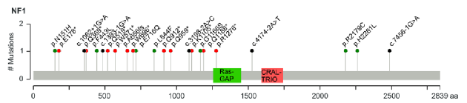
Role of NF1 and neurofibromin in tumor suppression
Tumor suppressor gene
Negative regulator of the Ras cellular proliferation pathway
NF1 aberrations in several sporadic tumors (brain, lung, ovarian, leukemia and melanoma)
Identification of NF1 aberrations is challenging
Clinical trials limited to preclinical studies
Unlikely to respond to BRAFi, benefit from anti-MEK and anti-PI3K
Yap et al. Oncotarget 2014;5:5873-92
Notes:
Neurofibromatosis type 1 (NF1) is common tumor predisposition syndrome related to germline aberrations of NF1, a tumor suppressor gene (ch 17), both copies need to be inactivated.
The gene product neurofibromin (327 KdA, 2818 aa) is a negative regulator of the Ras cellular proliferation pathway, and also exerts tumor suppression via other mechanisms. G-protein coupled receptors (GPCRs) and receptor tyrosine kinases receptors (RTKs) when activated by a ligand promote the formation of activated Ras-GTP complex. Neurofibromin inactivates Ras by accelerating the conversion of active Ras-GTP to inactive Ras-GDP with its Ras-GTPase activity. Consequently, neurofibromin suppresses activation of the downstream effectors of Ras, including PI3K, Akt, mTOR and RAF, MEK, ERK
NGS revealed somatic NF1 aberrations in several sporadic tumors (brain, lung, breast, ovarian tumors, melanoma and leukemia). They appear to be associated with resistance to therapy (BRAFi) and adverse outcome. Relevant to the advent of novel molecular therapies.
NF1 mutations and loss of NF1 protein expression occur in >90% of NF1 associated- and in > 40% sporadic malignant peripheral nerve sheath tumors.
Identification of germline and somatic NF1 aberrations is challenging since NF1 is one of the largest human gene (60 exons), absence of hot spots, presence of pseudogenes, epigenetic inactivation (miRNA, DNA methylation) limited utility of IHC).
Clinical trials of NF-1 therapeutic approaches are currently limited. Preclinical studies mainly on malignant peripheral nerve sheath tumor cell lines. Now development of NF-1 based txs for other tumor types. NF1 mutant melanomas are unlikely to respond to BRAFi but may benefit from drugs targeting MEK and PI3K pathways.

Slide 36
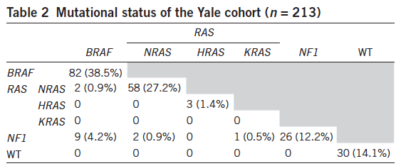
Recurrent NF1 mutations in cutaneous melanoma
NF1 mutations in 46% of BRAF or RAS wild type melanomas
NF1-mutant melanomas
Older patients
More somatic mutations
Concurrent RASopathy gene mutations (NF1+, BRAF, NRAS)
Similar overall patient survival compared to BRAF-mutant, RAS-mutant and triple wt melanomas
Krauthammer et al. Nat Genet 2015;47:996-1002
Notes:
Whole exome sequencing of 213 melanomas (matched DNA from 133 of them).
3 genes were mutated with an incidence > 10%: BRAF and NRAS with recurrent activating mutations, and NF1 with inactivating mutations (LOH or compound heterozygotes with 2 NF1 mutations)
BRAF mutations (38.5%), RAS mutations (28.6%)
NF1 mutations in melanomas with BRAF and RAS wt: 46.4% NF1 mutants were BRAF and RAS wt
NF1 mutant melanomas: harbored more somatic mutations, older patients, similar overall patient survival compared to BRAF-mutant, RAS-mutant and triple wt melanomas
NF-1 mutant melanoma (BRAF and NRAS wt) about 60% show a distinct pattern of co-mutation with Rasopathy genes: particularly RASA2, PTPN!!, SOS1, RAF1 and SPRED1
NF1 is a key tumor suppressor gene in melanoma and that concurrent RASopathy genes mutations may enhance its role in melanomagenesis (may require additional changes for robust MAPK activation.

Slide 37
333 melanomas (20% thick primaries and 80% mets, regional > skin > distant)
BRAF | N/H/K RAS | NF1 | Triple wild-type
52% tumors V600 > K601 Younger pts 90% UV-signature Mutually exclusive with NRAS | 28% tumors NRAS Q61, less G12-G13 Fewer HRAS and KRAS mut 93% UV-signature Mutually exclusive with BRAF | 14% tumors 39% wt BRAF/NRAS mela Mutation rate 92% UV-signature | Heterogenous group Older patients 30% UV- signature Copy number and complex rearrangement KIT mutations
Notes:
Triple WT: heterogeneous group, older pts, KIT mutations, 30% UV signature, enrichment of focal amplifications (copy number alterations) of known oncogens and complex structural rearrangements (fusion events). Other mutational processes involving structural rearrangement of the genome as compared to other subtypes
No significant outcome correlation with subtypes
Transcriptomic subclass enriched for immune gene expression associate with lymphocyte infiltrate and high LCK protein expression, a T cell marker, were associated with improved survival. Prognosis of melanoma patients with regional mets is influenced by tumor stroma biology.

Slide 38
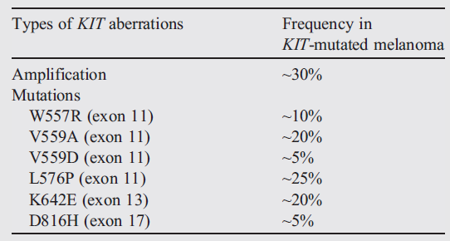
Somatic KIT mutations
1-3% melanomas
Molecular testing of exons 9, 11, 13, 17, 18
Bradish RD et al., 2014
Notes:
Anomalies found in the KIT gene include both amplification and mutations and are not mutually exclusive [51]. KIT mutations are present in only 3% of melanomas overall but are found in 23% of those melanomas arising in chronically sun-damaged skin and acral and mucosal sites [51-54].
KIT is necessary for the proper development and survival of melanocytes, and it is hypothesized that, in melanoma containing other mutations such as BRAF or NRAS, KIT plays a role in tumor suppression [52].
KIT loss has been demonstrated during progression of melanoma and the development of metastatic disease [55].
The most common KIT mutations in melanoma are L576P (exon 11) and K642E (exon 13); however, there is a wide array of possible KIT aberrations in melanoma, and therefore, sequencing the relevant exons, including 9, 11, 13, 17, and 18, is necessary to detect all KIT mutations (Table 4)[51,56-59]. Evidence suggests that only those mutations in exons 11 and 13, which contain the 2 most common mutations L576P (exon 11) and K642E (exon 13) are responsive to KIT inhibition.
Determining which patients are appropriate for the arduous task of sequencing KIT exons for detection of KIT mutations is important for proper allocation of resources.
It has been recommended that, after a patient with a mucosal or acral melanoma has been determined to be BRAF mutation negative, only then should they be tested for a KIT exon mutation [51].
Currently, testing usually consists of exons 9, 11, 13, 17, and 18. Amplification of the KIT gene also has some response to inhibition.

Slide 39
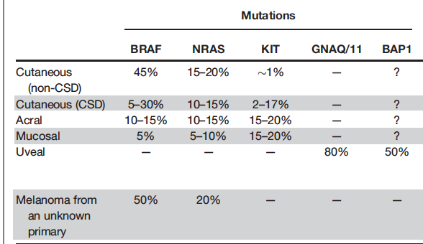
Somatic KIT mutations
Woodman et al, Clin Cancer Res 2012

Slide 40
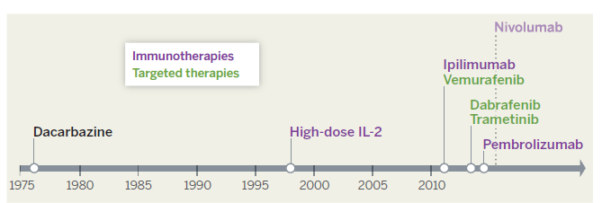
Targeted therapies in melanoma
The importance for genetics in melanoma is the proper assessment of molecular target therapies
Notes:
The importance for proper molecular classification of melanomas is due to the advent of target therapies, especially molecular target therapies as competitive, selective BRAF inhibitors.
The first targeted therapy to demonstrate substantial efficacy against melanoma was vemurafenib, a BRAF inhibitor (40). In the phase III clinical trial, vemurafenib conferred a survival advantage compared to dacarbazine chemotherapy in patients with BRAFV600E-mutant melanomas, with an overall response rate of 48% (41).
Dabrafenib, another BRAF inhibitor, provides similar clinical benefit (42).
Vemurafenib and dabrafenib were approved by the U.S. Food and Drug Administration (FDA) for treatment of advanced BRAFmutant
melanoma in 2011 and 2013, respectively
In addition to molecular targeted therapy, the field of oncology has also expanded towards antitumor immunotherapy,
which stems from the concept that tumors themselves can be immunogenic and can stimulate an immunemediated
antitumor response. On March 25, 2011, the US Food and Drug Administration approved ipilimumab for the treatment of metastatic melanoma. Ipilimumab (previously known as MDX-010), a monoclonal antibody, acts by promoting T-cell activation, which results
in antitumor effects on melanoma.

Slide 41
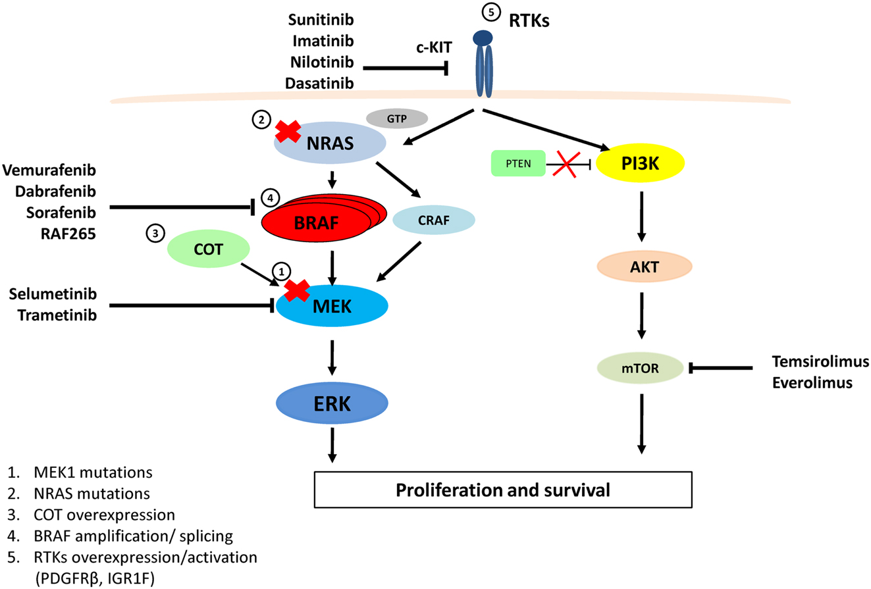
Targeted therapies in melanoma
Notes:
Vemurafenib is a potent inhibitor of the kinase domain of mutant BRAF, and leads to decreased proliferation through reductions of phosphorylated ERK and cyclin D1.
Dabrafenib is a reversible, ATP-competitive inhibitor that selectively inhibits BRAF Val600Glu. Dabrafenib has shorter half-life than does vemurafenib (5.2 h vs 50 h), but is otherwise similar to vemurafenib in mode of action and pharmacodynamic effects
Trametinib is an orally available, small-molecule, selective inhibitor of MEK1 and MEK2.
Combination Rx is regarded as standard of care for BRAF mutant melanomas.
These inhibitors are only effective in patients with BRAF mutant melanoma and have been shown to be potentially detrimental to patients with BRAF wild-type melanoma as they may induce paradoxical activation of RAF dimers resulting in increased signalling through this pathway. Therefore, the presence of a BRAFV600 mutation must be verified prior to initiation of therapy and is inherently critical to the efficacy of this treatment regimen
FIGURE 1|MAPKandPI3K/AKTpathways,therapeutictargetsfor melanoma andresistancetoVemurafenib. VemurafenibandDabrafenib are specificforBRAFV600E, while SorafenibandRAF-265 are pan-RAF inhibitors. Imatinib,Nilotinib,Dasatinib,andSunitinibtargetandinhibit c-KIT.SelumetinibandTrametinibinhibitMEKactivity.Temsirolimusand EverolimusinhibitthemTORprotein.ResistancetoVemurafenibarises from MAPKpathwayreactivationby(1)aMEK1C121S mutation,(2) NRASQ61R/K mutations,(3)COT1overexpression,(4)alternativelyspliced variantsofBRAFV600E or amplificationofthemutantBRAFallele,(5) OverexpressionoractivationofRTKs(PDGFRb or IGF1R)bypassesmutant BRAF andactivatesERKviaCRAF-MEKorthroughindependentERK mechanismsbyactivatingthePI3K/AKTpathway.

Slide 42
Distinct targeted therapies for genes of the MAPK pathway
Van Engen-van Grunsven et al, Frontiers in Medicine 2014

Slide 43
Non melanoma skin cancer (NMSC)

Slide 44
Epidemiology of NMSC
Non-melanoma skin cancer is the most frequently diagnosed cancer in humans
Approximately 2.2 to 5.0 million people were treated annually for NMSC in USA.
Basal cell carcinoma (BCC) is the most common skin cancer worldwide representing 70–80% of skin cancers.
The ratio of BCC to squamous cellcarcinoma (SCC) in white populations appears to lie between 4:1 and 2.5:1, in higher and lower latitudes, respectively.
The prevalence of BCC and SCC has increased by 35% and 133%, respectively, over the last 20 years

Slide 45
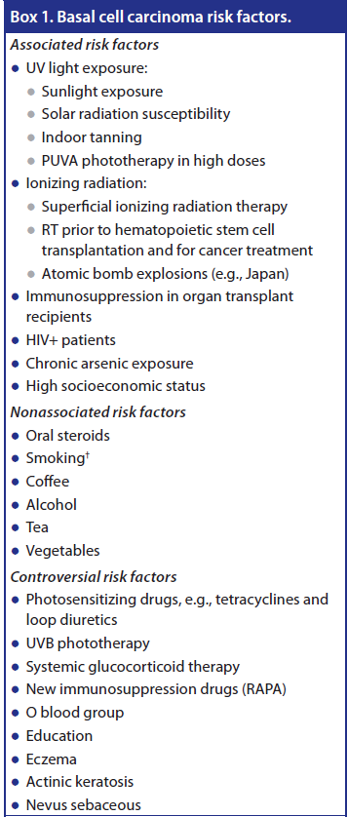
Epidemiological and environmental risk factors for NMSC
Genetic risk factors ??
Notes:
The appearance of BCC is strongly associated with exposure to ultraviolet (UV)
radiations: tumors develop primarily on the sun-exposed skin of elderly individuals with fair skin
type; they are rarely found on palmo-plantar surfaces or in children, and never appear on the mucosa.
Men are more frequently affected than women, usually after the age of 50.

Slide 46
Genetic of Basal cell Carcinoma

Slide 47
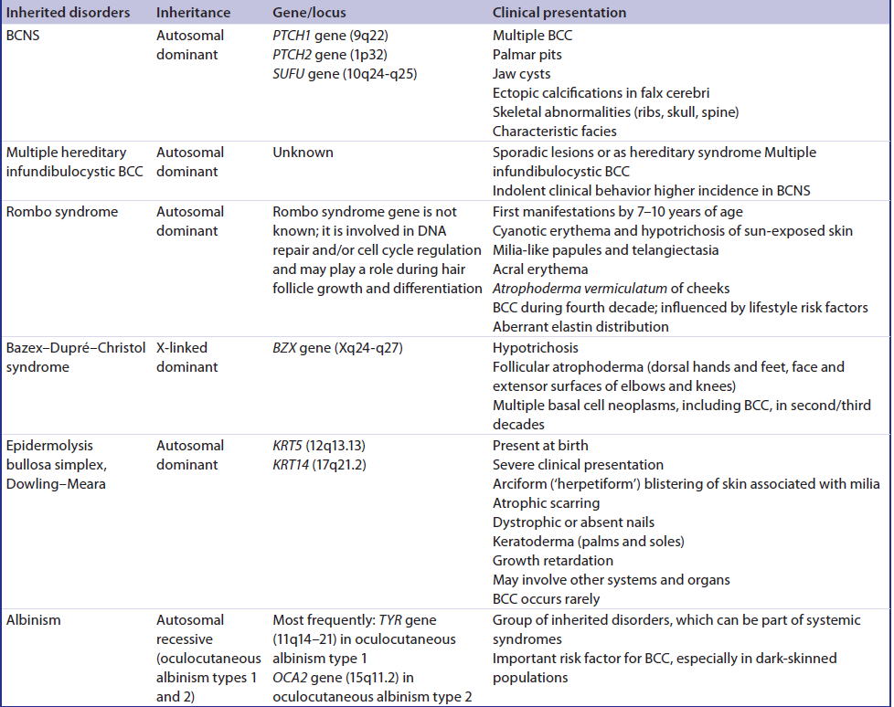
BCC genetic predisposition
Basal cell carcinoma syndromes
Notes:
Evidences of genetic alterations in BCC pathogenesis derive from studies of patients with a
hereditary predisposition syndrome, known as basal cell nevus syndrome (BCNS) or Gorlin syndrome.
As early as 1894, Jarisch and White first described patients with clinical features of the autosomally
inherited BCNS syndrome [6,7] which was later characterized in detail by Gorlin and Goltz [8].
BCNS patients typically develop multiple BCCs starting at a young age and are prone to develop
other tumors including medulloblastomas. Using family-based linkage studies of kindreds with BCNS,
the locus carrying the causative mutant gene was mapped to human chromosome 9q22 and then
to the Patched 1 (PTCH1) gene [9].
PTCH1 is a transmembrane receptor that acts negatively in the
hedgehog (HH) signaling pathway. After the identification of PTCH1 as the BCNS disease gene [10,11],
PTCH1 and other components of the HH pathway, as smoothened (SMO) and glioma-associated
oncogene (GLI), were investigated in sporadic BCC [12–14]. These pioneering studies demonstrated
that loss-of-function mutations of PTCH1 and/or gain-of-function mutations of SMO were implicated
in the pathogenesis of this disease. In subsequent reports, including a high number of sporadic
BCCs, molecular alterations of the HH pathway components were identified in about 90% of the
cases [12,14–19]. Therefore, the aberrant HH signaling activation was defined as a prerequisite for
the development of BCC both for the inherited (Gorlin’s syndrome) and for the sporadic forms of
the disease.

Slide 48
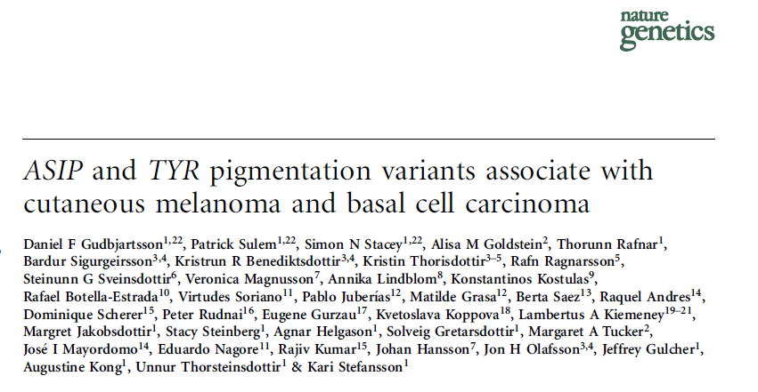
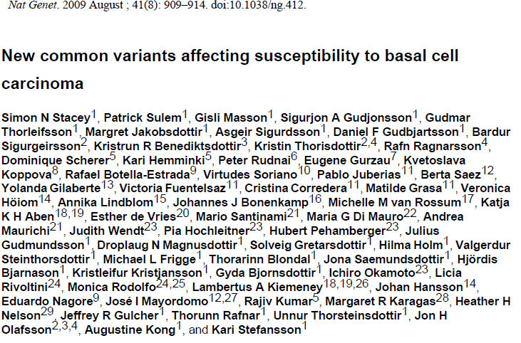
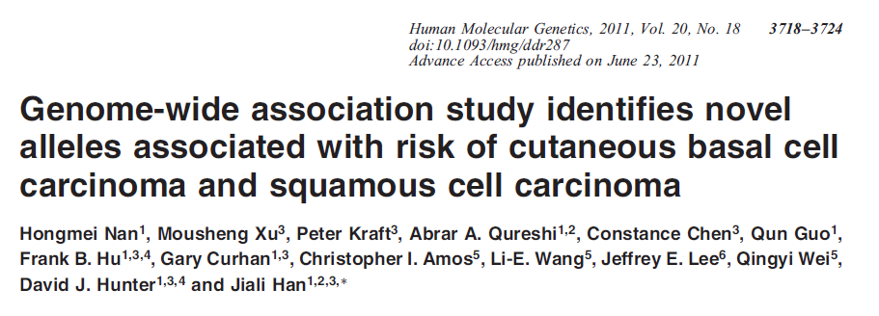
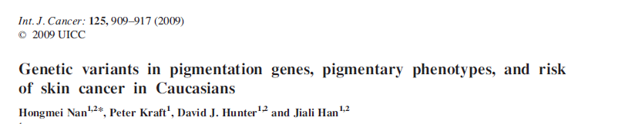
BCC genetic predisposition
ASIP, TYR, OCA2, MC1R and SLC45A2 genes
KRT5 gene and 7q32 locus, near the gene KLF14
TERT-CLPTM1L locus and TP53
Notes:
Genome-wide association studies identified common low-penetrance susceptibility alleles in ASIP, TYR, OCA2, MC1R and SLC45A2 genes, 6p25 and 13q32 locus that regulate solar radiation susceptibility traits and confer BCC susceptibility [103–105].
Other genetic variants, not associated with pigmentation traits, in 1p36 locus and 1q42 locus, were associated with 2.68 increased risk of BCC, as well as polymorphisms in KRT5 gene and 7q32 locus, near the imprinted gene KLF14 [106,107].
Cell cycle regulation and apoptosis are key factors in carcinogenesis, and variants in 9p21 locus, near CDKN2A and CDKN2B genes, both involved in cell cycle regulation, TERT-CLPTM1L locus, and TP53 increase susceptibility to BCC [107–109].
UV radiation suppresses immune responses through activity of CTLA4. CTLA4 CT60 GG genotype associates with decreased risk of BCC especially among individuals with higher lifetime number of severe sunburns [110].

Slide 49
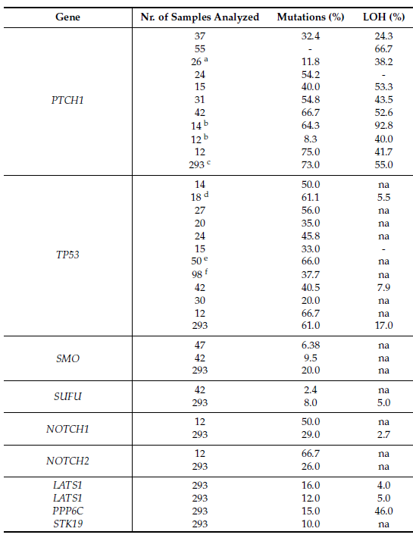
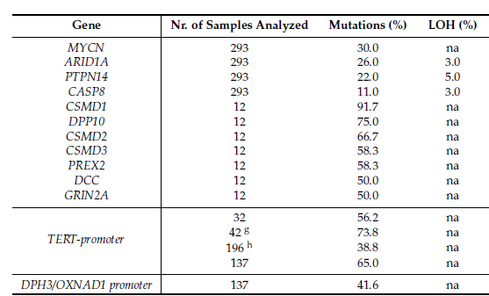
Somatic genetic alteration in BCC
UV-signature mutations (C>T or CC>TT)
Pellegrini C et al. IJMC 2017
Notes:
UV radiation plays a major role in BCC carcinogenesis. causing structural DNA changes known as UV signature mutations or UV fingerprints [61]. An important part of TP53 and, less frequently, PTCH1 and SMO mutations are UV fingerprints [91,97].

Slide 50
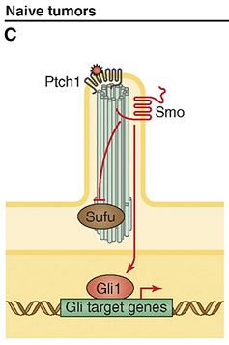
Established somatic genetic alteration: the HH pathway
Notes:
A simplified model for Hh signaling in mammalian cells. SMO is the key signal transducer of the Hh pathway. A, In the absence of Hh ligands,the PTCH receptor at the base of
the primary cilium suppresses the function of SMO by preventing its entry into the cilium. Without SMO activation, Gli proteins are processed with Su(Fu), GSK3β, PKA, and CKI into a
repressor form (Gli-R), which disable the Hh signaling pathway. B, In the presence of Hh, it binds to PTCH. The binding can be repressed by HIP and supported by Cdo, Gas1 and Boc.
Upon binding, the Hh/PTCH complex becomes internalized in endosomes and later degraded. Without inhibition from PTCH, SMO becomes activated and facilitated Gli activation n
(GliA), which stimulates Hh target gene expression.
Inactivating mutations of PTCH1 have been found in most exons of the PTCH1 gene
[120,121] in sporadic BCC. In the tumor, while one copy of PTCH1 is
mutated, the other copy is lost through chromosome loss in the region
where the PTCH gene resides.As a result of loss of PTCH1 function, SMO signaling is without control, leading to constitutive activation of the pathway. About 70% of BCCs contain genetic alterations in the
PTCH1 gene

Slide 51
Target Therapy for PTCH1 mutated BCC
Notes:
A simplified model for Hh signaling in mammalian cells. SMO is the key signal transducer of the Hh pathway. A, In the absence of Hh ligands,the PTCH receptor at the base of
the primary cilium suppresses the function of SMO by preventing its entry into the cilium. Without SMO activation, Gli proteins are processed with Su(Fu), GSK3β, PKA, and CKI into a
repressor form (Gli-R), which disable the Hh signaling pathway. B, In the presence of Hh, it binds to PTCH. The binding can be repressed by HIP and supported by Cdo, Gas1 and Boc.
Upon binding, the Hh/PTCH complex becomes internalized in endosomes and later degraded. Without inhibition from PTCH, SMO becomes activated and facilitated Gli activation n
(GliA), which stimulates Hh target gene expression.
Inactivating mutations of PTCH1 have been found in most exons of the PTCH1 gene
[120,121] in sporadic BCC. In the tumor, while one copy of PTCH1 is
mutated, the other copy is lost through chromosome loss in the region
where the PTCH gene resides.As a result of loss of PTCH1 function, SMO signaling is without control, leading to constitutive activation of the pathway. About 70% of BCCs contain genetic alterations in the
PTCH1 gene

Slide 52
Genetic of Squamous cell Carcinoma

Slide 53
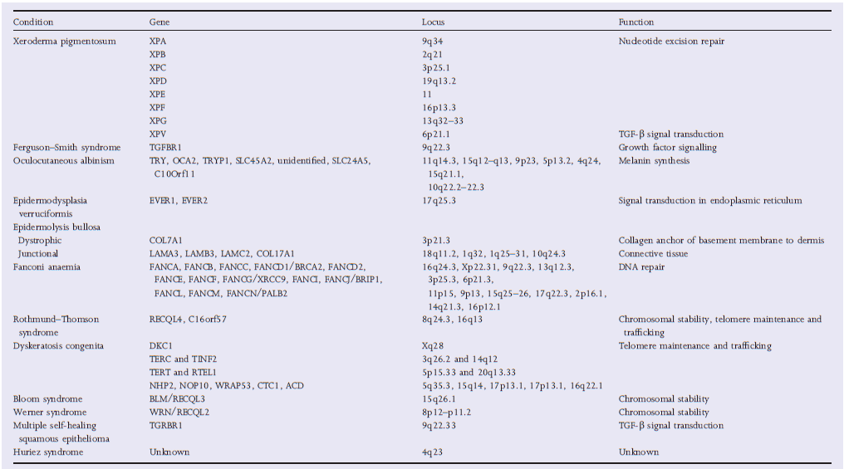
SCC genetic predisposition
Several genes associated with SCC have been identified in patients with hereditary disorders
Notes:
UV radiation plays a major role in BCC carcinogenesis. causing structural DNA changes known as UV signature mutations or UV fingerprints [61]. An important part of TP53 and, less frequently, PTCH1 and SMO mutations are UV fingerprints [91,97].

Slide 54
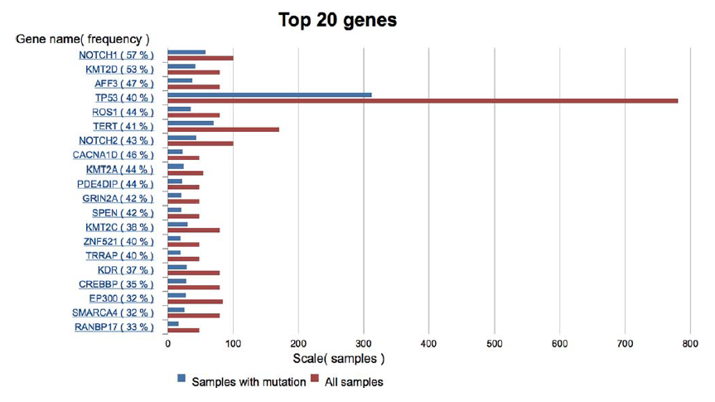
Somatic genetic alteration in SCC
TP53
NOTCH1
NOTCH2
UV-signature mutations (C>T or CC>TT)
Ashford BG, et al.Head & Neck. 2017;1–8

Slide 55
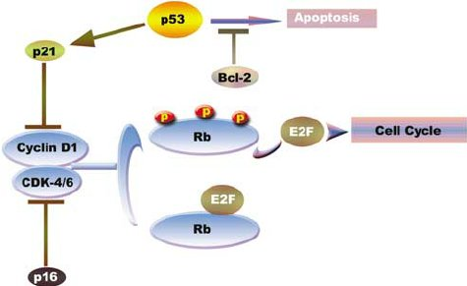
p53 signalling pathway
.
Jayasurya R., et al. Mod Pathol. 2005;18(8):1056-66

Slide 56
Take Home message
1
Genetic counseling
Genetic testing
Melanoma can be inherited
High pentrence genes
Intermediate genes
2
Somatic genetic alterations tumor specific (melanoma and BCC)
Target therapy
3
New
DNA technologies
Discover
new target therapy
Personalized
Medicine

Slide 57
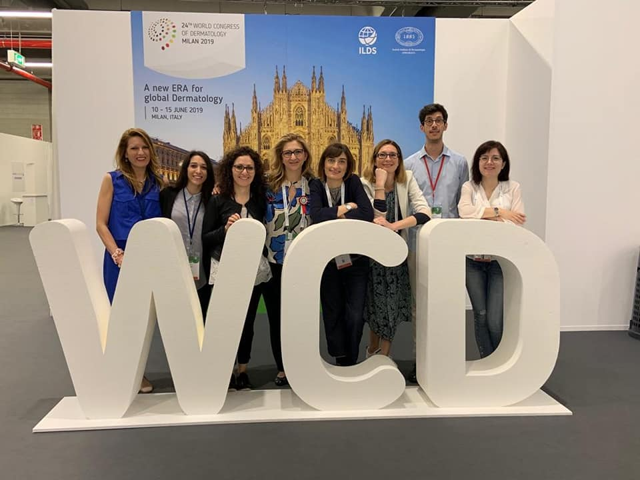

Thanks
Prof. Maria Concetta Fargnoli
Rosaria Fidanza
Maria Esposito
Carlota Gutiérrez
Antonella Piccioni
Ambra Antonini
Tea Rocco
Valeria Ciciarelli
Matteo Maini
Lucia Di Nardo
Ludovica Cardelli

