Slide 1
Chemotherapy combos in NSCLC
Chiara Lazzari
Thoracic Oncology
Department of Oncology, Division of Molecular Oncology
Scientific Institute San Raffaele University Hospital

Slide 2
The evolving role of systemic treatment in advanced NSCLC
One fits all
Pharmacogenetics and pharmacogenomics
1980
2000
2019
2004
2006
2007
2009
2016
EGFR mutation
discovered
Role of histotype
Phase III study
EML4/ALK
Immunotherapy
Antivascular agent
Phase III study

Slide 3
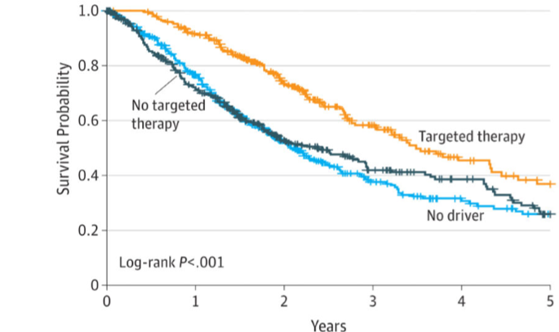
Improved OS in NSCLC
Carrying an oncogenic driver and receiving targeted therapy
Clinical trial
Approved
Clinical trial
Approved
Clinical trial
AIFA
Approved
Rosell and Karachaliou; Lancet; 2016
Kris et al; JAMA; 2014
Approved

Slide 4
Improved OS in NSCLC with cisplatin compared to BSC - phase III
Spiro et al; Thorax; 2004

Slide 5
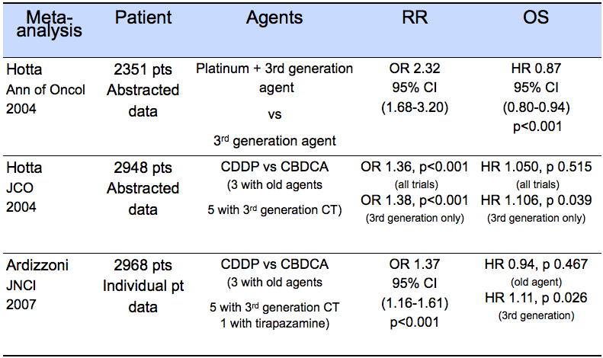
Platinum based chemotherapy -
Meta-analysis

Slide 6
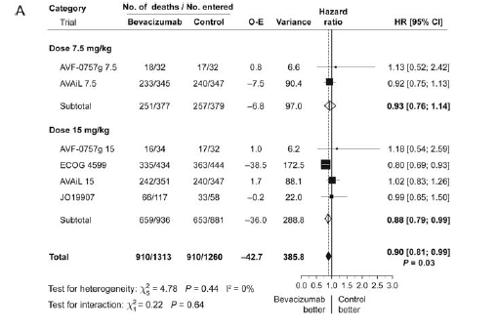
First line bevacizumab-
Meta-analysis
OS
Soria JC et al, Ann Oncol, 2013

Slide 7
Cisplatin - Pemetrexed in Non Squamous
 | Adenocarcinoma MS (months) | Squamous MS (months)
CDDP-Gemcitabine | 10.9 / 411 | 10.8 / 229
CDDP-Pemetrexed | 12.6 / 436 | 9.4 / 244
HR (95% CI) p value | 0.84 (0.71-0.99) 0.033 | 1.23 (1-1.51) 0.05
Scagliotti G et al, JCO, 2008

Slide 8
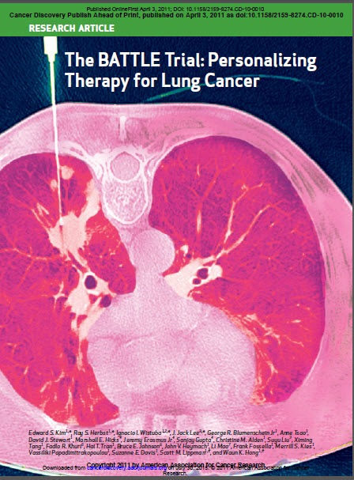
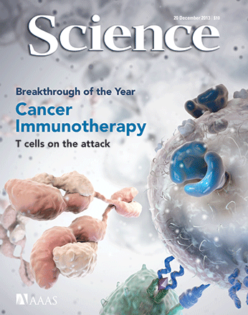
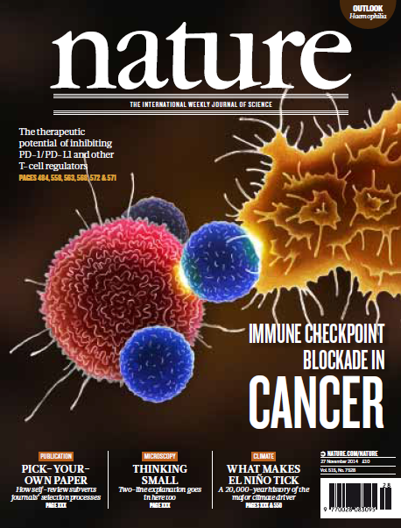
From Targeted Therapy to Immunotherapy
Herbst; Vienna; December 2016

Slide 9
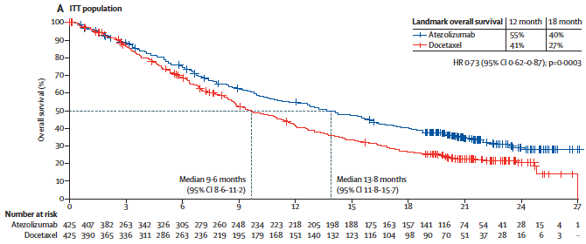
The new area of immunotherapy
CA-017 - squamous NIVOLUMAB
OAK- ATEZOLIZUMAB
Rittmeyer et al; Lancet; 2016
Horn et al; JCO; 2017
KEYNOTE-024
Reck et al; JCO; 2018

Slide 10
Chen et al; Nature; 2017

Slide 11
Chemotherapy can enhance the tumor priming phase
Immunogenic cell death
Dying
tumour cell
Immature DC
CD91
Mature DC
CRT
P2RX7
ATP
TLR4
HMGB1
Antigen
engulfment
IL-1β
ICD
Antigen
presentation
Therapy-induced
stress
T cell
Therapy-sensitive
tumour cells
IL-17
Vessel
Therapy-resistant
tumour cells
IFN-𝛄
CTLs
tumour cells
lysis
Modified by Kroemer G, et al. Annu Rev Immunol 2013.

Slide 12
Chemotherapy
+
PD-1/PD-L1 inhibitors
1
↑ MHC
4
↑ antigen presenting cells
2
tumor cells
5
↓ tumor cells
tumor cells and tumor microenvironment
3
↓ myeloid derivative suppressive

Slide 13
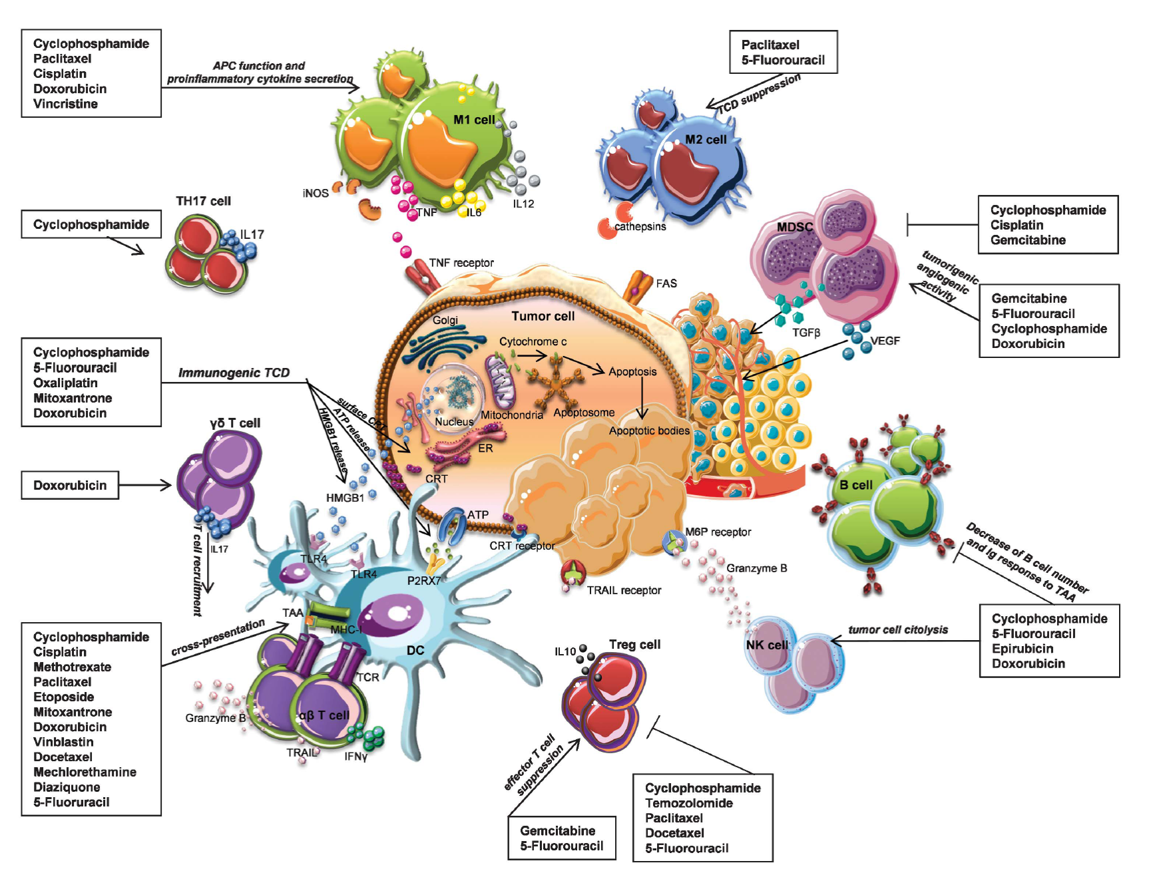
Drug | Immunological mechanism
Cisplatin or Carboplatin | enhanced T cell activation
Taxanes | reduction of the activity of T-reg
Pemetrexed | activation of IFN-y producing NK cells and CD45RO+ memory T cells
Gemcitabine | regulation of TAMs
Mathew et al; Pharmacology & Therapeutic; 2018

Slide 15
KEYNOTE-189
Platinum + Pemetrexed
+ pembrolizumab (x4)
Pemetrexed
+ pembrolizumab
616 patients stage IV naive
non-squamous
ECOG PS 0-1
EGFR WT
ALK -
stratified by
PD-L1
≥1% or < 1%
CDDP or CBDCA
Platinum + Pemetrexed
+ placebo (x4)
Pemetrexed
+ placebo
PRIMARY END POINTS:
OS
PFS
41.3%
Pembrolizumab
Gandhi et al; NEJM; 2018
KEYNOTE-407
CBDCA + PTX or NAB-PTX
+ pembrolizumab
Pembrolizumab
559 patients stage IV naive
squamous
ECOG PS 0-1
stratified by
PD-L1
≥1% or < 1%
paclitaxel or nabpaclitaxel
region
CBDCA + PTX or NAB-PTX
+ placebo
Placebo
PRIMARY END POINTS:
OS
PFS
Pembrolizumab
Paz-Ares et al; NEJM; 2018

Slide 16
KEYNOTE-189
PD-L1 <1%
61.7%
OS
15.2 months
52.2%
12.0 months
HR 0.59 (95% CI 0.38-0.92)
Not reached
PD-L1 1% - 49%
69.2%
11.3 m (8.7-15.1)
71.5%
49.4%
Not reached
50.9%
12.9 months
HR 0.55 (95% CI 0.34-0.90)
HR 0.49 (95% CI 0.38-0.64) p 0.001
PD-L1 ≥50%
Not reached
73%
48.1%
10 months
HR 0.42 (95% CI 0.26-0.68)
Gandhi et al; NEJM; 2018

Slide 17
KEYNOTE-189
PD-L1 <1%
HR 0.75 (95% CI 0.53-1.05)
PFS
6.1 months
5.1 months
PD-L1 1%-49%
HR 0.55 (95% CI 0.37-0.81)
8.8 m (7.6-9.2)
4.9 m (4.7-5.5)
9.0 months
4.9 months
PD-L1 ≥50%
HR 0.52 (95% CI 0.43-0.64) p< 0.001
HR 0.36 (95% CI 0.25-0.52)
9.4 months
Gandhi et al; NEJM; 2018
4.7 months
Gandhi et al; NEJM; 2018

Slide 18
KEYNOTE-407
PD-L1 <1%
HR 0.61 (0.38-0.98)
OS
48.3%
PD-L1 <1% - 49%
15.9 m (13.2-not reached)
HR 0.57 (0.36-0.90)
65.2%
11.3 m (9.5-14.8)
HR 0.64 (0.49-0.85) p<0.001
PD-L1 ≥50%
HR 0.64 (0.37-1.10)
↓ tumor cells
Paz-Ares et al; NEJM; 2018

Slide 19
KEYNOTE-407
PD-L1 <1%
HR 0.68 (0.47-0.98)
PFS
PD-L1 <1% - 49%
HR 0.56 (0.39-0.80)
6.4 m (6.2-8.3)
HR 0.56 (0.45-0.70) p<0.001
4.8 m (4.3-5.7)
4.8 m (4.3-5.7)
PD-L1 ≥50%
HR 0.37 (0.24-0.58)
Paz-Ares et al; NEJM; 2018

Slide 20
Angiogenesis and the immune system
VEGF promotes activation and differentiation of neutrophils, monocytes and MDICs, and impairs the immune-system by affecting DCs and specific T-cell subsets
VEGF deprivation induced by bevacizumab may stimulate immunological alterations and enhance the efficacy of chemotherapy and the survival of cancer patients
Khan KA et al; Nature Review; 2018
Fukumura D et al; Nat Rev Clin Oncol; 2018

Slide 21
Angiogenesis and the impact on tumor stroma
VEGF has been implicated in the generation of MDSC
Sunitinib
↓ tumor cells
Ko et al; Clin Canc Res; 2009

Slide 22
IMpower 150
↓ tumor cells
Socinski et al; NEJM; 2018

Slide 23
↓ tumor cells
Socinski et al; NEJM; 2018

Slide 24
↓ tumor cells

Slide 26
Effect on liver metastases

Slide 27
Conclusions
Conclusions
- Chemotherapy remains the gold standard for the majority of NSCLC pts
- Global therapeutic strategies are needed to define the optimal combination of immune checkpoint inhibitors and chemotherapy
Angiogenesis impacts on tumor microenvironment
Tumor microenvironment influences the activity of immune checkpoint blockade

Slide 28
Challanges
Which are the patients with PD-L1≥ 50% who might take advantage from concurrent chemotherapy and immunotherapy?
Which are the patients with PD-L1≥ 50% who should receive immunotherapy monotherapy?
Are ECOG PS and disease burden clinical factors to be considered for treatment choice?
- Translation research is required to identify those patients who may benefit from combinatorial approaches with ICB and antiangiogenesis, to discover intrinsic and acquired resistance mechanisms
Nivolumab 240 mg Q2W
n = 396

