Slide 1




Highlights on triple positive and luminal breast cancer
Prof. Patrizia Querzoli
Struttura Semplice di Patologia Mammaria
U.O Anatomia Patologica
Azienda Ospedaliero-Universitaria Ferrara
patrizia.querzoli@unife.it

Slide 2

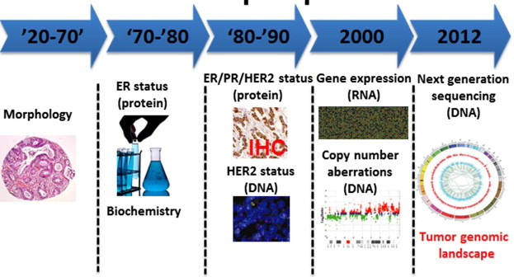
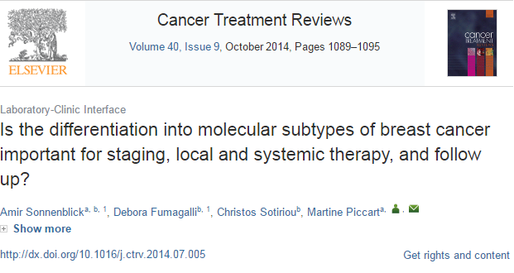
MOLECULAR CLASSIFICATION OF BC:
WHAT THE PATHOLOGIST NEED TO KNOW

Slide 3
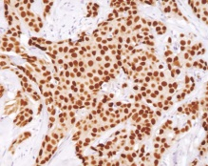
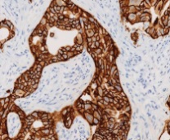
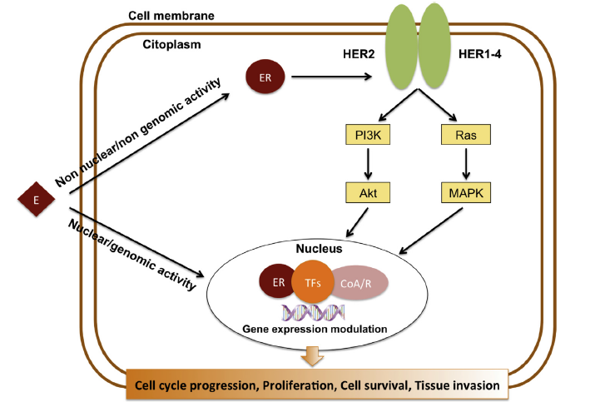
BREAST CANCER ER and HER2 SIGNALINGS ‘CROSS-TALK
This bidirectional cross-talk leads to cancer cell cycle progression, proliferation, survival and invasiveness
Schettini F et al, 2013

Slide 4


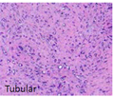
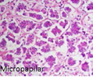
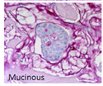

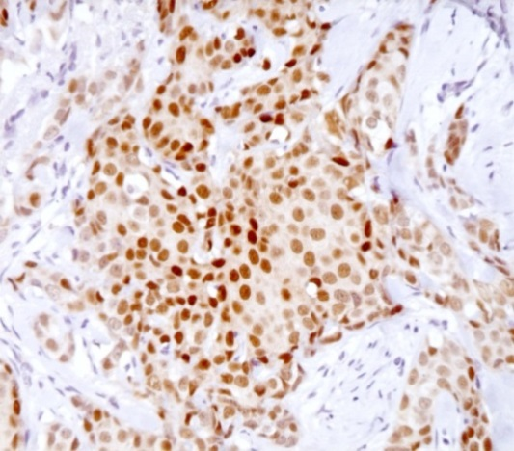
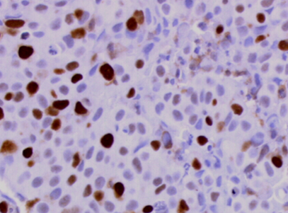
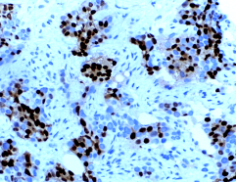
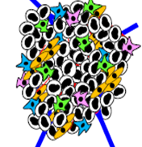
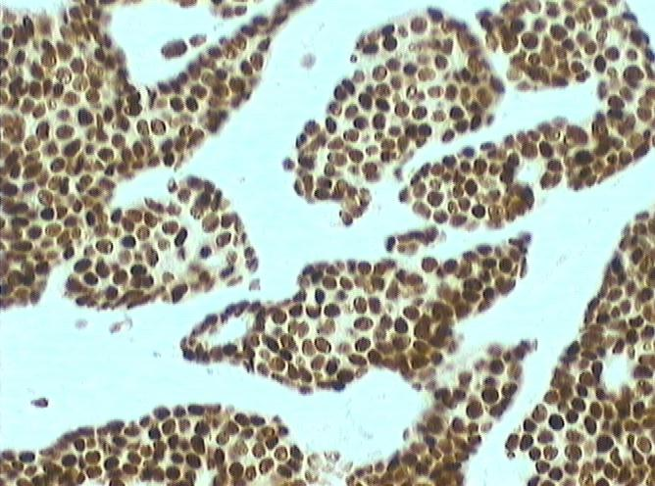
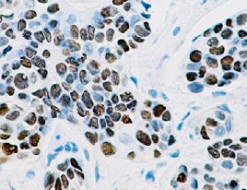
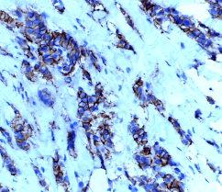

BREAST CANCER HETEROGENEITY
ER
KI67
PR
HER2
Coleman WB, 2017

Slide 5
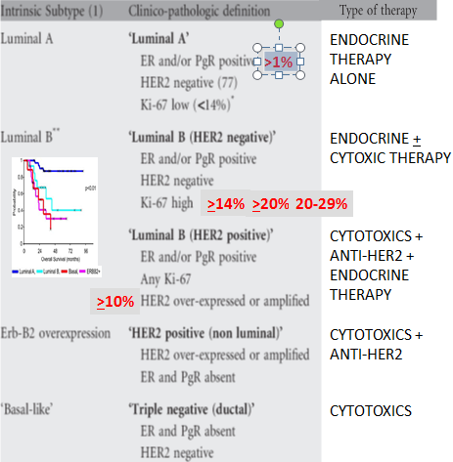
LUMINAL DEFINITION IN CLINICAL PRACTIC
Treatment-oriented classification of sub-groups of BC and combined definitions proposed in St Gallen consensus meeting
Subtype Definition Using Gene Expression Classifiers
Surrogate Histologic and IHC Markers
Prognostic Signatures Within Intrinsic Subtypes
Clinical Behavior
Benefit of CT, ET, HER2 T
Drug development
Annals of Oncology 2011-2013-2015-2017

Slide 6
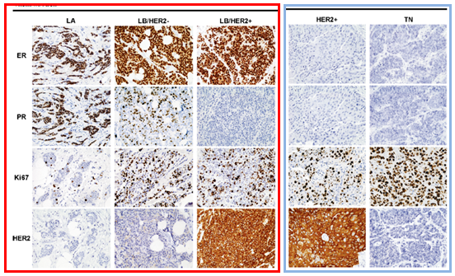
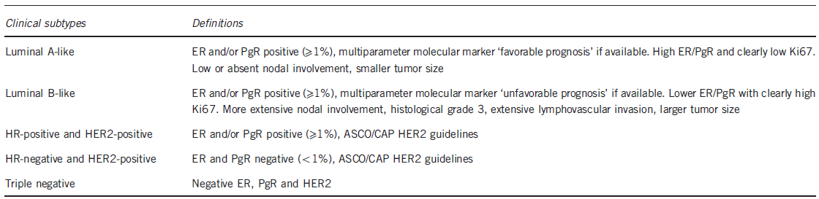
Treatment-oriented classification of sub-groups of BC and combined definitions proposed in St Gallen consensus meeting
Kurozumi S et al, 2017

Slide 7
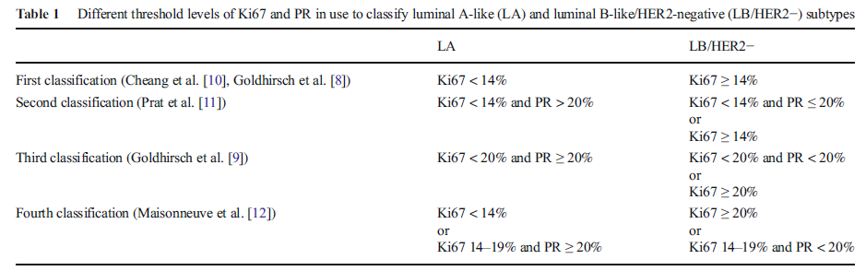
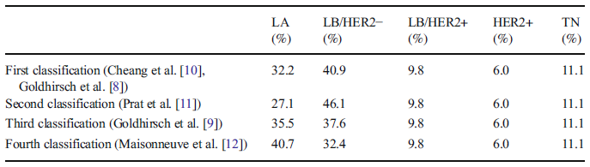
Breast cancer subtype discrimination using standardized 4-IHC
and digital image analysis
Using the most recently proposed surrogate definitions for the classification of luminal BC subtypes, the percentages of different subtypes were similar to those published
with genomic platforms:
40.7% Luminal A-like, 32.4% Luminal B-like/HER2-neg 9.8% Luminal B-like/HER2-pos,
6% HER2-pos , and 11.1% Triple Negative.
Invasive BC
(core needle biopsies)
Gandara-Cortes M, et al 2018

Slide 8
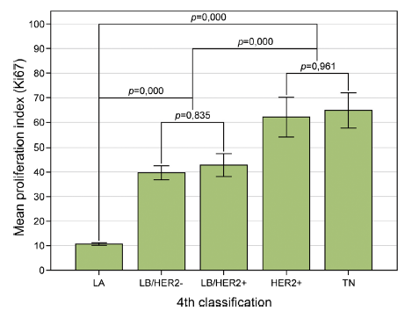
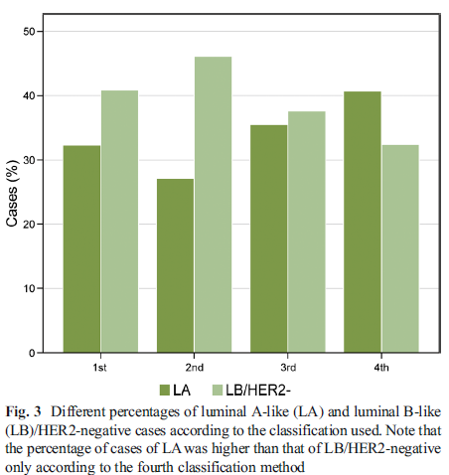
Breast cancer subtype discrimination using standardized 4-IHC
and digital image analysis
Ki67labeling index was low in the better prognostic subtype luminalA (10.7%);
intermediate in luminal B/HER2-neg(39.8%), and luminal B/HER2-positive (42.8%),
very high in the most aggressive subtypes(HER2-pos nonluminal 62.0% and Triple Negative 64.8%).
Gandara-Cortes M, et al 2018

Slide 9
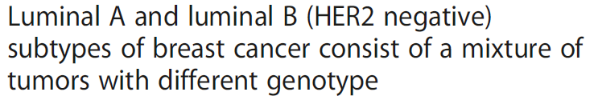
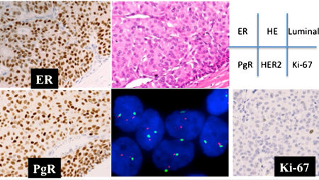
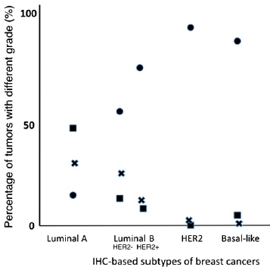
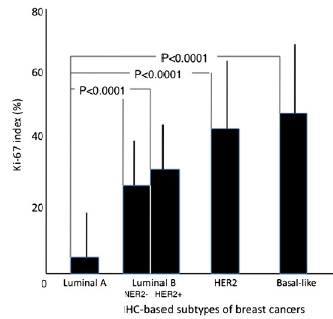
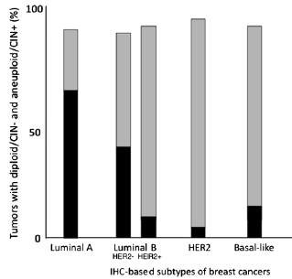
G1
G2
G3
Yanagawa et al., 2012,

Slide 10
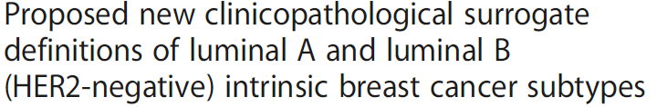
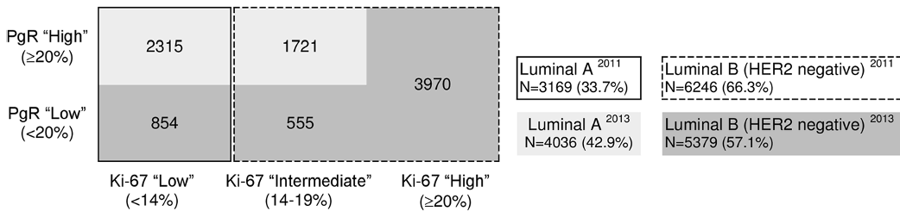
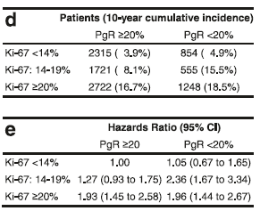
Luminal A and Luminal B
Maisonneuve et al, 2014
- 9,415 women with a median follow-up of 8.1 years , ER-positive, HER2–negative early BC
-The updated pathological definition of intrinsic molecular subtypes may maximize the number of patients classified as having the luminal A–like intrinsic subtype of BC and for whom the use of cytotoxic drugs could mostly be avoided.
- Lack of substantial PR positivity was associated with poorer outcomes only for patients with an
intermediate Ki-67 level (P < 0.001).
-Multivariate analysis confirmed statistically significant increased risks of distant metastasis for women with intermediate Ki-67 expression and low PR levels
*
*

Slide 11
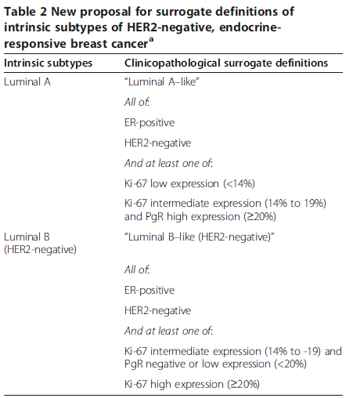
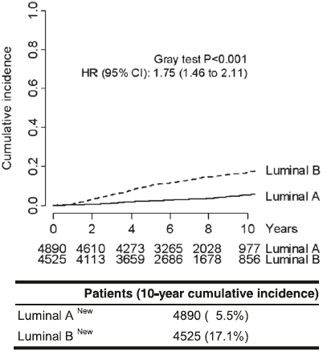
Luminal A and Luminal B
Distant disease-free survival according to
proposed intrinsic molecular subtypes
LA–like tumors (more endocrine-sensitive,indolent
and better prognosis)
LB–like tumors (less endocrine-sensitive, more aggressive and worse prognosis)
Maisonneuve et al, 2014

Slide 12
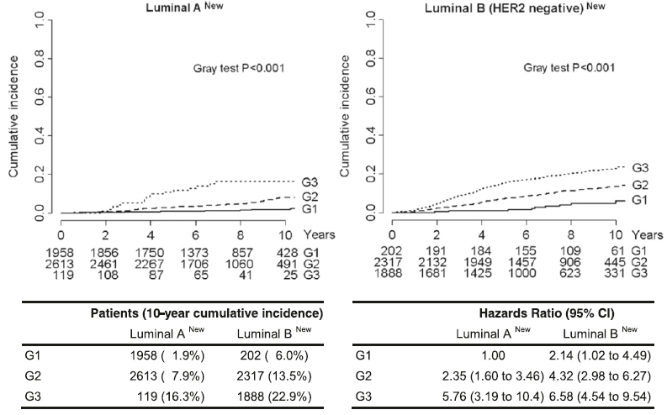
Luminal A and Luminal B
Distant disease-free survival according to our proposed new definitions of intrinsic molecular subtypes and tumor grades.
LA G1 41,7%, G2 55,7%, G3 2,5%; LB G1 4,6%, G2 52,6%, G3 42,8%

Slide 13

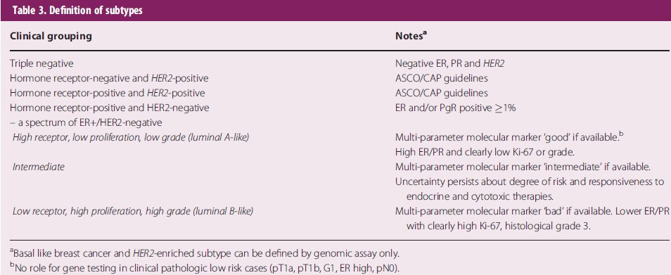
De-escalating and escalating treatments for early-stage breast cancer: the St. Gallen International Expert Consensus Conference on the Primary Therapy
of Early Breast Cancer 2017
Annals of Oncology 28: 1700, 2017
-For many patients with hormone receptor positive disease, chemotherapy can be omitted.ER and PR status is determined by IHC
-Specifically, the panel agreed that either G or Ki-67 could be used to distinguish between the Luminal—A- and B-like. LA -like tumors are typically low grade, strongly ER/PR positive.
LB-like tumors are ER positive but may have variable degrees of ER/PR expression, are higher grade, and have higher proliferative fraction.

Slide 14
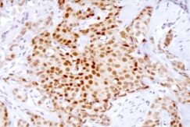
Triple positive BC 10%
ER and HER2 co-expression on breast cancer disease characteristics
-HER2 impact on ER positive disease was reflected by younger age, higher grade and TNM stage, and increased frequency of visceral involvement in de novo metastasis.
-Within the ER-positive/HER2-positive group, TPBC (ER+/PgR+/HER2+) was associated with younger age compared to (ER+/PgR-/HER2) disease (mean age of 50.8 vs. 56 years, p = 0.0226).
-2 subgroups HER+ HIGH level HR and HER+ LOW Level HR
-ER has a profound impact on breast cancer characteristics, including a retained impact when co-expressed with HER2.
-Similarly, HER2 dramatically modulates ER-positive breast cancer making it more aggressive. HER2 providing an earlier growth advantage in triple positive disease, suggesting a specific dependence for this subset on high estrogen levels.
Arpino G et al, 2008;Lee HJ ,2014; Alqaisi A et al, 2014 lVici P et al ,2015; Negi P et al, 2016;Iancu G et al, 2017; Vici P et al 2017

Slide 15







Luminal A and Luminal B
-An accurate assesment of tumor grade remains a powerful prognostic parameter,
though it is not included in any of the surrogate definitions for luminal tumors.
-The central pathological examination of all tumor specimens by a dedicated team of highly experienced pathologists, thus guaranteeing maximal reliability
and reproducibility of the evaluation of molecular tumor characteristics.
-This is particularly important because interlaboratory variations in the evaluation of ER, PgR and Ki-67 expression levels can impact the molecular classification of breast cancer when based on fixed threshold values

Slide 16
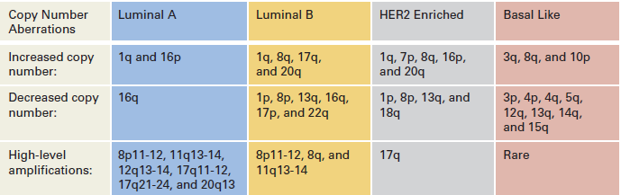
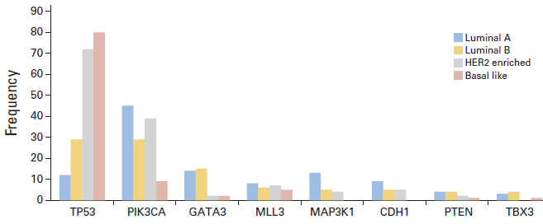
Luminal B : Molecular Characterization and Clinical Management
TP53 is one of the most
commonly mutated BC genes.
Mutation rates Luminal B
vs Luminal A cancers
(32% v 12%)
*
Ades et al, 2014

Slide 17
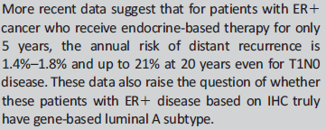
GENETIC MUTATIONS AND NOVEL PATHWAYS FOR LUMINAL A
-Santarpia et al. found PIK3CA to be the most frequently mutated gene in IHC-based ER+/luminal cancers, suggesting that the PIK3CA E545K mutation is found almost exclusively in the luminal A subtype
-Ciriello et al. looked at the molecular diversity of luminal A tumors and found that they had fewer mutations per sample but that the mutations tended to recur and affect similar genes. Patients with luminal A had not only the longest survival but also the most variability, with the risk of late mortality, after 10 years from diagnosis.
-Tobin et al. found ESR1, CASP3, AKT-MTOR, RAS, and BETA C genes to affect long-term and short-term survival
-Kroemer et al. looked at the role of immunotherapy in gene based luminal breast cancer and found that the frequency of CD471 circulating tumor cells correlates with metastatic spread and that their presence in ER+ tumors is a negative predictor of OS .
-Tumor-infiltrating lymphocytes (TILs) are also currently under investigation, and studies suggest that TILs are higher in ER-negative/HER2-negative and HER2+ tumor subgroups compared with ER1/HER2-negative subgroups.
- Results such as these suggest that not all luminal A tumors are the same and that further stratification based on mutational analyses may be needed.
TREATMENT IMPLICATIONS FOR LUMINAL A CANCERS
Currently available data suggests patients with luminal A subtype breast cancer and favorable clinical and genomic profiles may not need chemotherapy and could be treated with endocrine therapy alone.
Ultimately, both tumor anatomy and tumor biology should be taken into consideration when making clinical treatment decisions.

Slide 18
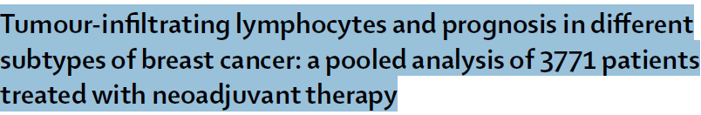
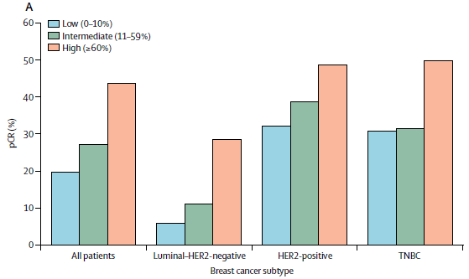
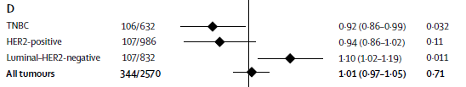

-In luminal–HER2-negative BC subtype, a pathological complete response (pCR) was achieved in 6% of patients with low TILs, (11%) with intermediate TILs, and 49 (28%) with high TILs.
-In the HER2-positive subtype, pCR was observed in 32% of patients with low TILs, 39% with intermediate TILs, and 48% of 262 with high TILs.
-Increased TIL concentration predicted response to neoadjuvant chemotherapy in all molecular subtypes
and was also associated with a survival benefit in HER2-positive breast cancer and TNBC.
-By contrast, increased TILs were an adverse prognostic factor for survival in luminal–HER2-negative breast cancer, suggesting a different biology of the immunological infiltrate in this subtype.
Breast cancer is immunogenic and might be targetable by immune-modulating therapies. The assessment of TILs—as an indicator of pre-existing immunogenicity—might be useful for further stratification of breast cancer in clinical trials involving chemotherapy, anti-HER2 therapies, and future combinations with immune therapies
In light of the results in luminal breast cancer, further research investigating the interaction of the immune system with different types of endocrine therapy is warranted.
Denkert C, et al 2018

Slide 19
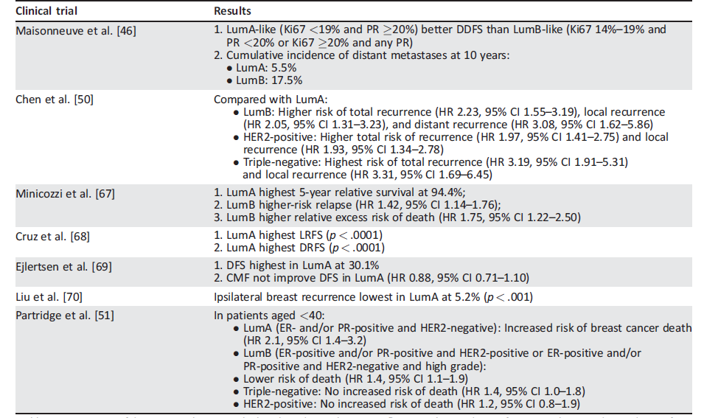
Key clinical trials of IHC-based subtypes
IHC-BASED MARKERS VERSUS GENE-BASED ASSAY CONCORDANCE
-Luminal A subtype, when determined by IHC-based markers, has better survival even with lower pCR rates
-Partridge et al. looked at IHC-based subtypes in patients aged <40 with breast cancer and found that those with luminal A subtype had an increased risk of breast cancer death
-Prat et al. reviewed the concordance between surrogate IHCbased and PAM50-based intrinsic subtype ( and found a discordance rate of 30.72% between the two classification systems
-Chia et al, evaluated the prognostic and predictive value of PAM50-based versus IHC-based intrinsic subtype. Patients with PAM50- based Lum A had the best 5-year DFS at 84.2% and OS at 95.7%, and PAM50 was prognostic for DFS and OS. When IHC was used to determine subtype, patients with lum A tumors had better prognosis for both
DFS and OS, but the findings were not statistically significant. PAM50 luminal subtype predicted tamoxifen benefit compared with nonluminal subtypes when looking at DFS.
-Whitworth et al.and Cristofanilli et al. looked at the concordance of the 70- and 80-gene signatures versus IHC and found a 22%–25% discordance rate. These studies suggest that perhaps the IHC-based and gene-based methods of identifying a tumor’s subtype are not the same and cannot be used interchangeably
Gao J J, 2018

Slide 20
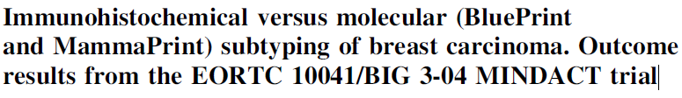
-The two methods look at different things: where ER, PgR, and HER-2 are measured
individually at the protein level by IHC, BluePrint was developed to capture the underlying biologic pathways .
-For ER mutations have been described that make it dysfunctional, and thus the tumor is non-luminal regulated; however, IHC identifies the tumor as being ER positive.
-BluePrint subtyping was in line with the genotype classifying these tumors as non-Luminal-type
-5806 samples
-St. Gallen 2013 surrogate definitions of Luminal A and B are in better concordance
(71%, 69–72 95% CI) with MammaPrint/BluePrint than the St. Gallen 2011 definitions (60%, 58–61 95% CI)
-The ‘optimal’ cutoff for Ki67 with respect to MammaPrint is 18%
-An updated pathological definition of intrinsic molecular subtypes has been proposed which
includes an additional stratification for patients with ‘‘intermediate’’(14 to 19%) or ‘‘high’’ (>=20%) Ki67 positivity stratified by PR expression (negative or low versus high)
Reclassification based on molecular subtyping

Slide 21
- The surrogate pathology-assessed definition of Luminal A and B tumors is largely based on the Ki67.
-Ki67 values and cut-offs for clinical decision-making cannot be transferred between laboratories without standardizing scoring methodology because the analytical validity is limited
-Misinterpretation of the Ki67 labeling index may result in a lost opportunity for patients to receive chemotherapy or may result in patients being over-treated
-The optimal threshold for Ki67 best correlating with the results of MammaPrint is 18%
-Approximately 1 in 50 IHC ER-positive breast cancer patients are classified as Basal-type by Molecular Subtyping and High Risk by MammaPrint (high expression of the dominant negative ERa-splicevariant ERD7 in ER-positive/Basal-type tumors as compared to ER-positive/Luminal-type tumors (p<0.0001). Expression of the dominant negative ERa variant ERD7 provides a rationale as to why tumors are BluePrint Basal-type while staining ER-positive by IHC
These tumors may lack a functional response to estrogen and consequently may not respond to endocrine therapy.
-
-The MINDACT study is not limited to the use of Adjuvant! Online for the clinical assessment of risk: When compared with a more contemporarily used classification method, including high-quality assessment of Ki67, the molecular classification may be able to identify a larger group of patients with a low risk of recurrence.

Slide 22

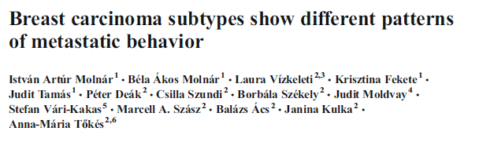

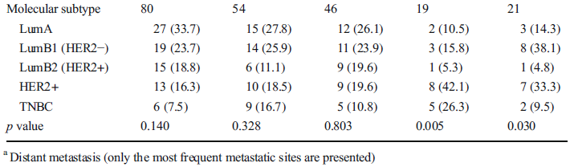
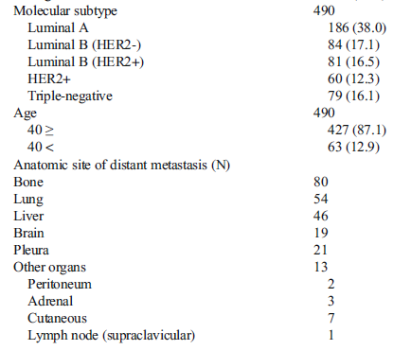
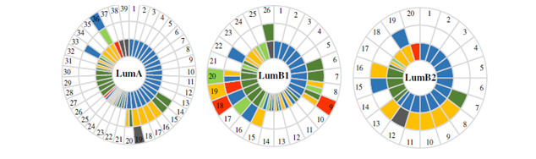

LUM A LUM B DISTANT METASTASES DISTRIBUTION
Notes:
Il pattern di metastasi varia in relazione all’espressione di HR e dello stato di HER2. È stato messo in evidenza che i carcinomi ERα+ sia i sottotipi luminali A che B hanno dei modelli di disseminazione distintivi, in particolare l’osso è il sito metastatico principale e di prima metastasi, di solito tardiva e unica, per i Luminali A, seguito dal polmone per i luminali B; mentre gli HER2 e i tripli negativi tendono più frequentemente e più precocemente a metastatizzare e hanno come localizzazione principale il cervello, l’istotipo lobulare si associa a metastasi a livello del tratto gastro-intestinale e dell’ovaio

Slide 23
Breast cancer subtype discrimination using standardized 4-IHC
Using IHC/ISH for surrogate pathology-based molecular classification: luminal A is indeed the more common luminal subtype, as other techniques have obtained concordant results: MammaPrint and BluePrint assays(combined analysis), 40% luminal A and 27% luminal B
and PAM50 assay, 34% luminal A and 32% luminal B in a cohort of 814 tumors, with high agreement between biomarker scoring by protein immunohistochemistry and gene expression
In conclusion, standardized 4-IHC and digital image analysis of the data, following the classification proposed by Maisonneuve et al. (2014), constitutes an accurate, fast , and economic method (compared to genomic assays) for surrogate definitions of biological subtypes of breast cancer.
Molecular biology will further refine taxonomy and provide data for improvements in prognosis and prediction, and in the near future, molecular classifications can themselves be expected to become embedded within routine practice, representing new challenges for pathologists

Slide 24
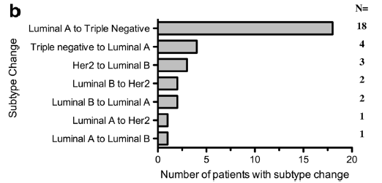
Breast cancer subtype discordance: impact on post-recurrence survival and potential treatment options
-Breast cancer subtype can change from the primary tumour to the recurrence
-132 consecutive patients. There were 31 (23.5%) changes in subtype; discordance occurred most frequently in luminal A breast cancer (n = 20), followed by T N (n = 4).
Patients who changed from luminal A to TN (n = 18) had a significantly worse post-recurrence survival (p < 0.05) with overall survival approaching significance (p = 0.064) compared to concordant Luminal A cases (n = 46).
Overall receptor discordance rates were: estrogen receptor 20.4% (n = 27), progesterone receptor 37.7% (n = 50) and HER2 3% (n = 4). Loss of ER and PR was more common than gain (21 vs. 6 (p=0.04) and 44 vs. 6 (p = 0.01) respectively). Nine patients (6.8%) gained receptor status potentially impacting treatment options.
Number of possible aetiologies for receptor
discordance.
-Firstly, variability exists in the reproducibility
and accuracy of IHC staining.
-Variability in sampling methods, ( FNA, CB versus
Surgical extraction in the primary tumour and in
sampling of the recurrence
-With the next generation sequencing technology,
it has become apparent that breast cancer
demonstrates both intra-tumour and inter-tumour
heterogeneity
The discordance in receptor status may demonstrate clonal genome evolution and the clone with the more aggressive phenotype could potentially initiate the micro-metastatic process
Heterogeneity between patient’s primary and recurrence may be due to newly acquired biological characteristics that allow tumour cells to travel via the circulatory/ lymphatic systems and to metastasize to new sites .
Change in receptor status may contribute to this increased capacity for invasion as endocrine and growth factor signalling pathways are implicated in invasion and metastasis.
McAnena PF et al, 2018

Slide 25
Endocrine resistance
Cyclin-Dependent Kinases
-Cycle-dependent kinase (CDK) deregulation confers a highly proliferative cellular phenotype and is also linked to endocrine resistance.
-High expression of cyclin D1 is associated with poor clinical outcome in tam-treated women
- Cyclin E2 expression is characteristic of luminal B cancer and correlated with shorter distant metastasis–free survival.
- CCND1(encoding gene for cyclin D1) amplification is found at higher frequencies in luminal B
compared with luminal A cancer (58% v 29%).
- METABRIC study identified a bad prognosis molecular subtype of luminal BC, where CCND1 is located
Phosphatidylinositol-3-Kinase/AKT/Mammalian Target of Rapamycin Signaling Pathway
-PI3K activation is implicated in de novo and acquired endocrine resistance. Luminal B cancers have higher PI3K activation than luminal A.
Insulin-Like Growth Factor Signaling Pathway
-IGF signaling pathway causes activation of the PI3K/AKT/mTOR and Ras/Raf/MEK/ERK pathways.
FGF Signaling Pathway
-FGFR1 amplification101 was identified in 16% to 27% of luminal B BC as a mechanism of endocrine resistance and as being associated with negative prognosis.1

Slide 26
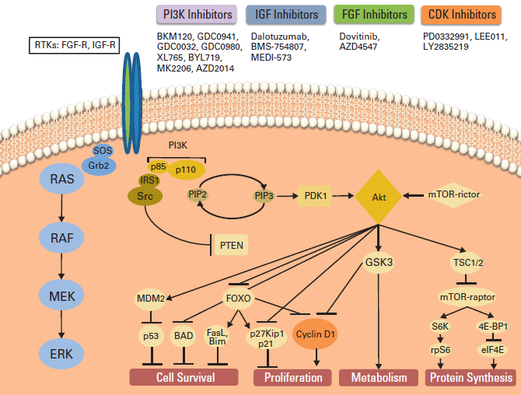
Signaling pathways under blockade with target compounds in luminal breast cancer.

Slide 27
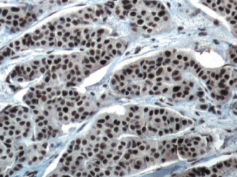


Immunohistochemical Expression of Phosphorylated RB and p16 Proteins in Association with Cyclin D1 and the p53 Pathway
pRB protein
cyclin D1 and p53
-Nuclear p16 protein expression
was the only significant prognostic
marker in terms of OS
-IHC expression of related factors does not necessarily reflect the complex molecular alterations that drive a gene’s functional diversity and cell cycle regulation.
nuclear and cytoplasmic p16
Gavressea et al, 2017

Slide 28


LUMINAL BC
Russnes et al

Slide 29





Slide 30


MECHANISM OF ENDOCRINE RESISTENCE
Overexpression of Raceptor of tyrosine kinases (RTKs)
PI3k-AKT-mTOR
MAPK
CDK4/6
Mutazioni ESR1
miRNAs

Slide 31

AP UNIFE
-The natural history of LumA, LumB1 (lumB/HER2-neg)and LumB2 (lumB/HER2-pos) breast cancer (BC) subtypes is usually less aggressive, their course is more indolent and they show more long-term relapses, more than 50% of relapses occur more than 5
Aims of this study was:
-to investigate about 78 patients with LumA or LumB1 or LumB2 tumour, and their respective metastases, the correlation of ER and PR status,HER2, and Ki67 expression between primary BC and metastatic sites (brain, liver, lung, ovary, skin).
-to investigate clinical implications of ESR1
-to verify whether miRNAs could represent useful diagnostic biomarkers of breast cancer.

Slide 32

AP UNIFE
78 patients:
luminal A and B with
histologic diagnosis of metastases
48 patients:
Accurate follow-up
(treatment skedules, DFS and OS)
Primary BC | LumA (n=26) |  |  | LumB1 (n=39) |  |  | LumB2 (n=13)
 | n | % |  | n | % |  | n | %
Age at surgery of primary tumour (years)
≤40 | 1 | 3,8 |  | 3 | 7,7 |  | 2 | 15,4
40,1-55 | 11 | 42,3 |  | 13 | 33,3 |  | 7 | 53,8
>55 | 14 | 53,9 |  | 23 | 59 |  | 4 | 30,8
Type of surgery
Ago-biopsy | 3 | 11,5 |  | 5 | 12,8 |  | 3 | 23,1
Mastectomy | 14 | 53,9 |  | 15 | 38,5 |  | 5 | 38,5
Conservative | 9 | 34,6 |  | 19 | 48,7 |  | 5 | 38,5
Tumour size (cm)
≤ 2 | 14 | 58,3 |  | 16 | 43,2 |  | 5 | 45,5
2,1-5 | 8 | 33,3 |  | 18 | 48,6 |  | 5 | 45,5
>5 | 2 | 8,3 |  | 3 | 8,1 |  | 1 | 9,1
Tumour grade
1 | 3 | 13 |  | 1 | 2,6 |  | 0 | 0
2 | 18 | 78,3 |  | 24 | 63,2 |  | 4 | 33,3
3 | 2 | 8,7 |  | 13 | 34,2 |  | 8 | 66,7
Histological typ
NST | 15 | 57,7 |  | 27 | 69,2 |  | 13 | 100
Lobular | 8 | 30,8 |  | 7 | 17,9 |  | 0 | 0
Other | 1 | 3,8 |  | 3 | 7,7 |  | 0 | 0
Ductal and lobular | 2 | 7,7 |  | 2 | 5,1 |  | 0 | 0
Vascular invasion
Present | 4 | 16 |  | 14 | 38,9 |  | 6 | 46,2
Absent | 21 | 84 |  | 22 | 61,1 |  | 7 | 53,8
Nodal status
pN0 | 8 | 34,8 |  | 10 | 28,6 |  | 5 | 38,5
pN+ | 15 | 65,2 |  | 25 | 71,4 |  | 8 | 61,5
Tissue site of recurrence/metastasis
Brain | 0 | 0 |  | 2 | 5,1 |  | 4 | 30,8
Liver | 8 | 30,7 |  | 19 | 48,7 |  | 6 | 46,2
Lung | 6 | 23,1 |  | 5 | 12,8 |  | 0 | 0
Skin | 6 | 23,1 |  | 11 | 28,2 |  | 3 | 23,1
Ovary | 6 | 23,1 |  | 2 | 5,1 |  | 0 | 0
Primary BC | LumA (n=18) |  | LumB1 (n=25) |  | LumB2 (n=5)
 | n |  | n |  | n
CT ADJ
Yes | 11 |  | 19 |  | 4
No | 7 |  | 6 |  | 1
RT ADJ
Yes | 11 |  | 14 |  | 3
No | 7 |  | 11 |  | 2
ET ADJ
TAM | 9 |  | 8 |  | 1
AIs | 5 |  | 10 |  | 1
Other | 3 |  | 4 |  | 1
No | 1 |  | 3 |  | 2
Recurrence occurs during ET ADJ
Yes | 11 |  | 17 |  | 2
No | 7 |  | 8 |  | 3
ET after first metastasis
Yes | 14 |  | 15 |  | 3
No | 4 |  | 10 |  | 2
Last FU
Live | 8 |  | 7 |  | 1
Died | 10 |  | 18 |  | 4
Notes:
Lo studio è stato condotto su una casistica complessiva di 78 pazienti affette da carcinoma mammario infiltrante ERα+ con secondarismi polmonari, epatici, cutanei, cerebrali e ovarici istologicamente definiti come metastasi diagnosticate presso la Sezione di Anatomia Patologica e Diagnostica Biomolecolare dell’Università di Ferrara tra il 1° Gennaio 2007 e il 31 Dicembre 2015. Criterio di inclusione nello studio è stata la positività del tumore primitivo per il recettore per gli estrogeni (ER≥1%), valutata mediante immunoistochimica. Per ciascuna paziente è stata effettuata, sia per il tumore primitivo che per la rispettiva metastasi, la caratterizzazione clinico-patologica (stato menopausale, dimensioni del tumore, istotipo, grado istologico, presenza di invasione vascolare, stato linfonodale, sede di metastasi) e biologica (recettori steroidei per estrogeni e progesterone, ERα e PR, attività proliferativa (Ki67/Mib1), espressione dell’oncogene HER2). Per un gruppo costituito da 48 pazienti sono state raccolte le informazioni relative al protocollo terapeutico (trattamento medico adiuvante ormonale e schema di chemioterapia, trattamento radioterapico) e follow-up (intervallo libero da malattia e sopravvivenza globale, sviluppo di ormonoresistenza) presso le Unità Operative di Oncologia della provincia di Ferrara (U.O. Oncologia Clinica Azienda Ospedaliera Universitaria Sant’Anna-Ferrara, Day-Hospital Medico-Oncologico Ospedale del Delta-Lagosanto, Day-Hospital Medico-Oncologico Ospedale S.A.-Cento). Per tutte le pazienti perse al follow up si è cercata, attraverso la consultazione dei dati disponibili presso il Centro Registri Tumori dell’Università di Ferrara, l’eventuale data di decesso o, per coloro non decedute, l’ultima data in corrispondenza della quale sono state riscontrate vive. sono stati esclusi: Pazienti con una diagnosi iniziale di carcinoma in situ, tumore primitivo ERα-, esordio con metastasi e pazienti di cui la caratterizzazione biologica del primitivo e/o della metastasi non era adeguata allo scopo dello studio

Slide 33




MATERIALS AND METHODS TISSUE SAMPLES
Selezione area di interesse su vetrino EE guida
Incisione con bisturi su blocchetto di paraffina
Notes:
La valutazione è stata condotta su sezioni convenzionali di spessore 4-5 μm colorate con EE, previa fissazione in formalina e inclusione in paraffina. All’osservazione iniziale, effettuata ad ingrandimento di x200-x400 (oculare x10, obiettivo x20-x40), sia per i campioni tumorali che per i campioni delle metastasi è stata selezionata l’area più rappresentativa (> 70%) del carcinoma e della metastasi. inoltre sulle sezioni derivanti dall’inclusione del carcinoma mammario si è selezionata, ove possibile, un’area di tessuto mammario normale, escludendo il tessuto adiposo, tessuto muscolare e tessuto necrotico .
Quindi, sul blocchetto incluso in paraffina di ciascun campione di tumore e metastasi utilizzando un bisturi è stata incisa l’area di interesse (FIG.9B), utilizzando come guida la rispettiva sezione colorata con EE (FIG.9A), e successivamente con il microtomo sono state ottenute 3 sezioni da 20 micron ciascuna.

Slide 34



PRIMARY BC IHC vs METASTASES IHC

Slide 35





DFS os
L’80% delle metastasi che compaiono entro 2 anni e da 2 a 5 anni dalla diagnosi si verificano in pazienti con carcinoma luminale B

Slide 36





Different domain of ER- Various techniques for ESR1 mutation detection
Schematic overview of the different domains of the ER. Activation function(AF) domain-1 present at the N-terminus acts in a ligand-independent manner,whereas, the AF-2 within the ligand binding domain (LBD) is dependent on
estradiol for its activation.The DNA binding domain encodes two zinc finger molecules, playing an important role in receptor dimerization and binding of the ER to specific DNA sequences: the estrogen response element (ERE) H = hinge
region. ESR1 mutations, some hotspot mutations shown as vertical red lines, mainly occur in the C-terminal domain of the receptor encoding for the LBD of the ER.
Angus L et al, (2017)

Slide 37





Slide 38



Slide 39

ESR1 MUTATIONS IN PRIMARY BC
Solo una mutazione accertata neitumori primitivi Y537S
Altre 3 mutazioni con frequenza 1-2%
MUTAZIONE TUMORE PRIMITIVO ALL’1-2%
Campione 39 | D538N (2%)
Campione 43 | D538N (1%), D538G (1%)
Campione 45 | D538N (1%)

Slide 40






ESR1 MUTATIONS IN BC METASTASES
Y537S
D538G

Slide 41


Slide 42


ESR1 MUTATIONS conclusion
12,5% di mutazioni accertate nella metastasi
Notes:
Abbiamo accertato la presenza di mutazione di ESR1 in 3 casi su 24 campioni di metastasi, con una percentuale quindi del 12,5% , in accordo con la letteratura e una mutazione tra i campioni del tumore primitivo. Tre mutazioni di tipo Y537S e una D538G, anche in questo caso concordando con la letteratura in quanto tali mutazioni sono le più diffuse, con frequenza rispettivamente del 28% e 36%.

Slide 43




NEW PROGNOSTIC AND PREDICTIVE MARKERS
MicroRNAs (miRNAs) are are small RNA molecules of 18 to 22 base pairs that regulate the expression of target mRNAs by inhibiting translation or degrading the transcripts
Notes:
Deregulation of physiologic miRNA expression and aberrant suppression or upregulation of various miRNAs may contribute to tumorigenesis, disease progression, and response to therapy.

Slide 44





Slide 45



The potential of miRNA for diagnosis, treatment and monitoring BC
History of intracellular miRNA-based diagnostic signatures
Intracellular and extracellular diagnostic miRNAs controlling BC hallmarks.
Bertoli G et al, 2016

Slide 46



The microRNAs associated with tumor development in breast cancer
The microRNAs associated with each molecular subtypes of breast cancer
Kurozumi S et al, 2017

Slide 47
Conclusioni
Il rischio di recidiva nei carcinomi luminali B è maggiore nei primi 5 anni dalla diagnosi rispetto ai luminali A, e decresce dopo 5 anni dalla diagnosi, anche se permane.
L’aumento dell’attività proliferativa nelle metastasi può aver guidato la progressione tumorale.
Le mutazioni di ESR1 vengono acquisite in seguito alla terapia , in particolare nelle pz che hanno ricevuto AI, pertanto il rilevamento di tali mutazioni potrebbe essere utile come biomarker di resistenza all’endocrino terapia e potrebbe aiutare nella scelta terapeutica più appropriata per i tumori metastatici ER+.
I diversi livelli di espressione di determinati miRNAs fanno risaltare delle differenze tra tessuto normale, tumore primitivo e metastasi e quindi potrebbero spiegare l’evoluzione della malattia tumorale.
La valutazione dell’espressione del miR-26a potrebbe essere un elemento di supporto nella distinzione del fenotipo biologico luminale A e luminale B.
Notes:
47

Slide 48




Biopsia Tessutale vs Biopsia liquida
Notes:
48
The roles of cell-free circulating tumour DNA (ctDNA) in breast cancers. A. stratificazione pazienti su base genica; B. monitoraggio della progressione tumorale e meccanismi di resistenza terapeutica
; C. precoce riconoscimento recidive; D. Decifrazione della eterogeneità intra- e inter-tumour Clonal and subclonal events are depicted in both the x-axis and y-axis for primary tumour and metastasis. I cerchi sono gli eventi clonali sia nel tumore primitivo che nella metastasi.

Slide 49


CONCLUSIONI
Le differenze che si colgono tra carcinoma mammario infiltrante ERα+ e metastasi sia dal punto di vista istopatologico, con l’IHC4, che molecolare, con i livelli di espressione dei miRNAs, sono espressione della eterogeneità intra-tumorale e potrebbero essere il risultato di una selezione di popolazioni clonali da parte delle terapie .

Slide 50

patrizia.querzoli@unife.it

