Slide 1
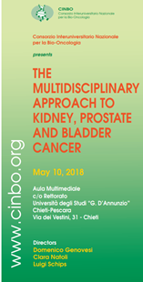
Adjuvant therapy for kidney cancer:
what’s going on?
Michele De Tursi
Cattedra di Oncologia Medica
Università G. D’Annunzio
Chieti - Pescara

Slide 2
Adjuvant therapy for kidney cancer
The multidisciplinary approach to kidney cancer – Chieti, 10 maggio 2018

Slide 3
Adjuvant therapy for kidney cancer
The multidisciplinary approach to kidney cancer – Chieti, 10 maggio 2018

Slide 4
Adjuvant therapy for kidney cancer
The multidisciplinary approach to kidney cancer – Chieti, 10 maggio 2018

Slide 5
Adjuvant therapy for kidney cancer
Historic adjuvant experience
The multidisciplinary approach to kidney cancer – Chieti, 10 maggio 2018

Slide 6
Adjuvant therapy for kidney cancer
The multidisciplinary approach to kidney cancer – Chieti, 10 maggio 2018

Slide 7
Adjuvant therapy for kidney cancer
The multidisciplinary approach to kidney cancer – Chieti, 10 maggio 2018

Slide 8
Adjuvant therapy for kidney cancer
The multidisciplinary approach to kidney cancer – Chieti, 10 maggio 2018

Slide 9
Adjuvant therapy for kidney cancer
The multidisciplinary approach to kidney cancer – Chieti, 10 maggio 2018

Slide 10
Adjuvant therapy for kidney cancer
The multidisciplinary approach to kidney cancer – Chieti, 10 maggio 2018

Slide 11
Adjuvant therapy for kidney cancer
The multidisciplinary approach to kidney cancer – Chieti, 10 maggio 2018

Slide 12
Adjuvant therapy for kidney cancer
The multidisciplinary approach to kidney cancer – Chieti, 10 maggio 2018

Slide 13
Adjuvant therapy for kidney cancer
The multidisciplinary approach to kidney cancer – Chieti, 10 maggio 2018

Slide 14
Adjuvant therapy for kidney cancer
The multidisciplinary approach to kidney cancer – Chieti, 10 maggio 2018

Slide 15
Adjuvant therapy for kidney cancer
The multidisciplinary approach to kidney cancer – Chieti, 10 maggio 2018

Slide 16
Adjuvant therapy for kidney cancer
The multidisciplinary approach to kidney cancer – Chieti, 10 maggio 2018

Slide 17
Adjuvant therapy for kidney cancer
The multidisciplinary approach to kidney cancer – Chieti, 10 maggio 2018

Slide 18
Adjuvant therapy for kidney cancer
The multidisciplinary approach to kidney cancer – Chieti, 10 maggio 2018

Slide 19
Adjuvant therapy for kidney cancer
The multidisciplinary approach to kidney cancer – Chieti, 10 maggio 2018

Slide 20
Adjuvant therapy for kidney cancer
The multidisciplinary approach to kidney cancer – Chieti, 10 maggio 2018

Slide 21
Adjuvant therapy for kidney cancer
The multidisciplinary approach to kidney cancer – Chieti, 10 maggio 2018

Slide 22
Adjuvant therapy for kidney cancer
The multidisciplinary approach to kidney cancer – Chieti, 10 maggio 2018

Slide 23
Adjuvant therapy for kidney cancer
The multidisciplinary approach to kidney cancer – Chieti, 10 maggio 2018

Slide 24
Adjuvant therapy for kidney cancer
The multidisciplinary approach to kidney cancer – Chieti, 10 maggio 2018

Slide 25
Adjuvant therapy for kidney cancer
The multidisciplinary approach to kidney cancer – Chieti, 10 maggio 2018

Slide 26
Adjuvant therapy for kidney cancer
The multidisciplinary approach to kidney cancer – Chieti, 10 maggio 2018

Slide 27
Adjuvant therapy for kidney cancer
The multidisciplinary approach to kidney cancer – Chieti, 10 maggio 2018

Slide 28
Adjuvant therapy for kidney cancer
The multidisciplinary approach to kidney cancer – Chieti, 10 maggio 2018

Slide 29
Adjuvant therapy for kidney cancer
The multidisciplinary approach to kidney cancer – Chieti, 10 maggio 2018

Slide 30
Adjuvant therapy for kidney cancer
The multidisciplinary approach to kidney cancer – Chieti, 10 maggio 2018

Slide 31
Adjuvant therapy for kidney cancer
ATLAS
SORCE
EVEREST
The multidisciplinary approach to kidney cancer – Chieti, 10 maggio 2018

Slide 32
Adjuvant therapy for kidney cancer
The multidisciplinary approach to kidney cancer – Chieti, 10 maggio 2018

Slide 33
Adjuvant therapy for kidney cancer
The multidisciplinary approach to kidney cancer – Chieti, 10 maggio 2018

Slide 34
Adjuvant therapy for kidney cancer
The multidisciplinary approach to kidney cancer – Chieti, 10 maggio 2018

Slide 35
Adjuvant therapy for kidney cancer
The multidisciplinary approach to kidney cancer – Chieti, 10 maggio 2018

Slide 36
Adjuvant therapy for kidney cancer
The multidisciplinary approach to kidney cancer – Chieti, 10 maggio 2018

Slide 37
Adjuvant therapy for kidney cancer
The multidisciplinary approach to kidney cancer – Chieti, 10 maggio 2018

Slide 38
Adjuvant therapy for kidney cancer
The multidisciplinary approach to kidney cancer – Chieti, 10 maggio 2018

Slide 39
Adjuvant therapy for kidney cancer
The multidisciplinary approach to kidney cancer – Chieti, 10 maggio 2018

Slide 40
Adjuvant therapy for kidney cancer
The multidisciplinary approach to kidney cancer – Chieti, 10 maggio 2018

Slide 41
Adjuvant therapy for kidney cancer
The multidisciplinary approach to kidney cancer – Chieti, 10 maggio 2018

Slide 42
Adjuvant therapy for kidney cancer
The multidisciplinary approach to kidney cancer – Chieti, 10 maggio 2018

Slide 43
Adjuvant therapy for kidney cancer
The multidisciplinary approach to kidney cancer – Chieti, 10 maggio 2018

Slide 44
Adjuvant therapy for kidney cancer
The multidisciplinary approach to kidney cancer – Chieti, 10 maggio 2018

Slide 45
Adjuvant therapy for kidney cancer
The multidisciplinary approach to kidney cancer – Chieti, 10 maggio 2018

Slide 46
Adjuvant therapy for kidney cancer
The multidisciplinary approach to kidney cancer – Chieti, 10 maggio 2018

Slide 47
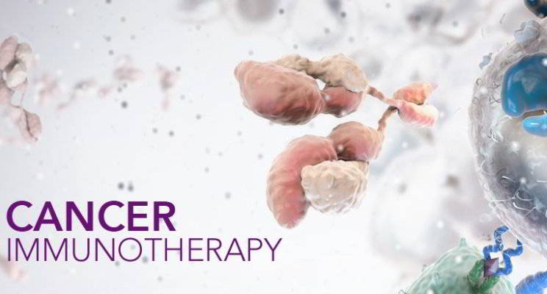
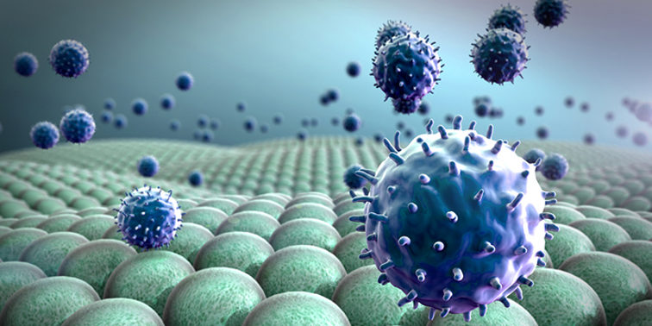
Adjuvant therapy for kidney cancer
The multidisciplinary approach to kidney cancer – Chieti, 10 maggio 2018

Slide 48
Adjuvant therapy for kidney cancer
The multidisciplinary approach to kidney cancer – Chieti, 10 maggio 2018

Slide 49
Adjuvant therapy for kidney cancer
The multidisciplinary approach to kidney cancer – Chieti, 10 maggio 2018

Slide 50
Adjuvant therapy for kidney cancer
The multidisciplinary approach to kidney cancer – Chieti, 10 maggio 2018

Slide 51
Adjuvant therapy for kidney cancer
The multidisciplinary approach to kidney cancer – Chieti, 10 maggio 2018

Slide 52
Adjuvant therapy for kidney cancer
The multidisciplinary approach to kidney cancer – Chieti, 10 maggio 2018

Slide 53
Adjuvant therapy for kidney cancer
The multidisciplinary approach to kidney cancer – Chieti, 10 maggio 2018

Slide 54
Adjuvant therapy for kidney cancer
The multidisciplinary approach to kidney cancer – Chieti, 10 maggio 2018

Slide 55
Adjuvant therapy for kidney cancer
The multidisciplinary approach to kidney cancer – Chieti, 10 maggio 2018

Slide 56
Adjuvant therapy for kidney cancer
The multidisciplinary approach to kidney cancer – Chieti, 10 maggio 2018

Slide 57
CheckMate 025: A randomized, open-label, phase III study of nivolumab versus everolimus in advanced renal cell carcinoma
Padmanee Sharma, Bernard Escudier, David F. McDermott, Saby George, Hans J. Hammers, Sandhya Srinivas, Scott S. Tykodi, Jeffrey A. Sosman, Giuseppe Procopio, Elizabeth R. Plimack, Daniel Castellano, Howard Gurney, Frede Donskov, Petri Bono, John Wagstaff, Thomas C. Gauler, Takeshi Ueda, Li-An Xu, Ian M. Waxman, Robert J. Motzer, on behalf of the CheckMate 025 investigators

Slide 58
Adjuvant therapy for kidney cancer
Randomized, open-labeled phase III study to compare nivolumab with everolimus in patients with advanced RCC after prior systemic therapy (NCT01668784)
Enrolled patients
Previously treated advanced or metastatic clear-cell RCC
1 or 2 prior anti-angiogenic treatments
Nivolumab
(N = 410)
3 mg/kg every 2 weeks intravenous
Treat until progression or intolerable toxicity
Treatment beyond progression was permitted if drug was tolerated and clinical benefit was noted
Randomize 1:1
Everolimus
(N = 411)
10 mg/day
oral
Disease assessments
Every 8 weeks from randomization through 12 months
Then every 12 weeks until progression or treatment discontinuation
Primary endpoint
Overall survival (OS)
The multidisciplinary approach to kidney cancer – Chieti, 10 maggio 2018

Slide 59
Adjuvant therapy for kidney cancer
 | Median OS, months (95% CI)
Nivolumab (N = 410) | 25.0 (21.8–NE)
Everolimus (N = 411) | 19.6 (17.6–23.1)
1.0
0.9
HR (98.5% CI),
0.73 (0.57–0.93) P = 0.0018
0.8
0.7
0.6
0.5
Nivolumab
0.4
Overall Survival (Probability)
0.3
Everolimus
0.2
0.1
0.0
0
3
6
9
12
15
18
21
24
27
30
33
Months
The risk of death was reduced by 27% in patients in the nivolumab treatment group compared with those in the everolimus group
Study stopped after planned interim analysis (398 deaths) because assessment by an independent data monitoring committee concluded that the study met its primary endpoint, demonstrating superior OS for nivolumab
This means that patients are more likely to live when treated with nivolumab versus everolimus
The multidisciplinary approach to kidney cancer – Chieti, 10 maggio 2018

Slide 60
Adjuvant therapy for kidney cancer
P < 0.0001
Objective Response Rate (%)
Patients on nivolumab treatment had a significantly better objective response rate than those on everolimus treatment
This means that more patients responded to treatment with nivolumab than to treatment with everolimus
The multidisciplinary approach to kidney cancer – Chieti, 10 maggio 2018

Slide 61
Adjuvant therapy for kidney cancer
The multidisciplinary approach to kidney cancer – Chieti, 10 maggio 2018

Slide 62
Adjuvant therapy for kidney cancer
The multidisciplinary approach to kidney cancer – Chieti, 10 maggio 2018

Slide 63
Adjuvant therapy for kidney cancer
The multidisciplinary approach to kidney cancer – Chieti, 10 maggio 2018

Slide 64
Adjuvant therapy for kidney cancer
The multidisciplinary approach to kidney cancer – Chieti, 10 maggio 2018

Slide 65
Adjuvant therapy for kidney cancer
The multidisciplinary approach to kidney cancer – Chieti, 10 maggio 2018

Slide 66
Adjuvant therapy for kidney cancer
The multidisciplinary approach to kidney cancer – Chieti, 10 maggio 2018

Slide 67
Adjuvant therapy for kidney cancer
The multidisciplinary approach to kidney cancer – Chieti, 10 maggio 2018

Slide 68
Adjuvant therapy for kidney cancer
The multidisciplinary approach to kidney cancer – Chieti, 10 maggio 2018

Slide 69
Adjuvant therapy for kidney cancer
The multidisciplinary approach to kidney cancer – Chieti, 10 maggio 2018

Slide 70
Adjuvant therapy for kidney cancer
The multidisciplinary approach to kidney cancer – Chieti, 10 maggio 2018

Slide 71
Adjuvant therapy for kidney cancer
The multidisciplinary approach to kidney cancer – Chieti, 10 maggio 2018

Slide 72
Adjuvant therapy for kidney cancer
The multidisciplinary approach to kidney cancer – Chieti, 10 maggio 2018

Slide 73
GRAZIE PER L’ATTENZIONE

