Slide 1



Department of Surgical, Oncological and Oral Sciences
U.O.C Medical Oncology
Director: Prof A. Russo
New potentials for liquid biopsy in oncology
Prof. Antonio Russo
Dr. Marta Castiglia, PhD

Slide 2
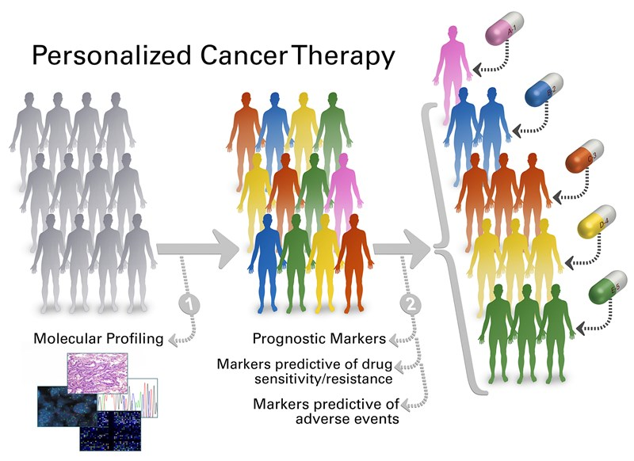
Precision medicine

Slide 3
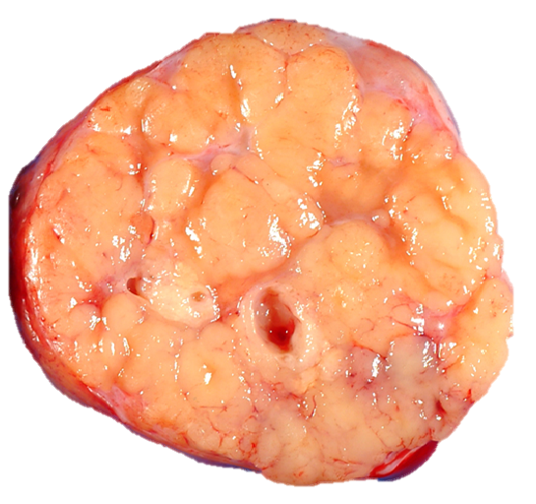
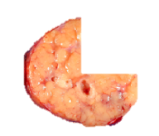
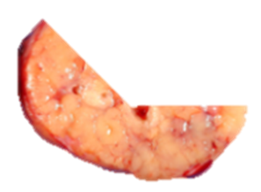





The tissue is the issue
Multiple Tests Require Large Tissue Volume
Tumor Biopsy
Histology
Cancer
Histological
Type
Adenocarcinoma
cMET
EGFR
BRAF
PI3K
FGFR
Finite tissue
≥2 slides
≥1 slide
5 μm tissue
RELAPSE
Confirmatory FISH
IHC (ALK+)
≥5 slides
≥2 slides
≥2 slides
but no tissue
Notes:
Come si può osservare sono necessarie diverse sezioni di tessuto dopo biopsia polmonare per la definizione istologica e per la caratterizzazione biomolecolare degli adenocarcinomi polmonari.
Alla luce di ciò si può affermare che per tutta questa sequenza di determinazioni sono necessarie molto sezioni di tessuto.( fetta più, fetta meno) Comunque per fare tutto serve sempre molto materiale, anche perché molti esami spesso necessitano di ripetizione
Potrebbe essere utile, infatti, precisare, almeno a voce, che adesso anche la sola ICH con l'anticorpo giusto può far sì che si faccia a meno della conferma FISH.

Slide 4
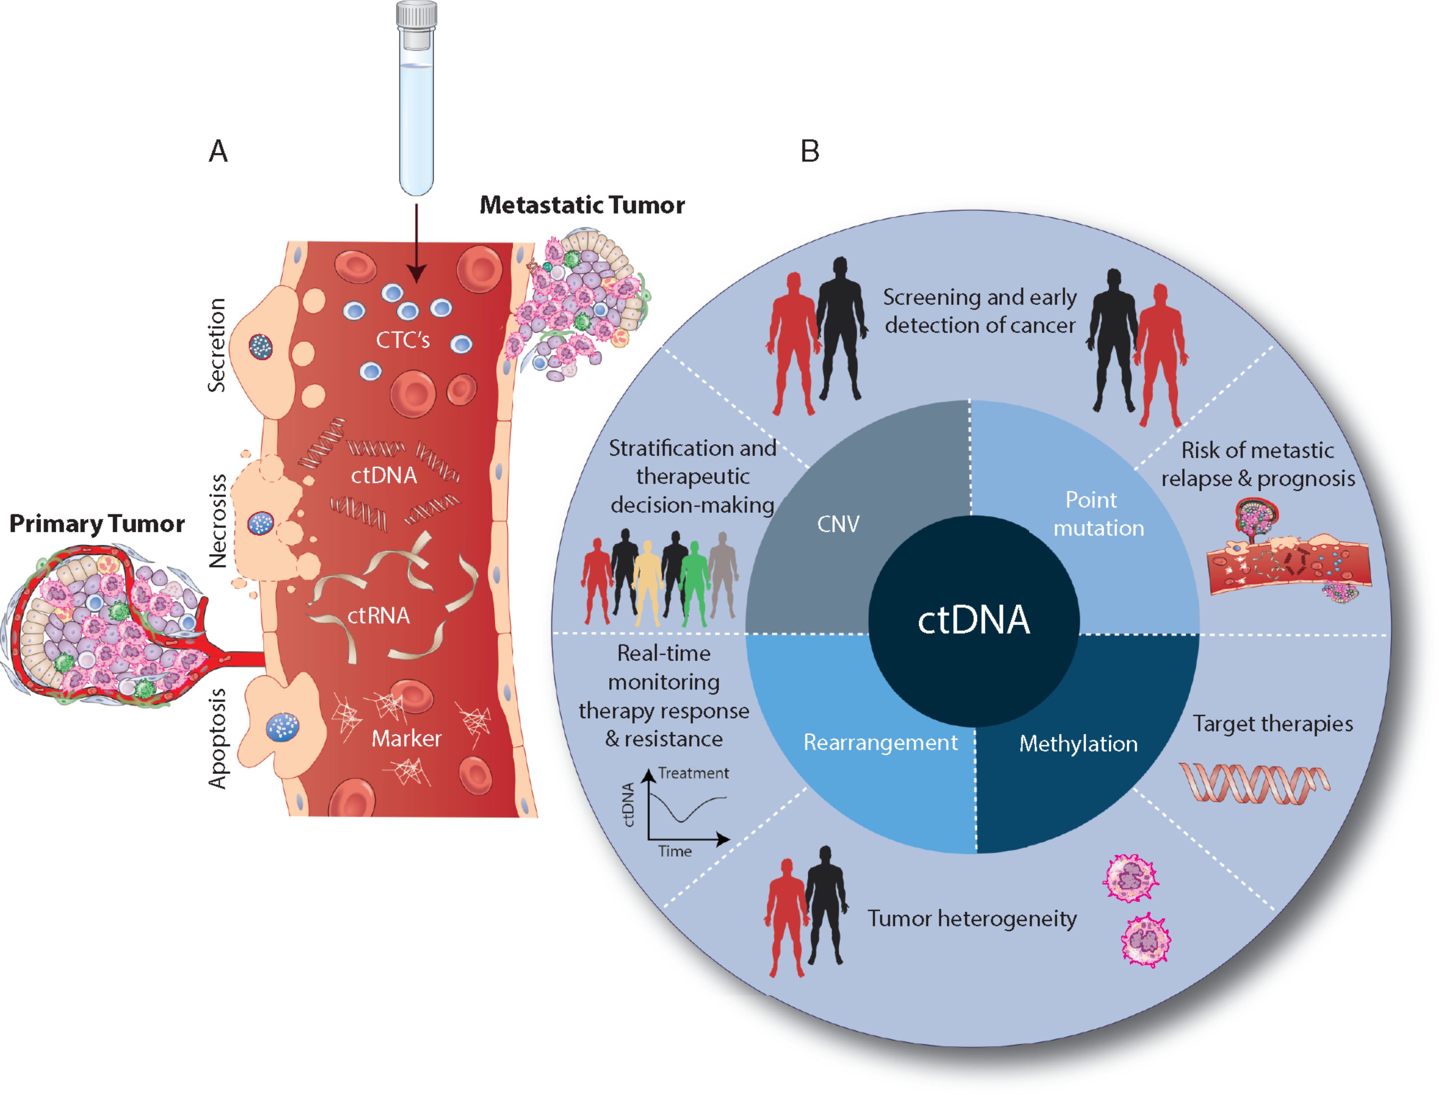
Liquid biopsy
Release mechanisms:
Secretion
Necrosis
Apoptosis
Components:
Circulating Tumor Cells (CTC)
Circulating nucleic acids (ctDNA, cfDNA, ctRNA, miRNAs)
Exosomes
Yang M, et al. Annals of Oncology 2018

Slide 5
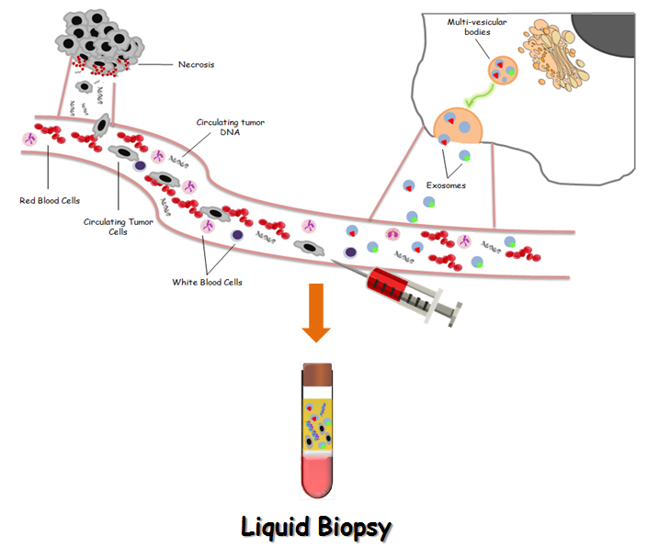
Circulating tumor DNA
Rationale
ctDNA
Portion of cell-free DNA released from tumor cells
It can be detected in several body fluids (plasma, urine, salive, effusion liquids)
Castiglia M, et al. BBA Cancer Reviews. 2014

Slide 6
Timeline of relevant ctDNA discoveries
Yang M, et al. Annals of Oncology 2018

Slide 7
Liquid biopsy
Clinical application
Yang M, et al. Annals of Oncology 2018

Slide 8
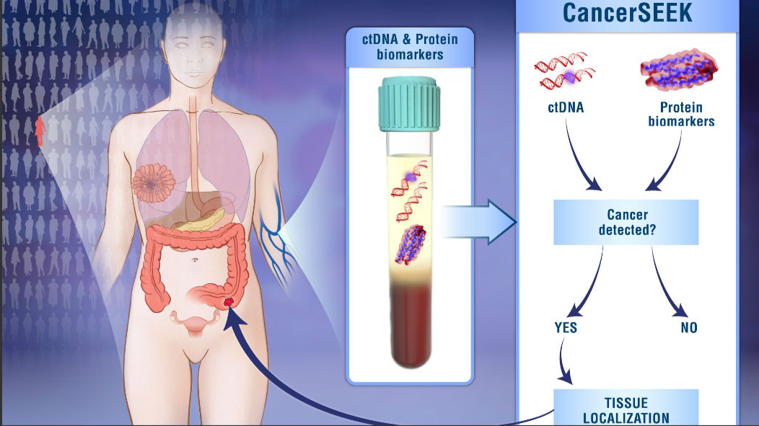
Liquid biopsy for cancer screening and early detection
The CancerSEEK test
Blood test that can detect eight common cancer types through assessment of the levels of circulating proteins and mutations in cell-free DNA
Cohen JD et al, Science 2018

Slide 9
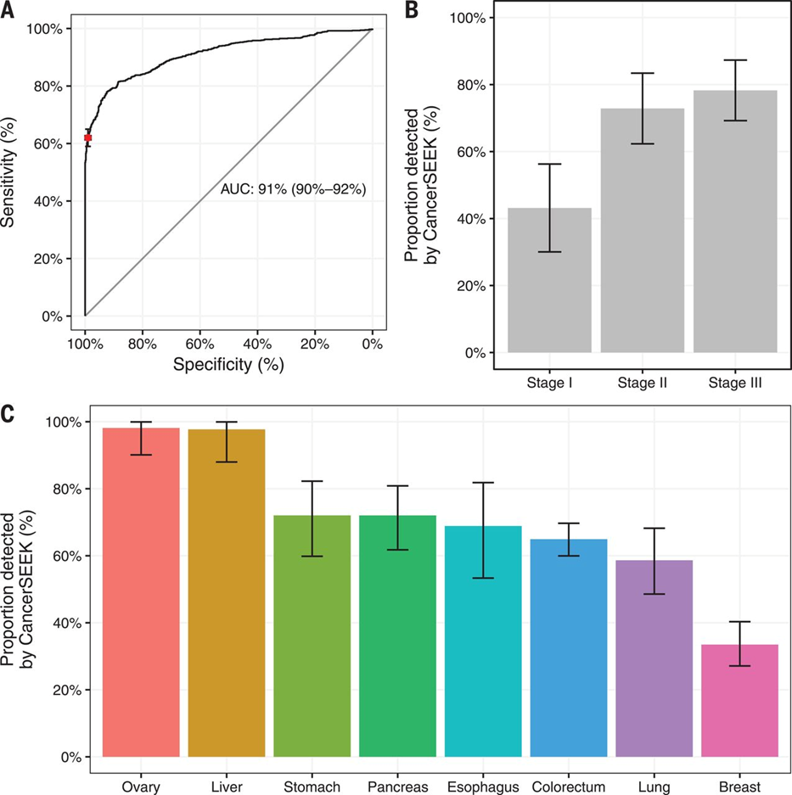
Liquid biopsy for cancer screening and early detection
The CancerSEEK test
1005 patients with nonmetastatic cancers (ovary, liver, stomach, pancreas, esophagus, colorectum, lung, or breast) and 812 healthy controls
The red point on the ROC indicates the test’s average performance (62%) at >99% specificity.
Proportion of detected cancer is higher advanced stage (stage III)
The median performance among the eight cancer types assessed was 70% raging from 98% in ovarian cancers to 33% in breast cancers

Slide 10
Liquid biopsy for cancer screening and early detection
Lung cancer: DNA integrity index and cfDNA concentration
Healthy controls: median absolute cfDNA concentration is 185,4 (127-233,5) ng/mL
NSCLC patient: median concentration of cfDNA is 603,7 (309-1470) ng/mL
Healthy controls: the median DII is 0,40 (0,33-0,45)
NSCLC patient: median DII was 0,50 (0,25-0,96)
Early stage: DII is 0,54 (0,25-0,96)
Advanced stage: DII is 0,46 (0,37-0,60)
Castiglia M et al, unpublished data
Notes:
This preliminary result might enhance the potential of DII as a diagnostic marker that could complement other diagnostic tools for early detection of lung cancer.

Slide 11
Liquid biopsy
Prognostic role of cfDNA in 41 lung cancer pts treated with immunotherapy
PFS
OS
Baseline
ctDNA cutoff | PFS | OS
< 0.47 ng/μL | 11 m | 16 m
> 0.47 ng/μL | 3 m | 6 m
Follow-up
ctDNA cutoff | PFS | OS
< 0.56 ng/μL | 11 m | 18 m
> 0.56 ng/μL | 3 m | 6 m
Castiglia, Perez, Passiglia, Russo
Unpublished data
Notes:
We also aimed to evalute the prognostic value of cfDNA in a cohort of patients under immuonotherapy. In this case, being EGFR wild type, no mutation can be targetable and we aimed to use cfDNA as a surrogate biomarker for immunotherapy response . All the patients have been asked to give plasma sample before and after Nivolumab administration. Aftter cfDNA extraction and quantification a mean cfDNA levels of 0.47 ng/uL was found at baseline and 0.56 ng/uL at follow up. We then correlated this value with prognostic clinical features as progression free survival and overall survival. Indeed the Kaplan-Meier curves demonstrate that both PFS and OS are worse in the subgroup of patients with higher cfDNA levels at baseline and at follow-up (Figure 14). Conversely, patients with lower cfDNA levels showed a better outcome.

Slide 12
Liquid biopsy
Prognostic role of cfDNA in 41 lung cancer pts treated with immunotherapy
PFS
OS
Castiglia, Perez, Passiglia, Russo
Unpublished data
Notes:
Finally, we stratified, at follow-up, patients on the basis of cfDNA dynamic changes during treatment and we observed that patients with a > 20% increase (respect to the baseline sample) had a significantly lower PFS and OS than those with no increase, suggesting a practical and useful cut-off for clinical practice after proper validation.
HR: la riduzione del rischio di progressione mediano o di morte fra campione A e B.
P: significatività del test
Intervallo di confidenza (importante per l’interpretazione del test, più è stretto più la stima del mio valore è preciso)
Il limite di questo test è che è univariato (una sola variabile considerata), bisognerebbe ampliare la casistica e integrare altri parametri clinici all’interno di un modello multivariato.
Studio osservazionale retrospettivo.

Slide 13
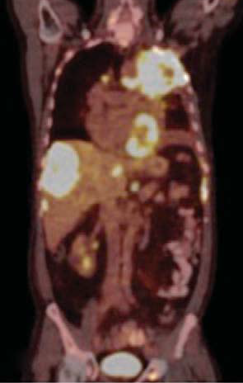
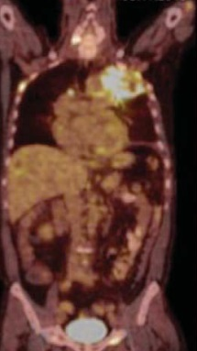
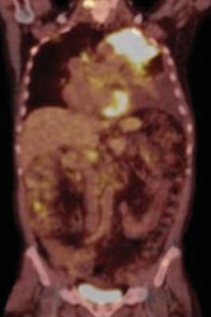
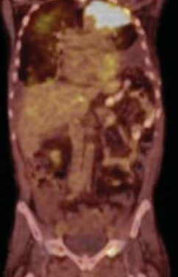
Liquid biopsy and (spatio-temporal) tumor heterogeneity
Pz ♂ (55 aa.), NSCLC Adenocarcinoma, EGFR mut (L858R)
Jun-2013
Oct-2013
Polmone (NGS)
EGFR_{L858R}
TP53_{C277*}
TP53_{R110C}
Muscolo
EGFR_{L858R}
TP53_{C277*}
↑ MET amp
TKI→CT
CT
TKI
Crizotinib
+
Erlotinib
Jan-2014
Apr-2014
Liq. Pleurico
e plasma
EGFR_{L858R}
EGFR_{T790M}
TP53_{R110C}
↓ MET amp
Liq. pleurico
EGFR_{L858R}
EGFR_{T790M}
TP53_{R110C}
TKI
3a g TKI
Crizotinib
+
Erlotinib
Scheffler M, et al. J Thorac Oncol 2015

Slide 14
Real Time monitoring of the disease
ctDNA detection as a maker for “Minimal Residual Disease”
41 NSCLC pts, plasma collection before and after surgery
Average plasma ctDNA mut. frequency
Stage Ia/Ib
Stage IIa/IV
Mut. frequency in ctDNA from stage Ia/Ib cancer patients had the most dramatic decrease after surgery (avg. 11.52% and 14.63%, respectively)
Mut. frequency in ctDNA from advanced cancer patients (IIa/IV) decreased to a lesser degree (avg. 0.57% and avg. 0.13%, respectively)
Guo N et al., Scientific Reports 2016

Slide 15
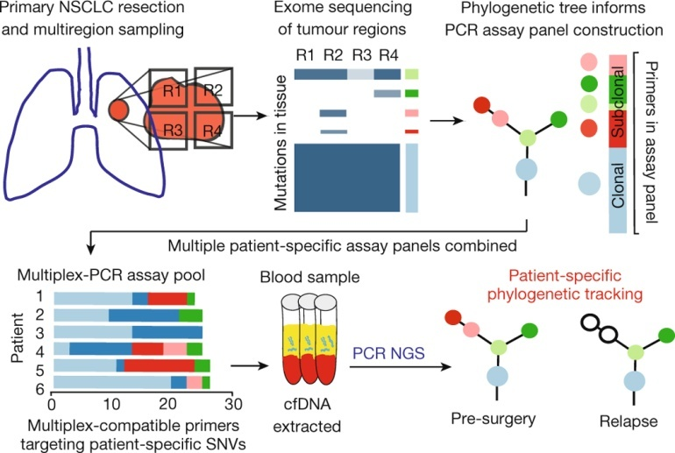
Real Time monitoring of the disease
Phylogenetic evolution
Abbosch C. Nature 2017

Slide 16
Real Time monitoring of the disease
Phylogenetic evolution
Liver metastasis: only 109 out of 149 SNVs classed as clonal in the primary tumor were detectable
Postoperative ctDNA profiling not only identified clonal SNVs present in the liver metastasis biopsy, but also revealed SNVs representing a subclone from the primary tumor
Abbosch C. Nature 2017
Notes:
Sequencing of the metastatic liver deposit revealed that only 109 out of 149 SNVs classed as clonal in the primary tumour were detectable in the metastasis. This was suggestive of an ancestral branching event that had not been resolved through the primary M-seq analysis (Fig. 5b). Postoperative ctDNA profiling not only identified clonal SNVs present in the liver metastasis biopsy, but also revealed SNVs representing a subclone from the primary tumour (Extended Data Fig. 7c). This subclone was not present in the metastatic liver deposit (Fig. 5b). These data may reflect ctDNA identified from the non-biopsied metastases, suggesting multiple metastatic events.

Slide 17
Real Time monitoring of the disease
ctDNA in intra- and extra-thoracic disease: a meta-analysis
Comparison of ctDNA analysis performance in the detection of EGFR mutation:
intra-thoracic vs. extra-thoracic disease
Study (reference) | EGFR mutation (ctDNA) | Sensitivity (M1b) n. (%) | Sensitivity (M1a) n. (%) | Odds Ratio (95% CI)
Oxnard et al. 2016 | Del19/L858R | 139/161 (86%) | 36/48 (75%) | 2.11 (0.95-4.66)
Normanno et al. 2016 | Del19/L858R | 52/82 (63%) | 13/57 (23%) | 5.87 (2.73-12.6)
Yi-Long Wu et al. 2016 | Del19/L858R | 180/234 (77%) | 63/105 (60%) | 2.22 (1.35-3.65)
Tseng et al. 2015 | Del19/L858R | 32/41 (78%) | 5/21 (24%) | 11.28 (3.27-39.6)
Kumar et al. 2017 | Del19/L858R | 21/28 (75%) | 15/27 (55%) | 2.40 (0.76-7.53)
Kasahara et al. 2017 | Del19/L858R | 26/33 (79%) | 8/16 (50%) | 3.71 (1.03-13.46)
Karlovic et al. 2016 | Del19/L858R | 52/55 (95%) | 7/18 (39%) | 27.24 (6.07-122.17)
Karlovic et al.* 2016 | T790M | 47/49 (96%) | 4/15 (27%) | 64.63 (10.47-398.8)
Thress et al. 2015 | T790M | 21/27 (78%) | 2/11 (18%) | 15.75 (2.65-93.46)
Jenkins et al. 2017 | T790M | 111/154 (72%) | 123/243 (51%) | 2.52 (1.63-3.88)
Passiglia F et al, CCDT 2018

Slide 18
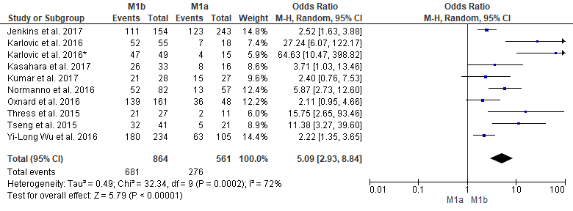
Real Time monitoring of the disease
ctDNA in intra- and extra-thoracic disease: a meta-analysis
Pooled OR: 5.09
ctDNA testing has a greater sensitivity in patients with extra-thoracic disease
Forest plot showing odds ratio for overall sensitivity of plasma ctDNA EGFR-mutation testing by metastatic sites location (M1b vs M1a)
Passiglia F et al, CCDT 2018

Slide 19
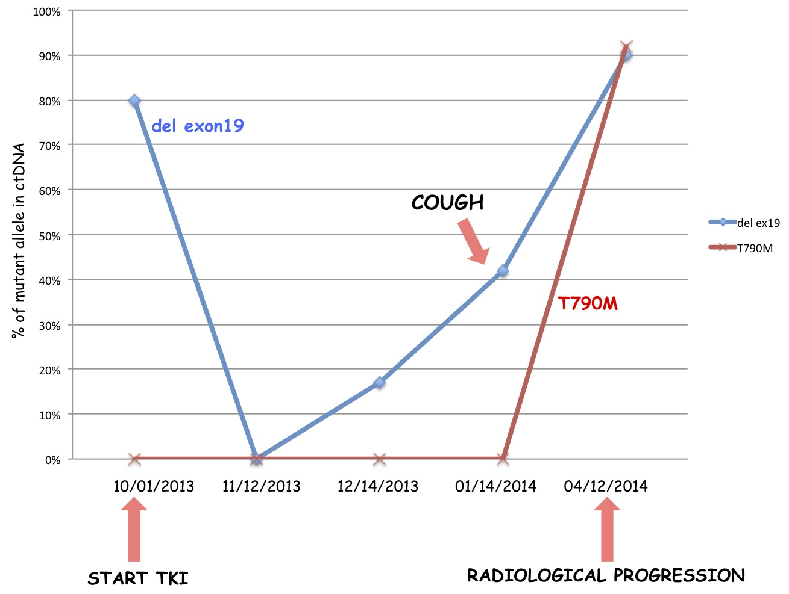
Liquid biopsy
Dynamic monitoring of EGFR mutation NSCLC
Notes:
E’ molto caratteristico nella nostra esperienza il caso di un paziente con delezione dell’esone 19 che si riduceva dopo l’inizio del TKI. In concomitanza della comparsa di tosse si osservava un incremento dei livelli della mutazione del plasma, seguito dalla comparsa e progressivo aumento della mutazione T790M nel plasma prima della comparsa di progressione radiologica.
- Possiamo affermare che si ha una riduzione del ctDNA per esempio della del exon 19 ma non di un azzeramento. Questo è in funzione della sensibilità della tecnica che utilizziamo vale a dire che se affermiamo che la curva tocca l'asse delle X ciò non indica che sia ha un azzeramento del ctDNA ma una riduzione in relazione alla sensibilità della metodica che viene utilizzata
- L'identificazione di una nuova mutazione non ci può indurre a cambiare la strategia terapeutica ma ci può indurre ad incrementare per esempio la strategia di follow-

Slide 20
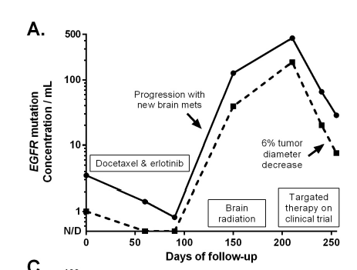
Real Time monitoring of the disease
Detecting resistance to 1st generation EGFR-TKI
Plasma collected from advanced NSCLC pts (N=23) for detection of L858R and T790M EGFR mutations in ctDNA
L858R
T790M
Concurrent EGFR mutations (L858R and T790M) by ddPCR trend in parallel
EGFR mutation detection in plasma is modified by treatment and follows tumor burden
Plasma DNA genotyping might be an useful clinical biomarker as surrogate endpoint for response or progression and early clinical trial endpoint
Oxnard G.R. et al, Clin. Cancer Res. 2014

Slide 21
T790M
From resistance to actionable mutation in NSCLC
AURA3 trial: Osimertinib vs Platinum–Pemetrexed in EGFR T790M–Positive Lung Cancer
Tissue based analysis
Plasma based analysis
PFS
10.1 months vs 4.4 months
HR: 0.30; 95% [CI], 0.23 to 0.41; P<0.001
PFS
8.2 months vs 4.2 months
HR: 0.42; 95% [CI], 0.29 to 0.61
After TKI treatment and experience of PD patients HAS to be re-tested for T790M mutation!
Mok et al, NEJ 2016

Slide 22
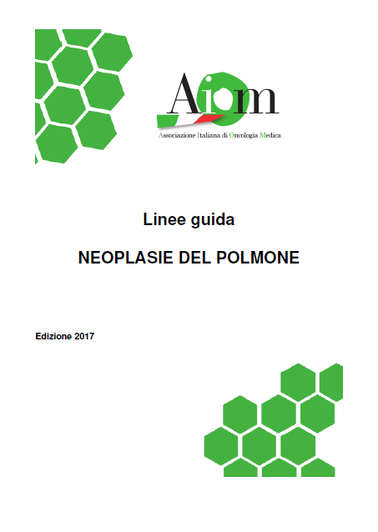
NSCLC: Use of plasma DNA genotyping
New paradigm (AIFA-approved)
Acquired resistance to
EGFR TKI
AIFA-approved plasma
assay for T790M and
sensitizing mutations
T790M+
T790M+
T790M-
Skip biopsy, start 3rd gen
EGFR TKI
Biopsy, AIFA-approved
FFPE assay for T790M
T790M+
T790M-
3rd gen
EGFR TKI
Chemo

Slide 23
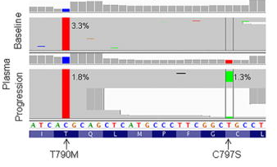
New resistance mechanisms
Beyond T790M mutations
Patient from AURA trial who progressed under AZD9291 after 23 weeks
Adapted from Thress KS, Nat Med 2015

Slide 24
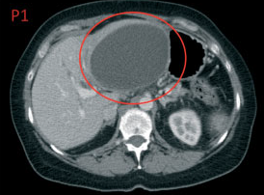
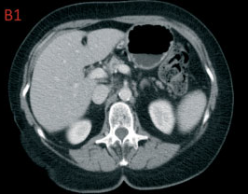
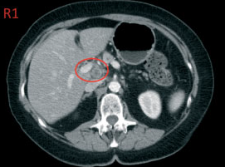
Real Time monitoring of the disease
Detecting resistance to PARP-inhibitors
Pts con adenocarcinoma ovarico, sieroso papillifero ad alto grado
Mutazione germinale: BRCA2 4705del4 (stop 1504)
Basale
Mutazione primitiva frameshift
c.4705_4708delGAAA; stop 1504
Olaparib per 34 mesi (studio di fase I)
BRC repeats
DNA binding
0
500
1000
1500
2000
2500
3000
3417
Risposta completa
Proteina tronca
0
500
1000
1500
Progressione linfonodale
DNA binding
0
500
1000
2000
2500
3000
3417
Mutazione secondaria delezione in-frame del12bp; p. I1490_E1493del
DNA somatico
Barber LJ, et al. J Pathol. 2013 Feb;229(3):422-9.
Notes:
In questo caso la paziente è portatrice della mutazione germline c.4705_4708delGAAA, che causa la produzione di una proteina tronca. Gli autori hanno ipotizzato che una seconda mutazione su BRCA2 potesse essere responsabile della resistenza al trattamento dopo 34 mesi di trattamento con olaparib.
L’analisi mutazionale per BRCA2 effettuata sul campione di tessuto metastatico ha evidenziato la presenza sia della mutazione c.4705_4708delGAAA che di una nuova delezione di 12bp. Questa seconda mutazione sembra ricostituire il frame di lettura portanda alla delezione di 4 amminoacidi scarsamente conservati. Questa piccola delezione sembra non influire signicativamente sulla funzionalità di BRCA2 e potrebbe quindi essere la cusa della resistenza al trattamento con PARPi.

Slide 25
Real Time monitoring of the disease
Detecting resistance to PARP-inhibitors
Modified from Mayor P at al, Gynecol Oncol Rep. 2017
June: PD
August: ctDNA NGS analysis
May: Cytoreduction HIPEC treatment
Olaparib initiation
May: STOP olaparib
Platinum-based chemotherapy
Olaparib for 6 months
Other treatment
OVca
2013: diagnosis high-grade serous ovarian cancer
2016: radiological evidence of PD
Germline BRCA analysis:
BRCA1: c.5266dupC, p.Q1756fs*74
Somatic BRCA analysis
on primary tumor:
BRCA1: c.5266dupC, p.Q1756fs*74
ctDNA results:
BRCA1: c.5266dupC, p.Q1756fs*74
+
c.5263_5272>TCCCCAGGAC
p.Q1756_D1757 > PG

Slide 26
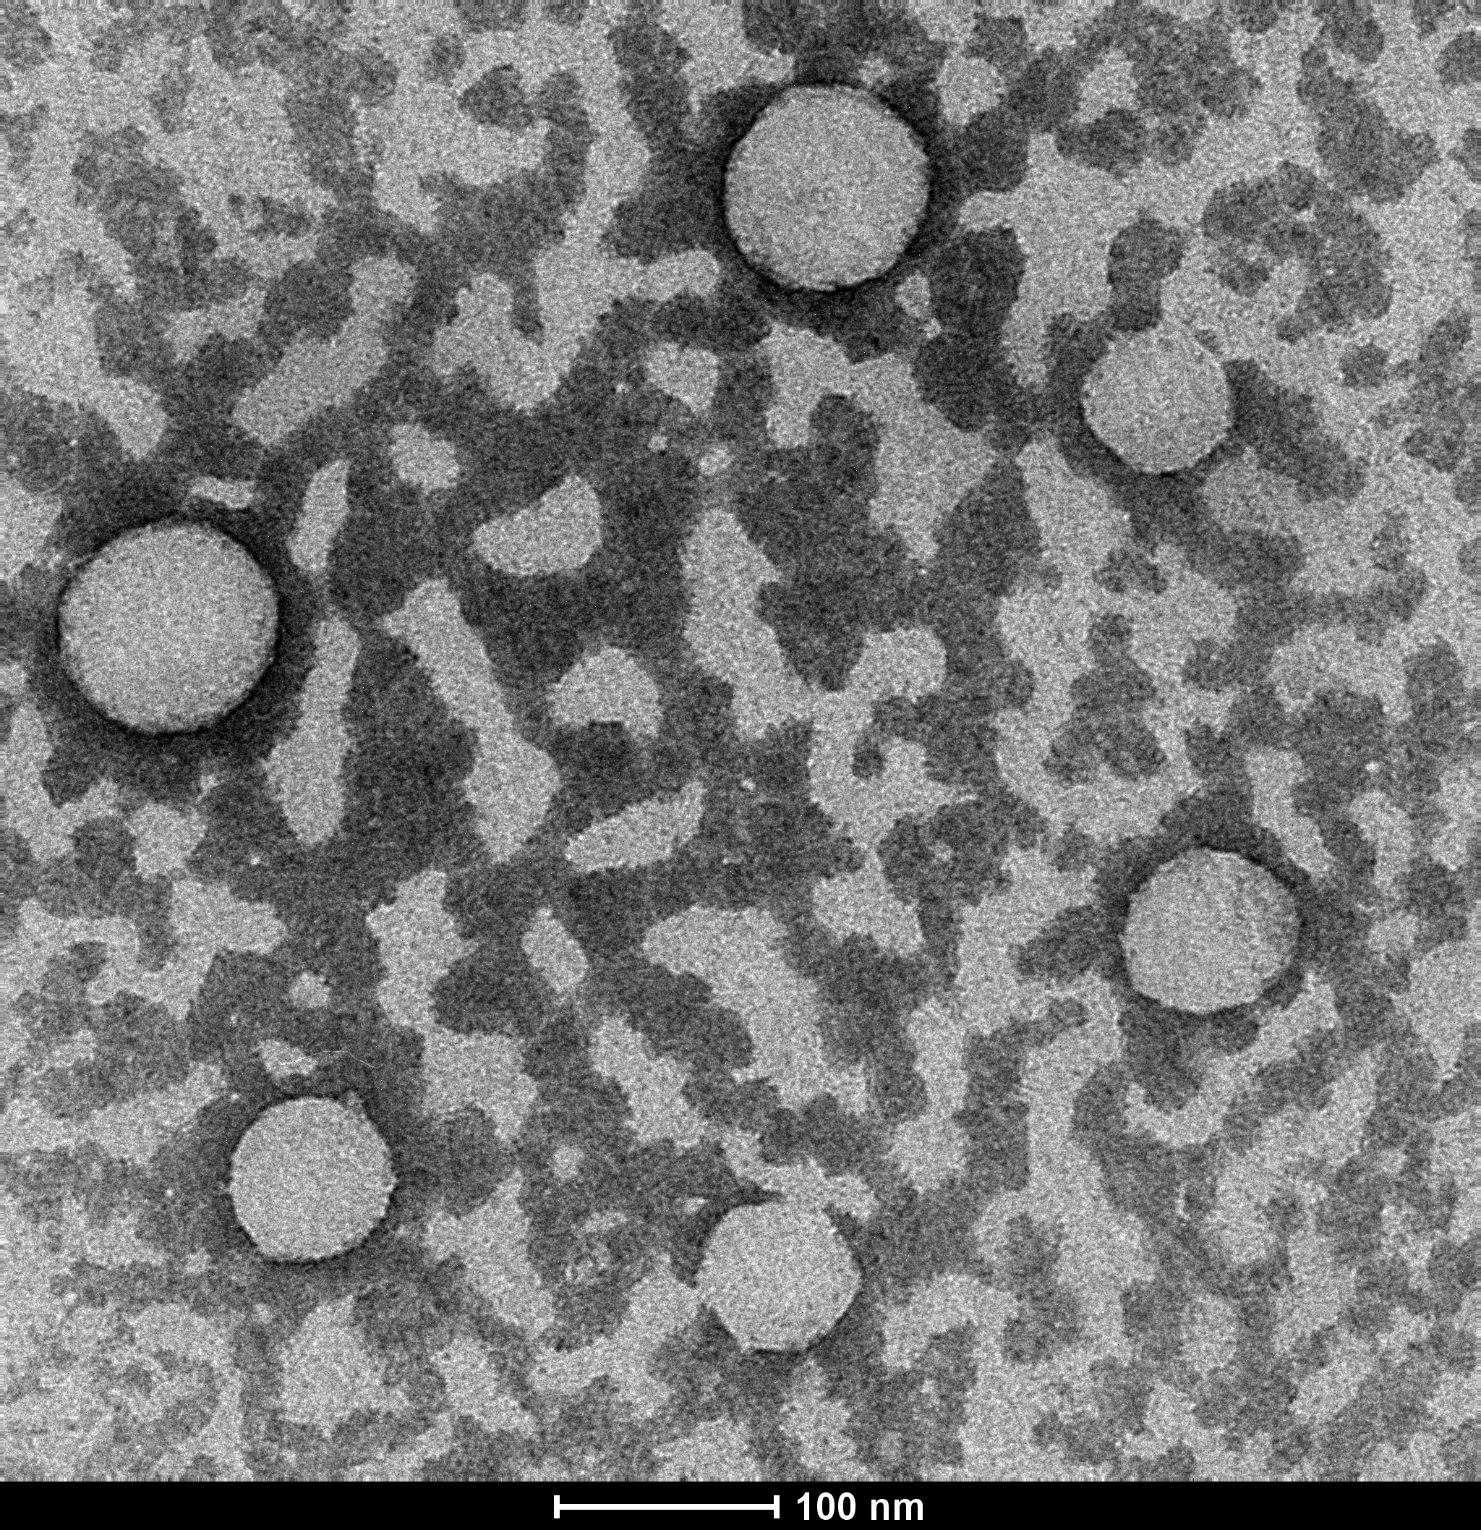
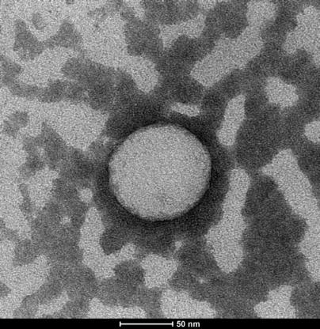
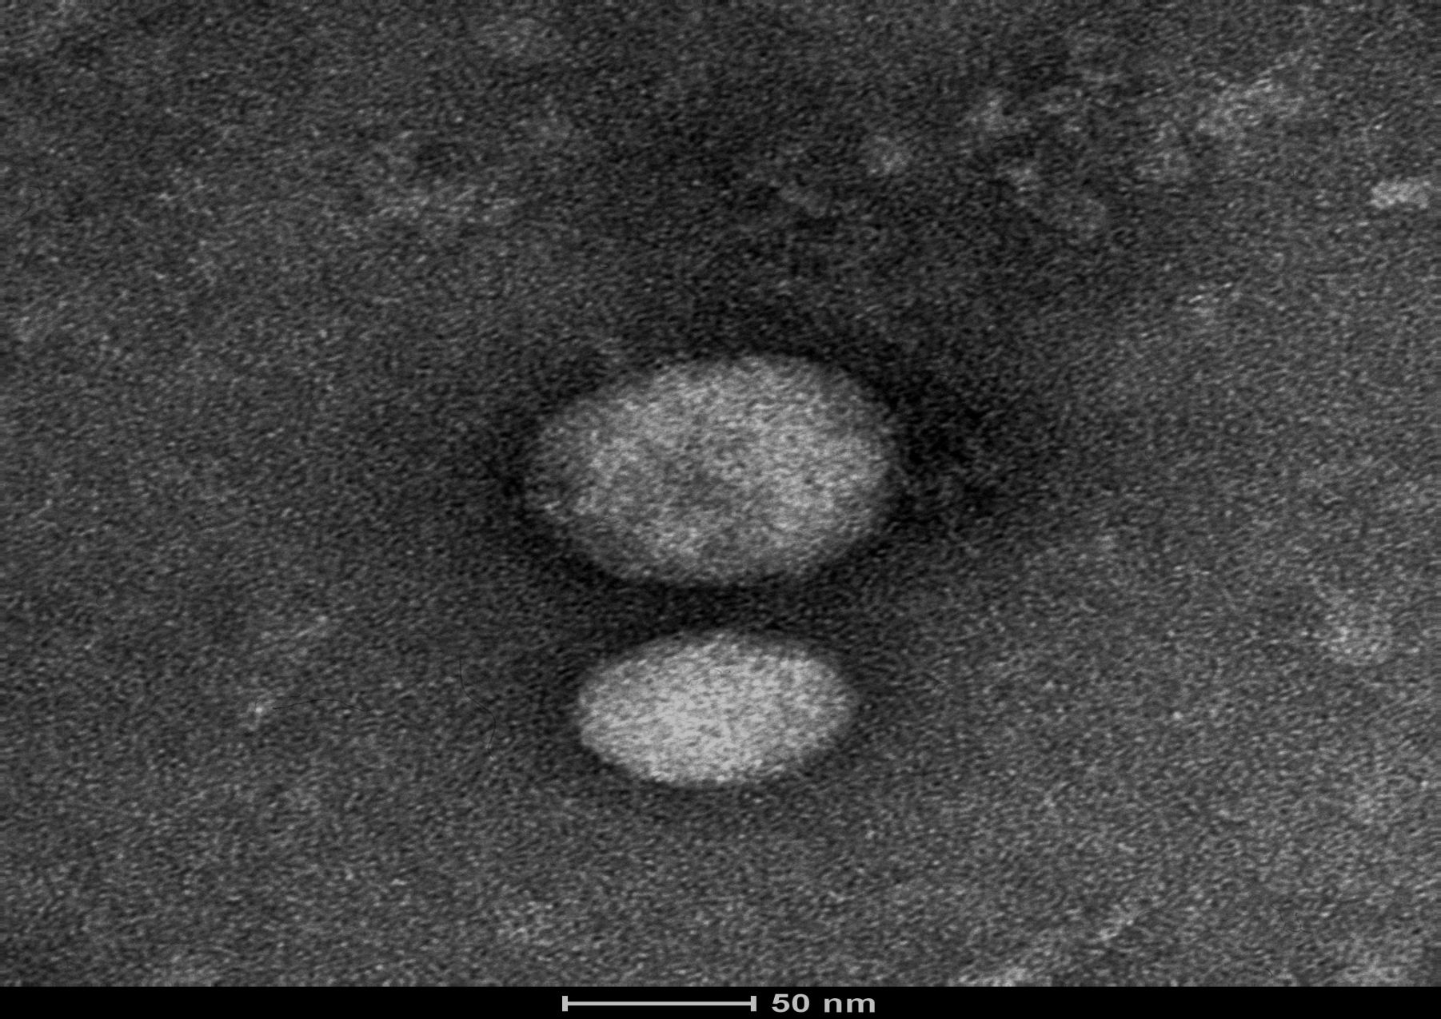
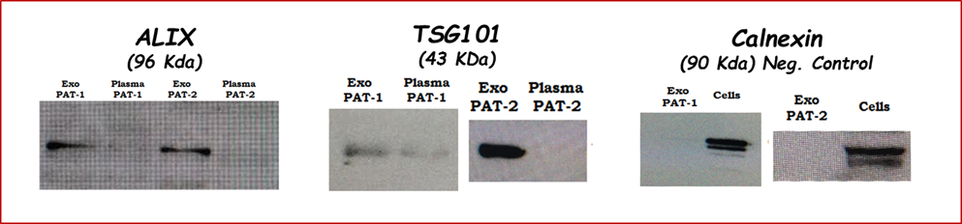
How the future of liquid biopsy looks like?
Exosomes
Small (30 to 100 nm) endocytic derived vesicles.
Released from normal, diseased, and cancer cells in the blood and other body fluids (i.e. urine, pleural effusion, ascites, saliva..).
Involved in cell-cell or organ-organ communications.
Reach in protein, mRNA, miRNA and DNA fragments.
Tsg101
Alix
miRNAs

Slide 27
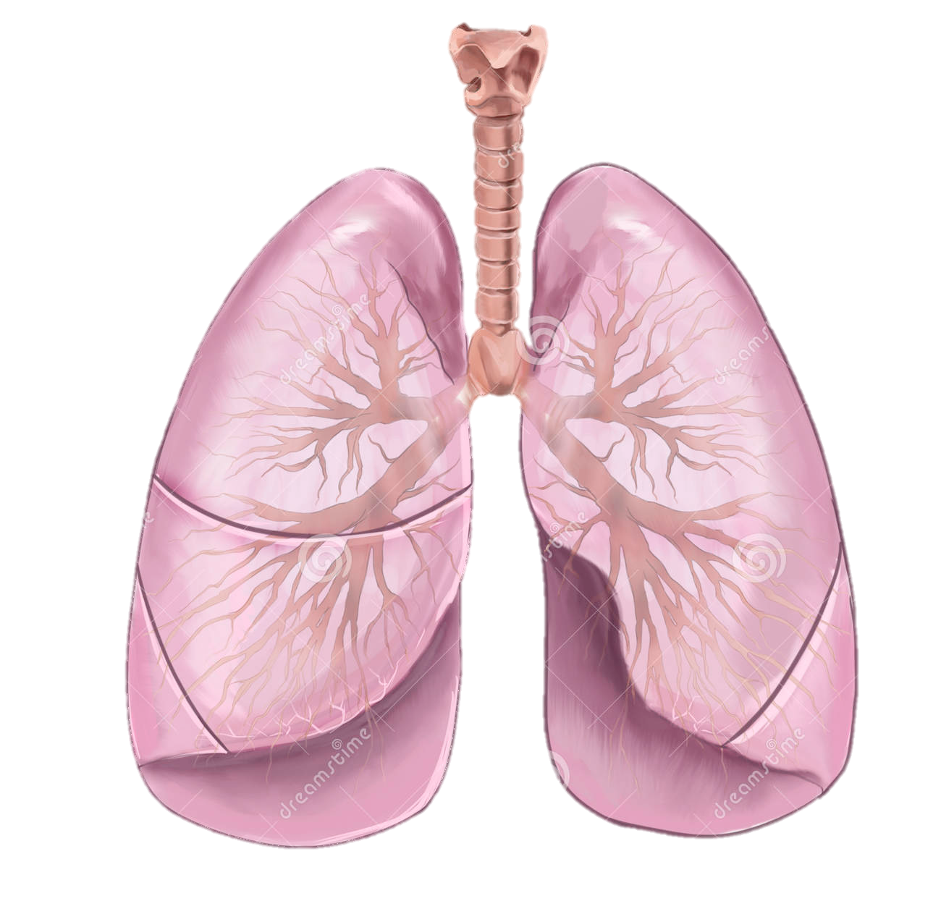
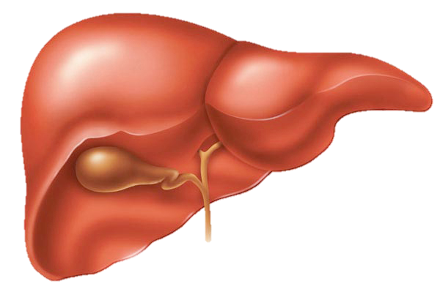
Revisited “Seed and Soil” theory
Tumor
Lung-tropic secreted exosomes
Liver-tropic secreted exosomes
Pre-metastatic niches
Adapted from Hoshino A, Nat 2015

Slide 28
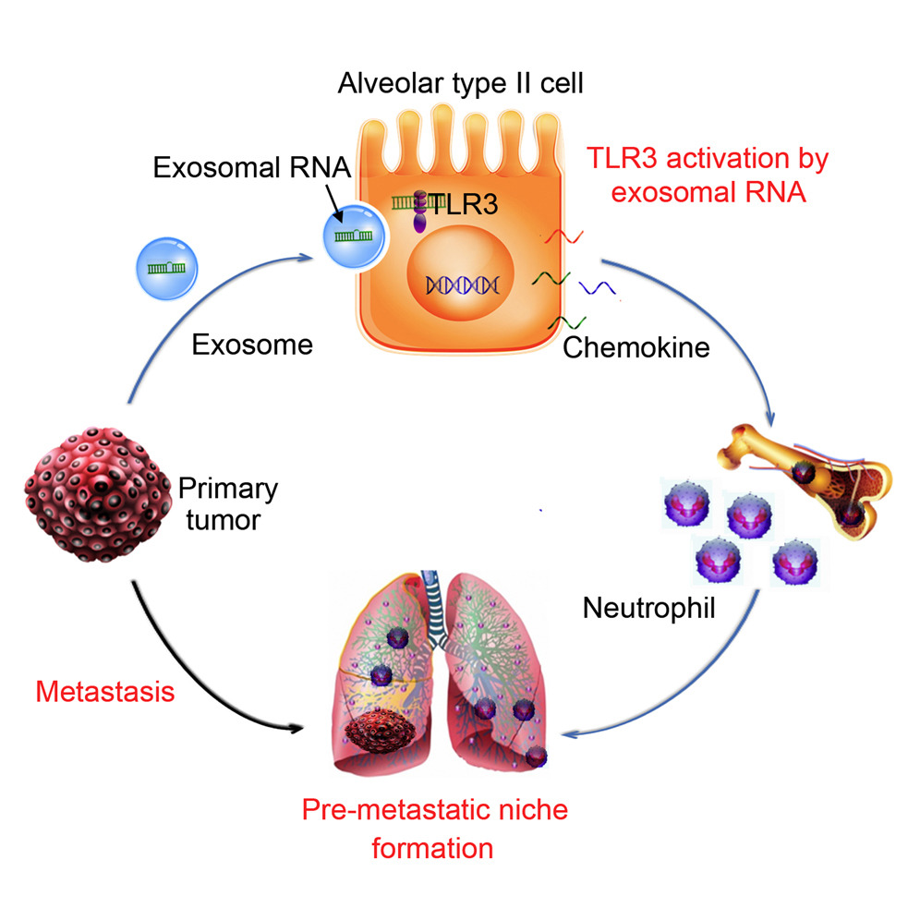
Metastasis development
The role of exosome pre-metastatic niche development
Primary tumor release exosome that are able to stimulate the activation of TLR3 in lung epithelial cell
Lung epithelial cells release chemokine that activate neutrophil proliferation
Disseminated tumor cells rich distant site and find a fertilized soil were to grab and grow
Neutrophil are recruited in the lung and contribute to create the pre-metastatic niche
Adapted from Liu e al, Cancer Cell 2016
Notes:
The pre-metastatic niche educated by primary tumor-derived elements contributes to cancer metastasis.

Slide 29
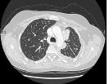

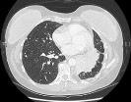

Follow-up analysis of exosomal microRNAs
One EGFR (T790M exon 20) NSCLC pt (EGFR1)
microRNA 30c
microRNA 30b
microRNA 221
microRNA 222
Start
AZD9291

Slide 30

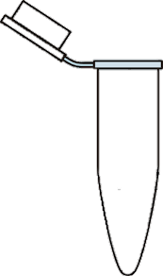
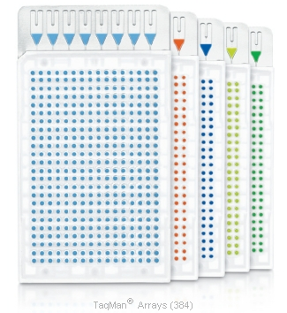
In vitro analysis for evaluating miRNAs involvement in NSCLC
A549
EGFR wt
miR30c
HCC827
EGFR del19+
miRNAs extraction
miR221
miR142-3p
miR126
tHCC827
+ERL
10nM:25nM
H820
EGFR del19+
T790M
TaqMan Array Human MicroRNA Cards A
Notes:
In the context of an unstoppable need of new biomarkers, we aimed also to evaluate in an in vitro approach, new putative prognostic biomarkers useful in NSCLC clinical practice. To do so we used four cell lines simulating the most common EGFR mutational condition of this neoplastic disease: wild type, harboring exon19 deletions, harboring exon 19 deletion under TKI treatment for 6 months and harboring exon20 T790M. After extraction e reverse transcription miRNAs, were analysed using TaqMan MicroRNA Assays. On the basis of different card combinations and a fold change of 5 for up-regulated and 0.6 for down-regulated we extrapolated a list of 8 miRNA which we then next evaluated directly in plasma of non small cell lung cancer patients.

Slide 31
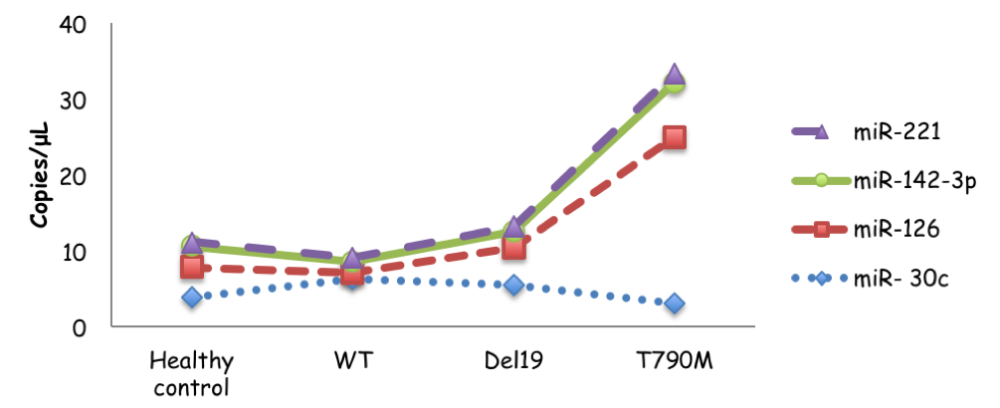
Plasma miRNAs signature in relation
to EGFR molecular status
Notes:
In particular we re-analyzed in plasma four miRNAs, 30c, 126, 142-3p, 221 in a small cohort of 3 wild type patients, 3 del19 patients, 3 del19+T790M patients and 10 healthy controls. After miRNAs extraction, reverse transcription they have been evaluated through dPCR as copies/microliter. Looking at the miRNA behaviour along the EGFR molecular status of the disease, in terms of copies/uL, miRNAs fluctuations seem to be characteristics of the oncogene-addicted disease. As showed in figure, in healthy controls and WT patients the selected miRNAs do not significantly fluctuate. Contrariwise, in Del19 and T790M+ patients there is an apparent modification according to mutational status.
miR-142-3p: in my knowledge this is the first time that this miRNA has been evaluated in plasma samples for prognostic purposes. There’s some in vitro work in which this miRNA has a suppressive role by targeting chromatin remodeling complexes. Its overexpression seems to be also correlated with increased chemo-sensitivity in NSCLC by targeting HMGB1.
miR-30c: low miR-30c levels are correlated with poor prognosis, indeed lower expression of miR-30c is linked with greater invasion abilities of the tumoral cells. It induces epithelial mesenchymal transition. Target MTA-1, modulates invasion and metastasis.
miR-126: its a pro angiogenic factor in NSCLC. miR-126 expression is reduced in lung cancer, elevated miR-126 expression alone also could be positively related to the overall survival (OS) in patients with NSCLC, indicating an important value of miR-126 expression alone in the prognosis of NSCLC patients. Target VEGF-A and EGFL7. il fatto che aumenti invece di diminuire in particolare a resistenza potrebbe essere dovuto ad un effetto del trattamento prolungato.
miR-221: it correlates with poor prognosis by enhancing cell migration and invasion. It’s considered as an oncogenic risk factor. It can be considered as a negative prognostic factor of PFS in NSCLC. Moreover, one of its target is FOXO1, a proapoptotic factor. miR-221 by targeting FOXO1 determine an antiapoptotic effect.

Slide 32


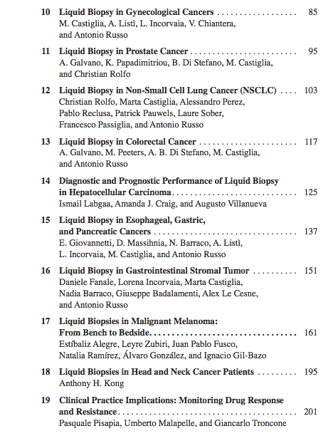
The first book on Liquid Biopsy!
Published!
October 2017

Slide 33
Conclusions
Liquid biopsy for early diagnosis…still not there yet…
Tracking lung cancer evolution with liquid biopsy: yes, are we ready to manage these information?
Resistance detection: ctDNA testing in lung cancer is approved in the clinic at disease progression (and in some cases at diagnosis)
Metastasis development: exosome are probably the Ariane’s thread that guide primary tumor cells to metastatic sites

Slide 34
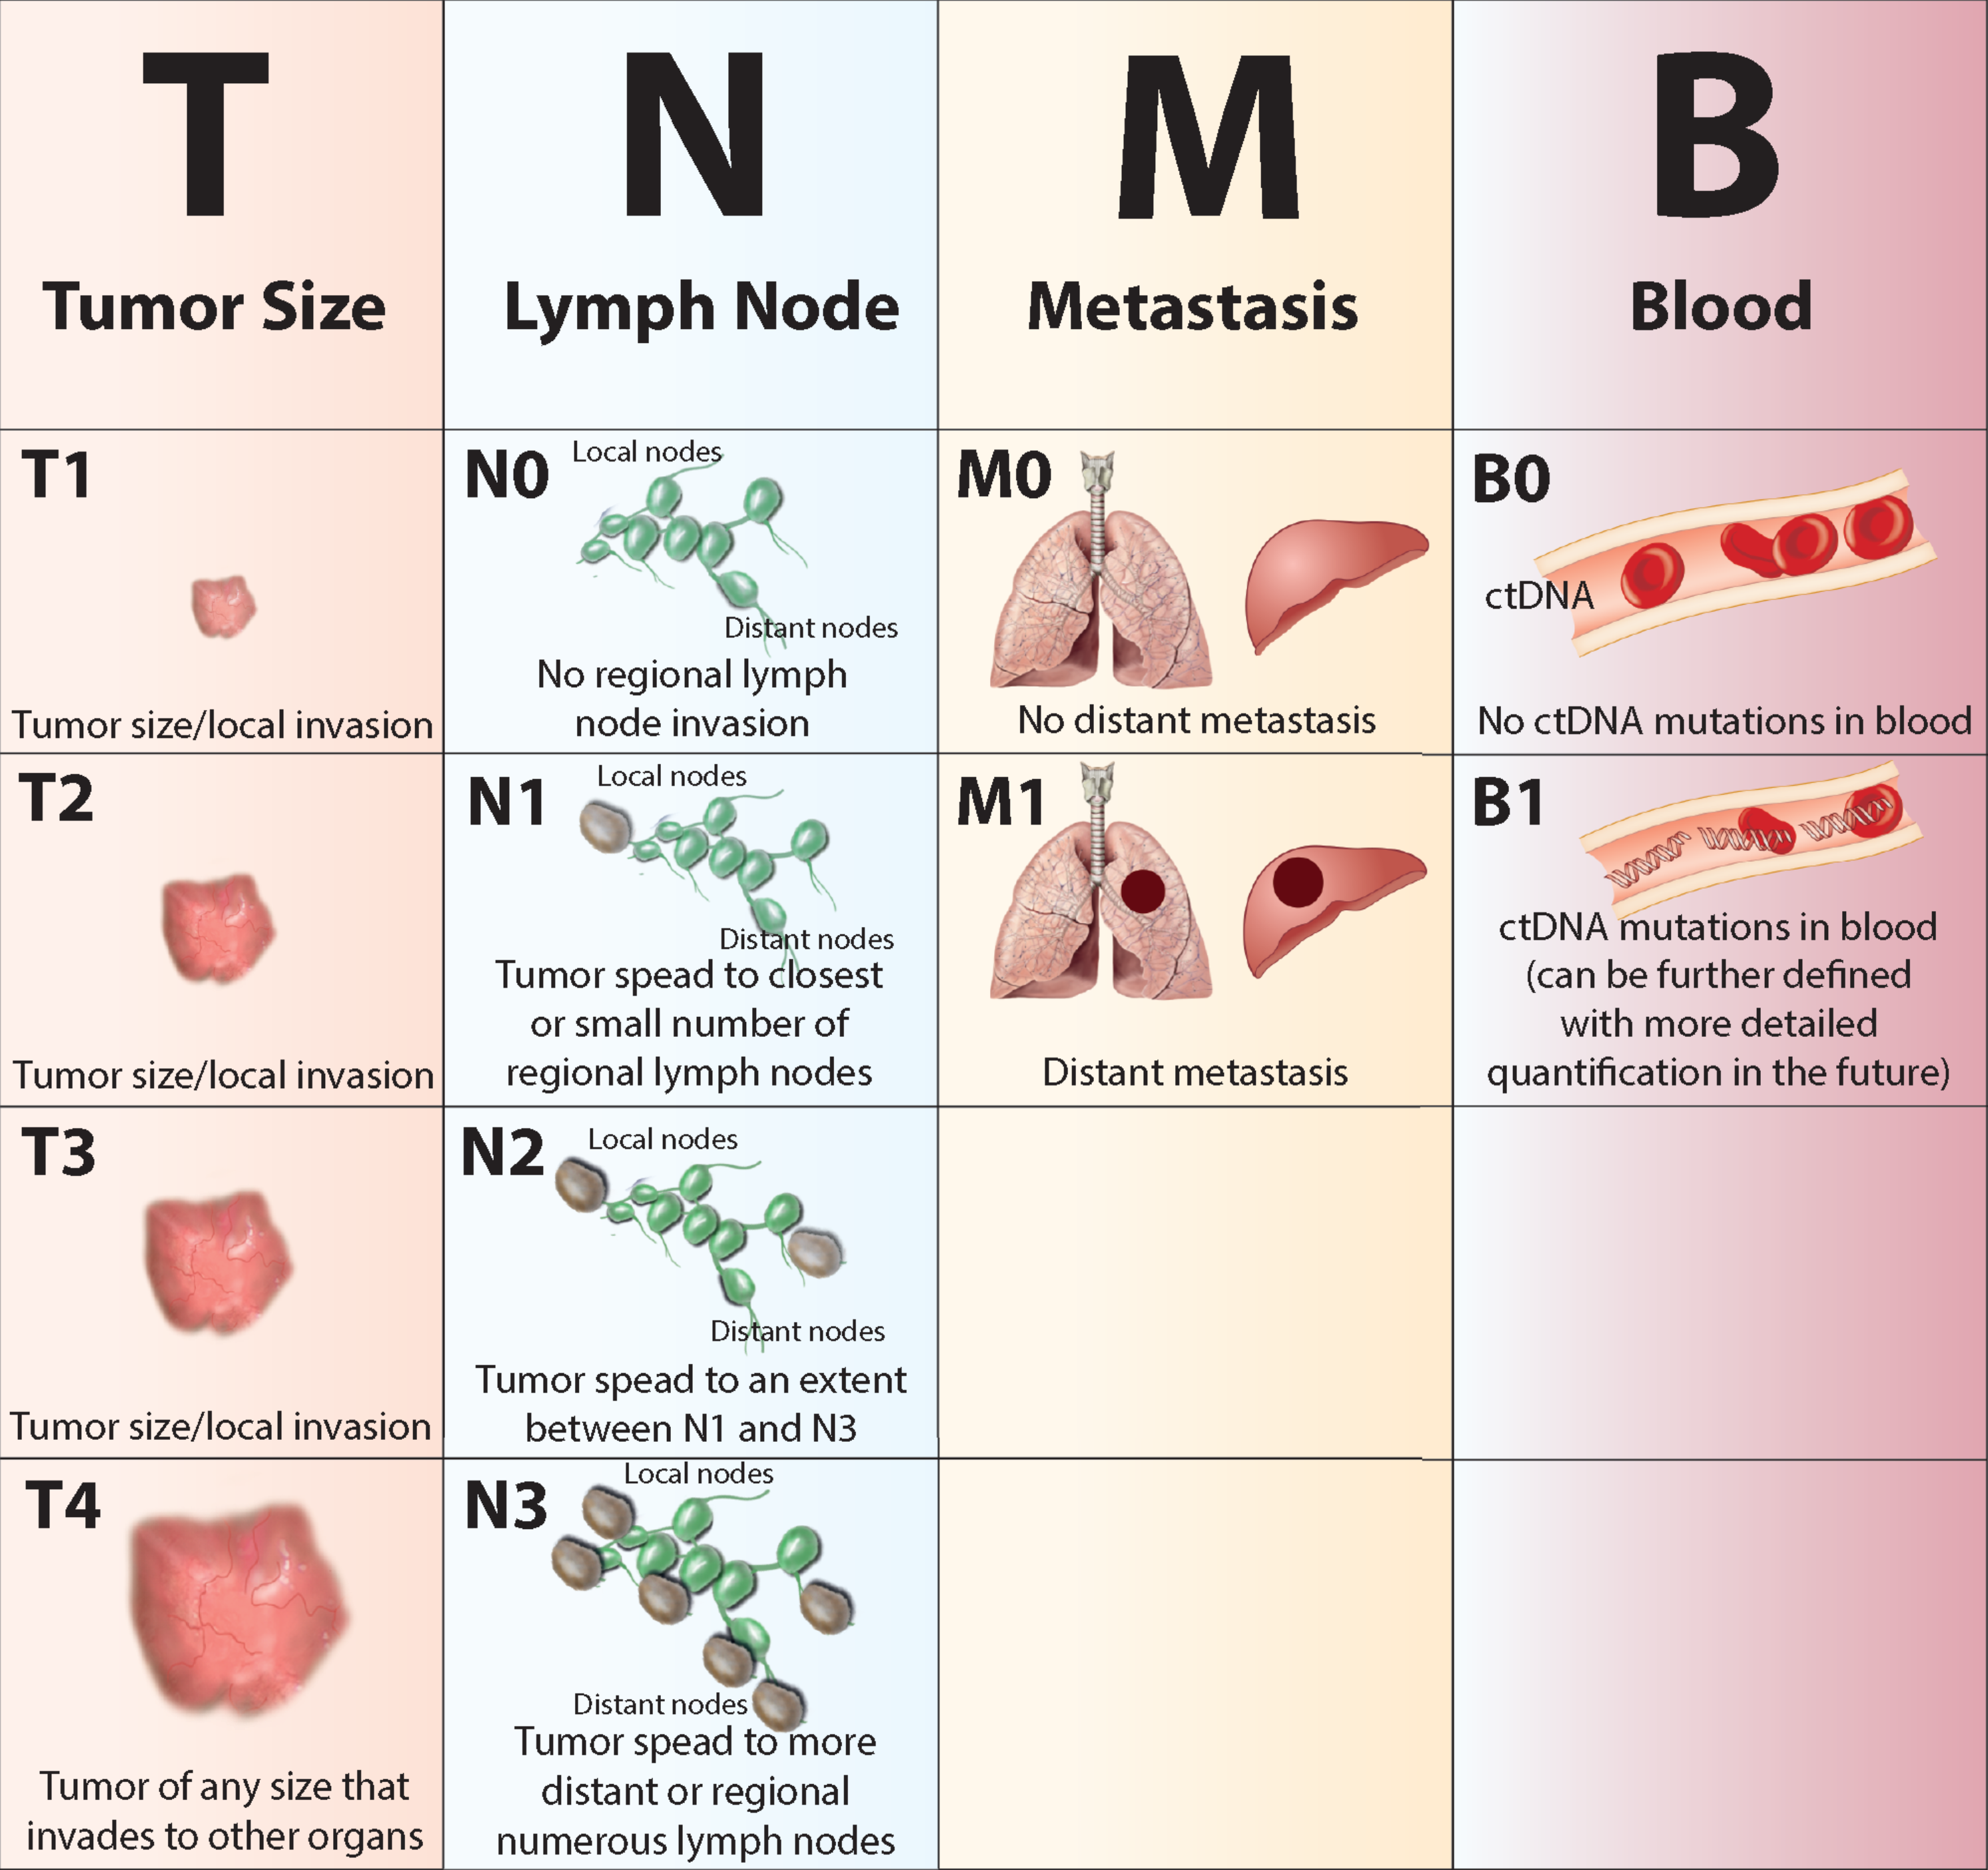
Is this the future?
Yang M, et al. Annals of Oncology 2018

Slide 35





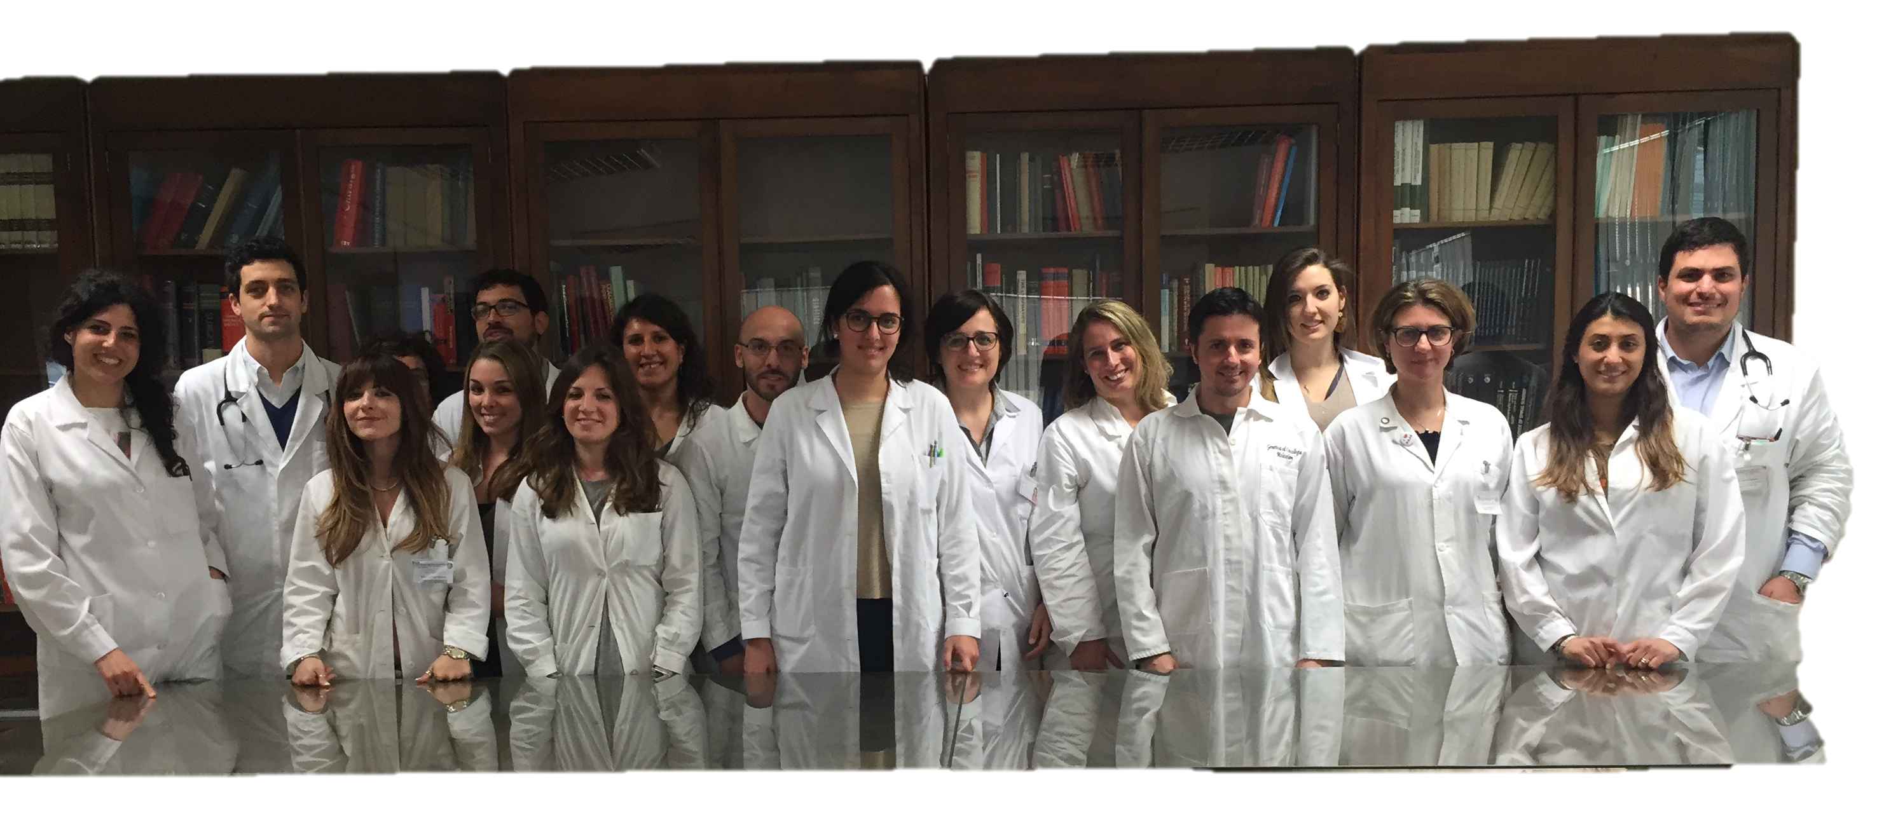
Our team

Slide 36

La scienza è sempre imperfetta. Ogni volta che risolve un problema, ne crea almeno dieci nuovi.
George Bernard Shaw
Grazie per l’attenzione!
martacastiglia@gmail.com
marta.castiglia@unipa.it
Notes:
La scienza può porre limiti alla conoscenza, ma non dovrebbe porre limiti all’immaginazione.
(Bertrand Russell)

