Slide 1
Male Breast Cancer: New Molecular Landscapes
Marcello Maugeri-Saccà, MD, PhD
“Regina Elena” National Cancer Institute

Slide 3
Some key facts about MBC
MBC is a rare disease that accounts for less than 1% of all cancers in men and about 1% of all BC
Increased incidence over a 15-year period. Reasons: probably lifestyle changes, i.e. with aging, the androgen/estrogen ratio shifts in favor of estrogens, as the decrease in testicular and adrenal T production is not coupled with parallel reduction of E2 levels. Such an imbalance stems from the age-associated increase of both aromatase activity and fat mass
White J et al, Breast Cancer Res. 2011
Cardoso F et al, Ann Oncol 2017
Maugeri-Saccà et al, Breast Cancer Res Treat. 2014

Slide 4
Risk factors for MBC
In an Italian multicenter study on MBC, it was reported a frequency of BRCA1/2 mutations of about 13%: BRCA1 mutations were found in about 1% and BRCA2 mutations in 12% of MBC cases
Ruddy Ann Oncol 2012
Ottini Ann Oncol 2013

Slide 5
Molecular Studies in MBC
CNV
methylation profiling
GEP
IHC !!!
Maugeri-Saccà M, Breast Canc Res Treat 2014

Slide 6
EORTC MBC project
Cardoso, Ann Oncol 2017

Slide 7
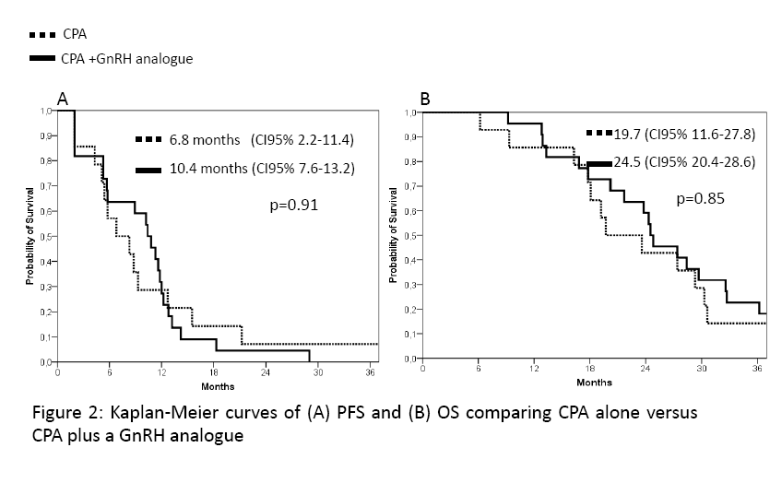
Antiandrogen therapy in mMBC patients
All the 4 patients with AR+tumors had a tumor response, including a patient with ER- MBC. Conversely, none of the 3 patients with AR- tumors had a tumor response.
Di Lauro L, Breast Cancer Res Treat. 2014
Di Lauro, J Hematol Oncol. 2015

Slide 8
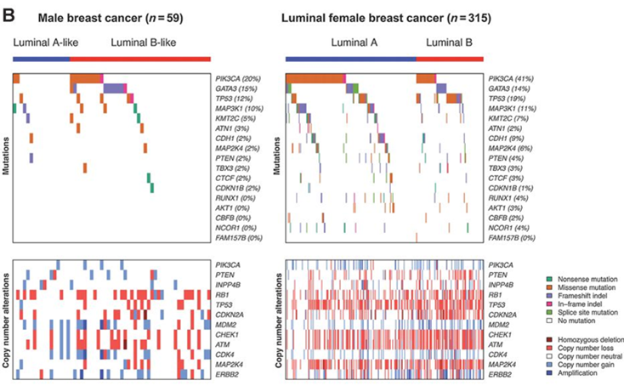
Repertoires of mutations and copy number alterations in male breast cancer, ER-positive/HER2-negative female breast cancer and female breast cancer of luminal subtype.
Piscuoglio Clin Cancer Res 2016
Notes:
Repertoires of mutations and copy number alterations in male breast cancer, ER-positive/HER2-negative female breast cancer and female breast cancer of luminal subtype. Somatic mutations in the 241 genes, either recurrently mutated in female breast cancer or related to DNA repair, included in the targeted capture massively parallel sequencing assay employed in this study. The results for ER-positive/HER2-negative male breast cancer and ER-positive/HER2-negative female breast cancer (A) and male breast cancer and female breast cancer of luminal subtype (B) are ordered from top to bottom in decreasing order of mutational frequency in male breast cancers (top). Patterns of copy number alterations in male breast cancers and female breast cancers in selected genes (middle). Expression of ER, PR, HER2, and Ki-67 (male breast cancer only) as defined by immunohistochemistry (IHC) in the samples analyzed (bottom). In B, male breast cancers were classified into luminal A-like and luminal B-like subtypes defined based on their immunohistochemical profiles following the St Gallen's criteria (27), and female breast cancers are classified into luminal A and luminal B molecular subtypes based on PAM50. Sequencing data, copy number data, and intrinsic subtype information of the female breast cancers were retrieved from The Cancer Genome Atlas (13).

Slide 9
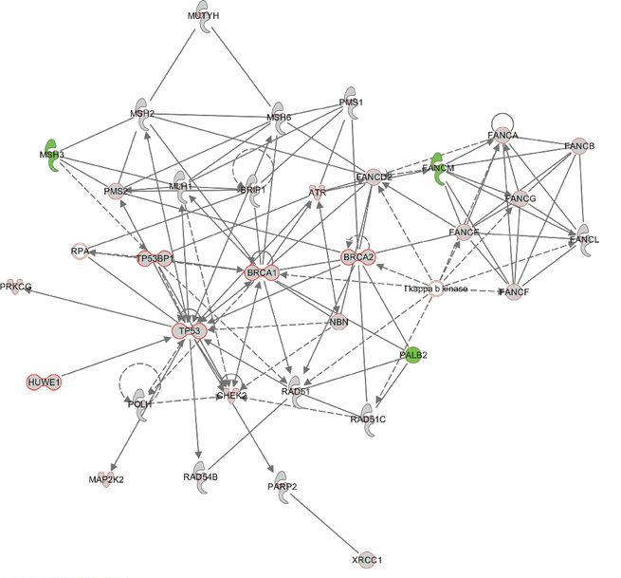
DDR pathways in MBC

Slide 10
ATM-ATR are central in the DDR machinery

Slide 11
The ATR-ATM pathway in MBC
Di Benedetto et al, Sci Rep 2017

Slide 12
DDR markers and survival in MBC
Di Benedetto et al, Sci Rep 2017

Slide 13
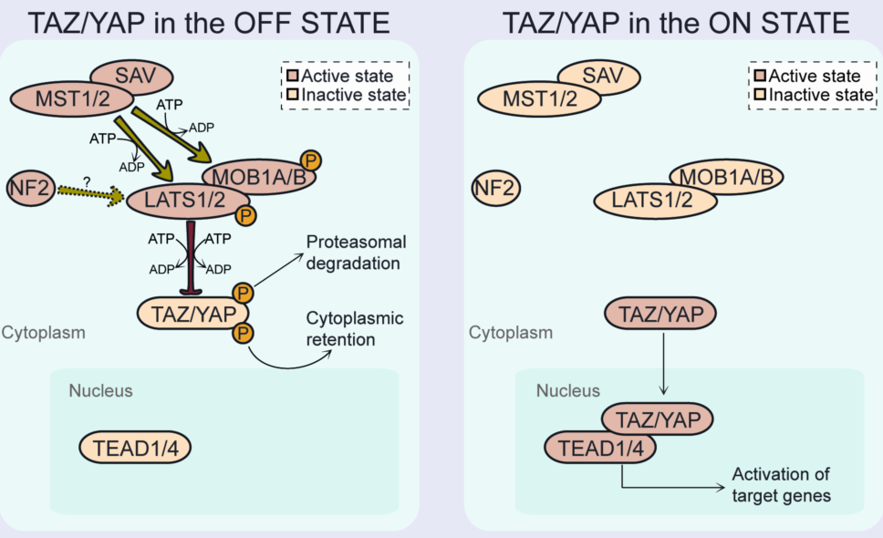
Deregulated Hippo pathway in MBC
Maugeri-Saccà M, et al.
Expert Rev Mol Med. 2015

Slide 14
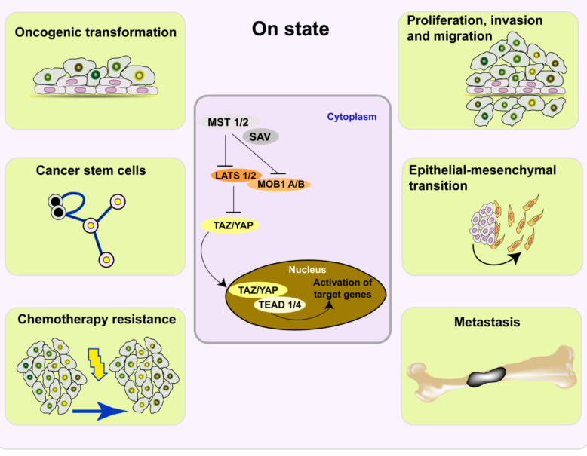
The Hippo pathway in BC
Maugeri-Saccà M, et al.
Expert Rev Mol Med. 2015

Slide 15
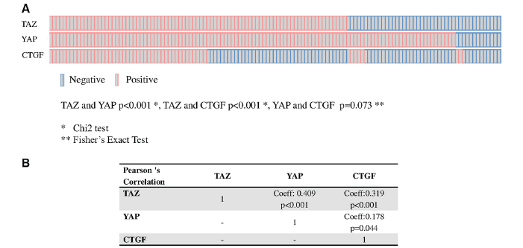
TAZ/YAP and their target CTGF in male breast cancer
Di Benedetto A et al., Oncotarget 2016

Slide 16
AXL, a TAZ/YAP target, in MBC
Di Benedetto A et al, J Cell Physiol. 2017

Slide 17
1) Cell polarity and
cell junction factors
2) Upstream activators
of Hippo kinases
3) Ligand-dependent
activation
CRB
Apical
TAOK
AMOTs
SAV
Tight
junctions
MST1/2
RHO GTPases
Adherens
junctions
α-catenin
LATS1/2
MOB1A/B
PTPN14
Actin
Basolateral
junctions
SCRIB
TAZ/YAP
RHO GTPases
TEADs
AMPK
4) Mechanical cues
HMG-CoAR
Basal
5) Metabolic factors

Slide 18
The mevalonate pathway controls YAP/TAZ….. and
Mancini R et al, Oncogene 2018

Slide 19
………… the production of steroid hormones

Slide 20
?????????????????????????

Slide 21
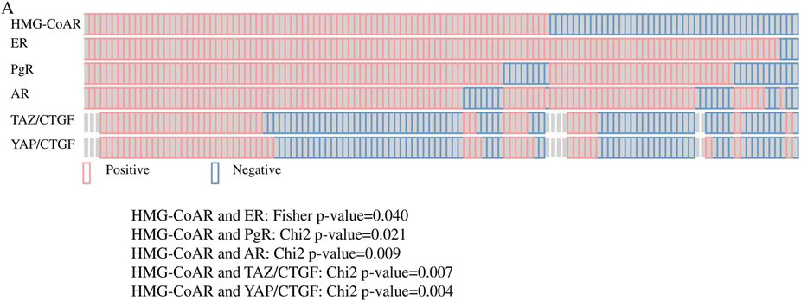
HMG-CoAR expression in male breast cancer (metabolic control of YAP/TAZ)
in subgroup analysis HMG-CoAR positivity was a protective factor in patients whose tumors harbored the TAZ/CTGF and YAP/CTGF phenotypes
Di Benedetto A et al, Sci Rep 2016

Slide 22
while the co-expression of TAZ/YAP and CTGF is associated with unfavorable survival outcomes, HMG-CoAR seems a protective determinant in the TAZ/CTGF- and YAP/CTGF-positive backgrounds.
in the subset of MBC with active TAZ/YAP-driven transcription, HMG-CoAR expression may delineate a further fraction of tumors at a prevalent endocrine-metabolic asset, and be possibly endowed with less aggressive molecular traits.
A link between metabolic cues, endocrine stimuli and stem cell pathways.

Slide 23
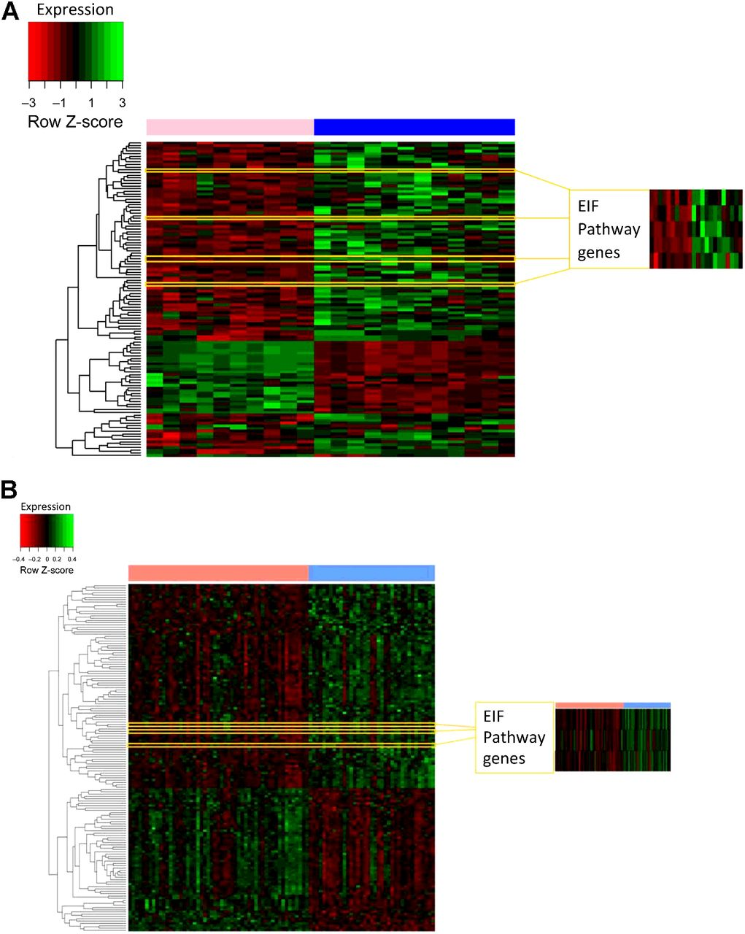
Identification of eIF (Eukaryotic Initiation Factor) pathway upregulation in MBC
(Function: enhanced translational efficiency, splicing, mRNA stability, RNA nuclear export)
Matthew P. Humphries et al. Clin Cancer Res
Notes:
Identification of eIF pathway upregulation in MBC by hierarchical clustering and validation in an external dataset. A, Heatmap showing gender-specific hierarchical clustering of differentially expressed genes in female (pink) and male (blue) breast cancers with exploded view of eIF genes, which were significantly overexpressed in MBC on the right (P < 0.0001; eIF pathway genes and P = 0.016; FDR). B, Hierarchical clustering of a reanalysis of the Callari et al. dataset (10) similarly identified members of the eIF family were overexpressed in MBC as shown in the exploded view on the right. Green, overexpression; red, underexpression.

Slide 24
Conclusion Remarks
MBC is mostly a HR-driven disease
AR is even more expressed than in FBC, raising therapeutic opportunities
HER2 less frequently overex/amp than in FBC
Some similarities, but also differences, with HR+ FBC
Mutations in DNA damage repair pathway components
Plausible deregulation of Hippo and EIF pathways
“Truly” comprehensive molecular characterization studies are still lacking

Slide 25
Not just for women.
Speirs V., Nature 2012

Slide 26
Chi Lin Nunnery temple
Hong Kong

