Slide 1
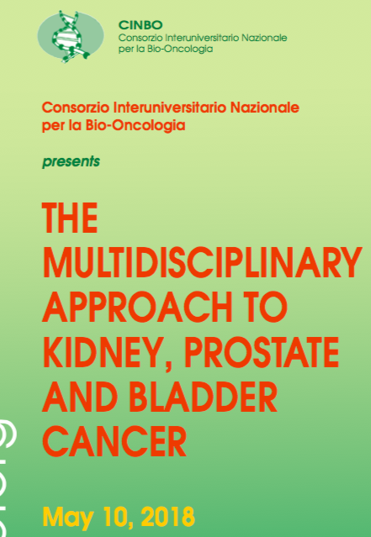
Germline mutations in prostate cancer: impact on clinical practice
.Liborio Stuppia, Medical Genetics
G. d’Annunzio University Chieti-Pescara, Italy

Slide 2
Conflict of Interest Disclosure Form
Note: A potential or actual conflict of interest exists when commitments and obligations are likely to be compromised by the nominator(s)’other material interests, or relationships (especially economic), particularly if those interests or commitments are not disclosed.
This Conflict of Interest Form should indicate whether the nominator(s) has an economic interest in, or acts as an officer or a director of, any outside entity whose financial interests would reasonably appear to be affected by the addition of the nominated condition to the newborn screening panel. The nominator(s) should also disclose any personal, business, or volunteer affiliations that may give rise to a real or apparent conflict of interest. Relevant Federally and organizationally established regulations and guidelines in financial conflicts must be abided by. Individuals with a conflict of interest should refrain from nominating a condition for screening
10/5/2018
Name: Liborio Stuppia
Position: Speaker
Please describe below any relationships, transactions, positions you hold (volunteer or otherwise), or circumstances that you believe could contribute to a conflict of interest:
_ _ I have no conflict of interest to report.
_ I have the following conflict of interest to report (please specify other nonprofit and for-profit boards you (and your spouse) sit on, any for-profit businesses for which you or an immediate family member are an officer or director, or a majority shareholder, and the name of your employer and any businesses you or a family member own:
1.
2.
3. I hereby certify that the information set forth above is true and complete to the best of my knowledge.
Signature: Date:
___
X
____

Slide 10
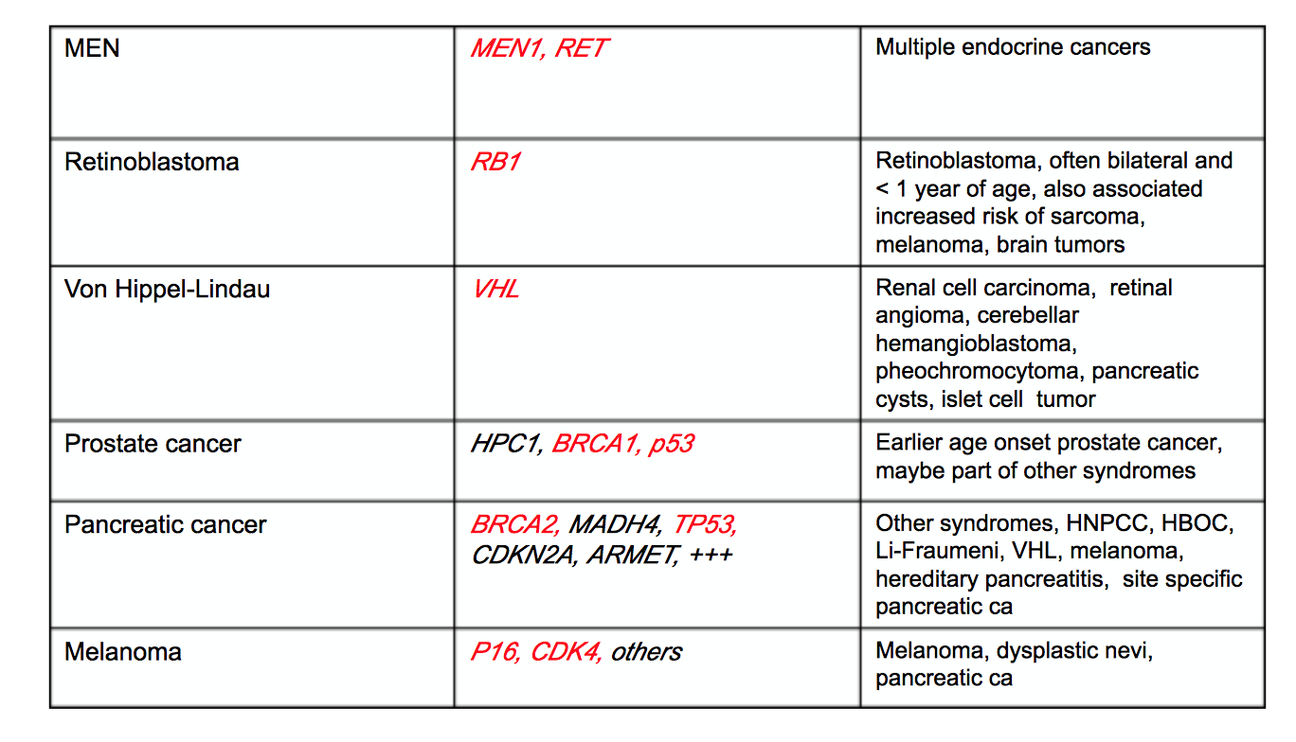

Slide 11
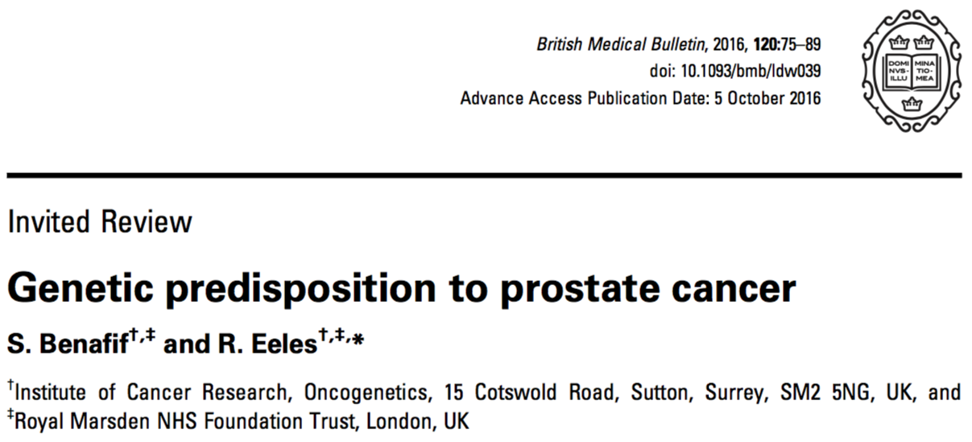
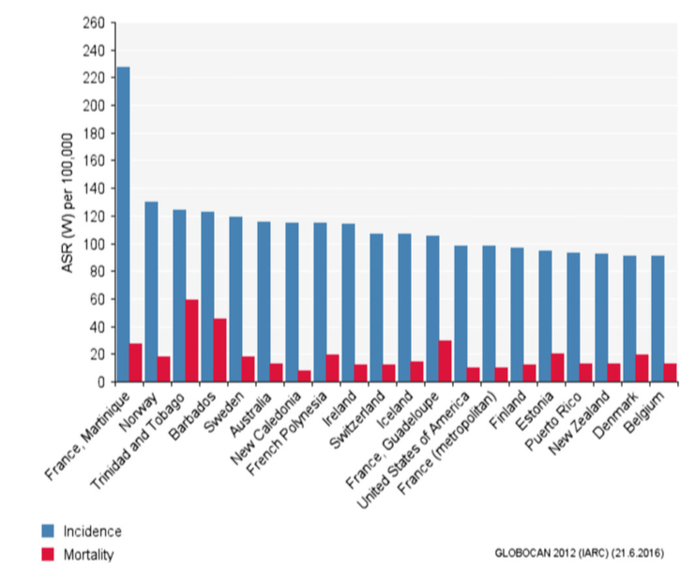
Common single-nucleotide polypmorphisms (SNPs), which confer a cumulative risk of PrCa development with increasing number of risk alleles.
Rare moderate–high-risk gene loci, which predispose to PrCa development when altered by mutation.
There are emerging data that castrate-resistant disease is associated with mutations in DNA repair genes.

Slide 12
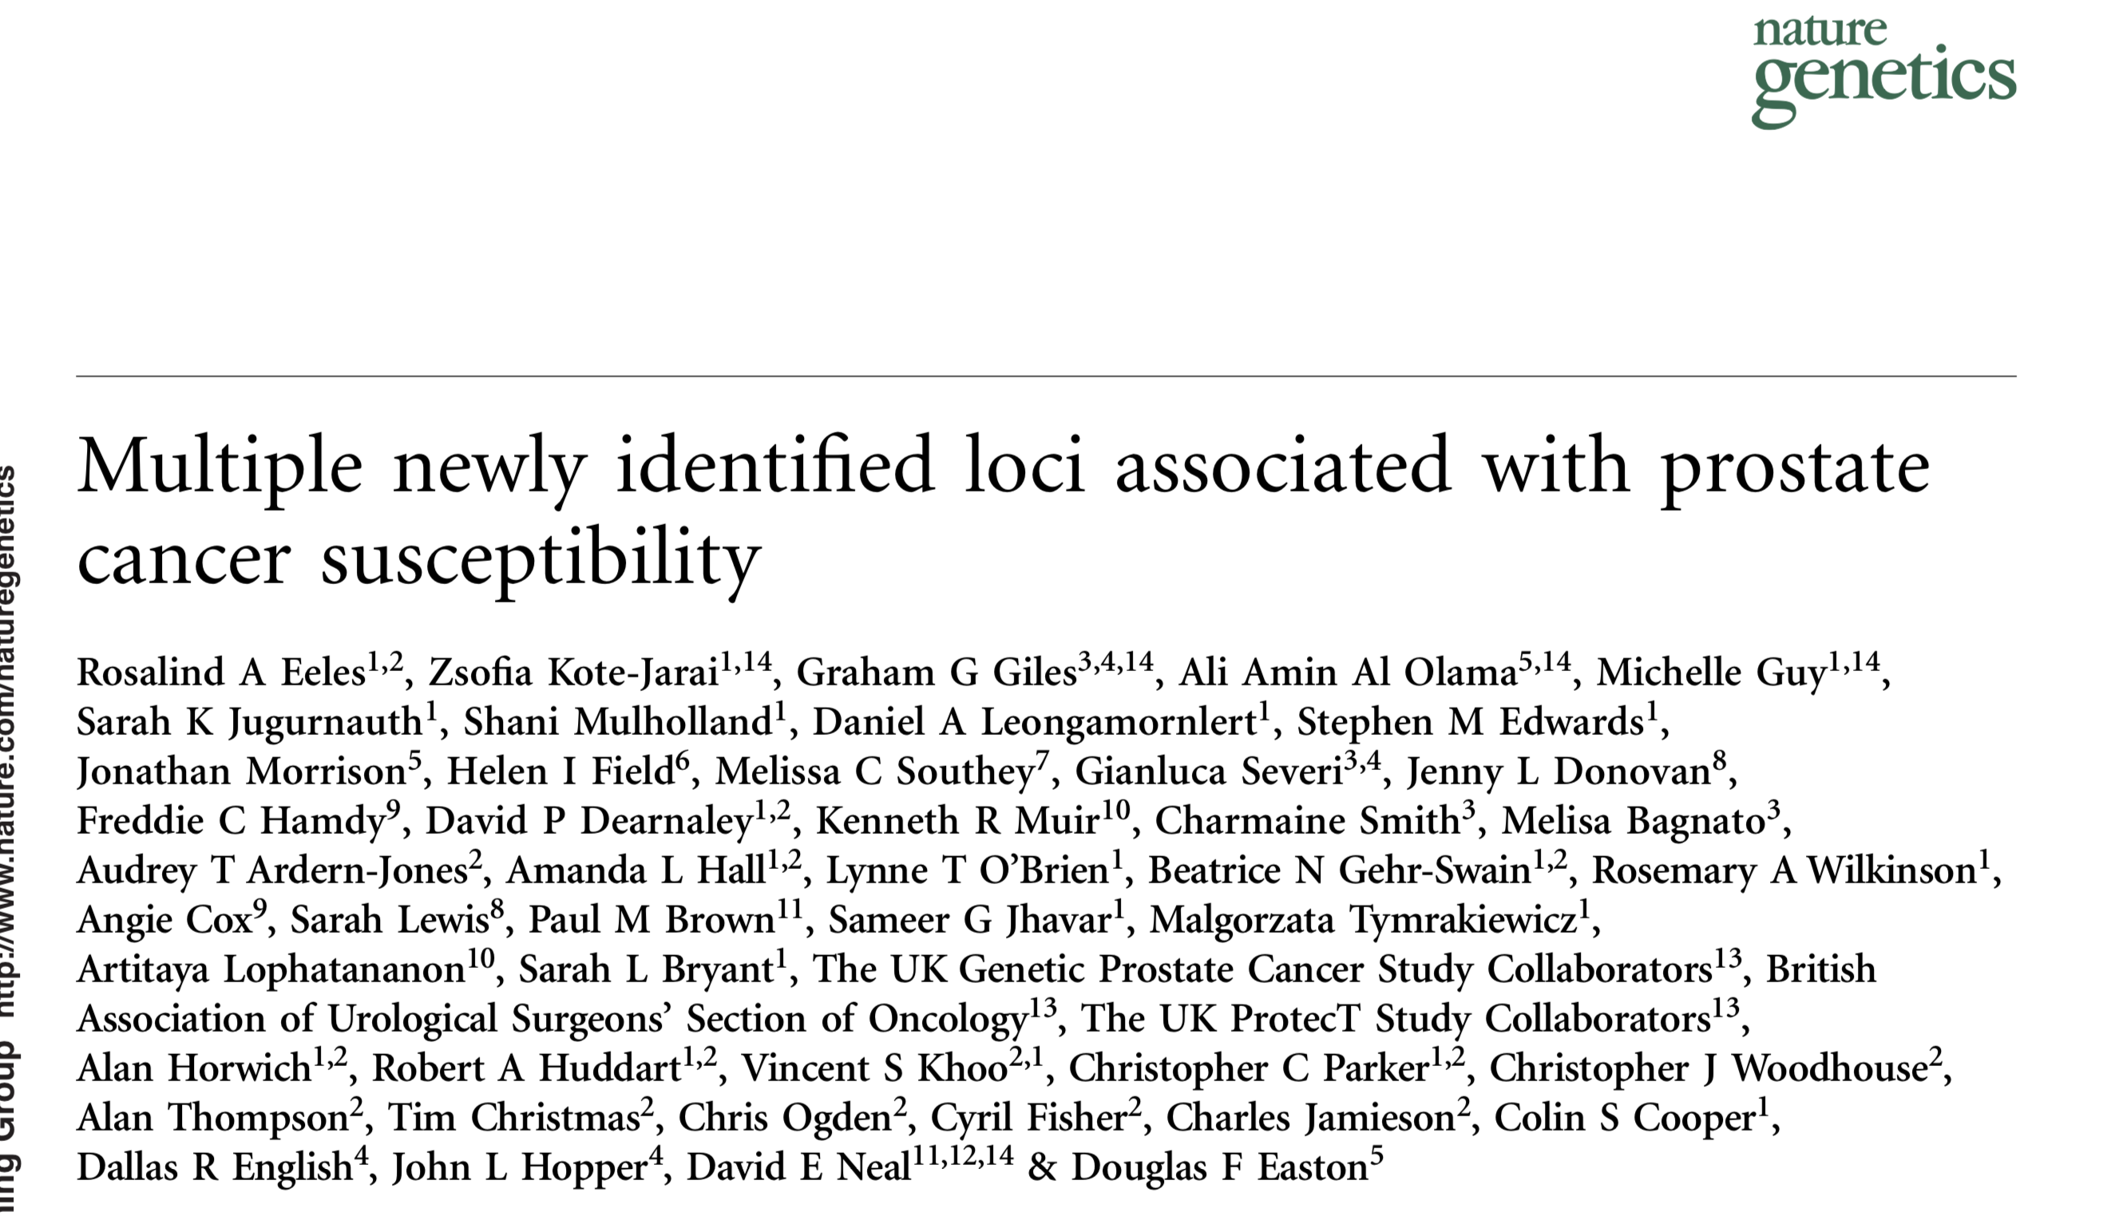
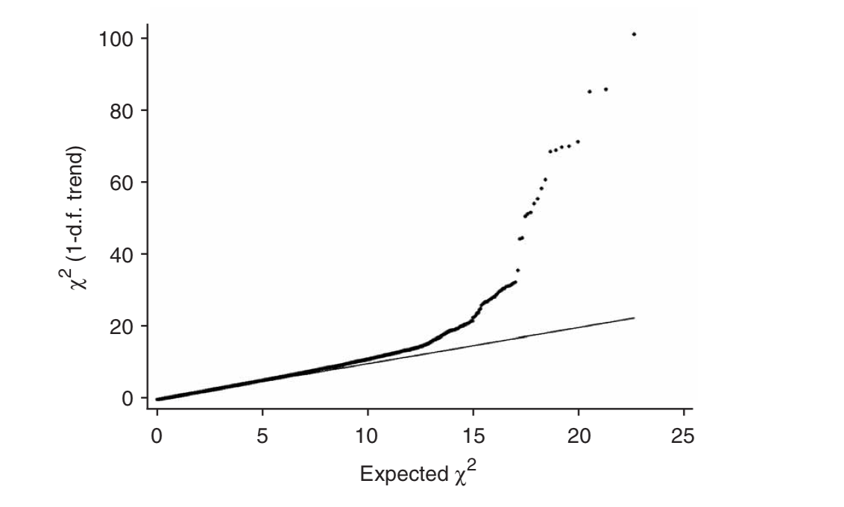
published online 10 February 2008
GWAS on 1,854 individuals with clinically detected prostate cancer diagnosed at <60 years or with a family history of disease, and 1,894 controls
Seven loci associated with prostate cancer on chromosomes 3, 6, 7, 10, 11, 19 and X

Slide 13
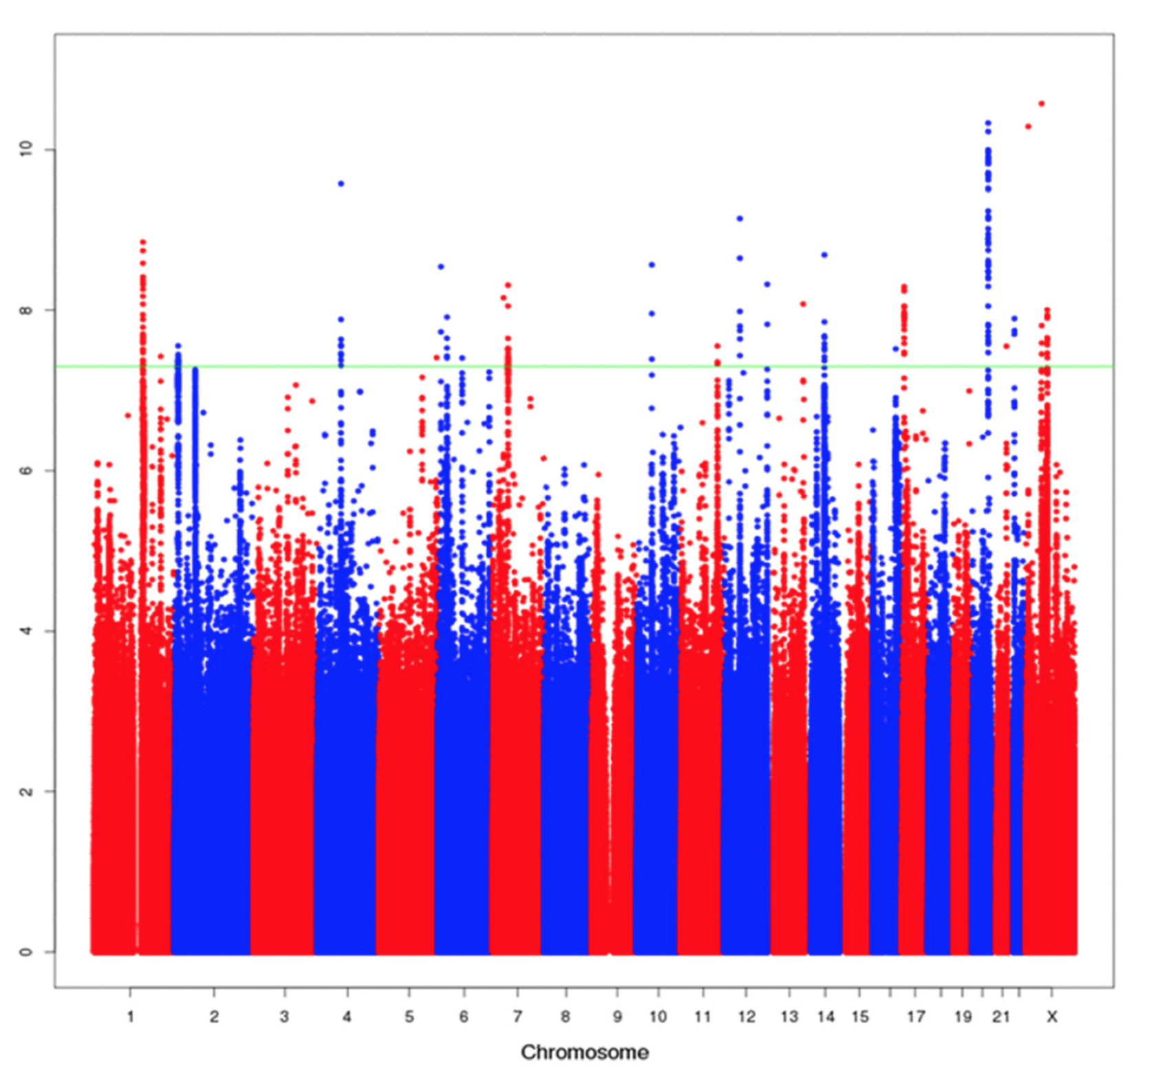
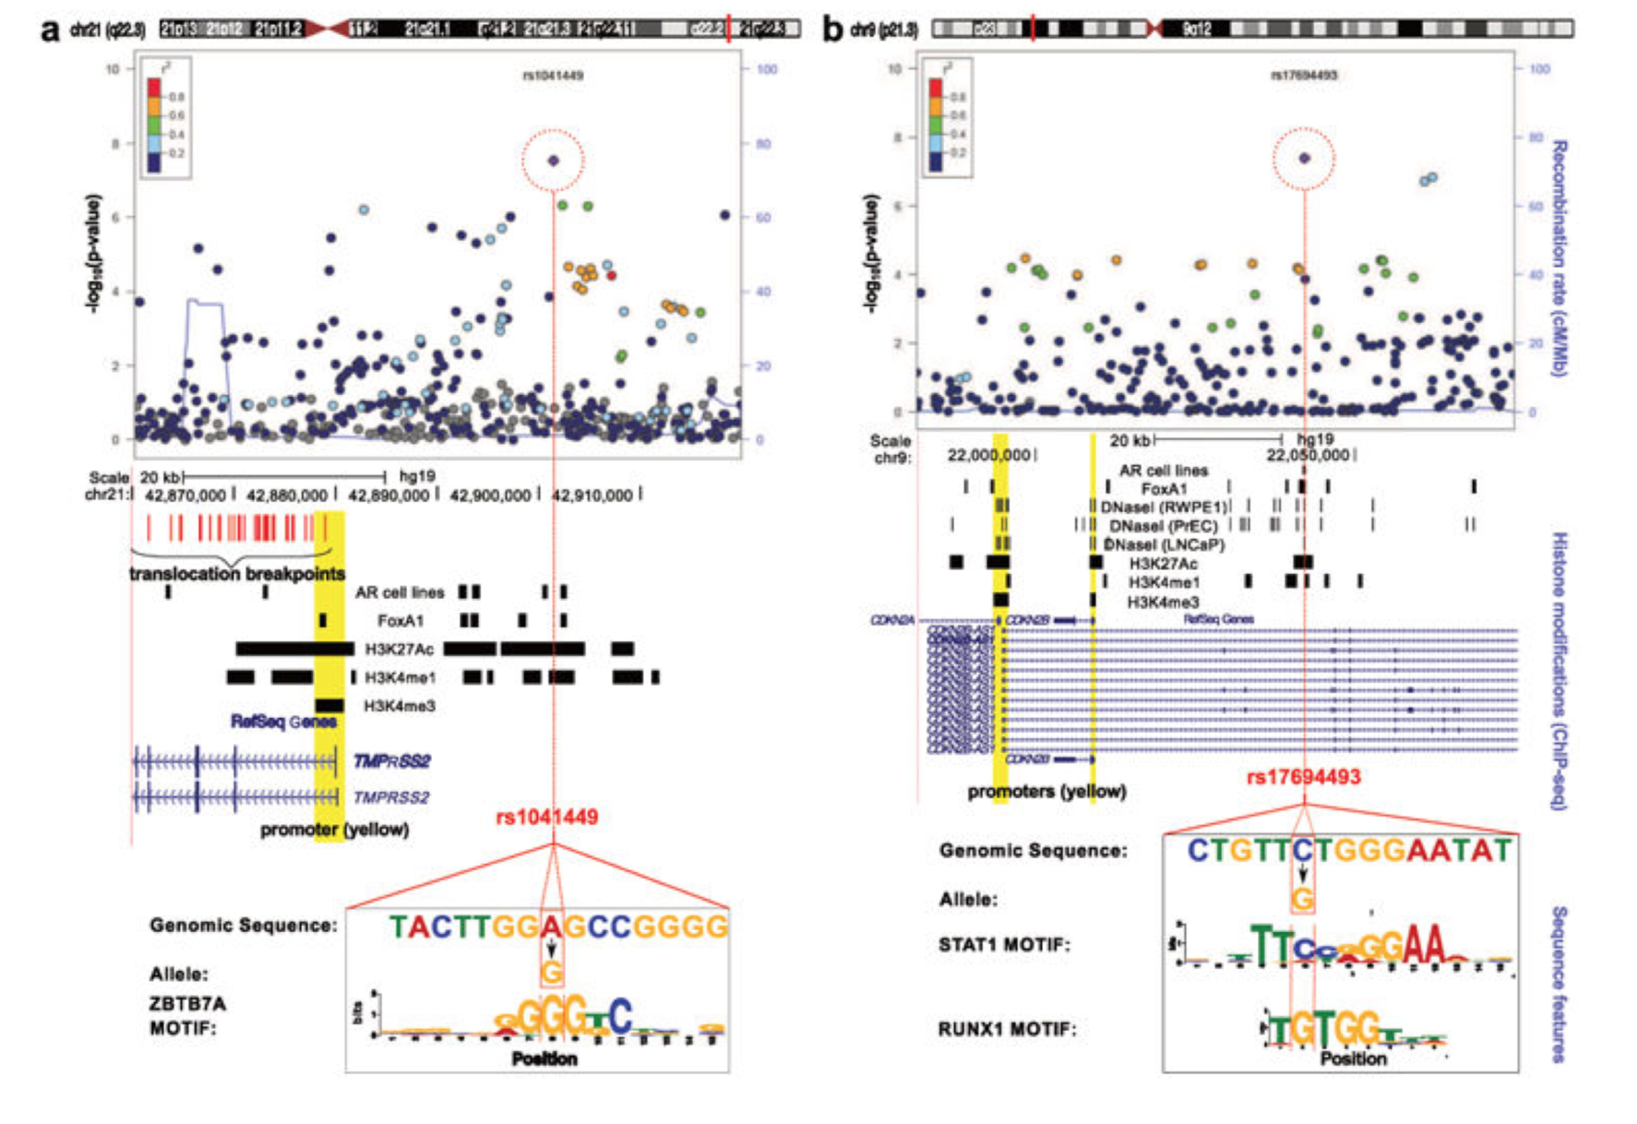

Slide 14
Vaidyanathan et al., 2017

Slide 15
Clinical applications of GWAS data
Screening using PSA-related SNPs
Screening using PrCa risk SNPs
Germline SNPs as predictive and prognostic biomarkers
Predicting aggressive disease
Predicting radiation toxicity
Benafif and Eales, 2016

Slide 18
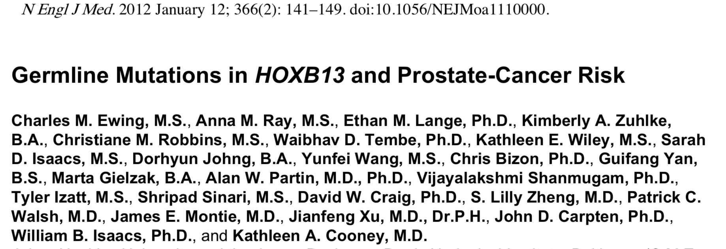
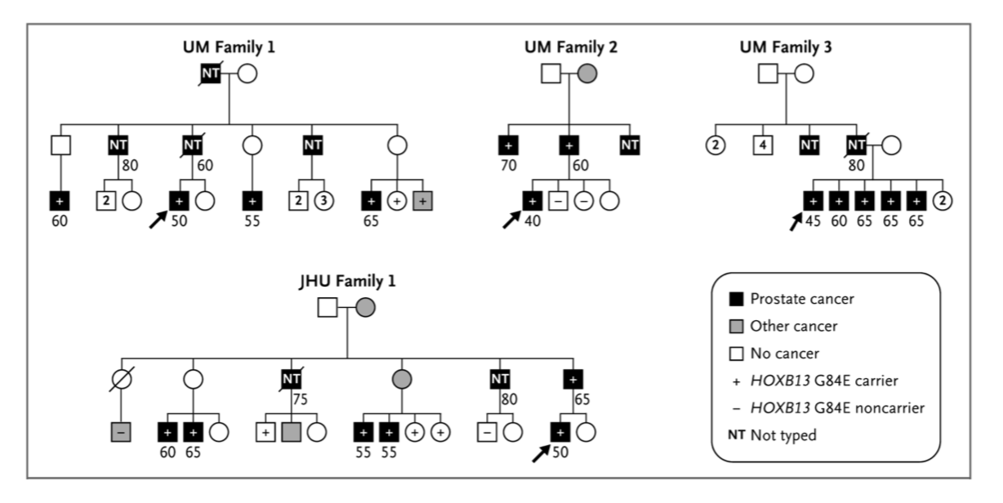
Eighteen probands from four families had a rare but recurrent mutation (G84E) in HOXB13, a homeobox transcription factor gene that is important in prostate development.
The same mutation was detected in 72/5083 (1,4%) unrelated prostate cancer patients carriers vs with 1 in 1401 control subjects (0.1%)
The mutation was significantly more common in men with early-onset, familial prostate cancer (3.1%) than in those with late-onset, nonfamilial prostate cancer (0.6%)

Slide 19
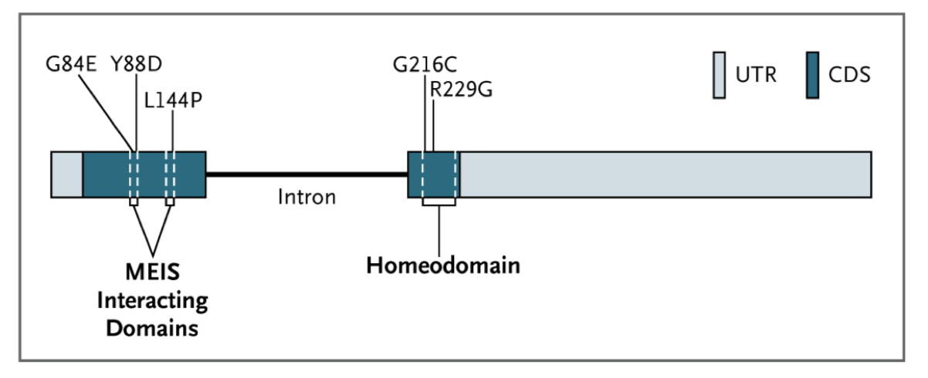
Ewing et al., 2012
Hong-Jian et al., 2013

Slide 20
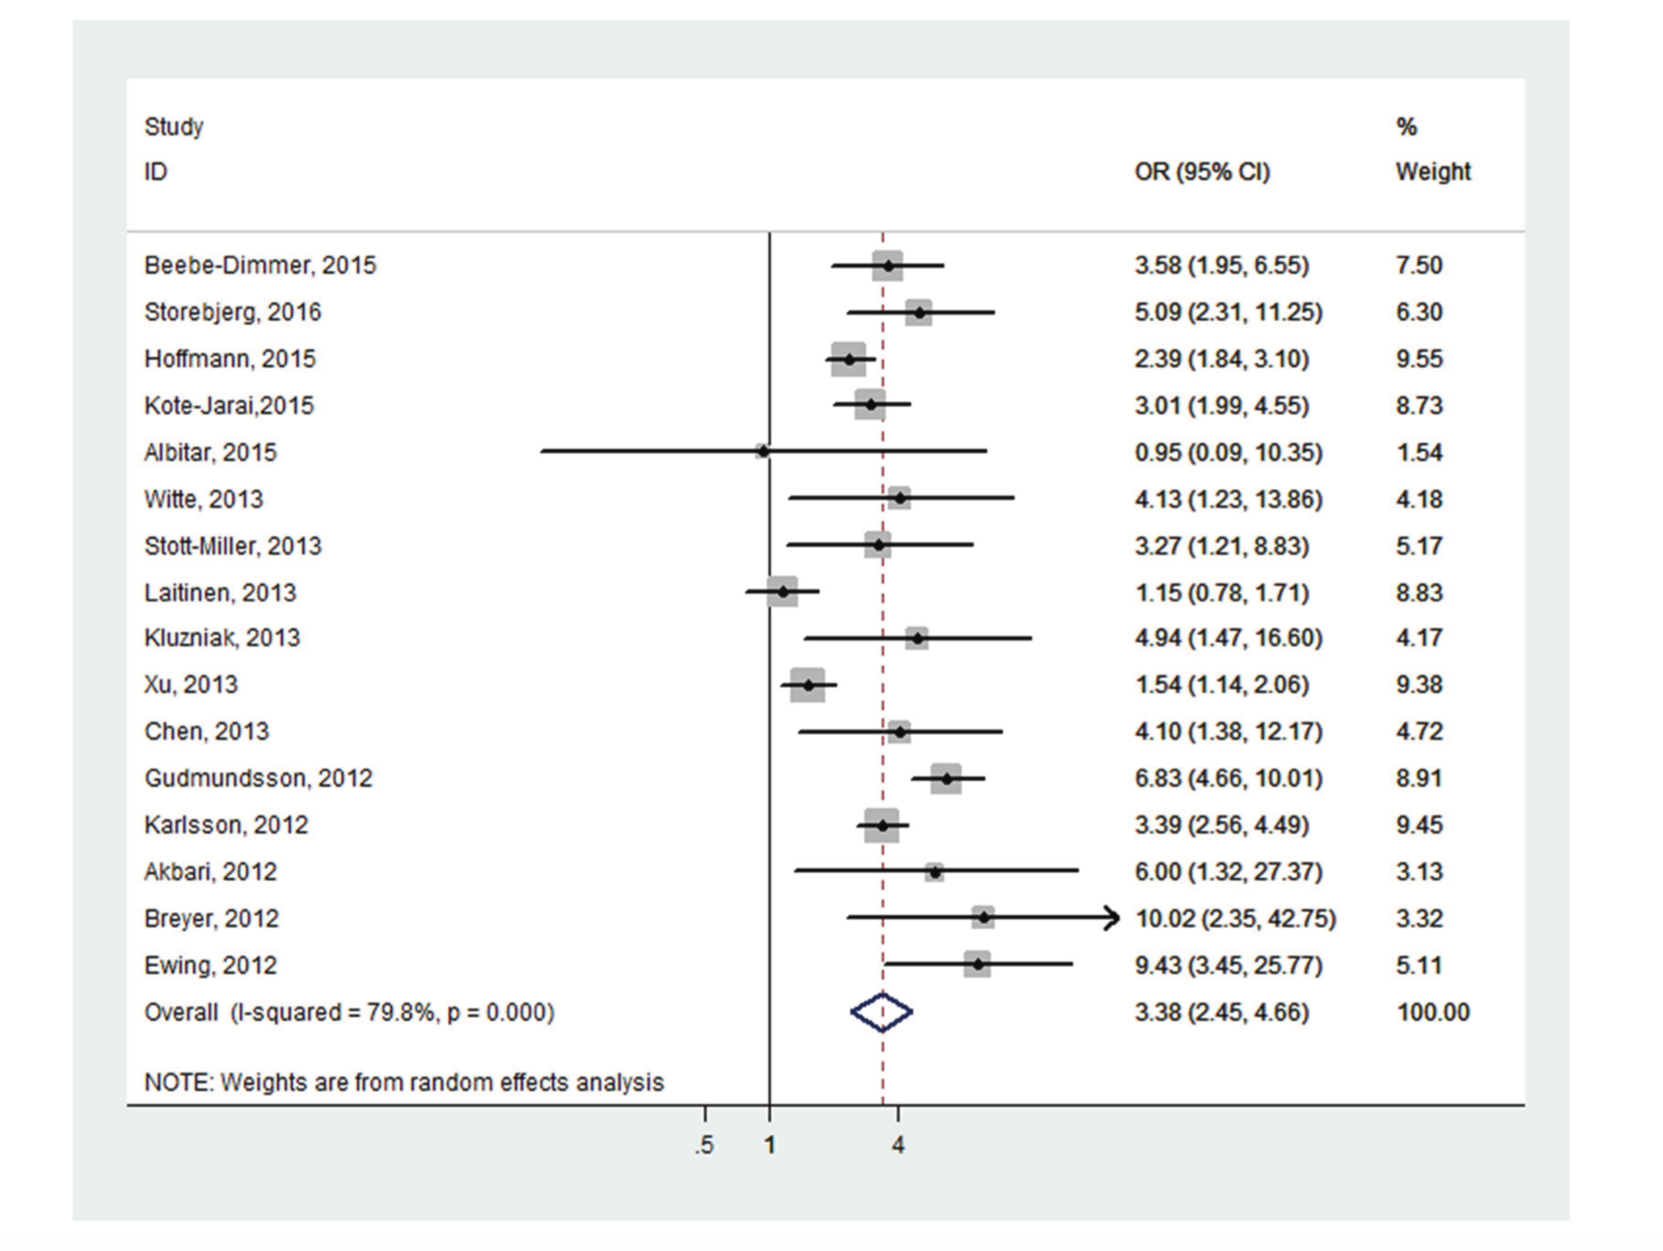
September 10, 2016
Significant increased PCa susceptibility was associated with HOXB13 G84E variant (OR = 3.38, 95% CI: 2.45–4.66), which is associated with:
early onset (OR = 2.90, 95% CI: 2.24–3.75);
affected relatives (OR = 2.60, 95% CI 2.19–3.10)
highly aggressive disease (OR = 2.38, 95% CI 1.84–3.08).

Slide 21
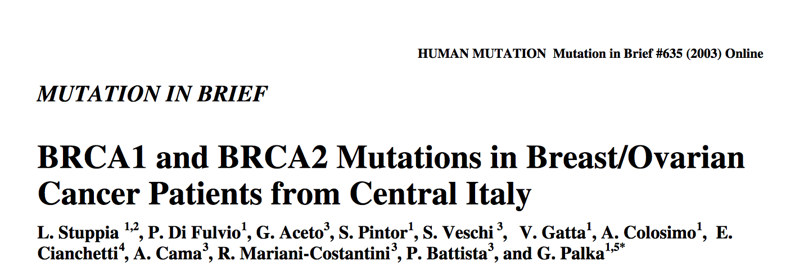
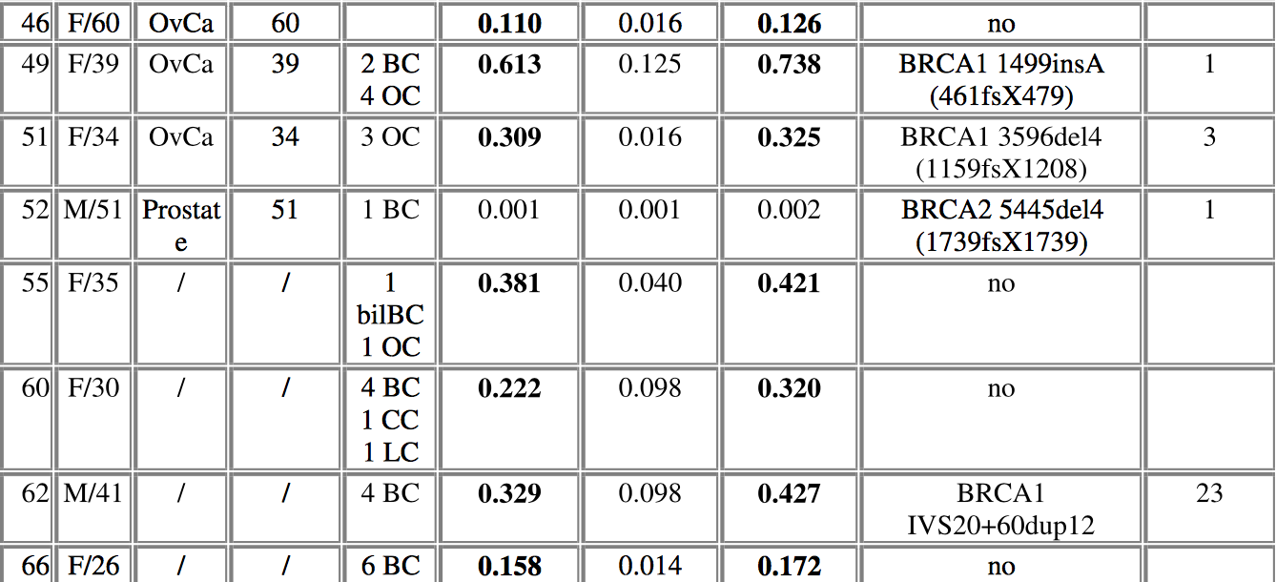
Interestingly, one BRCA2 mutation (5445del4) was detected in a patient with prostate cancer. Interestingly, an increased risk of prostate cancer in male carriers of BRCA2 mutations belonging
to families with multiple cases of BC, have been previously suggested (Bratt et al., 2000; Osorio et al., 2000).

Slide 22
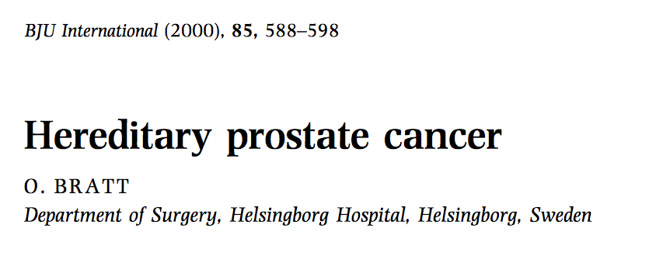
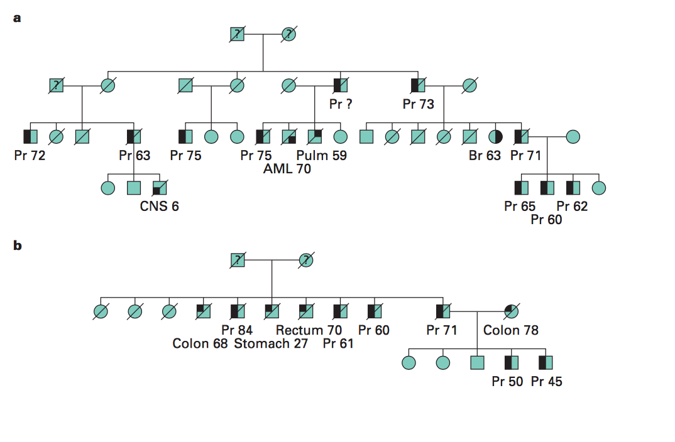
Apart from families with multiple cases of breast
cancer, germ-line mutations in BRCA1 and BRCA2 are
not likely to be of signifcant importance as causes of
prostate cancer

Slide 23
266 subjects from 194 HPC families participating in the Seattle-based Prostate Cancer Genetic Research Study screened for BRCA2 mutations
No evidence was found in this study for an association between BRCA2 mutations and susceptibility to HPC in men selected from high-risk families.

Slide 24
Germline mutations in the BRCA2 gene confer an 8.6-fold increased risk of PrCa by age 65, corresponding to an absolute risk of 15% by age 65.
These results suggest that routine testing of early onset PrCa cases for germline BRCA2 mutations will further help to refine the prevalence and risk associated with BRCA2 mutations and may be useful for guiding management options.
1864 men with PrCa aged between 36 and 88

Slide 26
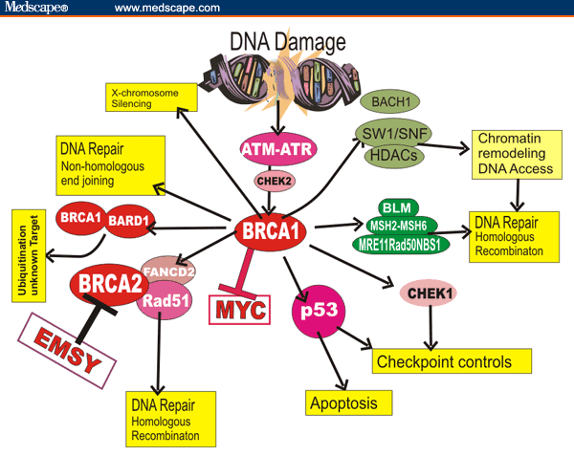

Slide 28
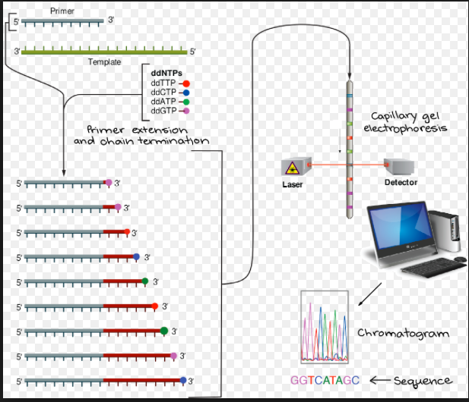

Slide 29
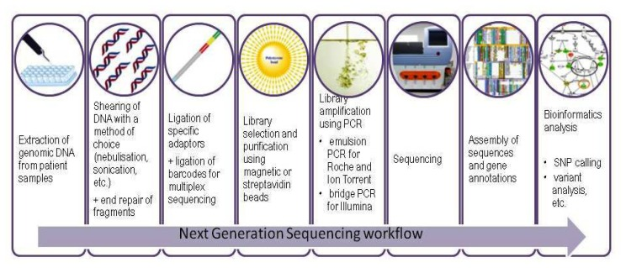
From Sanger to NGS Sequencing: Breast/ovarian cancer panels

Slide 31
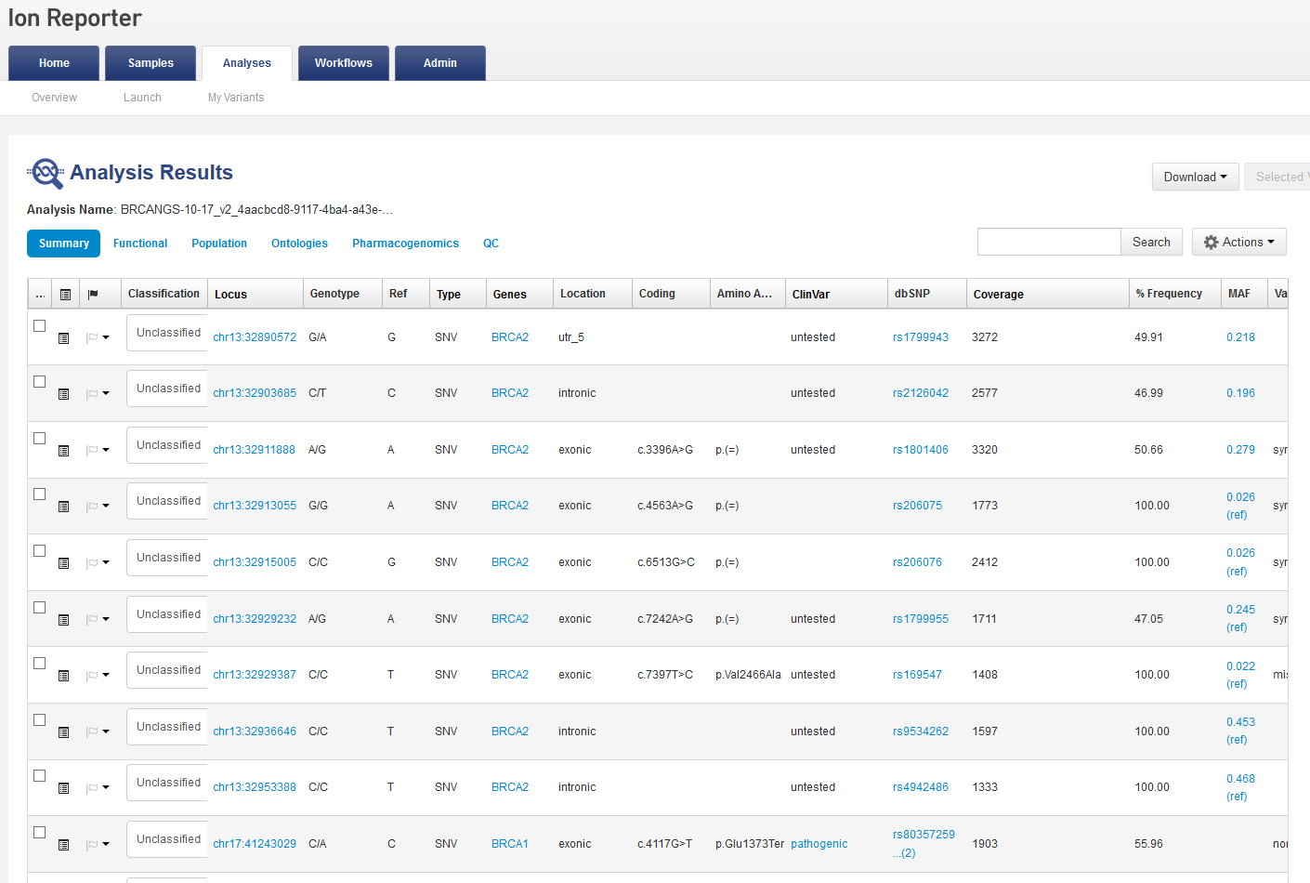
BRCA1 c.4117 G>T p.Glu1373Ter rs80357259

Slide 32
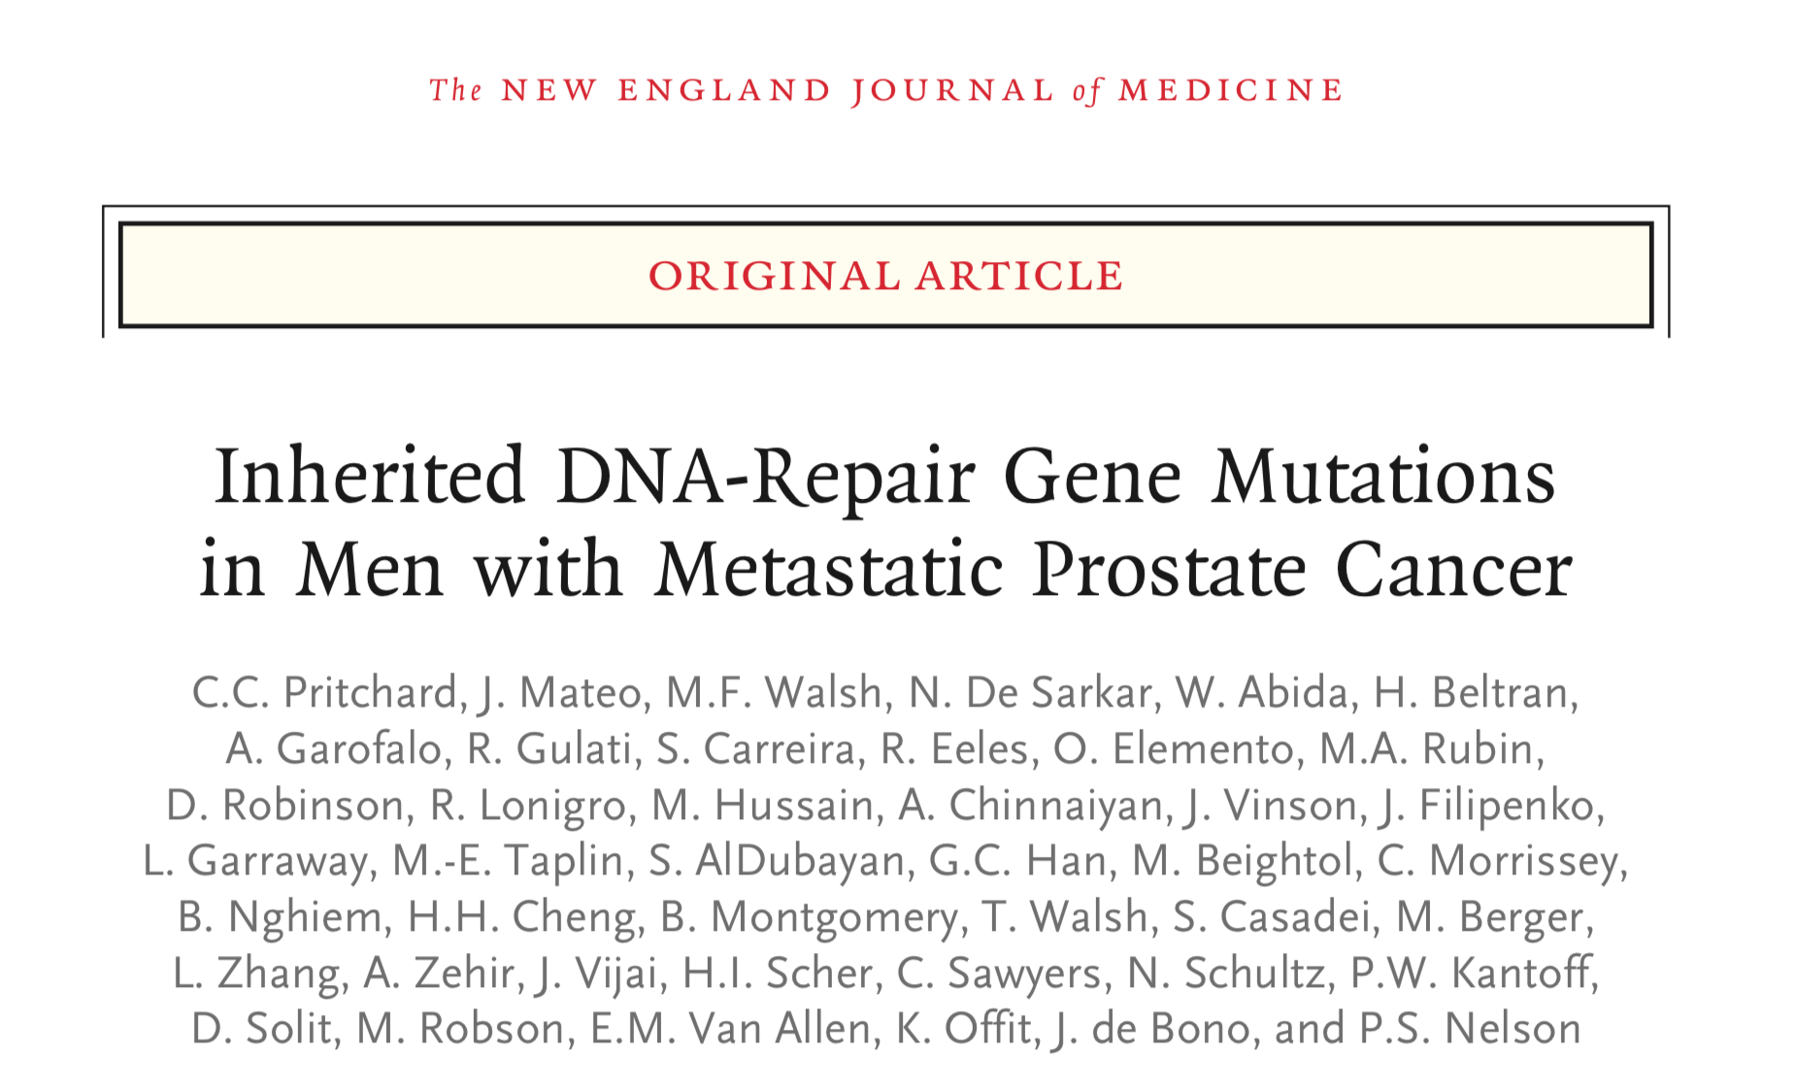
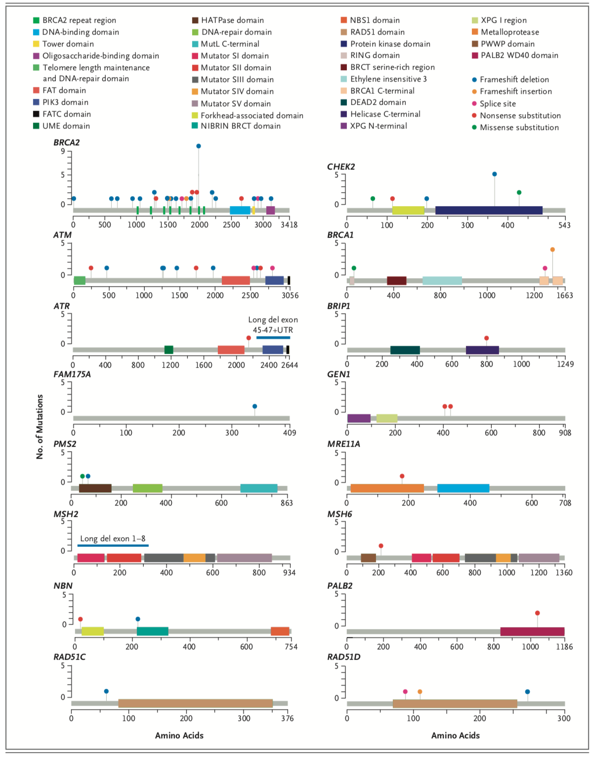
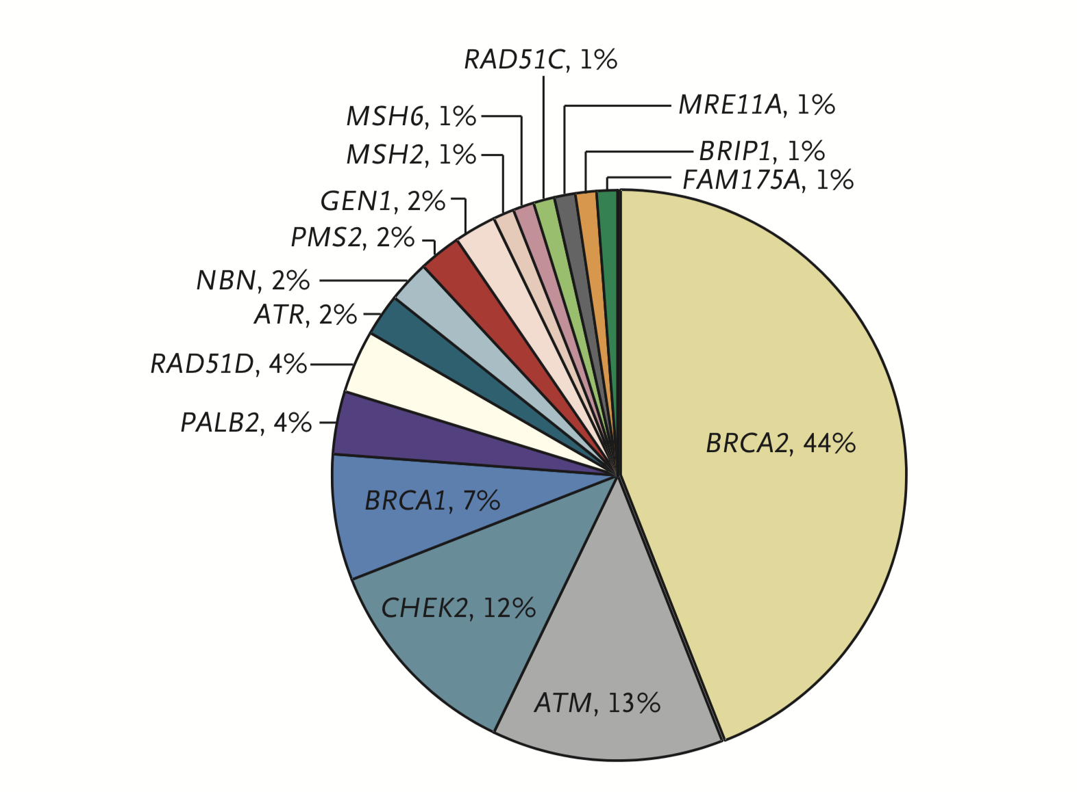
n engl j med 375;5 nejm.org August 4, 2016
The incidence of germline mutations in genes mediating DNA-repair processes in men with metastatic prostate cancer was 11.8%, significantly higher than the incidence among men with localized prostate cancer.

Slide 33
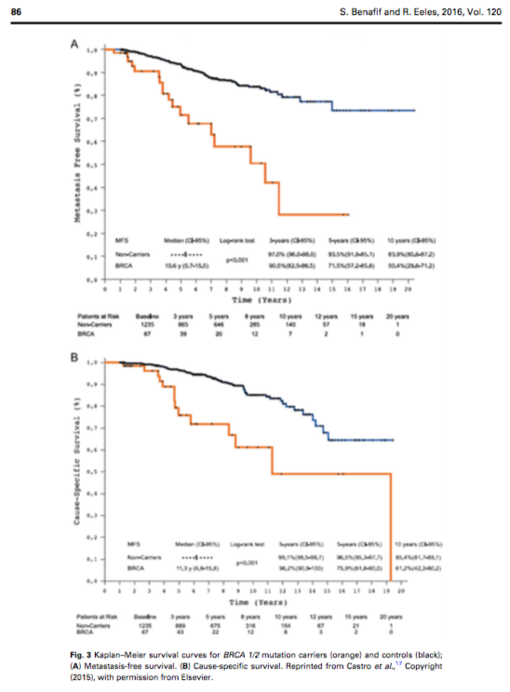
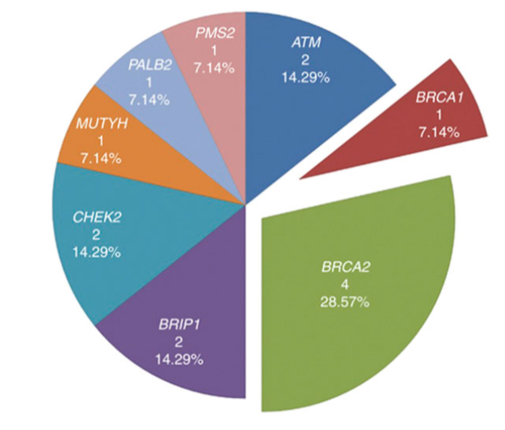
Benafif and Eeles, 2016

Slide 34
Poly(ADP-ribose) polymerases

Slide 35
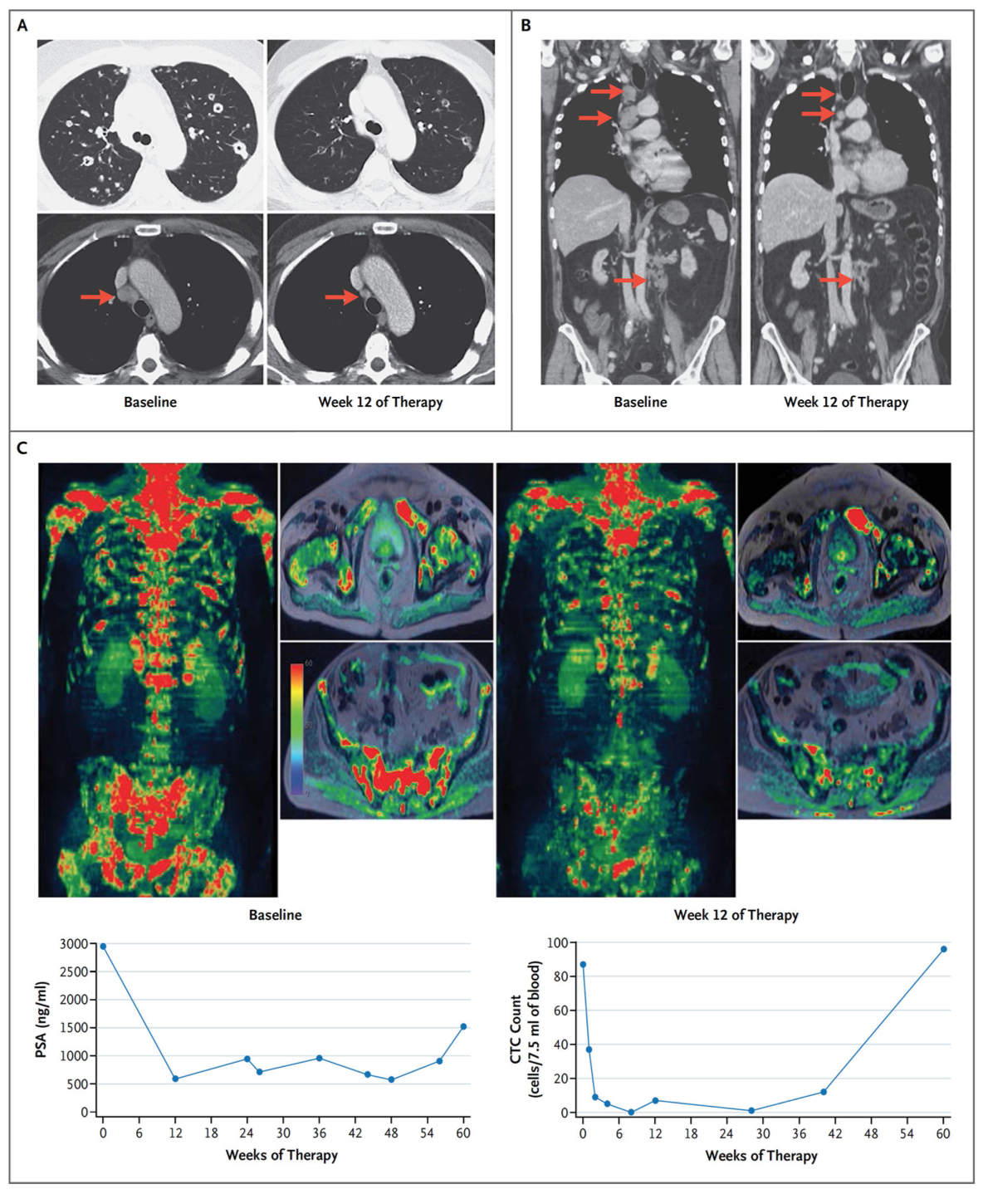
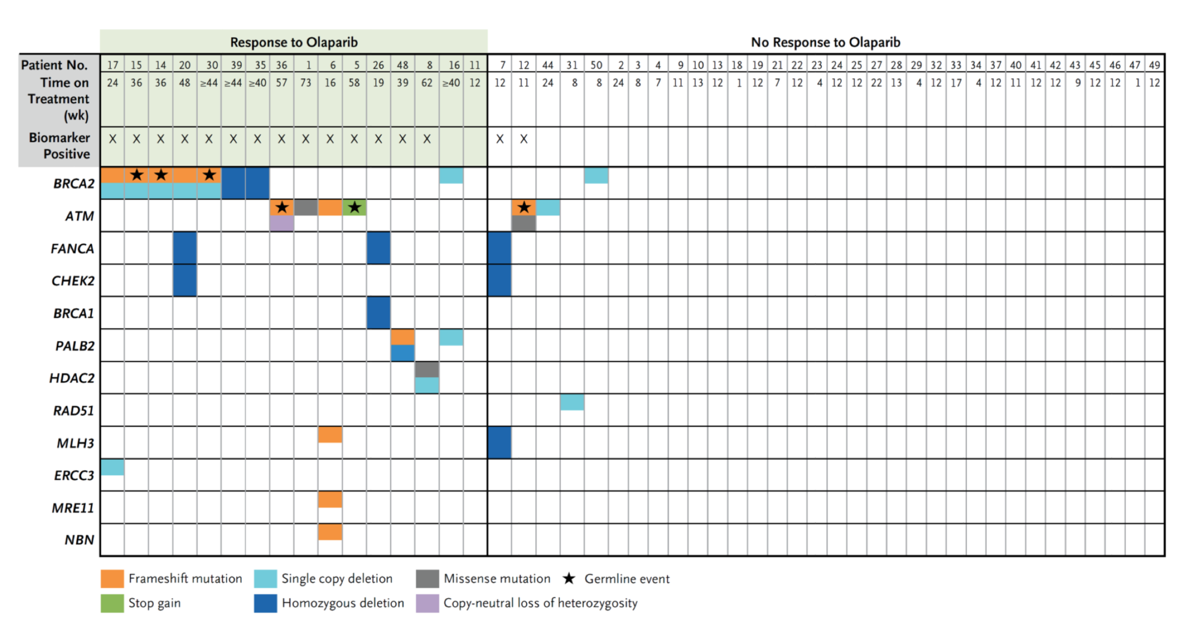
Treatment with the PARP inhibitor olaparib in patients no longer responding to standard treatments and with defects in DNA-repair genes led to a high response rate.

Slide 36
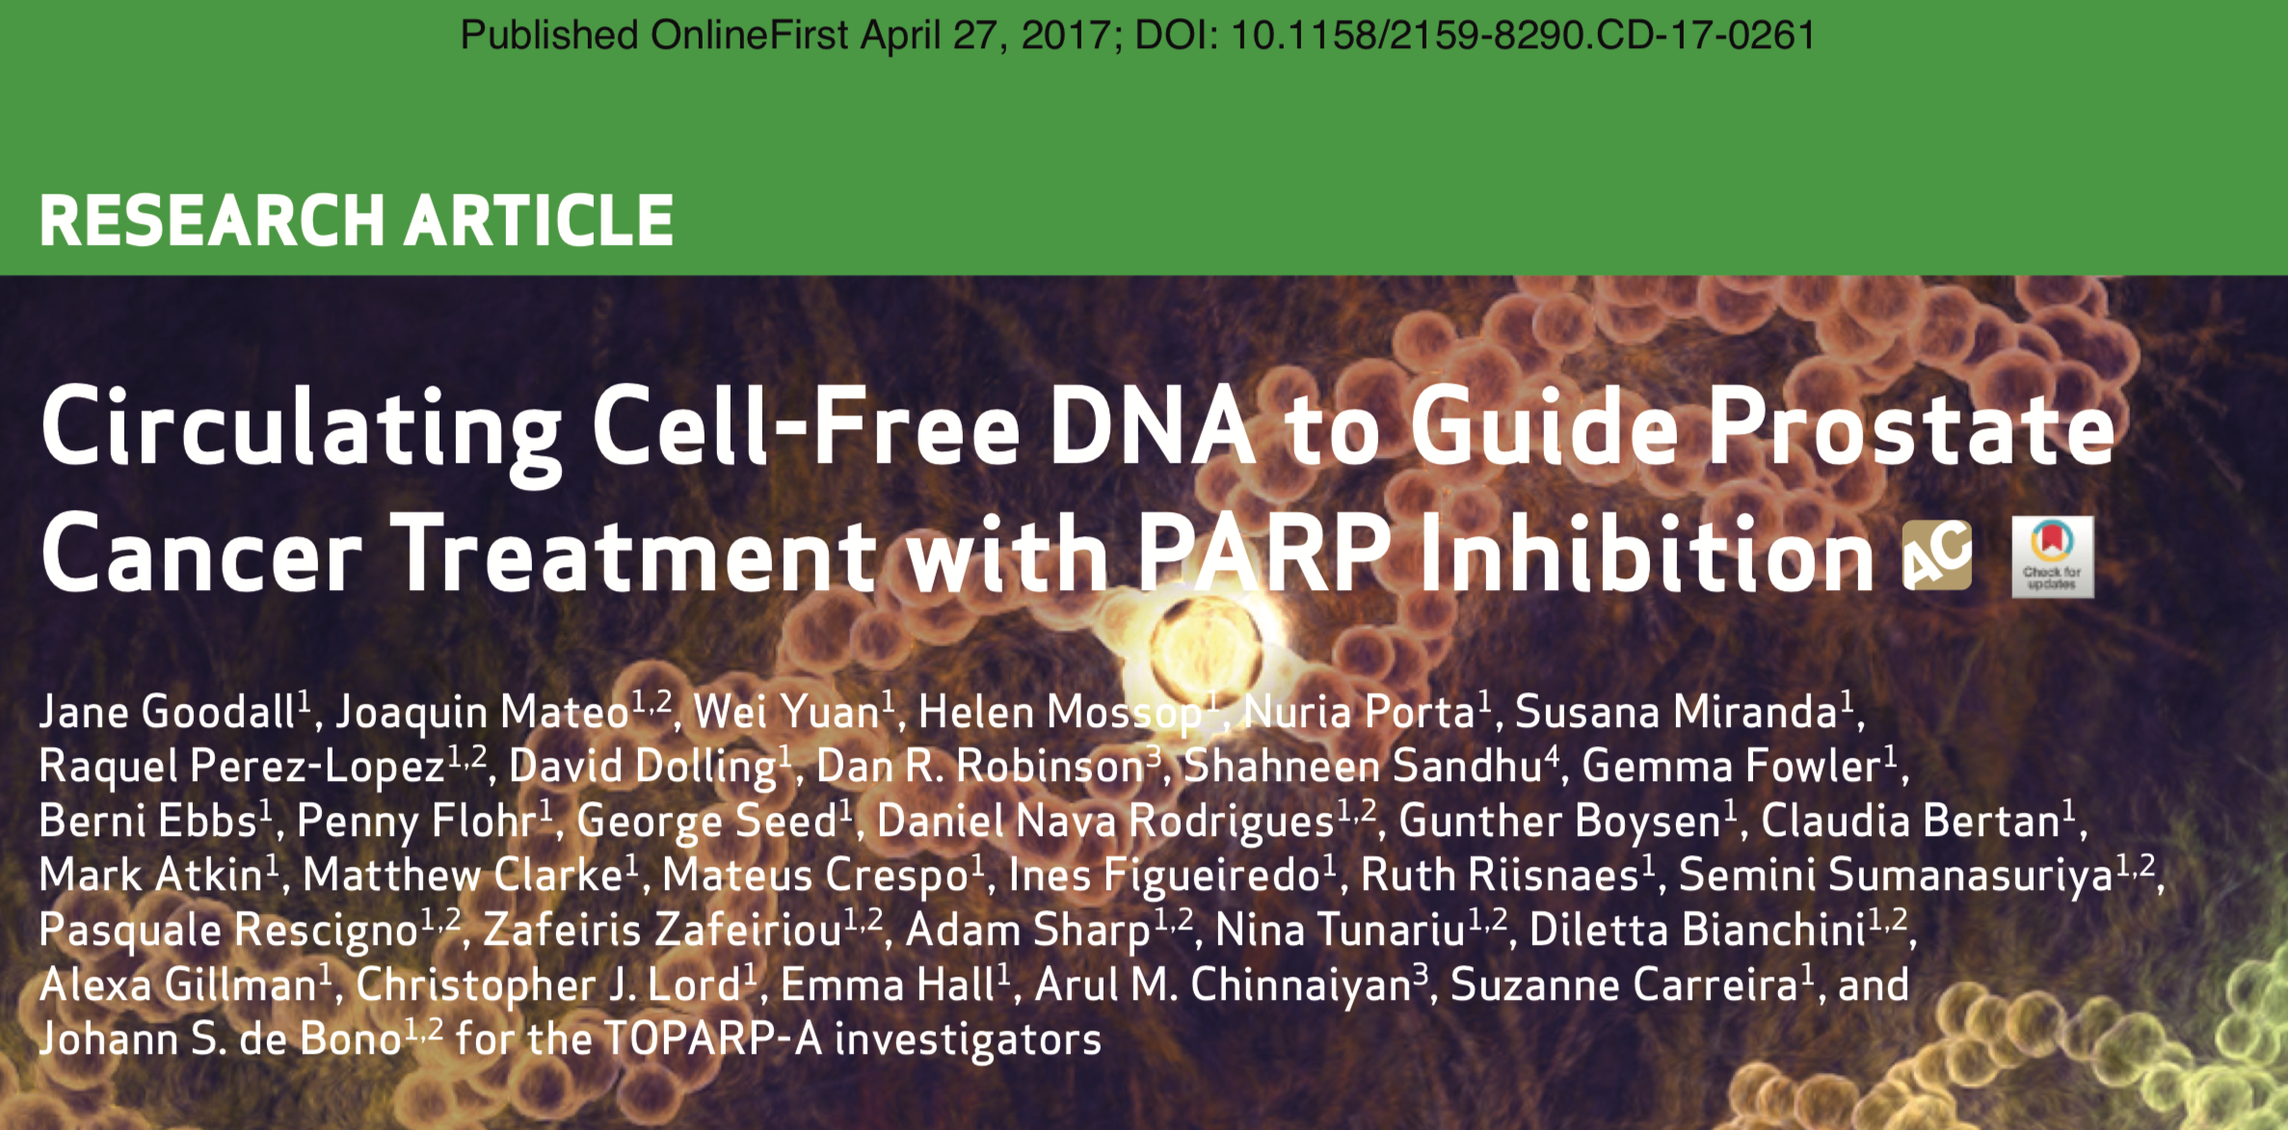
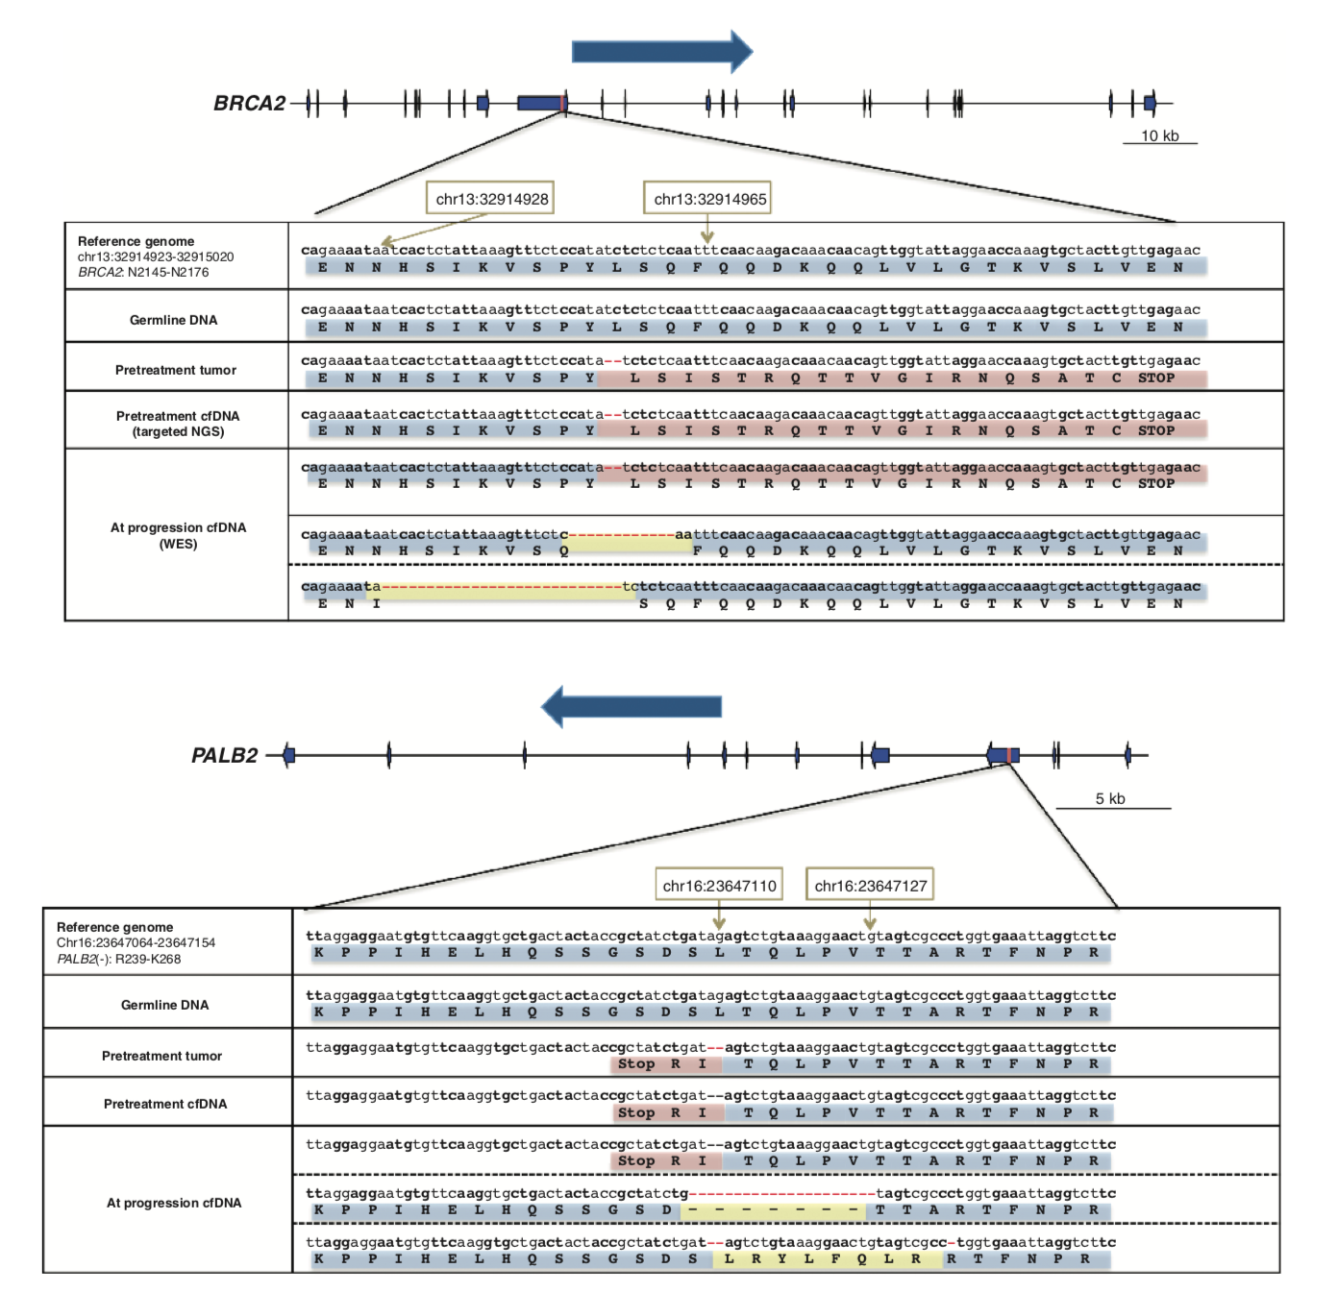
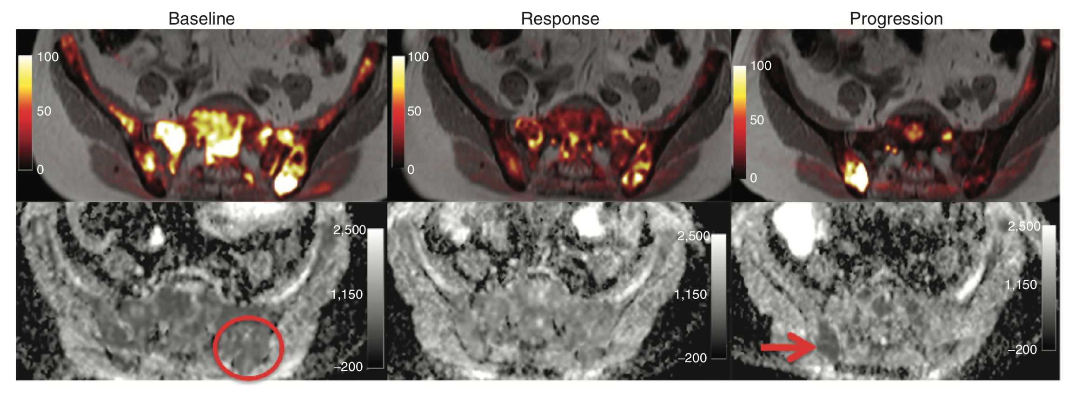
All tumor tissue somatic DNA mutations were detectable in cfDNA;
Allele frequency of somatic mutations decreased selectively in responding patients
At disease progression, following response to olaparib, multiple subclonal aberrations reverting germline and somatic DNA repair mutations (BRCA2, PALB2) back in frame emerged as mechanisms of resistance.

Slide 38
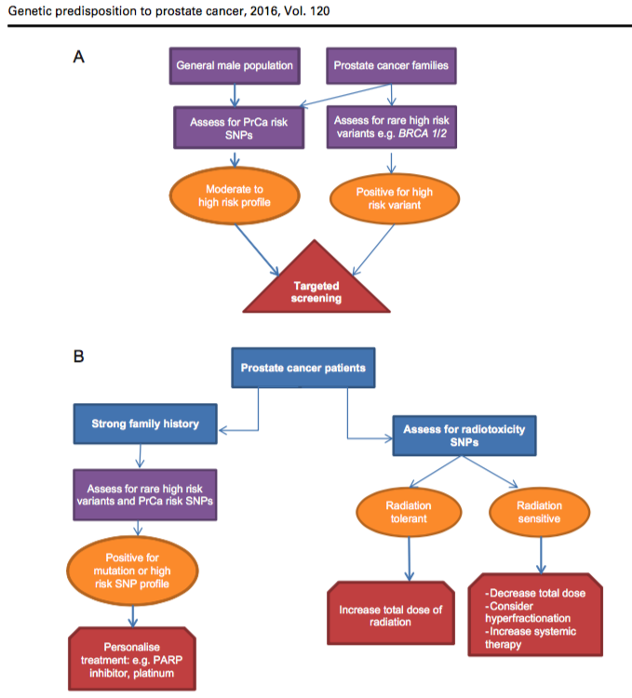
Benafif and Eales, 2016

Slide 39
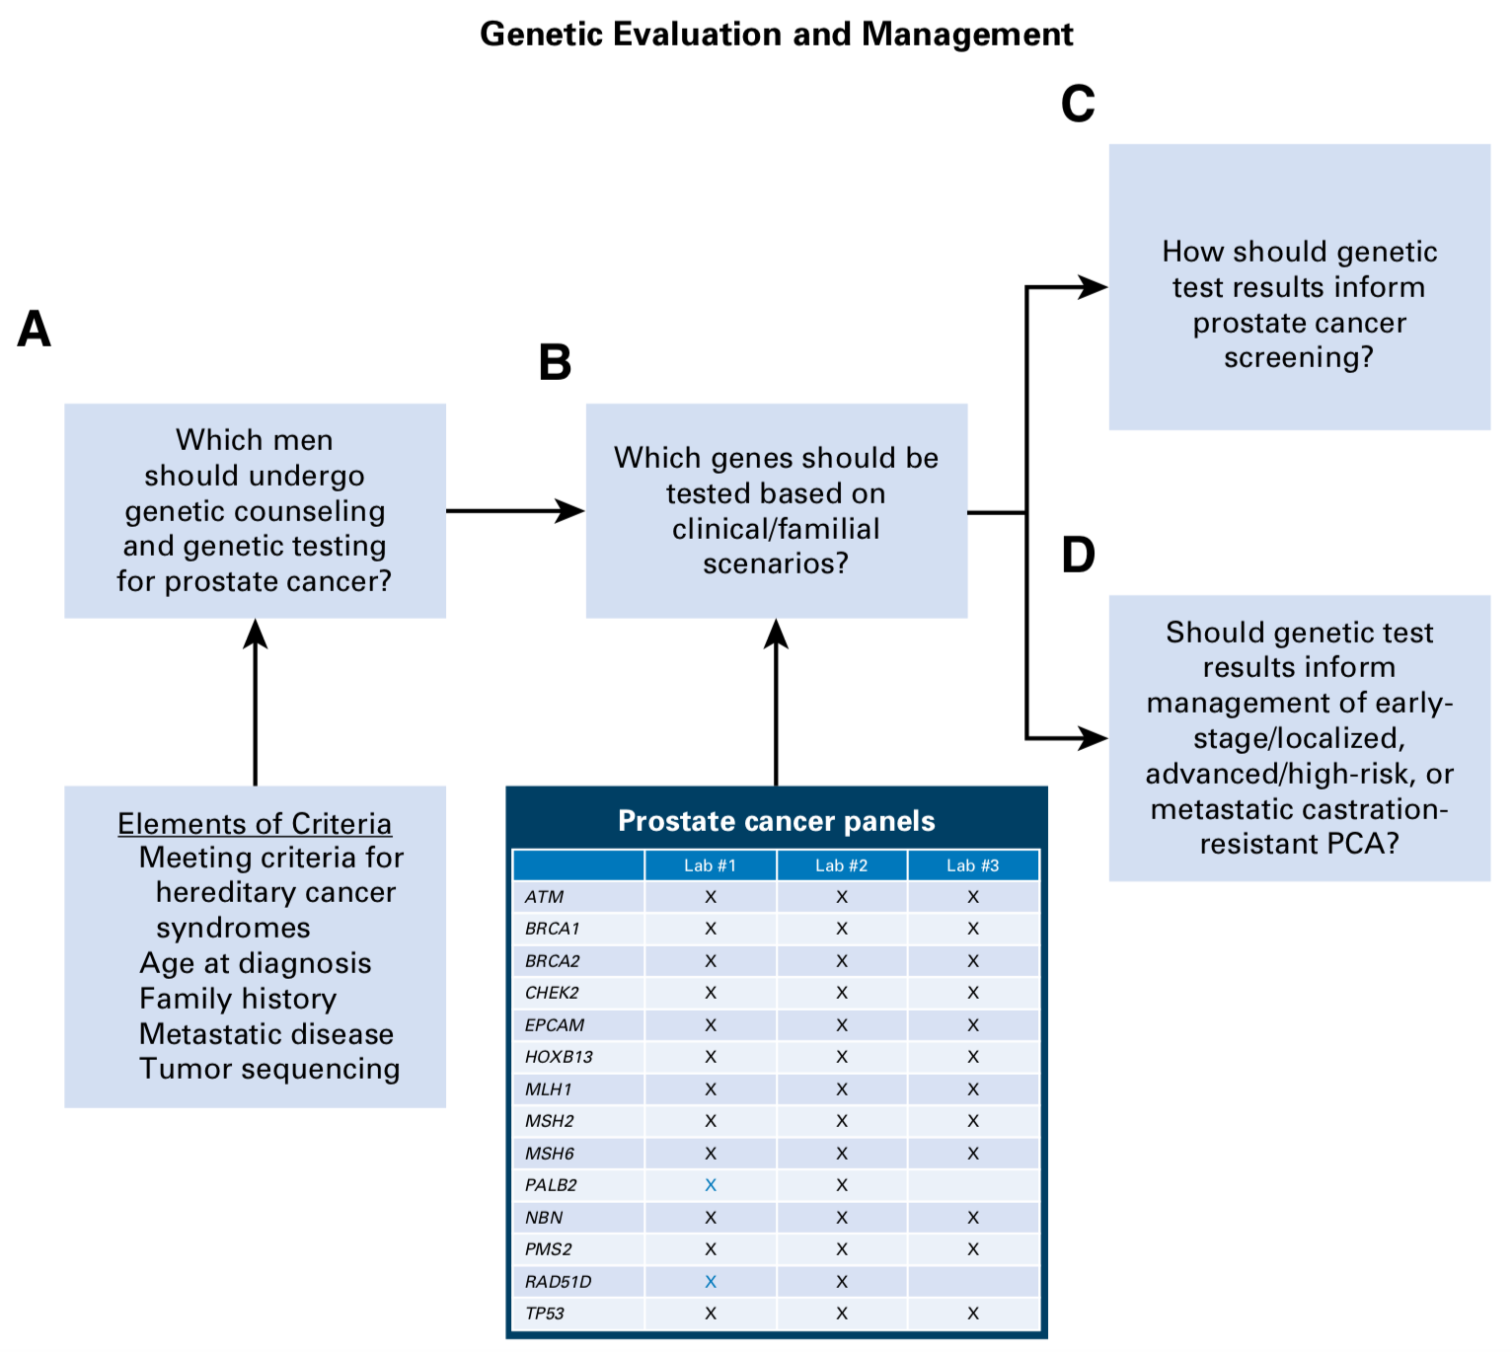
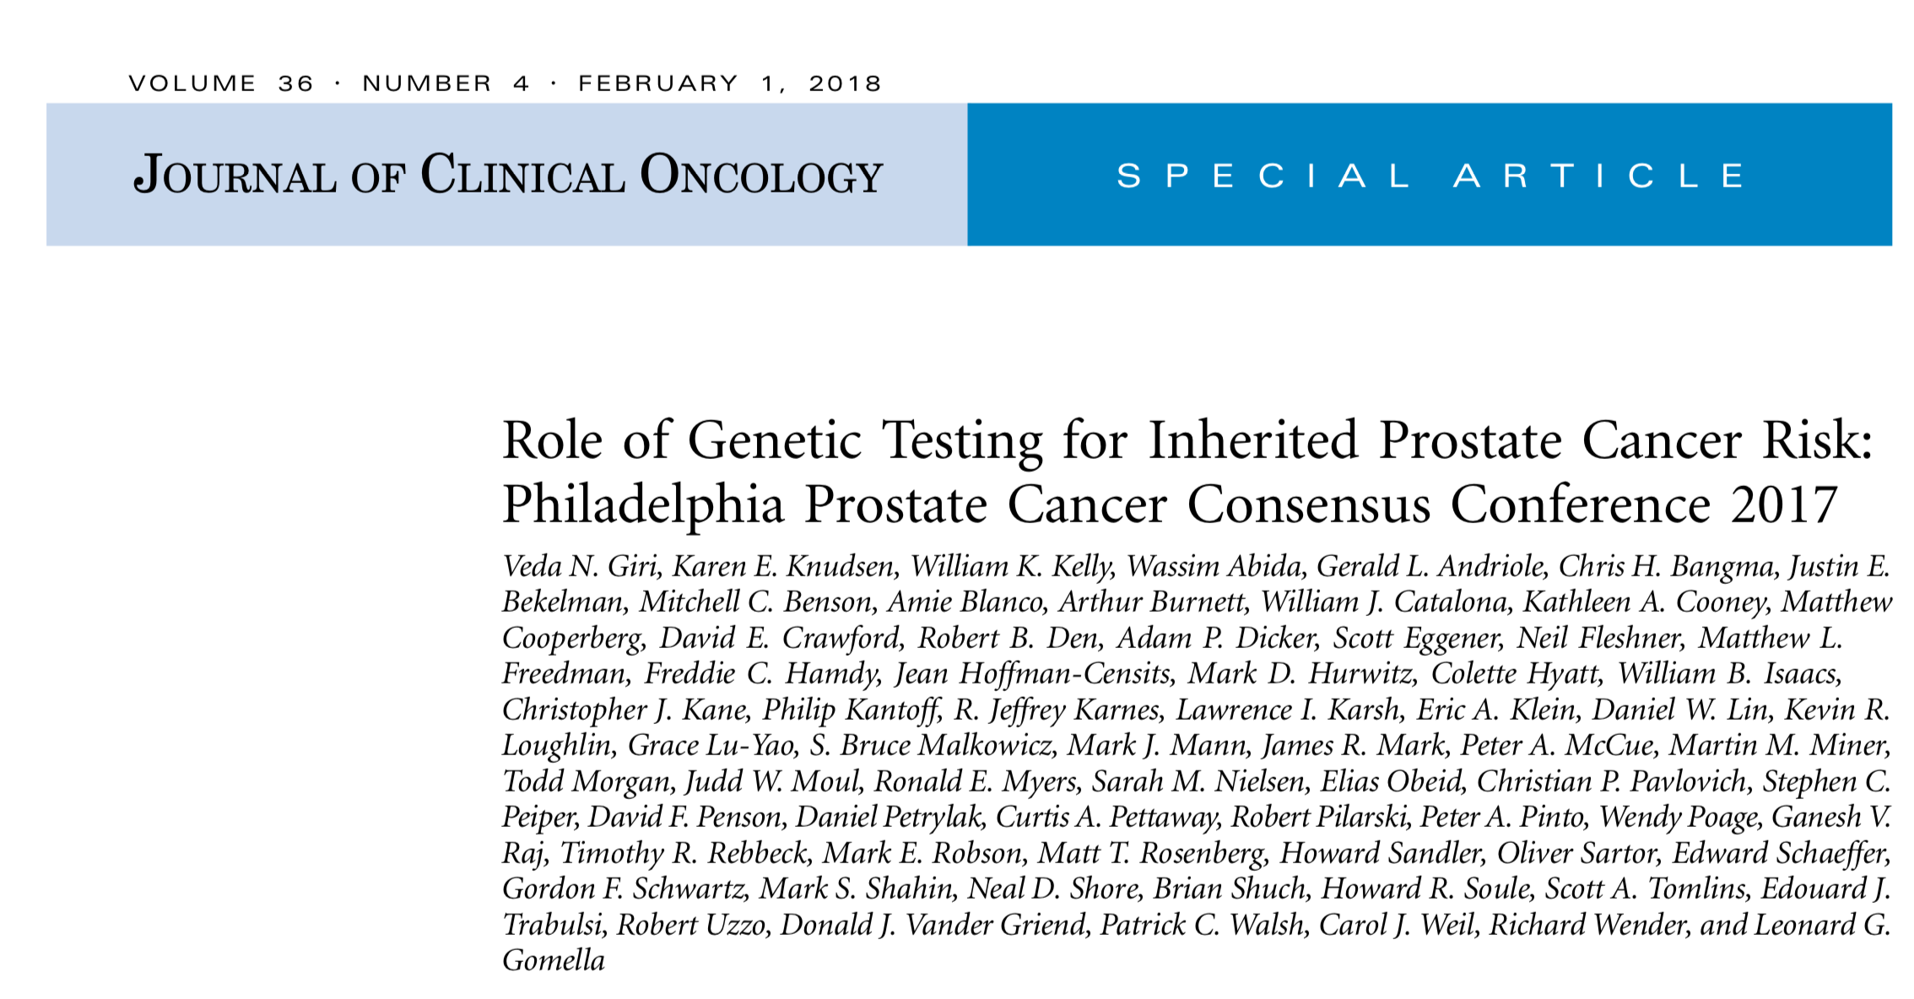

Slide 40
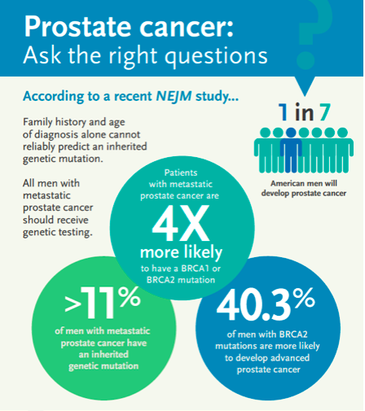
Dec 14, 2017

