Slide 1
Progress in the Management of Ovarian Cancer: Evolution Over 40 Years
Five-year survival
15%
30%
40%
?50%?
First use of oral PARPi
Key advances in chemo-therapy
Positive evidence
for weekly paclitaxel in first line
First use
of
cisplatin
First use
of
carboplatin
First use
of
Paclitaxel
First reports
of
bevacizumab
1970
1980
1990
2000
2010

Slide 2
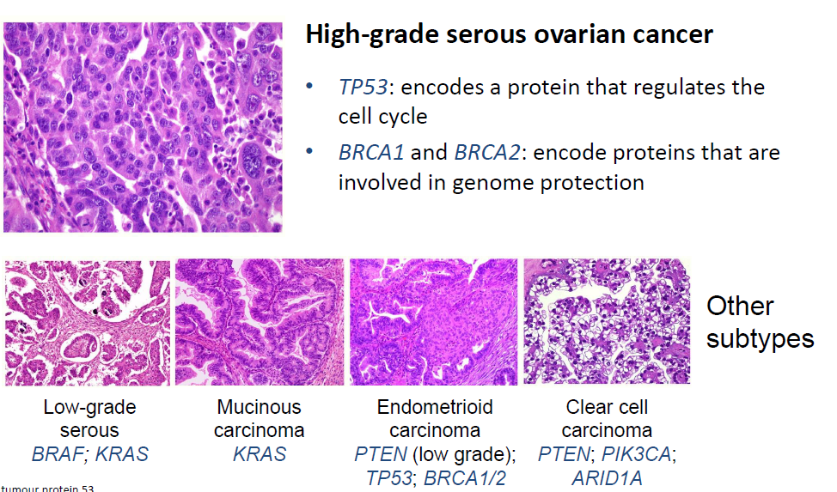
Ovarian cancer is not a single disease
70 %
5%
2%
15%
5%
Romero I et al. Endocrinology 2012; 153: 1593-1602

Slide 3
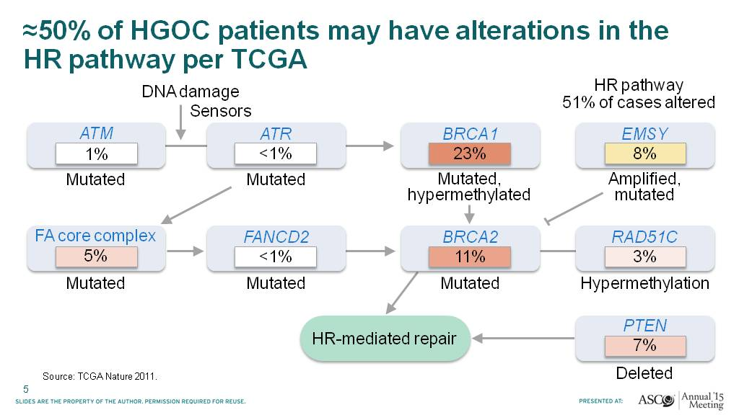
≈50% of HGOC patients may have alterations in the HR pathway per TCGA
Presented By Iain McNeish at 2015 ASCO Annual Meeting
Notes:
La mutazione germline di BRCA e’ solo uno dei meccanismi che controlla HR, ve ne sono molti altri che passano attraverso mutazioni somatiche del BRCA, o silenziamenti epigenetici con perdita di omozigosi e metilazioni del promotore di BRCA o che coinvolgono geni completamente diversi (FANCD, ATM, ATR, RAD 51) che controllano ugualmente HR.

Slide 4
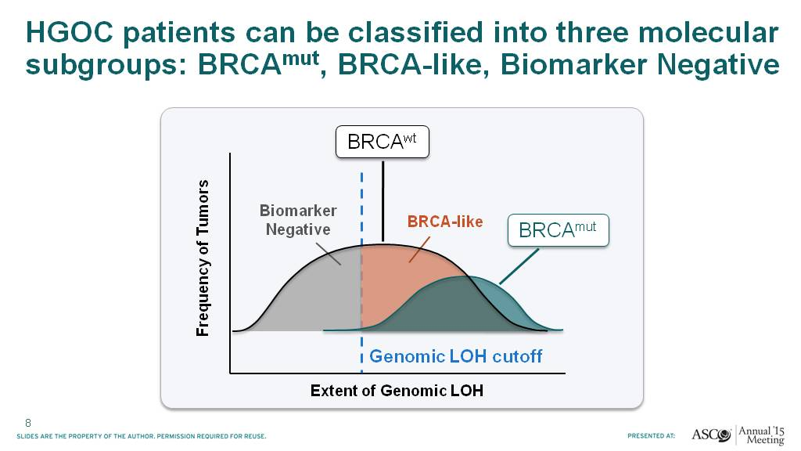
HGOC patients can be classified into three molecular subgroups: BRCAmut, BRCA-like, Biomarker Negative
Presented By Iain McNeish at 2015 ASCO Annual Meeting
Notes:
Per cui noi oggi abbiamo 3 popolazioni di ca ovaio: le BRCA mutate, le pazienti negative per deficit di HR e le BRCA like che comprendono tutte le altre che per vari motivi hanno un deficit di HR

Slide 5
PARP Inhibitors: A Recap
PARP inhibitors approved for use in patients with ovarian cancer
PARP inhibitor | Authority | Indication
Olaparib | EMA Dec 2014 | Monotherapy for the maintenance treatment of adult patients with platinum-sensitive relapsed BRCA-mutated (germline and/or somatic) high-grade serous epithelial ovarian, fallopian tube or primary peritoneal cancer who are in complete or partial response to platinum-based chemotherapy¹ Olaparib is not approved in Europe as a monotherapy in the treatment setting
 | US FDA Dec 2014 | Monotherapy in patients with deleterious or suspected deleterious germline BRCA-mutated (as detected by an FDA-approved test) advanced ovarian cancer who have been treated with three or more prior lines of chemotherapy²
 | Aug 2017 | Maintenance treatment of adult patients with recurrent epithelial ovarian, fallopian tube or primary peritoneal cancer, who are in a complete or partial response to platinum-based chemotherapy²
Niraparib | EMA Sept 2017 | Maintenance treatment of adult patients with recurrent epithelial ovarian, fallopian tube or primary peritoneal cancer who are in complete or partial response to platinum-based chemotherapy³
 | US FDA Mar 2017 | Maintenance treatment of adult patients with recurrent epithelial ovarian, fallopian tube or primary peritoneal cancer who are in complete or partial response to platinum-based chemotherapy³
Rucaparib | EMA | Not approved for use in Europe
 | US FDA Dec 2016 | Monotherapy for the treatment of patients with deleterious BRCA mutation (germline and/or somatic; as detected by an FDA-approved companion diagnostic for rucaparib) associated advanced ovarian cancer who have been treated with two or more chemotherapies⁴
PARP inhibitors in clinical development
Veliparib; Talazoparib. Veliparib and talazoparib are not approved for use.
EMA, European Medicines Agency; FDA, US Food & Drug Administration;
PARP, poly(ADP-ribose) polymerase
1. AstraZeneca. Olaparib Summary of Product Characteristics. 2017; 2. AstraZeneca. Olaparib Prescribing Information. 2014;
3. TESARO. Niraparib Prescribing Information. 2017; 4. Clovis Oncology. Rucaparib Prescribing Information. December 2016

Slide 6
In vitro PARP inhibition
DNA repair
Multiple functions (off target)
 | PARP1 | PARP2 | PARP3 | TNKS1 | TNKS2 | PARP6 | PARP7 | PARP8 | PARP10 | PARP11 | PARP12 | PARP14 | PARP15
Niraparib
Olaparib
Rucaparib
Talazoparib
 |  | < 10nM |  |  | 10-100nM |  |  | 100nM-1uM |  |  |  | > 1uM
(Potency)
1. PD001 PD002,, J. Med. Chem. 2009, 52, 7170−7185, 2. BPS-1001; 3. PDB 4R6E www.pdb.org 4. Cancer Res; 72(21) November 1, 2012

Slide 7
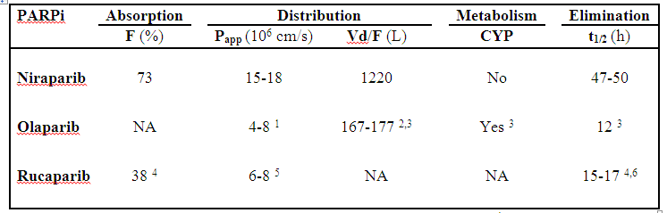
COMPARISON OF PK PROPERTIES AMONG PARP INHIBITORS IN HUMANS
Zangh z-Y et al, unpublished data
Notes:
High bioavailability
Extensive volume of distribution (in monkey in brain and cerebrovascular fluids)
Long terminal half life
Epatic metabolism quite indepemndent by cytocrome p 450

Slide 8
Parp Inhibitor: active disease setting
 | Rucaparib Pooled Analysis (103 pts) US and EMA label | Olaparib US Label (137 pts)
Potential Line of Therapy | ≥3rd line treatment (regardless platinum sensitivity) | ≥4th line treatment (regardless platinum sensitivity)
Dosing | 600 mg BID | 400 mg BID
Potential label Populations | Tumour BRCA^{mut} (includes germline and somatic mutations) | Germline BRCA^{mut}
Most common Grade ≥3 AEs in treatment setting | Fatigue (11%) Anaemia (23%) ↑ALT/AST (11%) | Fatigue (8%) Anaemia (18%) Abdominal pain (8%)
Dose interruptions/ reductions due to side effects | 8% 44.3% | 36% 42%
ORR (RECIST 1.1) by investigator | 54% | 34%
Progression free survival (median, months) | 10.0 | 7.0

Slide 9

Platinum combination followed by iPARP
Olaparib study design and patient selection
Study-19 aim and design
SOLO-2 aim and design
265 patients
295 patients
Olaparib
400 mg po bid
Platinum-sensitive high-grade serous ovarian cancer
≥2 previous platinum regimens
Last chemotherapy was platinum-based to which they had a maintained PR or CR prior to enrolment
Stable CA-125
Germilne BRCA1/2 mutation
Platinum-sensitive relapsed ovarian cancer
At least 2 prior lines of platinum therapy
CR or PR to most recent platinum therapy
Randomized
2:1
Olaparib
300 mg bid
n=196
Randomized 1:1
Placebo
po bid
Placebo
n=99
Primary end point : PFS
Primary endpoint: Investigator-assessed PFS
Ledermann J, et al. N Engl J Med 2012;366:1382–92
Pujade-Laurine et al. SGO 2017

Slide 10

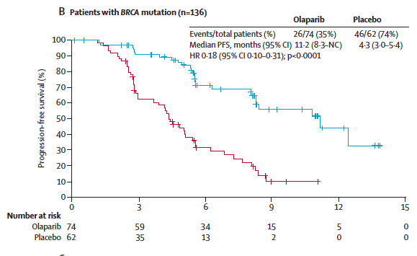
Platinum combination followed by iPARP
Olaparib data on primary endpoint: BRCA mutated patients
Study-19 PFS
SOLO-2 PFS
100
90
80
70
Olaparib
60
Progression-free survival (%)
50
40
30
Placebo
20
10
5.5
19.1
0
0
3
6
9
12
15
18
21
24
27
30
No. at risk
Olaparib
Placebo
Months since randomization
11.2 vs 4.3 months
HR 0.18 (95% CI: 0.10-0.31)
19.1 VS 5.5 months
HR 0.3 (95% CI: 0.22-0.41)
Ledermann et al. Lancet Oncol. 2014;15(8):852–861
Pujade-Laurine et al. SGO 2017

Slide 11
Platinum combination followed by iPARP
Niraparib: ENGOT ov16-NOVA study design
Platinum-Sensitive Recurrent High Grade Serous Ovarian Cancer
Treatment with 4-6 Cycles of Platinum-based Therapy
Response to Platinum Treatment
553
gBRCAmut
203
Non-gBRCAmut
350
2:1 Randomization
2:1 Randomization
Niraparib
300 mg once daily
Placebo
Niraparib
300 mg once daily
Placebo
Treat until Progression of Disease
Treat until Progression of Disease
Mirza MR et al. N Engl J Med 2016
Notes:
Script here needs to spell out the HRD test application
Point out that 100 events were needed for 90% power to detect a HR of 05 (4.8 vs 9.6 months).
Mention that PFS was by central read.
Make sure it is understood that there are 3 predefined efficacy populations: specifically state these

Slide 12
Platinum combination followed by iPARP
Niraparib: ENGOT ov16-NOVA primary end-point
PFS: gBRCAmut
PFS: non-gBRCAmut
Treatment | PFS Median (95% CI) (Months) | Hazard Ratio (95% CI) p-value
Niraparib (N=138) | 21.0 (12.9, NR) | 0.27 (0.173, 0.410) p<0.0001
Placebo (N=65) | 5.5 (3.8, 7.2)
Treatment | PFS Median (95% CI) (Months) | Hazard Ratio (95% CI) p-value
Niraparib (N=234) | 9.3 (7.2, 11.2) | 0.45 (0.338, 0.607) p<0.0001
Placebo (N=116) | 3.9 (3.7, 5.5)
Mirza MR et al. N Engl J Med 2016

Slide 13
Platinum combination followed by iPARP
Niraparib: ENGOT ov16-NOVA exploratory analyses
HRD-positive
HRD-negative
sBRCAmut
BRCAwt
Treatment | PFS Median (95% CI) (Months) | Hazard Ratio (95% CI) p-value | % of Patients without Progression or Death
 |  |  | 12 mo | 18 mo
Niraparib (N=35) | 20.9 (9.7, NR) | 0.27 (0.081, 0.903) p=0.0248 | 62% | 52%
Placebo (N=12) | 11.0 (2.0, NR) |  | 19% | 19%
Treatment | PFS Median (95% CI) (Months) | Hazard Ratio (95% CI) p-value | % of Patients without Progression or Death
 |  |  | 12 mo | 18 mo
Niraparib (N=71) | 9.3 (5.8, 15.4) | 0.38 (0.231, 0.628) p=0.0001 | 45% | 27%
Placebo (N=44) | 3.7 (3.3, 5.6) |  | 11% | 6%
Treatment | PFS Median (95% CI) (Months) | Hazard Ratio (95% CI) p-value | % of Patients without Progression or Death
 |  |  | 12 mo | 18 mo
Niraparib (N=92) | 6.9 (5.6, 9.6) | 0.58 (0.361, 0.922) p=0.0226 | 27% | 19%
Placebo (N=42) | 3.8 (3.7, 5.6) |  | 7% | 7%
Notes:
Now that we have talked about primary populations, we move to exploratory analysis of the non-gBRCA cohort subgroups.
Somatic: In this subgroup, a significant treatment effect similar to that in the gBRCAmut cohort was observed with niraparib compared to placebo. Of note, the HR observed in the gBRCAmut cohort (0.27) was identical to the HR observed in this HRDpos/sBRCAmut subgroup demonstrating the consistency of the niraparib treatment effect across cohorts and in 2 independent patient populations with similar underlying tumor biology

Slide 14
ARIEL3: Diagram of Analysis Cohorts
564 enrolled/randomised
196 BRCA mutant
368 BRCA wild type
HRD cohort (n=354)
130 rucaparib 66 placebo + 106 rucaparib 52 placebo
ITT population (n=564)
130 rucaparib 66 placebo + 106 rucaparib 52 placebo + 139 rucaparib 71 placebo
BRCA-mutant cohort (n=196)
130 rucaparib 66 placebo
130 germline
BRCA mutant*
56 somatic
BRCA mutant†
158 BRCA wild type/
LOH high‡
161 BRCA wild type/
LOH low
49 BRCA wild type/
LOH indeterminate
10 undefined
BRCA mutant
Notes:
T-dm-itt (rcd 062117), t-brca-itt (rcd 062117) qcd

Slide 15
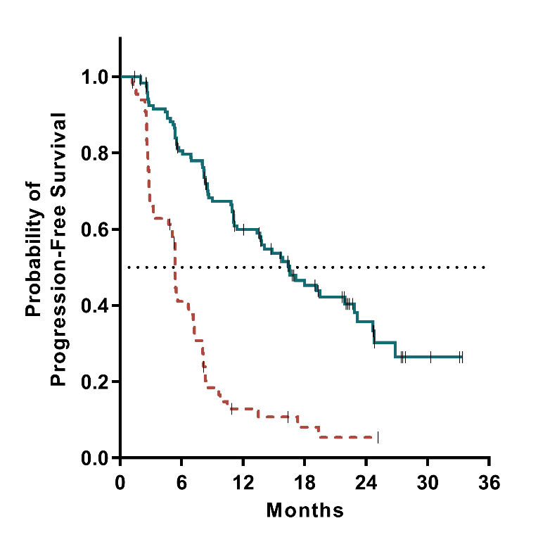
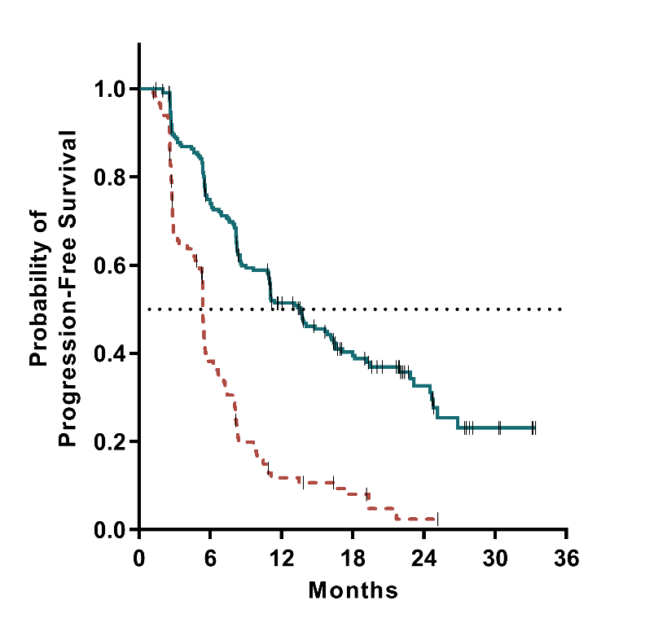
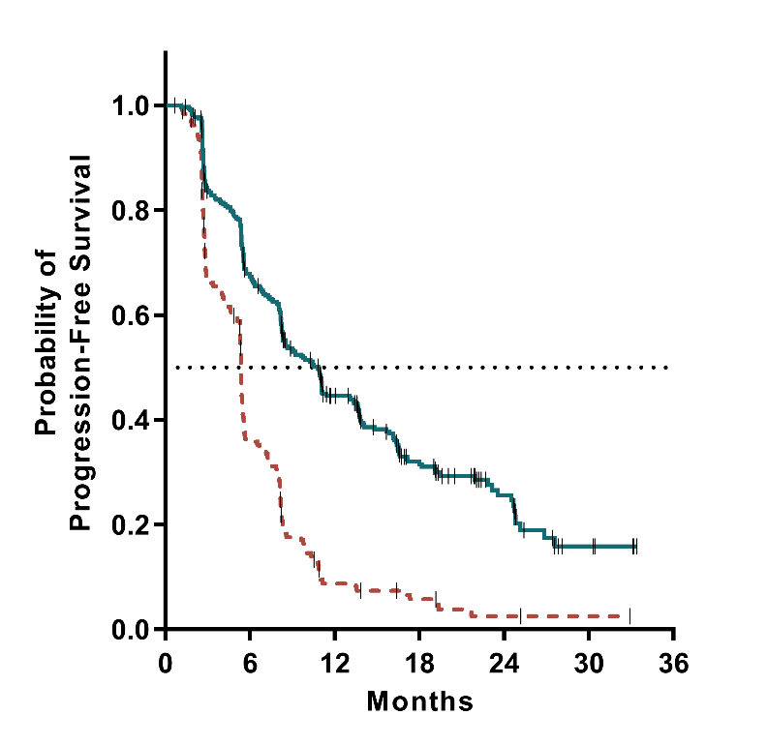
ARIEL3: Investigator-Assessed Progression-Free Survival
BRCA mutant
HRD
ITT
 | Median (months) | 95% CI
Rucaparib (n=130) | 16.6 | 13.4–22.9
Placebo (n=66) | 5.4 | 3.4–6.7
 | HR, 0.23; 95% CI, 0.16–0.34; P<0.0001
 | Median (months) | 95% CI
Rucaparib (n=236) | 13.6 | 10.9–16.2
Placebo (n=118) | 5.4 | 5.1–5.6
 | HR, 0.32; 95% CI, 0.24–0.42; P<0.0001
 | Median (months) | 95% CI
Rucaparib (n=375) | 10.8 | 8.3–11.4
Placebo (n=189) | 5.4 | 5.3–5.5
 | HR, 0.36; 95% CI, 0.30–0.45; P<0.0001
At risk (events)
Rucaparib | 130 (0) | 93 (23) | 63 (46) |  | 35 (58) | 15 (64) | 3 (67) | 0 (67)
Placebo | 66 (0) | 24 (37) | 6 (53) |  | 3 (55) | 1 (56) | 0 (56)
Rucaparib, 48% censored |  |  |  | Placebo, 15% censored
At risk (events)
Rucaparib | 236 (0) | 161 (55) | 96 (104) | 54 (122) | 21 (129) | 5 (134) | 0 (134)
Placebo | 118 (0) | 40 (68) | 11 (95) | 6 (98) | 1 (101) | 0 (101)
Rucaparib, 43% censored |  |  |  | Placebo, 14% censored
At risk (events)
Rucaparib | 375 (0) | 228 (111) | 128 (186) | 65 (217) | 26 (226) | 5 (234) | 0 (234)
Placebo | 189 (0) | 63 (114) | 13 (160) | 7 (164) | 2 (167) | 1 (167) | 0 (167)
Rucaparib, 38% censored |  |  |  | Placebo, 12% censored
Notes:
Data sources: F-pfs-tbrca (rcd 062117); f-pfs-hrd (rcd 062117); f-pfs-itt (rcd 062117); t-pfs (rcd 062117) qcd

Slide 16
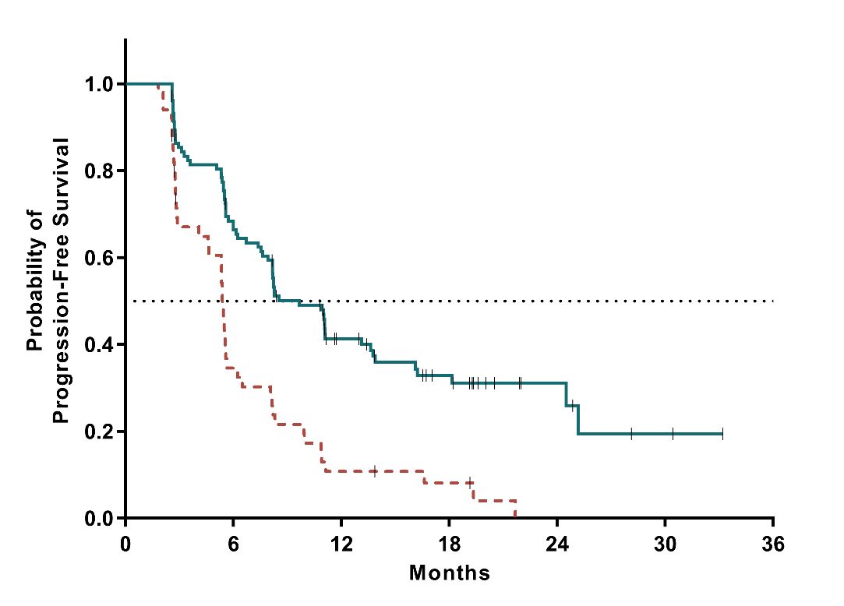
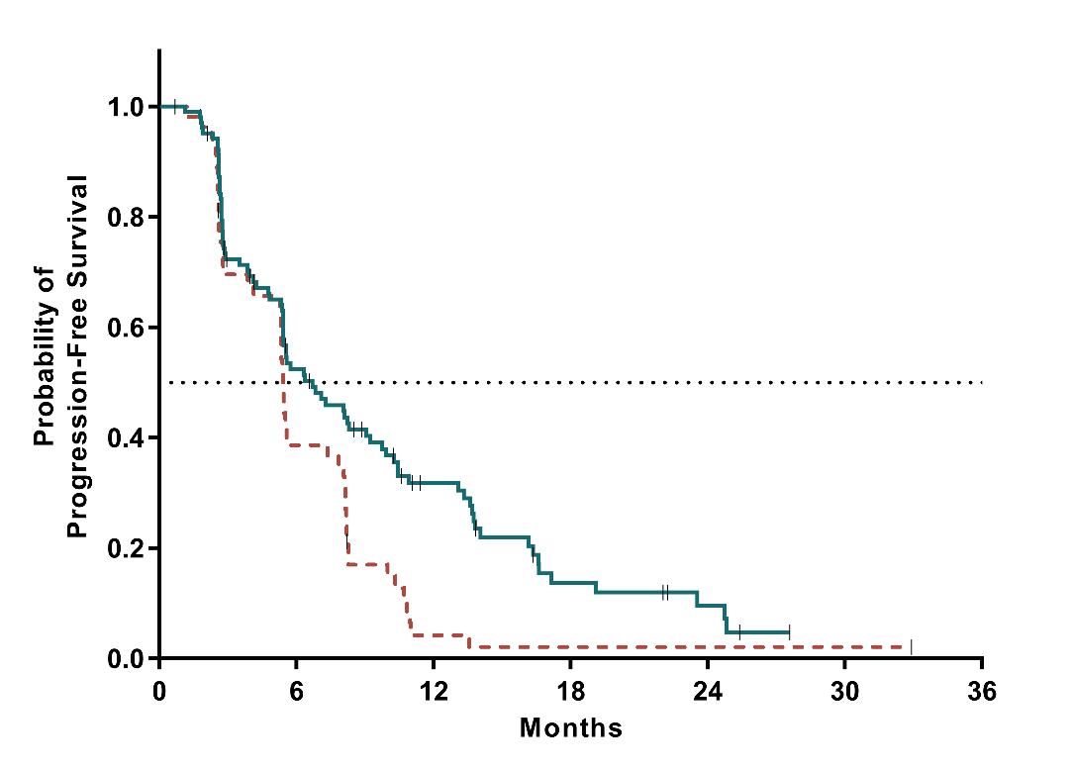
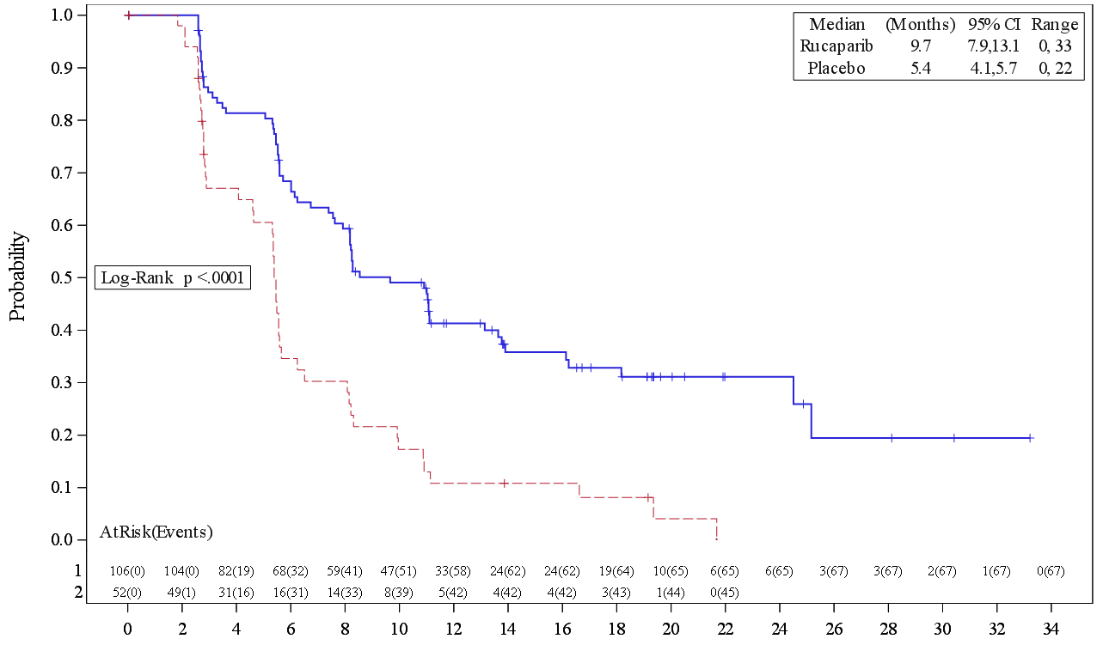
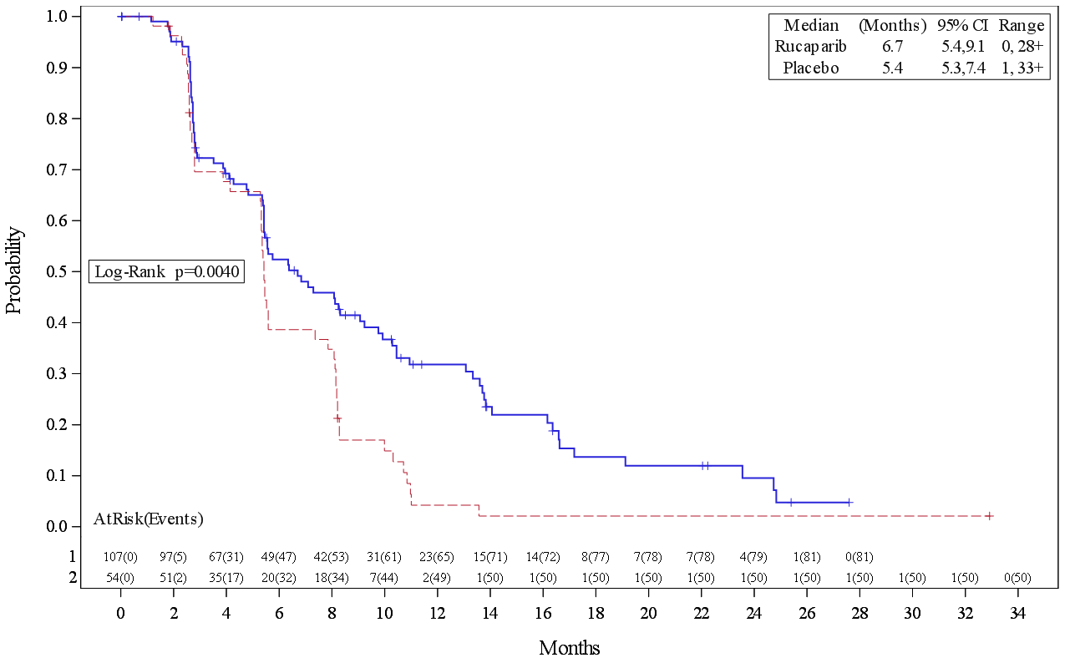
ARIEL3: Investigator-Assessed Progression-Free Survival:
Patients with BRCA Wild-Type OC (exploratoy analysis)
LOH high
LOH low
 | Median (months) | 95% CI
Rucaparib (n=106) | 9.7 | 7.9–13.1
Placebo (n=52) | 5.4 | 4.1–5.7
 | HR, 0.44; 95% CI, 0.29–0.66; P<0.0001
 | Median (months) | 95% CI
Rucaparib (n=107) | 6.7 | 5.4–9.1
Placebo (n=54) | 5.4 | 5.3–7.4
 | HR, 0.58; 95% CI, 0.40–0.85; P=0.0049
At risk (events)
Rucaparib | 106 (0) | 68 (32) | 33 (58) | 19 (64) | 6 (65) | 2 (67) | 0 (67)
Placebo | 52 (0) | 16 (31) | 5 (42) | 3 (43) | 0 (45)
 |  | Rucaparib, 37% censored |  | Placebo, 13% censored
At risk (events)
Rucaparib | 107 (0) | 49 (47) | 23 (65) | 8 (77) | 4 (79) | 0 (81)
Placebo | 54 (0) | 20 (32) | 2 (49) | 1 (50) | 1 (50) | 1 (50) | 0 (50)
 |  | Rucaparib, 24% censored |  | Placebo, 7% censored
Notes:
Data sources: F-pfs-non-plus (rcd 062117); f-pfs-nonneg (rcd 062117); t-pfs-gene (rcd 062117) qcd

Slide 17
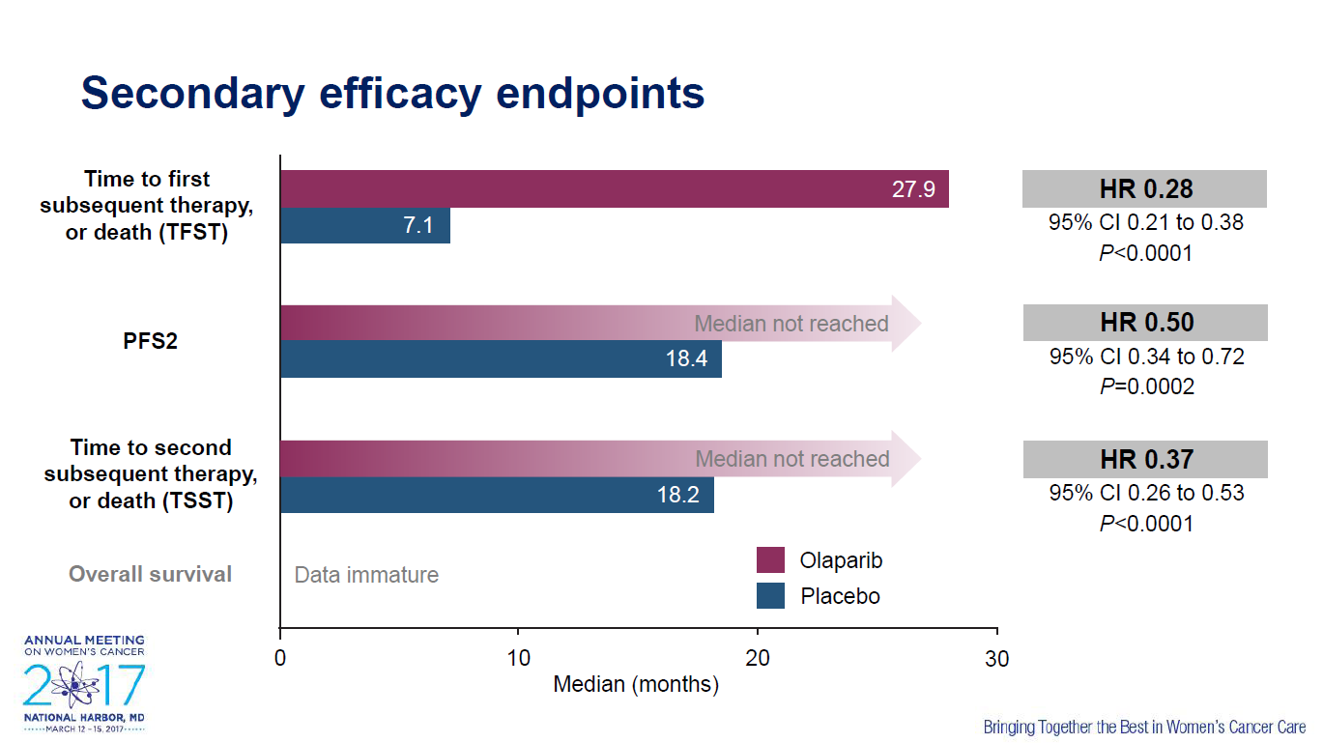

Slide 18
Tolerance (CTCAE grade 3/4)
 | Olaparib (SOLO2) (n=195) | Niraparib (NOVA) (n=367) | Rucaparib (ARIEL 3) (n=561)
Dose reductions due to AEs, (%) | 25 | 66.5 | 54.6
Treatment discontinuation due to AEs, (%) | 10.8 | 14.7 | 13.4
Hematologic toxicity (Gr 3/4) - Anemia - Neutropenia - Thrombocytopenia | 19.5 5 0 | 25 20 34 | 18.8 6.7 5.1
Hypertension | NR | 8 | NR
ASAT/ALAT | 2 | NR | 10.5
Nausea | 3 | 3 | 3.8
Fatigue | 4 | 8 | 6.7

Slide 19
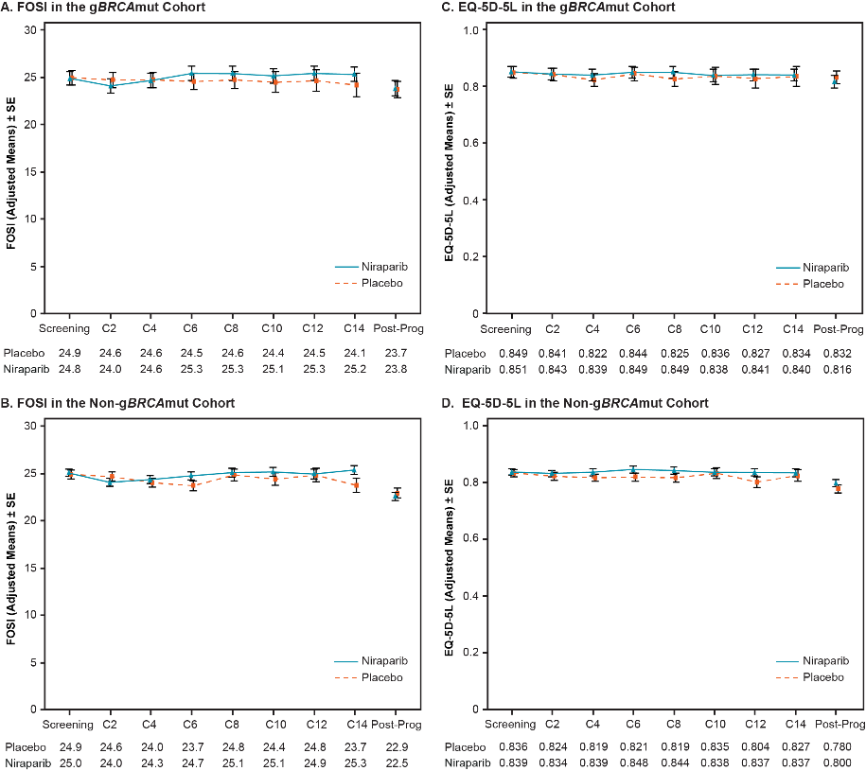
PATIENTS TREATED WITH NIRAPARIB MAINTAINED
THEIR QoL AS ASSESSED BY THE EQ-5D-5L
Baseline QoL (adjusted HUI score) was similar between niraparib and placebo-treated patient
QoL scores during treatment were similar between niraparib and placebo-treated patients
  gBRCAmut cohort: 0.812 niraparib vs. 0.803 placebo
  Non-gBRCAmut cohort: 0.845 niraparib vs. 0.828 placebo
gBRCAmut cohort
Non-gBRCAmut cohort

Slide 20
RESULTS OF INDIVIDUAL FOSI MEASURES
INCIDENCE OF NAUSEA AE (any grade)
FOSI: “I HAVE NAUSEA”
A transient increase in nausea abated over time
INCIDENCE OF VOMITING AE (any grade)
FOSI: “I HAVE VOMITING”
Niraparib
Placebo
Solid lines represent “Any Symptoms”
Dashed lines represent “Severe Symptoms”
Size of circles corresponds to # of patients
20

Slide 21
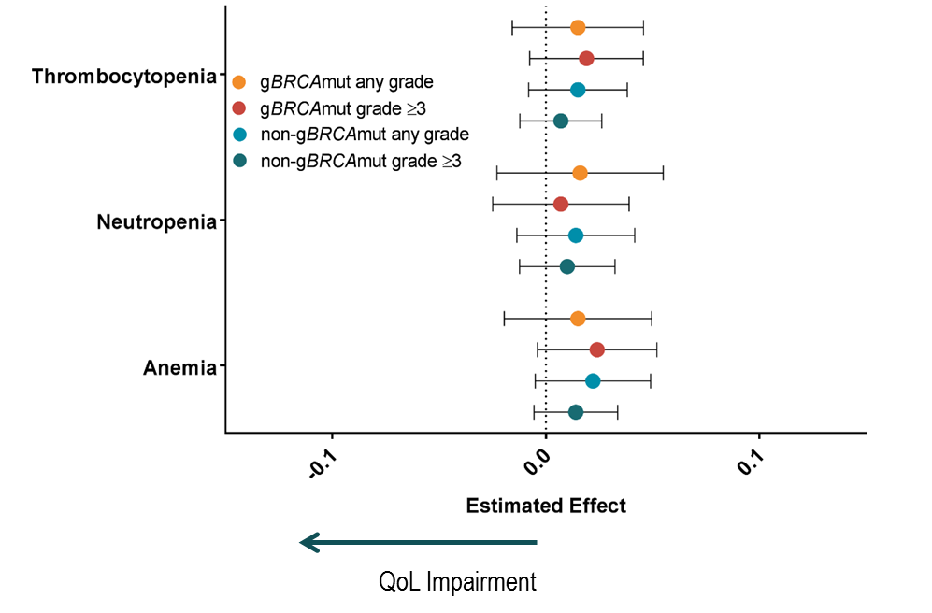
HEMATOLOGIC ADVERSE EVENTS DECREASED OVER
TIME AND DID NOT IMPACT QoL
Adjusted Mixed Model Effects Of Each AE On EQ-5D-5L By Cohort
INCIDENCE OF THROMBOCYTOPENIA (any grade)
INCIDENCE OF NEUTROPENIA (any grade)
INCIDENCE OF ANEMIA (any grade)
Niraparib
Placebo

Slide 22
Dose Modifications Result in Decreased Incidence of Adverse Events
Grade 3/4 AE (%) | Hematologic Grade 3/4 Events Occurring at Any Time During the Study by Dose
 | 300 mg (n=367) | 200 mg (n=254) | 100 mg (n=128) | Dose discontinuations (n=367)
Thrombocytopenia event | 33.2 | 5.9 | 2.3 | 3.3
Anemia event | 15.3 | 16.1 | 6.3 | 1.4
Neutropenia event | 18.0 | 8.3 | 2.3 | 1.9
Thrombocytopenia event
(Any grade)
Anemia event
(Any grade)
Neutropenia event
(Any grade)
The incidence of TEAEs was infrequent after month 3.

Slide 23
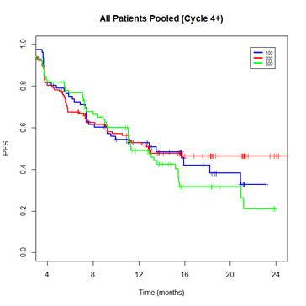
Estimated PFS Probability by Dose Level Measured
After Month 3
All Patients (month 4+)
1.0
■ 200 mg
■ 100 mg
■ 300 mg
0.8
0.6
Dose reduction from 300 mg did not appear to compromise efficacy in this retrospective analysis.
PFS
0.4
0.2
0
4
8
12
16
20
24
Time (months)
From Month 4: HR (300 vs 200): 1.01 (95%CI: 0.69, 1.48)
From Month 4: HR (300 vs 100): 1.05 (95%CI: 0.84, 1.31)
PFS, progression-free survival

Slide 24
Predicting Which Patients Will Require Dose Modification
Decision trees modeling was used to identify variables to predict the likelihood that a patient will develop ≥Grade 3 thrombocytopenia within 30 days of niraparib first dose
Body weight and baseline platelet counts were identified as the two most significant predictors of early dose modification
No other factors appeared to be significant predictors of early dose modification
Baseline covariates |  | Other Factors
Age | Albumin | Platelet nadir (overall, across all study visits)
Body weight | Bilirubin | Duration of prior chemotherapy
Platelet counts | AST | Lines of chemotherapy
Neutrophil counts | ALT | Time from last chemotherapy
Hemoglobin counts | ALP
LDH
ALP, alkaline phosphatase; ALT, alanine aminotransferase; AST, aspartate aminotransferase; LDH, lactate dehydrogenase

Slide 25
Incidence of Grade 3/4 Thrombocytopenia by Baseline Weight and Baseline Platelet Count
Grade 3/4 thrombocytopenia events in month 1 by weight
Grade 3/4 thrombocytopenia events in month 1 by baseline platelet count
Patients (%)
Patients (%)
<58
58—<77
≥77
≤180,000
180,000-215,000
215,000-273,000
≥273,000
Weight at baseline (kg)
Thrombocyte count at baseline (/µL)
58 kg = 128 lb
77 kg = 170 lb
Notes:
Analysis done by quartiles

Slide 26
Integrated Analysis
Grade 3/4 thrombocytopenia events in month 1 by integrated analysis of weight and
thrombocyte count at baseline
17% patients with body weight <77 kg or platelet count <150,000/µL remained at the 300 mg dose
Median daily dose 207 mg in the first 2 months
Grade 3/4 thrombocytopenia 9%ª in TOPACIO trial with a starting dose of niraparib 200 mg
Patients (%)
ªExcludes decreased platelet count (6%)
<77 kg or
<150,000/μL
≥77 kg and
≥150,000/μL

Slide 27

BRCA and Beyond!
Future Directions for Enhancing PARP Inhibitor Therapy
The clinical utility of PARP inhibitors for patients with BRCA mutations is evident¹
PARP inhibitors may have a role in non-BRCA-mutated patients²
How is the use of PARP inhibitors evolving and what is in the pipeline for PARP‑inhibitor research?
  Overcoming resistance
  to PARP inhibitors
  Retreatment with
  PARP inhibitors
  Use in earlier lines of therapy
  Combinations with other agents
Who?
Why?
How?
When?
What?
CSI: Chemo Scene Investigation
PARP, poly(ADP-ribose) polymerase
Evans T, Matulonis U. Ther Adv Med Oncol. 2017;9:253–267;
Mirza M et al. N Engl J Med. 2016;375:2154–2164

Slide 28
Unmet Clinical Need:
Future Research Into PARP Inhibitor Use
Resistance to PARP inhibitors
Retreatment with PARP inhibitors: Overcoming or compounding the resistance problem?
PARP inhibitors in the front-line setting
Combinations with other agents
  Anti-angiogenic agents
  Immuno-oncology agents
PARP, poly(ADP-ribose) polymerase

Slide 29
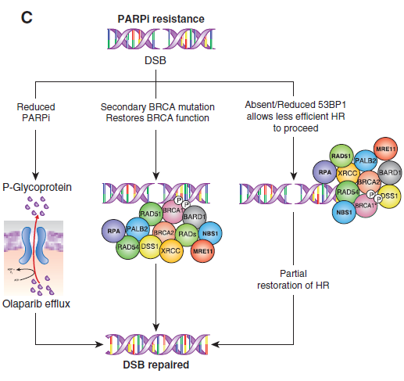
Understanding Mechanisms of Resistance
Pre-clinical observations: Innate and acquired resistance
Decreased intracellular availability of PARP inhibitor
  Upregulation of drug-efflux pumps^{1,2}
Decreased expression or activity of PARP1^{2,3}
Increased homologous recombination capacity
  BRCA mutation recovery/reversion^{1,2}
  Loss of end resection regulatory proteins
  53BP1 and REV7^{1,2,4,5}
BRCA-independent replication fork
stabilisation (e.g. loss of PTIP)²
EMT (mesenchymal phenotype)²
BRCA
BRCA
DSB, double-strand break; EMT, epithelial–mesenchymal transition;
HR, homologous recombination; PARP, poly(ADP-ribose) polymerase
1. Fojo T, Bates S. Cancer Discov. 2013;3:20–23; 2. Kim Y et al. Int J Biol Sci. 2017;13:198–208;
3. Yalon M et al. PLoS One. 2016;11:e0155711; 4. Jaspers JE et al. Cancer Discov. 2013;3:68–81;
5. Xu G et al. Nature. 2015;521:541–544
Notes:
Current long-term PARP inhibitor treatment is associated with emergence of resistance which could potentially limit their subsequent therapeutic benefit
With increased use comes increased resistance

Slide 30
Understanding Mechanisms of Resistance
Clinical observations: Acquired resistance
BRCA reversion responsible for 15–20% of resistance to PARP inhibitors
TP53BP1 has opposing activity to BRCA1 in preventing DNA resection and promoting NHEJ
  Mutations in TP53BP1 responsible for ~10% of
  resistance to PARP inhibitors
~75% of resistance is due to unknown mechanisms
BRCA
How can we overcome or avoid
further development of resistance?
NHEJ, non-homologous end joining; PARP, poly(ADP-ribose) polymerase
1. Edwards SL et al. Nature. 2008;451:1111–1115;
2. Lord CJ, Ashworth A. Nat Med. 2013;19:1381–1388

Slide 31
OReO: Study Design
Phase III, trial of olaparib retreatment following receipt of prior PARP inhibitor and complete or partial response to platinum-based chemotherapy in patients with epithelial ovarian cancer
Patient eligibility
gBRCA+ or sBRCA+ (n=136)
1 prior PARP inhibitor treatment
  18 months+ after first-line chemotherapy
  12 months+ after second-line chemotherapy
Olaparib 300 mg tablets
or last tolerable dose
BID
Primary endpoint
PFS, TFST, FACT-O,
safety, AESI, OS
CR or PR to
platinum-based
chemotherapy
(no bevacizumab)
BRCA wt all-comers (n=280)
R
2:1
1 prior PARP inhibitor treatment
  12 months+ after first-line chemotherapy
  6 months+ after second-line chemotherapy
Placebo
BID
Status: recruiting
Target enrolment: 416 pts
Olaparib no está autorizado en España por este tratamiento. Olaparib is not approved in Spain for this treatment setting.
AESI, adverse events of special interest; BID, twice daily; CR, complete response; FACT-O, functional assessment of cancer therapy – ovarian; g, germline; OS, overall survival; PARP, poly(ADP-ribose) polymerase; PFS, progression-free survival;
PR, partial response; s, somatic; TFST, time to first subsequent therapy; wt, wild type
ClinicalTrials.gov. NCT03106987. https://clinicaltrials.gov. Accessed 1 August 2017

Slide 32
Unmet Clinical Need:
Future Research Into PARP Inhibitor Use
Resistance to PARP inhibitors
Retreatment with PARP inhibitors: Overcoming or compounding the resistance problem?
PARP inhibitors in the front-line setting
Combinations with other agents
  Anti-angiogenic agents
  Immuno-oncology agents
PARP, poly(ADP-ribose) polymerase

Slide 33
SOLO-1 Trial: Study Design
Phase III, trial of olaparib as front-line maintenance therapy following front-line platinum-based chemotherapy in patients with germline BRCA-mutated advanced ovarian cancer
Patient eligibility
gBRCA mut
FIGO stage III–IV high-grade serous or high-grade endometrioid ovarian primary peritoneal cancer and/or fallopian tube cancer
CR or PR to first-line
platinum-based chemotherapy
Olaparib 300 mg
BID
Primary endpoint
PFS
2:1
R
Placebo
BID
Status: ongoing;
no longer recruiting
Target enrolment: 450 pts
Olaparib no está autorizado en España por este tratamiento. Olaparib is not approved in Spain for this treatment setting.
BID, twice daily; CR, complete response; FIGO, International Federation of Gynecology and Obstetrics; PFS, progression-free survival; PR, partial response
ClinicalTrials.gov. NCT01844986. https://clinicaltrials.gov. Accessed 1 August 2017

Slide 34
PRIMA: Study Design
Phase III, trial of niraparib as front-line maintenance therapy following front-line
platinum-based chemotherapy in patients with advanced ovarian cancer
Patient eligibility
FIGO Stage III or IV ovarian cancer with high risk of progression
CR or PR following front-line
platinum-based chemotherapy
Niraparib 300 mg QD
(n=203)
Primary endpoint
PFS as assessed by RECIST progression
on CT/MRI
2:1
R
Endpoint
assessment
Placebo QD
(n=102)
Status: recruiting
Target enrolment: 330 pts
Stratification factors
Neoadjuvant chemotherapy
administered: Yes or No
Best response to first
platinum therapy: CR or PR
HRD status: positive or
negative/not determined
Niraparib no está autorizado en España; solo está autorizado en los Estados Unidos de América. Niraparib is not approved in Spain; it is only approved for use in the United States of America.
CR, complete response; CT, computed tomography; FIGO, International Federation of Gynecology and Obstetrics;
HRD, homologous recombination deficiency; MRI, magnetic resonance imaging; PFS, progression-free survival;
PR, partial response; QD, once daily; RECIST, Response Evaluation Criteria in Solid Tumors
ClinicalTrials.gov. NCT02655016. https://clinicaltrials.gov. Accessed 1 August 2017

Slide 35
Unmet Clinical Need:
Future Research Into PARP Inhibitor Use
Resistance to PARP inhibitors
Retreatment with PARP inhibitors: Overcoming or compounding the resistance problem?
PARP inhibitors in the front-line setting
Combinations with other agents
  Anti-angiogenic agents
  Immuno-oncology agents
PARP, poly(ADP-ribose) polymerase
Notes:
Combination with other agents:
When adding chemotherapy, may induce SSBs in any cancerous cells without DNA repair defects, thereby making them susceptible to PARP inhibitors
Of particular interest to overcome resistance is combinations with anti-angiogenic and immuno-oncology agents.
Hypothesis: any PARP inhibitor resistant cells are affected by the other agent. This optimises efficacy of treatment and also avoids survival of PARPi resistant cells thereby reducing perpetuation of the mechanism of resistance

Slide 36
PARP Inhibitors in Combination with Anti-Angiogenic Agents: Scientific Support for Synergistic Effects
Preclinical studies demonstrated that HR can be suppressed by hypoxia through downregulation
of HR repair proteins such as
BRCA1 and RAD51^{1,2}
Further studies showed
sensitivity to PARP inhibitors enhanced in hypoxic states^{3,4}
Hypothesis: PARP inhibitors
and anti-angiogenics may
have synergistic effects
Phase I and II clinical studies show improved outcomes with the combination of olaparib and cediranib^{5,6}
Olaparib group
Cediranib plus olaparib group
100
80
60
Progression-free survival (%)
40
20
0
12
18
24
30
Number at risk
Olaparib group
Cediranib plus olaparib group
0
6
Months
46 27 13 6 1 0
44 38 24 11 3 0
Cediranib no está autorizado en España. Cediranib is not approved in Spain
HR, homologous recombination; PARP, poly(ADP-ribose) polymerase
1. Bindra RS et al. Cancer Res. 2005;65:11597–11604; 2. Bindra RS et al. Mol Cell Biol. 2004;24:8504–8518;
3. Chan N, Bristow RG. Clin Cancer Res. 2010;16:4553–4560; 4. Hegan DC et al. Proc Natl Acad Sci U S A. 2010;107:2201–2206;
5. Liu JF et al. Eur J Cancer. 2013;49:2972–2978; 6. Liu JF et al. Lancet Oncol. 2014;11:1207–1214
Notes:
Preclinical work demonstrated hypoxia supresses HR and increases sensitivity to PARP inhibitors. Led to the hypothesis that PARP inhibitors and antiangiogenic agents have synergistic effects. To investigate further, Phase I and II studies combining olaparib and cediranib were conducted and support the theory.

Slide 37
PAOLA-1: Study Design
Phase III trial of olaparib in combination with bevacizumab as first-line
maintenance therapy in patients with advanced ovarian cancer
Patient eligibility
Maintenance
FIGO stage IIIb–IV high-grade serous/endometrioid or non‑mucinous BRCA mutation ovarian, fallopian tube or primary peritoneal cancer
First line
  Surgery (primary or interval)
  Platinum–taxane based chemotherapy
≥3 cycles of bevacizumab†
CR/PR NED
Primary endpoint
Bevacizumab 15 mg/kg
Q3W 15 months +
olaparib 300 mg BID
2 years
PFS
2:1
R
PD†
Bevacizumab 15 mg/kg
Q3W 15 months
+ placebo 2 years
Status: recruiting
Target enrolment: 612
Stratification factors
Tumour BRCA status
First-line outcome
La combinación de olaparib y bevacizumab no está autorizado en España. The combination of olaparib and bevacizumab is not approved in Spain.
†Tumour sample taken to provide tumour BRCA status
BID, twice daily; CR/PR NED, complete response/partial response no evidence of disease; FIGO, International Federation of Gynecology and Obstetrics; PD, progressive disease; PFS, progression-free survival; Q3W, every 3 weeks
ClinicalTrials.gov. NCT02477644. https://clinicaltrials.gov/. Accessed 1 August 2017

Slide 38
MITO-25: Study Design^{1,2}
Phase II trial of rucaparib in combination with bevacizumab as first-line
maintenance therapy in patients with advanced ovarian cancer
Patient eligibility
Treatment
6 cycles
Maintenance
FIGO stage IIIb–IV high‑grade serous or endometrioid or clear-cell ovarian cancer, primary peritoneal and/or fallopian tube cancer, or other BRCA-mutated histotypes
Carboplatin AUC 5
+ paclitaxel 175 mg/mq
+ bevacizumab 15 mg/kg
Bevacizumab 15 mg/kg
16 cycles
Primary endpoint
PFS
1:1:1
Carboplatin AUC 5
+ paclitaxel 175 mg/mq
+ bevacizumab 15 mg/kg
Bevacizumab 15 mg/kg
16 cycles
+ rucaparib 600 mg BID
24 cycles
R
Status: due to start enrolling end 2017
Carboplatin AUC 5
+ paclitaxel 175 mg/mq
Rucaparib 600 mg BID
24 cycles
Stratification factors
Residual tumour at primary surgery
Stage of disease
HRD status (BRCA mutated vs
HRD positive vs biomarker negative)
Rucaparib no está autorizado en España; solo está autorizado en los Estados Unidos de América.
Rucaparib is not approved in Spain; it is only approved for use in the United States of America.
AUC, area under the curve; BID, twice daily; FIGO, International Federation of Gynecology and Obstetrics; HRD, homologous recombination deficiency
1. Adis Insight. 70028211. http://adisinsight.springer.com. Accessed 1 August 2017;
2. Adapted with input from the Principle Investigator from MITO Group. MITO 25. http://www.mito-group.it/en/xxix-riunione-mito-milano/diapositive/category/164-relazioni-mito-21-giugno-2017?download=745:12-lorusso. Accessed 1 August 2017

Slide 39
ICON9: Study Design
Phase III trial of olaparib in combination with cediranib as maintenance therapy in patients with relapsed platinum‑sensitive ovarian cancer following response to platinum-based chemotherapy
Patient eligibility
Maintenance
Relapsed platinum‑sensitive ovarian, fallopian tube, primary peritoneal cancer
PFI >6 months following first‑line platinum
CR or PR by RECIST 1.1 or CA‑125 after 4–6 cycles of second-line chemotherapy
Primary endpoint
Olaparib 300 mg BID
+ cediranib 20 mg QD
Not available
R
Olaparib 300 mg BID
Status: due to
open Q4 2017
Target enrolment: 618
Stratification factors
6–12 versus >12-month
progression-free interval
Surgery versus no surgery
at relapse prior to chemotherapy
Prior bevacizumab therapy
BRCA and HRD status
Cediranib no está autorizado en España. Cediranib is not approved in Spain
BID, twice daily; CA-125, cancer antigen 125; CR, complete response; HRD, homologous recombination deficiency;
PFI, progression-free interval; PR, partial response; QD, once daily; RECIST, Response Evaluation Criteria in Solid Tumors
Cancer Research UK & UCL Cancer Trials Centre. ICON9. http://www.ctc.ucl.ac.uk/TrialDetails.aspx?Trial=112. Accessed 1 August 2017

Slide 40
AVANOVA: Study Design^{1,2}
Phase I/II trial of niraparib in combination with bevacizumab
in patients with platinum-sensitive ovarian cancer
Patient eligibility
Phase I (AVANOVA I)
Recurrent, platinum-sensitive epithelial ovarian, fallopian tube, or primary peritoneal cancer with high‑grade serous/endometrioid histology
Primary endpoint
N=12
Niraparib 300 mg QD
+ bevacizumab
15 mg/kg Q21D
Endpoint assessment
Safety and tolerability of
niraparib–bevacizumab combination
Determine the recommended Phase II dose
Phase II (AVANOVA II)
1:1
Niraparib 300 mg
QD monotherapy
Platinum-sensitive epithelial ovarian, fallopian tube, or
primary peritoneal cancer
Primary endpoint
Endpoint assessment
PFS
Niraparib 300 mg QD
+ bevacizumab
15 mg/kg Q21D
AVANOVA II Status:
recruiting²
Target enrolment: 108
AVANOVA I results
The combination of bevacizumab with niraparib can be administered for an extended period of time¹
Toxicity of the combination is manageable and the combination can be administered using the full doses of each agent¹
This combination is active in recurrent ovarian cancer¹
Niraparib no está autorizado en España; solo está autorizado en los Estados Unidos de América. Niraparib is not approved in Spain; it is only approved for use in the United States of America.
PFS, progression-free survival; QD, once daily; Q21D, every 21 days
1. Mirza MR et al. ASCO 2016; Abstract 5555;
2. ClinicalTrials.gov. NCT02354131. https://clinicaltrials.gov. Accessed 1 August 2017
Notes:
Study sponsor: Nordic Society for Gynaecologic Oncology

Slide 41
Unmet Clinical Need: Future Research Into PARP Inhibitor Use
Resistance to PARP inhibitors
Retreatment with PARP inhibitors: Overcoming or compounding the resistance problem?
PARP inhibitors in the front-line setting
Combinations with other agents
  Anti-angiogenic agents
  Immuno-oncology agents
PARP, poly(ADP-ribose) polymerase

Slide 42
PARP Inhibitors in Combination with
Immuno-Oncology Agents: Rationale
Tumours with deleterious mutations in DNA repair genes (including BRCA1/2) have a high mutational load and a
higher number of protein-coding mutations (neoepitopes) due to the inability of the cancer cell to repair
DNA damage effectively¹
BRCA1/2 mutant and HR-deficient tumours are correlated with higher PD‑L1 expression and CD8 T-cell infiltration that predict PD‑(L)1 mAb response²
5
**
4
3
Coding mutations/Mb
2
1
0
BRCA1
BRCA2
HR
wild type
HR
deficient
HR, homologous recombination; mAb, monoclonal antibody;
PARP, poly(ADP-ribose) polymerase; PD-L1, programmed cell death ligand 1
1. Patch AM et al. Nature. 2015;521:489–494;
2. Strickland K et al. ASCO 2015; Abstract 5512

Slide 43
PARP Inhibitors in Combination with Immune Checkpoint Inhibitors: Ongoing Clinical Trials
Investigational drug | Study | Phase | Treatment setting and patients | Primary outcome
Olaparib + durvalumab¹ | NCT02484404 | I/II | Combination treatment in patients with advanced solid tumours, including persistent or recurrent ovarian, primary peritoneal or fallopian tube cancer who have received ≥2 prior lines of platinum-based chemotherapy or who are platinum‑resistant/refractory | RP2D, ORR
Olaparib + tremelimumab² | NCT02571725 | I/II | Combination treatment in patients with recurrent BRCA-mutated ovarian, primary peritoneal or fallopian tube cancer who have received ≥1 prior line of platinum‑based chemotherapy | RP2D, ORR
Olaparib ± tremelimumab³ | NCT02485990 | I/II | Dose escalation/expansion study of combination treatment in patients with persistent or recurrent ovarian, primary peritoneal or fallopian tube cancer who have received ≥1 prior line of platinum-based chemotherapy | Safety
Niraparib + pembrolizumab⁴ | TOPACIO NCT02657889 | I/II | Combination treatment in patients with metastatic triple-negative breast cancer or recurrent high-grade serous ovarian, primary peritoneal or fallopian tube cancer who have received ≥1 prior line of platinum-based chemotherapy | RP2D, ORR
Rucaparib + atezolizumab⁵ | NCT03101280 | Ib | Combination treatment in patients with confirmed diagnosis of gynaecological cancer (ovarian or endometrioid) who have received ≥1 prior line of therapy | RP2D, Safety
Rucaparib + nivolumab⁶ | Not yet registered | III | Combination front-line maintenance therapy in patients with stage III/IV high-grade ovarian, primary peritoneal or fallopian tube cancer | N/A
N/A, not available; ORR, objective response rate;
PARP, poly(ADP-ribose) polymerase; RP2D, Recommended Phase II Dose
1. ClinicalTrials.gov. NCT02484404. https://clinicaltrials.gov. Accessed 1 August 2017; 2. ClinicalTrials.gov. NCT02571725. https://clinicaltrials.gov. Accessed 1 August 2017; 3. ClinicalTrials.gov. NCT02485990. https://clinicaltrials.gov. Accessed 1 August 2017;
4. ClinicalTrials.gov. NCT02657889. https://clinicaltrials.gov. Accessed 1 August 2017; 5. ClinicalTrials.gov. NCT03101280. https://clinicaltrials.gov. Accessed 1 August 2017; 6. BMS Press Release. https://news.bms.com/press-release/. Accessed 1 August 2017

Slide 44
Ovarian cancer: conclusions
Treatment according to histotype is the future!
Parp inhibitors are changing the natual history of ovarian cancer disease in a group of patients.
Learning curve on toxicity management is necessary
The most appopriate setting and combinatons will be addressed into the ongoing trials

