Slide 1

Biosimilar drugs .
Current role in Medical Oncology in EU Community
Dr. Giovanni Rosti
Medical Oncology , San Matteo, IRCCS, Pavia

Slide 2
Original? Similar?
Equivalent?

Slide 3
Biosimilar who are you?
A similar biological or 'biosimilar' medicine is a biological medicine that is similar to another biological medicine that has already been authorised for use.
Biological medicines are medicines that are made by or derived from a biological source.
They can consist of relatively small molecules such as human insulin or erythropoietin, or complex molecules such as monoclonal antibodies.
Patent usually expires at least after ten years
EMA

Slide 4

Let’s start from the beginning
Biosimilars survey May 2008
17% familiar with the term biosimilar
43% never heard about
Notes:
4
Sostenibiltà (slide praglia)
Questi, tuttavia, conoscono in Italia un impiego ancora inferiore all’ottimale, soprattutto per il loro costo molto elevato rispetto alle molecole di sintesi. Il mercato del biotech farmaceutico nel nostro Paese vale circa 5 miliardi di euro, pari al 20% del valore della produzione complessivamente generato dal settore farmaceutico, e rappresenta circa il 40% della spesa farmaceutica ospedaliera. Eppure un modo per contenere la spesa ci sarebbe: i farmaci biosimilari - nuove versioni autorizzate dei medicinali biotecnologici esistenti i cui brevetti sono scaduti – potrebbero consentire un risparmio medio del 30% rispetto al medicinale originatore. Elemento, questo, molto importante sia per liberare risorse anche a vantaggio dell'immissione in commercio di nuovi farmaci innovativi, sia per offrire un più ampio accesso ai trattamenti disponibili. Ma il loro impiego è ancora limitato, così come sottovalutata la grande potenzialità di risparmio per il Servizio Sanitario Nazionale.
“I farmaci biotecnologici in oncologia hanno sicuramente avuto, e continuano ad avere, un impatto positivo nel ridurre la mortalità e migliorare la qualità di vita dei pazienti: il problema dei costi, tuttavia, ha il suo peso – commenta Enrico Cortesi, Direttore dell’Oncologia Medica B all’Università La Sapienza di Roma – e a volte, a seconda del farmaco, può condizionare la scelta terapeutica
Secondo le recenti proiezioni, che considerano una progressiva introduzione in diverse aree terapeutiche dei farmaci biotecnologici biosimilari nei prossimi 10 anni, il risparmio per il sistema sanitario italiano potrebbe progressivamente salire a 200 milioni di euro annui nel 2015 e raggiungere i 500 milioni di euro annui nel 2020. Complessivamente, le aziende sanitarie risparmierebbero il 3-4% sulla spesa complessiva per i farmaci”.

Slide 5
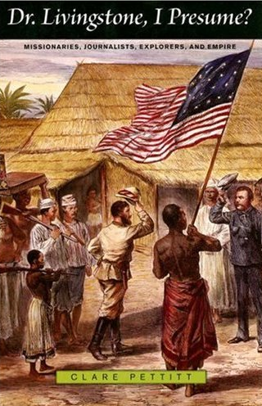
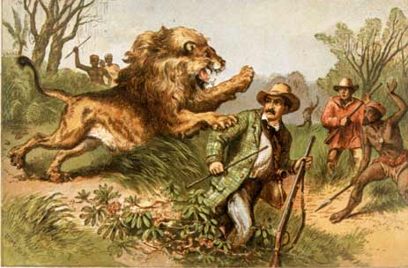
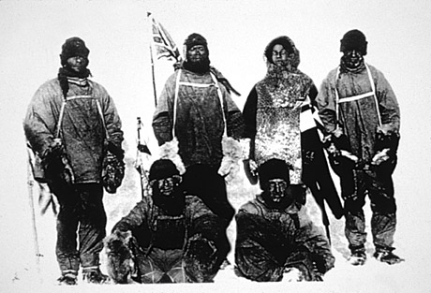
A world to be explored !
Notes:
5
Equivalenza o meno dei biosimilari con originator. Motivazioni
Indicazioni ema. Studi clinici fattori di crescita (recuperare) ed epo
Regione veneto
Aspetti economici. Possibili risparmi nazionale, regionale. Aziendale

Slide 6

Over 90% of Medical Oncologists utilize biotech drugs
24% give a correct definition of biosimilars
52% think that biosimilars may reduce overall costs
39% think that other forms of saving money have to be found
Survey among 508 Medical Oncologists, AIOM, 2013

Slide 7
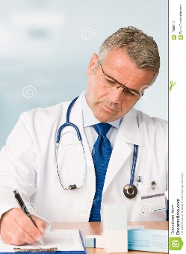
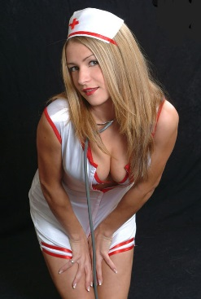
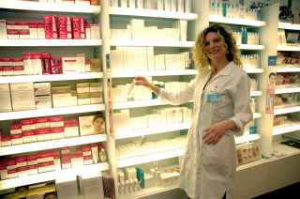
And what about USA ?
Zelenetz AD, JNCCN 2011

Slide 8
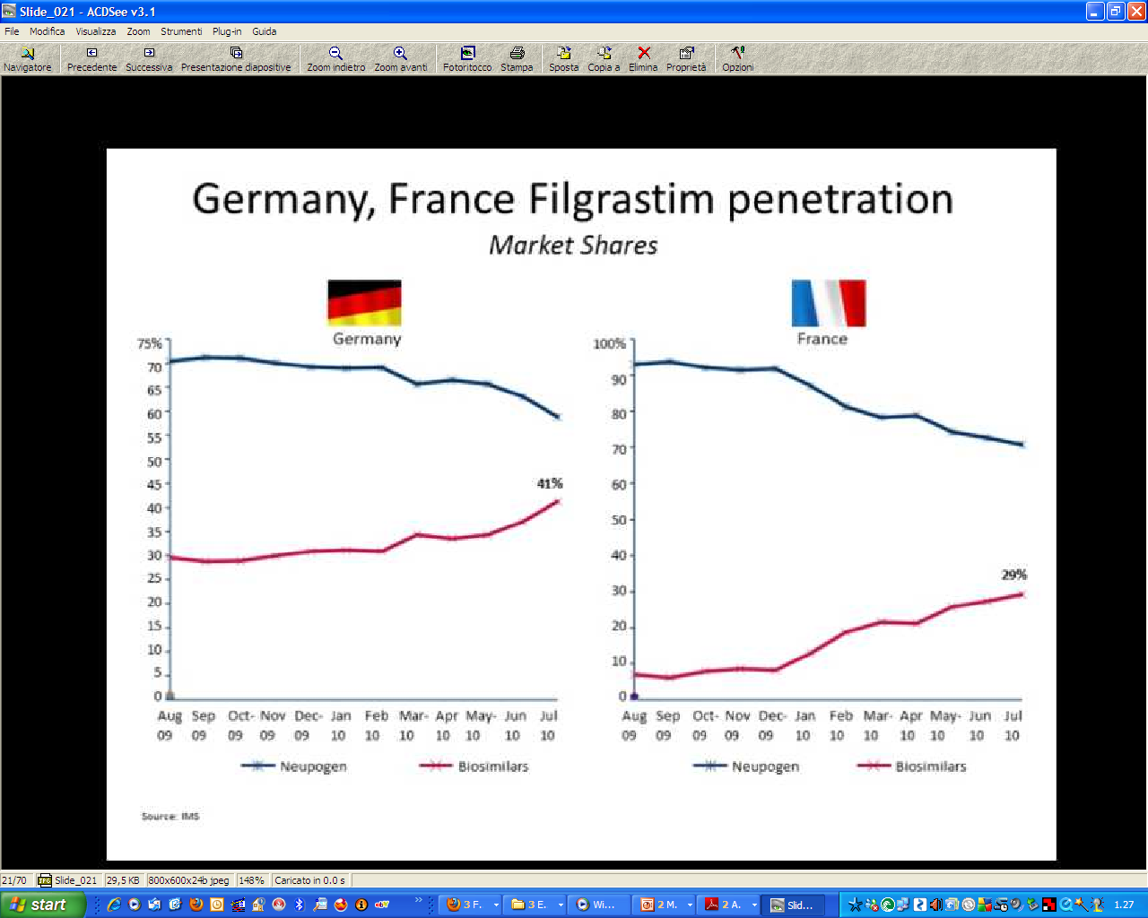
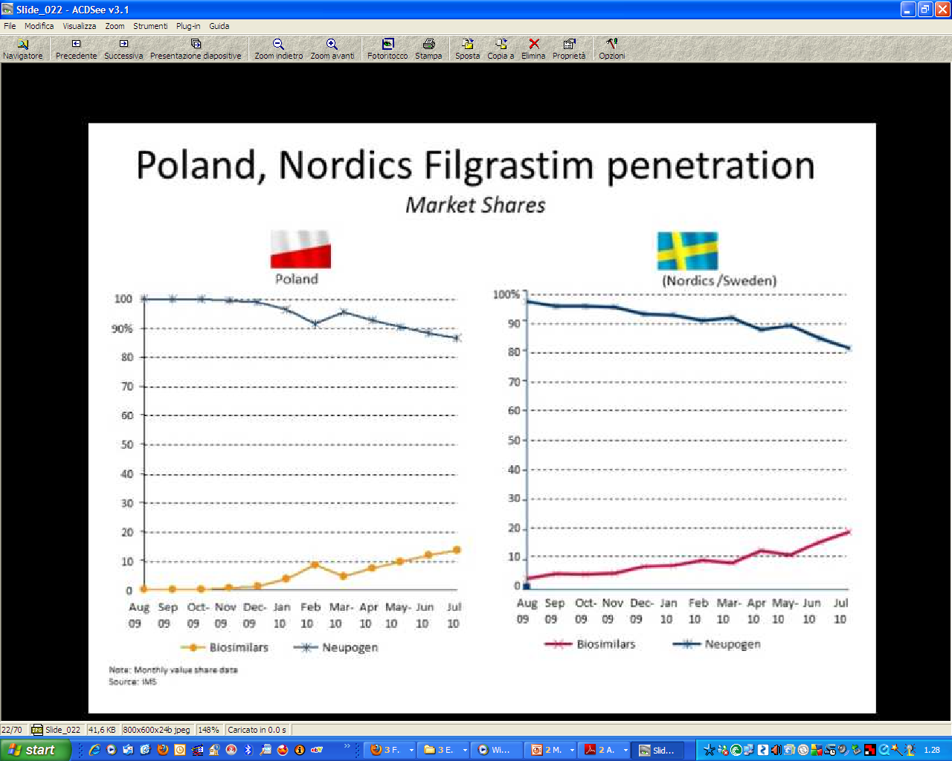
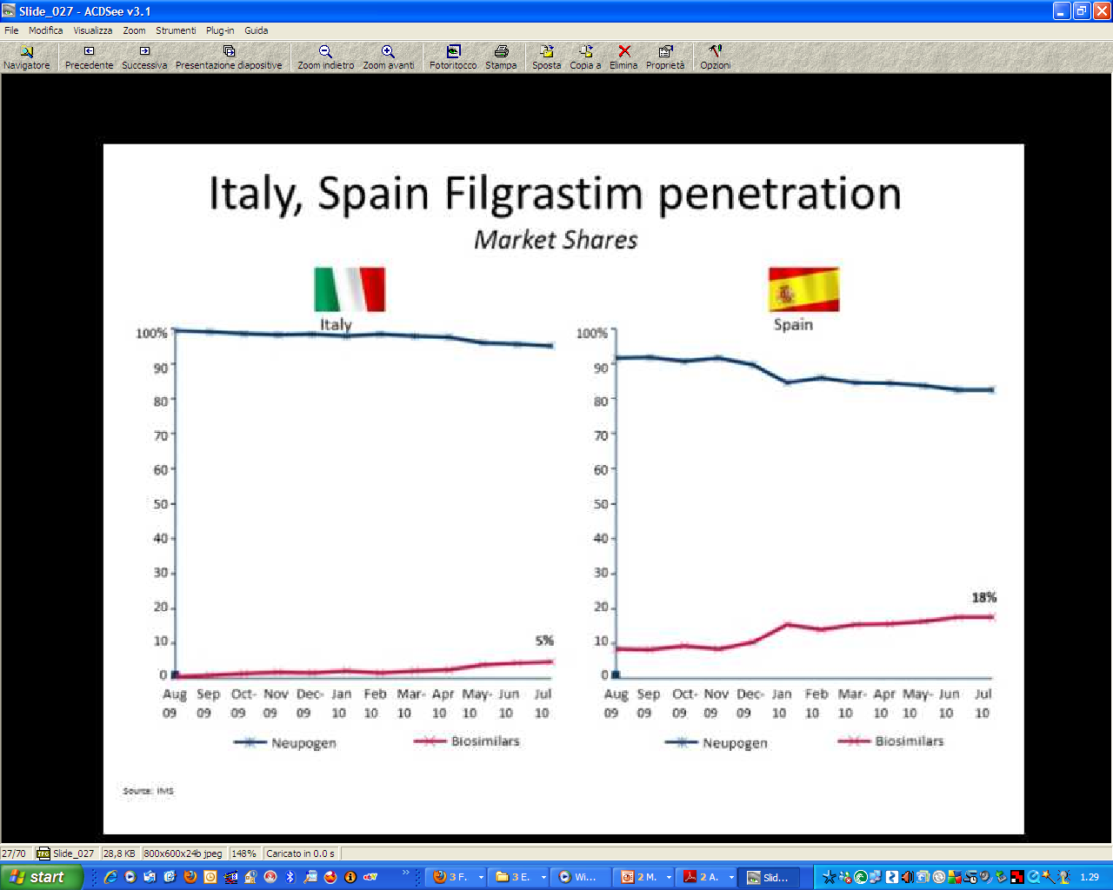
European (dis)Union! The early penetration (2010)
Germany, France Filgrastim penetration
Market Shares
Poland, Nordic Filgrastim penetration
Market Shares
Italy, Spain Filgrastim penetration
Market Shares
Notes:
8

Slide 9
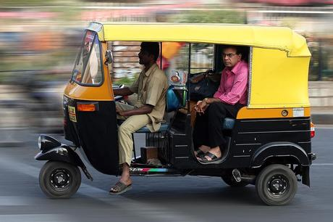

The fair of fears
Who knows where do they come from ? India, Cambodia?
Who knows if there is the correct dose of the «good» drug inside?
They give us such drugs just to save money !
They do not care of patients , but just of money !
Biosimilars delivery

Slide 10
Doctors see a biosimilar as a «new» drug, meanwhile the Health
Authorities consider it as a different version of the same drug.
Ekman N., European Conference on Biosimilars, Bruxelles, 2016

Slide 11

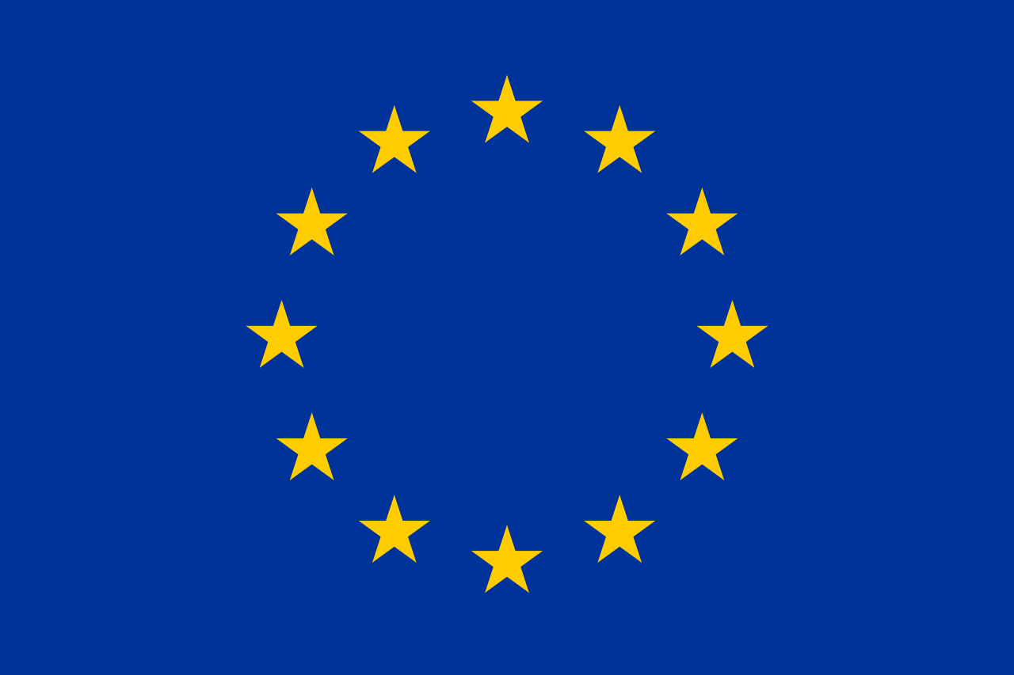

Europe April 2017
USA April 2017
28 biosimilars
9 biosimilars
(follow-on biologics)
GaBI, April 2017

Slide 12

28 Countries (27?)*
One approval , then received by each country 28(27)
* I have no idea where to place the UK after Brexit

Slide 13

Who decides what
UE (EMA)
CHMP ( guidelines)
MAA

Slide 14




Valid for UE plus FL, IS, N (EEA area)
Each company may submit its dossier
Guidelines for «comparability exercise» in order to evaluate
quality, safety and efficacy of a biosimilar product compared
to a brend approved in the EU
5 May 2017
EMA/940451/2011

Slide 15
EMA does not provide information regarding interchangeability
(each single member decides).
Nothing to share with the generic drugs regulations!
If it is a protein, the aminoacid sequence has to be the same.
Same posology and administration route (iv is iv)
Glyco-optimization is not compatible with biosimilarity

Slide 16
If biosimilarity has been demonstrated for an indication, it is possible to proceed
to extrapolation with another indication with adequate scientific motivation.
If «important» differences emerge between the originator and the compound
under evaluation, then for MAA a stand alone program is requested.

Slide 17

Concept paper AIFA 2016

Slide 18
……………. authorization of biosimilars be carried out using a stepwise approach.
Where the reference product has more than one therapeutic indication the group proposes that, once comparability has been demonstrated in one indication, ‘extrapolation of clinical data to other indications of the reference product could be acceptable’.
(GaBI Journal). 2017;6(1):42-7

Slide 19







Learning from Europe
a legal framework and regulatory
pathway for biosimilars

Slide 20
A new glossary
Bioequivalence
Comparability exercise(s)
Extrapolation

Slide 21
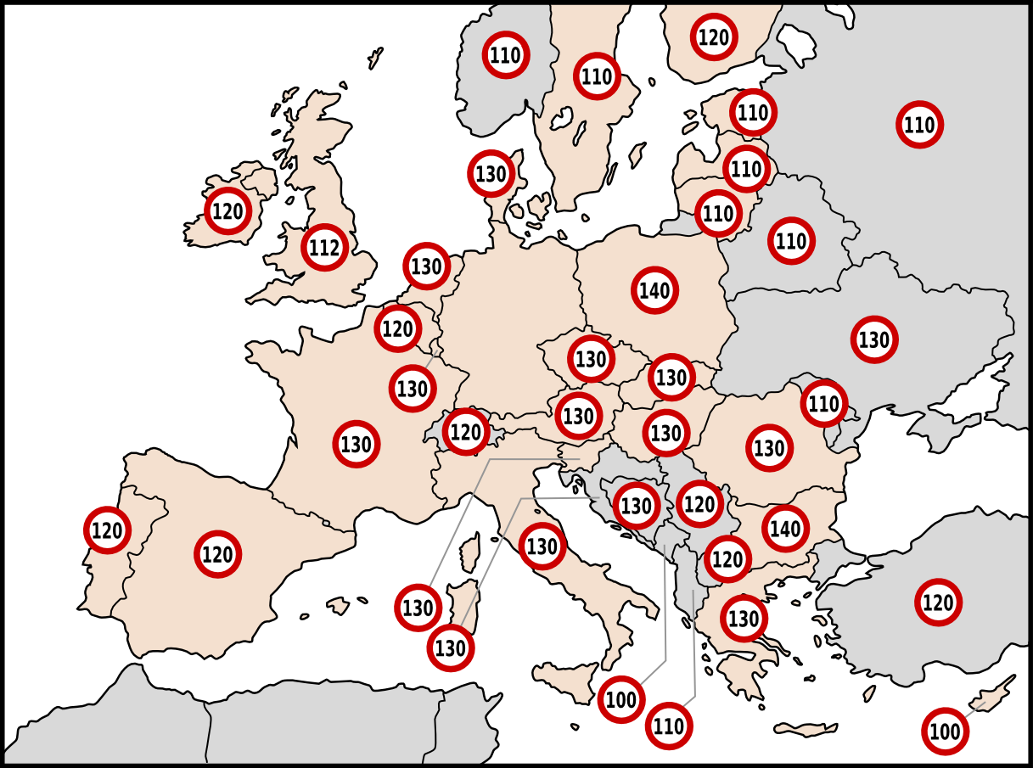

Speedy!!!
7 speed limits

Slide 22
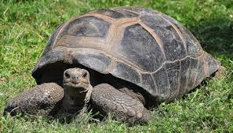
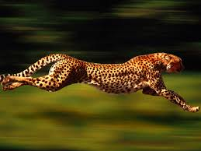
Europe with different speed limits
Rovira J. Et al, GaBI J ,2013

Slide 23
Europe or Europes ?

Slide 25
What happened in Europe
the uptake of biosimilars, followed by the UK and France.
Italy and Spain showed initial cultural resistance but are now catching up

Slide 26
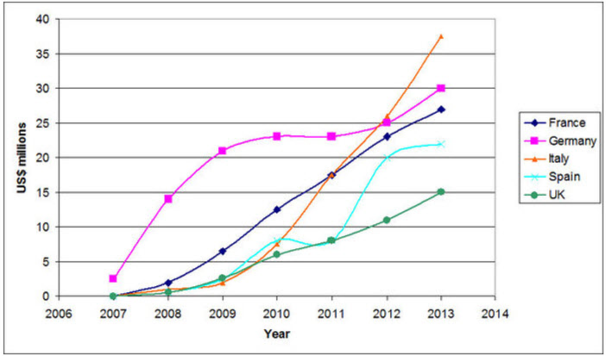
Yes !

Slide 27
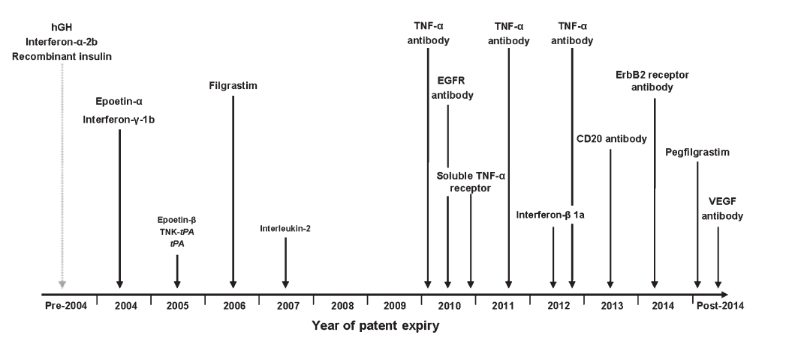
Where are we?… the end of the beginning !
Non anticancer drugs area Anticancer drugs area

Slide 28
The European Commission expects several new classes of biosimilar medicines to be submitted for approval in Europe in the coming years.
A number of ‘blockbuster’ biologics are expected to lose their EU patents before 2020, including leading treatments for breast cancer, diabetes, multiple sclerosis and rheumatoid arthritis.
The opportunities for clinical investigators in biosimilar research are expected to escalate throughout Europe.

Slide 29

A,a,a,a,a……chi ?
Fausto Leali et al. 1967

Slide 30
Epoietins onco-hematology: regional (volumes)
BIOSIMILARE
ORIGINATORE
Biosimilari +/-% 2016 vs 2015
TAA
79%
PIEM+VDO
72%
EMILIA R
70%
TOSCANA
69%
VENETO
68%
SICILIA
58%
LIGURIA
58%
UMBRIA
54%
BASILICATA
51%
188%
ITALIA
48%
CAMPANIA
44%
LOMBARDIA
44%
MARCHE
44%
PUGLIA
39%
159%
FVG
34%
ABR+MOL
30%
SARDEGNA
28%
LAZIO
27%
CALABRIA
14%
100%
Source: IMS MAT 08/2016
Short+Long-Acting

Slide 31
G-CSF – regional (volumes)
BIOSIMILARE
ORIGINATORE
Biosimilari +/-% 2016 vs 2015
EMILIA R
97%
TAA
90%
UMBRIA
90%
VENETO
89%
LIGURIA
89%
PIEM+VDO
83%
SICILIA
79%
TOSCANA
71%
ITALIA
62%
FRIULI V.G.
62%
LOMBARDIA
61%
MARCHE
53%
ABR+MOL
51%
LAZIO
51%
64%
CAMPANIA
49%
BASILICATA
39%
SARDEGNA
37%
CALABRIA
31%
PUGLIA
23%
57%
Source: IMS MAT 08/2016
100%

Slide 32
Short-acting biosimilars epoietins penetration
Biosimilars +/-% 2016 vs 2015
Germany
70%
+5%
Italy
54%
+39%
Spain
47%
+25%
France
30%
+19%
Source: IMS MAT 08/2016

Slide 33
Short-acting biosimilar filgrastim penetration
Biosimilars +/-% 2016 vs 2015
Itay
91%
+7%
France
86%
+3%
Spain
81%
+4%
Germany
78%
+3%
Source: IMS MAT 08/2016

Slide 34
Some available results

Slide 35
Few data about the use of epoetins in chemotherapy in clinical practice are available.
It is especially important to describe, in the Italian clinical practice, the trend of Hb levels in anaemic cancer patient for whom the physicians deemed to use Binocrit®.
The ANEMONE observational study contributed to enlarge information on Binocrit® utilization in Italian clinical practice.

Slide 36
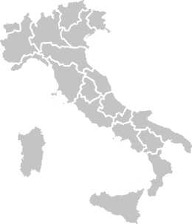
Anemone study: a National effort
Lambelet, Versilia Azienda Ulss 12, Lido Camaiore (LU)
Petrini, Azienda Ospedaliera Universitaria Pisana, Pisa (PI)
Bosi, A.O.U. Careggi, Firenze (FI)
Rosti, Ospedale Ca' Foncello, Treviso (TV)
Galieni, Ospedale C. e G. Mazzoni, Ascoli Piceno (AP)
Giglio, Ospedale Cardarelli, Campobasso (CB)
Bernardi, ULSS 10 "Veneto Orientale", San Donà di Piave (VE)
Scelzi, Ospedale di Castelfranco Veneto (ULSS 8), Castelfranco Veneto (TV)
Bonciarelli, Azienda ULSS17, Monselice (PD)
Falini, Ospedale Santa Maria della Misericordia, Perugia (PG)
Veltri, Ospedale S. Maria Goretti, Latina (LT)
Frassoldati, A.O.U. Arcispedale Sant'Anna , Cona di Ferrara (FE)
Maisano, Az. Osp. Bianchi Melacrino Morelli , Reggio Calabria (RC)
Tagliaferri, Fondazione "Tommaso Campanella", Catanzaro (CZ)
Minotto, Ospedale di Mirano - ULSS 13, Mirano (VE)
Gamucci, Ospedale S.S. Trinità , Sora (FR)
Gatti, Regione del Veneto - Azienda ULSS 14 Chioggia, Sottomarina di Chioggia (VE)
Ghio, A.O.U. San Martino di Genova, Genova (GE)
Moreo, Fondazione Cà Granda Ospedale Maggiore Policlinico, Milano (MI)
Gherlinzoni, Ospedale Cà Foncello, Treviso (TV)
Mencoboni, Az. Ospedale Villa Scassi - ASL 3 Genovese, Genova (GE)
Sponghini, Az. Osp. Maggiore della Carità, Novara (NO)
Angelini, Ospedale Regina Apostolorum, Albano Laziale (Roma)

Slide 37
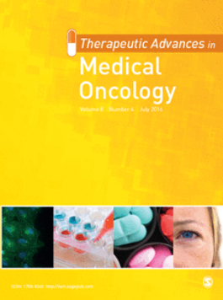
p<0.0001
Solid tumors
Treatment
start
Treatment
start + 4 weeks
Treatment
start + 12 weeks
Hematologic
tumors
p<0.0001
Treatment starts
Treatments start + 4 weeks
Treatment starts + 12 weeks
Rosti et al , Ther Adv Med Oncol, 2016

Slide 38

Improvement of Anemia
132 (61%) patients showed an improvement of anemia *:
55% were females
median age was 70 y [range 25-89 y]
* intended as an increase of Hb level ≥ 1 g/dL in the first 4 (+1) weeks and or an increase of Hb level ≥ 2 g/dL in the first 12 (+1) weeks

Slide 39
Serious Adverse events and adverse drug reactions
4 patients experienced one or more SAEs, for a total of 6 SAEs: one event of dyspnea resulted in a prolonged hospitalization, while the others were medically significant.
2 patients experienced ADR: one superficial and one deep venous thrombosis were reported, both considered with possible relationship with Binocrit.

Slide 40

5309 patients with cancer (2012-2014)
in the Lazio Region
BMJ Open, 2017

Slide 41
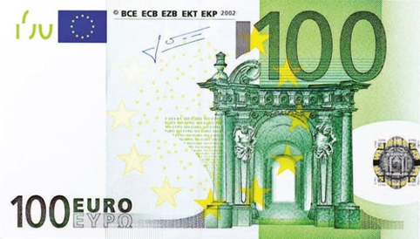
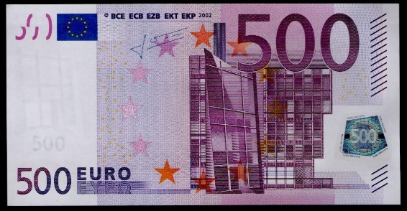
?
or
Bongiovanni, J Supp Care Cancer ,2016

Slide 42
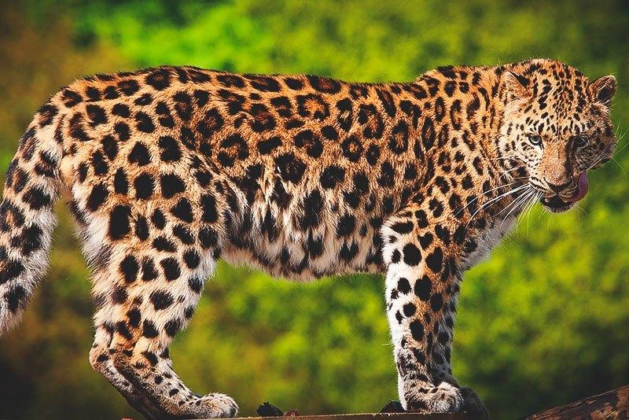

Slide 46
After the «appetizers»

Slide 47
The first approved biosimilar MoAb in Europe is Truxima
(rituximab) for all the indications apporved for MabThera.
Produced by Celltrion Healthcare and commercialized by MundiPharma
Global market of MabThera is 7.3 billions dollars/year

Slide 48


Advantages of biosimilars
More fruibility also through
market competition
Reallocation of resources
Studies on new molecules
Research
Help to «weak systems»

Slide 49
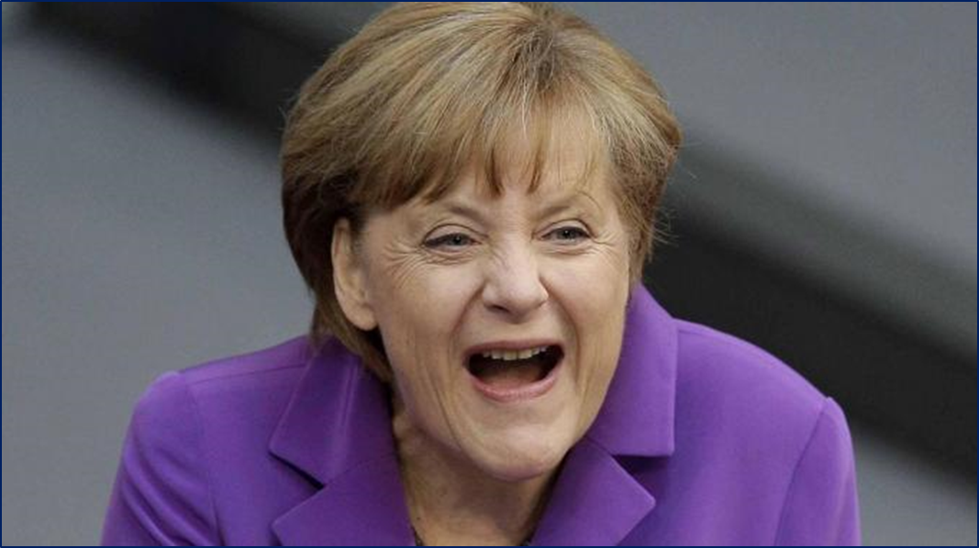
Ein Beispiel
Biosimilar epoietin from 2007 up to 2011 600M saved.

Slide 50
European Disunion
In the UK, at least eight breast cancer biologics with proven overall survival benefit have been rejected between 2011 and 2014 by the National Institute for Health and Care Excellence (NICE) for reimbursement on the National Health Service (NHS) because of cost.

Slide 51
Rémuzat C. et al

Slide 52
Biologic | Australia | Canada | European Union | Japan | South Korea | United States
Adalimumab |  |  | 1 |  |  | 1
Calcitonin |  |  |  |  |  | 1*
Enoxaparin sodium |  |  | 2
Epoetin alpha |  |  | 3 | 1
Epoetin lambda | 3
Epoetin zeta |  |  | 2
Etanercept | 1 | 1 | 1 |  | 2 | 1
Filgrastim (G-CSF) | 3 | 1 | 9 | 3 |  | 1
Follitropin alpha (FSH) |  |  | 2
Glucagon |  |  |  |  |  | 1*
Hyaluronidase |  |  |  |  |  | 1*
Infliximab | 1 | 2 | 3 | 1 | 1 | 1
Insulin glargine | 1 | 1 | 2 | 2 |  | 1*
Rituximab |  |  | 1 |  | 1
Somatropin | 2 | 1 | 2 | 1 | 1 | 1*
Teriparatide |  |  | 2
Trastuzumab |  |  |  |  | 1
Total | 11 | 6 | 30† | 8 | 6 | 9

Slide 53
Ruthless competition
Positive effect
But one question comes out.
And until now………………………..?

Slide 54

Economical «consequences» of biosimilars
Epoietin prices reduced by 35%
UK price reduction for infliximab 35%

Slide 55
Previsions with rituximab biosimilar
Assuming a price of 70% compared to the originator and a market share of
30% first year
40% second year
50% third year
Budget saving across EU equals 570 M Euros (49,000 pts)
Prof. L. Gulàcsi, 2017

Slide 56
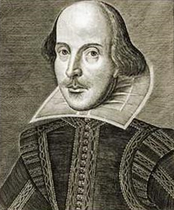

To Biosimilar or NOT to Biosimilar ?
Much , but very much adapted by Sir W.Shakespeare, The Tragedy of Hamlet, Prince of Denmark, 1518

