Slide 1
Deregulated Hippo pathway in breast cancer
Marcello Maugeri-Saccà, MD, PhD
“Regina Elena” National Cancer Institute

Slide 2
Biochemical and functional characterization of the Salvador-Warts-Hippo (SWH) pathway in flies
Loss of Warts (wts), Salvador (sav),
Hippo (hpo) , Mob as tumor suppressor (mats) ,
Overexpression of Yorkie (yki) and
Scalloped (Sd)
Justice, Genes Dev 1995; Xu , Development 1995; Kango-Singh, Development 2002; Tapon, Cell 2002; Harvey, Cell 2003; Lai, Cell 2005; Huang, Cell 2005

Slide 3
The Hippo pathway is a central regulator of organ size and tissue homeostasis in mammals
YAP overexpression
MST ablation
Camargo, Curr. Biol 2007; Dong, Cell 2007;
Reviewed in Piccolo, Physiol Rev.2014.; Yu , Cell 2015

Slide 4
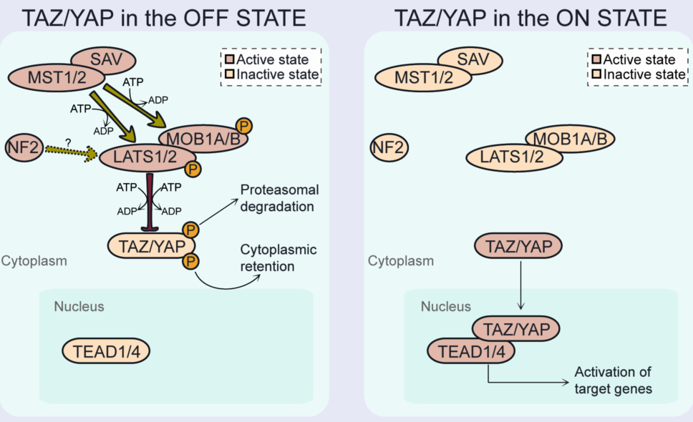
Architecture of the Hippo pathway
Maugeri-Saccà M, et al.
Expert Rev Mol Med. 2015

Slide 5
1) Cell polarity and
cell junction factors
2) Upstream activators
of Hippo kinases
3) Ligand-dependent
activation
CRB
Apical
TAOK
AMOTs
SAV
Tight
junctions
MST1/2
RHO GTPases
Adherens
junctions
α-catenin
LATS1/2
MOB1A/B
PTPN14
Actin
Basolateral
junctions
SCRIB
TAZ/YAP
RHO GTPases
TEADs
AMPK
4) Mechanical cues
HMG-CoAR
Basal
5) Metabolic factors

Slide 6
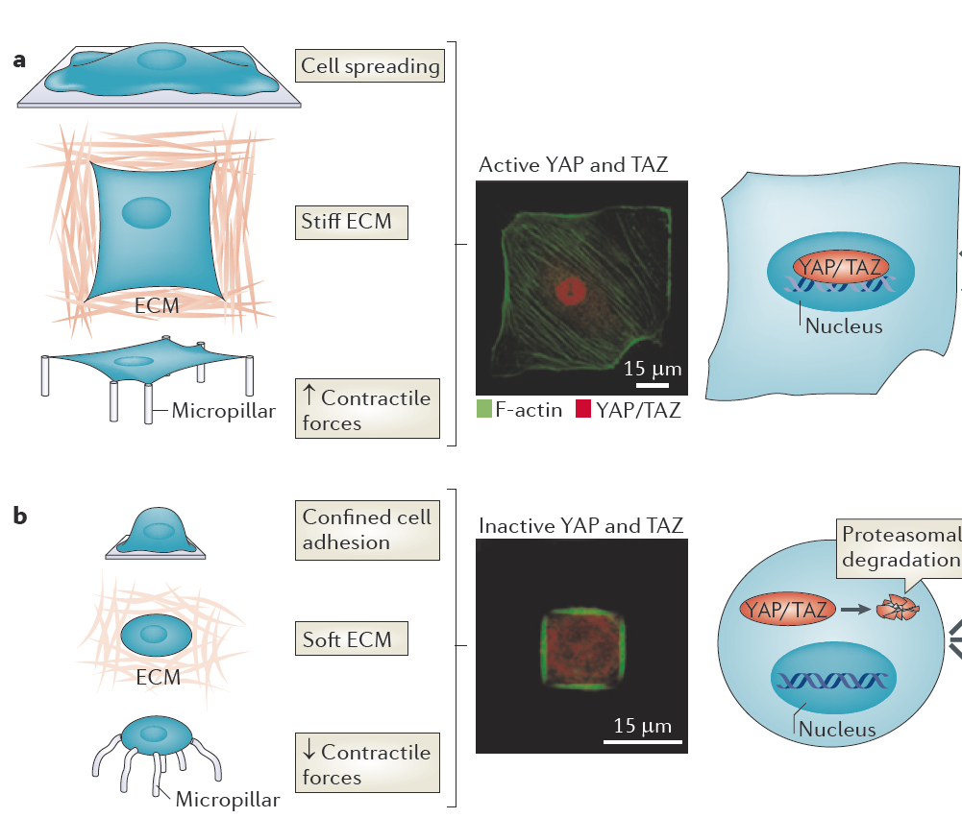
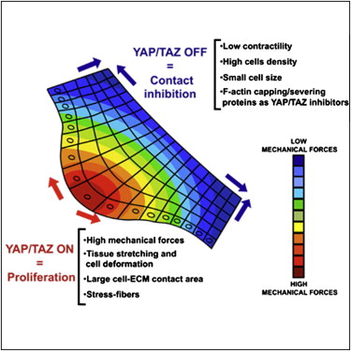
Mechanical regulation of YAP/TAZ: mechanotransduction
Halder, Nat Rev Mol Cell Biol. 2012

Slide 7
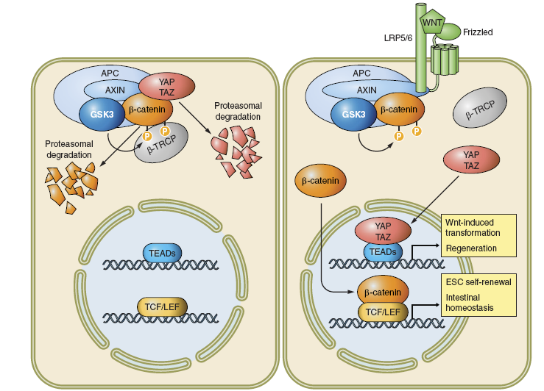
The Hippo-Wnt crosstalk
Azzolin, Cell 2014; Cai, Genes Dev. 2015

Slide 8
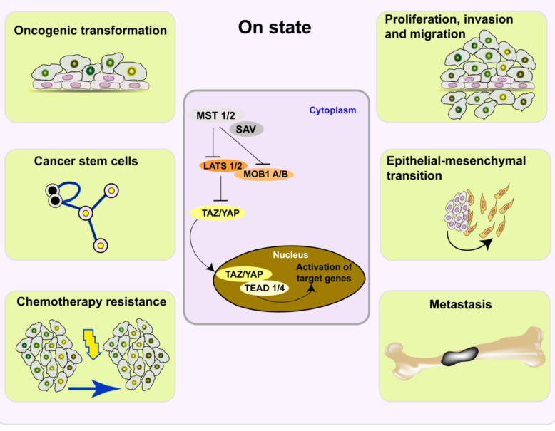
The Hippo pathway in BC
Maugeri-Saccà M, et al.
Expert Rev Mol Med. 2015

Slide 9
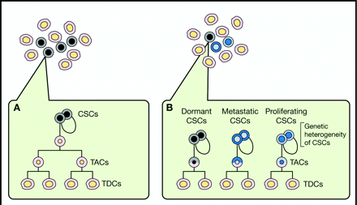
The origin and evolution of the CSCs concept
Maugeri-Saccà M, et al
Mol Cancer Ther. 2012

Slide 10
CSCs and therapeutic resistance
A-B-C: CSC-intrinsic
mechanisms
D: CSC-extrinsic
mechanisms
Maugeri-Saccà M .et al. Clin Cancer Res 2011
Notes:
CSC-intrinsic mechanisms of chemoresistance. A, high expression of MDR pumps that actively extrude chemotherapeutic agents of natural origin. B, proficient DNA repair machinery removes DNA adducts formed by alkylating agents. C, chemotherapy kills rapidly proliferating cells while slow-cycling/quiescent CSCs are spared from chemotherapy-induced cell death. D, microenvironmental stimuli associated with EMT and hypoxia indirectly contribute to chemoresistance through the generation of cancer stem-like cells.

Slide 11
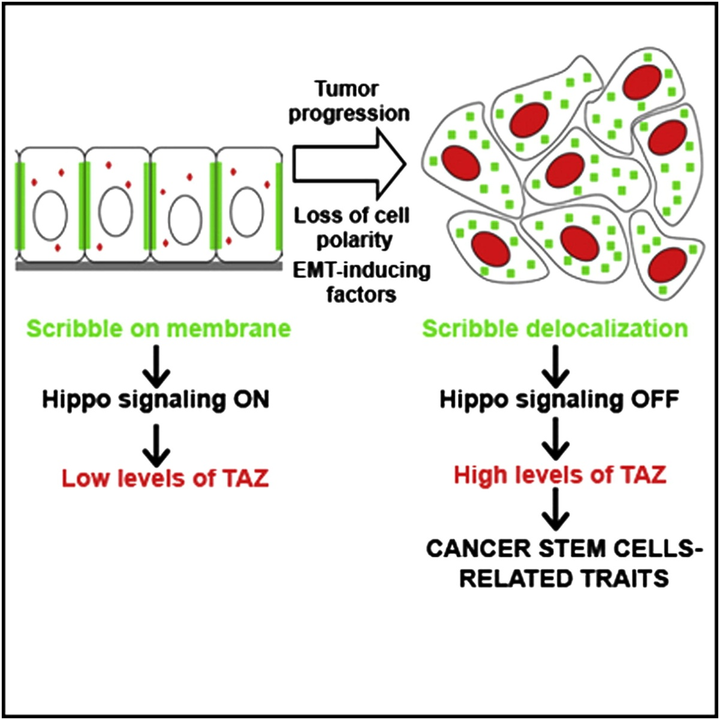
TAZ controls Breast Cancer Stem Cell (BCSCs) fate
Cordenonsi, Cell 2011

Slide 12
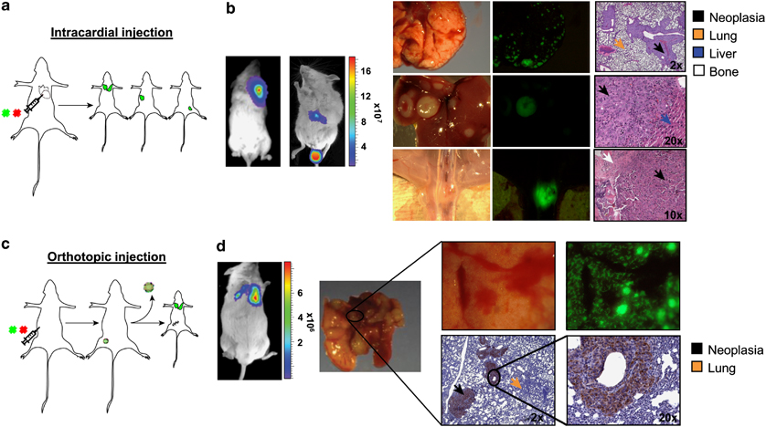
TAZ is required for metastatic activity and chemoresistance of BCSCs
Bartucci , Oncogene 2015

Slide 13
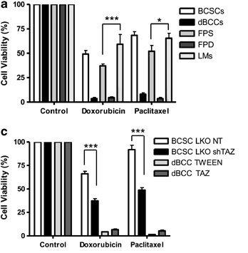
TAZ is required for metastatic activity and chemoresistance of breast cancer stem cells
Bartucci M. et al. Oncogene 2015

Slide 14
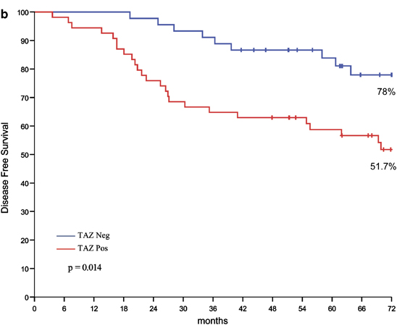
TAZ is required for metastatic activity and chemoresistance of breast cancer stem cells
TAZ expression
Bartucci M. et al. Oncogene 2015

Slide 15
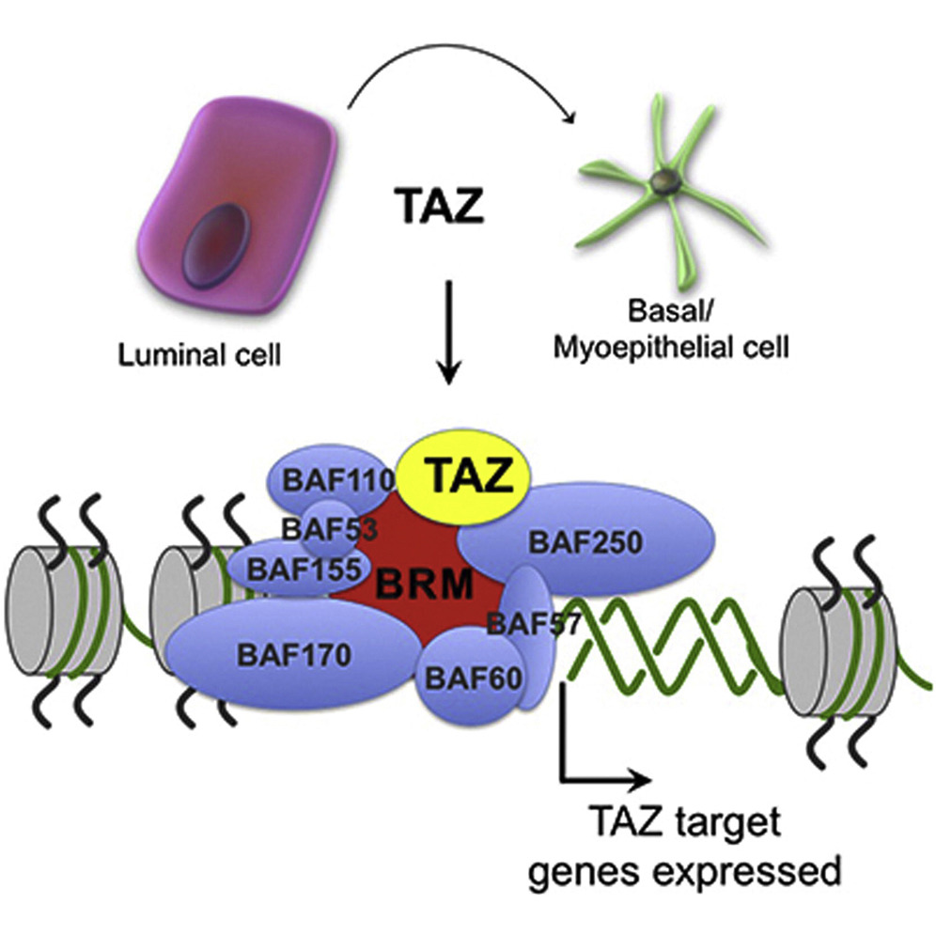
The Hippo Transducer TAZ Interacts with the SWI/SNF Complex to Regulate Breast Epithelial Lineage Commitment
Gain-of-Function Screen of
Epithelial Lineage Plasticity
Skibinski A. et al, Cell Rep. 2014

Slide 16
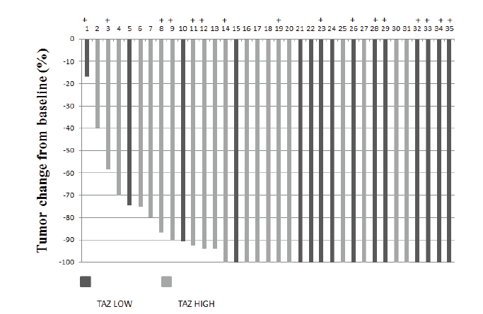
TAZ as a biomarker of pCR in HER2-positive BC patients treated with NAT
 |  | No pCR N (%) | pCR N (%) | p-value
Overall population |  | 20 (32,8) | 41 (67,2)
 | TAZ score ≤ 0,50 > 0,50 | 6 (21,4) 14 (42,4) | 22 (78,6) 19 (57,6) | ■0,082
HER2-enriched |  | 7 (26,9) | 19 (73,1)
 | TAZ score ≤ 0,50 > 0,50 | 3 (27,3) 4 (26,7) | 8 (72,7) 11 (73,3) | ●0,999
Luminal B |  | 13 (37,1) | 22 (62,9)
 | TAZ score ≤ 0,50 > 0,50 | 3 (17,6) 10 (55,6) | 14 (82,4) 8 (44,4) | ●0,035
TP50 |  | 6 (37,5) | 10 (62,5)
 | TAZ score ≤ 0,50 > 0,50 | 1 (11,1) 5 (71,4) | 8 (88,9) 2 (28,6) | ●0,035
Waterfall plot showing response data
for luminal B patients: + TP50
Vici P. et al. Oncotarget 2014

Slide 17
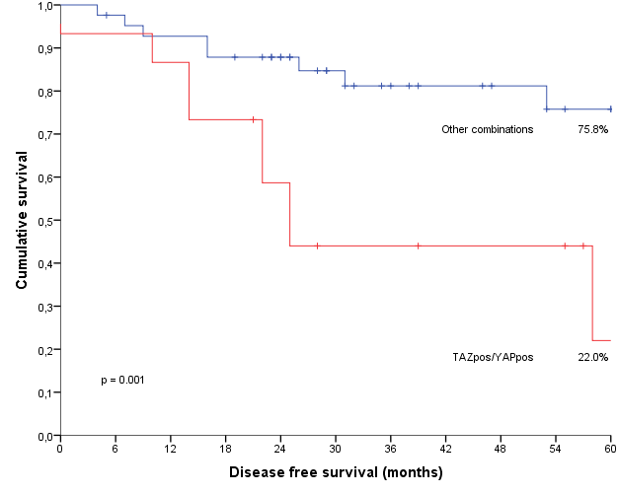
The Hippo transducers TAZ and YAP in TNBC patients treated with NAT
(N=10)
(N=9)
A)
Double positive
(N=15)
No double positive
(N=42)
p= 0.003 (Fisher's Exact Test)
* Recurrence
B)
Vici P. et al. J Exp Clin Cancer Res 2016

Slide 18
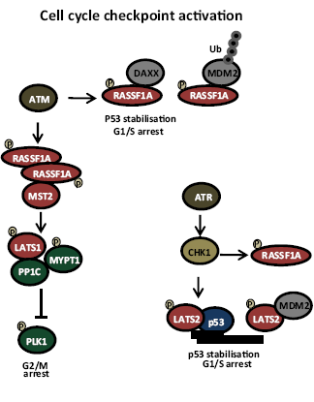
Subcellular compartment-dependent significance of pMST1/2 expression in TNBC and HER2-positive BC patients treated with NAT
Ercolani C et al., Cancer Biol Ther. 2017,
Pefani and O'Neill FEBS J. 2016

Slide 19
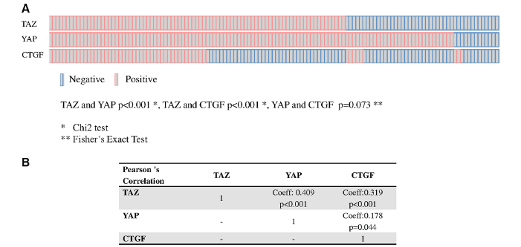
TAZ/YAP and their target CTGF in male breast cancer
Di Benedetto A et al., Oncotarget 2016

Slide 20
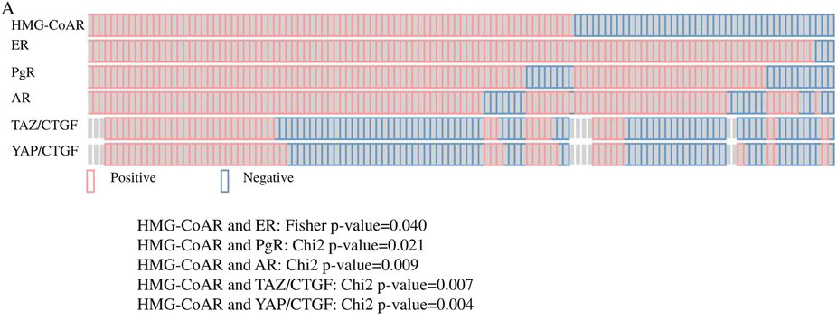
HMG-CoAR expression in male breast cancer (metabolic control of YAP/TAZ)
Di Benedetto A et al, Sci Rep 2016

Slide 21
YAP in BC: oncogene or oncosuppressor ?
YAP overexpression in non-transformed mammary epithelial cells or BC cell lines induces EMT, proliferation, anchorage-independent growth and metastatic proclivity
YAP stabilizes p73 inducing the transcription of pro-apoptotic genes
YAP is phosphorylated and inhibited by oncogenic Akt
YAP is located at 11q22.2, a site of frequent loss of heterozygosity in BC
functional studies described increased malignant features upon YAP knockdown in BC cell lines
Overholtzer et al, PNAS 2006; Zhang et al, Nat Cell Biol 2009; Wang et al, PNAS 2014; Lamar et al, PNAS 2012; Chen et al, Nat Med 2012
Strano et al, J Biol Chem 2001; Strano et al, Mol Cell 2005; Danovi et al, Cell Death Differ 2008; Levy et al, Cell Death Differ 2007; Basu et al., Mol Cell 2003; Carter et al, Cancer Res 1994; Yuan et al, Cell Death Differ 2008; Yu et al., Clin Cancer Res 2013

Slide 22
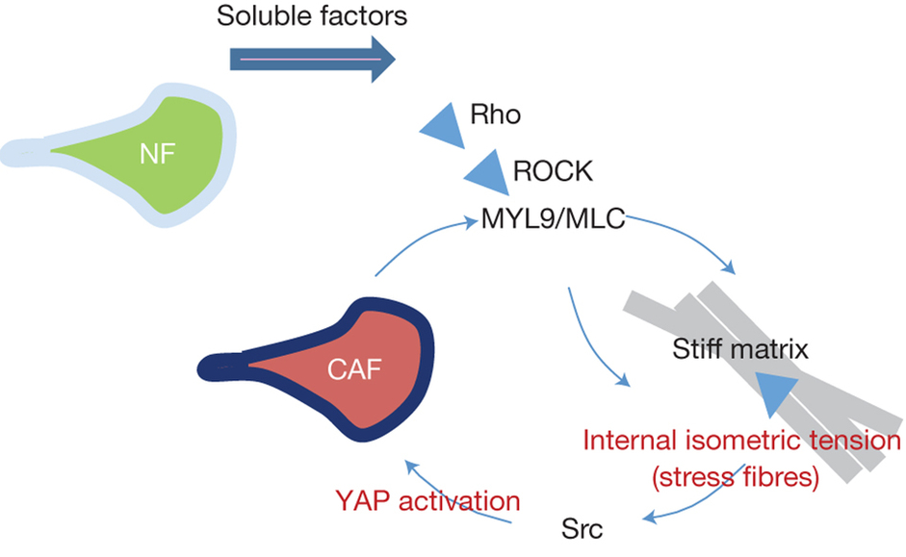
YAP in BC: oncogene or oncosuppressor? …….. P53 and CAFs
Di Agostino S et al., EMBO Rep. 2016
Calvo F et al., Nat Cell Biol 2013
Notes:
A range of soluble factors can promote matrix remodelling by normal fibroblasts. This requires some level of ROCK and actomyosin function. As the matrix becomes stiffer, isometric tension within the cell increases, leading to Src activation and the association of YAP with TEAD transcription factors. ActiveYAP then promotes the expression of ANLN and DIAPH3 mRNA and stabilizes actomyosin proteins. This leads to further matrix stiffening, thereby generating a positive feedback loop. NF, normal fibroblast.

Slide 23
An unexpected function of Hippo kinases: LATS1/2 deletion stimulates anti-cancer immunity
Moroishi et al., Cell 2016

Slide 24
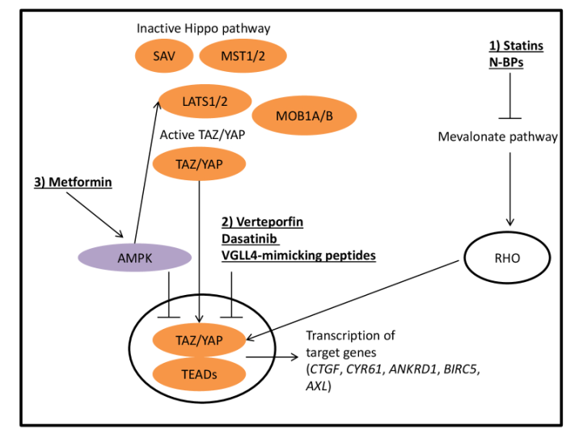
Strategies for targeting YAP/TAZ
Maugeri-Saccà M and De Maria R, Pharmacology & Therapeutics (under review)

Slide 25
Metabolic control of the Hippo pathway
Metformin
Sorrentino G et al., Nat Cell Biol. 2014
Santinon G et al., Trends Cell Biol. 2016

