Slide 1
BREAKTHROUGHS IN GASTROINTESTINAL CANCER TREATMENT
Immunotherapy and new perspectives
Dr Fabio Gelsomino

Slide 2
AGENDA
From molecular subtypes to stromal classification
Immunotherapy in MSI-H CRCs
Strategies to convert an immune ignorant tumor into an inflamed one
Molecular-driven therapeutic hypotesis

Slide 3
AGENDA
From molecular subtypes to stromal classification
Immunotherapy in MSI-H CRCs
Strategies to convert an immune ignorant tumor into an inflamed one
Molecular-driven therapeutic hypotesis

Slide 4
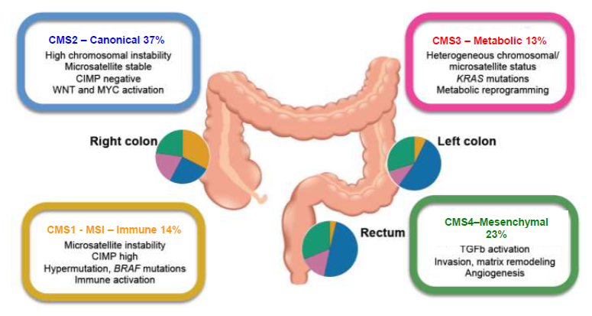
The Consensus Molecular Subtypes of Colorectal Cancer
Guinney J et al, 2015

Slide 5
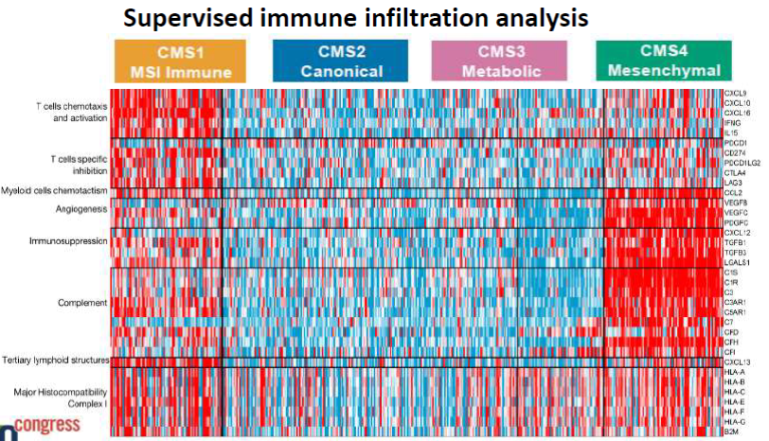
Immune and Stromal Classification of Colorectal Cancer is associated with Molecular Subtypes and Relevant for Precision Immunotherapy
Becht E et al, 2016

Slide 6
Immune vs Transcriptomic subtypes of CRC

Slide 7
AGENDA
From molecular subtypes to stromal classification
Immunotherapy in MSI-H CRCs
Strategies to convert an immune ignorant tumor into an inflamed one
Molecular-driven therapeutic hypotesis

Slide 8
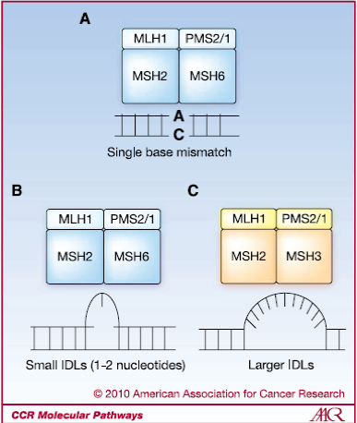
Therapeutic Targeting of the DNA Mismatch Repair Pathway
Martin SA et al, 2010

Slide 9
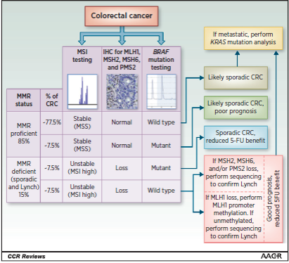
Microsatellite Instability as a Biomarker for PD-1 Blockade
Dudley JC et al, 2016

Slide 10
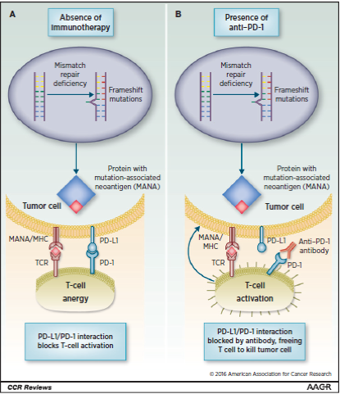
Microsatellite Instability as a Biomarker for PD-1 Blockade
Dudley JC et al, 2016

Slide 11
Polymerase proofreading domain mutations: new opportunities for immunotherapy in hypermutatad colorectal cancer beyond MMR deficiency
POLE mut 0,5-2% of mCRC
Somatic > germline
Younger, male, right-sided, earlier-stage and better prognosis in early-stage
Mutations in exonuclease domain of POLE associated with high mutation rate, multiple tumoral neo-epitopes and T-Lymphocytes infiltration → STRONG RATIONALE OR IMMUNOTHERAPY
Bourdais R et al, 2017

Slide 12
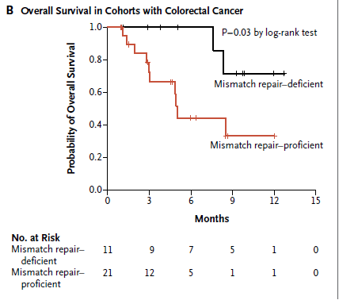
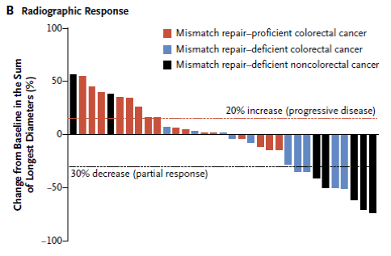
PD-1 Blockade in Tumors with Mismatch-Repair Deficiency
Le DT et al, 2015

Slide 13
KEYNOTE-164-3rd line (refractory)
A phase 2, Single-arm Study of Pembrolizumab in Pretreated patients to Address Significant Patient Unmet Needs

Slide 14
KEYNOTE-177-1st line
A phase 3 Study of Pembrolizumab Monotherapy vs Standard Chemotherapy in 1L MSI CRC

Slide 15
Nivolumab +/- Ipilimumab (Checkmate 142)
Overman MJ et al, 2016; Overman MJ et al, 2017

Slide 16
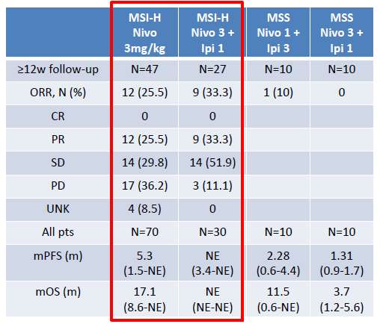
Nivolumab +/- Ipilimumab (Checkmate 142)
Overman MJ et al, 2016

Slide 17
Nivolumab +/- Ipilimumab (Checkmate 142)
Response in patients with MSI-H tumors
Overman MJ et al, 2016

Slide 18
Nivolumab (Checkmate 142 update)
Progression- free survival
Overman MJ et al, 2017

Slide 19
Nivolumab (Checkmate 142 update)
Overall survival
Overman MJ et al, 2017

Slide 20
Nivolumab +/- Ipilimumab (Checkmate 142)
Survival in patients with MSI-H tumors
Overman MJ et al, 2016

Slide 21
Nivolumab +/- Ipilimumab (Checkmate 142)
Reduction in Target Lesions Regardless of BRAF Mut Status and Lynch Syndrome
Overman MJ et al, 2017

Slide 23
PD-L1 BLOCKADE IN THE ADJUVANT SETTING IN MSI CRC

Slide 24
AGENDA
From molecular subtypes to stromal classification
Immunotherapy in MSI-H CRCs
Strategies to convert an immune ignorant tumor into an inflamed one
Molecular-driven therapeutic hypotesis

Slide 25
How can we best treat the other 95% of CRC tumors that are MSS: combination approaches
Kim and Chen, 2016
Hedge, 2016

Slide 26
MEK inhibition has a direct effect on t cells and the tumor microenvironment
Ebert, 2016

Slide 27
Cobimetinib + Atezolizumab in MSS mCRC
(phase Ib)
Bendell et al, 2016
Desai et al, 2016

Slide 28
Cobimetinib + Atezolizumab efficacy: change in tumor burden
Bendell et al, 2016
Desai et al, 2016

Slide 29
Cobimetinib + Atezolizumab
COTEZO TRIAL
NCT02788279

Slide 30
Combined chemotherapy plus Bevacizumab may create a favorable microenvironment for immunotherapy
Wallin et al, 2016

Slide 31
Atezolizumab plus Bevacizumab and/or FOLFOX in mCRC: phase Ib
Wallin et al, 2016

Slide 32
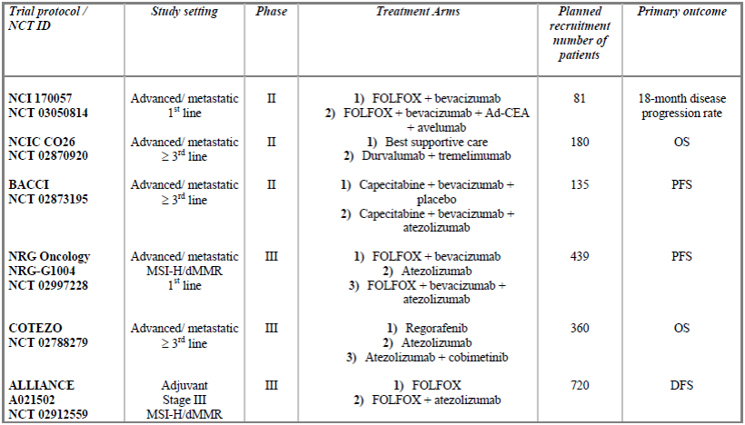
Chau I, 2017

Slide 33
Other agents with specific development in CRC
Clinicaltrials.gov

Slide 34
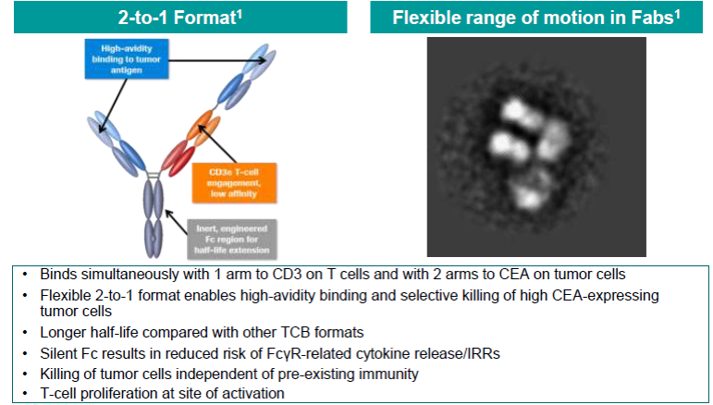
CEA-TCB is the first T-cell bispecific antibody with a novel 2-to-1 format, optimized for efficacy and safety

Slide 35
CEA-TCB at doses of >= 60mgª demonstrated clinical activity in mCRC
Argilès G, 2017

Slide 36
CEA-TCB + atezolizumab demonstrated promising clinical activity in mCRC
Argilès G, 2017

Slide 37
Examples of vaccines for immune-stimulation in CRC
Clinicaltrials.gov

Slide 38
Examples of adoptive cell therapy for immune-stimulation in CRC
Clinicaltrials.gov

Slide 39
AGENDA
From molecular subtypes to stromal classification
Immunotherapy in MSI-H CRCs
Strategies to convert an immune ignorant tumor into an inflamed one
Molecular-driven therapeutic hypotesis

Slide 40
Molecular-driven therapeutics hypothesis
Giannakis M, 2016

Slide 41
Molecular-driven therapeutics hypothesis

Slide 42
Thanks!!!
Dr. Fabio Gelsomino

