Slide 1

Neoadjuvant systemic therapy should be the standard of care
for HER2+/triple negative operable breast cancer > 2cm
Valentina Guarneri
Istituto Oncologico Veneto IRCCS
Dipartimento di Scienze Chirurgiche, Oncologiche e Gastroenterologiche -DiSCOG
Università di Padova

Slide 2
Neoadjuvant systemic therapy: no (or very little) room to debate
Affords identical outcomes to adjuvant therapy
Improves operability of locally advanced disease
Improves the chance for breast conservation
Is the standard of care for stage ≥III

Slide 3
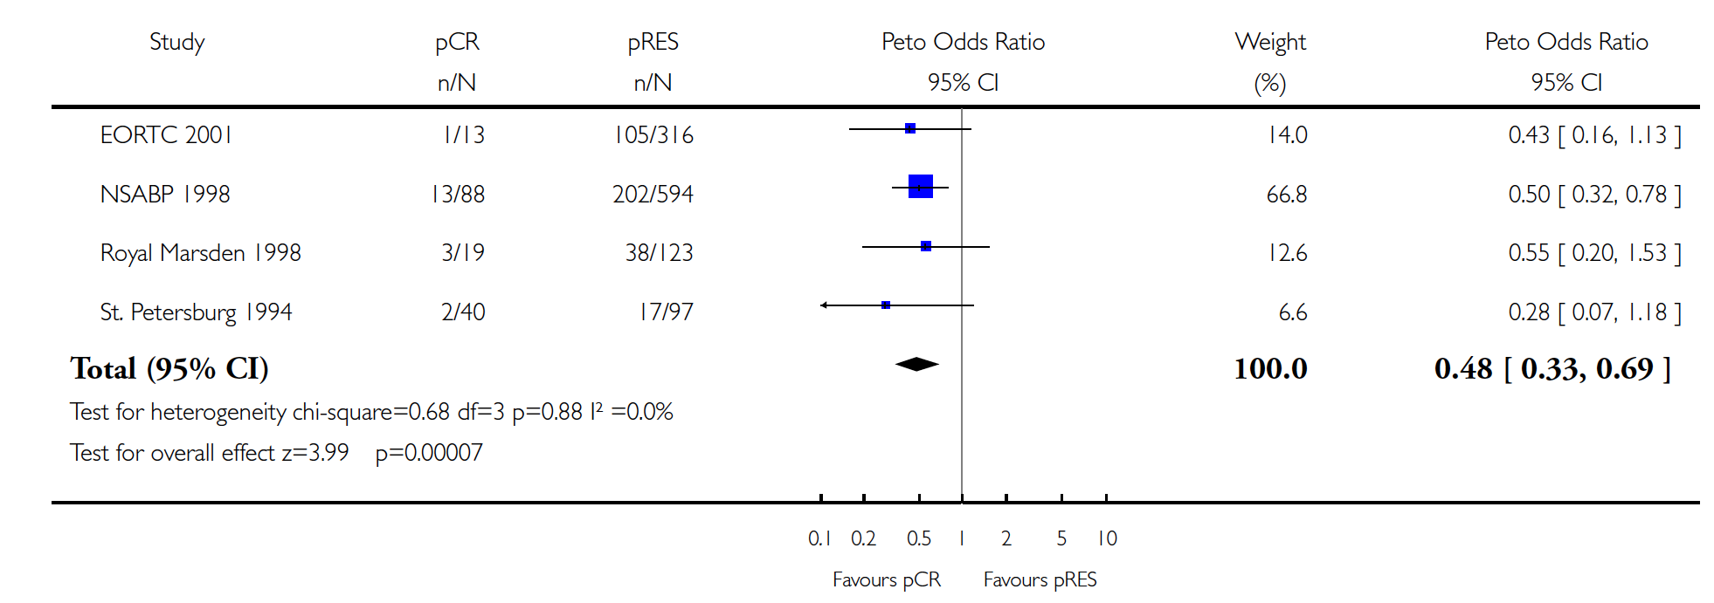

Preoperative chemotherapy for women with operable breast cancer (Review)
pCR vs residual disease, Overall Survival
The Cochrane Library, Issue 3, 2008

Slide 4
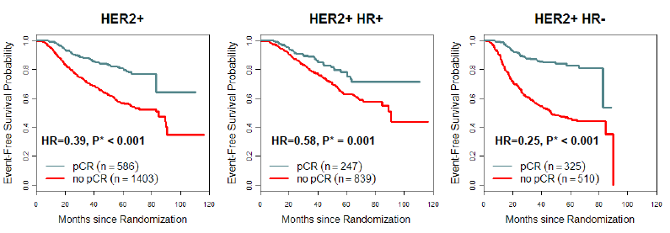
Association of pCR on EFS and OS: HR+
Cortazar P et al; Lancet, 2014

Slide 5
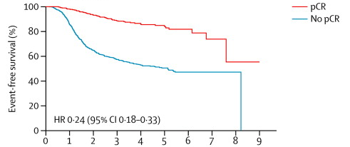
Chemosensitivity of TNBC: pCR and long-term outcome
Cortazar P, Lancet 2014
Notes:
TNBC is a chemosensitive disease. Conventional NACT with a and t based regimens results in pCR rates as high as 34%, as for the data from the FDA metanalysis. However, What is nowadays clear is that TNBC pts who achieve a pCR after NACT can experience a good prognosis and, to the opposite,those with residual disease have a particularly poor outcome. Therefore, there is the strong need to improve the efficacy of NACT for TNBC to increase pCRrate.

Slide 6
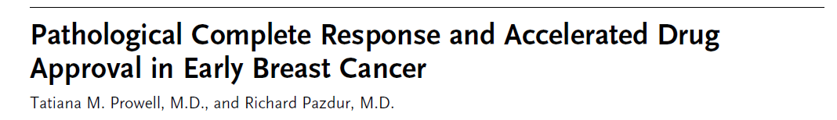


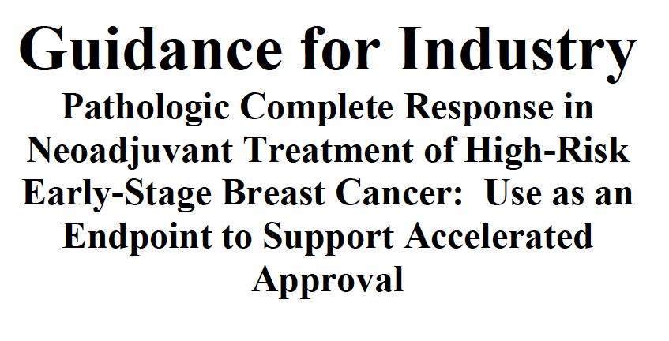

2012: Neoadjuvant results to accelerate drug approval

Slide 7
pCR rates (breast/axilla) in HER2+ BC
CT
CT + T
CT + T + L
70
CT + T + P
CT + T + Afatinib
60
50
40
30
20
10
0
MDACC¹
NOAH²
Z1041³
NeoALTTO⁴
Cher-LOB⁵
Gepar6⁶
NSABP
B-41⁷
CALGB
40601⁸
TRIO-US⁹
NeoSphere¹⁰
Tryphaena¹¹
Gepar7¹²
DAFNE¹³
1. Buzdar AU, J Clin Oncol 2005, CCR 2007; 2. Gianni L, Lancet 2010. 3. Buzdar AU, Lancet Oncol 2013. 4. Baselga J. Lancet 2012; 5. Guarneri V. J Clin Oncol 2012; 6. von Minckwitz. Lancet Oncol 2014; 7. Robidoux A. Lancet Oncol 2013; 8. Carey L .ASCO 2013; 9. Hurvitz S SABCS 2013 10. Gianni L . Lancet Oncol 2012; 11. Schneeweiss A . Ann Oncol 2013 ; 12 Untch M. SABCS 2014; 13. Hanusch C. Clin Cancer Res 2015

Slide 8
pCR rates (breast/axilla) in TNBC
60
50
40
30
20
10
0
TAC
Gepar3¹
EC-P
(+/-gem)
NeoTango²
EC-D EC-D+Bev
Gepar5³
PM PM+carbo
(+ Bev)
Gepar6⁴
P-AC P+carbo-AC
(+/- Bev)
CALGB40603⁵
P+carbo+bev
Ca.Pa.Be⁶
nabP-carbo
ADAPT⁷
P-EC nabP-EC
Gepar7⁸
1. Huober J, BCRT 2010; 2. Earl HM, Lancet Oncol 2014; 3. von Minckwitz, NEJM 2012; 4. von Minckwitz, Lancet Oncol 2014; 5. Sikov, J Clin Oncol 2015; 6. Guarneri V, Ann Surg Oncol 2015; 7. Gluz O, ASCO 2015; 8. Untch M, Lancet Oncology 2016

Slide 9
Possible reasons for NOT going to PST
Systemic treatment recommendations depend on pathological stage
Tumor biology assessed on core biopsy might be inaccurate
Residual disease is prognostic only

Slide 10
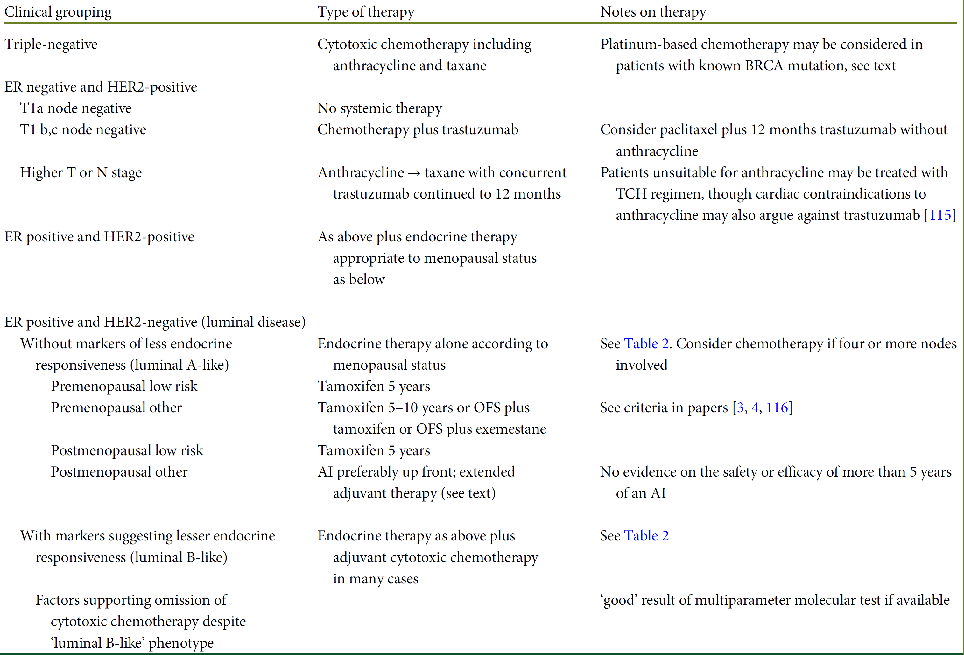
Adjuvant treatment options: St Gallen recommendations

Slide 11
SLNB before or after NACT
 | Before | after
Clinical Utility | + | +++
Feasibility | +++ | ++
Accuracy | +++ | ++
Oncologic Safety | +++ | ?
Courtesy C Khune
Notes:
Summarizing this we can conclude, that there is certainly more clinical utility in performing SLNB after than before NACT. SLNB as a dignostic tool is not quite as effective as it is before NACT. But we do not yet have data on the oncologic outcome of SLNB after NACT regarding DF and OS.

Slide 12
Possible reasons for NOT going to PST
Systemic treatment recommendations depend on pathological stage
Tumor biology assessed on core biopsy might be inaccurate
Residual disease has prognostic value only

Slide 13
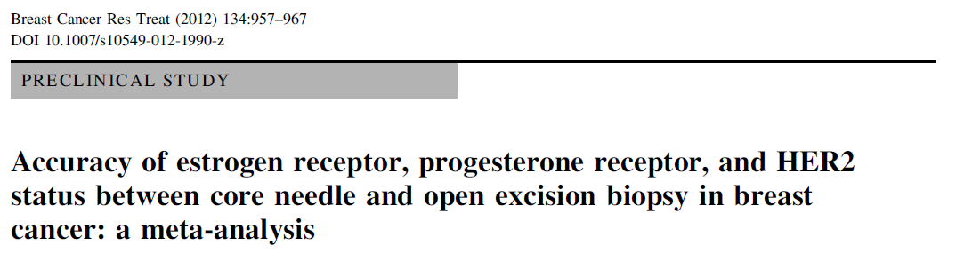
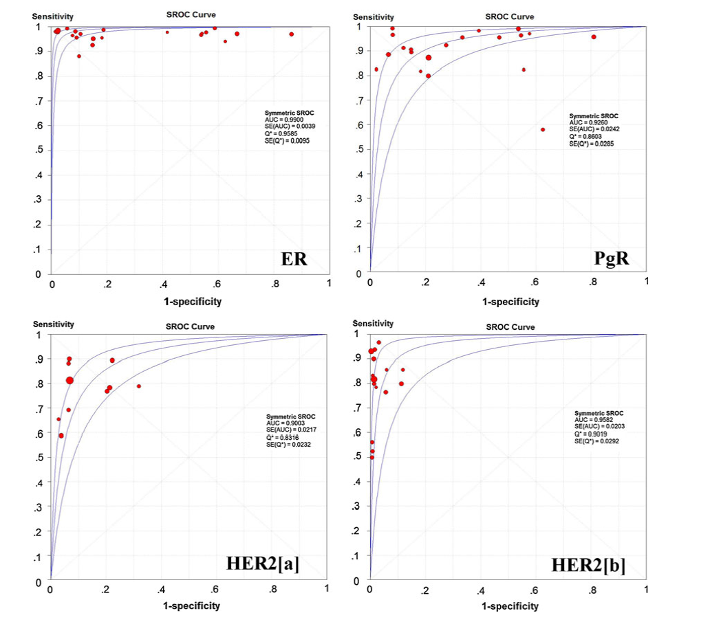
Chen et al.

Slide 14
Possible reasons for NOT going to PST
Systemic treatment recommendations depend on pathological stage
Tumor biology assessed on core biopsy might be inaccurate
Residual disease has prognostic value only

Slide 15
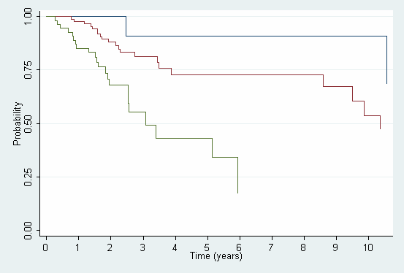

Ki-67 Prognostic significance after PCT
DFS by post-therapy Ki 67 and nodal status
Low Ki67 and N-
Post-therapy Ki-67<15%
High Ki67 or N+
High Ki67 and N+
Post-therapy Ki-67>/=15%
V Guarneri et al, Ann Oncol 2009
V. Guarneri, ASCO 2010

Slide 16
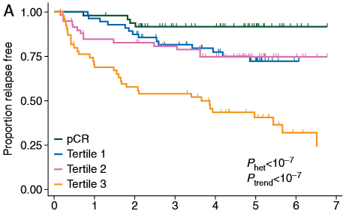
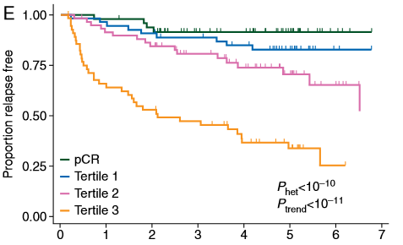
Residual proliferative cancer burden
n=220 patients treated with neoadjuvant chemotherapy.
Residual proliferative cancer burden (RPCB, χ2= 61.4) was significantly more prognostic than either RCB (χ2= 38.1) or Ki67 (χ2= 53.8) alone, p< 0.001.
Symmans VF, et al. Ann Oncol 2015

Slide 17
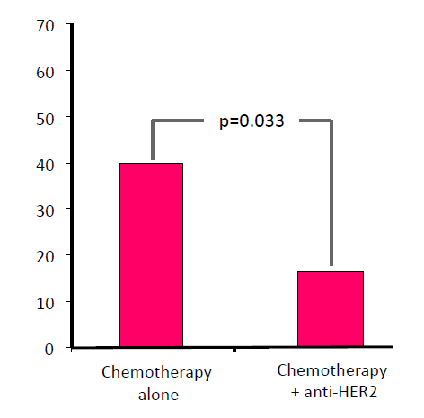
Prognostic role of HER2 loss after PCT
HER2 loss per treatment cohort
Guarneri V et al, Ann Oncol 2013

Slide 18
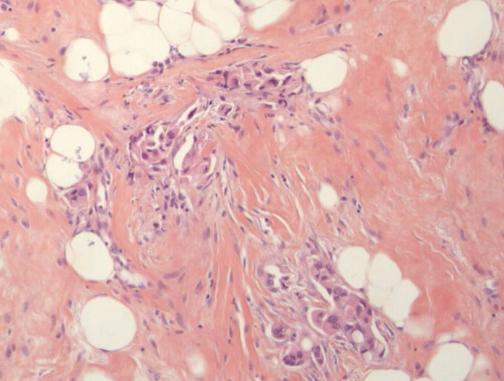
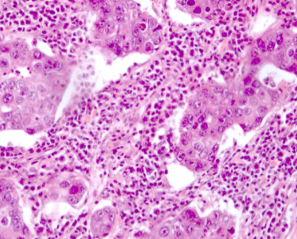
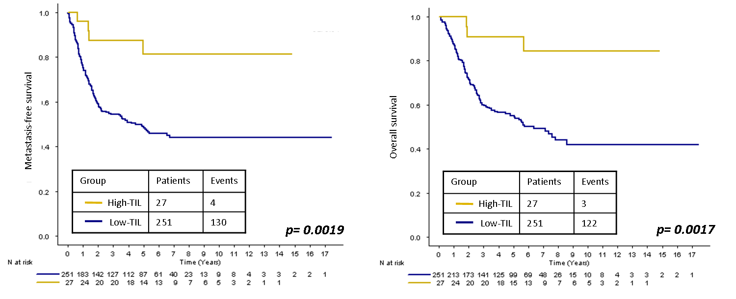
Prognostic value of TILs on residual disease after neoadjuvant chemotherapy for TNBC
Low-TIL residual disease (It and Str-TIL <=60%)
High-TIL residual disease (It and/or Str-TIL >60%)
Dieci MV et al; Ann Oncol 2014

Slide 19
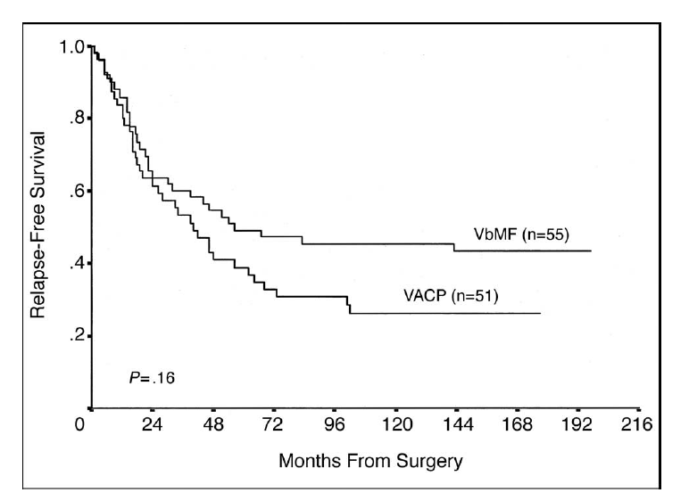
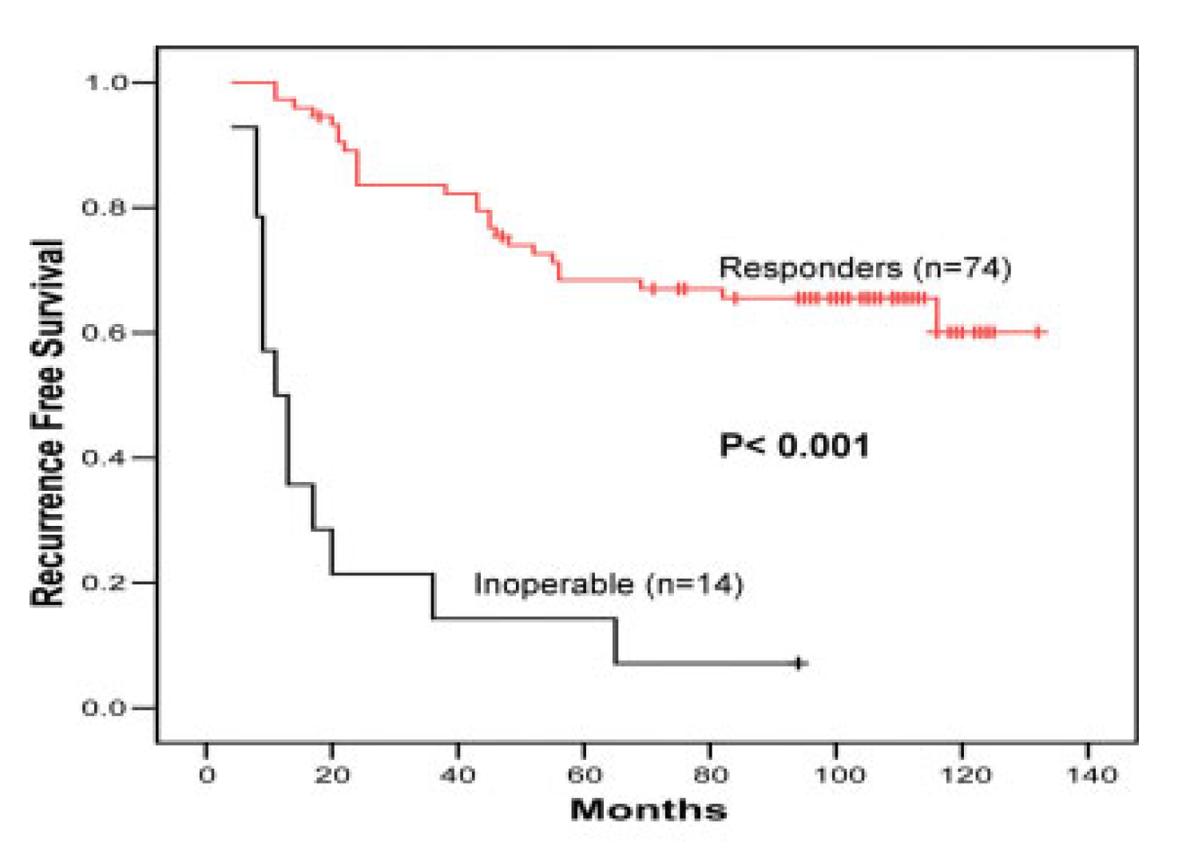
Non–Cross-Resistant Adjuvant
chemotherapy
Thomas E, et al. J Clin Oncol 2004
Alvarez R, et al. CANCER 2010
Notes:
VACP: Vincristina, Doxo, Ciclo, Prednisone
Vinblastina Metotherxate Fluoro
DOXO-TXT → CMF

Slide 20
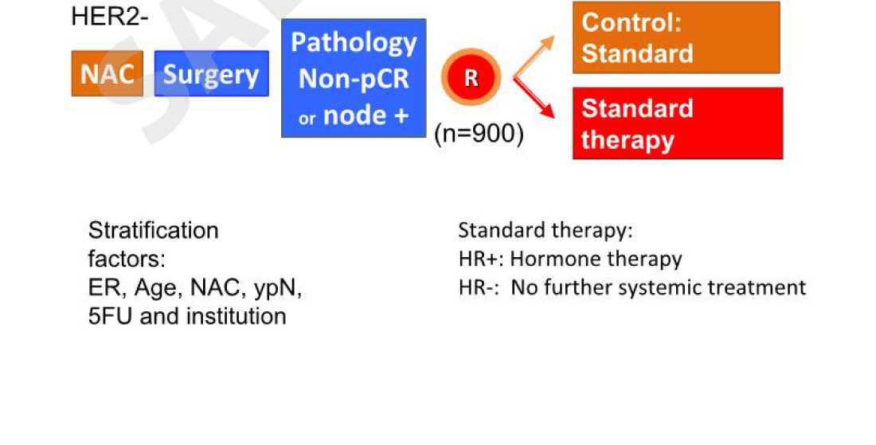
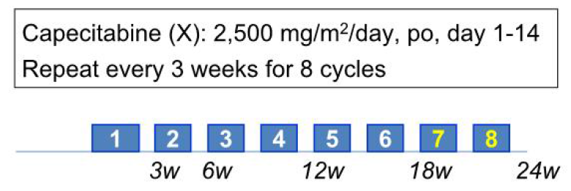
Capecitabine for REsidual cancer as Adjuvant ThErapy: CREATE-X
Lee SJ et al, SABCS 2015

Slide 21
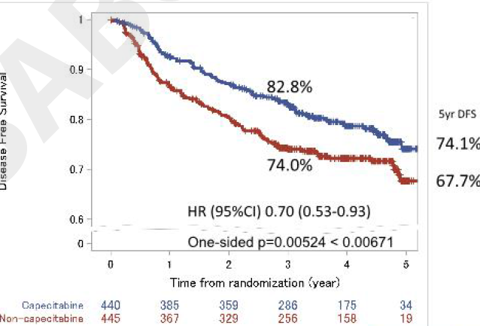
Disease-free Survival
Lee SJ et al, SABCS 2015

Slide 22
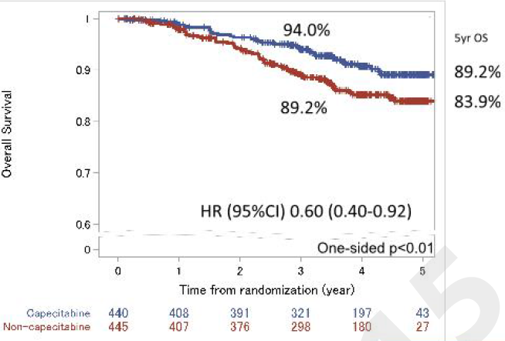
Overall Survival
Lee SJ et al, SABCS 2015

Slide 23
A Study of Trastuzumab Emtansine Versus Trastuzumab as Adjuvant Therapy in Patients With HER2-Positive Breast Cancer Who Have Residual Tumor in the Breast or Axillary Lymph Nodes Following Preoperative Therapy (KATHERINE)
Key inclusion criteria:
HER2+
cT1-4/N0-3/M0 (cT1a/bN0 excluded)
Neoadjuvant chemotherapy:
>=6 cycles and
>=16 weeks total duration and
>=9 weeks of trastuzumab and
>=9 weeks of taxane-based
no pCR after radical surgery
(breast and/or N residual disease)
TDM-1 3.6 mg/kg i.v.
q3w, 14 cycles
R
Trastuzumab 6 mg/kg i.v.
q3w, 14 cycles
Target accrual: n=1484
Enrollment started April 2013
Primary endpoint: IDFS
Secondary endpoints: DFS, OS, distant DFS, safety, cardiac events, QoL

Slide 24
OlympiA
Post-neoadjuvant gBRCA TNBC
Non pCR patients
Assumptions:
- Control arm 3-year EFS ~ 60%C
12 mos Olaparib 300mg bd
IDFS
DDFS, OS
1:1 R
Post-adjuvant gBRCA TNBC
Node positive or N0 with T>2 cm
Assumptions:
- Control arm 3-year EFS ~ 77%C
12 mos Placebo
N=1,320
Study to start recruiting patients with TNBC; plan to add ER/PR+ patients once data available from PK/PD interactions (expected Mid 2014)
Primary endpoint: IDFS (invasive disease-free survival; STEEP approach)
  HR=0.7 (CV=0.81), 90% power, 5% significance level, approx 330 events required
    Assumes consistent treatment effect (HR=0.7) across patient groups
    N=1320 (25% maturity), assuming 4 years recruitment, IDFS analysis estimated approx. 5.5–6 years from FSI

Slide 25

ADJUVANT TREATMENT FOR HIGH-RISK TRIPLE NEGATIVE
BREAST CANCER PATIENTS WITH THE ANTI-PD-L1 ANTIBODY
AVELUMAB: A Phase III randomized trial
Investigator-driven study
EUDRACT: 2016-000189-45
Study centers: Multicentric study (about 40 Italian Institution)
Sponsor: Dipartimento di Scienze Chirurgiche, Oncologiche e Gastroenterologiche DiSCOG – Università di Padova
Trial Office: Ufficio Sperimentazioni Cliniche e Biostatistica - IOV
Principal Investigator: Prof. Pierfranco Conte
Drug supply and financial support: Merck Serono

Slide 26
Stratum A: Adjuvant
High-risk TNBC pts (>4 metastatic axillary lymph nodes) who received curative intent surgery and completed adjuvant chemotherapy
Stratum B: Post-neoadjuvant
TNBC pts treated with neoadjuvant chemotherapy and with residual invasive breast cancer in the breast and/or in the axilla at surgery (except from ypT1micN0, ypT1micN0i+, ypT0N0i+)
Avelumab for 1 year
First patient randomized on June 21, 2016
R
Observation
Randomization 1:1 (after RT, if indicated) balanced for adjuvant and post-neoadjuvant patients.
Co-primary endpoints: 1. DFS in all-comers; 2. DFS in PD-L1+ patients
Secondary endpoints: OS, Safety, Biomarkers
n=335 (for the 1st co-primary endpoint)

Slide 27
Conclusions
In vivo test of treatment efficacy: at the individual patient level, pCR is per se clinically relevant
Patient & tumor characteristics are crucial to choose the most appropriate therapy
Best strategy to rank the winner regimen for entering large adjuvant trials
Molecular characterization of residual disease might give insights into biology of micrometastatic disease

