Slide 1




Pathways innovativi nel carcinoma della mammella
Ruggero De Maria
Institute of General Pathology
Catholic University, Rome

Slide 2
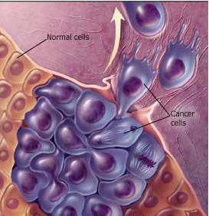
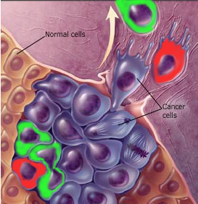
Symmetric
division
Asymmetric
division
Tumorigenic
cancer stem cells
Non tumorigenic transient amplifying progenitors
Non tumorigenic
differentiated cell
Old view
New view
Non
Metastatic
Potentially
metastatic
Non
Metastatic

Slide 3

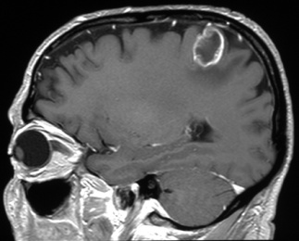
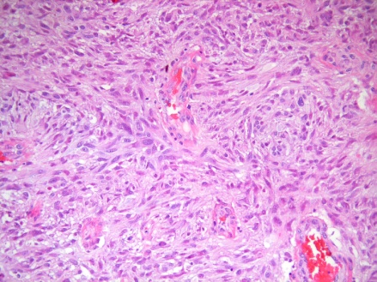

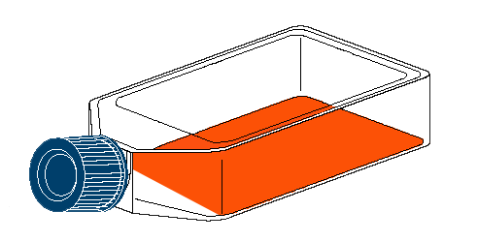
MRI
Diagnosis and tissue banking
H&E
Tumor dissociation
Tumor
database
Tumorsphere
culture
and expansion
Banking
GBM, Sarcoma, Melanoma, Colorectal, Lung, Breast and Renal carcinomas

Slide 4
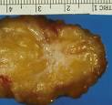
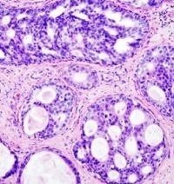

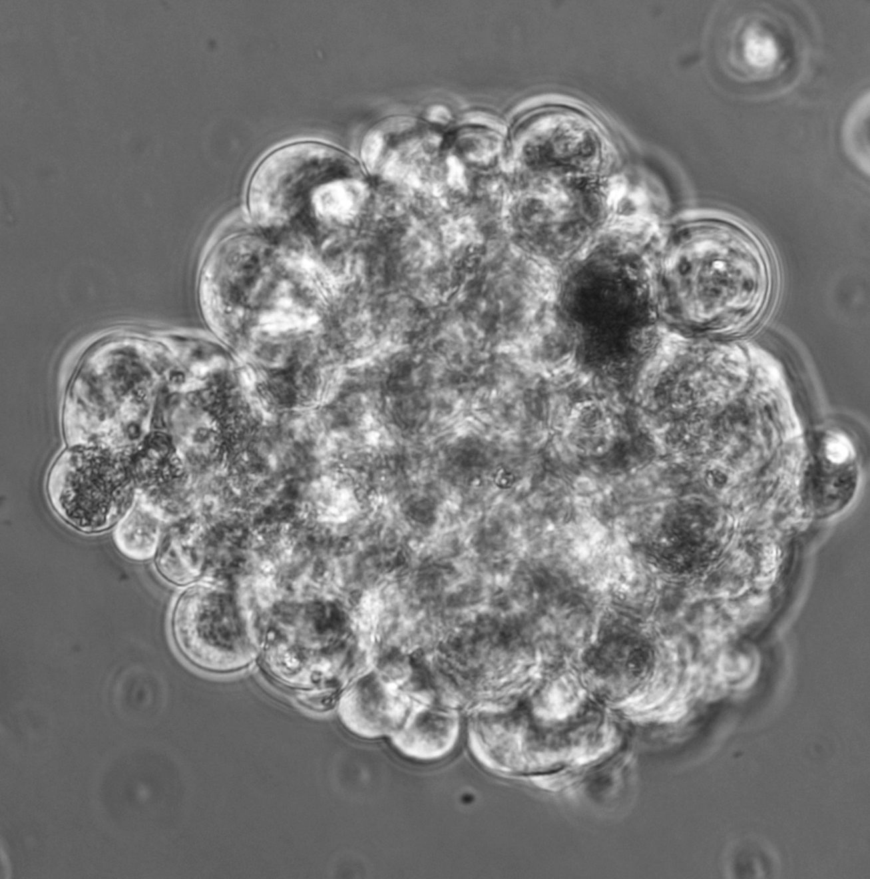


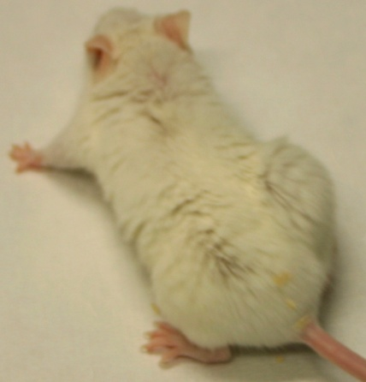
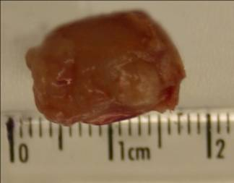
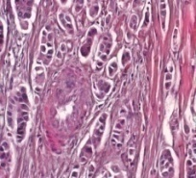
BREAST CSCs ISOLATION AND PROPAGATION
Tumor dissociation
Stem cells culture
Spheroid
Differentiation
+FBS
Crescita
+EGF
bFGF
H&E
No tumor

Slide 5
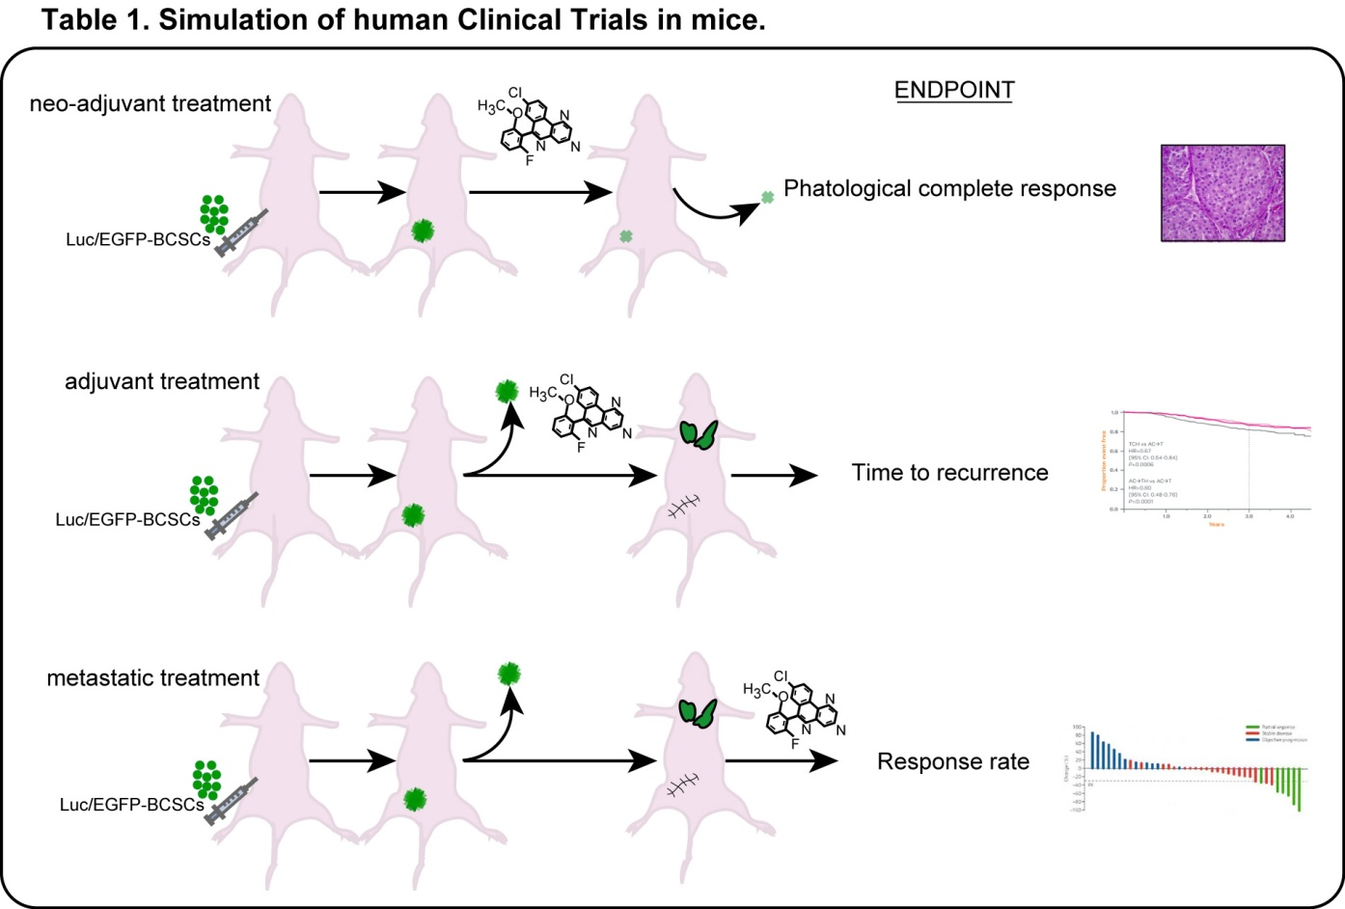
On Going: In vivo activity of potential anti-BCSC compounds
Preclinical testing of candidate therapeutic agents on BCSC xenografts.
The construction of a functional screening system coupled with in vivo studies of drug sensitivity within defined molecular background can become a paradigm for the development of tailored anticancer therapies and molecular predictors of response.

Slide 6
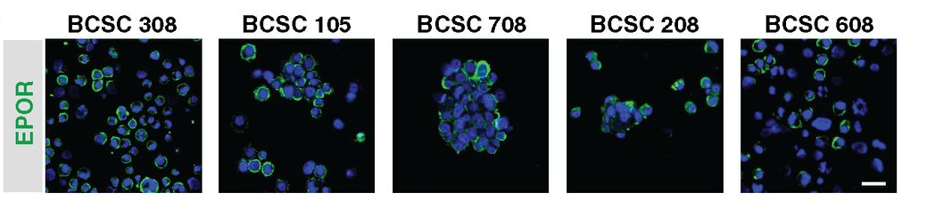
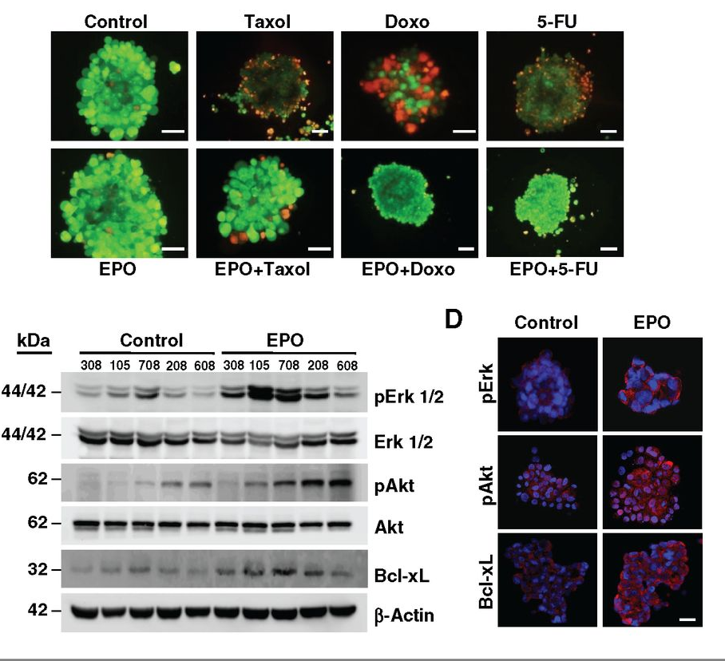
BCSCs express a functional EPOR
Todaro et al. Cancer Res 2013;73:6393-6400
Notes:
EPOR expression in breast cancer subtypes and EPO response of cultured BCSC. A, EPOR staining of tissue sections derived from human placenta, normal breast (top), and breast tumors of different subtypes (bottom). Black arrows indicate EPOR-positive cells. Bar, 45 μm (inset, 25 μm). B, number of cells obtained after 72 hours of culture in the absence (control) or in the presence of EPO 3 U/mL (EPO). Results shown are the mean ± SD of experiments carried out in triplicate with five BCSC lines. *, P < 0.05. C, number of colonies generated in semisolid culture conditions by BCSC lines in the absence (Control) or in the presence (EPO) of EPO 3 U/mL (left). Representative picture of the plates (BCSC line 308; right). *, P < 0.05.

Slide 7
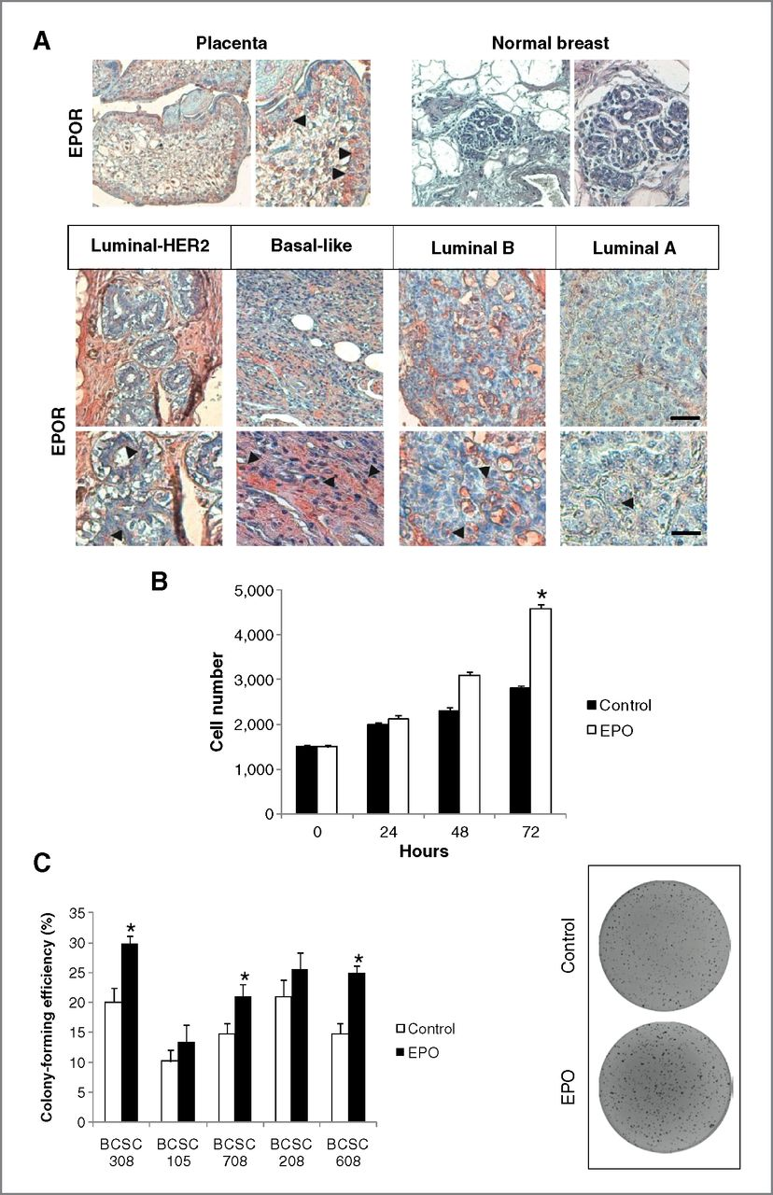
EPOR expression in breast cancer subtypes
EPO promotes BCSC expansion
EPO promotes BCSC proliferation
Todaro et al. Cancer Res 2013;73:6393-6400
Notes:
EPOR expression in breast cancer subtypes and EPO response of cultured BCSC. A, EPOR staining of tissue sections derived from human placenta, normal breast (top), and breast tumors of different subtypes (bottom). Black arrows indicate EPOR-positive cells. Bar, 45 μm (inset, 25 μm). B, number of cells obtained after 72 hours of culture in the absence (control) or in the presence of EPO 3 U/mL (EPO). Results shown are the mean ± SD of experiments carried out in triplicate with five BCSC lines. *, P < 0.05. C, number of colonies generated in semisolid culture conditions by BCSC lines in the absence (Control) or in the presence (EPO) of EPO 3 U/mL (left). Representative picture of the plates (BCSC line 308; right). *, P < 0.05.

Slide 8
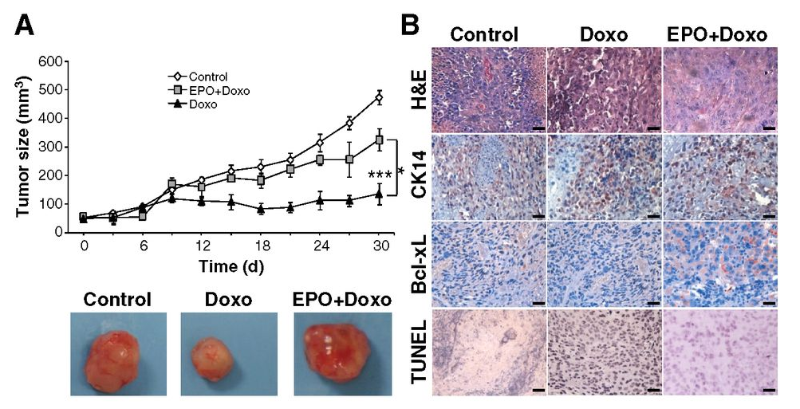
EPO protects breast cancer cells from chemotherapy
Todaro et al. Cancer Res 2013;73:6393-6400
Notes:
EPO protects primary and metastatic tumors from chemotherapy in vivo. A, growth of BCSC-derived tumor xenografts (BCSC line 308) vehicle-treated (Control), treated with doxorubicin (Doxo) alone, or in combination with EPO (Doxo+EPO) as described in Materials and Methods (top). Results shown are the mean ± SD of three experiments carried out with groups of 3 mice each. *, P < 0.05; ***, P < 0.001. Representative pictures of the tumors (bottom). B, immunohistochemical staining of xenograft sections obtained at the end of the experiment shown in A and stained with hematoxylin/eosin (H&E), with anti-cytokeratin 14 (CK14), anti-Bcl-xL (Bcl-xL), or TUNEL. Bar, 30 μm. C, whole-body imaging of tumors at different time points after injection (Day 0) of 5 × 10⁵ BCSCs transduced with Tween-LUC GFP in the mammary fat pad of NOD/SCID mice, as described in Materials and Methods. Five weeks after injection, when lung metastases (and in some cases peritoneal metastases) were visible, the primary tumor was removed and the treatment with EPO, paclitaxel, or paclitaxel + EPO was started (red arrow). After 3 weeks of treatment (8 weeks postinjection), mice were sacrificed and lungs were subjected to bioimaging to detect metastatic tumors (Lung metastases). The black square on the left side of the mice was positioned to shield luciferase signals emitted from residual cells that remained after primary-tumor removal. One representative experiment of 4 mice per group is shown. D, photon counts emitted from mice lungs derived in the experiment described in C. Photon/s/sr, photons per second per steradian. *, P < 0.05 and **, P < 0.01.

Slide 9
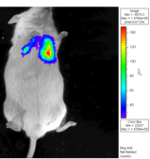
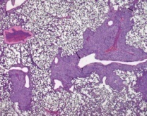
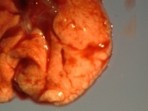
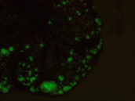
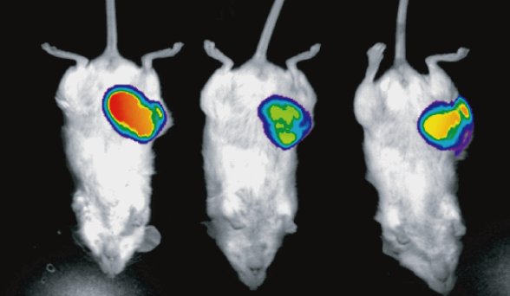
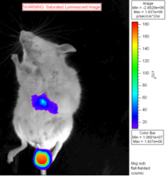
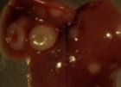
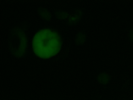
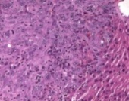
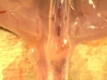
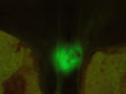
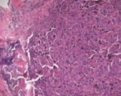
Only CSCs generate metastases in brest cancer
Orthotopic injection of:
Differentiated cells
Breast spheroids
After primary tumor explant
#105
NM 105 SC
Neoplasia
#1
Before primary tumor explant
Lung
2x
20x
Neoplasia
Liver
Neoplasia
Bone
10x
Bartucci et al. Oncogene, 34: 681-90, 2015
Notes:
Qui le diff sono state differenziate in siero o in mezzo Lonza. To obtain differentiated BC cells (dBCCs), dissociated BCSCs were plated on collagen-coated plates for 48 hrs. A layer of matrigel (BD Biosciences, San Jose, CA) was subsequently added and cells were grown in complete mammary epithelial cell growth medium (Lonza, Allendale, NJ).
Entrambe le 2 popolazioni (BCSCs e diff) esprimono la luciferasi, mentre si distinguono per l’espressione della GFP(Stem) ed RFP(diff).Vengono co-inoculate ortotopicamente in rapporto 1:1; dopo 3 settimane (volume del tumore 300mm³), i tumori vengono asportati e i topi vengono monitorati ogni 10 giorni all’IVIS. Le metastasi vengono riscontrate dopo circa 2 settimane. Topi sacrificati e le lesioni metastatiche analizzate allo stereomicroscopio.

Slide 10





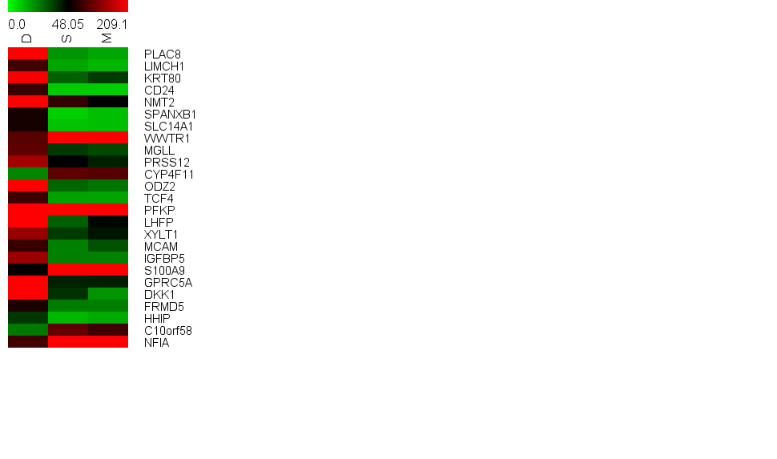
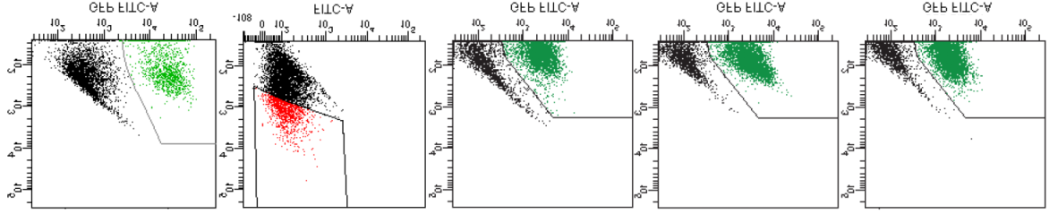
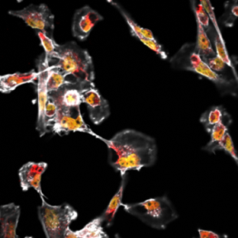
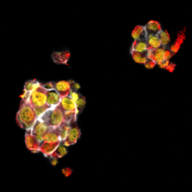
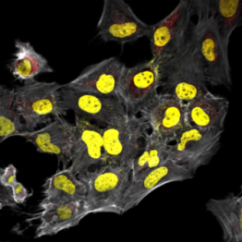
WWTR1/Taz is considerably upregulated in breast cancer metastatic cells
Primary Tumor
Lung Metastasis
FPD
FPS
LMs
50
40
30
TAZ protein expression
Tumor dissociation
(normalized values)
20
10
0
FPS
FPD
LM1
LM2
MCF-7
MDA-231
MDA-MB-231
FPS
FPD
Cell Sorting
20x
20x
20x
FPS
FPD
LMs
Phalloidine
DAPI
TAZ
Bartucci et al. Oncogene, 34: 681-90, 2015
Notes:
Reconstituting Merlin in NF2 deficient MDA-MB-231 breast cancer cells represents a robust bioassay to inhibit YAP/TAZ activity by activation of the Hippo pathway

Slide 11
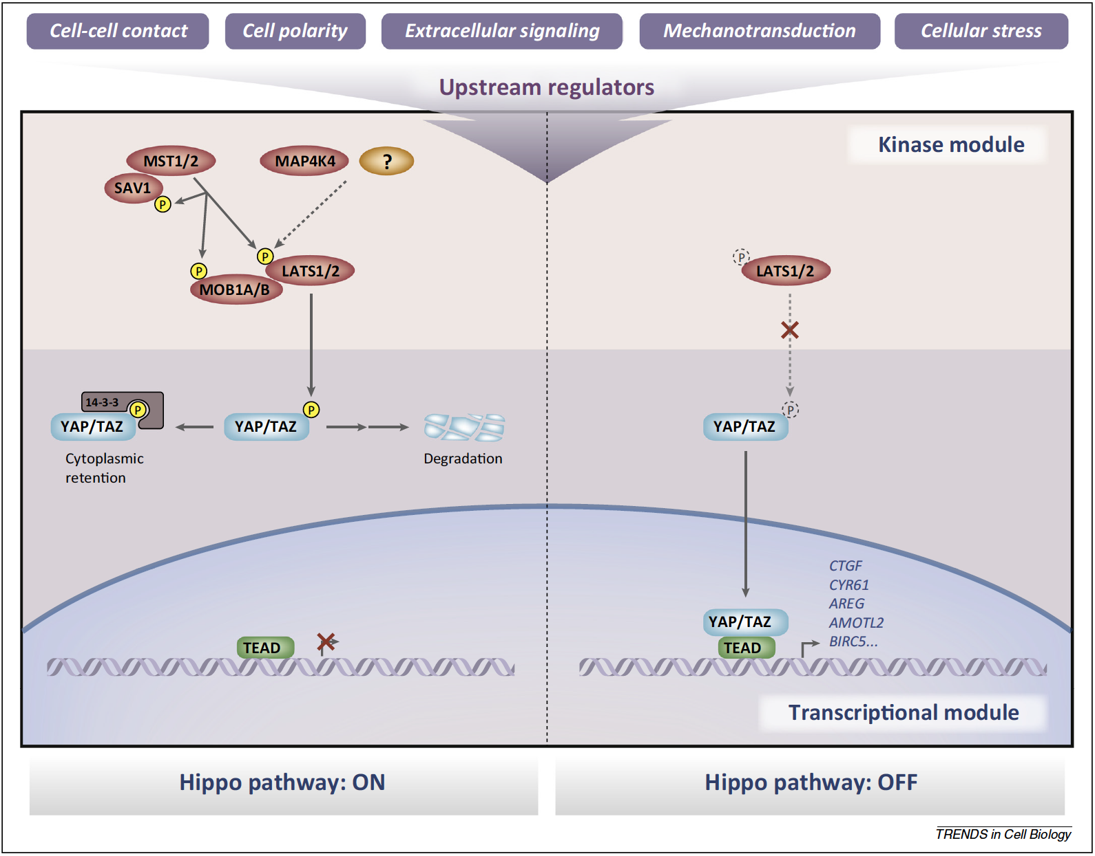
Hansen, Moroishi & Guan, 2015

Slide 12





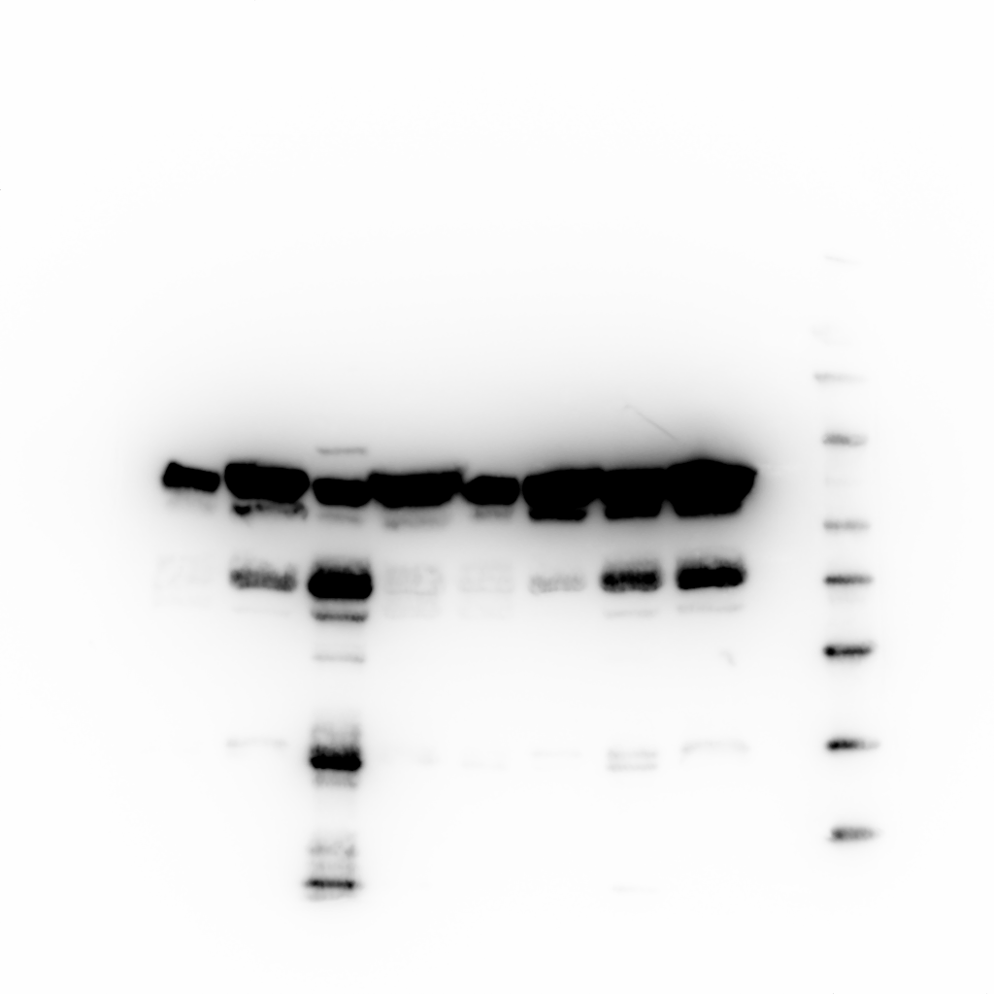
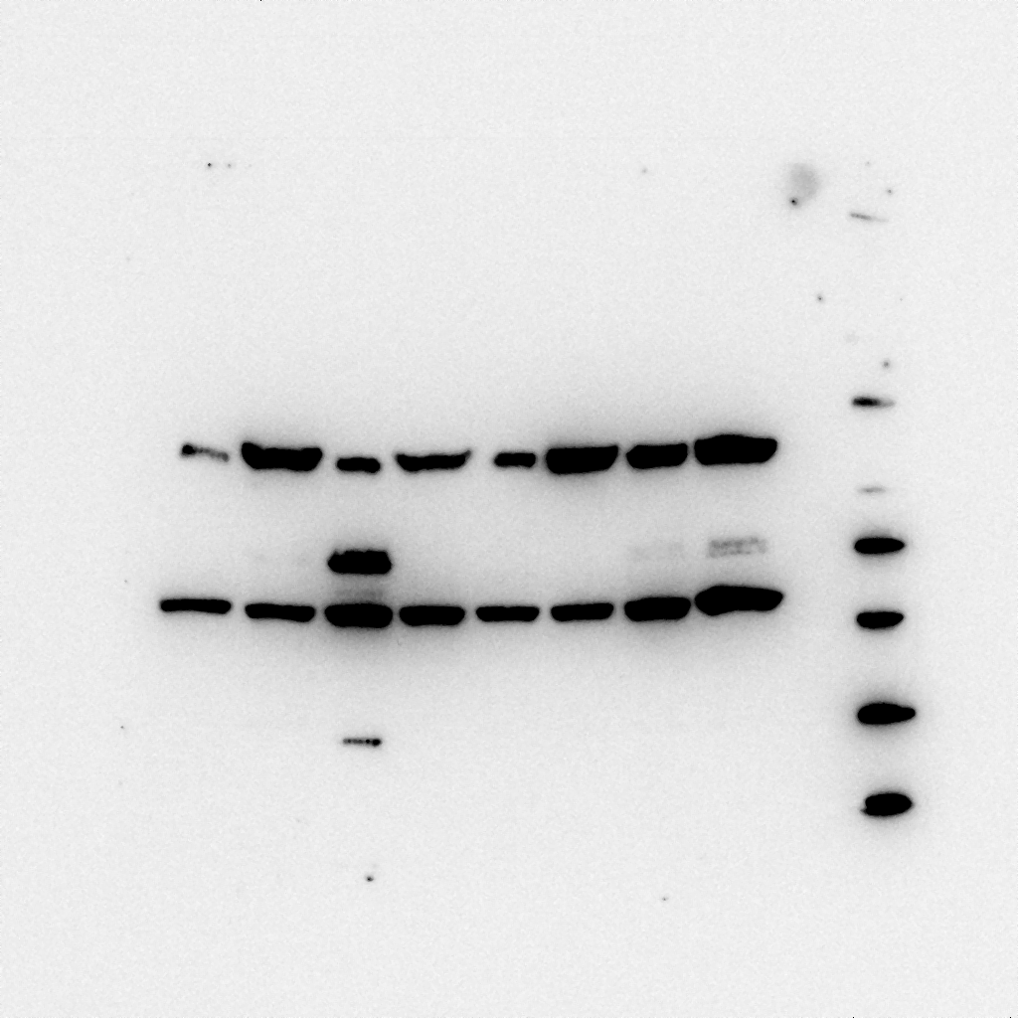
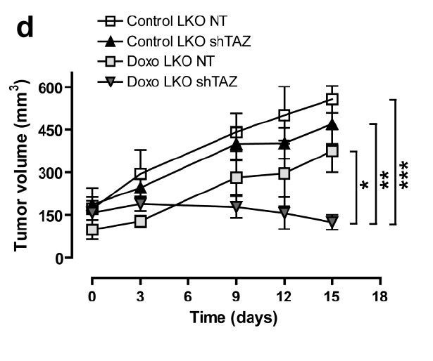
TAZ promotes tumorigenesis, metastasis and chemoresistance in breast cancer stem cells
BCSCs
dBCCs
BCSC
Untrasduced
TWEEN GFP
12
BCSC shTAZ
50 cells
5x10² cells
5x10³ cells
5x10⁴ cells
Untrasduced
11
LKO shTAZ
TAZ GFP
10
dBCC
LKO
9
dBCC TAZ
8
6
6
7
Photon emission
6
4
4
TAZ
5
4
2
2
3
2
β-actin
1
0
0
10
20
30
40
BCSC
Time (days)
BCSC shTAZ
***
100
***
BCSC
BCSC shTAZ
75
dBCC
dBCC TAZ
Cell Viability (%)
50
25
0
Control
Doxorubicine
Paclitaxel

Slide 13
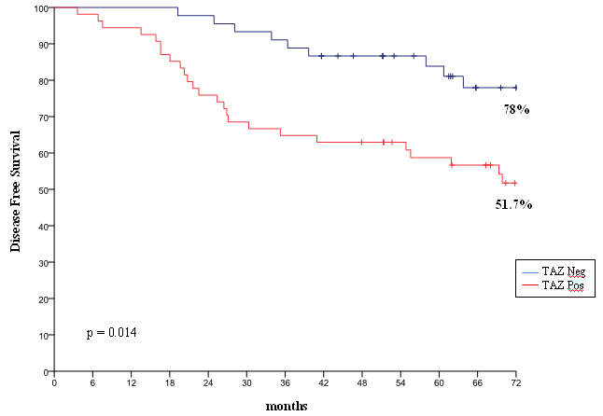
TAZ is a negative prognostic factor in breast cancer
TAZ
Disease-free survival (%)
Patients n. 99
Negative
Positive
N (%)
N (%)
p
-
value
Tumor size
T1
28 (46.7)
32 (53.3)
0.764
T2
-
T4
17 (43.6)
22 (56.4)
Lymph node status
Negative
29 (51.8)
27 (48.2)
0.149
Positive
16 (37.2)
27 (62.8)
Months
Grading
G1
8 (66.7)
4 (33.3)
0.001
G2
31 (56.4)
24 (43.6)
G3
6 (18.8)
26 (81.2)
ER
Negative
6 (31.6)
13 (68.4)
0.177
Positive
39 (48.8)
41 (51.2)
PgR
Negative
13 (37.1)
22 (62.9)
0.219
Positive
32 (50.0)
32 (50.0)
HER2
Negative
42 (52.5)
38 (47.5)
0.004
Positive
3 (15.8)
16 (84.2)
Ki67
Negative
27 (60.0)
18 (40.0)
0.008
Positive
18 (33.3)
36 (66.7)
Bartucci et al. Oncogene, 34: 681-90, 2015

Slide 14
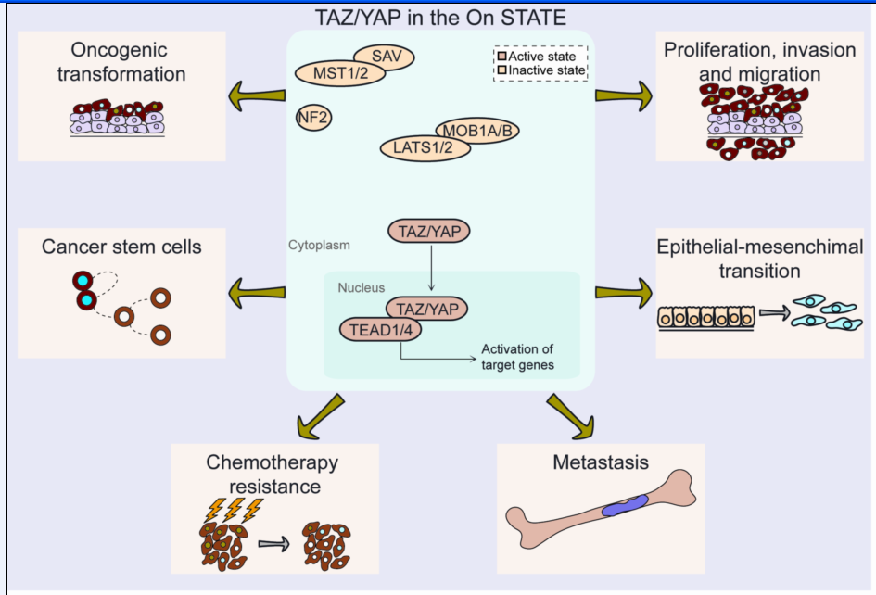
Oncogenic activities mediated by TAZ/YAP in breast cancer
Maugeri-Saccà M, et al Expert Rev Mol Med. 2015
Notes:
Activation of TAZ and YAP in BC is associated with multiple tumor-promoting functions including oncogenic transformation, proliferation, migration and metastasis. TAZ also promotes EMT, chemotherapy resistance and sustains self-renewal of CSCs.

Slide 15
TAZ as a biomarker of pCR in HER2-positive BC patients treated with trastuzumab-based neoadjuvant therapy: an exploratory analysis
 |  | No pCR N (%) | pCR N (%) | p-value
Overall population |  | 20 (32,8) | 41 (67,2)
 | TAZ score ≤ 0,50 > 0,50 | 6 (21,4) 14 (42,4) | 22 (78,6) 19 (57,6) | ■0,082
HER2-enriched |  | 7 (26,9) | 19 (73,1)
 | TAZ score ≤ 0,50 > 0,50 | 3 (27,3) 4 (26,7) | 8 (72,7) 11 (73,3) | ●0,999
Luminal B |  | 13 (37,1) | 22 (62,9)
 | TAZ score ≤ 0,50 > 0,50 | 3 (17,6) 10 (55,6) | 14 (82,4) 8 (44,4) | ●0,035
TP50 |  | 6 (37,5) | 10 (62,5)
 | TAZ score ≤ 0,50 > 0,50 | 1 (11,1) 5 (71,4) | 8 (88,9) 2 (28,6) | ●0,035
Vici et al, Oncotarget, 2014
Notes:
Abbreviations: pCR: pathological complete response; TP50: triple-positive tumors with expression of estrogen receptor and progesterone receptor ≥ 50%. ■Chi2 test, ●Fisher Exact test.

Slide 16

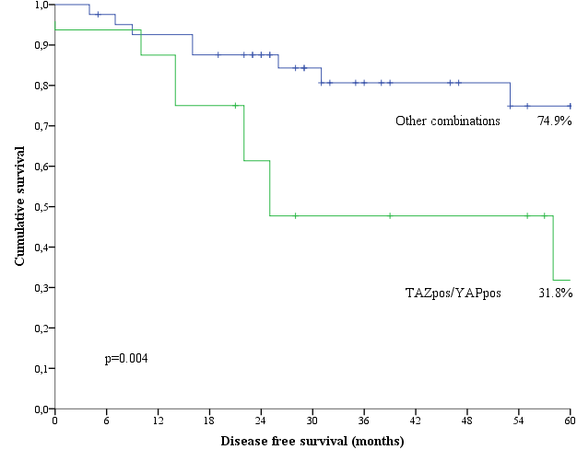
Impact of the combined expression of TAZ and YAP on tumor recurrence in TNBC patients
(N=10)
(N=9)
A)
Double positive (N=16)
No double positive (N=41)
p=0.004 (Chi2 test)
B)
Vici P et al. J Exp Clin Cancer Res. 2016
Notes:
(A): OncoPrint showing the individual distribution of tumor recurrences according to the combined nuclear expression of TAZ and YAP. Relapsed cases are indicated with the black line placed above the OncoPrint.
(B): Kaplan-Meier survival curves regarding disease-free survival in TAZ^{pos}/YAP^{pos} tumors compared with the negative counterparts.
NACT consisted in anthracycline-taxane-based chemotherapy regimens, either with a concomitant or sequential schedule, as detailed elsewhere [14]. Seven patients received adjuvant chemotherapy. pCR was defined as no residual invasive tumor in both breast and axilla, irrespective of the presence of ductal carcinoma in situ (ypT0/is ypN0).

Slide 17
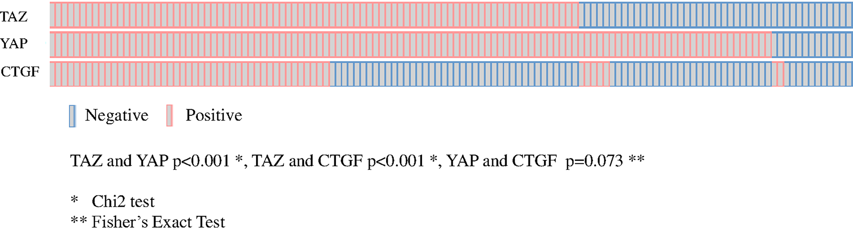
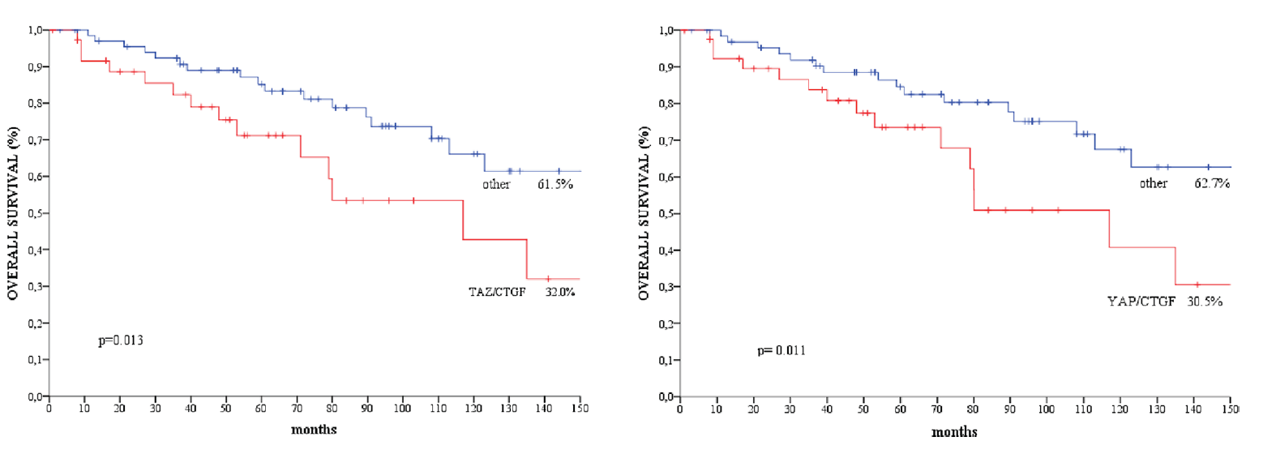
TAZ/YAP in Male Breast Cancer
Di Benedetto A et al Oncotarget. 2016
Notes:
Blue Box: Kaplan-Meier survival curves of overall survival regarding. (A) TAZ/CTGF and (B) YAP/CTGF in the entire study population (N = 129).
Orange Box: Kaplan-Meier survival curves of overall survival regarding. (A) TAZ/CTGF and (B) YAP/CTGF in patients with IDC, invasive ductal carcinoma (N = 108).
CTGF is a matricellular protein of the CCN family of extracellular matrix-associated heparin-binding proteins. CTGF has important roles in many biological processes, including cell adhesion, migration, proliferation, angiogenesis, skeletal development, and tissue wound repair, and is critically involved in fibrotic disease and several forms of cancers.

Slide 18
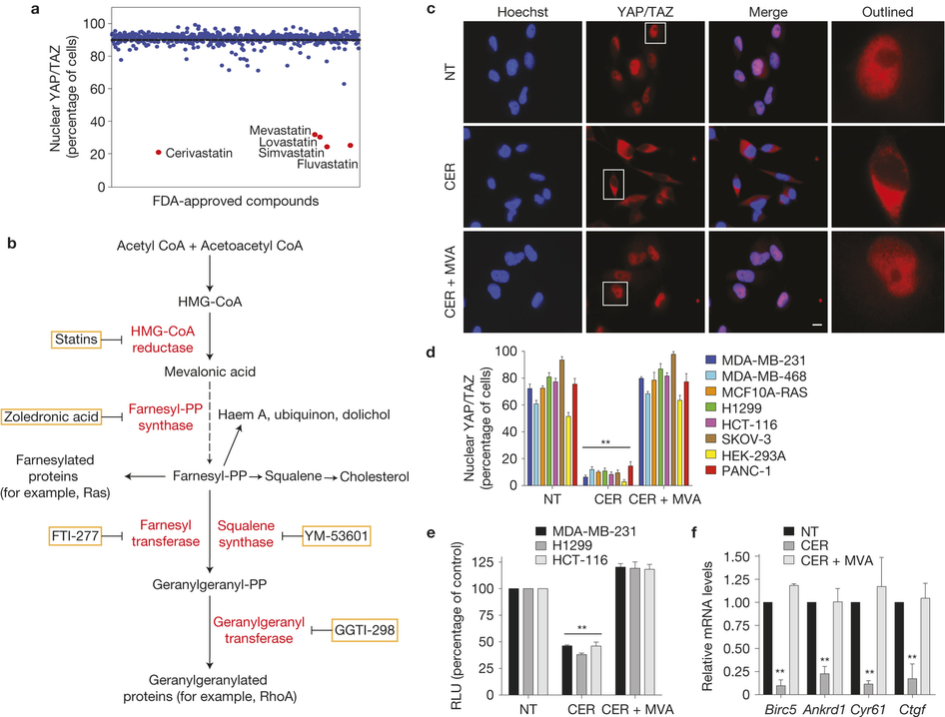
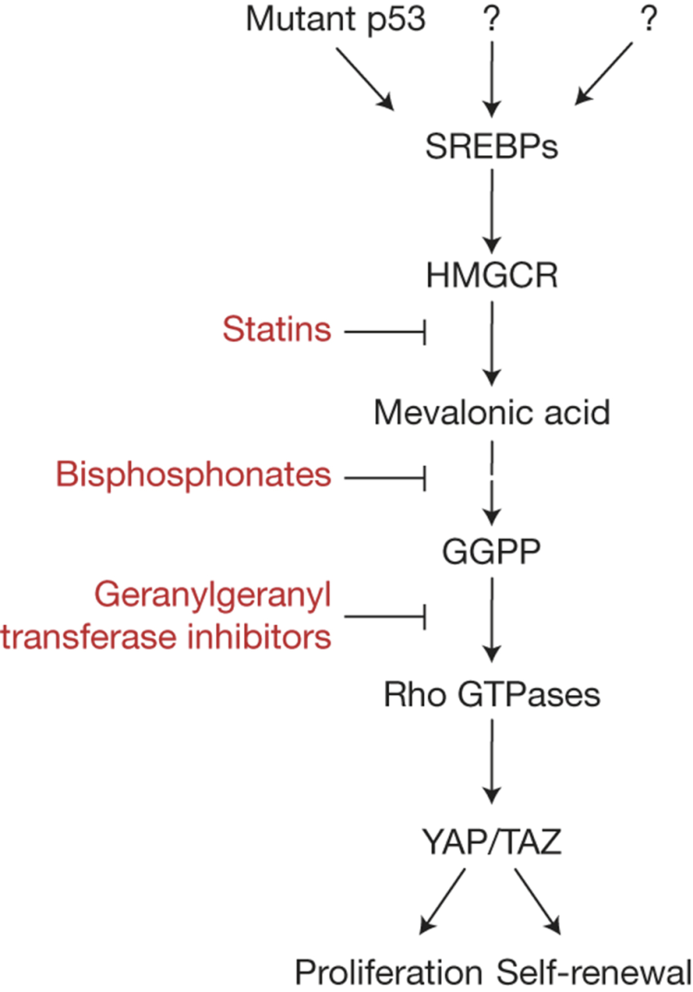
Inhibition of 3-hydroxy-3-methylglutaryl-coenzyme A reductase
prevents YAP/TAZ activation
Sorrentino et al. Nature Cell Biology 16: 357, 2014
Notes:
YAP/TAZ activity is controlled by the SREBP/mevalonate pathway. Inhibition of the rate-limiting enzyme of this pathway (3-Hydroxy-3-Methyl-Glutaryl-coenzyme A Reductase) by statins opposes YAP/TAZ nuclear localization and transcriptional responses. Mechanistically, the geranylgeranyl pyrophosphate produced by the mevalonate cascade is required for activation of Rho GTPases that, in turn, activate YAP/TAZ by inhibiting their phosphorylation and promoting their nuclear accumulation.

Slide 19
A phase II, randomized, non-comparative, pre-surgical study of atorvastatin or observation in Ki-67 positive, TAZ-expressing early breast patients
Target population: 78 patients
(power 80%, alpha=0.05)
Early BC
(stage I-IIa)
TAZ ≥10%
Ki67 ≥15%
atorvastatin 80 mg/day
for 3 weeks
(1:1)
surgery
observation
IHC
ER, PgR, Ki-67, TAZ, HMG-CoAR
IHC
ER, PgR, Ki-67, TAZ, HMG-CoAR
Objectives/endpoints of the study
primary objective: rate of Ki-67 reduction below the 15% (marker response)
Secondary objectives: rate of decreased TAZ expression and its correlation with Ki-67 reduction,
predictive value of HMG-CoA reductase expression, downgrading

Slide 20
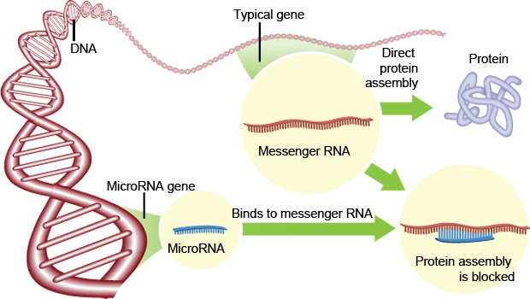
MicroRNAs induce mRNA degradation or translational inhibition

Slide 21
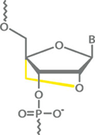
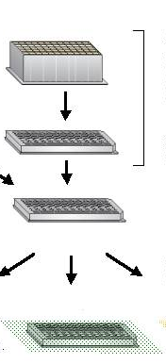
Broad scale anti-miR screening - genome wide LNA library
Structure of LNA
Basic principle of the screening
Exicon LNA based anti-miR library
Target cells plating
Locked Nucleic Acid (LNA™)
LNA library transfection
www.exiqon.com
Incubation for 72-96 hours
to ensure effects of anti-miR
on protein level
Enhanced stability and binding specificity
LNAs are already in PHASE II Clinical Trials on Chronic Hepatitis C patients (anti-miR-122, Miravirsen)
Readout: cell viability
(Cell Titer Glo Assay)

Slide 22
Broad scale anti-miR in lung cancer
potential hits leading to increase in viability
Viability (%)
potential hits leading to decrease in viability
LNA
Average ± S.E.M.
Fiori et al. Cell Death Differentiation 21:774, 2014 and unpublished results
Notes:
The choice of miR-197 was also based on recent literature sustaining its potential oncogenic role. MiR-197 was found over-expressed in lung, prostate and pancreas cancer tissues compared with normal specimen 17-19, while levels of circulating miR-197 in combination with other microRNAs were used to generate a signature of biomarkers for early detection of lung cancer 20, 21. Moreover, increased expression of miR-197 contributes to carcinogenesis and it is considered a reliable marker for diagnosis, patient stratification and prognosis assessment in follicular thyroid carcinomas 22-24, while promoting EMT and metastasis in pancreatic adenocarcinoma 25

Slide 23
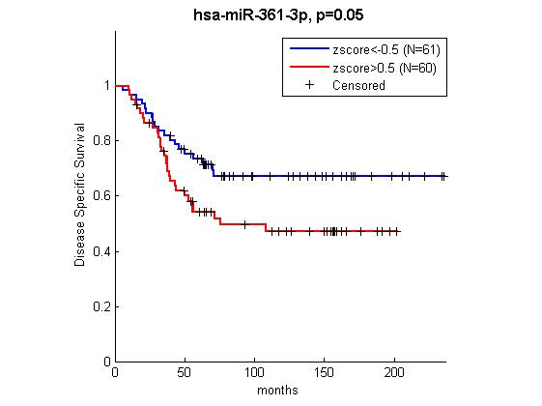
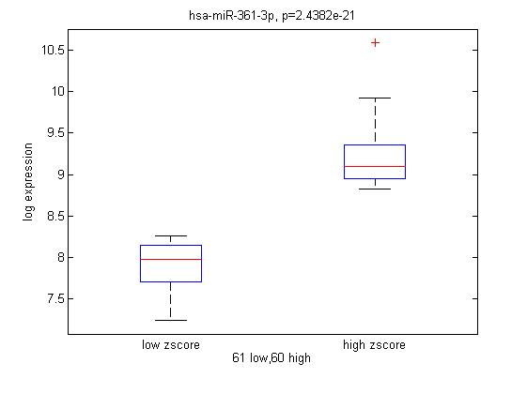
miR-362-3p is a prognostic marker in TNBC
In silico analysis from Metabric
Notes:
The choice of miR-197 was also based on recent literature sustaining its potential oncogenic role. MiR-197 was found over-expressed in lung, prostate and pancreas cancer tissues compared with normal specimen 17-19, while levels of circulating miR-197 in combination with other microRNAs were used to generate a signature of biomarkers for early detection of lung cancer 20, 21. Moreover, increased expression of miR-197 contributes to carcinogenesis and it is considered a reliable marker for diagnosis, patient stratification and prognosis assessment in follicular thyroid carcinomas 22-24, while promoting EMT and metastasis in pancreatic adenocarcinoma 25

Slide 24
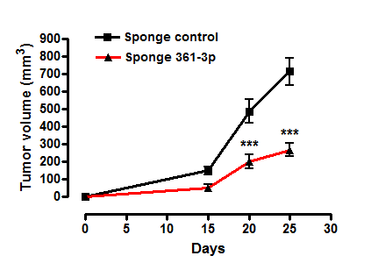







miR-361-3p is a new oncomiR in TNBC
LNA 361-3p
Sponge control
Control
Sponge- 361-3p
LNA 361-3p
DAPI
DAPI
EGFP
EGFP
SMA
CK8-18
Coppola et al. unpublished results
Notes:
NB:
Ho inserito come decimo LNA il 371-3p al posto del 133b che è ripetuto e già presente in tabella.
La viability è 25% ma la st dev è 21.
Riprendo il quadruplicato: 14, 15, 14, 56
Escludo 56 come outlier e inserisco LNA 371-3p in sesta posizione

Slide 25







EMP1, TBRG1 and TRIM33 are targets of miR-361-3p
C
LNA-
361
EMP1
3.5
TBRG1
1.9
LNA 512-5p
LNA 1226*
LNA 361-3p
LNA 1271
TRIM33
(TIF1γ)
1.9
Actin
TBRG1
EMP1
TRIM33
0. Normal breast (144) | 1. Benign Breast Neoplasm (3) | 2. Breast Carcinoma (14)
3. Breast Phyllodes Tumor (5) | 4. Ductal Breast Carcinoma in Situ (10) | 5. Invasive Breast Carcinoma (21)
6. Invasive Ductal Breast Carcinoma (1556) | 7. Invasive Ductal and Invasive Lobular Breast Carcinoma (90) | 8. Invasive Lobular Breast Carcinoma (148)
9. Medullary Breast Carcinoma (32) | 10. Mucinous Breast Carcinoma (46) | 11. Tubular Breast Carcinoma (67)
From Metabric dataset
Notes:
In an attempt to identify other mediators of LNA 361-3p effects, we performed an Affymetrix gene expression profiling of control and LNA 361-3p transfected BCSCs. Additionally, we used other three LNAs against potential oncomiRs as specificity controls. A list of potential candidates was generated by crossing mRNAs upregulated > 1.3 fold in LNA 361-3p-transfected cells with putative targets predicted by Target Scan in silico analysis (Supplementary Fig. 2b). A subset of mRNAs with a potential biological function as tumor suppressors was then selected for further investigation and real time PCR validation. Among these, EMP1, TBRG1 and TRIM33 were confirmed upregulated by LNA 361-3p at both mRNA and protein level.

Slide 26

YAP/
TAZ
Marcucci, Stassi & De Maria, Nat Rev Drug Discov. 2016

Slide 27










Regina Elena National Cancer Institute, Rome
P.Vici, M. Maugeri-Saccà,
Sperduti, M. Mottolese, M. Barba
I. Sperati,
Department OMM, ISS
A. Zeuner,
M. Biffoni,
M. Bartucci, V. Coppola
University of Palermo
R. Dattilo, A. Sacconi,
G. Stassi and M. Todaro labs
C. Ercolani, A. Di Benedetto, L. Pizzuti, L. Di Lauro, I. Terrenato, F. Di Filippo, C. Botti
Catholic University, Rome
Medical Oncology, ASL Frosinone
T. Gamucci, M.T. Ramieri
S. Careccia

