Slide 1
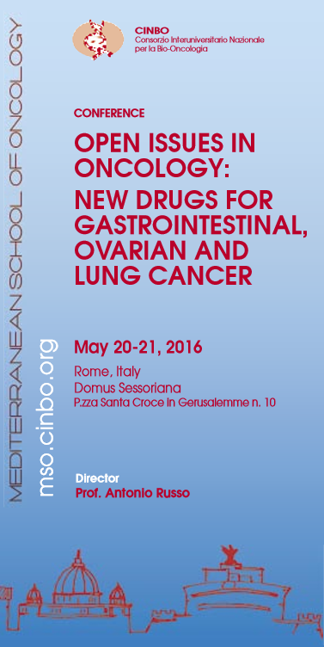
Innovation in 2nd line treatment of NSCLC Multi-target agents and angiogenesis
Roberto Bianco
Laboratori di Terapia Molecolare dei Tumori
Università di Napoli “Federico II”

Slide 2
New drugs for the 2° line.
The outline…….
Blocking the RAS/MEK signaling
Antibodies against the VEGF pathway
Multitarget agents
Combination therapies

Slide 3
Blocking the RAS/MEK signaling
Antibodies against the VEGF pathway
Multitarget agents
Combination therapies

Slide 4
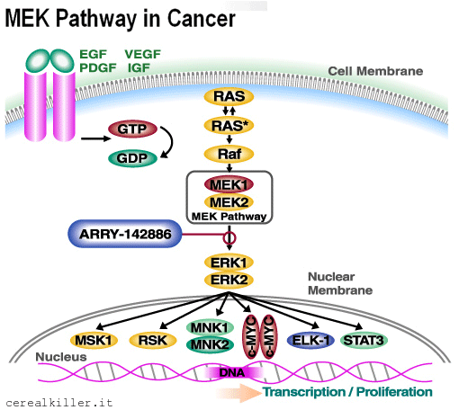
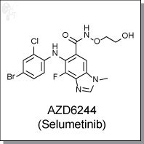
Selumetinib
SELUMETINIB
Potent, highly selective MEK1 inhibitor with IC50 of 14 nM in cell-free assays
Also inhibits ERK1/2 phosphorylation with IC50 of 10 nM
No inhibition to p38α, MKK6, EGFR, ErbB2, ERK2, B-Raf

Slide 5
Selumetinib plus docetaxel for KRAS-mutant advanced NSCLC:
a randomized, multicentre, placebo-controlled phase II trial
Selumetinib 75 mg tw/die
+
Docetaxel 75 mg/m2 q21
Patients:
NSCLC (IIIB–IV)
2nd line patients
KRAS mutant
87 pz
Primary
Overall Survival
Secondary
Progression Free Survival
Objective Response Rate
Duration of Response
Use of plasma & serum as source of CFDNA for analysis of KRAS mutation status
Investigate PK of selumetinib
1:1 randomisation
Placebo
+
Docetaxel 75 mg/m2 q21
Janne P, Lancet Oncol. 2013

Slide 6
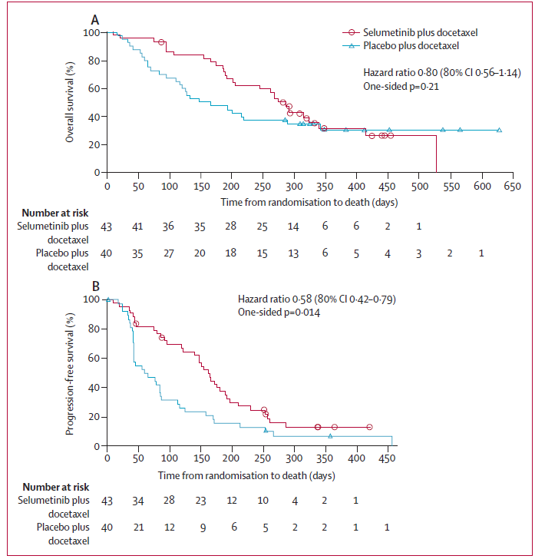
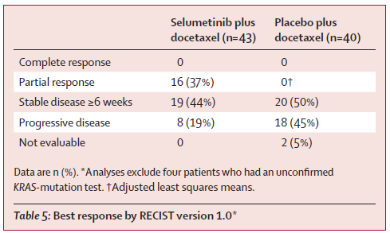
Selumetinib plus docetaxel for KRAS-mutant advanced NSCLC:
a randomized, multicentre, placebo-controlled phase II trial
Median OS: 9·4 months vs 5·2 months
Median PFS: 5·3 months vs 2·1 months
Janne P, Lancet Oncol. 2013
Notes:
Summary
Background No targeted therapies are available for KRAS-mutant non-small-cell lung cancer (NSCLC). Selumetinib is
an inhibitor of MEK1/MEK2, downstream of KRAS, with preclinical evidence of synergistic activity with docetaxel in
KRAS-mutant cancers. We did a prospective, randomised, phase 2 trial to assess selumetinib plus docetaxel in
previously treated patients with advanced KRAS-mutant NSCLC.
Methods Eligible patients were older than 18 years of age; had histologically or cytologically confi rmed stage IIIB–IV
KRAS-mutant NSCLC; had failed fi rst-line therapy for advanced NSCLC; had WHO performance status of 0–1; had
not received previous therapy with either a MEK inhibitor or docetaxel; and had adequate bone marrow, renal, and
liver function. Patients were randomly assigned (in a 1:1 ratio) to either oral selumetinib (75 mg twice daily in a 21 day
cycle) or placebo; all patients received intravenous docetaxel (75 mg/m² on day 1 of a 21 day cycle). Randomisation
was done with an interactive voice response system and investigators, patients, data analysts, and the trial sponsor
were masked to treatment assignment. The primary endpoint was overall survival, analysed for all patients with
confi rmed KRAS mutations. This study is registered with ClinicalTrials.gov, number NCT00890825.
Findings Between April 20, 2009, and June 30, 2010, we randomly assigned 44 patients to receive selumetinib and
docetaxel (selumetinib group) and 43 to receive placebo and docetaxel (placebo group). Of these, one patient in the
selumetinib group and three in the placebo group were excluded from effi cacy analyses because their tumours were not
confi rmed to be KRAS-mutation positive. Median overall survival was 9∙4 months (6∙8–13∙6) in the selumetinib group
and 5∙2 months (95% CI 3∙8–non-calculable) in the placebo group (hazard ratio [HR] for death 0∙80, 80% CI 0∙56–1∙14;
one-sided p=0∙21). Median progression-free survival was 5∙3 months (4∙6–6∙4) in the selumetinib group and 2∙1 months
(95% CI 1∙4–3∙7) in the placebo group (HR for progression 0∙58, 80% CI 0∙42–0∙79; one-sided p=0∙014). 16 (37%)
patients in the selumetinib group and none in the placebo group had an objective response (p<0∙0001). Adverse events
of grade 3 or higher occurred in 36 (82%) patients in the selumetinib group and 28 (67%) patients in the placebo group.
The most common grade 3–4 adverse events were neutropenia (29 [67%] of 43 patients in the selumetinib group vs
23 [55%] of 42 patients in the placebo group), febrile neutropenia (eight [18%] of 44 patients in the selumetinib group vs
none in the placebo group), dyspnoea (one [2%] of 44 patients in the selumetinib group vs fi ve [12%] of 42 in the placebo
group), and asthenia (four [9%] of 44 patients in the selumetinib group vs none in the placebo group).
Interpretation Selumetinib plus docetaxel has promising effi cacy, albeit with a higher number of adverse events than
with docetaxel alone, in previously treated advanced KRAS-mutant NSCLC. These fi ndings warrant further clinical
investigation of selumetinib plus docetaxel in KRAS-mutant NSCLC.
In this phase 2 trial, we found that although the addition of the MEK1/MEK2 inhibitor selumetinib to docetaxel as second-line treatment did not signifi cantly improve
overall survival for patients with KRAS-mutant NSCLC, the combination resulted in clinically meaningful and statistically signifi cant improvements in progression-free
survival, responses, and patient-reported outcomes.
To our knowledge, this is the fi rst prospective study to assess patients with KRAS-mutant NSCLC (panel).
Retrospective studies suggest that patients with NSCLC with KRAS-mutant tumours obtain less clinical benefit from chemotherapy compared with the general NSCLC
population.9,25 Our prospective study seems to support this notion, because patients who received docetaxel alone had fewer responses and reduced progression-free and overall survival compared with previous phase 3 trials of second-line docetaxel in a general NSCLC population.26,27 The mechanisms for the particularly
poor effi cacy of docetaxel in KRAS-mutant NSCLC are unknown and warrant further investigation. Notably, overall survival and the proportion of patients with an
objective response in the control group of our study were much the same as those in a retrospective subgroup analysis of patients with NSCLC with KRAS-mutant
tumours receiving docetaxel (n=27).28 The improved outcomes with selumetinib plus docetaxel were associated with an increase in adverse events and serious adverse events relative to placebo and docetaxel. The most common safety fi ndings were as expected on the basis of monotherapy tolerability profiles of selumetinib and docetaxel.16,26,27 We noted a higher occurrence of adverse events including diarrhoea, vomiting, stomatitis, and dry skin with selumetinib plus docetaxel. Furthermore, the combination was also associated with greater neutropenic eff ects than would be expected with docetaxel alone. The increased toxic eff ects
of the combination are thus a potential issue, but we anticipate this problem will be reduced with appropriate guidance and symptomatic management, such as the
use of growth factor support to decrease the incidence of neutropenia and, subsequently, the occurrence of admission to hospital and infections. Although we
recorded more admissions to hospital and dose alterations (interruption and reduction) with the combination of selumetinib and docetaxel than with placebo and docetaxel, these events did not result in a greater number of discontinuations because of adverse events or deaths.
In addition to increased proportions of responses and improved progression-free survival, we also noted a clinically meaningful improvement in disease-related
symptoms. In post-hoc analyses, more patients had improvements in lung cancer symptoms with selumetinib plus docetaxel than with placebo and docetaxel, and
occurrence of dyspnoea (all grades) was lower in the selumetinib group. These benefi ts might be attributable to the cytoreductive eff ects of the treatment.
The combination of the two drugs in our study seems to have a synergistic eff ect compared with monotherapy activity.16,27 This fi nding is consistent with preclinical data for selumetinib,13 but contrasts with most previous studies in NSCLC, in which addition of a targeted agent to chemotherapy has not resulted in improved effi cacy.
For example, studies of vandetanib plus chemotherapy as second-line treatment in unselected patients showed little or no benefi t.29 Additional studies are therefore
needed to understand why the combination studied here displays synergistic activity and whether this fi nding will also be recorded with other agents targeting MAPK
signalling or other chemotherapies.
Additional factors warrant further investigation to defi ne a subpopulation of KRAS-mutant NSCLC in which the combination of selumetinib and docetaxel leads to improved effi cacy. Diff erences in effi cacy might arise depending on the type of KRAS mutation present.
In our study most mutations were found in codon 12 (table 3) but the sample size is too small to determine whether any of the specifi c codon 12 mutations or
codon 13 mutations aff ect the effi cacy of selumetinib plus docetaxel. The therapeutic eff ect of specifi c KRAS mutations should be assessed in future clinical trials.
Other factors, such as concurrent tumour suppressor loss, including P53 and LKB1,17 and dosing schedule, could also modulate the activity of the combination, thus, additional dosing and scheduling might need to be assessed. In-vivo mechanistic drug sequencing studies have shown that administration of selumetinib after
docetaxel, rather than before, induced more apoptosis.18
This fi nding could have important clinical implications for any dosing schedule of this combination.
Potential limitations of our study include the small sample size and absence of independent confi rmation of progression-free survival and tumour response. The
study design was felt to be appropriate for a phase 2 proof-of-concept trial and was suffi ciently powered to show a statistical diff erence for overall survival, assuming an HR of 0∙57. We have not indentifi ed a clear explanation for the non-proportional hazards for overall survival, such as a subgroup eff ect, dependence
on docetaxel, or a pharmacokinetic interaction. As much the same proportion of patients in both groups recieved post-progression therapy, we believe any
confounding eff ect on the analysis of overall survival would have been small. However, in view of the clinical benefi t, additional larger studies of selumetinib plus
docetaxel in KRAS-mutant NSCLC are warranted. Our study has potential therapeutic implications for other tumours in which KRAS mutations are particularly
prevalent, such as colorectal and pancreatic cancers.30 In both cases, selumetinib monotherapy has shown no clinical benefi t versus chemotherapy.31,32 Whether addition of selumetinib to chemotherapy agents commonly used in these diseases, which do not include docetaxel, will result in enhanced clinical benefi t when combined remains to be established and should be tested in prospective clinical trials.

Slide 7
SELumetinib Evaluation as Combination Therapy-1 (SELECT-1):
Selumetinib plus docetaxel for KRAS-mutant advanced NSCLC:
a randomized, multicentre, placebo-controlled phase III trial
Selumetinib 75 mg tw/die
+
Docetaxel 75 mg/m2 q21
Patients:
NSCLC (IIIB–IV)
2nd line patients
KRAS mutant
WHO PS 0–1
634 pz
Primary
PFS
Secondary
OS
Objective Response Rate
Duration of Response
Symptom improvement rate
Safety and tolerability
Pharmacokinetics
1:1 randomisation
Placebo
+
Docetaxel 75 mg/m2 q21
Recruitment ended: 12/2015

Slide 8
Blocking the RAS/MEK signaling
Antibodies against the VEGF pathway
Multitarget agents
Combination therapies

Slide 9
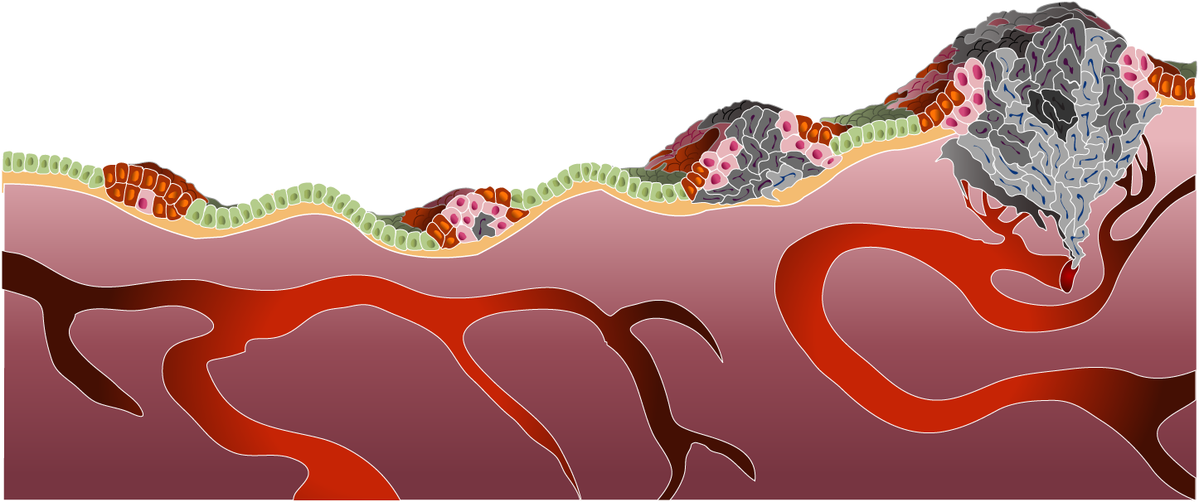
Tumor angiogenesis play a relevant role
in lung cancer growth and progression
Gene Methylation Mutations Translocations
HYPERPLASIA
DYSPLASIA
CARCINOMA
INVASIVE
CARCINOMA
Limitless potential for replication
Promotion of survival signals and
evasion of apoptosis
Cellular proliferation through independent growth signaling
Vascular recruitment and endothelial cell growth
Bronchial Epithelium
Tissue invasion
and metastasis
Adapted from Weinberg RA. Sci Am. 1996;275:62-70.
Notes:
Cancer is a genetic disease
Genetic lesions are acquired through:
Heredity
A mutated parental gene locus can be contributed to offspring, resulting in a hereditary predisposition to cancer¹
Environmental or other genomic insults
Occupational exposures (benzene, exhaust, pesticides, radiation)^{1,2}
Dietary exposures¹
Environmental exposures (sunlight, cigarette smoke, etc)³
The aging process²
Throughout a lifetime, a number of genetic alterations can accumulate and result in the ability of a cell or group of cells to progress toward malignancy¹
Genetic lesions lead to dysregulated cellular signaling processes
These complex mechanisms are the foundation of tumorigenesis⁴:
Cellular proliferation through independent growth signaling
Insensitivity to antigrowth signals and the promotion of survival signals
Evasion of apoptosis
Limitless potential for replication
Vascular recruitment and growth
Tissue invasion and metastasis
With genetic lesions fostering dysregulated signaling processes, the result is the acquisition of cellular and physiologic capabilities that drive tumor formation.
References:
1. Weinberg RA. How cancer arises. Sci Am. 1996;275:62-70.
2. Duesberg P. Chromosomal chaos and cancer. Sci Am. 2007;296:52-59.
3. Vogelstein B, Kinzler KW. Cancer genes and the pathways they control. Nat Med. 2004;10:789-799.
4. Hanahan D, Weinberg RA. The hallmarks of cancer. Cell. 2000;100:57-70.

Slide 10
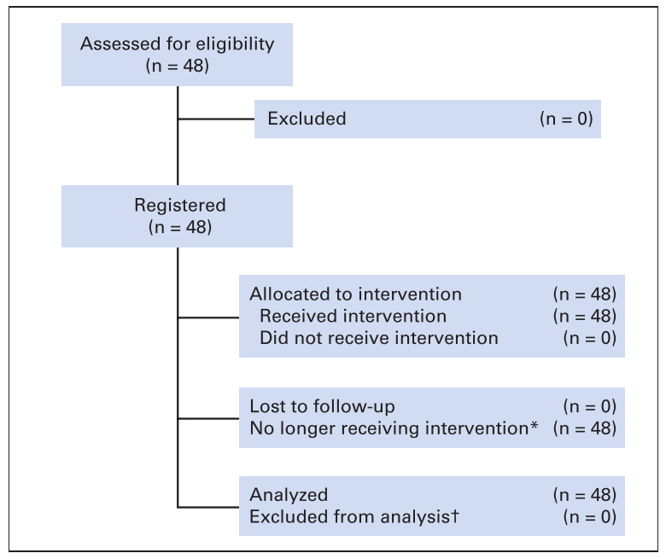
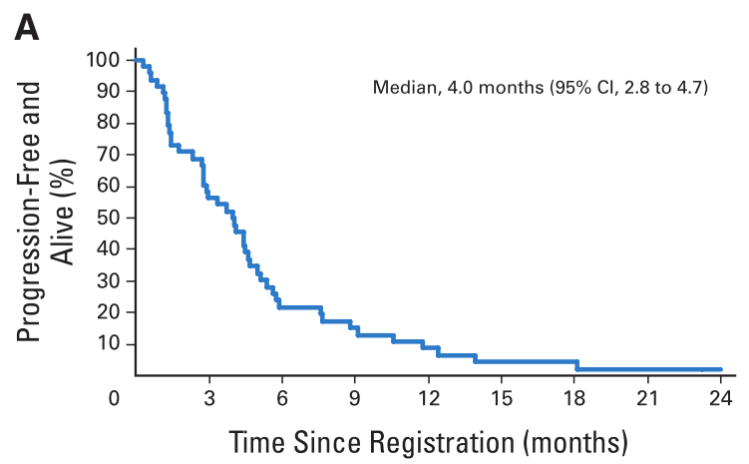
Single-arm phase II NCCTG/SWOG study N0426: pemetrexed and bevacizumab
Primary end-point not meet: NEGATIVE TRIAL!
Adjei et al JCO 2010

Slide 11
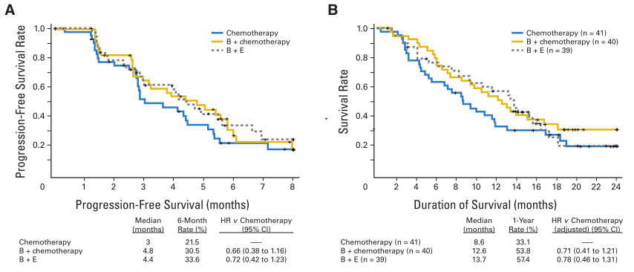
Phase II study of Bevacizumab in Combination With Chemotherapy or Erlotinib Compared With Chemotherapy Alone
Large phase III trial (ULTIMATE) in now ongoing:
docetaxel + bevacizumab vs docetaxel in 2° line therapy
Herst et al JCO 2017

Slide 12
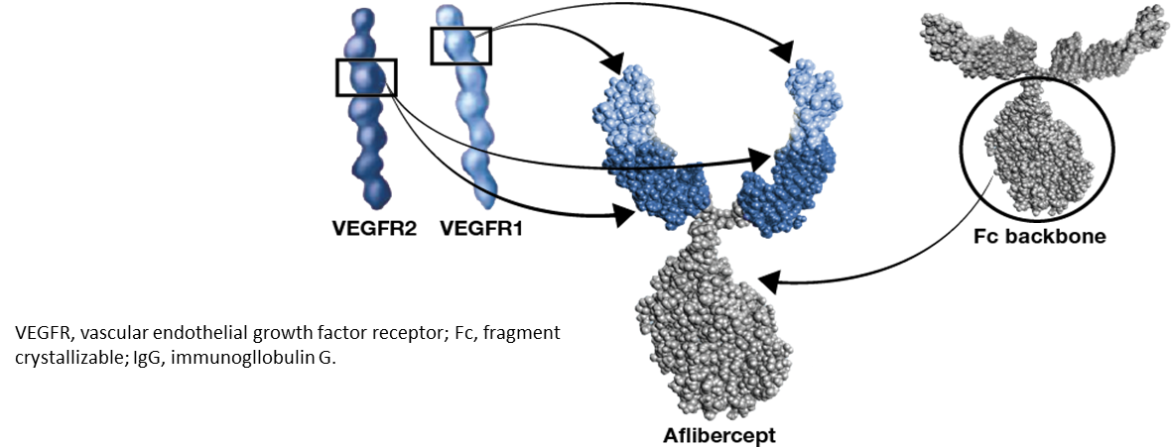
Aflibercept + Docetaxel vs Docetaxel in 2nd line therapy: randomized, controlled phase III Trial (VITAL)
Aflibercept 6 mg/kg d1
+
Docetaxel 75 mg/m2 q21
Patients:
NSCLC (IIIB–IV)
2nd line patients
913 pz
Primary
OS
Secondary
PFS
Objective Response Rate
QoL
1:1 randomisation
Placebo
+
Docetaxel 75 mg/m2 q21

Slide 13
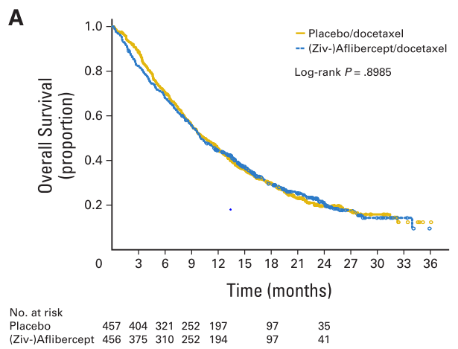
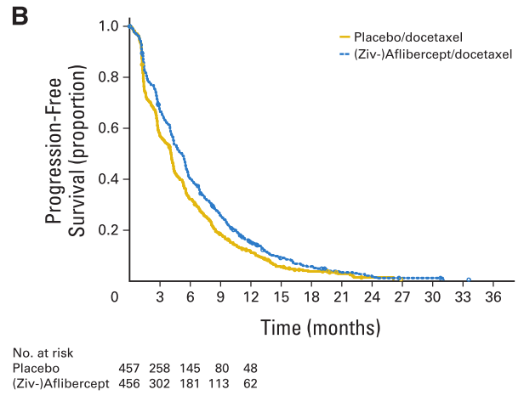
Aflibercept + Docetaxel vs Docetaxel in 2nd line therapy: randomized, controlled phase III Trial (VITAL)
Median OS: 10.1 m vs 10.4 m (HR 1.01, p=0.9)
Median PFS: 5.2 m vs 4.3 m (HR 0.82, p=0.0035)
ORR: 23.3% vs 8.9% (p=0.001)
Ramlau et al, JCO 2012

Slide 14
Ramucirumab (IMC-1121B), a fully human IgG1 monoclonal antibody, targets VEGFR2
VEGF- A₁₂₁
VEGF- A₁₄₅
VEGF- A₁₆₅
VEGF- A₁₈₉
VEGF- A₂₀₆
VEGF- B₁₆₇
VEGF- B₁₈₆
PlGF- 1,2
VEGF- C
VEGF- D
s-s
s-s
VEGFR1
(Flt-1)
NRP-1
NRP-2
VEGFR2
(Flk-1/KDR)
VEGFR3
(Flt-4)
Ramucirumab
Vasculogenesis
Angiogenesis
Angiogenesis
Lymphangiogenesis
www.researchvegf.com
Youssoufian H, Hicklin DJ, Rowinsky EK. Review: monoclonal antibodies to the vascular endothelial growth factor receptor-2 in cancer therapy. Clin Cancer Res. 2007 Sep 15;13(18 Pt 2):5544s-5548s.

Slide 15
Studies of ramucirumab in NSCLC
Study ID | Ph | Eligibility/Line | Arm(s) | N (projected)
NCT00735696 | II | Stage IIIB or IV (AJCC 6th ed.), first line | Ramucirumab + paclitaxel + carboplatin | 40
NCT01160744 | II | Stage IV , first line | Ramucirumab + Premetrexed + Carboplatin or Cisplatin Premetrexed + Carboplatin or Cisplatin Ramucirumab + Gemcitabine + Carboplatin or Cisplatin Gemcitabine + Carboplatin or Cisplatin | 280
NCT01168973 | III | Stage IV, second line | Docetaxel + Ramucirumab Docetaxel + Placebo | 1156

Slide 16
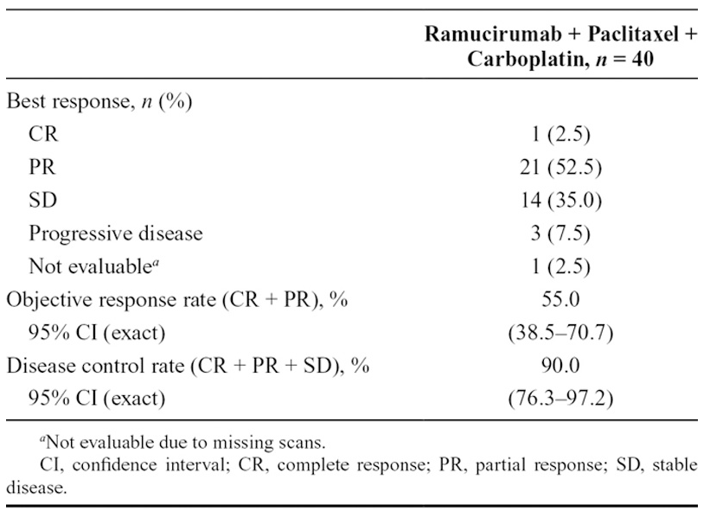
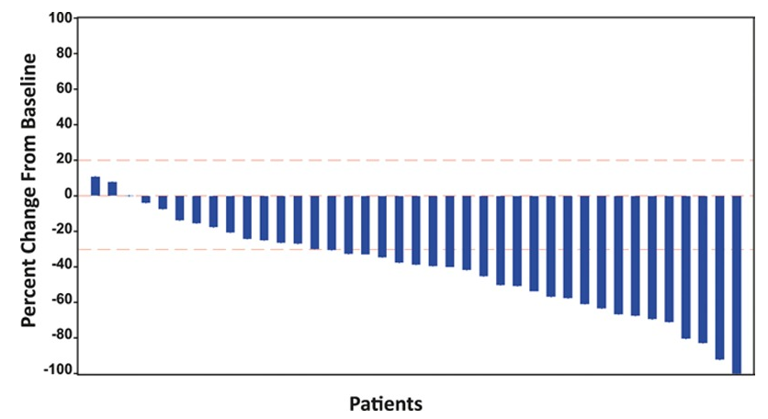
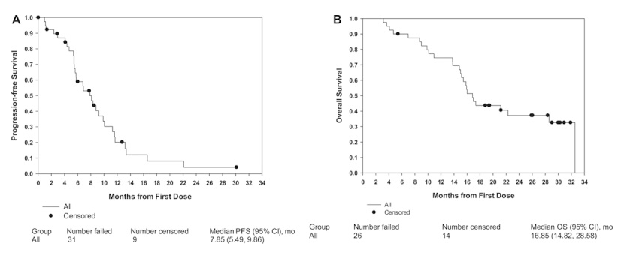
NCT00735696 - Phase 2 study in NSCLC
(1st-line: Ramucirumab + paclitaxel/carboplatin)
PFS: 7.85 mo
OS: 16.85 mo
Camidge et al, JTO 2014

Slide 17
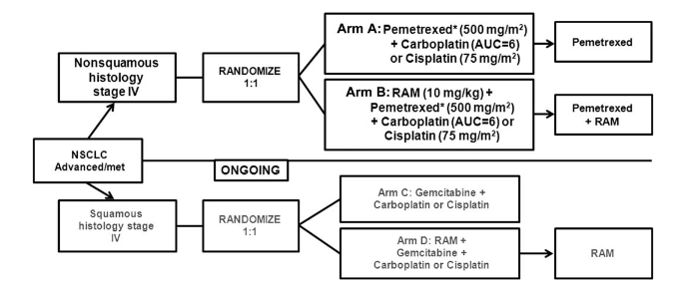
NCT01160744 - Phase 2, randomized, study in NSCLC
(1st-line: Pemetrexed/platinum +/- Ramucirumab)
Doebele et al, Cancer 2015

Slide 18
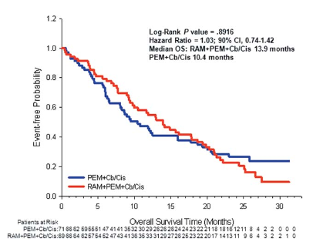
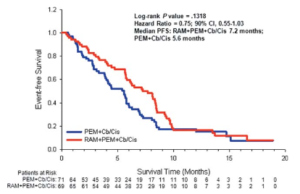
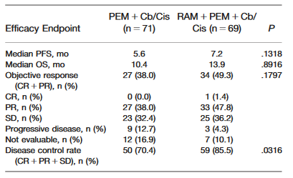
NCT01160744 - Phase 2, randomized, study in NSCLC
(1st-line: Pemetrexed/platinum +/- Ramucirumab)
Doebele et al, Cancer 2015

Slide 19
REVEL: Randomized Phase 3 Study in NSCLC
2nd line: Docetaxel +/- Ramucirumab
1:1
R
A
N
D
O
M
I
Z
E
Ramucirumab 10 mg/kg
+
Docetaxel 75 mg/m² q3wks
N=628
Stage IV NSCLC after one platinum- based chemo +/- maintenance
Prior Bev allowed
All histologies
PS 0 or 1
Treatment until disease progression
or unacceptable toxicity
Placebo
+
Docetaxel 75 mg/m² q3wks
N=625
Stratification factors:
ECOG PS 0 vs 1
Gender
Prior maintenance
East-Asia vs. ROW
Primary endpoint: Overall Survival
Secondary endpoints:
PFS, ORR, safety, patient-reported outcomes
Abbreviations: Bev=bevacizumab; ECOG PS=Eastern Cooperative Oncology Group performance status; ORR=objective response rate; PFS=progression-free survival; ROW=rest of the world; q3wks=every 3 weeks.
Garon et al, The Lancet 2014

Slide 20
REVEL: Patient Disposition
Screened (N=1825)
Excluded (n=572)
Randomized (ITT) Population N=1253
31%
RAM+DOC (N=628)
wt 33%
mutant 2.4%
unknown 64%
PL+DOC (N=625)
Patients not receiving treatment (n=4)
Patients not receiving treatment (n=4)
RAM+DOC (N=627)*
PL+DOC (N=618)*
Safety Population
N=1245
Reasons for discontinuation (N=613)
PD 341
Adverse event 94
Subject decision 90
Investigator decision 37
Death due to adverse events 30
Death from study disease 12
Other 9
On treatment at data cutoff N=11
Reasons for discontinuation (N=611)
PD 429
Adverse event 55
Subject decision 53
Investigator decision 19
Death due to adverse events 31
Death from study disease 14
Other 10
On treatment at data cutoff N=10
*Three PL+DOC arm patients were inadvertently treated with RAM and are therefore considered part of the RAM+DOC arm for the safety analyses, but the PL+DOC arm for the ITT efficacy analysis.
Garon et al, The Lancet 2014

Slide 21
REVEL:Tumor Response by RECIST v1.1 ITT Population, Investigator Assessment
 | RAM+DOC N=628 | PL+DOC N=625 | P-value
Response, n (%)
CR | 3 (0.5) | 2 (0.3)
PR | 141 (22.5) | 83 (13.3)
SD | 258 (41.1) | 244 (39.0)
PD | 128 (20.4) | 206 (33.0)
Unknown/not assessed | 98 (15.6) | 90 (14.4)
ORR (CR+PR), % (95% CI) | 22.9 (19.7-26.4) | 13.6 (11.0-16.5) | <.001
DCR (CR+PR+SD), % (95% CI) | 64.0 (60.1-67.8) | 52.6 (48.6-56.6 ) | <.001
Abbreviations: CI=confidence interval; CR=complete response; DCR=disease control rate; ITT=intention-to-treat; ORR=objective response rate; PD=progressive disease; PR=partial response; RECIST=Response Evaluation Criteria in Solid Tumors; SD=stable disease.
Garon et al, The Lancet 2014

Slide 22
REVEL: Progression-Free Survival ITT Population, Investigator Assessment
100
Median (95% CI)
Censoring Rate
RAM+DOC
4.5 (4.2-5.4)
11.1%
80
PL+DOC
3.0 (2.8-3.9)
6.7%
RAM+DOC vs PL+DOC:
Stratified HR (95% CI) = 0.762 (0.677-0.859)
60
Stratified log-rank P < .0001
Progression-Free Survival (%)
40
20
RAM+DOC
PL+DOC
0
0
3
6
9
12
15
18
21
24
27
30
33
36
Survival Time (months)
Number at risk
RAM+DOC
628
383
204
120
59
38
11
7
3
3
0
0
0
PL+DOC
625
301
172
95
37
17
9
4
3
2
0
0
0
Garon et al, The Lancet 2014

Slide 23
REVEL: Overall Survival ITT Population
100
Median (95% CI)
Censoring Rate
RAM+DOC
10.5 (9.5-11.2)
31.8%
PL+DOC
9.1 (8.4-10.0)
27.0%
80
RAM+DOC vs PL+DOC:
Stratified HR (95% CI) = 0.857 (0.751-0.979)
60
Stratified log-rank P = .0235
Overall Survival (%)
40
20
RAM+DOC
PL+DOC
0
0
3
6
9
12
15
18
21
24
27
30
33
36
Survival Time (months)
Number at risk
RAM+DOC
628
527
415
329
231
156
103
70
45
23
11
2
0
PL+DOC
625
501
386
306
197
129
86
56
36
23
9
0
0

Slide 24
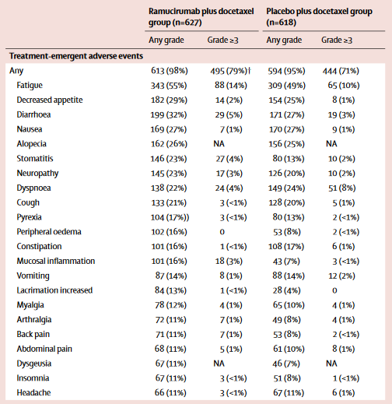
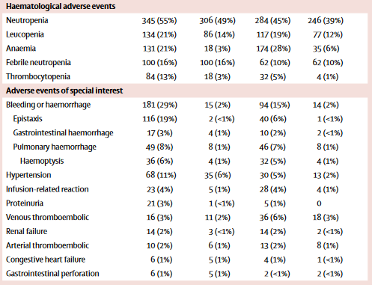
REVEL: Adverse events

Slide 25
Blocking the RAS/MEK signaling
Antibodies against the VEGF pathway
Multitarget agents
Combination therapies

Slide 26
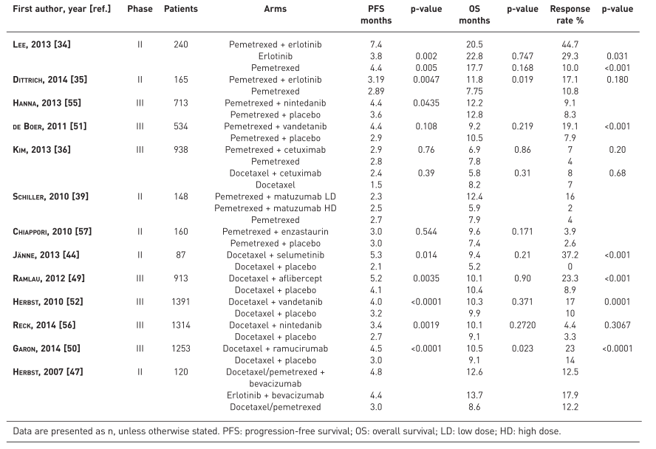
Combination chemotherapy with targeted therapy versus chemotherapy alone in second-line

Slide 27
Vandetanib + docetaxel vs docetaxel as 2° line (ZODIAC): a double-blind, randomised, phase 3 trial
Vandetanib 100 mg/die
+
Docetaxel 75 mg/m2 q21
Patients:
NSCLC (IIIB–IV)
2nd line patients
1391 pz
Primary
PFS
Secondary
OS
Objective Response Rate
Duration of Response
1:1 randomisation
Placebo
+
Docetaxel 75 mg/m2 q21
Herbst et al, Lancet 2010

Slide 28
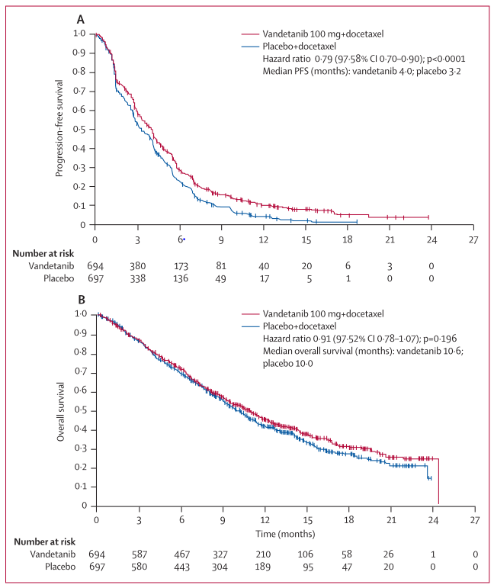
Vandetanib + docetaxel vs docetaxel as 2° line (ZODIAC): a double-blind, randomised, phase 3 trial
Herbst et al, Lancet 2010

Slide 29
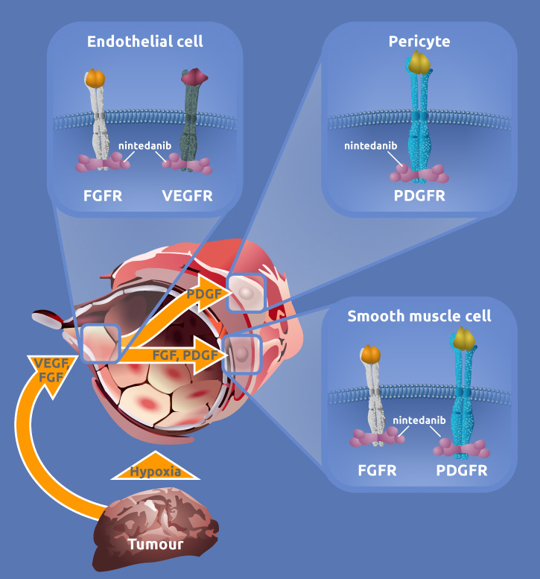
Nintedanib: multitarget antiangiogenic TKI
Oral angiokinase inhibitor targeting VEGFR 1-3, FGFR 1-3, and PDGFR α/β as well as RET^{[1,2]}
Manageable safety profile in combination with
Docetaxel^{[3]}
Pemetrexed^{[4]}
Paclitaxel/carboplatin^{[5]}
Gemcitabine/cisplatin^{[6]}
Afatinib^{[7]}
Single-agent nintedanib active in a phase II trial in recurrent NSCLC^{[8]}
1. Hilberg F, et al. Cancer Res. 2008;68:4774-4778. 2. Data on file. 3. Stopfer P, et al. Xenobiotica. 2011;41:297-311. 4. Bousquet G, et al. Br J Cancer. 2011;105:1640-1645. 5. Ellis PM, et al. Clin Cancer Res. 2010;16:2881-2889. 6. Doebele RC, et al. Ann Oncol. 2012;23:2094-2102. 7. Soria JC, et al. Ann Oncol. 2012;23(suppl 9): Abstract 979. 8.Reck M, et al. Ann Oncol. 2011;22:1374-1381. Used with permission.

Slide 30
LUME-Lung 1 Study Design
RANDOMIZE
Nintedanib 200mg BID p.o., D2–21, + Docetaxel 75mg/m² IV, D1, 21-day cycles (n=655)
PD
Stage IIIB/IV or recurrent NSCLC patients after 1st line chemotherapy
(all histologies)
1:1
Placebo BID p.o., D2–21, + Docetaxel 75mg/m² IV, D1, 21-day cycles (n=659)
PD
N=1314
Number of docetaxel cycles not restricted
Monotherapy allowed after ≥4 cycles of combination therapy
Primary end point: PFS
Next analysis step only allowed if PFS confirmed with all PFS events at time point of OS analysis
Stratification: ECOG PS (0 vs 1)
Prior bevacizumab (yes vs no)
Histology (squamous vs non- squamous)
Brain metastases (yes vs no)
Reck M et al, Lancet Oncol 2014

Slide 31
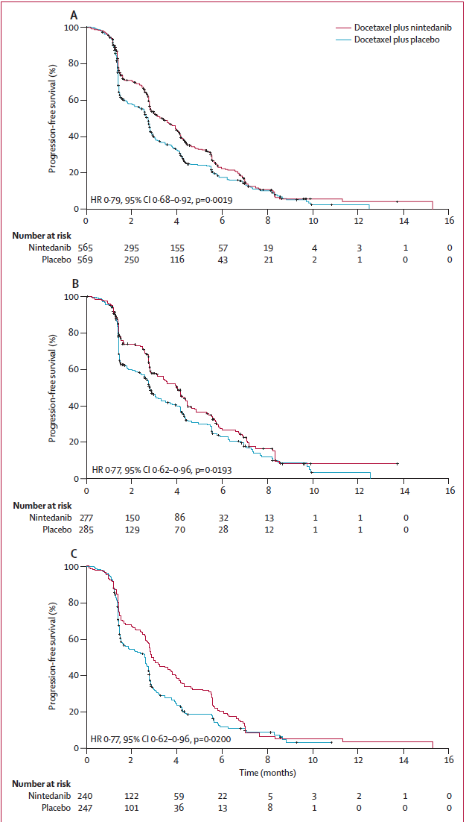
LUME1: PFS
TOTAL population
3.4 mo vs 2.7 mo
HR 0·79 [95% CI 0·68–0·92], p=0·0019
ADENOCARCINOMA
3.7 mo vs 2.7 mo
HR 0·77 [95% CI 0·62–0·96], p=0·0193
SQUAMOUS CARCINOMA
3.0 mo vs 2.5 mo
HR 0·77 [95% CI 0·62–0·96], p=0·020
Reck M et al, Lancet Oncol 2014

Slide 32
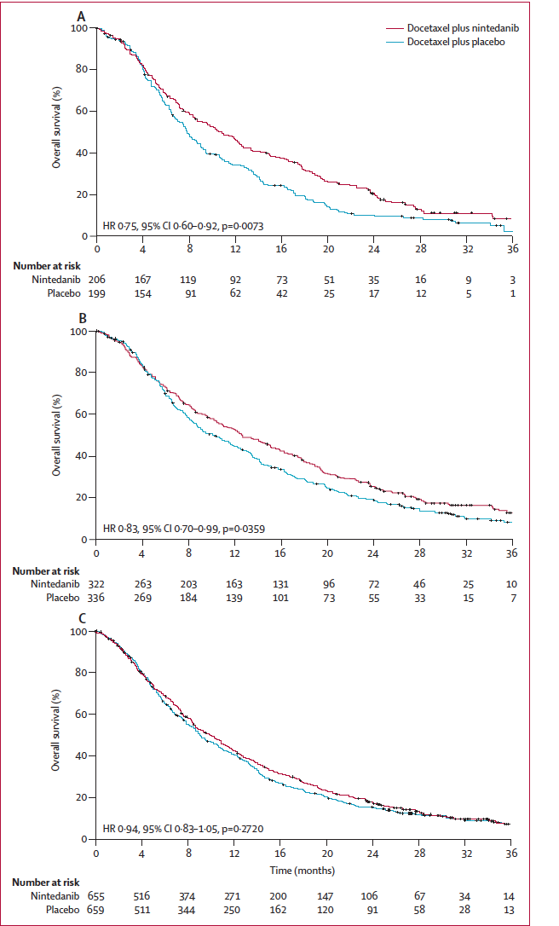
LUME1: OS
Adenocarcinoma <9mo
10.9 mo vs 7.9 mo
HR 0·75 [95% CI 0·60–0·92], p=0·0073
ADENOCARCINOMA
12.6 mo vs 10.3 mo
HR 0·83 [95% CI 0·70–0·99], p=0·0359
Total population
10.1 mo vs 9.1 mo
HR 0·94 [95% CI 0·83–1·05], p=0·272
Reck M et al, Lancet Oncol 2014
Notes:
who progressed within 9 months after starting
fi rst-line treatment, PFS was signifi cantly longer in the
docetaxel plus nintedanib group than in the docetaxel
plus placebo group, which translated to an improvement
in overall survival.

Slide 33
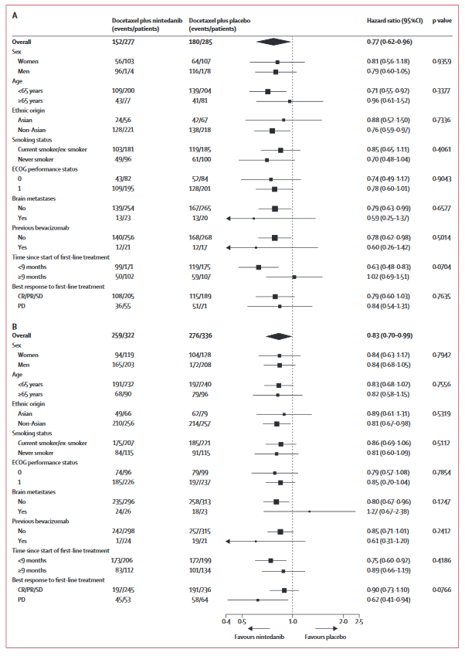
Effect of treatment on survival in subgroups by baseline characteristics in patients with adenocarcinoma histology
PFS
OS
Reck M et al, Lancet Oncol 2014

Slide 34
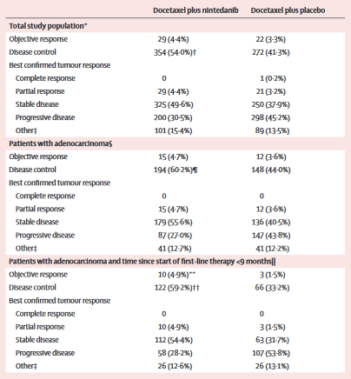
Confirmed best tumor response and disease control
Reck M et al, Lancet Oncol 2014

Slide 35
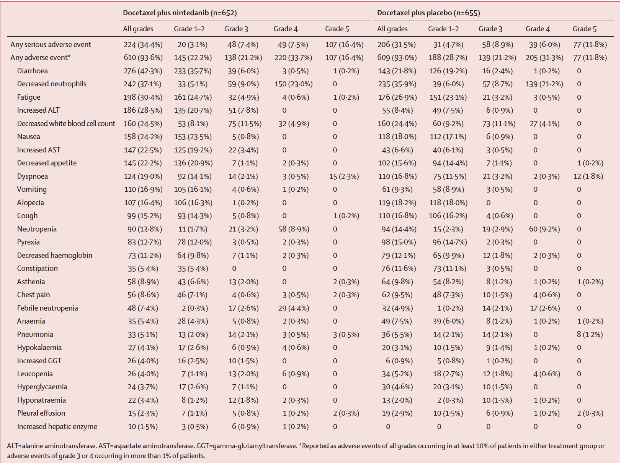
LUME1: Safety
Reck M et al, Lancet Oncol 2014

Slide 36
LUME-1: conclusions
Second-line combination therapy with nintedanib and docetaxel significantly improved PFS vs docetaxel alone in patients with NSCLC independent of disease histology
Addition of nintedanib to docetaxel also significantly improved OS vs docetaxel in patients with adenocarcinoma
Safety profile of nintedanib in combination with docetaxel was manageable, with no unexpected safety signals

Slide 37
Blocking the RAS/MEK signaling
Antibodies against the VEGF pathway
Multitarget agents
Combination therapies

Slide 38
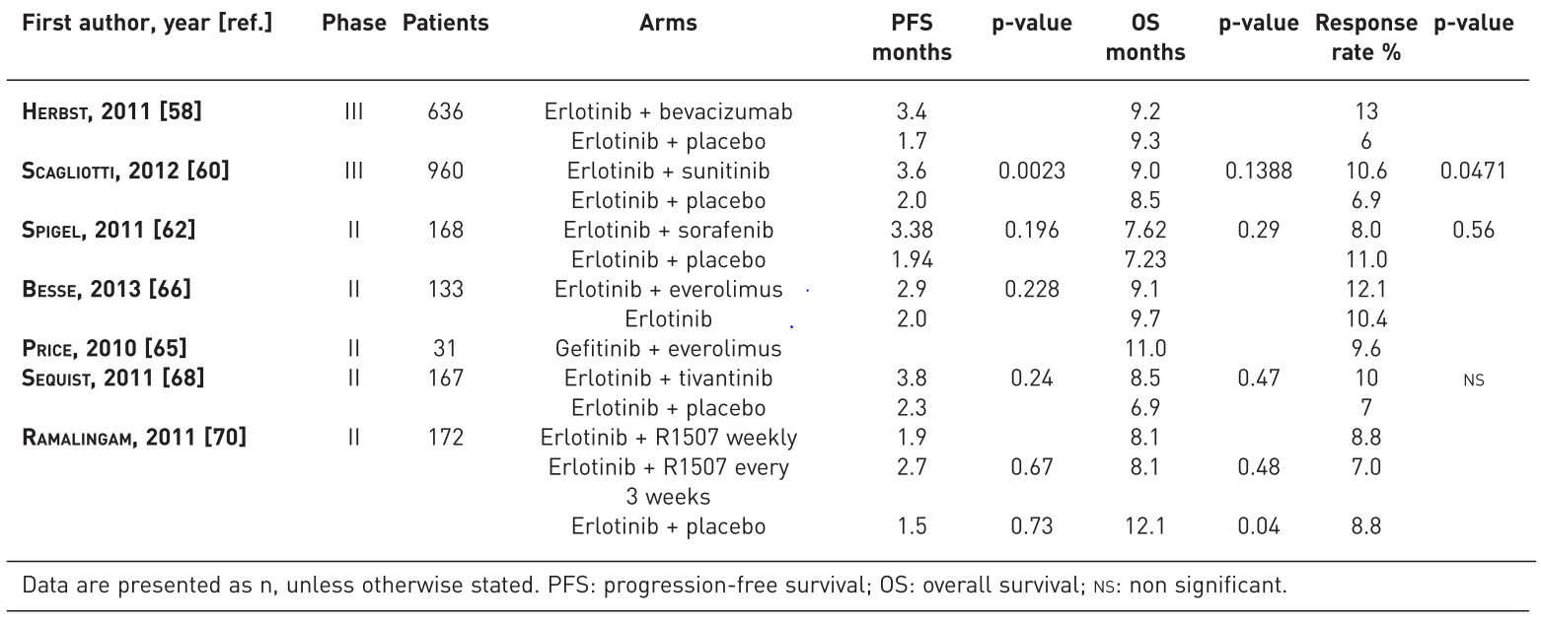
Combination therapy with targeted and
anti-angiogenic agents in second-line NSCLC

Slide 39
Overview of Current Second-line Treatment
Numerous factors involved in choice of treatment
Previous therapy
Histology
Performance status
Organ function
Ramucirumab + Docetaxel better than Docetaxel alone in all histologies
Nintedanib + Docetaxel better than Docetaxel alone in adenocarcinoma
Notes:
EGFR, epidermal growth factor receptor; QoL, quality of life; TKI, tyrosine kinase inhibitor; WT, wild-type.

