Slide 1
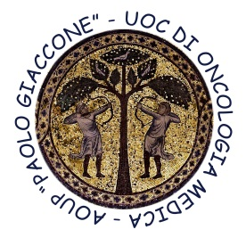


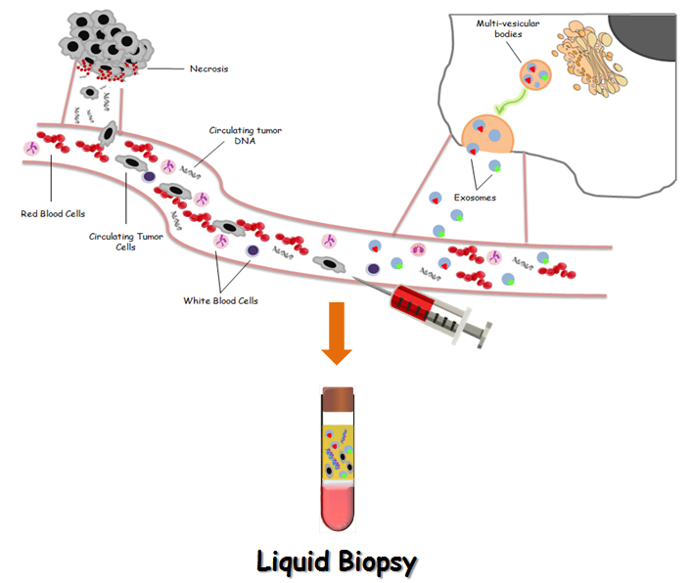
Department of Surgical, Oncological and Oral Sciences
U.O.C Medical Oncology
Director: Prof A. Russo
Session 1: innovative strategies for gastrointestinal cancers
Liquid Biopsy in Gastrointestinal tumors
Dr. Marta Castiglia, PhD

Slide 2
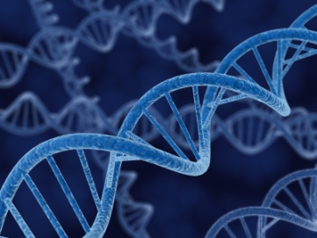
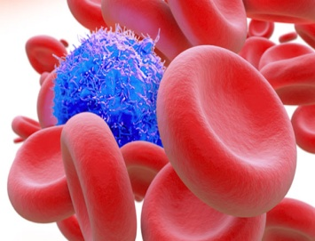
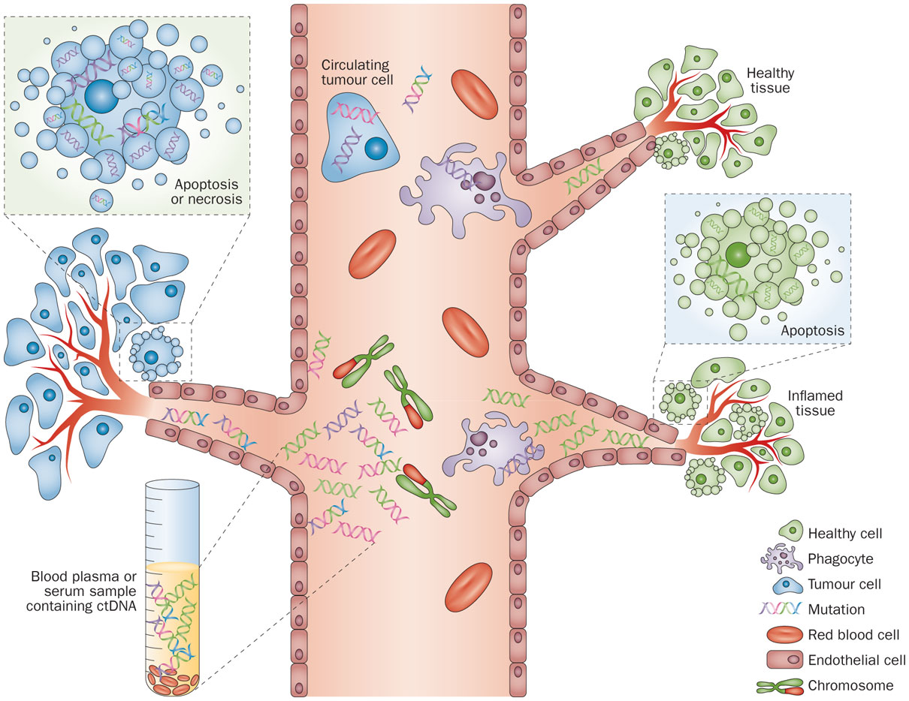
Liquid Biopsy
Definition
Detection of positive and negative biomarkers as circulating tumor cells (CTC) and cell-free circulating tumor DNA (ctDNA) from peripheral blood samples
Crowley, E. et al. Nat. Rev. Clin. Oncol. 2013

Slide 3
Why the need of liquid biopsy?
Tumor biopsy of both primary and metastasis is often difficult for practical reason
Tissue biopsy is not always representative for the all tumor (especially for FNB) → Tumor Heterogeneity
Lack of sensitive and specific biomarker for tumor early detection and monitoring (treatment response, relapse, etc…)

Slide 4
Possible application of liquid biopsy
Screening and early detection
Stratification and therapeutic intervention
LIQUID BIOPSY
Real-Time monitoring of therapy
Therapeutic targets and resistance mechanisms
Risk for metastatic relapse

Slide 5
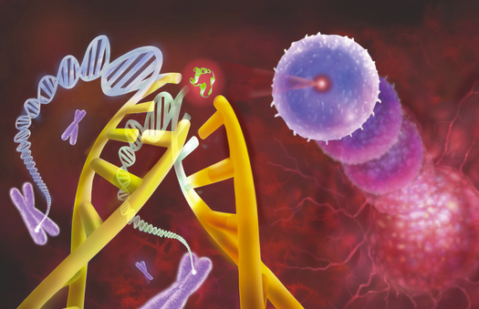
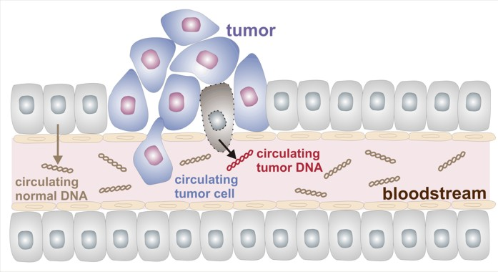
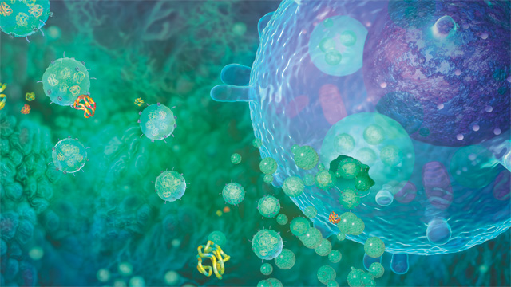
Liquid Biopsy
Circulating Tumor DNA and Circulating Tumor Cells and exosomes
Portion of cell-free DNA released from tumor cells
Real time monitoring of “molecular condition” of the disease
Prognostic and predictive value
High CTC numbers associate with aggressive disease, increased metastasis, and decreased time to relapse
Tumorigenic in xenograft model
Small (40 to 100 nm) vesicles
Released from normal, diseased, and neoplastic cells in the blood and other body
Involved in cell-cell or organ-organ communications
Reach in protein, mRNA, miRNA and DNA fragments

Slide 6
Circulating Tumor Cells
PROs & CONs
PROs
CONs
Presence of benign circulating epithelial cells
Heterogeneity
Not detectable in every tumor
CTCs analysis is expensive
Minimal invasive prognostic marker
Therapeutic management:
CTC reduction or loss could
indicate a response to treatment
FDA-approved technique for CTCs isolation

Slide 7
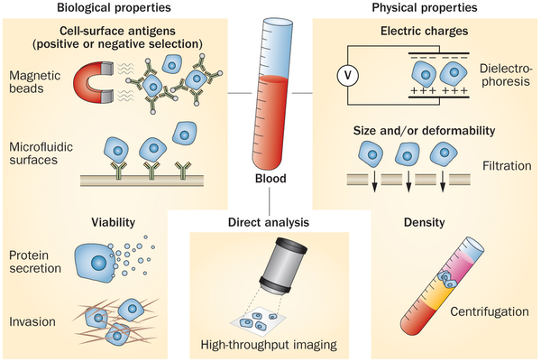
CTCs enrichment techniques
Physical properties
Biological properties
Miyamoto DT et al., Nature Reviews Clinical Oncology, 2014

Slide 8

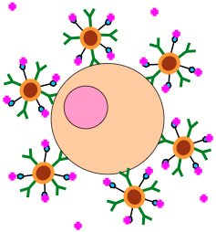
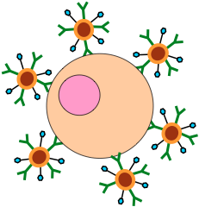

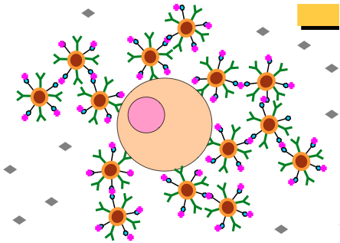
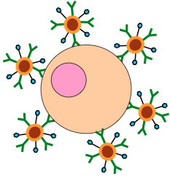
Cell Search™ System
Ferrofluid
Streptavidin
CTCs
Anti-EpCAM ferrofluids binds toCTCs
Streptavidin binds to biotin analogue
to amplify volume of iron nano-particle
Biotin
Biotin bounds to streptavidin releasing excess of Anti-EpCam ferrofluids
Only Anti-EpCAM ferrofluids remains bound to CTCs
CellSearch™ Circulating Tumor Cells Kit
EpCAM positive; round-to-oval morphology; DAPI+ nucleus; positive for CK (8/18 and/or 19); negative for CD45

Slide 9
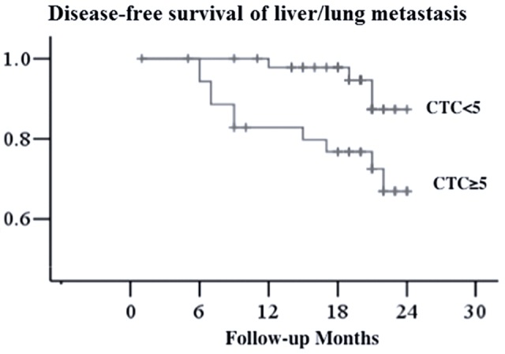
Colorectal Cancer
CTCs as prognostic marker for distant metastasis in non-metastatic patients
15 mCRC pts, 95 non metastatic pts, 48 healthy controls.
Technique: microfluidic device, antibody-based isolation
Disease free-survival of liver/lung metastasis
≥5 cells per 2 mL of blood → increased risk of developing a distant metastasis
<5 cells per 2mL of blood →better disease-free survival
P= 0.015
Tsai WS et al., Sci Rep 2016

Slide 10
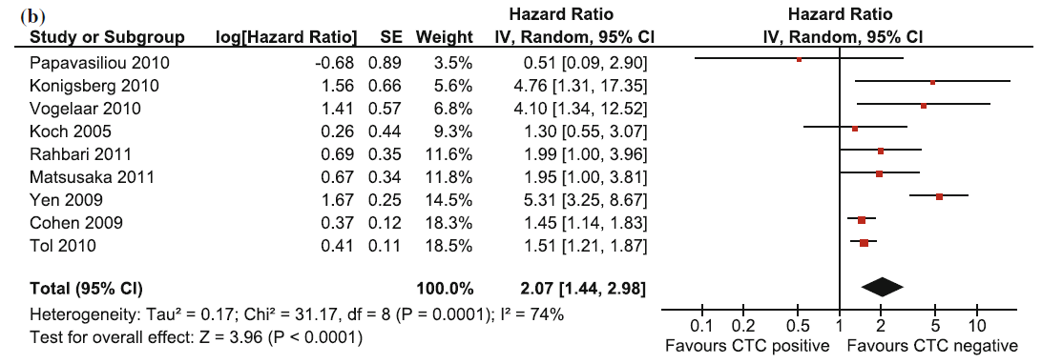
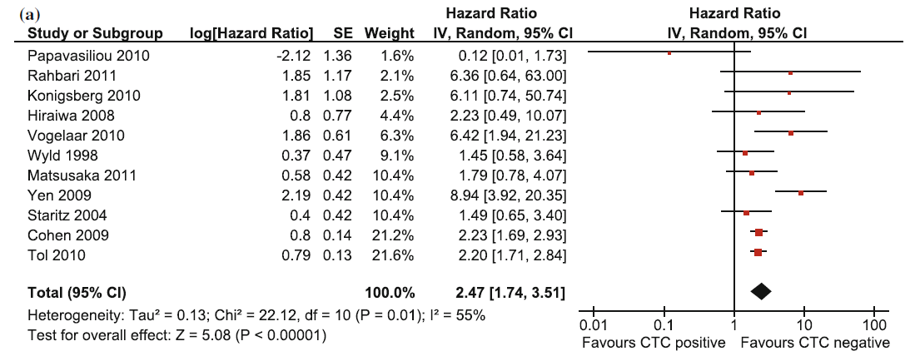
mCRC: Prognostic value of CTCs
Literature-based meta-analysis of 12 studies in mCRC pts (N=1329)
PFS
OS
Detection of CTCs in mCRC pts is associated with a worse PFS and OS
Groot et al., Ann Surg Oncol 2013

Slide 11
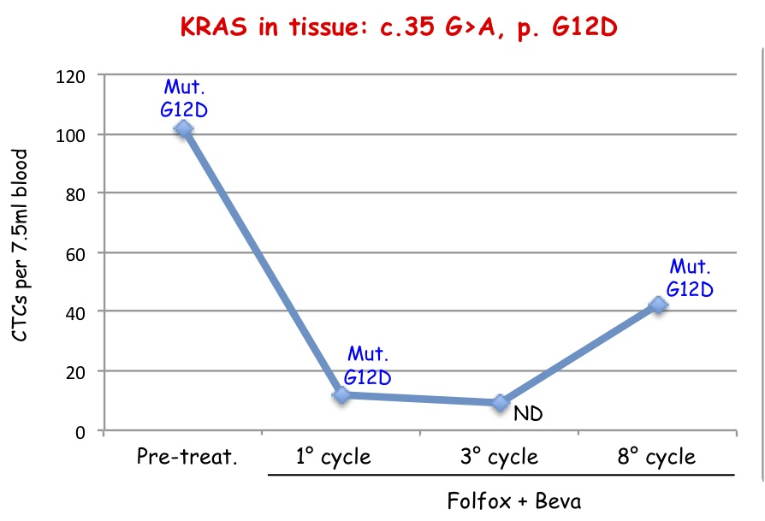
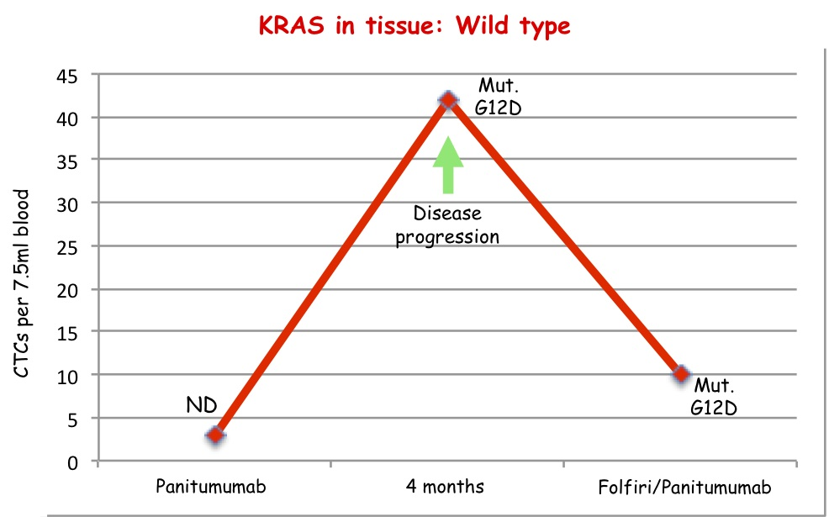
mColorectal Cancer:
Predictive value of CTCs in mCRC (N=31)
Pts #1
Pts #15
KRAS status in tumor tissue | CTC count | KRAS status in CTCs | Time point
Wild type | 3 | ND | Maintenance therapy with Panitumumab
 | 42 | c.35G>A; p.G12D | Progression on Panitumumab
 | 10 | c.35G>A; p.G12D | Post cycle 2 of 2nd line Folfiri/Panitumumab
KRAS status in tumor tissue | CTC count | KRAS status in CTCs | Time point
c.35G>A, p.G12D | 102 | c.35G>A, p.G12D | Prior 1st line FOLFOX/Beva
 | 12 | c.35G>A, p.G12D | Prior cycle 1 of 1st line
 | 9 | ND | Post cycle 3 of 1st line
Kalikaki A., PLoS one 2014

Slide 12
Cell-free DNA and cancer
cfDNA does exist at a steady-state and increases sometimes dramatically in some pathological conditions (trauma, inflammation, strokes, cancer, etc…).
In oncology the detection of cfDNA derived from tumor (ctDNA) is challenging due to:
    discrimination of ctDNA from cfDNA
    low levels of ctDNA (specially in early stage disease)

Slide 13
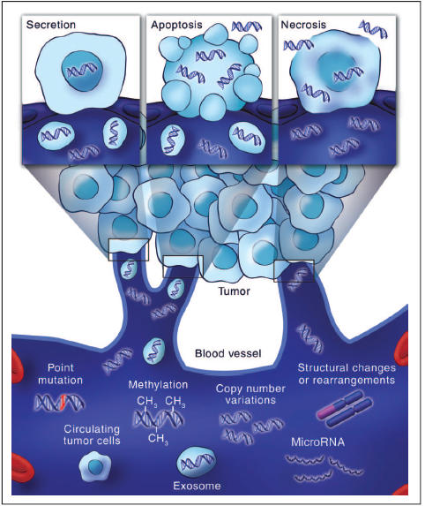
Mechanisms of ctDNA shedding
Tumor growth determines an increases in the cellular turnover → apoptotic and necrotic cells
Apoptotic and necrotic remains are cleared by infiltrating phagocytes
This does not happen efficiently within the tumor mass → release of DNA
Diaz L. and Bardelli A. JCO , 2014

Slide 14
Circulating tumor DNA
PROs & CONs
PROs
CONs
Minimally invasive marker
Early detection of drug resistance development
Driver mutation detection from blood samples
Solving the issue regarding “insufficient material for analysis”
Lack of standardized and widely approved methods for analysis
Contamination with cfDNA from healthy cells
Low levels of ctDNA
Accurate quantification of the mutant allele in the sample

Slide 15
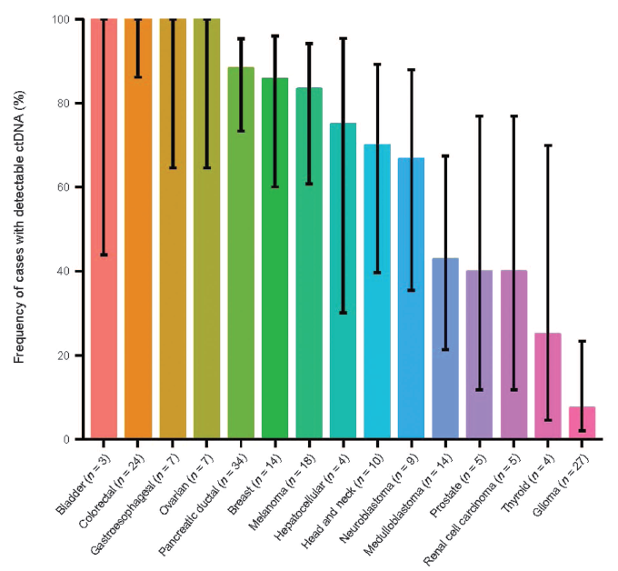
Liquid biopsy
ctDNA: Distribution in different tumors
Bettegowda et al., Sci Trans Med, 2014

Slide 16
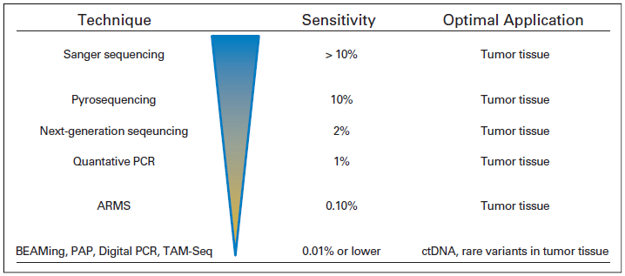
Circulating tumor DNA
Technique sensitivity
Diaz L. and Bardelli A. JCO , 2014

Slide 17
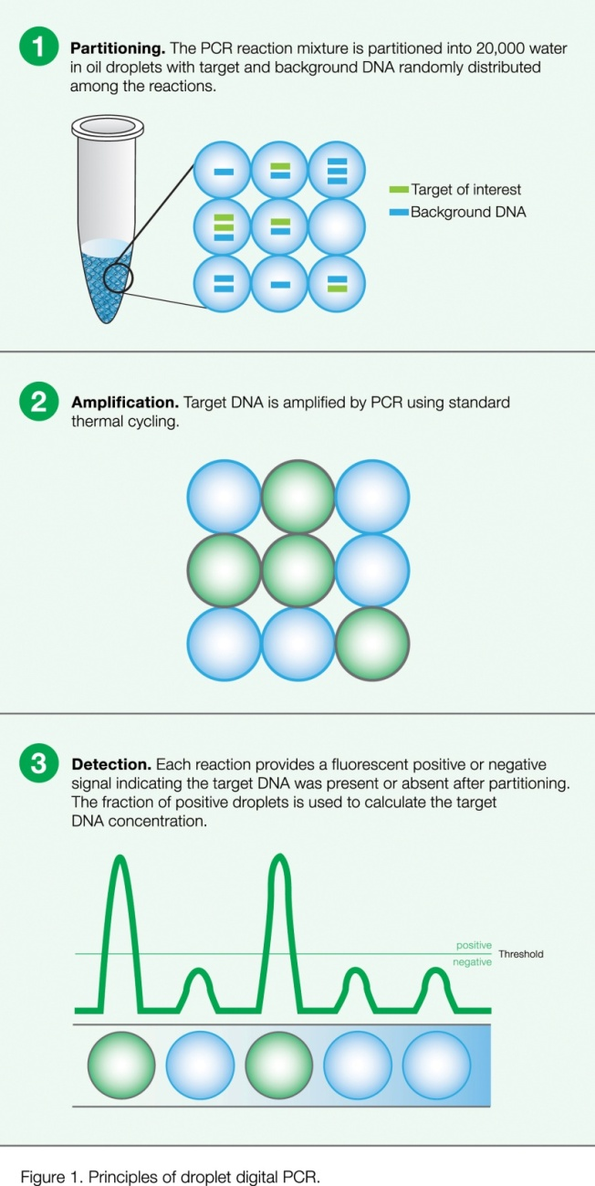
Methodologies for ctDNA analysis
Droplet Digital PCR
 | QX200 | RainDrop
Droplet volume | 1 nl | 5 pl
Number of droplet generated | 20.000 | 1.00.000
Multi-target per droplet | Possible | Improbable
SYBR green or Eva green | Yes | No
TaqMan probe technology | Yes | Yes
Multiplex | Yes | yes
Sensitivity | 0.01%-0.001% | 0.001%

Slide 18
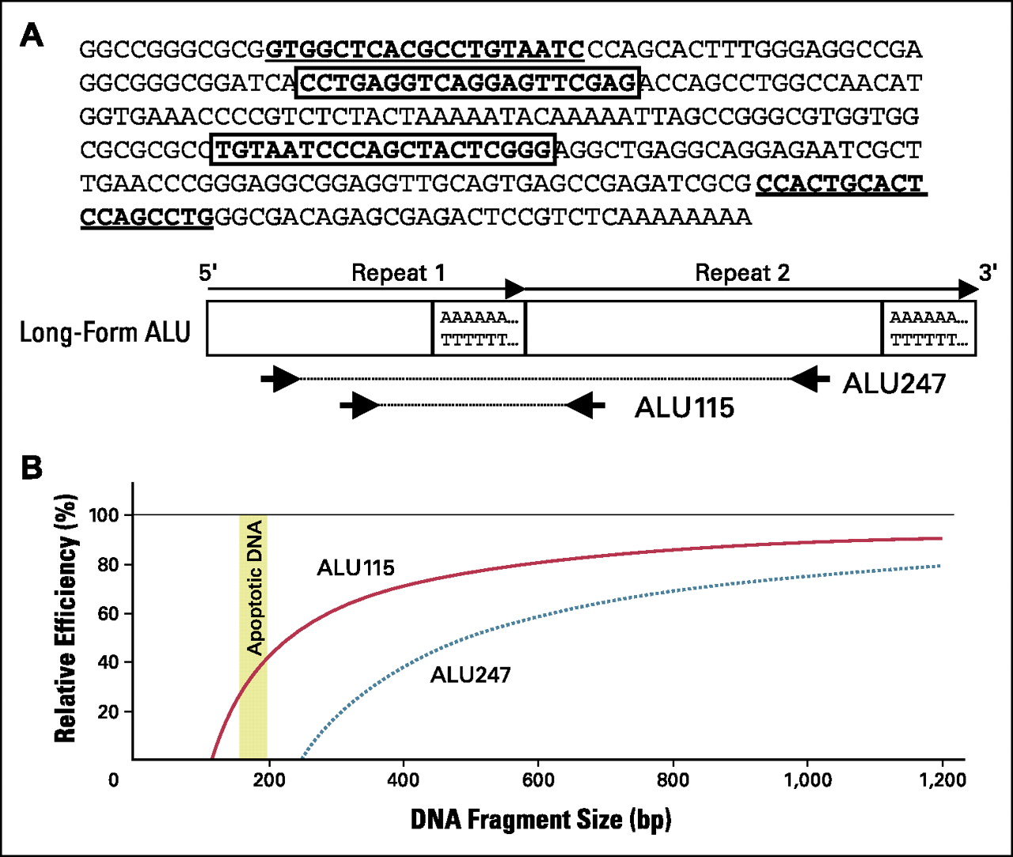
DNA Integrity Index (DII)
ALU247
DII =
ALU115
Apoptotic
cells
DNA fragments size usually:
185 to 200bp in length
Malignant T.
cells
DNA fragments:
varies in size
Elevated levels of long DNA fragments may be a good marker for detection of malignant tumor DNA in blood
Umetani et al, JCO 2006

Slide 19
DNA Integrity Index (DII)
Adopted from Hao et al., BJC 2014

Slide 20
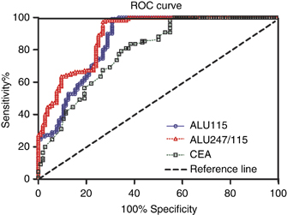
DNA integrity index in mCRC
Sensitivity and Specificity
Marker | Primary CRC | Normal controls | Cutoff | AUC | P-value
ALU115 (ng/mL) | 1046.0 (582.7-1694.0) | 385.4 (205.7-587.1) | 694 | 0.85 | <0.0001
ALU247/115 | 0.62 (0.51-065) | 0.38 (0.29-0.49) | 0.52 | 0.89 | <0.0001
CEA (ng/mL) | 3.4 (<0.5-710.5) | 1.6 (0.3-4.0) | 5 | 0.78 | <0.0001
Hao et al., BJC 2014

Slide 21

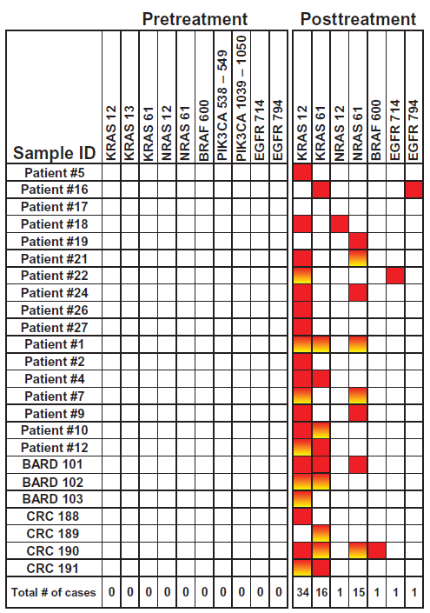
Liquid biopsy: ctDNA
Colorectal Cancer
ctDNA is a useful tool for monitoring patients for resistance-conferring mutations
23/24 patients (96%) screened developed at least one mutations in the selected genes at PD
multiple mutations development in the same patients
exon 61 mutations both in KRAS and NRAS gene represent the 46% of the detected mutation in patients resistant to EGFR blockade
Bettegowda et al., Sci Trans Med, 2014

Slide 22
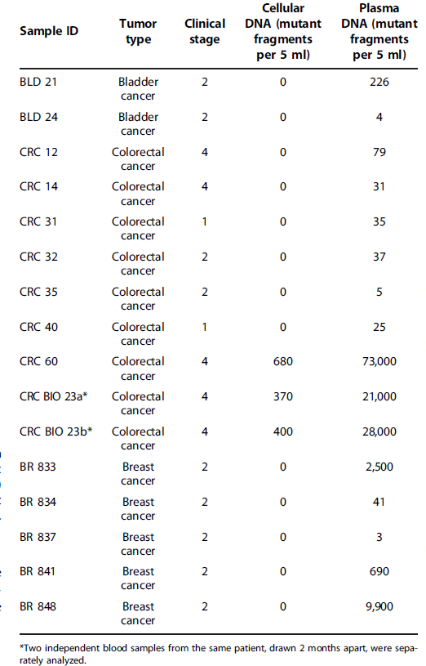
Liquid biopsy:
CTCs vs ctDNA
In many cases (13 of 16; 81%) in which ctDNA was detected, no CTCs were detectable
No cases in which CTCs were detected but not ctDNA
In three cases where both CTCs and ctDNA levels were detectable, the average number of mutant fragments in the plasma was >50-fold higher than analogous levels in CTCs.
Bettegowda et al., Sci Trans Med, 2014

Slide 23
mCRC: ctDNA
Dynamic change of ctDNA levels during intermittent anti-EGFR treatment
Tumor load
12
KRAS G12V
10
8
Mutated allele (%)
6
4
2
0
Baseline
1st CT scan
1st-line PD
Baseline
re-challenge
1st CT scan
2nd-line PD
Irinotecan+Cetux
Tomox
Cetux
CRC treated with EGFR-specific antibodies display remarkable plasticity that reflects the dynamic clonal competition → Re-challenge may be a real option?
Adopted from Siravegna G. et al., Nat Med, 2015

Slide 24
mCRC: ctDNA
Dynamic change of ctDNA levels during intermittent anti-EGFR treatment
Tumor load
KRAS G13D
1
KRAS G12V
0.8
0.6
Mutated allele (%)
0.4
0.2
0
Baseline
1st CT scan
2nd CT scan
3rd CT scan
Baseline
re-challenge
5th CT scan
2nd—line PD
Irinotecan+Cetux
No treatment
(pts refusal)
Panitumumab
CRC treated with EGFR-specific antibodies display remarkable plasticity that reflects the dynamic clonal competition → Re-challenge may be a real option?
Adopted from Siravegna G. et al., Nat Med, 2015

Slide 25
ctDNA testing in Gastrointestinal stromal tumors (GIST)
Biopsy of gastric mass
Pelvic nodule
Partial response
Treatment with Imatinib
Months
0
1
2
3
4
5
6
7
8
9
10
11
12
13
14
15
16
Tissue testing: KIT ex 11 del
p. K558_E562
Plasma analysis:
KIT ex 17 missense p. S821F
KIT ex 11 del p. K558_E562
Allele frequency:
KIT ex11 del → 79,01%
Allele frequency:
KIT ex11 del → 1.58%
KIT ex17 missense → 1.52%
Adopted from Kang G et al., Targ Oncol 2015

Slide 26
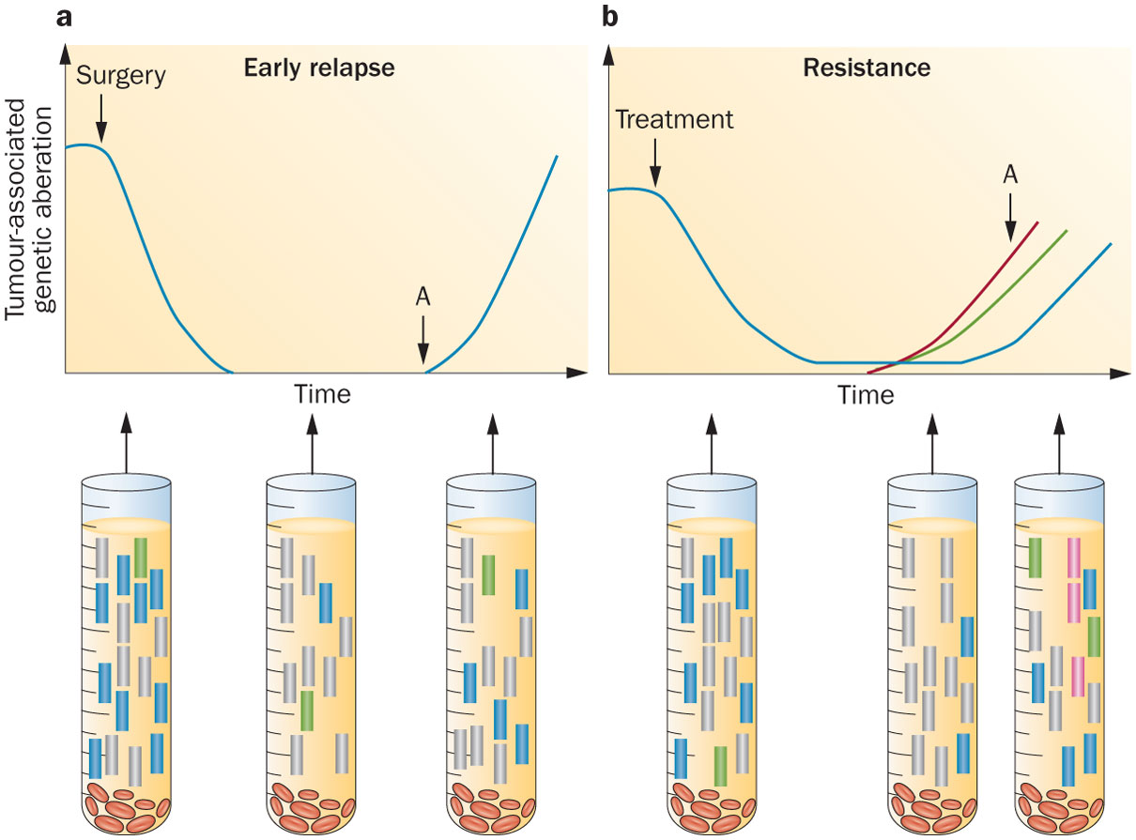
Two hypothetical scenarios
Monitoring tumour-specific aberrations to detect recurrence and resistance
Crowley, E. et al. Nat. Rev. Clin. Oncol. 2013

Slide 27
Liquid biopsy: CTCs & ctDNA
Future perspectives
Treatment Response
Diagnosis
Relapse
CTCs and ctDNA levels in plasma
Circulating tumor DNA
Tumor burden
CT/PET scan
Circulating tumor cells
Disease Progression in time (from diagnosis to relapse)
Rolfo C, Castiglia M, Peeters M, Russo A, Pauwels P
Liquid biopsies in lung cancer: the new ambrosia of researchers. Biochim Biophys Acta. 2014

Slide 28
Conclusions
Need of new and more sensitive techniques with increased sensitive for liquid biopsy analysis
Surrogate endpoint marker for the monitoring of treatment response
Identification of resistance prior to clinically evaluable disease progression
Identification of new treatment target and resistance mechanisms
Evaluation of the dynamic changes that occurs during tumor growth

