Slide 1



Department of Surgical, Oncological and Oral Sciences
U.O.C Medical Oncology
Director: Prof A. Russo
Ovarian cancer
Case Report 1
Dr. Lorena Incorvaia, MD PhD

Slide 2
PATIENT FEATURES
  Age= 57 years old, Karnofsky PS= 90%
  Hypertension
  No Familial cancer history
  Gynecological history: first menstruation age 10 years, regular periods, nulliparous

Slide 3
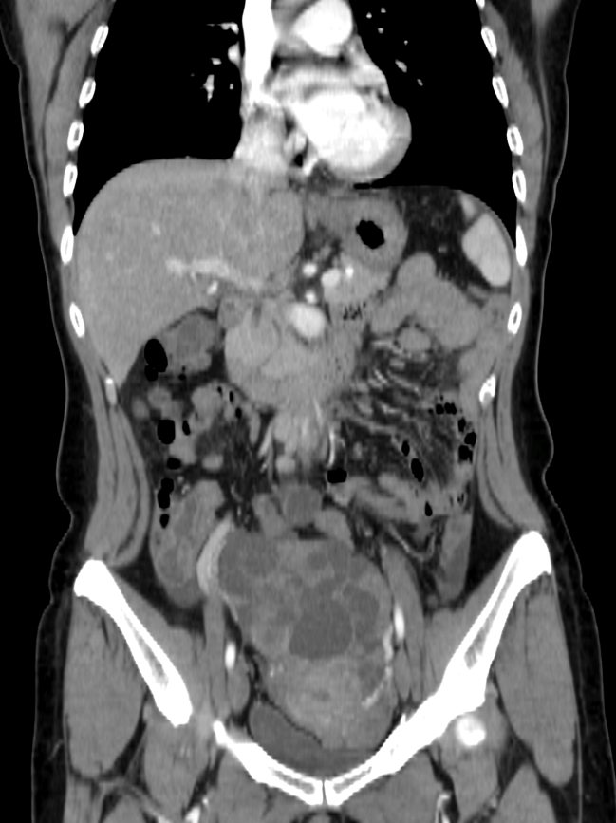
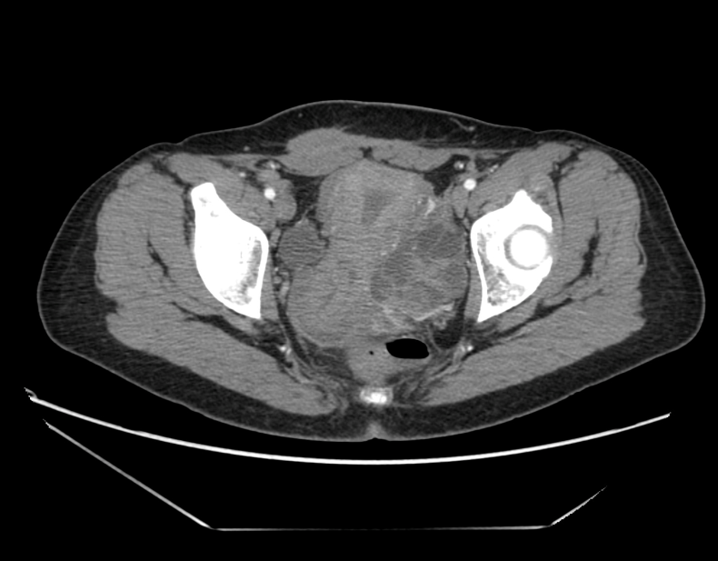
HISTORY
09.2012: severe dysmenorrhea and pelvic pain
CA 125: 258 U/ml
CT-scan: complex left pelvic mass (82 x 49 x 51 mm), bilateral pelvic lymphadenopathies, peritoneal carcinomatosis.

Slide 4
HISTORY
10.2012:
Laparoscopic documentation of omental nodules, peritoneal carcinomatosis and left adnexal mass (10 cm maximum diameter)
LPT: Hysterectomy, bilateral salpingo-oophorectomy, omentectomy diaphragmatic peritonectomy, anterior resection of the sigmoid colon and rectum, appendectomy and lymphadenectomy.
Residual tumor =0
Pathological examination: high-grade serous ovarian carcinoma with metastatic omentum and pelvic lymph nodes (FIGO Stage IIIC)
11.2012:
Post-operative CT-scan negative
CA125= 72 U/ml

Slide 5
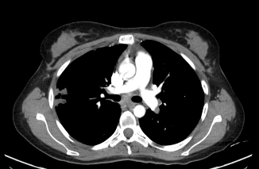
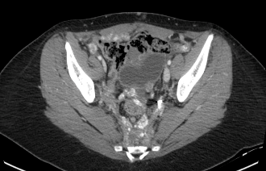
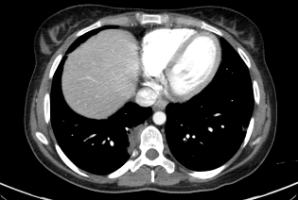
HISTORY
11.2012: Carboplatin (AUC 5) and Paclitaxel (175 mg/m2) x 6 (last cycle 03/2013)
04.2013: CT scan: negative, Ca125= 14 U/ml
01.2014: Elevation of CA 125: 263 U/ml
01.2014 CT-scan: abdominal and pelvic recurrence of disease (subcutaneous nodules of the anterior abdominal wall, peritoneal carcinomatosis), mediastinic lymphadenopathies and multiple subpleuric nodules (PFI=10 months)

Slide 6

Factor for selecting treatment
Platinum Free Interval
Previous treatment and result
Clinical situation and co-morbidities
Desire and expectations
Residual toxicity
Sites of disease and extension
BRCA?

Slide 7
Treatment according to platinum-free interval
Partially
Sensitive
(6-12 months)
Fully
Sensitive
(>12 months)
Refractory
(<4 weeks)
Resistent
(<6 months)
Sequential
Monotherapy
Paclitaxel
PLD
Topotecan
Gemcitabine
Non-platinum
combination
Trabectedin and PLD
Carboplatin
combination
Paclitaxel
PLD
Gemcitabine

Slide 8
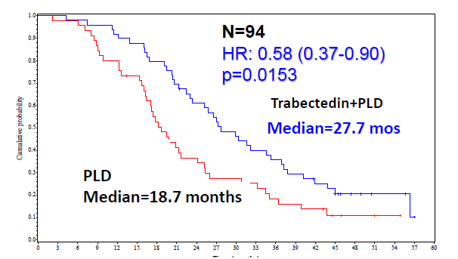
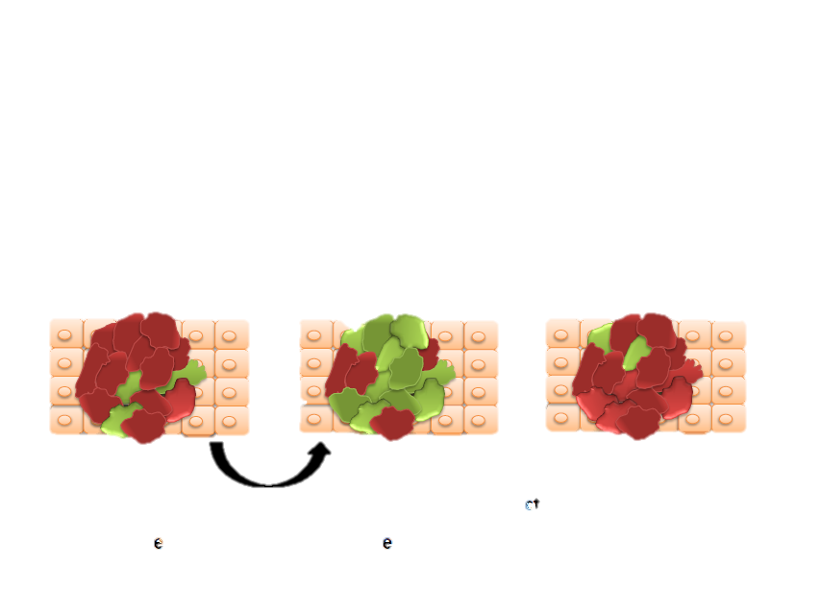
Clinical Observation
in OVA-301
Patients with PFI 6-12 mo relapse treated with Trabectedin-PLD followed by Platinum after progression achieved longer OS
NER-proficient cell
sensitive to trabectedin
NER-deficient cell
sensitive to platinum
Increased sensitivity to Pt
Trabectedin

Slide 9
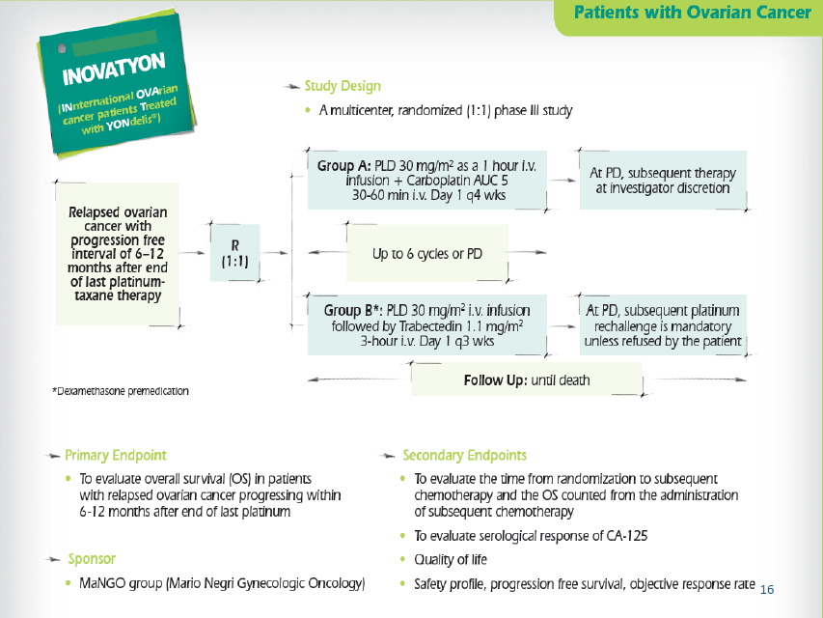

Slide 10
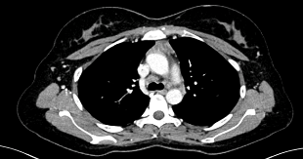
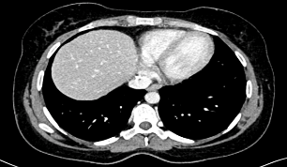
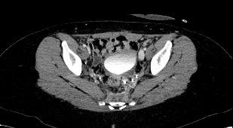
HISTORY
02. 2014 09.2014:
Trabectedin (1.3 mg/m²) + PLD (30 mg/m²⁾, q21
(10 cycles)
CT scan: partial response
CA 125 levels: return to normal limit

Slide 11
HISTORY
05. 2015:
Elevation of CA 125 IU=118 U/ml
CT-scan: Relapse, increase in the number of subpleuric nodules
PFS= 15 months
PFI= 26 months
06.2015:
Carboplatin + GEM 1,8 q21
Plan BRCA test

Slide 12
HISTORY
06.2015 - 10.2015:
Carboplatin + GEM 1,8 q21 (6 cycles)
633delCBRCA1 (BIC)
CT-scan: partial response
Last therapy platinum-based
Response to platinum
BRCA mutated 1 or 2
Selecting Olaparib
Begin maintenance therapy with olaparib
The patient is still on treatment

Slide 13
Trabectedin is more effective in cells lacking functional homologous
recombinant repair (HRR) mechanisms, such as those endowed with
BRCA gene mutation.^{1,2}
BRCA1-mutated patients treated with Trab/PLD showed longer PFS
(13.4 vs 5.5 months; p=0.0002) and OS (27.3 vs 18.7 months; p=0.0093) compared to PLD.³
1. D'Incalci 2010; Tavecchio 2008; 3. Monk (2014) ASCO,Abs 99.

Slide 14
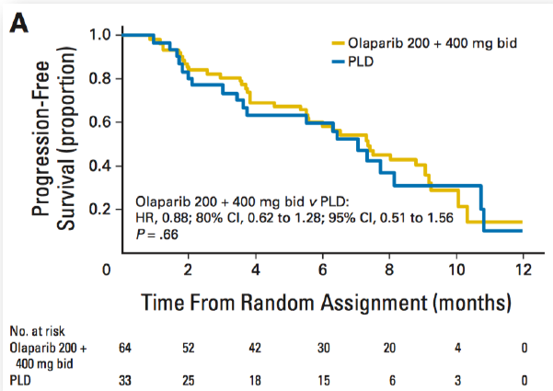
Chemotherapy option in BRCAmut
PLD is active in BRCAmut patients with a PFI< 12 months
S. Kaye et al. J Clin Oncol 2011

Slide 15
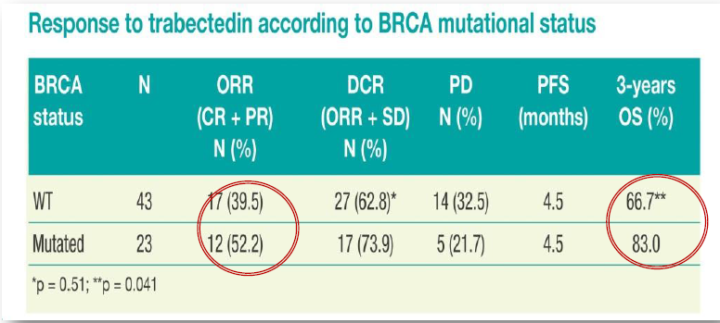
Trabectedin in patients with BRCA-mutated and BRCAness Phenotype Advanced Ovarian Cancer (AOC): Phase II prospective MITO-15 Study
Lorusso d, et al. Ann Oncol. 2016

Slide 16
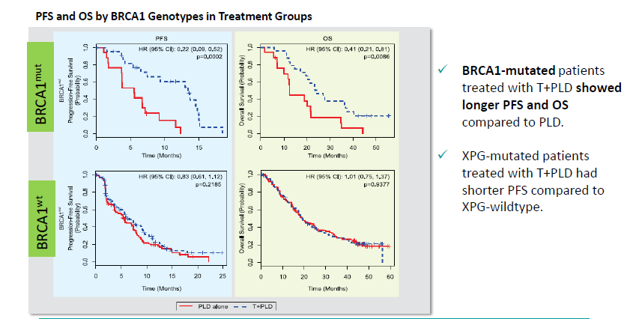
Analysis of OVA-301 according to BRCA status
Monk et al. 2015

Slide 17
Case timeline and summary
Platinum Free Interval: 26 months
PFS 14 m
PFS 15 m
PFS 12 months
Trabectedin
+ PLD
10 cycles
Treatment
interruption(patient decision)
Carbo
+ Gem
PR
BRCA mut
Olaparib
1st line
Carbo
+taxol
6 cycles
Relapse
Patient still on treatment
Relapse
PPS
Pt comb.
(+Tax, +Gem, +PLD)
non-Pt comb.
(Trabectedin-PLD)
Pt comb.
(+Tax, +Gem, +PLD)
PARP Inhib.
(eg. Olaparib)

Slide 18
CONCLUSIONS
Clinical case of a sporadic ovarian cancer patient with known BRCA1 mutation and PPS disease:
Trabectedin + PLD was administered for a long-term period (10 cycles), and provided a long progression-free survival (15 months).
The subsequent platinum-rechallenge resulted in a PR allowing the patient to treatment with olaparib.
These results are aligned with the hypothesis of the resensitization to platinum after treatment with trab/PLD in patients with PPS and the higher efficacy of trabectedin reported in BRCAmut patients.
The intercalation of trabectedin+PLD before platinum rechallenge has shown to be an effective strategy for BRCAmut patients with PPS disease, thus increasing the options for an optimal sequence of treatments.
Grazie

