Slide 1
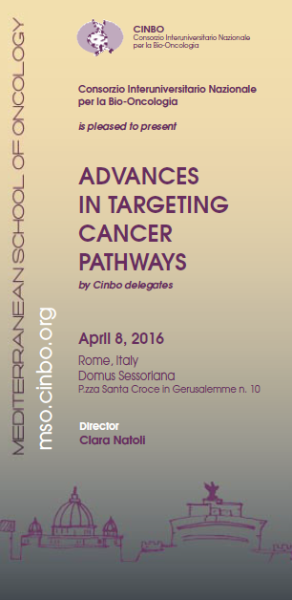
Targeting new pathways in colorectal cancer
Francesco Pantano MD,Phd
Oncologia Medica
Università Campus Bio-Medico di Roma

Slide 2
2016: up to date
The Tortoise and the Hare: lesson from Aesop’s fable
Waiting for VEGF versus EGFR «final fighting»…..
NO «changing-practice» agents in 2016!!!
Notes:
With palliative care involvement over various stages in this patient’s disease course, the goals of treatment could have been more clearly redefined, and options for oncological treatment and supportive care explained in an open and honest way, so that new plans could have been made together with the patient and his wife, alleviating the burden of decision-making in crisis mode.

Slide 3
OUTLINE
In the wake of the VEGF pathway: new agents
In the wake of the EGFR pathway: new agents
BRAF inhibition
An old story: back to antimetabolites… TAS 102
Immunotherapy: pembrolizumab
Lesson from gastric cancer: HER2 rescue
MGMT ipermethylation: temozolomide
Gene profiling: molecular subtypes definitions
Notes:
With palliative care involvement over various stages in this patient’s disease course, the goals of treatment could have been more clearly redefined, and options for oncological treatment and supportive care explained in an open and honest way, so that new plans could have been made together with the patient and his wife, alleviating the burden of decision-making in crisis mode.

Slide 4
In the wake of the VEGF pathway: new agents
VEGF pathway
Notes:
With palliative care involvement over various stages in this patient’s disease course, the goals of treatment could have been more clearly redefined, and options for oncological treatment and supportive care explained in an open and honest way, so that new plans could have been made together with the patient and his wife, alleviating the burden of decision-making in crisis mode.

Slide 5
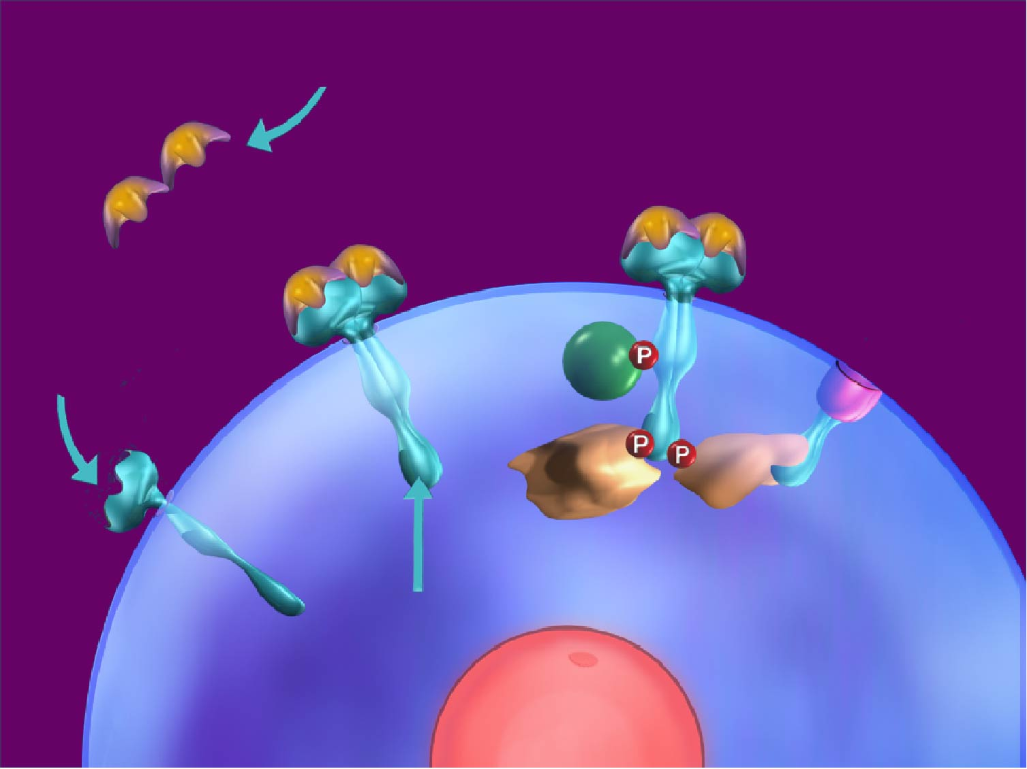
Anti-angiogenetic signal: new insights!
Ligand sequestration: MAbs, soluble receptors
Indirect - inhibition
of growth factors,
HER-2
Receptor blocking Mabs, soluble receptors
p85
ras
PLCg
GRB2
SOS
Inhibition of tyrosine phosphorylation and downstream
signaling
inhibition
Tyrosine kinase inhibition: TKIs
Inhibit receptor
production; ribozymes
Transcription
factor inhibition
Notes:
With palliative care involvement over various stages in this patient’s disease course, the goals of treatment could have been more clearly redefined, and options for oncological treatment and supportive care explained in an open and honest way, so that new plans could have been made together with the patient and his wife, alleviating the burden of decision-making in crisis mode.

Slide 6
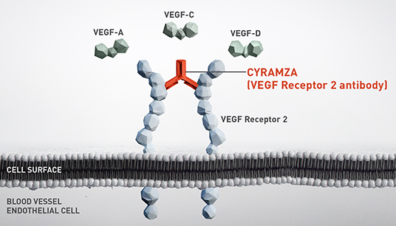
RAMUCIRUMAB
Ramucirumab is a recombinant human IgG1 monoclonal antibody that binds to the extracellular domain of VEGFR-2, preventing ligand binding and receptor activation
RAISE
phase III trial
R
A
N
D
O
M
I
Z
E
(1:1)
Ramucirumab (8 mg/kg) and FOLFIRI* every 2 weeks per cycle
N=536
Treatment until disease progression
or unacceptable toxicity
Primary endpoint: Overall survival
Secondary end-point : PFS, ORR, Safety,PRO,PK,IG
Progression during or after bevacizumab, oxaliplatin, and a fluoropyrimidine
Placebo and FOLFIRI* every 2 weeks per cycle
N=536
Tabernero et al, Lancet Oncology 2015
Notes:
With palliative care involvement over various stages in this patient’s disease course, the goals of treatment could have been more clearly redefined, and options for oncological treatment and supportive care explained in an open and honest way, so that new plans could have been made together with the patient and his wife, alleviating the burden of decision-making in crisis mode.

Slide 7
RAMUCIRUMAB
Raise trial: Primary Endpoint OS MET
Tabernero et al, Lancet Oncology 2015

Slide 8
RAMUCIRUMAB
Raise trial: Secondary Endpoint PFS MET
Tabernero et al, Lancet Oncology 2015

Slide 9
RAMUCIRUMAB
Tabernero et al, ASCO GI 2015

Slide 10
DOVITINIB
Dovitinib is an oral inhibitor of FGFRs and VEGFRs, PDGFR, c-KIT, FLT-3, CSF1R ¹
Exhibits direct anti-tumor and anti-angiogenic activity ²
1 Lopes de Menezes DE, et al, Clin Cancer Res. 2005; 11:5281-91
2 Renohowe PA, et al, J Med Chem 2009; 52:278-92
Notes:
With palliative care involvement over various stages in this patient’s disease course, the goals of treatment could have been more clearly redefined, and options for oncological treatment and supportive care explained in an open and honest way, so that new plans could have been made together with the patient and his wife, alleviating the burden of decision-making in crisis mode.

Slide 11
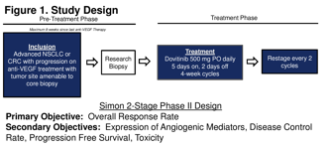
DOVITINIB
Presented By Thomas John Semrad at Gastrointestinal Cancers Symposium 2016
Notes:
With palliative care involvement over various stages in this patient’s disease course, the goals of treatment could have been more clearly redefined, and options for oncological treatment and supportive care explained in an open and honest way, so that new plans could have been made together with the patient and his wife, alleviating the burden of decision-making in crisis mode.

Slide 12
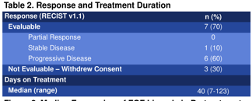
DOVITINIB
Primary Endpoint Unmet
Presented By Thomas John Semrad at Gastrointestinal Cancers Symposium 2016
Notes:
With palliative care involvement over various stages in this patient’s disease course, the goals of treatment could have been more clearly redefined, and options for oncological treatment and supportive care explained in an open and honest way, so that new plans could have been made together with the patient and his wife, alleviating the burden of decision-making in crisis mode.

Slide 13
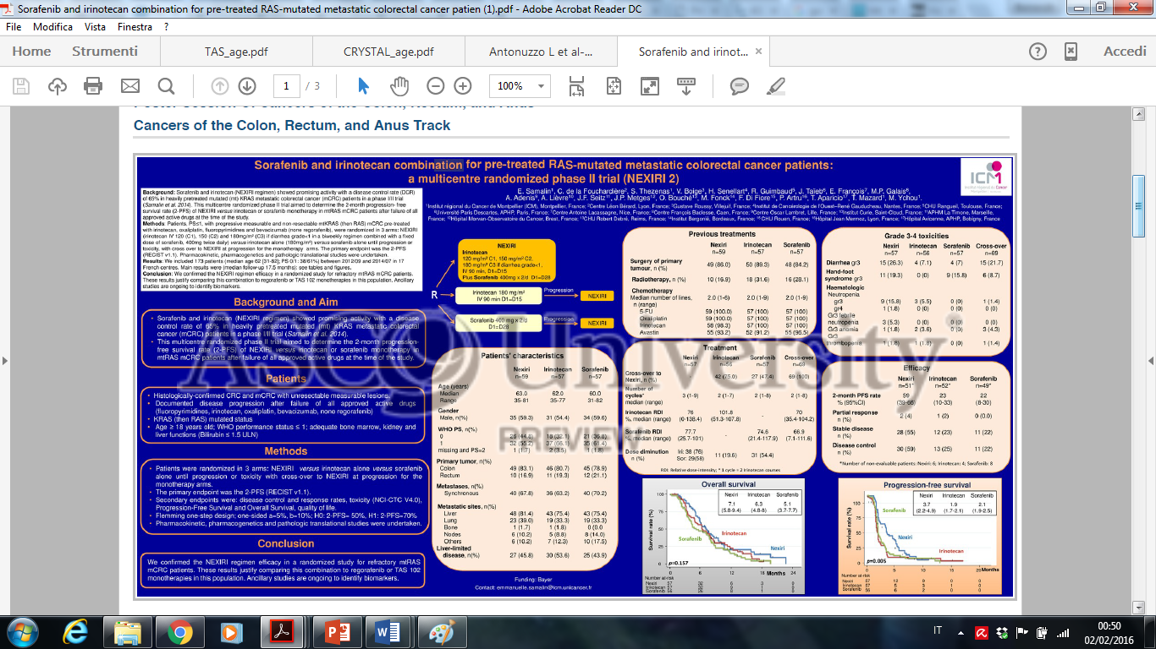
SORAFENIB in KRAS mutated pts: NEXIRI2 trial
Notes:
With palliative care involvement over various stages in this patient’s disease course, the goals of treatment could have been more clearly redefined, and options for oncological treatment and supportive care explained in an open and honest way, so that new plans could have been made together with the patient and his wife, alleviating the burden of decision-making in crisis mode.

Slide 14
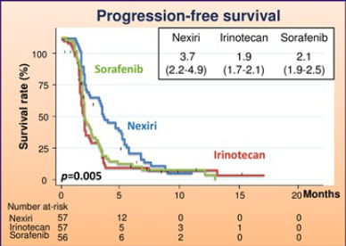
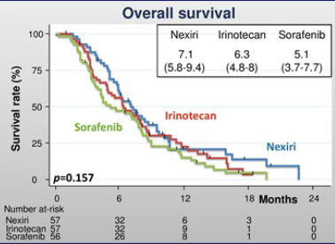
SORAFENIB in KRAS mutated pts: NEXIRI2 trial
Primary Endpoint Met
Notes:
With palliative care involvement over various stages in this patient’s disease course, the goals of treatment could have been more clearly redefined, and options for oncological treatment and supportive care explained in an open and honest way, so that new plans could have been made together with the patient and his wife, alleviating the burden of decision-making in crisis mode.

Slide 15
SORAFENIB in KRAS mutated pts: NEXIRI2 trial
Notes:
With palliative care involvement over various stages in this patient’s disease course, the goals of treatment could have been more clearly redefined, and options for oncological treatment and supportive care explained in an open and honest way, so that new plans could have been made together with the patient and his wife, alleviating the burden of decision-making in crisis mode.

Slide 16
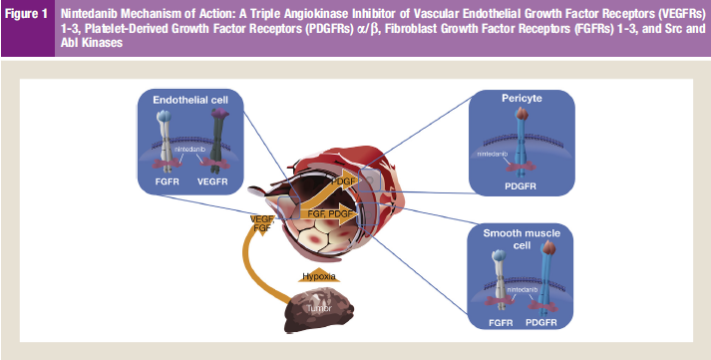
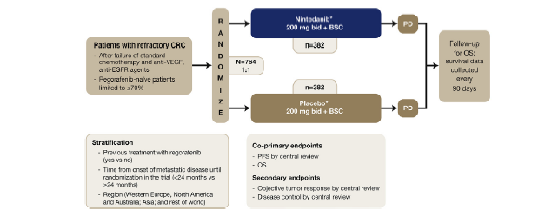
NINDETANIB
Nintedanib is an oral, twice-daily, triple angiokinase inhibitor of
VEGFR-1 to 3, PDGFR-a/b, and FGFR-1 to 3
Estimated completion date:
mid-2016
LUME Colon - 1
phase III trial

Slide 17
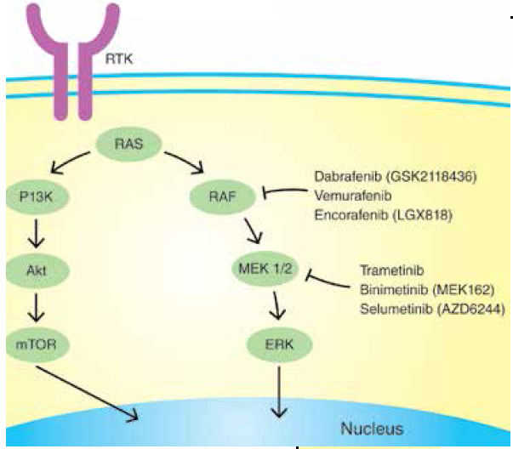
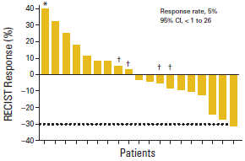
BRAF mutated mCRC: VEMURAFENIB
BRAF MUTATION
BRAF «TARGETABLE» CASCADE

Slide 18
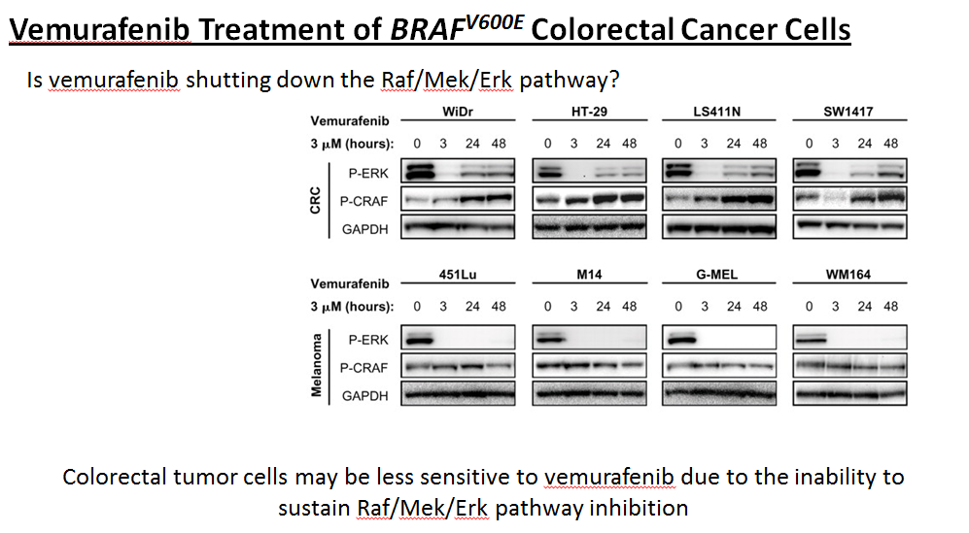
BRAF mutated mCRC: VEMURAFENIB
In CRC: PI3K/AKT pathway activation results in de novo and acquired resistance to BRAF inhibition
Corcoran RB; Cancer Discovery 2012, 2:227-235

Slide 19
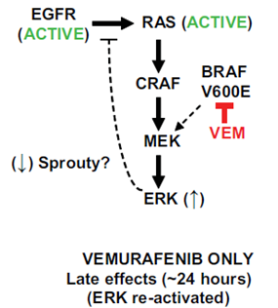
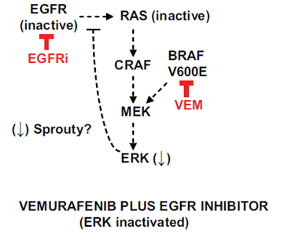
BRAF mutated mCRC: VEMURAFENIB
preclinical
rationale
TAKE HOME MESSAGE: Targeting EGFR and PI3K are viable combination strategies worthy of immediate clinical implementation in doublet or triplet regimens
Corcoran RB; Cancer Discovery 2012, 2:227-235

Slide 20
In the wake of the EGFR pathway: new agents
EGFR pathway
Notes:
With palliative care involvement over various stages in this patient’s disease course, the goals of treatment could have been more clearly redefined, and options for oncological treatment and supportive care explained in an open and honest way, so that new plans could have been made together with the patient and his wife, alleviating the burden of decision-making in crisis mode.

Slide 21
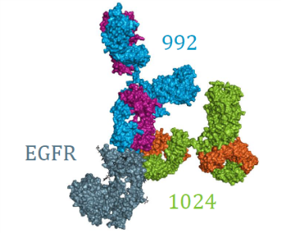
EGFR signal: new insights!
Sym004 is a 1:1 mixture of two recombinant, human–mouse chimeric mAbs directed against nonoverlapping EGFR epitopes (mAb992 and mAb1024)
Phase I trial
Phase II trial
Notes:
With palliative care involvement over various stages in this patient’s disease course, the goals of treatment could have been more clearly redefined, and options for oncological treatment and supportive care explained in an open and honest way, so that new plans could have been made together with the patient and his wife, alleviating the burden of decision-making in crisis mode.

Slide 22
An old story: back to antimetabolites…
TAS-102
Notes:
With palliative care involvement over various stages in this patient’s disease course, the goals of treatment could have been more clearly redefined, and options for oncological treatment and supportive care explained in an open and honest way, so that new plans could have been made together with the patient and his wife, alleviating the burden of decision-making in crisis mode.

Slide 23
TAS-102
TAS-102 is an oral formulation of an antimetabolite inhibiting TP
It consists of:
- A cytotoxin (trifluridine), which inhibits cell growth
- A thymidine phosphorylase inhibitor (tipiracil hydrochloride), which protects trifluridine from breakdown
In a phase II trial,^{[1]} TAS-102 demonstrated promising efficacy and a manageable safety profile in patients with mCRC who were refractory or intolerant to standard chemotherapies
[1] Yoshino et al, WCGIC 2014
Notes:
With palliative care involvement over various stages in this patient’s disease course, the goals of treatment could have been more clearly redefined, and options for oncological treatment and supportive care explained in an open and honest way, so that new plans could have been made together with the patient and his wife, alleviating the burden of decision-making in crisis mode.

Slide 24
TAS-102
Notes:
With palliative care involvement over various stages in this patient’s disease course, the goals of treatment could have been more clearly redefined, and options for oncological treatment and supportive care explained in an open and honest way, so that new plans could have been made together with the patient and his wife, alleviating the burden of decision-making in crisis mode.

Slide 25
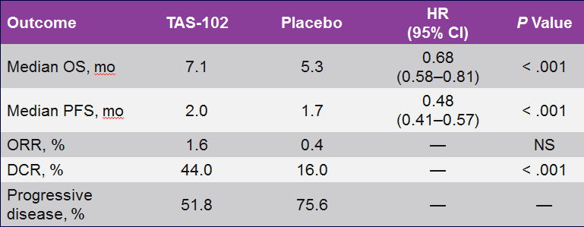
TAS-102
Primary Endpoint Met
Notes:
With palliative care involvement over various stages in this patient’s disease course, the goals of treatment could have been more clearly redefined, and options for oncological treatment and supportive care explained in an open and honest way, so that new plans could have been made together with the patient and his wife, alleviating the burden of decision-making in crisis mode.

Slide 26
Progress in the Treatment of Colorectal Cancer
Treatment | First-time |  | Second-line |  | Third-line and beyond
 | OS | PFS | OS | PFS | OS | PFS
Bevacizumab |  |  |  |  | - | -
Cetuximab
Panitumumab
Aflibercept | - | - |  |  | - | -
Regorafenib | - | - | - | -
TAS-102 | - | - | - | -

Slide 27
Immunotherapy in CRC
Anti-PD L1
Notes:
With palliative care involvement over various stages in this patient’s disease course, the goals of treatment could have been more clearly redefined, and options for oncological treatment and supportive care explained in an open and honest way, so that new plans could have been made together with the patient and his wife, alleviating the burden of decision-making in crisis mode.

Slide 28
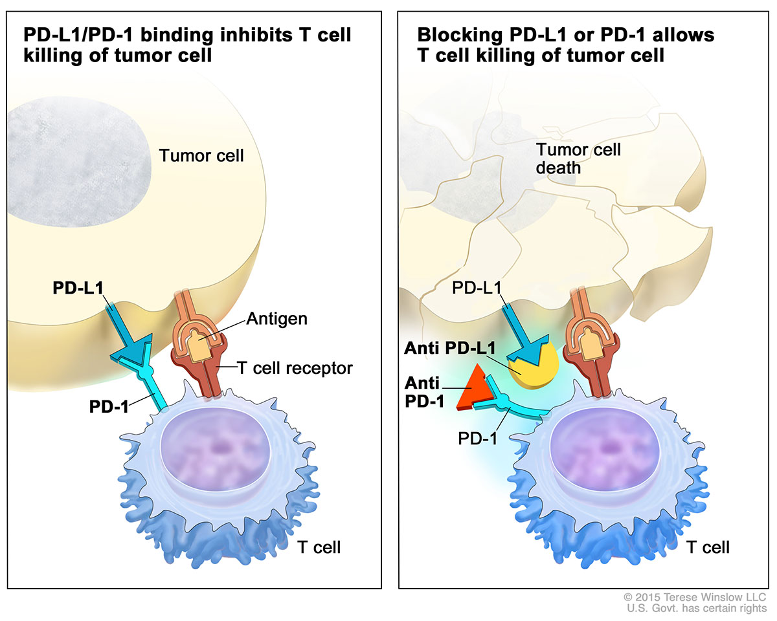
Immunotherapy in CRC
Notes:
With palliative care involvement over various stages in this patient’s disease course, the goals of treatment could have been more clearly redefined, and options for oncological treatment and supportive care explained in an open and honest way, so that new plans could have been made together with the patient and his wife, alleviating the burden of decision-making in crisis mode.

Slide 29
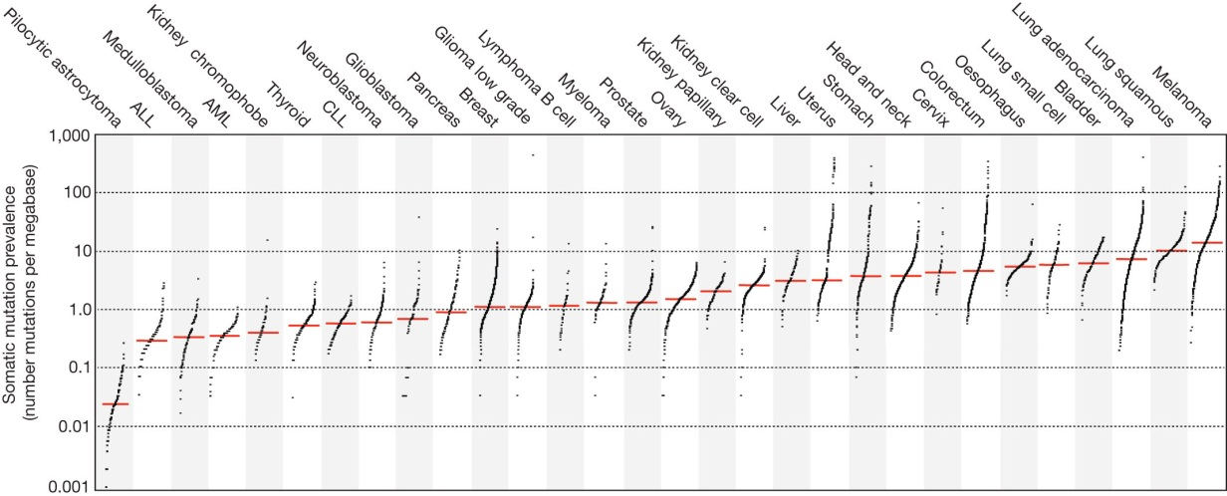
Immunotherapy in CRC
Mutational burden in human tumours varies
The prevalence of somatic mutations across human cancer types.
Signature of mutational processes in human cancer; Alexandrov et al, Nature 500, 415-21, (2013)
Notes:
With palliative care involvement over various stages in this patient’s disease course, the goals of treatment could have been more clearly redefined, and options for oncological treatment and supportive care explained in an open and honest way, so that new plans could have been made together with the patient and his wife, alleviating the burden of decision-making in crisis mode.

Slide 30
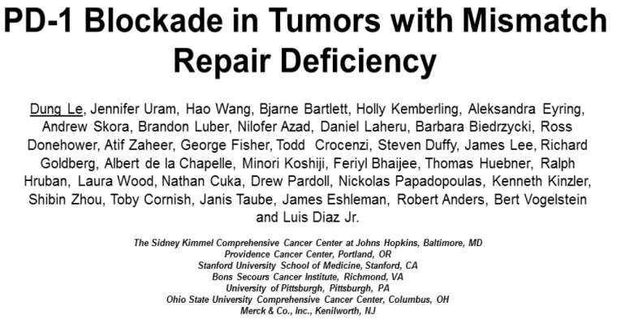
Immune Checkpoint Inhibition
PD-1 Blockade in MMR-Deficient Tumors:
Background
Somatic mutations encode for mutant proteins possibly recognized as “nonself” immunogenic antigens
Prevalence of somatic mutations increased in tumors with genetic defects in MMR
MMR deficiency common in particular tumor types, such as CRC, ampullary cancer, and endometrial cancer
Pembrolizumab: humanized IgG4 monoclonal antibody inhibiting PD-1 immune checkpoint
Current study evaluated whether MMR-deficient tumors demonstrate enhanced susceptibility to immune checkpoint blockade
Le DT, et al.NEJM 2015.
.
Notes:
With palliative care involvement over various stages in this patient’s disease course, the goals of treatment could have been more clearly redefined, and options for oncological treatment and supportive care explained in an open and honest way, so that new plans could have been made together with the patient and his wife, alleviating the burden of decision-making in crisis mode.

Slide 31
Immune Checkpoint Inhibition
PFS
Le DT, et al.NEJM 2015.
.

Slide 32
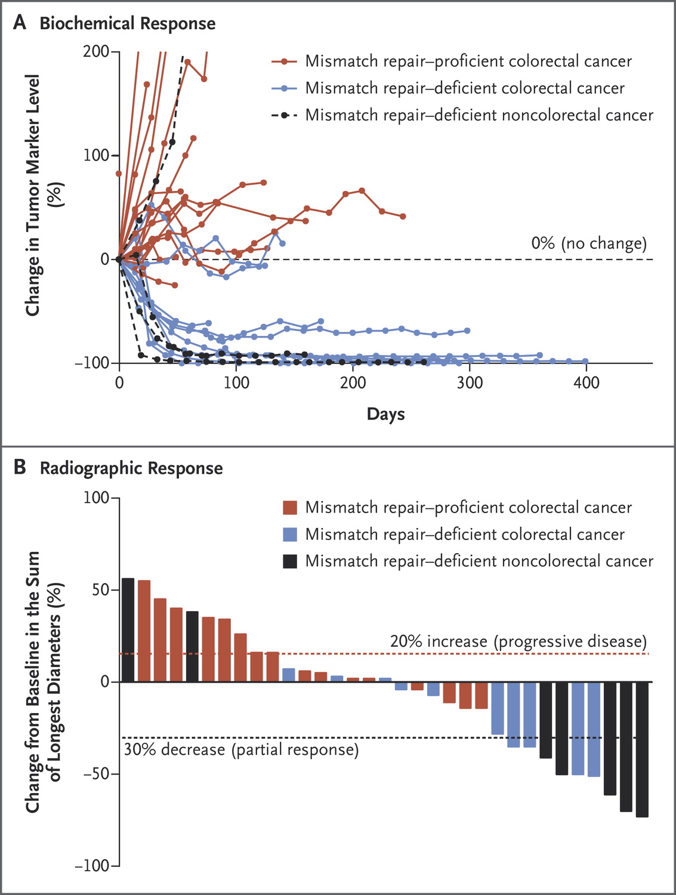
Immune Checkpoint Inhibition
Le DT, et al.NEJM 2015.
.

Slide 33
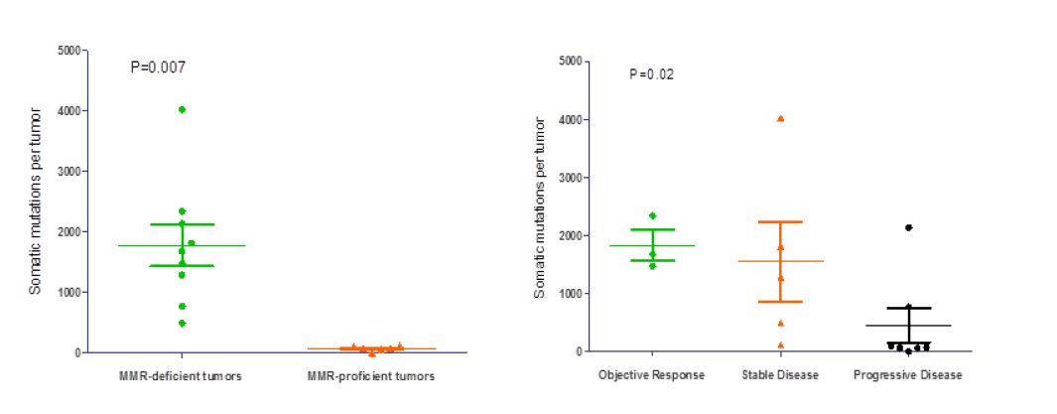
Immune Checkpoint Inhibition
PD-1 Blockade in MMR-Deficient Tumors:
Analysis of Mutations
MMR-deficient tumors highly mutated
~ 1700 vs ~ 70 mutations in MMR-proficient tumors (P = .007)
Mutation burden significantly associated with efficacy (P = .02)
Le DT, et al. ASCO 2015. Abstract LBA100.

Slide 34
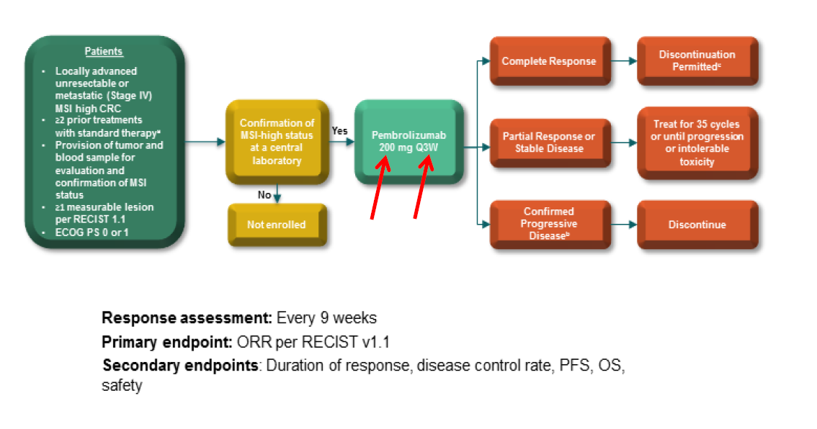
Immune Checkpoint Inhibition
KEYNOTE 164 phase II trial

Slide 35
Immunotherapy in CRC
ONGOING NEW DRUGS DEVELOPMENT
Notes:
With palliative care involvement over various stages in this patient’s disease course, the goals of treatment could have been more clearly redefined, and options for oncological treatment and supportive care explained in an open and honest way, so that new plans could have been made together with the patient and his wife, alleviating the burden of decision-making in crisis mode.

Slide 36
Immunotherapy in CRC
Bavituximab targets phosphatidylserine, the predominant immunosuppressive phospholipid exposed on tumor endothelium. In addition to blocking vasculogenesis, bavituximab repositions macrophages from the M2 to the M1 phenotype, promoting dendritic cell and cytotoxic T-cell activation.
→ It is currently in phase I testing as an adjunct to capecitabine and radiation in patients with localized rectal cancer (NCT01634685)
Urelu-mab, currently in phase I development (NCT02110082), is a monoclonal agonistic antibody toward CD137, which is a co-stimulatory molecule expressed on activated NK and memory T cells.V
Ensituximab (NPC-1C), a chimeric antibody that promotes antibody-dependent cell mediated toxicity, is directed against the MUC5AC-related antigen, which mediates mucosal immunity. Initial results of a phase I/II trial have been encouraging, with a median overall survival of 10.2 months in patients with CRC whose disease progressed on at least two lines of therapy (NCT01040000).
Notes:
With palliative care involvement over various stages in this patient’s disease course, the goals of treatment could have been more clearly redefined, and options for oncological treatment and supportive care explained in an open and honest way, so that new plans could have been made together with the patient and his wife, alleviating the burden of decision-making in crisis mode.

Slide 37
Lesson from gastric cancer
HER2

Slide 38
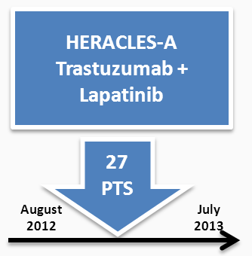
HER2
5,4% of metastatic CRCs have HER2 amplification

Slide 39
HER2
More than 900 patients were screened
Previous lines medium number = 5
The HERACLES trial met its primary endpoint with 8/23 objective responses in pts heavily pretreated with standard therapies, including EGFR-targeted agents, indicating that the dual anti HER2 therapy is effective and deserves further clinical assessment in earlier lines of treatment of HER2+ mCRC patients.

Slide 40
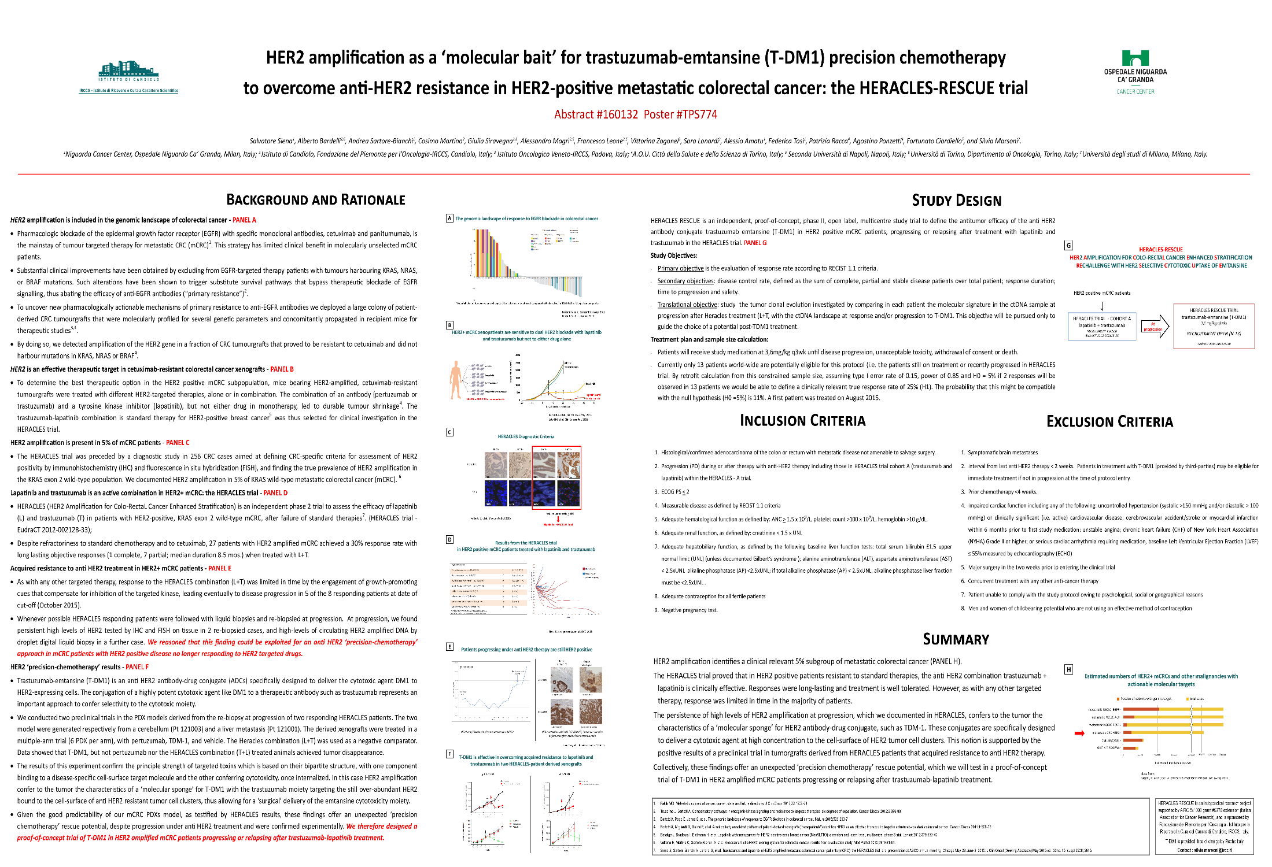
HER2
Presented Salvatore Siena at Gastrointestinal Cancers Symposium 2016

Slide 41
MGMT ipermethylation
Temozolomide

Slide 42
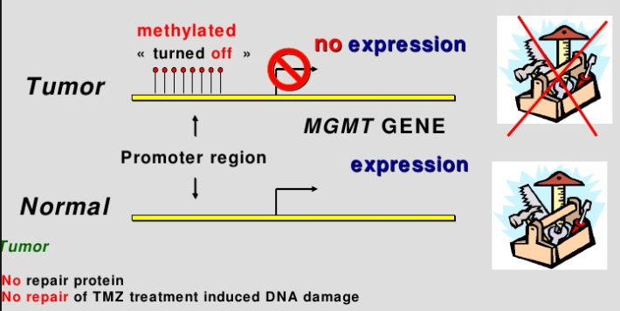
MGMT ipermethylation
- The DNA repair gene O6-methylguanine-DNA methyltransferase (MGMT) is responsible of the elimination of alkyl groups from the O6-position of guanine.
- If inactive, it may be involved in early steps of colorectal tumorigenesis through an increase of mutational rate—particularly, G-to-A point mutations of KRAS gene

Slide 43
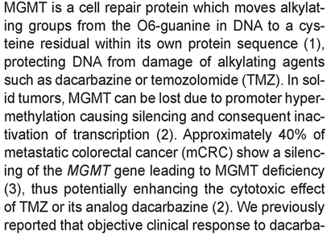
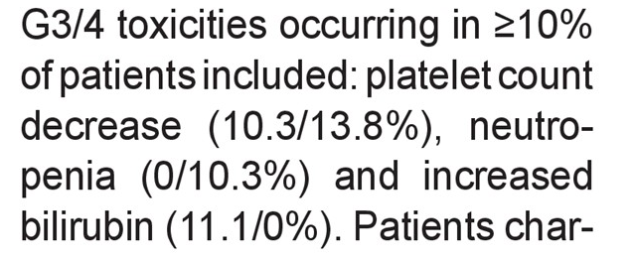
MGMT ipermethylation
From December 2012 to May 2014:
150 pts
All progressed under standard therapy
TMZ 150 mg/m2 1-5 q28
I° EP: PFS
40%

Slide 44
Gene signature
Genomic landscape

Slide 45
Gene signature

Slide 46
Gene signature

Slide 47
Gene signature

Slide 48
Gene signature

Slide 49
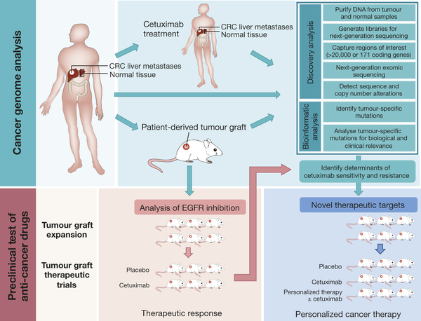
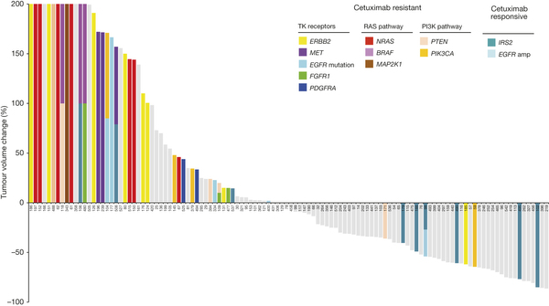
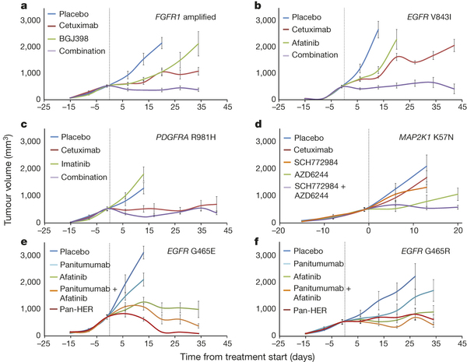
Gene signature
Bertotti A, et al. Nature 2015.
.

Slide 50
CONCLUSIONS
No real news in terms of new active agents for colorectal cancer
Immunotherapy showed a promising landscape: studies examining the effect of MSI status, as well as the role of Lynch and other hereditary syndromes, on the efficacy of immune-based regimens will be especially revealing.
In patients with refractory colorectal cancer, TAS-102, as compared with placebo, was associated with a significant improvement in overall survival. (RECOURSE ClinicalTrials.gov number, NCT01607957.)
Although a minority of CRC patients exhibited HER2 gene amplification (~6%), these patients would be potential candidates for anti-HER2 therapy
…....genomic... genomic..... It’s evolution baby !

Slide 51
f.pantano@unicampus.it

