Slide 1
Next generation techniques for biomarker identification
Ettore Capoluongo
Head of Laboratory of Clinical Molecular and Personalized Diagnostics
Departiment of Diagnostics and Laboratory Medicine
A. Gemelli – School of Medicine, Rome

Slide 2
Issues regarding BRCA1/2
Sanger Seq?
The dideoxy method is good only for 500-750 bp reactions
Expensive
Takes a while
The human genome is very long and complex for SS in routine

Slide 3

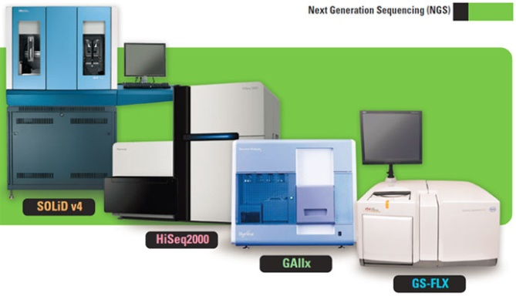
NGS VISION
NGS is used in both clinical and research settings
Targeted genetic tests are currently used as diagnostic and prognostic tools in clinical oncology, and more extensive genomic tests seem likely to come into regular use in the near future
Targeted cancer panels are advantageous due to their low cost and relatively simple interpretability. Many exist both for specific cancers, such as prostate cancer, and for more general application, such as solid tumours

Slide 4
Improvements linked to NGS
(SGS and TGS)
The specific strategy employed by each platform determines the:
QUALITY
QUANTITY
and BIASES
of the resulting sequence data and the platform’s usefulness for particular application

Slide 5

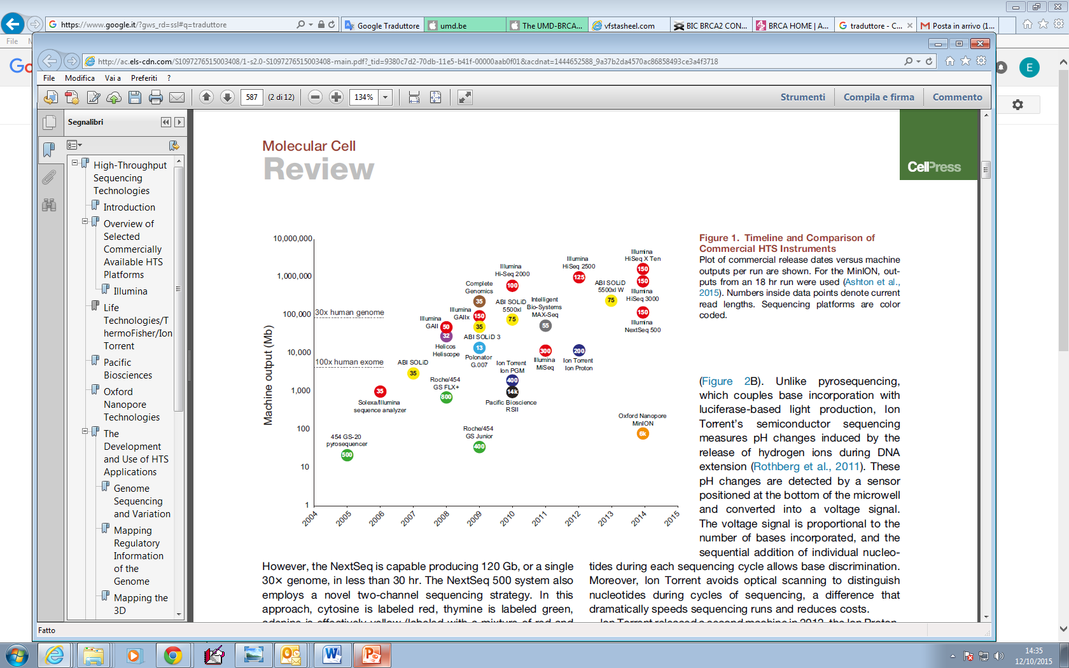
On the market (Today)
2015

Slide 6
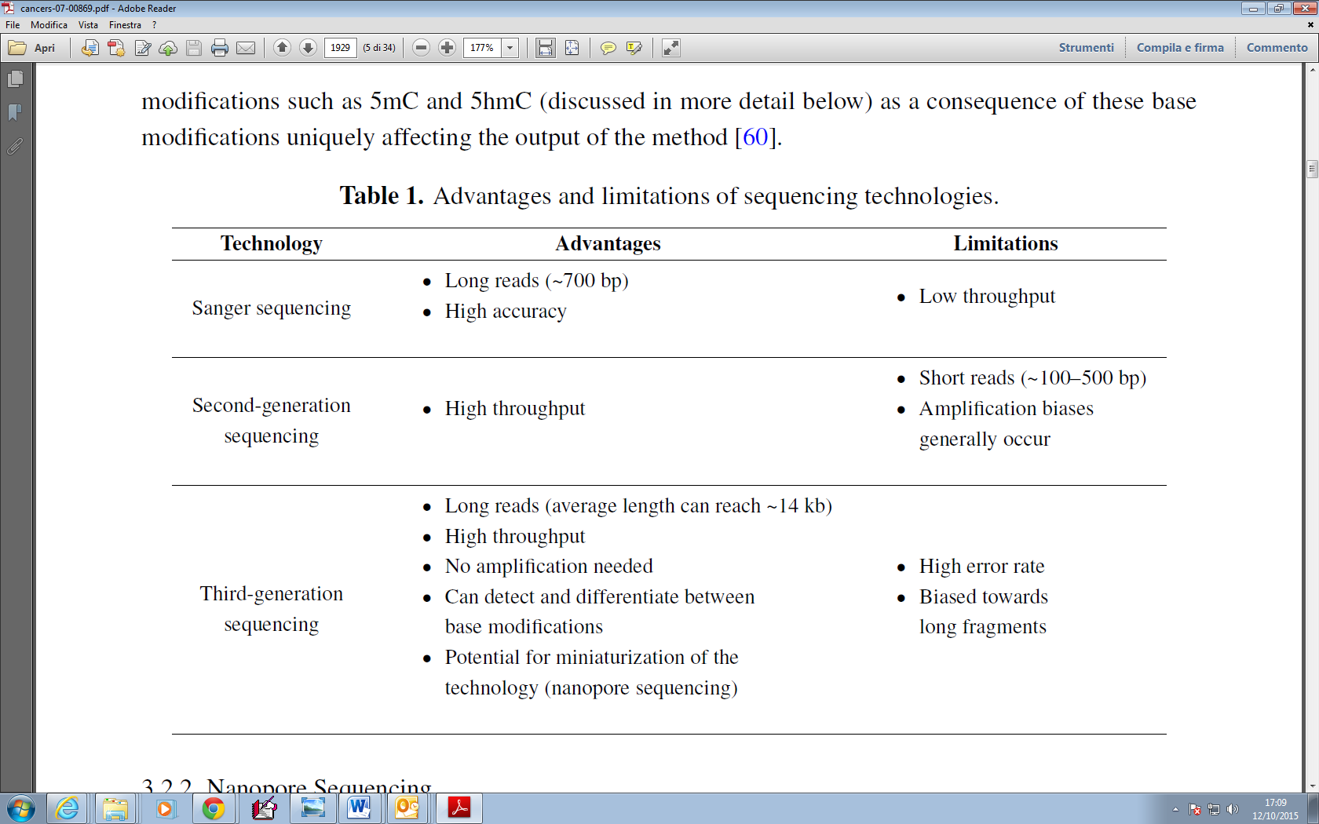
Differences among sequencing technologies

Slide 7
NGS is NEEDED in CLINICAL SETTING
Precision medicine is an emerging approach for:
disease prevention and treatment that takes individual variability into account.
To achieve “individual variability” requires:
analyzing multiple genes with little amounts of specimen
INEXPENSIVELY
QUICKLY
SENSITIVELY

Slide 8
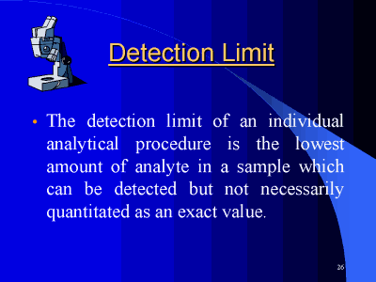
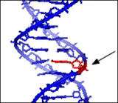
Limitations and challenges in DNA NGS-based technologies

Slide 9
Limit of detection - % allele burden
Type of Assay | Average limit of detection (% allele burden)
Genome sequencing | ~20 – 30%
Exome sequencing | ~20 – 30%
Sanger sequencing | 20%
NGS-based gene panels | 5 – 10%
Single mutation assay | <10%

Slide 10







Some mutation types are difficult to detect by Genome or Exome sequencing technologies
Mutation type | LEVEL of Difficulty
Single nucleotide variant
Small indels (<10-20 bp)
Copy-number variants
Structural variants
Larger indels

Slide 11
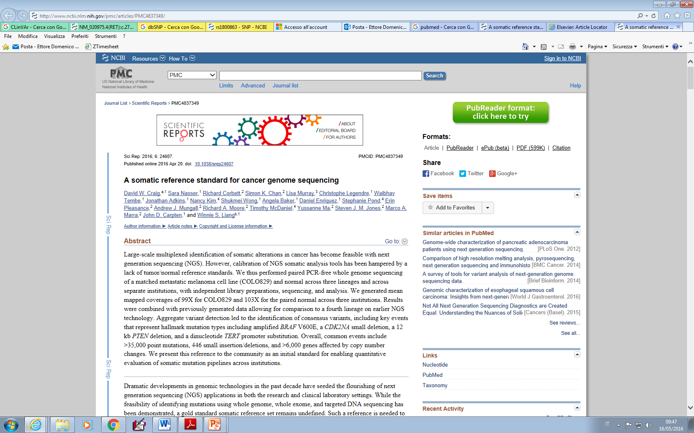
Lack of Gold Standard
PREMISE: While the feasibility of identifying mutations using whole genome, whole exome, and targeted DNA sequencing has been demonstrated
A GOLD STANDARD SOMATIC REFERENCE SET REMAINS UNDEFINED

Slide 12
Lack of Gold Standard
Such A REFERENCE is needed to enable INTERPRETATION of results generated using analytical pipelines that :
May differ significantly across institutions
to account for bias or variability in sample preparation and sequencing

Slide 13
How to define STANDARDS
National Institute of Standards and Technology (NIST) has established the Genome in a Bottle (GIAB) Consortium
By integrating 14 sequencing data sets generated from the NA12878 cell line using 5 different technologies and that were analyzed using
multiple aligners
multiple variant detection tools

Slide 14
However, a similarly well-characterized somatic reference set for whole genome sequencing data has yet to be established
Previous studies have contributed to this undertaking by performing analytical and clinical validation of DNA sequencing, comparing the performance of mutation callers, and publically releasing somatic alterations identified from paired tumor/constitutional cell lines available from ATCC

Slide 15
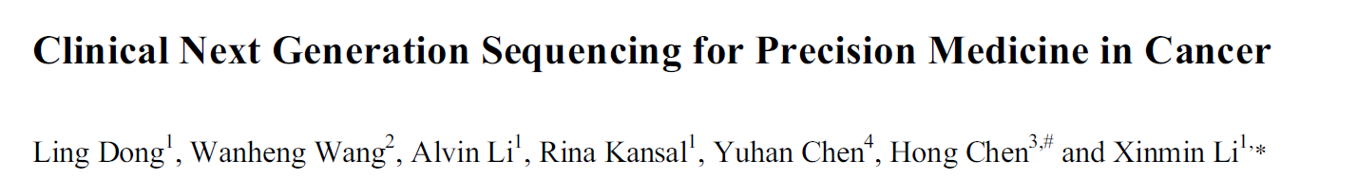
Current Genomics, 2015, 16, 253-263
Sanger sequencing has been supplanted by the next generation sequencing (NGS) technology.
Compared with Sanger sequencing, NGS has many advantages:
Speed: NGS is massively parallel, producing 500GB data in a single run on a single flow cell of HiSeq2500
Cost: the massively parallel nature of NGS reduces sequencing time, man power and reagents that translate into significant savings

Slide 16
Current Genomics, 2015, 16, 253-263
SENSITIVITY: NGS can reliably detect >1% mutations, critically important for detecting SOMATIC MUTATIONS in the heterogeneous tumor samples
Amount of sample: advances of library construction technology, allow NGS to perform well with the nanogram range of DNA.

Slide 17
Current Genomics, 2015, 16, 253-263
Both MiSeq and Ion PGM can sequence around 50 targeted genes with 10-50ng of FFPE DNA.
This is particularly useful for the most accessible cytology specimens

Slide 18
In many clinical situations, the only available specimen is a:
fine needle core
aspiration biopsy
FFPE tissue slides
which DO NOT PROVIDE enough DNA for classical Sanger sequencing

Slide 19
The number of targets: NGS technology can sequence multiple genes at a higher coverage
Since genomic research has facilitated the pace of target discovery for disease management, the numbers of disease-associated genes is increasing rapidly

Slide 20
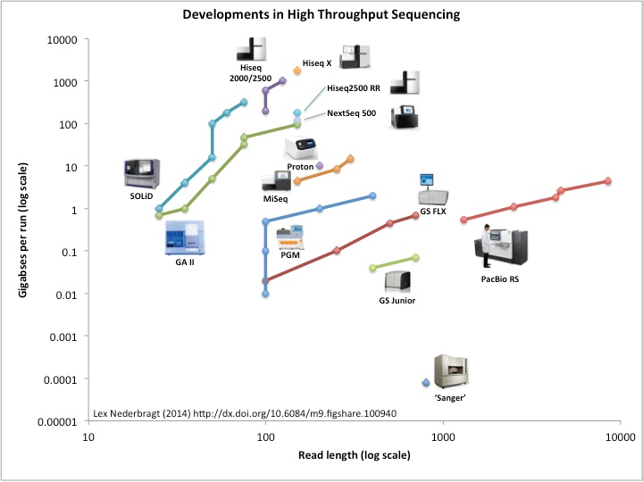

NGS technology is still rapidly evolving
Throughput
HiSeq2500 increased from 600GB to 1TB by the combination of newer V4 chemistry and a newer camera model which supports the higher cluster densities
Costs

Slide 21
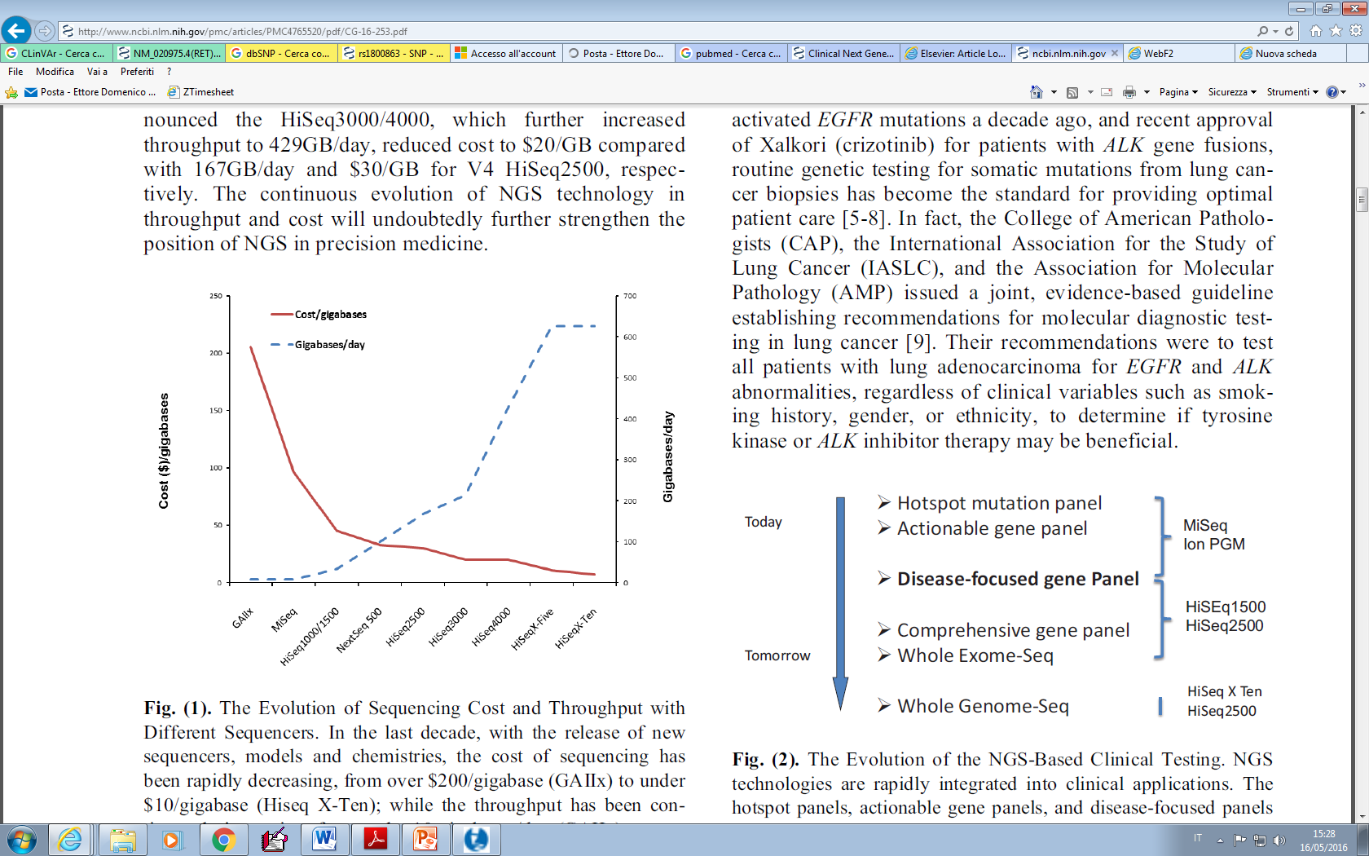


Slide 22
NGS technology is rapidly making its way into clinical laboratories
CLINICAL APPLICATIONS
In DIAGNOSTIC TESTING for hereditary disorders
more recently for RISK SCREENING for hereditary cancers
therapeutic decision-making for somatic cancers

Slide 23
The NGS present and future
hotspot panels
actionable gene panels
disease-focused panels
more comprehensive panels (future)
Although WES and WGS approaches are beginning to emerge, given the INCOMPLETE CLINICAL ANNOTATION of the human genome,
Panel-based testing is more practical in clinical applications

Slide 24
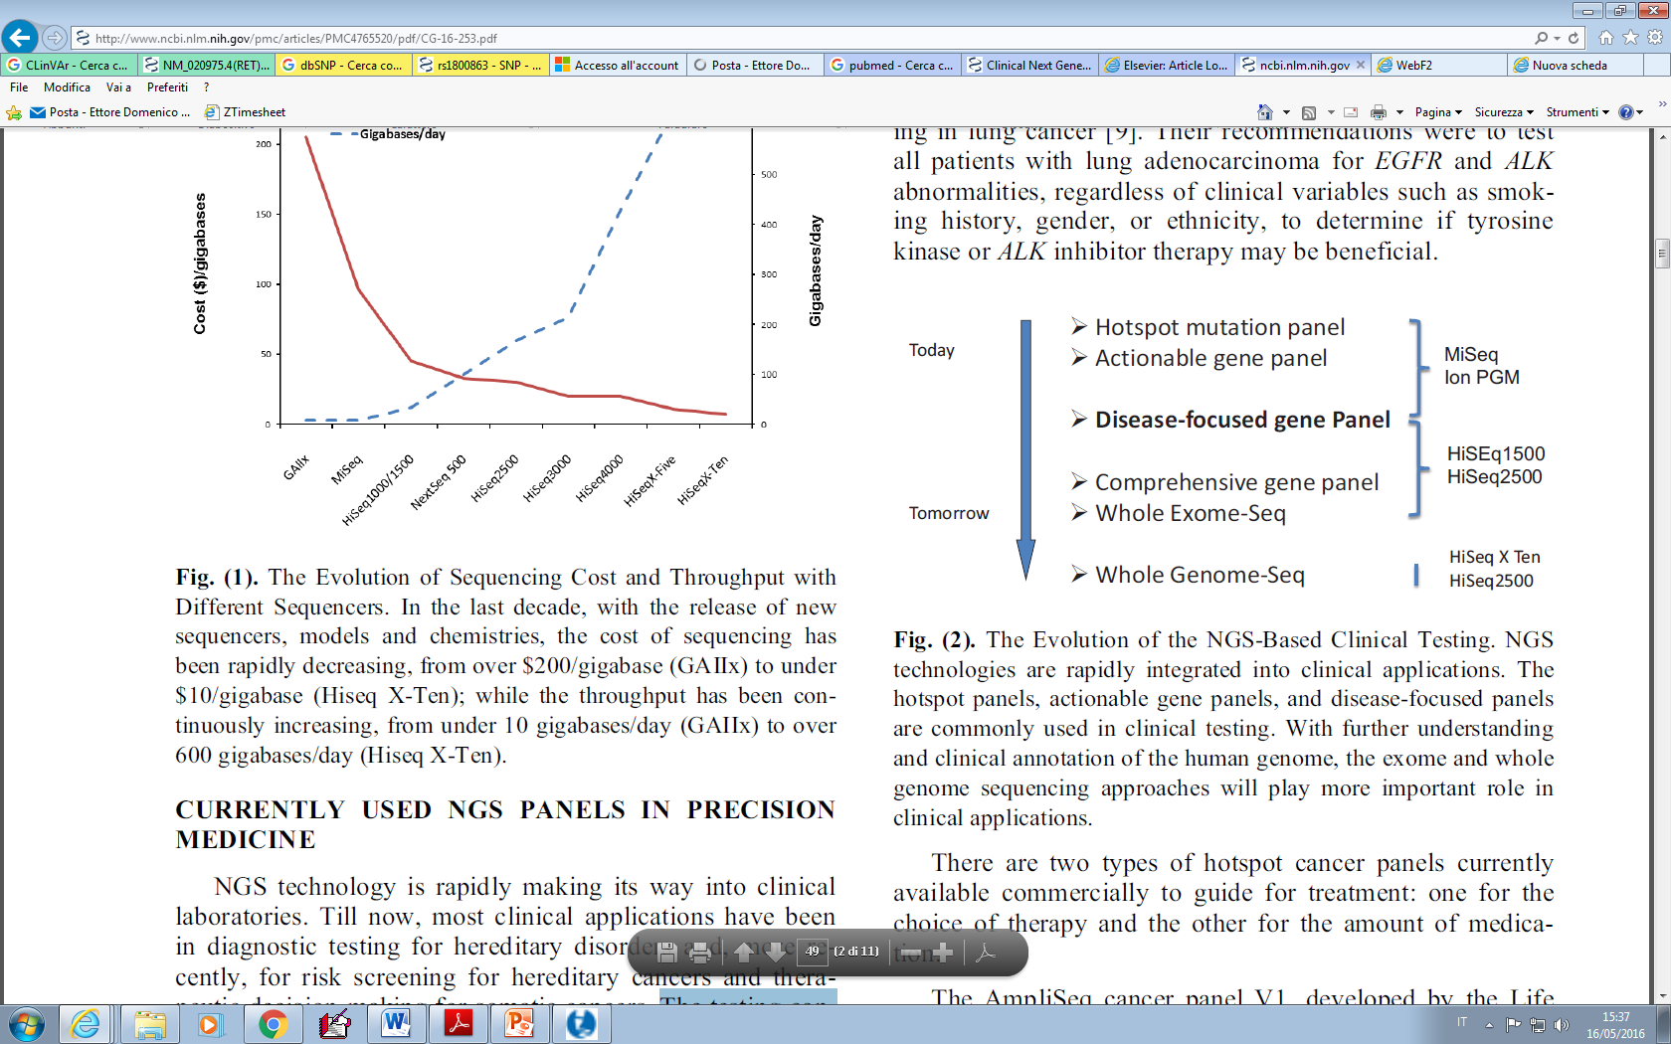


Slide 25
Hot-spot PANELS
DEFINITION: it is a collection of frequently mutated hotspots that are either clinically actionable or with diagnostic/prognostic significance
In the last years, major shift in cancer diagnostics from physical and histological findings to
ADDITIONAL ASSESSMENT OF TARGETABLE GENOMIC MUTATIONS

Slide 26
TWO types of hotspot cancer panels currently
available commercially to guide for treatment
for the choice of therapy
for the amount of medication
AmpliSeq cancer panel V1 (LifeTech):
covers 739 clinically relevant hotspot mutations (from 46 cancer genes) including well-established tumor suppressor genes and oncogenes.

Slide 27



TWO types of hotspot cancer panels currently
available commercially to guide for treatment
Illumina subsequently released a similar product
Truseq Amplicon cancer panel targeting 48 genes with 212 amplicons

Slide 28
A study on about 900 tumor samples showed
the reliability of the NGS technology to examine multiple gene loci across different tumor types in a single workflow
Clinically significant mutations were identified in 63% of pts
26% pts had mutations with therapeutic implications

Slide 29
PGxOne™ TESTING
Pharmacogenomics test (Admera Health, represents the second type of hotspot panel (http://www.admerahealth.com/pgxone/).
Screens for 152 frequently mutated sites from 13 well-established pharmacogenomics genes affecting:
Drug absorption
Metabolism
Activity
In order provide information for physicians to prescribe appropriate dose for effective treatment

Slide 30
ACTIONABLE GENE PANEL
It represents an EVOLUTION from hotspot panels by including all exons of targeted genes (or all clinical relevant regions) so that other pathogenic mutations outside frequently mutated sites can be interrogated
They focus on actionable genes:
EGFR
BRAF
KRAS
PIK3CA
NRAS
KIT
ALK
which are often targets of FDA-approved
drugs in different tumor types

Slide 31
ACTIONABLE GENE PANEL
A useful
complement to traditional cancer treatment tools
expansion of treatment options, by matching each patient with targeted therapies and clinical trials

Slide 32

ACTIONABLE GENE PANEL
The first commercially released, small actionable gene panel is the TruSight Tumor panel, that identify:
Low-frequency mutations
26 genes for targeted therapy of
          Lung
          Colon
          Gastric
          Ovarian
          Melanoma

Slide 33

ACTIONABLE GENE PANEL
The V2 Comprehensive Cancer Gene Set
Customized cancer panel
includes 42 clinically actionable cancer genes
  20 for Solid tumors
  16 for Liquid tumors
  6 for both
Disease substyping
Tailored therapy

Slide 34

ACTIONABLE GENE PANEL
Foundation One
COMPREHENSIVE
ACTIONABLE GENE PANEL.
Entire cds of 236 cancer-related genes
+ 47 introns from 19 genes often rearranged or altered in solid tumor tissues: SOMATIC ALTERATIONS
It provides more potential treatment options from:
FDA-approved targeted therapies
CLINICAL TRIALS

Slide 35
MyRisk- Myriad
Hereditary cancer
Risk assessment and patient management
25-gene panel: clinically significant mutations impacting inherited risks for 8 important cancers:
Breast
Colorectal
Ovarian
Endometrial
Gastric
Melanoma
Pancreatic
Prostate cancer
The test interpretation combines test results with:
personal/family cancer history
for clinically actionable risk assessment, and provides specific medical management recommendations based on the
guidelines of leading professional
medical societies

Slide 36
Disease-Focused Panels
Largely used for the germ line mutations to screen for:
    the risk of inherited diseases
    to diagnose suspected genetic diseases
At present, the hereditary cancer panels are popular tests
Approximately 5-10% of all cancers are hereditary
More than 100 cancer: susceptibility reported

Slide 37
Disease-Focused Panels
Hereditary breast and ovarian cancer syndrome (HBOC)
Lynch Syndrome
Cowden syndrome (CS)
Li-Fraumeni Syndrome (LFS)
Many of these risk genes share molecular pathways and play a role in the repair of DNA damage:
high risk gene BRCA1 and BRCA2
modest risk gene BRIP1 and PALB2
which are all part of the Fanconi Anemia (FA)-BRCA Molecular Pathway and associated with increased risk of breast and ovarian cancer

Slide 38
NGS-based screening for all of those genes for a particular cancer provides critical risk information for preventive management
These panels generally have a limited set of genes allowing multiplex and greater depth of coverage for increased:
Analytical sensitivity
Specificity
Decreased cost

Slide 39
Comprehensive Panels: ISSUES
Clinical laboratories are facing SERIOUS FINANCIAL and PRACTICAL
CHALLENGES associated with:
Development and validation of different disease-focused panels according to the American College of Medical Genetics and Genomics (ACMG) guidelines
Limited number of clinical specimens required for clinical testing for any given disease at any given
time
the requirement to constantly update the content of existing panels

Slide 40



Advantages for Physicians
Request testing using a specific disease focused sub-panel that is relevant to the patient’s phenotype
ADDITIONAL ANALYSIS COULD BE REQUESTED USING THE FULL PANEL, IF CLINICALLY INDICATED
LEVEL

Slide 41
Illumina’s TruSight One: comprehensive panel
Includes > 60 well established sub-panels
Covers 4813 genes having known association with clinical phenotypes

Slide 42
Illumina’s TruSight One: comprehensive panel
All exonic regions harboring disease-causing mutations identified based on information in the
Human Gene Mutation Database (HGMD Professional) Online Mendelian Inheritance in Man (OMIM) catalog, GeneTests.org
Other commercially available sequencing panels
Thus, this comprehensive panel analyzes all genes currently reviewed in clinical research settings, and could be used for any disease focused sub-panel testing after being completely validated in the clinical
laboratory

Slide 43
WES vs WGS
WES an ideal tool for testing the pts with:
  undiagnosed diseases of suspected hereditary origin for possible elucidation of a cause of the disease.
Few academic institutes have already been offering clinical WES:
Baylor College of Medicine
Washington University of St. Louis
UCLA
Emory Genetics Laboratory (EGL): developed a new generation of clinical whole exome sequencing test, named Medical EmExome

Slide 44
WES vs WGS
Emory Genetics Laboratory (EGL): developed a new generation of clinical whole exome sequencing test, named Medical EmExome
But… non still implemetable in clinical routine
>97% coverage of 22,000 genes
Mean read depth of 100X
Of the ~4600 disease-associated genes analyzed 3000 have 100% coverage (20X) of all exons (significantly higher than other commercial whole exome sequencing tests)
sub-panel relevant to the patient’s phenotype

Slide 45
WGS
WGS represents the next step in the progression to complete elucidation of the genomic determinants of a patient’s heritable make-up, and thus is the most comprehensive tool for future clinical application
It is expected to provide full coverage of all protein coding regions like WES as well as intronic and other noncoding regions associated with inherited diseases.
With the recent release of Illumina HiSeq X Ten, a human genome can be sequenced at 30x coverage under $1000.
Thus, the cost of sequencing is not a barrier for clinical WGS anymore

Slide 46



Lack of Clinically Annotated Genetic Variants for accurate
Data Interpretation
From data acquisition to data interpretation
An important challenge of efficiently translating NGS data into actionable information for clinicians

Slide 47

THESE VARIANTS REQUIRE MASSIVE SOURCES OF:
a) GENOMIC AND PHENOTYPIC DATA
b) SHARED EFFORTS IN STUDYING VARIANTS
This will take many years and requires a lot of collective effort
The International Collaboration for Clinical Genomics is working closely with NCBI to develop standards,
to assist clinical laboratories in:
sharing their data
to develop approaches to curate the shared data

Slide 48


Driver vs passenger mutations
DRIVER MUTATION:
CASUALLY implicated in oncogenesis
It conferred GROWTH ADVANTAGES on the cancer cell
PASSENGER MUTATION:
Has not been selected
Has not conferred clonal GROWTH ADVANTAGE
Has not contributed to cancer development

Slide 49
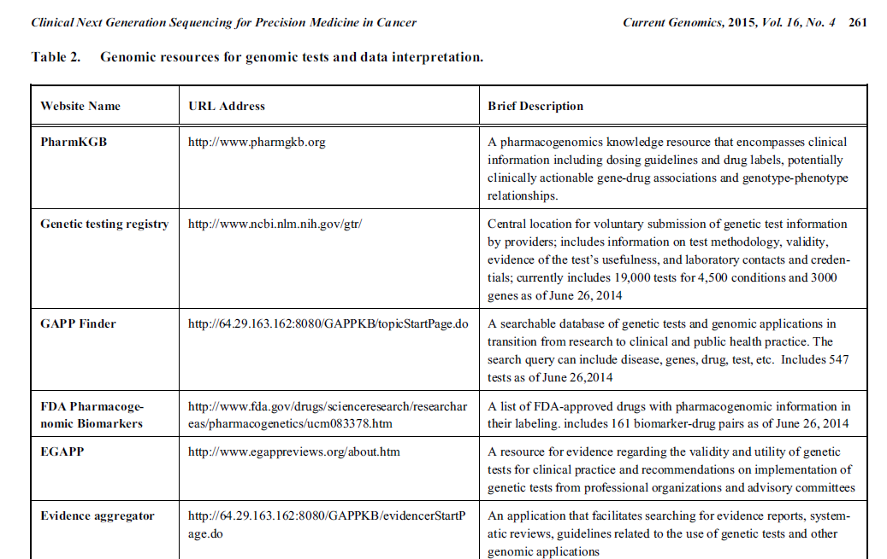
GENOMIC SOURCES

Slide 50
Future perspectives
NGS technology: dramatic impact on precision medicine from
    risk assessment
    early diagnosis, prognosis and treatment
Successful application of NGS technology to cytology specimens can further enhance its power in the disease management
However, there are several key challenges that impede the wide adoption of NGS in clinical laboratories

Slide 51
Future perspectives
Addressing the following challenges can pave the way for:
Gene panels
WES
WGS testing
in the daily practice of precision medicine

Slide 52

In general, classification is hierachical and multidimensional
Tumor sub-classification by
Genomic
Epigenomic
Transcriptomic
Proteomic
Metabolomic
Interactomic
  The goals of molecular classification are:
  to identify shared characteristics within a group of tumors that may predict
  DISEASE COURSE
  TREATMENT RESPONSE

Slide 53
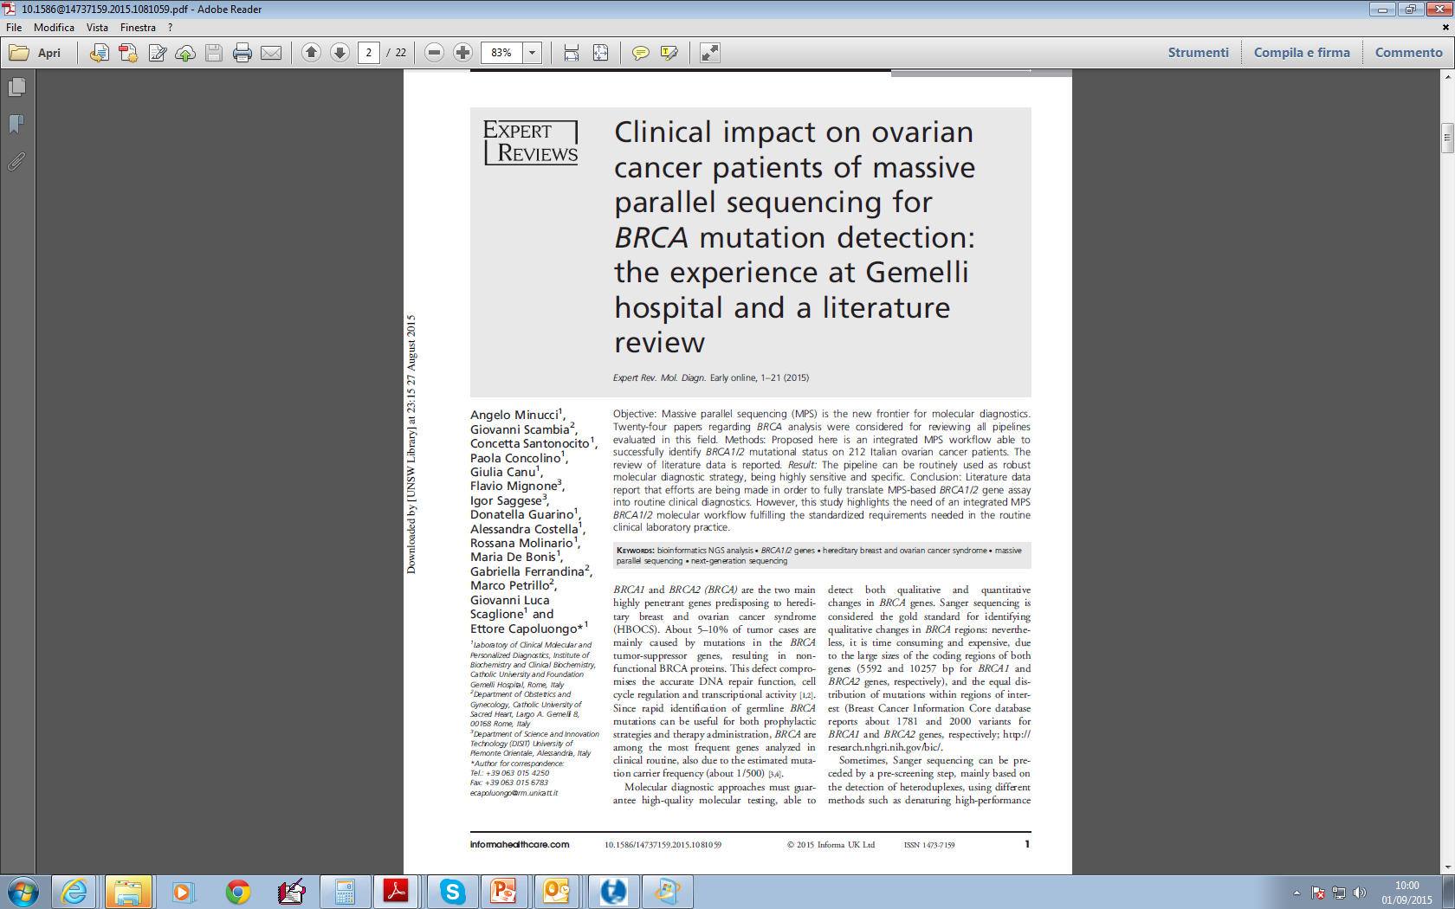

Slide 54
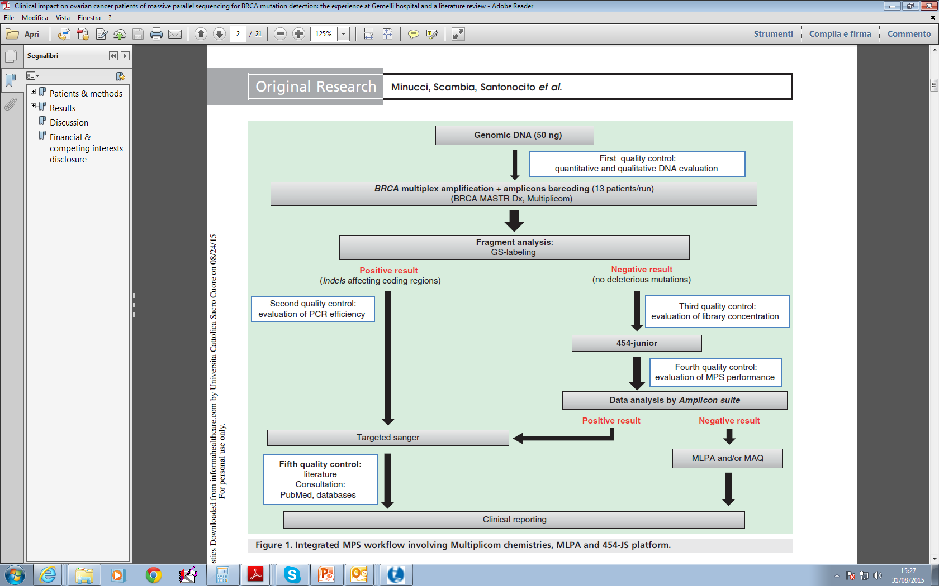

1
2
3
4
5

Slide 55
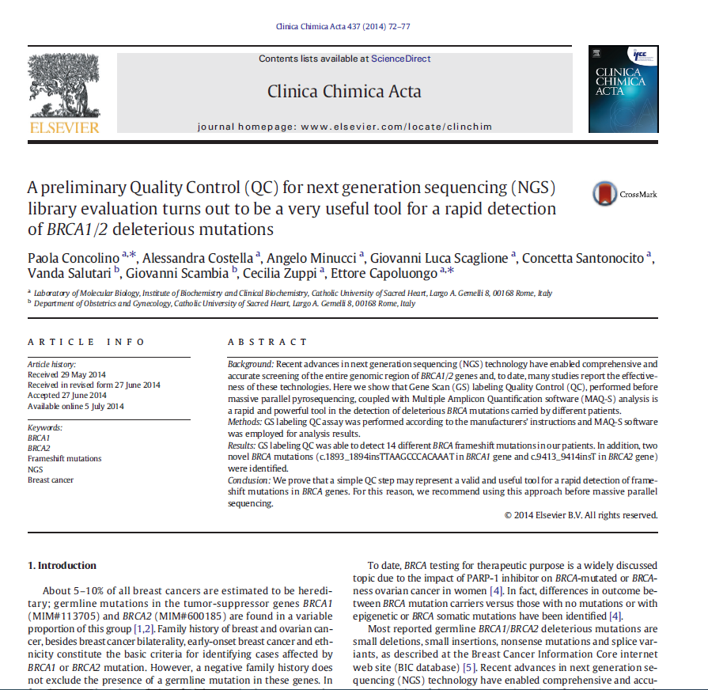

Slide 56

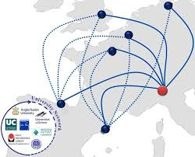
VUS evaluation
QC management
BRCA testing
Germline database man
Ref Lab: complete tecnologies for BRCA1/2 testing
Somatic database man
BRCA testing

Slide 57



Conclusions
MULTIDISCIPLINARY APPROACH in tumor testing may guarantee the success in BrCa/ OvCa patients’ managment
Notes:
Tenendo sotto controllo il margine di errori che si insidiano in questa procedura multistep è possibili valutare le CNV in futuro
Se si raccolgono I dati NGS tra le serie e nelle varie corse
Traendo le dovute conclusioni clinico/diagnostice e analitiche valutando I dati ottenuti dall’analisi bionformatica post-sequenziamente in stretta relazione con I dati relativi alla librerie pre-ngs con l’ausilio del tool Amplicon Suite

Slide 58
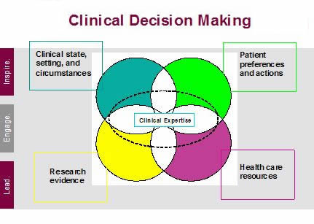

Clinical Decision Making & Utility
Role of Ac LABs
CLINICAL VALIDATION
ANALYTICAL VALIDATION
TECHNICAL FEASIBILITY

Slide 59

Collaborations
University of Piemonte Orientale
Bioinformatic Facility Unit
Thomas Jefferson University
Department of Cancer Genomics
My staff:
Faculty of Medicine Hospital Fellows
Prof. A. Minucci Dr. S. Palumbo Dr. C. Autilio
Prof. P. Concolino Dr. S. Rocchetti Dr. A. Costella
Prof. C. Santonocito Dr. K. Pocino
Dr. G. Canu, PhD Dr. R. Rizza
Dr. C. Paolillo, PhD Dr. D. Guarino
Dr. G.L. Scaglione, PhD Dr. M. De Bonis

Slide 60


