Slide 1
Targeting endocrine-resistance pathways in breast cancer
Clara Natoli, Chieti

Slide 2
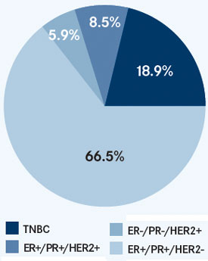
Endocrine responsive breast cancer
Luminal A
High expression of ER
& ER-related genes
Lower proliferation rates
Less aggressive behavior
High responsiveness to ET
Luminal B
Relatively lower expression
of ER and ER-related genes
Higher proliferation rates
More aggressiveness
Lower endocrine sensitivity
the largest single breast cancer subtype

Slide 3
Probability of response to ET
Adjuvant ET
ET for advanced disease
Relapse on vs. after adjuvant ET
Best response to first line ET
Yes
No
PD within
6 months
PD within
6-24 months
PD after
24 months
Firts
2 Years
> 2 Years
Free interval
since completion
of adjuvant ET
Low
Medium
High
Very Low
Low
< 1 Years
> 1 Years
Medium
High
Primary resistance
Primary resistance
Acquired resistance
Acquired resistance
T Reinert and CH Barrios, Ther Adv Med Oncol 2015, Vol. 7(6) 304–320

Slide 4
Endocrine therapy is a major treatment modality for hormone-dependent breast cancer.
However, resistance to endocrine therapy occurs in the majority of patients, and is a major obstacle to optimal clinical management.

Slide 5
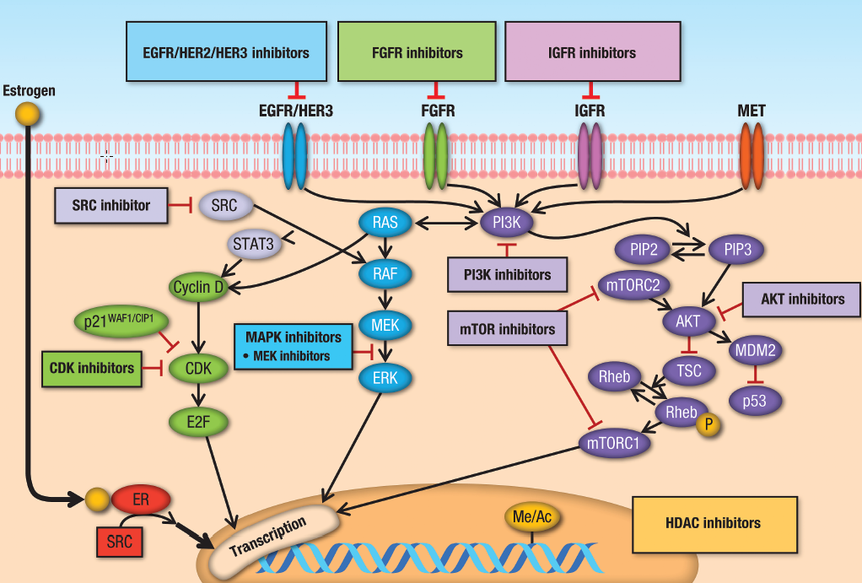
Targeting endocrine resistance pathways in breast cancer
Zardavas D, Baselga J, Piccart M. Nat Rev Clin Oncol. 2013;10(35):191–210.

Slide 6
Bio-markers of response
Predictive biomarkers of both acquired and de novo (primary) resistance are highly required to improve patient selection and identify poor-responders who may benefit from alternative first and later-line treatments.

Slide 7
Single agent endocrine therapy
Combination of endocrine therapies
Combination of endocrine and
targeted therapies

Slide 8
Single agents, optimal sequence ER+ HER2- metastatic breast cancer?
1° Line
NSAIs
2° Line
Exemestane
HD-Fulvestrant
Progression
Progression
3° Line
Tamoxifen

Slide 9
Single agent endocrine therapy
Combination of endocrine therapies
Combination of endocrine and
targeted therapies

Slide 10
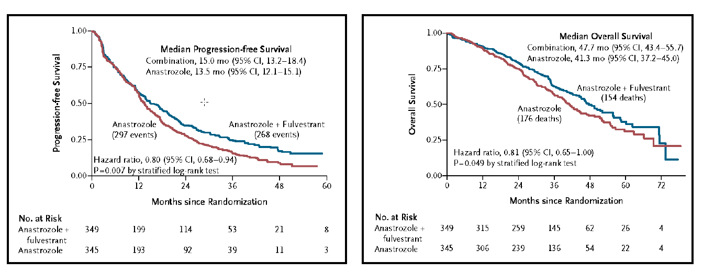
Combination of endocrine therapies
in the first-line setting
SWOG S0226 trial
Dual ER pathway targeting
The SWOG S0226 trial randomized 694 patients with similar characteristics as in the FACT trial, and the same arms of anastrozole only or anastrozole plus fulvestrant.
40% presented with de novo metastatic disease, while 60% had not received adjuvant tamoxifen
Mehta RS, et al. N Engl J Med 367:435-44, 2012

Slide 11
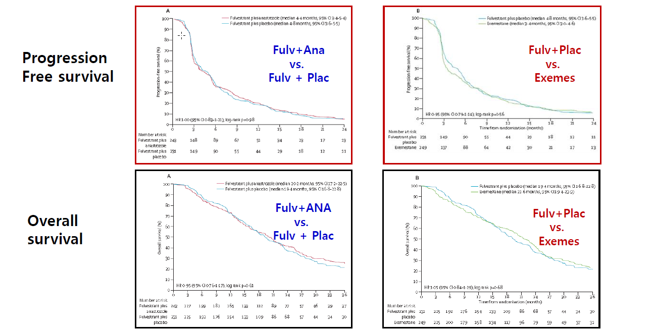
Combination of endocrine therapies
in the second-line setting
SOFEA
Dual ER pathway targeting
Combining fulvestrant to anastrozole is not more effective that fulvestrant alone or exemestane alone in HR+ ABC that has progressed during therapy with a NAI
Johnston SR, Lancet Oncol 2013; 14: 989–98

Slide 12
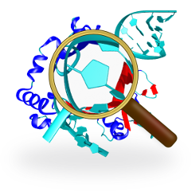
No identified bio-markers of response

Slide 13
Single agent endocrine therapy
Combination of endocrine therapies
Combination of endocrine and
targeted therapies/ CDK4_6 inhibitors

Slide 14
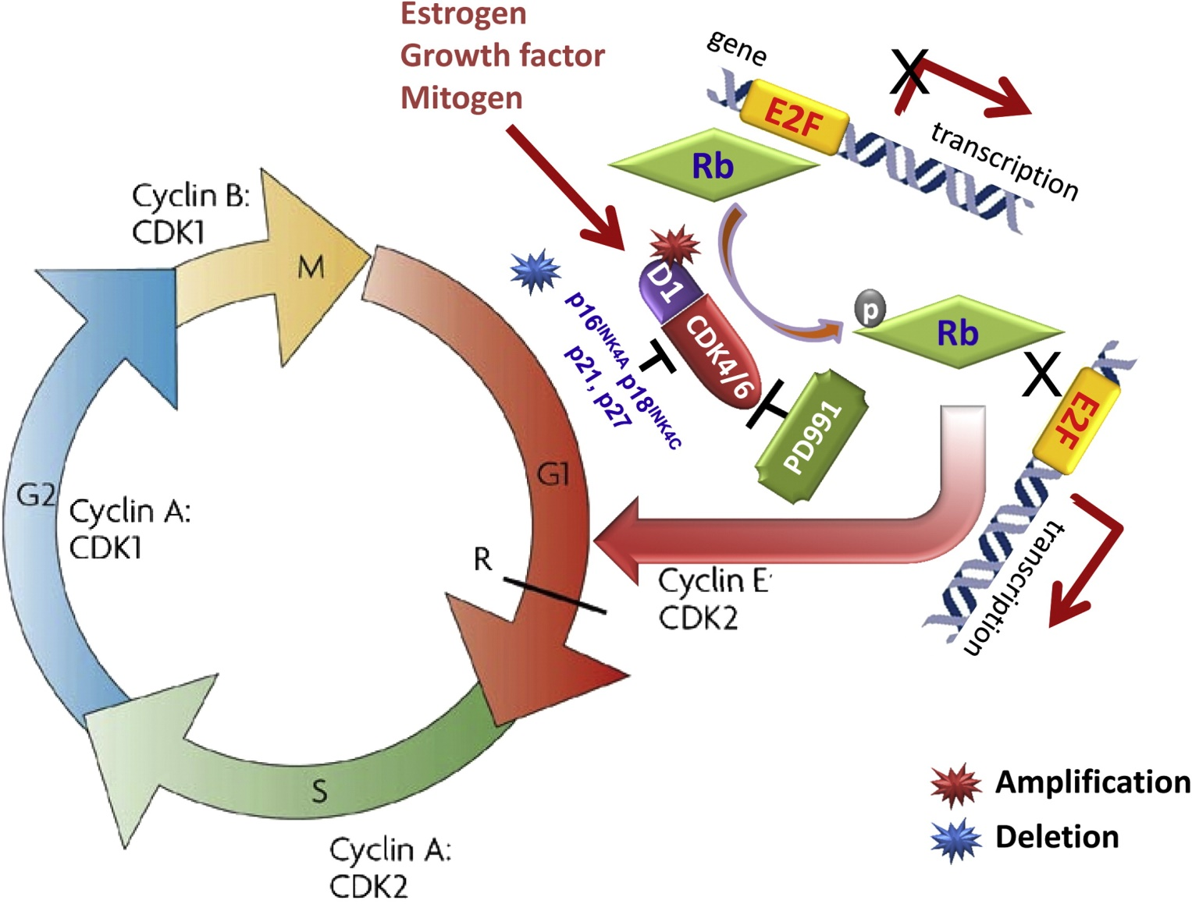
Combination of endocrine therapy and
CDK4/6 inhibitors in the first-line setting
Cyclin D1 activates CDK4/6
phosporilates & inactivates Rb
allows progression through the G1/S checkpoint
Growth of ER+ breast cancer is dependent upon cyclin D1
Palbociclib is an orally bioavailable small-molecule inhibitor of CDK4 and CDK6, with a high level of selectivity for CDK4 and CDK6 over other cyclin-dependent kinases
The American Journal of Pathology 2013 183, 1096-1112DOI: (10.1016/j.ajpath.2013.07.005)

Slide 15
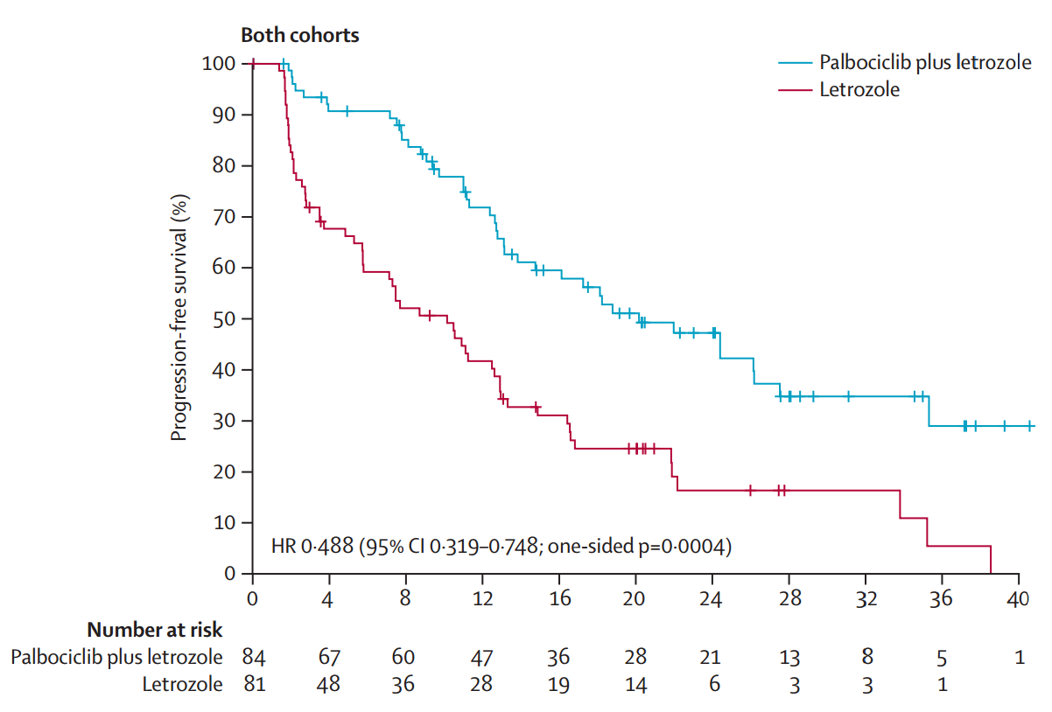
Combination of endocrine therapy and
CDK4/6 inhibitors in the first-line setting
The PALOMA-1
Finn, RS, et al., Lancet Oncol 2015;16: 25-35.

Slide 16
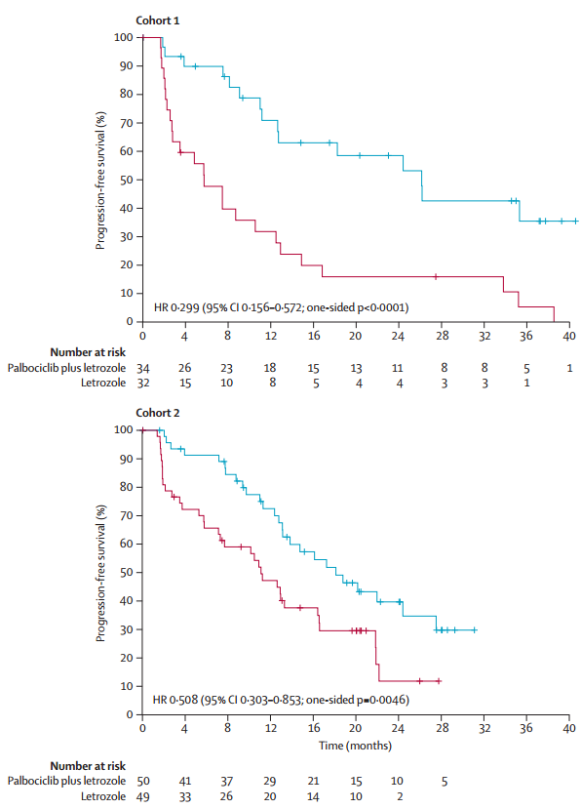
Combination of endocrine therapy and
CDK4/6 inhibitors in the first-line setting
The PALOMA-1
estrogen receptor-positive & HER2-negative
Accelerated FDA approval in 2/2015
estrogen receptor-positive & HER2-negative & amplification of cyclin D1 (CCND1), loss of p16 (INK4A or CDKN2A), or both
Genetic changes in cyclin D1 and p16 did not improve patient selection beyond use of estrogen receptor-positive status alone.
Finn, RS, et al., Lancet Oncol 2015;16: 25-35.

Slide 17
No identified bio-markers of response
Cyclin D1 amp/p27 loss present versus absent
HR = 0.37 versus 0.19 (p NR)
Finn, RS, et al., Lancet Oncol 2015;16: 25-35.

Slide 18
Combination of endocrine therapy and
CDK4/6 inhibitors in the second-line setting
PALOMA-3
Turner NC et al. N Engl J Med 2015;373:209-219.

Slide 19
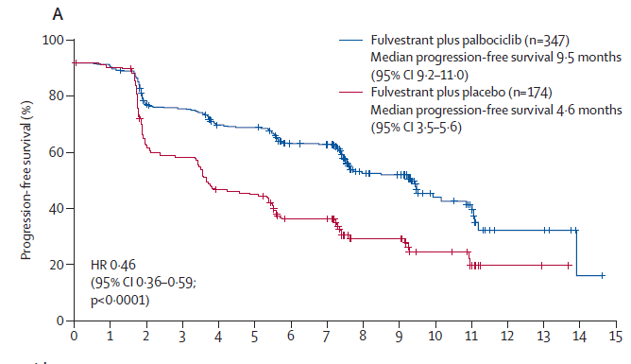
Combination of endocrine therapy and
CDK4/6 inhibitors in the second-line setting
PALOMA-3
Patients in the intention-to-treat population
Published online March 2, 2016 http://dx.doi.org/10.1016/S1470-2045(15)00613-0

Slide 20
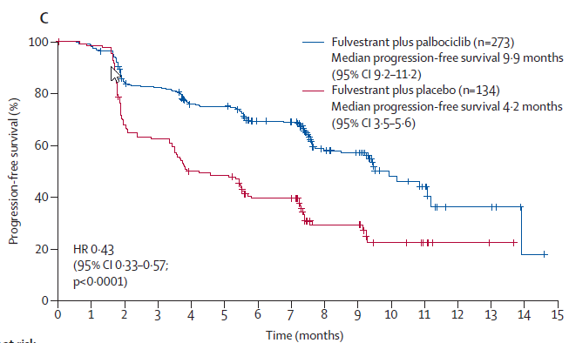
Combination of endocrine therapy and
CDK4/6 inhibitors in the second-line setting
PALOMA-3
Patients who received at least one previous systemic therapy for metastatic breast cancer
Published online March 2, 2016 http://dx.doi.org/10.1016/S1470-2045(15)00613-0

Slide 21
Combination of endocrine and and
CDK4/6 inhibitors in the first and second-line setting
PALOMA-3
February 25, 2016
FDA has granted an expanded indication for palbociclib. The drug is now approved for use in combination with fulvestrant in women with HR-positive, HER2-negative advanced or metastatic breast cancer whose disease progressed following endocrine therapy.
Palbociclib was initially approved in February 2015 for the treatment of HR–positive, HER2-negative metastatic breast cancer, in women who had not yet received endocrine therapy.
The new approval was granted under the FDA’s breakthrough therapy designation.

Slide 22
No identified bio-markers of response
Neither PIK3CA status nor hormone-receptor expression level significantly affected treatment response.
Published online March 2, 2016 http://dx.doi.org/10.1016/S1470-2045(15)00613-0

Slide 23
Ongoing RCTs with ET + CDK 4/6 inhibitors in HR+ MBC
Trials | Phase | N | Endpoint | Study design | Status
Palbociclib
Paloma 2 | 2 | 650 | PFS | Letrozole +/- palbo | closed to accrual
Pearl | 3 | 348 | PFS | Exem/palbo vs capecitabine after NS-AI | recruiting
Abemaciclib
Monarch 2 | 3 | 680 | PFS | Fulvestrant +/- abema | closed to accrual
Monarch 3 | 3 | 450 | PFS | NS-AI +/- abema | recruiting
Ribociclib
CLEE011X2108 | 2 | 216 | PFS | Fulvestrant +/- BYL719 or BKM120 | recruiting
Monaleesa 2 | 3 | 500 | PFS | Letrozole +/- rociclib | closed to accrual
Monaleesa 2 | 3 | 660 | PFS | LHRH-agonist/Tam or NSAI +/- ribo | recruiting
dicklerm@mskcc.org San Antonio Breast cancer Symposium 2015

Slide 24
Single agent endocrine therapy
Combination of endocrine therapies
Combination of endocrine and
targeted therapies/mTor inhibitors

Slide 25
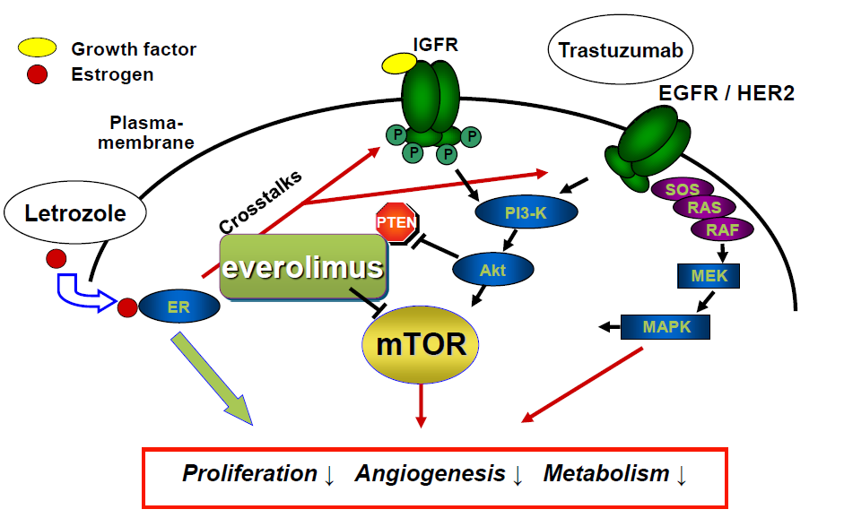
Combination of endocrine therapy and
mTor inhibitors
Estrogen activates the estrogen receptor and cells proliferate through the activation of the mTOR pathway
Hyperactivation of the PI3K/mTOR pathway is observed in endocrine –resistant breast cancer cells
mTOR is rational target to enhance the efficacy of hormonal therapy

Slide 26
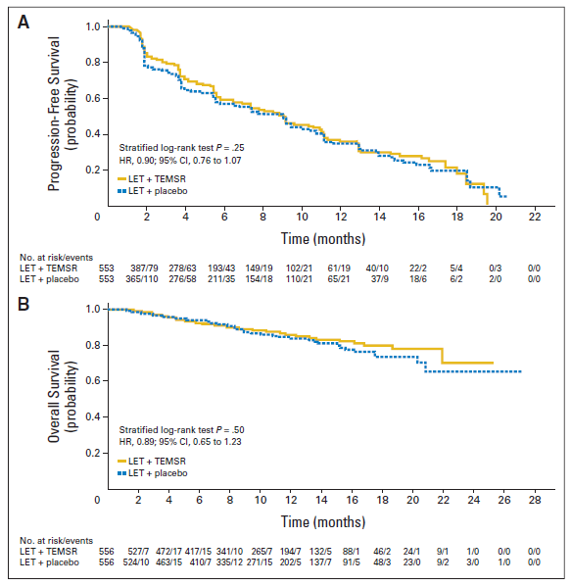
Combination of endocrine and
mTor inhibitors in the first-line setting
HORIZON
Randomized Phase III Placebo-Controlled Trial of Letrozole
Plus Oral Temsirolimus As First-Line Endocrine Therapy in
Postmenopausal Women With Locally Advanced or
Metastatic Breast Cancer
Wolff AC et al, J Clin Oncol 31:195-202. © 2012

Slide 27
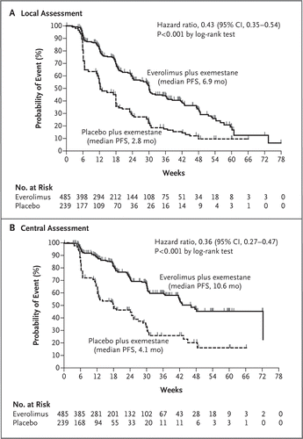
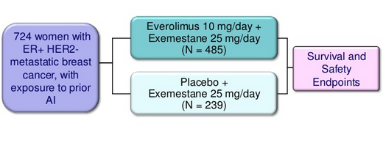
Combination of endocrine and
mTor inhibitors in the second-line setting
BOLERO-2
N Engl J Med 2012; 366:520-529

Slide 28
No identified bio-markers of response
Correlative Analysis of Genetic Alterations and Everolimus Benefit in Hormone Receptor-Positive, Human Epidermal Growth Factor Receptor 2-Negative Advanced Breast Cancer: Results From BOLERO-2.
RESULTS:
Progression-free survival benefit with everolimus was maintained regardless of alteration status of PIK3CA, FGFR1, and CCND1 or the pathways of which they are components. However, quantitative differences in everolimus benefit were observed between patient subgroups defined by the exon-specific mutations in PIK3CA (exon 20 v 9) or by different degrees of chromosomal instability in the tumor tissues.
CONCLUSION:
The data from this exploratory analysis suggest that the efficacy of everolimus was largely independent of the most commonly altered genes or pathways in hormone receptor-positive, human epidermal growth factor receptor 2-negative breast cancer. The potential impact of chromosomal instabilities and low-frequency genetic alterations on everolimus efficacy warrants further investigation.
J Clin Oncol. 2016 Feb 10;34(5):419-26. doi: 10.1200/JCO.2014.60.1971. Epub 2015 Oct 26.

Slide 29
Other bio-markers of response?

Slide 30
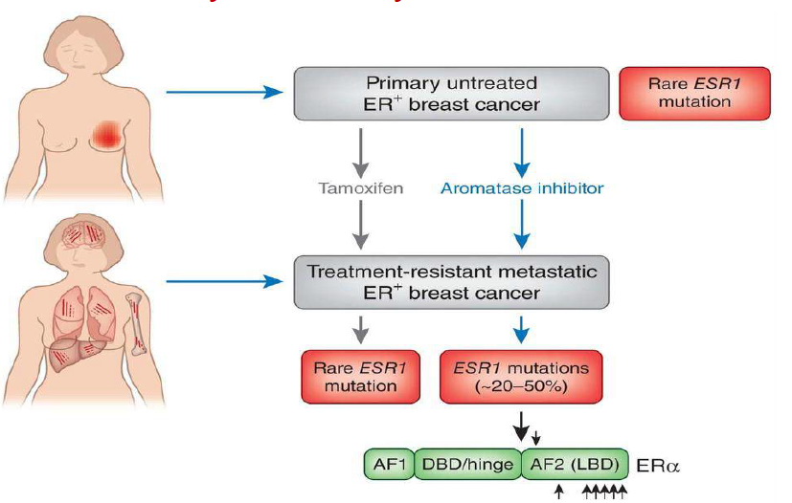
Mutations of ESR1 in Metastatic Breast Cancer
Oesterreich and Davidson, Nature Genetics, 2013

Slide 31
Mutations of ESR1 in Metastatic Breast Cancer

Slide 32
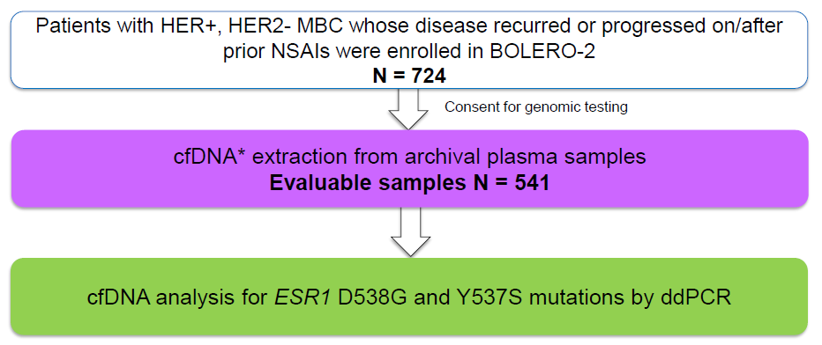
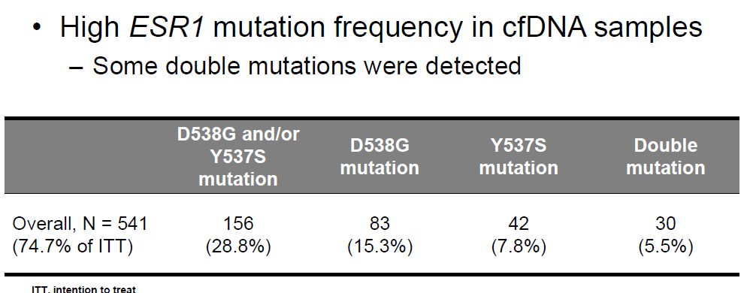
BOLERO-2
ChandarlapatyS, et al. Presented at: 2015 San Antonio Breast Cancer Symposium; December 8-12, 2015; San Antonio, Texas. Abstract S2-07.

Slide 33
D538G and Y537S mutations appear to be associated with a more aggressive disease biology as demonstrated by a shorter OS

Slide 34
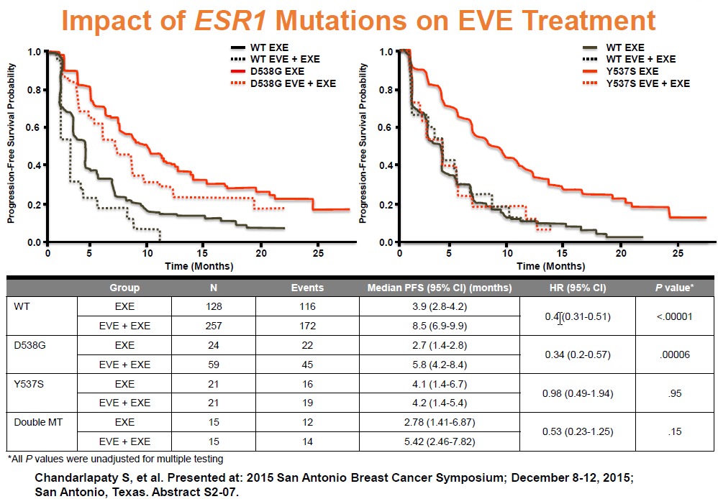
D538G EVE + EXE
WT EVE + EXE
WT EVE + EXE
Y537S EXE
D538G EXE
WT EXE
Y537S EVE +EXE
WT EXE
In the EXE only arm, patients with D538G mutation had a shorter PFS as compared to wild-type
Patients with D538G mutation demonstrate PFS benefit with the addition of EVE, whereas those with Y537S mutation did not

Slide 35
Mutations of ESR1 in Metastatic Breast Cancer
Ongoing clinical trials
Targets | Study title | Phase | Study status | Estimated primary completion date | Clinicaltrials.gov identifier
ESR1 / SERD | A Study of GDC-0810 Versus Fulvestrant in Women With Advanced or Metastatic Breast Cancer Resistant to Aromatase Inhibitor Therapy (HydranGea) | 2 | Recruiting | April 2018 | NCT02569801
ESR1 / SERD | A Study of ARN-810 (GDC-0810) in Postmenopausal Women With Locally Advanced or Metastatic Estrogen Receptor Positive Breast Cancer | 2 | Recruiting | July 2017 | NCT01823835
GDC-0810 or ARN-810: orally bioavailable SERDs, potent antagonists and degraders of ER-α
Asia-Pac J Clin Oncol 2016; 12(Suppl. 1): 19–31

Slide 36
Single agent endocrine therapy
Combination of endocrine therapies
Combination of endocrine and
targeted therapies/PI3K inhibitors

Slide 37
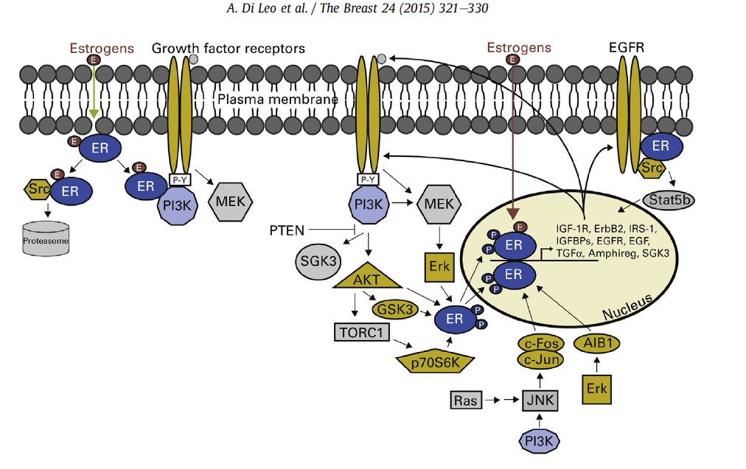
Activation of PI3K Pathway in ER+ Breast Cancer
Estrogen independent activation of ER
Dual targeting of ER and PI3K pathway in preclinical models overcomes resistance
Notes:
Cross-talk between estrogen receptor (ER) and growth factor receptor signaling pathways.
Receptor tyrosine kinases (RTKs) and G-protein-coupled receptors activate phosphatidylinositol 3-kinase (PI3K; blue) and MAPK/Erk (MEK) signaling pathways. These signal transducers then phosphorylate ER (green arrow) and/or coactivators and corepressors to modulate ER transcriptional activity not necessarily dependent on ER ligands. In turn, ER transcribes genes
encoding components of growth factor signaling pathways, thus completing the signaling cycle of RTKs to ER to RTKs. ER also complexes with RTKs and Src to rapidly induce nongenomic signaling. ER-interacting proteins are shown in color.
AIB1, amplified in breast cancer 1; EGFR, epidermal growth factor receptor; GSK-3, glycogen synthase kinase-3;
IGF-1R, insulin-like growth factor-1 receptor; IGFBP, insulin-like growth factor binding protein; IRS-1, insulin receptor substrate 1; JNK, c-Jun N-terminal kinase; MAP, mitogenactivated protein kinases; PI3K, phosphatidylinositol 3-kinase; PTEN, phosphatase and tensin homolog; RTK, receptor tyrosine kinase; SGK3, serum/glucocorticoid-regulated kinase- 3; Stat5b, signal transducer and activator of transcription 5b; TGFa, transforming growth factor alpha; TORC1, target of rapamycin complex 1.

Slide 38
Combination of endocrine therapy and PI3K inhibitors in the second-line setting
BELLE-2
Postmenopausal women with HR+/HER2- inoperable locally advanced or metastatic BC, with progression on/after AI therapy
(N = 1147)
Buparlisib 100 mg/day + Fulvestrant 500 mg
(n = 576)
Placebo + Fulvestrant 500 mg
(n = 571)
Median PFS, Mos (95% CI) | Buparlisib + Fulvestrant (n = 576) | Placebo + Fulvestrant (n = 571) | HR (95% CI) | P Value
Overall population | 6.9 (6.8-7.8) | 5.0 (4.0-5.2) | 0.78 (0.67-0.89) | < .001
PI3K-activated pts* | 6.8 (4.9-7.1) | 4.0 (3.1-5.2) | 0.76 (0.60-0.97) | .014†
Baselga J, et al. SABCS 2015. Abstract S6-01.

Slide 39
Bio-markers of response?

Slide 40
Combination of endocrine therapy and PI3K inhibitors in the second-line setting
BELLE-2
Buparlisib + fulvestrant extended PFS in pts with PIK3CA mutations vs fulvestrant alone
ORR higher with buparlisib + fulvestrant in pts with PIK3CA mutations vs fulvestrant alone (18.4 % vs 3.5%) but similar in pts with non-mutant PIK3CA (11.6% vs 10.6%)
Median PFS, Mos (95% CI) | Buparlisib + Fulvestrant | Placebo + Fulvestrant | HR (95% CI) | P Value
ctDNA PIK3CA mutant (n = 200)* | 7.0 (5.0-10.0) | 3.2 (2.0-5.1) | 0.56 (0.39-0.80) | < .001
ctDNA PIK3CA non-mutant (n = 387)† | 6.8 (4.7-8.5) | 6.8 (4.7-8.6) | 1.05 (0.82-1.34) | .642
Baselga J, et al. SABCS 2015. Abstract S6-01.

Slide 41
Ongoing RCTs with ET + PI3K inhibitors in HR+ MBC
Several pan-isoform inhibitors that target the PI3K/Akt are currently being tested in endocrine-resistant MBC with prospective stratification/selection for PIK3CA mutation status.
Trials | Phase | N | Endpoint | Study design | Status
BELLE3 (BKM120) | 3 | 420 | PFS | Fulvestrant +/- BKM120 after progression on mTORi | recruiting
Solar-1 (BYL719) | 3 | 820 | PFS | Fulvestrant +/- BYL719 | recruiting
Sandpiper (GDC0032) | 3 | 600 | PFS | Fulvestrant +/- GDC003 | recruiting
dicklerm@mskcc.org San Antonio Breast cancer Symposium 2015

Slide 42
Bio-markers of response?
Whether PIK3CA mutations, which represent the most common genomic alteration in HR+ breast cancer, will be found predictive for benefit from specific PI3K inhibitors remains to be determined.

Slide 43
De novo disease
Endocrine therapy naive
Fulvestrant
AI
Tamoxifen
Letrozole + palbociclib
Anastrozole + fulvestrant
1° line
Exemestane + everolimus
Fulvestrant + palbociclib
Fulvestrant
AI
Tamoxifen
2° line
3° and further lines
Defined according to the previous two lines
T Reinert and CH Barrios, Ther Adv Med Oncol 2015, Vol. 7(6) 304–320

Slide 44
Long DFI on adjuvant AI or long PFS on previous line as surrogate for acquired resistance
Short DFI on adjuvant AI or short PFS on previous line as surrogate for acquired resistance
1° line (previously exposed to AI)
Fulvestrant
Tamoxifen
Exemestane + everolimus
Fulvestrant + palbociclib
1° line (previously exposed to AI)
Exemestane + everolimus
Fulvestrant + palbociclib
Exemestane + everolimus
Fulvestrant + palbociclib
Tamoxifen
Fulvestrant
2° line
Exemestane + everolimus
Fulvestrant + palbociclib
2° line
3° and further lines
Defined according to the previous two lines
3° and further lines
>> a less endocrine sensitive population,
chemotherapy should be considered at an earlier point depending on the clinical course
T Reinert and CH Barrios, Ther Adv Med Oncol 2015, Vol. 7(6) 304–320

Slide 45
New bio-markers of response?

Slide 46
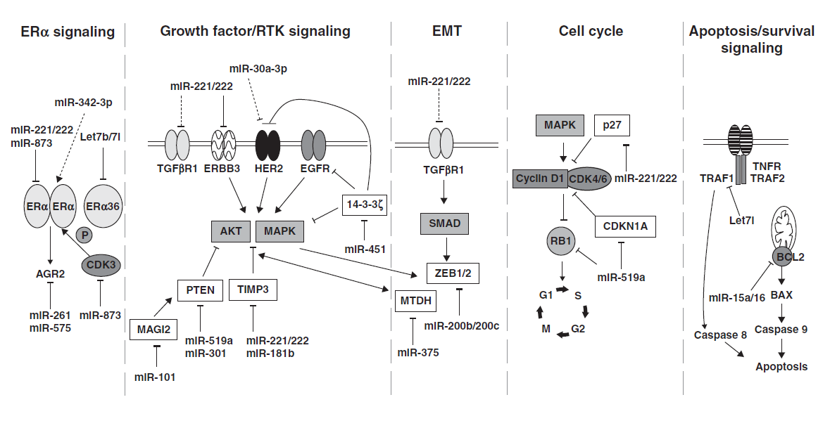
Established targets of miRNAs in
endocrine-resistant breast cancer
miRNAs are dysregulated in endocrine-resistant breast cancer and these miRNAs regulate specific genes in growth-promoting, apoptosis-resistant, and EMT pathways that result in TAM and AI resistance
http://erc.endocrinology-journals.org DOI: 10.1530/ERC-15-0355

Slide 47
New bio-markers of response
Genomic profiling together with next-generation sequencing are needed to identify relevant genomic mutations which may help identify those ER+ breast cancers characterized by primary or secondary endocrine resistance
Translational studies continue to remain crucial for optimizing clinical benefit from any new targeted therapy, utilizing either the original primary tumor or the relapsed metastatic sample, where the molecular profile may have changed.

