Slide 1
Esiste uno standard nella terapia medica della malattia avanzata?
Clara Natoli, Chieti

Slide 2
We all agree that:
Breast cancer is not only one disease –
Breast cancer is a heterogeneous disease
Different histologies and receptors, different biological behaviors
Different host characteristics
... going from a single common disease to many rare diseases

Slide 3
In this setting it is quite difficult to define a standard treatment fo MBC
… but, what is a “standard of care”?

Slide 4
Historical development of the Standard of Care
Initial Definition
Based on custom
That which is typically done is what is considered standard
The 20th Century Definition (Helling v. Carey; The TJ Hooper)
That which is customarily done plus anything that seems reasonable even if not typically done
The Modern Definition (Hall v. Hilburn; McCourt v. Abernathy; Johnston v. St. Francis Medical Center)
That which a minimally competent physician in the same field would do under similar circumstances
West J Emerg Med. 2011 Feb; 12(1): 109–112.

Slide 5
NCI Dictionary of Cancer Terms
Standard of care
Treatment that is accepted by medical experts as a proper treatment for a certain type of disease and that is widely used by healthcare professionals. Also called best practice, standard medical care, and standard therapy.
… there is no medical definition for “standard of care”, although the term is firmly established in law and is defined as “the caution that a reasonable person in similar circumstances would exercise in providing care to a patient.”

Slide 6
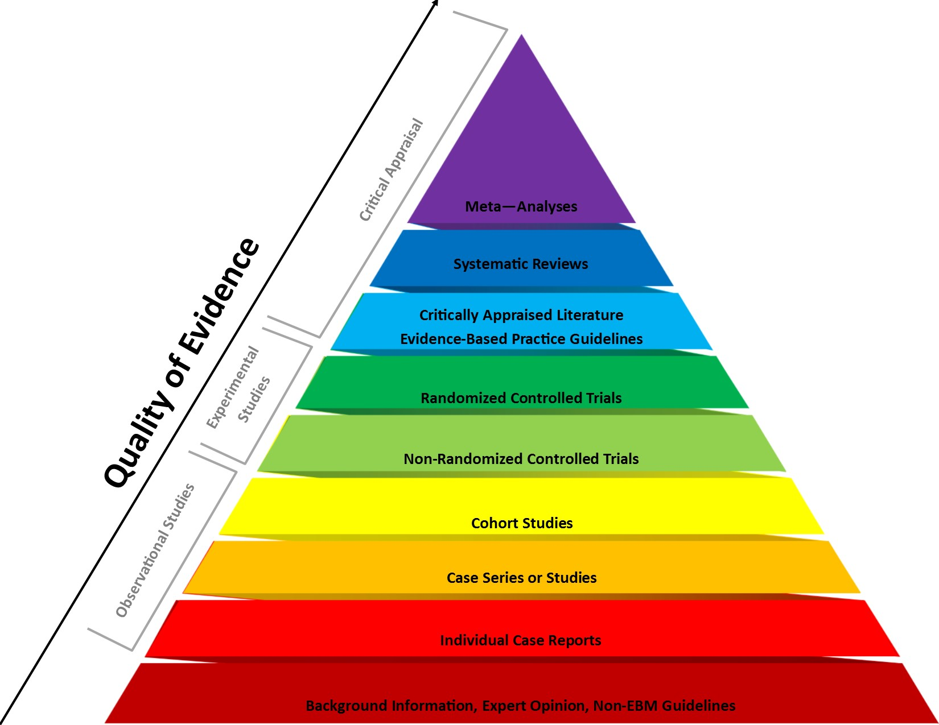
Clinical Practice Guidelines and the Standard of Care
Most practice guidelines are based on Evidence Based Medicine
Is this enough?

Slide 7
Evidence-based Consensus Allows Comprehensive Guideline
Evidence-based guideline
Continuum of disease and patient care
Evidence-based consensus guideline
High-level evidence exists
Gaps in evidence filled with expert consensus

Slide 8
Legge 8 novembre 2012, n. 189
GU n. 263 del 10-11-2012 - Suppl. Ordinario n.201
“c.d. legge Balduzzi”
Art. 3
1. L'esercente la professione sanitaria che nello svolgimento della propria attivita' si attiene a linee guida e buone pratiche accreditate dalla comunita' scientifica non risponde penalmente per colpa lieve.

Slide 9
NOTE
“l’area della non punibilità è ingiustificatamente premiale per coloro che manifestano acritica e rassicurante adesione alle linee guida o alle buone prassi ed è altrettanto ingiustificatamente avvilente e penalizzante per chi se ne discosta con una pari dignità scientifica”.
In tal modo si “blocca l’evoluzione del pensiero scientifico e la sperimentazione clinica”, violando, di fatto, gli articoli 3 e 33 della Costituzione.

Slide 10
“disegno di legge Gelli”
Responsabilità professionale del personale sanitario: attualmente in votazione al Senato …

Slide 11
Finalità
Migliorare e standardizzare “la pratica clinica” e insieme “strumento” di formazione
Offrire al paziente sull’intera territorio nazionale la possibilità della “migliore cura”
Garantire un riferimento basato sull’evidenza per le istituzioni nazionali e regionali, per gli organismi regolatori ed i “payers”
Metodologia standardizzata (fonti, SIGN, GRADE)

Slide 12
NCCN Guidelines
Comprehensive across all stages, modalities and continuum of care
44 multidisciplinary expert panels
Cancer screening, diagnosis, treatment and supportive care
Updated at least annually and up to 4 times per year since 1995
Category of evidence and consensus designated for each recommendation
Transparent processes
Centerpiece of suite of tools to support quality oncology care

Slide 13
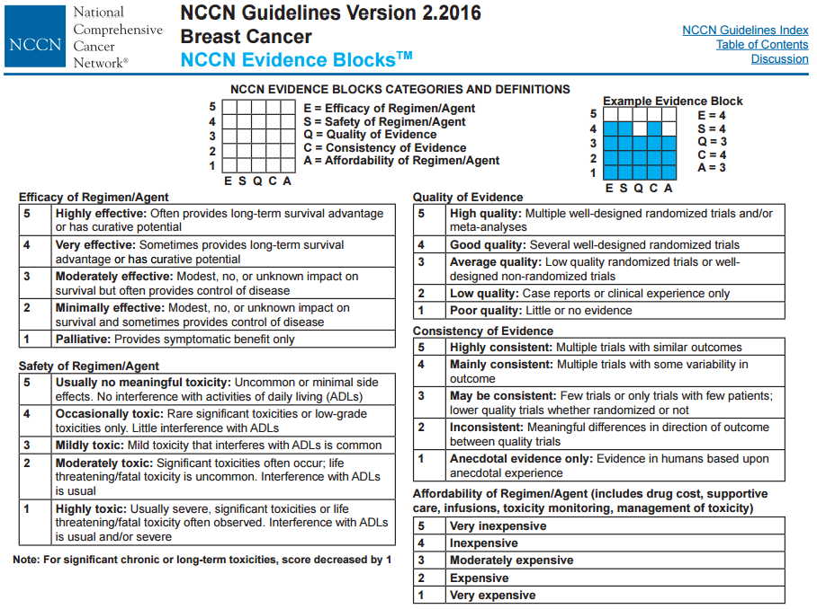

Slide 14
Just an example of standard therapies for MBC according to different clinical practice guideline

Slide 15
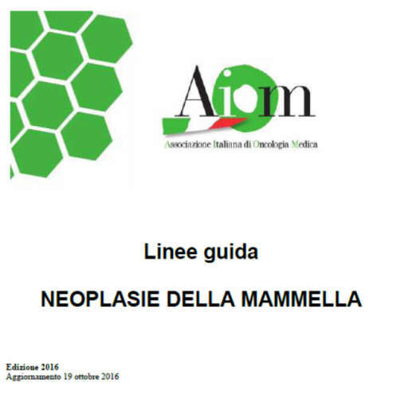
Le pazienti con carcinoma mammario metastatico ER+ e/o PgR+ in premenopausa, candidate a terapia ormonale con Tamoxifene, dovrebbe essere presa in considerazione l’associazione LHRH-analogo. Nelle pazienti con carcinoma mammario metastatico ER+ e/o PgR+ in premenopausa, già trattate in adiuvante o in prima linea metastatica con tamoxifene associato o meno a LHRH-analogo, può essere presa in considerazione l’associazione di un inibitore dell’aromatasi e LHRH-analogo
L’utilizzo di fulvestrant ed LHRH analogo, o di everolimus in combinazione ad IA ed LHRH-analogo, nelle pazienti in progressione, non è al momento supportata da evidenze sperimentali.

Slide 16
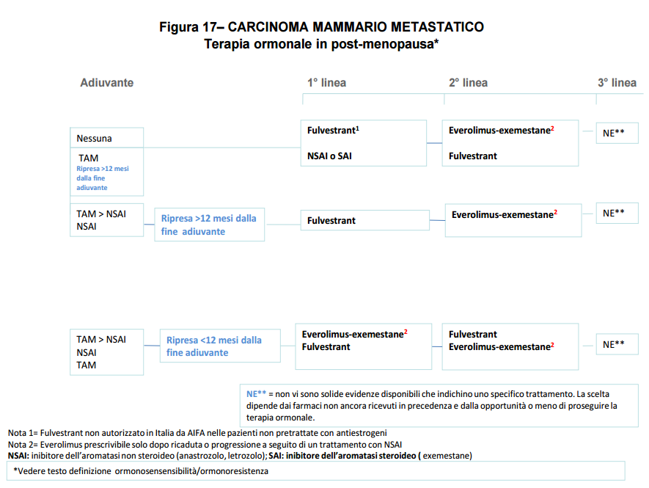

Slide 18
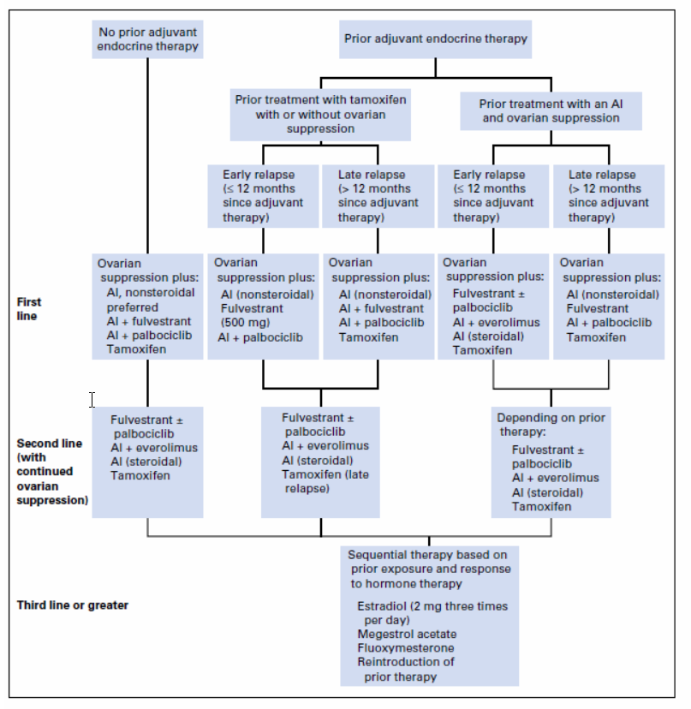
Hormone therapy for premenopausal women with
HR+ MBC (ASCO Guidelines)
J Clin Oncol 34:3069-3103 2016

Slide 19
Any legal issue with a metastic pre-menopausal breast cancer patients not treated with ovarian suppression & guidelines for post-menopausal patients?
.. or if we treat her with ovarian suppression & guidelines for post-menopausal patients?
… or should we propose surgical ovariectomy?

Slide 20
There is today a standard medical therapy of metastatic breast cancer?

Slide 21
The answer is ….
since we have many standards of care for MBC

Slide 22
… but, history of breast cancer therapy teach us …
that the standard is to shoot specific breast cancer targets identified according to current definitions of molecular subtypes of disease
>>> is it enough?

Slide 23
>> even if recent advances in the medical treatment of patients with some of the most frequent subtypes have resulted in a significant improvement of their median OS, however metastatic breast cancer is still an incurable disease.

Slide 24
so, what do we need?

Slide 25
New trends of drug development
EMPIRICAL ONCOLOGY
MOLECULAR ONCOLOGY
1980 1990 2010
Phase I
Phase II
Phase III
Phase I -II
Phase III

Slide 26
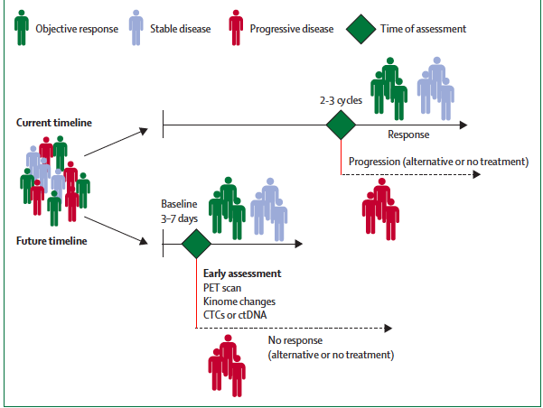
Development of reliable endpoints to allow an early recognition of clinical benefit
ENDPOINTS
Effect on molecular target
Circulating tumor cells
Circulating tumor DNA
Functional imaging
Wilson et al. Lancet Oncol 2015

Slide 27
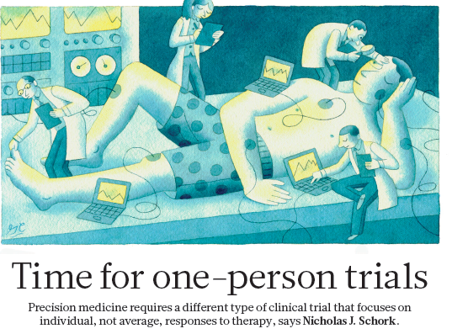
The precision medicine trials aim to indicate a treatment individually.
Sharp A, Harper-Wynne C (2014) Treatment of Advanced Breast Cancer (ABC): The Expanding Landscape of Targeted Therapies. J Cancer Biol Res 2(1): 1036.

Slide 28
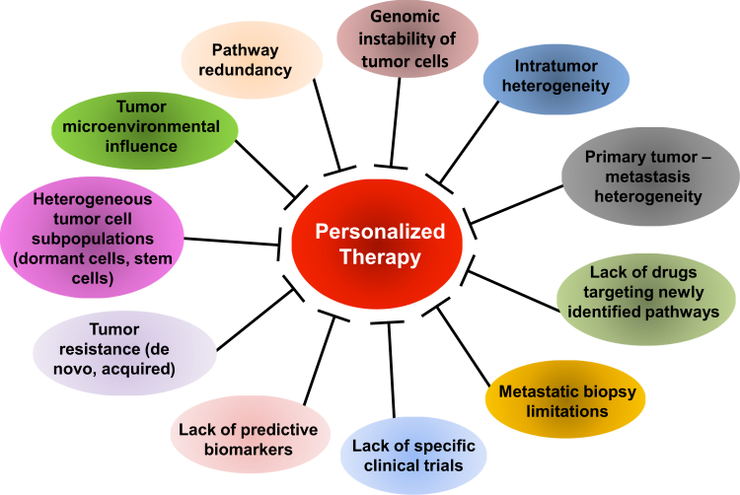
Precision Medicine trials design
basket trials
umbrella trials
Adaptive Design
Sharp A, Harper-Wynne C (2014) Treatment of Advanced Breast Cancer (ABC): The Expanding Landscape of Targeted Therapies. J Cancer Biol Res 2(1): 1036.

Slide 29
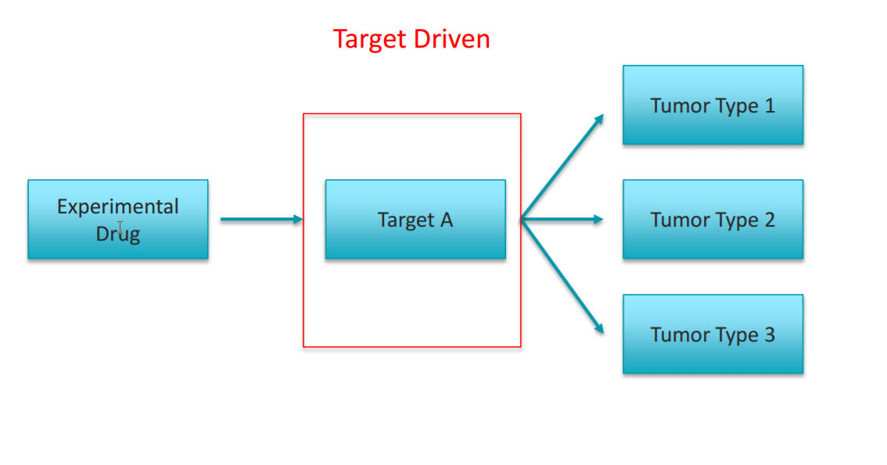
THE BASKET TRIAL
One Molecular Abnormality Targeted Across Multiple Tumor Types Simultaneous execution of multiple studies
Redig, A. and Pasi, JA. Basket Trials and the Evolution of Clinical Trial Design in an Era of Genomic Medicine. Journal of Clinical Oncology, Vol. 33, 2015

Slide 30
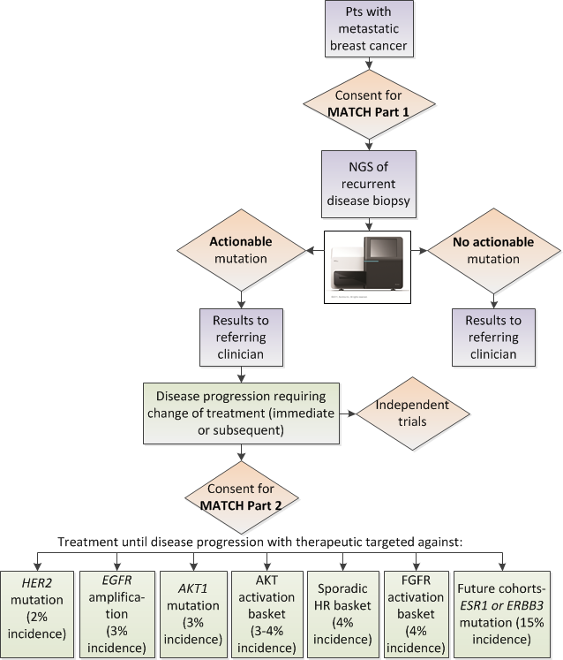
NCI-MATCH study
Courtesy of Stephen Johnston

Slide 31
NCI-Molecular Analysis for Therapy Choice (NCI-MATCH or EAY131)
Interim Analysis Results
Study Chairs: Keith T. Flaherty¹, Alice P. Chen², Peter J. O'Dwyer³, Barbara A. Conley², Stanley R. Hamilton⁴, Mickey Williams⁵, Robert J. Gray⁶, Shuli Li⁶, Lisa M. McShane⁶, Lawrence V. Rubinstein², Susanna I. Lee¹, Frank I. Lin⁷, Paolo F. Caimi⁸, Albert A. Nemcek, Jr.,⁹ Edith P. Mitchell¹⁰, James A. Zwiebel²
¹Massachusetts General Hospital, Boston, MA; ²National Cancer Institute (NCI), Division of Cancer Treatment and Diagnosis, Bethesda, MD; ³University of Pennsylvania, Philadelphia, PA; ⁴MD Anderson Cancer Center, Houston, TX; ⁵ NCI Frederick National Laboratory for Cancer Research, Frederick, MD; ⁶Dana-Farber Cancer Institute, Boston, MA; ⁷NCI Cancer Imaging Program, Rockville, MD ⁸Case Western Reserve University, Cleveland, OH, ⁹TNorthwestern University, Chicago, IL, ¹⁰Thomas Jefferson University, Philadelphia, PA
Notes:
This is a presentation of the first interim analysis of the NCI-MATCH trial, a phase two precision medicine trial that seeks to determine whether matching certain drugs or drug combinations in adults whose tumors have specific gene abnormalities will effectively treat their cancer, regardless of their cancer type. This trial was co-developed by the ECOG-ACRIN Cancer Research Group and the National Cancer Institute, and its broad leadership spans all of the cooperative groups of the NCI National Clinical Trials Network, as shown here. This interim analysis was presented at the annual meeting of the American Association for Cancer Research in New Orleans, Louisiana, in April 2016. Dr. Barbara Conley presented a poster and Dr. Peter O’Dwyer spoke as an invited guests at a special session on precision medicine. Their two presentations are combined here in the slides that you are about to view.

Slide 32
NCI-MATCH Enrollment Status of Patients with Treatment Assignments to First Ten Arms
 | Assigned to Rx (N-33) | No Longer Met Overall Study Eligibility | Ineligible for Arm | Progressed/ Deteriorating Condition/ Started Other Rx | Died | Enrolled for Rx (N=16)
Q: Ado-trastuzumab emtansine in HER2 amplifications | 11 |  | 3 |  | 2 | 6
U: Defactinib in NF2 loss | 7 | 2 | 1 | 1 | 1 | 2
B: Afatinib in HER2 mutations | 5 | 1 |  |  | 1 | 3
H: Dabrafenib+Trametinib in BRAF V600 | 5 | 1 |  | 2 |  | 2
R: Trametinib in BRAF non-V600 | 2 |  | 1 |  |  | 1
E: AZD9291 in EGFR T790M | 1 |  |  |  |  | 1
F: Crizotinib in ALK translocations | 1 |  |  |  |  | 1
V: Sunitinib in cKIT mutations | 1 | 1
A: Afatinib in EGFR mutations
G: Crizotinib in ROS1 translocations
Total | 33 | 5 | 5 | 3 | 4 | 16
Notes:
And here we see the actual arms to which the patients were accrued. You see that for about half of the 33 patients who were assigned to a treatment, several factors led to them not being able to enroll on a treatment arm. For ten patients, eligibility was the issue. Seven patients either started other treatment, experienced disease progression, or died. We will be addressing this issue with renewed outreach and education about the importance of following the eligibility criteria in the selection of patients. These include having a good ECOG performance status of zero or one and adequate organ function. It is important to select patients who will be able to withstand being off treatment for a month or more.

Slide 33
NCI-MATCH Expanding to 24 Arms in Late May 2016
Arm / Target | Drugs(s)
A EGFR mut | Afatinib
B HER2 mut | Afatinib
C1 MET amp | Crizotinib*
C2 MET ex 14 sk | Crizotinib*
E EGFR T790M | AZD9291
F ALK transloc | Crizotinib
G ROS1 transloc | Crizotinib
H BRAF V600 | Dabrafenib+trametinib
I PIK3CA mut | Taselisib
N PTEN mut | GSK2636771
P PTEN loss | GSK2636771
Q HER 2 amp | Ado-trastuzumab emtansine
Arm / Target | Drug(s)
R BRAF nonV600 | Trametinib
S1 NF1 mut | Trametinib
S2 GNAQ/GNA11 | Trametinib
T SMO/PTCH1 | Vismodegib
U NF2 loss | Defactinib
V cKIT mut | Sunitinib
W FGFR1/2/3 | AZD 4547*
X DDR2 mut | Dasatinib
Y AKT1 mut | AZD 5363*
Z1A NRAS mut | Binimetinib*
Z1B CCND1,2,3 amp | Palbociclib*
Z1D dMMR | Nivolumab*
*Pending approval
Notes:
The trial will be expanding to 24 arms in late May 2016. Here are the molecular targets for each arm along with the drug or drug combination being studied. The asterisks on this slide indicate seven arms that are currently undergoing regulatory review. The other arms are fully approved.

Slide 34
NCI-MATCH Laboratory Bottleneck
Caused by High Accrual
Staffed for 4 Patient Cases/Day; Received > 20 Cases/Day
Lack of Automated Extractors
1 Tumor Sample/ Sequencing Chip
Avg 80 Samples/Week - by Week 8
Bottleneck
Turn-around Times > 14 Days
Notes:
Here you see an illustration of the bottleneck that occurred in the laboratories because of the rapid accrual.

Slide 35
NCI-MATCH Conclusions from the Interim Analysis
A trial of therapy based on genetic characteristics of the tumor is feasible on a national scale in the NCI-sponsored networks
Unprecedented with registration higher than for any other NCTN trial to date
The whole process of tumor characterization from accrual to biology read-out is feasible, having been accomplished in 87% of patients
A high proportion of less common malignancies in this early analysis opens options for advances in these cancers
Notes:
Our conclusions from this interim analysis therefore are as follows: (read verbatim).

Slide 36
New trials design
basket trials
umbrella trials
Adaptive Design
Sharp A, Harper-Wynne C (2014) Treatment of Advanced Breast Cancer (ABC): The Expanding Landscape of Targeted Therapies. J Cancer Biol Res 2(1): 1036.

Slide 37
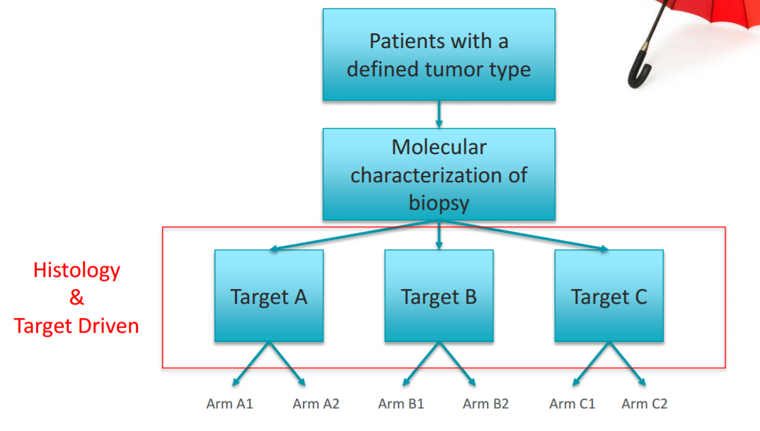
Umbrella Studies
One tumor type, multiple molecular targets
• Efficiency in drug evaluation compared with traditional histology driven sequential studies • Evaluate large effects of targeted agents on relatively rare targets • Different types with shared molecular aberrations may be more similar than tumors from same type lacking molecular features
Sleijfer, S et al. Designing Transformative Clinical Trials in the Cancer Genome Era. J Clin Oncol 31: 1834-184

Slide 38
New trials design
basket trials
umbrella trials
Adaptive Design
Sharp A, Harper-Wynne C (2014) Treatment of Advanced Breast Cancer (ABC): The Expanding Landscape of Targeted Therapies. J Cancer Biol Res 2(1): 1036.

Slide 39
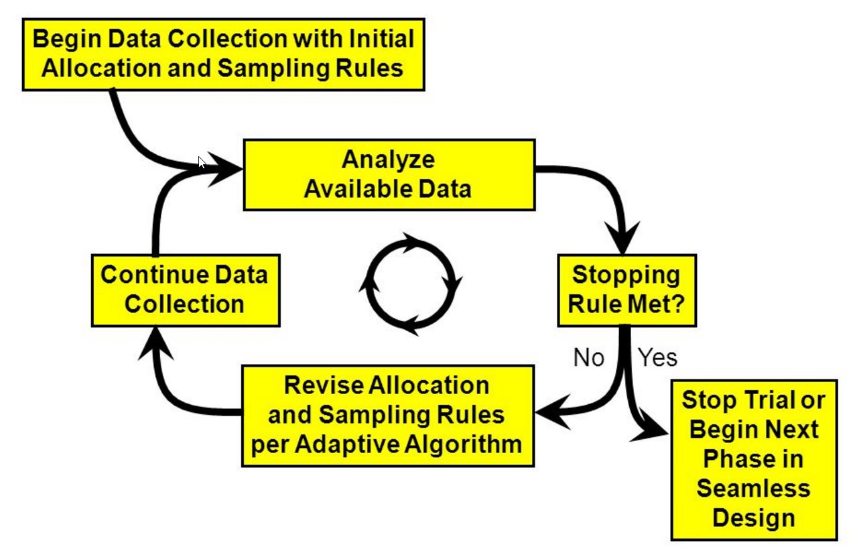
Adaptive Trial Designs
Chow, SC and Chang, M. Adaptive design methods in clinical trials – a review. Orphanet Journal of Rare Diseases 2008, 3:11

Slide 40
Conclusion
The emerging new technologies with liquid biopsy (CTCs, ctDNA), leading to potential serial and non-invasive mutational analyses, likely will become available in the near future.
Efforts to realize the dream of PRECISION MEDICINE for breast cancer (or other cancers) will include drug development and intelligent design of clinical trials for increasingly small subgroup of patients with specific host and disease characteristics through a multidisciplinary platform.
Thus allowing a standard care to the single patient!

