Slide 1
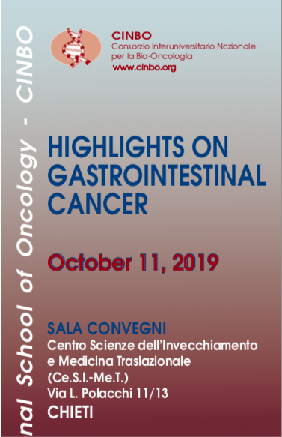
Hereditary pancreatic cancer
L. Stuppia, Medical Genetics
G. d’Annunzio University Chieti-Pescara, Italy

Slide 2
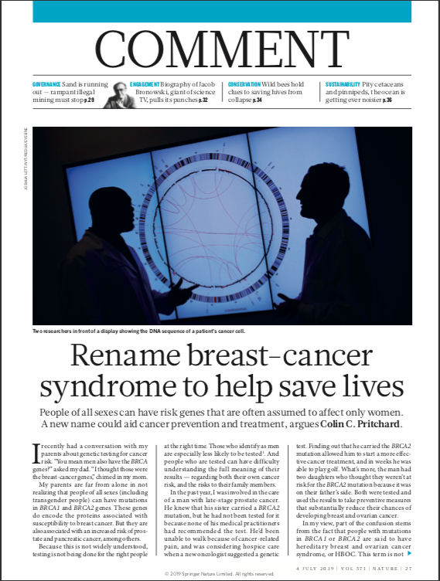

Slide 3
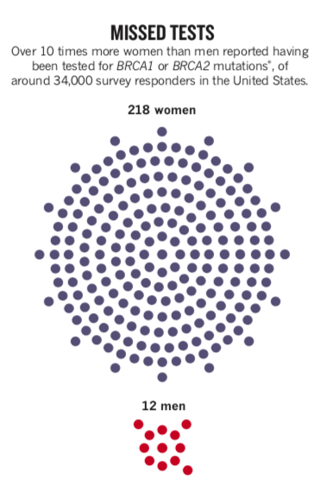

Slide 10
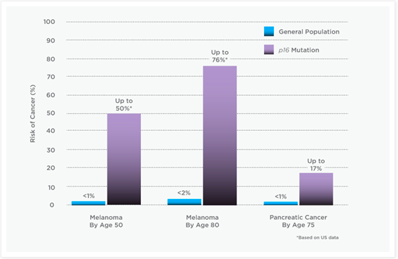

Slide 12
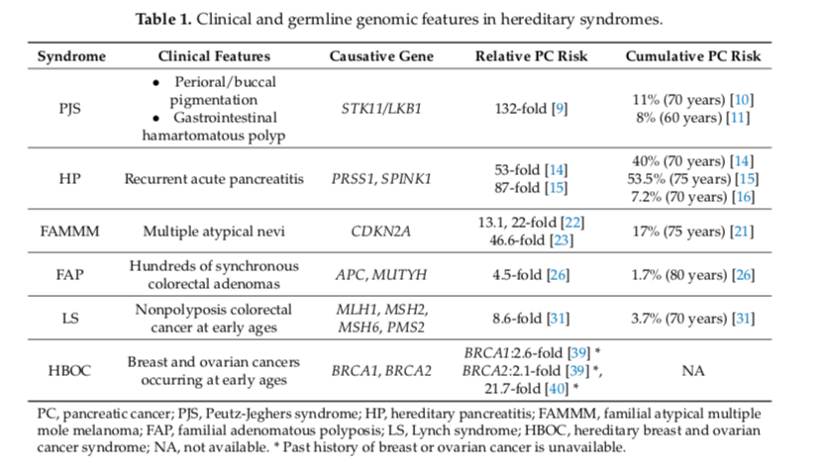
Int. J. Mol. Sci. 2019, 20, 561;

Slide 13
Peutz-Jeghers Syndrome (PJS)
Autosomal dominant
Prevalence: 1-9 / 1 000 000
Perioral/buccal pigmentation and gastrointestinal multiple hamartomatous polyps in more than 95% of cases.
Inactivating mutations of the STK11/LKB1
15.2-fold increased risk of any cancer, 132-fold for PC
These data highlight PJS as one of the highest risk factors for PC onset.

Slide 14
Hereditary Pancreatitis (HP)
Recurrent acute pancreatitis, leading eventually to chronic pancreatitis
Autosomal dominant, 80% penetrance
Prevalence: 3-6/1.000.000
Early onset (age < 25 years)
Activating mutations in PRSS1 encoding the cationic trypsinogen related to trypsin activation
Inactivating mutations in SPINK1 inhibiting trypsin.
HP increases PC risk by 53-fold and the cumulative PC risk reaches 40% at 70 years.

Slide 15
Familial Atypical Multiple Mole Melanoma (FAMMM)
Multiple (> 50) atypical nevi progressing to melanoma.
AD, unknown prevalence
Increased incidences of PC as well as breast, lung and endometrium cancers
Inactivating mutations in CDKN2A (p16)
Cumulative PC risk in FAMMM families harboring CDKN2A mutation 17% at 75 years of age
Indian J Dermatol 2015;60:217

Slide 16
Familial Adenomatous Polyposis (FAP)
Hundreds colorectal adenomas inevitably progressing into malignancies at an average age of 35–40 years.
Mutations in APC and MUTHY genes
AD or AR, prevalence 1-9 / 100 000
Increased PC risk by 4.5-fold and cumulative PC risk 1.7% at 80 years of age.
Unusual histology in PC cases deriving from FAP (poorly differentiated neuroendocrine carcinoma, acinar cell carcinoma, pancreatoblastoma).

Slide 17
Lynch Syndrome (LS)
Colorectal cancer at early ages
Inactivating mutations in MMR genes (MLH1, MSH2, MSH6 and PMS2) and EPCAM.
Increased PC risk by 8.6-fold and cumulative PC risk 3.7% to 7.8 at 75 years of age, based on the mutated gene

Slide 18
Hereditary Breast and Ovarian Cancer Syndrome (HBOC)
Breast and ovarian cancers occurring before the age of 50
Inactivating mutations in BRCA1/2, involved in the homologous recombination repair (HRR) pathway.
BRCA2 mutation widely accepted as a PC risk factor
Relative PC risk:
1 to 2.6 in BRCA1 carriers
2.1 to 21.7 in BRCA2 carriers

Slide 19
Familial Pancreatic Cancer (FPC)
FPC refers to individuals having two or more FDRs
Relative PC risk:
4.5 in cases with one affected FDR
6.4 in cases with two affected FDRs
32.0 in cases with three or more affected FDRs

Slide 20
Int. J. Mol. Sci. 2019, 20, 561;

Slide 21
La sorveglianza

Slide 22
Considering the low incidence of PC, comprehensive surveillance for the general population is not recommended, and only cases with increased PC risk > 10-fold or lifetime PC risk > 5% are considered as feasible candidates for surveillance

Slide 23
Expert consensus practice recommendations International Symposium of Inherited Diseases of the Pancreas, 2007
Individuals with PJS or hereditary pancreatitis;
BRCA1, BRCA2 or CDKN2A mutation carriers with at least one affected first- or second-degree relative;
Individuals with three or more affected first-degree, second-degree or third-degree relatives;
Individuals with two affected relatives including at least one FDR

Slide 24
International Cancer of the Pancreas Screening (CAPS) Consortium, 2013
Individuals with PJS;
CDKN2A, BRCA2 or MMR gene mutation carriers with at least one affected FDR;
Individuals with at least two affected FDRs.

Slide 25
Germline mutations in cancer susceptibility genes are also found in cases without definite family history or association with hereditary syndromes.
The disparity in germline mutation prevalence between FPC and sporadic PC is not dramatic, and that current screening strategies chiefly based on family history cannot completely extract susceptibility gene carriers.

Slide 26
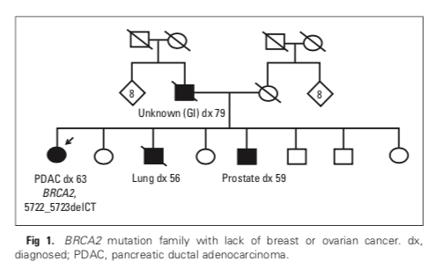
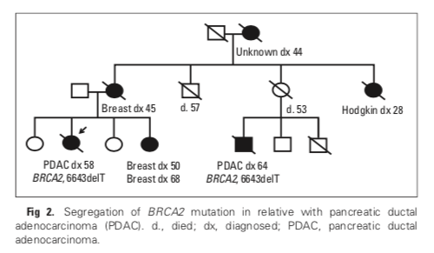

Slide 27
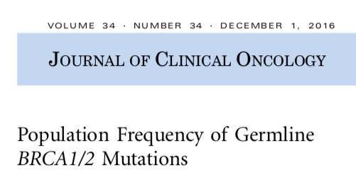
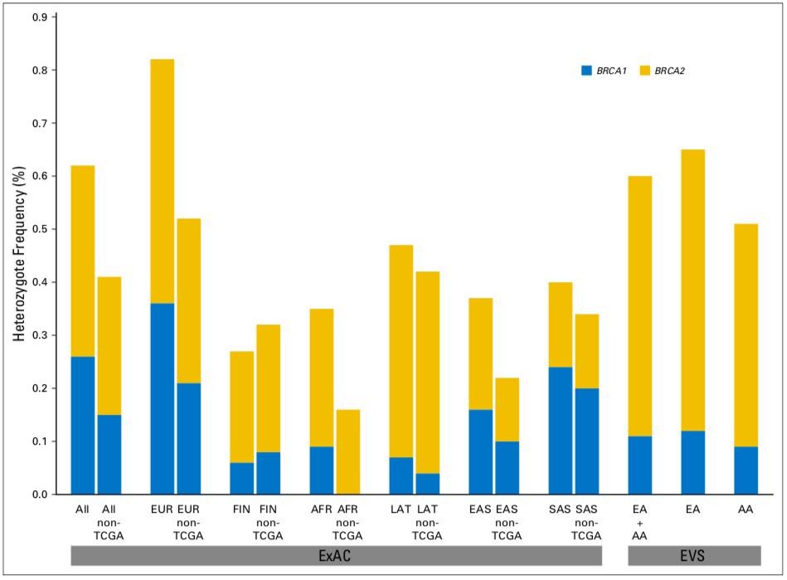
Previously reported population frequency of pathogenic BRCA1/2 mutations : 1:400
Observed frequency 0.65% (1:153)
BRCA1 0.20% (1:500)
BRCA2 0.45% (1:222).

Slide 29
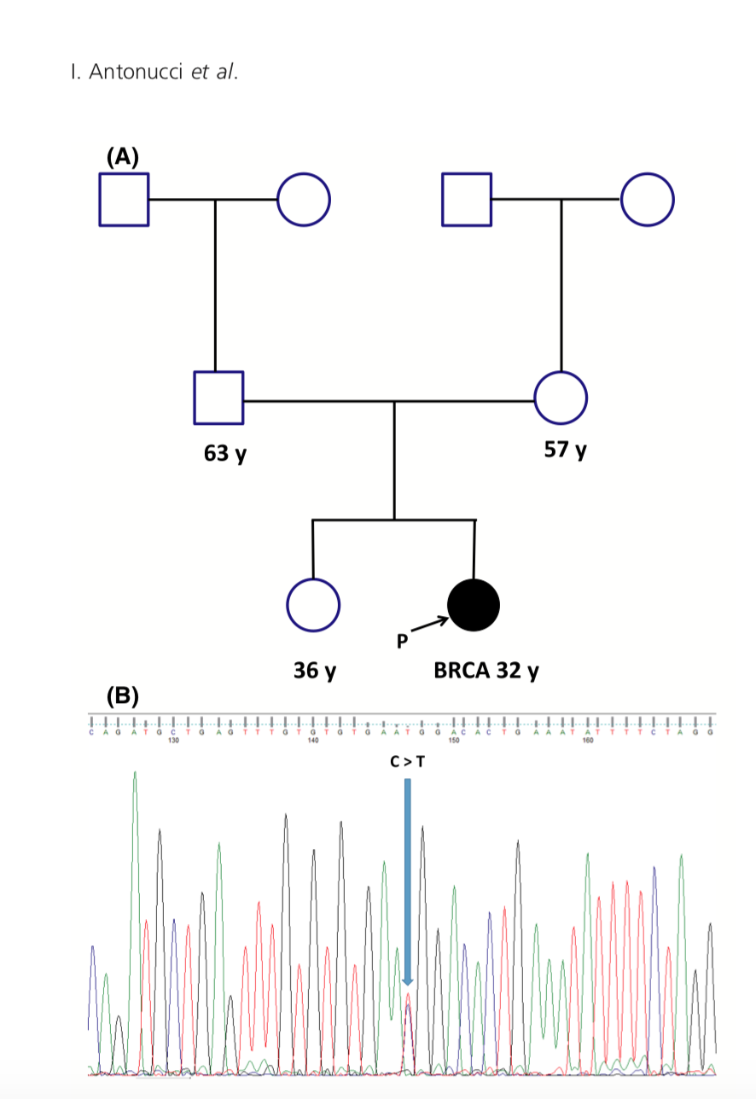

Slide 30
La terapia

Slide 31
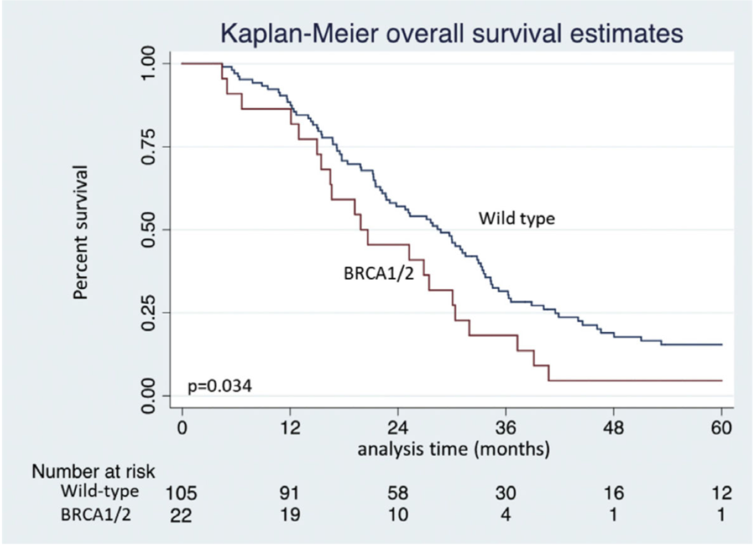
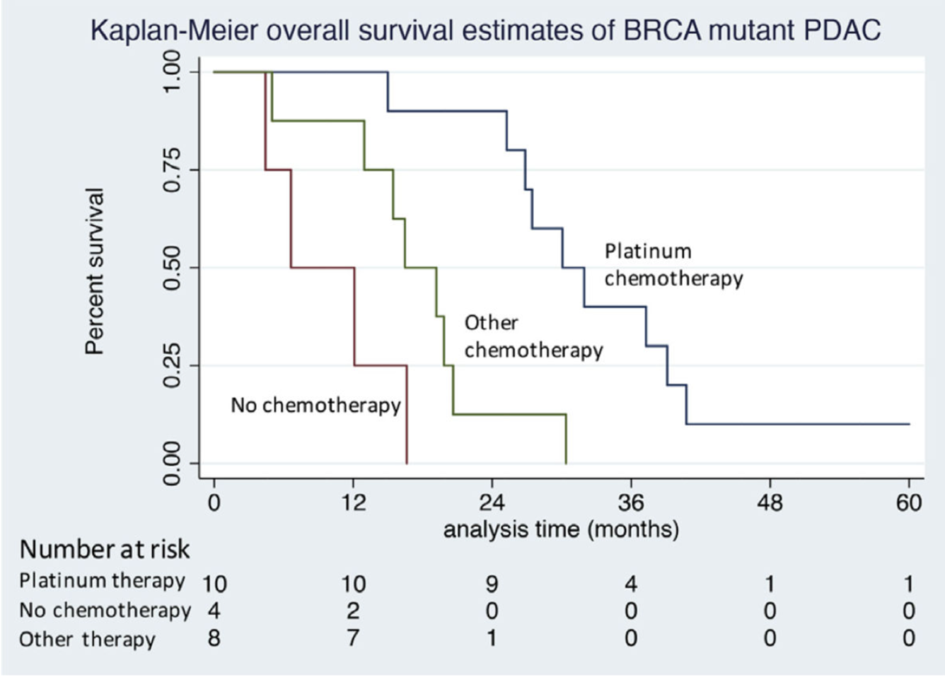
CONCLUSIONS:
Carriers of BRCA1/BRCA2 mutation with sporadic PDAC had a worse survival after pancreatectomy than their BRCA wild-type counterparts.
However, platinum-based chemotherapy regimens were associated with markedly improved survival in patients with BRCA1/BRCA2 mutations,with survival differences no longer appreciated with wild-type patients.

Slide 32
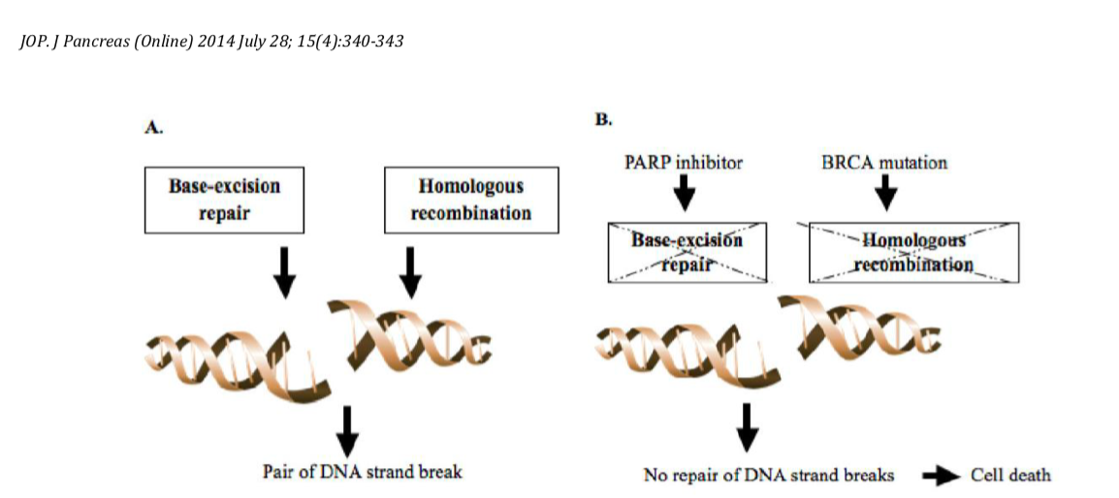

Slide 34
Poly(ADP-ribose) polymerases

Slide 35
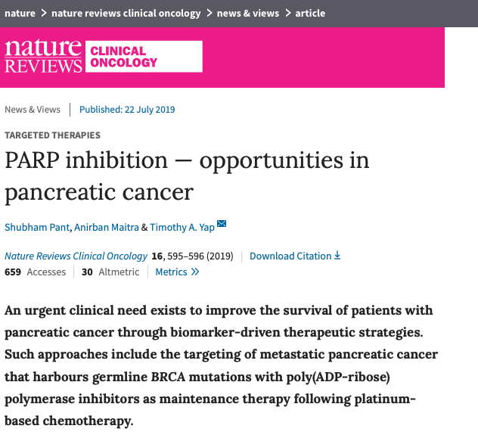

Slide 36
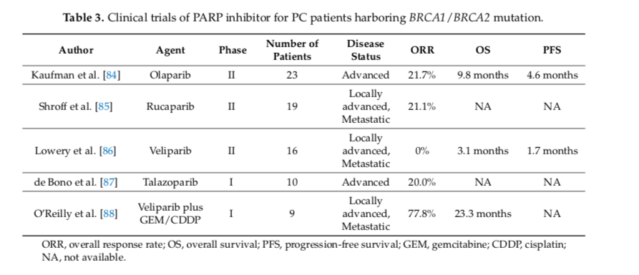
Int. J. Mol. Sci. 2019, 20, 561;

Slide 37
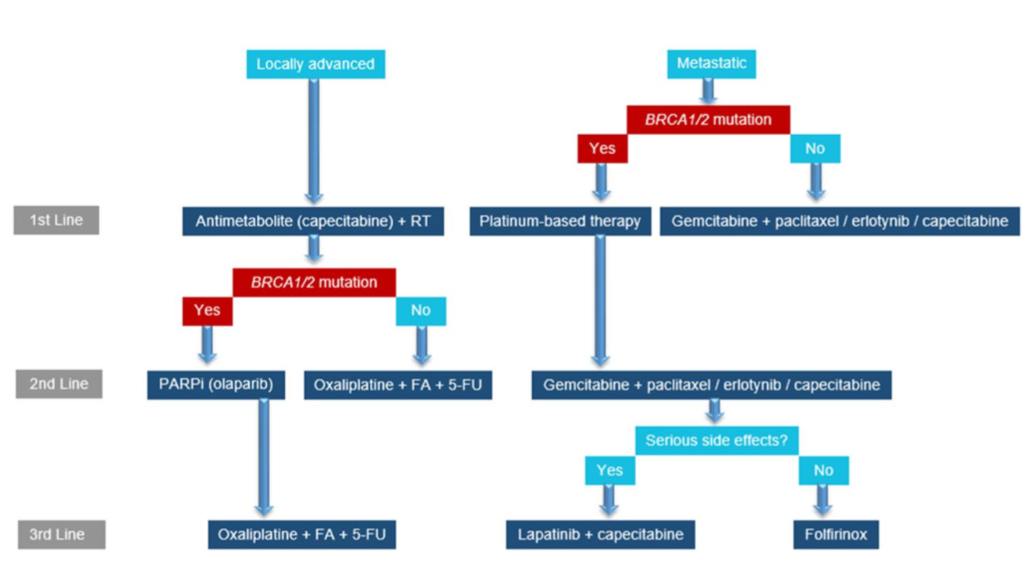
Journal of Cancer Research and Clinical Oncology (2018)

Slide 38
Il test genetico

Slide 40
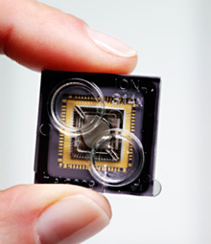
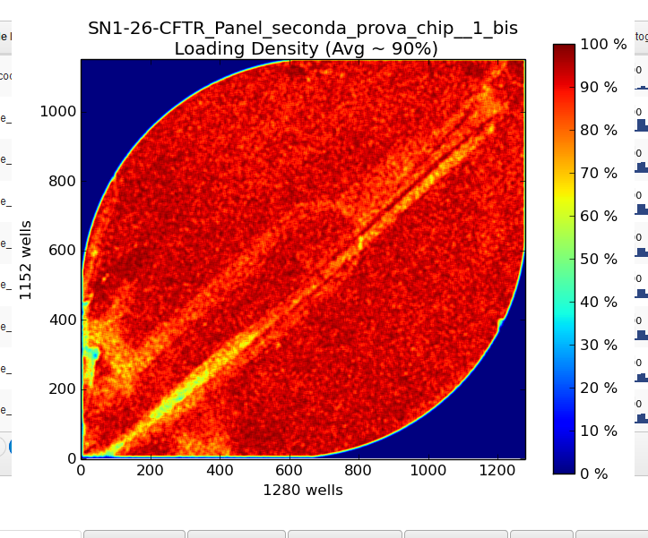
NGS ANALYSIS

Slide 41
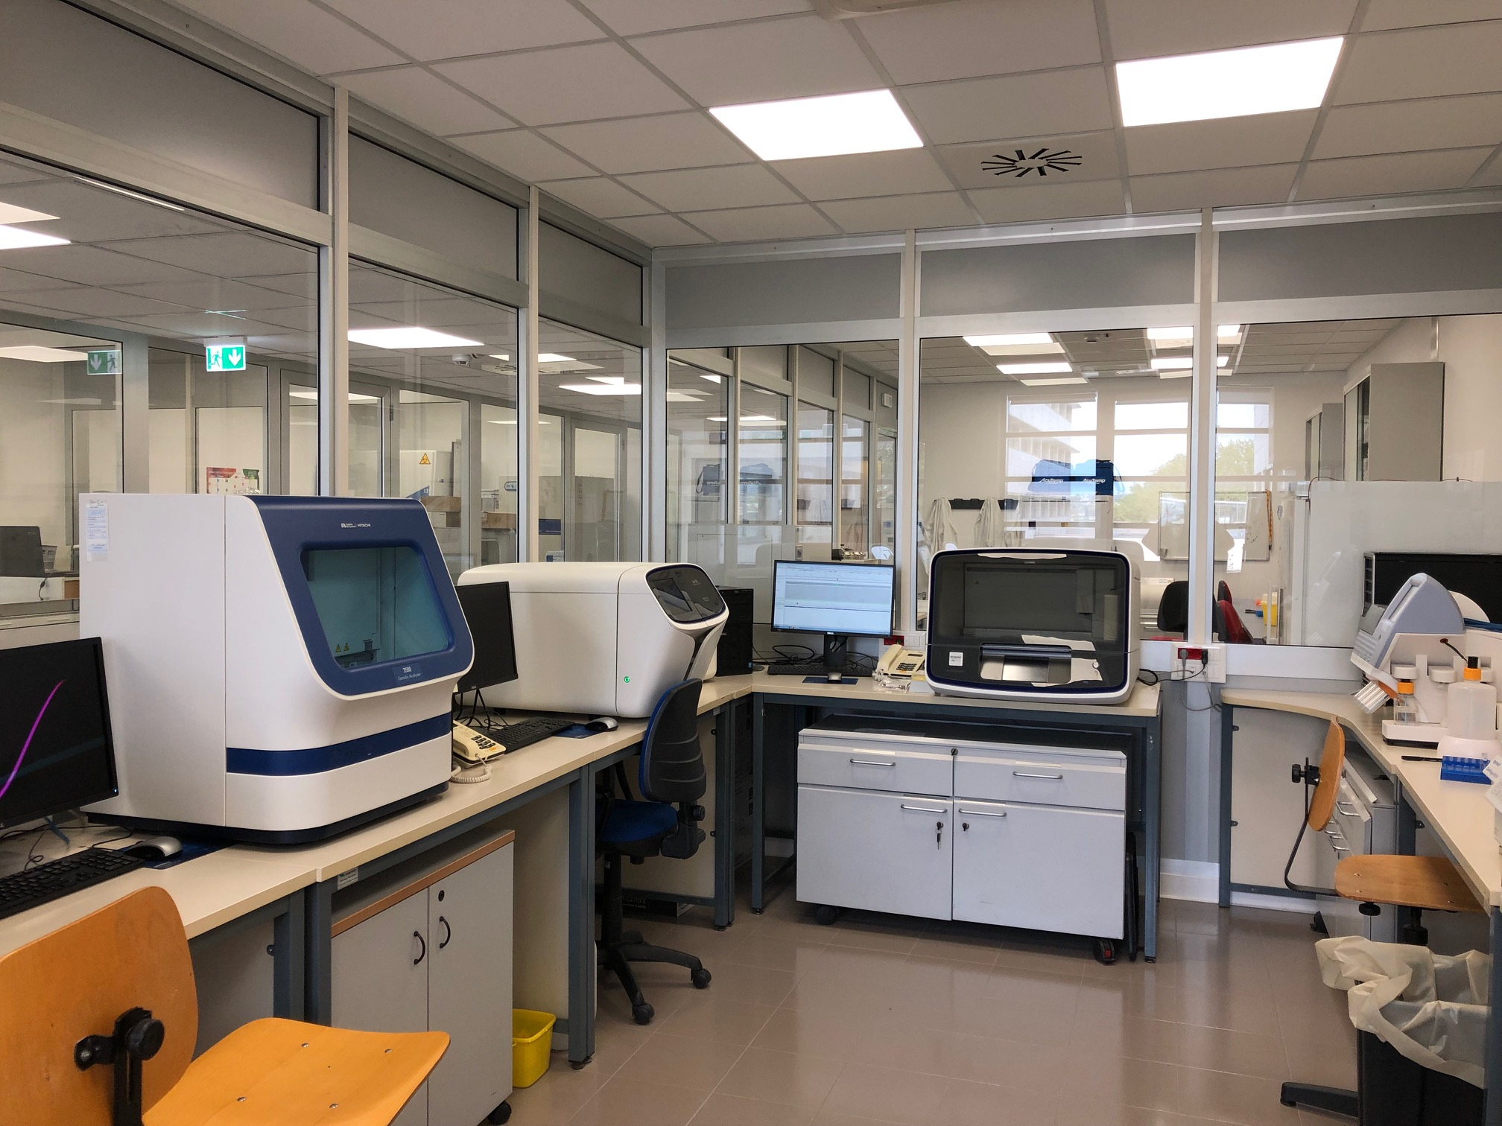

Slide 42
PANNELLO MULTIGENICO PER LA PREDISPOSIZIONE AI TUMORI
BREAST CANCER
OVARIAN CANCER
GASTRIC CANCER
BRCA1 | BRCA2 | ATM
PALB2 | CHEK2 | BARD1
PTEN | STK11 | CDH1
TP53 | NBN | NF1
BRCA1 | BRCA2 | ATM
EPCAM | BRIP1 | RAD51D
MSH2 | MSH6 | MLH1
STK11 | PMS2 | RAD51C
CDH1 | EPCAM | BMPR1A
MSH2 | MLH1 | MSH6
SMAD4 | STK11 | PMS2
 | APC
COLORECTAL CANCER
PANCREATIC ADENOCARCINOMA
PROSTATE CANCER
APC | BMPR1A | ATM
EPCAM | CHEK2 | SMAD4
MSH2 | MSH6 | MLH1
STK11 POLE POLD1 | TP53 PTEN GREM1 BLM | MUTYH PMS2 AXIN1
CDKN2A | BRCA2 | ATM
MLH1 | MSH2 | MSH6
STK11 | PALB2 | PMS2
BRCA1 | BRCA2 | CHEK2
MLH1 | MSH2 | MSH6
PALB2 | PMS2 | ATM
MELANOMA
CDK4 BRCA2 CDKN2A
TOTALE GENI PANNELLO TUMORI=31

Slide 43
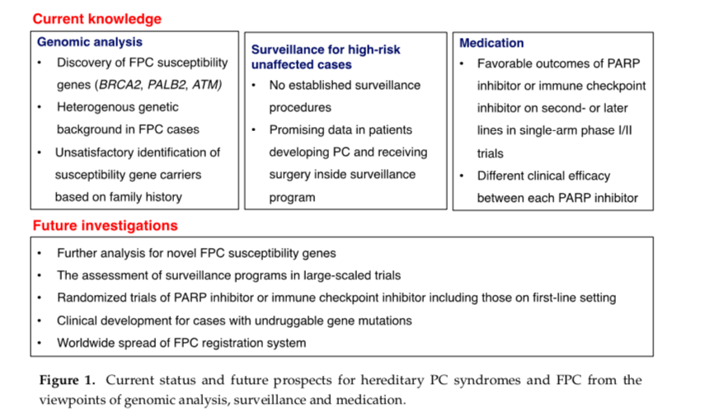
Int. J. Mol. Sci. 2019, 20, 561;
Int. J. Mol. Sci. 2019, 20, 561;

Slide 45
