Slide 1

Therapeutic approach to
HER 2 breast cancer
in metastatic setting
GIULIANA D’AURIA
UOC Oncologia ASL Roma 2
Osp Pertini-S.Eugenio-CTO

Slide 2

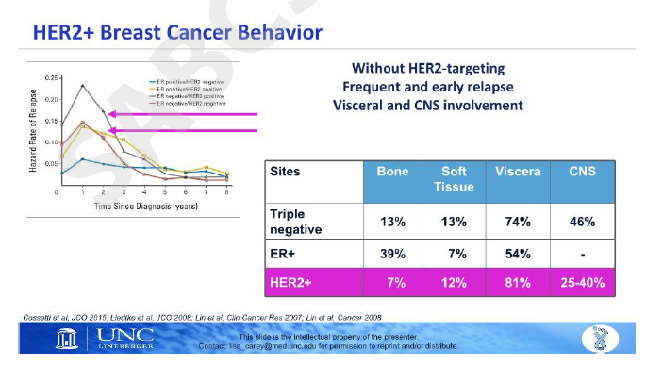
Lisa Carey, SABCS 2018

Slide 3

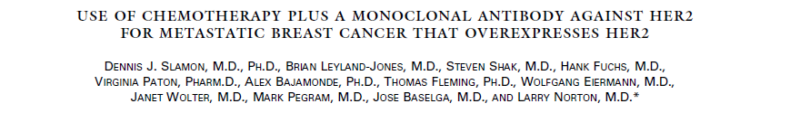
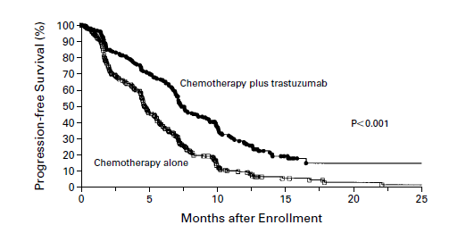
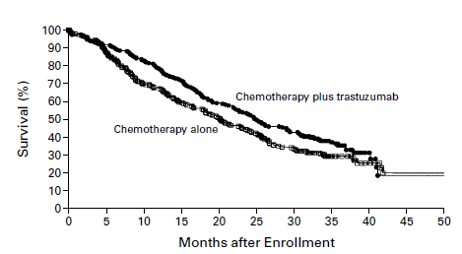
La malattia HER2 positiva: Trastuzumab

Slide 4
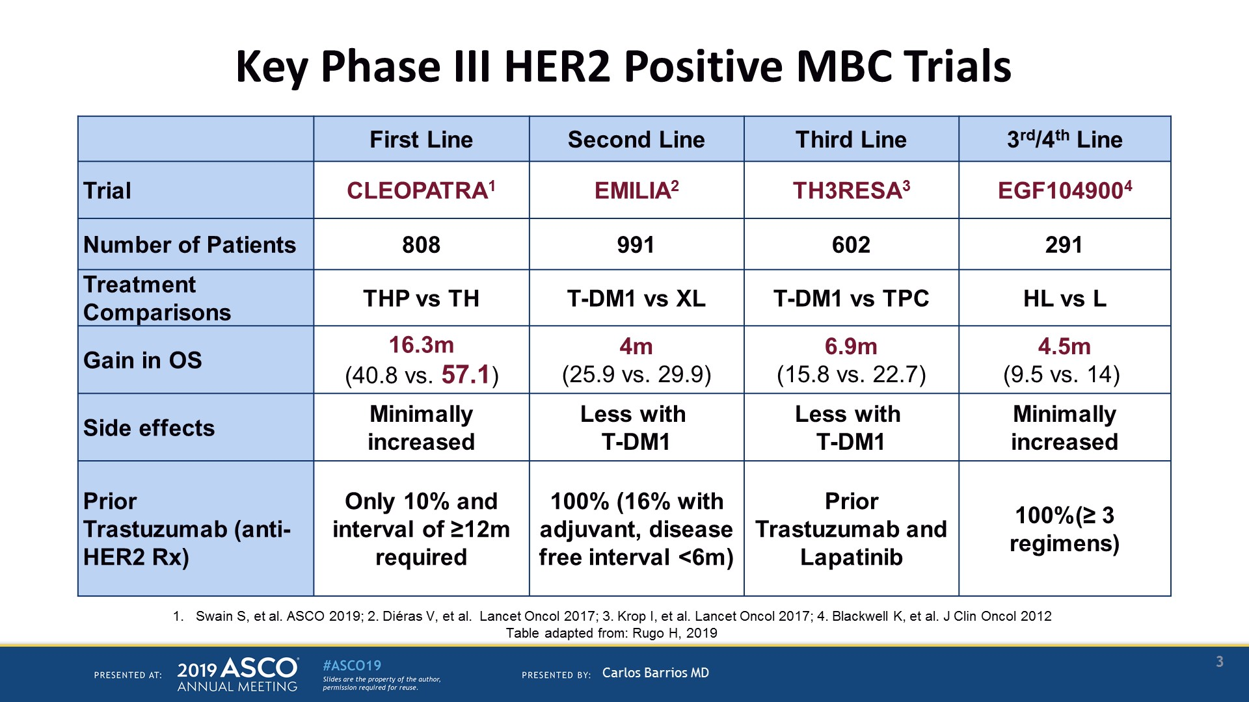
Key Phase III HER2 Positive MBC Trials
Presented By Carlos Barrios at 2019 ASCO Annual Meeting

Slide 5
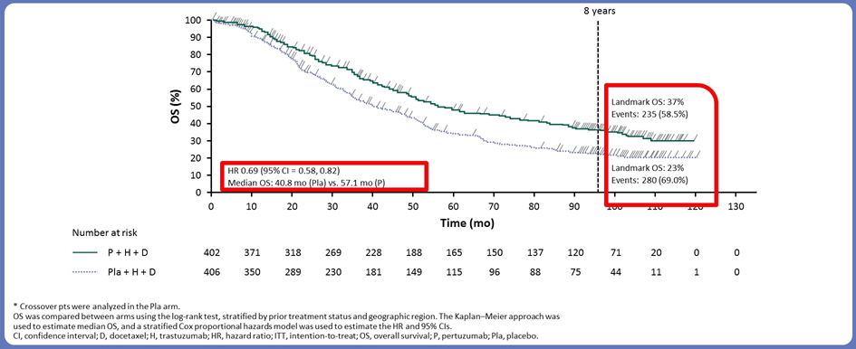
8-year follow-up of the CLEOPATRA trial (OS)
Swain et al, Abstr. 1020, ASCO 2019

Slide 6
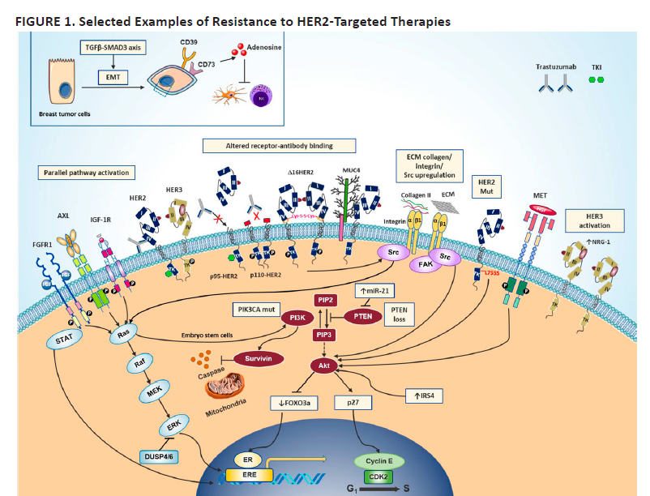
Mark D. Pegram 2018 ASCO EDUCATIONAL BOOK

Slide 7
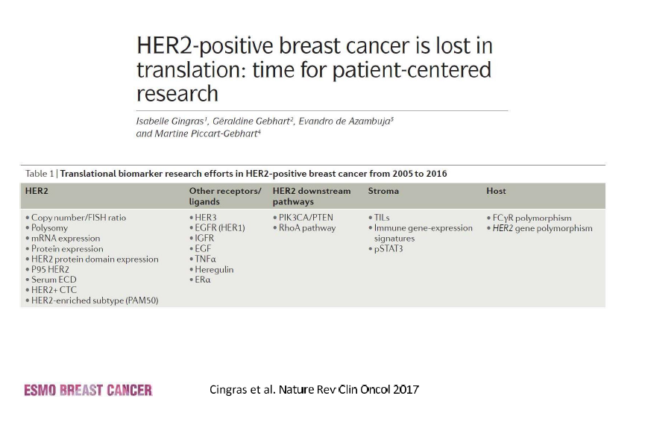
Awada, ESMO Breast 2019

Slide 8
Awada, ESMO Breast 2019

Slide 9
OUTLINE
Margetuximab
Neratinib
Pyrotinib
New drugs and combinations

Slide 10
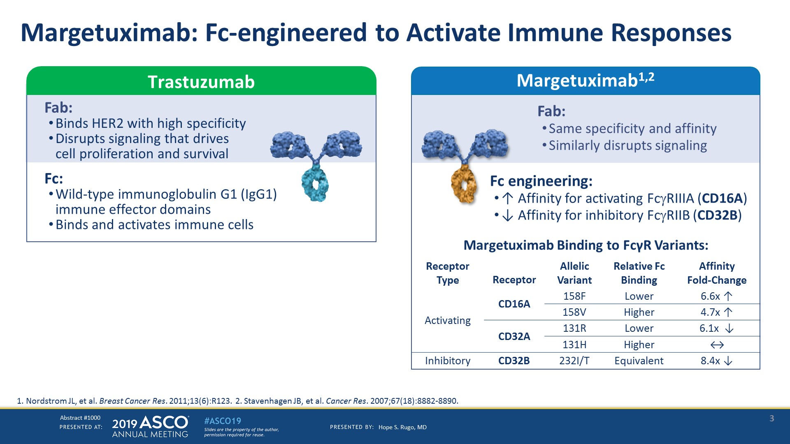
Margetuximab: Fc-engineered to Activate Immune Responses
Presented By Hope Rugo at 2019 ASCO Annual Meeting

Slide 11
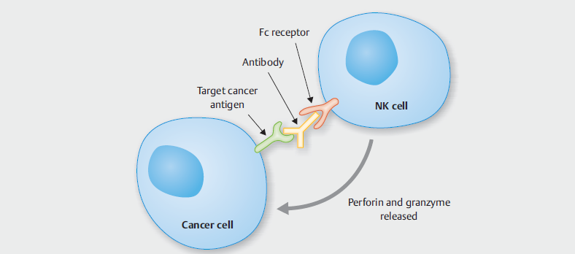
ADCC

Slide 12
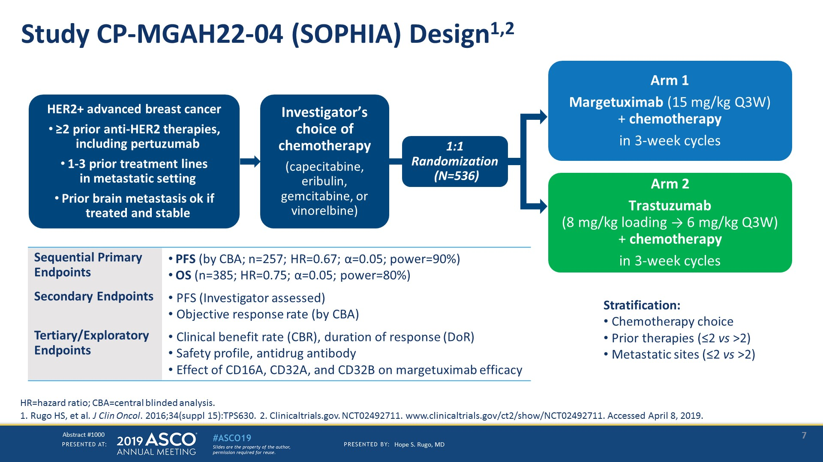
Study CP-MGAH22-04 (SOPHIA) Design1,2
Presented By Hope Rugo at 2019 ASCO Annual Meeting

Slide 13
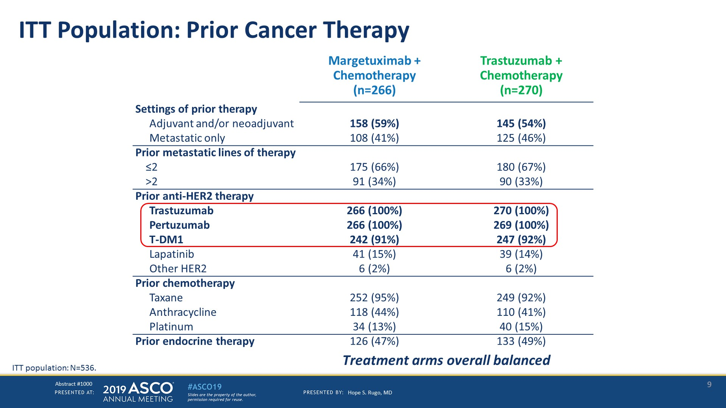
ITT Population: Prior Cancer Therapy
Presented By Hope Rugo at 2019 ASCO Annual Meeting

Slide 14
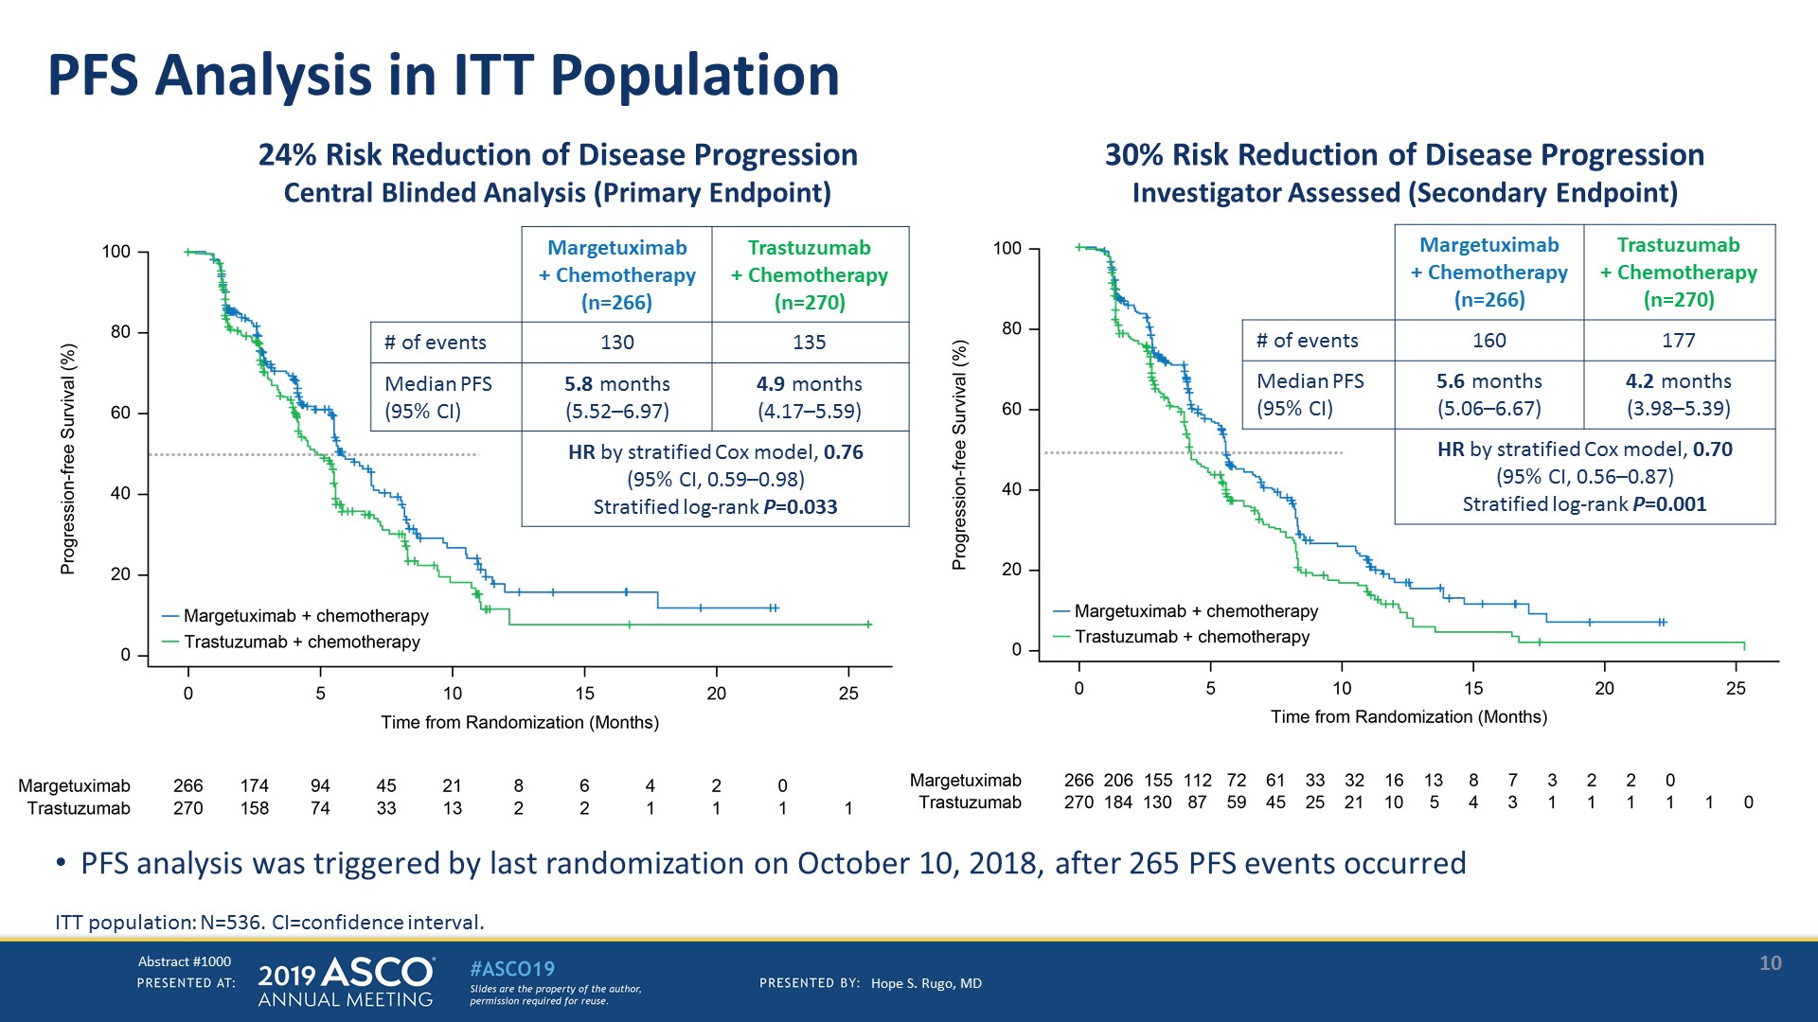
PFS Analysis in ITT Population
Presented By Hope Rugo at 2019 ASCO Annual Meeting

Slide 15
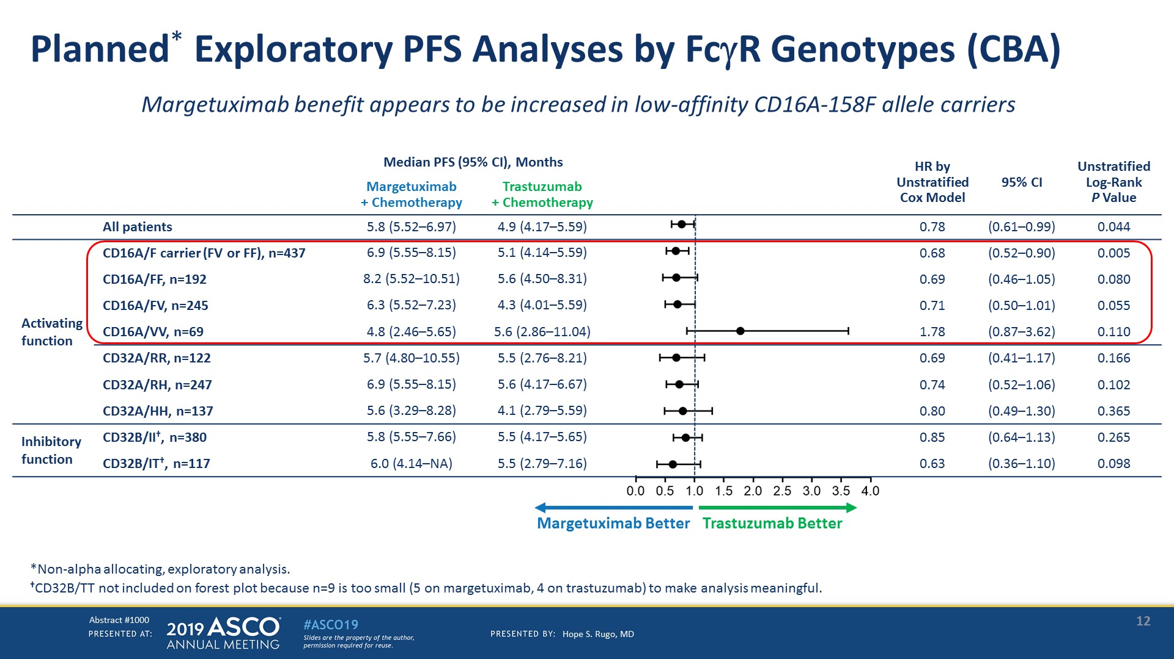
Planned* Exploratory PFS Analyses by FcR Genotypes (CBA)
Presented By Hope Rugo at 2019 ASCO Annual Meeting

Slide 16
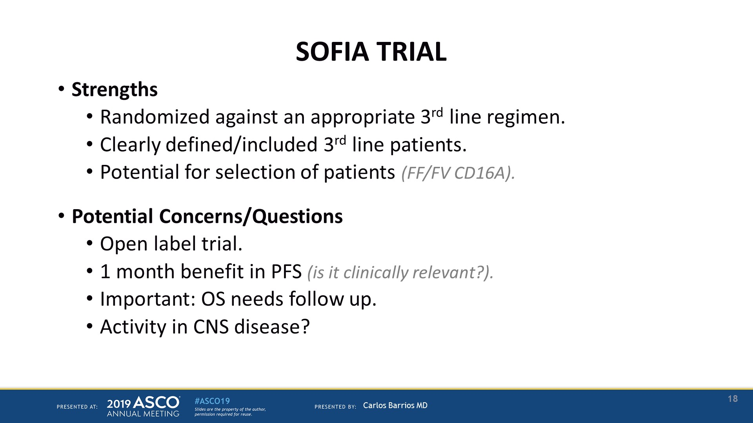
SOFIA TRIAL
Presented By Carlos Barrios at 2019 ASCO Annual Meeting

Slide 17
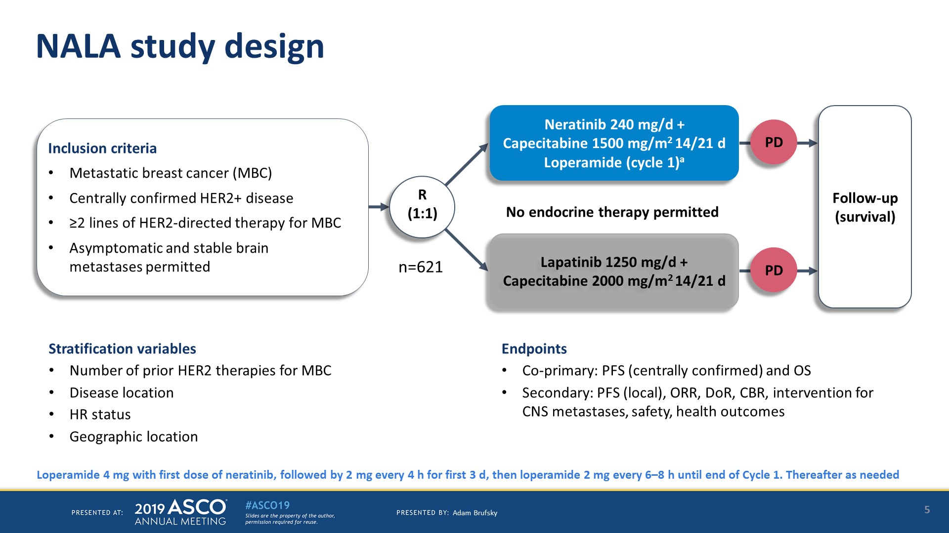
NALA study design
Presented By Cristina Saura at 2019 ASCO Annual Meeting

Slide 18
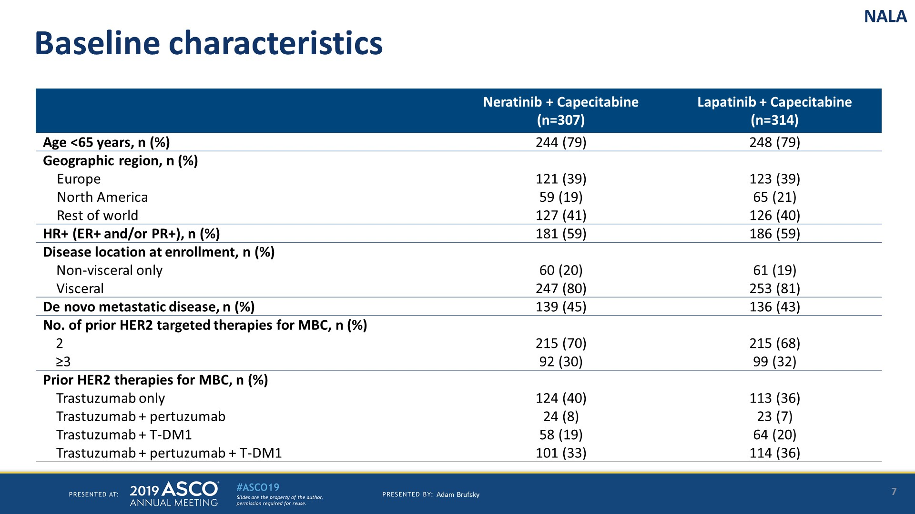
Baseline characteristics
Presented By Cristina Saura at 2019 ASCO Annual Meeting

Slide 19
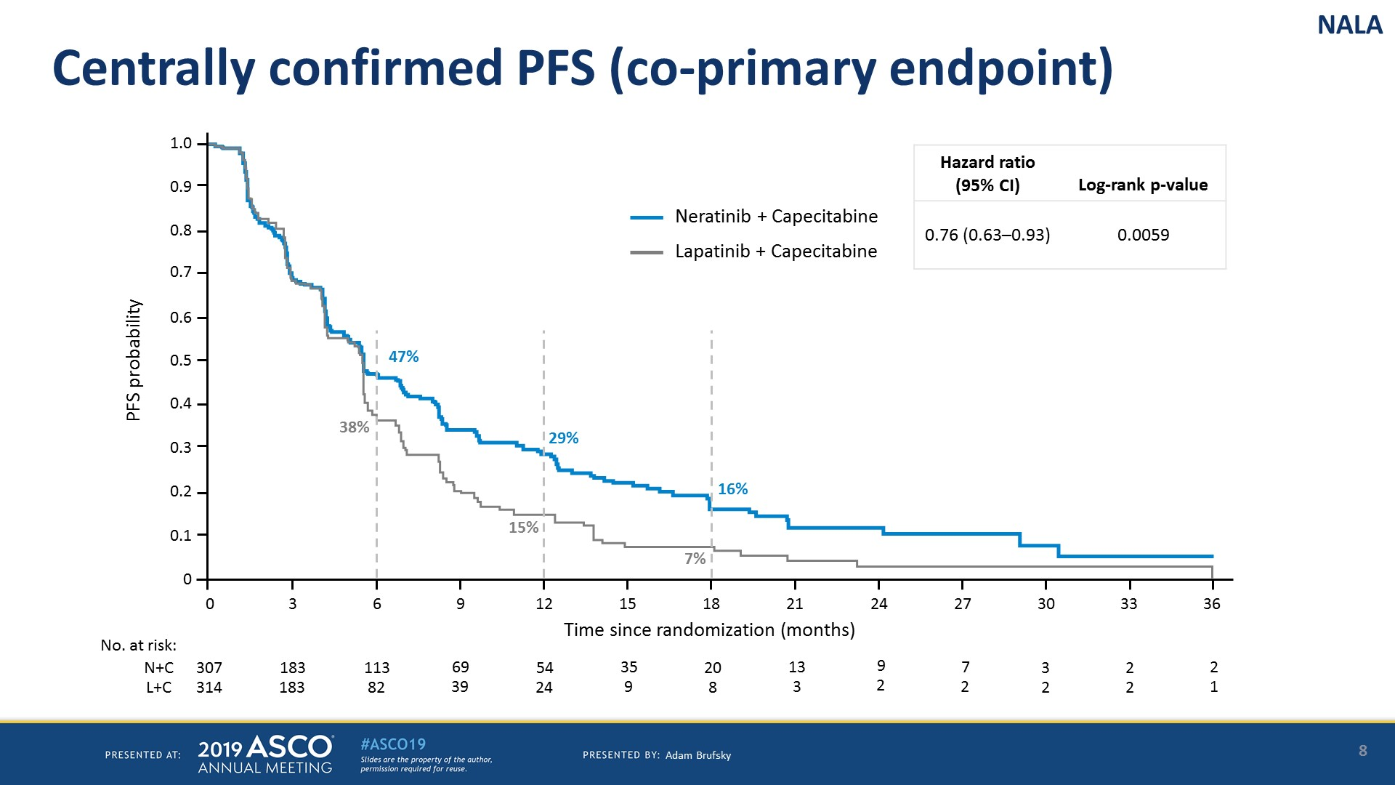
Centrally confirmed PFS (co-primary endpoint)
Presented By Cristina Saura at 2019 ASCO Annual Meeting

Slide 20
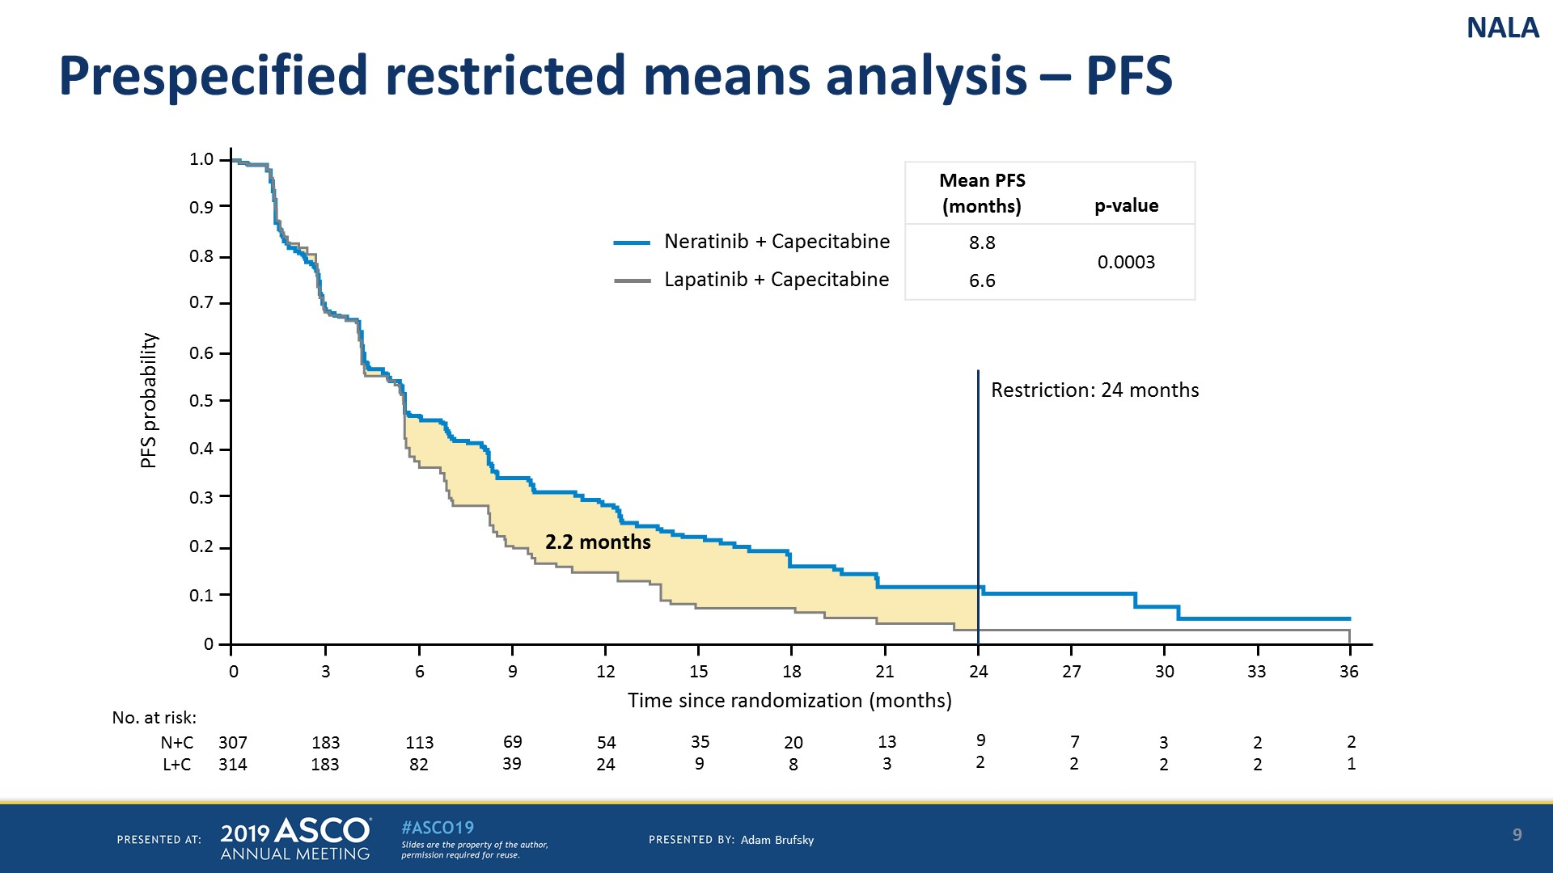
Prespecified restricted means analysis – PFS
Presented By Cristina Saura at 2019 ASCO Annual Meeting

Slide 21
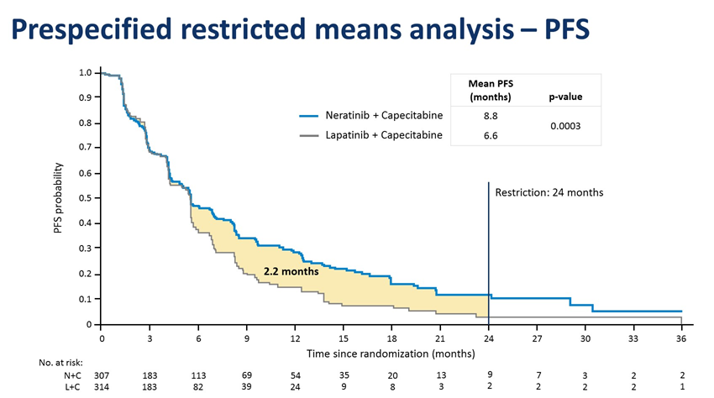
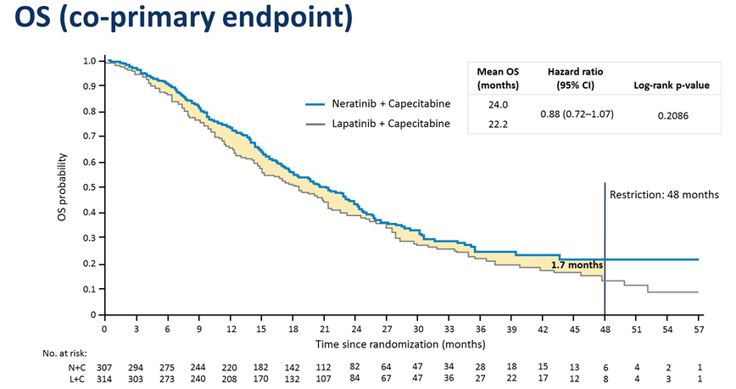
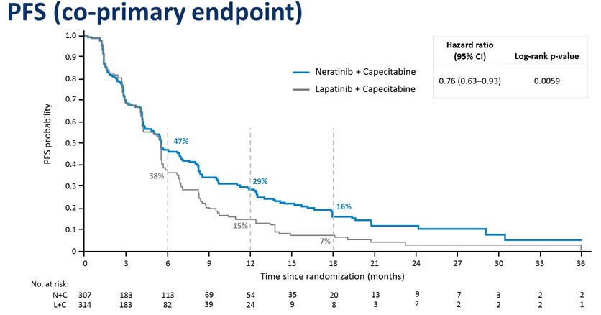
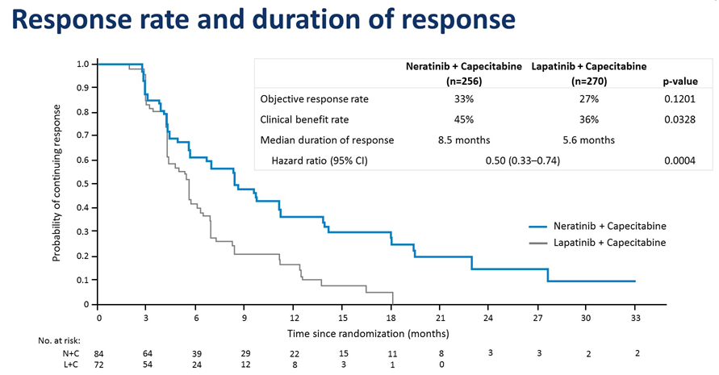
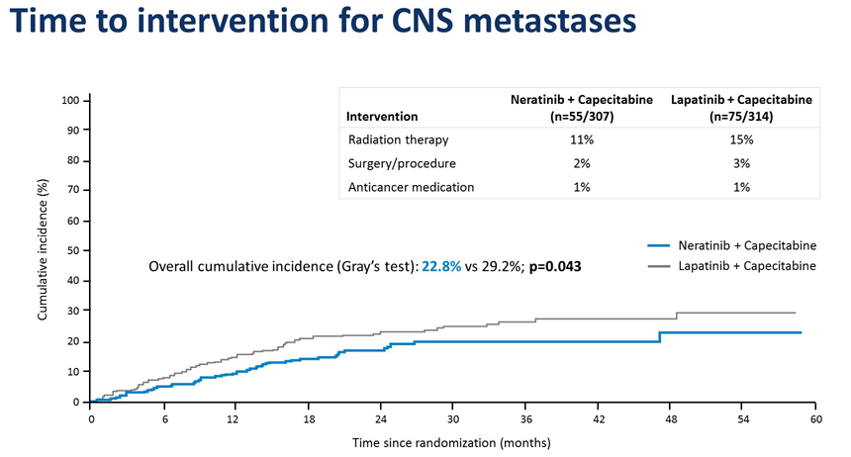
NALA summary of results
Swain et al, Abstr. 1020, ASCO 2019

Slide 22
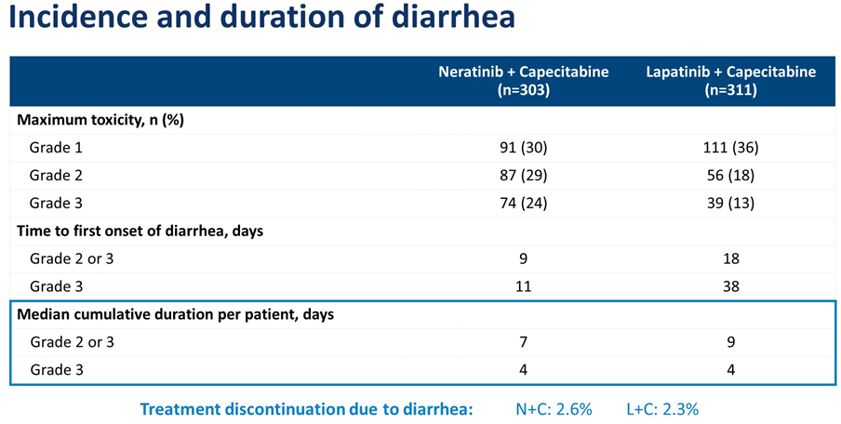
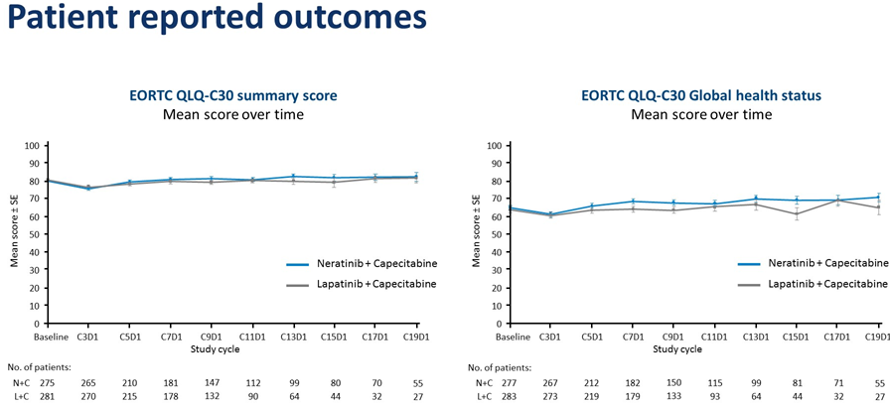
NALA safety considerations
Swain et al, Abstr. 1020, ASCO 2019

Slide 23
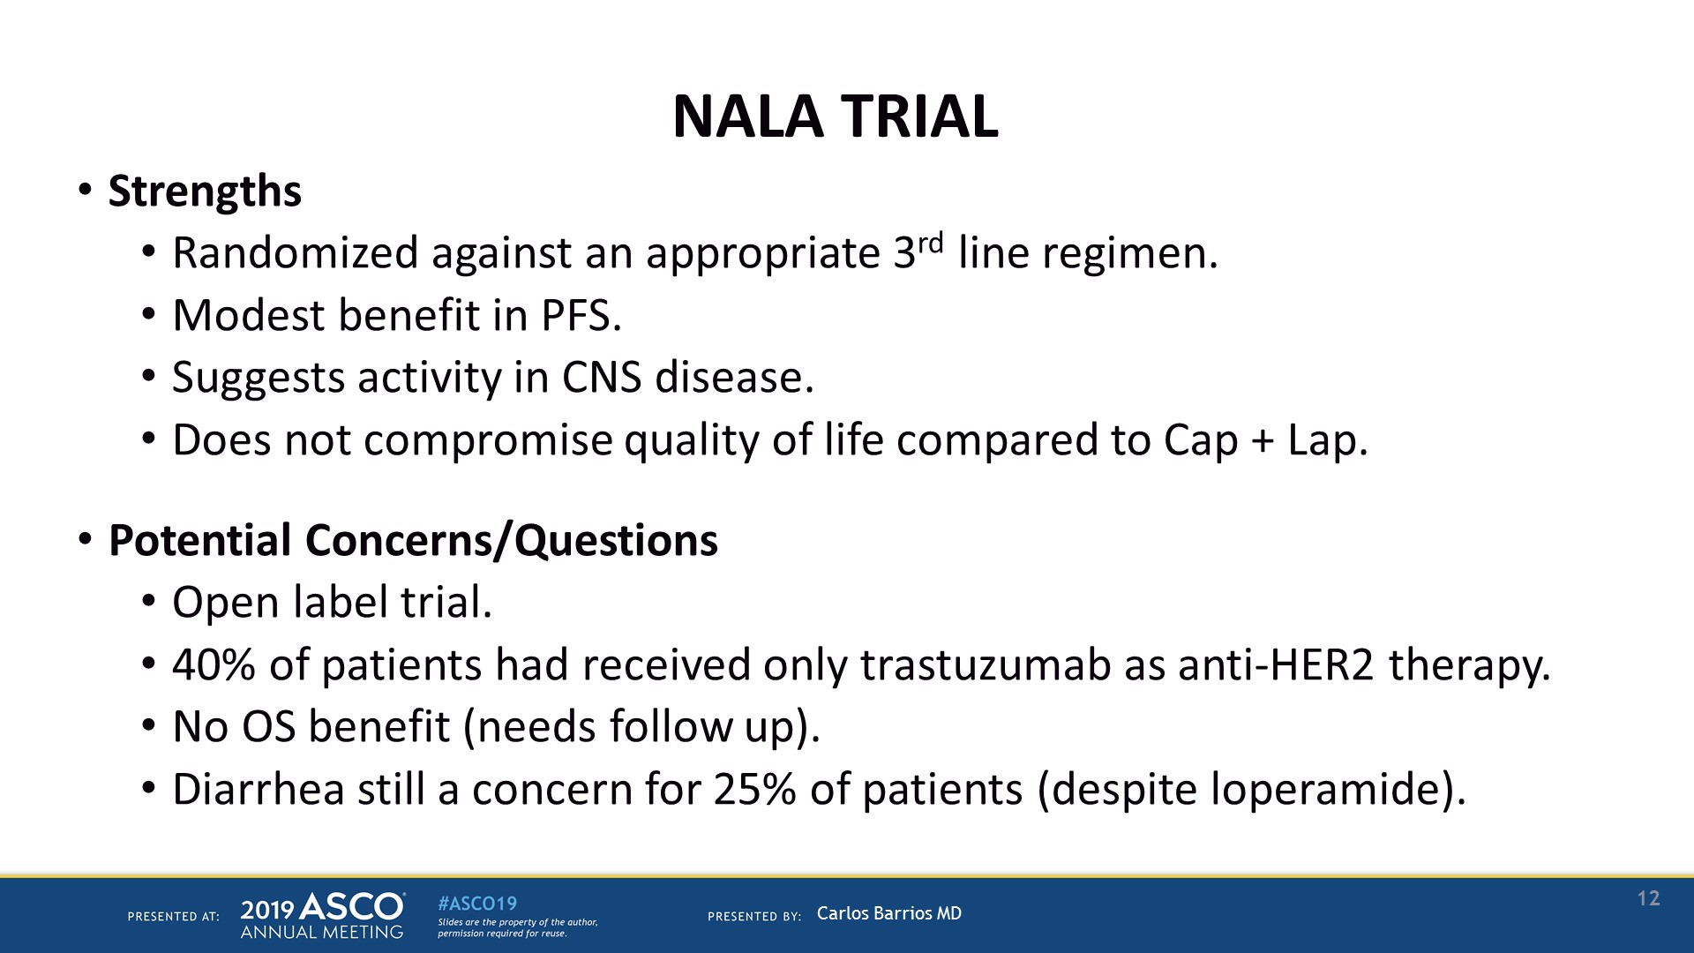
NALA TRIAL
Presented By Carlos Barrios at 2019 ASCO Annual Meeting

Slide 24
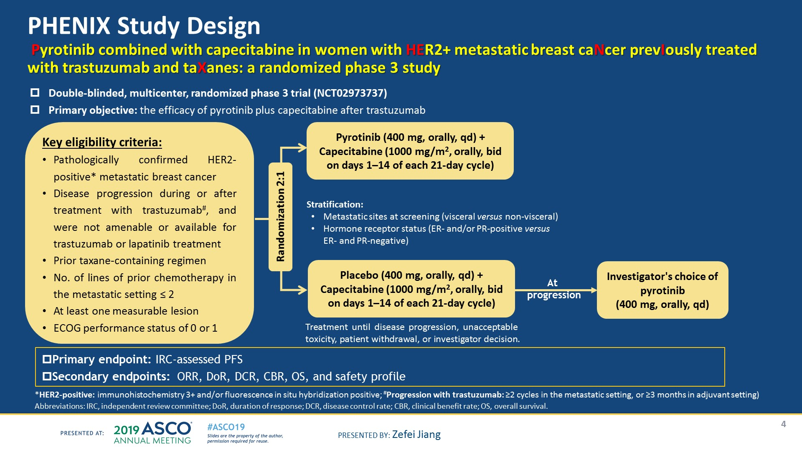
PHENIX Study Design<br /> Pyrotinib combined with capecitabine in women with HER2+ metastatic breast caNcer prevIously treated with trastuzumab and taXanes: a randomized phase 3 study<br />
Presented By Zefei Jiang at 2019 ASCO Annual Meeting

Slide 25
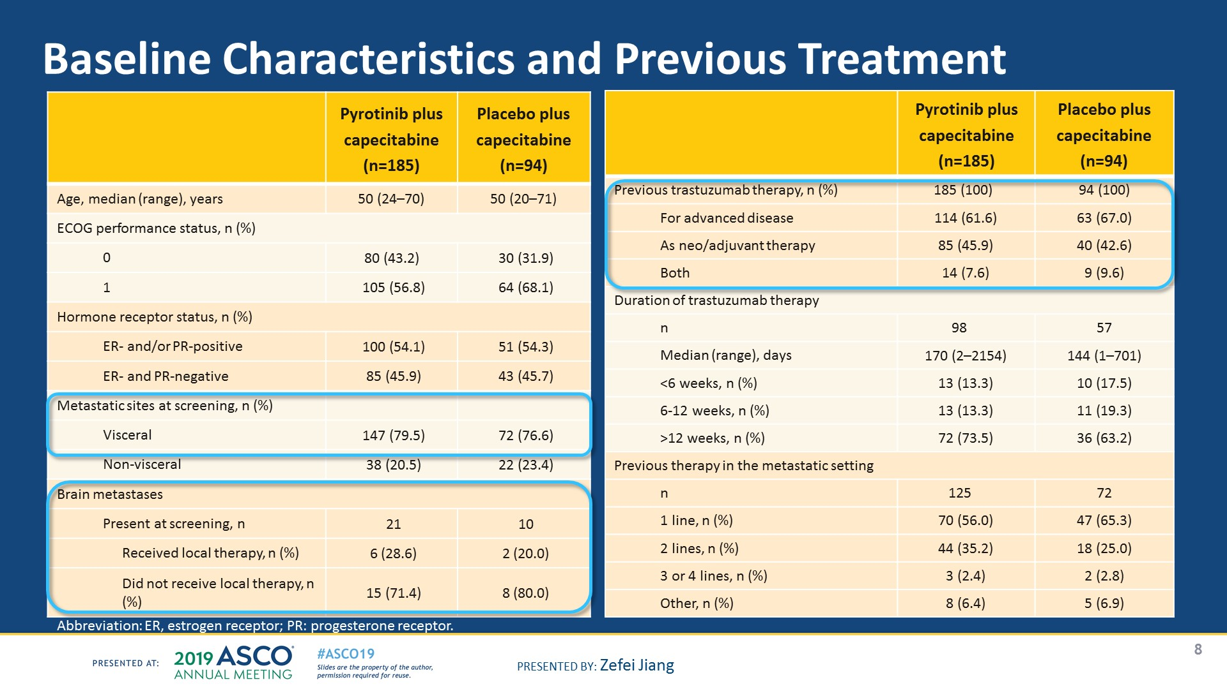
Slide 8
Presented By Zefei Jiang at 2019 ASCO Annual Meeting

Slide 26
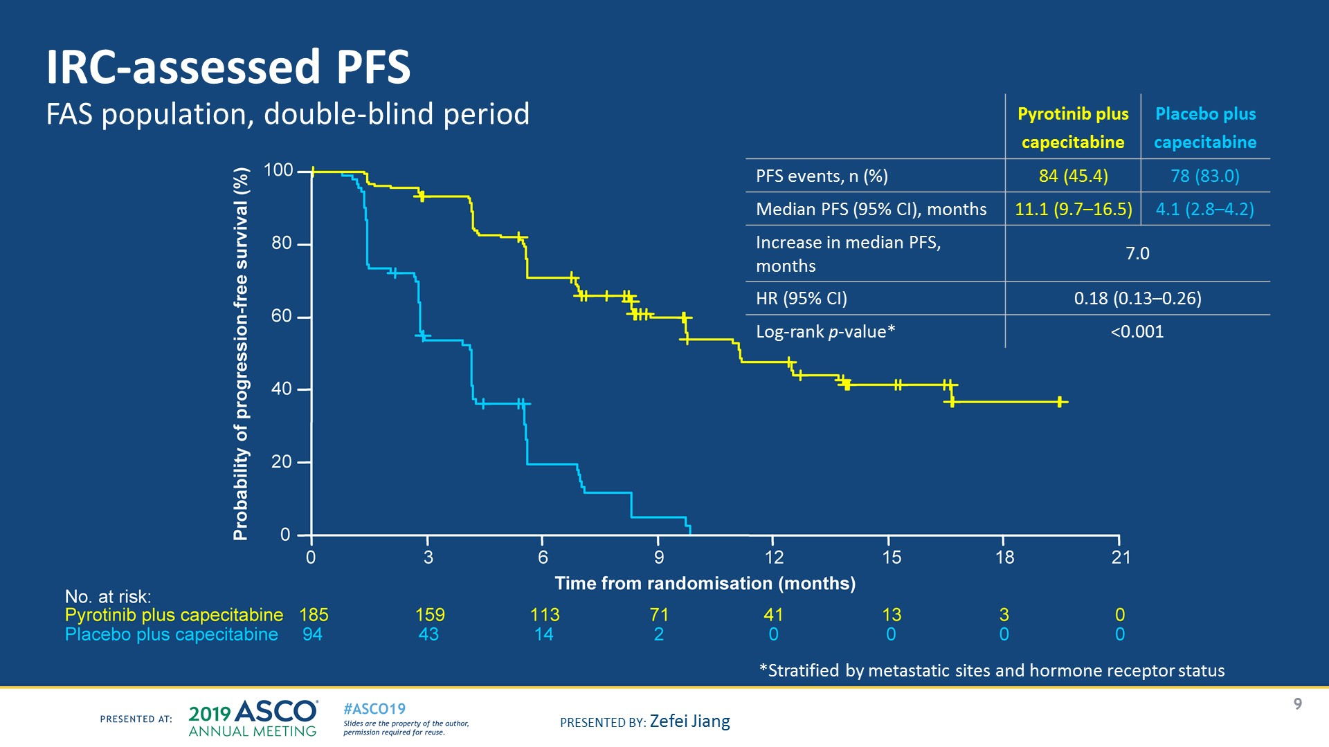
Slide 9
Presented By Zefei Jiang at 2019 ASCO Annual Meeting

Slide 27
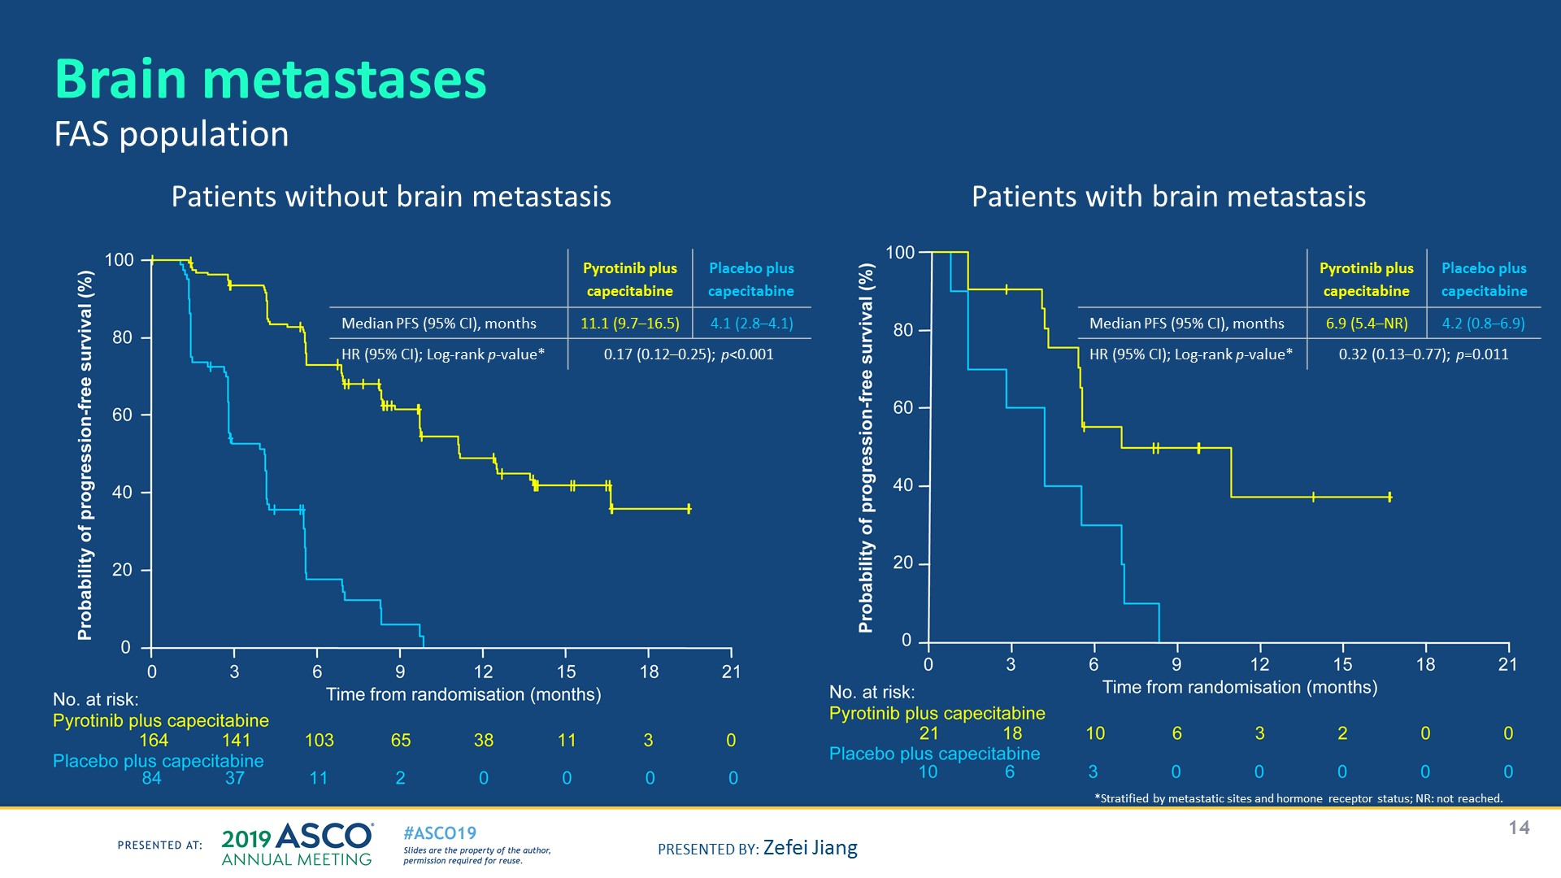
Slide 14
Presented By Zefei Jiang at 2019 ASCO Annual Meeting

Slide 28
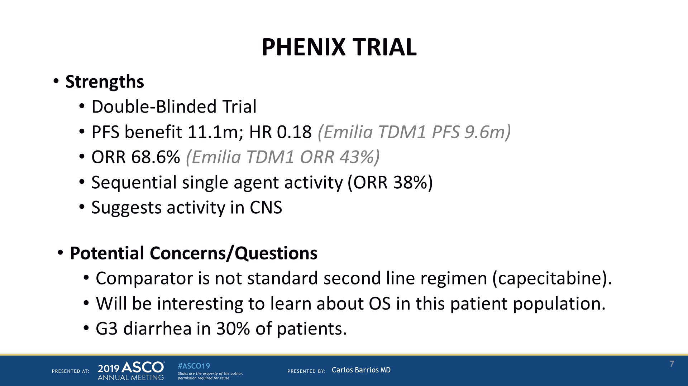
PHENIX TRIAL
Presented By Carlos Barrios at 2019 ASCO Annual Meeting

Slide 29
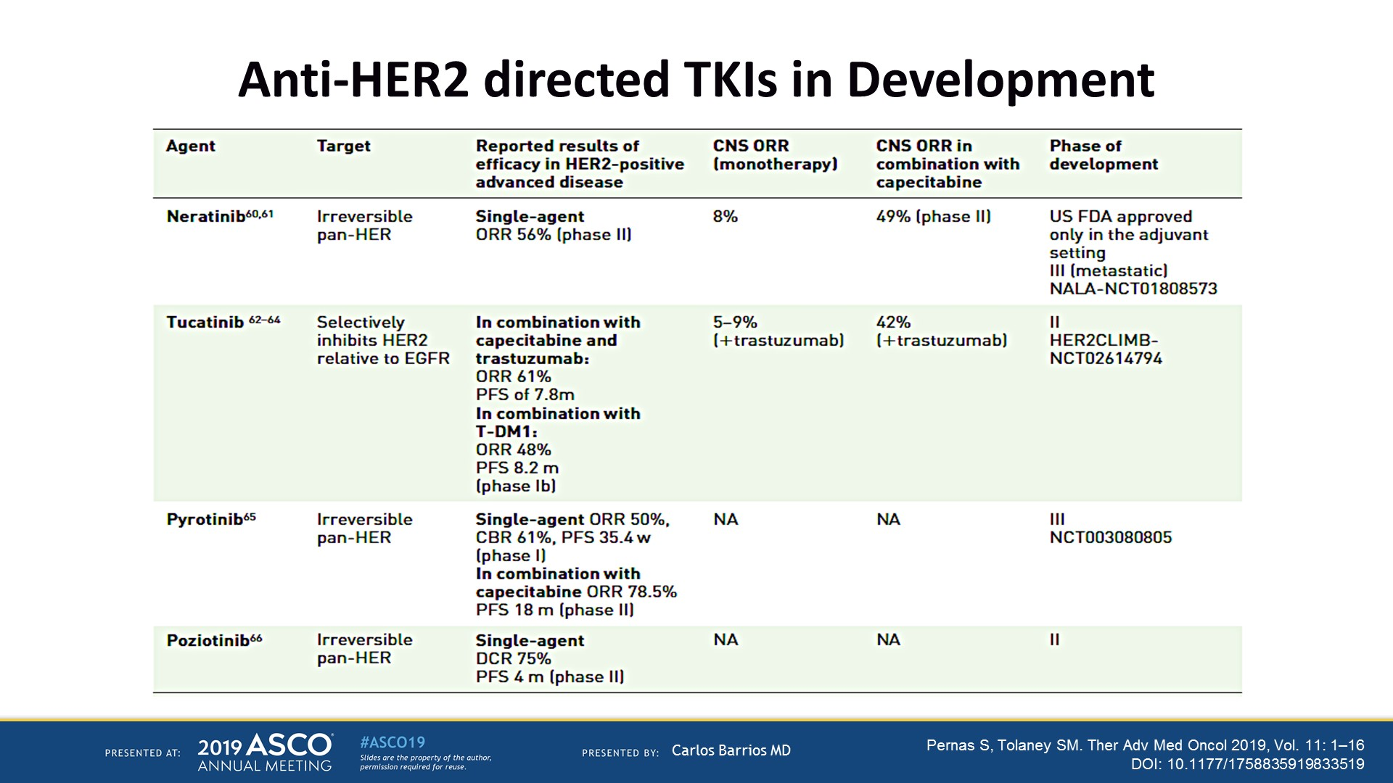
Anti-HER2 directed TKIs in Development
Presented By Carlos Barrios at 2019 ASCO Annual Meeting

Slide 30
OUTLINE
Margetuximab
Neratinib
Pyrotinib
New drugs and combinations

Slide 31
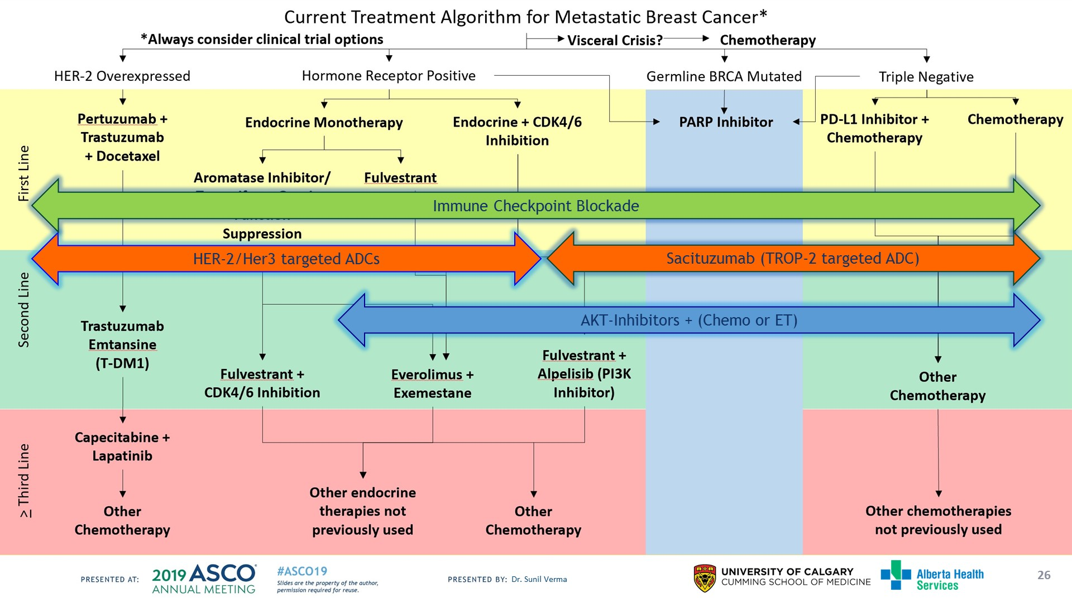
Slide 26
Presented By Sunil Verma at 2019 ASCO Annual Meeting

Slide 32
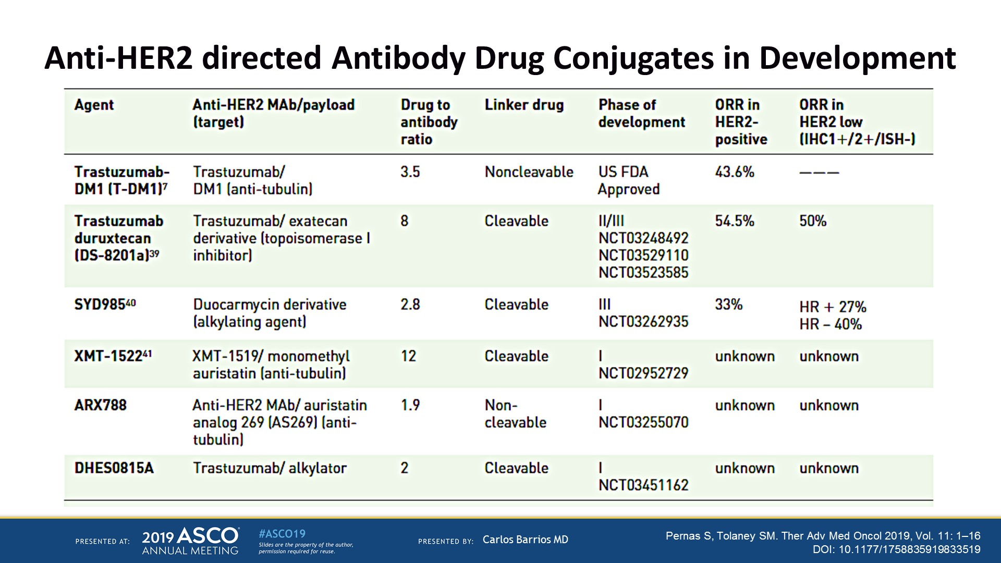
Anti-HER2 directed Antibody Drug Conjugates in Development
Presented By Carlos Barrios at 2019 ASCO Annual Meeting

Slide 33
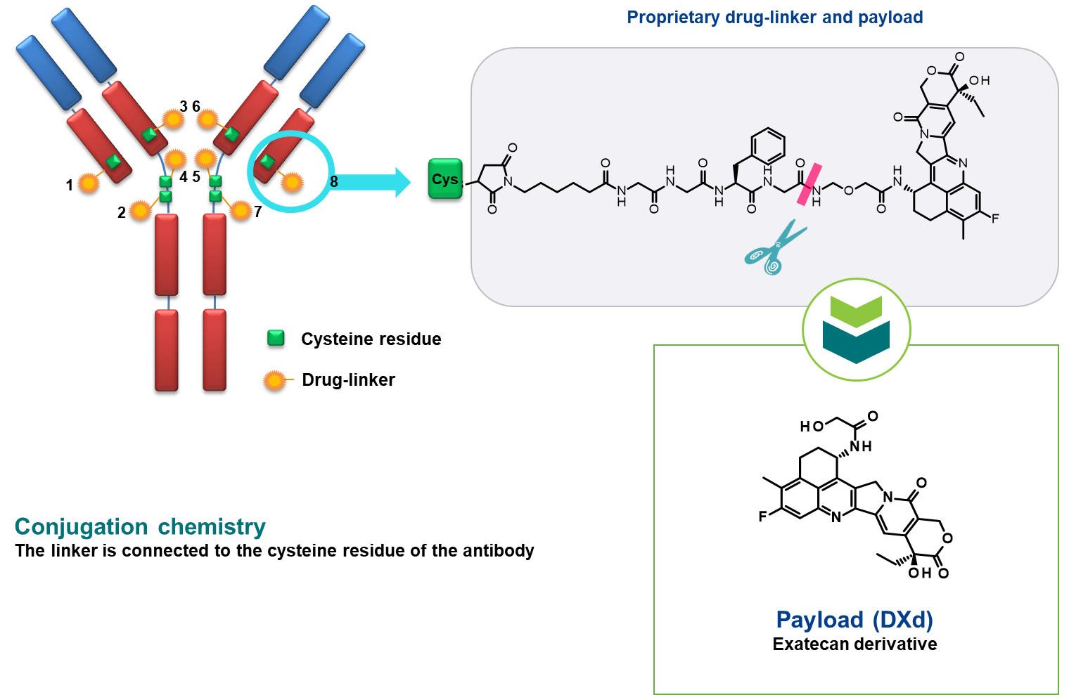
Trastuzumab Deruxtecan (DS-8201a): Structure and Mechanism of Action
Payload with a different mechanism of action
High potency of payload
Payload with short systemic half-life
Bystander effect
Stable linker-payload
Tumor-selective cleavable linker
High drug-to-antibody ratio (~1:8)
Iwata et al. ASCO 2018.
Notes:
DS-8201a is a novel HER2-targeted antibody–drug conjugate with a humanised anti-HER2 antibody, cleavable peptide-based linker, and topoisomerase I inhibitor payload.

Slide 34
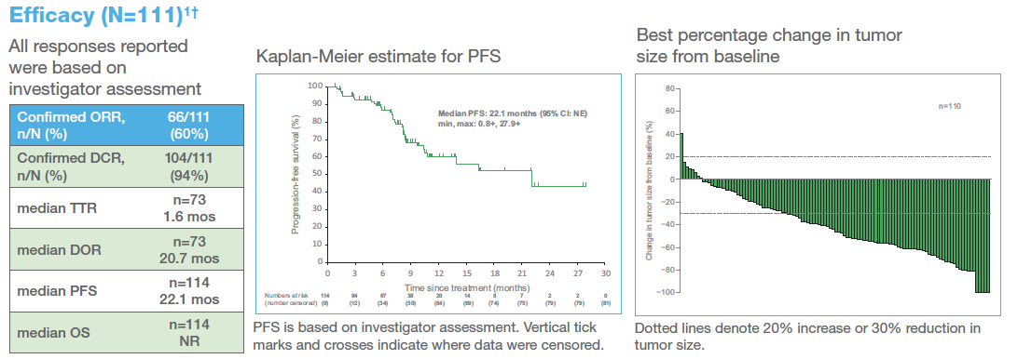
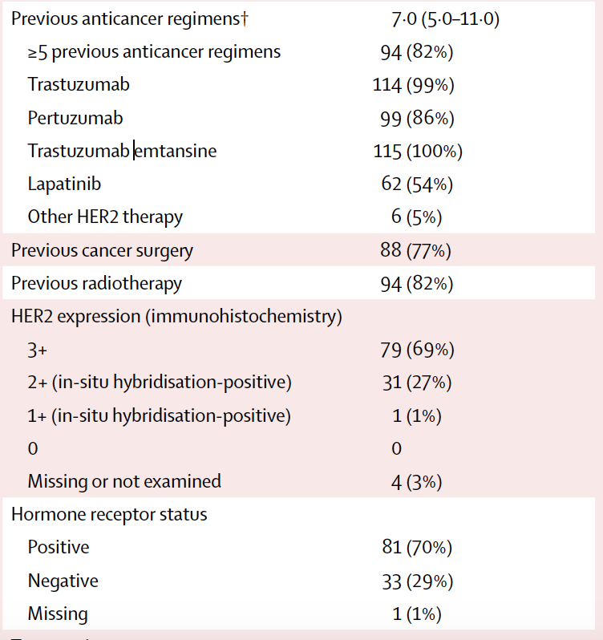
Efficacy of DS-8201a in HER2+ mBC: Phase I study
N = 111
Tamura et al, Lancet Oncology 2019
Notes:
A phase 1, non-randomised, open-label, multiple-dose study was done to assess the safety, tolerability, and activity of DS-8201 in HER2+ advanced solid tumours.

Slide 35
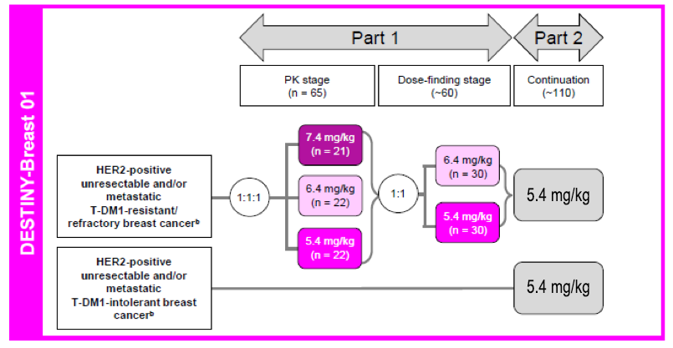
DESTINY-Breast01 study:
DS-8201a in HER2+ MBC with prior T-DM1
Accrual complete as of September 2018
ClinicalTrials.gov NCT03248492
Notes:
The dose escalation (part 1) has been reported and the recommended doses for expansion of 5·4 mg/kg or 6·4 mg/kg were established.

Slide 36
Ongoing Phase III Trials:
DS-8201a in MBC
Study Name | Description/Population | CT.gov Identifier and EUDRA CT Identifier | Recruitment Status
DESTINY-Breast02 | DS-8201a vs investigator’s choice in HER2-positive unresectable and/or MBC previously treated with standard of care anti-HER2 therapies including T-DM1 | NCT03523585* 2018-000221-31 | Recruiting
DESTINY-Breast03 | DS-8201a vs. T-DM1 in HER2-positive unresectable and/or MBC | NCT03529110* 2018-000222-61 | Recruiting
DESTINY-Breast04 | DS-8201a vs. physician’s choice in HER2-low, unresectable and/or MBC | NCT03734029* 2018-003069-33 | Recruiting
ClinicalTrials.gov accessed 26APR2019
Notes:
NCT03523585*
NCT03529110*
NCT03734029*

Slide 37
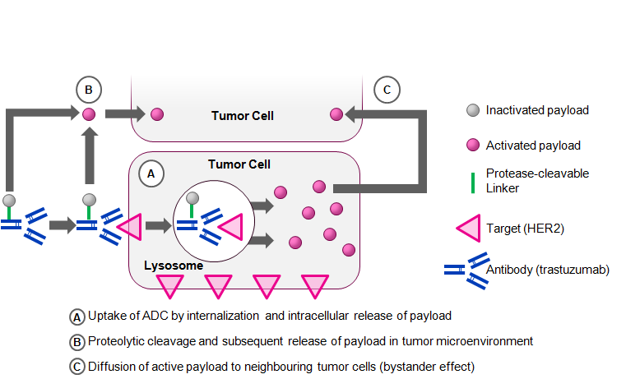
SYD-985: Trastuzumab Duocarmazine
HER2-targeting ADC based on trastuzumab
Protease cleavable linker with a DNA alkylating toxin duocarmycin
Toxin incorporated into the linker as an inactive prodrug
Proteolytic cleavage: release of the membrane permeable active toxin
Notes:
Trastuzumab duocarmazine is a novel HER2-targeting antibody–drug conjugate comprised of trastuzumab covalently bound to a linker drug containing duocarmycin

Slide 38
Efficacy of SYD-985 in MBC: Phase I study
HER2+ (n=48): ORR 33%
Saura C, et al. ASCO 2018
Notes:
In this first-in-human study, the safety and activity of trastuzumab duocarmazine in patients with advanced solid tumours was assessed

Slide 39
Phase III: Tulip Trial (n=345)
HER2+ MBC
≥2 HER2-Rx regimens
SYD985 (1.2 mg/kg Q3W)
Primary endpoint: PFS
Secondary endpoints: OS, ORR, PRO
Physician's choice
(as per SOC)
CT.gov: NCT03262935

Slide 40
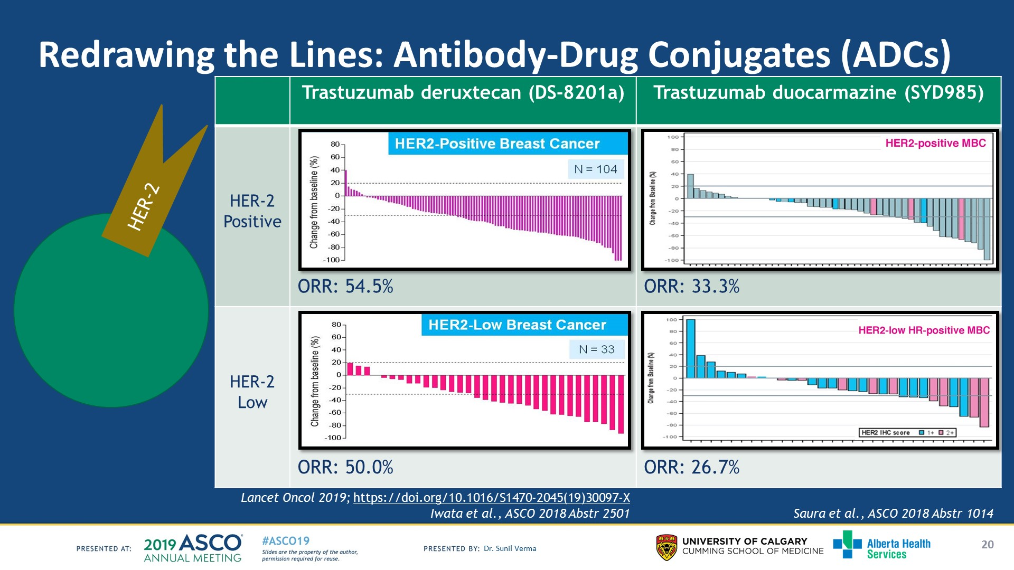
Slide 20
Presented By Sunil Verma at 2019 ASCO Annual Meeting

Slide 41
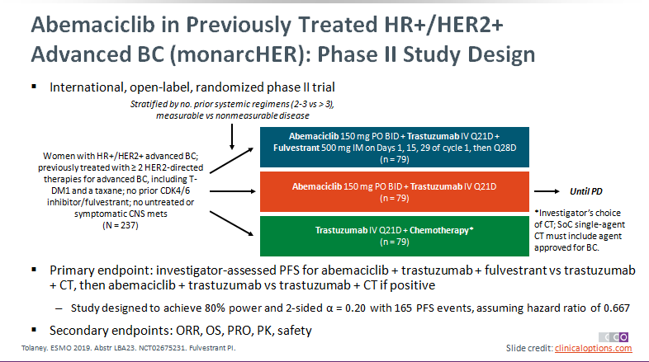

Slide 42
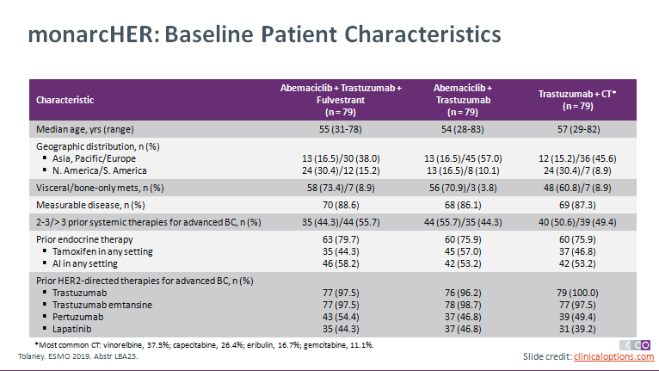

Slide 43
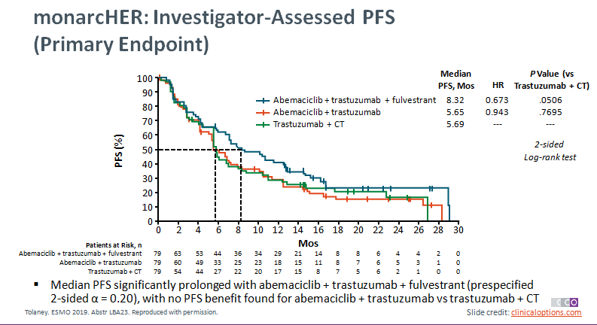
Notes:
BC, breast cancer; CT, chemotherapy; mets, metastases.

Slide 44

monarcHER: Conclusions
In the randomized phase II monarcHER trial, the primary endpoint of median PFS was significantly prolonged with abemaciclib + trastuzumab + fulvestrant vs trastuzumab + CT in patients with hormone receptor–positive/HER2-positive advanced BC previously treated with HER2-directed therapies
  Median PFS: 8.32 vs 5.69 mos; HR: 0.673; P = .0506 (prespecified α = 0.20)
  Median PFS did not improve with abemaciclib + trastuzumab vs trastuzumab + CT
Confirmed best ORR significantly higher with abemaciclib + trastuzumab + fulvestrant vs trastuzumab + CT in ITT population (32.9% vs 13.9%; P = .0042) and in subgroup with measurable disease (35.7% vs 16.2%; P = .0111)
Safety profile generally tolerable with no new signals observed
Investigators concluded that abemaciclib has shown clinical activity in hormone receptor–positive/HER2-positive advanced BC
Tolaney. ESMO 2019. Abstr LBA23.
Slide credit: clinicaloptions.com
Notes:
BC, breast cancer; CT, chemotherapy; ITT, intention-to-treat

Slide 45
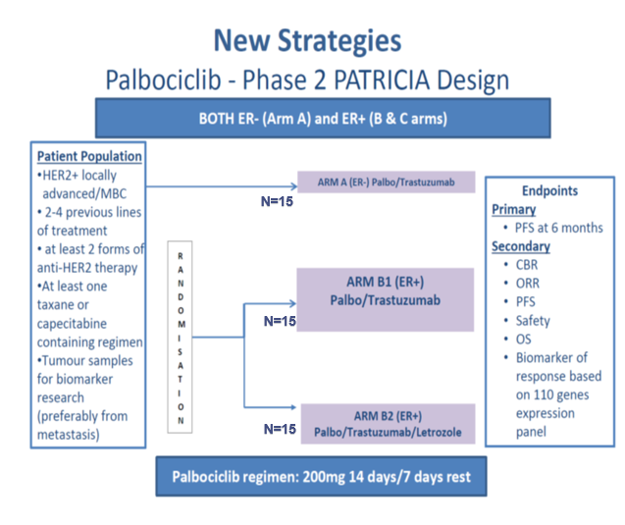
PFS6 Rates:
Cohort A: 33,3% (5/15),
Cohort B: 40.0% (6/15)
Cohort B2: 53.3% (8/15)
Median PFS in cohorts B1+B2,
Luminal vs Non-Luminal (defined by PAM50) :
12.4 vs. 4.1 months
(HR=0.30; p-value=0.025).
CBR6 in Luminal vs Non-Luminal :
73% vs. 25%
(p=0.022)
N=15
Safety:
Grade 1-2 in 97.7% of pts
Grade 3-4 in 84.4% of pts, mainly neutropenia (80%) and thrombocytopenia (17%).
Dose reductions were required in 60% of pts.
E Ciruelos,et al. Abstracts: 2018 San Antonio Breast Cancer Symposium; December 4-8, 2018; San Antonio, Texas
Notes:
Lo studio è ancora aperto in fase di reclutamento, abstract pubb .
Results: A total of 45 pts were recruited (n=15 in each cohort). Median age was 59.5y, and median number of prior lines was 3.0. The PFS6R in cohorts A, B1 and B2 were 33.3% (5/15), 40.0% (6/15) and 53.3% (8/15), respectively. Regarding safety, grade 1-2 and 3-4 toxicities occurred in 97.7% and 84.4% of pts. The most common grade 3-4 toxicities were neutropenia (80%) and thrombocytopenia (17%). Dose reductions were required in 60% of pts. Regarding PAM50, a total of 40 (83.9%) tumors samples (22 primary and 18 metastasis) were profiled. Subtype distribution was as follows: 92.9% HER2-enriched (HER2-E) and 7.1% Basal-like in cohort A, and 46.2% HER2-E, 23.1% Luminal B, 19.2% Luminal A and 11.5% Normal-like in cohorts B1+2. No significant differences in PFS were observed across the 3 cohorts. In cohorts A+B1+B2, Luminal disease defined by PAM50 showed a higher median PFS compared to non-luminal disease (12.4 vs. 4.1 months; adjusted hazard ratio=0.37; p-value=0.052). Clinical Benefit Rate (CBR6) was 73% in Luminal Vs. 31% in non-luminals (p=0.031). In cohorts B1+B2, Luminal disease defined by PAM50 showed a higher median PFS compared to non-luminal disease (12.4 vs. 4.1 months; adjusted hazard ratio=0.30; p-value=0.025). CBR6 was 73% in Luminal Vs. 25% in non-luminals (p=0.022). No clinical-pathological variable was found associated with PFS or CBR6 in all pts or in cohorts B1+B2.
Conclusion: Palbociclib in combination with TTZ is safe and active in TTZ pre-treated HER2+ advanced BC, specially within ER+ disease. Identification of the non-luminal subtypes by PAM50 might help identify pts who might not derive a large benefit from this treatment strategy regardless ER status. Our results might have important implications for current and future clinical trials evaluating CDK4/6 inhibitors in HER2+ disease. In Part 2, a total of 92 pts in cohorts B1 and B2 will be included to better assess the efficacy of this treatment strategy.

Slide 46

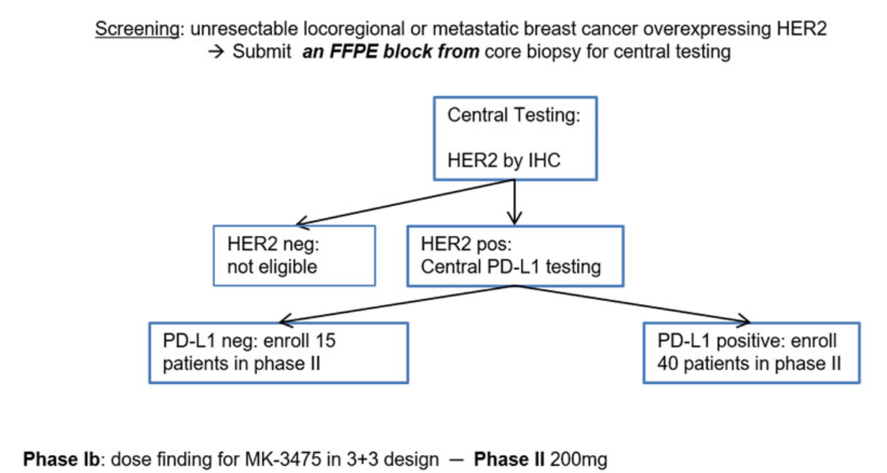
Primary endpoint of the Phase II part of the study : ORR
Secondary endpoints: PFS, DCR, duration of response, duration of disease control, OS

Slide 47

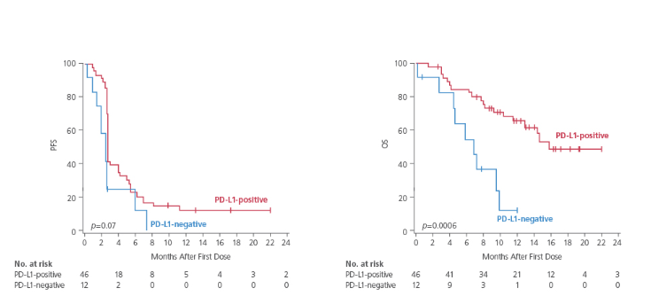
Results:
  PDL1 + cohort (n= 46)
    ORR: 15,2% (CI 7-27%)
    Median PFS: 2,7 mo
    Median duration of disease control: 11,1 mo
    Median OS: 16,1 mo
  PDL1 - cohort (n= 12)
    ORR: 0
    12-months PFS Rates:13%
    12-months OS Rates: 65%
    12-months PFS Rates:0%
    12-months OS Rates: 12%
Notes:
ELIMINEREI IL RIQUADRO ROSSO E LA MEDIAN DURATION OF RESPONSE, PARLANDO SOLO DEGLI ALTRI DATI (ORR, PFS E OS)

Slide 48
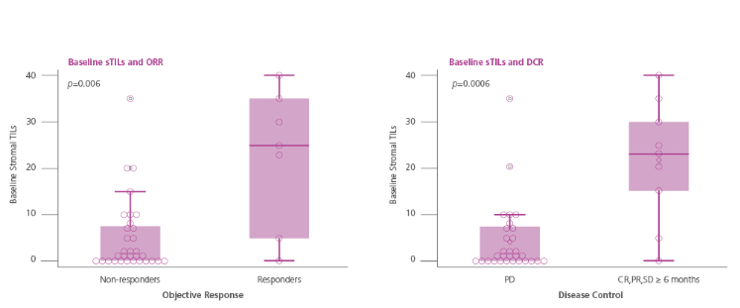
Stromal TILs (sTILs) from metastatic biopsy:
  ORR 39% (sTILs+) vs 5% (sTILs-)
Toxicity: 2/58 with grade III/IV pneumonitis

Slide 49
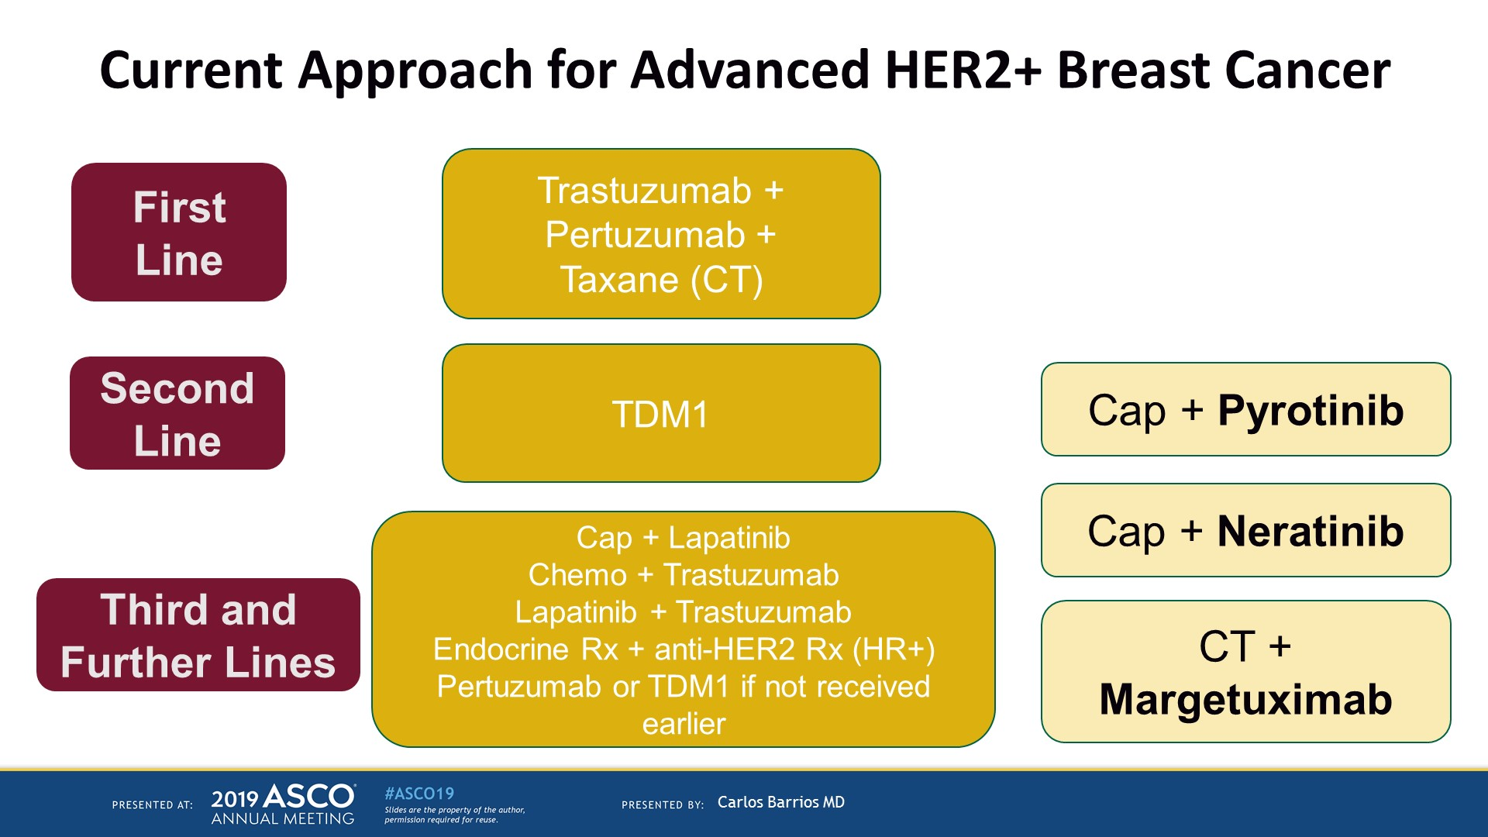
Current Approach for Advanced HER2+ Breast Cancer
Presented By Carlos Barrios at 2019 ASCO Annual Meeting

Slide 50

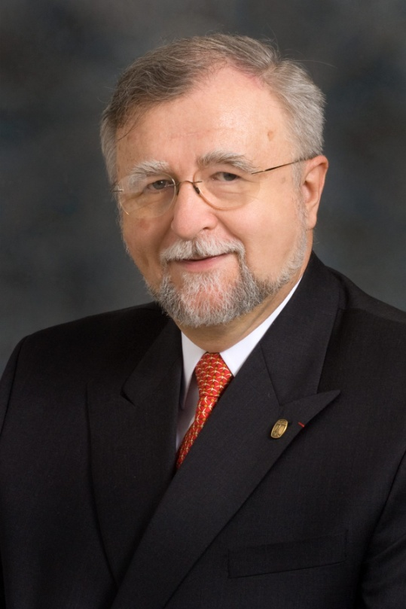
"If I have seen further it is by standing upon the shoulders of giants."
Presented By Gabriel Hortobagyi at 2019 ASCO Annual Meeting

