Slide 1


- GIM13
Chieti 22 Novembre 2019
THE GIM-13 TRIAL: UPDATES
Studio Osservazionale Longitudinale sulle scelte terapeutiche del carcinoma mammario metastatico HER2-negativo nella pratica clinica Italiana
Giorgio Mustacchi
Prof emerito di Oncologia Medica, Università di Trieste
Vicepresidente e Responsabile Scientifico AIRC FVG

Slide 2
GIM13-AMBRA
Promoter | Consorzio Oncotech Dipartimento di Medicina Clinica e Chirurgia Oncologica Università degli Studi di Napoli “Federico II” Via Pansini 5, 80131 – Napoli Phone: +39 081 5457281 mail: info@oncotech.org
Principal Investigator | Marina Cazzaniga Oncologia Medica - Azienda Ospedaliera San Gerardo, Monza
Scientific Board | Marina Cazzaniga Oncologia Medica, Azienda Ospedaliera San Gerardo, Monza ------------------------------------------------ Giorgio Mustacchi Oncologia Medica, Università di Trieste ------------------------------------------------ Paolo Pronzato Oncologia Medica, IRCCS Azienda Ospedaliera Universitaria San Martino, Genova
Steering Committee | Sabino De Placido Oncologia Medica, Università Federico II ------------------------------------------------ Paolo Marchetti Oncologia Medica, Facoltà di medicina e chirurgia «Sapienza» – Università di Roma ------------------------------------------------ Michele De Laurentiis Oncologia Medica, Istituto tumori IRCCS Fondazione Pascale Napoli
Promoter: Consorzio Oncotech
Funding: Unconditionated Grant by Celgene
Funding: Unconditionated Grant by Celgene

Slide 3
Disegno dello studio
Studio osservazionale multicentrico sulla gestione terapeutica delle pazienti affette da carcinoma metastatico della mammella HER2-negativo
Pazienti che abbiano ricevuto o meno terapia endocrina per la malattia metastatica e che tra Gennaio 2010 e Giugno 2018 abbiano ricevuto un trattamento di 1° linea di chemioterapia per la malattia metastatica (la I linea di chemioterapia non può essere antecedente al 2010)
Viene registrata ogni linea di terapia successiva e la Paziente viene seguita fino al decesso, perdita Fup o fino al 30 giugno 2019
Previsione: 1.500 pazienti

Slide 4

Centri partecipanti e status arruolamenti
Status | Dettaglio
Centri attivi | 42
Centri che hanno arruolato almeno 1 paziente | 40
Centri che non hanno arruolato | 2
Totale | 42
Status arruolamenti | Num. Pz
al 25/10/2019 | 927

Slide 5
Adjuvant Chemotherapy Regimens
SABCS 2016, Poster P5-15-07

Slide 6
Adjuvant CHT in
Luminal A patients
63.3% of Luminal A patients received adjuvant CHT
SABCS 2016, Poster P5-14-09

Slide 7
1stLine Treatments
Taxanes +/- Beva and Cape/Vin were
the preferred choices in any subtype
SABCS 2016, Poster P5-15-07

Slide 8
2ndLine Treatments
In Luminals Tumors HT alone is preferred
SABCS 2016, Poster P5-15-07

Slide 9
3rdline Treatments
SABCS 2016, Poster P5-15-07

Slide 10
Taxanes
SABCS 2016, Poster P5-15-07; ASCO 2017 Abs 1055

Slide 11
TNBC: Adj and M1 CHT
Median values
Age at T : 53 years
DFS : 23.2 mos
PFS 1stLine : 6.5 mos
PFS 2ndLine: 4.3 mos
Taxanes play a crucial role both in Adj and M1 settings
SABCS 2019, Poster P2-15-14

Slide 12
Time To Treatment Change and PFS
SABCS 2016, Poster P5-15-07 TTC only,
(comparison with PFS unpublished)

Slide 13
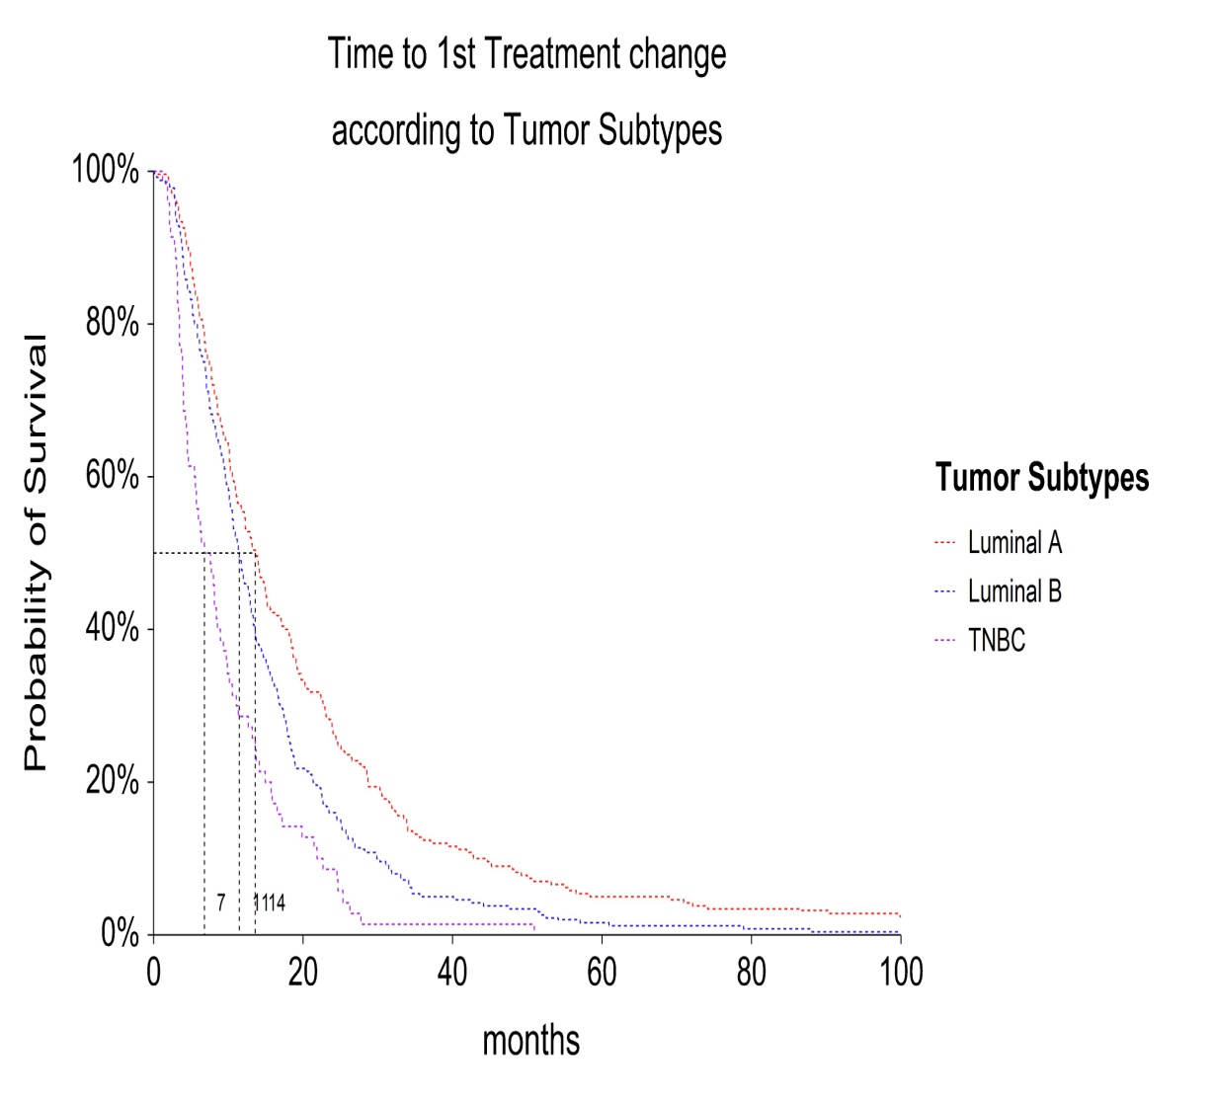
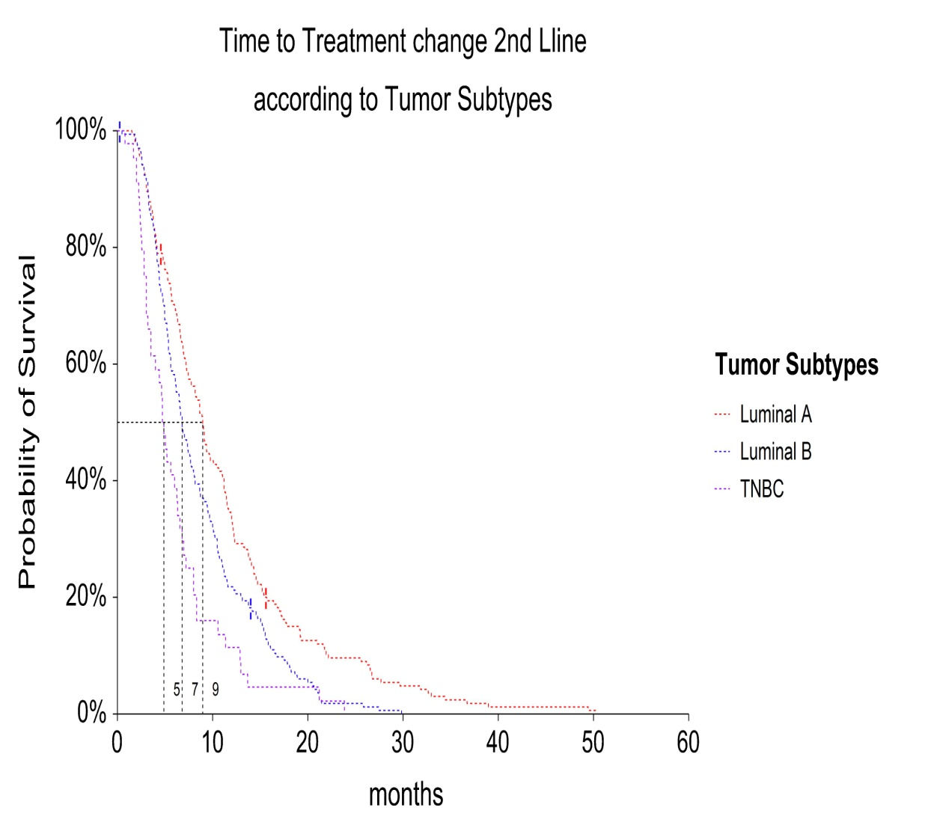
Time to Treatment change and Subtype
HR
Lum A/Lum B: 0.74 p= 0.0005
Lum A/TNBC : 0.47 p= 0.0000
Lum B /TNBC: 0.61 p= 0.0000
HR
Lum A/Lum B: 0.70 p= 0.0012
Lum A/TNBC : 0.45 p= 0.0000
Lum B /TNBC: 0.63 p= 0.0063
HR : Cox Mantel Hazard ratio; alpha at 0.05
SABCS 2019, P5-07-10

Slide 14
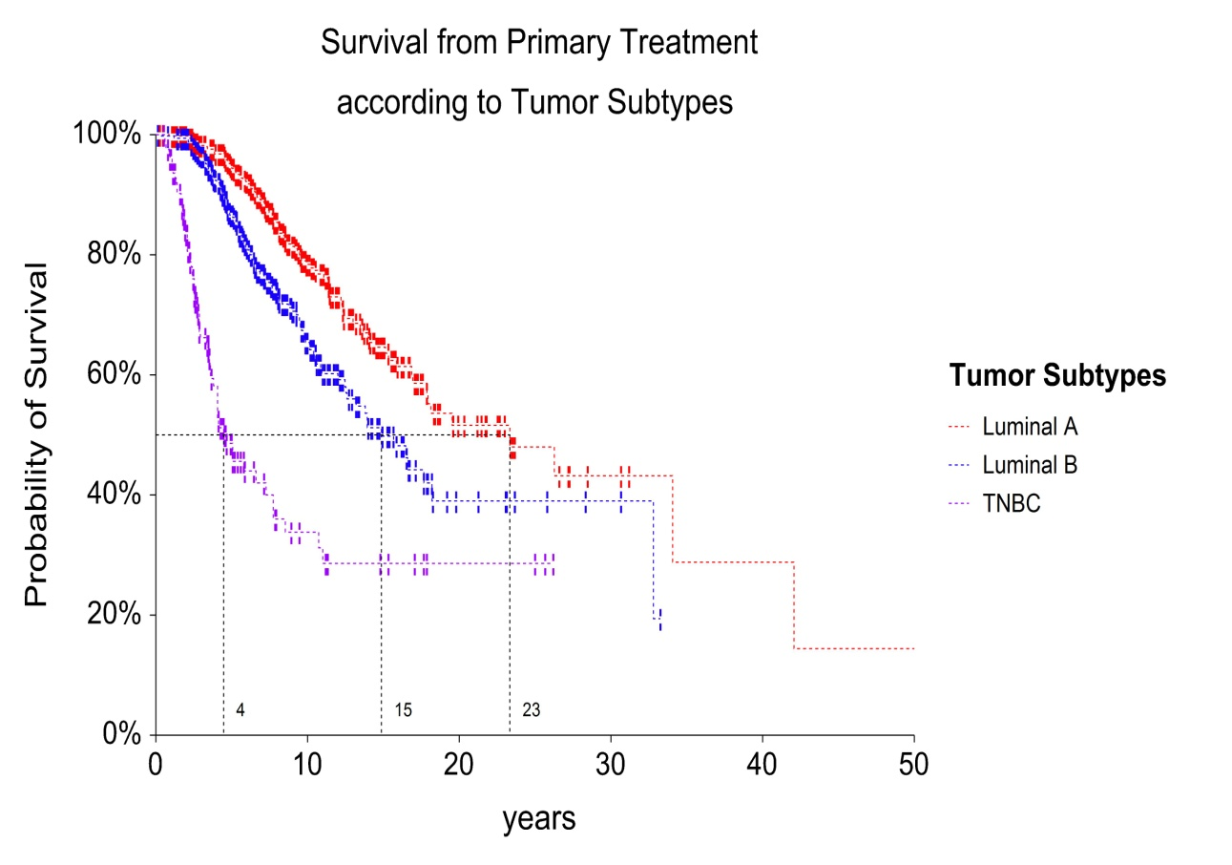
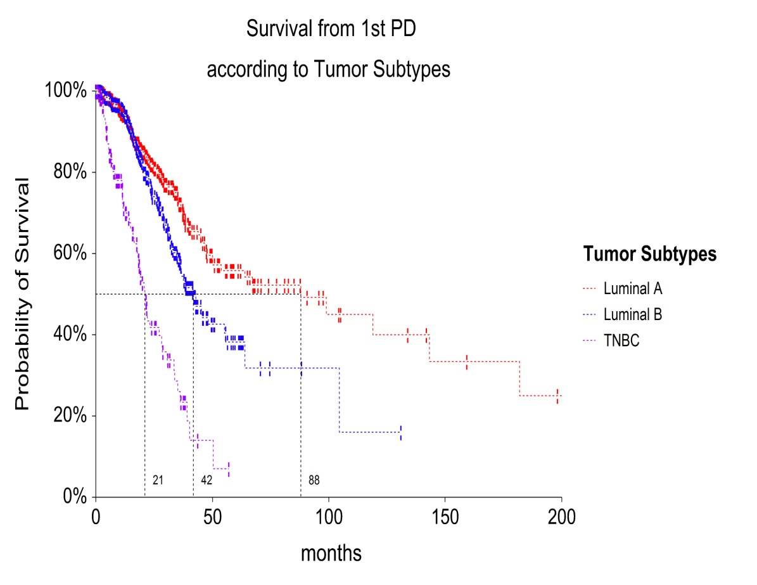
Overall and metastatic survival by Subtype
years
months
HR
Lum A/Lum B: 0.59 p= 0.0002
Lum A/TNBC : 0.21 p= 0.0000
Lum B /TNBC: 0.31 p= 0.0000
HR
Lum A/Lum B: 0.66 p= 0.0034
Lum A/TNBC : 0.26 p= 0.0000
Lum B /TNBC: 0.35 p= 0.0000
SABCS 2019, P5-07-10
HR : Cox Mantel Hazard ratio; alpha at 0.05

Slide 15
Luminal A:
Biological subtypes at the re-test
57.3% of the patients underwent a biopsy
at the first relapse
SABCS 2016, Poster P5-14-09

Slide 16
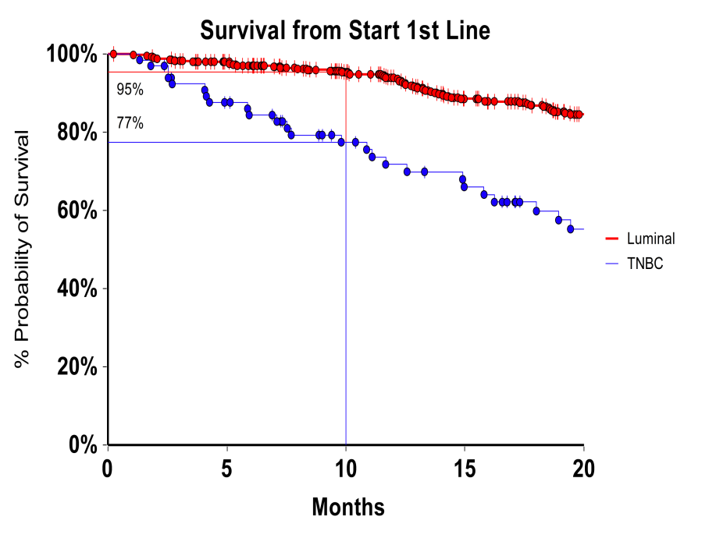
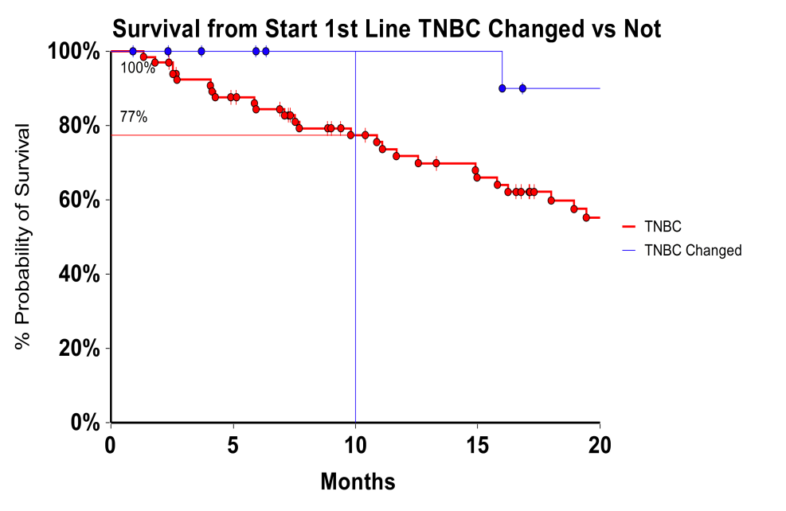
Survival from 1stLine
HR 0,30
P = 0.0000
N= 407 vs 66
HR 0,53
P = 0.192
N= 431 vs 31
HR 0,56
P = 0.40
N= 407 vs 15
HR 0,17
P = 0.006
N= 15 vs 66

Slide 17
Change of subtype at retesting and outcome
Cox Mantel HR : 0.14
(95%CI: 0.07-0.26)
Logrank Test: 0.0000
Cox Mantel HR : 0.14
(95%CI: 0.07-0.26)
Logrank Test: 0.0000
Remaining
Luminal N= 465 | TNBC N=67
Changing
Lum->TNBC N=47 (10.1%) | TNBC->Lum N=16 | TNBC->Lum N=16 (23.8%)
Cox Mantel HR : 0.64
(95%CI: 0.41 - 1)
Logrank Test: 0.06
ESMO 2019, Abs #3093

Slide 18
alcuni punti su cui riflettere

Slide 19
About Guide Lines for CHT in Italy
ABC 1 & 2 Recommendations for chemotherapy (Cardoso F, Annals of Oncology 25: 1871–1888, 2014) | n/n (% of adherence)
Anthracycline- or taxane-based regimens, preferably as a single agent, would usually be considered as first-line CHT, in those pts who have not received these regimens as adjuvant treatment | A/T mono : 59/270 (21.8%) | 160/270 (59.2%)
 | A/T poly : 101/270 (37.4%)
In pts with taxane-naive and anthracycline-resistant MBC, taxane-based therapy, preferably as a single agent, would usually be considered as the treatment of choice. | Taxane mono 89/431 (20.6%) |  | Taxane 208/431 (48.2%)
 | Taxane combo 119/431 (27.6%)
Other options are Capecitabine and Vinorelbine | 135/586 (23.0%)
If given in the adjuvant setting, a taxane can be re-used in the metastatic setting, particularly if there has been at least 1 year of disease-free survival. | DFI > 12 months 74/79 (93.7%) | 79/151 (52.3%)
 | DFI ≤ 12 months 5/79 (6.3%)
ESMO 2017, Abs 1830

Slide 20
About Guide Lines for HT in Italy
ESO-ESMO 2° Int Consensus for Advanced BC (Cardoso et al. The Breast 2014, 23: 489-502) | n/n (% of adherence)
1 - In HR+ pts ET is preferential even with visceral relapse (but in case of known resistance or visceral crisis) | 187/647 (27.8%) 56/187 (29.9%)
2 - The preferred 1stline ET for postmenopausal pts is an aromatase inhibitor or Tamoxifen | 100/186 (53.7%) 6/186 (3.2%) | 171/186 (91.9%)
3 - Fulvestrant High-Dose is also an option | 65/186 (34.9%)
4 - The addition of Everolimus to an AI is a valid option for some postmenopausal pts with disease progression after a NSAI visceral relapse | 15/186 (8.1%) 5/186 (2.7%)
The adherence to clinical recommendation about the use of ET as 1st-line treatment in HR+ pts is low
ASCO 2017, Abs 1057

Slide 21
“The Remains of the Day…”
Time from end of last CHT and Death
A few therapeutic fury ? 80% good clinical practice
months
Median | Mean | Min | Max
2.3 | 3.5 | 0 | 27.5
Overall Deaths 267 (255 evaluable)
CHT as last treatment 181 (70%)
No toxic Deaths reported
SABCS 2019, P5-07-10

Slide 22
Pubblicazioni
(Poster Totali 22)
Primo Lavoro “in extenso” pubblicato Settembre 2019, Breast care

Slide 23
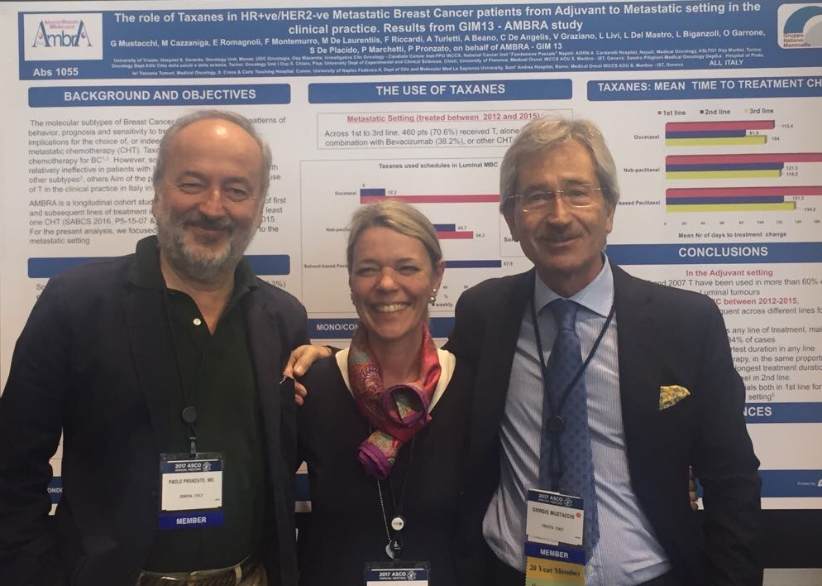
GIM13: Scientific Board at ASCO 2017

