Slide 1
Trastuzumab biosimilars: therapeutic continuity, switch, interchangeability
Clara Natoli
Pietro Di Marino
G. D’Annunzio University, Chieti-Pescara

Slide 2
What Are Biologics?
Biologics are active pharmaceutical ingredients prepared by the use of living systems such as organisms, tissue cultures or cells
Greater than 50% of medicines in clinical development are biologic medicines
Biological medicines have revolutionised the treatment of several life-threatening diseases and chronic clinical conditions:
diabetes, rheumatoid arthritis, IBD and……cancers!
There are more than 250 biologic medicines on the market
More than 350 million patients worldwide use biologics
Stevenson JG, et al. Ann Pharmacother 2017

Slide 3
What Are Biologics?
Conventional drugs
Small molecular weight
Structurally simple
Stable
Manufactured in predictable manner easily characterised
Biologicals :
Large molecular weight
Complex structure
Unstable
Manufactured in manner difficult to characterised
Stevenson JG, et al. Ann Pharmacother 2017

Slide 4
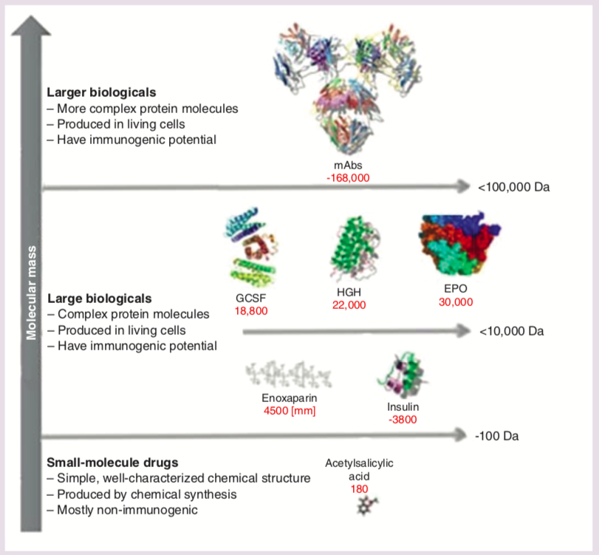
Molecular weight comparisons: small-molecule drugs versus larger biologicals
Thill et al. Future Oncol 2019

Slide 5
Biological medicine
To produce a biological medicine a manufacturer uses a unique cell line and a unique manufacturing processes

Slide 6
Heterogeneity of Biologics

Slide 7
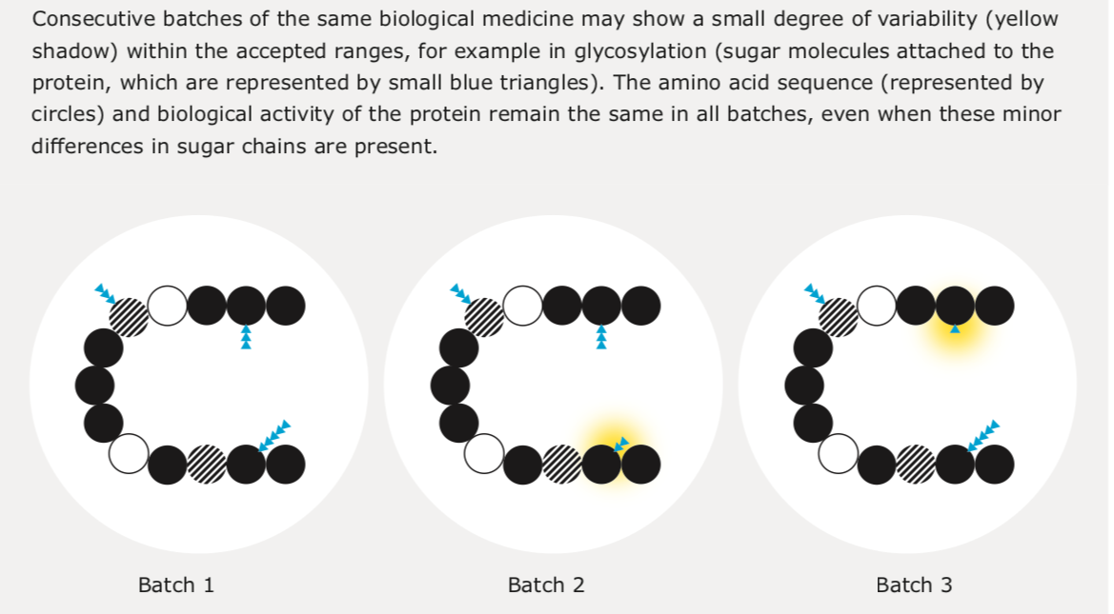
Variability of biological medicine
Biosimilars in the EU. Information Guide for Healthcare Professionals.

Slide 8
Biosimilars
“A biosimilar is a biological medicinal product that contains a version of the active substance of an already authorised original biological medicinal product (reference medicinal product) in the European Economic Area”
The aim of biosimilar development is to demonstrate biosimilarity-high similarity in terms of structure, biological activity and efficacy, safety and immunogenicity profile.
Comparability exercise
"Head to head"
defining the differences deemed acceptable, since they are not clinically relevant.
Biosimilars in the EU. Information Guide for Healthcare Professionals.

Slide 9
Biosimilar manufacturers have limited knowledge of the reference product

Slide 10
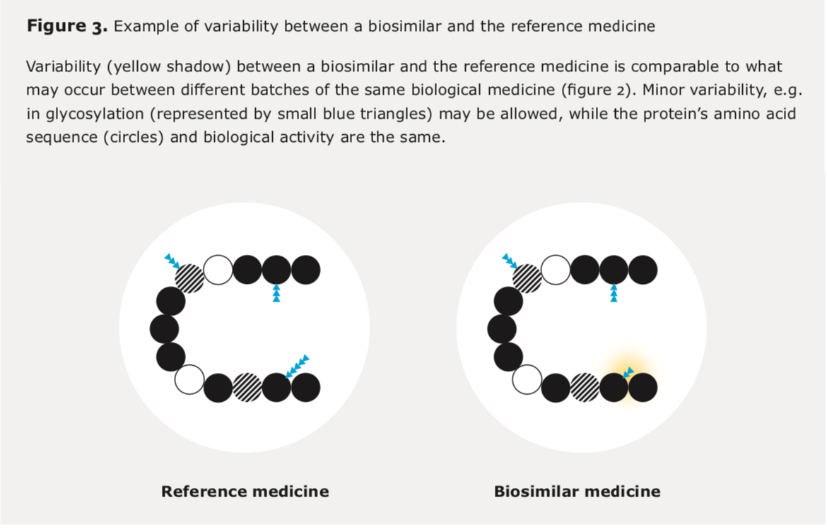
Variability between a biosimilar and reference medicine
Biosimilars in the EU. Information Guide for Healthcare Professionals.

Slide 11
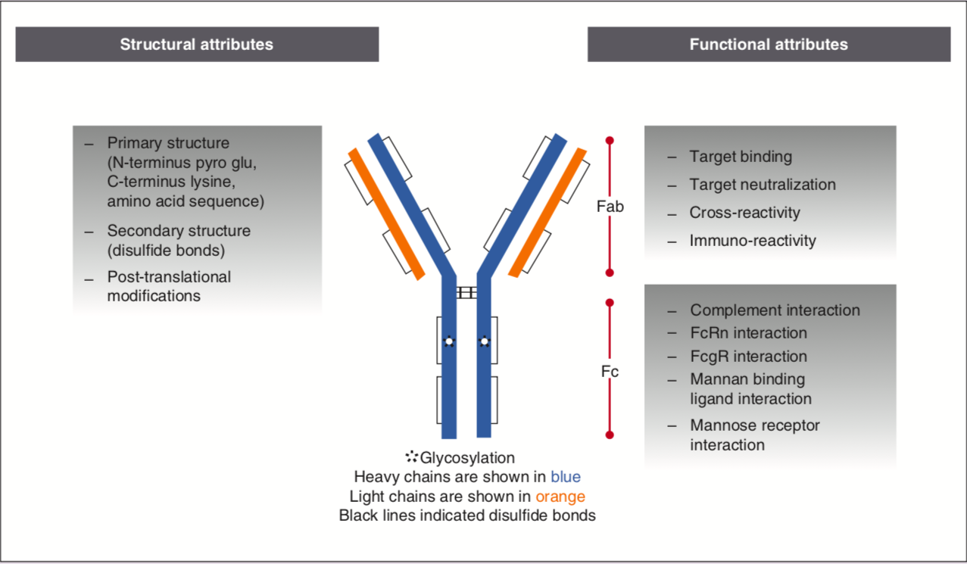
Critical quality attributes of a monoclonal antibody biosimilar
Thill et al. Future Oncol 2019

Slide 12
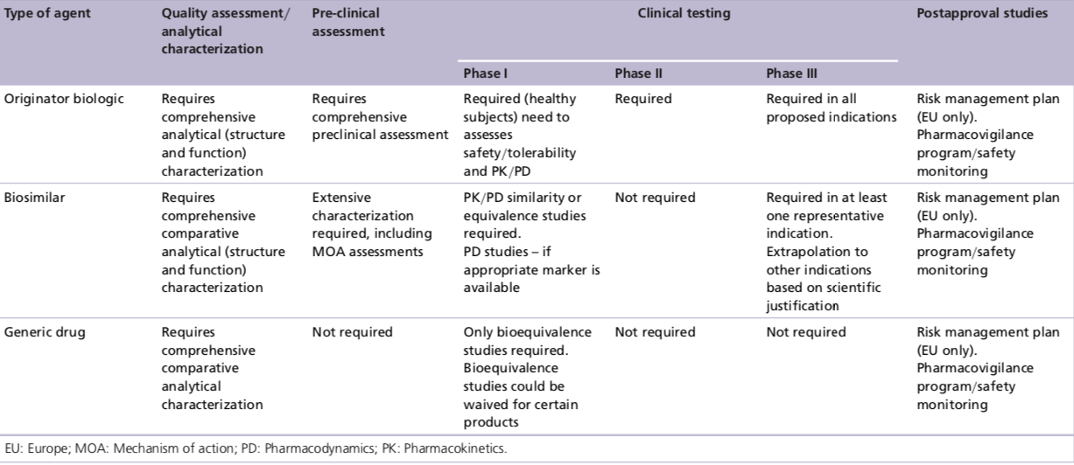
Regulatory requirements for originator biologics, generics and biosimilars

Slide 13
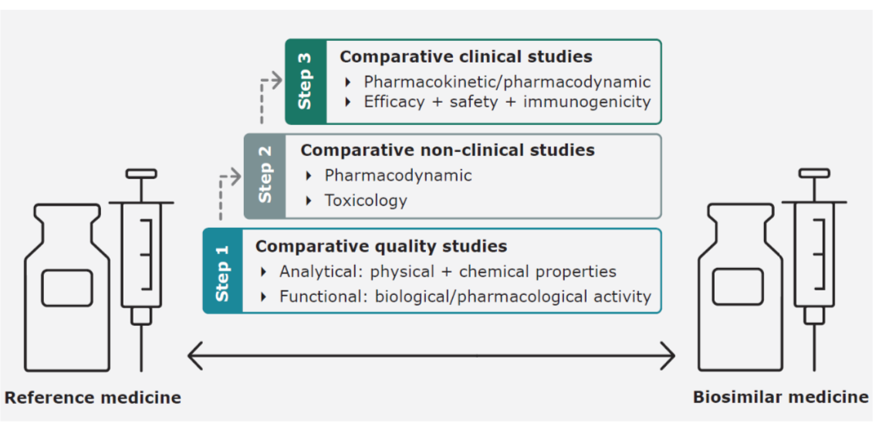
Development of biosimilars
Biosimilars in the EU. Information Guide for Healthcare Professionals.

Slide 14
EMA guidelines: study design

Slide 15
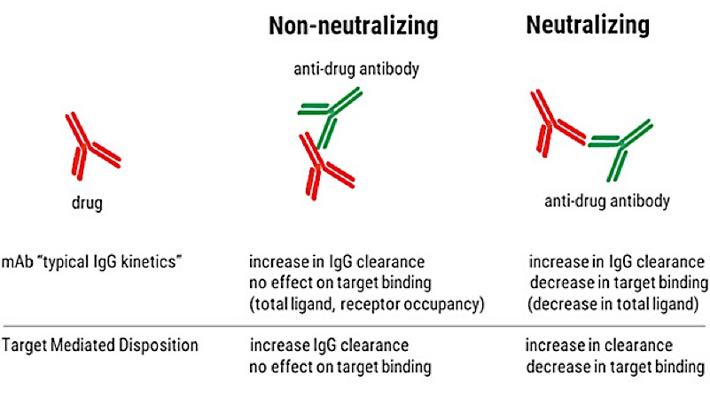
Immunogenicity
Severe reactions due to an increased immune response are very rare and most often an immune response against a biological medicine is not associated with clinical consequences (e.g. anti- drug antibodies could be transient).
For approval immunogenicity data required
Incidence
Title antibodies against the biological medicine (ADAs)
Persistence
Biosimilars in the EU. Information Guide for Healthcare Professionals.

Slide 16
Extrapolation
The EMA defines extrapolation as “extending information and conclusions available from studies in one or more subgroups of the patient population (source population)... to make inferences for another subgroup of the population (target population), or condition or product, thus reducing the need to generate additional information... to reach conclusions for the target population”…
Biosimilars in the EU. Information Guide for Healthcare Professionals.

Slide 17
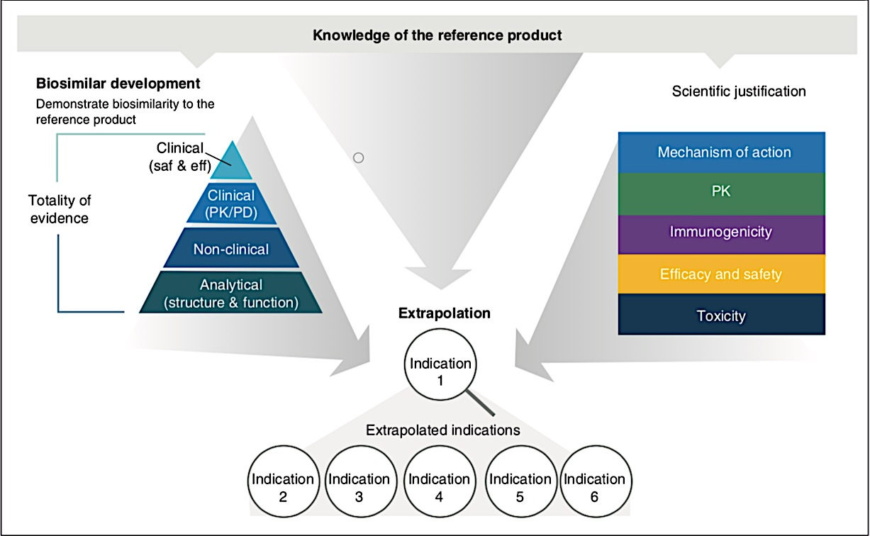
Extrapolation of indication
Thill et al. Future Oncol 2019

Slide 18
Extrapolation of indication
Thill et al. Future Oncol 2019

Slide 19
Extrapolation of indication
Thill et al. Future Oncol 2019

Slide 20
Extrapolation of indication
Thill et al. Future Oncol 2019

Slide 21
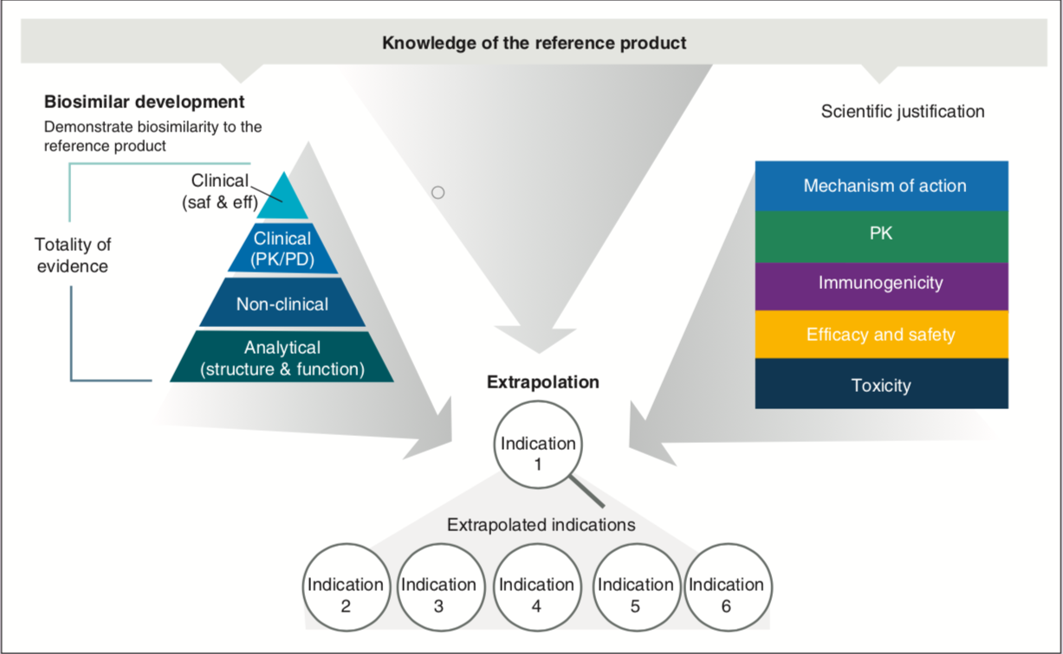
Extrapolation of indication
Extrapolation of immunogenicity data
Extrapolation of safety data
Thill et al. Future Oncol 2019

Slide 22
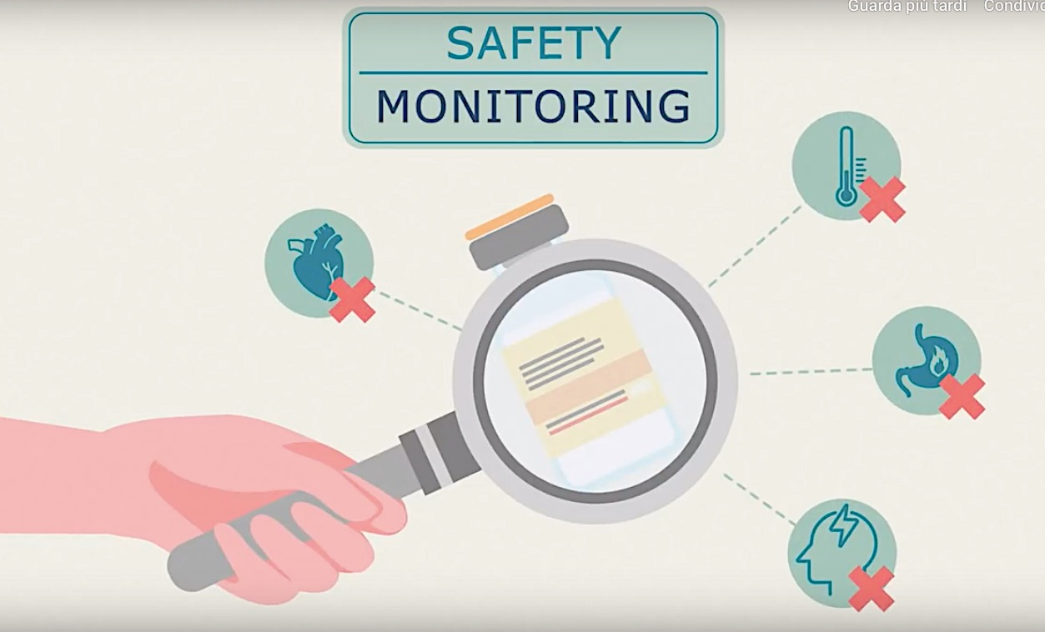
Post approval: Pharmacovigilance
Biosimilars in the EU. Information Guide for Healthcare Professionals.
Notes:
strumenti di monitoraggio postmarketing, inclusa la conduzione di studi clinici prospettici di real life, possono essere opportuni per aumentare la fiducia nel farmaco biosimilare, incentivandone l’accettazione da parte della classe medica.

Slide 23
Post approval: Pharmacovigilance
12 /7/19
Valutazione dei Rapporti Periodici di Sicurezza (PSURs)
Notes:
strumenti di monitoraggio postmarketing, inclusa la conduzione di studi clinici prospettici di real life, possono essere opportuni per aumentare la fiducia nel farmaco biosimilare, incentivandone l’accettazione da parte della classe medica.

Slide 24
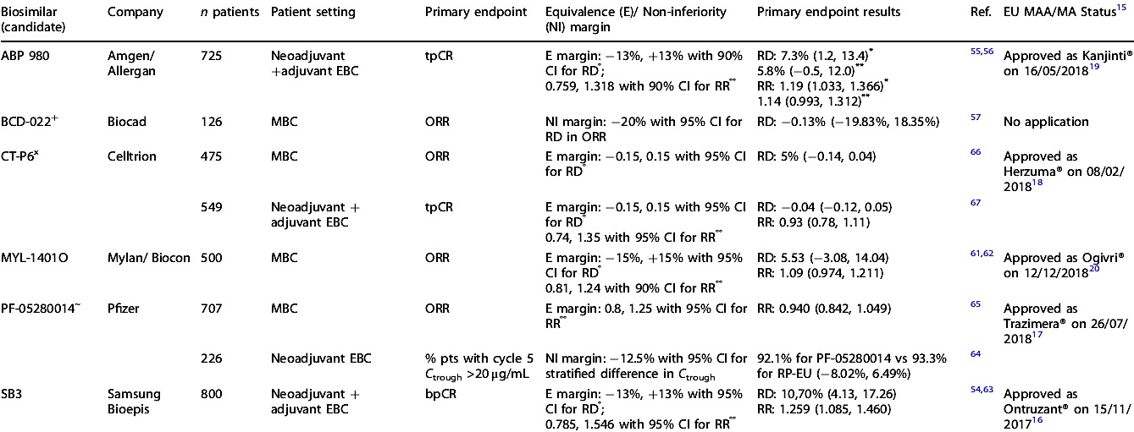
Phase III- primary endpoint results for the trastuzumab biosimilars
Barbier L et al. Br J Cancer 2019

Slide 25
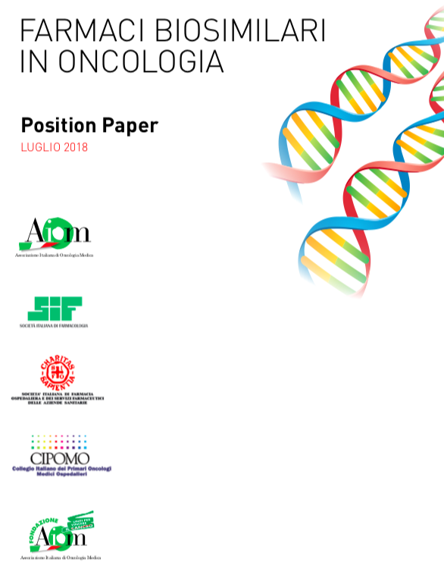

Slide 27
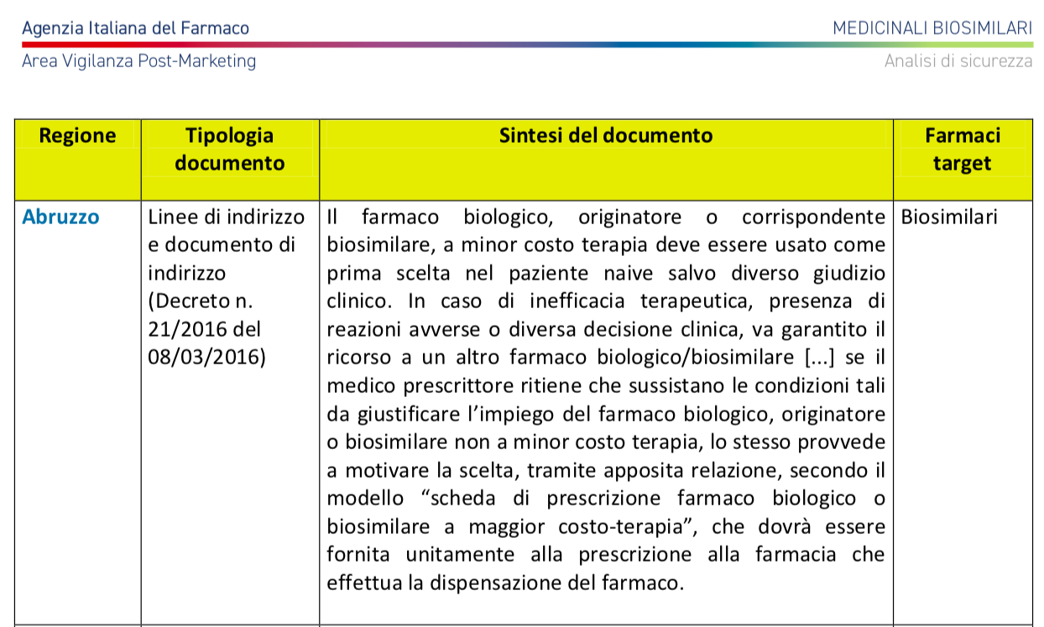

Slide 28
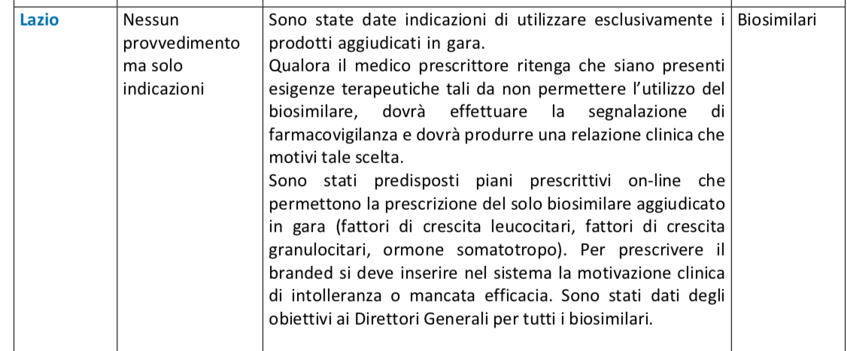

Slide 29
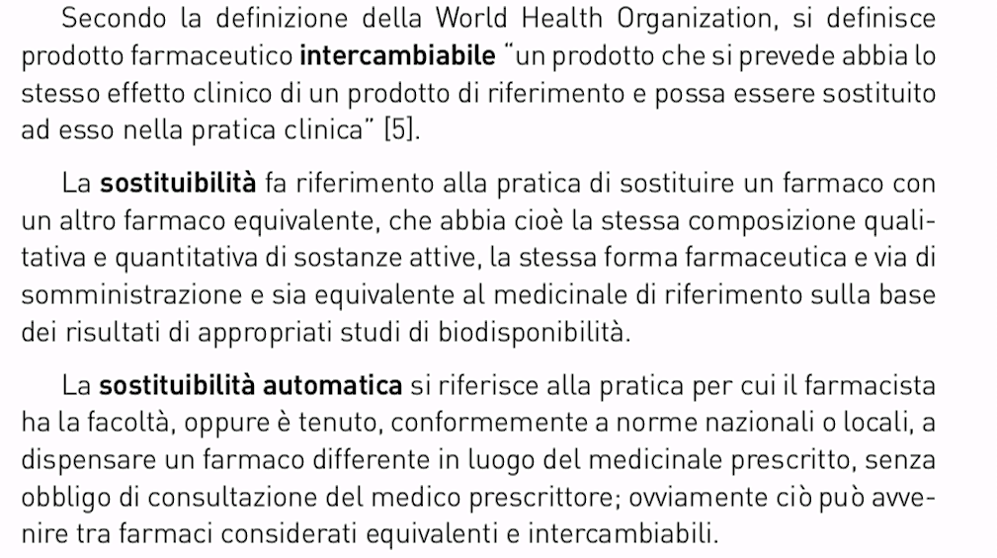
Interchangeability , Switch, Automatic Switch

Slide 30
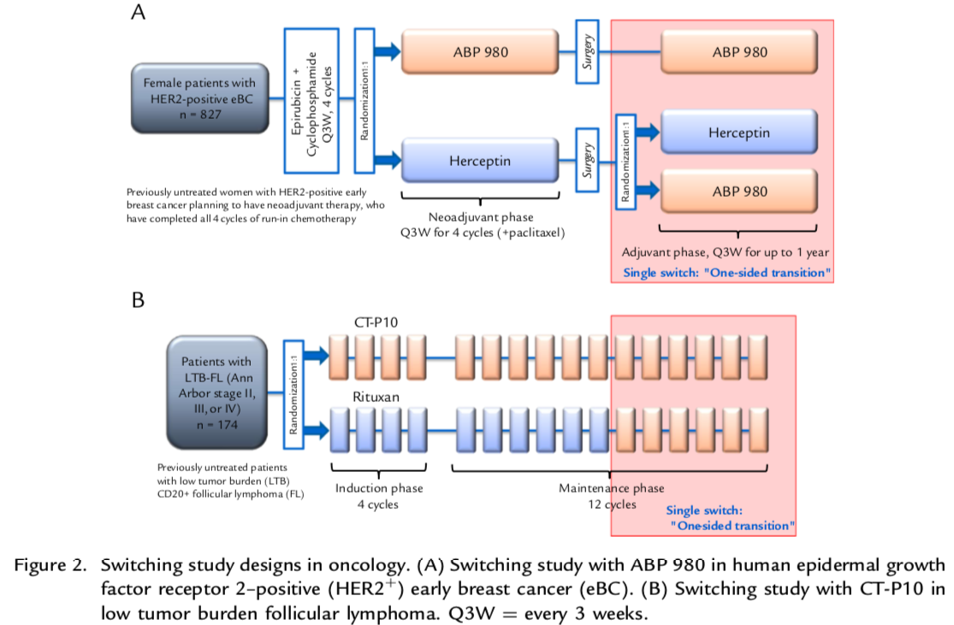
Switching study designs in oncology
Declerck P et al. Clin Ther 2018

Slide 31
LILAC trial: phase III equivalence study

Slide 32
LILAC trial: phase III equivalence study

Slide 33
LILAC trial: phase III equivalence study

Slide 34
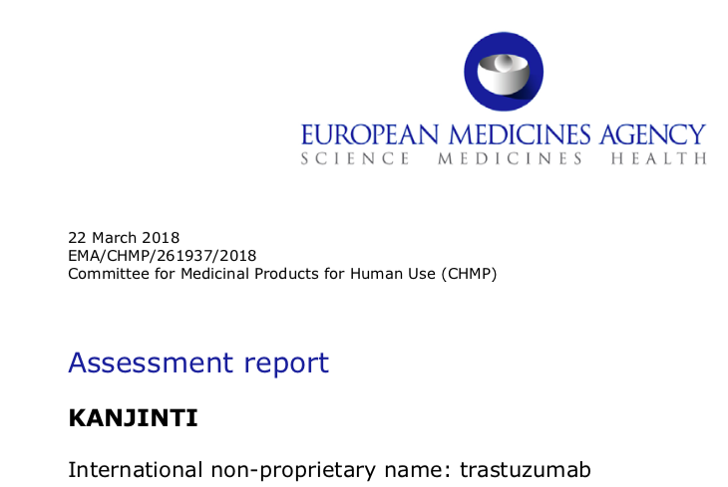
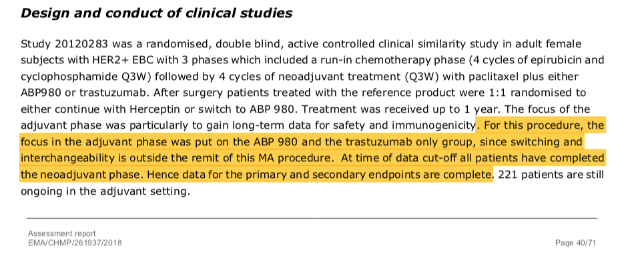

Slide 35
The decision on whether to allow interchangeable use and substitution of the reference biological medicine and the biosimilar is taken at national level.
Interchangeability and switching should only be permitted if:
the physician is well-informed about the products;
the patient is fully briefed by the physician
A nurse is closely monitoring the changes and tracking any adverse events.
Automatic substitution, which might be practice for generics, should therefore be avoided in the field of biosimilars !
J Tabernero et al. ESMO 2017

Slide 36
J Tabernero et al. ESMO 2017

Slide 37
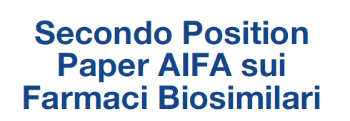
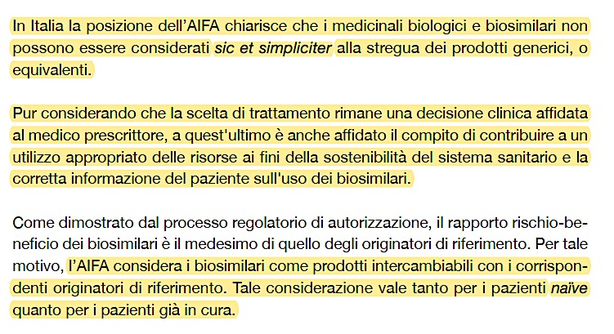

Slide 39
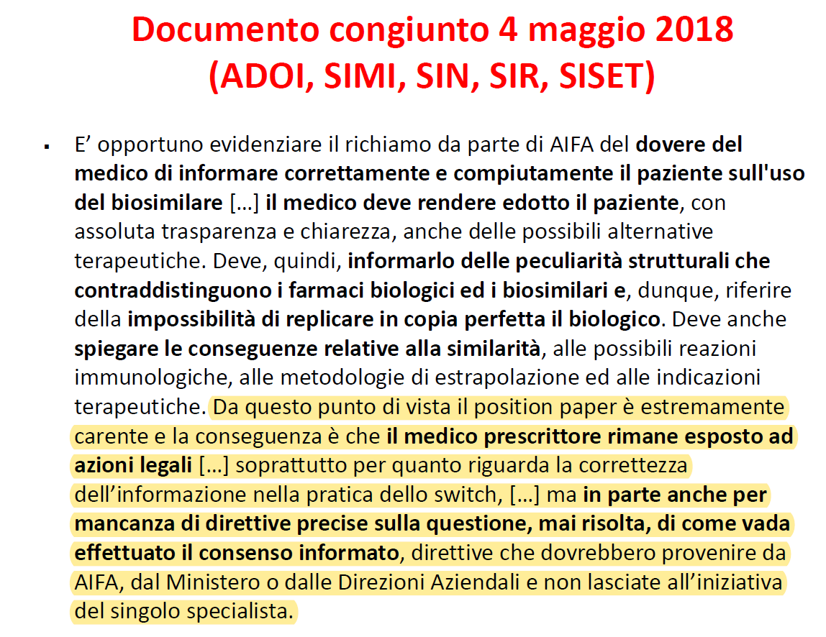

Slide 41
Results of Switching Studies in Inflammatory Diseases With Biosimilars of Other mAbs
“Switching data from these studies generally found no differences in terms of efficacy and safety profile between patients who switched treatment versus patients who did not.
However, for many of these biosimilars the longer term impact of switching has not yet been fully assessed and it is also important to keep in mind that results of switching studies cannot be generalized to other biologics and their biosimilars”
Declerck P el al. Clin Ther 2018

Slide 42
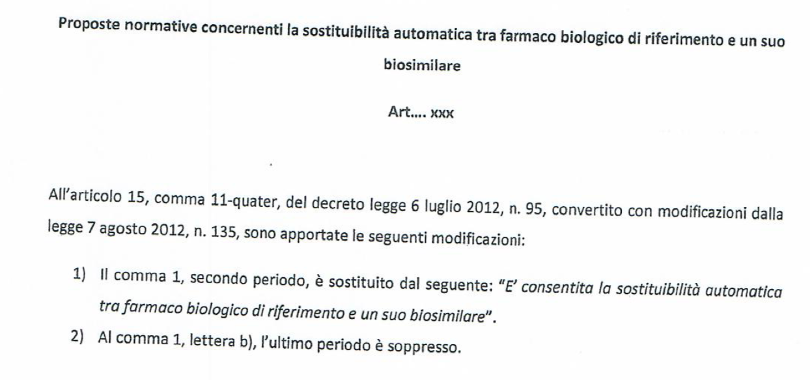

Slide 43
Why do need biosimilars

Slide 44
Take home messages
Biological medicines are innovative and are making a significant contribution to the treatment and management of a wide variety of diseases
Potentially, biosimilars could open up patient access to these medicines at a reduced cost, without impacting on quality, efficacy or safety
Pharmacovigilance is a key element in the acceptance of biosimilars, since the clinical studies required for the biosimilar pathway are abbreviated in comparison with those conducted by the original manufacturer of the drug molecule.
When switching between biosimilars or between a biosimilar and the originator formulation decisions should be based on the scientific data available and accurate clinical follow-up observations should be made
Grazie a tutti per l’attenzione!

