Slide 1
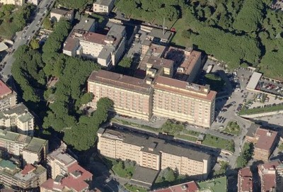
New drugs for the treatment of advanced melanoma: immunotherapy & target therapy
Antonio M. Grimaldi
Melanoma, Cancer Immunotherapy and Innovative Therapy Unit
Istituto Nazionale Tumori Fondazione “G. Pascale” - Napoli
Direttore: Paolo A. Ascierto

Slide 2
Therapies approved for BRAFV600 metastatic melanoma
2011 | 2012 | 2013 | 2014 | 2015 | 2016 | 2017 | 2018 | 2019
IPI FDA approved
DAB FDA approved
NIVO FDA approved
ENCO + BINI FDA approved
IPI EMA approved
DAB EMA approved
NIVO EMA approved
ENCO + BINI EMA approved
VEM FDA approved
DAB + TRAM FDA approved
IPI + NIVO EMA approved
VEM EMA approved
DAB + TRAM EMA approved
IPI + NIVO FDA approved
VEM + COBI FDA approved
VEM + COBI EMA approved
Notes:
Full reference list
Business Wire. Press release. 20 Sep 2018. Available from: https://www.businesswire.com/news/home/20180920005705/en/Pierre-Fabre-Receives-EU-Approval-BRAFTOVI%C2%AE-encorafenib (Accessed 10 Oct 2018); EMA. Cotellic: EPAR product information. Aug 2018. Available from: https://www.ema.europa.eu/documents/variation-report/opdivo-h-c-3985-ii-0003-epar-assessment-report-variation_en.pdf (Accessed 10 Oct 2018); EMA. Mekinist: EPAR product information. Sep 2018. Available from: https://www.ema.europa.eu/documents/product-information/mekinist-epar-product-information_en.pdf (Accessed 10 Oct 2018); EMA. Opdivo: EPAR product information. Oct 2018. Available from: https://www.ema.europa.eu/documents/product-information/opdivo-epar-product-information_en.pdf (Accessed 10 Oct 2018); EMA. Opdivo: EPAR assessment report variation. Jun 2016. Available from: https://www.ema.europa.eu/documents/variation-report/opdivo-h-c-3985-ii-0003-epar-assessment-report-variation_en.pdf (Accessed 10 Oct 2018); EMA. Tafinlar: EPAR product information. Sep 2018. Available from: https://www.ema.europa.eu/documents/product-information/tafinlar-epar-product-information_en.pdf (Accessed 10 Oct); EMA. Yervoy: EPAR product information. Oct 2018. Available from: https://www.ema.europa.eu/documents/product-information/yervoy-epar-product-information_en-0.pdf (Accessed 10 Oct 2018); EMA. Zelboraf: EPAR product information. Aug 2018. Available from: https://www.ema.europa.eu/documents/product-information/zelboraf-epar-product-information_en.pdf (Accessed 10 Oct 2018); FDA. Braftovi new drug application approval. Jun 2018. Available from: https://www.accessdata.fda.gov/drugsatfda_docs/appletter/2018/210496Orig1s000ltr.pdf (Accessed 10 Oct 2018); FDA. Cotellic new drug application approval. Nov 2015. Available from: https://www.accessdata.fda.gov/drugsatfda_docs/appletter/2015/206192Orig1s000Ltr.pdf (Accessed 10 Oct 2018); FDA. Mekinist new drug application approval. May 2013. Available from: https://www.accessdata.fda.gov/drugsatfda_docs/appletter/2013/204114Orig1s000ltr.pdf (Accessed 10 Oct 2018); FDA. Opdivo biologicals license application approval. Dec 2014. Available from: https://www.accessdata.fda.gov/drugsatfda_docs/appletter/2014/125554Orig1s000ltr.pdf (Accessed 10 Oct 2018); FDA. Opvido/Yervoy supplemental biologics license application approval. Sep 2015. Available from: https://www.accessdata.fda.gov/drugsatfda_docs/appletter/2015/125554Orig1s002ltr.pdf (Accessed 10 Oct 2018); FDA. Tafinlar new drug application approval. May 2013. Available from: https://www.accessdata.fda.gov/drugsatfda_docs/appletter/2013/202806Orig1s000ltr.pdf (Accessed 10 Oct 2018); FDA. Yervoy biologicals license application approval. Mar 2011. Available from: https://www.accessdata.fda.gov/drugsatfda_docs/appletter/2011/125377s000ltr.pdf (Accessed 10 Oct 2018); FDA. Zelboraf new drug application approval. Aug 2011. Available from: https://www.accessdata.fda.gov/drugsatfda_docs/appletter/2011/202429Orig1s000ltr.pdf (Accessed 10 Oct)

Slide 3
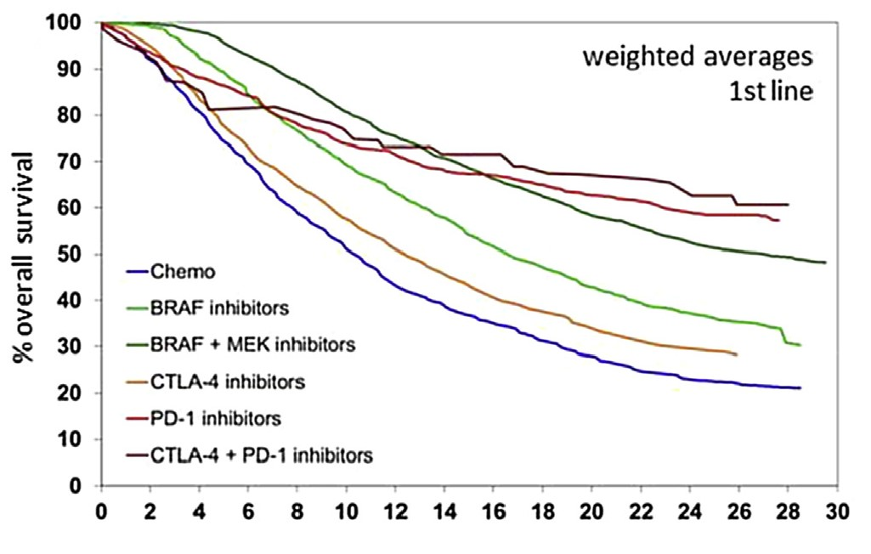
First-line therapy: Overall survival
Korn metanalysis
Mean survival curves created by weighted averaging of digitised Kaplan-Meier survival curves of metastatic melanoma patients treated in selected clinical trials.
Ugurel S, Roehmel J, Ascierto PA, Flaherty KT, Grob JJ, Hauschild A, Larkin J, Long GV, Lorigan P, McArthur GA, Ribas A, Robert C, Schadendorf D, and Garbe C: Eur J Cancer 53: 125-134 (2016)
Paolo A. Ascierto

Slide 4
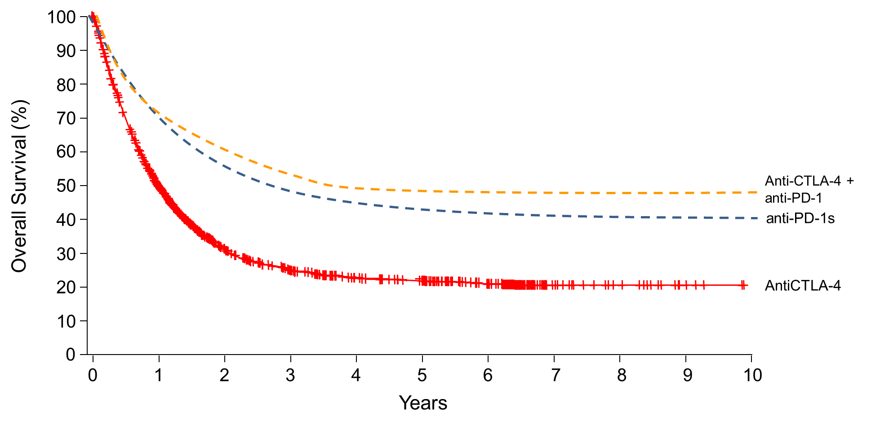
Long-term benefit …
Paolo A. Ascierto

Slide 5
Are there still unmet needs in advanced melanoma ?
Paolo A. Ascierto

Slide 6
Long-term benefit …
Paolo A. Ascierto

Slide 7
How can we make more responsive the tumor? (overcoming primary resistance)
How can we reduce the risk of relapse?
(overcoming acquired resistance)
Paolo A. Ascierto

Slide 8
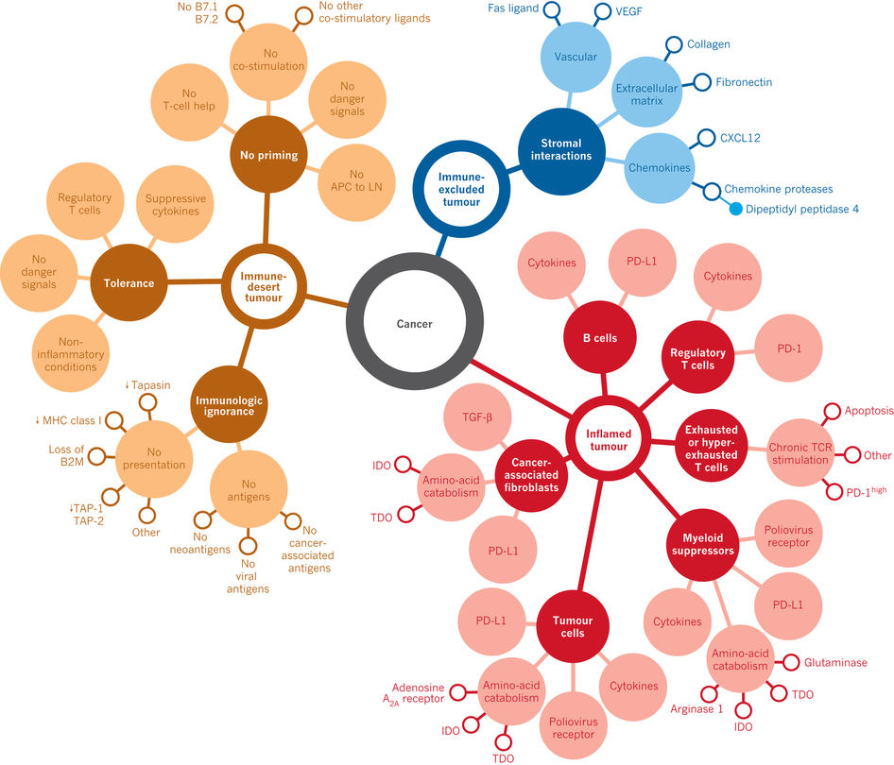
Cancer-immune phenotypes
Chen DS, Mellman I Nature 2017; 541, 321–330.
Paolo A. Ascierto

Slide 9
Potential combination strategies for the treatment of cancer
Immunotherapy plus radiotherapy
Immunotherapy plus immunotherapy
Potential combinations
Immunotherapy plus targeted therapy
Immunotherapy plus chemotherapy
Paolo A. Ascierto

Slide 10
Potential combination strategies for the treatment of cancer
Immunotherapy plus immunotherapy
Potential combinations
Paolo A. Ascierto

Slide 11
What about the role of loco-regional treatments ?
Paolo A. Ascierto

Slide 12
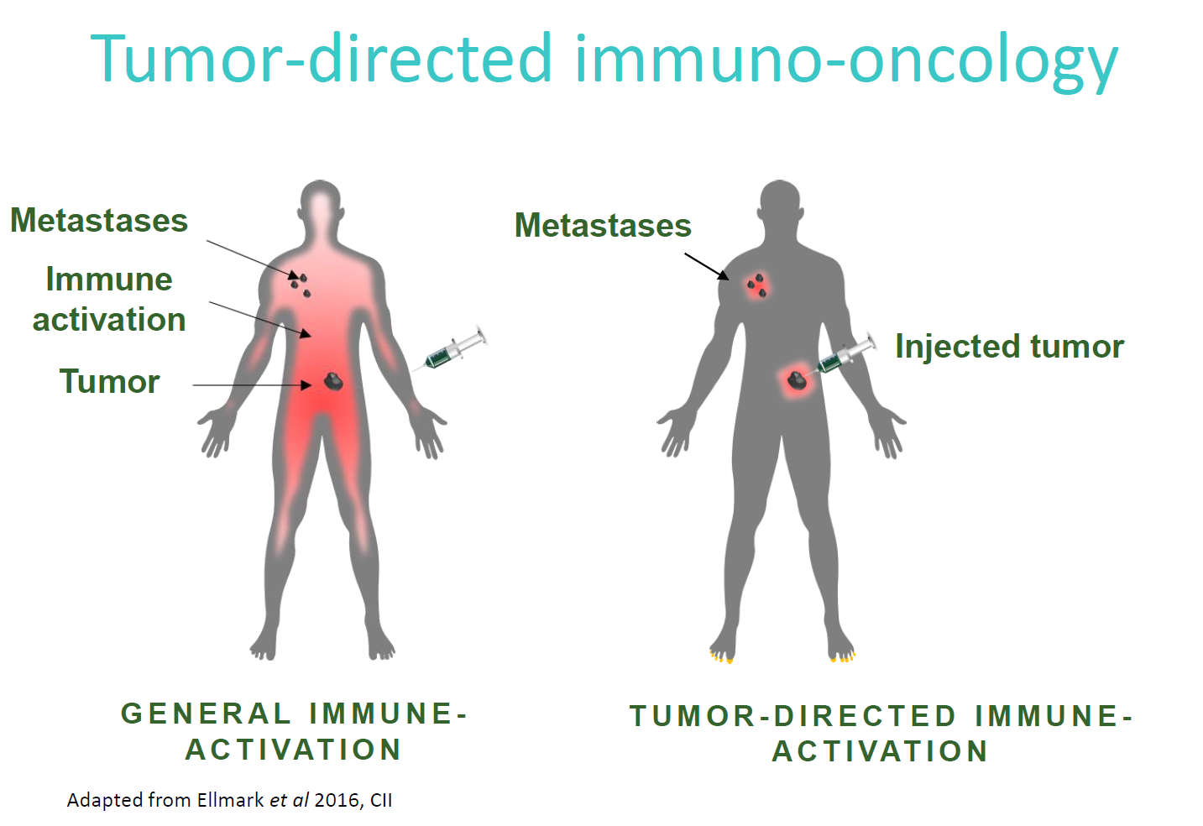

Slide 13
T-VEC + ipilimumab
All lesions
Non injected visceral lesions
Chesney et al JCO 2017
Paolo A. Ascierto

Slide 14
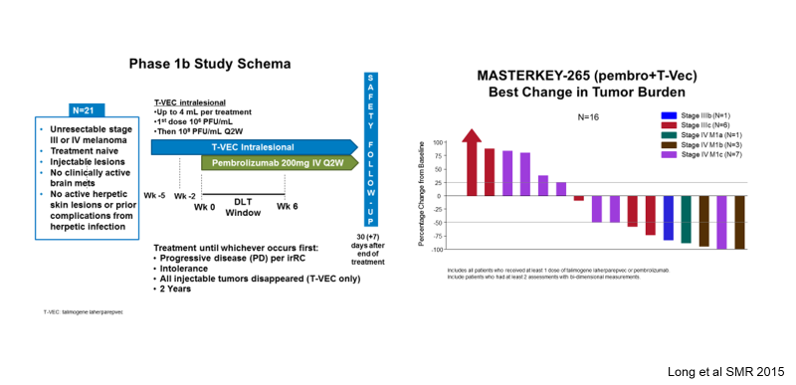
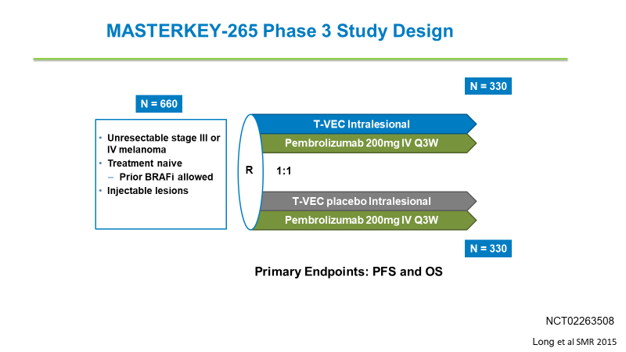
T-VEC + pembrolizumab
Long et al SMR 2015
Paolo A. Ascierto

Slide 15
Loco-regional drugs in clinical development …
T-VEC (Talimogene laherparepvec) (approved FDA/EMA)
PV-10 (10% rose bengal disodium) (phase III)
CVA21 (Coxsackie virus A21) (phase I-II)
pIL-12 (Plasmid IL-12 and electroporation) (phase I-II)
LTX-315 (peptide derived from lactoferricin) (phase I)
Others (TLRs, STING agonist, etc.) (phase I and III)
Paolo A. Ascierto

Slide 16
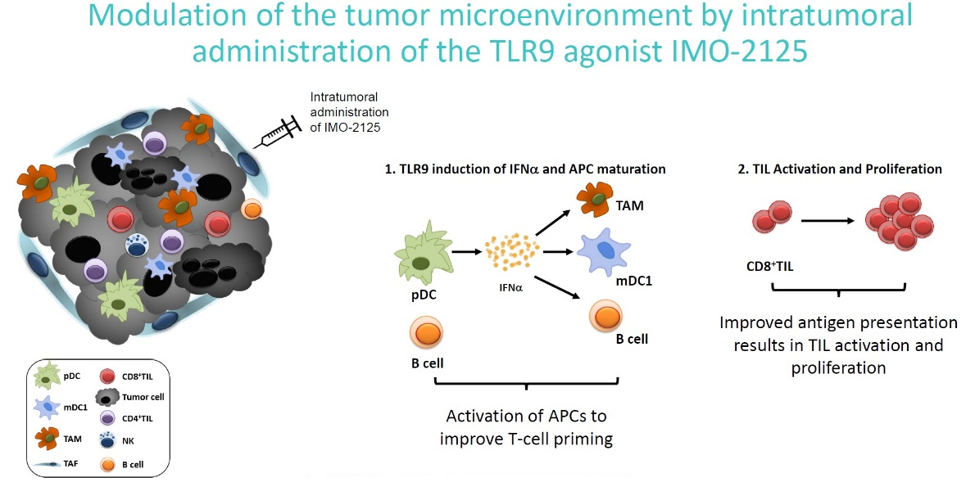
New emerging compounds for future combinations: TLR-9
Presented by Paolo A. Ascierto at ASCO 2018

Slide 17
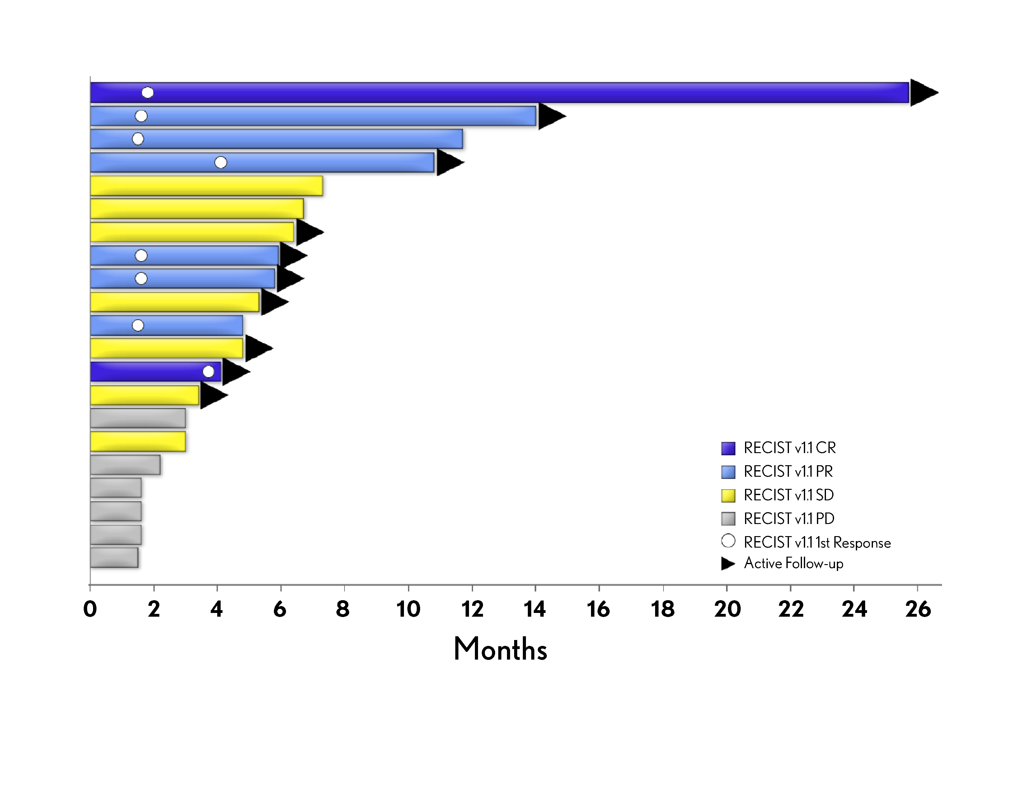
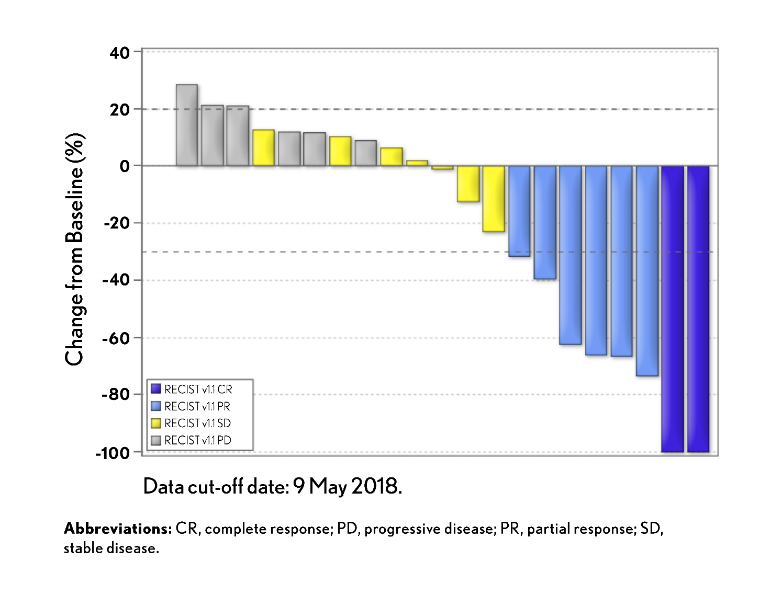
New emerging compounds for future combinations: tilsotolimod
ORR = 38,1%

Slide 18
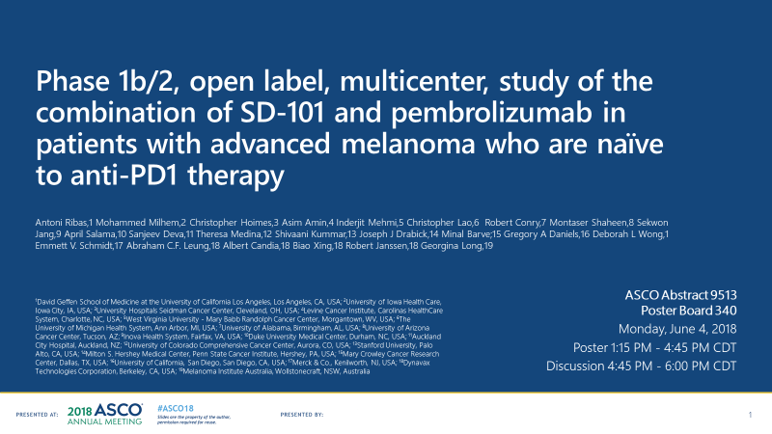
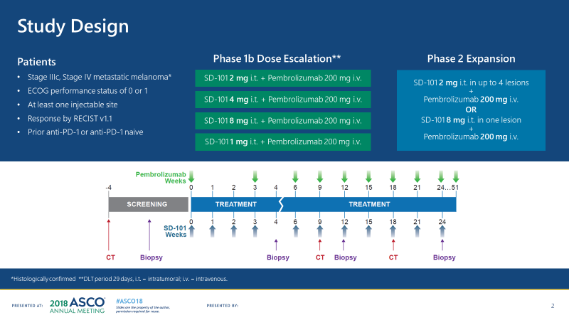
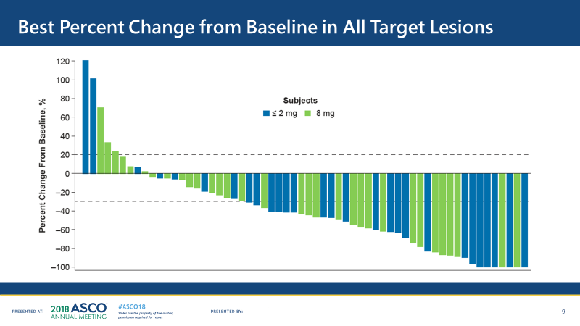
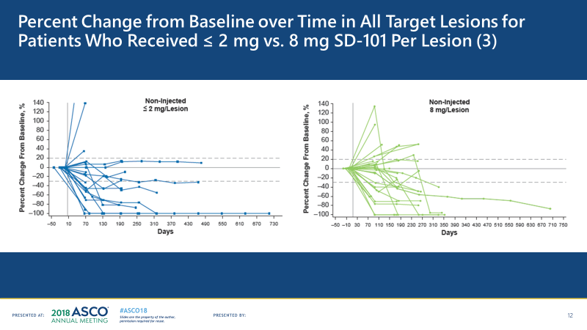
ORR (2 mg/kg)= 70%
ORR (8 mg/kg)= 70%

Slide 19
New emerging pathways for future combination with anti-PD-1/PD-L1 compounds
HDAC inhibitor (eg., entinostat [Ph 2])
IDO1 inhibitor (eg., epacadostat [Ph 3], etc.)
Anti-GITR (eg., BMS-986156 (Ph 1/2])
Anti-LAG-3 (eg., relatlimab [Ph 1/2])
GITR, glucocorticoid-induced TNFR-related protein; HDAC, histone deacetylases; IDO1, indoleamine 2,3-dioxygenase 1; LAG-3, lymphocyte-activation gene 3
Presented by Paolo A. Ascierto at ASCO 2018
Ascierto PA & McArthur JA. J Transl Med 2017;15:173

Slide 20
New emerging pathways for future combination with anti-PD-1/PD-L1 compounds: IDO1 inhibition
IDO1 inhibitors
(eg., epacadostat [ph. 2/3], indoximod [ph. 2/3], BMS.986205 [ph. 2/3])
Ascierto PA & McArthur JA. J Transl Med 2017;15:173
Paolo A. Ascierto

Slide 21
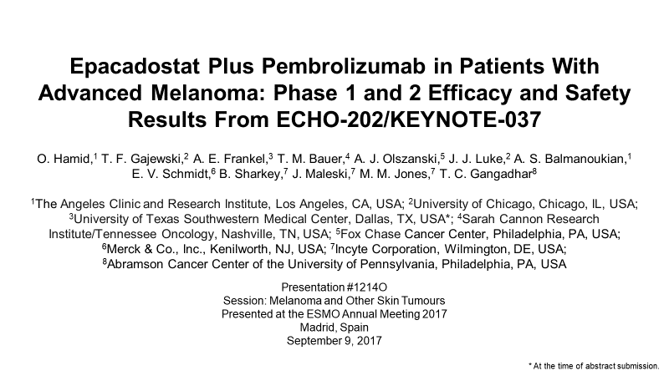
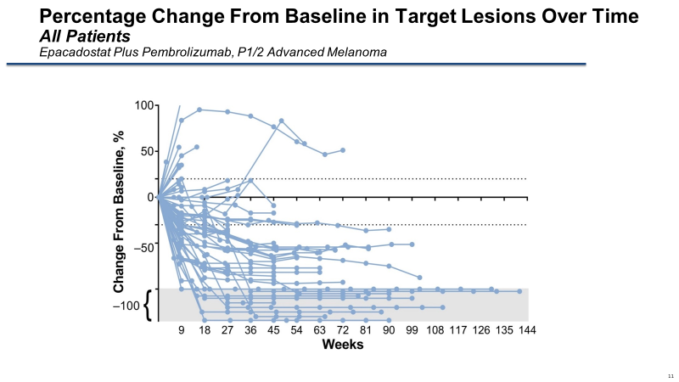
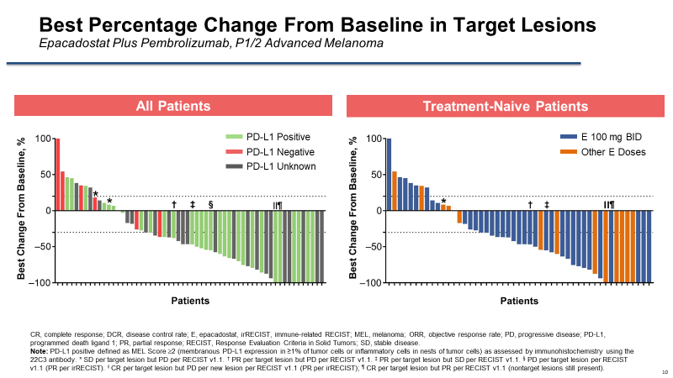
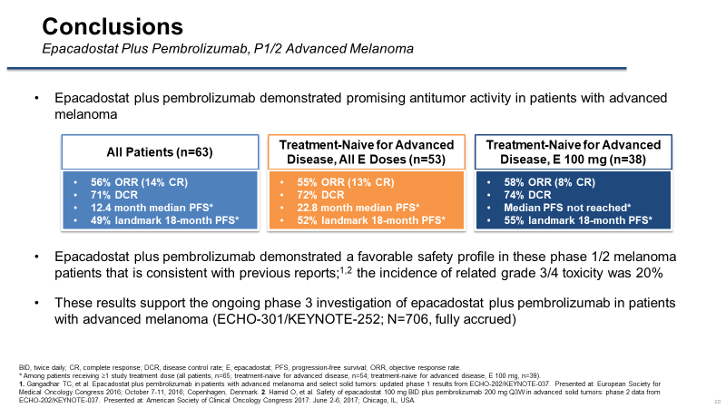
Presented by Paolo A. Ascierto at ASCO 2018

Slide 22
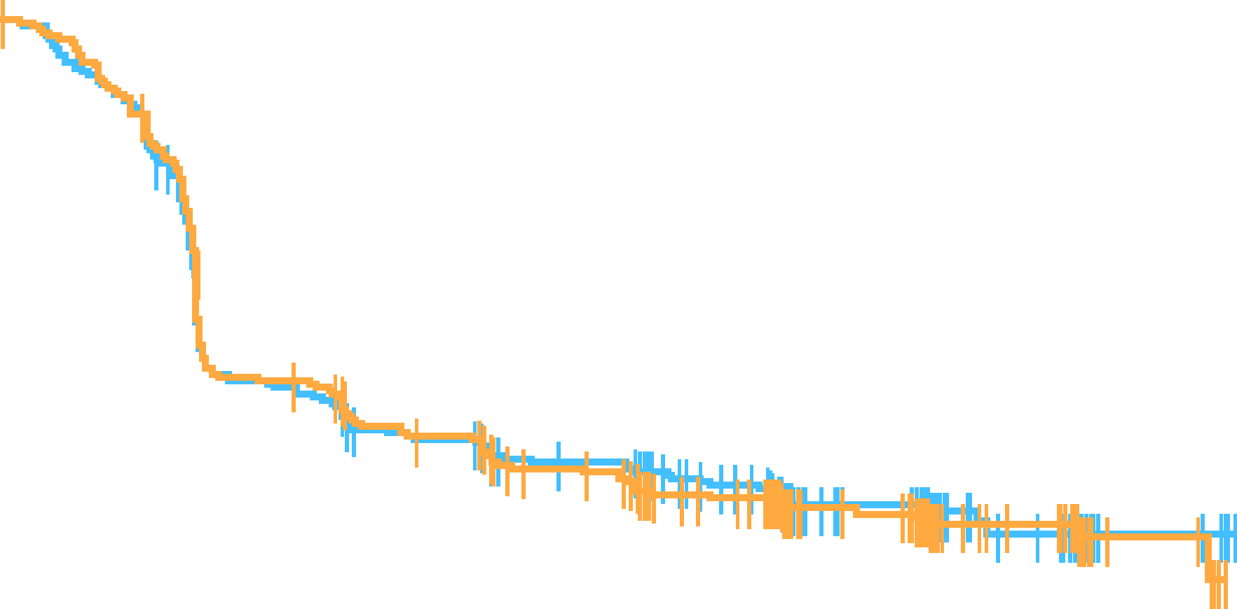
Progression-Free Survival (RECIST v1.1, BICR)
100
 | Events, n (%) | Median PFS, months (95% CI)
E + P | 218 (61.6) | 4.7 (2.9−6.8)
Placebo + P | 219 (62.2) | 4.9 (2.9−6.8)
90
80
70
HR (95% CI): 1.00 (0.83−1.21)
P = 0.517
60
45.8%
36.9%
Progression-Free Survival (%)
45.8%
36.6%
50
40
30
E + P
Placebo + P
20
10
0
0
2
4
6
8
10
12
14
16
18
Number at risk
Time, months
E + P
Placebo + P
354
352
309
304
181
181
155
151
137
132
114
109
57
65
25
28
5
7
0
0
BICR, blinded independent central review; CI, confidence interval; E, epacadostat; HR, hazard ratio; P, pembrolizumab; PFS, progression-free survival; RECIST, Response Evaluation Criteria In Solid Tumors.
PFS defined as time from randomization to disease progression or death, whichever occurred first.
Georgina V. Long

Slide 23
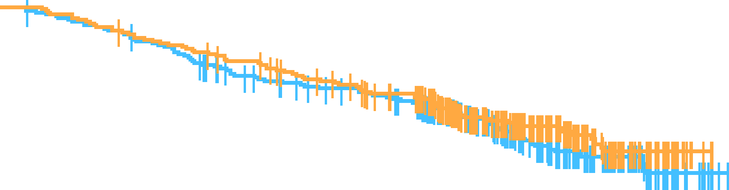
Overall Survival
 | Events, n (%) | Median OS, months (95% CI)
E + P | 106 (29.9) | NR (NR, NR)
Placebo + P | 98 (27.8) | NR (NR, NR)
100
90
HR (95% CI): 1.13 (0.86–1.49)
P = 0.807
80
70
84.1%
60
87.2%
74.4%
Overall Survival (%)
74.1%
50
40
E + P
Placebo + P
30
20
10
0
0
2
4
6
8
10
12
14
16
18
Number at risk
Time, months
E + P
Placebo + P
354
352
340
342
322
323
290
304
274
285
263
263
183
186
96
115
42
43
5
2
CI, confidence interval; E, epacadostat; HR, hazard ratio; NR, not reached; OS, overall survival; P, pembrolizumab.
Georgina V. Long

Slide 24
New emerging pathways for future combination with anti-PD-1/PD-L1 compounds: anti-LAG-3
anti-LAG-3
(eg., relatlimab [ph. 1/2/3], etc.)
Ascierto PA & McArthur JA. J Transl Med 2017;15:173
Paolo A. Ascierto

Slide 25
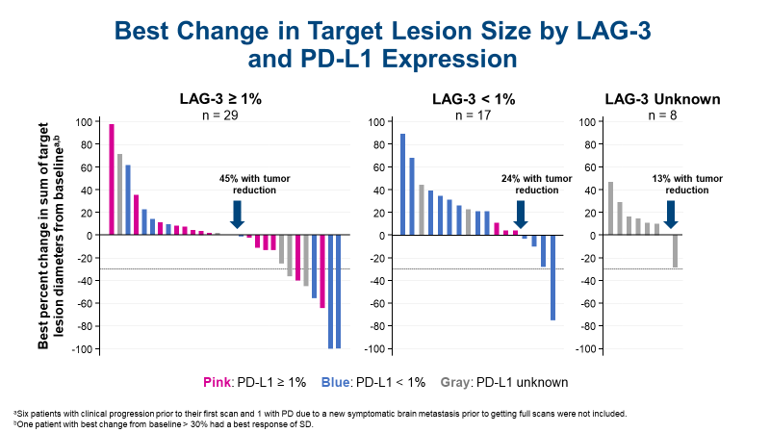
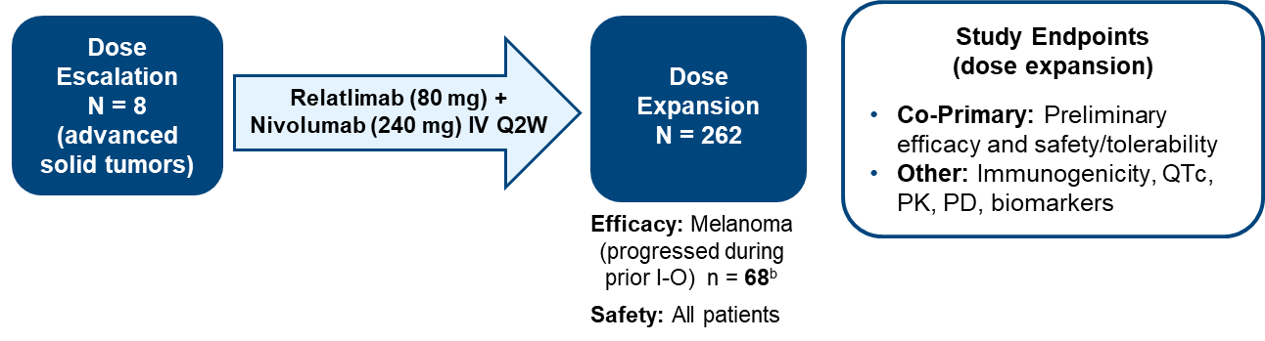
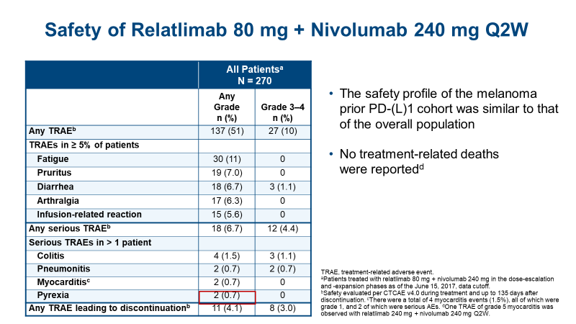
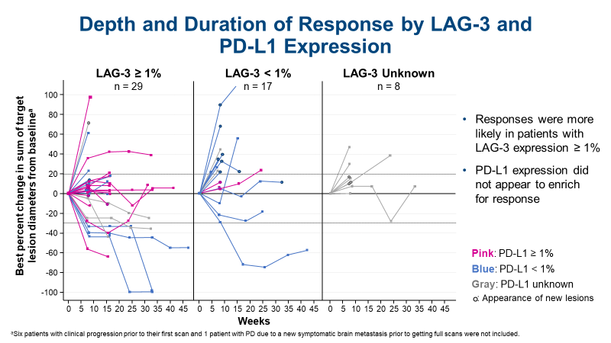
Presented by Paolo A. Ascierto at ASCO 2018
Ascierto PA, et al. ESMO 2017

Slide 26
CA224-047: Randomized, Double-blind Phase 2/3 Study of Relatlimab Combined with Nivolumab versus Nivolumab in Participants with Previously Untreated Metastatic or Unresectable Melanoma
Phase II
Phase III
ARM A
relatlimab + nivolumab
160/480 mg IV Q4W
ARM A
relatlimab + nivolumab
160/480 mg IV Q4W
Unresectable or metastatic melanoma
Previously untreated
Tissue available for LAG-3, PD-L1, TMB assessment
Stratify by:
    LAG-3 status
    PD-L1 status
    BRAF status
    AJCC M-stage
R
1:1
Interim
analysis
R
1:1
N = 400 pts
additional
N = 300 pts
ARM B
nivolumab
480 mg IV Q4W
ARM B
nivolumab
480 mg IV Q4W
Phase II primary endpoint: ORR assessed by a BICR
Phase II secondary endpoint: ORR, DOR, DCR, PFS rates, and 1- and 2-year OS rates according LAG-3 and PD-L1 status, safety and tolerability
Phase III primary endpoint: PFS
Phase III secondary endpoint: ORR, OS
Presented by Paolo A. Ascierto at ASCO 2018
Clinicaltrial.gov identifier NCT03470922

Slide 27
New emerging pathways for future combination with anti-PD-1/PD-L1 compounds: HDAC inhibitors
HDAC inhibitors (eg., entinostat, etc.)
Ascierto PA & McArthur JA. J Transl Med 2017;15:173
Paolo A. Ascierto

Slide 28
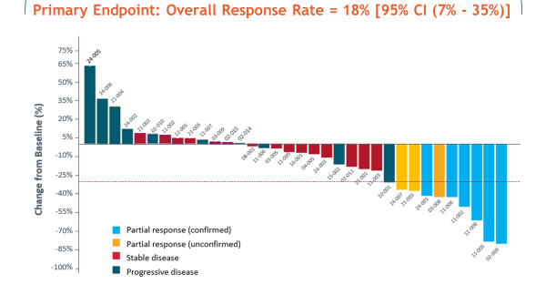
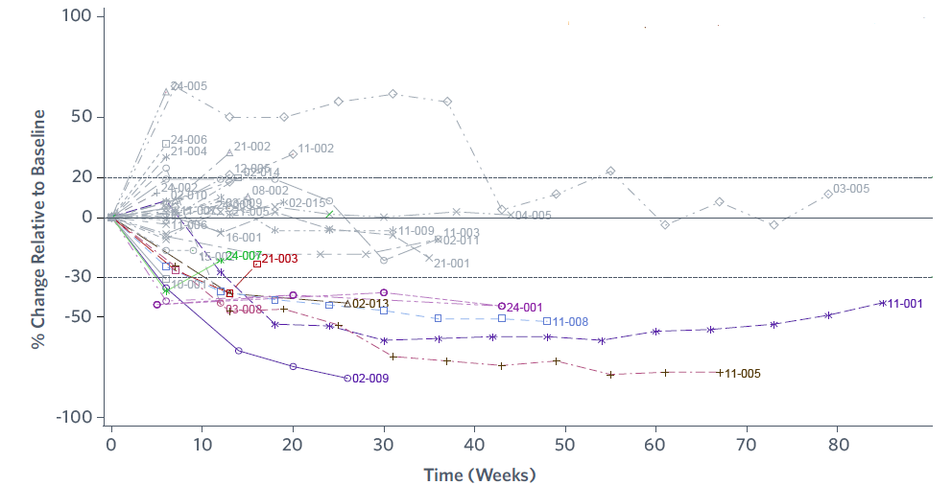
Entinostat + pembrolizumab
Related AEs occurring in >10% of patients | Total (n = 34)
 | All Grades | Grade ≥3
Subjects w/ >1 related adverse event | 30 (88%) | 14 (41%)
Nausea | 18 (53%) | -
Fatigue | 12 (35%) | 1 (3%)
Diarrhea | 7 (21%) | -
Pruritus | 6 (18%) | -
Decreased neutrophils | 5 (15%) | -
Anemia | 4 (12%) | 2 (6%)
Arthralgia | 4 (12%) | -
Myalgia | 4 (12%) | -
Decreased platelets | 4 (12%) | -
Rash | 4 (12%) | 2 (6%)
Agarwala SS, et al. ASCO 2018. Abstract 9530

Slide 29
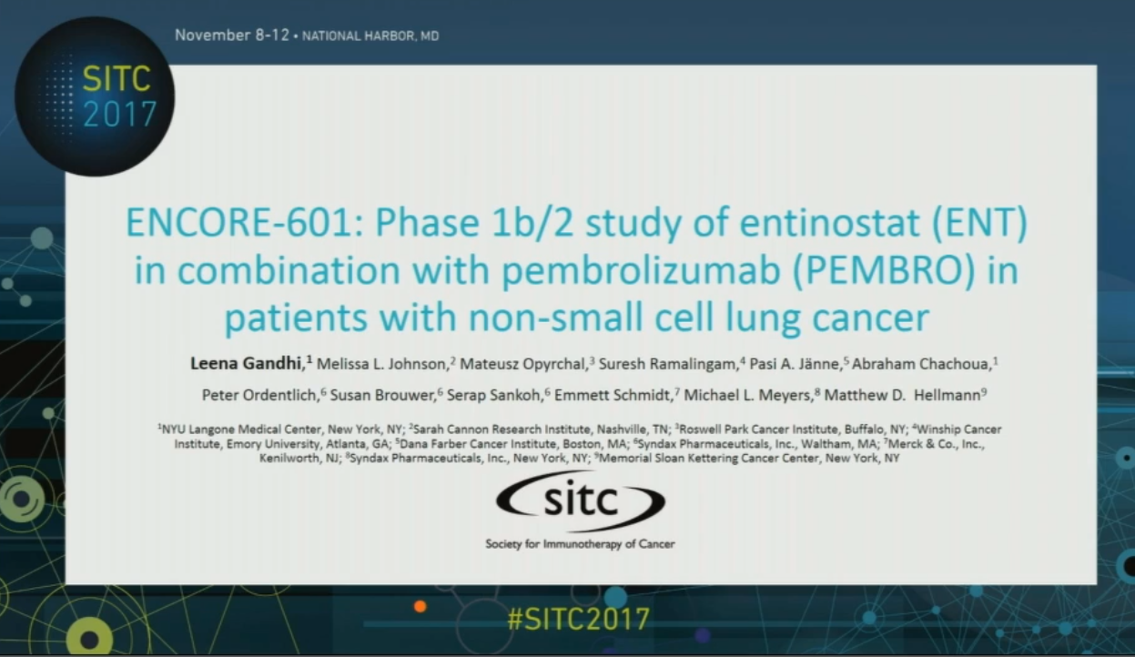
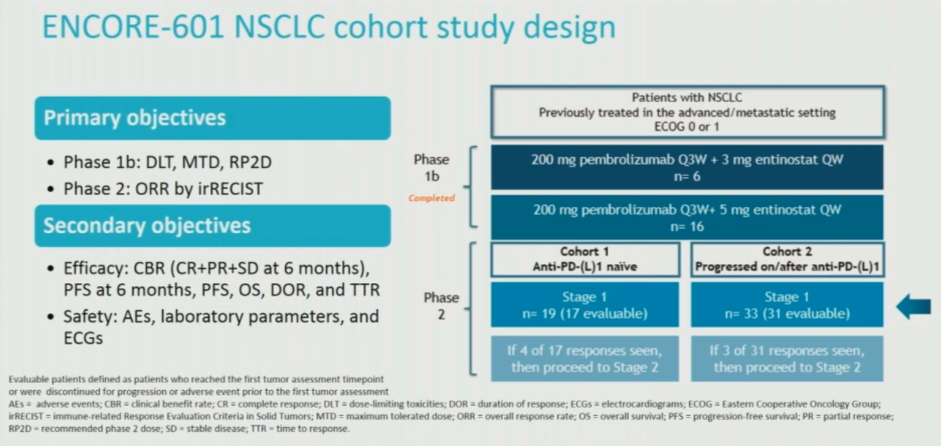
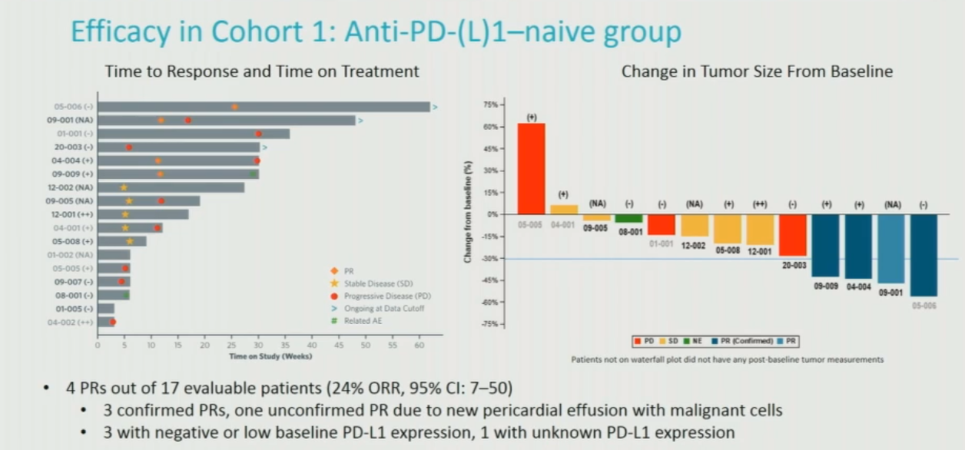
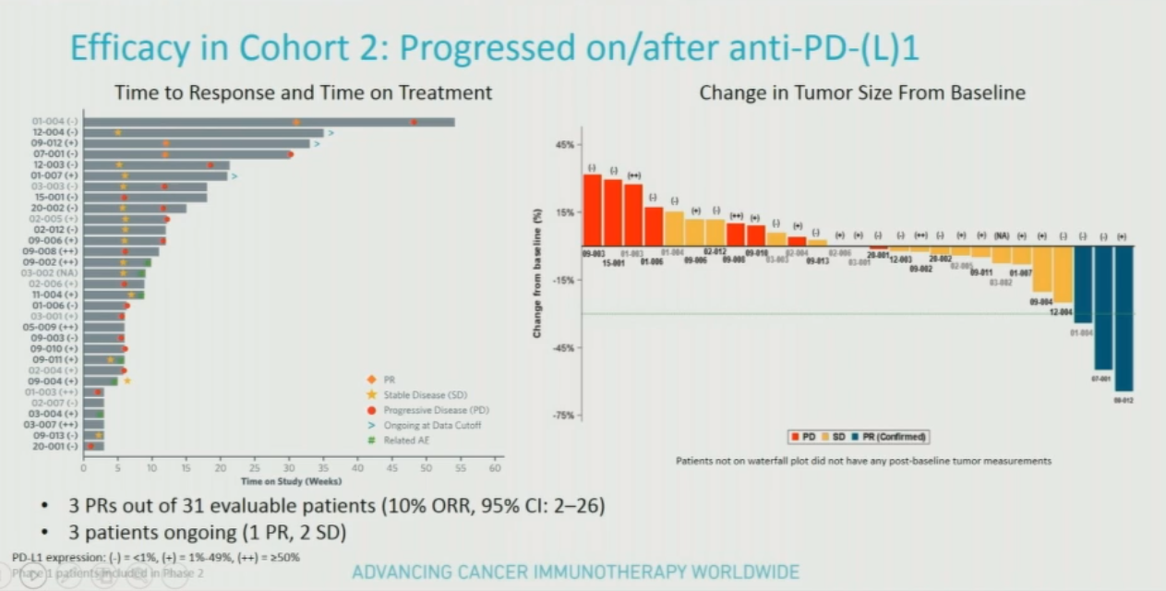

Slide 30
Durable responses were observed in patients who experienced progression on prior anti-PD(L)1 therapy
75%
100
65%
mPFS = 2.8 months (95% CI: 2.1-4.1)
50%
75
35%
20%
50
5%
25
Change from baseline (%)
-10%
Percent change relative to baseline
-25%
0
-40%
-25
-55%
-50
-70%
-85%
-75
-100%
-100
PD SD PR Confirmed
0
6
12
18
24
30
36
42
48
54
60
66
72
78
Time to last scan (weeks)
Objective response rate with ENT + PEMBRO was 10% (7 of 72, 95% CI: 4-19%)
  Prespecified ORR target not reached; median duration of response was 5.3 months
  An additional 50% of patients achieved disease stabilization
Experience similar in PD1-pretreated melanoma (ORR = 18%)¹
CI, confidence interval; ENT, entinostat; PEMBRO, pembrolizumab; PD, progressive disease; PR, partial response; SD, stable disease.
1. Gandhi L, et al. Presented at ASCO 2018. Abstract 9036.

Slide 31
New emerging pathways for future combination with anti-PD-1/PD-L1 compounds: anti-GITR
anti-GITR
(eg., BMS-986156 [Ph 1/2], etc.)
Ascierto PA & McArthur JA. J Transl Med 2017;15:173
Paolo A. Ascierto

Slide 32
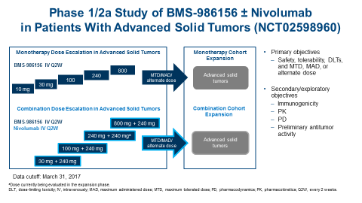
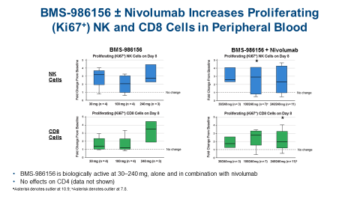
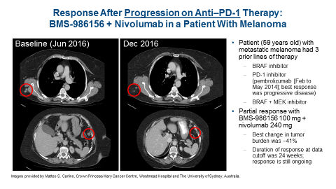
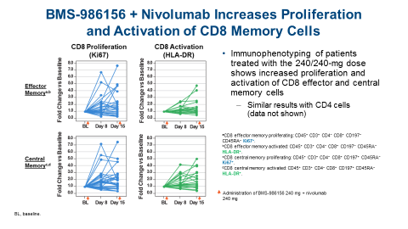
No DLTs or treatment-related deaths
Safety of BMS-986156 + nivolumab is consistent with that observed in prior studies of nivolumab monotherapy
Siu et al ASCO 2017
Presented by Paolo A. Ascierto at ASCO 2018

Slide 33
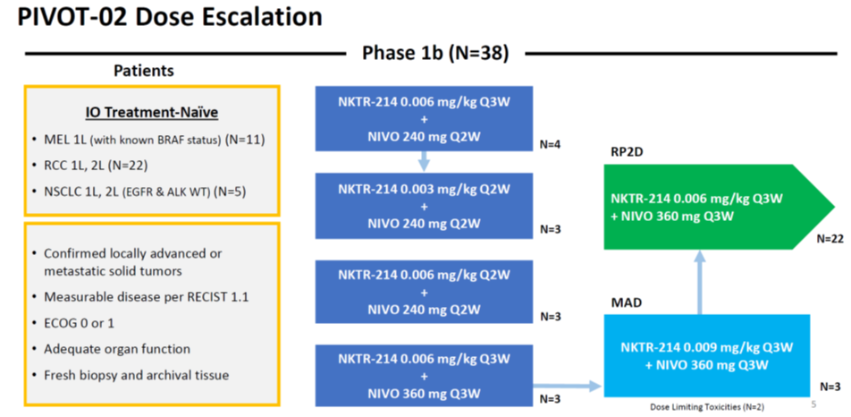
Combination of CD122 agonist with anti-PD-1/PD-L1
Presented by Paolo A. Ascierto at ASCO 2018
Diab et al SITC 2017

Slide 34
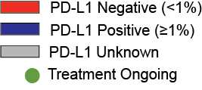
Stage IV IO-Naïve 1L Melanoma Cohort at RP2D: Achieved Pre-Specified Efficacy Criteria
Stage 1: ORR 11/13 (85%)
Stage 2: Best Overall Response ORR=14/28 (50%); DCR=20/28 (71%)
Median Time on Study 4.6 Months (N=28)
As of May 29, 2018
§
ORR PD-L1 (-) 5/12 (42%)
ORR PD-L1 (+) 8/13 (62%)
ORR PD-L1 Unknown 1/3 (33%)
Data cut: May 29, 2018
Diab et al ASCO 2018
Horizontal dotted lines indicate the thresholds for PD, PR and CR response according to RECIST (version 1.1) criteria. -100% is PR for complete clearance of target lesions. CR is a complete response. “u”: Unconfirmed. *Best overall response is PD; SD for target lesions but PD due to a new lesion. §Off study treatment with confirmed CR due to patient decision.
One PD-L1(-) patient had PD due to non-target lesions and target lesions were not assessed, therefore 27/28 patients included in waterfall plot..

Slide 35
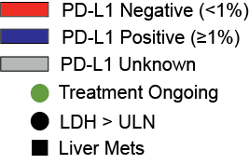
Stage IV IO-Naïve 1L Melanoma Cohort at RP2D Best Overall Response by Independent Radiology
1L Melanoma (n=38 Efficacy Evaluable) | Overall Response Rate
Confirmed ORR (CR+PR) | 20 (53%)
CR | 9 (24%)
DCR (CR+PR+SD) | 29 (76%)
PD-L1 negative (n=14) | 6 (43%)
PD-L1 positive (n=19) | 13 (68%)
PD-L1 unknown (n=5) | 1 (20%)
LDH > ULN (n=11) | 5 (45%)
Liver metastases (n=10) | 5 (50%)
High level of concordance in ORR between independent central radiology (53%) and investigator-assessed 19/38 (50%).
12/38 (32%) 100% Reduction Target Lesions
9/38 (24%) Complete Responses
Diab et al SITC 2018
Per protocol, efficacy evaluable is defined as patients with ≥ 1 post baseline scan. 3 patients discontinued prior to 1st scan due to an unrelated TEAE [n=1] and Patients Decision [n=2].
One patient not represented in plot had target lesions per protocol by investigator assessment but did not have target lesions at baseline by independent central radiology; patient achieved SD based on non-target lesions during the study.
#: Best overall response is PD. *: Best overall response is SD. + Best overall response is PR with -100% reduction of target lesions. §: Best overall response of CR is unconfirmed; PR confirmed.
6

Slide 36
New emerging pathways for future combination with anti-PD-1/PD-L1 compounds
HDAC inhibitors
IDO1 inhibitors
Triplet !
Anti-GITRs
Anti-LAG-3s
GITR, glucocorticoid-induced TNFR-related protein; HDAC, histone deacetylases; IDO1, indoleamine 2,3-dioxygenase 1; LAG-3, lymphocyte-activation gene 3
Presented by Paolo A. Ascierto at ASCO 2018
Ascierto PA & McArthur JA. J Transl Med 2017;15:173

Slide 37
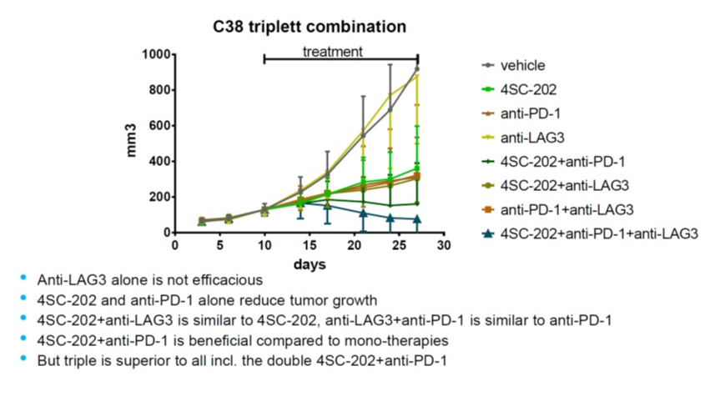
Evaluation of the HDACi +anti-PD1+anti-LAG3 triple combination
Hamm et al AACR 2018 Abstract #4722
Paolo A. Ascierto

Slide 38
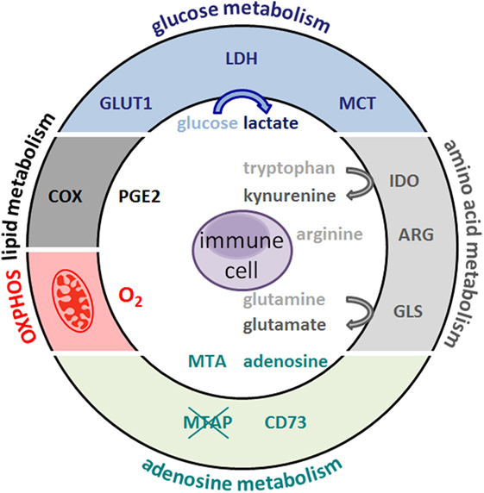
Metabolic Hallmarks of Tumor and Immune Cells in the Tumor Microenvironment
Renner K. et al. Front. Immunol. 2017
Paolo A. Ascierto

Slide 39
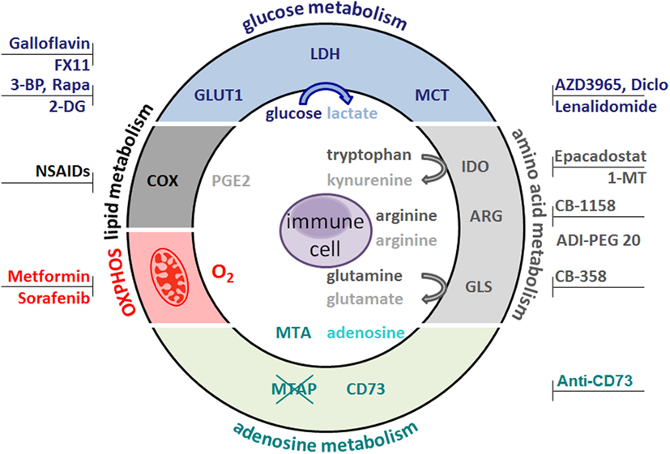
Metabolic Hallmarks of Tumor and Immune Cells in the Tumor Microenvironment
Renner K. et al.
Front. Immunol. 2017
Paolo A. Ascierto

Slide 40
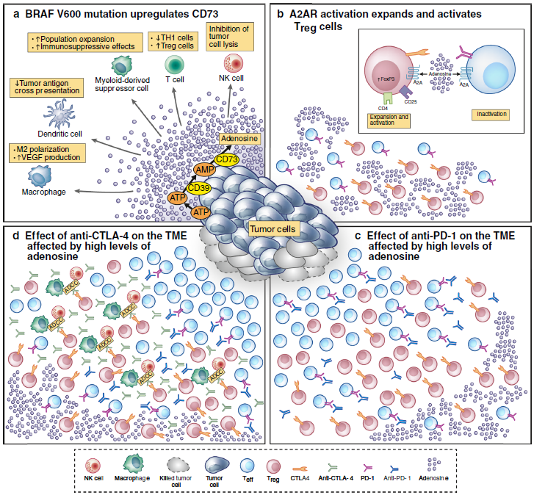
Hypothetical model about how BRAFV600 mutation in melanoma cells could affect the tumor microenvironment and response to ipilimumab and combination of ipilimumab and nivolumab.
Ascierto and McArthur
J Trans Med 2017
Paolo A. Ascierto

Slide 41

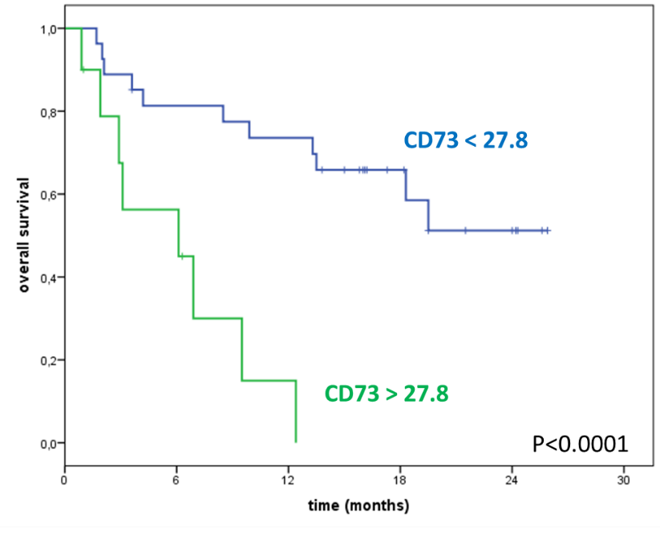
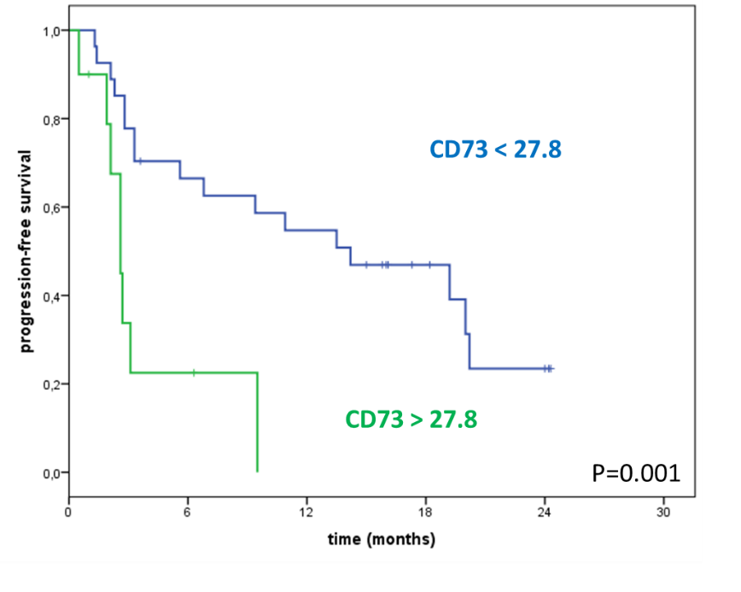
sCD73 baseline enzymatic activity and survival with anti-PD-1
Overall survival
Progression-free survival
CD73<27.82 | CD73>27.82
Not reached | 6,1 months (95% CI: 0-14.8)
CD73<27.82 | CD73>27.82
14.2 months (95% CI: 4,6-23,8) | 2.6 months (95% CI: 1,9-3,3)
The optimal cut-off* of sCD73 activity for both overall survival and progression-free survival was 27,82 pmol/min/mg protein
* Best cut-off values were located with an R routine implemented on the online software (Cut-off Finder) which maximize differences in survival between the two groups.
Morello S et al. J Transl Med 2017
Paolo A. Ascierto

Slide 42
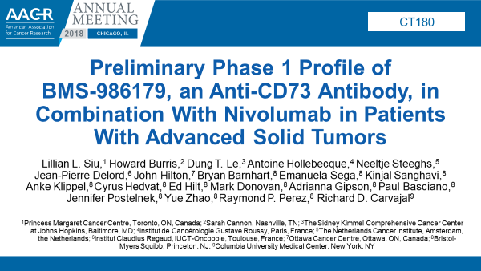
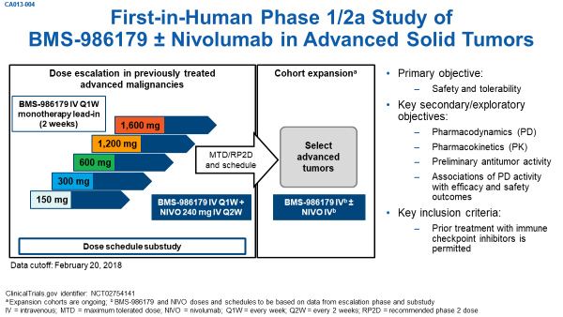
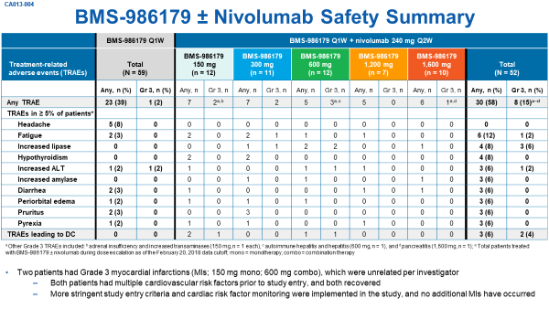
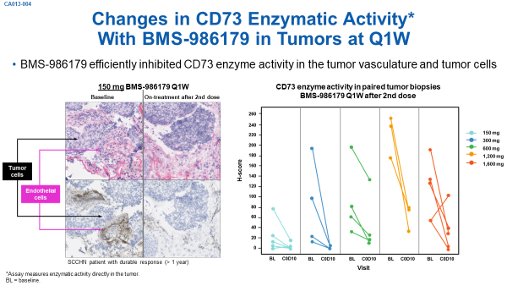
Combination of anti-CD73 with anti-PD-1/PD-L1
Siu et al AACR 2018
Presented by Paolo A. Ascierto at ASCO 2018

Slide 43
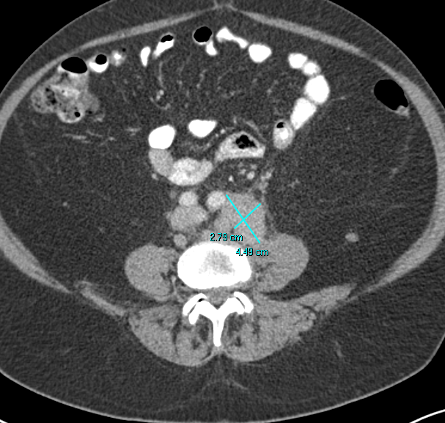
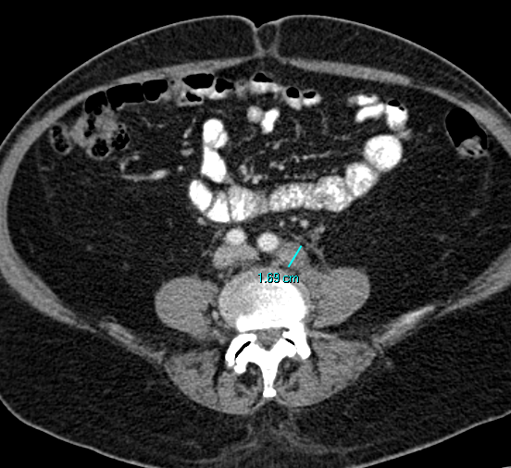
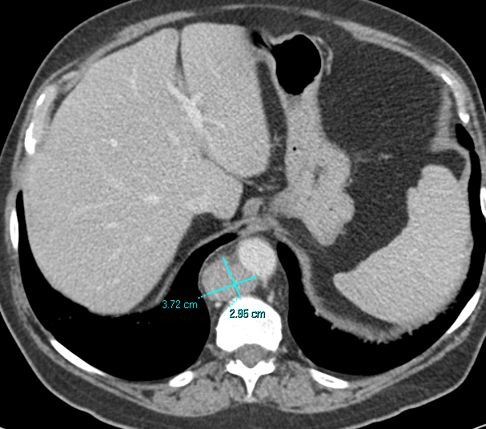

Antitumor Activity of BMS-986179 + Nivolumab in a Patient With Castration-Resistant Prostate Carcinoma (CRPC)
66-year-old man
Gleason 7; microsatellite stable
Prior treatments: enzalutamide, triptorelin, testosterone, docetaxel, cabazitaxel
Partial response with BMS-986179 300 mg + nivolumab 240 mg
  Prostate-specific antigen: baseline 692;
  nadir < 0.1; current 0.1
  Response achieved by week 10, sustained until week 35
  Best reduction in target lesion tumor burden was 75%
  Solitary spinal metastasis, resected + external radiotherapy
  Combination treatment resumed and patient is ongoing at week 68+
11/3/2016
3/28/2017
Images provided by Dung Le from The Sidney Kimmel Comprehensive Cancer Center at Johns Hopkins University.
Siu et al AACR 2018

Slide 44
Antitumor Activity of BMS-986179 + Nivolumab in a Patient With Gastroesophageal Junction (GEJ) Carcinoma
61-year-old man
Adenocarcinoma of GEJ
Microsatellite stable; HER2 negative
Prior treatments: FOLFOX, paclitaxel + ramucirumab
Partial response with BMS-986179 600 mg + nivolumab 240 mg
  Response achieved by week 59
  Best reduction in target lesion tumor burden was 36%
  Tumor reduction is ongoing, and patient continues on treatment at week 67+
10/16/2016
2/20/2018
Images provided by Dung Le from The Sidney Kimmel Comprehensive Cancer Center at Johns Hopkins University.
FOLFOX = leucovorin, fluorouracil, and oxaliplatin; HER2 = human epidermal receptor 2
Siu et al AACR 2018

Slide 45

Paolo A. Ascierto

Slide 46
Potential combination strategies for the treatment of cancer
Potential combinations
Immunotherapy plus targeted therapy
Paolo A. Ascierto

Slide 47

BRAF/MEK inhibitors as immunomodulating agents
T reg
CD4-CD8+ lymphocytes
Myeloid-derived suppressor cells
Melanoma cell
MHC ↑
NRAS
IFNAR ↑
BRAFi
BRAF
TAA ↑
MEKi
MEK
CD73 ↓
ERK
Tumour microenvironment after
BRAFi and MEKi:
↓ Adenosine
↓ Treg and myeloid-derived suppressor cells
↑ Activity of CD4-CD8+ lymphocytes
BRAFi/MEKi induce profound changes in:
Antigen display ↑
Expression of MHC ↑
IFNAR ↑ and CD73 ↓
Tumour microenvironment before BRAFi and MEKi
ADE, adensosine; IFNAR, interferon-α/β receptor; MHC, major histocompatibility complex; TAA, tumour-associated antigen; Treg, regulatory T cell
Image modified from Ascierto & Dummer, Oncoimmunology 2018

Slide 48
Targeted therapy with immunotherapy – a rational combination for advanced BRAF^{V600} mutant melanoma
Targeted therapy
Immunotherapy
Combination
Rapid and clinically significant
tumour response
Less frequent tumour response, but clinically significant durability
Durable tumour response and prolonged survival?
Percent alive
+
=
Percent alive
Percent alive
0
1
2
3
0
1
2
3
0
1
2
3
Years
Years
Years
Figure modified from Ribas et al., Clin Cancer Res. 2012.
Paolo A. Ascierto

Slide 49


Clinical Trials Combining BRAFi + MEKi
+ anti–PD-1/L1
Dabrafenib + trametinib
+ durvalumab¹
Dabrafenib + trametinib
+ pembrolizumab^{2,3}
Vemurafenib + cobimetinib
+ atezolizumab⁴
Dabrafenib + trametinib
+ spartalizumab⁵
55
PD
SD
CR-PR
Discontinued all treatment
New lesion
100
N = 9
50
V600E
45
80
Complete responseª
Partial response
Study treatment ongoing
100
35
80
25
60
V600K
15
40
60
5
0
40
−5
20
−15
20
−25
Change from baseline, %
Change from Baseline, %
−35
0
Change from baseline, %
Change from baseline, %
0
−45
−20
−20
−55
−50
−65
−40
−40
*
−75
−60
−60
*
*
*
−85
−80
*
−95
−80
−100
−100
*
*
−100
0
8
16
24
32
40
48
56
64
0
4
8
12
16
20
24
0
20
24
100
252
260
410
0
1
2
3
4
5
6
7
8
9
10
Time, weeks
Time, months
40
Time, days
Months From First Dose of Study Drug
100
N = 9
20
Unknown
Unknown
80
M1A
M1A
M1C
60
M1C
M1B
M1C
M1C
M1B
M1A
M1C
M1B
IIIC
IIIC
IIIC
IIIC
M1A
IIIC
IIIC
IIIC
IV
IV
IIIC
Complete responseª
Partial response^{b}
IV
IV
IV
IV
0
IV
40
−20
20
V600E
V600K
Treatment ongoing
PR
CR
PD
Unconfirmed
response
Best change from baseline
(measurable lesions), %
Best change in SLD from baseline, %
0
Time to and on-treatment response
−40
−20
Time to response
−60
−40
D/C treatment
Response ongoing
*
−60
−80
−80
0
6
12
18
24
30
36
42
48
54
60
66
72
78
0
4
8
12
16
20
24
Time, weeks
4
−100
−100
Time, months
BID, twice daily; CR, complete response; PD, progressive disease; PR, partial response; QD, once daily; SD, stable disease. ª Patients with CR and < 100% change in sum of diameters (SOD) have (a) 100% change for non-nodal target lesions and all nodal target lesions are < 10 mm and (b) CR for nontarget lesions. ^{b} Patients with PR and 100% change in SOD have (a) 100% change for all target lesions and (b) non-CR/non-PD response for nontarget lesions.
1. Ribas A, et al. J Clin Oncol. 2015; 33(suppl) [abstract 3003]; 2. Ribas A, et al. J Clin Oncol. 2016; 34(suppl) [abstract 3014]; 3. Ribas A, et al. Ann Oncol. 2017; 28(suppl 5)
[abstract 1216O]; 4. Hwu P, et al. Ann Oncol. 2016; 27(suppl 6) [abstract 1109PD]; 5. Dummer, R, et al. J Clin Oncol. 2018;36(suppl 5S) [abstract 189].
PRESENTED BY R DUMMER AT AACR 2018
Courtesy of Dr Dummer

Slide 50
Keynote 022: Progression-Free Survival
 | Events, n | Median,ª mo (95% CI) | HR^{b} (95% CI)^{b} | P Value^{c}
Pembro + D + T | 31 | 16.0 (8.6-21.5) | 0.66 (0.40-1.07) | 0.04287
Placebo + D + T | 41 | 10.3 (7.0-15.6)
100
90
80
PFS did not reach statistical significance threshold per study design (required HR for significance ≤0.62,
P ≤ 0.025)
70
59%
60
PFS %
50
40
30
45%
20
10
0
0
2
4
6
8
10
12
14
16
18
20
22
24
26
Time, months
No. at risk
Pembro + D + T
60
55
49
39
36
34
27
21
17
12
5
4
1
0
Placebo + D + T
60
59
52
38
35
29
23
20
16
9
4
3
0
0
Ascierto et al ESMO 2018
ªBased on Kaplan-Meier estimate of PFS, per investigator assessment.
^{b}Based on Cox regression model with treatment as a covariate stratified by ECOG PS (0 vs 1) and LDH (LDH >1.1 × ULN vs =1.1 × ULN); owing to the small number of patients enrolled in the ECOG PS 1 and LDH ≤1.1 × ULN strata, these strata were combined.
^{c}One-sided P value based on stratified log-rank test.
Data cutoff: Feb 15, 2018.

Slide 51


Best Percentage Change From Baseline in Target Lesion Sizeª
Placebo + D + T
100
Pembro + D + T
100
80
80
60
36/57 (63%) patients had ≥60% reduction
60
30/59 (51%) patients had ≥60% reduction
40
40
20
20
0
0
Change From Baseline, %
Change From Baseline, %
–20
–20
–40
–40
–60
–60
–80
–80
–100
–100
Ascierto et al ESMO 2018
ªMaximum percentage change in target lesion size based on investigator assessment in patients with post-baseline values.
Data cutoff: Feb 15, 2018.

Slide 52
Kaplan-Meier Analysis of Duration of Responseª
DOR | DOR^{b} ≥18 mo n (%) | Median (range),^{b} mo
Pembro + D + T | 4 (59.8) | 18.7 (1.9+-22.1)
Placebo + D + T | 3 (27.8) | 12.5 (2.1-19.5+)
100
90
80
70
60
Response, %
50
40
30
20
10
0
0
2
4
6
8
10
12
14
16
18
20
22
No. at risk
Month
Pembro + D + T
38
37
34
29
27
19
15
12
9
4
1
1
Placebo + D + T
43
43
34
27
23
19
17
10
6
3
0
0
Ascierto et al ESMO 2018
ªConfirmed response based on investigator assessment per RECIST v1.1.
^{b}From Kaplan-Meier method for censored data.
+ indicates there was no progressive disease at last disease assessment.
Data cutoff: Feb 15, 2018.

Slide 53
Overall Survival
 | Events, n | Medianª (95% CI), mo | HR^{b} (95% CI)^{b} | P Value^{c}
Pembro + D + T | 19 | NR (19.6-NR) | 0.76 (0.41-1.39) | 0.18467
Placebo + D + T | 24 | 23.4 (17.8-NR)
100
90
79%
80
70
73%
60
Overall Survival, %
50
40
30
20
10
0
0
2
4
6
8
10
12
14
16
18
20
22
24
26
28
No. at risk
Month
Pembro + D + T
60
60
59
56
53
50
43
35
29
23
18
9
4
1
0
Placebo + D + T
60
60
59
55
51
47
39
36
31
25
18
7
2
0
0
Ascierto et al ESMO 2018
ªBased on Kaplan-Meier estimate of overall survival.
^{b}Based on Cox regression model with treatment as a covariate stratified by ECOG PS (0 vs 1) and LDH (>1.1 × ULN vs ≤1.1 × ULN; owing to the small number of patients enrolled in the ECOG PS 1 and LDH ≤1.1 × ULN strata, these strata were combined.
^{c}P values are provided for descriptive purposes only, no multiplicity adjustment is made. One-sided P value based on stratified log-rank test.
Data cutoff: Feb 15, 2018.

Slide 54



Presented by Paolo A. Ascierto at ASCO 2018

Slide 55

Figure 1. Study Schemata for COMBI-i (A) Part 1: Safety Run-In, (B) Part 2: Biomarker Cohort, and (C) Part 3: Randomized Phase 3 Portion

Slide 56

Results (continued)
Figure 2. Confirmed Objective Response and Best Percent Change From Baseline in Sum of Diameters by Local Investigator Review
PR, partial response; SD, stable disease.
ª One patient with SD had a best change of 0% in the target lesion.
^{b} Best percent change in the target lesion was not available for 1 patient with PD.

Slide 57
Results (continued)
Table 2. Overview of Time-to-Event Endpoints
 | (N = 36)
DOR, median (95% CI), mo | 20.7 (16.8-NE)
12-month DOR rate (95% CI), % | 80.3 (59-91)
Median in patients with elevated baseline LDH levels (95% CI), mo | NE (3.9-NE)
Median in patients with stage IV M1c disease (95% CI), mo | NE (9.2-NE)
PFS, median (95% CI), mo | 23.7 (12.0-NE)
12-month PFS rate (95% CI), % | 66.7 (49-80)
Median in patients with elevated baseline LDH levels (95% CI), mo | 10.7 (4.6-NE)
Median in patients with stage IV M1c disease (95% CI), mo | 12.9 (6.6-NE)
OS, median (95% CI), mo | NE (NE-NE)
12-month OS rate (95% CI), % | 86.1 (70-94)
Median in patients with elevated baseline LDH levels (95% CI), mo | NE (7.0-NE)
Median in patients with stage IV M1c disease (95% CI), mo | NE (11.2-NE)

Slide 58

Results (continued)
Figure 3. Time on Treatment and Duration of Response by Local Investigator Reviewª
ª Data reported as time from treatment start and shows the first occurrence of response.

Slide 59

Results (continued)
Figure 4. Percent Change From Baseline in Sum of Diameters Over Time by Local Review
UNK, unknown.

Slide 60
Results (continued)
Table 3. Overview of Adverse Events
Category, n (%) | N = 36
 | Any Grade | Grade ≥ 3
AEs | 36 (100) | 28 (78)
Treatment-related | 36 (100) | 26 (72)
Serious AEs | 23 (64) | 18 (50)
Treatment-related | 19 (53) | 13 (36)
AEs leading to dose adjustment/interruption | 36 (100)
AEs leading to treatment discontinuation of any study drug | 17 (47)
Spartalizumab + D + T | 6 (17)
Treatment-related deathsª | 0
ª One patient died of cardiac arrest that was not considered related to study treatment.

Slide 61
Phase 3 Study of Atezolizumab (Anti–PD-L1) + Cobimetinib (Anti-MEKi) in Previously Untreated BRAF Wild-type Patients With Advanced Melanoma
RANDOM
I
SAT
I
ON
Cobimetinib + Atezolizumab
Previously Untreated Advanced Melanoma
BRAF wild-type
Measurable disease by RECIST v1.1
Anti–PD-1 inhibitor
Co-primary endpoints:
Investigator-assessed PFS and OS
Secondary endpoints:
Independently-assessed PFS
ORR
DOR
Safety
Quality of life
DOR, duration of response; ORR, overall response rate; OS, overall survival; PD-1, programmed death receptor-1; PD-L1, programmed death ligand 1; PFS, progression-free survival; RECIST, Response Evaluation Criteria in Solid Tumors.
Infante J et al. SMR presentation 2016.
Presented by Paolo A. Ascierto at ASCO 2018

Slide 62
Raising the bar…
Paolo A. Ascierto

Slide 63



Thank you!
Via Mariano Semmola, 80131, Napoli, Italy
Tel. +39 081 5903 431; Fax +39 081 5903 841
Email: p.ascierto@istitutotumori.na.it

