Slide 1

New drugs in clinical trials targeting breast cancer oncogenic pathways
Antonino Grassadonia
Università «G. D’Annunzio» Chieti - Pescara

Slide 2





Luminal Tumor
Mutations
Basal-like Tumor
Mammary duct
Luminal
Progenitors
Differentiated Luminal Cells
Pluripotent
Progenitors
or
Staminal Cells
Differentiated Mioepithelial Cells
Mioepithelial
Progenitors

Slide 3
Oncogenic pathways in breast Cancer
Gain of function
Loss of function
Specific pathways
Common pathways
BRCA1/2 mutations
ER signaling
CDK4/6 Signaling
ATM (ataxia telangiectasia)
HER2 signaling
TP53 (Li-Fraumeni syndrome)
- Ras/MAPK pathway
PTEN (Cowden syndrome)
- PI3K/AKT7mTOR pathway
PALB2 (Fanconi’s anemia)
Notch signaling
Sonic Hedgehog (SHH) signaling
Wnt/b-catenin signaling
Androgen receptor (AR) signaling

Slide 4
Timeline of FDA Drug Approvals for MBC

Slide 5
Main strategies in HR+ Breast cancer
Blocking cross-talk between steroid receptors, growth factor receptors,and intracellular pathways
Novel and more active SERDS
Inhibiting ER transcription

Slide 6
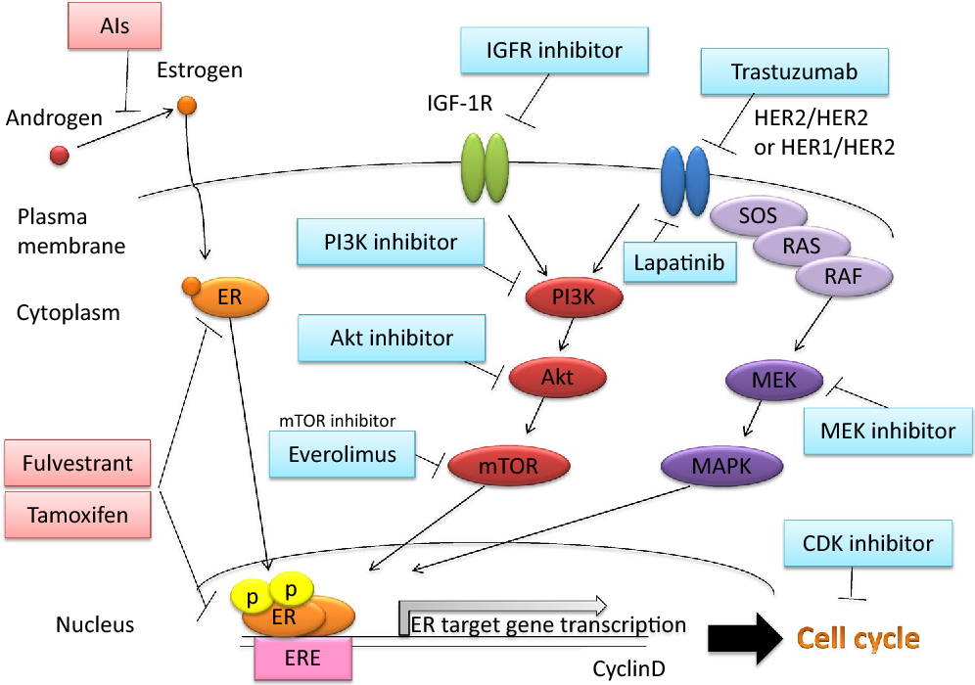
Blocking cross-talk

Slide 7
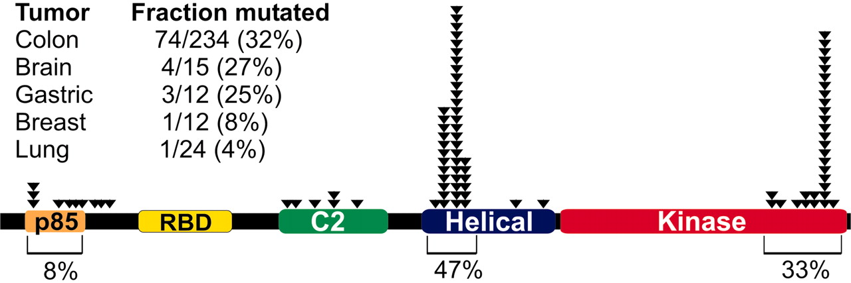
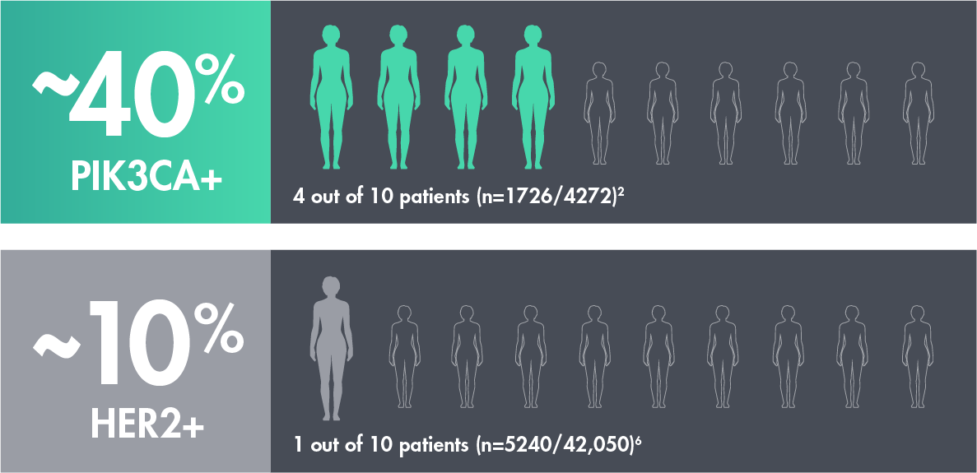
Mutational analyses of PIK3CA in cancer

Slide 8
Phase III SOLAR-1: Alpelisib + Fulvestrant vs Placebo + Fulvestrant in HR+/HER2- Advanced Breast Cancer
Stratification by
presence of liver/lung metastases,
prior CDK4/6 inhibitor treatment
Alpelisib 300 mg QD PO +
Fulvestrant 500 mg IM*
(n = 169)
Men or postmenopausal women with HR+/HER2- advanced BC with recurrence or progression on/after prior AI, measurable disease or
≥ 1 predominantly lytic bone lesion, ECOG PS 0-1
(N = 572)
PIK3CA-
Mutant Cohort
(n = 341)
Placebo QD PO +
Fulvestrant 500 mg IM*
(n = 172)
Alpelisib 300 mg QD PO +
Fulvestrant 500 mg IM*
(n = 115)
PIK3CA-Nonmutant Cohort
(n = 231)
Placebo QD PO +
Fulvestrant 500 mg IM*
(n = 116)
*Fulvestrant given on Days 1,15 of 28 in cycle 1, then Day 1 thereafter.
Primary endpoint: PFS (locally assessed) in PIK3CA-mutant cohort
Secondary endpoints: OS in PIK3CA-mutant and PIK3CA-nonmutant cohorts, PFS in PIK3CA-nonmutant cohort and PIK3CA mutant–positive ctDNA, ORR/CBR, safety
André. NEJM. 2019;380:1929. Andre. ESMO 2018. Abstr LBA3_PR. NCT02437318.

Slide 9
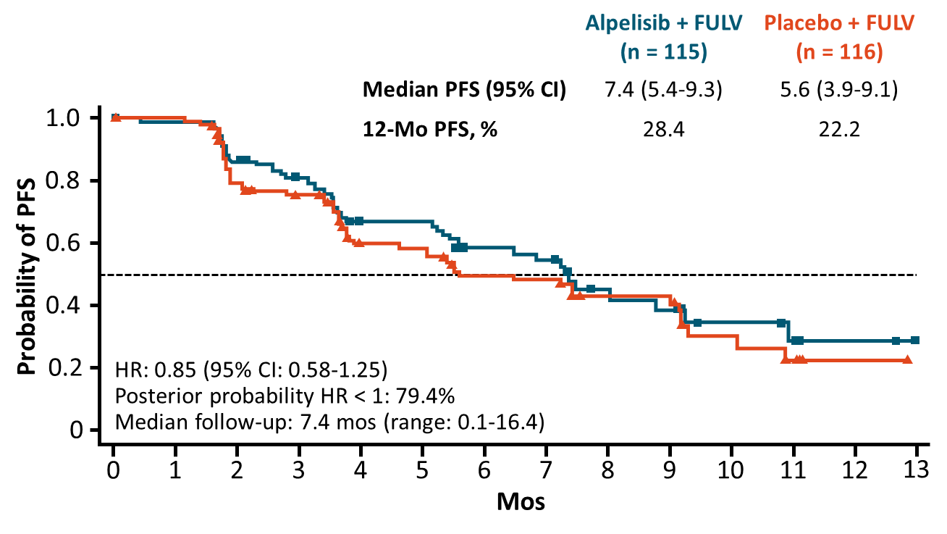
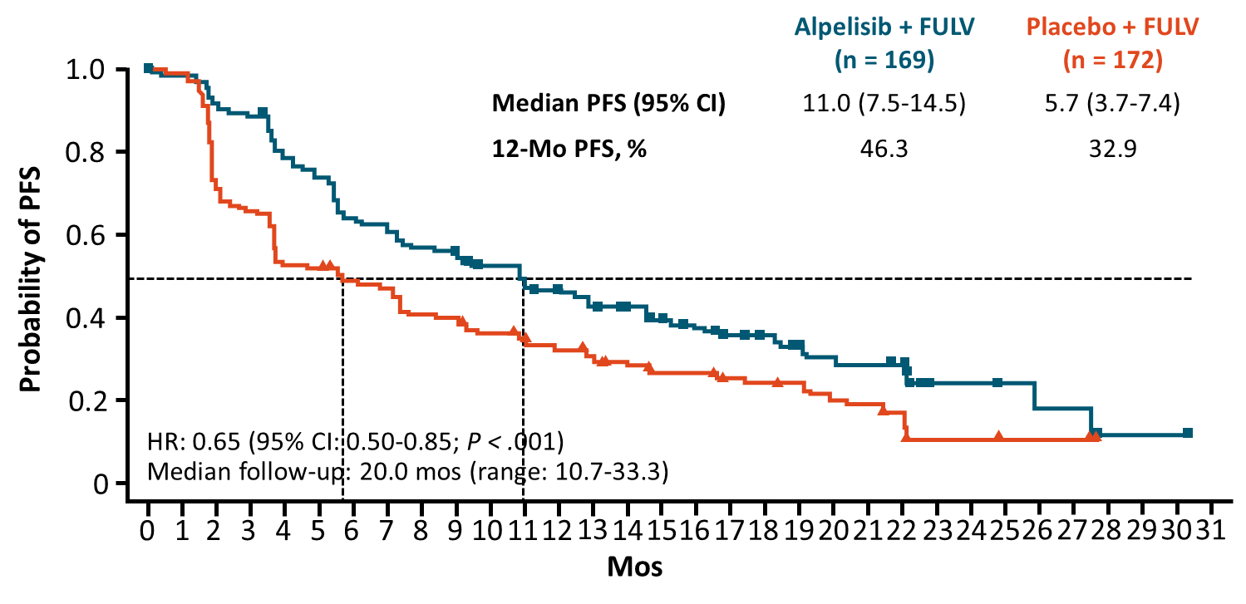
SOLAR-1: Locally Assessed PFS (Primary Endpoint)
PIK3CA-Nonmutant Cohort
PIK3CA-Mutant Cohort
André. NEJM. 2019;380:1929.
FDA approved alpelisib in combination with fulvestrant for PIK3CA-mutated HR+/HER2- advanced or metastatic BC in men or postmenopausal women following progression on ET

Slide 10
Clinical trials with CDK4/6 inhibitors in combination with inhibitors of PI3 kinase pathway and endocrine therapy in advanced HR+HER2- breast cancer

Slide 11
Clinical trials with PI3K or CDK4/6 inhibitors in combination with anti-HER2 and endocrine therapy in advanced HR+HER2+ breast cancer
STUDY | INTERVENTION | RECRUITMENT | PHASE
NCT03767335 | MEN1611 + Trastuzumab +/-Fulvestrant (after >2 lines of anti-HER2 txt) | Recruiting | I
NCT02947685 | Palbociclib + trastuzumab/pertuzumab + Endocrine Therapy vs trastuzumab/pertuzumab + Endocrine Therapy | Recruiting | III
NCT03709082 | Palbociclib, +Letrozole +T-DM1 (after I line with Trast +/-Pert.) | Recruiting | II

Slide 12
Novel SERDS
AZD9496 GDC-0810 Elacestrant (RAD1901)
More active than Fulvestrant, even in ER-mutated
ESR1 mutations are rare in primary tumors
Up to 30 percent in metastatic ER-positive breast cancers
Acquired ESR1 mutations induced by AI, not by SERM or SERD
Cancers become resistant to AIs, but respond to SERM or SERD (at higher doses)

Slide 13
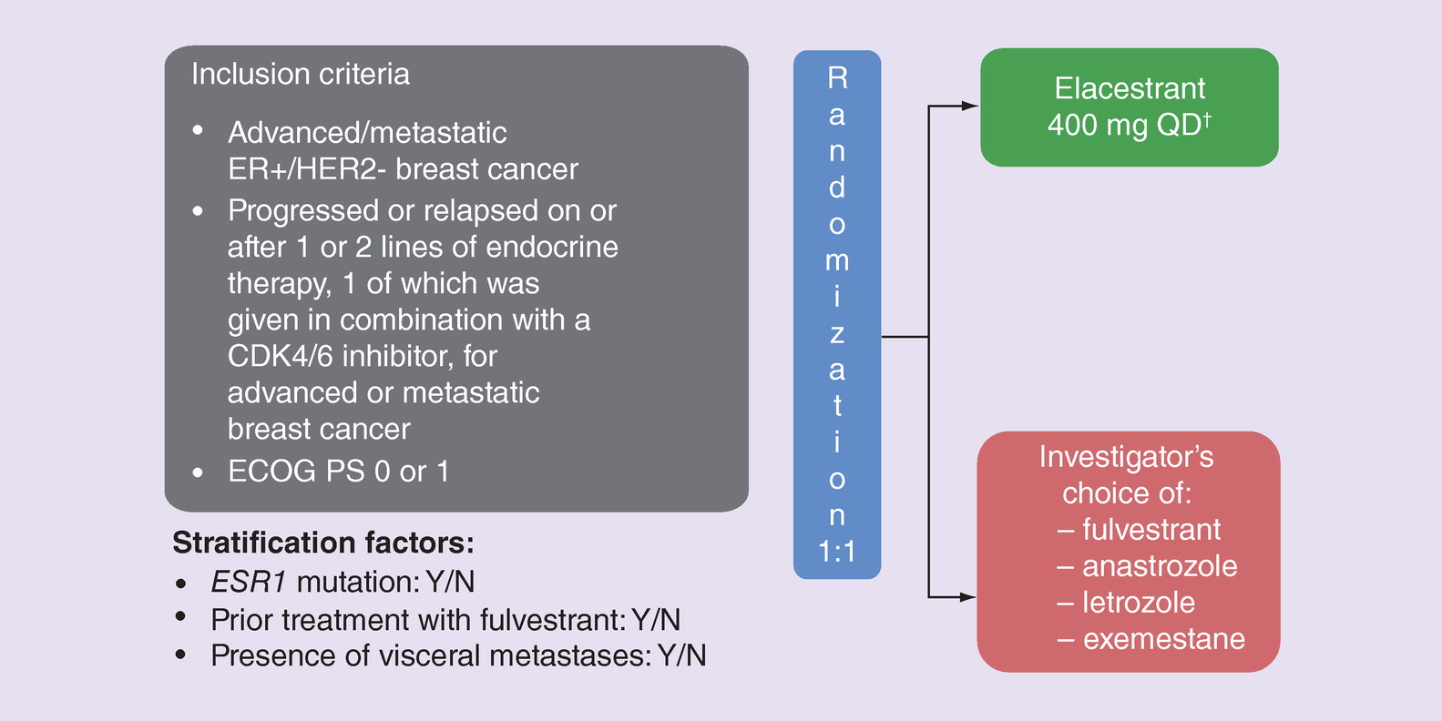
Novel SERDS: Clinical Trials
AZD9496 short half-life and GDC0810 low activity are limitations for clinical development
Elacestrant (RAD1901) is in phase 3 clinical trial (EMERALD trial; NCT03778931)

Slide 14
Main strategies in HER2+ Breast cancer
Blocking cross-talk between HER2 and intracellular pathways
Optimize Antigen-Dependent Cell Cytotoxicity (ADCC)
Novel Antibody-Drug Conjugate
Novel TKI

Slide 15
Blocking cross-talk in HER2+ BC
Clinical trials with CDK4/6 inhibitors and anti-HER2 Treatment
STUDY | INTERVENTION | RECRUITMENT | PHASE
NCT02575231 (MonarcHER) | Abemaciclib+Trastuzumab+Fulvestrant vs Abemaciclib+Trastuzumab vs Trast.+Chemio (after >2 lines of anti-HER2 txt) | Recruiting | III
NCT02947685 (PATINA) | Palbociclib +Trastuzumab/Pertuzumab+ Endocrine Therapy vs rastuzumab/pertuzumab + Endocrine Therapy (after Trast./Pert. ) | Recruiting | III
NCT02448420 (PATRICIA) | Palbociclib +Trastuzumab+ Endocrine Therapy vs treatment of physician's choice (after >2 lines of anti-HER2 txt) | Recruiting | II/III
Clinical trials with PI3 kinase inhibitors and anti-HER2 Treatment
STUDY | INTERVENTION | RECRUITMENT | PHASE
NCT02167854 | Alpelisib +Trastuzumab + LJM716 (after Trast., Pert. and T-DM1) | Active, not recruiting | I
NCT02038010 | Alpelisib + T-DM1 (after Trast., Pert. ) | Active, not recruiting | I
NCT03767335 | MEN1611 + Trastuzumab +/-Fulvestrant (after >2 lines of anti-HER2 txt) | Recruiting | I

Slide 16
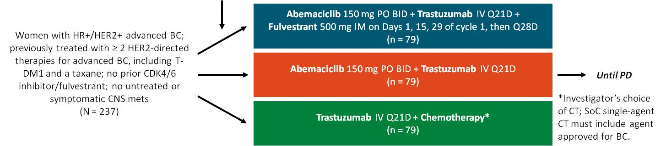
Abemaciclib in Previously Treated HR+/HER2+ Advanced BC (monarcHER): Phase II Study Design
International, open-label, randomized phase II trial
Stratified by no. prior systemic regimens (2-3 vs > 3), measurable vs nonmeasurable disease
Primary endpoint: investigator-assessed PFS for abemaciclib + trastuzumab + fulvestrant vs trastuzumab
+ CT, then abemaciclib + trastuzumab vs trastuzumab + CT if positive
  Study designed to achieve 80% power and 2-sided α = 0.20 with 165 PFS events, assuming hazard ratio of 0.667
Secondary endpoints: ORR, OS, PRO, PK, safety

Slide 17
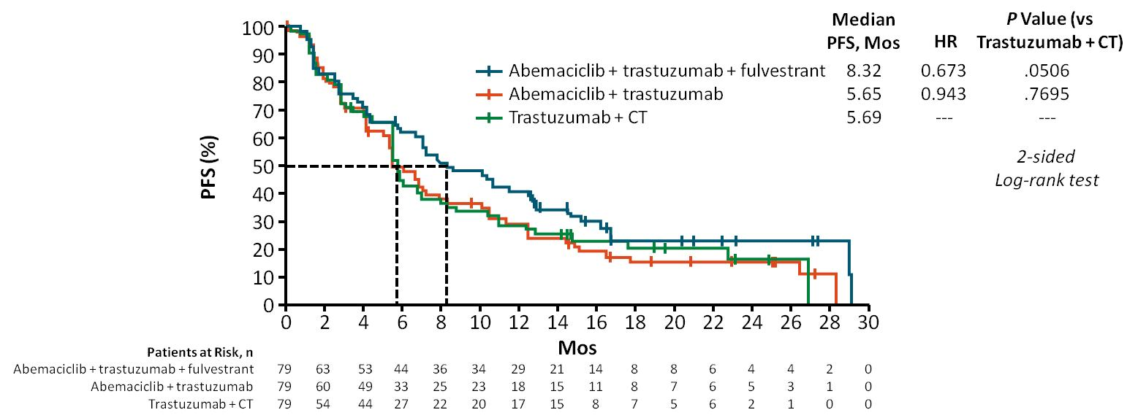
monarcHER: Investigator-Assessed PFS
(Primary Endpoint)
Median PFS significantly prolonged with abemaciclib + trastuzumab + fulvestrant (prespecified
2-sided α = 0.20), with no PFS benefit found for abemaciclib + trastuzumab vs trastuzumab + CT
Tolaney. ESMO 2019. Abstr LBA23. Reproduced with permission.

Slide 18
Optimize Antigen-Dependent Cell Cytotoxicity (ADCC)
Mergetuximab: Trastuzumab with increased ADCC
5 amino acid changed
Trastuzumab
Mergetuximab

Slide 19
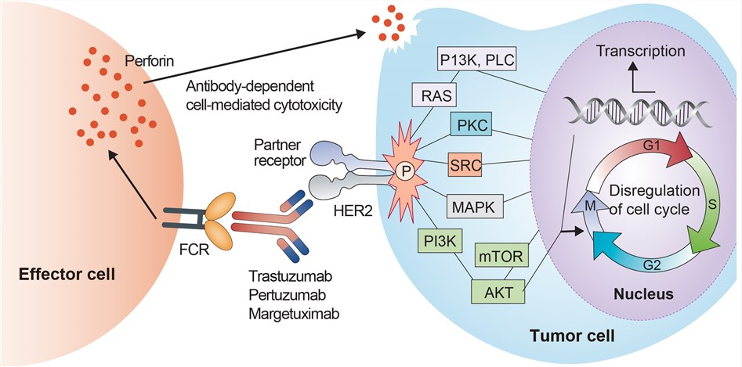
Optimize Antigen-Dependent Cell Cytotoxicity (ADCC)
Margetuximab: trastuzumab with Fc engineered (5 aa difference) to have increased affinity for activating Fcγ receptor CD16A (both lower and higher affinity alleles) and decreased affinity for inhibitory Fcγ receptor CD32B^{[3]}

Slide 20
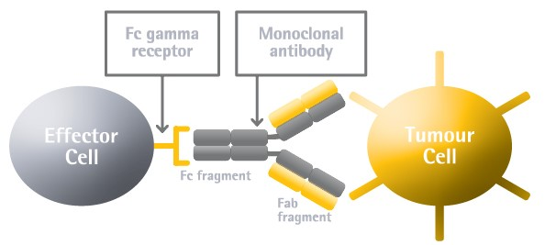
Fc-gamma polymorphisms influence immune responses
V: Valine aa158 (Lower affinity allele)
F: Phenylalanine aa158 (Higher affinity allele)
FcγRIIIa (CD16A)
Type III Fcγ receptor = CD16
FcγRIIIb (CD16B)
FcγRIIa (CD32A)
Type II Fcγ receptor = CD32
FcγRIIb (CD32B) → inhibitory effect
Type I Fcγ receptor = CD64
FcγRI (CD64)

Slide 21
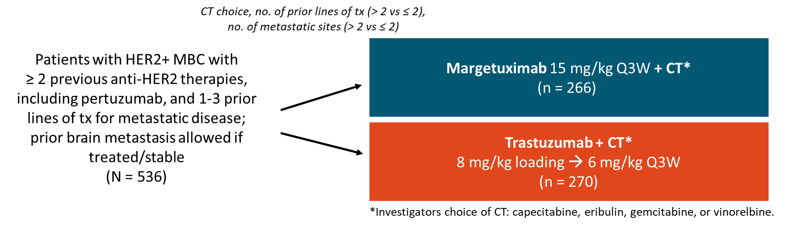
SOPHIA: Study Design
Randomized, open-label phase III trial
Sequential primary endpoint: PFS, OS
Secondary endpoints: ORR and investigator assessed PFS
Exploratory endpoints: CBR; DoR; effect of CD16A, CD32A, and CD32B alleles on efficacy

Slide 22
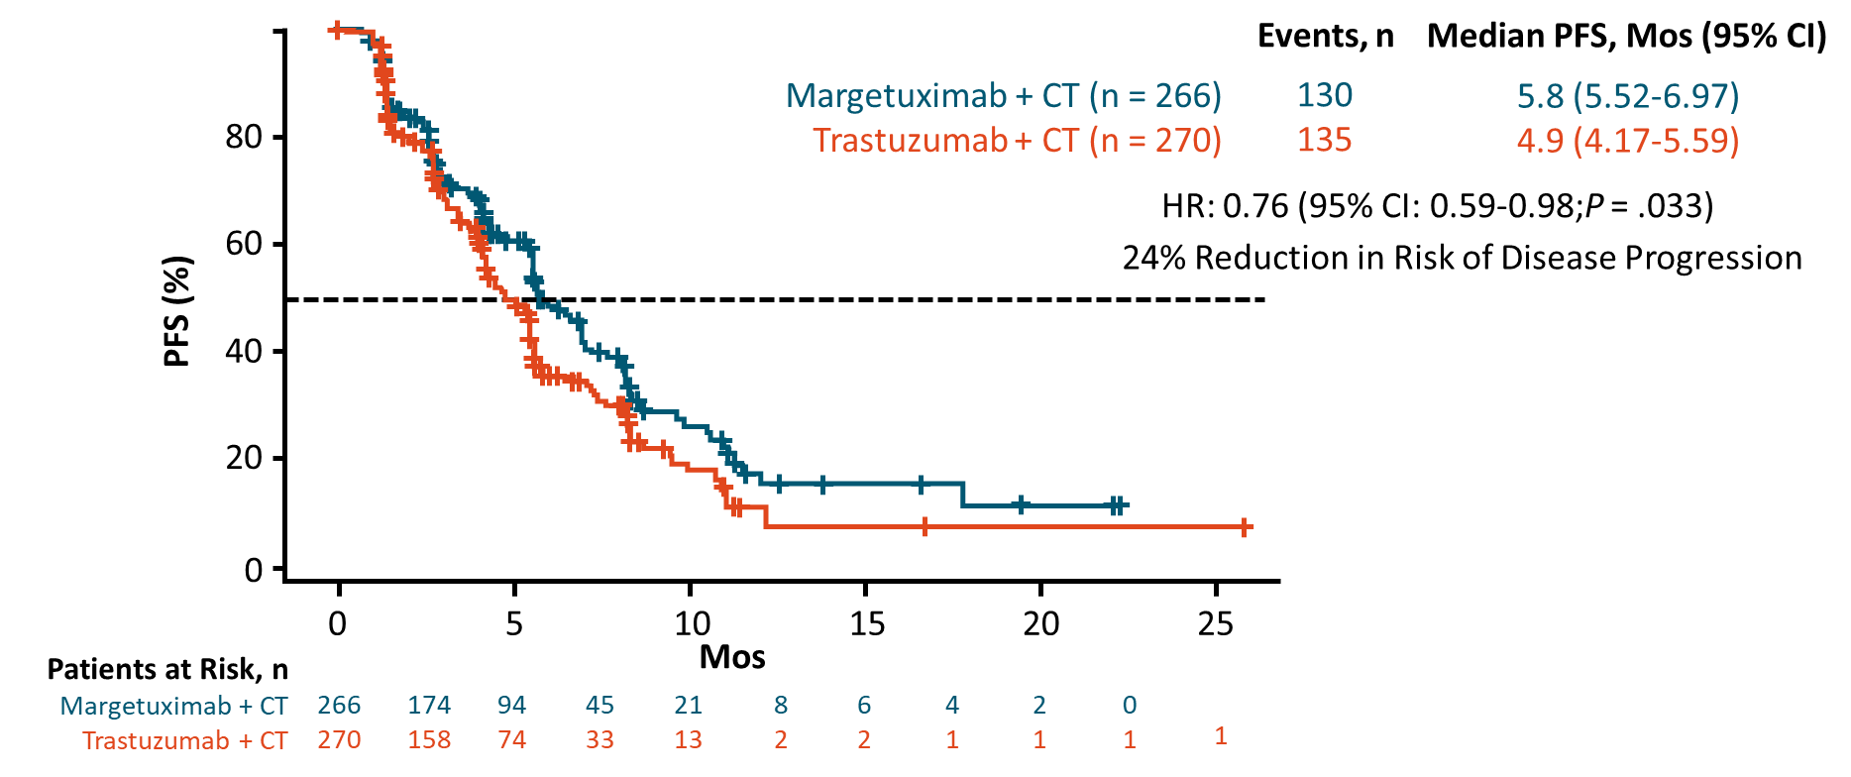
SOPHIA: PFS in ITT Population by Central Blinded Analysis
(Primary Endpoint)
Rugo. ASCO 2019. Abstr 1000

Slide 23
Margetuximab: Exploratory analysis by CD16A genotype
VV genotype (N=99) | Margetuximab+ Chemo | Trastuzumab Chemo+
Median PFS, months | 6,9 | 5,1
HR (95% CI) | 0.68
One-sided p-value | 0.005
FF or FV genotype (N=437) | Margetuximab+ Chemo | Trastuzumab +Chemo
Median PFS, months | 6,9 | 5,1
HR (95% CI) | 0.68
One-sided p-value | 0.005

Slide 24
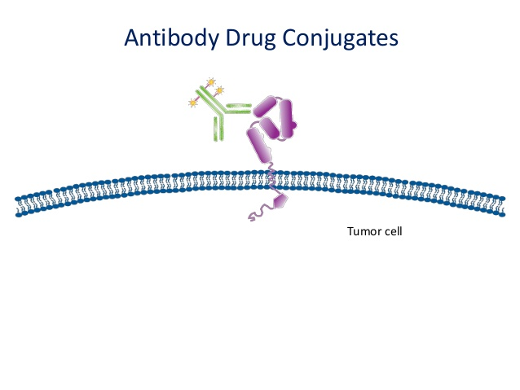
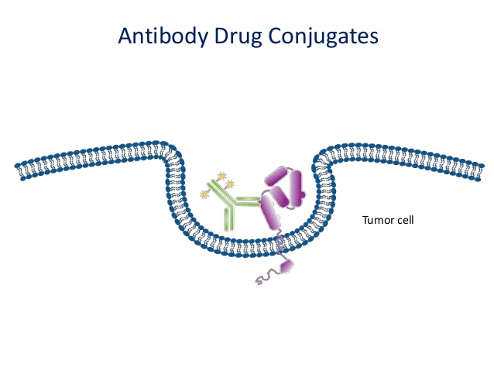
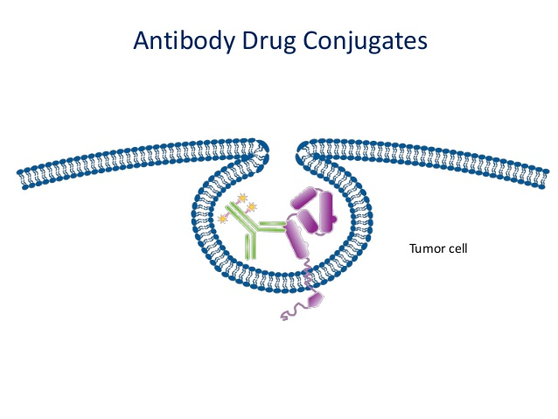
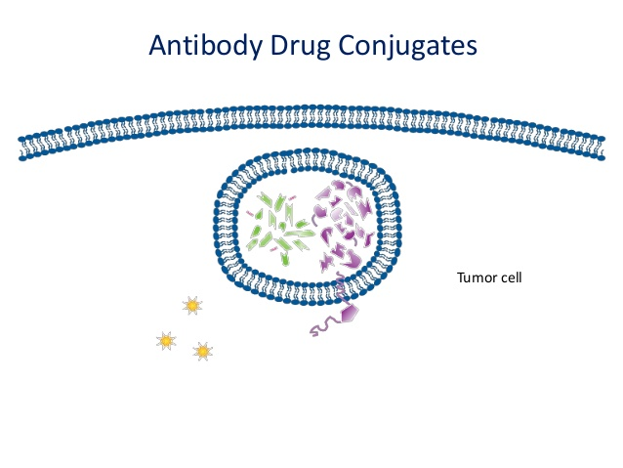
Novel Antibody-Drug Conjugates

Slide 25
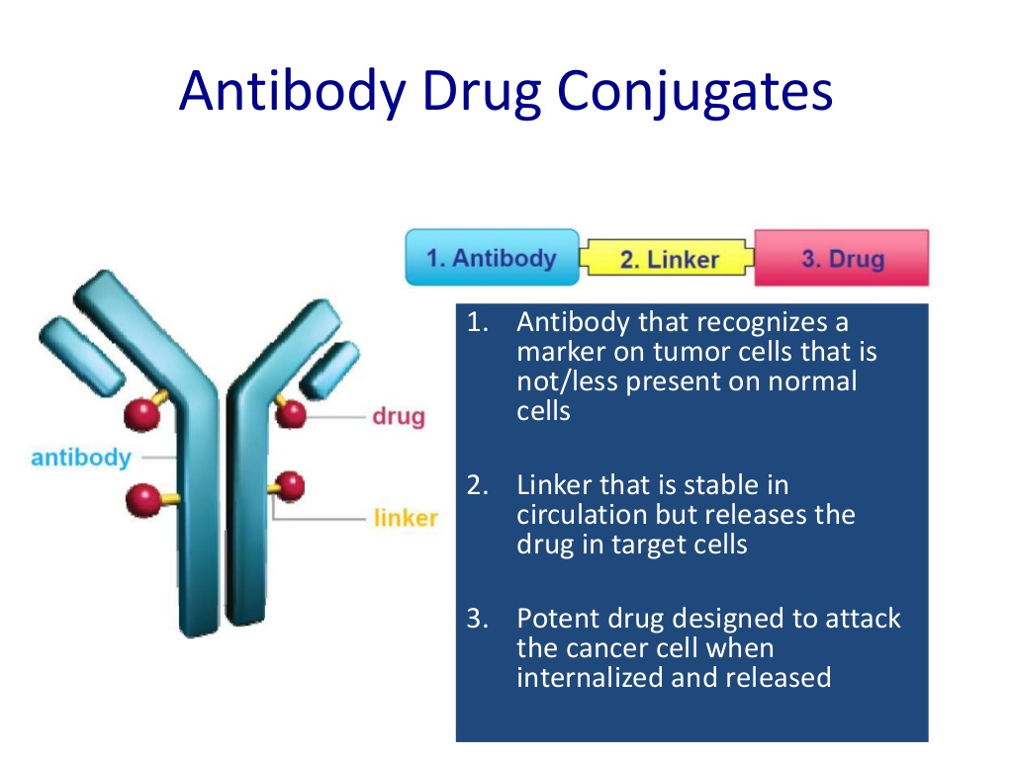
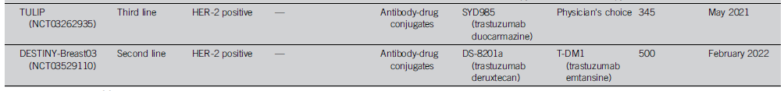
DRUGs
Deruxtecan
(Topoisomerase I Inhibitor)
Duocarmazine
(Alkylant)
Trastuzumab
Phase III trials

Slide 26
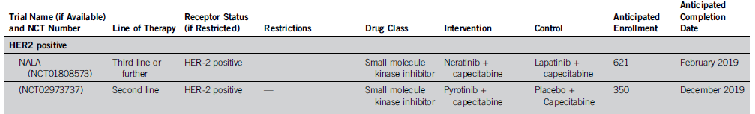
Novel TKI in HER2+ BC
Neratinib
a next-generation TKI irreversibly inhibiting EGFR and HER2
Pyrotinib
a next-generation TKI irreversibly inhibiting HER2

Slide 27
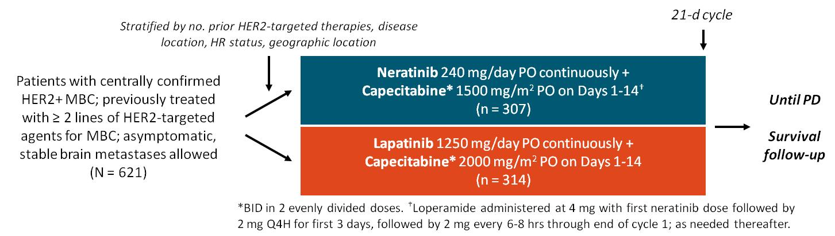
NALA: Study Design
International, open-label, randomized phase III trial
Coprimary endpoints: OS, PFS (centrally confirmed)
Study positive if either endpoint statistically significant (OS, P < .04; PFS, P < .01)
Secondary endpoints: PFS (locally determined), ORR, DoR, CBR, intervention for CNS metastases, safety, PRO
Saura. ASCO 2019. Abstr 1002. NCT01808573.

Slide 28
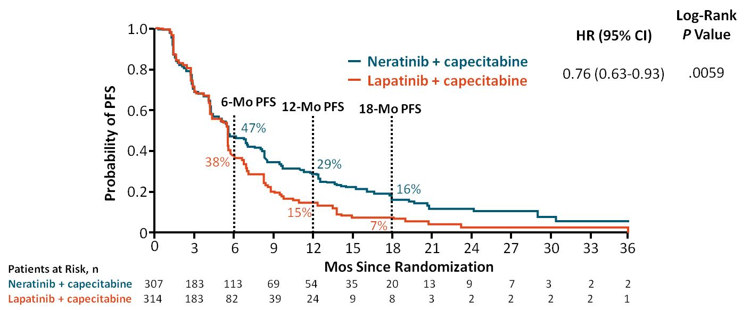
NALA: Centrally Confirmed PFS (Coprimary Endpoint)
Prespecified restricted means analysis (restriction: 24 mos) found a statistically significant difference of 2.2 mos in mean PFS with neratinib arm vs lapatinib arm (8.8 vs 6.6 mos; P = .0003)
Saura. ASCO 2019. Abstr 1002. Reproduced with permission.

Slide 29
Main strategies in Triple-Negative Breast cancer
Immune checkpoint Inhibitors
Novel Antibody-Drug Conjugate
Targeting novel oncogeniv pathways

Slide 30
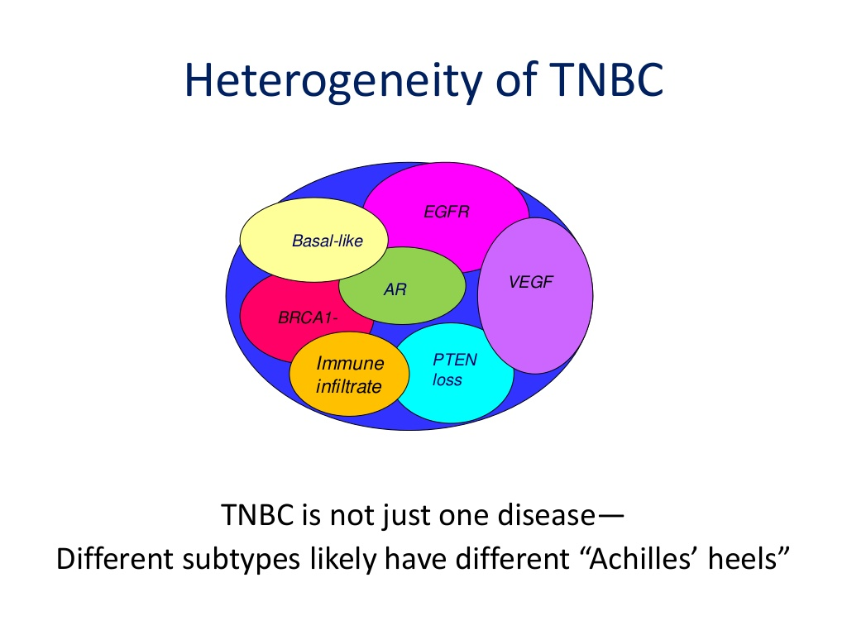

Slide 31
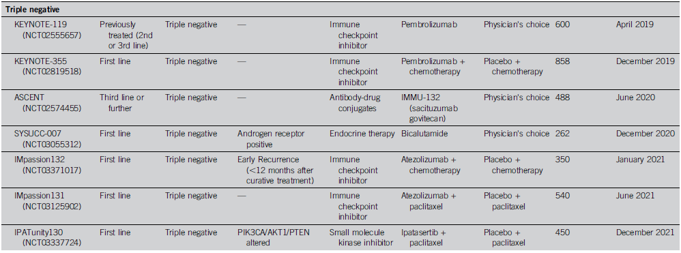
Main strategies in Triple-Negative Breast cancer

Slide 32
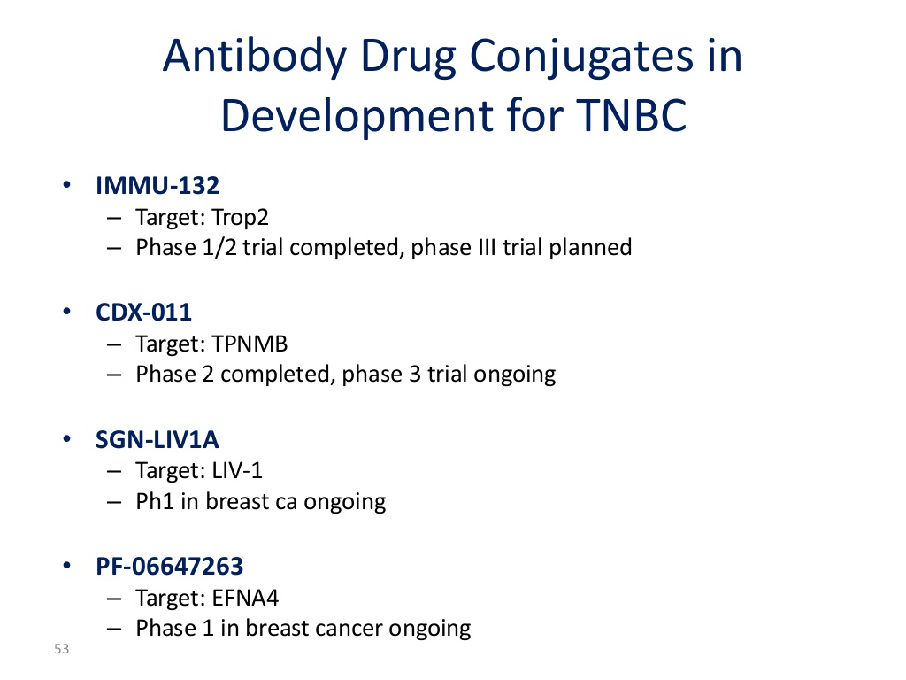

Slide 33
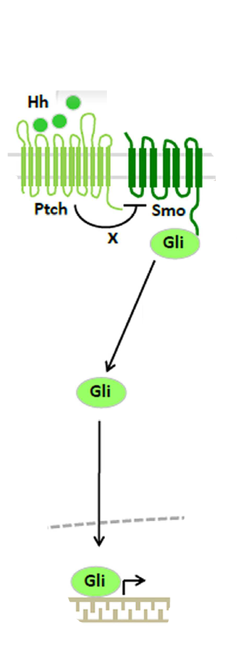
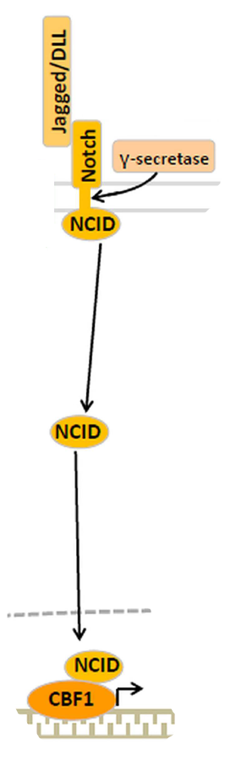
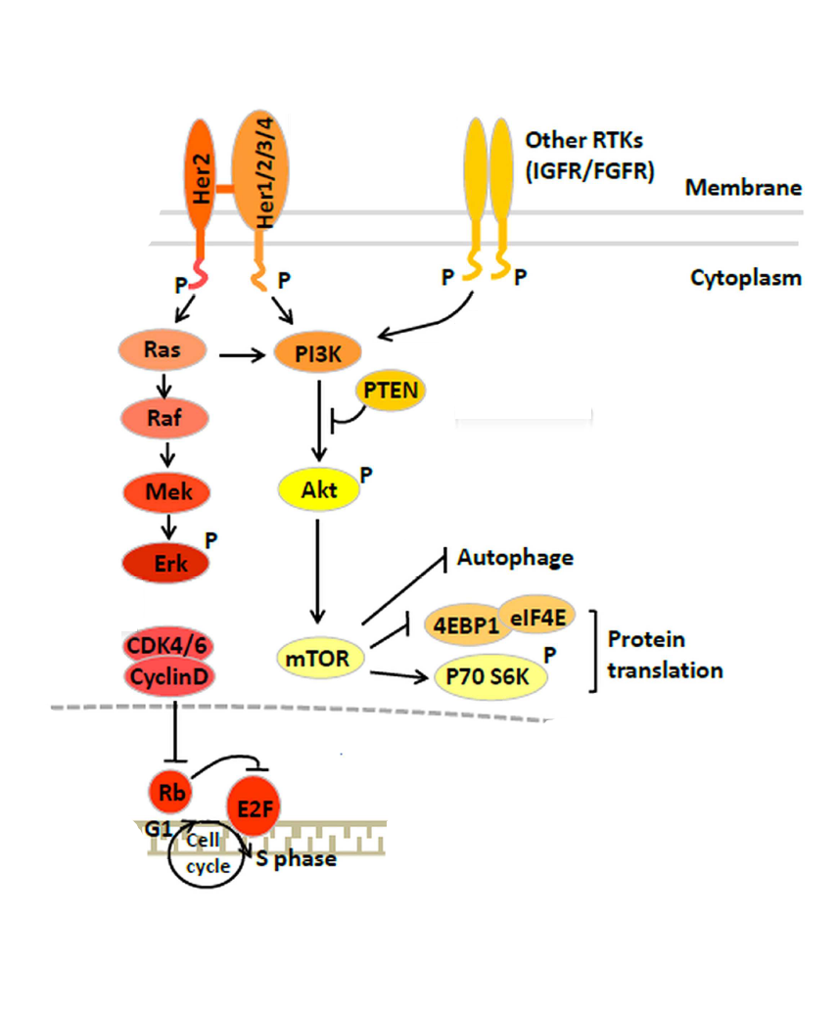
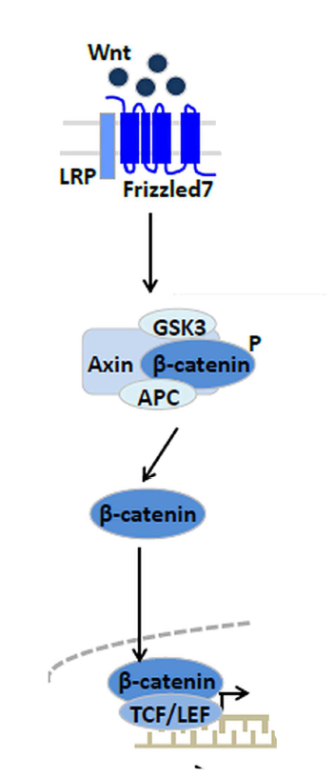
Other Oncogenic pathways in breast Cancer

Slide 34
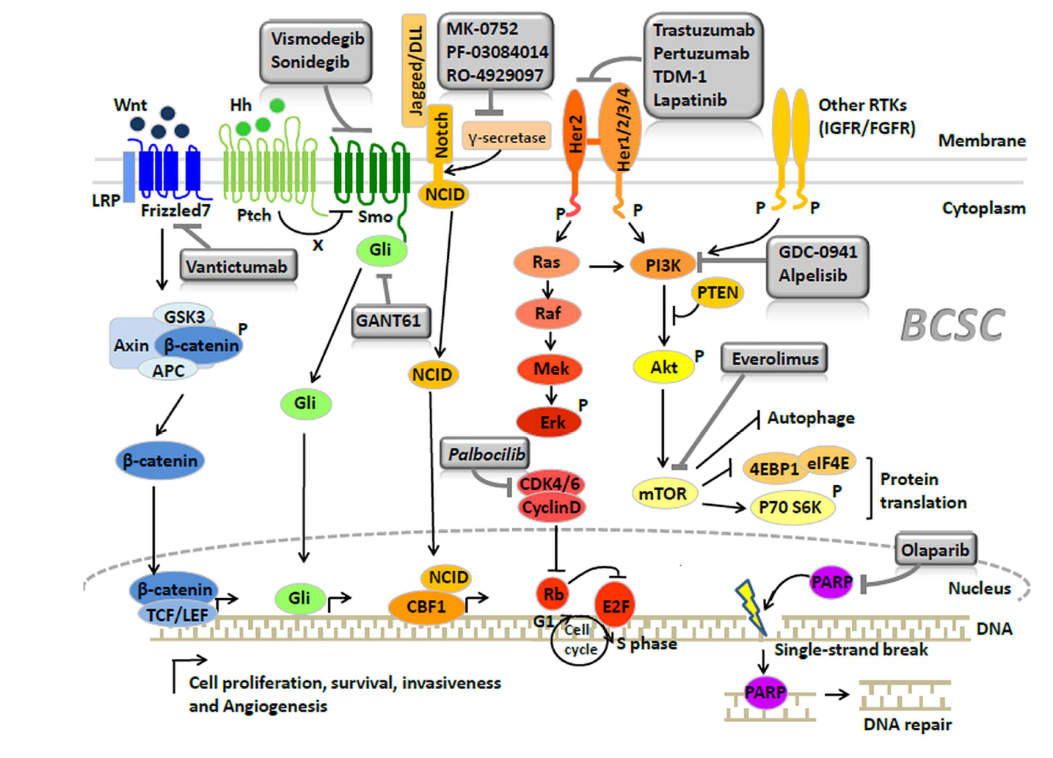
Targeting novel Oncogenic pathways in BC

Slide 35
New therapeutic strategies rely on identifying the key biomarkers driving treatment resistance and cancer progression
Thank You

