Slide 1

New imaging facilities for improving response evaluation
Andrea Laghi
Dept. of Medical-Surgical Sciences and Translational Medicine
SAPIENZA – University of Rome,
Sant’Andrea University Hospital, Rome, ITALY
andrea.laghi@uniroma1.it ; Skype: andrealaghimd

Slide 2
CONFLICTS OF INTEREST
Speaker’s fees:
  Bayer
  Bracco
  GE Healthcare
  Guerbet
  Merck
Advisory board:
  GE Healthcare

Slide 3
NEW ONCOLOGIC THERAPIES

Slide 4
TEACHING OBJECTIVES
  To present the evolution of objective response criteria and discuss limitations in assessing response to target therapy and to immunotherapy
  To review current status of imaging in assessing response to target therapy and to immunotherapy
  To present future directions of imaging

Slide 5
THE ERA OF CYTOTOXIC DRUGS
  WHO (1979)
  RECIST 1.0 (2000)
  RECIST 1.1 (2009)

Slide 6
FROM WHO TO RECIST
Response Evaluation Criteria for Solid Tumours
From 2D to 1D
Sum of the longest diameters of the appointed target lesions in the transversal plane
A
A
B
WHO
RECIST

Slide 7
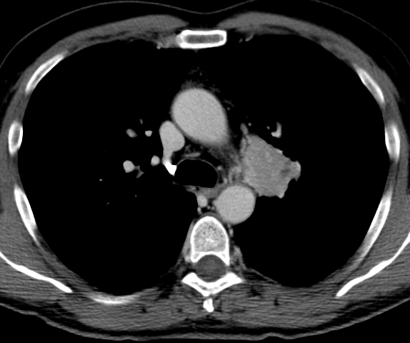
2D >>> 1D, A STEP BACKWARD?
1st reader:
3 cm x 4 cm = 12 cm²
2nd reader:
3.45 cm x 4.6 cm = 15.87 cm²
T0
T1
WHO = 15.87 cm²-12.0 cm²/12.0 cm² = 0.32
i.e. PD (cut-off for ≥ 25%)

Slide 8
2D >>> 1D, A STEP BACKWARD?
1st reader:
3 cm x 4 cm = 12 cm²
2nd reader:
3.45 cm x 4.6 cm = 15.87 cm²
T0
T1
RECIST = 4.6 cm – 4 cm / 4 cm = 0.15
i.e. SD (cut-off for PD ≥ 20%)

Slide 9
RECIST 1.0 (2000) vs 1.1 (2009)

Slide 10
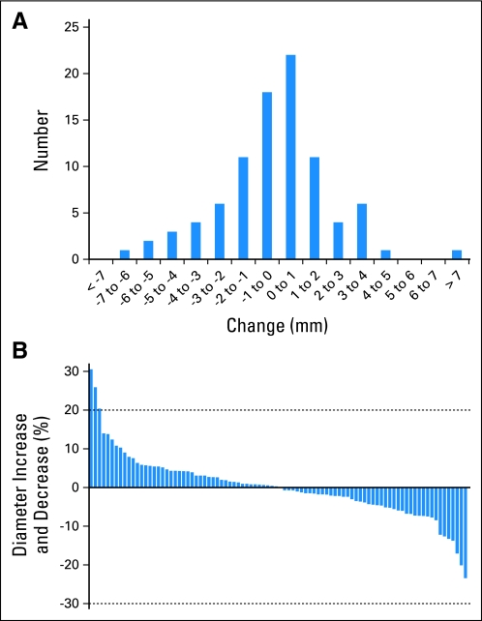
RECIST LIMITATIONS
Inter-observer variability
Oxnard G, JCO Vol 29; 2011

Slide 11
SOFTWARE AUTOMATION

Slide 12
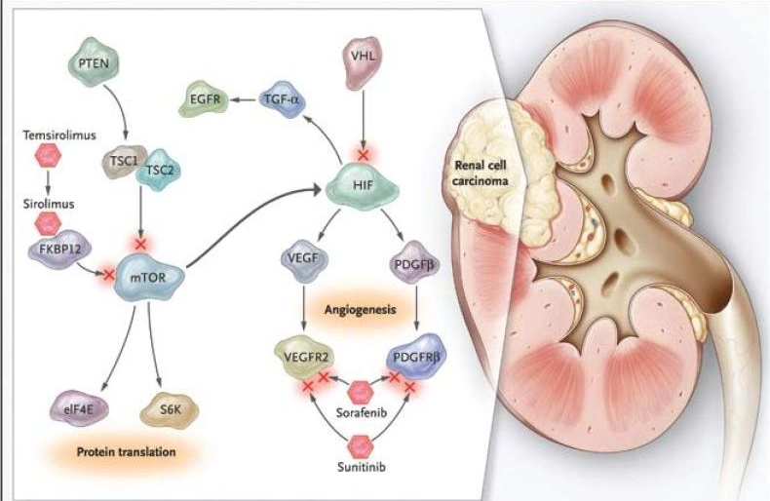
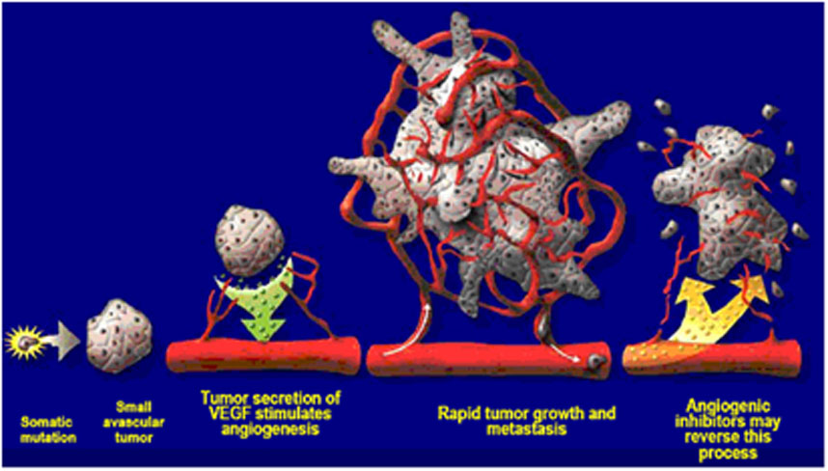
RECIST LIMITATIONS
Inter-observer variability
Different morphological behaviour of lesions when using targeted therapies

Slide 13
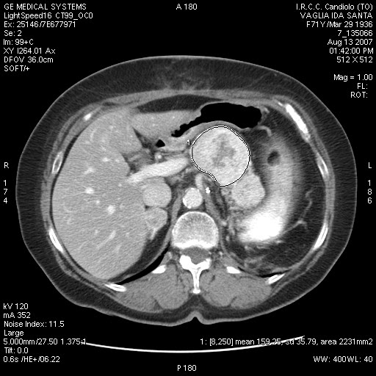
CLINICAL CASE
71 year old woman
Left radical nefrectomy (Fuhrmam type I/IV, pT3, lung and pancreatic mets)
August 13th 2007 baseline CT scan

Slide 14
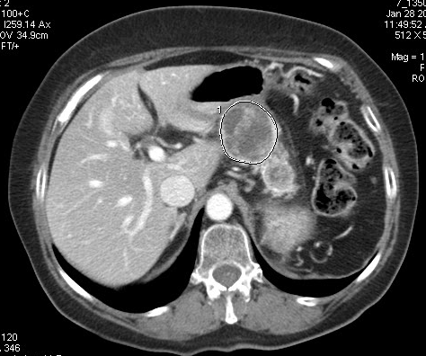
CLINICAL CASE
Three cycles of sunitinib (50mg/day)
Follow-up CT scan 28th of January 2008
SD or PR?

Slide 15
CLINICAL CASE
SLD=110mm
SLD=93mm
Overall size reduction=15% (SD)

Slide 16
CHOI CRITERIA
SIZE
DENSITY
RECIST
Choi

Slide 17
CHOI CRITERIA: DRAWBACKS
Reliability is limited, especially in pts with:
    most lesions <15 mm
    a small number of lesions
    heterogeneous lesions
    hypodense lesions at baseline
Because Choi criteria were not able to early identify patients with PD, these criteria will not change the management of sunitinib treated mRCC patients

Slide 18
IMMUNOTHERAPY
Stop treatment
To continue therapy with a non effective drug would delay the switch to salvage therapy
Progress
Response
Pseudo-progress
Continue treatment
Not desirable to discontinue an effective treatment earlier
from Ganten et al., RöFo 2014

Slide 19
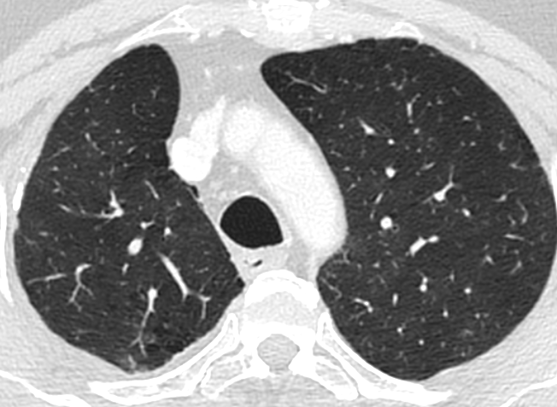
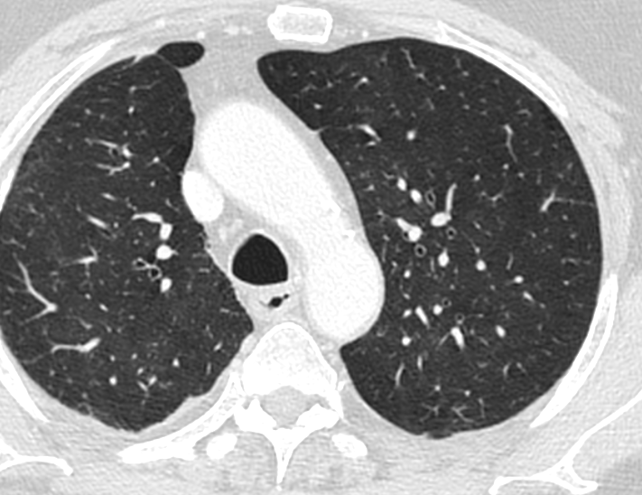
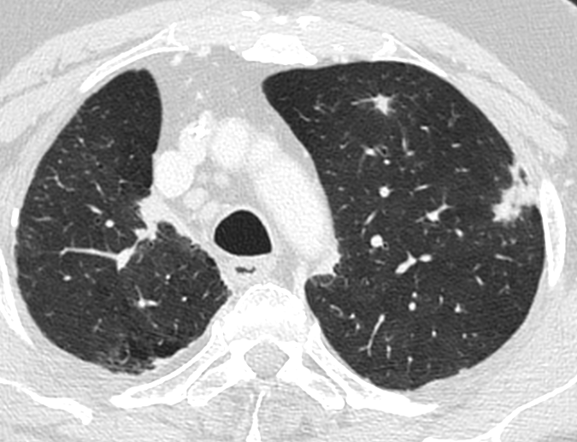
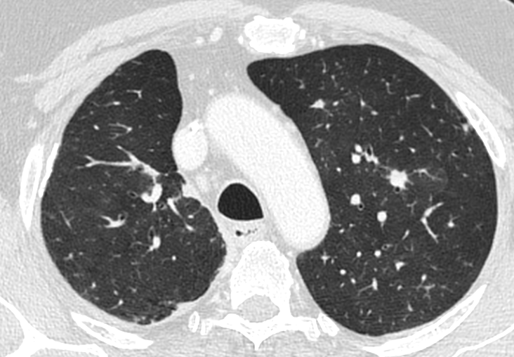
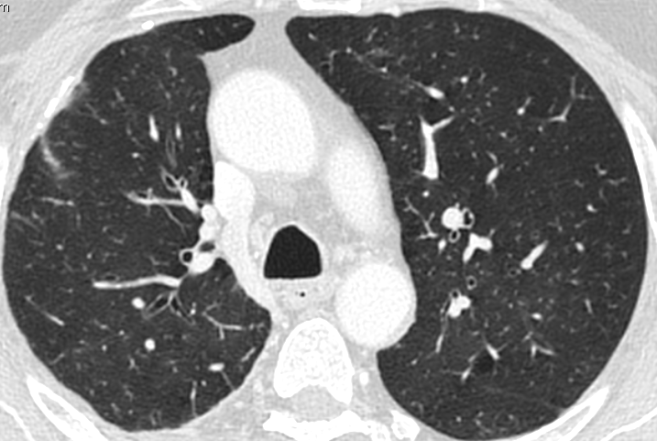
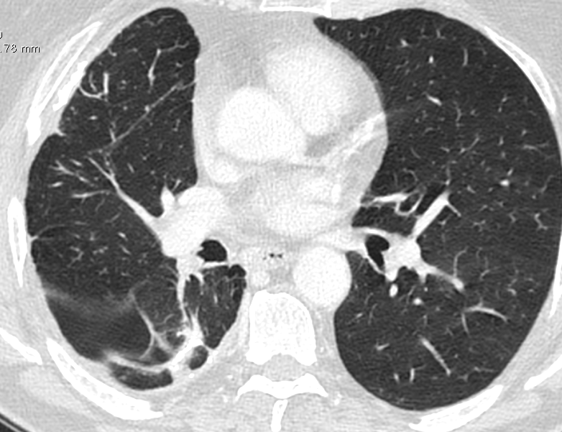
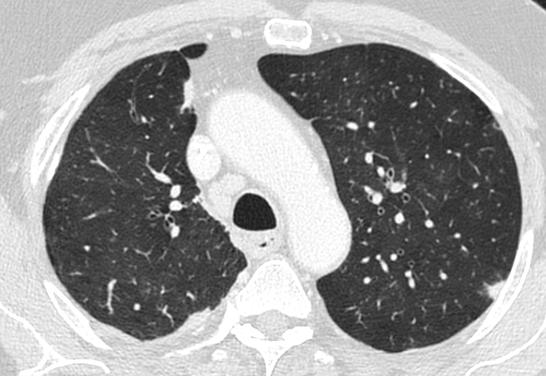
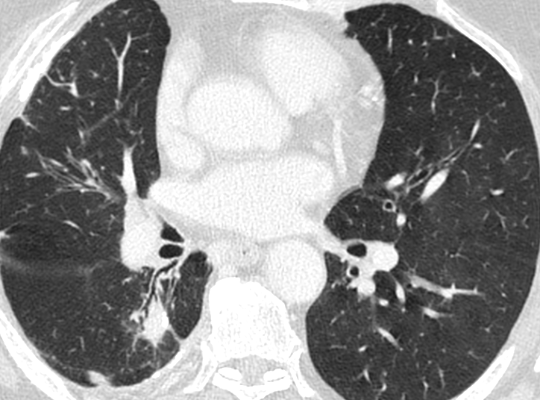
NSCLC under treatment with Pembrolizumab
BASELINE
TP1

Slide 20
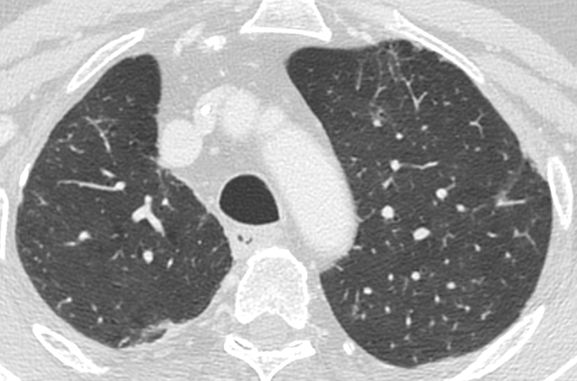
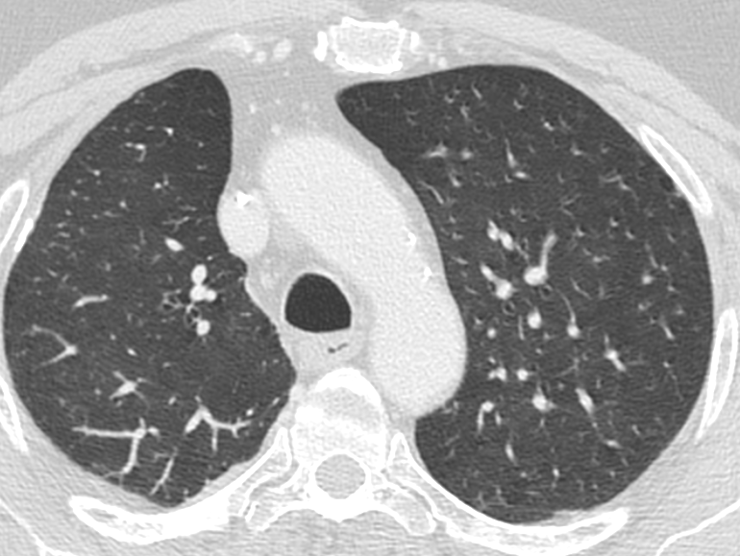
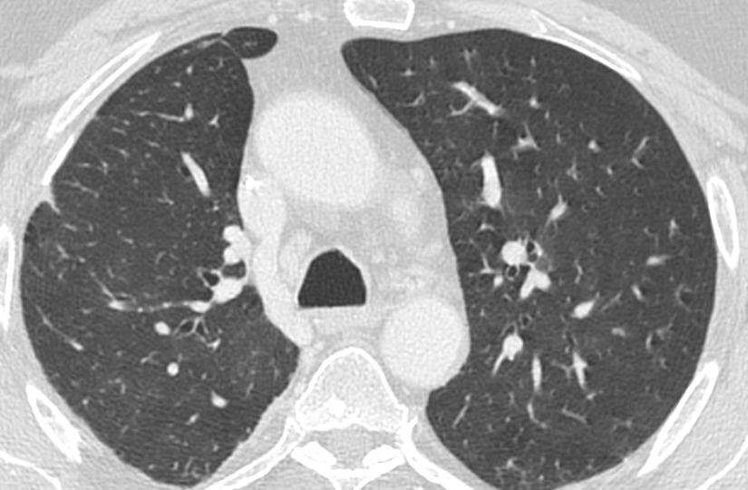
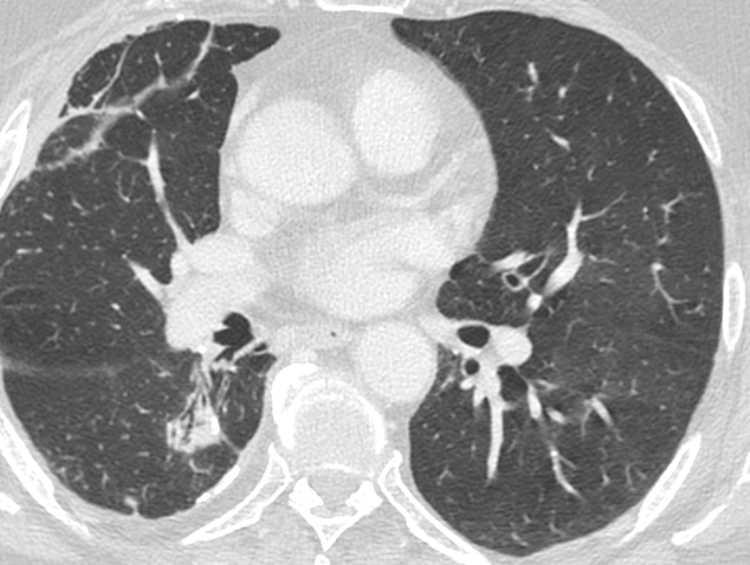
NSCLC under treatment with Pembrolizumab
TP1
TP2

Slide 21
KEY POINTS IN ASSESSING RESPONSE
TO IMMUNOTHERAPY
  The evidence of a measurable antitumoral activity may take longer for IT than for conventional cytotoxic drugs
  Discontinuation of IT agents can be inappropriate unless PD is confirmed
  In IT, treatment response can occur also after PD, as defined by conventional criteria
RECIST CRITERIA
ARE INADEQUATE

Slide 22

Immune-Related Response Criteria (2009)
  Modified WHO criteria (Wolchok ed al. Clin Cancer Res 2009)
New measurable lesions (≥5x5 mm) incorporated in tumor burden
  Tumor Burden = SPD_{index lesions} + SPD_{new, measurable lesions}
  New non-measurable lesions (<5x5 mm) do not define progression

Slide 23
Immune-Related Response Criteria (2009)
  Modified WHO criteria (Wolchok ed al. Clin Cancer Res 2009)
New measurable lesions (≥5x5 mm) incorporated in tumor burden
  Tumor Burden = SPD_{index lesions} + SPD_{new, measurable lesions}
  New non-measurable lesions (<5x5 mm) do not define progression
Confirmation of CR, PR, PD

Slide 24

From irResponse Criteria to irRECIST
  Bidimensional have larger variability than unidimensional measurements
  Inaccurate capture of small changes of tumor burden during therapy
  Modified RECIST criteria (2013)
    New lesion(s) does not define progression
    Measurements of new lesion(s) included in the sum of the measurements
    Confirmation by two consecutive observations not less than 4 wks apart
Clin Cancer Res 2013;19:3936–3943

Slide 25
From irRC and irRECIST to iRECIST
irRC e irRECIST recommendations
not always costantly applied
Doubts about comparison of data and
results among different trials
Nishino et al. Eur J Radiol. 2015
Nishino et al., J Immunother Cancer. 2014
iRECIST (2017)
modified RECIST 1.1 for
immune-based therapeutics
Seymour et al. Lancet Oncology 2017;18:143-52

Slide 26
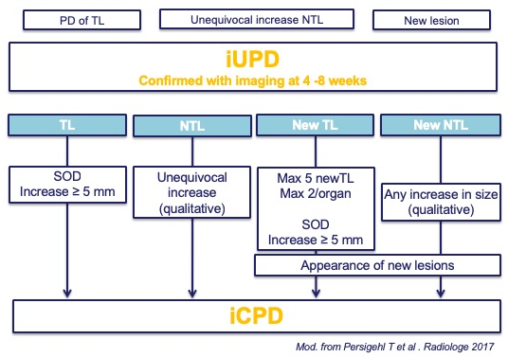
iRECIST
  Definitions of measurable and non-measurable disease; numbers and site of target disease as per RECIST 1.1.
  Evaluation, but separate recording of new lesions
  Confirmation of PD is required
  New categories
    Unconfirmed immune PD (iUPD)
    Confirmed immune PD (iCPD)
Seymour et al. Lancet Oncology 2017;18:143-52

Slide 27
iRECIST
“The major change for iRECIST is the concept of resetting the bar”: reference point during treatment is VARIABLE (not only BASELINE and NADIR)

Slide 28
iRECIST

Slide 29
iRECIST

Slide 30
iRECIST

Slide 31
iRECIST

Slide 32
iRECIST

Slide 33
iRECIST
BEST OVERALL RESPONSE (iBOR)
the best timepoint response recorded from the start of the study treatment until the end of treatment
% VARIATION
iUPD
20
iUPD
SD
10
iUPD
- 10
- 20
- 30
iPR
BASELINE
TP1
TP2
TP3
TP4
TP5
iBOR

Slide 34
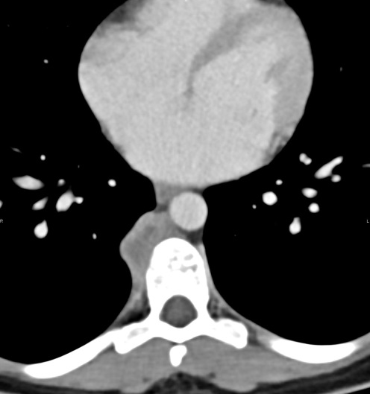
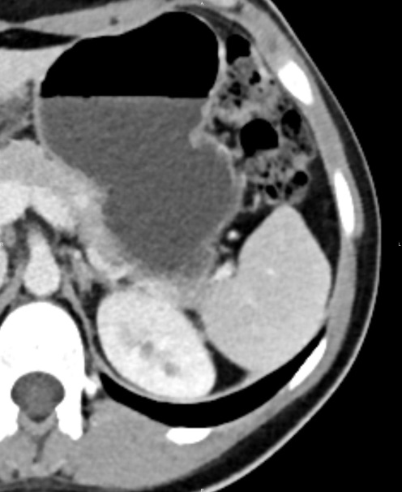
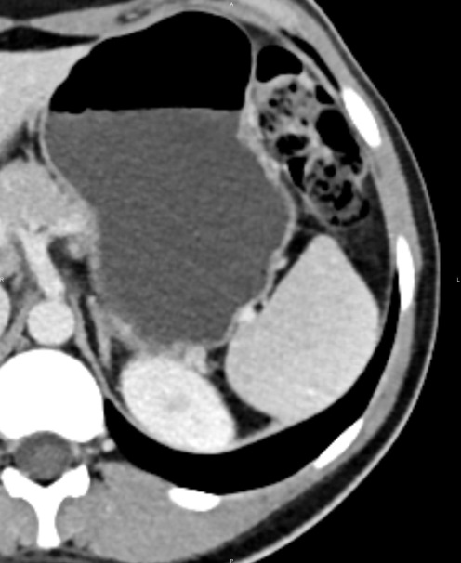
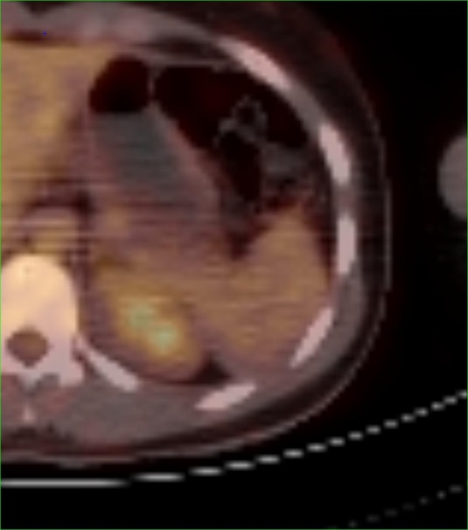
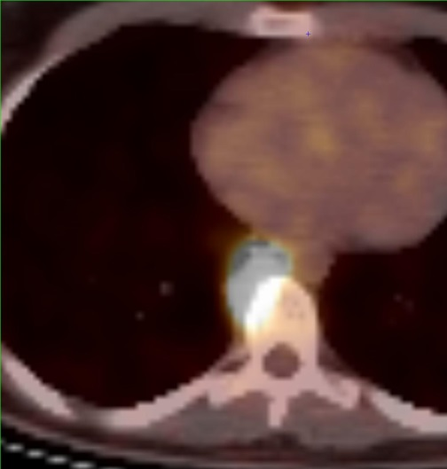
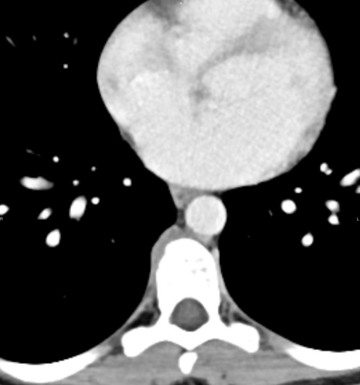
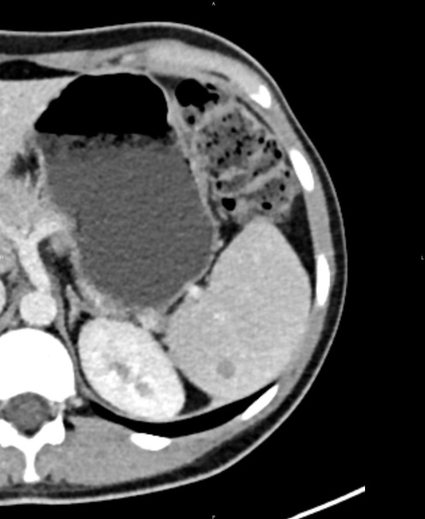
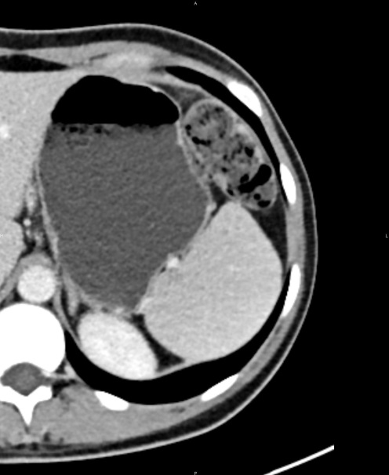
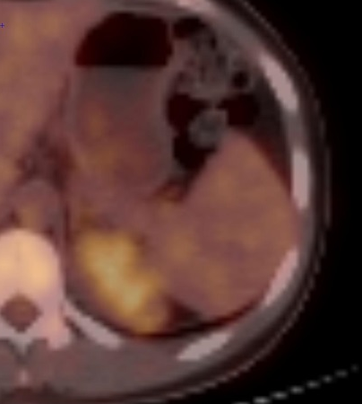
M1 Melanoma under treatment with Ipilimumab
BASELINE
Clear clinical benefit
Continue Immunotherapy
Follow up splenic lesions
iPR
New NON TARGET
iUPD
TP1

Slide 35
HYPER-PROGRESSION
Tumor growth kinetics ratio
International Immunopharmacology 58 (2018) 125–135

Slide 36
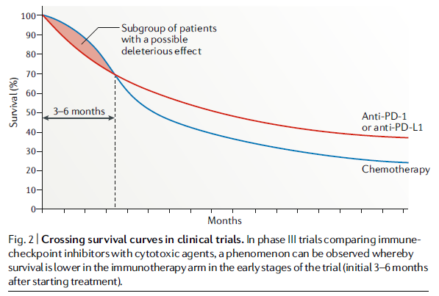
HYPER-PROGRESSION
«Paradoxical acceleration of tumor growth kinetics after the initiation of treatment with anti-PD-1/PD-L1 agents»
Variable incidence: ∼10%
No consistence predictors

Slide 37
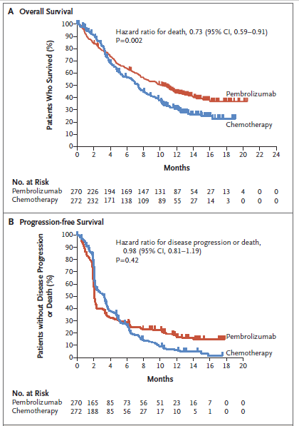
HYPER-PROGRESSION
«Paradoxical acceleration of tumor growth kinetics after the initiation of treatment with anti-PD-1/PD-L1 agents»
Variable incidence: ∼10%
No consistence predictors
Champiat S, et al. Nat Rev Clin Oncol. 2018.
Bellmunt J, et al. N Engl J Med 2017;376:1015-26.

Slide 38
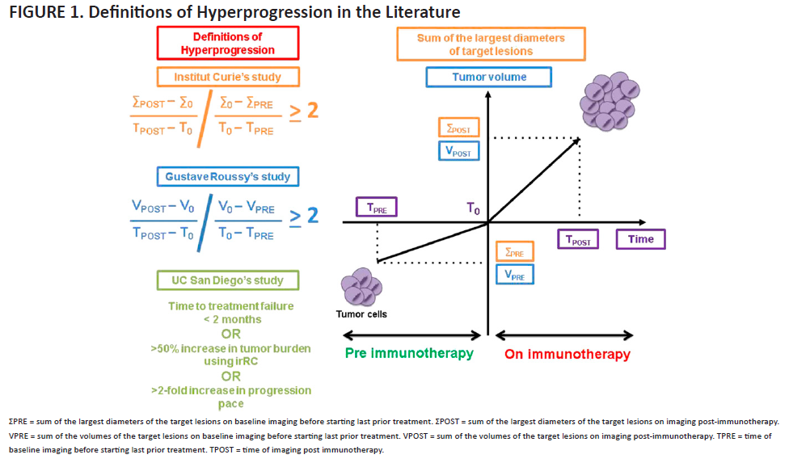
HYPER-PROGRESSION
«Paradoxical acceleration of tumor growth kinetics after the initiation of treatment with anti-PD-1/PD-L1 agents»
Variable incidence: ∼10%
No consistence predictors
2018 ASCO EDUCATIONAL BOOK

Slide 39
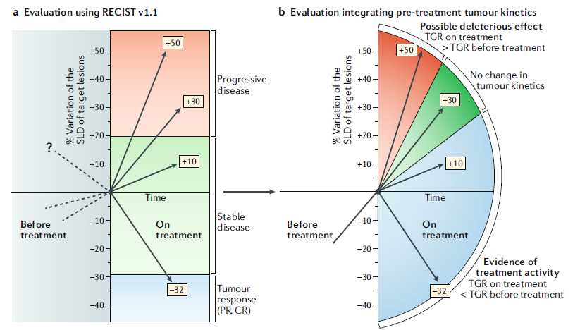
HYPER-PROGRESSION
«Paradoxical acceleration of tumor growth kinetics after the initiation of treatment with anti-PD-1/PD-L1 agents»
Variable incidence: ∼10%
No consistence predictors
2018 ASCO EDUCATIONAL BOOK

Slide 40
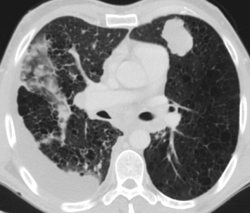
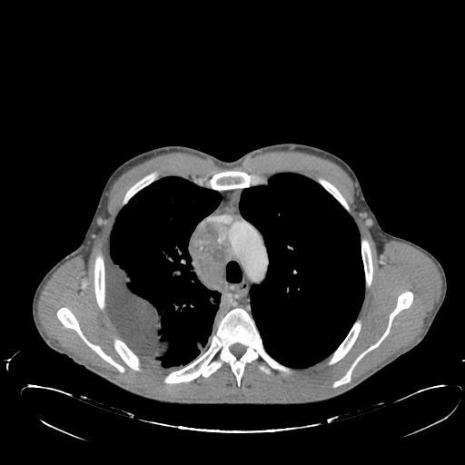
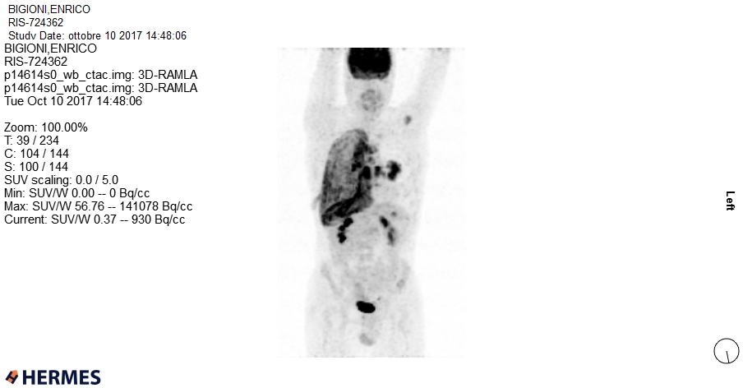
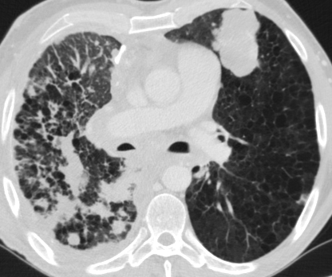
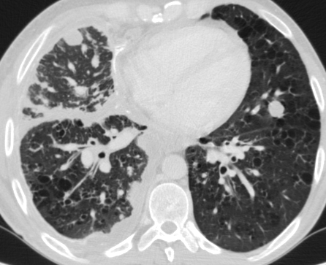
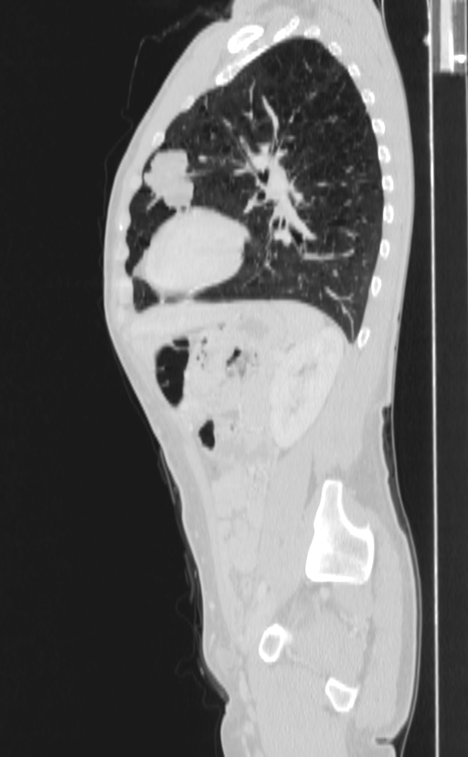
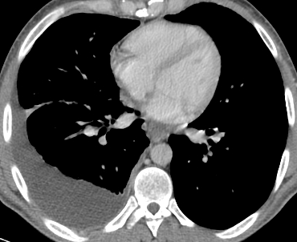
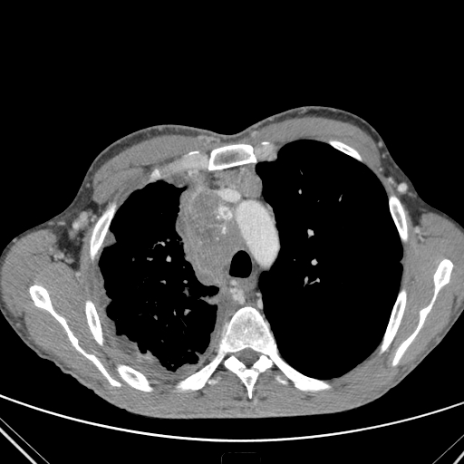
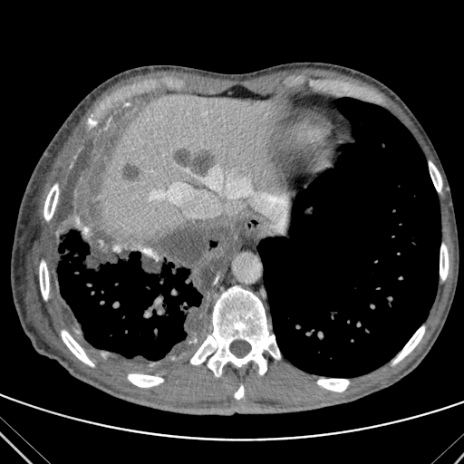
HYPER-PROGRESSION
NSCLC - Pembrolizumab
Baseline
5 wks
12 wks

Slide 41
irRC and irRECIST vs iRECIST
160 NSCLC patients
Atypical response, 20 (13%)
ATYPICAL:
Pseudoprogression, 5%
Dissociated responses, 8% (concomitant decrease in certain tumoral elements and increase in other elements)
CONCLUSIONS
RECIST 1.1 underestimated the benefit of immune checkpoint inhibitors in 11% of the progressive patients.
IrRECIST and iRECIST identified these unconventional responses, with 3.8% discrepancy rate

Slide 42
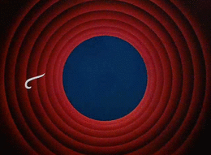


Slide 43
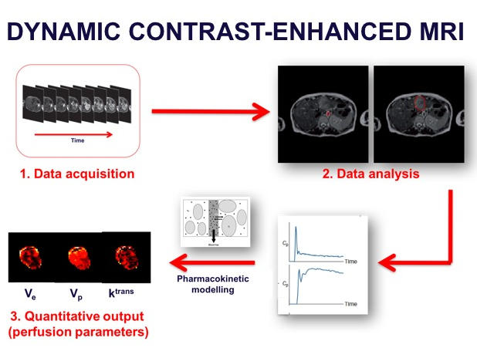
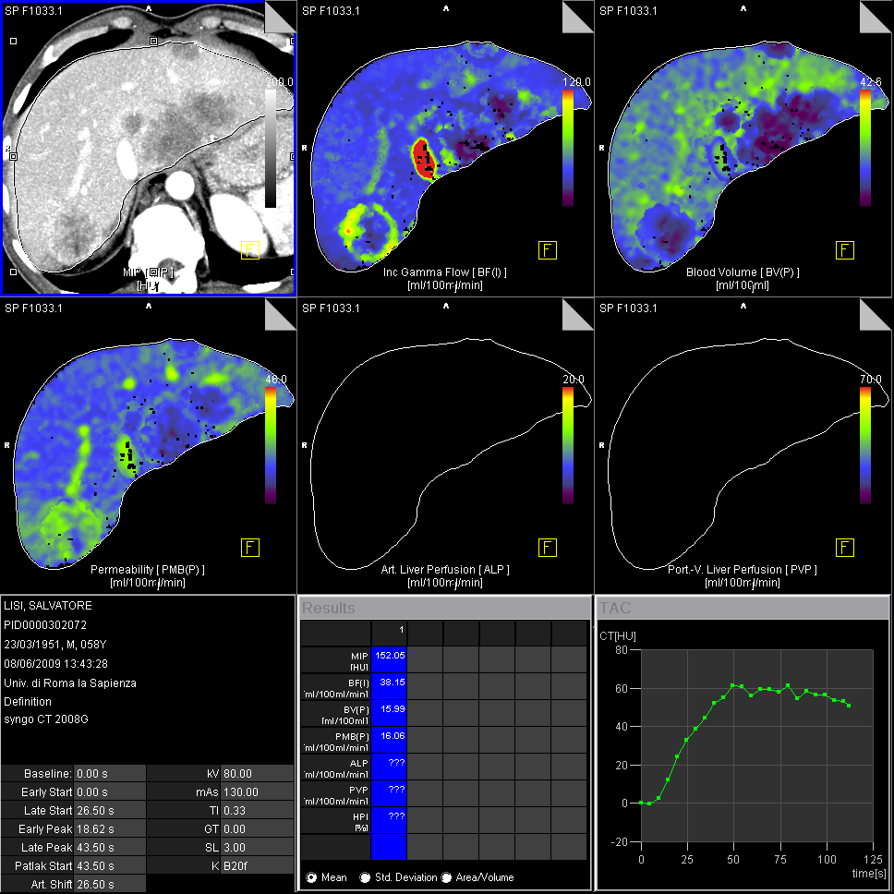
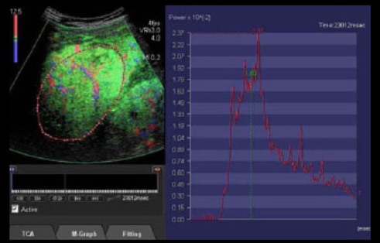
A SHIFT FROM MORPHOLOGY TO FUNCTION
EXPLORE TUMOR VASCULARITY
  DCE-MRI (MR-perfusion)
  CT-perfusion; DECT
  CEUS
BF ⬆
BV ⬆
PS ⬆
Consensus on two imaging biomarkers*:
k^{trans} and IAUGC_{BN}
k^{trans}: VEGF and VEGFR-2
  VEGF blockage ⬇ vascular permeability
  effect: ⬇ tumor k^{trans}
*Data obtained at 1.5T using low-molecular-weight extracellular Gd-based CM with 20% within-subject coefficient of variation for solid tumors at least 2 cm in diameter

Slide 44
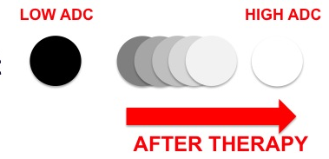
A SHIFT FROM MORPHOLOGY TO FUNCTION
EXPLORE TUMOR CELLULARITY
  Diffusion (DWI)
  IVIM
NO DATA ON PERFUSION/DWI AND IMMUNOTHERAPY

Slide 45
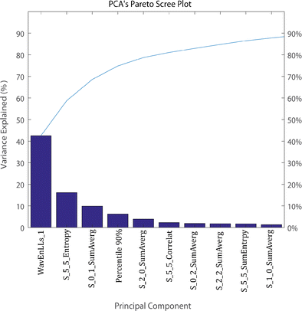
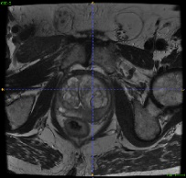
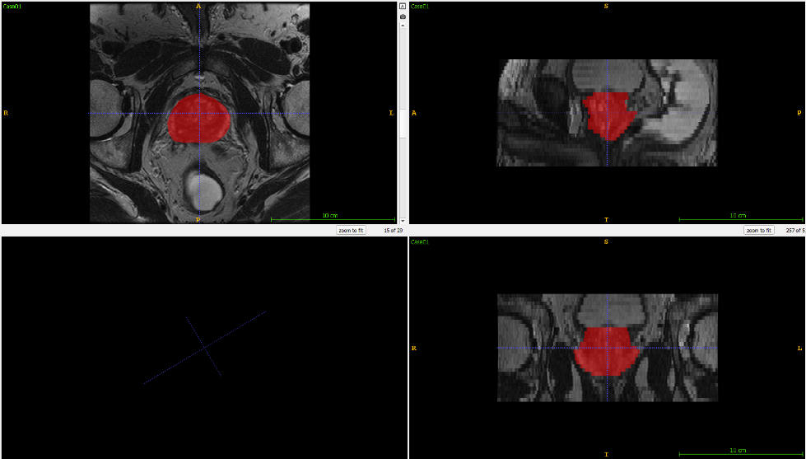
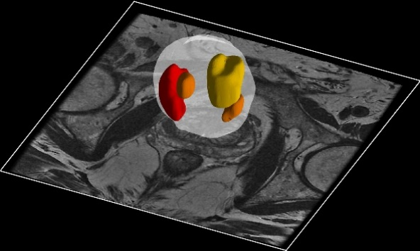













RADIOMICS: the conversion of digital images into mineable data
Source images
Segmentation
Feature extraction
T2w
Organ extraction
Volume/Shape features
ANATOMY
DWI
DIFFUSION
Clustering
Histogram features
D
DCE-MRI
Nosological image
Texture Features
PERFUSION
K^{trans}
RADIOMIC SIGNATURE

Slide 46
RADIOMICS AND IMMUNOTHERAPY
WHY?
WHAT DO WE KNOW?
Only 20–50% of patients with advanced solid tumours respond to IT treatment
Inability to precisely identify the patients who will benefit from IT has limited the applicability of immune checkpoint blockade and could put patients at higher risk of immune-related toxicity
Radiomics have shown accuracy as a prognostic tool by identifying high-risk from low-risk patients
Radiomics on pretreatment images has shown promising results in also identifying patients that will respond to therapy and those that may not
Delta-radiomics could serve as an effective and noninvasive way to assess effectiveness of therapy as well as predict early treatment response.

Slide 47
RADIOMICS AS AN IMAGING BIOMARKER FOR IMMUNOTHERAPY
BACKGROUND: 3 Nishino et al. phenotypes
  immune-inflamed, immune-excluded, immune-desert
  characterised by dense, functional CD8 cell infiltration, increased interferon-γ signalling, expression of cell checkpoint markers (such as PD-L1), and a high mutational burden
RESPOND TO IT

Slide 48
RADIOMICS AS AN IMAGING BIOMARKER FOR IMMUNOTHERAPY
LIMITATIONS
  Heterogeneous cohort
  Analysis focused only on immune-inflamed and immune-desert phenotypes
  CD8 cells only
  Radiomics data dependent on CT acquisition protocol (i.e. kV, kernel filter)
Sun R et al, Lancet Oncol 2018

Slide 49




CAN RADIOMICS HELP IN PREDICTING HYPERPROGRESSION?
BASELINE PR VS HYPERPROGRESSION
PR
HP

Slide 50
CONCLUSIONS
  Radiologists need to be aware of the mechanism of action of new oncologic drugs, including immunotherapy
  Assessment of response to therapy should be performed by specific criteria
  In IT pseudo- and hyperprogressions are uncommon, but real
  Functional imaging and radiomics are expected to provide more detailed information about response to IT

