Slide 1
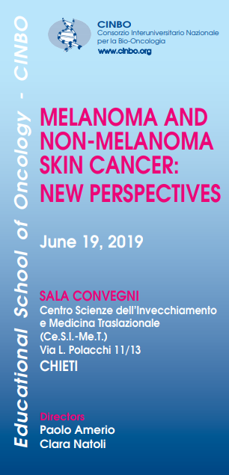
Current and emerging treatment options in the treatment of basal cell carcinoma
Alessio Cortellini/Maria Concetta Fargnoli
Oncologia Medica/Dermatologia generale ed Oncologica
Ospedale San Salvatore
Dipartimento di Scienze Cliniche Applicate e Biotecnologie
Universitá degli studi de L’Aquila

Slide 2
BCC: World Health Organization
NMSC are approximately 90% or more of all skin malignancies
70% of NMSC are basal cell carcinomas (BCC)
BCC: Squamous Cell Carcinomas ≈ 5:1
The overall mortality rate is generally low
→ BCC metastatic spread is rare and mostly seen in advanced/neglected BCC
Advanced BCC may not be amenable to radiation therapy and can be challenging to treat with surgery without causing significant morbidity, loss of function, or disfigurement when they are located in a difficult-to-treat area
Large, aggressive, or recurrent tumors or those that penetrate deeper into surrounding tissues
Notes:
Most patients with primary cutaneous non-melanoma skin cancer (NMSC) have an excellent prognosis.

Slide 3
Advanced Basal Cell Carcinoma: definition
AJCC stage II or above: tumor more than 2 cm (≥T2)
Disease-related factors:
Tumor size (e.g. giant BCC)
Tumor location (e.g. “H” zone)
Number of tumors
Tumor subtype (e.g. morpheic tumors)
Likelihood of successful treatment (e.g. Baso-squamo, infiltrative, ecc..)
Patient-related factors:
Age
Performance Status
Comorbidities
Patient’s priorities (e.g. cosmetic outcomes)
Lear JT, et al. Br J Cancer 2014
Khoo AB, et al. Curr Opin Oncol 2016
Maly TJ, et al. J Drugs Dermatol 2014
Peris K, et al. Future Oncol 2015
Notes:
LaBCC: more difficult to characterize due to hererogeneity. No formal wide accepted definition exists. In general large, aggressive, or recurrent tumors or those that penetrate deeper into the underlying skin and surrounding tissues are considered laBCC.
LaBCCs may not be amenable to radiation therapy and can be challenging to treat effectively with surgery without causing significant morbidity, loss of function, or disfigurement when they are located in a difficult-to-treat area (eg, periorbital)

Slide 4
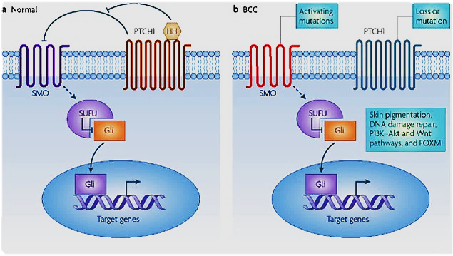
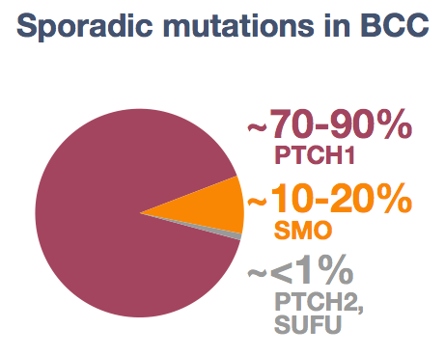
Constitutive activation of the Hedgehog Pathway
is the MOST COMMON DRIVER in BCC
Epstein EH, Nat Rev Cancer. 2008; 8:743-54
Notes:
PTCH patched, SMO smoothened, protein suppressor of fused
Suppressed of fused homologus
Glioblastoma associated oncogene (zinc finger protein)

Slide 5
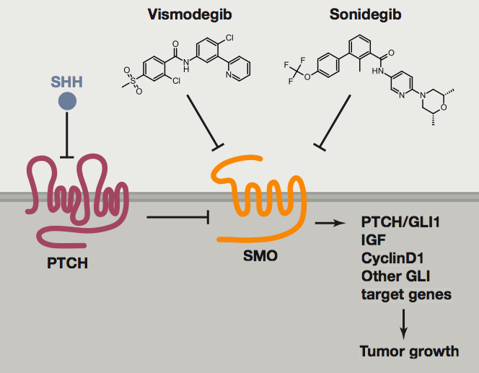
Approved SMO inhibitors
January 2012 → FDA approved
July 2013 → EMA approved
July 2015 → FDA approved
August 2015→ EMA approved
Vismodegib
(GDC-0449)
Sonidegib
(LDE225)
laBCC
laBCC
mBCC
Continue treatment as long as clinical benefit or until unacceptable toxicity
Notes:
But only vismodegib and sonidegib have been approved in 2012 and 2015 respectively, and are commercially available. Both have been approved for the treatment of adults with locally advanced basal cell carcinoma who are not candidates for surgery or radiation therapy, and only vismodegib has been approved for metastatic basal cell carcinoma.
Sonidegib approved in Switzerland and Australia also for mBCC.
Vismodegib was the first oral SMO inhibitor that received approval
BOTH: Treatment should be continued as long as clinical benefit is observed or until unacceptable toxicity develops
The pregnancy prevention plan and a pharmacovigilance plan will be implemented as part of the marketing authorization.

Slide 6
SMO inhibitors: Vismodegib
ERIVANCE
Single-arm, two-cohort, non-randomized (non-comparative)
104 patients, 2 cohort: mBCC and laBCC
Vismodegib 150 mg/daily
Primary endopoint: ORR
At the primary analysis (minimum f.up ≥ 9 months):
laBCC ORR: 43%
mBCC ORR: 30%
Median duration of treat 10 m.

Slide 7
SMO inhibitors: Vismodegib
12-month and 30-month (final) update confirmed the results.
Median duration of treat. 13 m.
Median time to response:
laBCC: 4.6 months
mBCC: 1.9 months
Notes:
The expanded access study was an open-label, multicenter US study that enrolled 119 patients
This study was terminated early by the sponsor due to FDA approval of vismodegib; therefore, the median duration of exposure was only 5.5 months.
STEVIE was a multicenter, open-label trial that evaluated the safety (primary objective) and efficacy of vismodegib in 1227 patients
Evaluable adult patients (N = 1215, 1119 locally advanced; 96 metastatic BCC) from 36 countries were treated; 147 patients (12%) remained on study at time of reporting. Median (range) treatment duration was 8.6 (0-44) months.

Slide 8
SMO inhibitors: Sonidegib
Randomized, non-comparative, multicenter, double-blind, phase II trial
Patients: 194 laBCC and 38 mBCC
Randomization: 1:2 proportion to be treated with sonidegib 200 mg or 800 mg.
Primary end point: ORR
At the primary analysis (minimum f.up ≥ 6 months)
200 mg ORR: 36%
800 mg ORR: 34%
Notes:
Serious adverse events occurred in 11 (14%) of 79 patients in the 200 mg group and 45 (30%) of 150 patients in the 800 mg group.

Slide 9
SMO inhibitors: Sonidegib
30-month update
Median DOR:
laBCC: 26.2 months
mBCC: 14.8 months

Slide 10
LaBCC - Efficacy of VISMODEGIB and SONIDEGIB
Sekulic et al, NEJM 2012 and JAAD 2015; Chang et al, JAAD 2013; Basset-Seguin et al, Lancet Oncol 2015 and EJC 2017; Migden et al Lancet Oncol 2015 and Cancer Treat 2018; Dummer et al, JAAD 2016
Notes:
Efficacy data of sonidegib and vismodegib for BCC treatment, when comparing the objective response rate, are similar, 47 and 43%, but vismodegib shows higher complete rates,

Slide 11
mBCC - Efficacy of VISMODEGIB and SONIDEGIB
Sekulic et al, NEJM 2012 and JAAD 2015; Chang et al, JAAD 2013; Basset-Seguin et al, Lancet Oncol 2015 and EJC 2017; Migden et al Lancet Oncol 2015 and Cancer Treat 2018; Dummer et al, JAAD 2016
Notes:
In the mBCC cohort of ERIVANCE, the ORR was 30% (Table 3); all responses were PRs (n = 10) [43]. SD and PD were reported in 21 patients (64%) and 1 patient (3%), respectively. Most patients with mBCC (73%) experienced tumor shrinkage. The median DOR was 7.6 months, and the median PFS was 9.5 months [43].

Slide 12
Similar safety profiles of VISMODEGIB and SONIDEGIB
Sonidegib
(LDE225)
Vismodegib
(GDC-0449)
Lacouture. The Oncologist. 2016
Notes:
AE commonly observed in HH inhibitors treated patients are: muscle spams, alopecia, and dysgeusia, with similar rates in both drugs
Nearly all patients experience at least one treatment emergent adverse event, most were classified as grade 1 or 2, the presence of adverse events of grade 3 and 4 is low, <20%
Although the severity is mainly grade 1-2, the long term nature of these AEs can lead to decrease QoL, treatment interruption and in some cases discontinuation all of which might affect clinical outcome.
Exposure ≥12 months did not lead to increased incidence or severity of new TEAEs. The majority of the most common TEAEs ongoing at time of treatment discontinuation resolved by 12 months afterwards
A follow-up 21-month analysis of ERIVANCE (12-month update relative to the primary analysis; cutoff: November 28, 2011), at which time 22 patients with laBCC (31%) and 7 patients with mBCC (21%) were still receiving treatment, confirmed the efficacy of vismodegib and demonstrated the durability of the responses achieved.

Slide 13
DROPS OUT!
Most patients experienced ≥ 1 EA that were primarily grade 1/2
Sekulic et al, NEJM 2012 and JAAD 2015; Chang et al, JAAD 2013; Basset-Seguin et al, Lancet Oncol 2015 and EJC 2017; Migden et al Lancet Oncol 2015 and Cancer Treat 2018; Dummer et al, JAAD 2016
Notes:
Although all patients (N = 104) experienced ≥ 1 adverse event (AE), most patients (57%) had only grade 1/2 AEs. The most common AEs (any grade) included muscle spasms (68% of patients), alopecia (63%), dysgeusia (51%), decreased weight (46%), fatigue
(36%), nausea (29%), decreased appetite (23%), and diarrhea (22%). Thirteen patients (12%) discontinued treatment due to AEs, and muscle spasms (n = 2) were the most common AE leading to discontinuation. Serious AEs were reported in 25% of patients. Sixteen patients died by the time of the primary analysis. None of these deaths occurred during treatment or were considered related to
vismodegib.

Slide 14
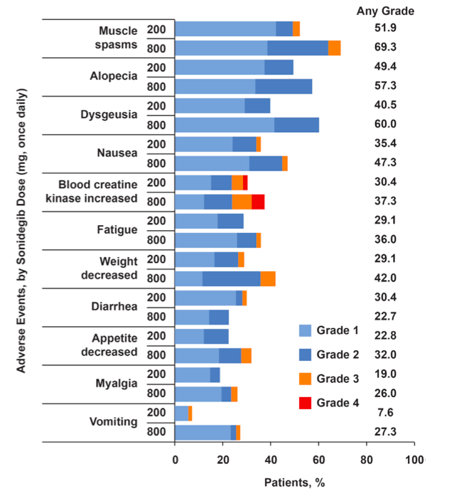
Sonidegib
(LDE225)
The safety profile of sonidegib remained similar between the primary and 12-month analyses.
The most common grade 3/4 adverse event, occurring in 6.3% (200 mg) and 13.3% (800 mg) of patients
CK monitoring
Notes:
The safety profile of sonidegib remained similar between the primary and 12-month analyses.20 Nearly all patients (200 mg, 97.5%; 800 mg, 100%) experienced 1 or more adverse events. In general, the most common adverse events, including muscle spasms, alopecia, dysgeusia, nausea, increased creatine kinase, fatigue, weight loss, decreased appetite, myalgia, and vomiting, occurred less frequently in the 200- versus 800-mg arm
Increased creatine kinase was the most common grade 3/4 adverse event, occurring in 6.3% (200 mg) and 13.3% (800 mg) of patients The most common adverse events leading to discontinuation (200- vs 800-mg arm) in the 12-month analysis included muscle spasms (5.1% vs 8.7%), dysgeusia (3.8% vs 4.7%), nausea (3.8% vs 4.7%), and alopeci (1.3% vs 6.0%); 59% of patients who discontinued treatment because of adverse events had only grade 1/2 events.
Musculoskeletal adverse effects (AEs) including serum CK elevations are the most clinically relevant AEs reported in sonidegib-treated patients and are a class effect of Hh pathway inhibitors. Not evaluated in ERIVANCE but reported with vismodegib. The Hedgehog pathway is believed to maintain the tissue regeneration/repair mechanism.
No association between CPK abnormalities and muscle spasms (STEVIE)
Patients with muscle symptoms characterized primarily by muscle spasms, musculoskeletal pain, and myalgia need to be monitored for CK elevation because it can be a sign of pending muscle damage.

Slide 15
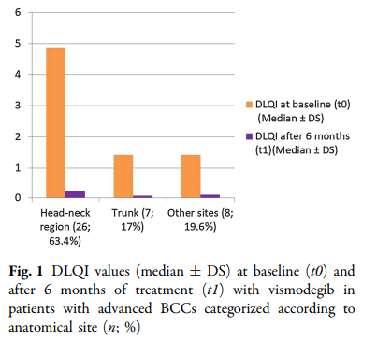
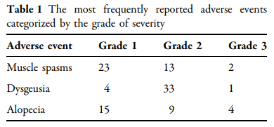
Safety e Qualitá di vita, rapporto non univoco
Real-life prospective study
Forty-eight patients
DLQI at baseline and after 6-months
Villani A, et al. Dermatol Ther (Heidelb) 2019
Notes:
Dermatology Life Quality Index (DLQI) Test

Slide 16
SPASMI MUSCOLARI
Preventive and management strategies to increase treatment duration
DIARREA
ALOPECIA
NAUSEA
PERDITA DI PESO
Notes:
Development of mechanism-based preventive and management strategies. Counseling and supportive care inteventions all of which will contribute to improved QoL and optimal benefit from therapy.
Is so important to follow the easy indications of prevention and treatment of AE in order to increase duration of treatment.

Slide 17
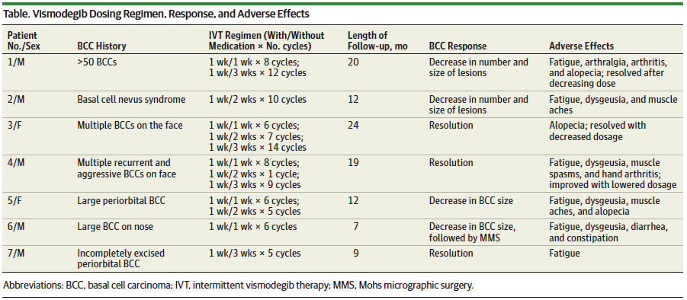
Intermittent dosing schedule
Efficacy with drug holidays of 1- 3 weeks decreasing toxicity
Notes:
Adverse effects have limited treatment duration and tolerability.
This analysis opens a new therapeutic strategy, the intermittent approach. This year has been published this article in which is observed the efficacy of treatment with drug holidays of 1 to 3 weeks, with the important advantage of the decreasing toxicity.
A total of 7 patients with advanced BCC, including 1 with confirmed basal cell nevus syndrome, were treated with intermittent dosing of vismodegib, with dosing regimens that ranged from 1 week receiving medication followed by 1 to 3 weeks without receiving medication (Table). All patients experienced improvement in their BCCs (Figure), and BCCs were resolved in 3 patients. Improvement was determined by clinical decreases in size and number of BCCs using clinical photos from previous visits.
To our knowledge, this is the first study to demonstrate efficacy with 1- to 3-week drug holidays. An intermittent dosing schedule of vismodegib should be considered when treatment-related AEs would cause discontinuation of treatment. Dosing regimens as low as 1 week with and 3 weeks without medication continued to demonstrate clinical improvement in patients with BCCs in this cohort.

Slide 18
Vismodegib resistance is associated with Hh pathway (re)activation
Mutation of SMO either directly impair drug binding or activate SMO to varying levels
Copy number changes in SUFU and GLI2.
Intra-tumor heterogeneity with multiple mechanisms of resistance (combination therapy)
Sharpe et al, Cancer Cell 2015
Notes:
Genomic analysis of tumor biopsies revealed that vismodegib resistance is associated with Hedgehog (Hh) pathway reactivation, predominantly through mutation of the drug target SMO and to a lesser extent through concurrent copy number changes in SUFU and GLI2 . SMO mutations either directly impaired drug binding or activated SMO to varying levels.
Furthermore, we found evidence for intra-tumor heterogeneity (multiple mechanisms of resistance), suggesting that a combination of therapies targeting components at multiple levels of the Hh pathway is required to overcome resistance.
A single relapsed tumor can harbor clones different resistance mutations
Disease recurrence in patients who initially respond to HPI therapy, including those with a CR, may be due to residual tumor cells escaping the cytotoxic effects of HPI therapy or becoming resistant to HPI therapy
Thus, recurrence was associated with the proliferation of resistant, possibly preexisting subclones that emerged after the larger HPI-sensitive cell populations had been eliminated

Slide 19
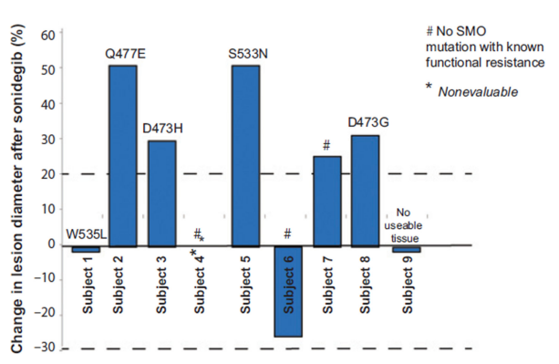
9 pts with aBCC resistant to vismodegib
Sonidegib 6 weeks
5 pts PD
3 pts discontinued for AE (1) or election to surgery (2), 1 NE
SMO mutations in 5/9 (functional in vitro resistance)
Clin Cancer Res 2016
Patients who experienced resistance to vismodegib were also resistant to sonidegib:
probable cross-resistance
Notes:
Patients with aBCC previously resistant to vismo similarly demonstrated Tx resistance with sonidegib.
In terms of efficacy, the cross resistance between vismodegib and sonidegib has been already proven.
Trial, 9 patients with aBCC resistant to vismo
Sonidegib for 6 weeks
5 pts PD, 3 pts SD discontinued for AE (1) or election to surgery (2)
SMO mutations suggesting resistance identified in 5/9 patients (no patient experienced response with sonidegib).
Target BCC size determination of clinically visible lesions, and overall responses of enrolled subjects. Color photographs were taken of all clinically visible lesions with a ruler in the plane of the lesion. A, in cases where the tumor borders are complex, clean plastic grids were placed over the lesions and traced to document the longest diameter. B, photograph of target lesion in a subject before study start. C, photograph of same target lesion after 6 weeks of sonidegib. Arrows indicate areas of tumor growth. D, change in target tumor diameter from baseline (%) after sonidegib. None of the patients met the 30% partial response (top gray dotted line) per RECIST, version 1.1. SMO mutations that are known to ead to functional resistance in vitro found in individual tumors are annotated for each patient.
l

Slide 20
Phase I Study – Taladegib (LY2940680)
Multicenter, open label, dose-escalation study - advanced cancers
47/84 patients with aBCC (laBCC and mBCC)
All response in BCC patients - ORR: 46.8% - HPI-treated (11/31) and HPI-naïve patients (11/16)
AE Hhi class-effect
Phase 2
Bendell, et al. Clin Cancer Res 2018
Notes:
The initial pathological diagnosis was BCC for 47 patients (56.0%)
47 BCC patients were classified as follows: 18 patients had metastatic disease, 21 patients had locally advanced disease, and 8 patients could not be classified based on currently available data
Recommended phase 2.

Slide 21
Vismodegib rechallenge is feasible in patients discontinuing the drug for progression
However, lower clinical activity and duration of response and more toxic
Intercurrent therapies may eliminate tumor clones resistant to vismodegib
ORR: 50% - PR: 50%
Notes:
Retrospective study
6 aBCC patients enrolled in STEVIE who discontinued vismo for PD and were retreated with vismo
ORR 50% al secondo cicl
Clinical activity slightly lower and less durable more toxic (G3/G4 AE reported only during SVC)

Slide 22
2 cases of recurrent, aBCC
Treated with concurrent radiotherapy and vismodegib
Concurrent treatment appeared to be well tolerated and efficacious
JAMA Dermatol. 2015;151(9):998-1001. doi:10.1001/jamadermatol.2015.0326
Notes:
Combination of vismodegib and radiotherapy is feasible for patients with recurrent or locally advanced BCC
Radiation therapy has matured since the days when dermatologists relied on superficial machines to deliver low-energy photons; modern radiation therapy for skin cancer provides multiple options. First, brachytherapy produces an intense but very superficial amount of energy to treat shallower tumors (≤4 mm deep) in low fraction numbers.8 Second, collimated beams of orthovoltage, superficial, or electron energies use more deeply penetrating energy. Finally, high-energy electrons and photons, generated in a linear accelerator, are suitable for deep tumors. It is this high-energy irradiation strategy that the Pollom et al successfully combined with vismodegib treatment.
The authors found that the combination of vismodegib and radiotherapy is feasible for these patients,
Combined use of currently available therapies for advanced BCC warrants further prospective study.
Altro caso BCC multifocale: Franco 2018

Slide 23
Immune checkpoints inhibitors in
Non-Melanoma Skin Cancers
Pre-existing tumor immune response (enhanced by inhibiting PD1 immune checkpoint)
High mutation load (correlation with anti-PD1 tumor response)
Immune suppression in the growth of SCC
Efficacy in other tumors with squamous differentiation (H/N, lung)
Urosevic and Dummer. Cancer 2002
Notes:
NMSC show ideal precondition for immunotherapy such as tumor-specific immune response (probably as a result of the number of neoantigens available) and the presence of tumor-associated antigens. Tumor nests of BCC and SCC are frequently surrounded by mononuclear cells indicating that an immune response has been initiated to control tumor growth.
Highly immunogenic tumor and are more likely to express neoantigens that activate effector T cells, which can be further enhanced by inhibiting PD1 immune checkpoint.
Furthermore the mutation load in skin cancers is high. Tumor response to PD1 therapy correlates with a high somatic burden in multiple cancers
The PD1/PDL1 pathway plays a major role in cancer immunology and immune evasion of tumor cells.
Efficacy in other tumor entities with squamous differentiation (head and neck, lung)
Gli anticorpi anti PD-1/PD-L1 potenziano la risposta anti-tumorale dei linfociti T a livello tumore-specifico impedendo l’interazione del recettore inibitorio PD-1 sulle cellule T con PD-L1 espresso sulle cellule tumorali

Slide 24
5 heavily pretreated patients (4 with mSCC, and 1 patient with mBaso-squamous ca)
PD-1 inhibitor (nivolumab or pembrolizumab) as rescue therapy
2 patients had PR and 3 patients had SD after 3 months
Responses maintained beyond 6 months in 4 patients
4 months
Notes:
Despite the reported favourable side-effect profile of anti- PD-1 inhibitors in our series, some patients had serious and mortal adverse effects that could be due to therapy. These remain to be considered in further studies. Despite the limitations of our retrospective series with short follow-up, PD-1 appears to represent a valuable target in aggressive CSCC. Controlled studies will need to define the role of checkpoint modulation in the management of nonmelanoma skin cancers.
Sx: Case 1. Locally advanced unresectable cutaneous squamous cell carcinoma. Clinical features prior to therapy with anti-programmed cell
death protein 1 inhibitor. There are two large ulcerated lesions with infiltrated, partly vegetating borders involving the entire vertex (a) and the
left occipitotemporal region (c). Four months after starting therapy, there is significant reduction of the surface of the ulcerations on both the
vertex (b) and on the posterior scalp. The latter (d) completely regressed. The borders of the ulceration are significantly less infiltrated in (b).
Computed tomography scan of the soft tissue of the neck shows an exophytic soft tissue mass of 32 9 14 cm in size in the left
retroauricular region (a). Four months after starting an anti-PD-1 inhibitor, the posterior mass has almost completely resolved (b).

Slide 25
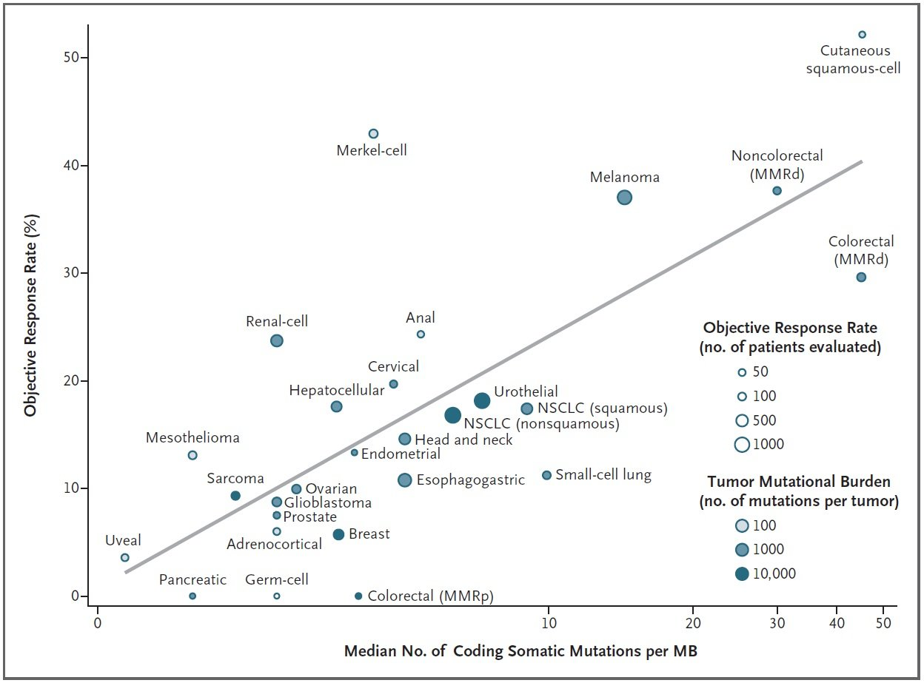
Immune checkpoints inhibitors in
Non-Melanoma Skin Cancers
Yarchoan M, et al. N Engl J Med 2017.
Notes:
Through an extensive literature search, we identified 27 tumor types or subtypes for which data regarding the objective response rate are available. For each tumor type, we pooled the response data from the largest published studies that evaluated the objective response rate. We included only studies of anti–PD-1 or anti–PD-L1 monotherapy that enrolled at least 10 patients who were not selected for PD-L1 tumor expression
The median tumor mutational burden for each tumor type was obtained from a validated comprehensive genomic profiling assay performed and provided by Foundation Medicine.4
We observed a significant correlation between the tumor mutational burden and the objective response rate (P<0.001). The correlation coefficient of 0.74 suggests that 55% of the differences in the objective response rate across cancer types may be explained by the tumor mutational burden. Some cancer subtypes have a response to therapy that is better than would be predicted by the tumor mutational burden (e.g., Merkel-cell carcinoma), and some have a response that is worse than would be predicted (e.g., colorectal cancer with mismatch repair proficiency).

Slide 26
Comprehensive Genomic Profiling of 8 aBCC pts
The TMB (mutations/mb) (median (range)) was 90 (3-103) for the BCCs versus 4 (1-860) for 1637 cancers other than BCC (P < 0.0001).
4 patients treated with anti-PD-1
Response rate was 75% (3 of 4 patients), with a median PFS of 10.7 months (range, 3.8 to 17.6+ months)
OncoImmunology 2017
Notes:
Median progression-free survival (PFS) for all four patients treated with PD-1 blockade was 10.7 months (range, 3.8 to 17.6+ months); three patients had an objective response.
In conclusion, advanced/metastatic BCC often has biological features (high TMB; PD-L1 amplification) predictive of immunotherapy benefit, and patients frequently respond to PD-1 blockade
Basal cell carcinoma is one of the most mutated types of human cancer10. Similar to melanoma, the majority of mutations identified in basal cell carcinoma have an ultraviolet (UV) signature.
approximately 90% of basal cell carcinomas are positive for PD-L1 by immunohistochemistry9, and the intensity of PD-L1 staining on basal cell carcinoma cells increases with the number of prior treatment modalities9
Advanced basal cell carcinomas have features (PD-L1 positivity and high TMB) that would predict checkpoint inhibitor response.

Slide 27
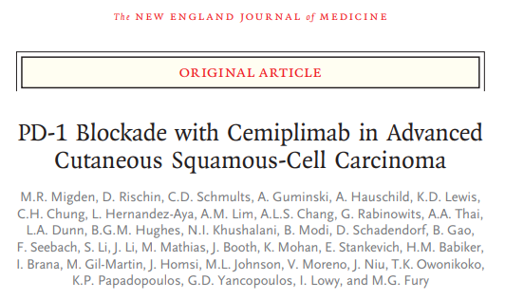
REGN2819 «Cemiplimab» anti-PD-1
Notes:
We report the results of the phase 1 study of cemiplimab for expansion cohorts of patients with locally advanced or metastatic cutaneous squamous-cell carcinoma, as well as the results of the pivotal phase 2 study for a cohort of patients with metastatic disease (metastatic-disease cohort) 3 mg/Kg

Slide 28
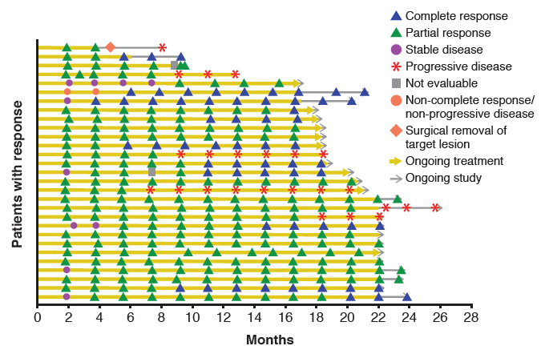
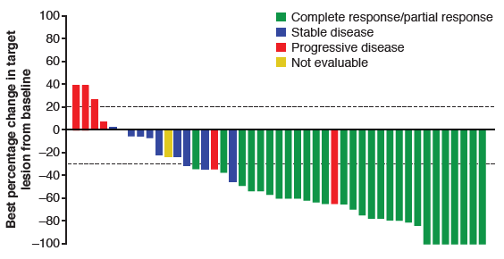
Metastatic cutaneous squamous cell carcinoma: 12-month follow-up
59 patients
ORR 49.2%, DCR 71.2%
Median DOR: not reached
Median PFS: 18.4 months
Median OS: not reached
Aes (regardless of attribution): any grade 100%, G3/G4 50.8%
Guminski A, ASCO 2019

Slide 29
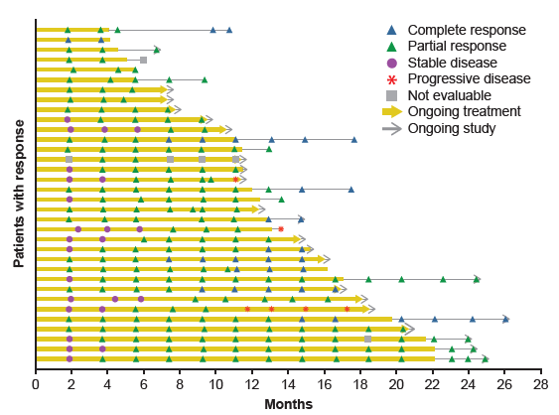
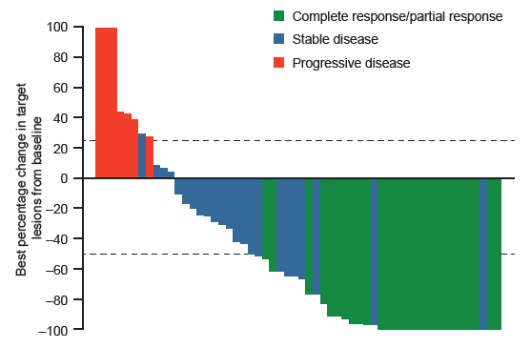
LA cutaneous squamous cell carcinoma: Primary analysis (median FU 9.3months)
78 patients
ORR 43.6%, DCR 79.5%
Median DOR: not reached
Median PFS: not reached, 12-months 58.1%
Median OS: not reached , 12-months 93.2%
Aes (regardless of attribution): any grade 100%, G3/G4 43.6%
Activity in both PD-L1 positive and negative subgroups
Preliminary association with TMB
Migden MR, ASCO 2019

Slide 30
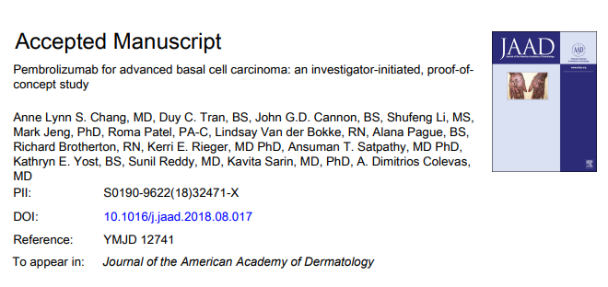
PD-1 blockade in combination with Visomdegib in BCC?
16 patients: 9 pembro, 7 pembro plus Vismo
18 weeks ORR: 44% and 29%, respectively

Slide 31
Multi-disciplinary managing of patient with advanced BCC
Head and neck surgeon
Plastic surgeon
Derm-surgeon
Radio-oncologist
Dermato/pathologist
Tumour board
Surgeon
Oncologist/Dermato-oncologist

Slide 32
ACKNOWLEDGMENTS
UOSD Dermatologia Generale ed Oncologica
Dipartimento Scienze Cliniche Applicate e Biotecnologie
Universitá degli Studi dell’Aquila
UOC Oncologia Medica, Ospedale San Salvatore
Dipartimento Scienze Cliniche Applicate e Biotecnologie
Universitá degli Studi dell’Aquila
Maria Concetta Fargnoli
Rosaria Fidanza
Maria Esposito
Astrid Lappi
Alessandra Ventura
Cristina Pellegrini
Lucia Di Nardo
Ludovica Cardelli
Valeria Ciciarelli
Tea Rocco
Gianluca Calianno
Matteo Maini
Corrado Ficorella
Giampiero Porzio
Katia Cannita
Olga Venditti
Tina Sidoni
Paola Lanfiuti Baldi
Lucilla Verna
Alessandro Parisi
Carla D’Orazio
Francesco Pavese
Leonardo Patruno
Silvia Rotondaro
Maria Vittoria Pensieri
Veronica Agostinelli

