Slide 1

Therapeutic algorithm in metastatic gastric cancer
Alessandro Parisi
U.O.C. Oncologia Medica
Ospedale San Salvatore
Dipartimento di Scienze Cliniche Applicate e Biotecnologie
Universitá degli studi de L’Aquila

Slide 2
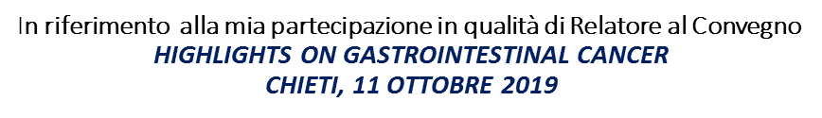
Io sottoscritto dr. Alessandro Parisi
Dichiaro
che negli ultimi due anni NON ho avuto rapporti diretti di finanziamento con soggetti portatori di interessi commerciali in campo sanitario

Slide 3
AGENDA
FIRST LINE
SECOND AND THIRD LINE
TARGET THERAPIES AND IMMUNOTHERAPY

Slide 4

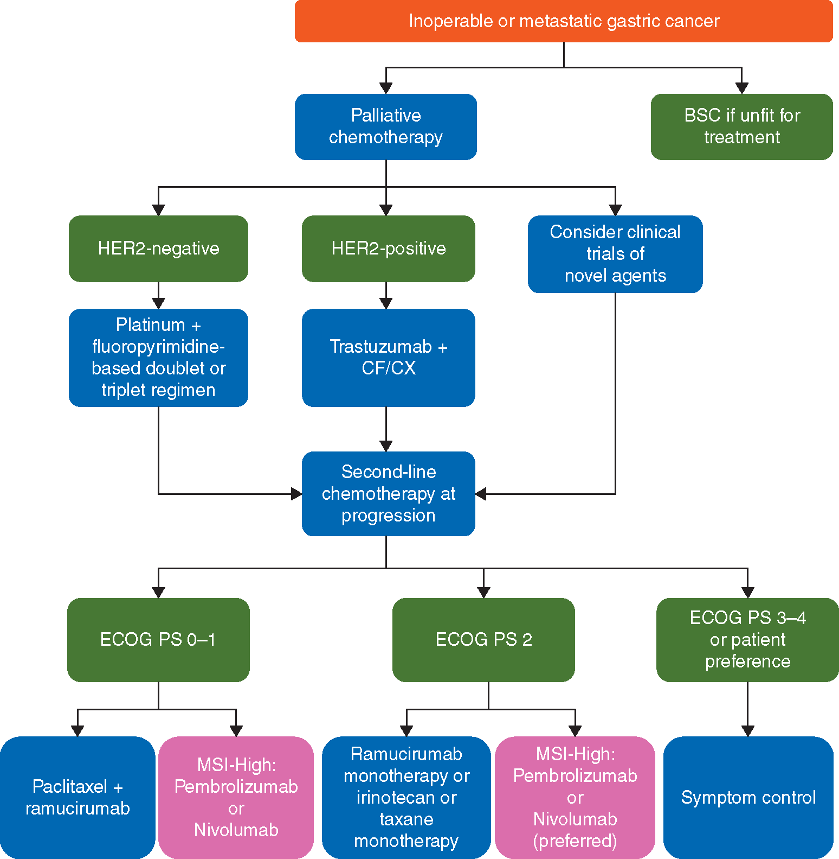
Treatment for advanced Gastric Cancer:
ESMO guidelines (Pan-Asian adapted)
Re-assess
Surgery
Pembrolizumab and Nivolumab approved in Asia and USA but not in EU
Modified from Muro K et al. Annals of Oncology 30: 19–33, 2019

Slide 5
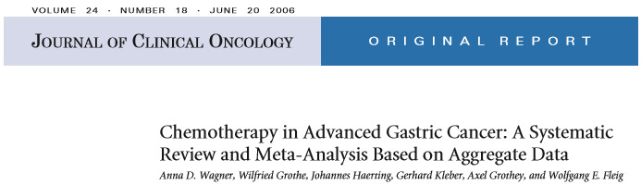
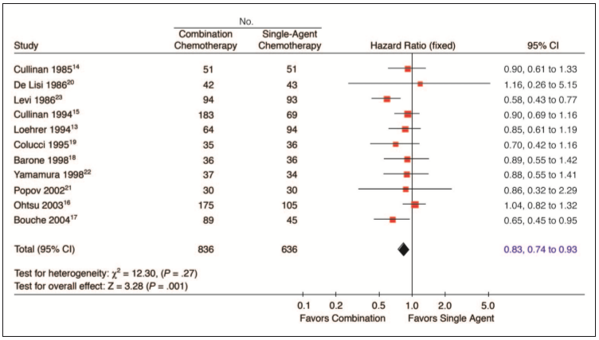
First Line: BSC vs CT
CT better than BSC
(HR = 0.39; 95% CI, 0.28 to 0.52)
Combo better than Mono
(HR = 0.83; 95% CI = 0.74 to 0.93)
Wagner et al. JCO 2006

Slide 6
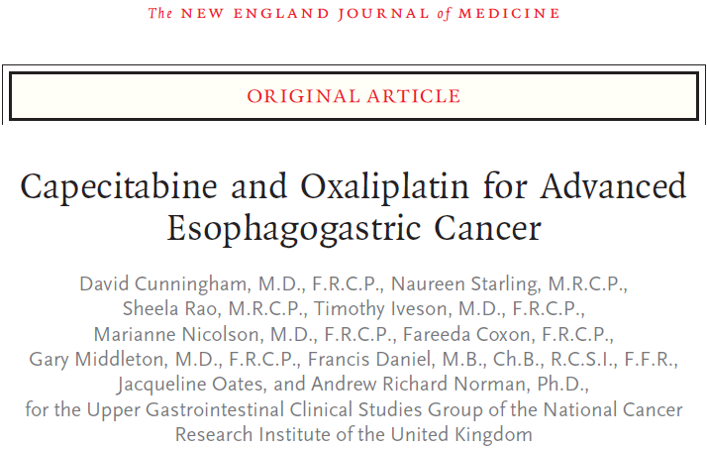
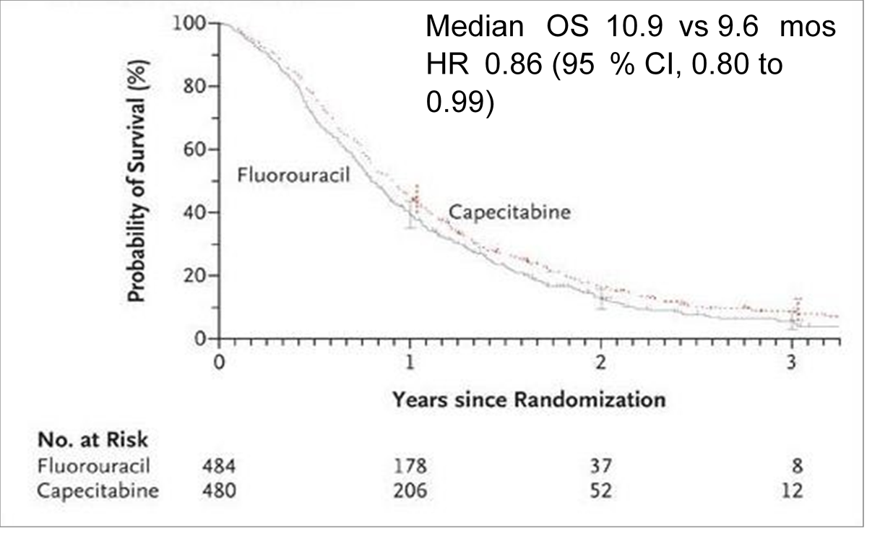
First Line: Platinum and Fluoropyrimidines
Non-inferiority of Oxaliplatin versus Cisplatin and Capecitabine versus 5-FU
The upper limit of the 95% confidence interval for non-inferiority: 1.23
Cunningham D. et al. N Engl J Med 2008; 358:36-46

Slide 7
Treatment for advanced Gastric Cancer:
ESMO guidelines (Pan-Asian adapted)
Re-assess
Surgery
Pembrolizumab and Nivolumab approved in Asia and USA but not in EU
Modified from Muro K et al. Annals of Oncology 30: 19–33, 2019

Slide 8
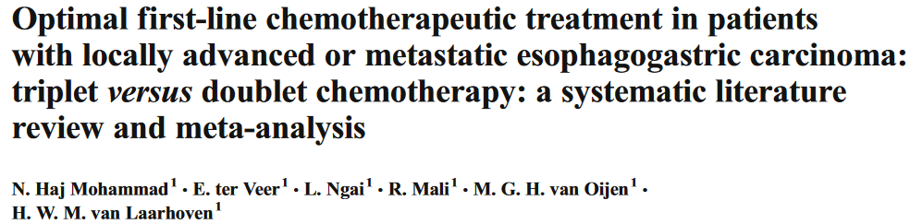
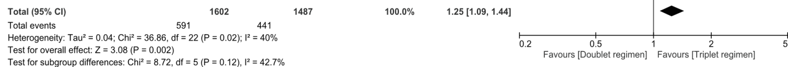
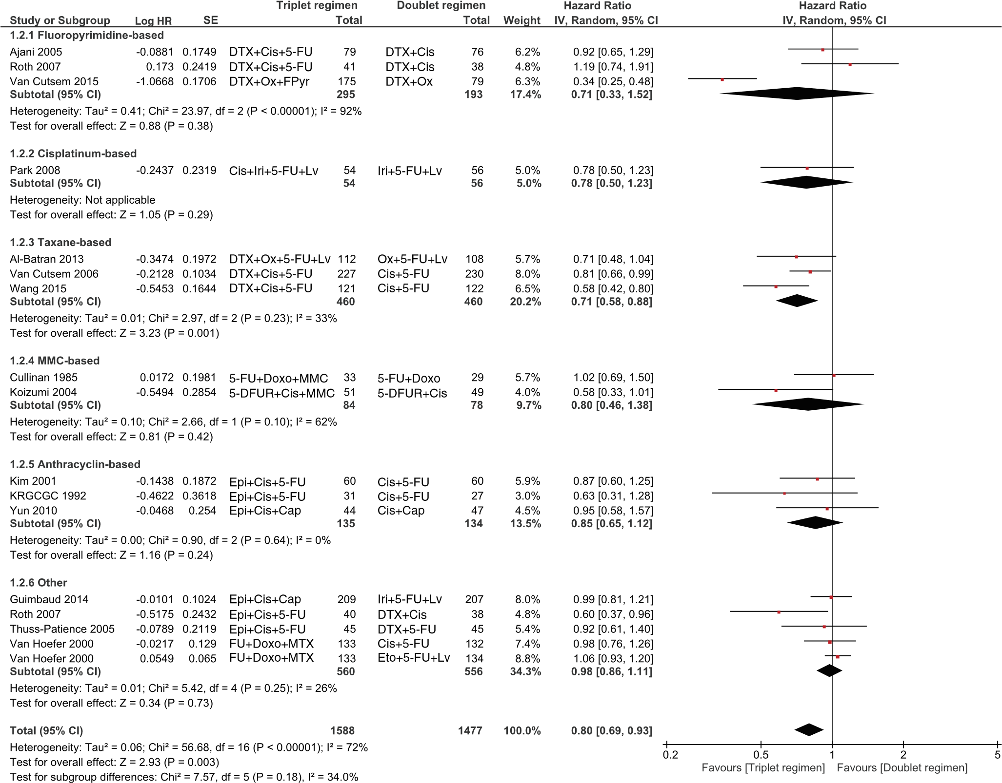
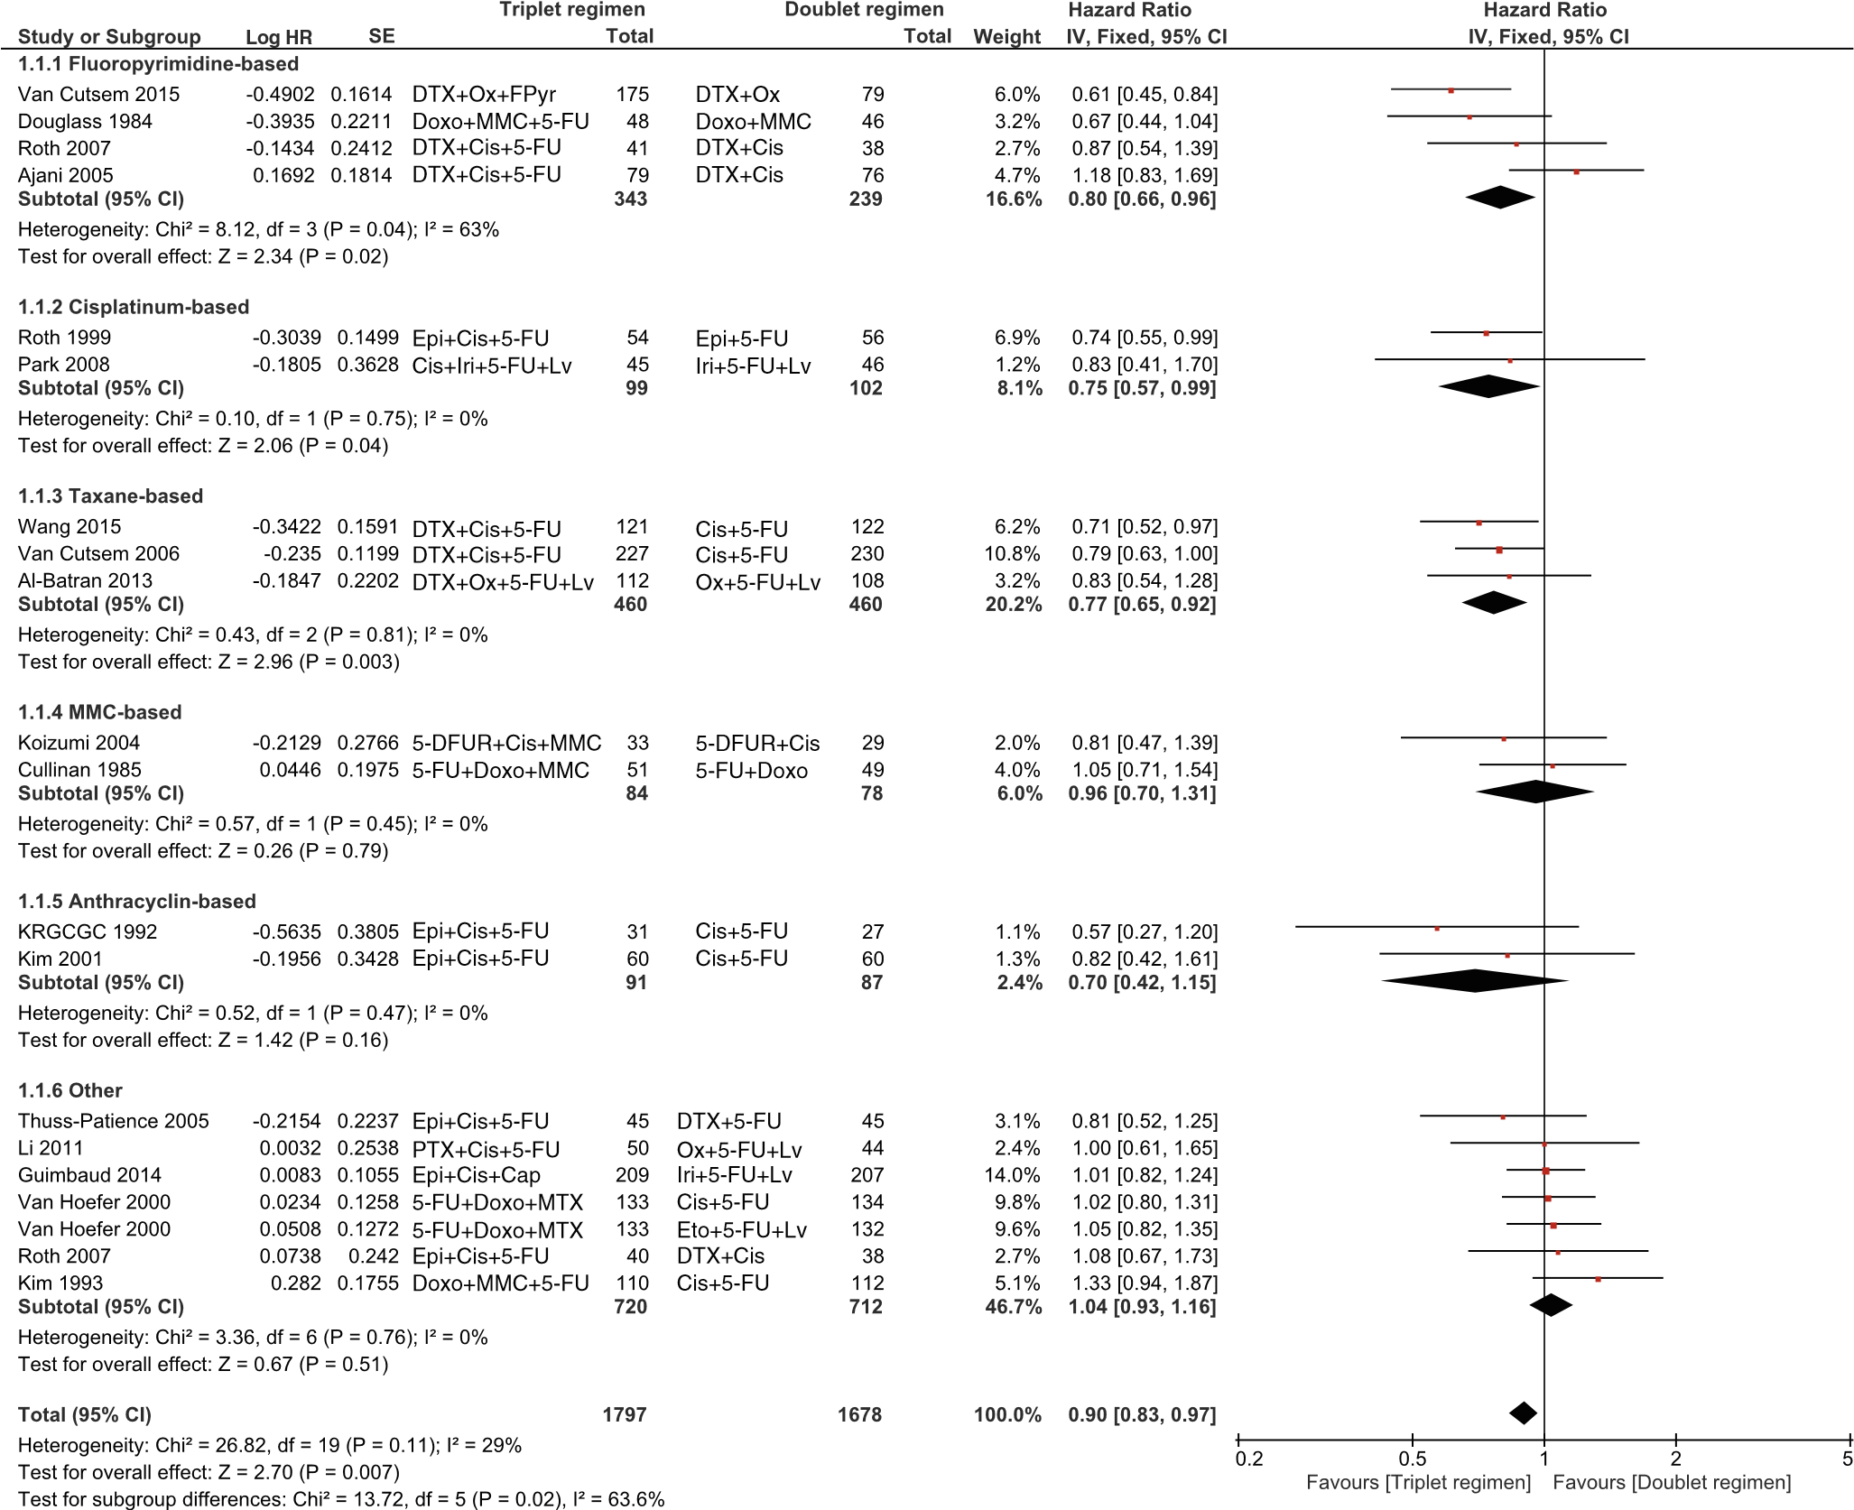
First Line: 3 vs 2 CT agents
ORR: TRIPLET > DOUBLET (mainly if with taxanes and fluorophyrimidines)
PFS: TRIPLET > DOUBLET (mainly if with taxanes)
OS: TRIPLET > DOUBLET (mainly if with taxanes and cisplatin)
TOX: TRIPLET > DOUBLET (G3-4 mucositis, thrombocytopenia, infection)
Mohammad N.H et al, Cancer Metastasis Rev 2015

Slide 9
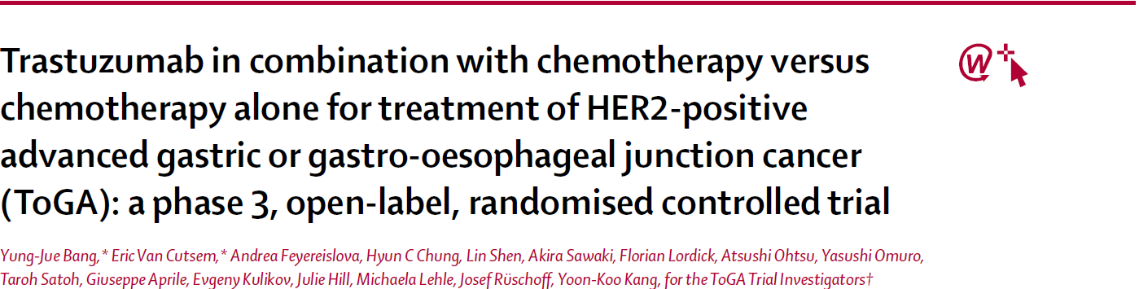
First Line in HER-2 positive advanced Gastric Cancer
- HER2 positivity: ~20%
- Significant HER2 positivity: ~16%
- Proximal > distal gastric cancer
- Intestinal >> diffuse gastric cancer
HER2, human epidermal growth factor receptor 2
Bang Y, et al. Lancet 2010

Slide 10
Treatment for advanced Gastric Cancer:
ESMO guidelines (Pan-Asian adapted)
Re-assess
Surgery
Pembrolizumab and Nivolumab approved in Asia and USA but not in EU
Modified from Muro K et al. Annals of Oncology 30: 19–33, 2019

Slide 11
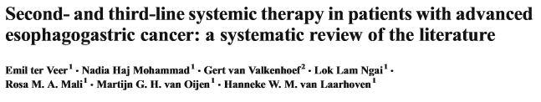
Second Line matters
OS: CT > BSC
PFS: DOUBLET > MONO
OS: DOUBLET = MONO
TOX: DOUBLET > MONO (mainly neutropenia and anemia)
BSC: Best Supportive Care;
PFS: Progression-Free Survival
OS: Overall Survival;
TOX: Toxicities
Veer TE, et al. Cancer Metastasis rev 2016

Slide 12
Second Line phase III trials
Trial Author | Year | Patients random (n) | Treatment | HR OS | P value | Gain in median survival
Thuss-Patience, et al. ¹ | 2011 | 40 1:1 | Irinotecan vs BSC | 0.48 | 0.0023 | 2.4 months
Kang, et al.² | 2012 | 193 2:1 | Irinotecan vs Docetaxel | 0.65 | 0.004 | 1.3 months
Hironaka, et al.³ | 2013 | 223 | Irinotecan vs Paclitaxel | 1.13 | 0.38 | 0.9 months for irinotecan
Ford, et al.⁴ | 2014 | 168 1:1 | Docetaxel vs BSC | 0.67 | 0.01 | 1.6 months
Fuchs, et al.⁵ | 2014 | 355 2:1 | Ramucirumab vs BSC | 0.77 | 0.047 | 1.4 months
Wilke, et al.⁶ | 2014 | 665 | Paclitaxel +/- Ramucirumab | 0.8 | 0.017 | 2.2 months
1. Thuss-Patience PC, et al. Eur J Cancer 2011 - 2. Kang JH, et al. J Clin Oncol 2012 - 3. Hironaka JS, et al. J Clin Oncol 2013 - 4. Ford HE, et al. Lancet Oncol 2014 - 5. Fuchs CS, et al. Lancet 2014 – 6. Wilke H, et al. Lancet Oncol 2014
BSC: Best Supportive Care

Slide 13
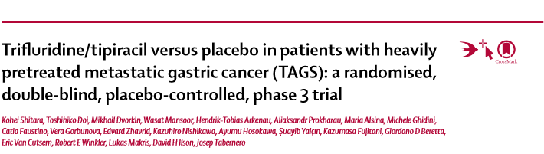
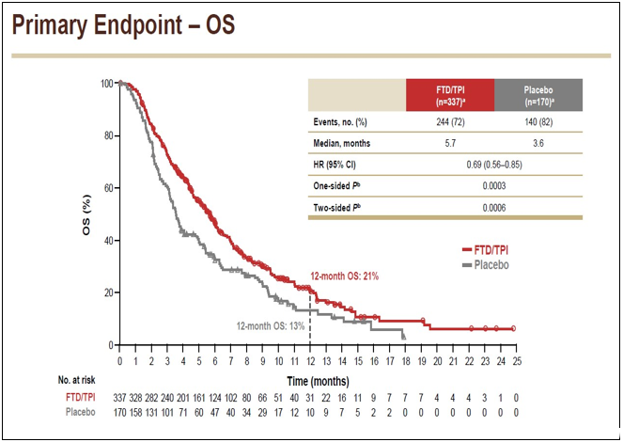
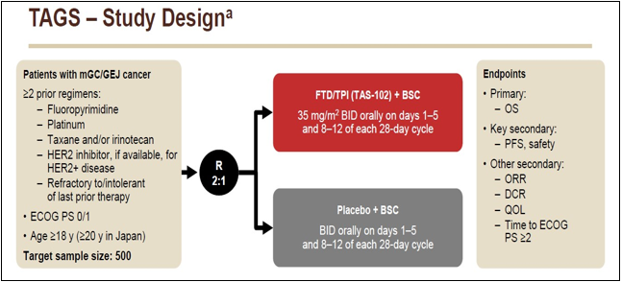
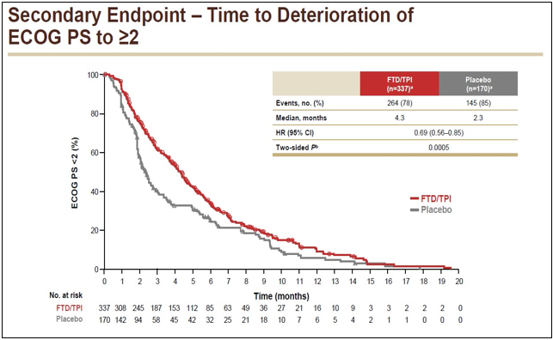
Third Line: Trifluridine/tipiracil as first standard of care
Grade 3-4 adverse events of any cause:
80% in trifluridine/tipiracil versus 58% in the placebo group.
neutropenia (n=114 [34%]) and anaemia (n=64 [19%]) in the trifluridine/tipiracil group
Abdominal pain (n=15[9%]) and general deterioration of physical health (n=15[9%]) in the placebo group
Shitara K, et al. Lancet 2018

Slide 14
Who really benefit from a Third-line treatment?
Third-line PFS and OS according to previous lines PFS
PFS
OS
Fanotto V, The Oncologist 2017

Slide 15
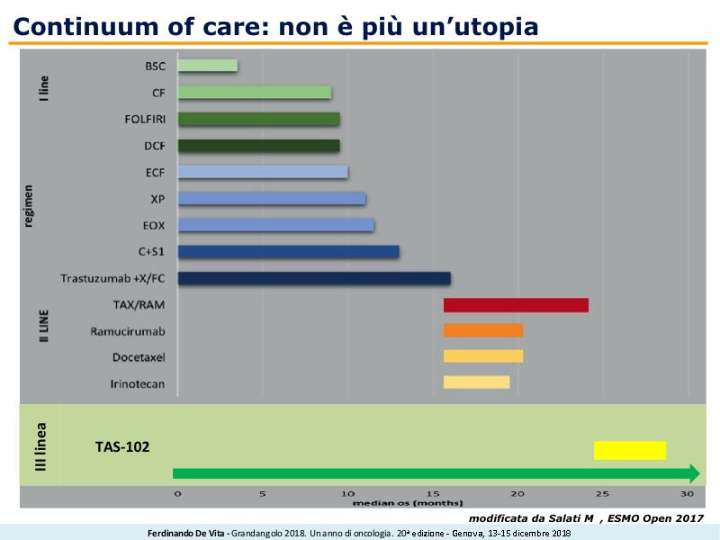
Continuum of care: a reality also for advanced gastric cancer
Modificata da Salati M, ESMO Open 2017

Slide 16
Treatment for advanced Gastric Cancer:
ESMO guidelines
(Pan-Asian adapted)
Re-assess
Surgery
I LINE
Pembrolizumab and Nivolumab approved in Asia and USA but not in EU
Modified from Muro K et al.
Annals of Oncology 30: 19–33, 2019
II LINE
III LINE
TAS-102 or Irinotecan or Pembro/Nivo (for MSI-high)

Slide 17
AGENDA
FIRST LINE
SECOND AND THIRD LINE
TARGET THERAPIES AND IMMUNOTHERAPY

Slide 18
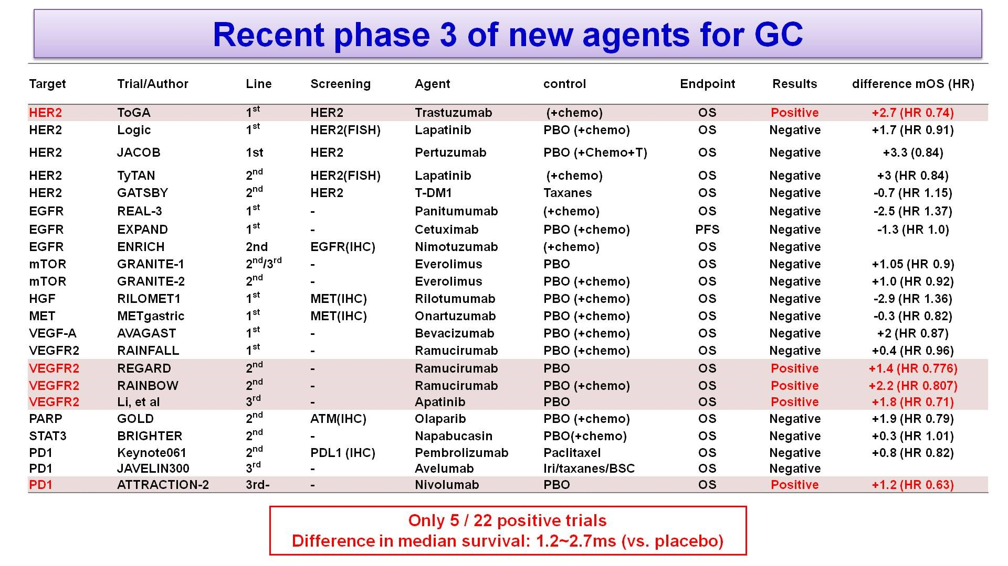
Target Therapy and Immunotherapy in advanced gastric cancer
Slide 3
Presented By Kohei Shitara at 2018 ASCO Annual Meeting

Slide 19
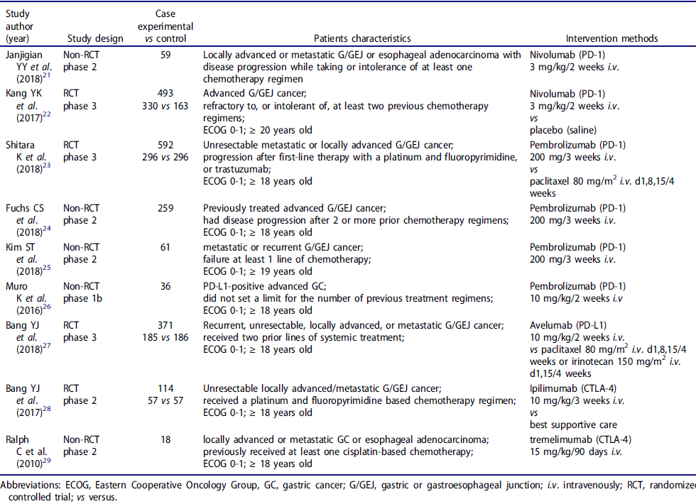
Immunotherapy in advanced gastric cancer
Cong C, et al. OncoImmunology 2019
POS
NEG
NEG

Slide 20
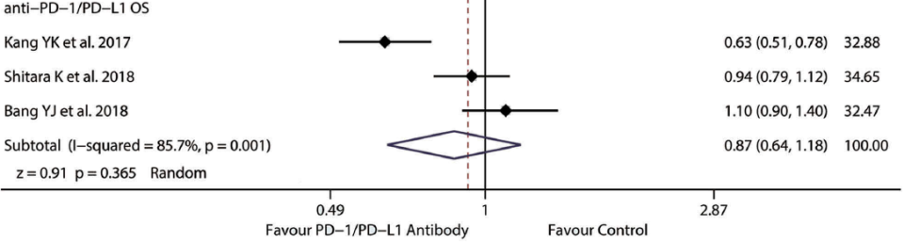
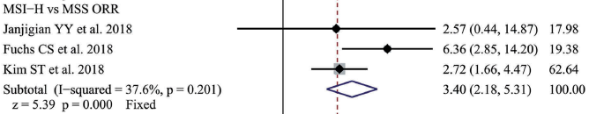
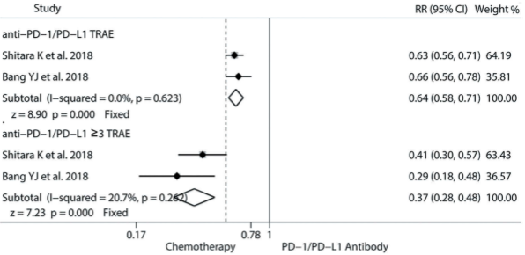
Immunotherapy in advanced gastric cancer
Cong C, et al. OncoImmunology 2019
ICI demonstrated a non statistically significant trend toward a better OS compared with control in all comers populations
OS and ORR : ICI seems to be superior than CT in particular populations (H-MSI, intestinal type, GEJC tumors, ECOG-PS 0-1)
TOX: ICI better than CT (especially for grade 3-4 events)
ICI:Immune Checkpoint Inhibitors; CT:Chemotherapy; PFS:Progression-Free Survival, OS:Overall Survival; TOX:Toxicities

Slide 21
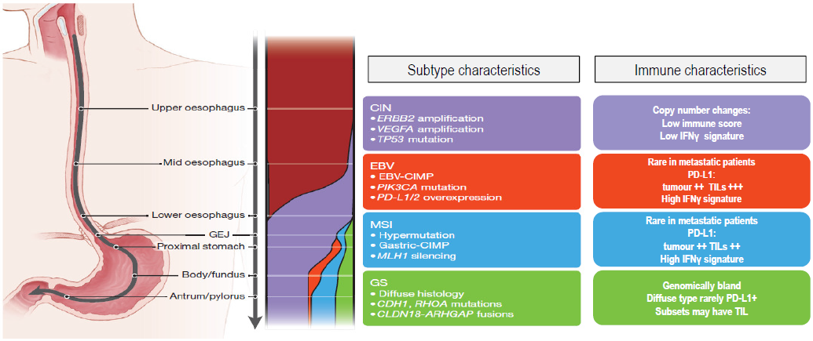

From morphological to molecular heterogeneity
50%
9%
22%
20%

Slide 22
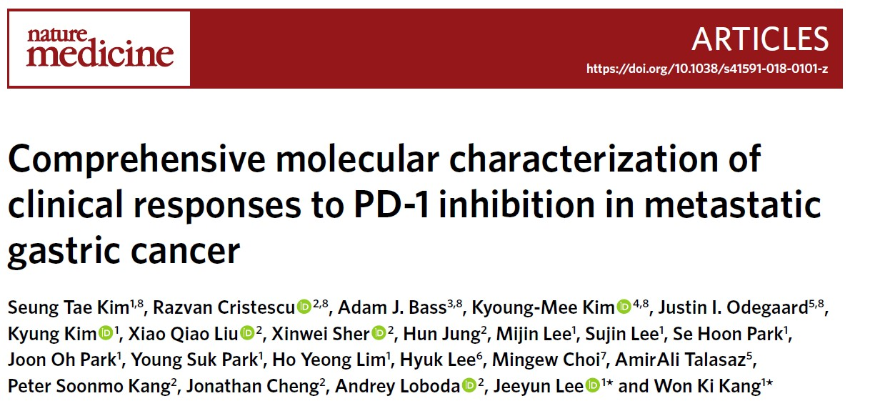
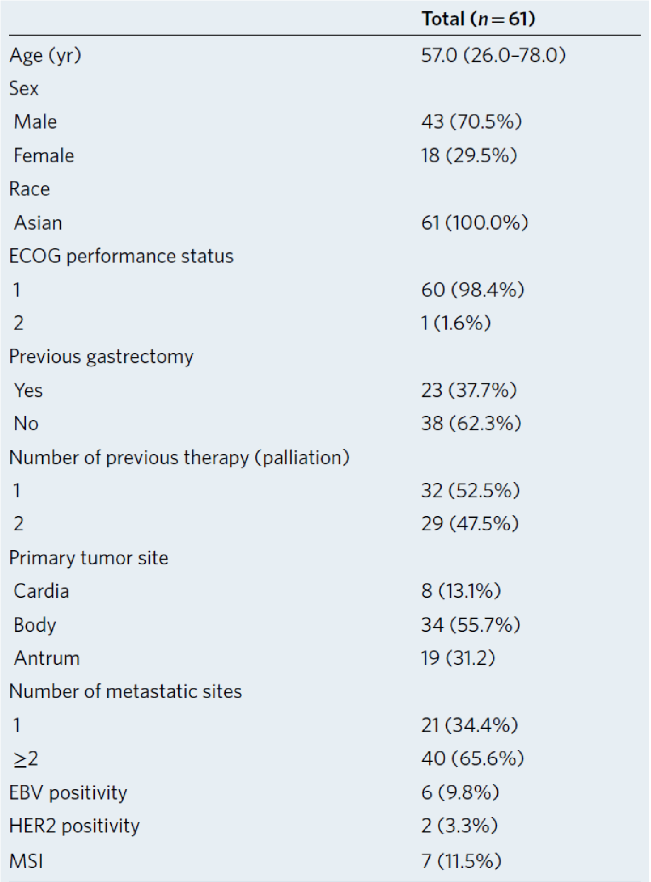
Immunotherapy in advanced gastric cancer
unselected patients treated with pembro salvage therapy (Ph2 trial)
Molecular characterization or tissues and ct-DNA
To correlate clinical and outcomes with molecular and genomic biomarkers for the optimal patient selection
Kim ST et al. Nat Med. 2018;24:1449-1458

Slide 23
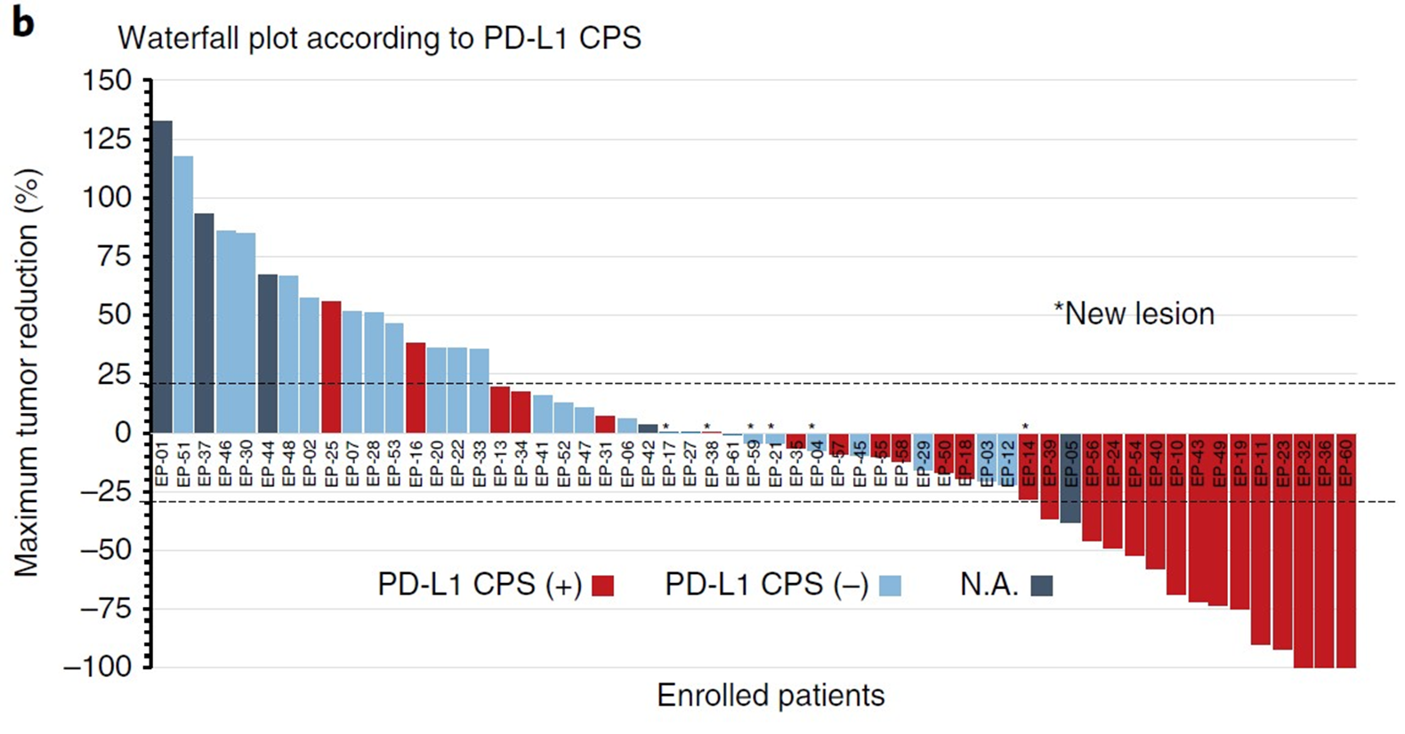

Immunotherapy in advanced gastric cancer
ORR 85% in MSI-h
ORR 100% in EBV-positive
ORR 50% in PDL-1 positive
ORR 0% in PDL1 negative

Slide 24
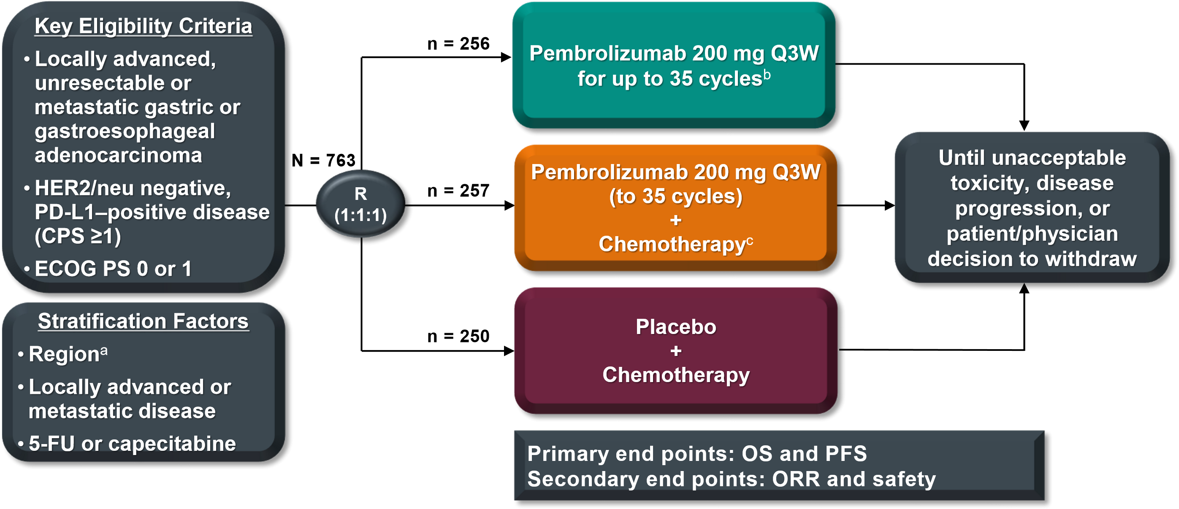
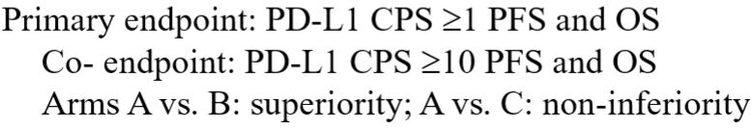
Keynote-062 Trial: Pembrolizumab as first-line treatment
KEYNOTE-062 Study Design (NCT02494583)
Arm C
Arm B
Arm A
A Europe/North America/Australia, Asia (South Korea, Hong Kong, Taiwan, Japan), Rest of world (including South America).
B Administration of pembrolizumab monotherapy was not blinded.
C Chemotherapy: cisplatin 80 mg/m2Q3W + 5-FU 800 mg/m2/d for 5 days Q3W or capecitabine BID days 1-14 Q3W(cisplatin may be capped at 6 cycles as per country guidelines).

Slide 25
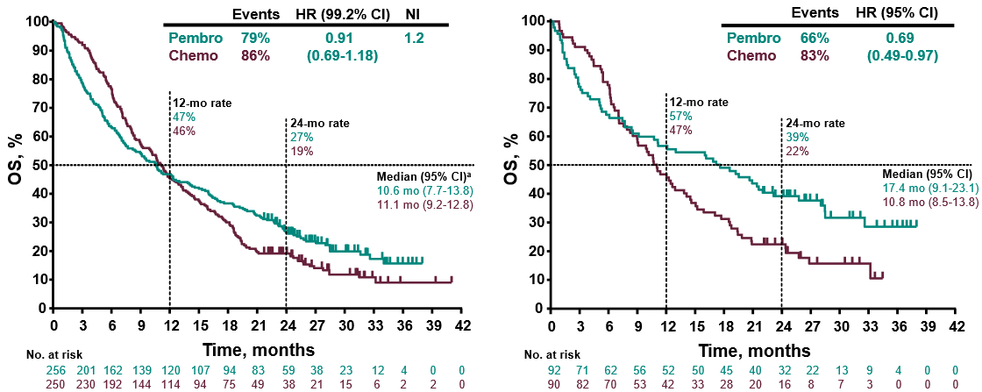
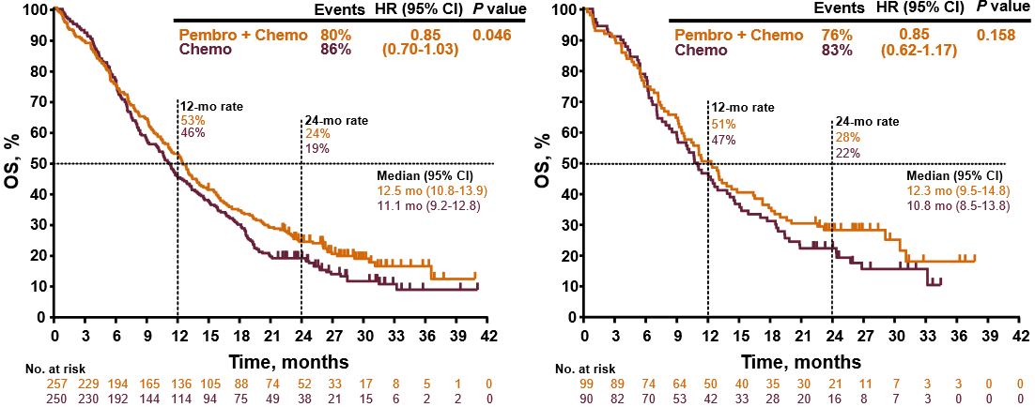
Keynote-062 Trial: Pembrolizumab as first-line treatment
KEYNOTE-062: OS Results according to CPS status in P vs C and P+C vs C cohorts
OS: P vs C (CPS ≥ 1)
OS: P vs C (CPS ≥ 10)
HR: 0.91
95% CI: 0.69-1.18
HR: 0.69
95% CI: 0.49-0.97
OS: P + C vs C (CPS ≥ 1)
OS: P + C vs C (CPS ≥ 10)
HR: 0.85
95% CI: 0.70-1.03
HR: 0.85
95% CI: 0.62-1.17
Modified from Shitara K, et al. ESMO 2019

Slide 26
Keynote-062 Trial: Pembrolizumab as first-line treatment
KEYNOTE-062: OS Results according to CPS and MSI status in P vs C cohort
Overall Survival: P vs C (CPS ≥ 1)
Overall Survival: P vs C (CPS ≥ 10)
HR: 0.91
95% CI: 0.69-1.18
HR: 0.69
95% CI: 0.49-0.97
MSI-H
HR: 0.94
95% CI: 0.71-1.14
HR: 0.76
95% CI: 0.54-1.09
NON
MSI-H
Modified from Shitara K, et al. ESMO 2019

Slide 27
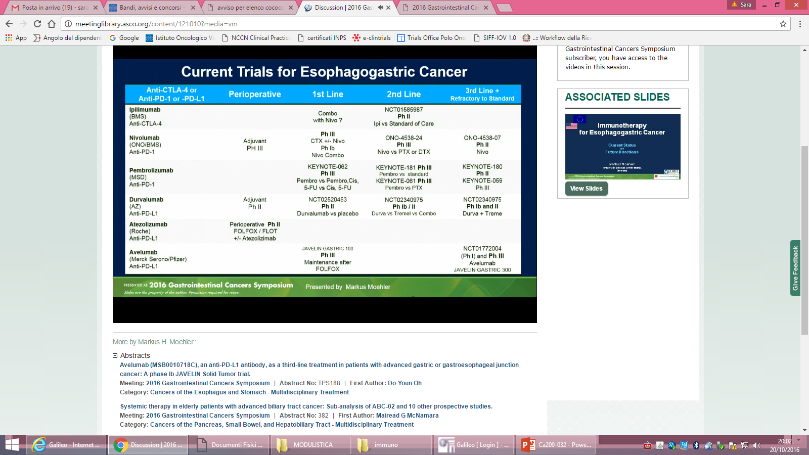
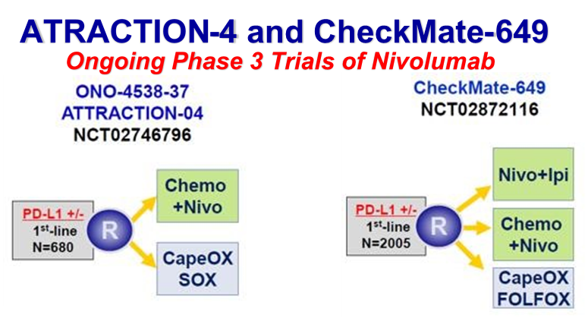
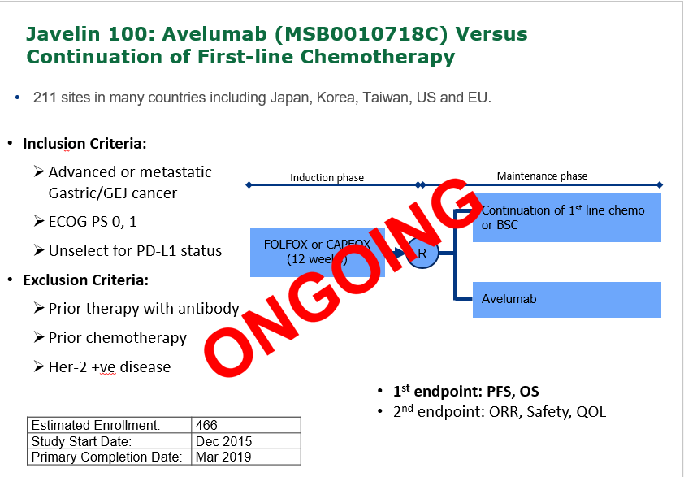
Immunotherapy in advanced gastric cancer: ongoing trials

Slide 28
Take Home Messages
1. FIRST LINE:
  Locally advanced unresectable disease and/or symptomatic disease > Response Rate, QoL, PFS, OS: Triplet CT (better if taxane-based).
  Metastatic disease > OS, PFS, QoL : Doublet CT (+ Trastuzumab if HER2+).
  2. SECOND LINE: Paclitaxel-Ramucirumab as preferred regimen for OS and QoL benefit.
3. THIRD LINE: Trifluridine-Tipiracil (TAS-102) as a new potential standard of care.
4. TARGET THERAPY:
  Window of opportunity for better trial design and patients stratification/selection

Slide 29
Take Home Messages
5. IMMUNE CHECKPOINT INHIBITORS
  Immunotherapy is a tumor agnostic therapy for MSI-H tumors
  EBV and MSI are predictive factors
  Keynote-062 showed pre-planned non-inferiority of first-line Pembro vs SOC with lower AE or discontinuation rate that may support non-inferiority
    Crossed OS curve necessitate further improvement in patients selection (CPS10 – MSI-high pts may have greater treatment effects)
  Advanced, 1st line (pending results)
    KEYNOTE-590 (esophagus/GEJ: CDDP-5FU vs CDDP-FU-Pembro)
    KEYNOTE-859 (GEJ/gastric: DDP-5FU/CAPOX vs Pembro+DDP-5FU/CAPOX)
    CHECKMATE-649 (GEJ/gastric: NIVO+IPI vs NIVO+XELOX/FOLFOX vs XELOX/FOLFOX)
    JAVELIN-100 (GEJ/gastric: AVELUMAB maintenance after FOLFOX/CAPOX
  Novel predictive biomarkers:
    Tumor Mutational Burden, Microbiote, Molecular subtypes and Immune signatures - Validation in clinical trials

Slide 30

THANK YOU FOR YOUR KIND ATTENTION!

