Slide 1
Immunotherapy for advanced urothelial carcinoma: a changing scenario?
Franco Morelli
IRCCS Casa Sollievo della Sofferenza
San Giovanni Rotondo (FG)

Slide 2
Conflict of Interest Disclosure Form
Note: A potential or actual conflict of interest exists when commitments and obligations are likely to be compromised by the nominator(s)’other material interests, or relationships (especially economic), particularly if those interests or commitments are not disclosed.
This Conflict of Interest Form should indicate whether the nominator(s) has an economic interest in, or acts as an officer or a director of, any outside entity whose financial interests would reasonably appear to be affected by the addition of the nominated condition to the newborn screening panel. The nominator(s) should also disclose any personal, business, or volunteer affiliations that may give rise to a real or apparent conflict of interest. Relevant Federally and organizationally established regulations and guidelines in financial conflicts must be abided by. Individuals with a conflict of interest should refrain from nominating a condition for screening.
Date: 10/03/2018
Name:
Franco Morelli
Position:
Speaker
Please describe below any relationships, transactions, positions you hold (volunteer or otherwise), or circumstances that you believe could contribute to a conflict of interest:
_ _ I have no conflict of interest to report.
_ X I have the following conflict of interest to report (please specify other nonprofit and for-profit boards you (and your spouse) sit on, any for-profit businesses for which you or an immediate family member are an officer or director, or a majority shareholder, and the name of your employer and any businesses you or a family member own:
1. Astra Zeneca
2. BMS
3. MSD
4__Roche_
I hereby certify that the information set forth above is true and complete to the best of my knowledge.
Signature: Franco Morelli Date: 10/03/2018
___
____

Slide 3
Evolution of Systemic Therapy for Urothelial Cancer
Apr 2017
May 2017
Atezolizumab
1st-line cis ineligible
Durvalumab 2nd line
Feb 2017
May 2017
Nivolumab 2nd line
Avelumab 2nd line
Feb
Mar
Apr
May
2017
Standard MVAC
Accelerated MVAC
Pembrolizumab 1st-line cis ineligible
May 2017
Publication
1989
2001
Pembrolizumab 2nd line
May 2017
Docetaxel
GC
2000
Paclitaxel
Vinflunine
1997
1997
2002
2009
1997
2000
2003
2006
2009
2012
2015
2017
1974
Doxorubicin
FDA approved
2008
Gemcitabine
EMA approved
2016
Agency Action
Atezolizumab
FDA approved
2009
1978
Cisplatin
FDA approved
Vinflunine
EMA approved
Notes:
cis, cisplatin; EMA, European Medicines Agency; GC, gemcitabine/cisplatin; MVAC, methotrexate/vinblastine/doxorubicin/cisplatin

Slide 14
Lancet Oncol 2017; 18: 312-22

Slide 19
KEYNOTE-045 Update: OS and PFS
Outcome | Pembrolizumab | CT | HR (95% CI) | P Value
ITT Population | n = 270 | n = 272
Median OS, mos (95% CI) | 10.3 (8.0-12.3) | 7.3 (6.1-8.1) | 0.70 (0.57-0.85) | .00017*
1-yr OS, % | 44.4 | 29.8
2-yr OS, % | 27.0 | 14.3†
Median PFS, mos (95% CI) | 2.1 (2.0-2.2) | 3.3 (2.4-3.5) | 0.96 (0.79-1.16) | .31714
1-yr PFS, % | 18.4 | 9.5
2-yr PFS, % | 12.5 | 2.5
CPS-Stratified Population
Median OS, mos CPS ≥ 10% CPS < 10% | 8.0 (n = 74) 10.8 (n = 186) | 4.9 (n = 90) 7.7 (n = 176) | 0.56 (0.38-0.82) 0.75 (0.59-0.95) | .00153* .00859*
*1-sided P value from stratified log-rank test. †By 24 mos, 60.6% of CT arm had received immunotherapy, including pts who crossed over to pembrolizumab arm.
OS generally favored pembrolizumab across multiple analyzed pt subgroups
Bellmunt J, et al. ASCO GU 2018. Abstract 410.
Notes:
CPS, combined positive score; CT, chemotherapy; ITT, intent to treat.

Slide 20
KEYNOTE-045 Update: Response
Outcome in ITT Population | Pembrolizumab (n = 270) | CT (n = 272)
ORR, % CR PR | 21.1 9.3 11.9 | 11.0 2.9 8.1
Median TTR, mos (range) | 2.1 (1.4-6.3) | 2.1 (1.7-4.9)
Median DoR, mos (range) | NR (1.6+ to 30.0+) | 4.4 (1.4+ to 29.9+)
Similar response patterns observed in pts with PD-L1 CPS ≥ 10% and CPS < 10%
Bellmunt J, et al. ASCO GU 2018. Abstract 410.
Notes:
CPS, combined positive score; CT, chemotherapy; DoR, duration of response; ITT, intent to treat; TTR, time to response.

Slide 29
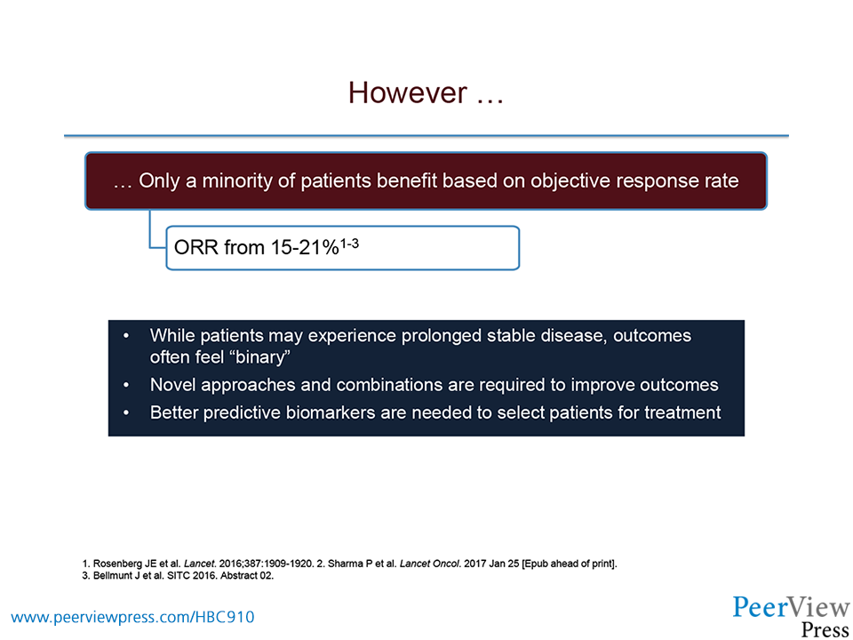

Slide 30
Reprogramming host microbiome

Slide 33
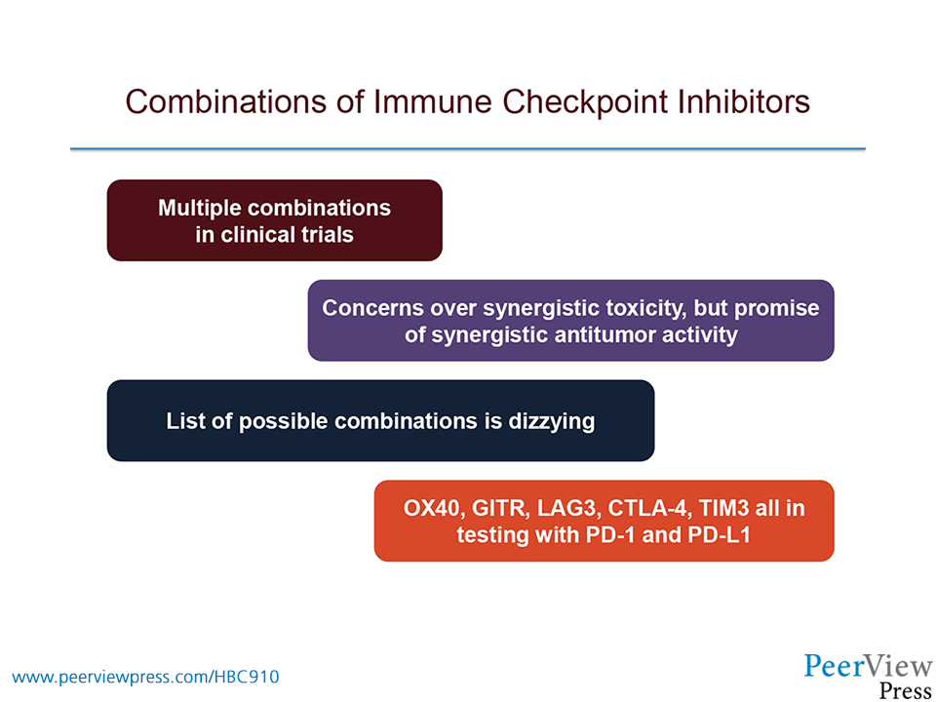
Combinations of immune Checkpoint Inhibitors

Slide 38
ECHO-202/KEYNOTE-037: Best Objective Response (RECIST v1.1)
Phase II: PD during/following platinum-based therapy in adjuvant or advanced disease setting; tumor cohorts included melanoma, SCCHN, UC, NSCLC, RCC, TNBC, OC, MSI-high CRC, DLBCL, GC, and HCC
Current analysis in UC (N = 40): ORR, change in target lesions, TTR, DoR, safety, PD-L1 biomarker analysis
Outcome, n (%) | UC Pts (N = 40) | Prior Lines of Tx |  |  | PD-L1 Expression
 |  | 0-1 (n = 32) | ≥ 2 (n = 8) |  | CPS ≥ 1% (n = 11) | CPS < 1% (n = 8) | Unknown (n = 21)
ORR CR PR | 14 (35) 3 (8) 11 (28) | 12 (38) 3 (9) 9 (28) | 2 (25) 0 2 (25) |  | 7 (64) 0 7 (64) | 1 (13) 0 1 (13) | 6 (29) 3 (14) 3 (14)
SD | 7 (18) | 7 (22) | 0 |  | 1 (9) | 1 (13) | 5 (24)
DCR | 21 (53) | 19 (59) | 2 (25) |  | 8 (73) | 2 (25) | 11 (52)
PD | 14 (35) | 10 (31) | 4 (50) |  | 2 (18) | 6 (75) | 6 (29)
NE | 5 (13) | 3 (9) | 2 (25) |  | 1 (9) | 0 | 4 (19)
≥ 25%
44%
mDoR : 30,6 wks (9,7-93,1)
Notes:
CPS, combined positive score; DCR, disease control rate; ir, immune related; NE, not evaluable; PD, progressive disease; RECIST, Response Evaluation Criteria in Solid Tumors; SD, stable disease.

Slide 44
Mutation Load and Survival With Immunotherapy in Urothelial Cell Carcinoma
IMvigor210 Cohort 1^{[1]}
IMvigor210 Cohort 2^{[2]}
Responses by Mutation Load^{[2]}
100
Responder/Nonresponder
100
50
P < .01
80
40
80
30
Mutation Load/MB
60
20
60
10
Probability of OS (%)
Probability of OS (%)
0
40
40
CR/PR
SD/PD/NE
Objective Response Status
20
20
50
0
40
0
30
0
100
200
300
400
500
600
700
0
100
200
300
400
500
600
700
Mutation Load/MB
Days
Days
20
10
Mutation Load (Range)
Mutation Load (Range)
0
Q4: (> 16 to ≤ 62.2)
Q3: (> 8.1 to ≤ 16)
Q2: (> 5.4 to ≤ 8.1)
Q1: (≥ 0.9 to ≤ 5.4)
Q4: (≥ 13.5 to ≤ 46.8)
Q3: (> 8.1 to ≤13.5)
Q2: (> 5.4 to ≤ 8.1)
Q1: (> 0.1 to ≤ 8.1)
CR
PR
SD
PD
NE
1. Balar AV, et al. Lancet. 2017;389:67-76. 2. Loriot Y, et al. ESMO 2016. Abstract 783P.
Notes:
NE, not estimable; PD, progressive disease; SD, stable disease.

Slide 47
IMvigor211 Biomarker Analysis: tGE3
Median OS, Mos | Atezo | CT | HR (95% CI)
PD-L1 IC2/3 IC0/1 | 11.1 8.2 | 10.6 7.3 | 0.81 (0.59-1.10) 0.84 (0.71-1.00)
tGE3 High Low | 9.2 8.0 | 9.3 7.1 | 0.77 (0.61-0.98) 0.92 (0.73-1.15)
tGE3: 3-gene signature assessed by RNA sequencing (n = 793)
  IFNG, CXCL9, CD274 (encodes PD-L1)
  Resultant score used as surrogate for PD-L1 expression by IHC
OS by tGE3 and PD-L1 expression subgroups comparable
  High tGE3 score, PD-L1 overexpression associated with longer OS in both treatment arms
IMvigor211 Biomarker Analysis: TMB and DDR
Median OS, Mos0 | Atezo | CT | HR (95% CI)
PD-L1 IC2/3 IC0/1 | 11.1 8.2 | 10.6 7.3 | 0.81 (0.59-1.10) 0.84 (0.71-1.00)
TMB High Low | 11.3 8.3 | 8.3 8.1 | 0.68 (0.51-0.90) 1.00 (0.75-1.32)
TMB high and PD-L1 IC2/3 | 17.8 | 10.6 | 0.50 (0.29-0.86)
TMB assessed by validated comprehensive genomic profile
(n = 544)
  Defined as high (≥ median) or low
  (< median)
  Score does not correlate with PD-L1 expression
Prolonged OS with atezolizumab vs CT in pts with high TMB ± high PD-L1 expression
DDR mutations correlated with higher TMB but not increased atezolizumab efficacy (HR: 0.91; 95% CI: 0.57-1.46)
Powles T, et al. Lancet. 2018;391:748-757. Powles T, et al. ASCO GU 2018. Abstract 409.
Notes:
Atezo, atezolizumab, CT, chemotherapy; IC, immune cell; tGE, tumor gene expression.

Slide 49
Roberston AG, Cell 2017; 171:540-566

Slide 50
Conclusions
Checkpoint inhibition therapy demonstrates significant antitumor activity in advanced urothelial carcinoma:
  As initial therapy in cisplatin-ineligible patients
  In patients with cisplatin pretreated disease (level 1 evidence for Pembro)
  No data from randomizewd trials in 1° line to date
Trials are ongoing to explore immunotherapy based combinations and the use of immunotherapy in earlier stages of disease
A thorough understanding of the markers of resistance and response will help to designing future trials in earlier disease

