Slide 1
HER2+ breast cancer: from RCT to the real world scenario
Antonino Grassadonia
Università G. D’Annunzio
Chieti-Pescara

Slide 2
LEVEL OF EVIDENCE
META-ANALISYS
(of RCTs)
CRITICAL
REVISIONS
TRIALs (RCTs)
COHORT STUDIES
CASE-CONTROL STUDIES
DESCRIPTIVE STUDIES
CLINICAL OBSERVATIONS
IN VIVO (ANIMALS) STUDIES
IN VITRO STUDIES

Slide 3
Timeline of anti-HER2 therapies
Geyer, NEJM, 2006
Baselga, NEJM, 2012
Slamon, ASCO, 1998
(NEJM, 2001)
Lapatinib
+ Capecitabine
II line MBC
Pertuzumab
+Trastuzumab
+ Docetaxel
I line MBC
Trastuzumab
+ Paclitaxel
I line MBC
Piccard, NEJM, 2006
Romond, ASCO, 2005
(NEJM, 2005)
Trastuzumab
Adjuvant BC
(node neg)
Verna, NEJM, 2012
Trastuzumab
Adjuvant BC
(node pos)
T-DM1
II line MBC
HER2-driven
oncogenesis
1980’s
1998
2006
2007
2008
2012
2013
H0648g
EGF100151
EMILIA
RCTs→→
NCCTG N9831
+
NSABP B-31
HERA
CLEOPATRA

Slide 4
Evidence from RCTs
Regulatory and subsidy approval
2) Guideline recommendations
BUT………
Not always representative of the whole population
< 3% of adult cancer patients participate in trials in USA
RCTs usually rule out poor prognosis patients
RCTs usually rule out patients with comorbidities

Slide 5
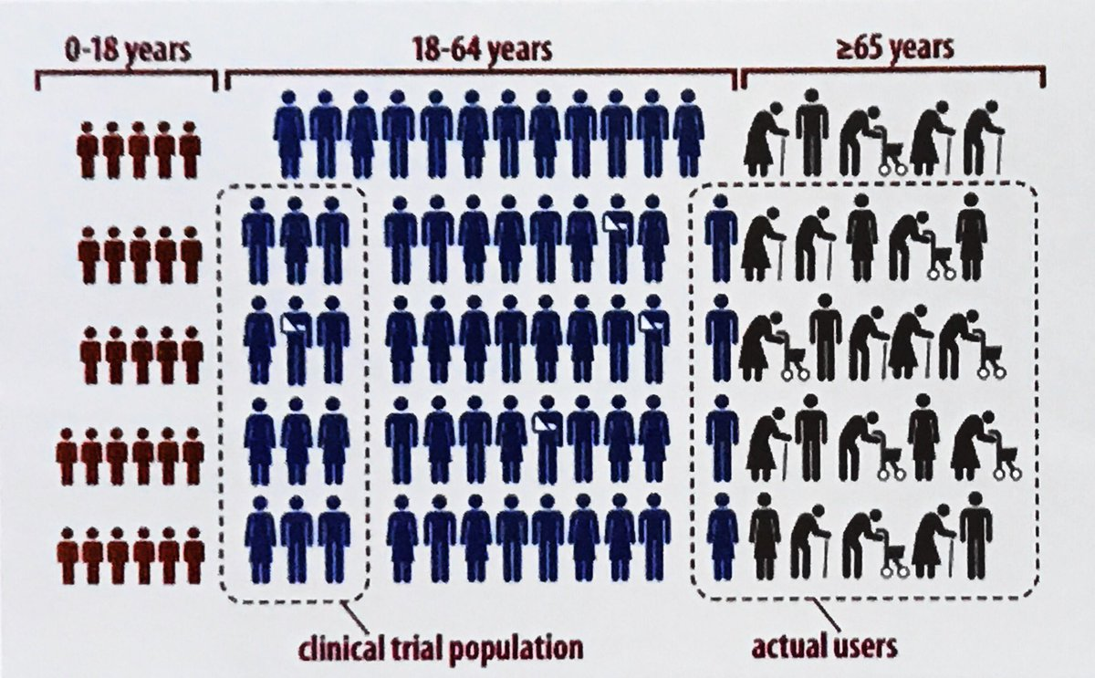
RCTs might not be representative of the cancer population

Slide 6
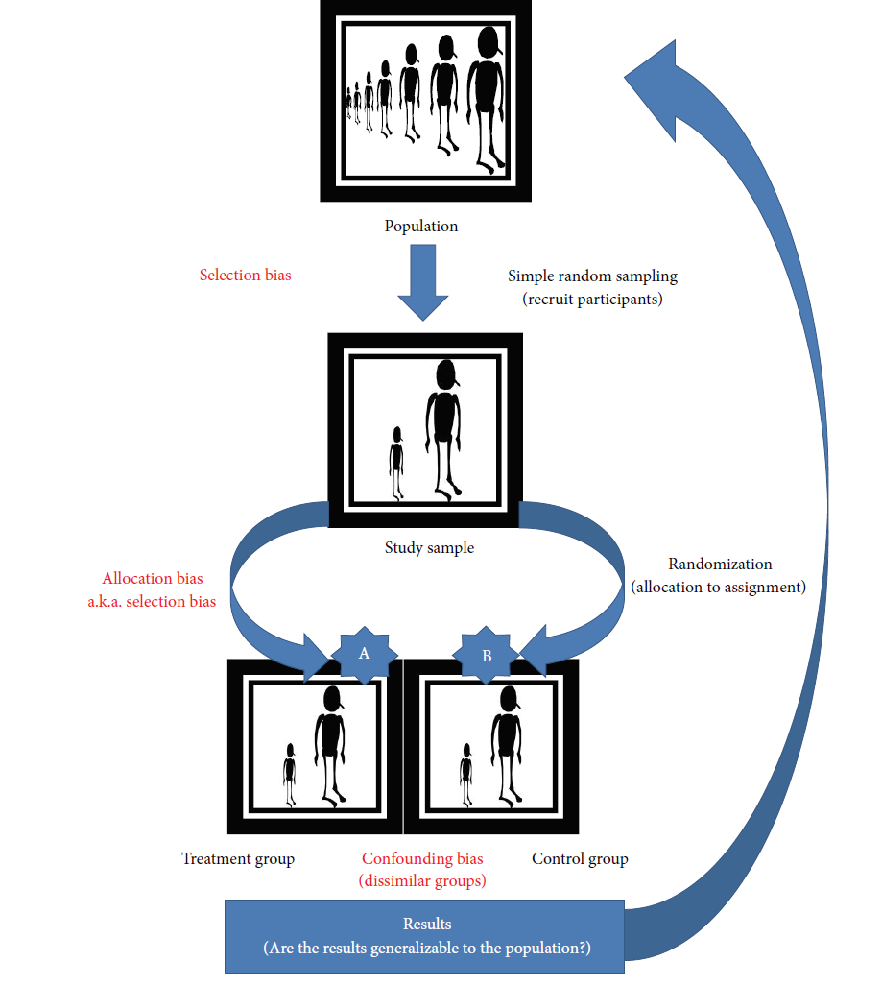
A balance between homogeneity and generalizability
Trial eligibility criteria
Sufficiently narrow to garantee a homogeneus sample with consistent Tx effect.
Sufficiently broad to generalize to population
If too narrow
Results not applicable
to population
If too broad
Risk including patients not optimal for the Tx that could mask the effect

Slide 7
The real-world setting
- To determine the feasibility and tollerability of treatment in patients encountered in the clinical practice
- To confirm the better outcome observed in RCTs (in a longer follow-up period)
- To verify the existence of subgroups who benefit less or more from treatment

Slide 8
HER2+ Breast Cancer
Adjuvant scenario

Slide 9
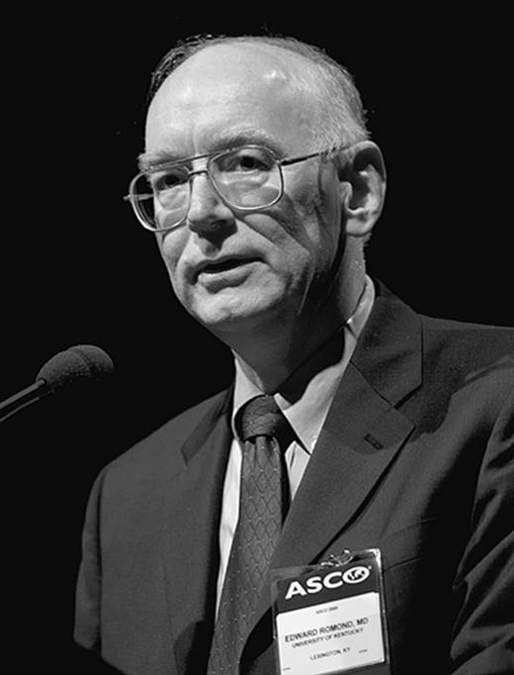
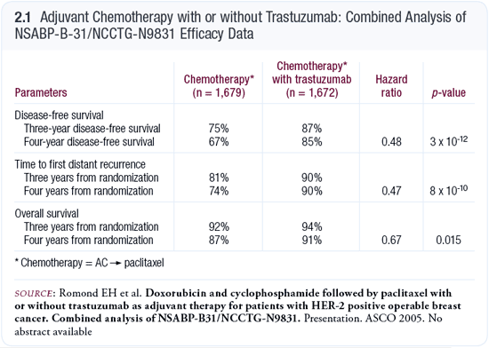
ORLANDO-- 2005-- ASCO annual meeting
Edward H. Romond, M.D., University of Kentucky in Lexington
At the close of the session, George W. Sledge Jr., M.D said in an interview: “I have never seen anything like this in 25 years of breast cancer research.”

Slide 10
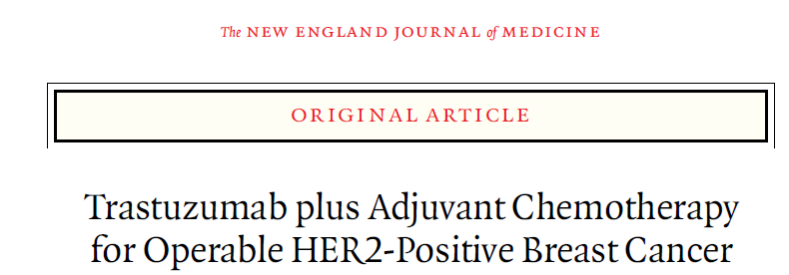
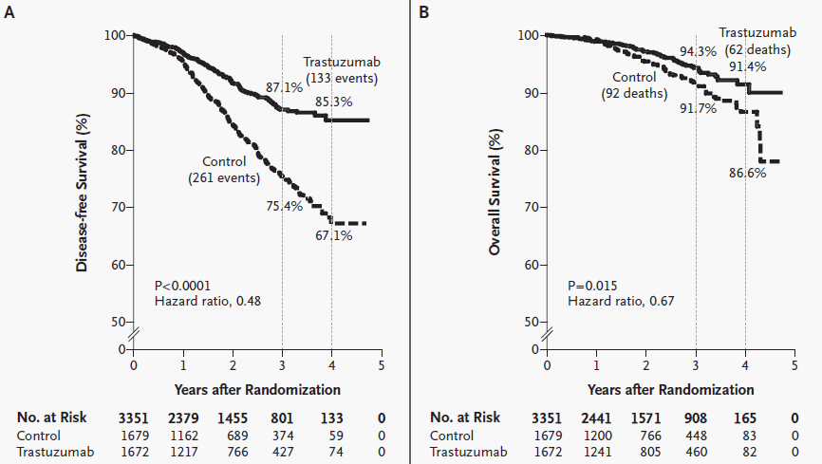

Slide 12
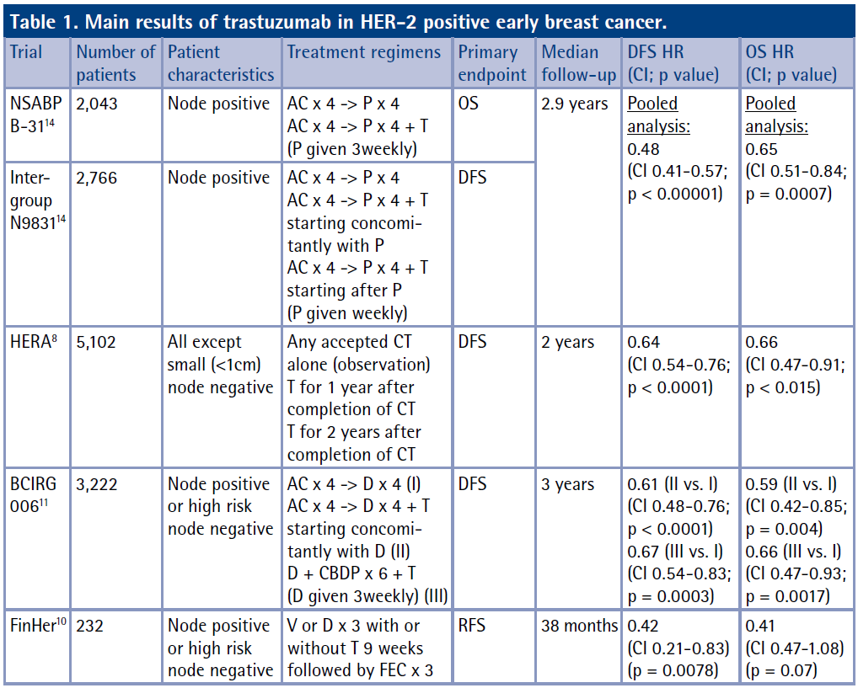

Slide 13
8.4 years
0.63
0.53 -0.68
P < .001
0.63
0.54 -0.73
P < .001
Perez EA, J Clin Oncol 2014;32:3744-52
11.3 years
0.76
0.68 -0.86
P < .001
0.74
0.64 -0.86
P < .001
Cameron D, Lancet 2017;389:1195-1205
10 years
0.72 (IIvsI)
0.61 -0.85
P < .0001
0.72 (IIIvsI)
0.61 -0.87
P < .0001
0.77 (IIvsI)
0.65 -0.90
P = .0011
0.76 (IIIvsI)
0.62 -0.93
P < .0075
0.74
0.64 -0.86
P < .001
Slamon D, SABCS 2015

Slide 14
et. al.
A retrospective analysis of HER2-positive early breast cancer patients treated in the ‘‘pre-trastuzumab’’ and ‘‘trastuzumab’’ eras, with the aim to determine patients’ outcomes in real-world practice.
925 women in ten Italian oncologic center
cohort A, 352 patients
cohort B, 573 patients
Adjuvant chemotherapy alone
adjuvant chemotherapy followed or
combined with trastuzumab

Slide 15
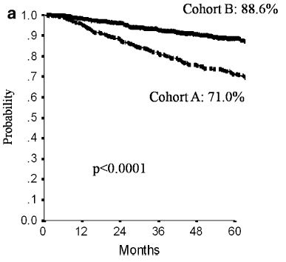
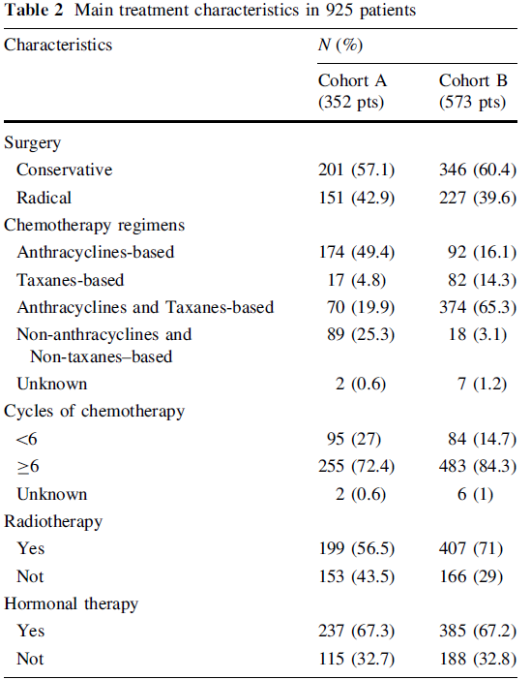
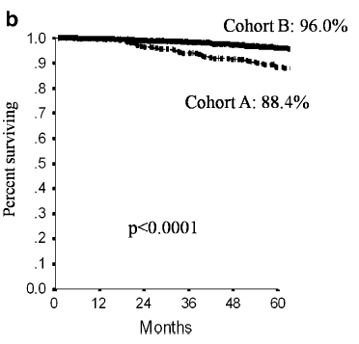
DFS
OS

Slide 16
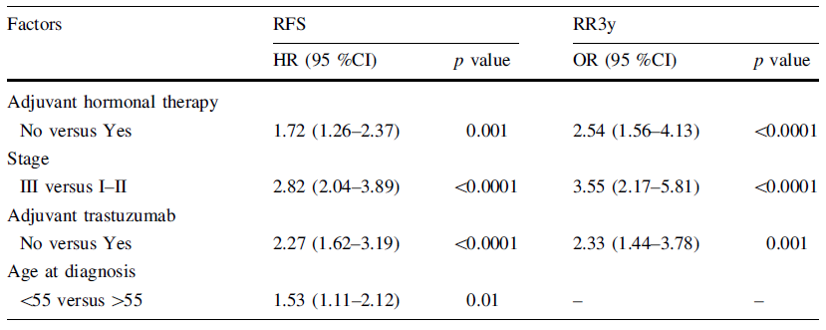
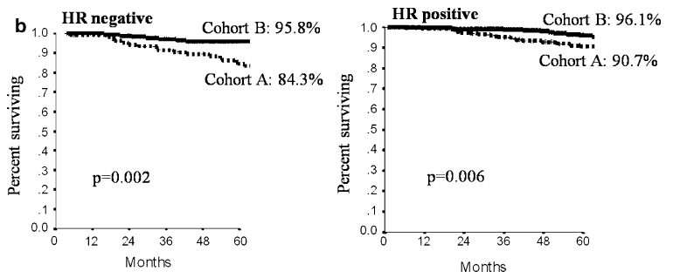
OS
OS

Slide 17
HER2+ Breast Cancer
Neoadjuvant scenario

Slide 18
99 women LABC HER2-
235 women LABC HER2+
118 women
117 women
Adjuvant chemotherapy alone
adjuvant chemotherapy followed or
combined with trastuzumab
pCR in 23/118 (19.5%)
pCR in 45/117 (38.5%)

Slide 19
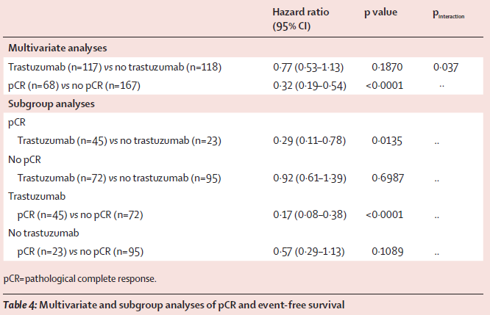

Slide 20
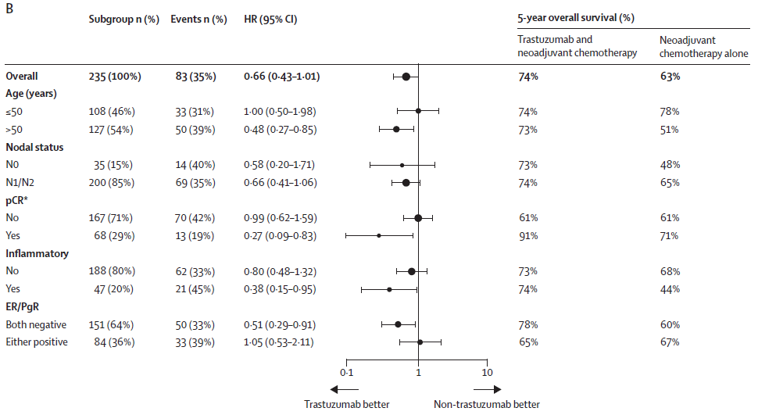

Slide 21
et. al.
205 women in ten Italian oncologic center with operable or locally advanced HER2
neoadjuvant chemotherapy combined with trastuzumab
pCR/0 in 51/205 (24.8 %)
pCR/is in 96/205 (46.8 %)

Slide 22
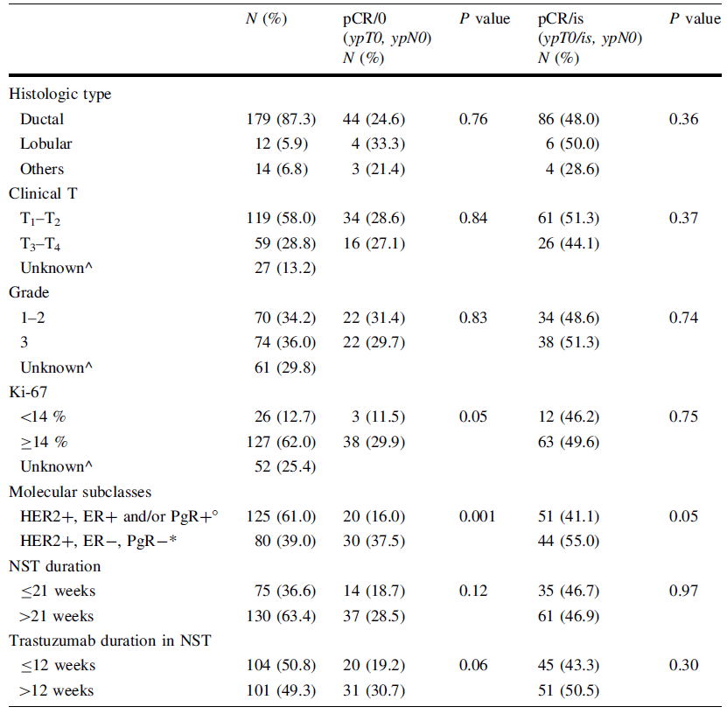
Association of clinical characteristics and pCR in univariate analysis

Slide 23
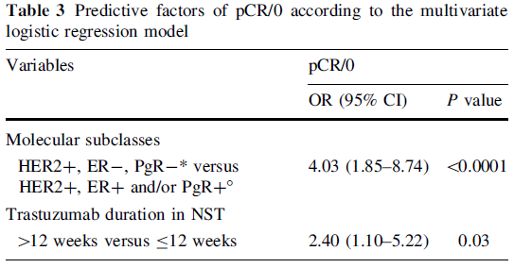
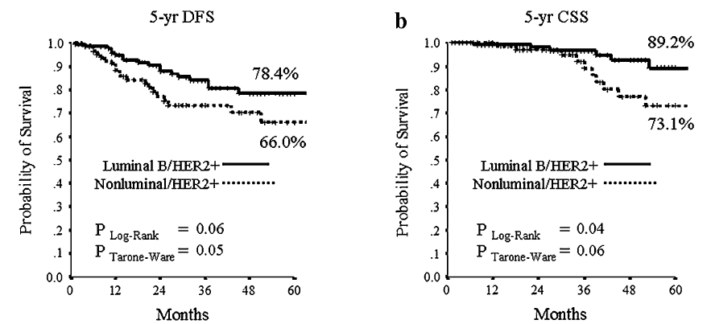

Slide 24
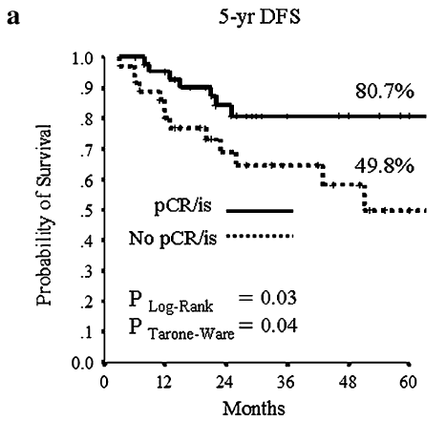
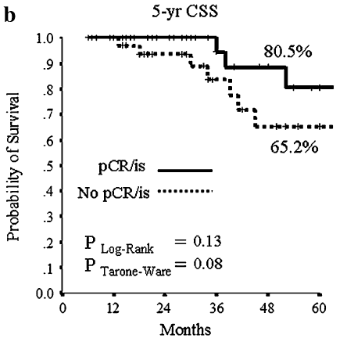
nonluminal
nonluminal

Slide 25
HER2+ Breast Cancer
Metastatic scenario

Slide 26
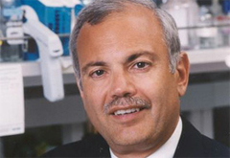
LOS ANGELES -- May 18, 1998 -- ASCO annual meeting
Dennis Slamon, M.D., University of California, Los Angeles School of Medicine

Slide 28
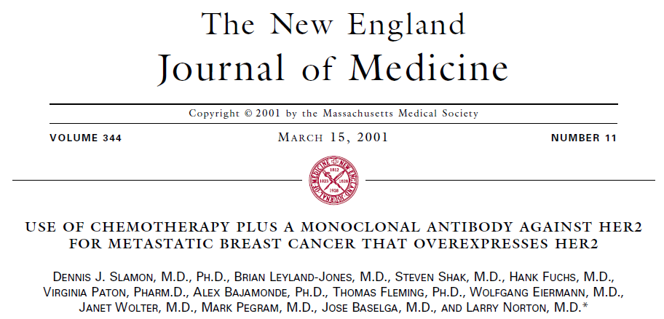
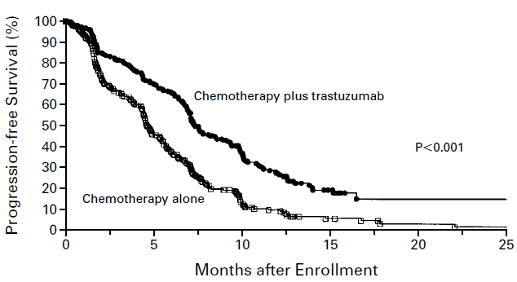
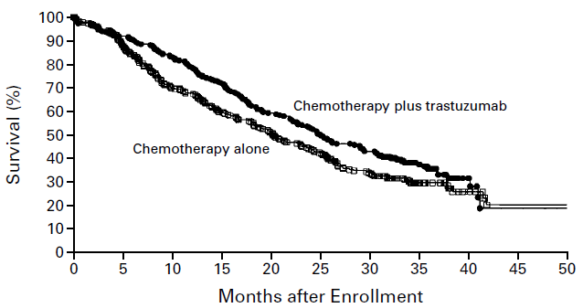
7.4
25.1
4.6
p = 0.046
20.3

Slide 29
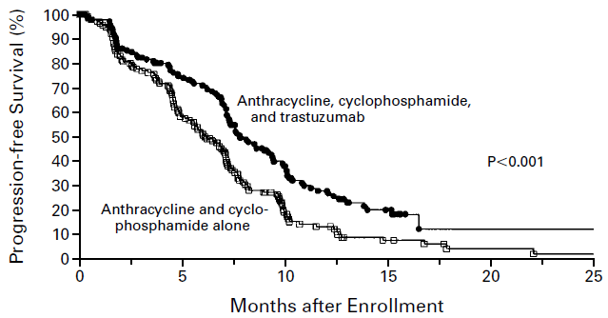
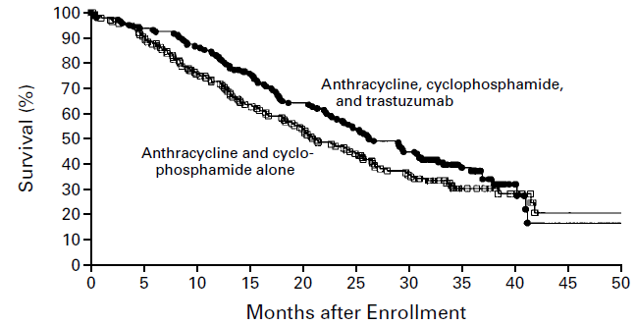
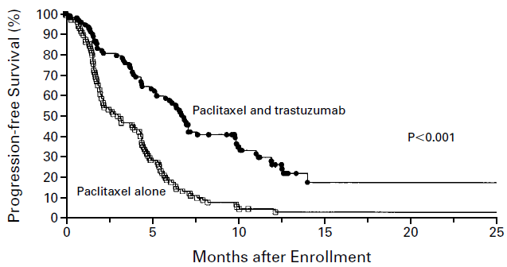
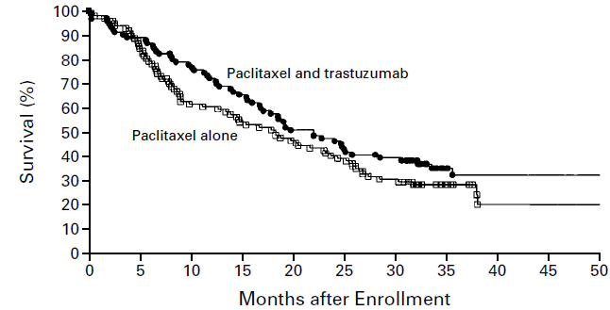
7.8
26.8
6.1
21.4
6.9
22.1
3
18.4

Slide 31
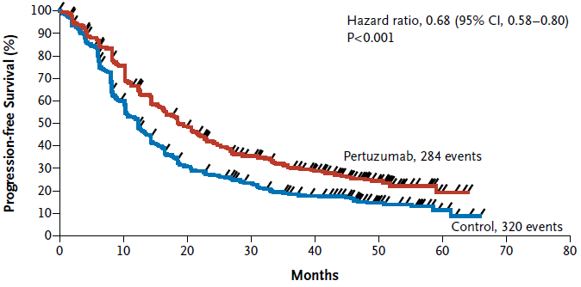
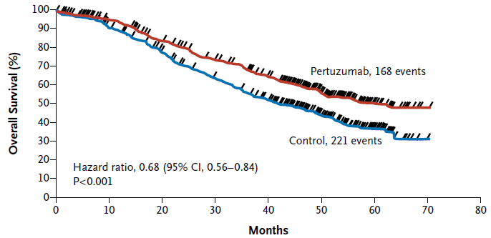
2015;372:724-34
et. al.,
Median PFS
18.7
Pertuzumab: 18.7 months
Control: 12.4 months
12.4
Median OS
Pertuzumab: 56.5 months
Control: 40.8 months
56.5
40.8

Slide 32
Australian Government
Department of Human Services
Medicare Benefits
Schedule (MBS)
Pharmaceutical
Benefits Scheme (PBS)
Herceptin Program
Patients data from 1 January 2001 to 30 June 2016
- year of birth,
- month/year of death
- patient weight at enrolment
- HER2 status (IHC or FISH)
- dispensed trastuzumab records: dates and quantity supplied
5899 women were dispensed trastuzumab for HER2+MBC
The largest cohort of HER2+MBC patients treated in routine clinical care, with the longest observation period, in the published literature.

Slide 33
Data available to evaluate patients characteristics, time on trastuzumab treatment, and OS outcomes
5899 women
Group 1 (December 2001-2008)
Group 2 (2009-July 2015)
3122 women
2777 women
Representative of the early years of HER2-targeted therapy
Representative
of current practice
COMPARABLE TO:
COMPARABLE TO:
Trastuzumab arm of
the original pivotal trial H0648g
Control arm of
the Cleopatra trial

Slide 34
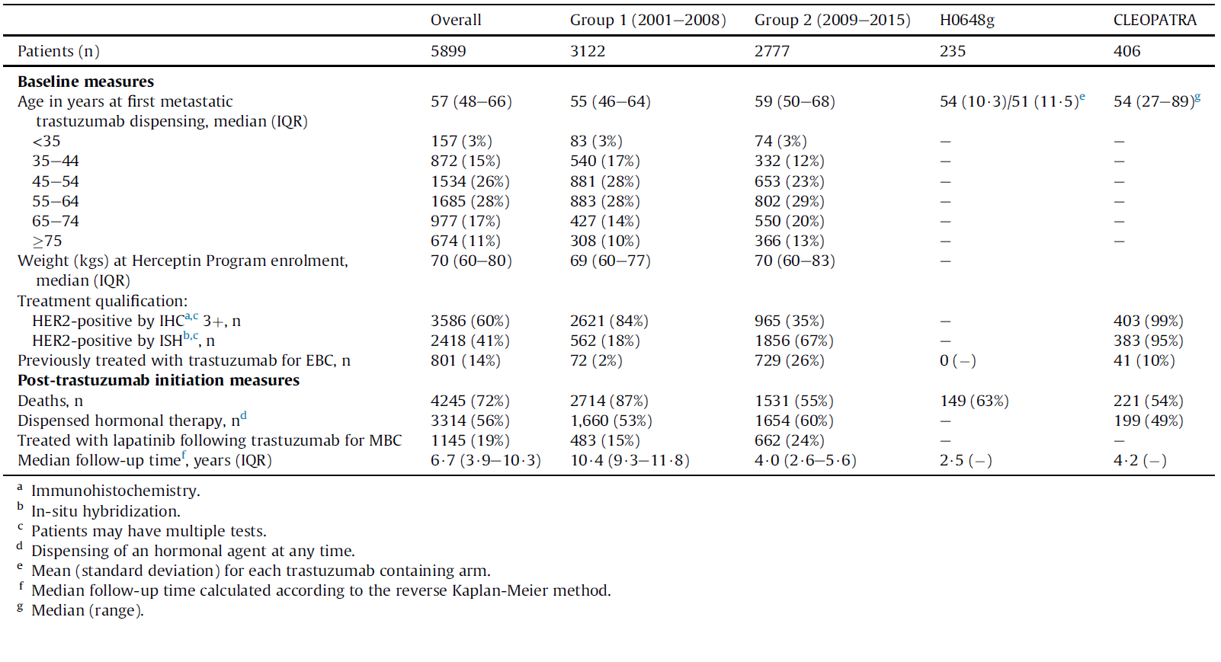
Patient characteristics of entire cohort and according to period of initiation, and in the two reference clinical trials.
16%
2%

Slide 35
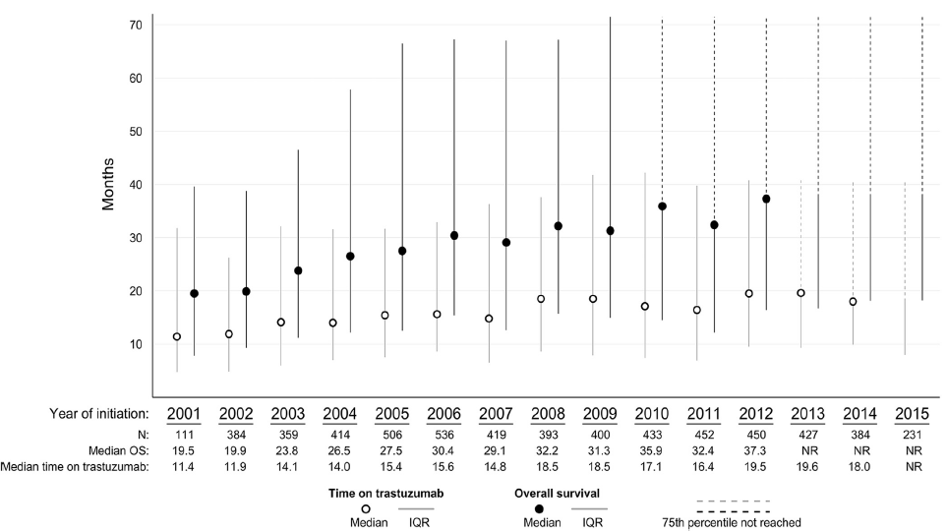
Median and interquartile range (IQR) for overall survival and time on trastuzumab stratified by year of trastuzumab for MBC initiation.

Slide 36
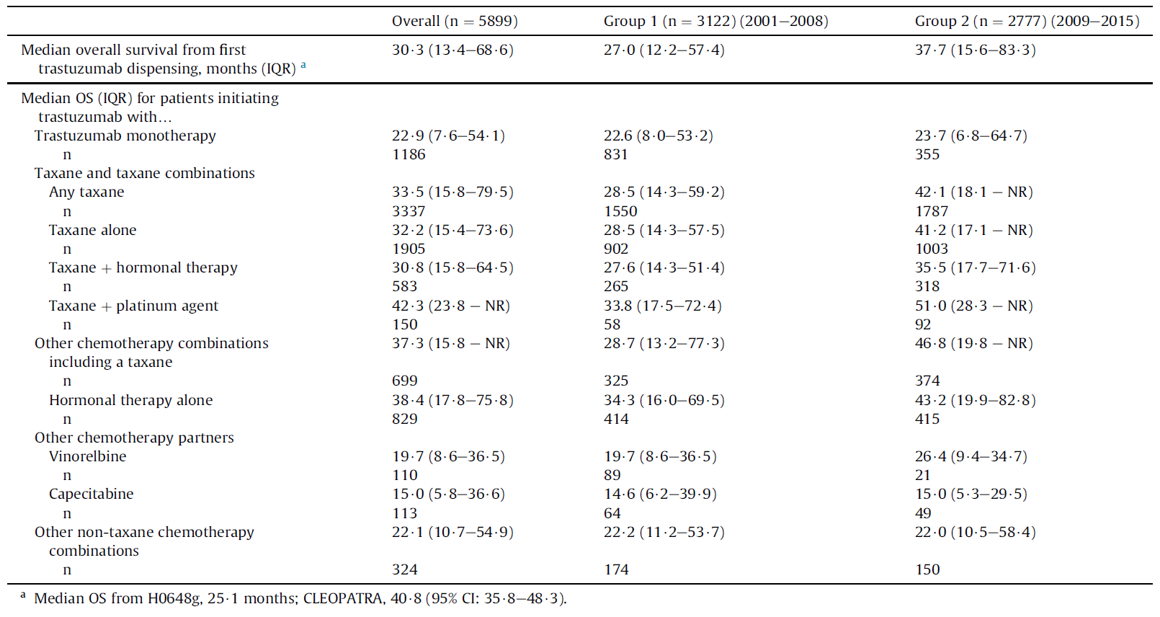
Overall survival estimates from first trastuzumab dispensing. Presented for all patients and stratified by first observed treatment partner.

Slide 37
Comparison between real-life and trials
Patients in this whole-of-population cohort were older than
those from the clinical trials
HER2+MBC patients previously treated with (neo)adjuvant trastuzumab are a growing patient sub-group in real-world practice.
Clinicians continue trastuzumab beyond progression while changing the partner cancer therapy
OS is comparable to those from clinical trials and increases over time:
median OS has not been reached for patients initiating treatment
between 2013 and 2015 probablly due to the availability of new, more active subsequent therapies, such as lapatinib and T-DM1.

Slide 38
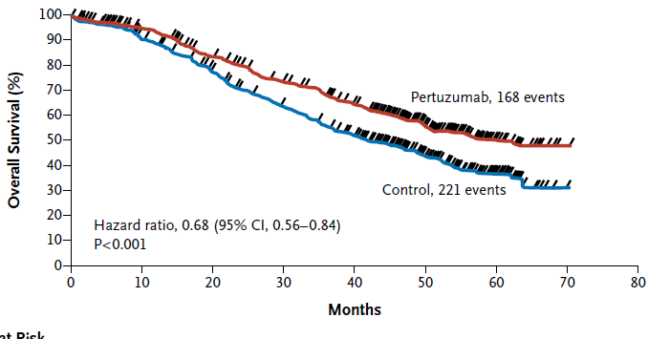
Improvement of OS over time in RCTs
H0648g
25.1
20.3
56.5
CLEOPATRA
25.1
40.8

Slide 39
Good reasons to expect even longer survival time for patients diagnosed and starting treatment today
Use of pertuzumab in first line
Use of T-DM1 in second line
Maintenance HT with trastuzumab and pertuzumab after taxanes
(not allowed in the CLEOPATRA trial)
It will takes several years to know the survival outcomes of patients in routine practice receiving these newer treatments

