Slide 1
May 26, 2017
TOWARDS PRECISION
MEDICINE IN CANCER TREATMENT
Auditorium c/o Rettorato
Università degli Studi “G. D’Annunzio” Chieti
Biological and clinical impact of cancer stem cells in ovarian cancer
by Ugo Cavallaro
Relatore: dott.ssa Federica Tomao
Università di Roma “Sapienza”

Slide 2
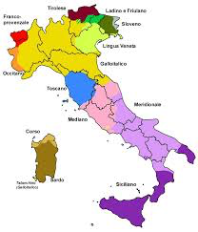
Ovarian Cancer Statistics
Incidence and mortality worldwide
and in Italy?
-Età (80%): 45-65 anni
5 years OS: 49,7%
New cases/years: 485
New deaths/years: 320
5 years OS: 38% (37-39)
Torre LA et al., CA CANCER J CLIN 2015; AIRTUM ( 2005-2009); FIGO Annual Report, 2006

Slide 3
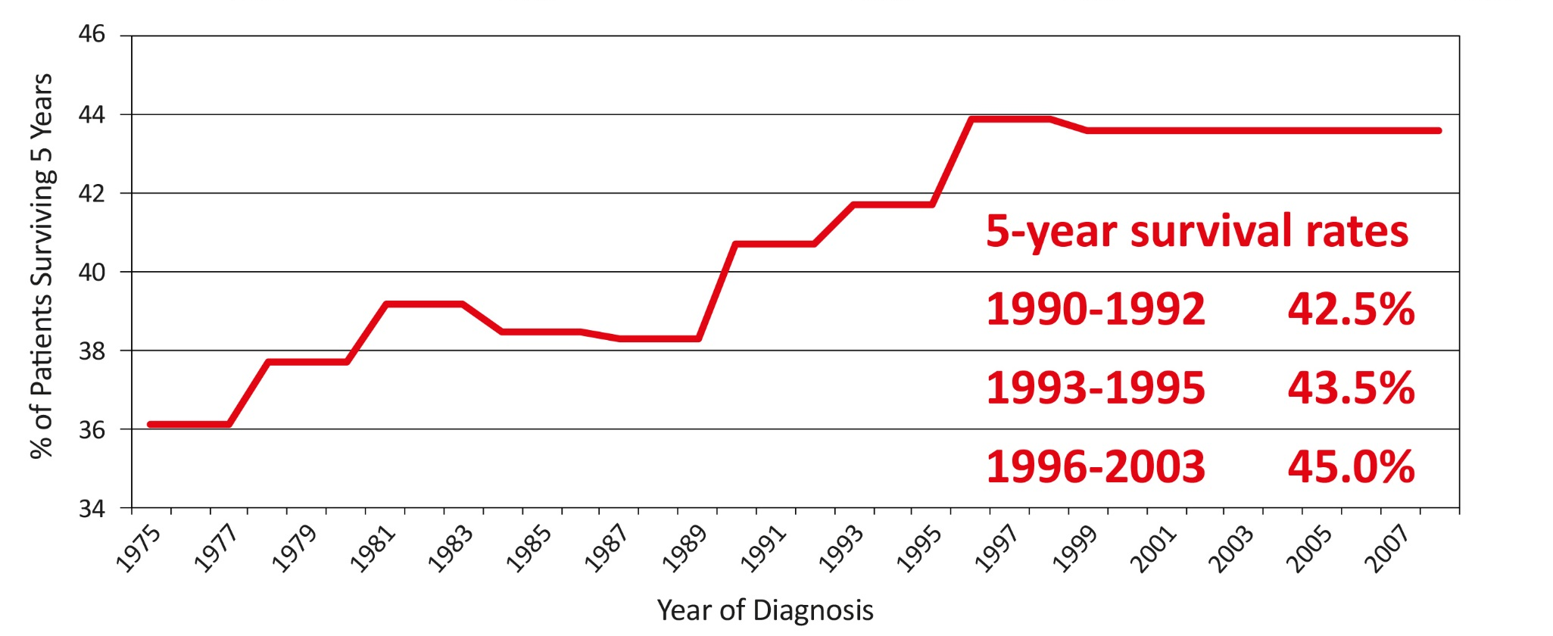
Survival modification within the years
RT: the most important prognostic factor
The importance of expertize of surgeons
Bristow RE, Gynecol Oncol 2010

Slide 4
Evolution of medical treatment

Slide 5
Evolution of knowledge about tumour development

Slide 6
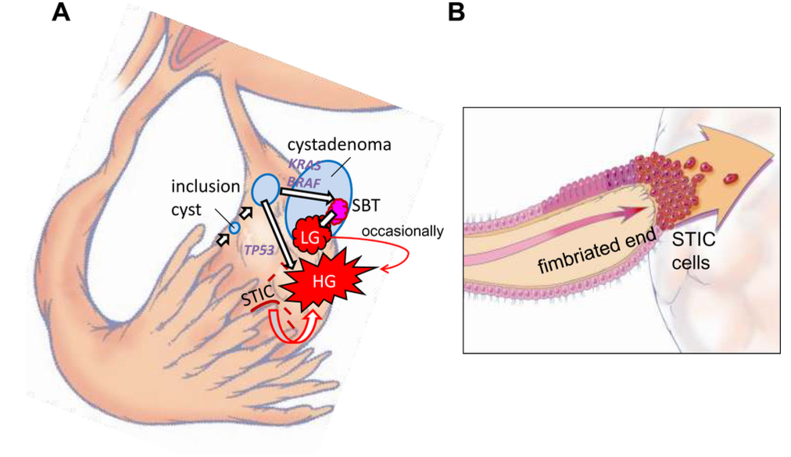
Last hypothesis about OC pathogenesis
Kurman RJ et al., Am J Surg Pathol, 2010

Slide 7
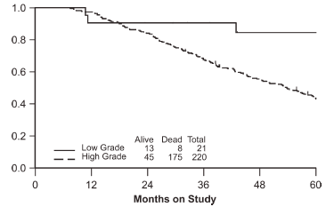
Women with high-grade versus low-grade serous carcinoma of the ovary are 2 distinct patient populations.

Slide 8
Recent evidences on OC carcinogenesis: Type 1 and 2
 | Type 1 |  | Type 2
Behavior | Indolent |  | Aggressive
Stage at diagnosis | Early stage |  | Advanced stage
Survival rate at 5 years | About 55% |  | About 30%
Histological type/Precursors | Endometrioid Clear cell Mucinous LGSCs Transitional cell carcinoma | Endometriosis Endometriosis Mucinous Cystadenoma, Endometriosis Teratoma, Brenner Tumor, and MBT Serous cystadenoma, Adenofibroma, Atypical proliferative serous tumor (SBT), M¨ullerian epithelial cyst Brenner tumor | HGSCs Undifferentiated Carcinosarcoma | Probably de novo starting at the tubo-ovarian surface epithelium; SCOUT→P53 signature→ STIL/TILT→ STIC or ovarian hilum stem cell ? ?
Gene expression | PTEN; HNF-1 beta; overexpression; ARID1A mutation; CTNNB1 mutation; PIK3CA; Microsatellite instability; KRAS mutation; BRAF mutation; APO E overexpression (12%); Ki67 proliferation index (10-15%) |  | TP53 mutation; HER2/neu overexpression; AKT overexpression; p16 inactivation; HLA-G overexpression; APO E overexpression (66%); BRCA 1/BRCA2 mutation; Ki67 proliferation index (50-75%)

Slide 9
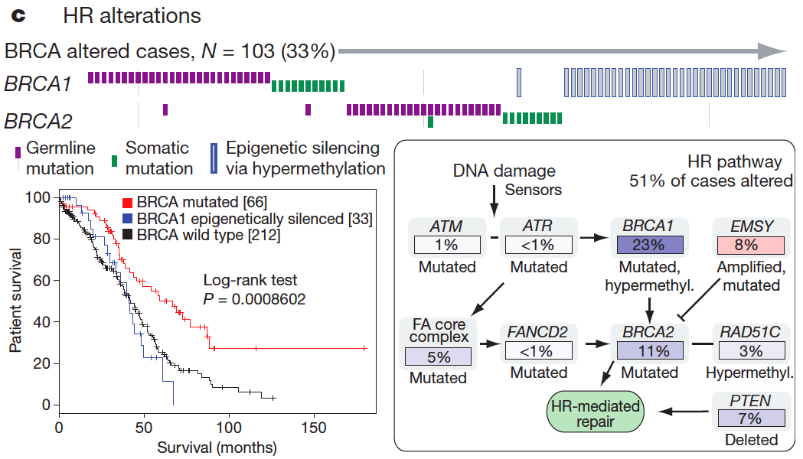
Homologous recombination defects
Other HRD 7%: TP53, RAD51C, PALB2, RAD50, MRE11A, BARD1, CHEK2, BRIP1, FANCD2, ATR, ATM
TCGA, Nature 2011; Swisher et al, PNAS 2011 in press; Turner, et al NatRevCancer 2004; Weberpals, et al JCO 2008;
Tan et al, JCO 2008; Mendes-Pereira et al, EMBO Mol. Med. 2009

Slide 10
The TCGA new genomic classification of HGSCs
Immunoreactive: T-cell chemokine ligands, CXCL11 and CXCL10, and the receptor, CXCR3,
Differentiated: high expression of MUC16 and MUC1 and with expression of the secretory fallopian tube maker SLPI, suggesting a more mature stage of development
Proliferative: high expression of transcription factors such as HMGA2 and SOX11, low expression of ovarian tumor markers (MUC1, MUC16) and high expression of proliferation markers such as MCM2 and PCNA
Mesenchymal: high expression of HOX genes and markers suggestive of increased stromal components such as for myofibroblasts (FAP) and microvascular pericytes (ANGPTL2, ANGPTL1)

Slide 11
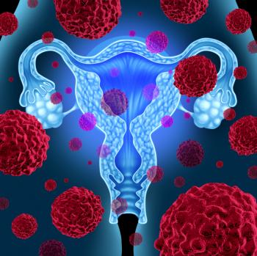
“Several works support the fact that all histological cell types
of EOC have different cellular origin with specific biologic
and genetic profiles”
Heinzelmann-Schwarz VA et al., J Cancer 2006, Lim D, Oliva E: Pathology 2013

Slide 12
Platinum resistance depends on…
DNA damage repair system and on response to DNA damage of cancer cells
DNA damage involving the activtion of checkpoints of the cell cycle as well as pro-apoptotic and anti-apoptotic factors.
Tumor stroma and normal cells infiltrating the tumors
Decreased uptake due to low expression of copper transporter or organic cation transporters
Increased drug efflux
Rapid binding of active site by GSH or metallothioneins preventing interaction with DNA
Increased DNA repair system
Micro-RNA expression,
Transcription factors and small GTP-ases,
Inactivation of apoptotic pathways
Activation of epithelial mesenchymal transition (EMT)
Notes:
Sul mio lavoro i meccanismi legati a CSCs sono:
drug effluxion
glutathione (GSH) system
apoptosis;
enrichment of CSCs during disease progression
tumor dormancy and CSC quiescence

Slide 13
Increase of interest in ovarian cancer stem cells

Slide 14
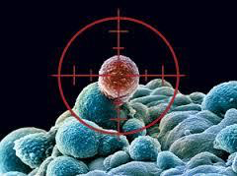
Definition of Cancer Stem Cells
“A cell within a tumor that possesses the capacity to selfrenew
and to cause the heterogeneous lineages of cancer
cells that comprise the tumor”

Slide 15
Two General Models for Cancer Heterogeneity
1. All cancer cells are potential cancer stem cells but
have a low probability of proliferation in clonogenic assays
2. Only a small definable subset of cancer cells are cancer stem cells that have the ability to proliferate indefinitely.

Slide 16
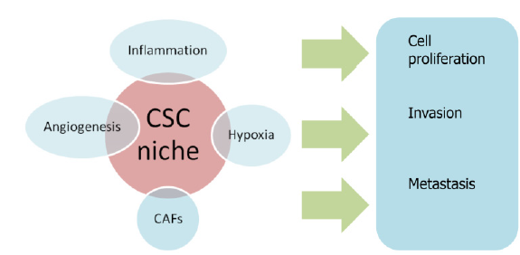
Influence of CSC niche on biological processes of cancerogenesis
CAFs: Cancer-associated fibroblasts.
Tomao F et al., Journal of Cancer 2014

Slide 17
Normal stem cells
Rare cells within organs with the ability to selfrenew
and give rise to all types of cells within the
organ to drive organogenesis
Cancer stem cells
Rare cells within tumors with the ability to selfrenew
and give rise to the phenotypically diverse
tumor cell population to drive tumorigenesis

Slide 18
Properties shared by normal stem cells and cancer stem cells
Asymetric Division:
Self renewal
Tissue-specific normal stem cells must self-renew throughout the lifetime of the animal to maintain specific organs
Cancer stem cells undergo self-renewal to maintain tumor growth
Differentiation into phenotypically diverse mature cell types
Give rise to a heterogeneous population of cells that compose the organ or the tumor but lack the ability for unlimited proliferation (hierarchical arrangement of cells)
Regulated by similar pathways
Pathways that regulate self-renewal in normal stem cells are dysregulated in cancer stem cells

Slide 19
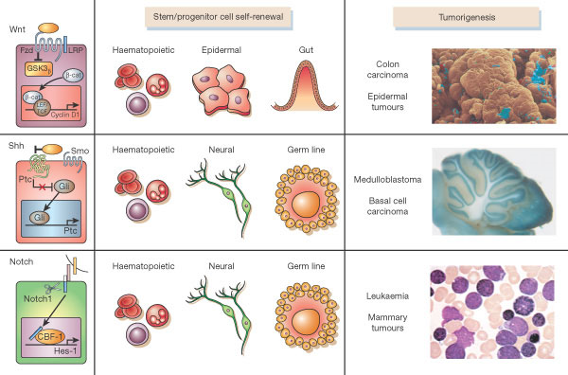
Pathways involved in self-renewal that are deregulated in cancer cells
Wnt, Shh, and Notch pathways have been shown to contribute to the self-renewal of stem cells and/or progenitors in a variety of organs, including the haematopoietic and nervous systems. When dysregulated, these pathways can contribute to oncogenesis. Mutations of these pathways have been associated with a number of human tumours, including colon carcinoma and epidermal tumours (Wnt), medulloblastoma and basal cell carcinoma (Shh), and T-cell leukaemias (Notch).

Slide 20
Epithelial mesenchymal transition
Since many CSCs stay in G0 and are not susceptible to cell cycle-specific chemotherapeutic agents, this sub-population could survive to such treatments and later it is able to regenerate the tumor.
EMT process plays an important role in tumor invasion, metastasis, recurrence and chemoresistance. This process is potentially regulated by different mechanisms, including EMT inducer signaling pathways, EMT transcription factors, dyregulation of miRNAs as well as several kinds of growth factors. In addition, MET may also happen during tumor progression in order to allow tumor growth and colonization, resulting in tumor settlement.

Slide 21
Origin of the Theory of Cancer Stem Cells
Only a small subset of cancer cells is capable of
extensive proliferation
Liquid Tumors
In vitro colony forming assays:
- 1 in 10,000 to 1 in 100 mouse myeloma cells obtained from ascites away from normal hematopoietic cells were able to form colonies
In vivo transplantation assays:
- Only 1-4% of transplanted leukaemic cells could form spleen colonies
Solid Tumors
- A large number of cells are required to grow tumors in xenograft models
- 1 in 1,000 to 1 in 5,000 lung cancer, neuroblastoma cells, ovarian cancer cells, or breast cancer cells can form colonies in soft agar or in vivo

Slide 22
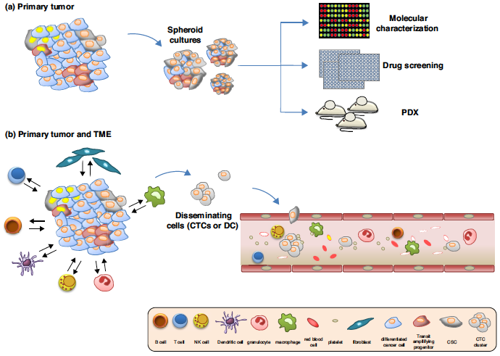
CSCs as a tool for pre-clinical studies and a target for immune-mediated therapies.
De Fiori M & De Maria R et al., Curr Op in Pharmacol, 2017

Slide 23
Cells surface markers of ovarian CSCs
Marker | Biological function | Lowest number of tumorigenic OCSC
CD44 | HA receptor. Stimulates EGFR-Ras-ERK. Cell proliferation, differentiation, motility, chemoresistance. | 10² (CD44+/CD117+)
CD24 | Transmembrane glycoprotein. Activates STAT3. Stemness, cell adhesion, tumor cell malignancy, metastasis. | 5x10³ (CD24+)
CD117 | Receptor tyrosine kinase. Regulates PI3K/Akt, Ras/ERK, Src and JAK/STAT pathways. Cell signaling, apoptosis, cell differentiation, proliferation, cell adhesion. | 10³ (CD117+)
CD133 | Transmembrane glycoprotein. Induces PI3K/Akt pathway. CSC maintenance, tumor formation, chemoresistance. | 10²(CD133+)
Lupia M et al., Molec Cancer 2017

Slide 24
Other markers?
Markers | Type | Function
ALDH | Transcription factor | Its activity is strictly related to wnt/βcatenin pathway. The inhibition of ALDH cause the block of sphere formation. Its activity interfere with drugs transporters, leading to chemoresistance. Cells expressing ALDH seem to have more multipotent phenotype than all the other marker combinations.
NANOG | Transcription factor | Maintenance of pluripotency and self-renewal in ESCs, overexpression is associated with high grade tumour, advanced clinical stage of disease and, resistance to chemotherapy, regulates EMT and chemotherapy resistance through activation of STAT3
OCT4 | Transcription factor | Induces tumour initiation and chemotherapy resistance
SOX2 | Transcription factor | Maintenains pluripotency and self-renewal in ESCs
SSEA-4 | Surface antigen | Pluripotency in OSE

Slide 25
Cancer cells with the surface marker profile CD44+/CD24- have previously been described to possess cancer stem cell-like properties.
Increased risk of recurence and shorter progression-free survival in patients with ovarian cancer.
Meng E et al, Clin Exp Metastasis, 2012

Slide 26
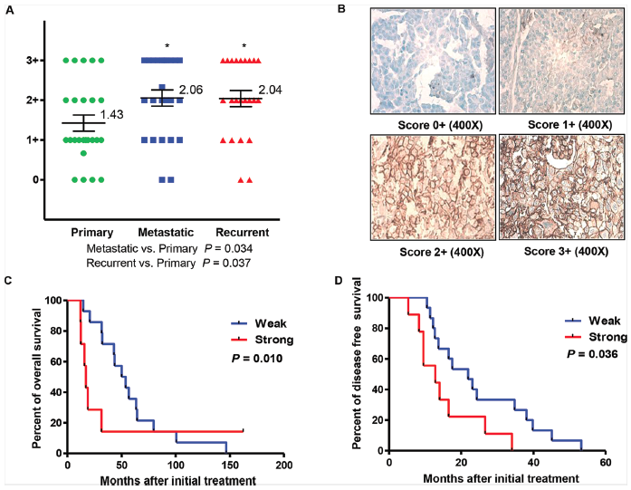
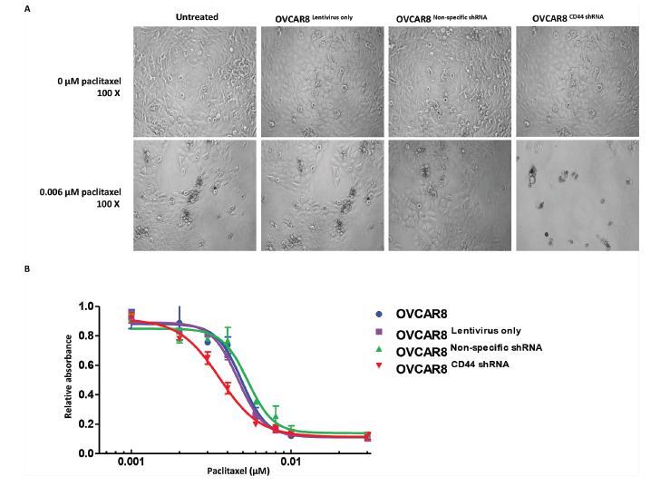
Both the metastatic and recurrent OC tissues expressed higher level of CD44 than the patient-matched primary tumor.
A significant association has been shown between CD44 expression and PFS and OS.
A strong increase of CD44 was found in the tumor recurrence of mouse model.
When CD44 was knocked down, proliferation, migration/invasion activity, and spheroid formation were significantly suppressed, while drug sensitivity was enhanced.
Gao Y et al., Oncotarget 2015

Slide 27
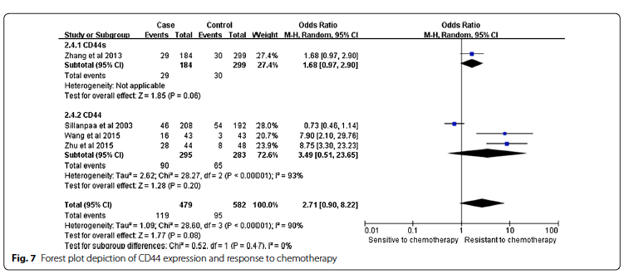
The prognostic role of the cancer stem cell marker CD44 in ovarian cancer: a meta-analysis
Detection of CD44 may be an eff ective tool for pathological diagnosis and prognostic prediction of ovarian cancer patients in clinical applications.
Lin J et al. Cell Int 2017

Slide 28
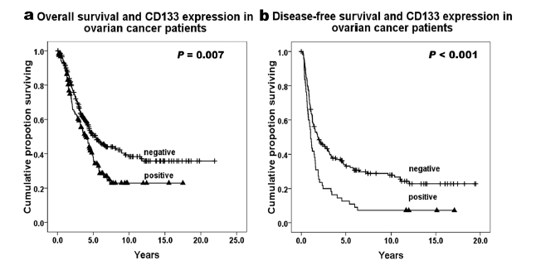
CD133 expression was associated with high-grade serous carcinoma (P = 0.035), late-stage disease (P < 0.001), ascites level (P = 0.010), and non-response to chemotherapy (P = 0.023).
Response to chemotherapy:.
Responders vs non-responders: P = 0.023.
Responders vs non-responders in cisplatin-based postsurgery subgroup: P = 0.014.
Zhang J et al., Mol Pathol, 2012

Slide 29
Our study indicates that the immunohistochemical assessment of CD133 and CD117 expression may have potential clinical value in predicting disease progression and prognosis in the high grade serous ovarian cancer. CD133 proved to be an independent prognostic factor in the high grade serous ovarian cancer patients.

Slide 30
ALDH1A1 is an intracellular enzyme that oxidizes aldehydes,
serving a detoxifying role, and converts retinol to retinoic acid, mediating control on
differentiation pathways.
ALDH1A1 subpopulation is associated with chemoresistance and outcome in ovarian cancer patients, and targeting ALDH1A1 sensitizes resistant cells to chemotherapy.
Landen et al. Mol Cancer, 2010
Notes:
ALDH1A1, one of 17 ALDH isoforms, is an intracellular enzyme that oxidizes aldehydes,
serving a detoxifying role, and converts retinol to retinoic acid, mediating control on
differentiation pathways. The ALDH1A1 population defines normal hematopoietic stem
cells, being used to isolate cells for stem cell transplants in patients. Using the
ALDEFLUOR assay, a functional flow cytometric assay that identifies cells with active
ALDH1A1, TIC-enriched populations have been identified in multiple malignancies (20),
including breast (11–14), colon (15–16), pancreas (17), lung (18), and liver (19).
More importantly, while ALDH1A1 is implicated in chemoresistance
pathways, it is not known whether targeting ALDH1A1 can sensitize resistant cells to
chemotherapy, and therefore represent a potential target for cancer stem cell-directed
therapy. We sought to characterize expression of ALDH1A1 in ovarian cancer cell lines and
patient samples, determine if it contains TIC properties, and examine whether targeting
ALDH1A1 sensitizes cells to chemotherapy in both in vitro and in vivo ovarian cancer
models.

Slide 31
Ovarian cancer stem cells: our contribution

Slide 32
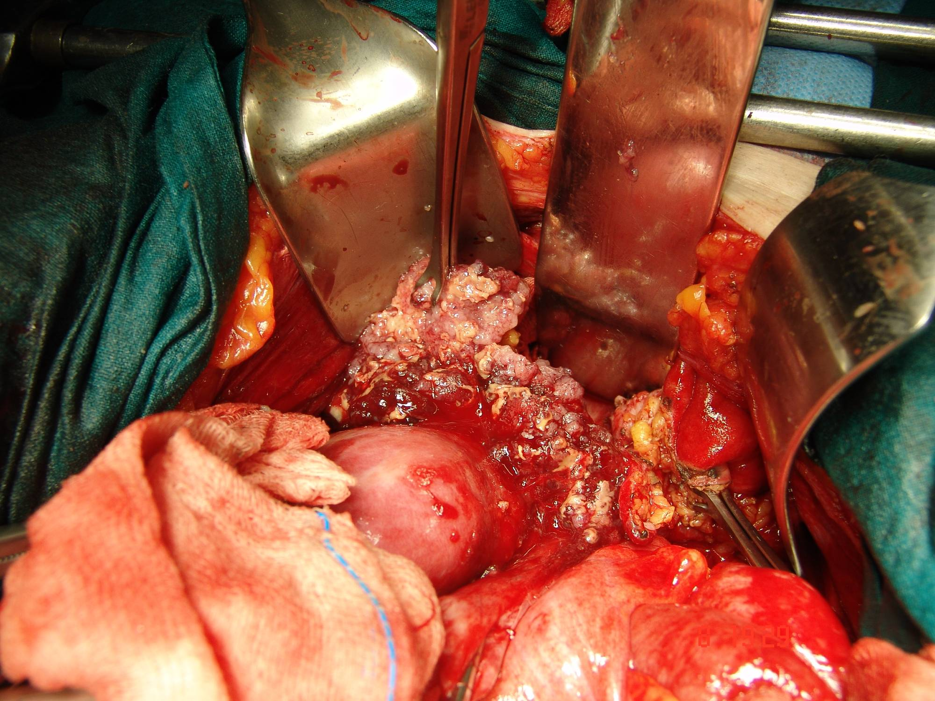
Notes:
32

Slide 33
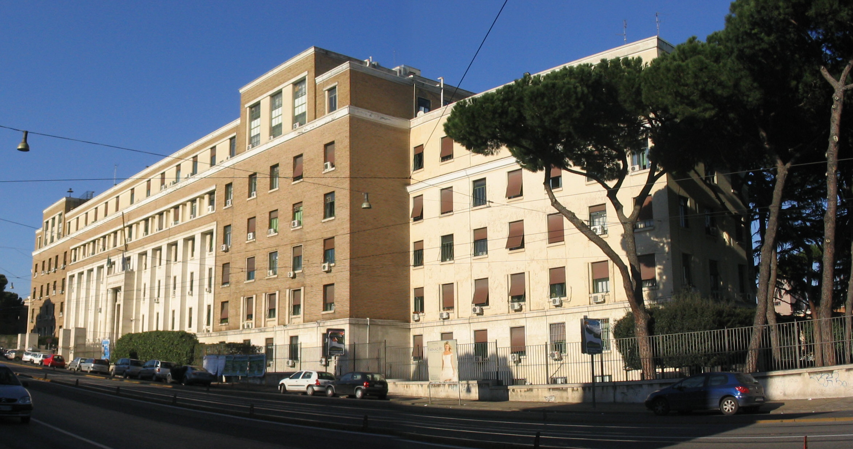
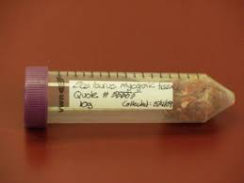
Tissue biopsies, storage and transportation

Slide 34
Cells Colture and tests performed
Dissociation of samples in single cells suspension by mechanical and enzymatic digestion containing collagenase, DNAse and hyaluronidase for a max of 2 h at 37°C.
Cells will be plated into 96-well anti-adherent plates in quadruplicate, at a density of 2000-3000 cells per well in a volume of 80 μl of complete stem cells serum-free medium, enriched with growth factors (EGF, bFGF) –produced by ISS-.
Flow cytometry technology is performed on ovarian cancer cell lines investigating main markers that are EpCAM, CD44, CD24, CD133, CD117, ABCG2, ALDH, C-kit , with other markers used to evaluate differentiation state (ie Cytokeratin). SOX2, OCT4, NANOG and other markers of cancer stem cells population are usually evaluated through immunofluorescence assay.
In order to confirm the staminality origin of cells isolated from cancer tissues, cells will be injected in NOD-SCID IL-2R gamma defective mice by subcoutaneous/intraperitoneal and orthotopic implantation to test their tumorigenicity.
Cancer cells are in vitro tested with different chemotherapic regimens in order to evaluate chemosensitivity of drugs.

Slide 35
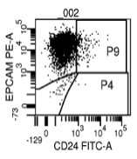
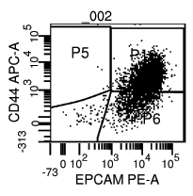
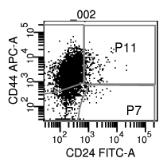
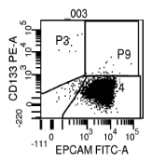
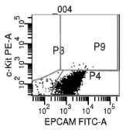
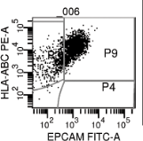
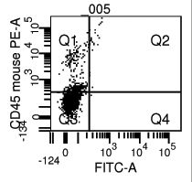
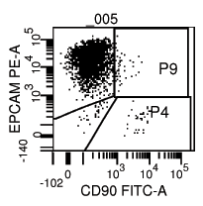
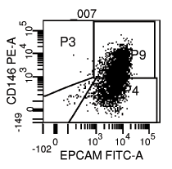
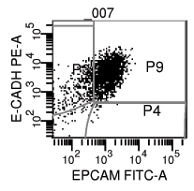
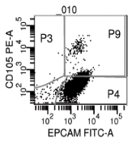
OVARIAN CANCER “STEM CELLS” CHARACTERIZATION AFTER IN VIVO XENOTRANSPLANTATION
HIGH HETEROGENIC EXPRESSION OF KNOWN “OVARIAN CANCER STEM CELL” MARKERS
EXCLUSION OF MOUSE- AND
NON-EPITHELIAL CELLS
EXCLUSION OF
FIBROBLAST CELLS
Possible EMT?

Slide 36
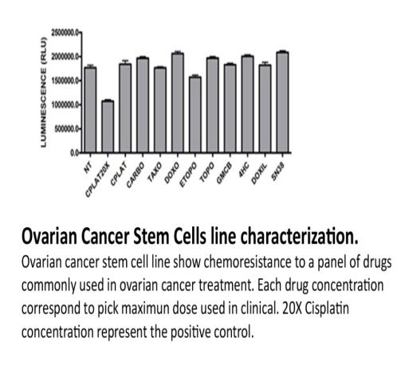
OVARIAN CANCER STEM CELLS CHEMORESISTANCE
Cell Titer-Glo Assay

Slide 37
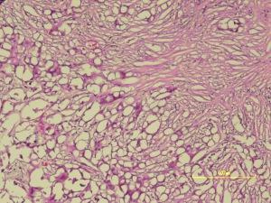
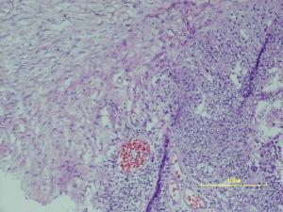
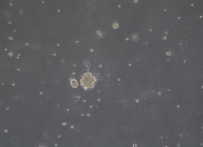
Xenograft tissue has similar histopathological histotype to primary tumors
In vivo IMAGING
(IVIS)
d8
d24
IHC
In vitro Culture
Primary
Xenograft

Slide 38
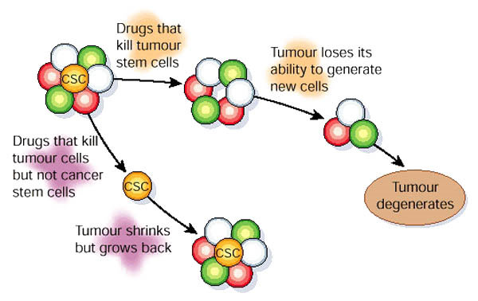
Therapeutic implications of Cancer Stem Cells
Most therapies fail to consider the difference in drug sensitivities of cancer stem cells
compared to their non-tumorigenic progeny.
Most therapies target rapidly proliferating non-tumorigenic cells and spare the
relatively quiescent cancer stem cells.

Slide 39
Future perspectives…Targeting CSCs
Inhibitor/key factor | Targeted pathway | Tumor type
Salinomycin CD271/p53 n.a. Enaxin miR-141 miR-200 family/miR-34 lncRNA-ATB BCAR4 (lncRNA) miR-326 lncRNA-Hh miR-371-373 lncTCF7 VS-5584 PF-2341066 BEZ235, MLN128, RAD001, Lucitanib U0126, ICG-001, SCH7729846, PD184352 Prostratin Curcumin | KRAS DNA damage response DNA damage response Processing machinery for microRNAs biogenesis EMT TGFb—EMT EMT—STAT3 Histone acetylation—noncanonical Hedgehog/GLI2 Hedgehog Hedgehog—EMT Wnt/b-catenin Wnt PI3K-mTOR c-Met—Wnt/b-catenin Notch1—PI3 K/mTOR MEK/ERK—Wnt/b-catenin MAPK—noncanonical Wnt NF-kB signaling | Breast cancer Metastatic melanoma Smoking-related lung cancer Ewing sarcoma Prostate cancer Colorectal cancer Hepatocellular carcinoma Breast cancer CML Breast cancer Breast cancer; colorectal cancer Hepatocellular carcinoma Breast cancer; ovarian cancer; small-cell lung cancer Head and neck squamous carcinoma Triple-negative breast cancer Colorectal cancer Pancreatic cancer Liver cancer
Fiori ME et al. Cur Op Pharmacol 2017

Slide 40
Conclusions
Self-renewing ovarian CSCs or ovarian cancer-initiating cells, and mesenchymal stem cells (SCs) too, are probably implicated in the etiopathogenesis of OC, in its intra- and extra-peritoneal diffusion and in the occurrence of chemoresistance.
The CSC hypothesis has been put forward as a paradigm to describe varying levels of aggressiveness in heterogeneous tumors.
Specifically, many subpopulations have been clearly demonstrated to possess increased tumorigenicity in mice, broad differentiating capacity, and resistance to therapy.
Several cell markers have been investigated
To increase the sensitivities and specificities for the detection of CSCs, further investigations are needed
Targeting CSCs might be a strategy to improve outcome of cancer patients but the complexities that lie within this approach will provide many challenges in clinical applications.
Combined treatments that target CSCs will be a new direction in the future.

Slide 42
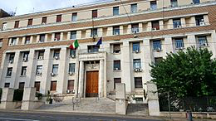
Acknowledgments
Prof. Pierluigi Benedetti Panici
Prof. Muzii
dr. Innocenza Palaia
dr. Giorgia Perniola
dr. Claudia Marchetti
dr. Violante Di Donato
dr. Angela Musella
dr. Serena Boccia
Prof. Ruggero De Maria
dr. Mauro Biffoni
dr. Ugo Testa
dr. Luca Pasquini
dr. Eleonora Petrucci

