Slide 1
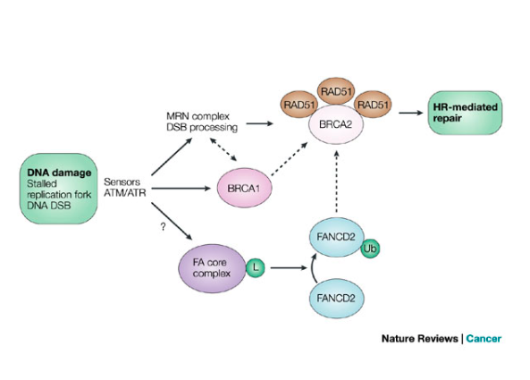
Pathways involved in hereditary breast cancer
L. Stuppia, Medical Genetics
G. d’Annunzio University
Chieti-Pescara, Italy

Slide 2
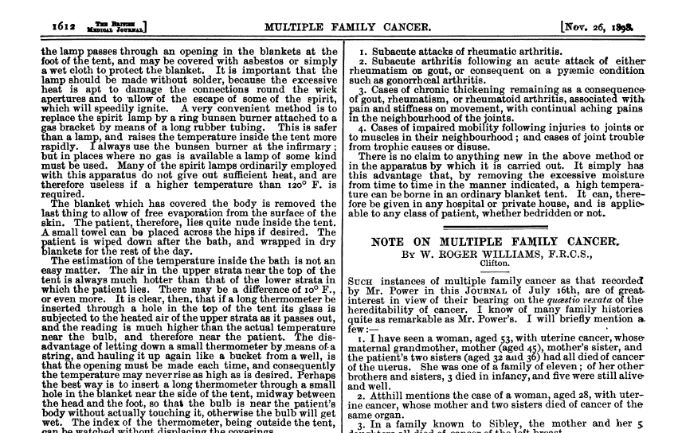

Slide 3
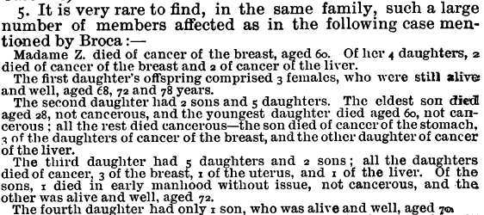
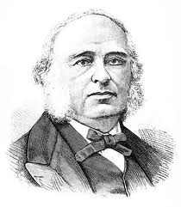
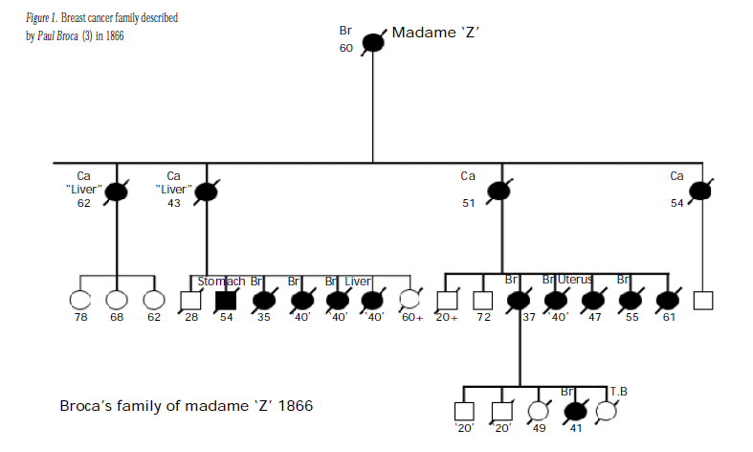

Slide 4
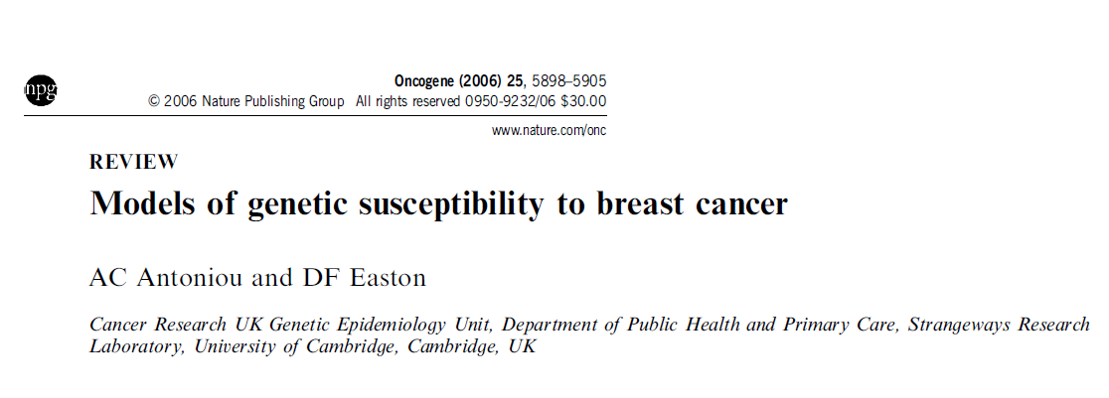
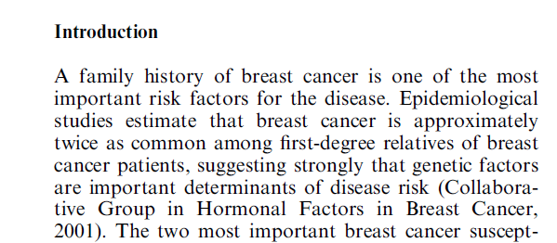

Slide 6
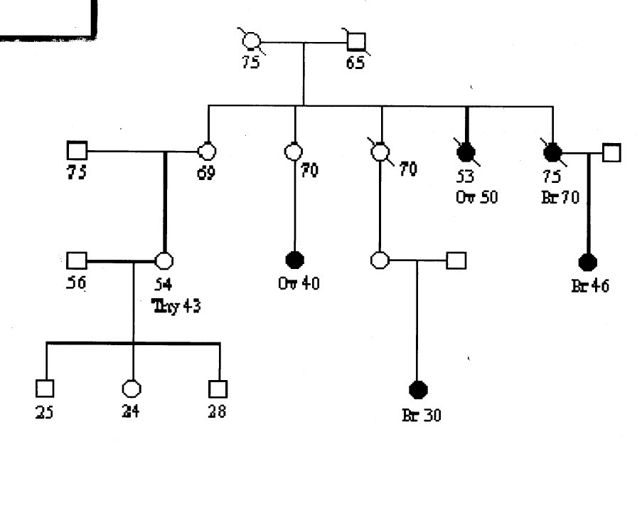
Familiar aggregation of cancer cases

Slide 7
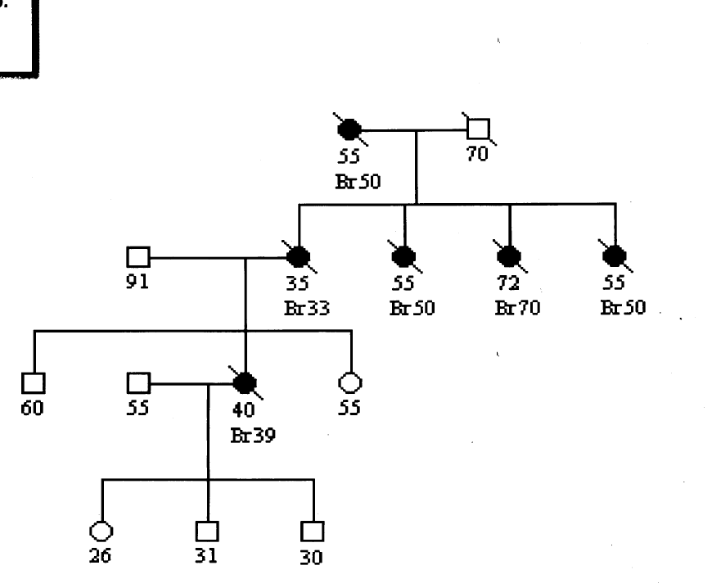
Hereditary cancer

Slide 8
Features of hereditary BC
Early onset (50% before age 40)
Multiple cancers
Several affected members within a family with direct trasmission (high penetrance dominant inheritance)

Slide 9
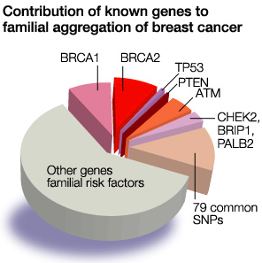

Slide 10
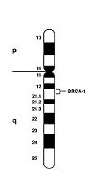
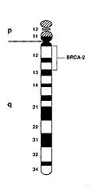
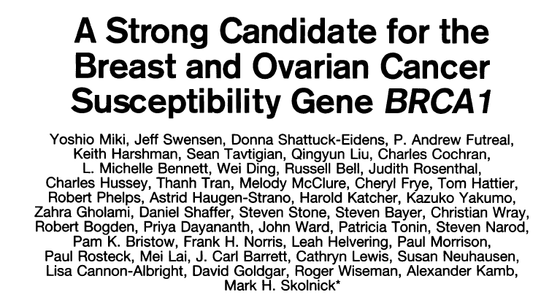
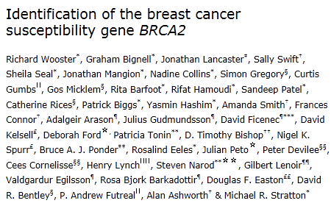
BRCA1 (17q12) BRCA2 (13q12)

Slide 11
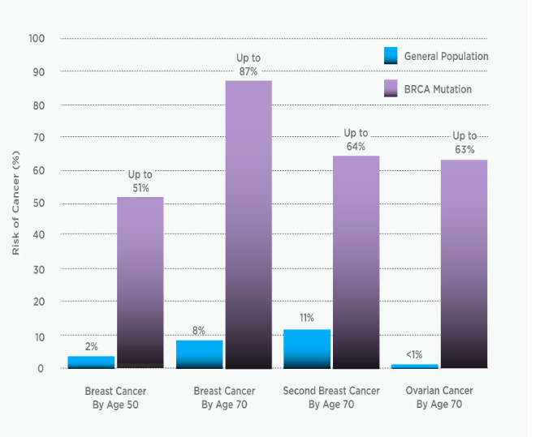
https://myriad.com/patients-families/disease-info/breast-cancer/

Slide 12
Pedigrees of families carrying BRCA1 and BRCA2 mutations.

Slide 13
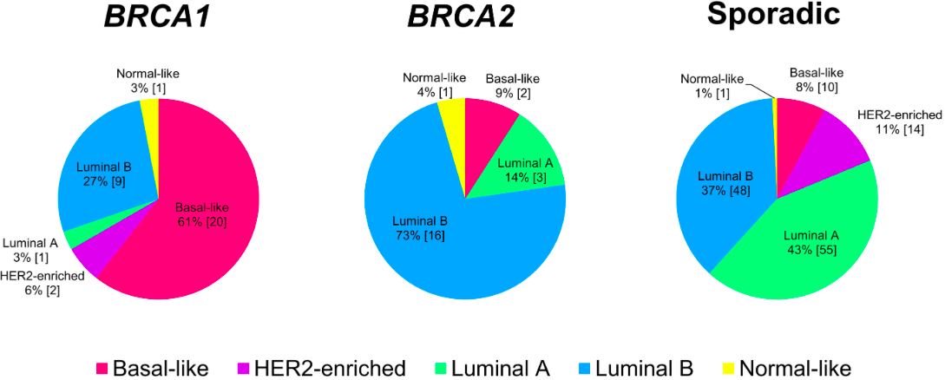
Larsen et al., 2013

Slide 15
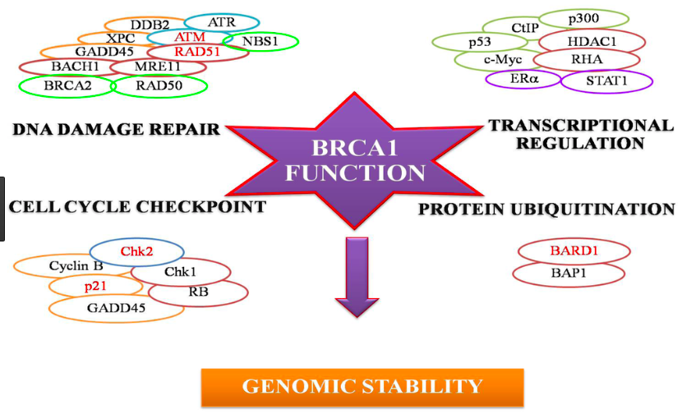

Slide 16
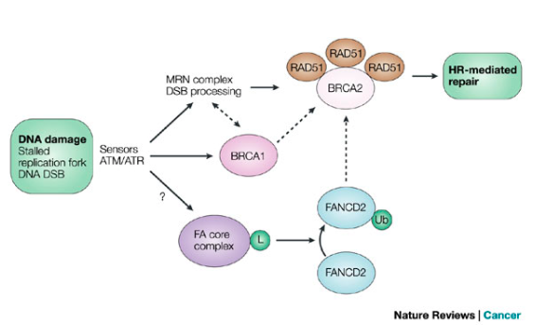
BRCA1 and DNA repair

Slide 17
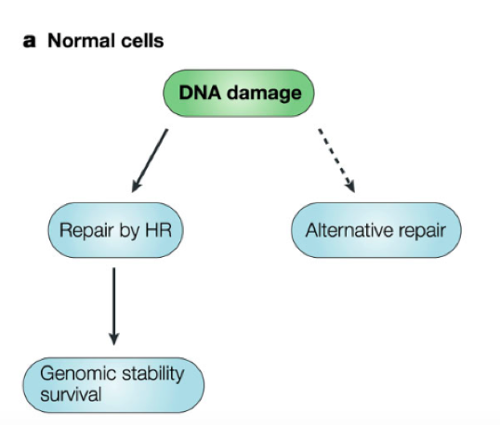
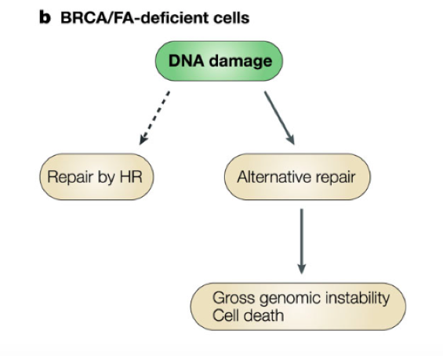

Slide 18
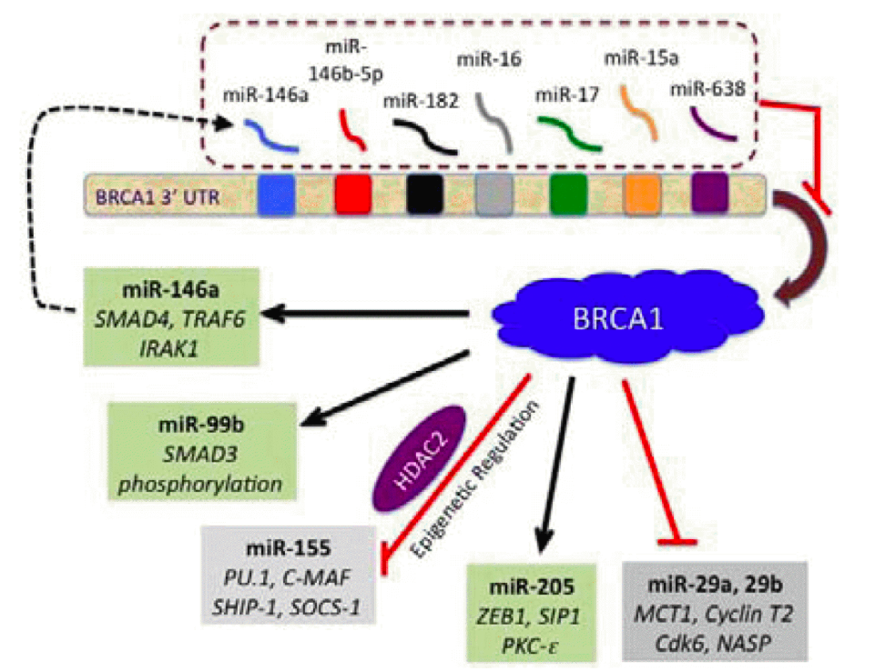
BRCA1 and miRNA

Slide 19
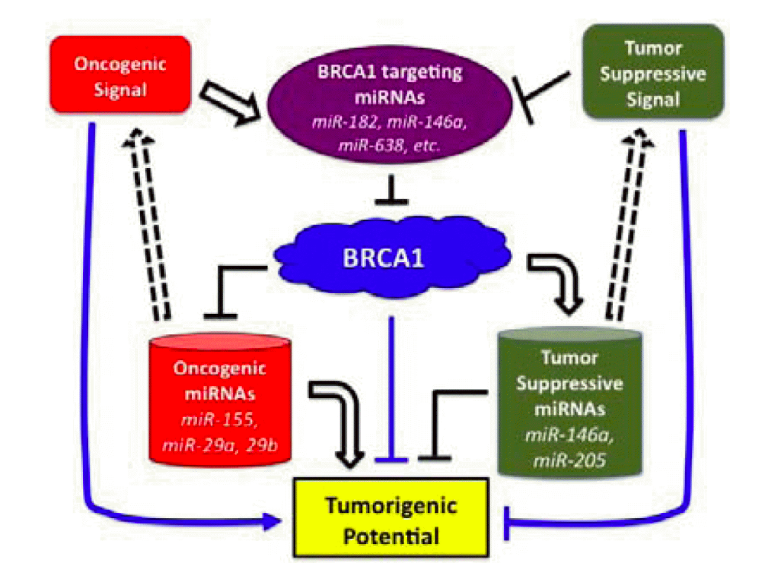

Slide 20
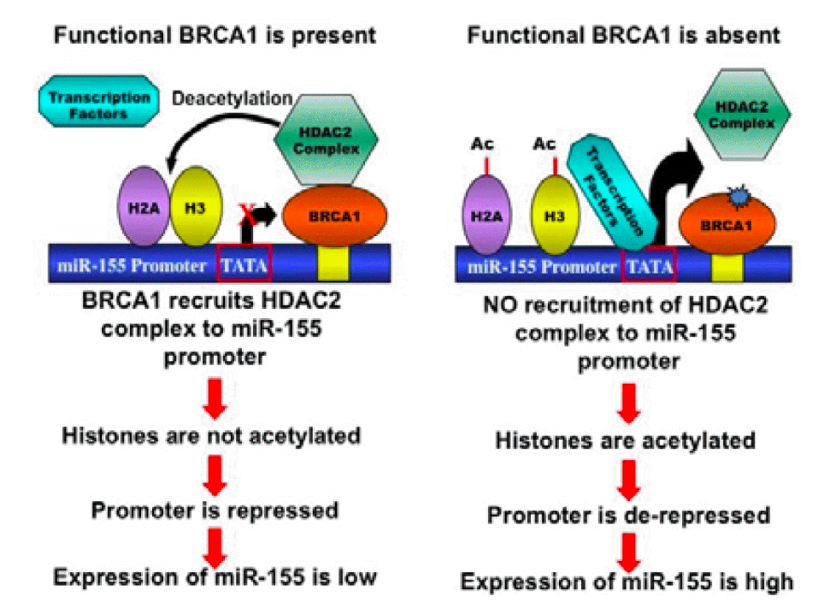

Slide 21
Knowledge of BRCA1/2 mutation status in a patient has gone from a research question to demonstrated clinical utility directly affecting patient care.
(Lee et al., 2014)

Slide 22
Why BRCA1/2 testing?
Prevention
2nd cancer in affected patients
1st cancer in non affected subjects
Familiar risk
Therapy

Slide 23
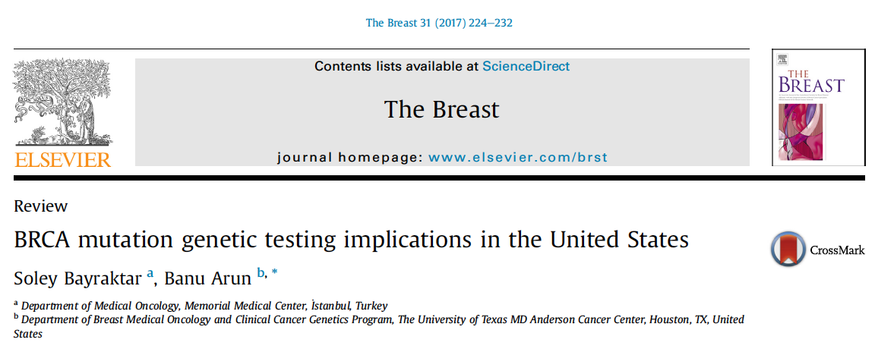
Impact of BRCA mutation status on clinical stage of breast cancer diagnosis:
BRCA1/2 mutation carriers who have knowledge of their status are more likely to have early stage disease at the time of breast cancer diagnosis
Impact on local therapy (PM) for women with breast cancer:
Prediction that of 100 women treated with PM, 87 would be alive at 20 years compared with 66 of 100 women treated with unilateral mastectomy.
Impact of BRCA mutation status on use of chemoprevention:
Inconsistent results about a 50-70% reduction risk after tamoxifene treatment

Slide 24
Impact of BRCA mutation status on surveillance strategies:
Increased surveillance also for pancreatic, melanoma, colorectal, and other gastrointestinal tumors?
Impact of BRCA mutation status for a woman with childbearing potential:
To provide oncofertility services and fertility preservation options to BRCA carriers to protect their reproductive health and preserve current or future fertility

Slide 25
Does genetic testing really benefit public health?
These data, coupled with emerging evidence of reduced mortality following risk reducing surgeries, suggest that BRCA1/2 testing may beneficially impact cancer mortality and thus public health.

Slide 26
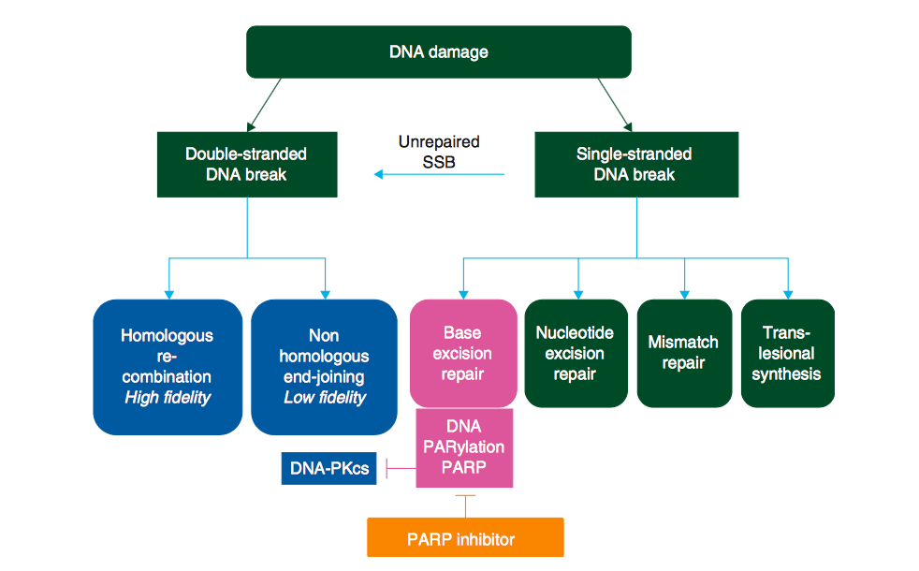

Slide 27
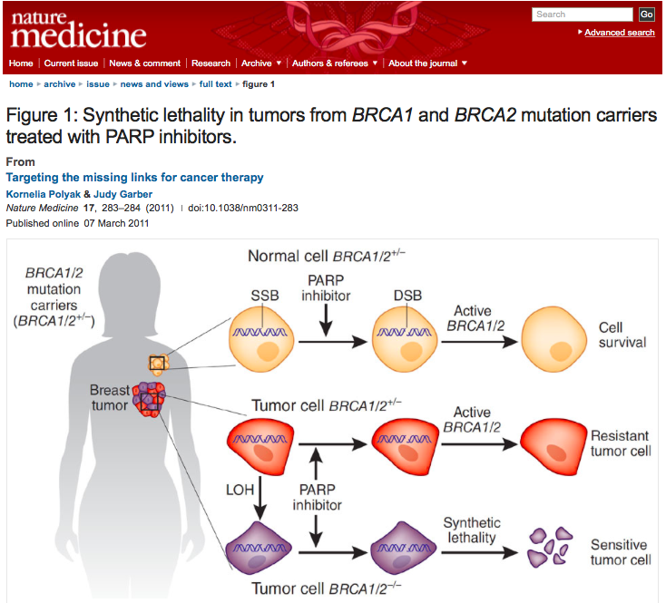

Slide 28
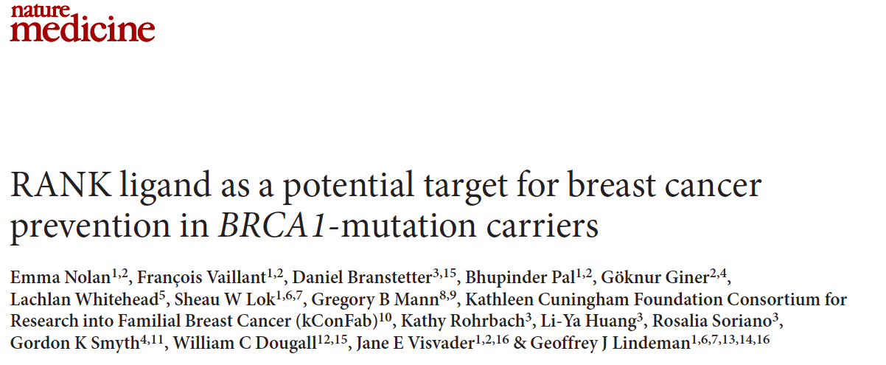
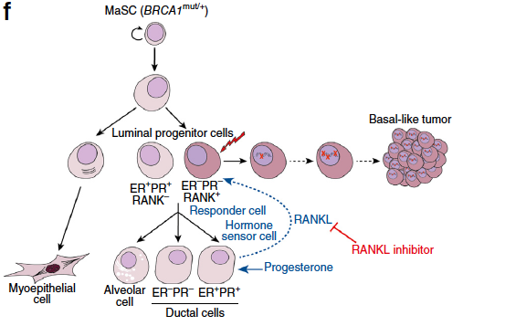
Inhibition of RANKL signaling by treatment with denosumab in three-dimensional breast organoids derived from pre-neoplastic BRCA1mut/+ tissue attenuated progesterone-induced proliferation.

Slide 29
New challenges in BRCA1/2 testing
Selection criteria
De novo mutations
Pre-surgery test
Variant classification

Slide 30
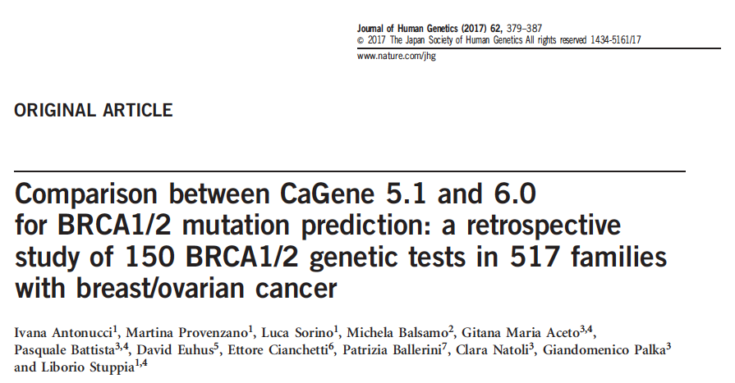
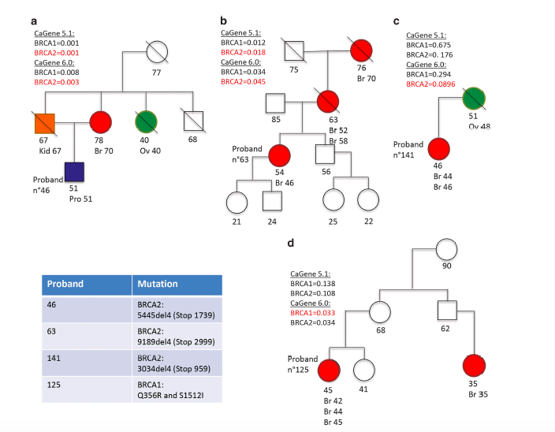

Slide 31
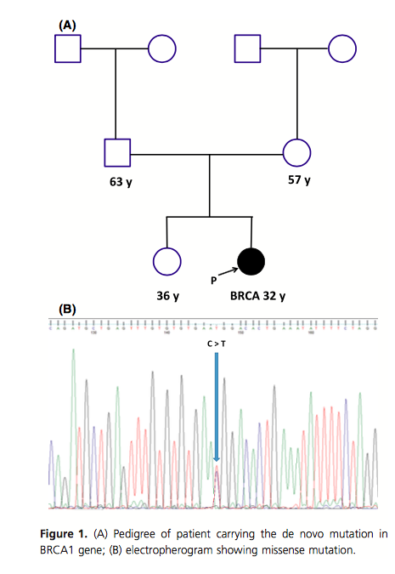

Slide 32
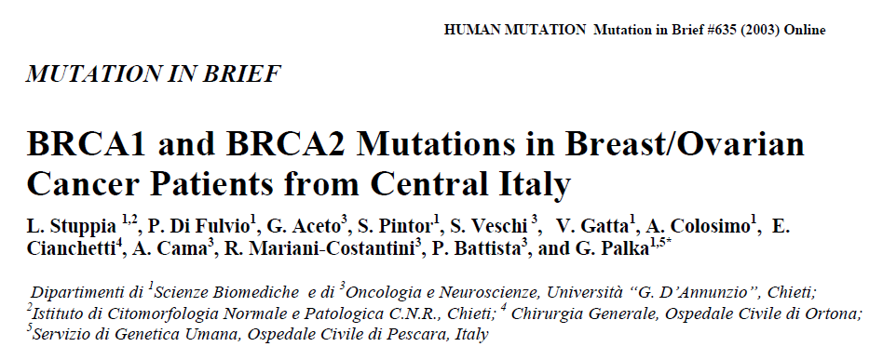
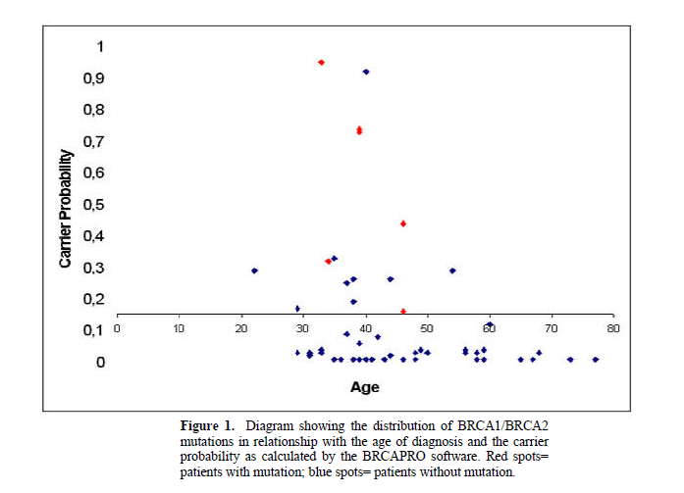
DR: 36,8% in pazienti con CP>10%

Slide 33
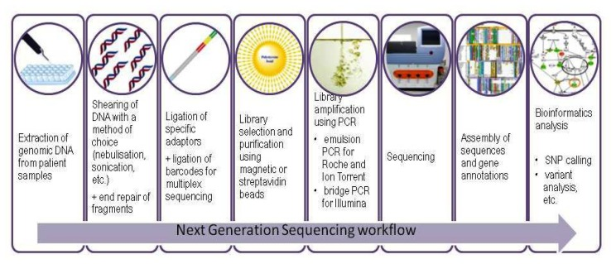
From Sanger to NGS Sequencing: Breast/ovarian cancer panels

Slide 34
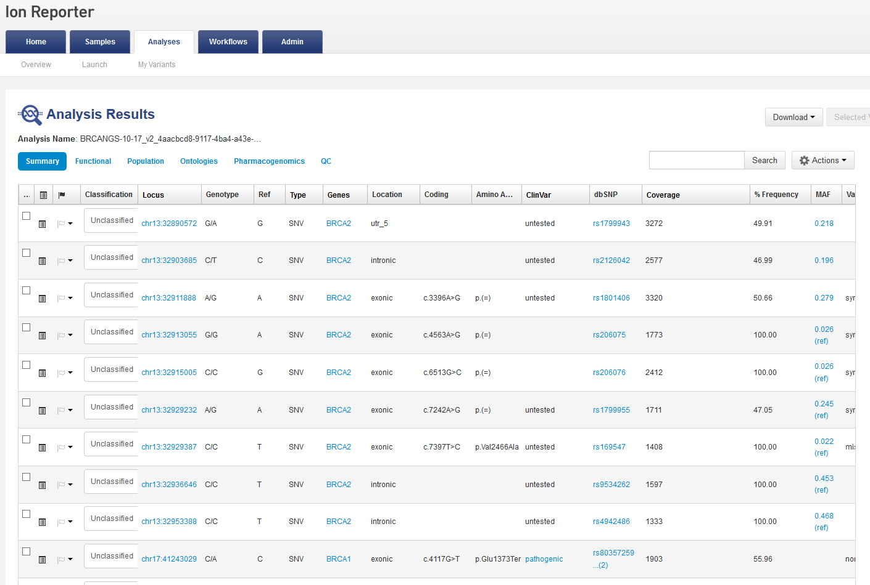
BRCA1 c.4117 G>T p.Glu1373Ter rs80357259

Slide 36
Beyond BRCA1 and BRCA2

Slide 37
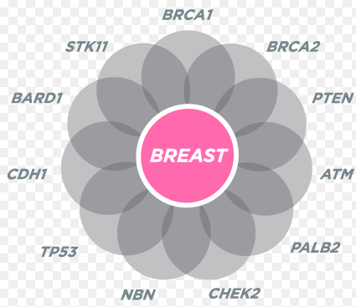

Slide 38
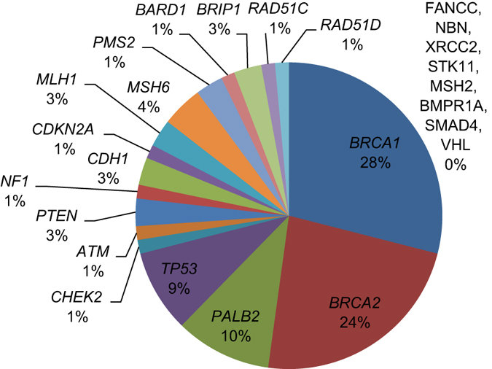

Slide 39
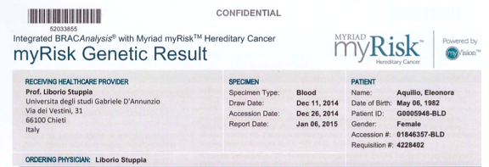

Slide 40
Who should undergo extended test?
Very high BRCAPro risk patients without BRCA1/2 mutations
Patients with multiple familiar cases and BRCAPro values <10
Very young patients without familiar cases (BRCAPro <10)

Slide 41
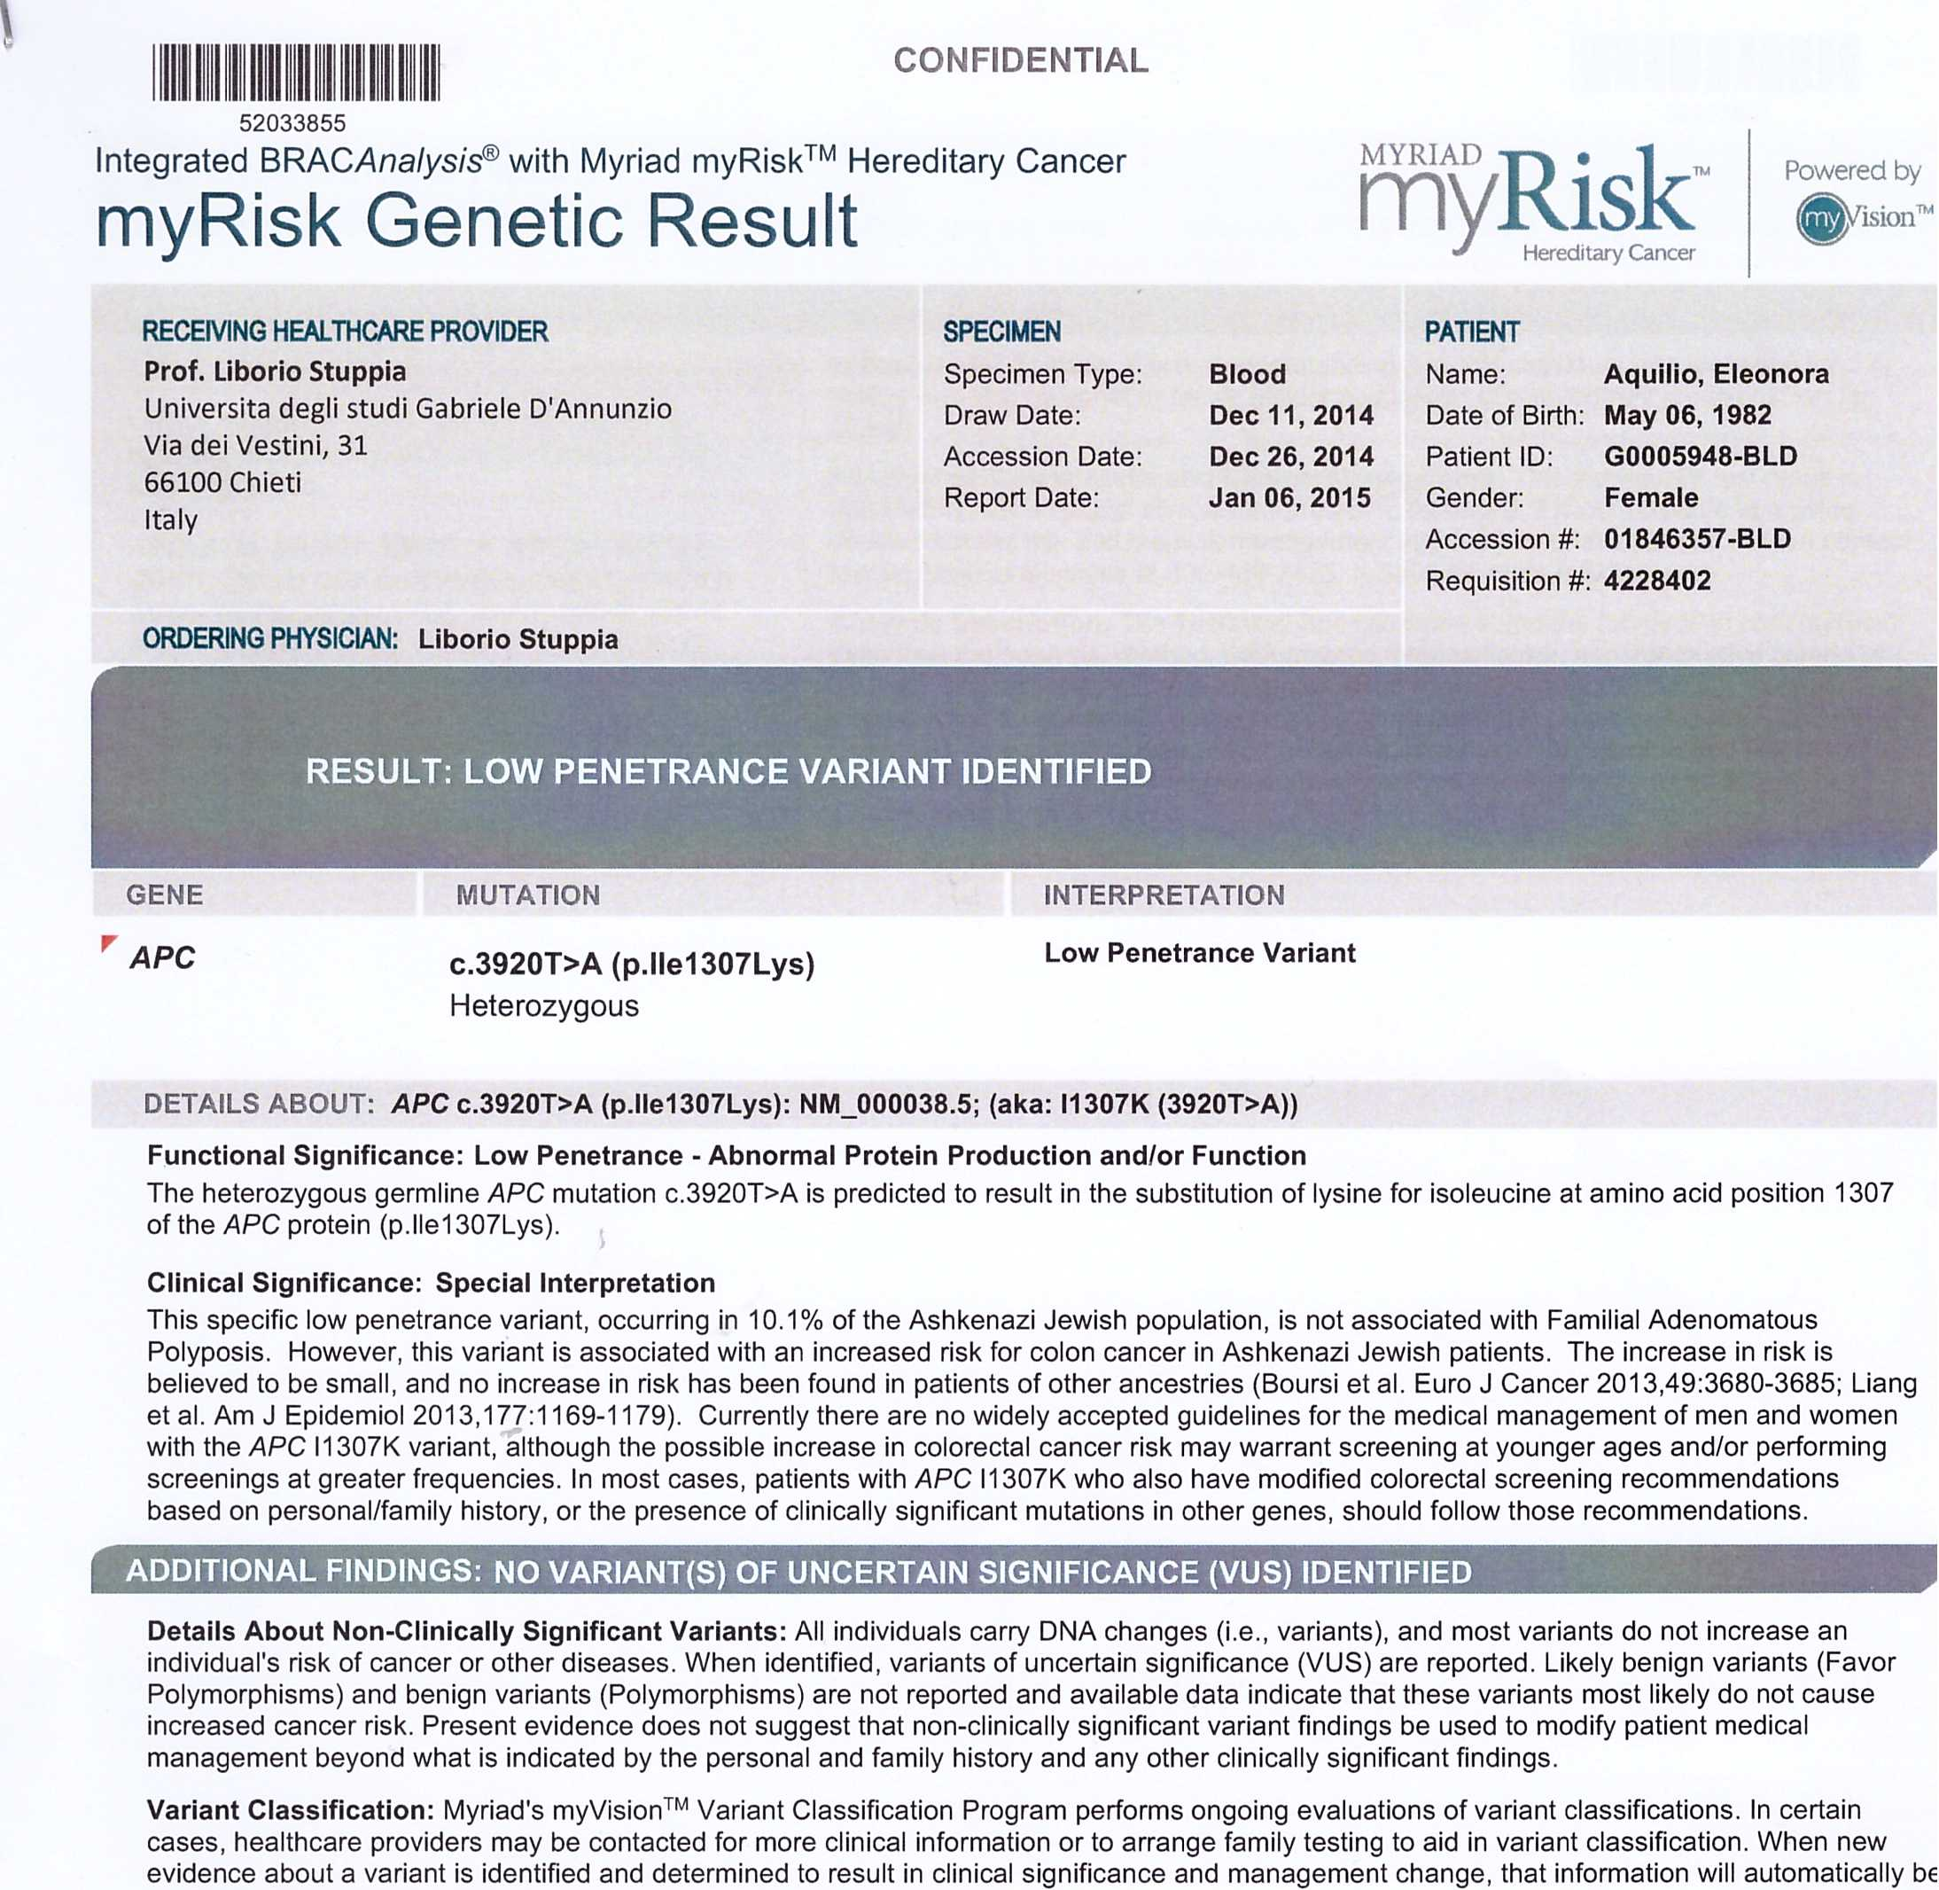
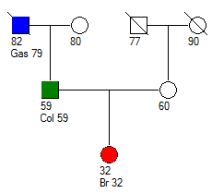
CaGene 5.1:
BRCA1: 0.014
BRCA2: 0.008
CaGene 6.0:
BRCA1: 0.012
BRCA2: 0.007
APC gene mutation:
p. Ile 1307 Lys
Normale

Slide 42
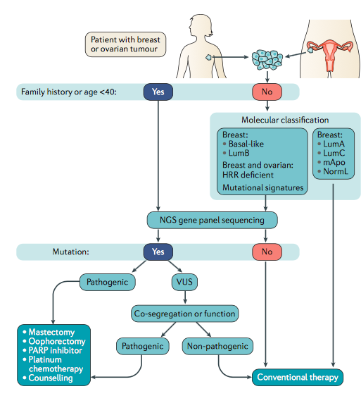
NATURE REVIEWS | CANCER, 2016

Slide 43
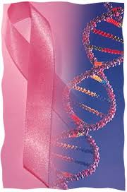
Thanks to:
Ivana Antonucci
Luca Sorino
- Giandomenico Palka

