Slide 1

News in molecular biology of bone metastases
Daniele Santini
Università Campus Bio-Medico
Roma

Slide 2
My disclosures
Research grants from: Amgen, Janssen, Roche
Advisory boards from: Amgen, Janssen, Merck, Roche, Bayer, Novartis, Bristol

Slide 3
1. High bone turnover increases the risk of new bone metastases and of skeletal progression

Slide 4
ELEVATO TURNOVER OSSEO
(eta’ –livelli vit D – Terapia ormonale adiuvante- metastasi)
CTIBL
FRAGILITÀ
PROGRESSIONE OSSEA
SRE
Nuova metastasi
Homing delle cellule tumorali
Crescita della metastasi ossea
Perdita ossea
CTX
NTX
P1NP
SDF-1
TGF b
PDGF
IGF-1
OP
CTX
NTX
P1NP
SDF-1
TGF b
PDGF
OP
CTX
NTX
P1NP
SDF-1
TGF b
PDGF
OP
Scheletro non metastatico Nicchia premetastatica Metastasi ossea
Bertoldo F

Slide 5

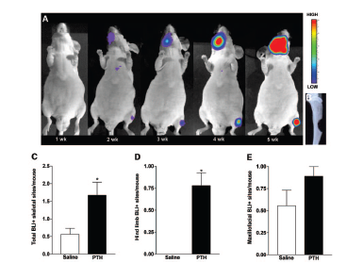
Schnieder A Endocrinology 2005

Slide 6
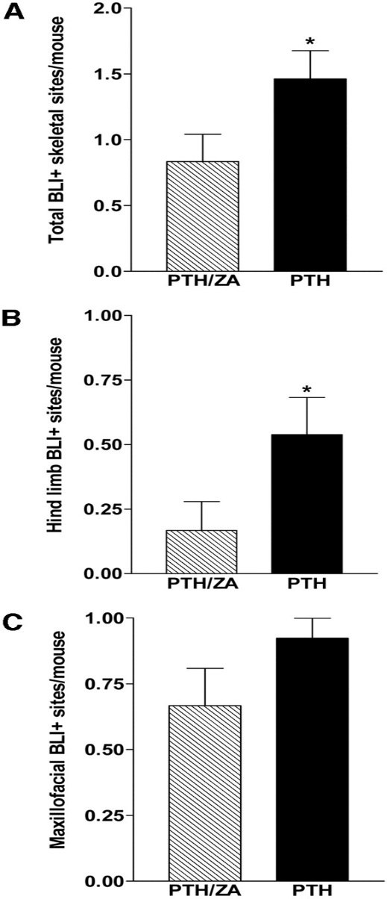
Schnieder A Endocrinology 2005

Slide 7

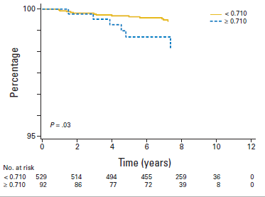
Pretreatment serum CTX (>0.710,) preditcs bone only relaps
Lipton A J Clin Oncol 2011

Slide 8
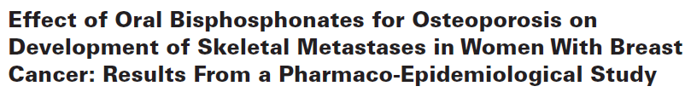
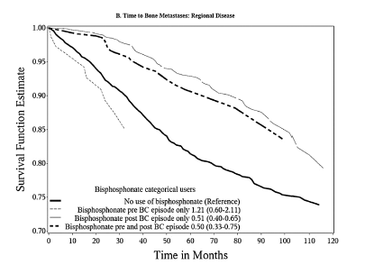
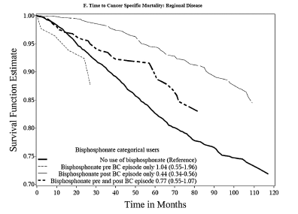
21.6664 BC pt 10 yr follow up
TIME TO BONE METASTASIS
TIME TO CANCER SPECIFIC MORTALITY
Kremer R et al JNCI 2014

Slide 9
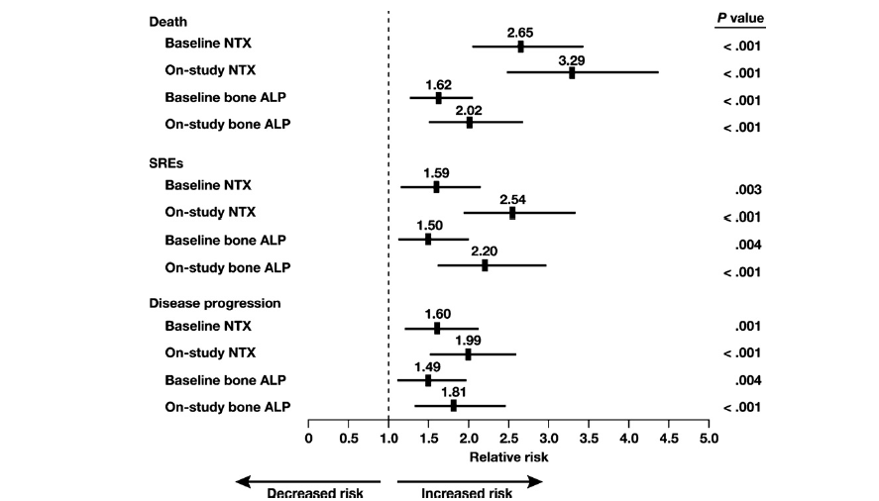


CORRELATIONS BETWEEN BONE TURNOVER AND CLINICAL OUTCOME
IN PATIENTS WITH BONE METASTASES FROM SOLID TUMORS (NO BPs)

Slide 10
2. Osteocytes have an important role in bone turnover regulation and in the metastatization process

Slide 11
Functions of osteocytes
Kowgawa M J Bone Miner Res 2013
Dallas SL et al. Endocr Rev, 2013

Slide 12
Osteocytic Connexin hemichannel suppress breast cancer growth and bone metastases
Zhou JZ et al, Oncogene, 2016

Slide 13
3. Osteobasts have an important role in the bone homing of cancer cells

Slide 14
Endothelial cell
OSTEOCLAST PRECURSOR
OCL
Receptors
VCAM-1
E-selectin
N-cadherin
Sinusoid in bone
metaphysis
CXCR4
RANK
BMP-R Ia,Ib,II
ICAM-1
αvβ3, αvβ2
TGFβ-RI-II
IL-1
IL-6
IL-11
PGE
SDF-1
RANKL
PTH
TNFα
ΙL-6
TGFb
BMPs
OPN
BSP
Activated osteoblast
Lining cell
Osteoclast
Bone
Bertoldo F, Santini D .Textbook of Osteoncology 2009
Notes:
Ci sono vari sistemi in cui gli osteoblasti attivano gli osteoclasti. Uno è anche una molecola di adesione che richiama immunociti dal circolo e il rank è importante per attivare gli osteoclasti.
Ma il rank L è anche un potente chemiotattico, per gli osteoclasti e per le cellule neoplastiche. Le cellule neoplastiche sono in grado di esprimere, tra le varie cose, anche il rank, esattamente come i precursori degli osteoclasti. Dunque, una condizione di osso che esprima tanto rank porterà ad una condizione favorente la penetrazione e l’homing delle cellule neoplastiche.
Il bersaglio rank L diventa importante non solo nel bloccare l’attività osteoclastica attiva ma anche nel prevenire la penetrazione delle cellule neoplastiche con la determinazione della nicchia pre-metastatica.

Slide 15
Endothelial cell
Cancer Cell
Cancer Cell
Receptors
VCAM-1
E-selectin
N-cadherin
Sinusoid in bone
metaphysis
CXCR4
RANK
PLT
BMP-R Ia,Ib,II
ICAM-1
αvβ3, αvβ2
TGFβ-RI-II
IL-1
IL-6
IL-11
PGE
VEGF
SDF-1
PTHrP
TNFa
PDGF
CSR
RANKL
PTH
TNFα
ΙL-6
TGFb
BMPs
OPN
BSP
Activated osteoblast
Lining cell
Osteoclast
Bone
Bertoldo F, Textbook of Osteoncology 2009
Notes:
And engage the same molecular pathway that osteoclast precursor and actve osteclasts

Slide 16
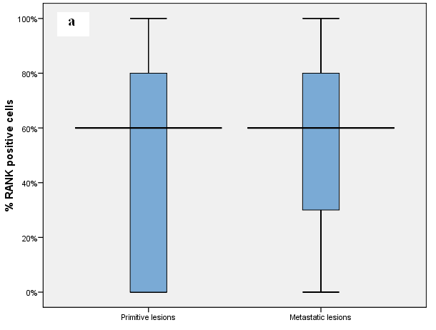
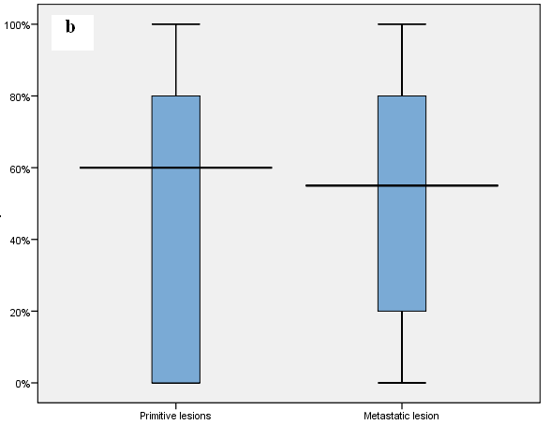
RANK is expressed in humans by cancer cells both at primary tumor and at bone metastases
PRIMITIVI
METASTASI
PRIMITIVI
METASTASI
(p= .194)
(p= .528)
Relantionships primary-bone metastases (all samples)
b. Relantionships primary-bone metastases (in the same patients)
Santini D. J Cell Phys, 2010
Notes:
16
In animal models with intracardiac injection of human MDA-231 breast cancer cells, the ability of OPG to inhibit tumor-induced osteoclastogenesis, and osteolysis was evaluated.¹ The injection of MDA-231 breast cancer cells into the left ventricle of nude mice resulted in experimental bone metastases that were associated with osteolytic lesions. Mice were treated with OPG (at the indicated doses, 3 times per week for 4 weeks) starting immediately after tumor cell inoculation. RANK Ligand inhibition with OPG dose-dependently decreased the number and area of radiographically evident lytic bone lesions.¹ OPG treatment at the highest doses completely prevented the radiographic appearance of osteolytic lesions (right radiograph). In the animals treated with OPG, note the increased radio-opacity of the tibial and femoral metaphyseal growth plate region associated with OPG treatment. This increase is a normal pharmacological response to OPG treatment by growing mice, whereby resorption of the secondary spongiosa is inhibited, and trabecular bone accumulates. RANK Ligand inhibition was also observed to significantly decrease the number of osteoclasts within the tumor, with a maximal reduction of 90% at 3 mg/kg (P < 0.01). In this model of experimental bone metastases, RANK Ligand inhibition was associated with significant reductions in both the frequency and the size of skeletal tumor nests and in preventing tumor-associated osteolysis.¹
Morony S, et al. Osteoprotegerin Inhibits Osteolysis and Decreases Skeletal Tumor Burden in Syngeneic and Nude Mouse Models of Experimental Bone Metastasis. Cancer Res. 2001;61:4432-6.

Slide 17
RANK expression in primary tumours is associated with bone metastasis occurrence in breast cancer patients
Low RANK expression was associated with better disease outcomes vs high RANK expression in human breast cancer patients
Disease-free survival
Overall survival
100
RANK low
100
RANK low
RANK high
RANK high
80
80
60
60
Disease-free survival (%)
Overall survival (%)
40
HR, 0.675
(95% CI, 0.449−1.015)
Log-rank P = 0.059
40
HR, 0.535
(95% CI, 0.338−0.848)
Log-rank P = 0.008
20
20
0
0
0
5
10
15
20
0
5
10
15
20
Years
Years
Santini D, et al. PLoS One 2011;6:e19234.
Notes:
Analysis of 295 primary breast cancer tissues from the Netherlands Cancer Institute (NKI) microarray dataset showed that patients with low RANK expression had better disease-free survival (P = 0.059) and statistically significantly improved overall survival (P = 0.0078) compared with patients with high RANK expression.¹
Reference
Santini D, Schiavon G, Vincenzi B, et al. Receptor activator of NF-kB (RANK) expression in primary tumors associates with bone metastasis occurrence in breast cancer patients. PLoS One 2011;6:e19234.
17

Slide 18
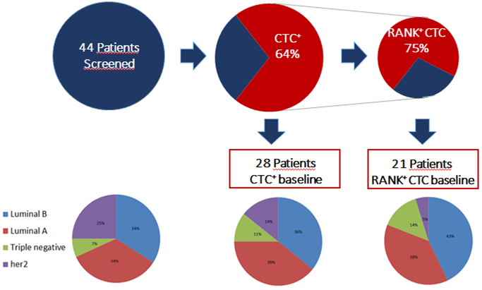
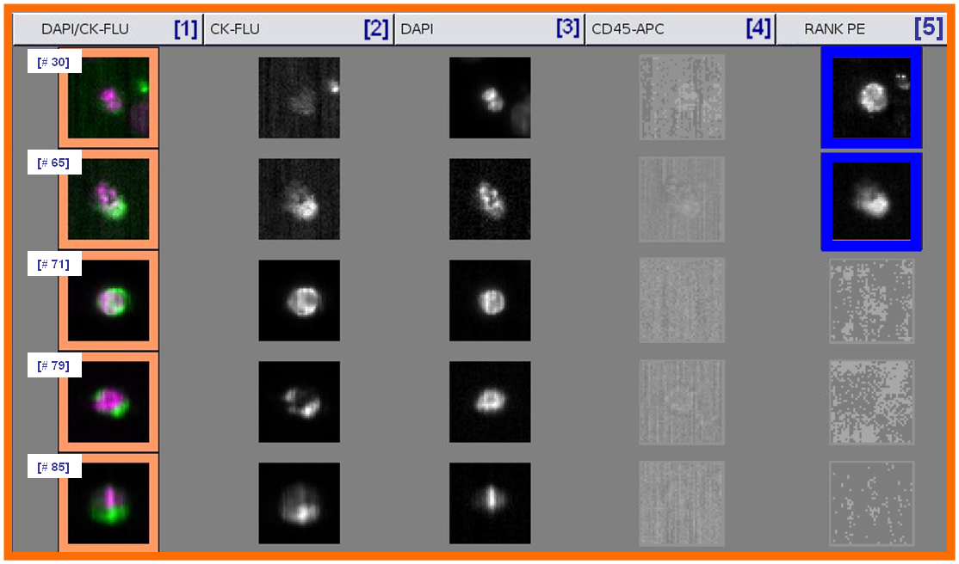
RANK is expressed on CTC
7
21
CTC at baseline
RANK+ CTC at baseline
Santini D et al.Unpublished data
Notes:
CTCs immunostaining: analysis of five rare cells (event #: 30, 65, 71, 79, 85) in a blood sample of a metastatic breast cancer patient (MBC) using an Analyzer II device. Horizontally, the photos show the same cell, imaged separately, and stained for different fluorophores: [1] combination of DAPI (violet, nucleated cells) and CK-FLU (green, epithelial marker), [2] CK-FLU only; [3] DAPI only, [4] CD45-APC only (specificity control), [5] RANK-PE only (osteotropic marker). The orange squares indicate positively stained cells both for DAPI and CK, blu squares show RANK positive cells; both dim and strong CK staining are presented. Based on RANK staining profile (sufficient signal relative to background), event # 30 and # 65 are classified as RANK-positive CTCs.

Slide 19
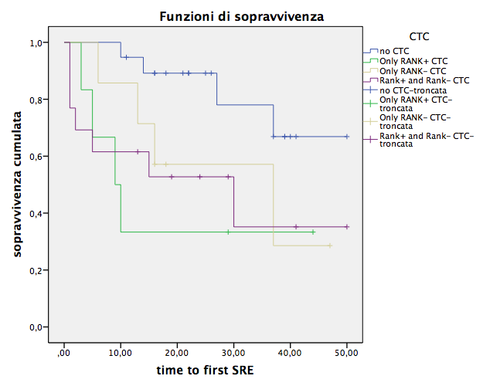
Time to first SRE according to CTC Rank+/Rank-
at baseline (day 0)
41 m
29 m
25 m
19 m
p = 0,058
Santini D et al.Unpublished data

Slide 20
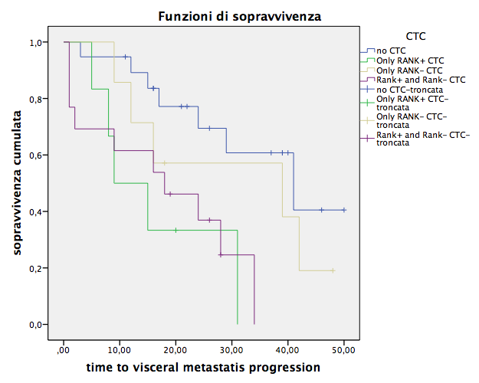
Time to visceral progression according with CTC Rank+\Rank- at baseline (day 0)
39 mesi
41 mesi
18 mesi
9 mesi
p = 0,011
Santini D et al.Unpublished data

Slide 21
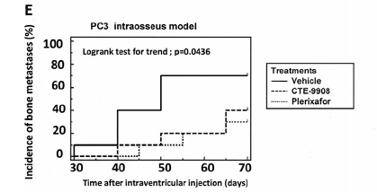
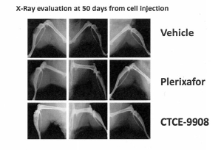
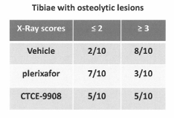
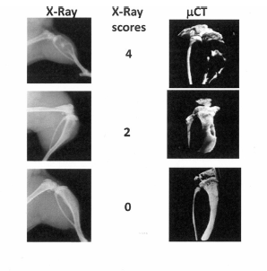

CXCR4 pharmacological Inhibition Reduces
Bone Metastatic Burden
Intraventricular injection
Intratibial injection of PC3 cells

Slide 22
4. Role of bone microenvironment bone cells

Slide 23
Interactions between cancer cells and bone microenvironment cells
Modified from F. Bertoldo
VEGF
FGF
IL-6
IGF-1
MMP-2
MMP-9
Cancer cells and CSCs
Cancer
CEP, CEC
Periferal circulation
Sinusoidal
endothelial
cells
Macrophages
DTCs
T cells
VEGF
FGF
IGF-1
TGF-β
SDF
Opn
Integrin
VEGF
FGF
IL-6
IGF-1
Bone marrow niche
MSC
HSC
PTHrP
TNF-α
PDGF
VEGF
Stromal cells
SDF
Opn
RANKL
TGF-β
BMPs
OPN
BSP
MMP-2
MMP-9
Bone niche
OB
Osteoblast
Lining cell
Osteoblast
Osteoclast
23
Notes:
23

Slide 24
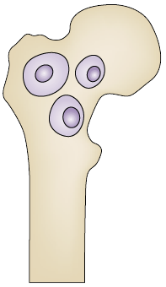
The cells of preneoplastic niche
Circulating tumor cells (CTCs)
Disseminated tumor cells (DTCs)
Osteoclasts and macrophages
Osteoblasts
Bone marrow stromal cells
Circulating endothelial progenitors (CEPs) and cells (CECs)
Gamma/delta (γδ) and alfa/beta (α/β) T cells
Mesenchimal stem cells (MSCs)
HSC VEGFR1⁺ or 2⁺
Cancer stem cells (CSCs)
Osteocytes
Cancer cell niche
Abbreviations: HSC VEGFR1⁺ or 2⁺, hematopoietic stem cell vascular endothelial growth factor receptor 1-positive or 2-positive.

Slide 25
5. Role of preneopastic osteoblastic niche

Slide 26
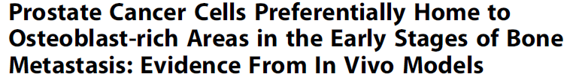
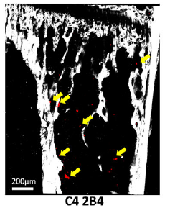
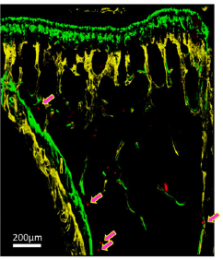
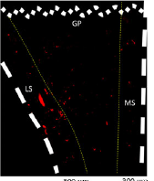
Wang N J Bone Miner Res 2015

Slide 27
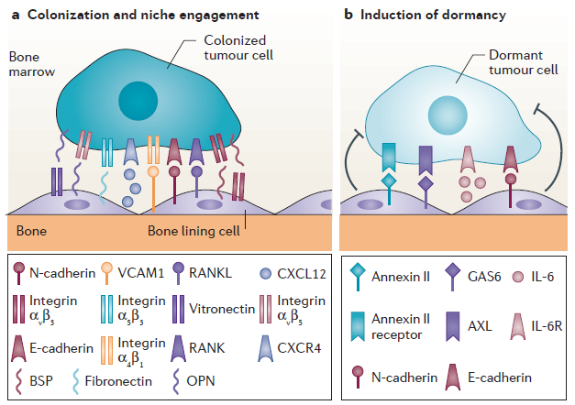
Osteoblasts regulate the cancer cell fatus in the preneoplastic niche
Bone metastasis: the importance of the neighbourhood. NATURE REVIEWS. 2016
Notes:
Tumour cells use a repertoire of molecules that are important in colonizing bone and engaging in a niche in bone (panel a). These include C‑X‑C motif chemokine receptor 4 (CXCR4), integrin α4β1, receptor activator of nuclear factor‑κB (RANK), integrins αvβ5 and α5β3, osteopontin (OPN), bone sialoprotein (BSP) and E‑cadherin, which bind to their cognate ligands on cells in the niche: C‑X‑C motif chemokine ligand 12 (CXCL12), vascular cell adhesion molecule 1 (VCAM1), RANK ligand (RANKL), OPN, BSP, fibronectin, vitronectin, integrin αvβ3 and N‑cadherin, respectively. The engagement of cells in the niche leads to the expression of genes that can induce dormancy (panel b). These include the annexin II receptor and AXL on tumour cells and their ligands annexin II and growth arrest-specific protein 6 (GAS6) on bone lining cells. Local cytokines and growth factors, for example interleukin‑6 (IL‑6), may also control dormancy by binding IL‑6 receptor (IL‑6R) on tumour cells.

Slide 28
The osteobastic preneoplastic niche
Bone Marrow Niche
N cadherin
β1 integrin
PTH/PTHrp
PTH/PTHrp
CXCR4
NOTCH
OPN
Jagged 1
SDF-1
PTH/PTHrp R1
RANNKL
Wnt/βcatenin
RANK
MMP9
CATHEPSIN K
Endosteal niche
OSTEAL Macrophages
BONE
Ratajczak MZ Leukemia 2010; Kollet Ot Nature 2006; Calvi LM Ann NY Acad Sci 2006
Notes:
Osteblast manage cancer stem cell as hsc: CSC are tightly linkedto OB trough moluculR LINK: AND THIS ALLOWS TO CSC TO RENEWAL WITHOUT PROLIFERATE AND DIFFERENTIATE

Slide 29
6. The vicious cycle in the “modern era”

Slide 30


IGF1
TGFβ−1
IGF1
TGFβ−1
Osteocalcina
ALP
TGF-β1
ET1
uPA
>RANKL/<OPG
PTHrP
IL-6
OPG
Wnt DDK-1
Bertoldo F, Santini D Textbook of Osteoncology 2010

Slide 31
7. Our “in vitro bone models”
Investigating the bone effects of new drugs

Slide 32
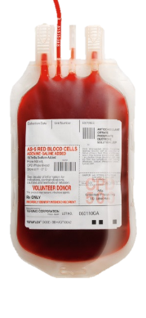
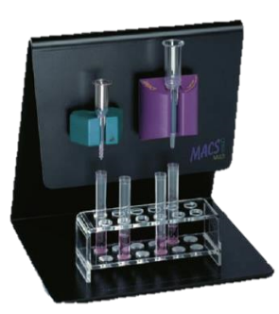
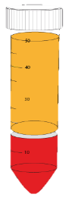
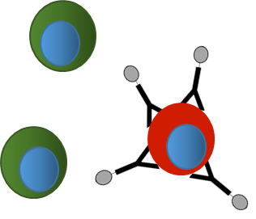
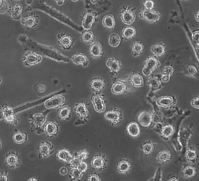
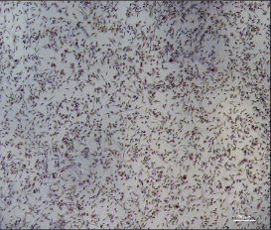
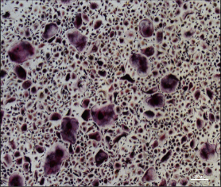
IN-VITRO MODELS OF BONE CELLS
PRIMARY HUMAN OSTEOCLASTS
CD14 + CELLS
LABELING
WITH MICROBEADS
PBMCs
PURIFICATION
MAGNETIC
ISOLATION
SEEDING
DIFFERENTIATION (TRAP ASSAY)
ACTIVITY (OSTEOASSAY)
UNDIFFERENTIATED
DIFFERENTIATED
UNDIFFERENTIATED
DIFFERENTIATED
BONE LAYER
RESORBED AREA

Slide 33
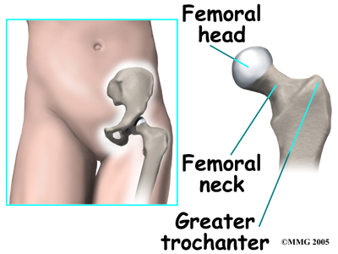
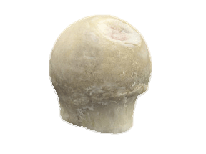
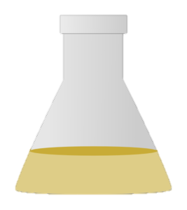
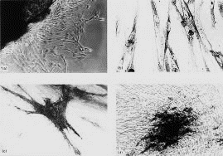




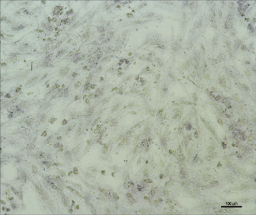
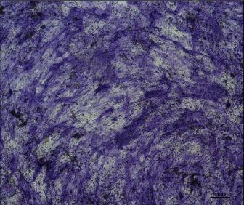
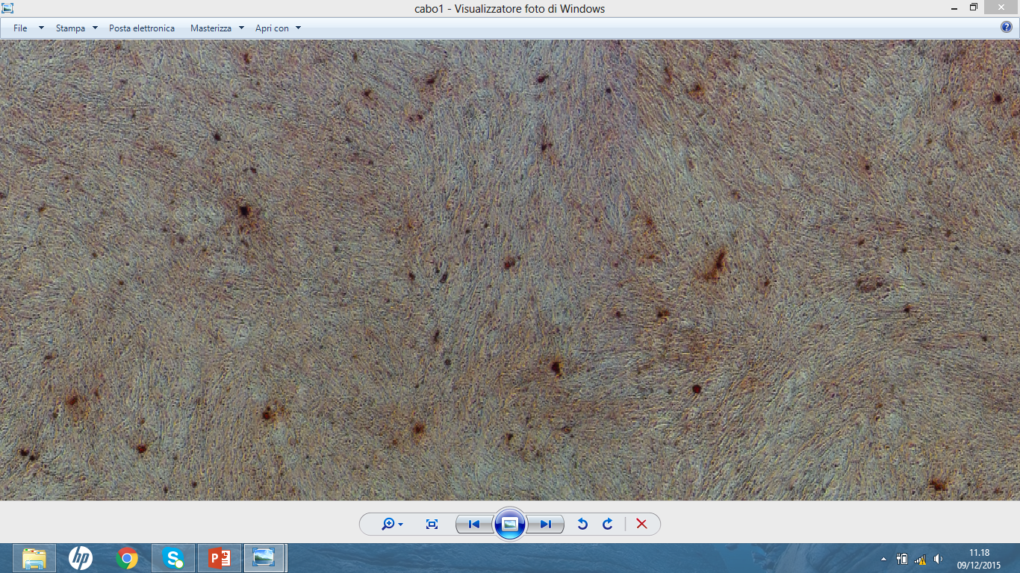
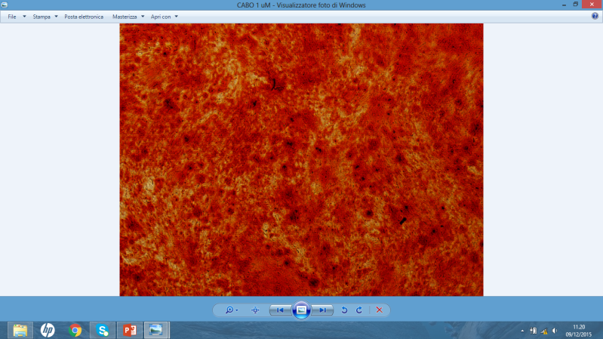
IN-VITRO MODELS OF BONE CELLS
PRIMARY HUMAN OSTEOBLASTS
CHEMICAL
DIGESTION
CELLULAR
OUTGROWN
SEEDING
DIFFERENTIATION (ALP ASSAY)
ACTIVITY
(ALIZARIN RED ASSAY)
UNDIFFERENTIATED
DIFFERENTIATED
UNDIFFERENTIATED
DIFFERENTIATED

Slide 34
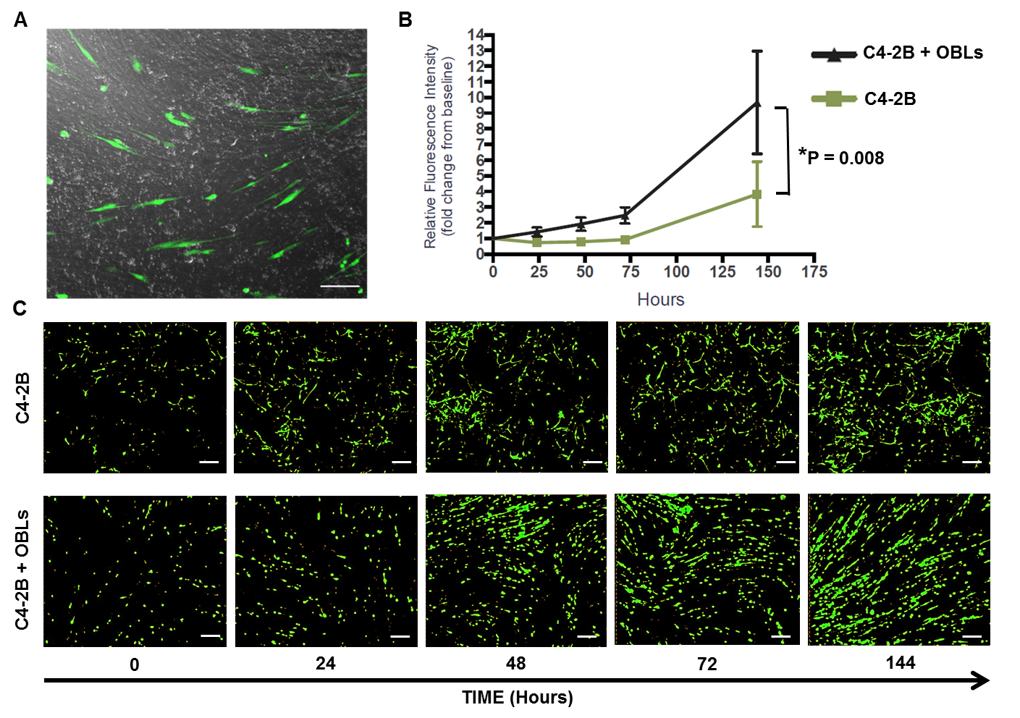
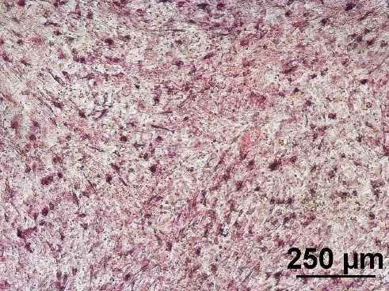
IN-VITRO COCOLTURE SYSTEMS
Direct cocultures:
Osteoblasts/ Osteoclasts
Osteoblasts/ Cancer cells
Osteoclasts
Prostate cancer cell
Osteoblasts
Osteoblasts

Slide 35
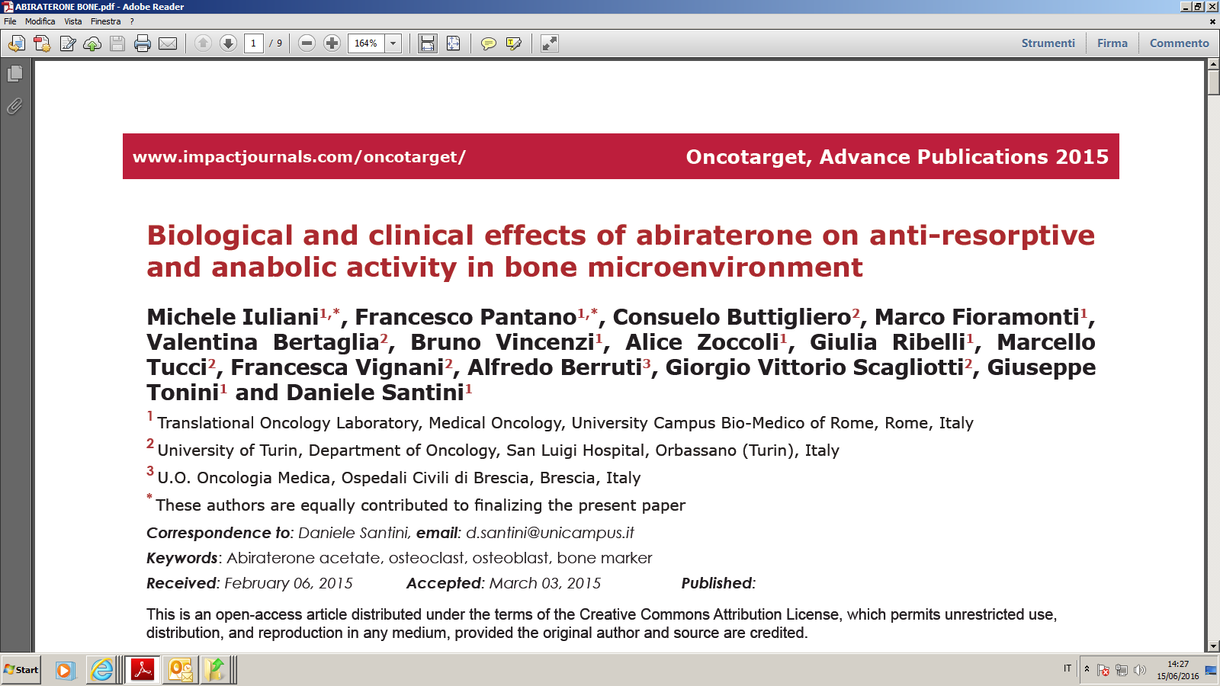

Slide 36
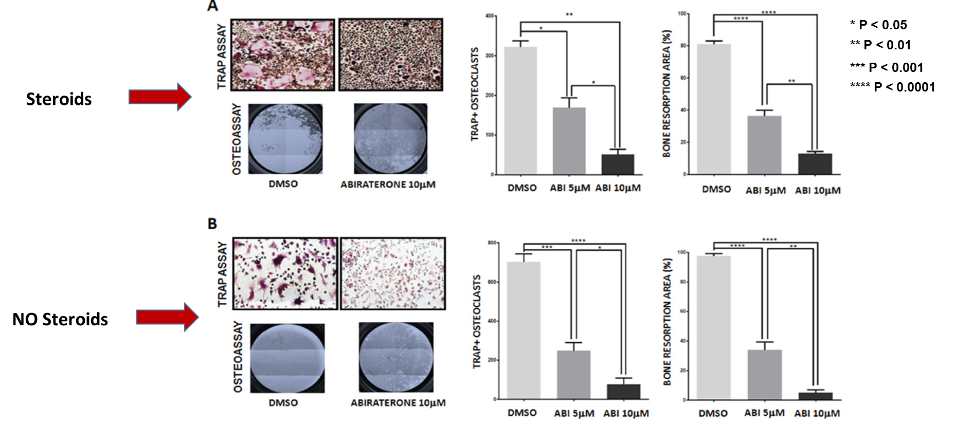
Abiraterone treatment inhibits osteoclast differentiation and activity both in presence and absence of steroids

Slide 37
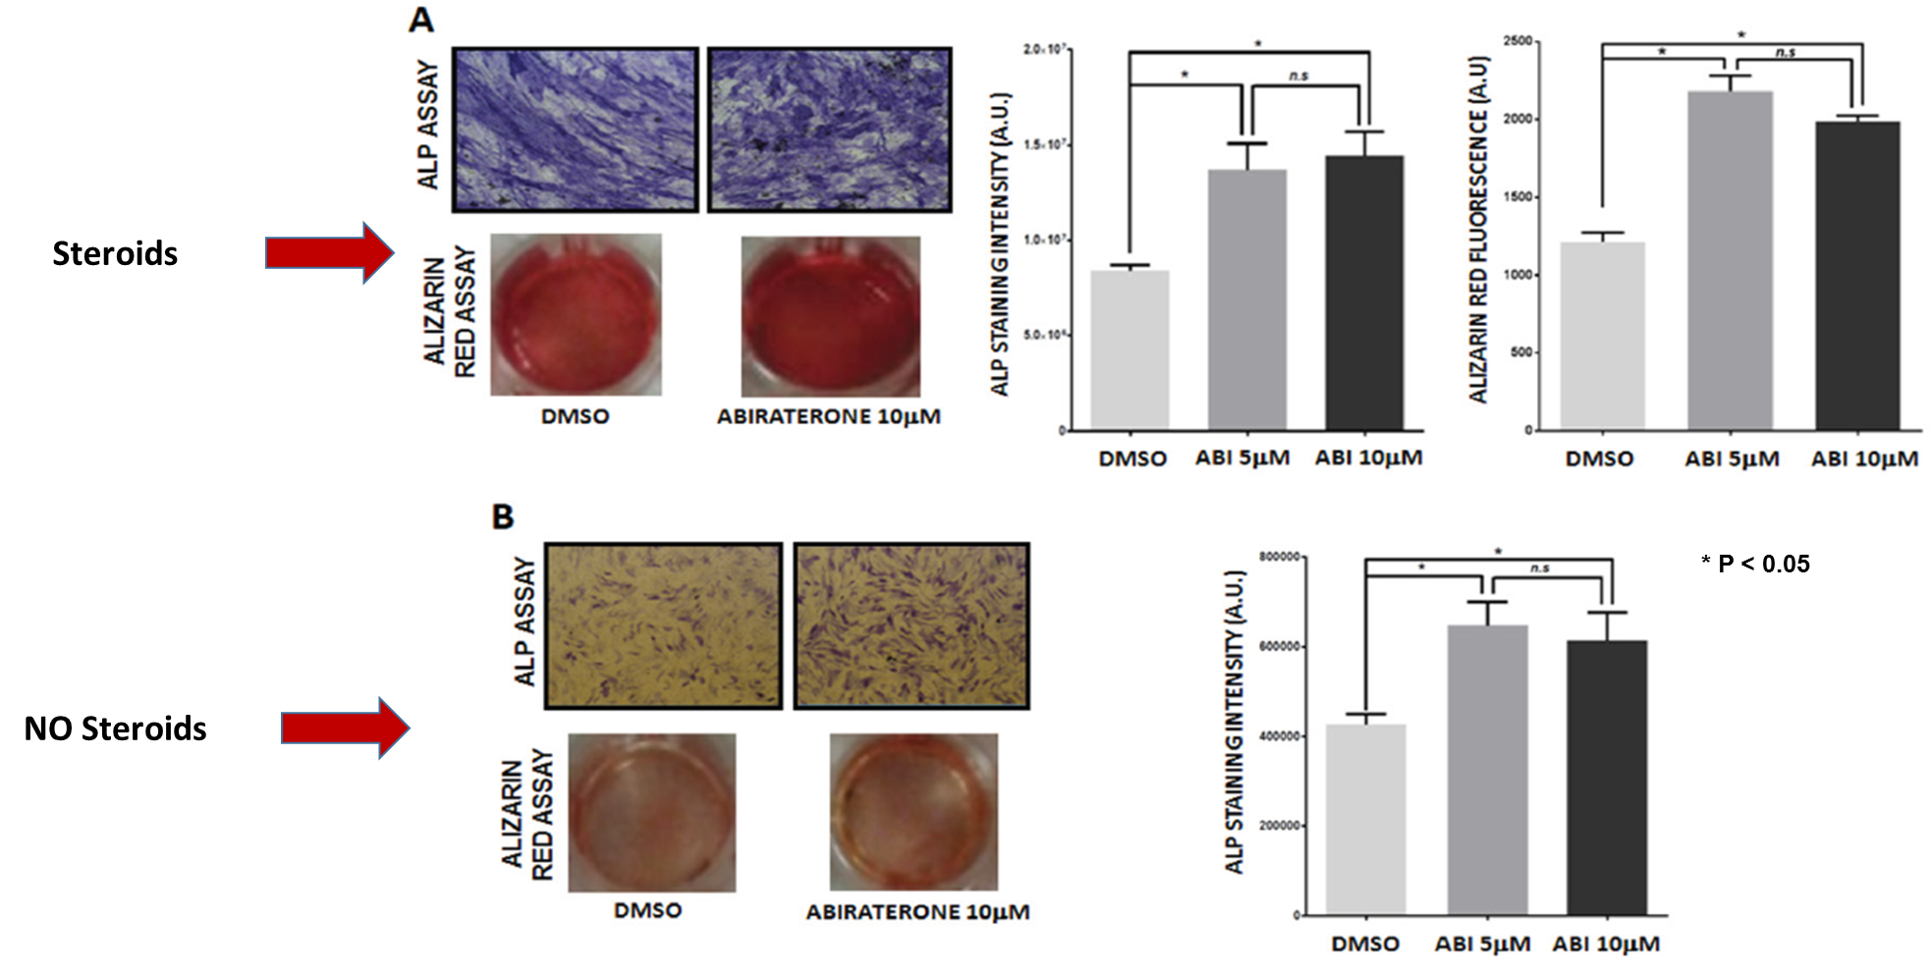
Abiraterone treatment increases osteoblast differentiation and activity both in presence and absence of steroids

Slide 38
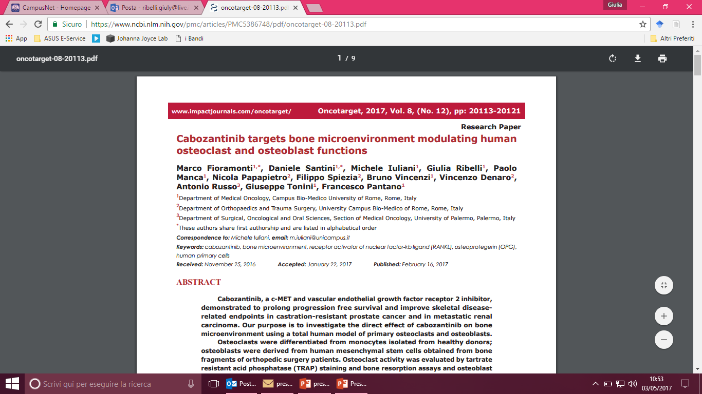

Slide 39
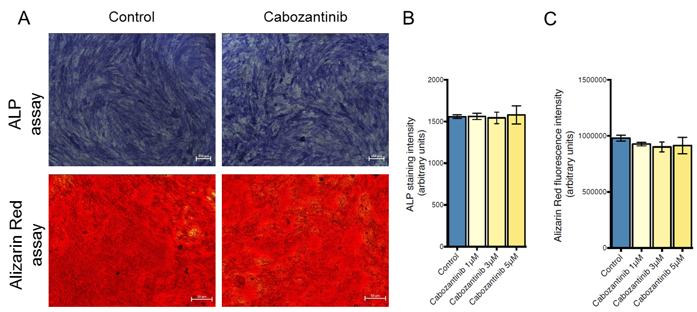
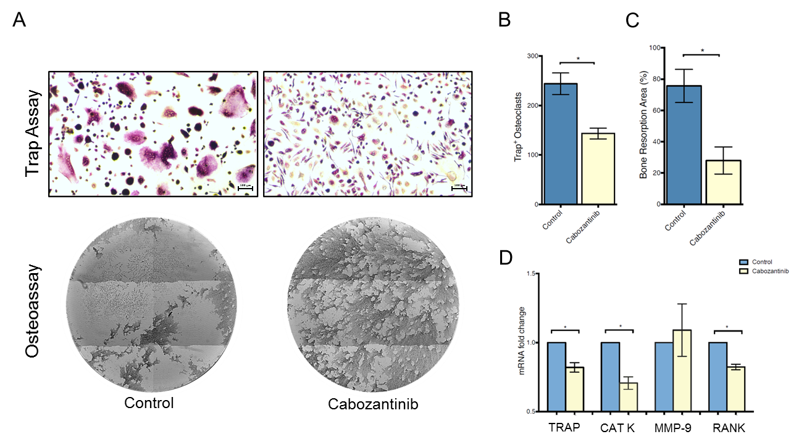
* P < 0.05
Cabozantinib inhibits osteoclast differentiation and activity
Cabozantinib does not affect osteoblast differentiation and activity

Slide 40
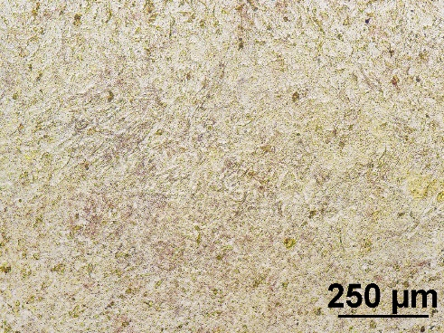
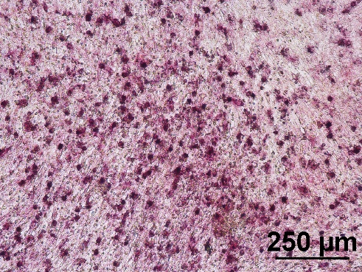
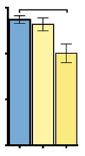
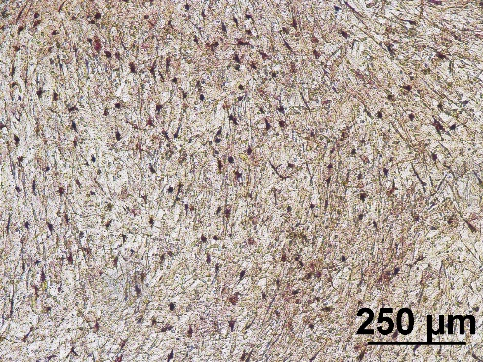
A
B
E
300
*
200
Trap+ Osteoclasts
C
D
100
0
control
cabozantinib 3μM
cabozantinib 5μM
CABOZANTINIB TREATED OSTEOBLASTS EFFECT OSTEOCLASTS DIFFERENTIATION

Slide 41
….in summary
High bone turnover increases the risk of new bone metastases and of skeletal progression
The osteocytes have an important role in bone turnover regulation and in the metastatization process
The osteoblasts have an important role in the bone homing of cancer cells
The cells of bone microenvironment interact with the cancer cells
The importance of preneoplastic osteoblastic niche
The vicious cycle in the “modern era”
New bone effects for new antitumoral drugs

Slide 42
I believe in a “bone revolution”
We moved from the “Seed and Soil” to the preneoplastic niche “era”: the cancer cells know where to go before homing bone and how to go away from the bone
We moved from the osteoclast protagonist to multiple cells interactions in bone microenviroment: new cells, new targets, new drugs
We moved from single molecular pathway to multiple molecular interactions in bone microenviroment: new pathways, new targets, new drugs

Slide 43
Thank you for your Attention

