Slide 1


Breast cancer Controversies
Triple negative disease
Andrea Michelotti
U.O. Oncologia Medica I
Ospedale S. Chiara
Pisa
“in”

Slide 2
Triple Negative BC (TNBC)
Defined as negative for ER PgR & Her2 receptors
Rapresents about 15% of all BC
More likely to present in younger women (< 40 yrs old)
or in women Africa-America or Hispanic background
May be associated with having an inherited mutation in
BRCA ½ genes
TNBC and basal-like breast cancer overlap but are not identical
TNBC is generally initially chemosensitive but aggressive
with a characteristic relapse pattern

Slide 3
Clinical Characteristic of Metastatic TNBC
No consistent association with nodal status or stage
Relapse pattern
  Higher risk
  Early timing
  Sites differ from luminal:
    CNS 46%
0.35
0.30
Other (290 of 1421)
Triple negative (61 of 180)
0.25
0.20
HR
0.15
0.10
0.05
0
0
1
2
3
4
5
6
7
8
9
10
Yrs After First Surgery
 | n | Bone, % | Soft Tissue, % | Viscera, %
TNBC | 79 | 13 | 13 | 74
ER+ | 123 | 39 | 7 | 54
HER2+ | 78 | 7 | 12 | 81
Liedtke C, et al. J Clin Oncol. 2008;26:1275-1281. Lin NU, et al. Cancer. 2008;113:2638-2645.

Slide 4
Each subgroup of breast cancer patients has a different prognosis
Overall survival¹
1.0
ErbB2–/ER+
ErbB2+/ER+
0.8
ErbB2–/ER–
ErbB2+/ER–
0.6
Probability
0.4
0.2
N=72
0
0
24
48
72
96
Months
1. Sorlie et al. Proc Natl Acad Sci U S A 2003; 100: 8418–23; 2. Brenton et al. J Clin Oncol 2005; 23: 7350–60; 3. Onitilo et al. Clin Med Res 2009; 7(1-2): 4–13; 4. Zarcone et al. Ann N Y Acad Sci 2009; 1155: 222–6

Slide 5
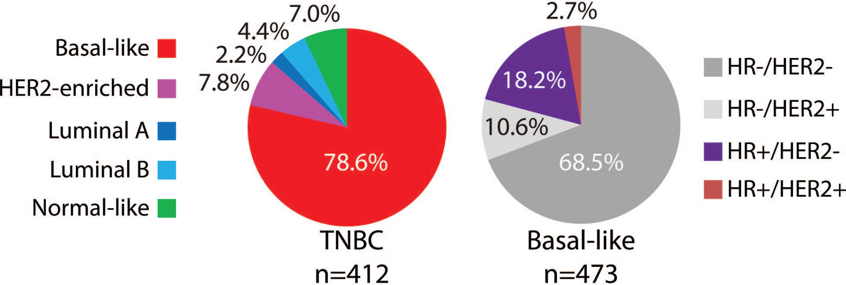
TheOncologist2013;18:123–133 www.TheOncologist.com

Slide 6
BL1 Basal Like 1
BL2 Basal Like 2
IM Immunomodulatory
LAR Luminal Androgen receptor
M Mesenchymal
MSL Mesenchymal stem-cell like
UNC Unknown
Lehman et al - J Clin Invest 2011
TheOncologist2016;21:1050–1062 www.TheOncologist.com

Slide 7
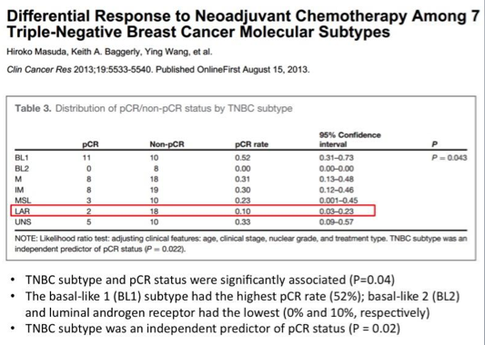

Slide 8
How to target advanced TNBC?
-Increased sensitivity to Platinum CT
-Capecitabine
-PARP Inhibitors
-TILs & immunotherapy

Slide 9
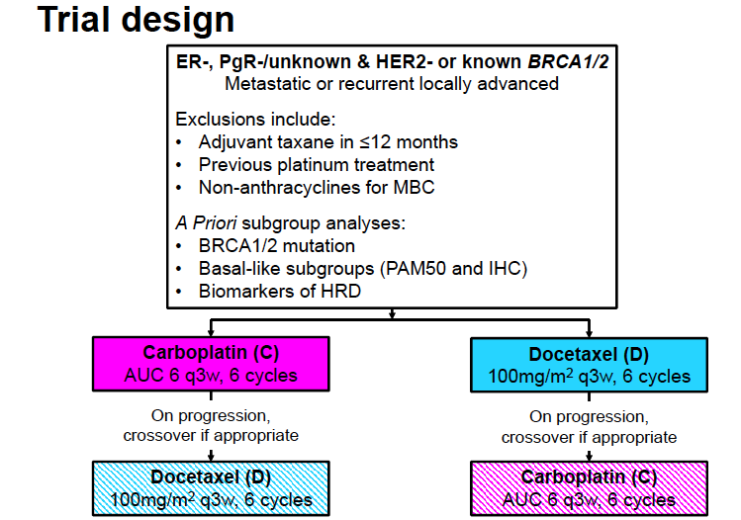
TNT phase III trial - TNBC
Tutt A et al, SABCS 2014
Notes:
9

Slide 11
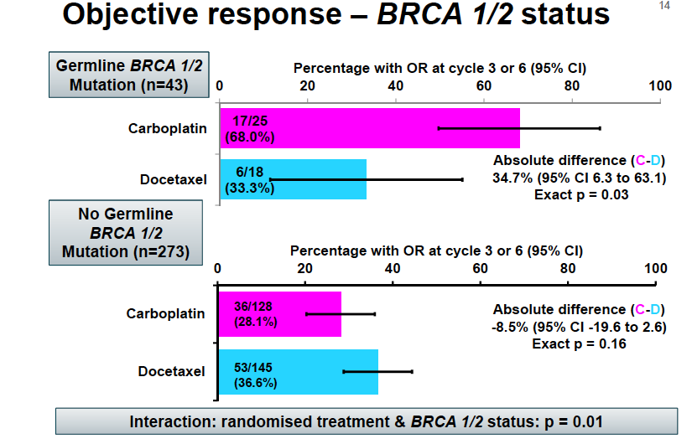
TNT phase III trial - TNBC
Tutt A et al, SABCS 2014
Notes:
11

Slide 12
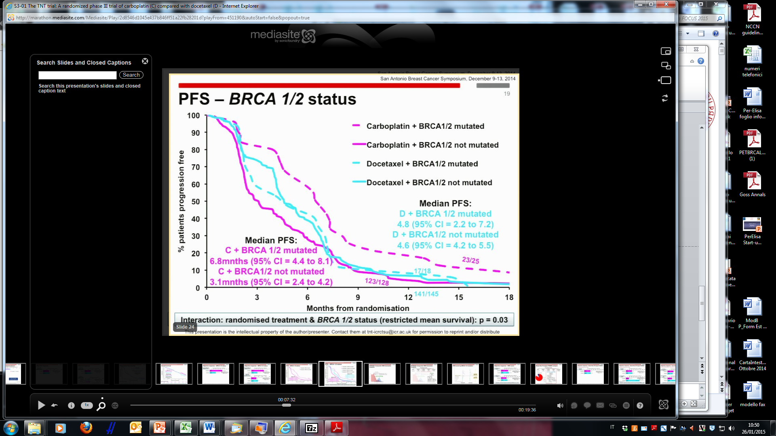
TNT phase III trial - TNBC
Tutt A et al, SABCS 2014

Slide 13
GeparSixto: Neoadjuvant Carboplatin Chemotherapy in TNBC Subgroup
Bevacizumab 15 mg/kg q3w +
Paclitaxel 80 mg/m² q1w +
Nonpegylated liposomal doxorubicin 20 mg/m² q1w
Centrally confirmed TNBC with clinical stage T2-T4a-d
or T1c with N+ disease
(N = 315)^{[1]}
Subgroup of main study with HER2+ or TNBC (N = 595)^{[2]}
Surgery
Bevacizumab 15 mg/kg q3w +
Paclitaxel 80 mg/m² q1w +
Nonpegylated liposomal doxorubicin 20 mg/m² q1w +
Carboplatin AUC 1.5-2.0 q1w
Primary endpoint of subanalysis: compare pCR (ypT0 ypN0) with or without carboplatin
Secondary endpoint of subanalysis: correlate germline BCRA alterations and/or family history for breast or ovarian cancer with pCR
1. von Minckwitz G, et al. ASCO 2014. Abstract 1005.
2. von Minckwitz G, et al. Lancet Oncol. 2014;15:747-756.

Slide 14
GeparSixto: pCR in Patients With TNBC
ypT0 ypN0
ypT0/is ypN0
 |  | gBRCA/RAD Alteration
 |  | No (n = 250) | Yes (n = 44)
 | No (n = 193) | 40.4% (69/171) | 45.5% (10/22)
 | Yes (n = 101) | 44.3% (35/79) | 63.6% (14/22)
 |  | gBRCA/RAD Alteration
 |  | No (n = 250) | Yes (n = 44)
 | No (n = 193) | 43.9% (75/171) | 45.5% (10/22)
 | Yes (n = 101) | 49.4% (39/79) | 81.8% (18/22)
Family History for BC/OC
Family History for BC/OC
-Alterations of gBRCA or gRAD50/51 detectable in ≥ 15% of participants with TNBC from GeparSixto trial
-pCR rates higher in patients with family history of BC/OC (49%), gBRCA/RAD alterations (55%), or both risk factors (64%) compared with neither risk factor (40%)
-Germline mutation status and family history may help identify patients who can benefit from adding carboplatin to neoadjuvant chemotherapy
von Minckwitz G, et al. ASCO 2014. Abstract 1005.
Notes:
BC, breast cancer; gBRCA/RAD, germline BCRA or RAD ; OC, ovarian cancer; pCR, pathologic complete response; TNBC, triple-negative breast cancer.
Joyce O’Shaughnessy, MD:
The results show that patients who had both a family history of breast or ovarian cancer and germline BRCA1/2 or RAD50/51C (gBRCA/RAD) alterations achieved the highest rates of pathologic complete response (pCR), regardless of the chemotherapy regimen they received. Approximately 64% of these patients achieved ypT0 ypN0 pCR and 82% achieved ypT0/is ypN0 pCR. All other patients, including those with either a family history or a genetic alteration, had pCR rates of approximately 40% to 49%. It is important to point out that there were only 22 patients with a genetic alteration but no family history of cancer and 22 patients with both a family history and a genetic alteration, which are small patient numbers.

Slide 15
CREATE-X: Study Design
Stratified by ER status, age, neoadjuvant chemotherapy, use of 5-FU, institution, node status
Wk 24
CAPECITABINE
2500 mg/m²/day PO Days 1-14
Q3W for 8 cycles‡
Hormonal therapy if ER/PgR+
(n = 455)†
Pts 20-74 yrs of age
with stage I-IIIB HER2- BC and residual disease
(non-pCR, N+) after neoadjuvant chemotherapy* and surgery;
ECOG PS 0 or 1;
no previous oral fluoropyrimidines
(N = 910)†
Hormonal therapy if ER/PgR+
No further therapy if ER/PgR-
(n = 455)†
Primary endpoint: DFS
Secondary endpoints: OS, time from first day of preoperative chemotherapy to recurrence or death, safety, cost-effectiveness
*Anthracycline/taxane, anthracycline containing, or docetaxel/cyclophosphamide.
†25 pts were removed from treatment (n = 10) and control (n = 15) arms due to failure to meet eligibility criteria.
‡IDMC recommended extension to 8 cycles following interim safety analysis
of first 50 pts receiving 6 cycles.^{[2]}
1. Toi M, et al. SABCS 2015. Abstract S1-07.
2. Ohtani S, et al. SABCS 2013. Abstract P3-12-03.
Notes:
5-FU, 5-fluorouracil; BC, breast cancer; ECOG, Eastern Cooperative Oncology Group; ER, estrogen receptor; IDMC, Independent Data Monitoring Committee; N+, positive lymph nodes; pCR, pathologic complete response; PgR, progesterone receptor; PS, performance status.

Slide 16
CREATE-X: 5-Yr Efficacy
Capecitabine achieved significantly higher 5-yr DFS and OS in HER2- BC pts with residual disease
Characteristic, % | Capecitabine (n = 440) | No Capecitabine (n = 445) | HR (95% CI) | P Value
5-yr DFS | 74.1 | 67.7 | 0.70 (0.53-0.93) | .00524
5-yr OS | 89.2 | 83.9 | 0.60 (0.40-0.92) | < .01
Toi M, et al. SABCS 2015. Abstract S1-07.
Notes:
BC, breast cancer; DFS, disease-free survival; OS, overall survival.

Slide 18
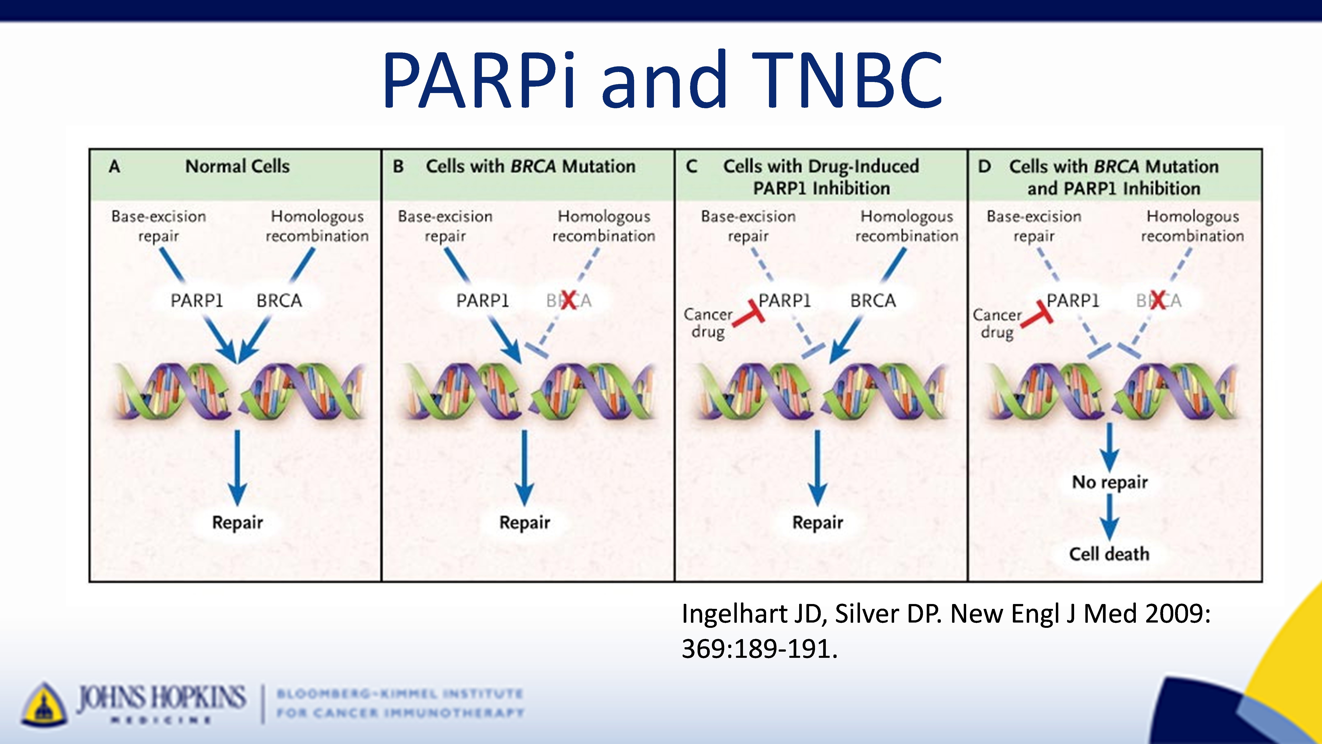
PARPi and TNBC
Poly ADP Ribose Polymerase Inhibitors & TNBC
Presented By Leisha Emens at 2017 ASCO Annual Meeting

Slide 19
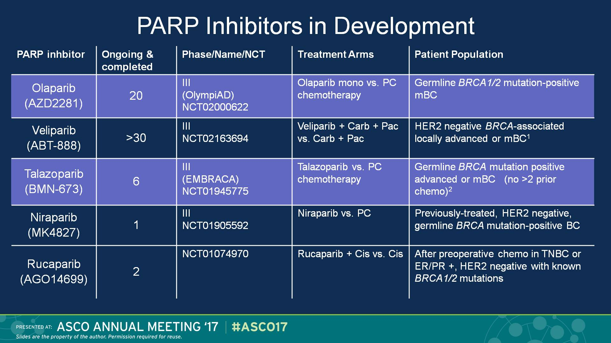
PARP Inhibitors in Development
Presented By Rebecca Dent at 2017 ASCO Annual Meeting

Slide 20
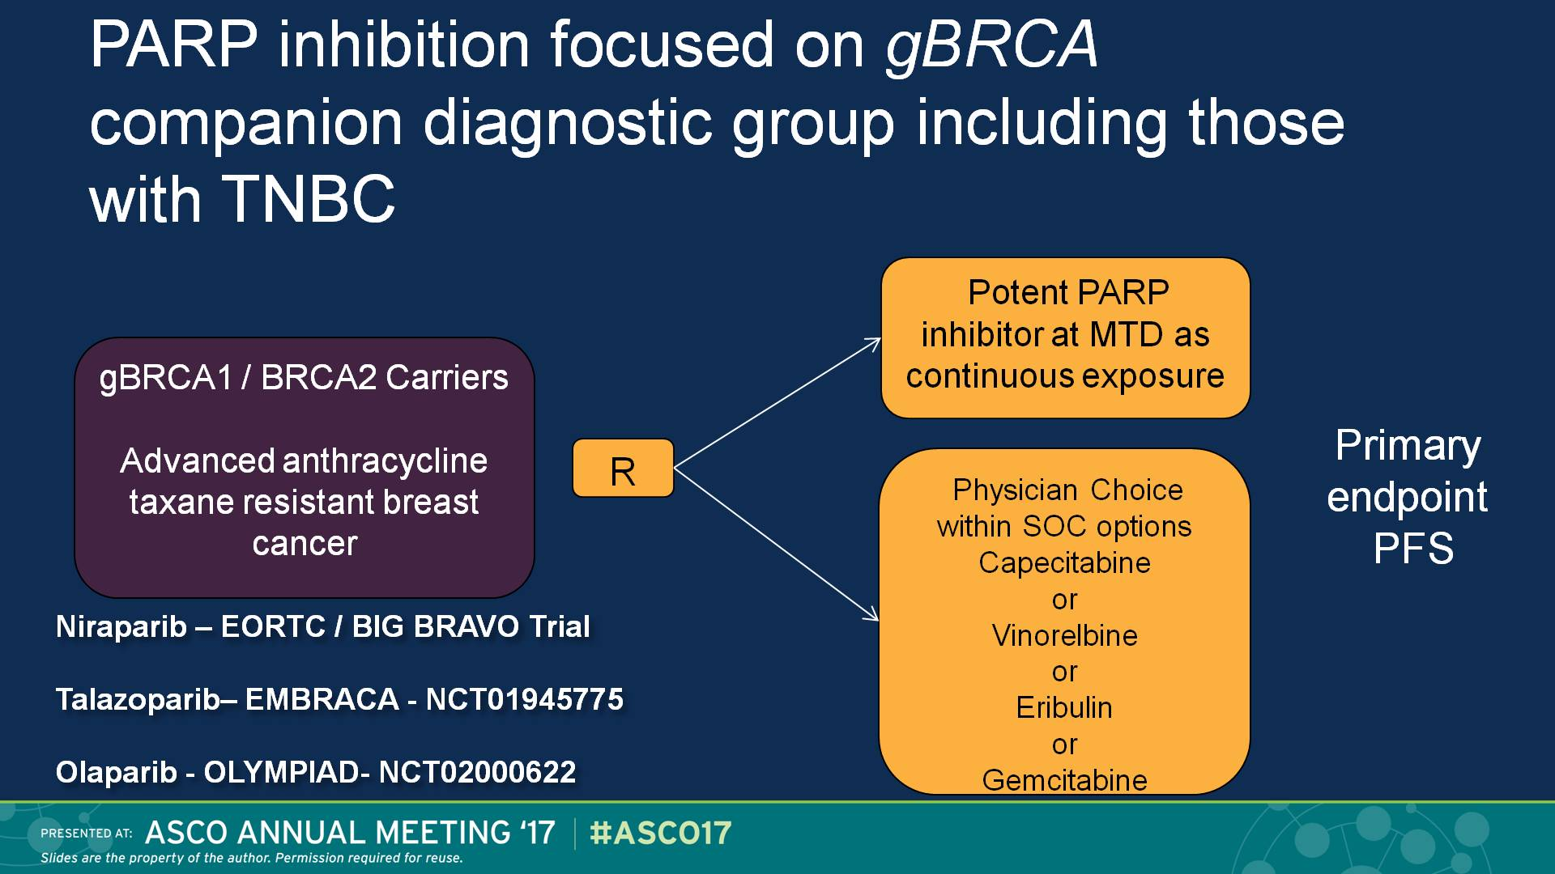
PARP inhibition focused on gBRCA companion diagnostic group including those with TNBC
Presented By Rebecca Dent at 2017 ASCO Annual Meeting

Slide 21
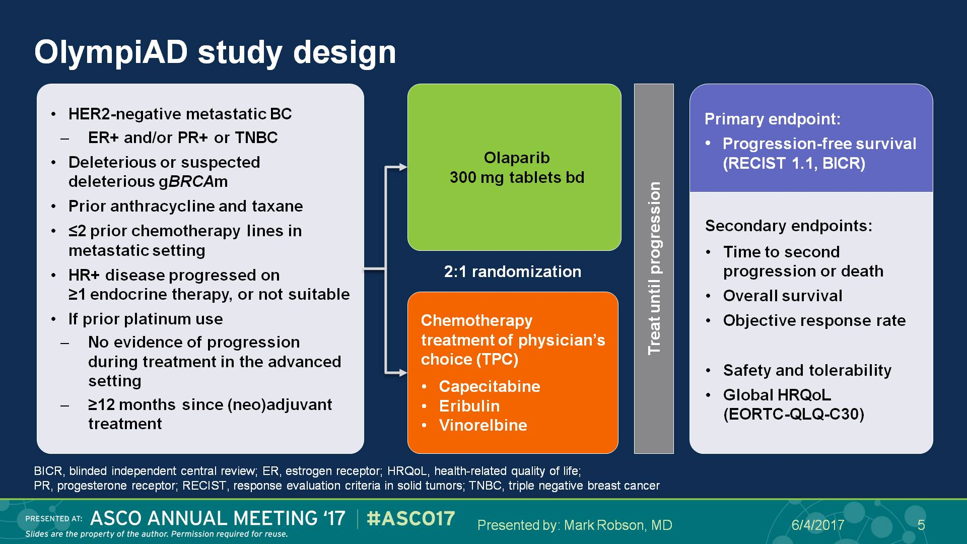
OlympiAD study design
*
*Blinded Independent Central Review
Presented By Mark Robson at 2017 ASCO Annual Meeting

Slide 22
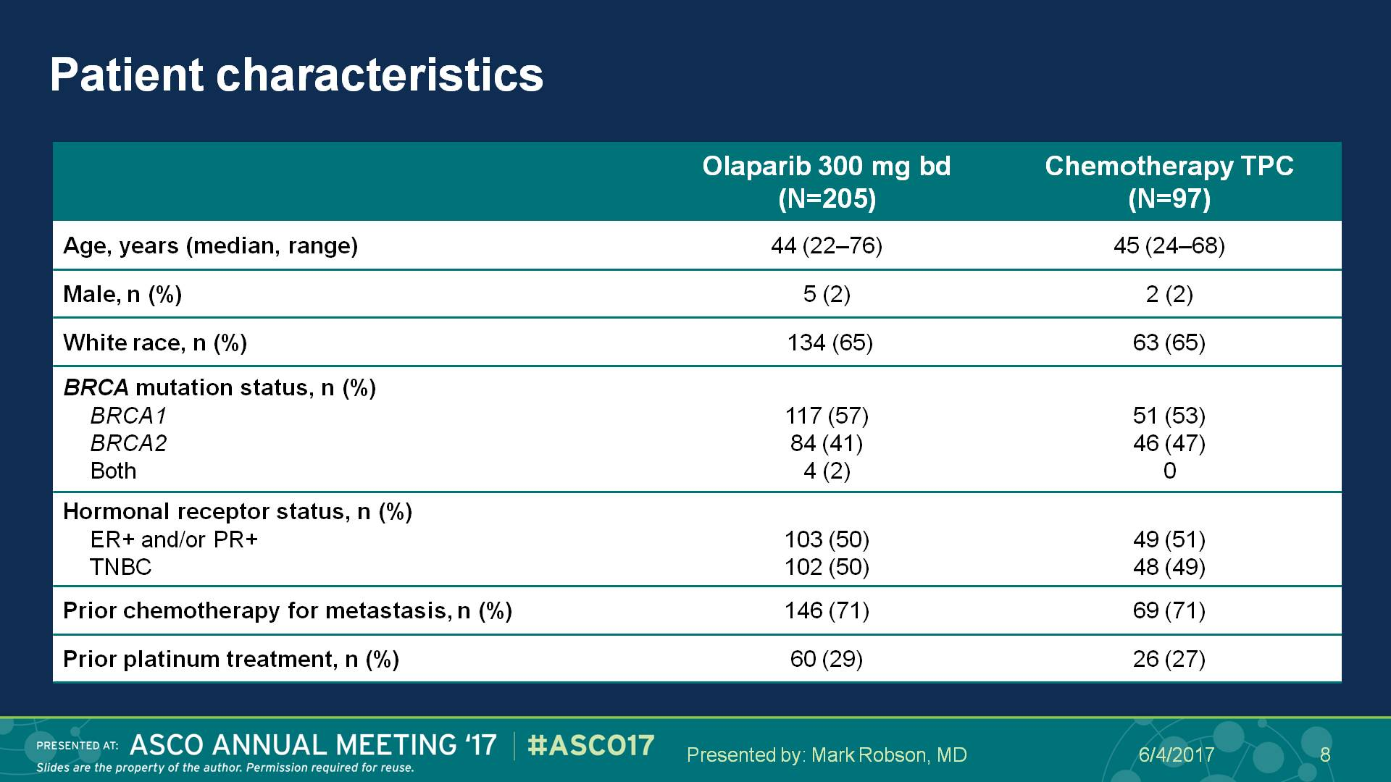
Patient characteristics
Presented By Mark Robson at 2017 ASCO Annual Meeting

Slide 23
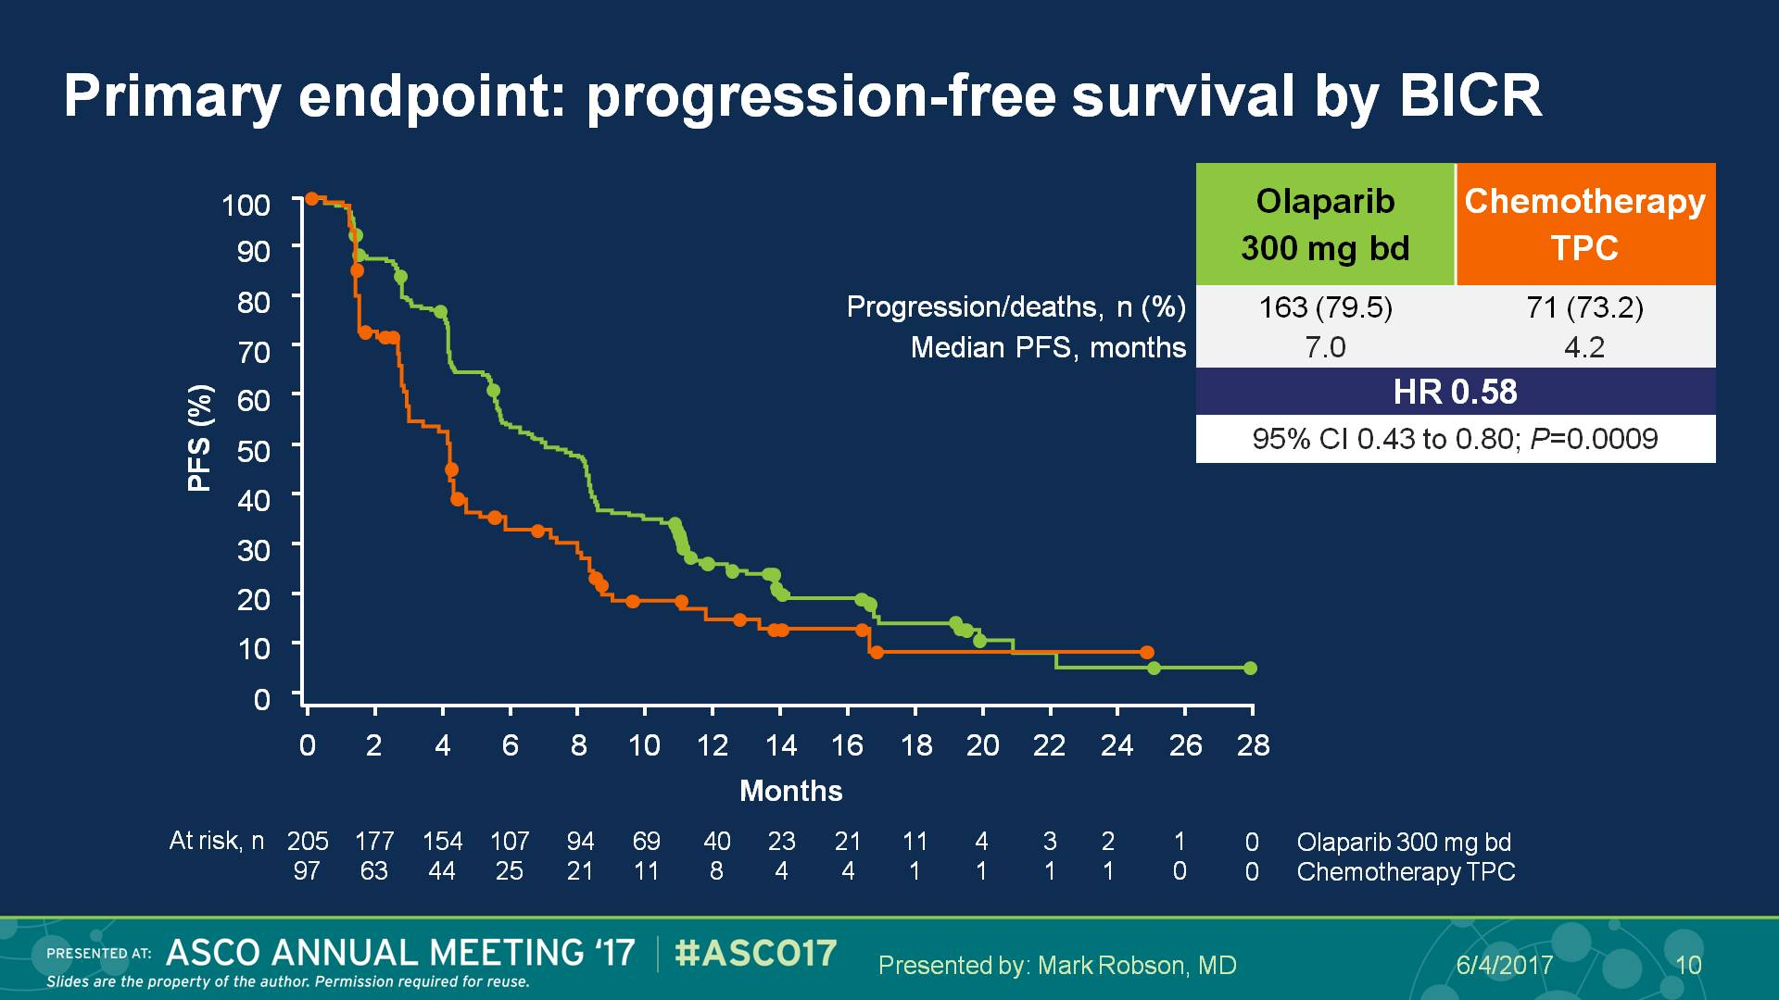
Primary endpoint: progression-free survival by BICR
*Blinded Independent Central Review
Presented By Mark Robson at 2017 ASCO Annual Meeting

Slide 24
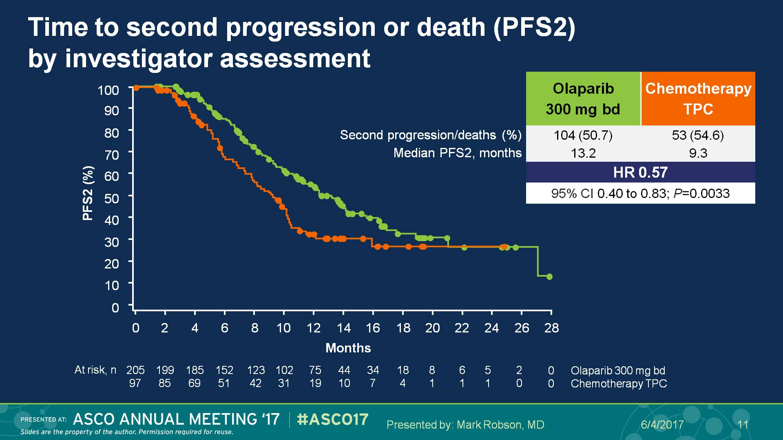
Time to second progression or death (PFS2) <br />by investigator assessment
Presented By Mark Robson at 2017 ASCO Annual Meeting

Slide 25
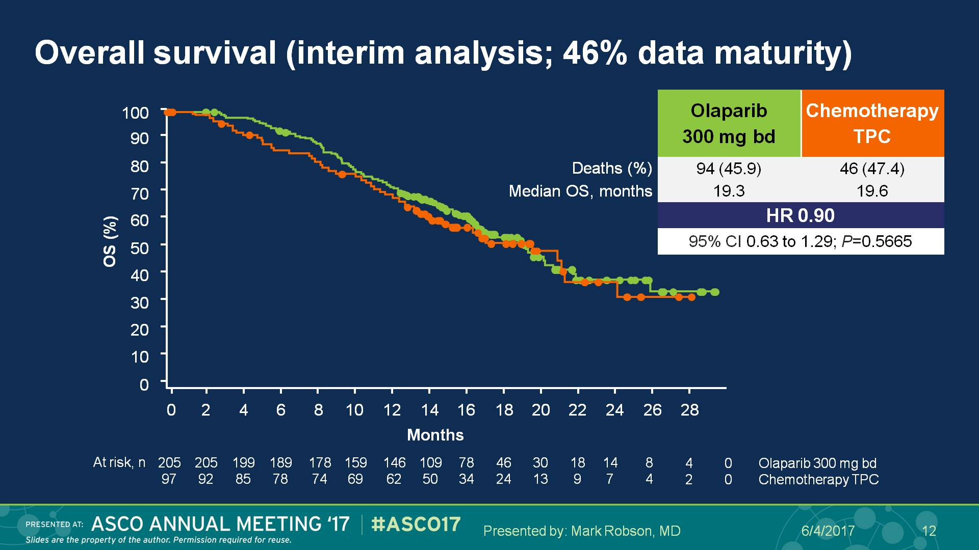
Overall survival (interim analysis; 46% data maturity)
Presented By Mark Robson at 2017 ASCO Annual Meeting

Slide 26
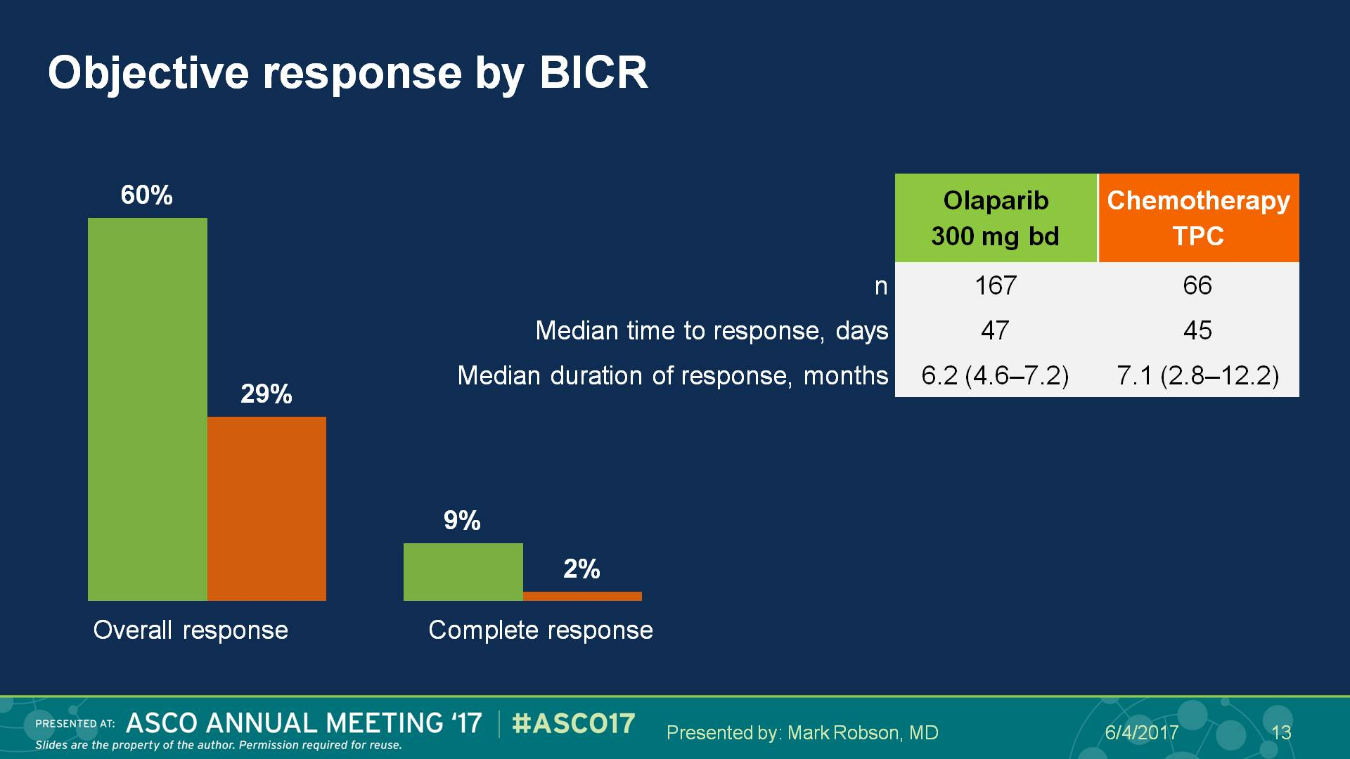
Objective response by BICR
Presented By Mark Robson at 2017 ASCO Annual Meeting

Slide 27
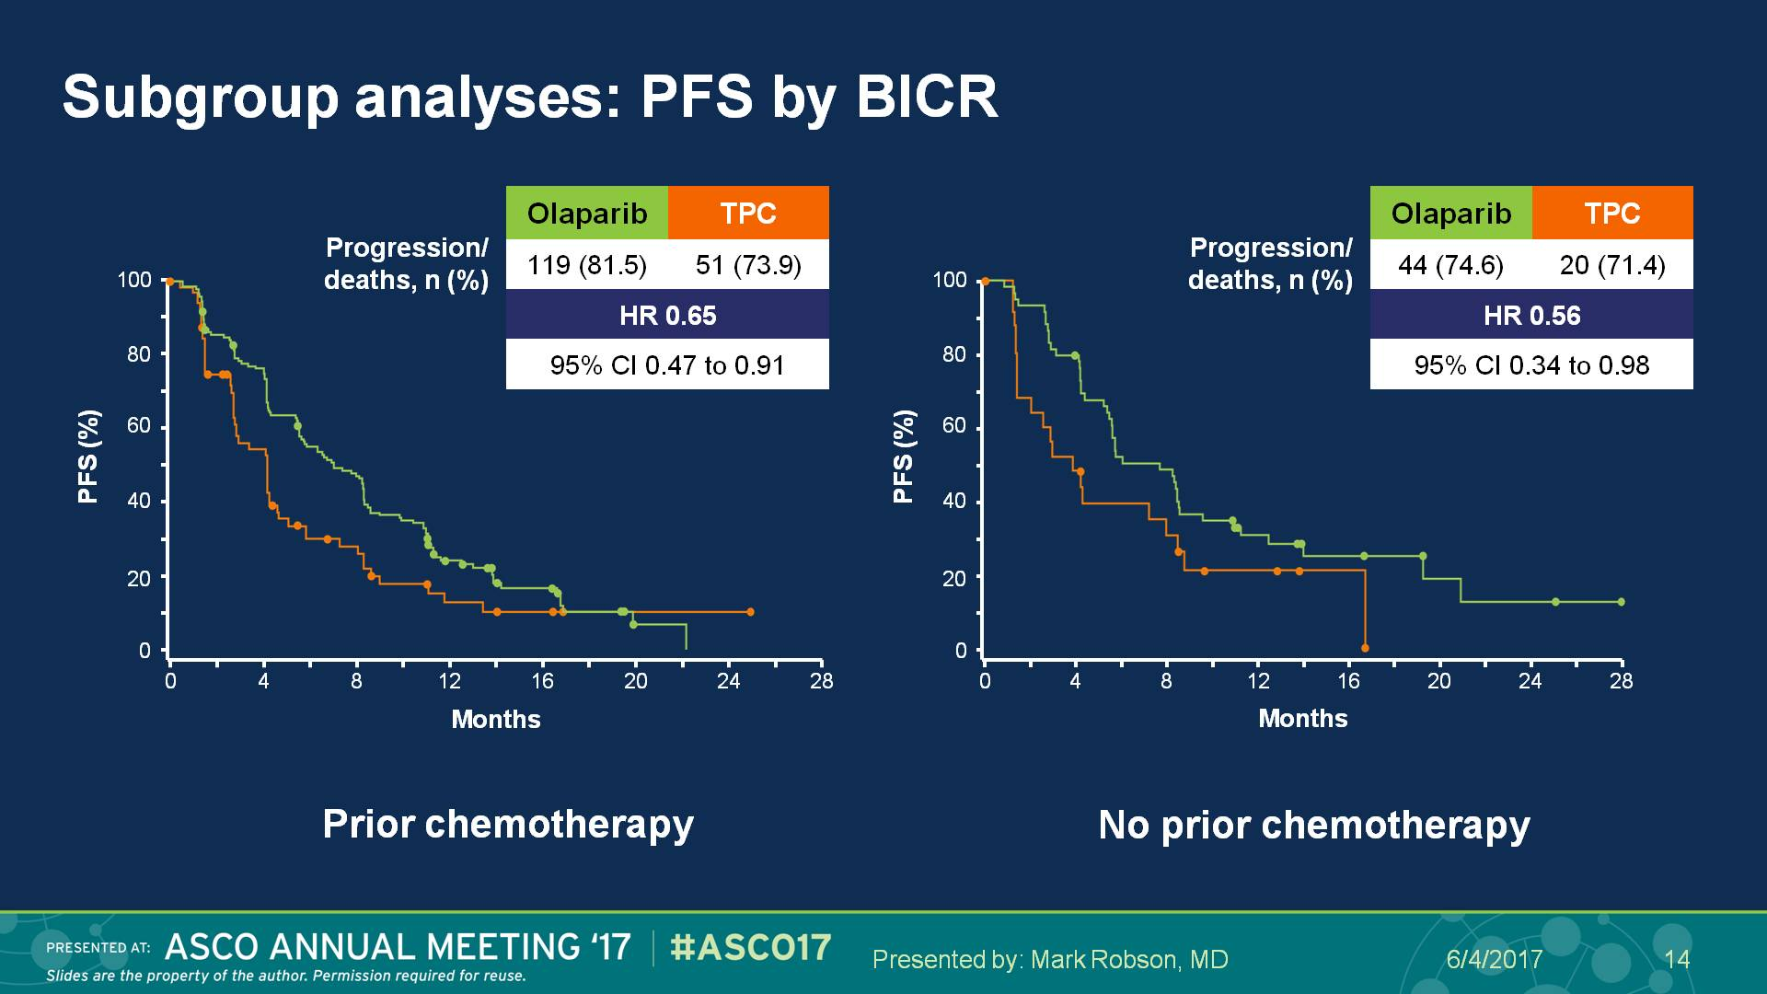
Subgroup analyses: PFS by BICR
Presented By Mark Robson at 2017 ASCO Annual Meeting

Slide 28
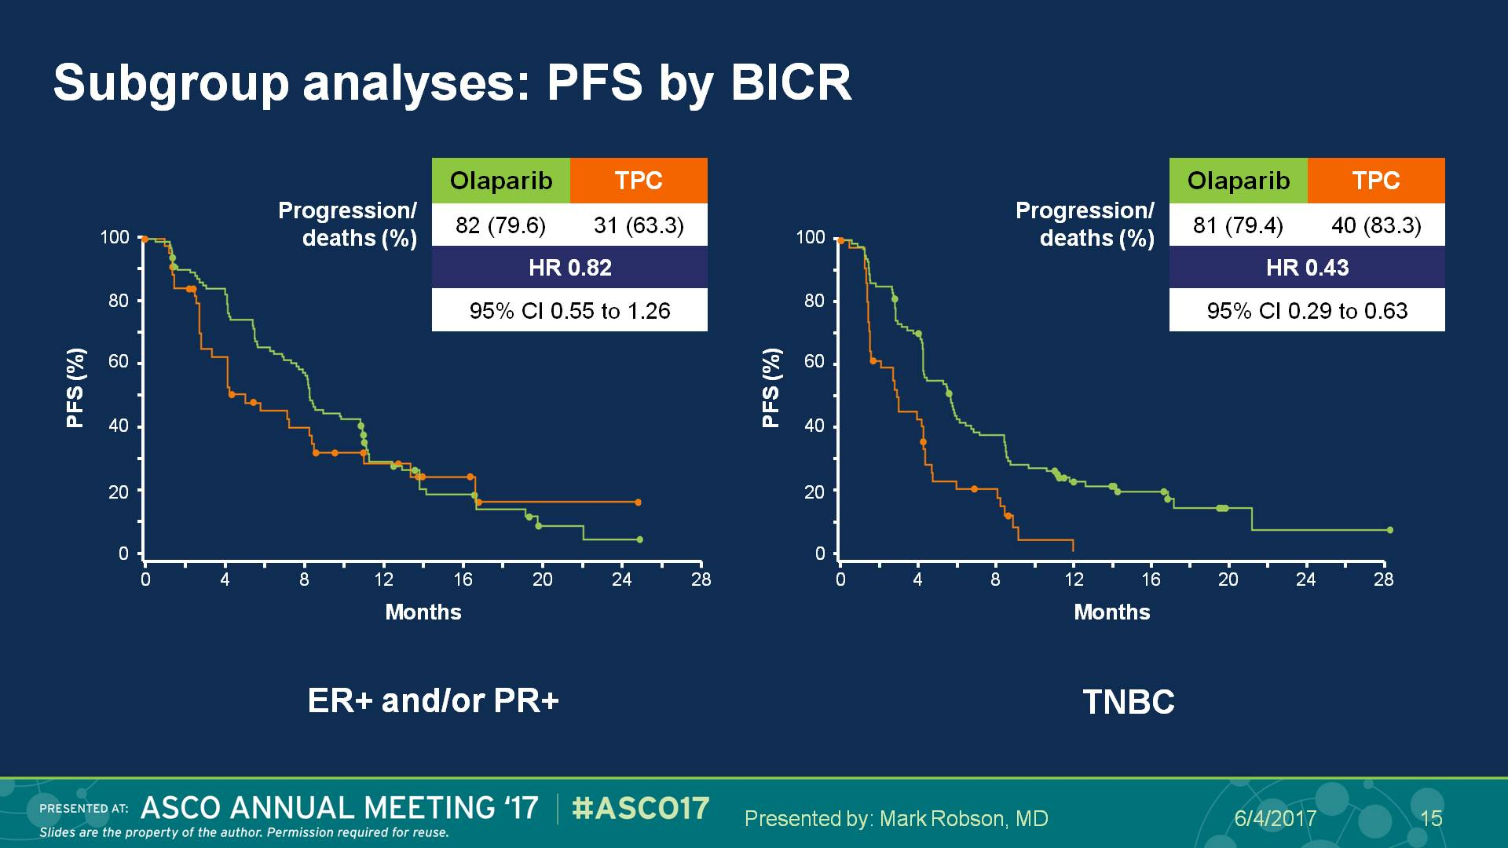
Subgroup analyses: PFS by BICR
Presented By Mark Robson at 2017 ASCO Annual Meeting

Slide 29
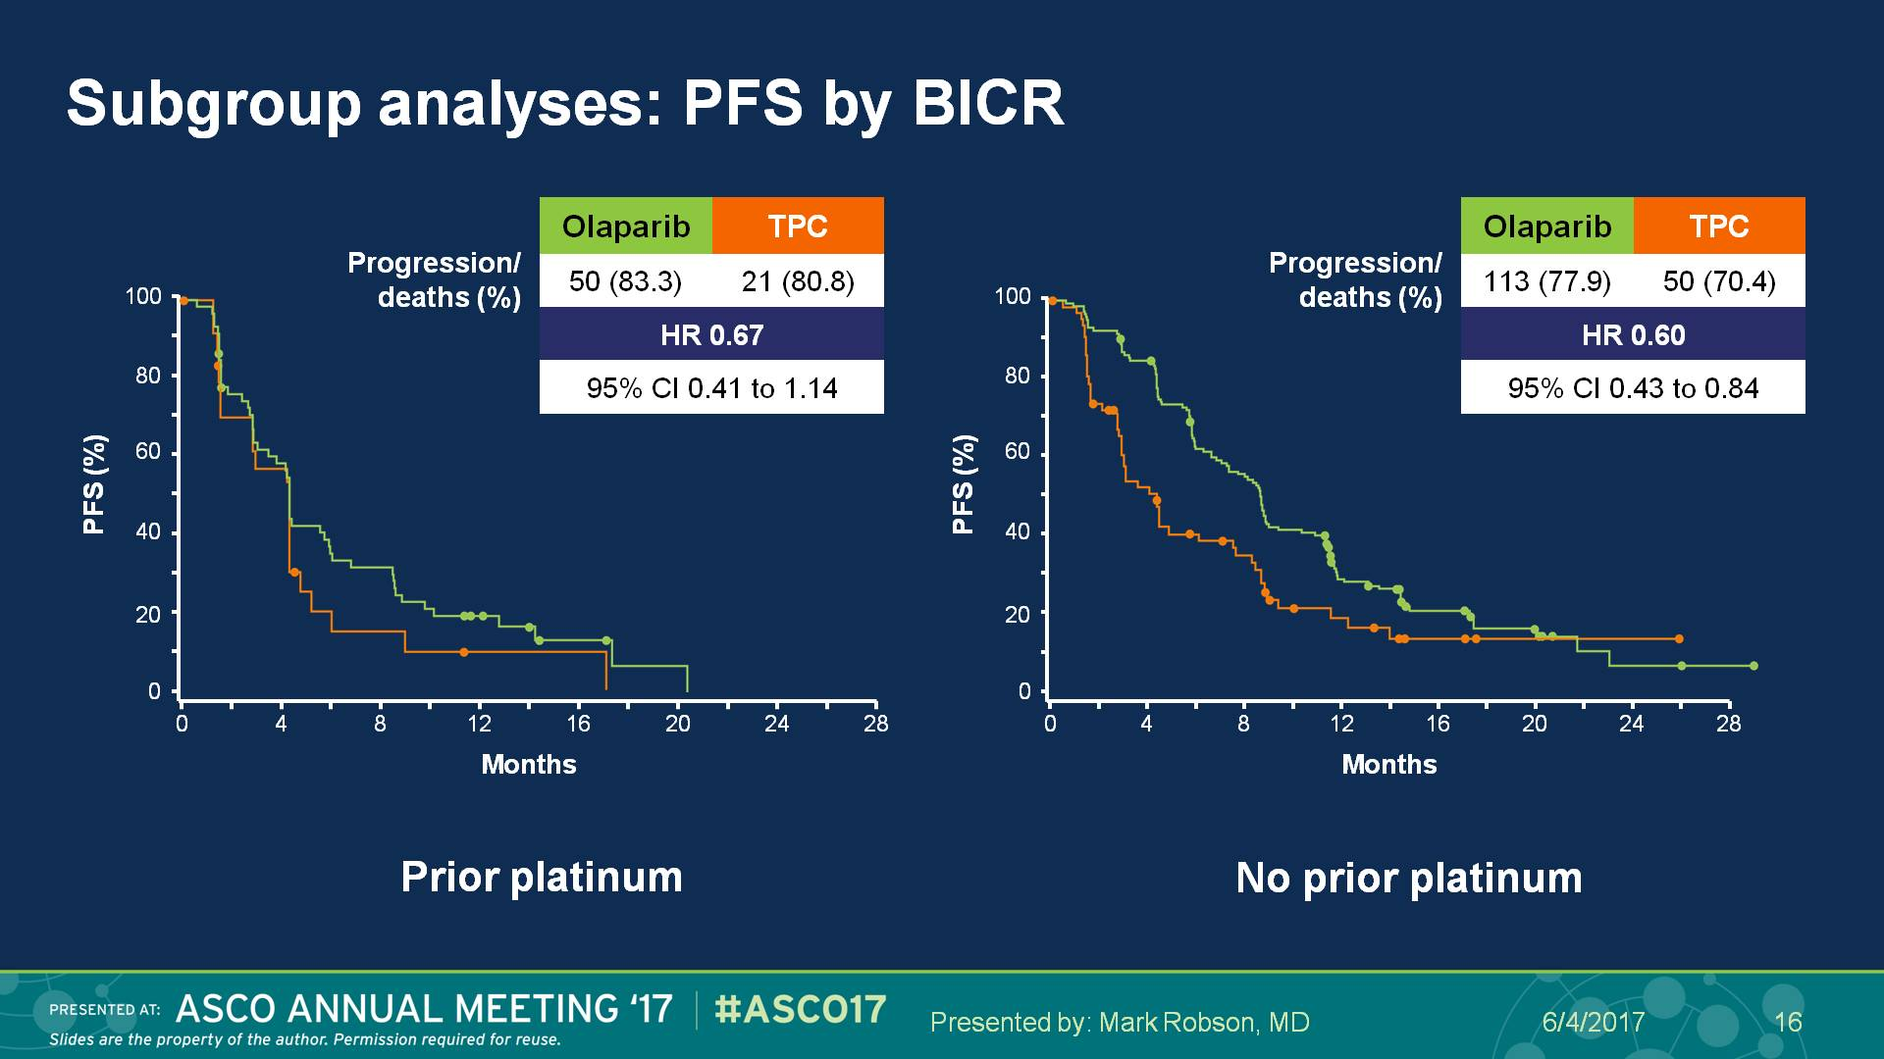
Subgroup analyses: PFS by BICR
Presented By Mark Robson at 2017 ASCO Annual Meeting

Slide 30
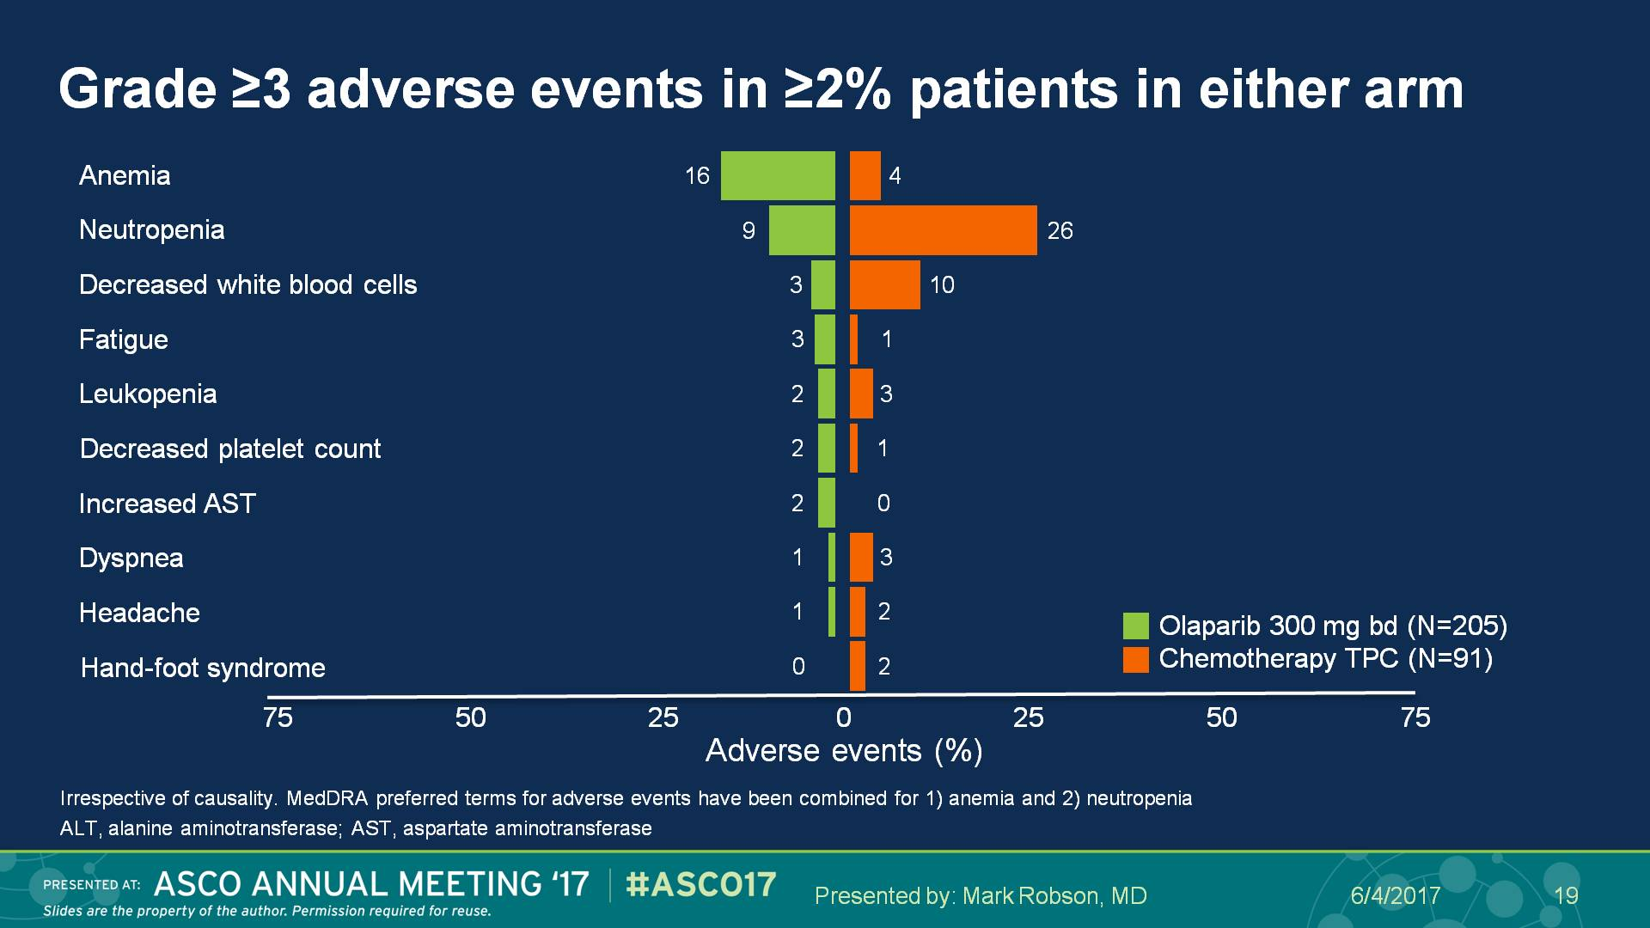
Grade ≥3 adverse events in ≥2% patients in either arm
Presented By Mark Robson at 2017 ASCO Annual Meeting

Slide 31
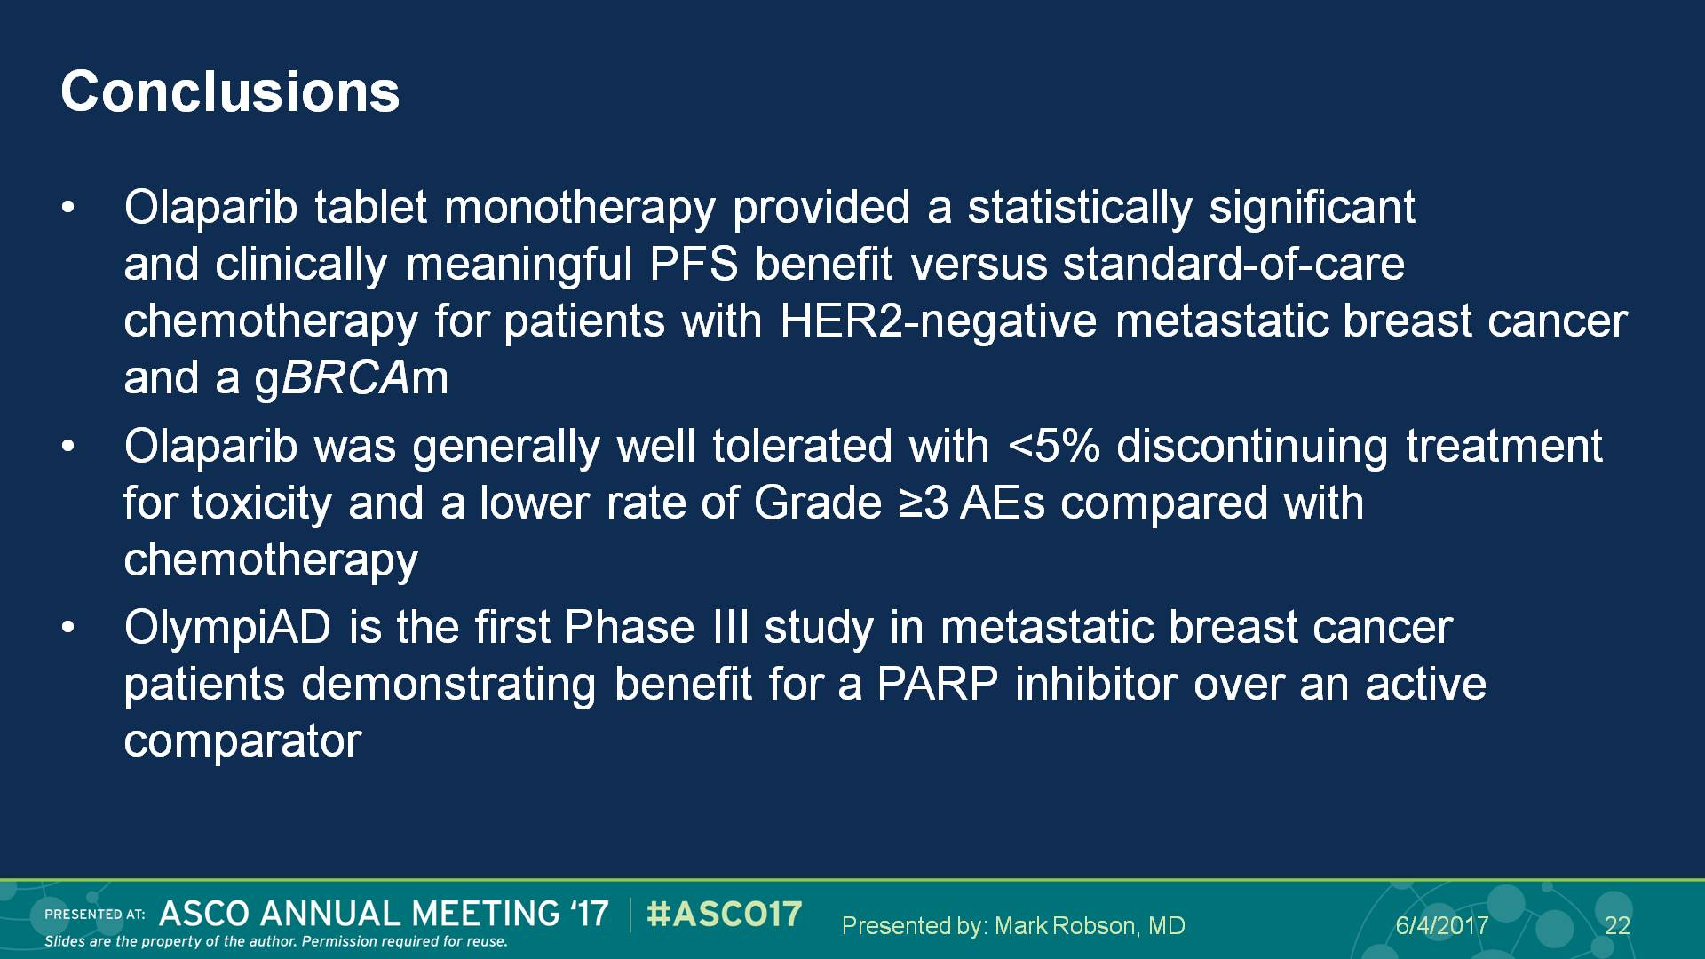
Conclusions
Presented By Mark Robson at 2017 ASCO Annual Meeting

Slide 32
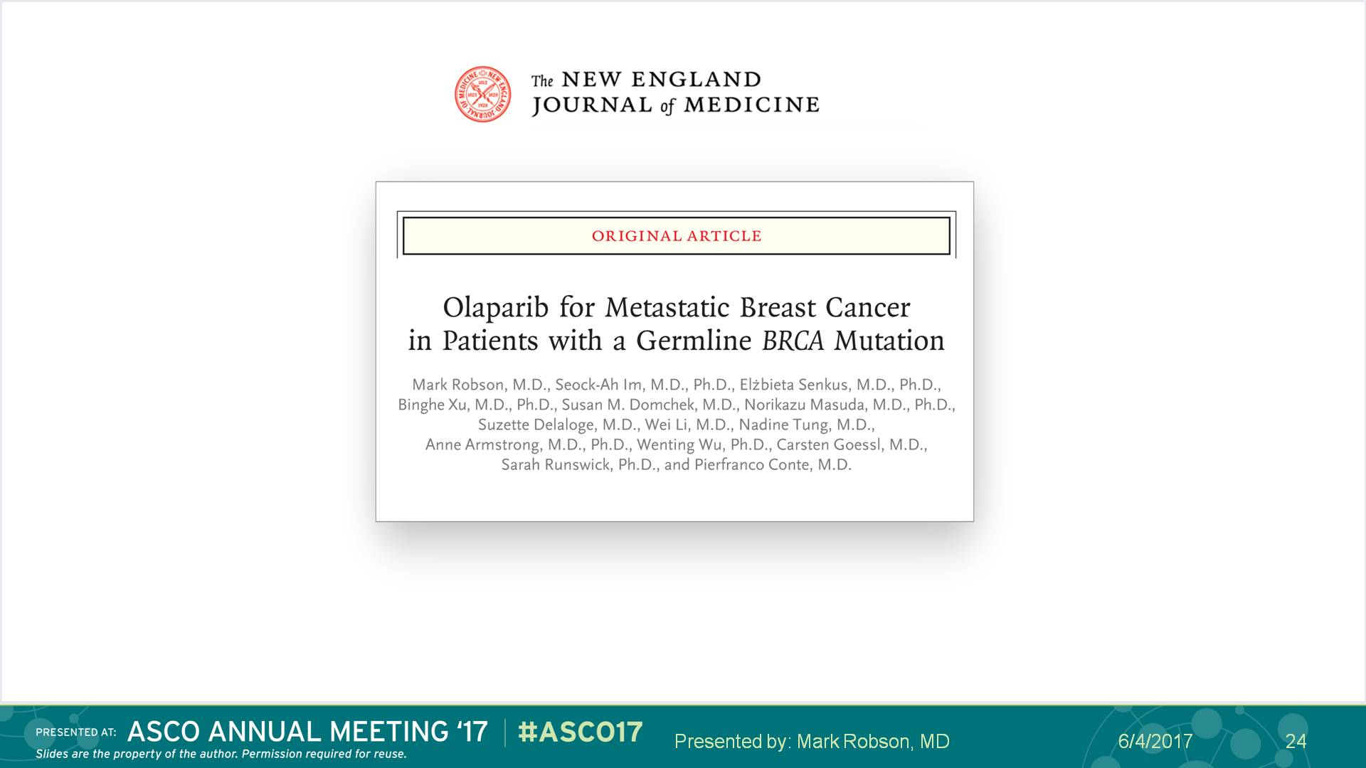
Slide 24
Presented By Mark Robson at 2017 ASCO Annual Meeting

Slide 33
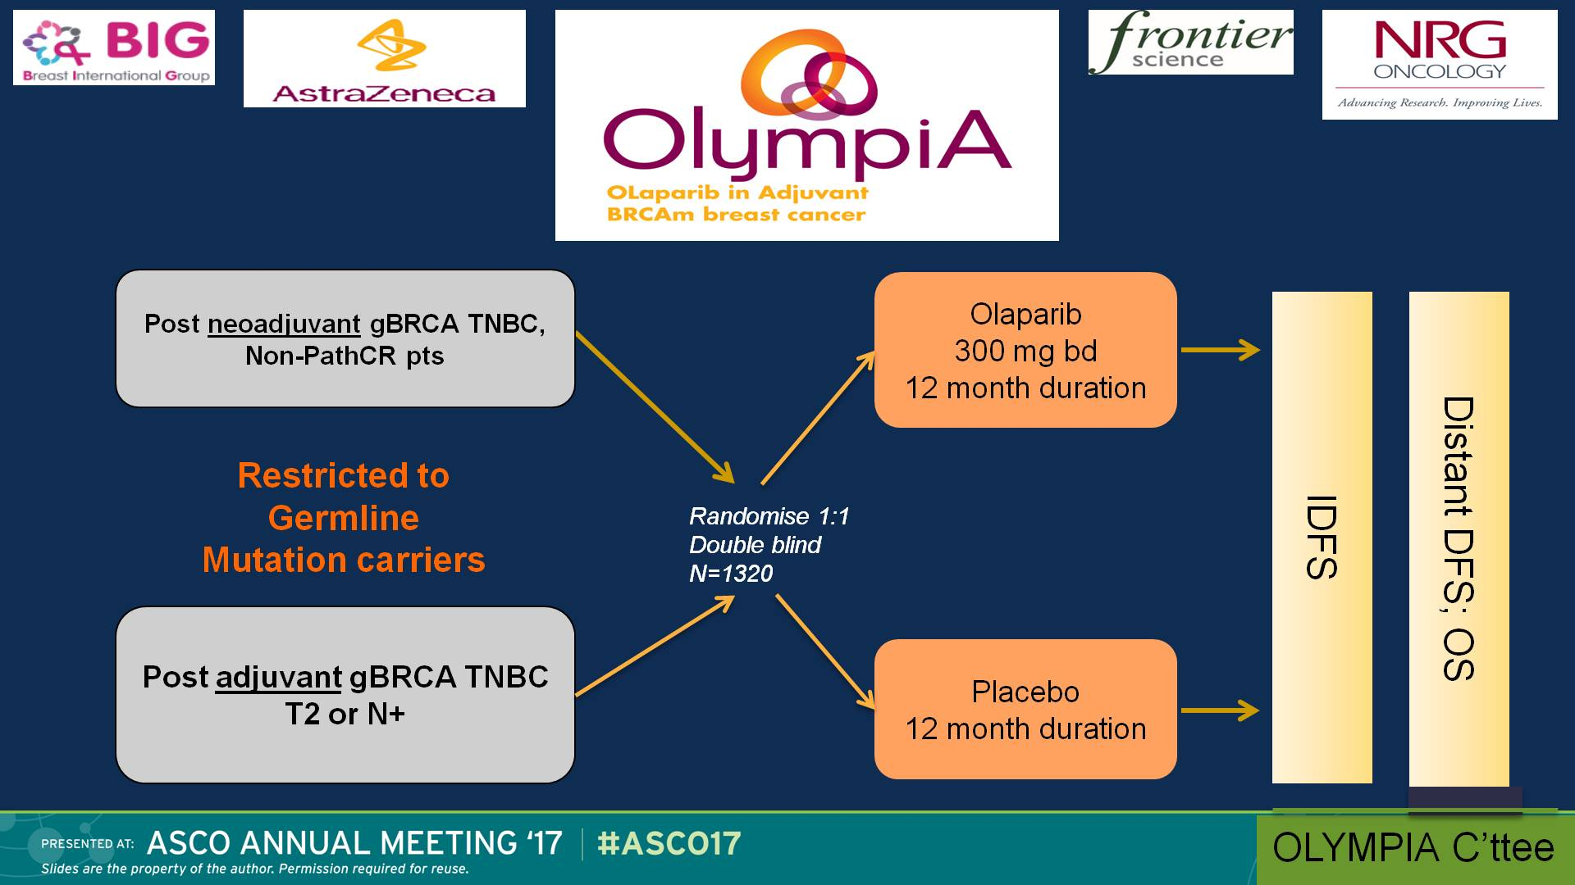
<br /><br /><br />
Presented By Rebecca Dent at 2017 ASCO Annual Meeting

Slide 34
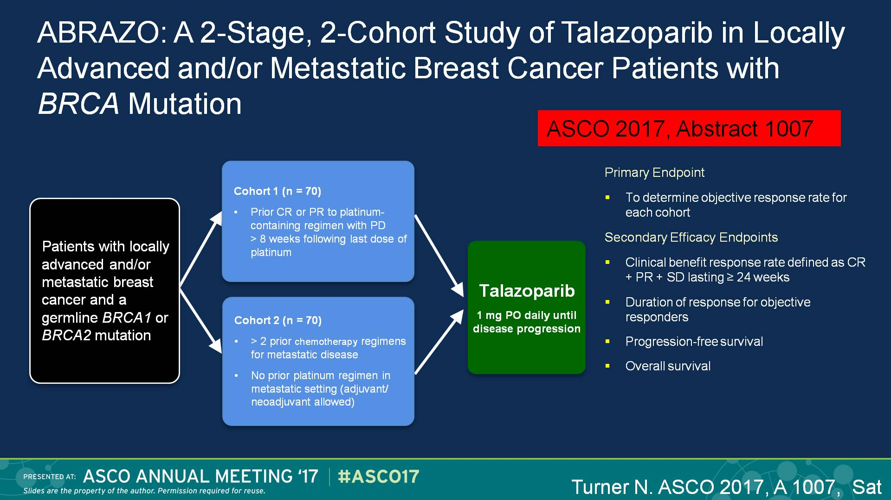
Slide 18

Slide 35
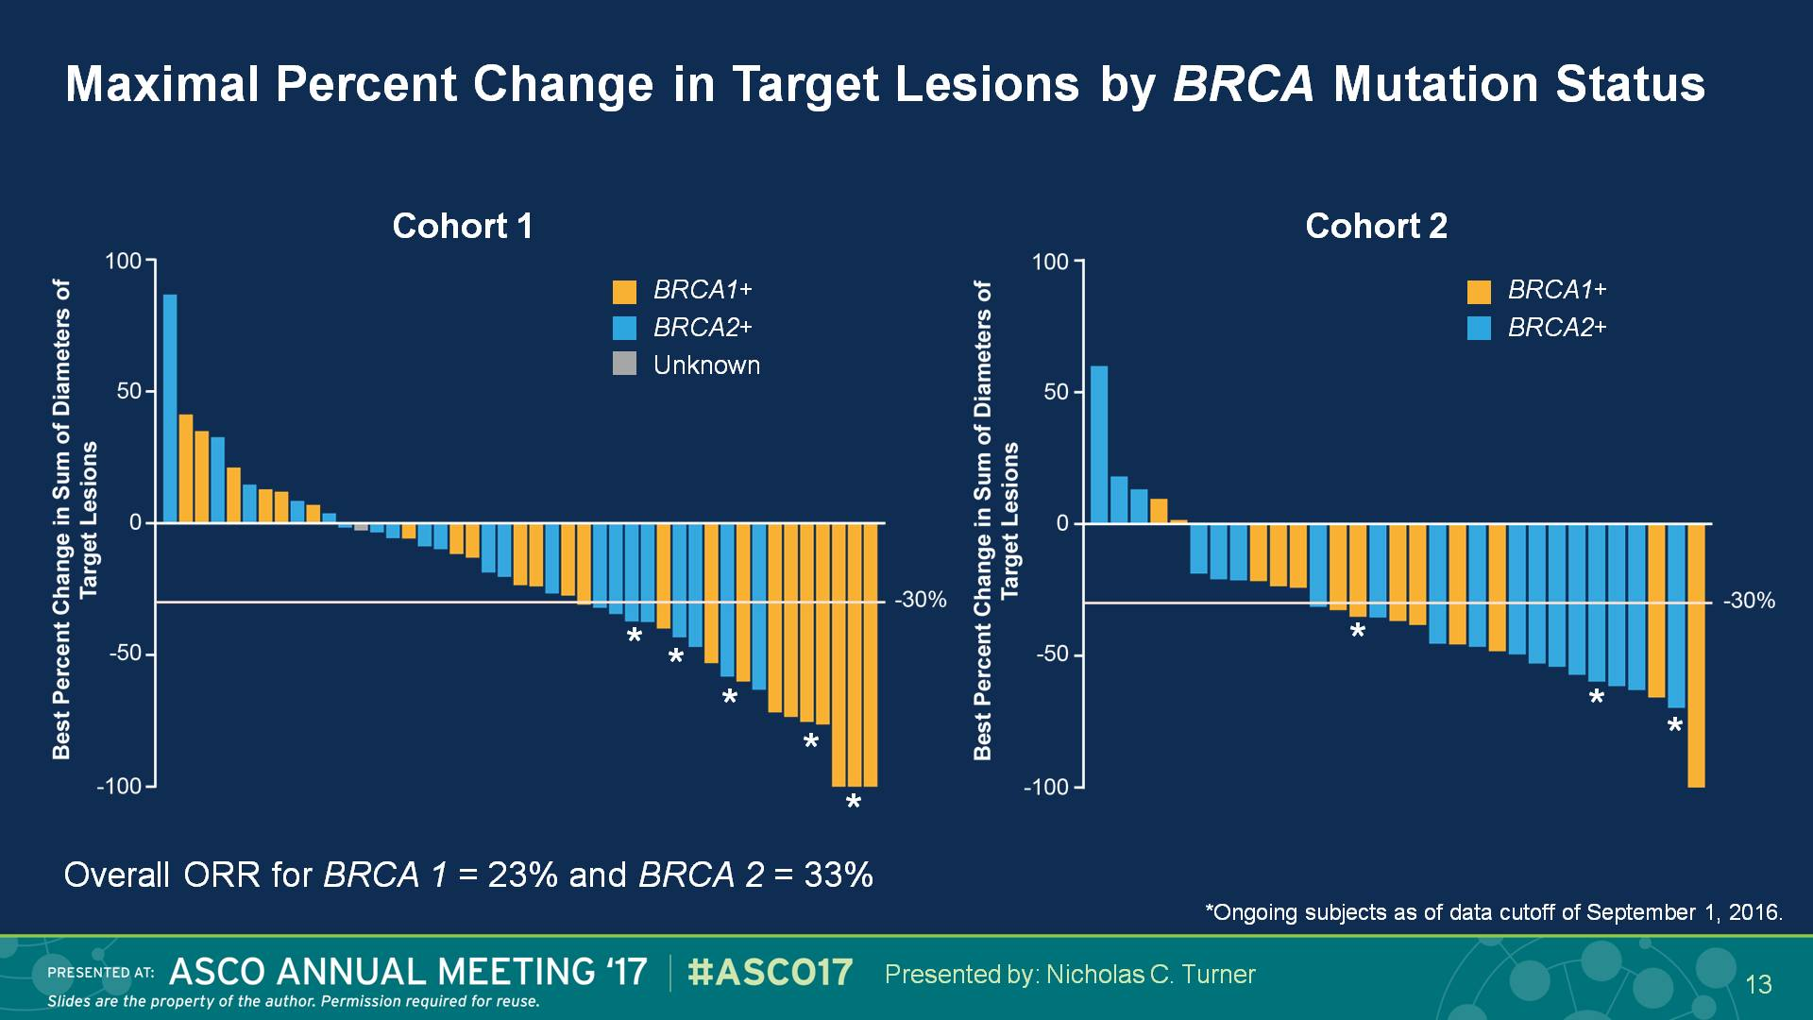
Maximal Percent Change in Target Lesions by BRCA Mutation Status
CR 4%
PR 17%
CR 0%
PR 37%
Presented By Nicholas Turner at 2017 ASCO Annual Meeting

Slide 36
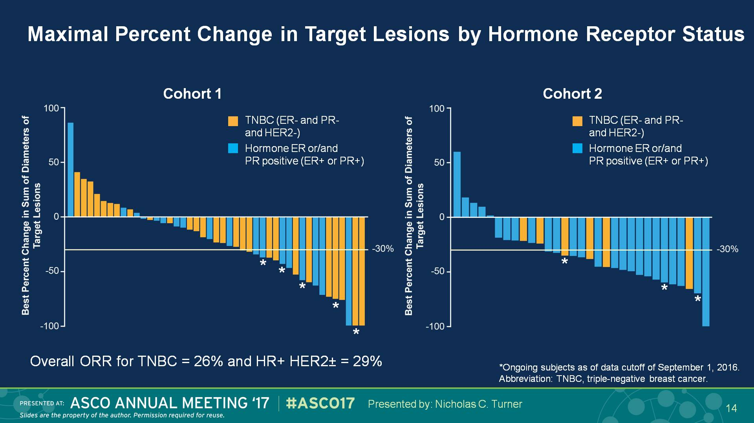
Maximal Percent Change in Target Lesions by Hormone Receptor Status
Presented By Nicholas Turner at 2017 ASCO Annual Meeting

Slide 37
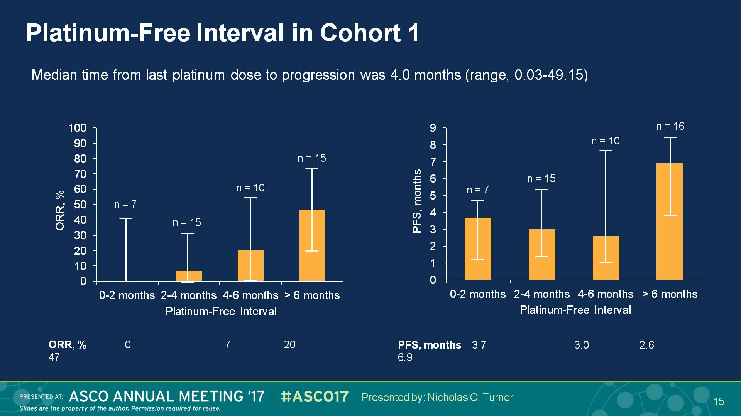
Slide 15
Presented By Nicholas Turner at 2017 ASCO Annual Meeting

Slide 38
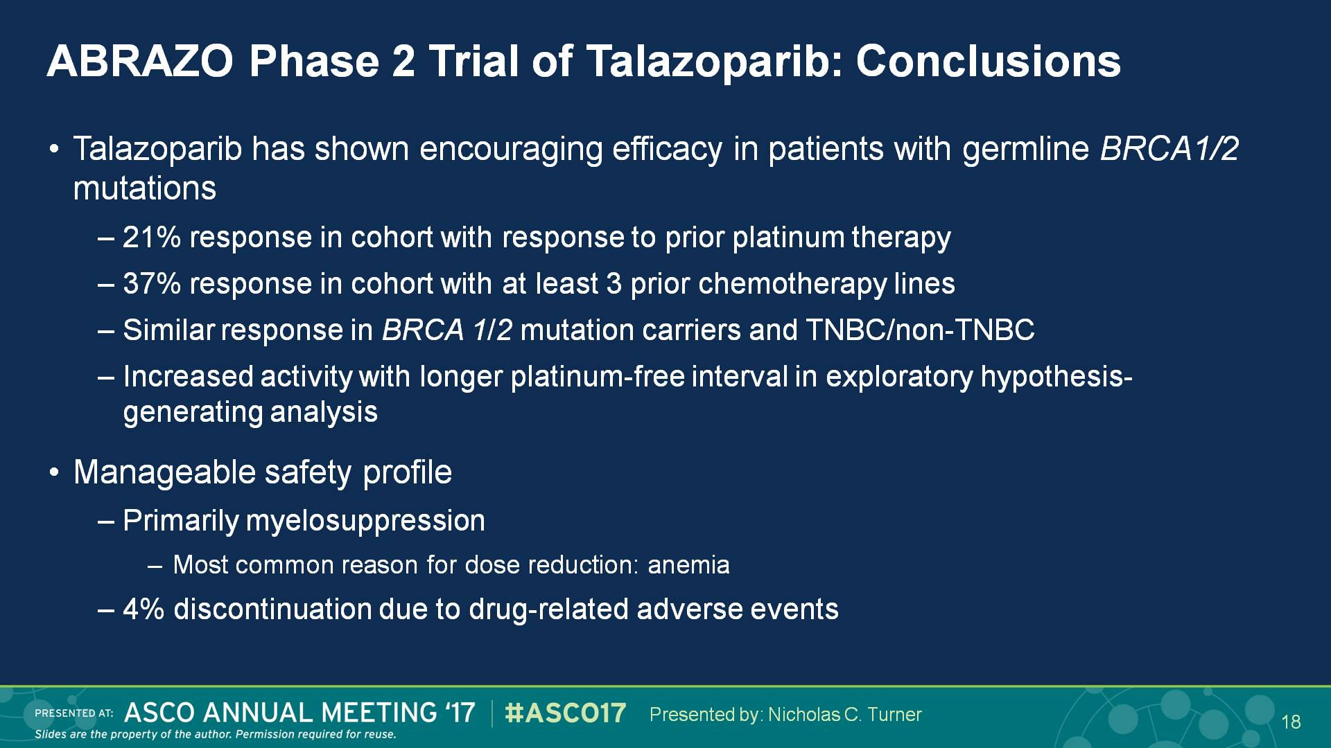
Slide 18
Presented By Nicholas Turner at 2017 ASCO Annual Meeting

Slide 39
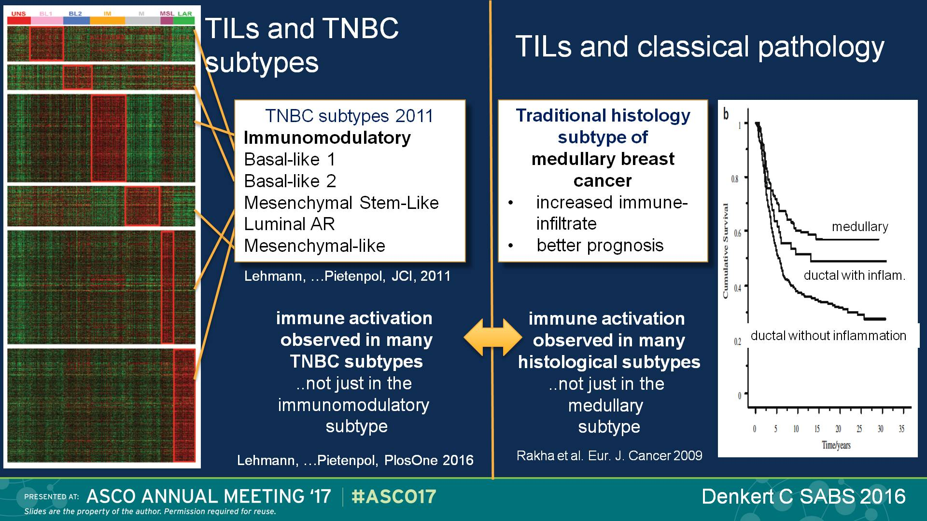
TILs and TNBC subtypes
Presented By Rebecca Dent at 2017 ASCO Annual Meeting

Slide 40
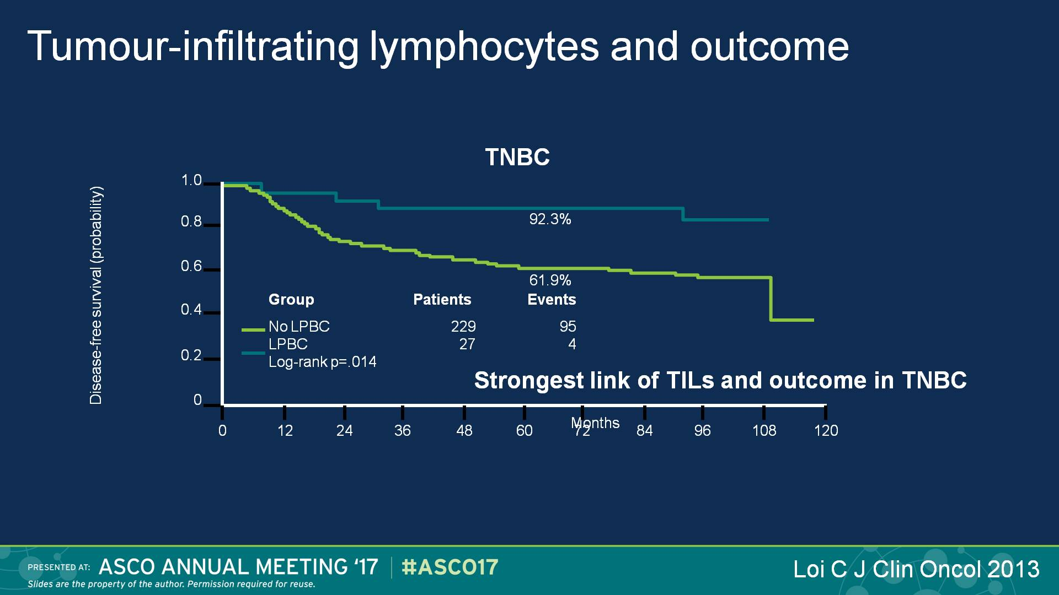
Tumour-infiltrating lymphocytes and outcome
LPBC: Predominant Lymphocytic Infiltrate BC
Presented By Rebecca Dent at 2017 ASCO Annual Meeting

Slide 41
TILs independent prognostic marker of
DFS, DRFI & OS
481 pts; DRFI events 107; deaths events 142

Slide 42
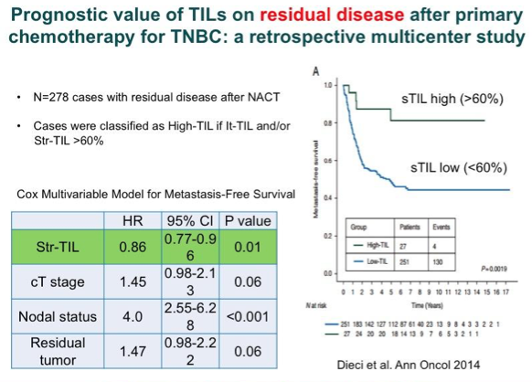

Slide 43
Immune checkpoint inhibitors in metastatic TNBC
 | Pembrolizumab TN (anti PD-1) | Atezolizumab TN (anti PDL-1) | Avelumab TN (anti PDL-1)
% PD-L1+/screened | 58% | 69% | 4%-69%
PD-L1 cut-off | >1% tumor cells or any stromal staining | >5% TILs | multiple cut-offs
Evaluable pts | 27 (PD-L1+) | 21 (PD-L1+) | 58 (9 PD-L1+)
ORR | 18.5% | 19% | 9%-44%*
SD | 25.9% | 27% (>24w) | 22.4%
*ORR up to 44% in PD-L1+ TNBC pts (with the >10% immune cell «hotspots» cut-off)
Rugo H, SABCS 2015; Nanda SABCS 2014; Emens L, AACR 2015; Dirix L, SABCS 2015

Slide 44
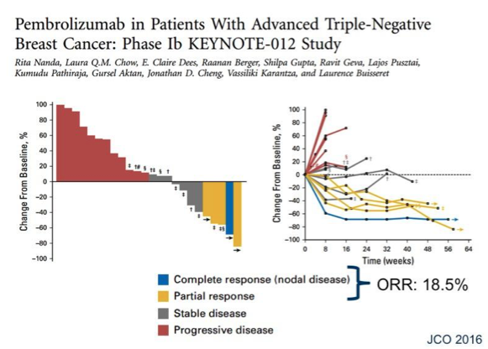

Slide 45
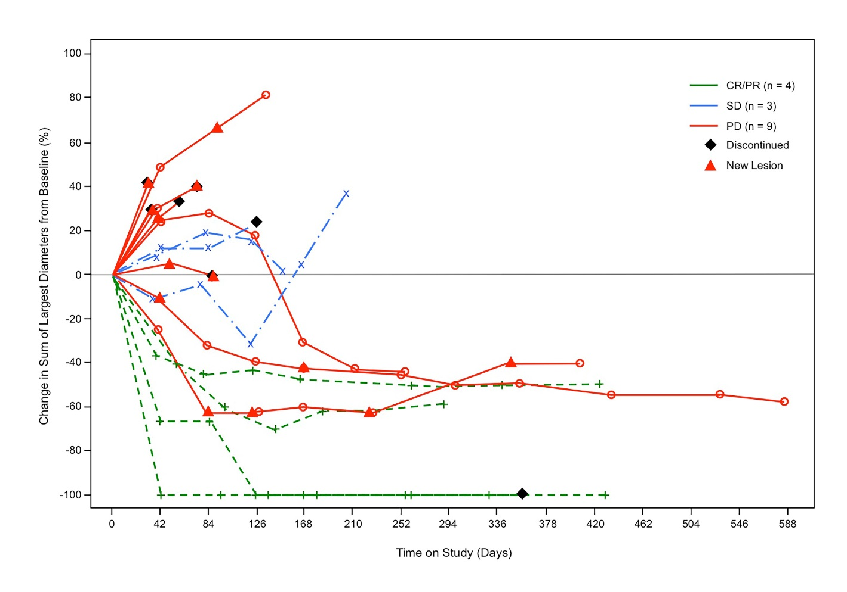
Atezolizumab in TNBC
PD-L1 IC scores 2/3 patients, nª | ORR (95% CI) | 24-Week PFS(95% CI)
21 | 19% (5-42) | 27% (7-47)
  Pseudo-PD with subsequent durable response
Emens et al. AACR 2015

Slide 46
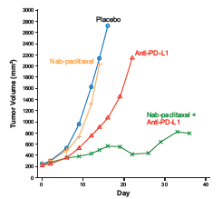
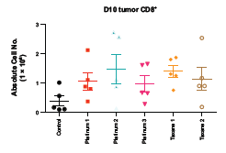
Combination of Immunotherapy & Chemotherapy
Synergistic effect of chemotherapy and anti-PD-L1 treatment in vivo
Platinum or taxane therapy increased the number of tumor-infiltrating CD8+ T cells
Increased tumor PD-L1 expression/infiltration of CD8+ T cells have been observed with serial biopsies in patients treated with atezolizumab + chemo
High response rates and durable responses have been observed with atezolizumab plus chemotherapy in NSCLC
Adams S, et al. SABCS 2015

Slide 47
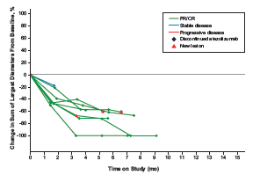
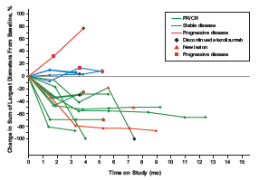
Combination of Immunotherapy & Chemotherapy in TNBC
Nab-Paclitaxel + anti-PD-L1 (atezolizumab)
1st line Patients
2nd/≥3rd line Patients
ORR 66.7%
(unconfirmed 88.9%)
ORR 25% / 28.6%
(unconf. 75% / 43%)
Adams S, et al. SABCS 2015

Slide 48
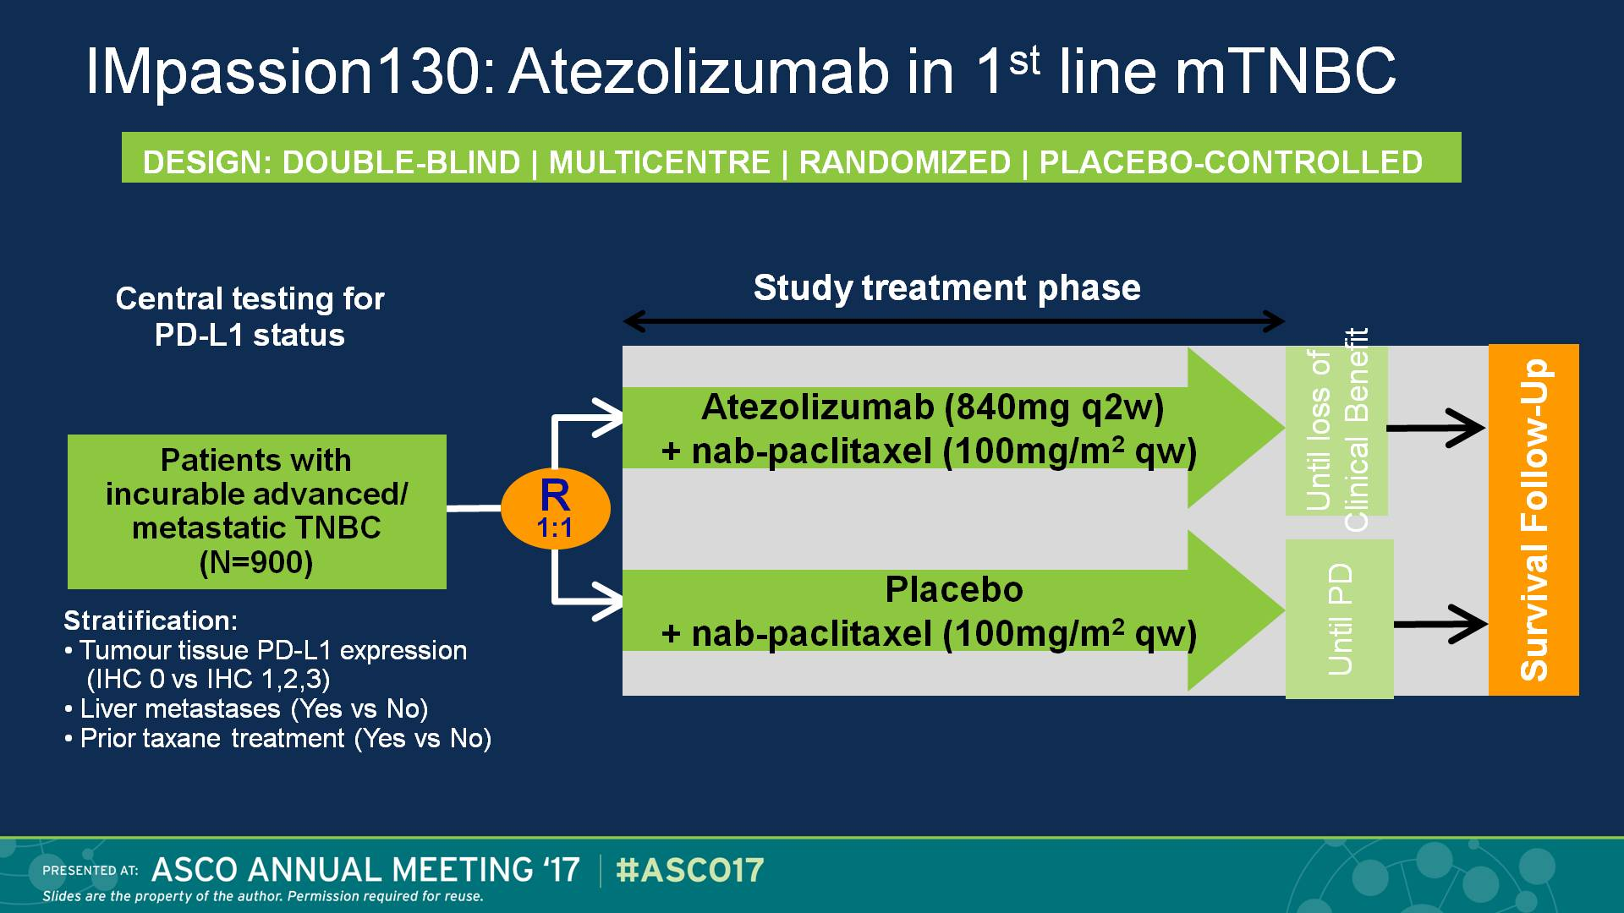
IMpassion130: Atezolizumab in 1st line mTNBC
Presented By Rebecca Dent at 2017 ASCO Annual Meeting

Slide 49
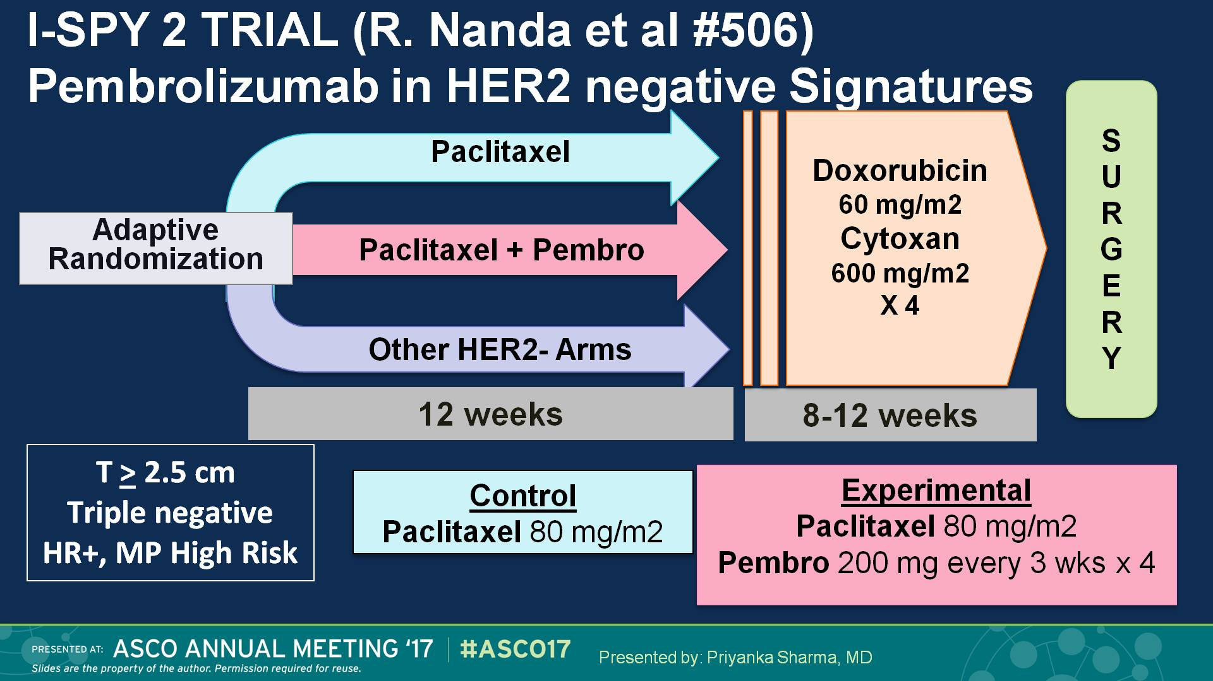
I-SPY 2 TRIAL (R. Nanda et al #506) <br />Pembrolizumab in HER2 negative Signatures
Presented By Priyanka Sharma at 2017 ASCO Annual Meeting

Slide 50
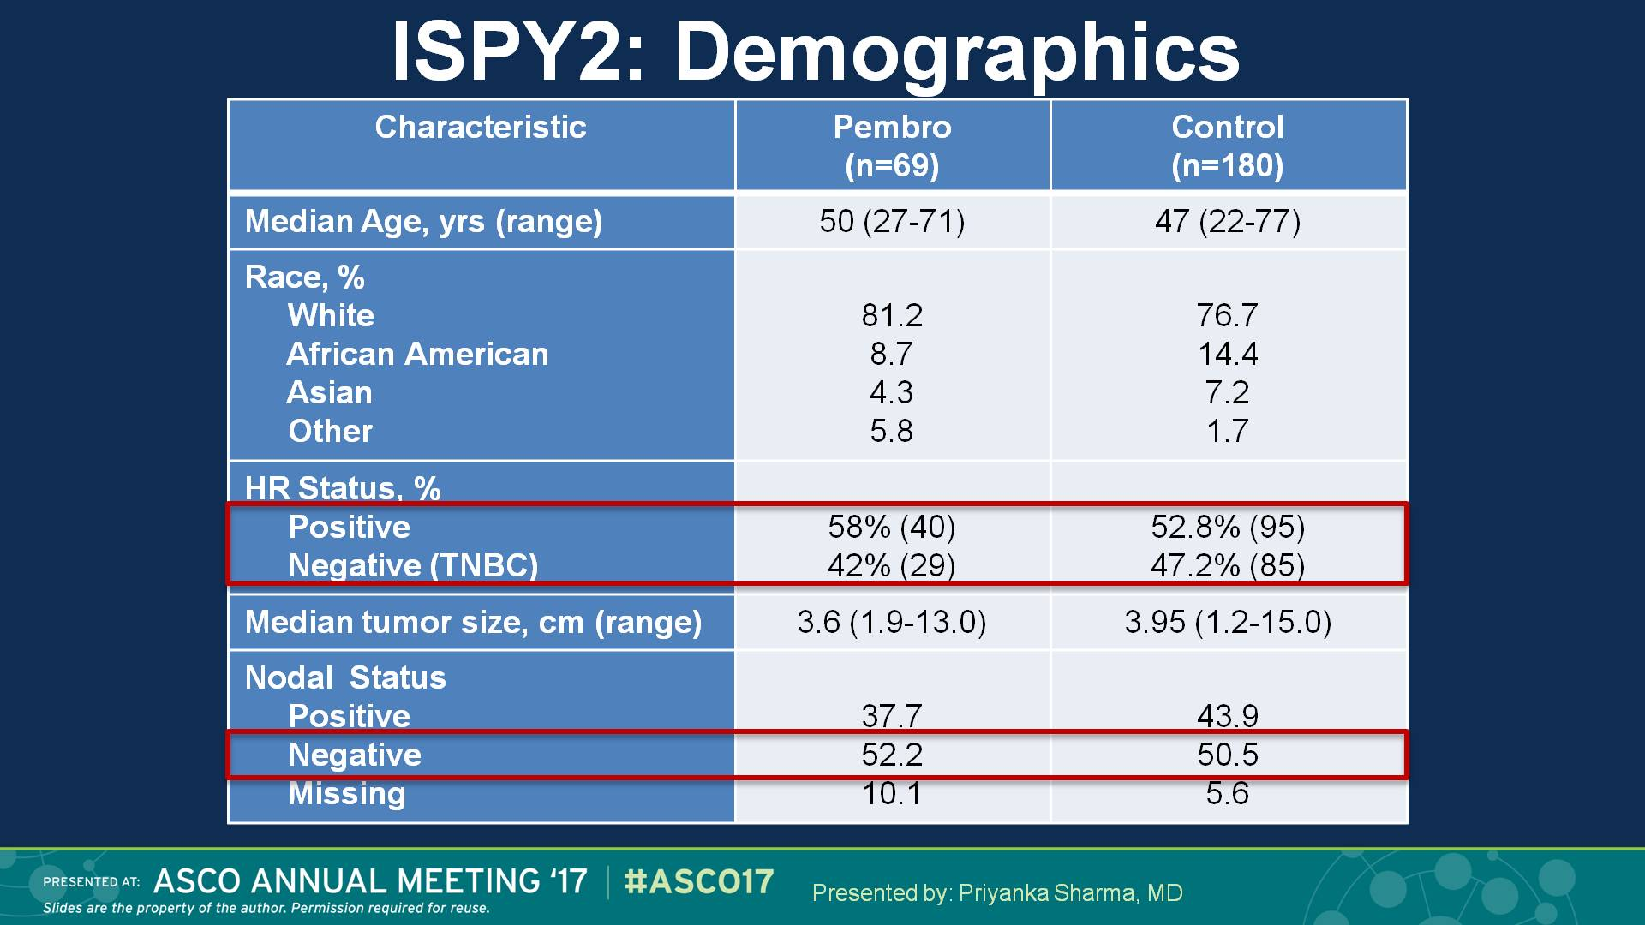
ISPY2: Demographics
Presented By Priyanka Sharma at 2017 ASCO Annual Meeting

Slide 51
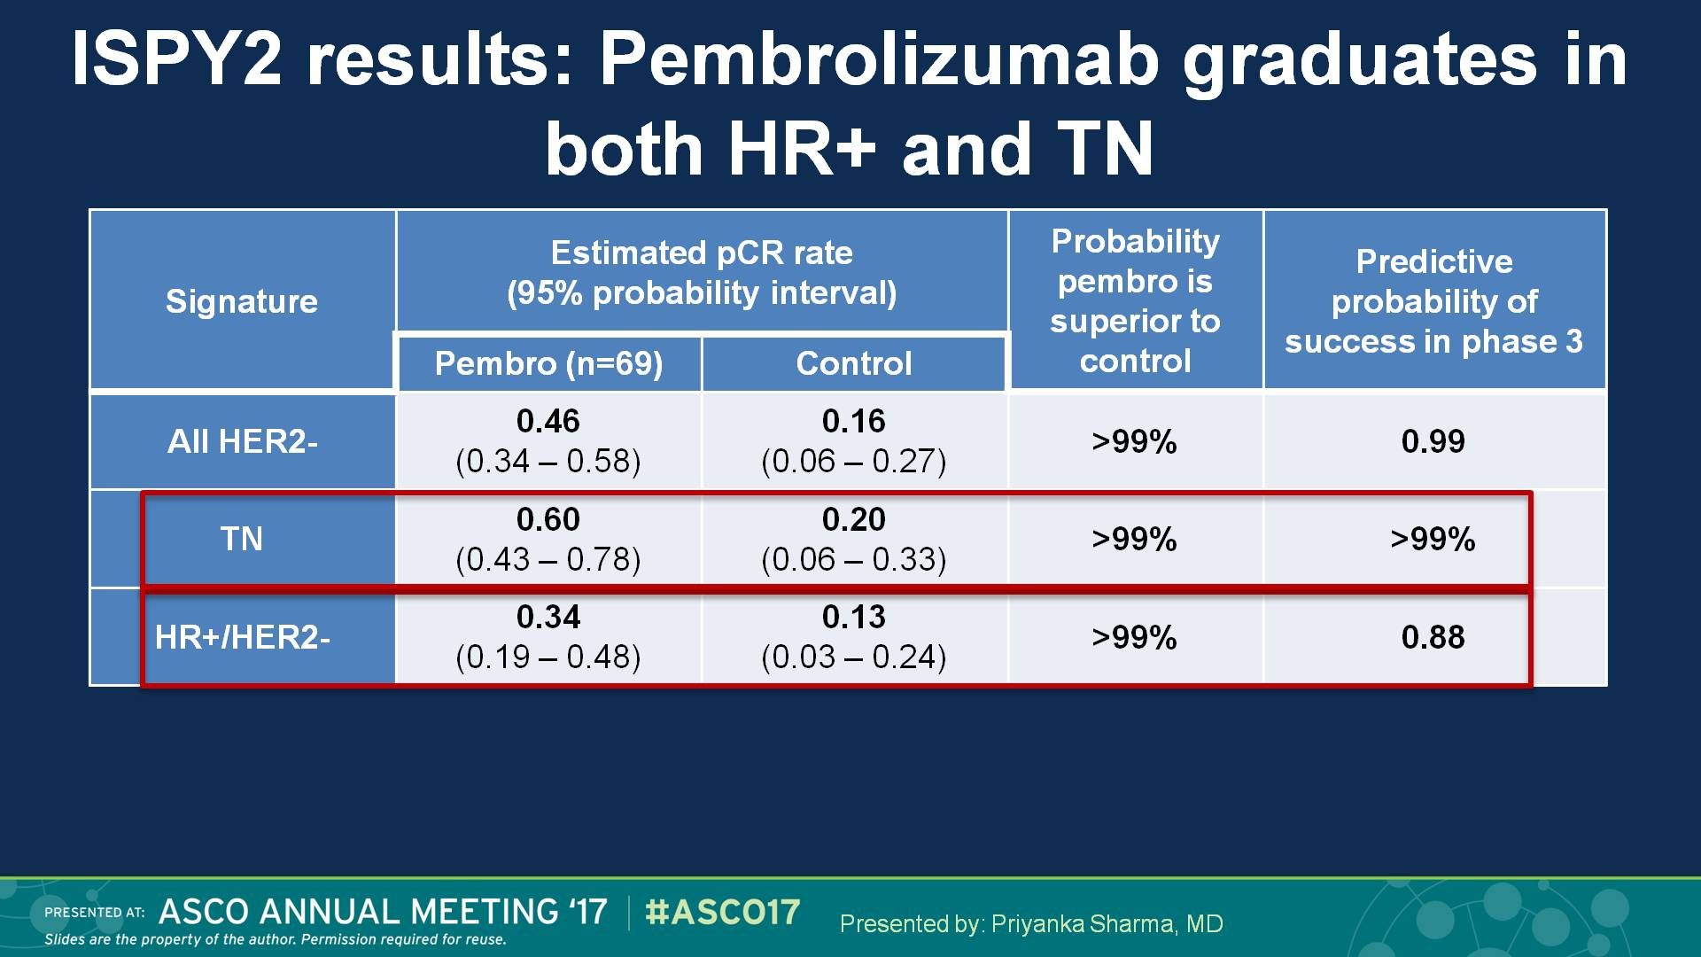
ISPY2 results: Pembrolizumab graduates in both HR+ and TN
Presented By Priyanka Sharma at 2017 ASCO Annual Meeting

Slide 52
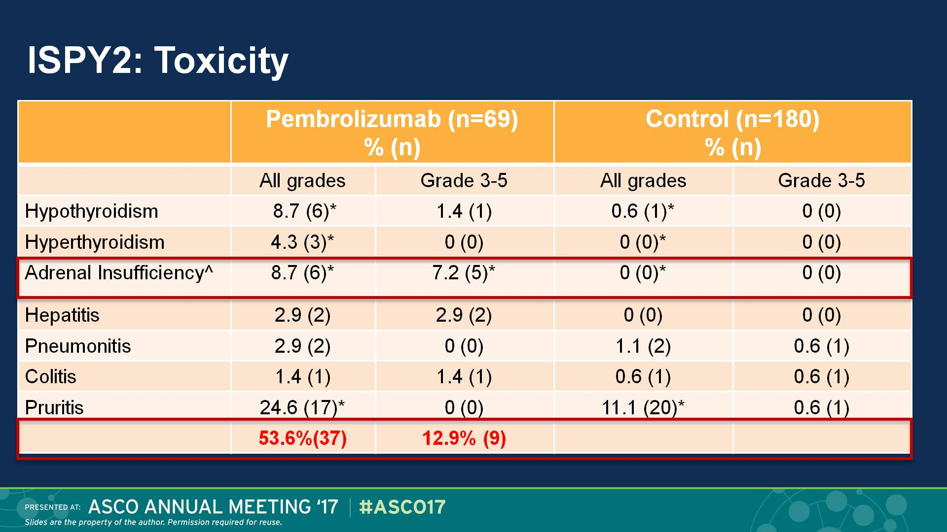
ISPY2: Toxicity
Presented By Priyanka Sharma at 2017 ASCO Annual Meeting

Slide 53
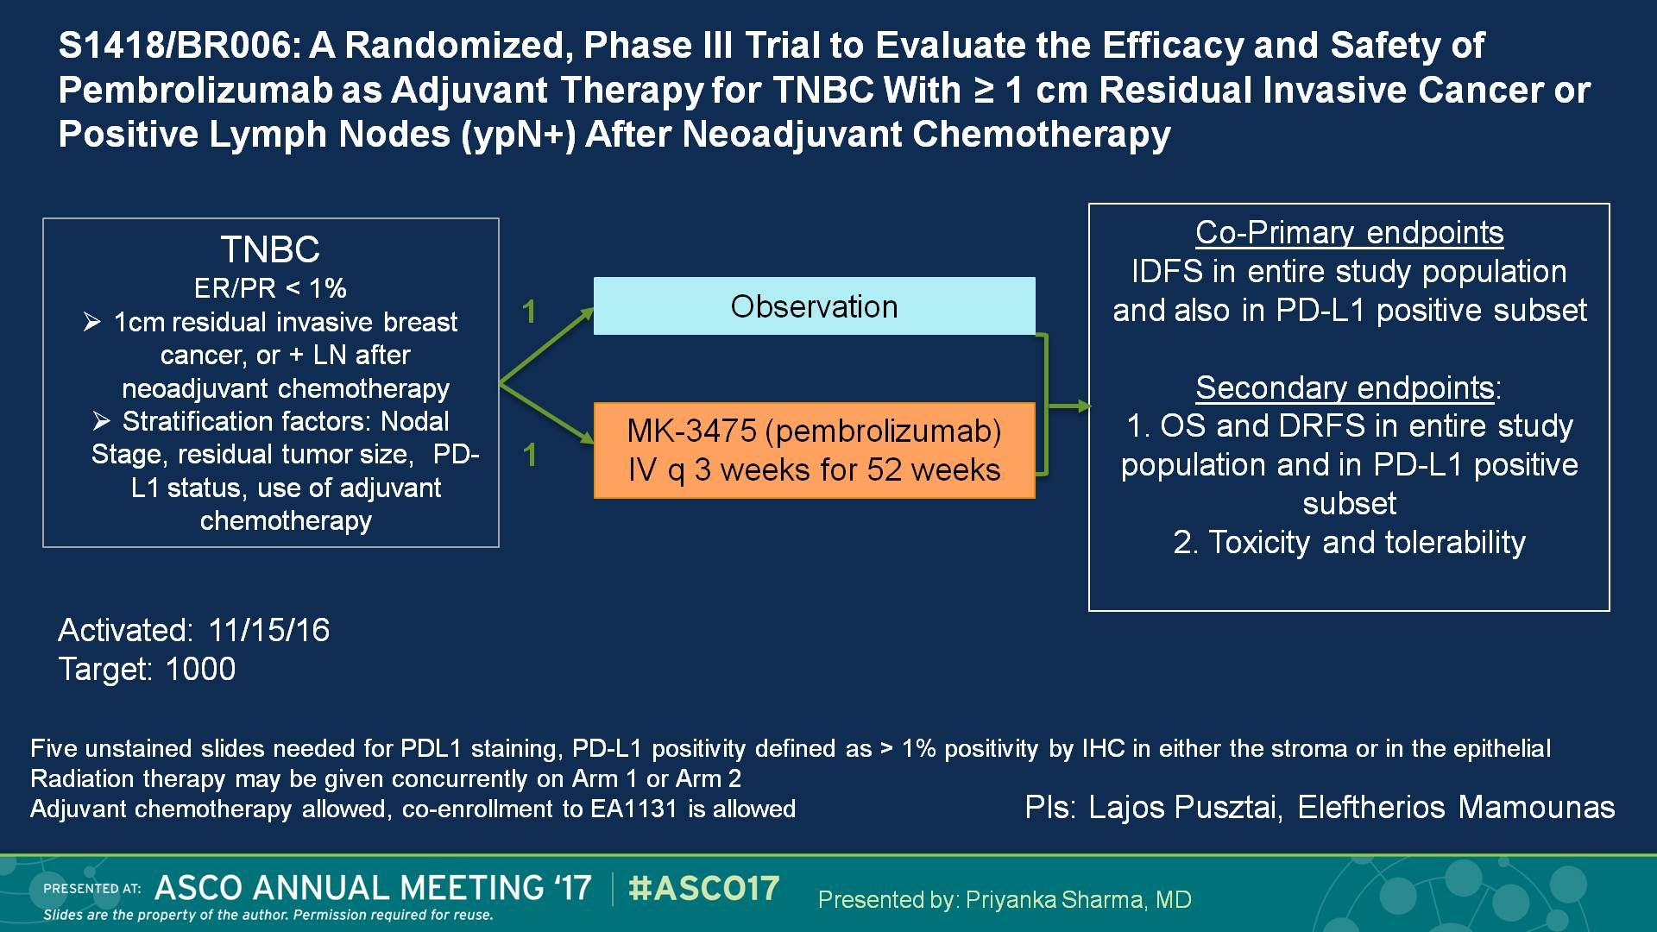
S1418/BR006: A Randomized, Phase III Trial to Evaluate the Efficacy and Safety of Pembrolizumab as Adjuvant Therapy for TNBC With ≥ 1 cm Residual Invasive Cancer or Positive Lymph Nodes (ypN+) After Neoadjuvant Chemotherapy
Presented By Priyanka Sharma at 2017 ASCO Annual Meeting

Slide 54
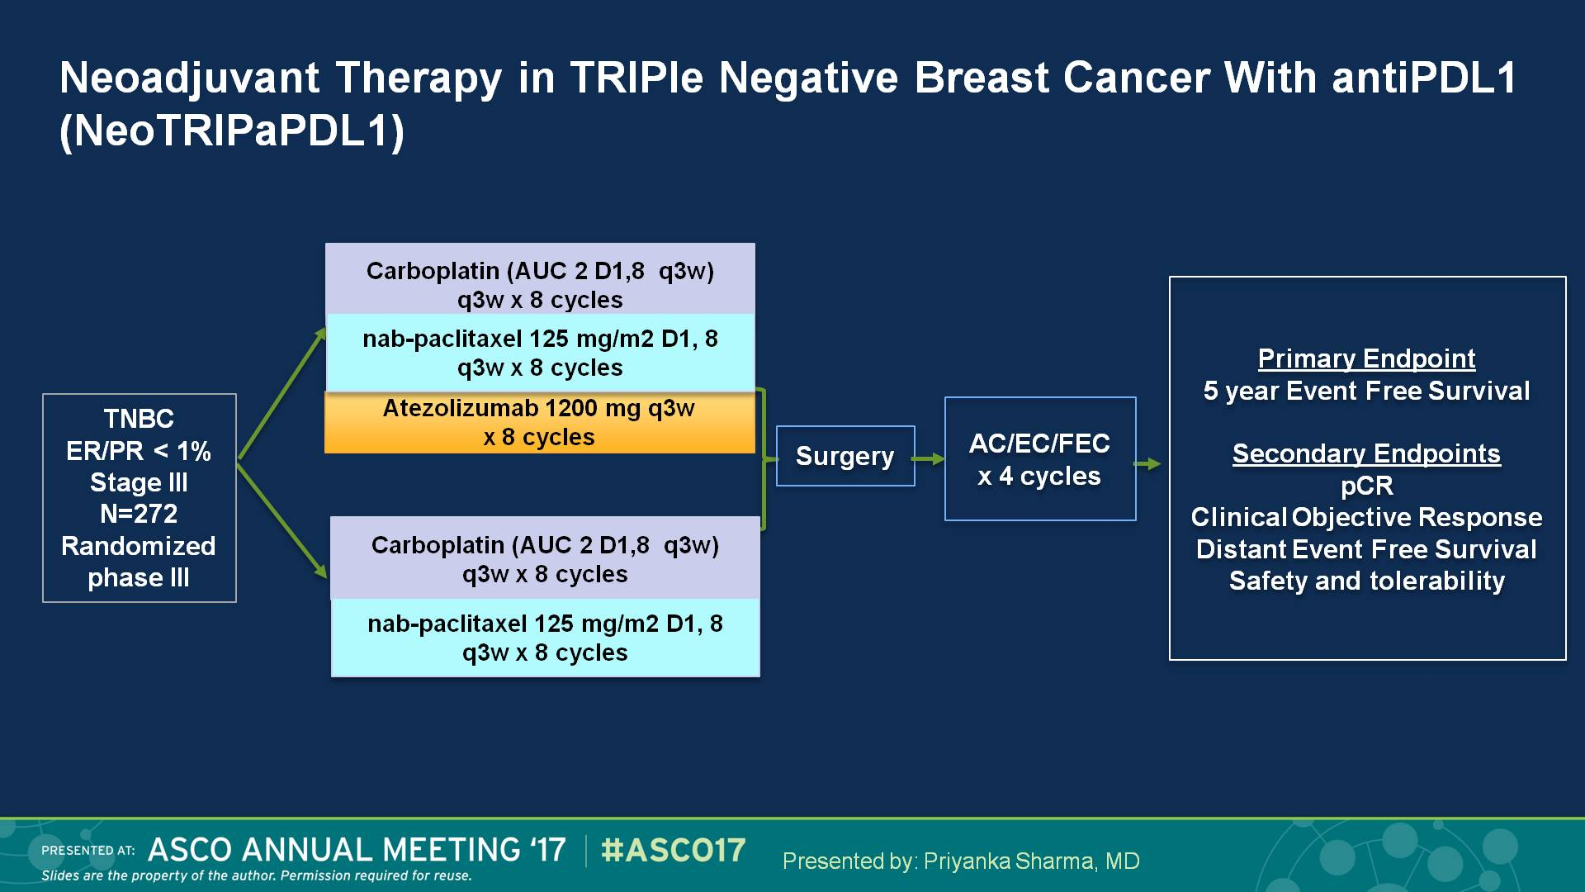
Neoadjuvant Therapy in TRIPle Negative Breast Cancer With antiPDL1 (NeoTRIPaPDL1)
Presented By Priyanka Sharma at 2017 ASCO Annual Meeting

Slide 55
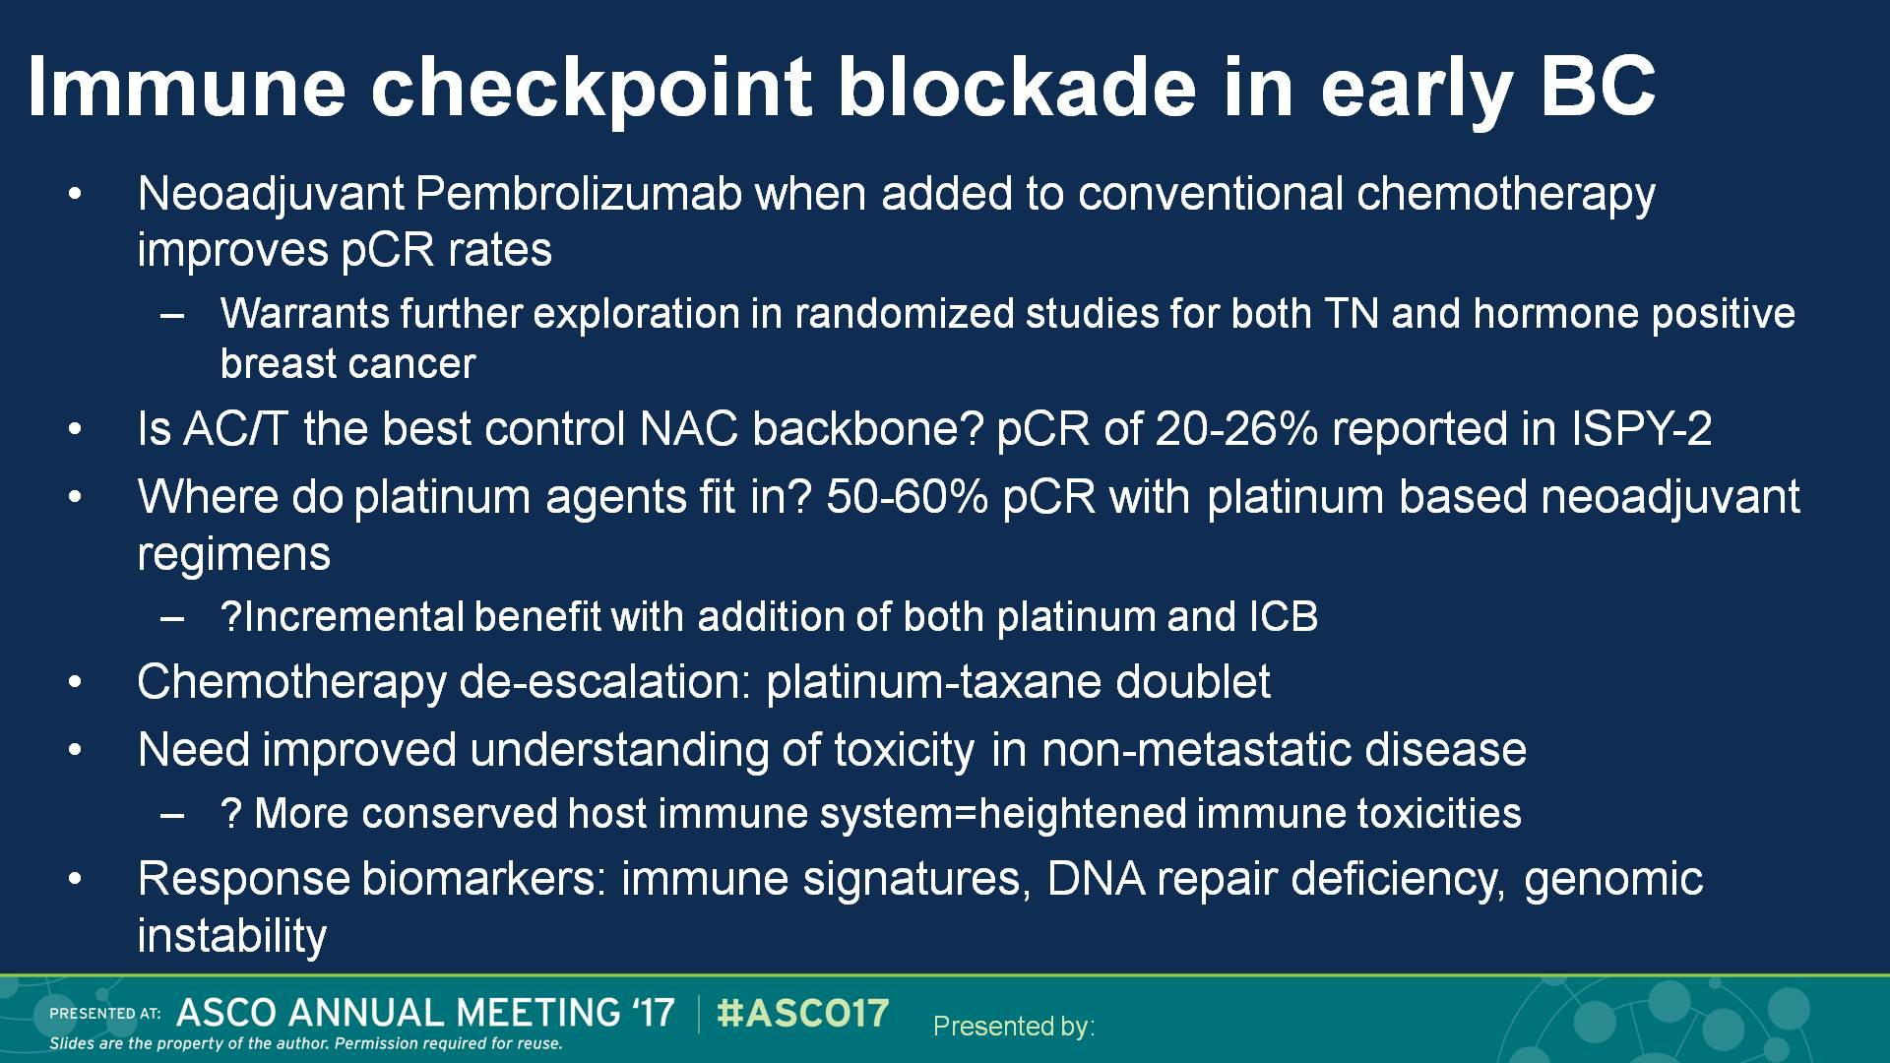
Immune checkpoint blockade in early BC
Presented By Priyanka Sharma at 2017 ASCO Annual Meeting

Slide 56
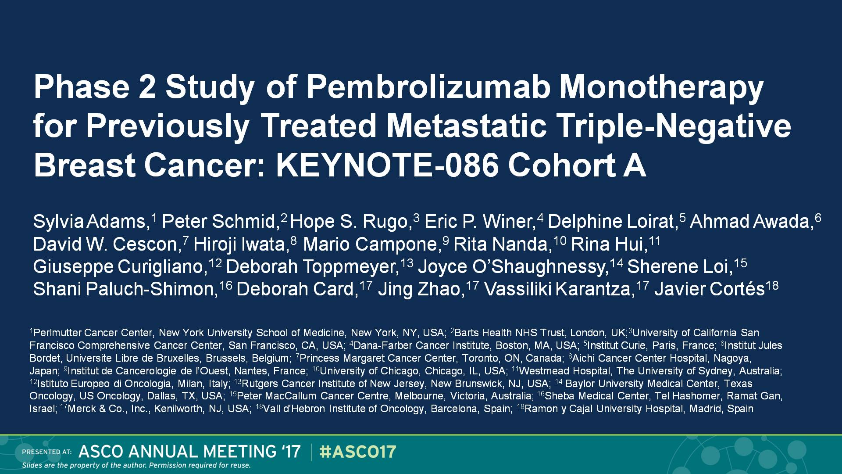
Slide 1
Presented By Sylvia Adams at 2017 ASCO Annual Meeting

Slide 57
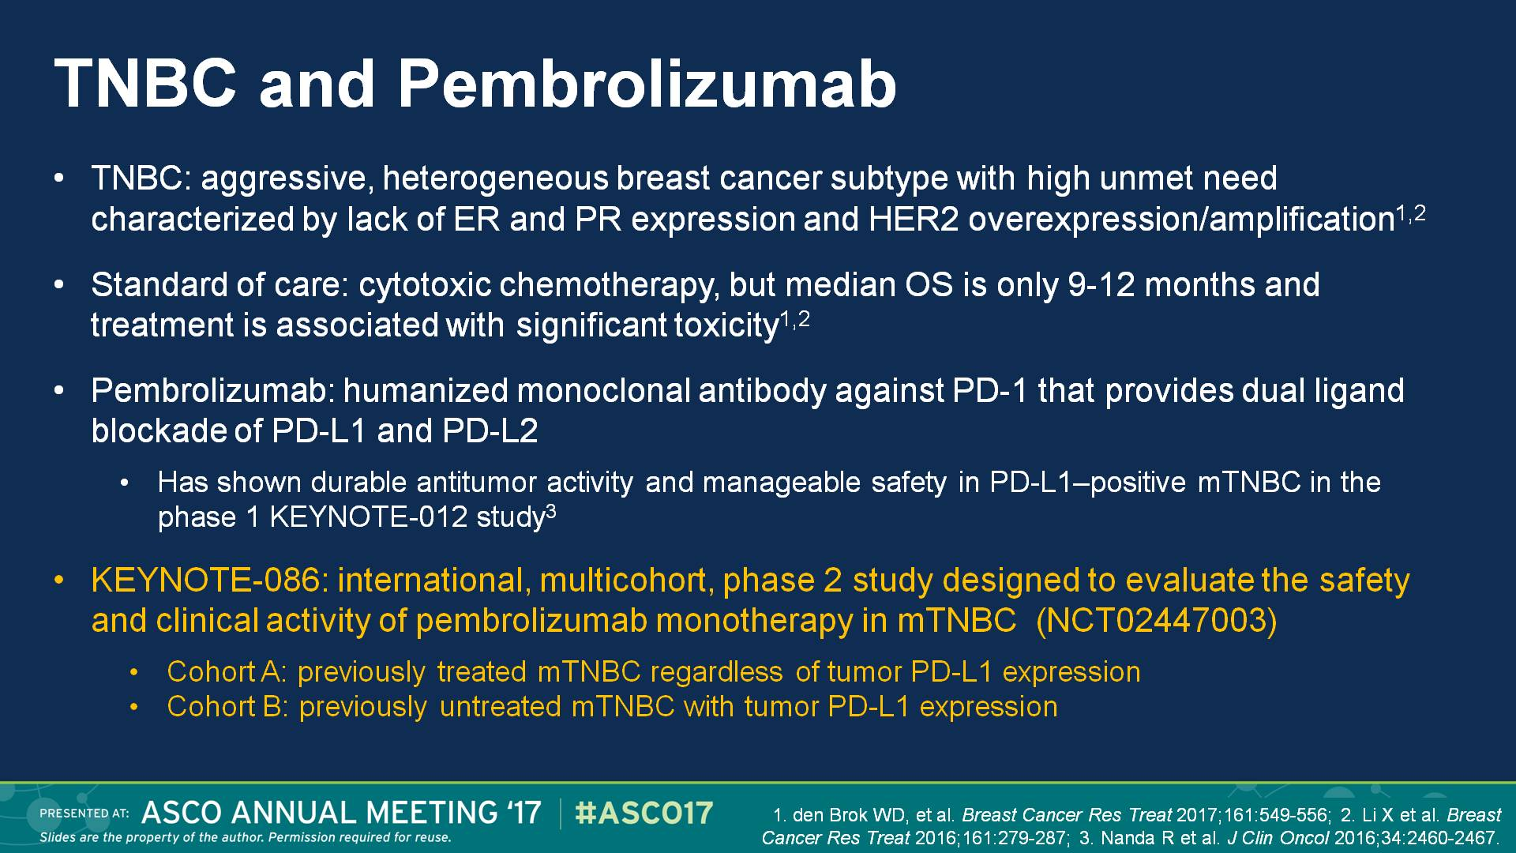
TNBC and Pembrolizumab
Presented By Sylvia Adams at 2017 ASCO Annual Meeting

Slide 58
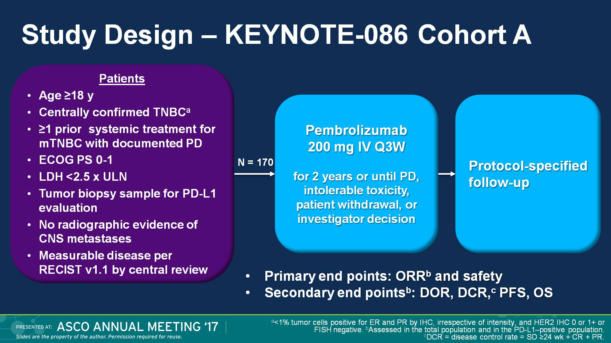
Slide 4
Presented By Sylvia Adams at 2017 ASCO Annual Meeting

Slide 59
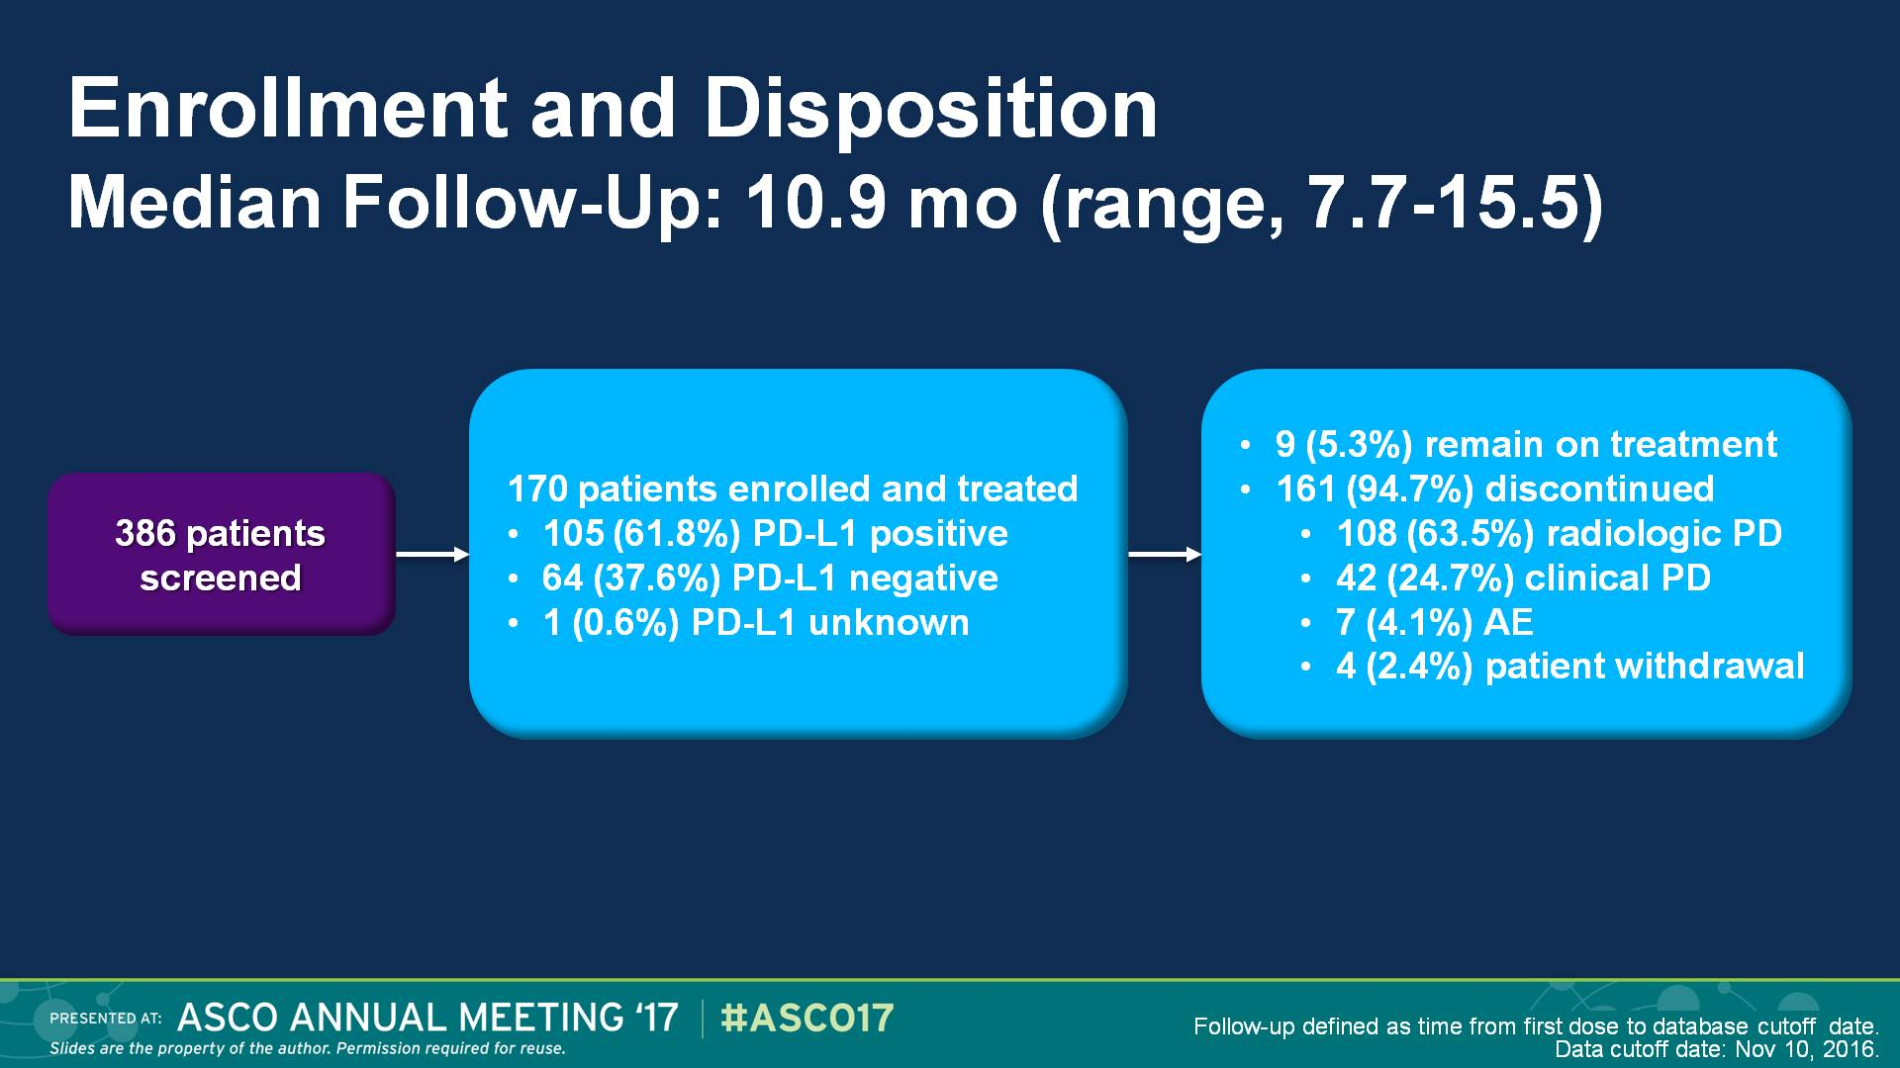
Slide 7
Presented By Sylvia Adams at 2017 ASCO Annual Meeting

Slide 60
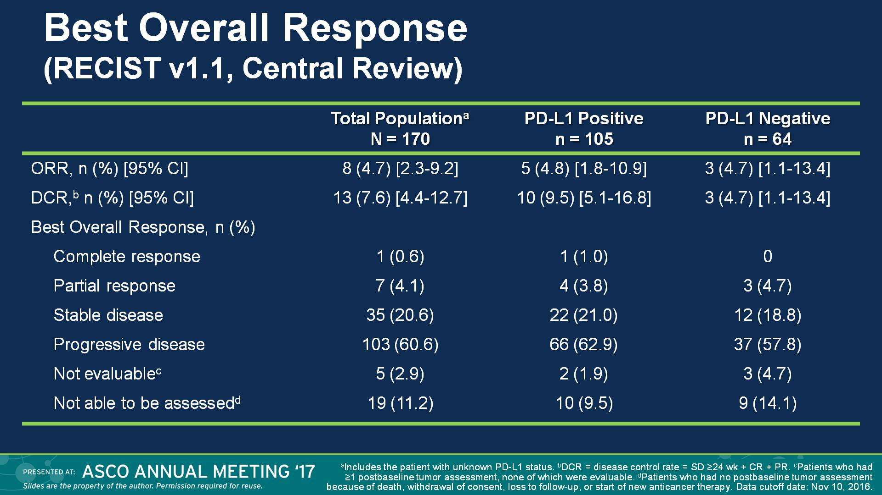
Best Overall Response <br />(RECIST v1.1, Central Review)
Presented By Sylvia Adams at 2017 ASCO Annual Meeting

Slide 61
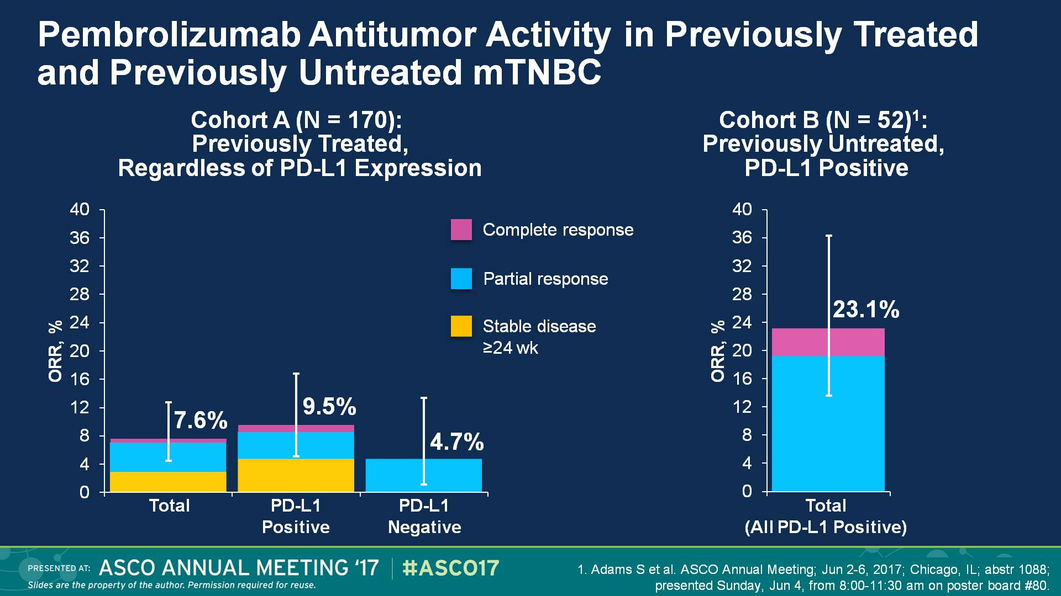
Pembrolizumab Antitumor Activity in Previously Treated and Previously Untreated mTNBC
Presented By Sylvia Adams at 2017 ASCO Annual Meeting

Slide 62
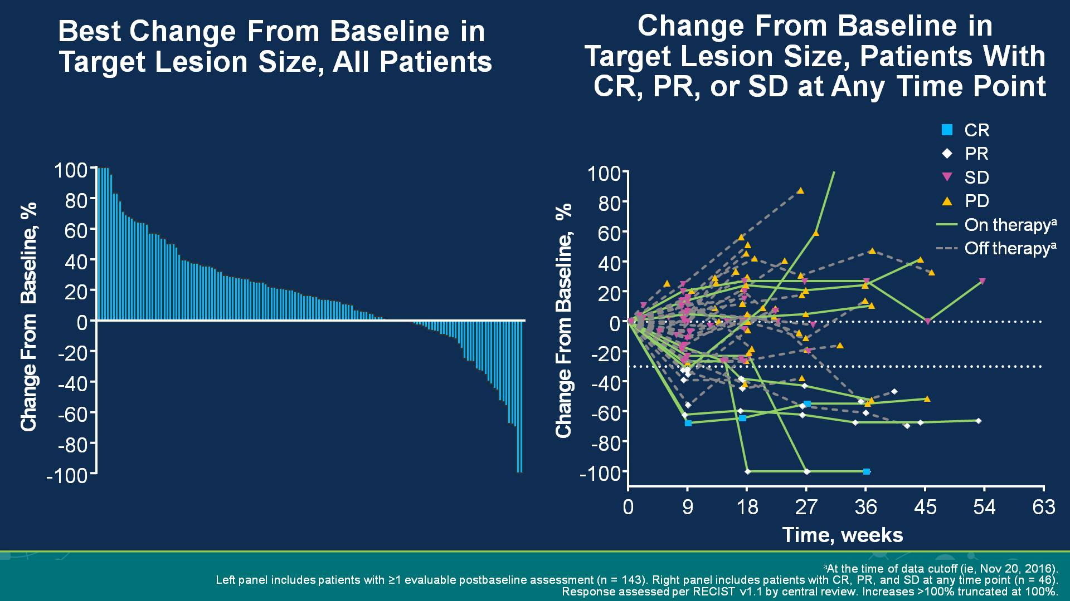
Slide 11
Presented By Sylvia Adams at 2017 ASCO Annual Meeting

Slide 63

Time to Response and Duration of Response and Stable Disease (RECIST v1.1, Central Review)
Presented By Sylvia Adams at 2017 ASCO Annual Meeting

Slide 64

Kaplan-Meier Estimate of PFS<br />(RECIST v1.1, Central Review)
Presented By Sylvia Adams at 2017 ASCO Annual Meeting

Slide 65

Kaplan-Meier Estimate of OS
Presented By Sylvia Adams at 2017 ASCO Annual Meeting

Slide 66

Overall Survival by Best Overall Response
Presented By Sylvia Adams at 2017 ASCO Annual Meeting

Slide 67

Slide 17
Presented By Sylvia Adams at 2017 ASCO Annual Meeting

Slide 68

Pembrolizumab Antitumor Activity in Previously Treated and Previously Untreated mTNBC
Presented By Sylvia Adams at 2017 ASCO Annual Meeting

Slide 69

Summary and Conclusions
Presented By Sylvia Adams at 2017 ASCO Annual Meeting

Slide 70
Pembrolizumab in TNBC
Pembrolizumab is active in pretreated TNBC
-activity independent of PD-L1 expression
-greater in less pretreated disease
-prolonged DOR in responsive pts (CR PR SD)
Treatment was well tolerated
Further randomized studies with Pembrolizumab monotherapy
or Pembro based are ongoing in TNBC

