Slide 1
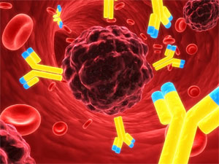
INNOVATIVE TREATMENTS IN CANCER MEDICINE
ROME MAY 18-19 2016
VENUE: SAPIENZA UNIVERSITY – AULA ORGANI COLLEGIALI
PIAZZALE ALDO MORO 5
Olaparib and beyond in ovarian cancer
Relatore: dott.ssa Federica Tomao
Dipartimento di Scienze Ginecologico-Ostetriche e Scienze Urologiche
Università di Roma “Sapienza”

Slide 2
Ovarian Cancer Statistics
Incidence and mortality worldwide
and in Italy?
-Età (80%): 45-65 anni
5 years OS: 49,7%
New cases/years: 485
New deaths/years: 320
5 years OS: 38% (37-39)
Torre LA et al., CA CANCER J CLIN 2015; AIRTUM ( 2005-2009); FIGO Annual Report, 2006

Slide 3
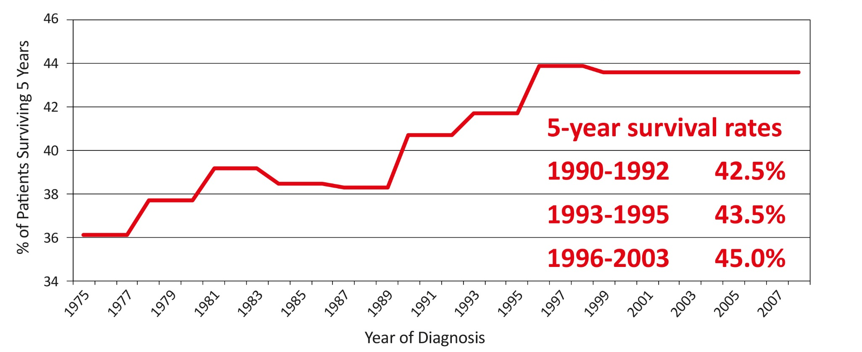
Survival modification within the years
RT: the most important prognostic factor
The importance of expertize of surgeons
Bristow RE, Gynecol Oncol 2010

Slide 4
Evolution of adjuvant treatment
Different combination regimens
(until 1970)
Bevacizumab
2013
Carboplatin 1985
Carboplatin + Paclitaxel
1998
Cisplatin 1971
Cisplatinin + Paclitaxel
1996
Intraperitoenal CT
2006
In the future?
Tailered tretments

Slide 5
Standard
Median PFS 15.4-16.4 months
5 Years OS 30-35%
Carboplatino AUC5-6 + Taxolo 175mg/mq every 21 days (6 cycles)

Slide 6
Angiogenesi
Indications: FIGO stage III B, III C e IV
Spread of disease (ascites, CA125…) and RT are the most important predictors of response
NOT for FDA

Slide 7
Recurrent OC
IIIC-IV Stage
50-75% of recurrences
 | Response to Platinum compounds
 | Time to Recurrence | Further response to platinum compounds
Platinum-sensitive (PS) | >12 months | 30-60%
Partially-platinum sensitive (PPS) | 6-12 months | 25-30%
Platinum-resistant (PR) | < 6 months | < 10%
Platinum-refractory (PD) | 0-1 months | N/A

Slide 8
Standard of treatment at recurrent disease
PS | Platino+Taxolo o PLD o Gemcitabina o Etoposide
PPS | To define (platinum vs platinum-free strategy)
PR | Seconda linea (Topotecan, PLD, Gemcitabina, Etoposide)
RD | To define
Notes:
But an alternative possibility is emerging: In this setting the response rate to platinum is in the order of 25-30%

Slide 9
PFI definition
The historical classification of recurrent ovarian cancer according to PFI
has recently been criticized for various reasons…
Platinum sensitivity definition has been defined arbitrarily, based on observational studies, and a probabilistic partition with the likelihood of response being a continuous variable.
It can be heavily influenced by the timing of follow-up visits, and the use of CA125 as a trigger leading to further imaging examinations, modalities which have significantly changed over the time.
Furthermore, improvements in surgical cytoreduction technique and the introduction of biological agents as maintenance therapy could have modified the natural course of disease.
Finally, the platinum sensitivity definition only applies to chemotherapy, since no similar relationship has been demonstrated for other agents currently used in the clinical practice.
Tomao F & Colombo N, (under submission) 2017

Slide 10
Trials in recurrent ovarian cancer should incorporate
-Treatment-free interval (TFI)
TFIp (platinum)
TFInp (non-platinum), TFIb (biological agent to be specified)
-Histological type
-BRCA status (gBRCA, and others including somatic BRCA and HRDa to be considered as data emerge)
-Type of prior therapy (anti-angiogenic agents, PARP inhibitors, chemotherapy and others)
-Number of prior lines of chemotherapy (trials should not be limited to second or third line)
-Presence or absence of symptoms and type (e.g. ascites, abdominal symptoms, pain, performance status)
-Other factors to be considered: tumour volume and previous surgical outcome 2. Separate trials are needed for populations with unmet needs:
Medically compromised and/or elderly patients
Multiple lines of prior chemotherapy
Wilson MK, Ann Oncol 2017

Slide 11
Evolution of treatment in recurrent disease
Different combination regimens
(until 1970)
Bevacizumab in PS
2012
Bevacizumab in PR
2014
Parp-Inhibitors in BRCAm in PS
2012
Classification of recurrence according to PFI 1991
In the future?
Tailered tretments

Slide 12
Increase of interest towards
Target approaches

Slide 13
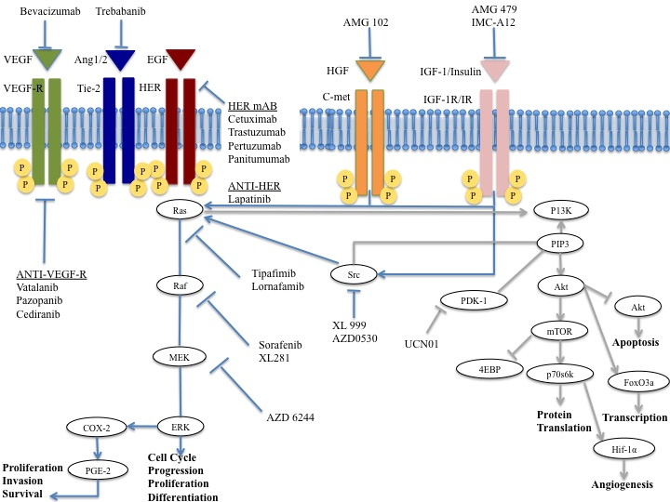
Other targets?
Tomao F, Exp Op Pharmacoth, 2017 (inpress)

Slide 14
Other targets?
DNA repair
HR repair
DNA modulators
Iniparib
Olaparib
Niraparib
Rucaparib
Decitabine, 5-aza-2’-deoxycytidine azacitidine, 5-azacytidine vorinostat
ATM
ATR
p53
BRCA
Rad51
Others
Mirvetuximab Soravtansine
Avelumab
Chk1
UCN-01
LY2606368
AZD7762
ER
HNF-1beta
Tomao F, Exp Op Pharmacoth, 2017 (inpress)

Slide 15
The PARP-Inhibitors ERA
NB: 233 publications on Olaparib (2009-2017)!!!!!!!!!

Slide 16
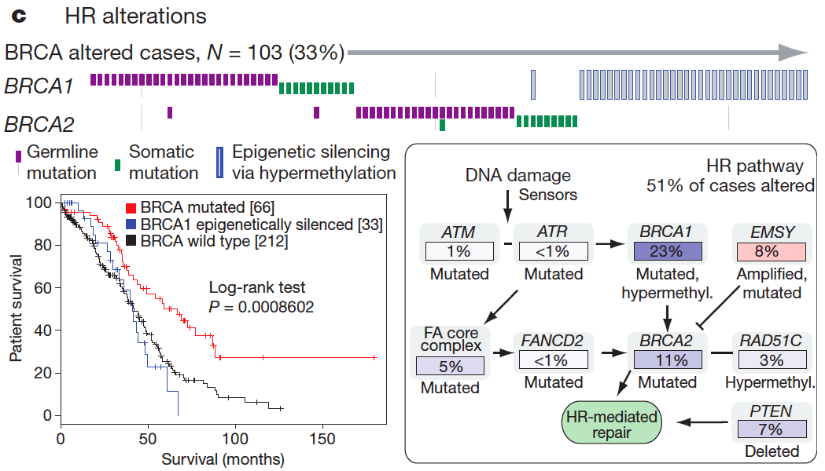
Homologous recombination defects
Other HRD 7%: TP53, RAD51C, PALB2, RAD50, MRE11A, BARD1, CHEK2, BRIP1, FANCD2, ATR, ATM
TCGA, Nature 2011; Swisher et al, PNAS 2011 in press; Turner, et al NatRevCancer 2004; Weberpals, et al JCO 2008;
Tan et al, JCO 2008; Mendes-Pereira et al, EMBO Mol. Med. 2009

Slide 17
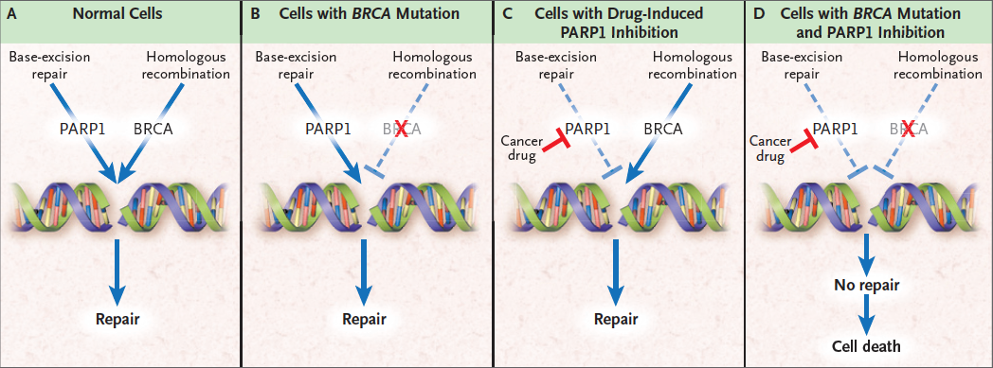
Synthetic Lethality
Dirk Iglehart J, Silver DP. The New England Journal of Medicine 2009

Slide 18
Mechanism of action similar to other chemotherapic drugs
The concept of PARP trapping and the expression of PARP for PARP-I efficacy
Understanding mechanism of action of PARP-I is necessary: FURTHER STUDIES ARE NEEDED
Pommier Y et al., Sc Transl Med, 2016

Slide 19
PARP inhibitors
Based on “tumour synthetic lethality” targeting cells with homologous recombination deficiency (HRD) − is this a new treatment for BRCA mutation associated ovarian cancer?
Exquisite preclinical
efficacy of PARP inhibitors
Phase I trial confirms excellent tolerance and expansion in 50 BRCA patients showed 46% response
Randomized trial (maintenance therapy) showed marked PFS benefit
“This is not like chemotherapy”
Farmer H et al.
Nature 2005;434:917-21
Fong P et al. N Engl J Med 2009;361:123-34
Fong P et al. J Clin Oncol 2010;28:2512-9
Ledermann J et al.
NEJM 2012;366:1382-92

Slide 20
Olaparib: the study 19
N=265
Platinum-sensitive recurrent high-grade serous ovarian cancer
≥2 prior regimens of platinum-based chemotherapy
Complete or partial response to most recent platinum-based regimen
Primary endpoint: Progression-free survival (PFS) by RECIST 1.0
Secondary endpoints included: Overall survival (OS), safety and tolerability
Exploratory endpoints: Time to first subsequent therapy or death (TFST), time to second subsequent therapy or death (TSST)
n=136
Olaparib maintenance monotherapy
(400 mg bid, capsules)
Double-blind randomization
1:1
Treatment until progression
Placebo (bid, capsules)
n=129
BRCA testing:
Previous local germline BRCA testing (case report forms)
Retrospective germline BRCA testing or tumour BRCA testing
BRCAm: n=136
BRCAwt:* n=118
*BRCAwt patients did not have a detected BRCAm or had a BRCAm of unknown significance.
bid, twice daily; BRCAwt, BRCA1/2 wild type; RECIST, Response Evaluation Criteria in Solid Tumours

Slide 21
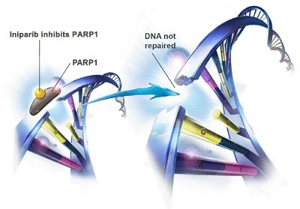
Olaparib: the study 19
 | Olaparib | Placebo
Events: patients (%) | 60:136 (44.1) | 93:129 (72.1)
Median (months) | 8.4 | 4.8
326 pz
Ledermann J et al. NEJM 2012
Notes:
PARP (poli-ADP ribosio-polimerase) sono una famiglia di enzimi coinvolti nei meccanismi di riparazione del DNA

Slide 22
PFS according to BRCA status
82% risk reduction of death and progression
BRCAm (n=136)
 | Olaparib | Placebo
Events: total patients (%) | 26:74 (35.1) | 46:62 (74.2)
Median PFS (months) | 11.2 | 4.3
HR=0.18 95% CI (0.11, 0.31); P<0.00001
1.0
0.9
0.8
0.7
0.6
Proportion of patients progression-free
0.5
0.4
0.3
Olaparib BRCAm
0.2
Placebo BRCAm
0.1
0
0
3
6
9
12
15
Time from randomization (months)
Number at risk
Olaparib BRCAm
74
59
33
14
4
0
Placebo BRCAm
62
35
13
2
0
0
Ledermann J et al, Lancet Oncol, 2014

Slide 23
9.3 Terapia di II linea
Il test BRCA è raccomandato a tutte le pazienti con carcinoma ovarico non mucinoso, non border-line in quanto, oltre a rappresentare uno strumento di prevenzione, può essere di aiuto nella programmazione terapeutica.
Qualità dell’evidenza SIGN | Raccomandazione clinica | Forza della raccomandazione clinica
A | Nelle pazienti con malattia platino- refrattaria/resistente con indicazione alla chemioterapia, dovrebbe essere preso in considerazione un trattamento monochemioterapico | Positiva forte
A | Nelle pazienti con malattia platino-sensibile, dovrebbe essere preso in considerazione un trattamento con carboplatino in combinazione con paclitaxel, gemcitabina o doxorubicina pegilata | Positiva forte
A | Nelle pazienti non pretrattate con bevacizumab, bevacizumab dovrebbe essere preso in considerazione in associazione alla chemioterapia e continuato come mantenimento | Positiva forte
B | Nelle pazienti con mutazione di BRCA, olaparib dovrebbe essere preso in considerazione dopo la chemioterapia e continuato come mantenimento | Positiva forte*
B | Nelle pazienti con recidiva tra 6 e 12 mesi, non candidate a platino, dovrebbe essere presa in considerazione la combinazione di trabectedina e doxorubicina pegilata | Positiva forte
* anche in presenza di mutazioni somatiche

Slide 24
Study 19 OS analyses
28 Aug 2008
31 Oct 2011
26 Nov 2012
30 Sep 2015
FSI
DCO
DCO
DCO
1
2
3
OS data maturity: 38%
Alpha (two-sided) = 0.1%
HR=0.94
95% CI: 0.63-1.39, p=0.75¹
OS data maturity: 58%
Alpha (two-sided) = 3%
HR=0.88
95% CI: 0.64-1.21, p=0.44²
OS data maturity: 77%
Alpha (two-sided) = 0.95%
Additional follow-up since previous analysis = 3 years
CI, confidence interval; DCO, data cut-off; FSI, first subject; OS, overall survival
1. Ledermann J et al. New Engl J Med 2012; 2. Ledermann J et al. Lancet Oncol 2014

Slide 25
OS in BRCAm population
BRCAm (n=136)
 | Olaparib (n=74) | Placebo (n=62)
Deaths, n (%) | 47 (64) | 48 (77)
Median OS (months) | 34.9 | 30.2
Maturity: 70%
Criterion for statistical significance
not met (p<0.0095)
Summary of the Cox proportional hazards analysis of OS
in the overall study population and different BRCAm subgroups
Ledermann J et al. Lancet Oncol 2016

Slide 26
OS adjusted for postprogression
PARP-Inhibitor Therapy
All sites BRCAm (n=136) |  |  | PARP-I excluded after progression BRCAm (n=97)
 | Olaparib | Placebo | Olaparib | Placebo
Events: total patients (%) | 37:74 (50.0) | 34:62 (54.8) | 28:57 (49.1) | 22:40 (55.0)
Median OS (months) | 34.9 | 31.9 | 34.9 | 26.6
 | HR=0.73 95%CI (0.45,1.17); P=0.192 |  | HR=0.52 95% CI (0.28,0.97); P=0.039
14 pts received Olaparib post-progression
Matulonis UA et al., Cancer 2016

Slide 27
Study 19: adverse events
 | Overall patient population |  |  |  | Patients with BRCA mutation
 | All grades |  | Grade ≥3 |  | All grades |  | Grade ≥3
 | Olaparib (n=136) | Placebo (n=128) | Olaparib (n=136) | Placebo (n=128) | Olaparib (n=74) | Placebo (n=62) | Olaparib (n=74) | Placebo (n=62)
Any adverse event | 132 (97%) | 119 (93%) | 55 (40%) | 28 (22%) | 72 (97%) | 58 (94%) | 28 (38%) | 11 (18%)
Legend
Data are number of patients (%).
Adverse events (any grade) in ≥10% of patient overall and grade ≥3 events in ≥3% of patients in either treatment group.
Ledermann J et al. Lancet Oncol 2014

Slide 28
Other Phase II studies on Olaparib
Trial | Patient population | Pts | Treatment | Results
Study 12 | gBRCA mutation carriers, No prior PLD. Recurrence within 12 months. | 97 | -Olaparib 400 mg BID -Olaparib 200 mg BID -PLD 50 mg/m2 | No difference amongst arms for PFS; 6.5 mos (200), 8.8 mos (400), 7.1 mos (PLD)
NCT01081951 | Platinum sensitive recurrent HGSOC (BRCAm and wt) | 162 | -Olaparib (200 mg BID, d1–10/21) + Pac (175 mg/m2 iv, d1) + C (AUC4 iv, d1), olaparib 400 BID maintenance -C AUC 6, Pac 175 mg/m2 | Median PFS 12.2 (olaparib arm) versus 9.6 mos (no olaparib) p = 0.0012
NCT01116648 | Platinum-sensitive recurrent HGSOC (BRCAm and wt) | 90 | -Cediranib 30 mg daily and olaparib 200 mg BID (ced/olap) -olaparib 400 mg BID (olap) | Median PFS 17.7 months (ced/olap) versus 9 months (olap) For gBRCA pts: 19.4 versus 16.5 months For BRCAwt or unknown: 16.5 versus 5.7 months

Slide 29
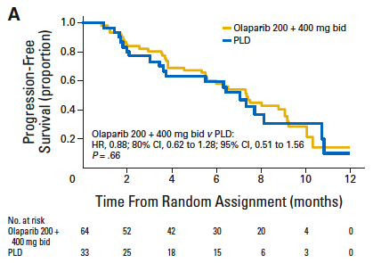
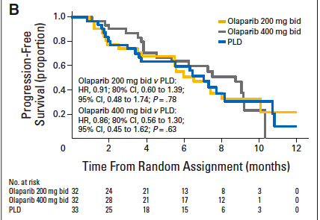
Study 12
ORR:
31% Olaparib 400 mg
vs 18% PLD
BRCA1-2mut patients
Recurrence within 12 months
Kaye SB et al. JCO 2012

Slide 30
Olaparib plus CT
 | Olaparib + CT | CT
Events: total patients (%) | 7/20 (35.0%) | 16/21 (76.2%)
Median PFS (months) | NR (95% CI 9.6-NR) | 9·7 months (95% CI 7·3–10·0)
HR=0.21 95% CI (0.08, 0.55); P<0.0015
OS
Oza AM et al, Lancet Oncol, 2015

Slide 31
Cediranib-Olaparib
PFS= 17.7 months with cediranib-olaparib vs 9.0 months with olaparib alone (HR 0.42, 95% CI 0.23–0.76; p=0.005).
Strongest benefit in PFS in gBRCAwt/u (p = 0.008) in 32-76% (p = 0.006)
More grade 3-4 adverse events in combination arm (12 pts vs 5 pts), diarrhoea (10 pz vs 1 pz), hypertension (18 pts vs 0).
Liu JF et al. Lancet Oncol 2014

Slide 32
The BAROCCO Study
v
Italian multicenter randomized phase II study of weekly paclitaxel vs. Cediranib-Olaparib with continuous schedule vs. Cediranib-Olaparib with intermittent schedule in patients with platinum resistant high grade epithelial ovarian, fallopian tube, or primary peritoneal cancer.
SPONSOR: Mario Negri Gynaecology Oncology Group (MaNGO)
PI: Prof.ssa Nicoletta Colombo, Istituto Europeo di Oncologia
SUPPORT: AstraZeneca

Slide 33
Phase II studies on
other Parp-Inhibitors
Trial | Patient population | Pts | Treatment | Results
NCT01113957 | Recurrent HGSOC (BRCAm and wt) | 168 | -Veliparib + temozolomide -PLD | NA
NCT01081951 | Recurrent HGSOC (BRCAm and wt) | 74 | -Oral cyclophosphamide 50 mg daily and veliparib 60 mg daily -Oral cyclophosphamide 50 mg daily | No improvement of ORR with additional of veliparib

Slide 34
ARIEL2 Trial
HRD causes genome-wide loss of heterozygosity (LOH)
that can be measured by comprehensive
genomic profiling based on NGS
Primary endpoint PFS according to subgroups:
-BRCA mutant (deleterious germline or somatic),
-BRCA wild-type and LOH high (LOH high group), or
-BRCA wild-type and LOH low (LOH low group)
ASCO 2015

Slide 35
ARIEL2 Trial
206 PTS: 192 classified as:
BRCA mutant (n=40),
LOH high (n=82), or
LOH low (n=70).
HRD subgroup | Median PFS, mo (90% CI)
BRCAm | 9.4 (7.3, Not Reached)
BRCA-like | 7.1 (3.7, 10.8)
Biomarker negative | 3.7 (3.5, 5.5)
Subgroup comparison | HR (90% CI)
BRCAm vs Biomarker negative | 0.47 (0.35, 0.64)
BRCA-like vs Biomarker negative | 0.61 (0.41, 0.92)

Slide 36
Phase III studies of PARP inhibitors
-frontline treatment-
Trial | Patient population | Pts | Treatment | Status
Solo 1 | BRCAm (HGSOC or endometrioid III and IV stage) | 344 | -Olaparib vs placebo maintenance (post-platinum) | Accrual completed; results pending
NCT02655016 | HRD positive, stage III and IV | 305 | Niraparib vs placebo as maintenance postresponse to platinum based chemotherapy | Accrual ongoing
PAOLA1 | Newly diagnosed HGSOC | 612 | -Platinum/taxane/bev, bev maintenance -Platinum/taxane/ bev, bev/olaparib maintenance | Accrual ongoing
GOG-3005 | Advanced HGSOC (BRCAm and wt) | 1100 | -Platinum/taxane -Platinum/taxane/veliparib -Platinum/taxane/veliparib followed by veliparib as maintenance | Accrual ongoing

Slide 37
Phase III studies of PARP inhibitors
-recurrent disease-*
Trial | Patient population | Pts | Treatment | Status
ARIEL3 | BRCAm (HGSOC or endometrioid III and IV stage) | 540 | Rucaparib vs placebo postplatinum-based chemotherapy | Accrual completed; results pending
SOLO3 | Platinum-sensitive BRCAm HGSOC | 411 | Olaparib vs MD choice nonplatinum chemotherapy | Accrual ongoing
NRG-GY004 | Platinum sensitive recurrent high-grade ovarian cancer BRCA stratified | 450 | Olaparib vs olaparib/cediranib vs platinum doublet | Accrual ongoing
NRG-GY005 | Platinum resistant recurrent HGSOC | 680 | Olaparib/cediranib vs single agent chemotherapy | Accrual ongoing
*excluding SOLO2 and NOVA (Niraparib) reported in the next slides

Slide 38
Niraparib
Phase III study (2:1)
Objective: efficacy of maintenance treatment with Niraparib
after platinum-based therapy
553 Pts affected by platinum-sensitive disease
PFS: 21.0 vs 5.5 months
PFS: 12.9 vs 3.8 months
PFS: 9.3 vs 3.9 months
P<0.001
P<0.001
P<0.001
Grade III-IV advers events:
Trombocytopenia (in 33.8%),
Anemia (in 25.3%),
Neutropenia (in 19.6%)
Mirza MR et al., New Eng J Med, 2016
Notes:
2 Niraparib 1 placebo

Slide 39
SOLO2/ENGOT-Ov21
Patients
BRCA1/2 mutation
Platinum-sensitive relapsed ovarian cancer
At least 2 prior lines of platinum therapy
CR or PR to most recent platinum therapy
Randomized
2:1
Olaparib^
300 mg bid
n=196
Primary endpoint
Investigator-assessed
PFS
Placebo
n=99
^ Tablets
Sensitivity analysis: PFS by blinded independent central review (BICR)
Key secondary endpoints:
Time to first subsequent therapy or death (TFST), time to second progression (PFS2), time to second subsequent therapy or death (TSST), overall survival (OS).
Safety, health-related quality of life (HRQoL*).
*Primary endpoint for HRQoL was trial outcome index (TOI) of the FACT-O (functional assessment of cancer therapy for ovarian cancer); CR, complete response; PFS, progression-free survival; PR, partial response

Slide 40
PFS by investigator assessment
 | Olaparib (n=196) | Placebo (n=99)
Events (%) | 107 (54.6) | 80 (80.8)
Median PFS (months) | 19.1 | 5.5
HR=0.30
95% CI: 0.22-0.41, p<0.0001
100
90
80
70
60
50
Olaparib
Progression-free survival (%)
40
30
Placebo
20
10
0
0
3
6
9
12
15
18
21
24
27
30
No. at risk
Olaparib
Placebo
Months since randomization
196
99
182
70
156
37
134
22
118
18
104
17
89
14
82
12
32
7
29
6
3
0

Slide 41
PFS by central assessment
Similar HR → Median PFS in Olaparib group: 30.2 months!!!
 | Olaparib (n=196) | Placebo (n=99)
Events (%) | 81 (41.3) | 70 (70.7)
Median PFS (months) | 30.2 | 5.5
HR=0.25
95% CI: 0.18-0.35, p<0.0001
100
90
80
70
60
Olaparib
50
Progression-free survival (%)
40
30
Placebo
20
10
5.5
30.2
0
0
3
6
9
12
15
18
21
24
27
30
33
No. at risk
Olaparib
Placebo
Months since randomization
196
99
176
62
148
26
128
18
112
16
103
14
88
14
82
11
30
6
28
5
3
0
1
0

Slide 42
PFS by investigator and central
assessments comparison
 | Olaparib (n=196) | Placebo (n=99)
Events (%) | 107 (54.6) | 80 (80.8)
Median PFS (months) | 19.1 | 5.5
 | Olaparib (n=196) | Placebo (n=99)
Events (%) | 81 (41.3) | 70 (70.7)
Median PFS (months) | 30.2 | 5.5
HR=0.30
95% CI: 0.22-0.41, p<0.0001
HR=0.25
95% CI: 0.18-0.35, p<0.0001
100
90
80
70
60
Olaparib
50
Progression-free survival (%)
40
30
Placebo
20
10
5.5
19.1
30.2
0
0
3
6
9
12
15
18
21
24
27
30
33
Months since randomization

Slide 43
Secondary efficacy endpoints
Time to first subsequent therapy, or death (TFST)
27.9
HR=0.28
95% CI: 0.21-0.38 p<0.0001
7.1
Median not reached
HR=0.50
95% CI: 0.34-0.72 p=0.0002
PFS2
18.4
Time to second subsequent therapy, or death (TSST)
Not reached
Median not reached
HR=0.37
95% CI: 0.26-0.53 p<0.0001
18.2
Overall survival
Data immature
Olaparib
Placebo
0
10
20
30
Median (months)

Slide 44
Total adverse events
Characteristic, n (%) | Olaparib (n=195) | Placebo (n=99)
Any AE | 192 (98.5) | 94 (94.9)
Any AE grade ≥3 | 72 (36.9) | 18 (18.2)
Any serious AE | 35 (17.9) | 8 (8.1)
Any AE leading to dose reduction | 49 (25.1) | 3 (3.0)
Any AE leading to discontinuation of study treatment | 21 (10.8) | 2 (2.0)
Any AE with an outcome of death | 1 (0.5) | 0
AE, adverse event

Slide 45
Hematologic adverse events (Study 19 vs SOLO 2)
Study 19
 | All grades |  | Grade ≥3
 | Olaparib (n=136) | Placebo (n=128) | Olaparib (n=136) | Placebo (n=128)
Anaemia | 29 (21%) | 7 (5%) | 7 (5%)* | 1 (<1%)
Neutropenia | 7 (5%) | 5 (4%) | 5 (4%)† | 1 (<1%)
Adverse events (any grade) in ≥10% of patient overall and grade ≥3 events in ≥3% of patients in either treatment group.
* 1 patient with a grade 4 adverse event.
† 3 patients with a grade 4 adverse event.
Grade 4 events not listed: leucopenia (n=1, olaparib group [BRCA mutation subgroup]), thrombocytopenia (n=1, olaparib group [BRCA mutation subgroup]).
SOLO 2
 | All grades |  | Grade ≥3
 | Olaparib (n=195) | Placebo (n=99) | Olaparib (n=195) | Placebo (n=99)
Anemia* | 85 (43.6) | 8 (8.1) | 38 (19.5) | 2 (2.0)
Neutropenia* | 38 (19.5) | 6 (6.1) | 10 (5.1) | 4 (4.0)
Thrombocytopenia* | 27 (13.8) | 3 (3.0) | 2 (1.0) | 1 (1.0)
MDS/AML: 4 cases in olaparib group (2.1%), including one case of CMML; 4 cases in placebo group (4.0%)

Slide 46
Ongoing Trials
Evans T et al. Ther Adv Med Oncol 2017

Slide 47
Future perspectives
Identification of mechanisms of action and
predictors of response to PARP-I
Interaction with antiangiogenics
PARP-Inhibitors + CT
PARP-Inhibitors
Synergic effect with checkpoint inhibitors
Combination with anti-PI3k
Other biologic agents?

Slide 48
CONCLUSIONS
Efficacy of PARP-I in recurrent ovarian cancer and particularly in patients with HRD are undeniable.
Future studies to better define the effects or combination with other agents are needed.
Understanding mechanisms of action of these agents and significance of PARP trapping is mandatory in order to define patients who will benefit of PARP-I treatment.

Slide 49
Towards Personalized treatment
The long and winding road
Paul McCartney…The Beatles

