Slide 1



Colorectal cancer
Metastatic colorectal cancer, right vs left: how to take it into consideration in the clinical practice?
Alberto Zaniboni
Oncologia Medica
Fondazione Poliambulanza - Brescia

Slide 2
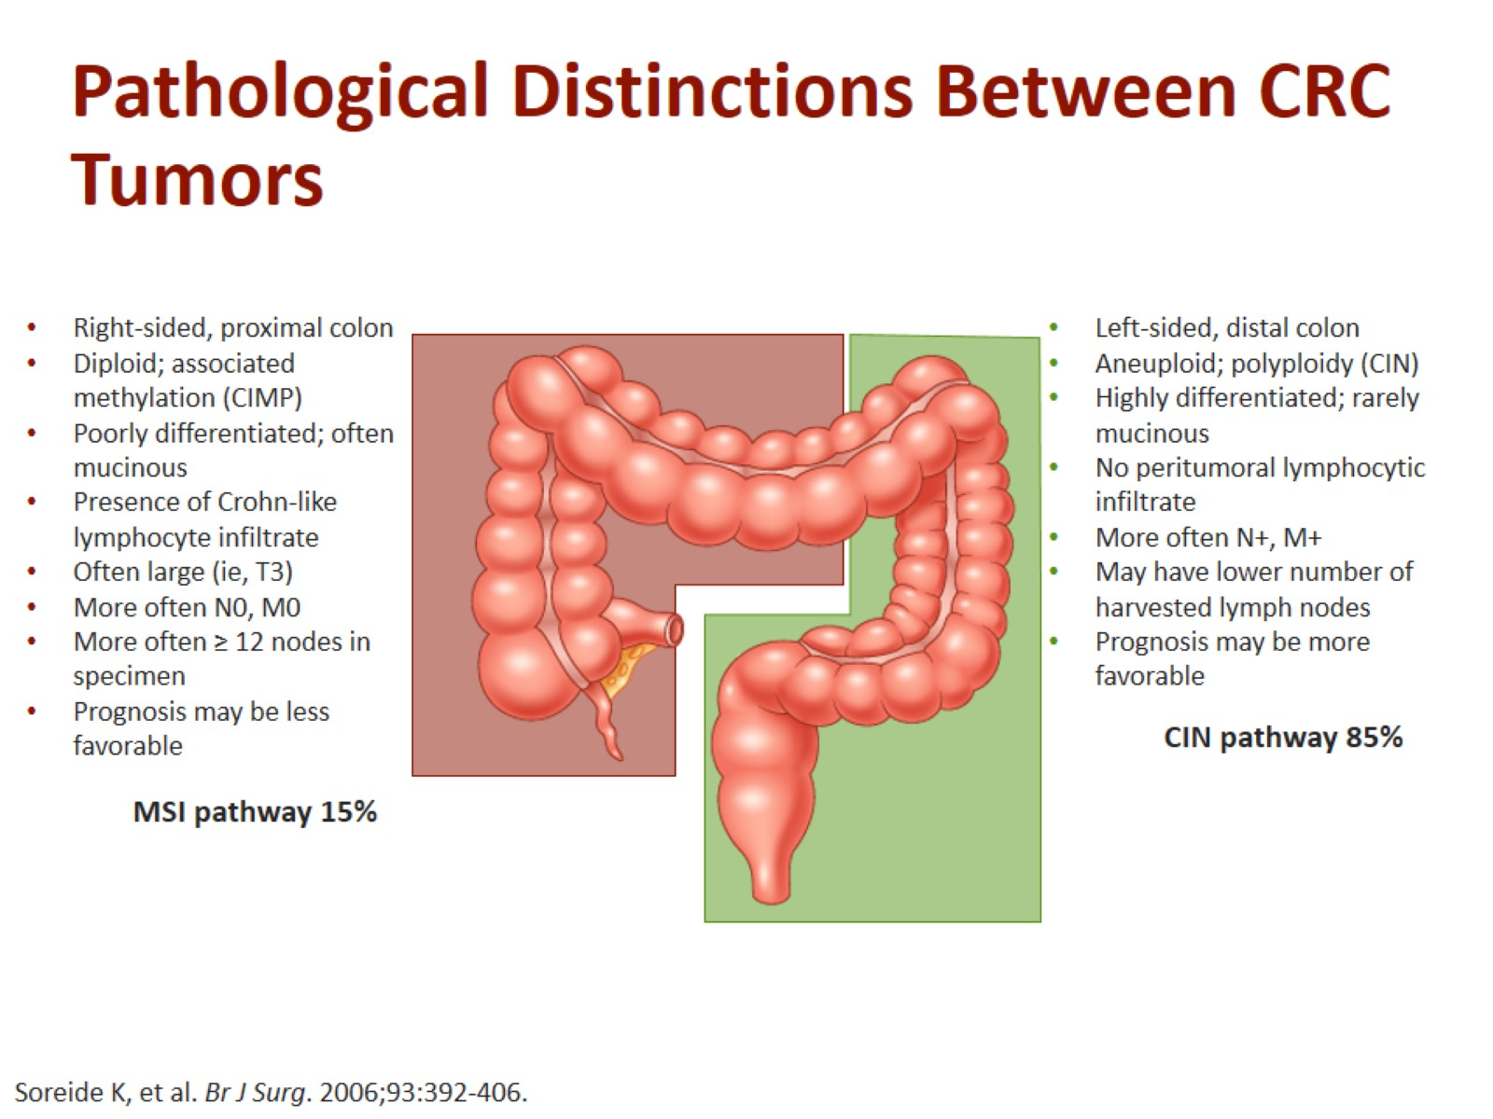
Pathological Distinctions Between CRC Tumors

Slide 3
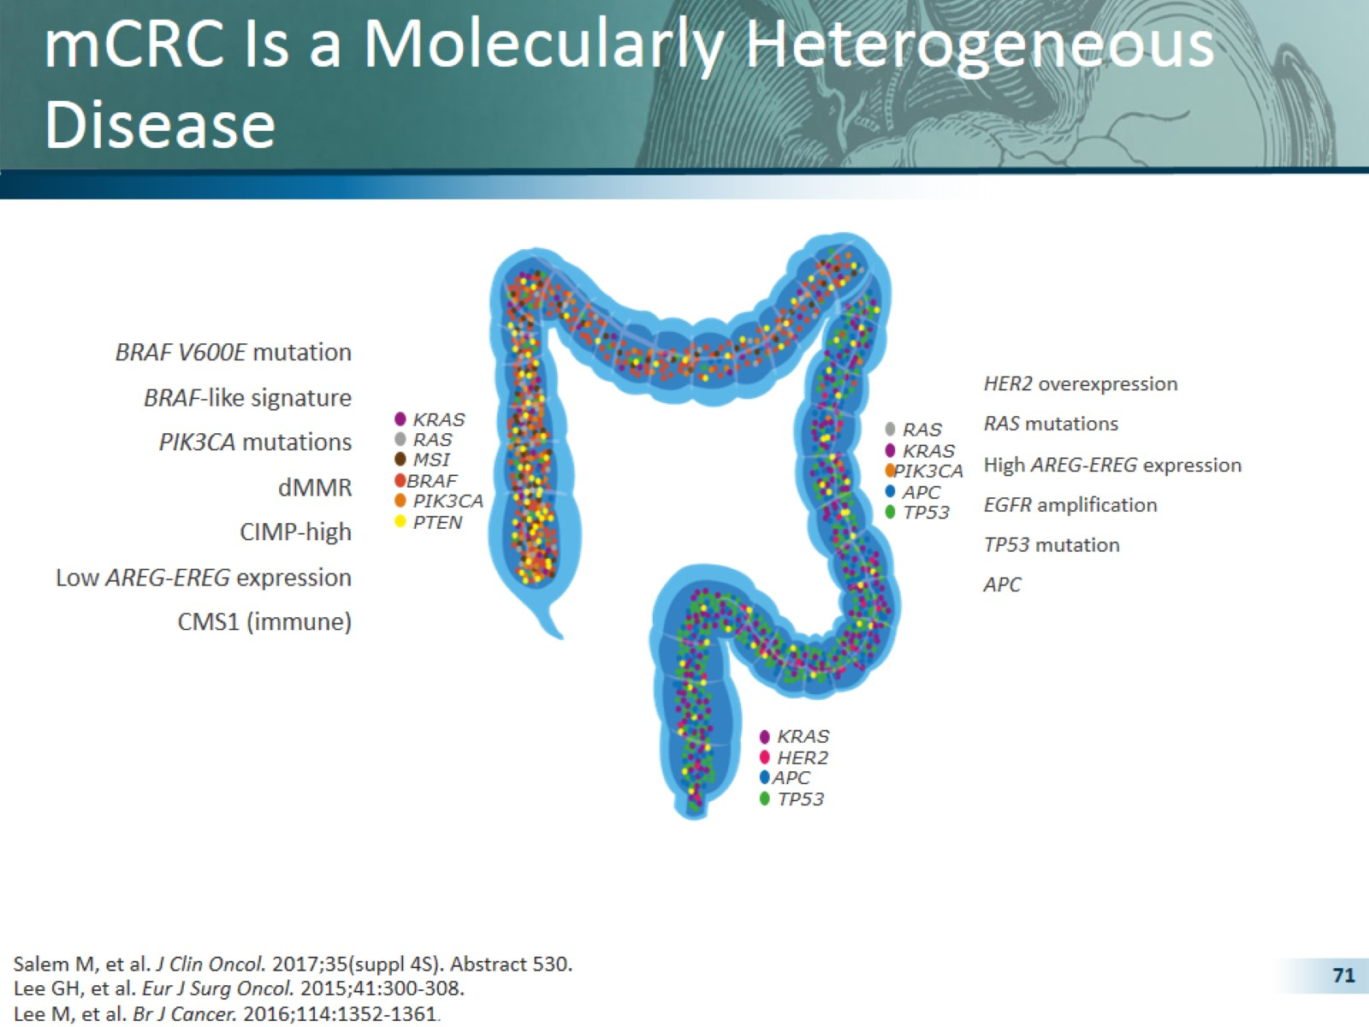
mCRC Is a Molecularly Heterogeneous Disease

Slide 5
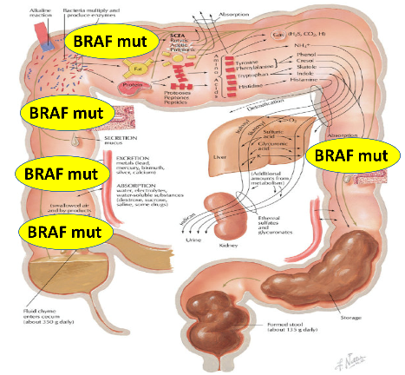
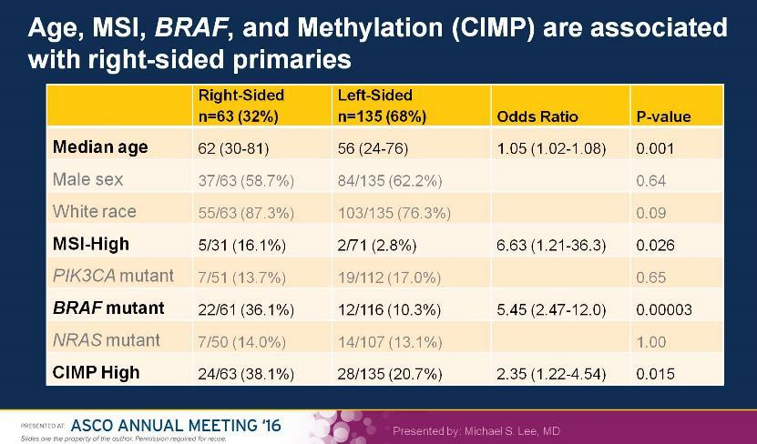
4. Genetic
Why tumor location (right vs. left) matters?
Clarke CN & Kopetz ES. J Gastrointest Oncol 2015;6(6):660–667.
Lee MS et al. ASCO 2016. (Abstract 3506).

Slide 6
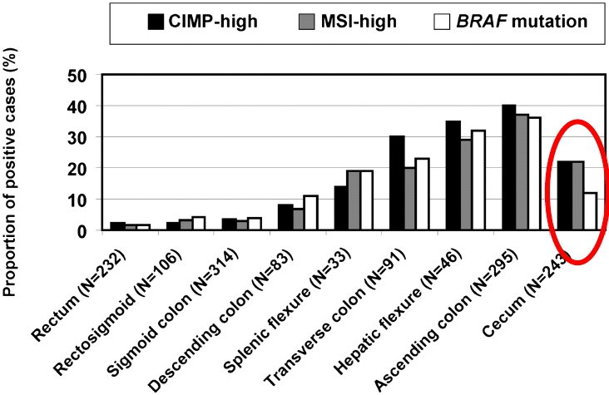

Increased Incidence of MSI-H, BRAF, and
CIMP-H in Right-sided CRC

Slide 7
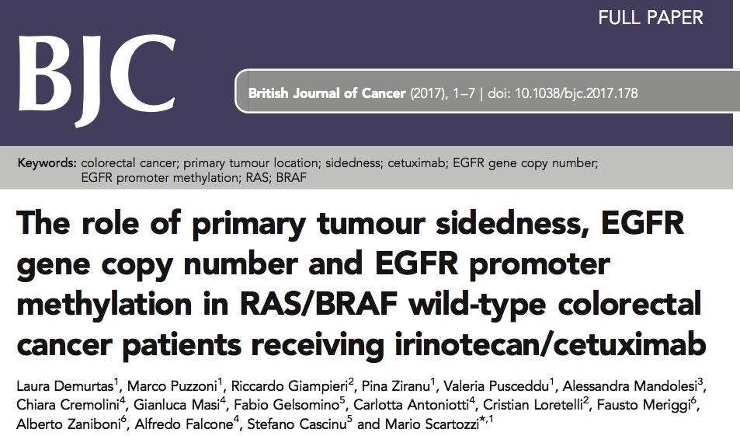
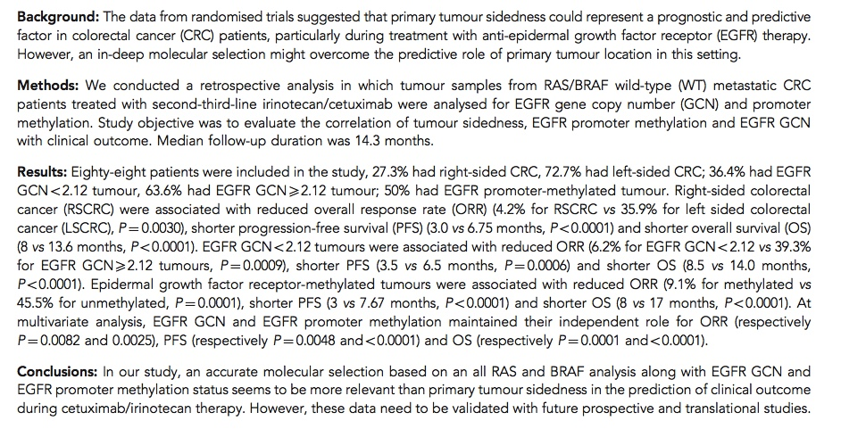

Slide 8
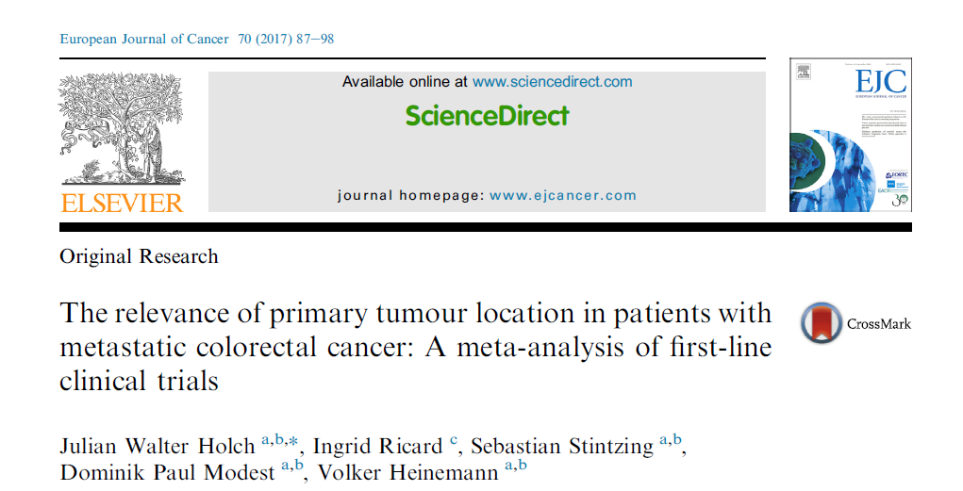

Slide 9
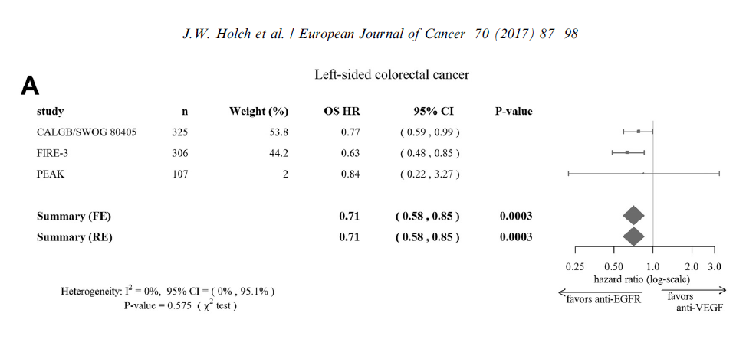
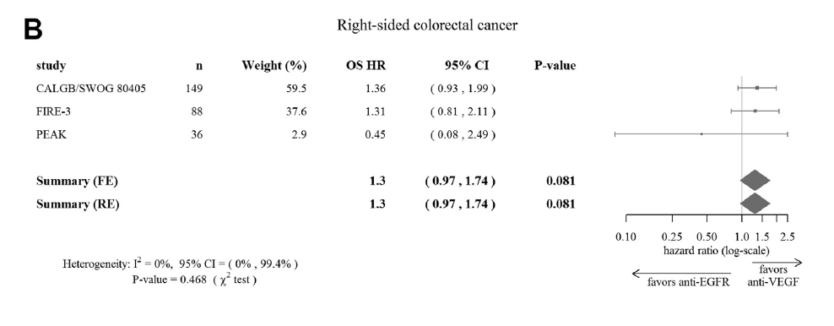
OS
Colon sinistro
Colon destro

Slide 10
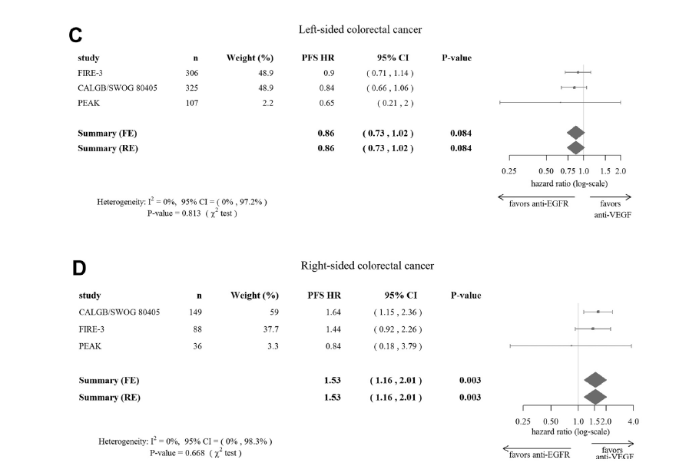
PFS

Slide 11
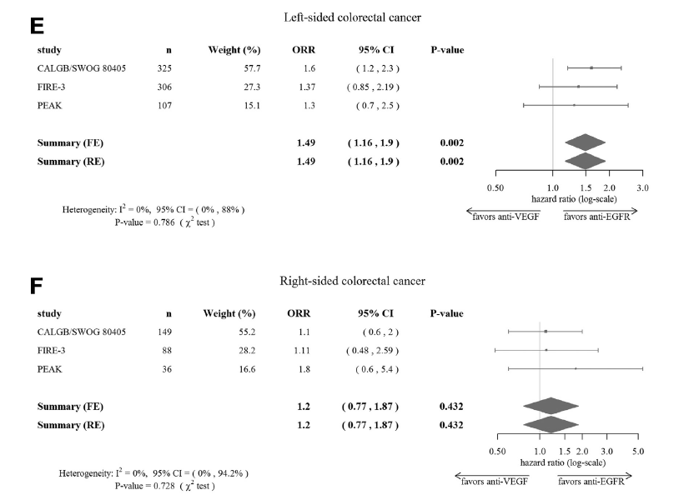
ORR

Slide 12
Cetuximab is the 1st line therapy that demonstrates significant survival benefit over bevacizumab in left-sided RAS wt mCRC in the Phase III FIRE-3 trial^{1–3}
40
38.3
+10.3 months
HR=0.63
(p=0.002)
30
28.0
Median OS (months)
20
10
0
Cetuximab
+ FOLFIRI
(n=157)
Bevacizumab
+ FOLFIRI
(n=149)
Figure created with data from:
1. Tejpar S, et al. JAMA Oncol 2017;3:194–201;
2. Holch JW, et al. Eur J Cancer 2017;70:87–9;
3. Arnold D, et al. Ann Oncol 2017;28:1713–1729;
4. Heinemann V et al. Lancet Oncol 2014;15:1065–1075;
5. Erbitux SmPC June 2014.
Phase III FIRE-3^{1–3}
(retrospective analysis of patients with left-sided RAS wt mCRC)
FIRE-3 did not meet its primary endpoint of significantly improving overall response rate (ORR) based on investigators’ read in patients with KRAS (exon 2) wt mCRC.⁴ Cetuximab is indicated for the treatment of patients with epidermal growth factor receptor (EGFR)-expressing, RAS wild-type metastatic colorectal cancer in combination with irinotecan-based chemotherapy, in first-line in combination with FOLFOX and as a single agent in patients who have failed oxaliplatin- and irinotecan-based therapy and who are intolerant to irinotecan⁵

Slide 13
Cetuximab is the 1st line therapy that demonstrates significant survival benefit over bevacizumab in left-sided RAS wt mCRC in the Phase III
CALGB/SWOG 80405 trial^{1–3}
40
39.3
+6.7 months
HR=0.77
(p=0.04)
30
32.6
Median OS (months)
20
10
0
Cetuximab
+ FOLFOX/FOLFIRI
(n=173)
Bevacizumab
+ FOLFOX/FOLFIRI
(n=152)
Figure created with data from:
1. Holch JW, et al. Eur J Cancer 2017;70:87–9;
2. Arnold D, et al. Ann Oncol 2017;28:1713–1729;
3. Venook AP, et al. ESMO 2016 (Abstract no. 3504);
4. Venook A, et al JAMA. 2017;317:2392-2401;
5. Erbitux SmPC June 2014.
Phase III CALGB/SWOG 80405^{1–3}
The CALGB/SWOG 80405 study did not meet its primary endpoint of significantly improving overall survival in the cetuximab + CT arm vs bevacizumab + CT arm in patients with KRAS (exon 2) wt mCRC⁴ Cetuximab is indicated for the treatment of patients with epidermal growth factor receptor (EGFR)-expressing, RAS wild-type metastatic colorectal cancer in combination with irinotecan-based chemotherapy, in first-line in combination with FOLFOX and as a single agent in patients who have failed oxaliplatin- and irinotecan-based therapy and who are intolerant to irinotecan⁵
(retrospective analysis of patients with left-sided RAS wt mCRC)

Slide 14
TAILOR: Increased ORR with Erbitux + CT vs CT alone in both LS and RS subgroups
Left-sided
Right-sided
OR=2.60
(95% CI: 1.64–4.14)
p<0.001
OR=2.58
(95% CI: 1.00–6.67)
p=0.065
ORR, %
ORR, %
HR, hazard ratio; PFS, progression free survival
Qin S, et al. ASCO GI 2017 (Abstract No. 683)

Slide 15
Response rates
 | CR+PR (%)
 | left | right
PRIME (1st line)
Pmab - FOLFOX | 68 | 42
FOLFOX | 53 | 35
PEAK (1st line)
Pmab FOLFOX | 64 | 63
Beva FOLFOX | 57 | 50
181 (2nd line)
Pmab FOLFIRI | 50 | 13
FOLFIRI | 13 | 3

Slide 16
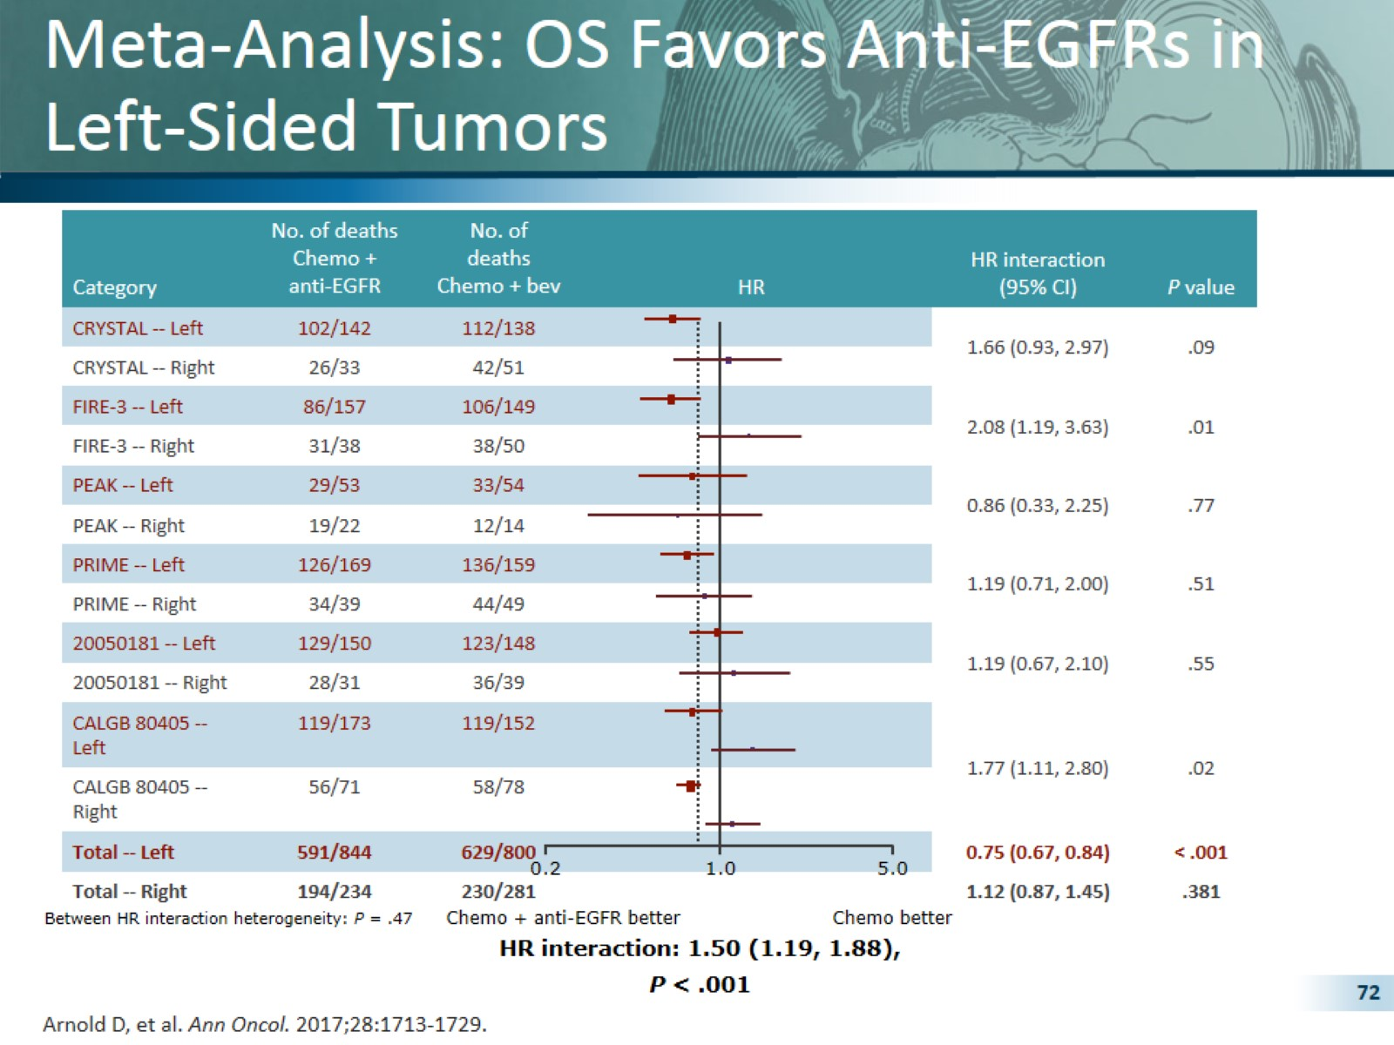
Meta-Analysis: OS Favors Anti-EGFRs in Left-Sided Tumors

Slide 17
Pooled Analyses for OS
Arnold et al, ESMO 2017

Slide 18
Pooled Analyses for PFS
Arnold et al, ESMO 2017

Slide 19
Pooled Analyses for ORR
Arnold et al, ESMO 2017

Slide 20
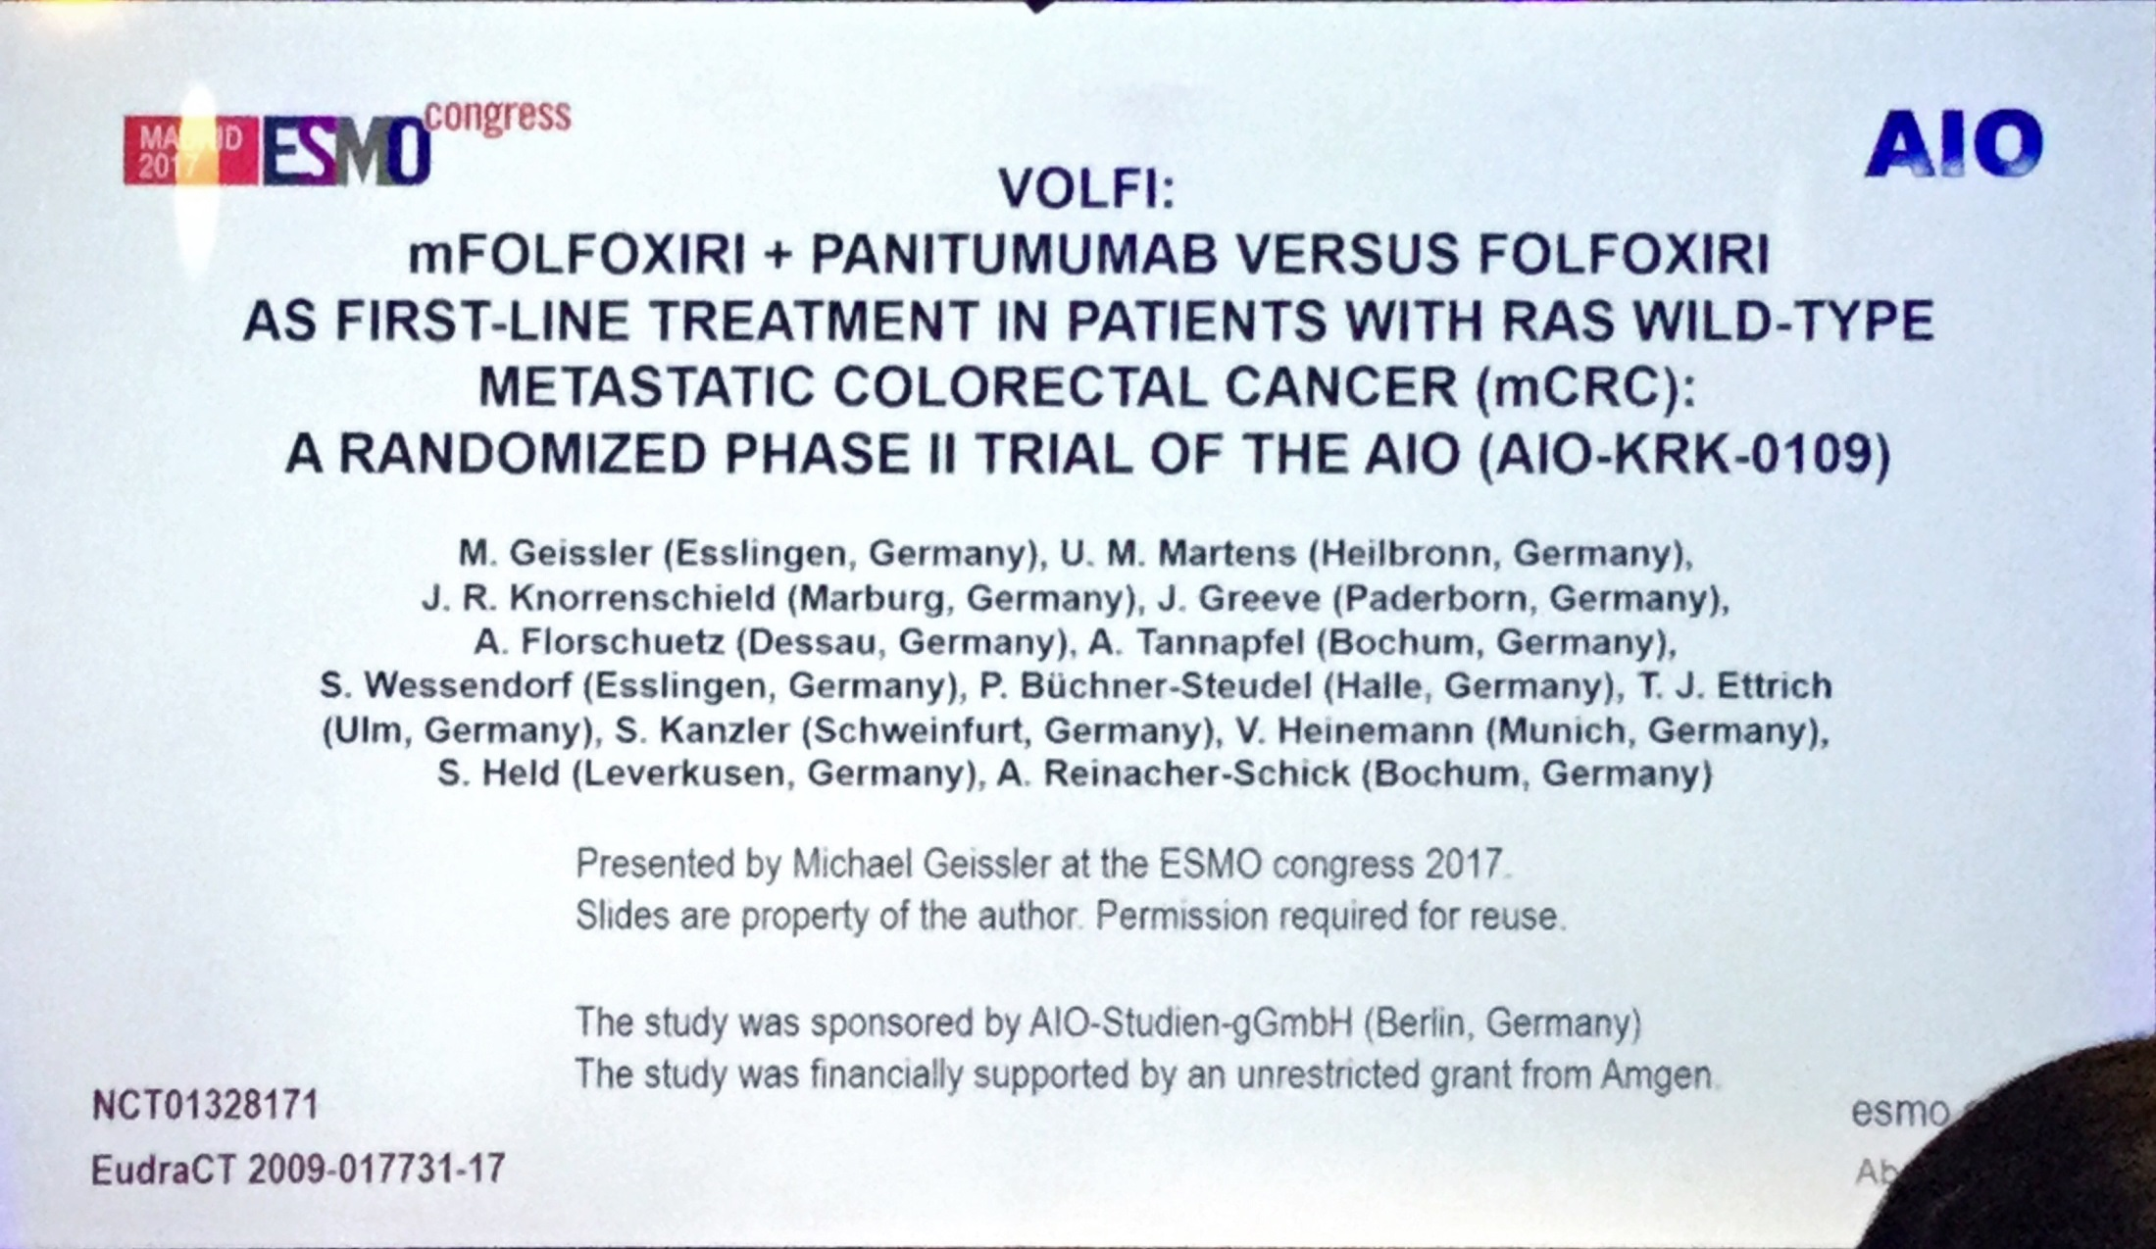

Slide 21
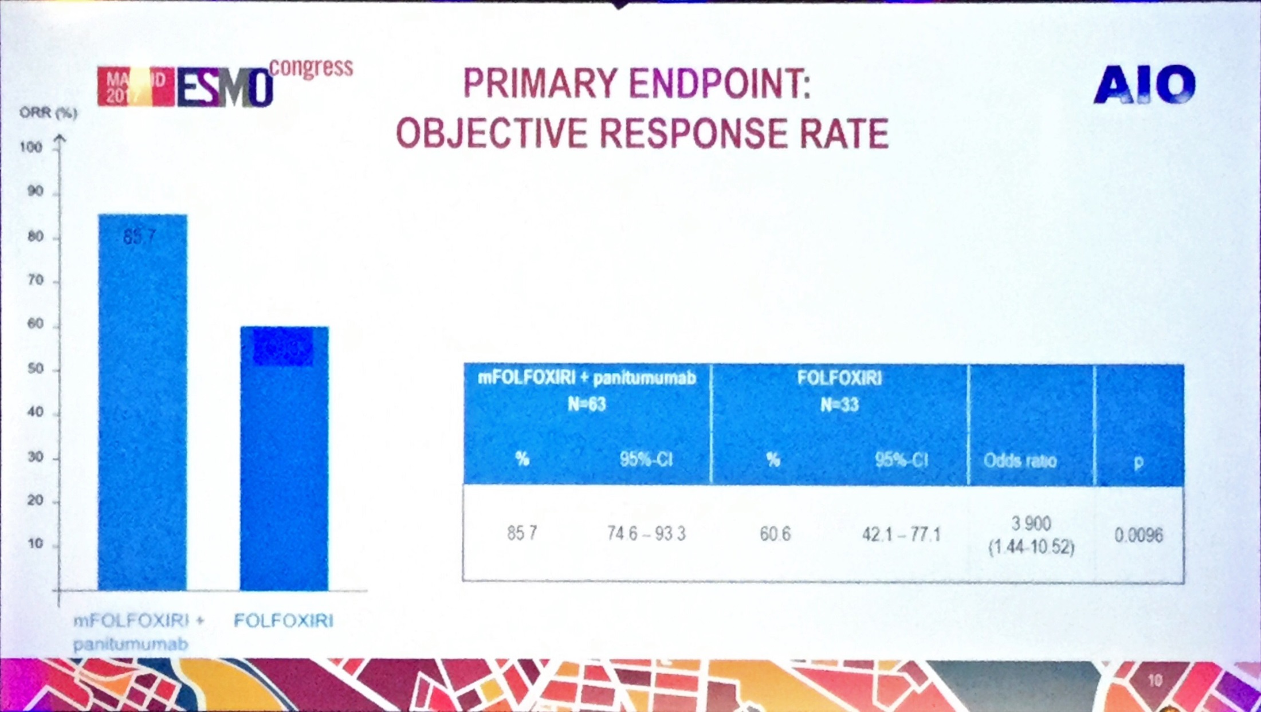

Slide 22
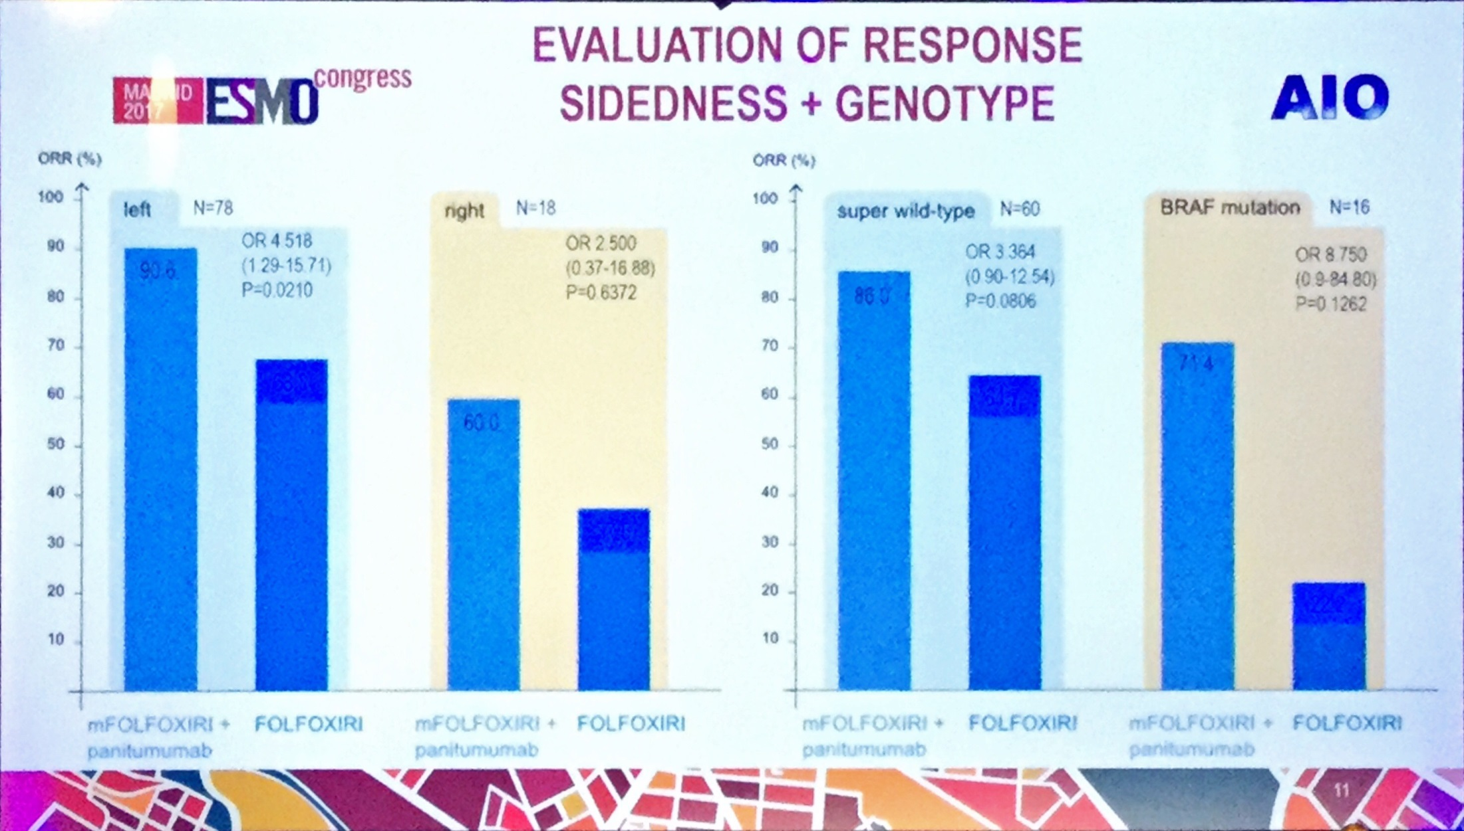

Slide 23
Disegno dello studio
Fase III randomizzato
mFOLFOX6+pan
(fino a max 12 cicli)
5-FU/LV+pan
(fino a PD)
PD
Arm A
1ª linea
RAS e BRAF wt
Malattia mts
non resecabile
R
mFOLFOXIRI+pan
(fino a max 12 cicli)
5-FU/LV+pan
(fino a PD)
Arm B
Primary endpoint: Response Rate
Target accrual: 432 pts
INDUZIONE
MANTENIMENTO
Fattori di stratificazione:
ECOG PS: 0 vs 1-2
Sede del tumore primitivo: colon dx (dal ceco al trasverso) vs colon sx (dalla flessura sx al retto)
Metastasi limitate al fegato: si vs no

Slide 24
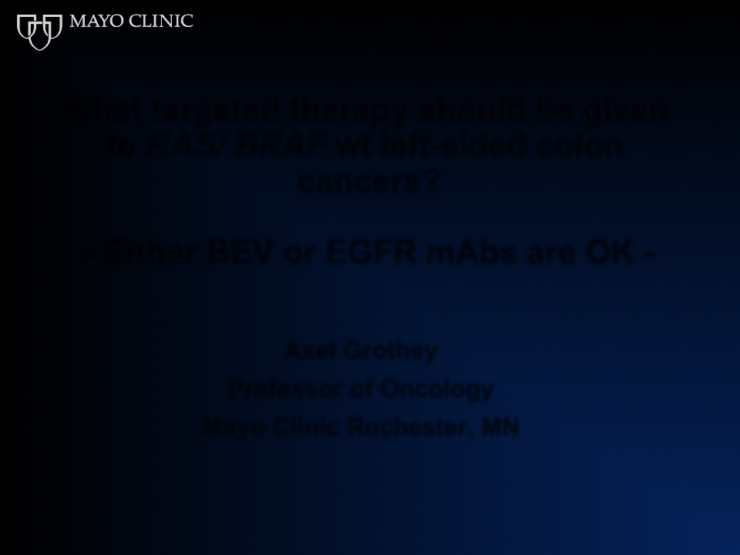

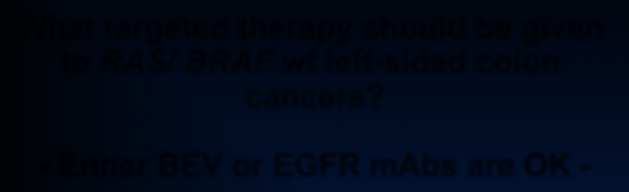

What targeted therapy should be given
to RAS/ BRAF wt left-sided colon
cancers?
- Either BEV or EGFR mAbs are OK -
Axel Grothey
Professor of Oncology
Mayo Clinic Rochester, MN

Slide 25
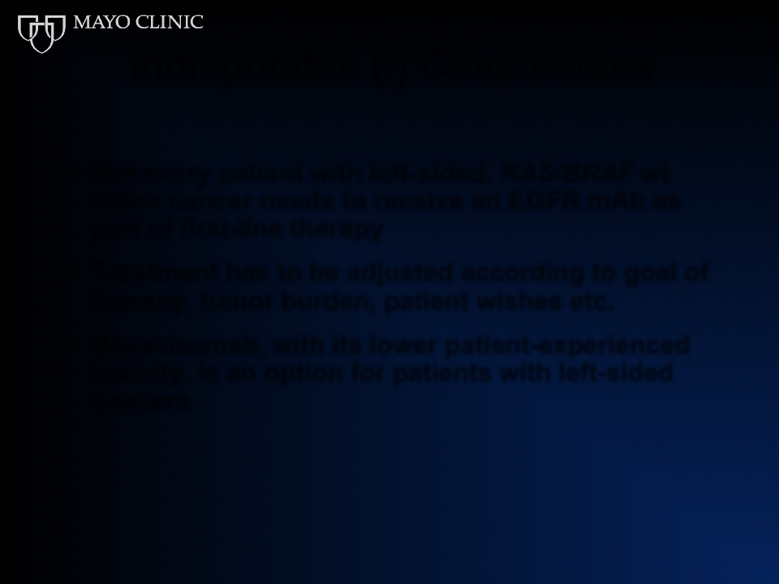

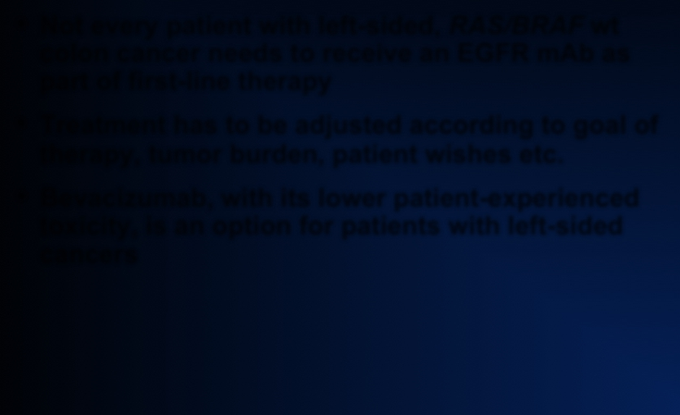
Indisputable (!) Conclusions
• Not every patient with left-sided, RAS/BRAF wt
colon cancer needs to receive an EGFR mAb as
part of first-line therapy
• Treatment has to be adjusted according to goal of
therapy, tumor burden, patient wishes etc.
• Bevacizumab, with its lower patient-experienced
toxicity, is an option for patients with left-sided
cancers

Slide 26
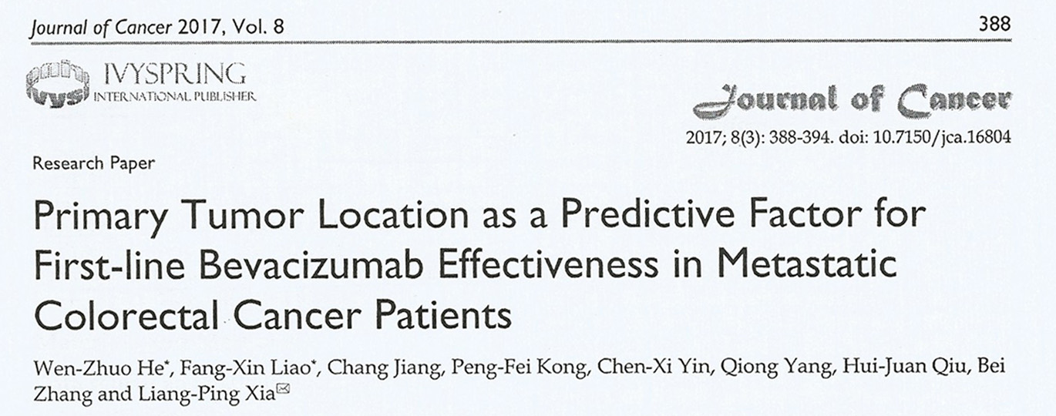
740 pts
dx sx retto
con la sola CT: 19,7 22,3 21,1
con CT + beva: 20,2 26,3 26,4

Slide 27
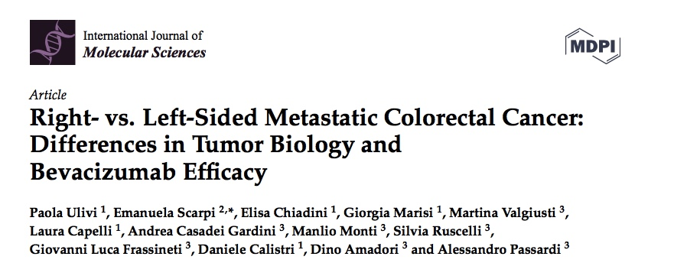


Slide 28
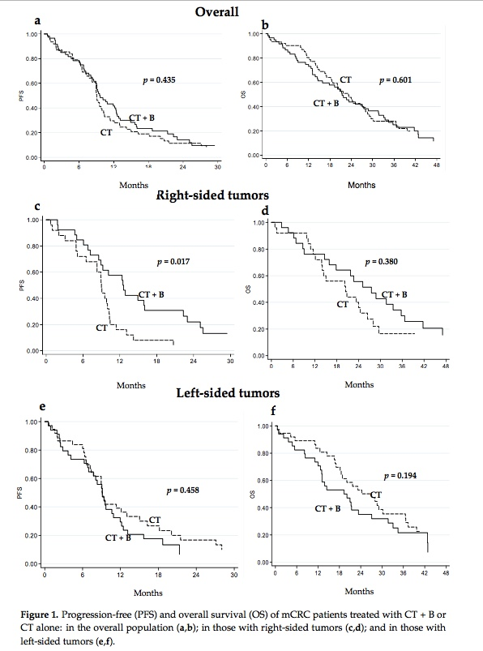

Slide 29
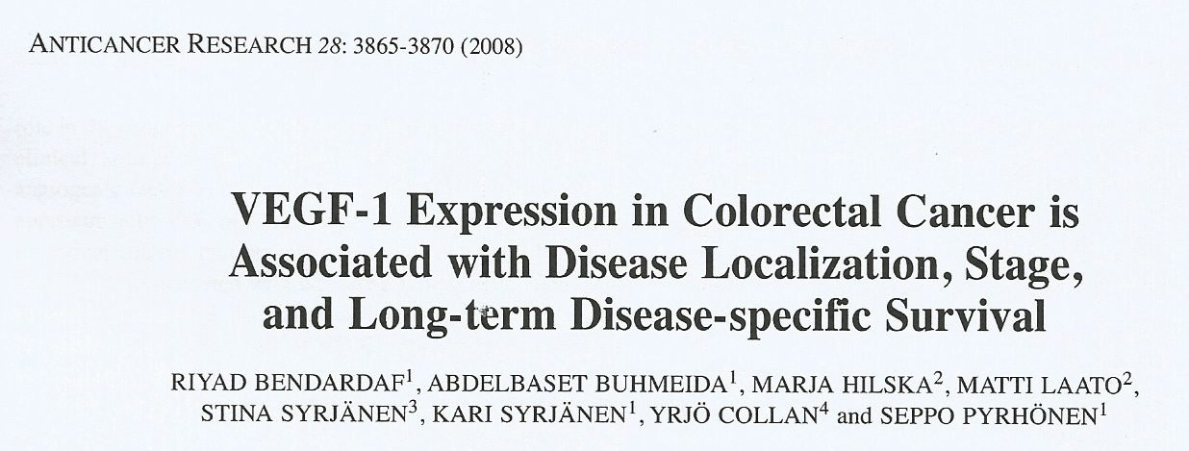
VEGF-1 expression in the left colon and rectum was significantly higher then that in the right colon
(61% vs 45%, respectively), p=0,006

Slide 30




Tumor location is now included in all clinical guidelines
“For the treatment of patients with left-sided RAS wt (BRAF wt) tumours going forward the preferred therapy option for patients would be a chemotherapy doublet plus EGFR antibody therapy, independent of treatment goal, for the majority of patients”²
“The strongest evidence for the predictive value of primary tumor sidedness and response to EGFR inhibitors is in the first-line treatment of patients in the phase III CALGB/SWOG 80405 trial… patients with all RAS wild-type, left-sided primary tumors... had longer OS if treated with cetuximab than if treated with bevacizumab...”¹
Pan-Asia adapted ESMO consensus guidelines expected at ESMO Asia November 2017
The CALGB/SWOG 80405 study did not meet its primary endpoint of significantly improving overall survival in the cetuximab + CT arm vs bevacizumab + CT arm in patients with KRAS (exon 2) wt mCRC³ Cetuximab is indicated for the treatment of patients with epidermal growth factor receptor (EGFR)-expressing, RAS wild-type metastatic colorectal cancer in combination with irinotecan-based chemotherapy, in first-line in combination with FOLFOX and as a single agent in patients who have failed oxaliplatin- and irinotecan-based therapy and who are intolerant to irinotecan⁴
1. NCCN guidelines. Colon Cancer Version 2.2017;
2. Arnold D, et al. Ann Oncol 2017;28:1713–1729;
3. Venook A, et al JAMA. 2017;317:2392-2401;
4. Erbitux SmPC June 2014.

Slide 31
Courtesy by V. Heinemann

Slide 32
Tumor location is key driver of treatment decisions for patients with RAS wt mCRC: Left-sided tumors
RAS/RAF wt | Treatment guidelines
 | ESMO¹ | NCCN²
Left-sided | EGFR mAbs are Standard of Care in 1st line | No clear preference for EGFR mAbs or bevacizumab in 1st line
WCGC 2017 | Practice
Axel Grothey³ | Scott Kopetz
EGFR mAbs are preferred, bevacizumab can be used in select patients in 1st line | EGFR mAbs are preferred after discussion with patient
1. Arnold D, et al. Ann Oncol 2017;28:1713–1729;
2. NCCN guidelines. Colon Cancer Version 2.2017;
Table modified from 3. Grothey A, et al. WCGC 2017 (oral presentation).

Slide 33
Tumor location is key driver of treatment decisions for patients with RAS wt mCRC: Right-sided tumors
RAS/RAF wt | Treatment guidelines
 | ESMO¹ | NCCN²
Right-sided | EGFR mAbs can be considered in first line if response is goal | No EGFR mAbs in 1st line and potentially not in any line
WCGC 2017 | Practice
Axel Grothey³ | Scott Kopetz
No EGFR mAbs in 1st line (if response is goal, consider triplet), but allow EGFR mAbs in later line | No EGFR mAbs in 1st line, but allow EGFR mAbs in later line
Arnold D, et al. Ann Oncol 2017;28:1713–1729;
NCCN guidelines. Colon Cancer Version 2.2017;
Table modified from 3. Grothey A, et al. WCGC 2017 (oral presentation)

Slide 34

ESMO: RAS testing and tumor location are integral to 1st line treatment decision-making
Goal/condition | Molecular | Preferred 1st line regimen
Cytoreduction | All WT | Left: Doublet/EGFR Right: FOLFOX/beva or FOLFOXIRI/beva or doublet/EGFR
 | RAS mut | FOLFOX/beva or FOLFOXIRI/beva
 | BRAF mut | FOLFOXIRI/beva or doublet/beva
Disease stabilization | All WT | Left: Doublet/EGFR Right: Doublet/beva
 | RAS mut | Doublet/beva
 | BRAF mut | Doublet/beva or FOLFOXIRI/beva
“Frail” or chosen sequential treatment | No BRAF | Capecitabine/beva

Slide 35
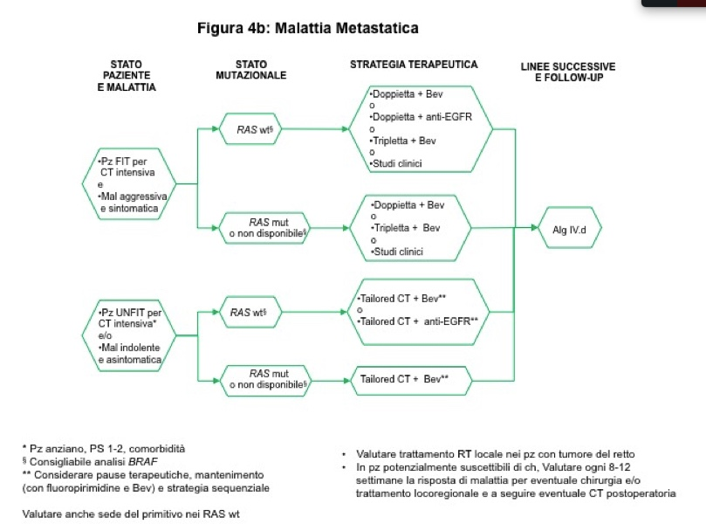
LG AIOM 2017

Slide 36
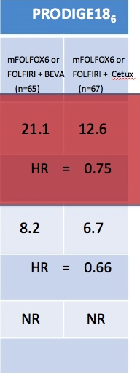



Slide 37

Sidedness influences prognosis in stage III but not in stage II colon cancer patients receiving an adjuvant therapy.
A GISCAD analysis from three randomized trials including 5234 patients.
S. Cascinu,, D.Poli, A. Zaniboni, R.Labianca, A.Sobrero, V. Torri
on behalf of GISCAD investigators

Slide 38
Patient
characteristics

Slide 39
“Summarizing” results
 | DFS | PPS | OS
All population | L=R | L>R* | L>R*
Stage III | L>R* | L>R* | L>R*
Stage II | L<R* | L≥R^ | L=R
* Statistically significant; ^ trend towards an advantage

Slide 40
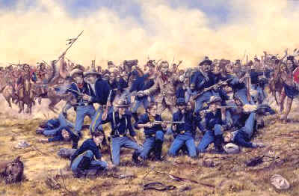

Slide 41







Which complexity are we talking about?
For the patients with non resectable RAS wt mCRC, treatment decisions are based on some molecular determinants that are also prognostic factors
Clinical decision
Genetic factors²
Not (potentially)
resectable
Primary
tumor location¹
BRAF
RAS
Tumor burden
MSI
Complex tumor Biology³
Prognostic and predictive
marker of response to
biologicals
CMS1
CMS2
CMS3
CMS4
From the clinical point of view, primary tumor location is as valuable
as all the molecular biology information^{4,5}
The new CMS classification of colon cancers may improve the choice of personalized treatment in the future
1. Tejpar S, et al. JAMA Oncol 2017;3(2):194–201; 2. Van Cutsem E, et al. Ann Oncol 2016;27:1386–1422;
3. Guinney J, et al. Nat Med 2015;21:1350–1356; 4. Arnold D, et al. Ann Oncol 2017;28(8):1713–29;
5. Holch JW, et al. Eur J Cancer 2017;70:87–98.

Slide 42
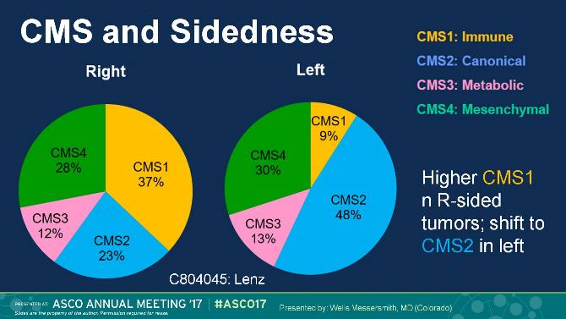

How these prognostic molecular markers can be transformed into a “master” prognostic factor?
Left colon
= tumor location
(“master” prognostic marker)
CMS4
molecular
prognostic
factors
Right colon
CMS2
MSI-Stable
CMS1
CIMP-Low
CMS3
BRAF wt
MSI-High
CMS2 and CMS4
predominate in the
left colon
RAS wt
CIMP-High
BRAF mt
Suddenly we realize
… the left colon incorporates the better prognostic factors!
RAS mt
Lievre A, et al. Cancer Res 2006;66(8):3992–3995.
Samowitz WS, et al. Cancer Res 2005;65(14):6063–6069.
Barault L, et al. Cancer Res 2008;68(20):8541–8546.
Messersmith W, et al. ASCO 2017. oral presentation;
Tran B, et al. Cancer 2011;117:4623–32;
Heinemann V et al. Lancet Oncol 2014;15:1065–1075;
Venook A, et al JAMA. 2017;317:2392-2401.
Worse
Better
FIRE-3 did not meet its primary endpoint of significantly improving overall response rate (ORR) based on investigators’ read in patients with KRAS (exon 2) wt mCRC.⁶ The CALGB/SWOG 80405 study did not meet its primary endpoint of significantly improving overall survival in the cetuximab + CT arm vs bevacizumab + CT arm in patients with KRAS (exon 2) wt mCRC⁷
Prognosis (no units =qualitative)

Slide 43
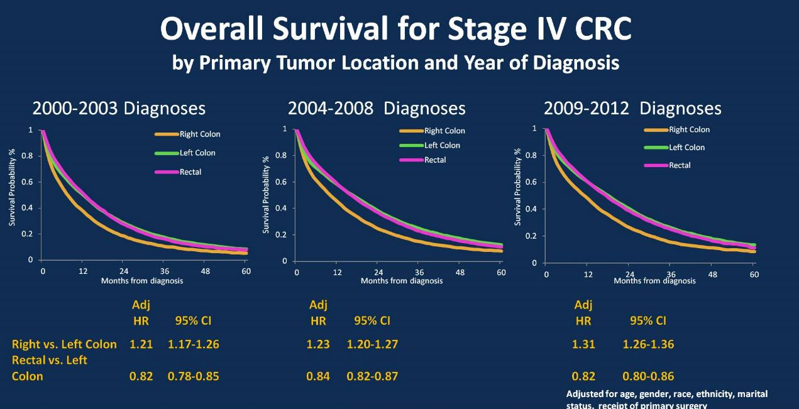

All RAS wt + mt
21 months
Left
6 mo.
7mo
Sidedness
4mo
15 months
Right
Before the introduction of the biologicals, TUMOR LOCATION contributed to a 4–7 months difference (mean 6 months) in median survival between right and left colon cancer if CHEMOTHERAPY alone was administered
1. Schrag D, et al. ASCO 2016 (Abstract No. 3505).

Slide 44
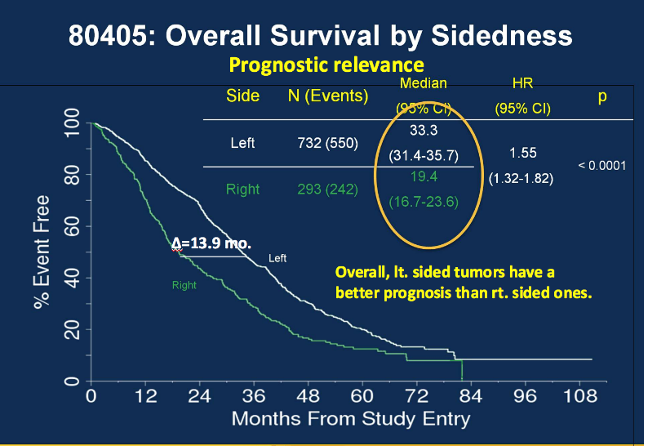

But, when BIOLOGICALS were included in the treatment, TUMOR LOCATION on the left side, became an even more impressive PROGNOSTIC marker, translated into a PREDICTIVE marker of response to biologicals
ASCO 2016
Biologicals add another
7.9 mo. survival benefit
Left
7.9 mo
Biologicals
21 months
Δ=13.9
mo
6 mo
Sidedness
15 months
Right
Median
survival
Do bevacizumab and cetuximab have an identical added value or can TUMOR LOCATION predict if one biological is better than the other in prolonging survival?
The CALGB/SWOG 80405 study did not meet its primary endpoint of significantly improving overall survival in the cetuximab + CT arm vs bevacizumab + CT arm in patients with KRAS (exon 2) wt mCRC.² Cetuximab is indicated for the treatment of patients with epidermal growth factor receptor (EGFR)-expressing, RAS wild-type metastatic colorectal cancer in combination with irinotecan-based chemotherapy, in first-line in combination with FOLFOX and as a single agent in patients who have failed oxaliplatin- and irinotecan-based therapy and who are intolerant to irinotecan³
Venook AP, et al. ASCO 2016 (Abstract No. 3504);
Venook A, et al JAMA. 2017;317:2392-2401;
Erbitux SmPC June 2014.

Slide 45




What have we learnt so far?
Right-sided
Left-sided
Clinical differences¹
More common in women
More common in men
MUTYH-associated polyposis
Familial adenomatous polyposis
PIK3CA mutation
HER2 overexpression
Molecular differences^{1,2}
BRAF mutation
KRAS mutation
dMMR/MSI-H
High AREG-EREG expression
CIMP-high
TP53 mutation
Low AREG-EREG expressions
APC
CMS1 (immune)
CMS2 (canonical)
Prognostic impact¹
Poorer prognosis
Better prognosis
Initial evidence for predictive relevance for anti-EGFR
Predictive impact^{3,4}
To be examined in more detail…
1. Lee GH, et al. Eur J Surg Oncol 2015;41:300–308;
2. Stintzing S, et al. E J Cancer 2017;84:69–80; 3. Tejpar S, et al. JAMA Oncol 2017;3(2):194–201; 4. Venook AP, et al. ASCO 2016 (Abstract No. 3504).

Slide 46
Phase III FIRE-3 trial: Significant improvements in subsequent lines after 1st line cetuximab + FOLFIRI in patients with left-sided RAS wt mCRC
OS from start of 2nd line therapy¹
1.0
1st line cetuximab + CT (n=170): 17.6 months
1st line bevacizumab + CT (n=139): 14.1 months
1st line cetuximab may sensitize tumors to subsequent anti-VEGF therapy?²
0.8
0.6
Proportion alive
0.4
HR=0.65 (0.49-0.85)
p value=0.002
0.2
0.0
0
12
24
36
48
60
Time (months)
These data confirm cetuximab as 1st line choice in left-sided RAS wt mCRC¹
FIRE-3 did not meet its primary endpoint of significantly improving overall response rate (ORR) based on investigators’ read in patients with KRAS (exon 2) wt mCRC.³ Cetuximab is indicated for the treatment of patients with epidermal growth factor receptor (EGFR)-expressing, RAS wild-type metastatic colorectal cancer in combination with irinotecan-based chemotherapy, in first-line in combination with FOLFOX and as a single agent in patients who have failed oxaliplatin- and irinotecan-based therapy and who are intolerant to irinotecan⁴
Figures adapted from Modest DP, et al. ASCO 2017 (Abstract No. 3525);
2. Wainberg ZA, Drakaki A. Expert Opin Biol Ther 2015;15:1205–1220;
3. Heinemann V et al. Lancet Oncol 2014;15:1065–1075
4. Erbitux SmPC June 2014.

Slide 47
Tumor location is now included in all clinical guidelines
“For the treatment of patients with left-sided RAS wt (BRAF wt) tumours going forward the preferred therapy option for patients would be a chemotherapy doublet plus EGFR antibody therapy, independent of treatment goal, for the majority of patients”²
“The strongest evidence for the predictive value of primary tumor sidedness and response to EGFR inhibitors is in the first-line treatment of patients in the phase III CALGB/SWOG 80405 trial… patients with all RAS wild-type, left-sided primary tumors... had longer OS if treated with cetuximab than if treated with bevacizumab...”¹
Pan-Asia adapted ESMO consensus guidelines expected at ESMO Asia November 2017
The CALGB/SWOG 80405 study did not meet its primary endpoint of significantly improving overall survival in the cetuximab + CT arm vs bevacizumab + CT arm in patients with KRAS (exon 2) wt mCRC³ Cetuximab is indicated for the treatment of patients with epidermal growth factor receptor (EGFR)-expressing, RAS wild-type metastatic colorectal cancer in combination with irinotecan-based chemotherapy, in first-line in combination with FOLFOX and as a single agent in patients who have failed oxaliplatin- and irinotecan-based therapy and who are intolerant to irinotecan⁴
1. NCCN guidelines. Colon Cancer Version 2.2017;
2. Arnold D, et al. Ann Oncol 2017;28:1713–1729;
3. Venook A, et al JAMA. 2017;317:2392-2401;
4. Erbitux SmPC June 2014.

Slide 48
The evidence is clear for patients with left-sided RAS wt mCRC
Patients with left-sided RAS wt mCRC should be treated with cetuximab + FOLFOX or FOLFIRI in 1st line…^{1–3}
…but what about patients with right-sided
RAS wt tumors?
Cetuximab is indicated for the treatment of patients with epidermal growth factor receptor (EGFR)-expressing, RAS wild-type metastatic colorectal cancer in combination with irinotecan-based chemotherapy, in first-line in combination with FOLFOX and as a single agent in patients who have failed oxaliplatin- and irinotecan-based therapy and who are intolerant to irinotecan⁴
Tejpar S, et al. JAMA Oncol 2017;3:194–201;
2. Arnold D, et al. Ann Oncol 2017;28:1713–1729;
3. Holch JW, et al. Eur J Cancer 2017;70:87–9;
4. Erbitux SmPC June 2014.

Slide 49
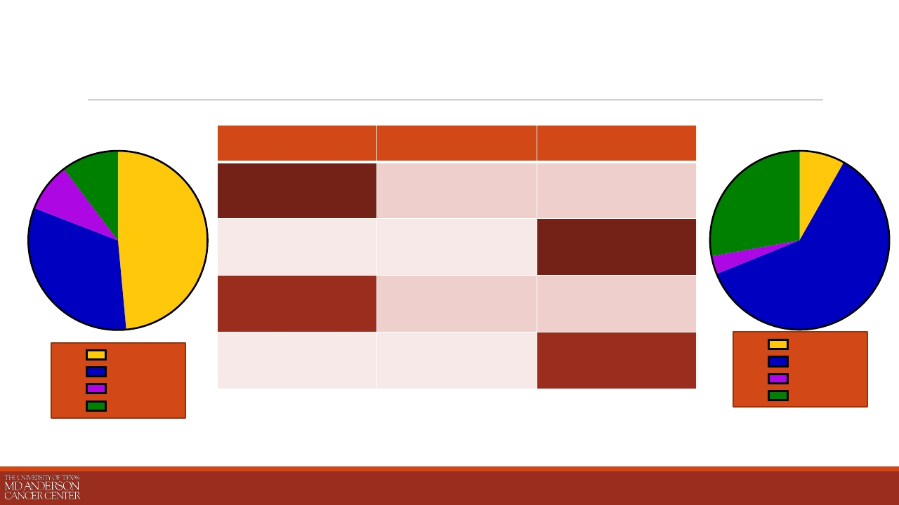
Right-sided primary is associated with CMS1 & 3
Right-Sided
Le;-Sided
CMS 1
Immune
CMS 2
Canonical
CMS 3
Metabolic
33/68 (49%)
22/68 (32%)
6/68 (9%)
5/61 (8%)
37/61 (61%)
2/61 (3%)
CMS 4
Mesenchymal
CMS1
CMS2
CMS3
CMS4
CMS1
CMS2
CMS3
CMS4
7/68 (10%)
17/61 (28%)
PRESENTED BY: MICHAEL S. LEE, MD

Slide 50
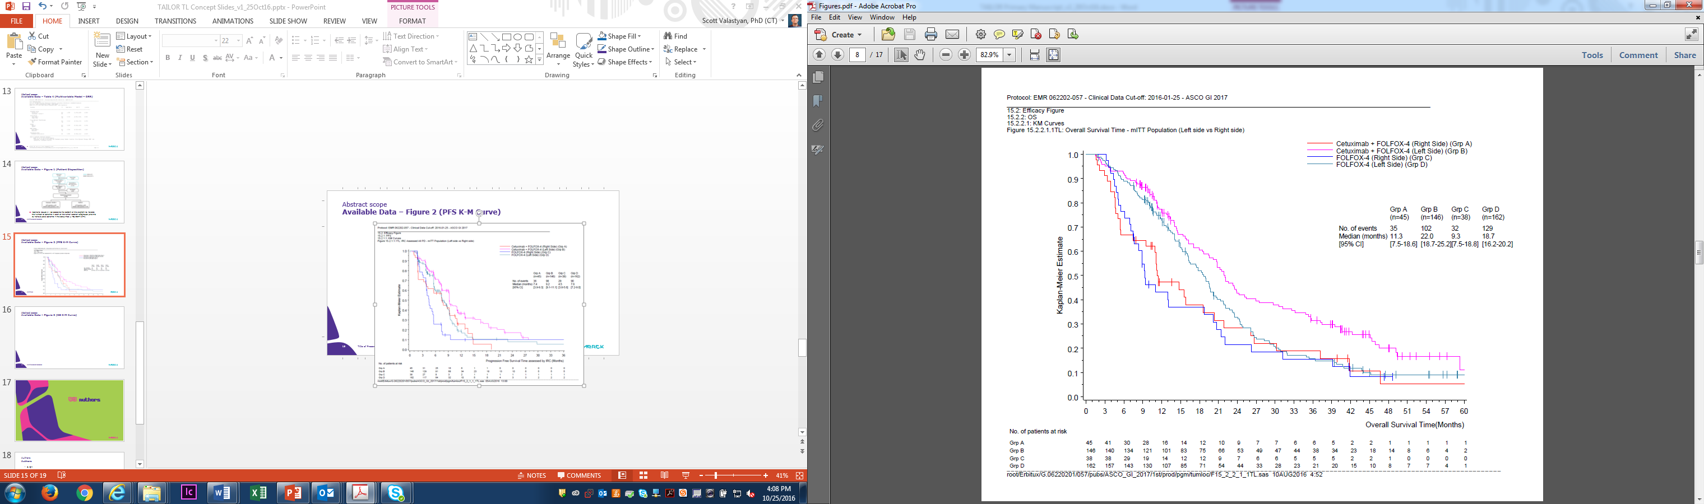
TAILOR: Significant increase in OS in patients with LS RAS wt mCRC
Subgroup, arm (n) | Median, months | HR (95% CI) p-value
Left-sided, Erbitux + CT (n=146) | 22.0 | 0.69 (0.53–0.90) p=0.006
Left-sided, CT (n=164) | 18.7
Right-sided, Erbitux + CT (n=45) | 11.3 | 0.94 (0.58–1.51) p=0.787
Right-sided, CT (n=38) | 9.3
22.0
11.3
18.7
9.3
31% reduction in risk of death for patients with LS RAS wt mCRC
HR, hazard ratio; PFS, progression free survival
Qin S, et al. ASCO GI 2017 (Abstract No. 683)
Notes:
The present observations from tumor location subgroup analyses of the TAILOR study are partly in contrast to previously presented subgroup results from the CRYSTAL, FIRE-3, and CALGB 80405 trials
The TAILOR study clearly confirms the prognostic value of primary tumor location, as well as the predictive benefit of adding cetuximab to FOLFOX chemotherapy in patients with left-sided RAS wt mCRC in terms of PFS, OS, and ORR
However, the results in patients with right-sided tumors should be interpreted with caution due to imbalances in baseline characteristics between treatment arms in the right-sided subgroup, as well as the small number of patients in our study with right-sided mCRC

Slide 51
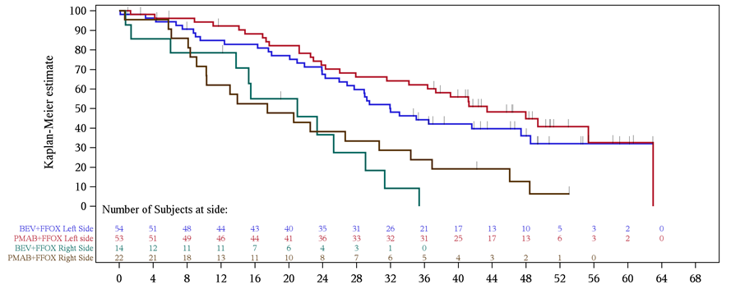
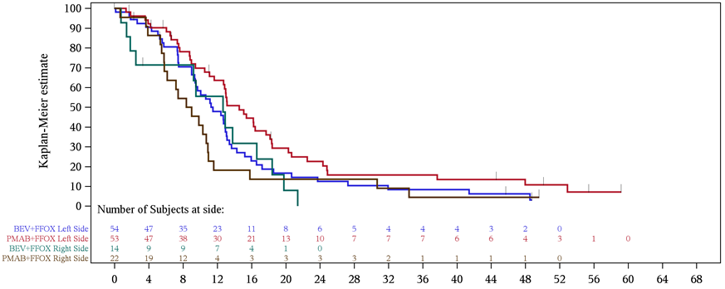
PEAK – OS/PFS – 1st Line
 | OS (m)
 | Left | Right
Pmab FOLFOX | 43.4 | 17.5
Beva FOLFOX | 32.0 | 21.0
HR | 0.84 | 0.45
 | PFS (m)
 | Left | Right
Pmab FOLFOX | 14.6 | 8.7
Beva FOLFOX | 11.5 | 12.6
HR | 0.65 | 0.84
Notes:
20070509: Progression-free Survival by Side and Treatment -RAS WT/BRAF WT Subjects
20070509: Overall Survival by Side and Treatment -RAS WT/BRAF WT Subjects

Slide 52
How these prognostic molecular markers can be transformed into a “master” prognostic factor?
Left colon
= tumor location
(“master” prognostic marker)
CMS4
molecular
prognostic
factors
Right colon
CMS2
MSI-Stable
CMS1
CIMP-Low
CMS3
BRAF wt
MSI-High
CMS2 and CMS4
predominate in the
left colon
RAS wt
CIMP-High
BRAF mt
Suddenly we realize
… the left colon incorporates the better prognostic factors!
RAS mt
Lievre A, et al. Cancer Res 2006;66(8):3992–3995.
Samowitz WS, et al. Cancer Res 2005;65(14):6063–6069.
Barault L, et al. Cancer Res 2008;68(20):8541–8546.
Messersmith W, et al. ASCO 2017. oral presentation;
Tran B, et al. Cancer 2011;117:4623–32;
Heinemann V et al. Lancet Oncol 2014;15:1065–1075;
Venook A, et al JAMA. 2017;317:2392-2401.
Worse
Better
FIRE-3 did not meet its primary endpoint of significantly improving overall response rate (ORR) based on investigators’ read in patients with KRAS (exon 2) wt mCRC.⁶ The CALGB/SWOG 80405 study did not meet its primary endpoint of significantly improving overall survival in the cetuximab + CT arm vs bevacizumab + CT arm in patients with KRAS (exon 2) wt mCRC⁷
Prognosis (no units =qualitative)

Slide 53
Tumor location is key driver of treatment decisions for patients with RAS wt mCRC: Left-sided tumors
RAS/RAF wt | Treatment guidelines
 | ESMO¹ | NCCN²
Left-sided | EGFR mAbs are Standard of Care in 1st line | No clear preference for EGFR mAbs or bevacizumab in 1st line
WCGC 2017 | Practice
Axel Grothey³ | Scott Kopetz
EGFR mAbs are preferred, bevacizumab can be used in select patients in 1st line | EGFR mAbs are preferred after discussion with patient
1. Arnold D, et al. Ann Oncol 2017;28:1713–1729;
2. NCCN guidelines. Colon Cancer Version 2.2017;
Table modified from 3. Grothey A, et al. WCGC 2017 (oral presentation).

Slide 54
Tumor location is key driver of treatment decisions for patients with RAS wt mCRC: Right-sided tumors
RAS/RAF wt | Treatment guidelines
 | ESMO¹ | NCCN²
Right-sided | EGFR mAbs can be considered in first line if response is goal | No EGFR mAbs in 1st line and potentially not in any line
WCGC 2017 | Practice
Axel Grothey³ | Scott Kopetz
No EGFR mAbs in 1st line (if response is goal, consider triplet), but allow EGFR mAbs in later line | No EGFR mAbs in 1st line, but allow EGFR mAbs in later line
Arnold D, et al. Ann Oncol 2017;28:1713–1729;
NCCN guidelines. Colon Cancer Version 2.2017;
Table modified from 3. Grothey A, et al. WCGC 2017 (oral presentation)

Slide 55
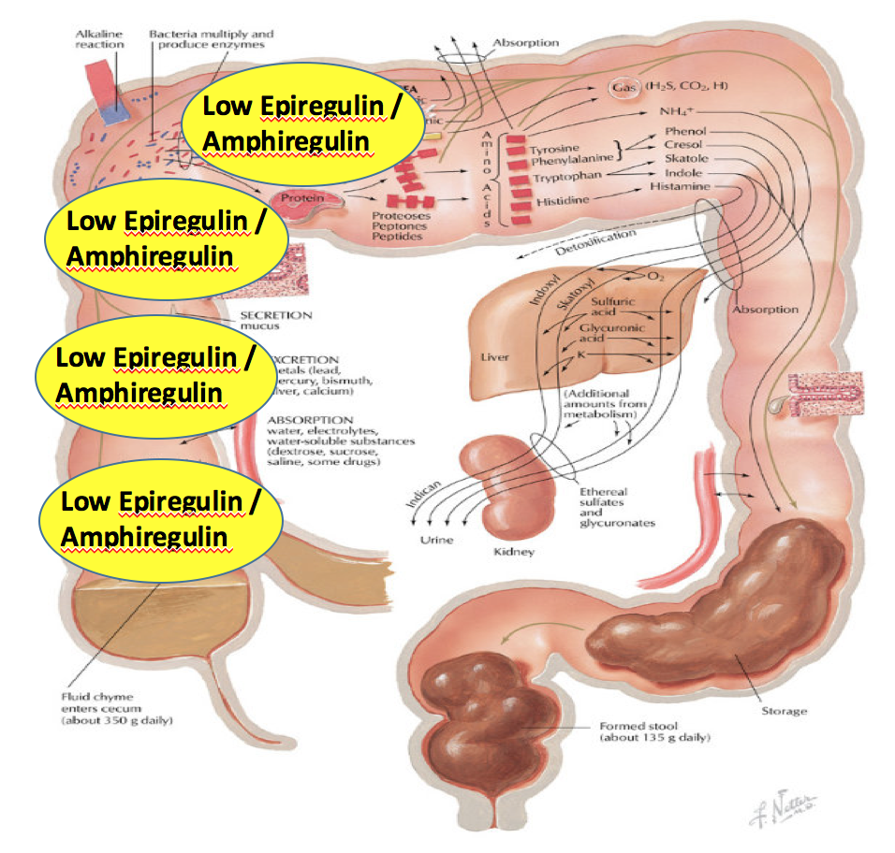
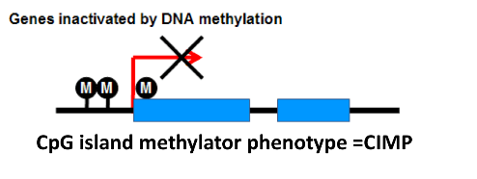
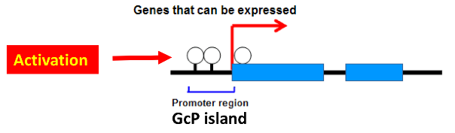
Epigenetic changes predominate on the right side of the colon – CIMP high
5. Epigenetic
MSI-High
MSI-High
CIMP-H
CIMP-H
MSI-High
MSI-High
MSI-High
CIMP-H
Sporadic CRC
CIMP-H
MSI-High
Right colon
Left colon
Epiregulin
Amphiregulin
Methylation
Expressed proteins
MLH1
Promoter region
Proteome
CpG
Floch M & Netter F. (2010). Netter's gastroenterology. Philadelphia: Saunders/Elsevier.
2. Clarke CN & Kopetz ES. J Gastrointest Oncol 2015;6(6):660–667;
3. Bettington M, et al. Histopathology 2013;62:367–386;
4. Lee M.S, et a. BJC 2016;114:1352–1361.

Slide 56
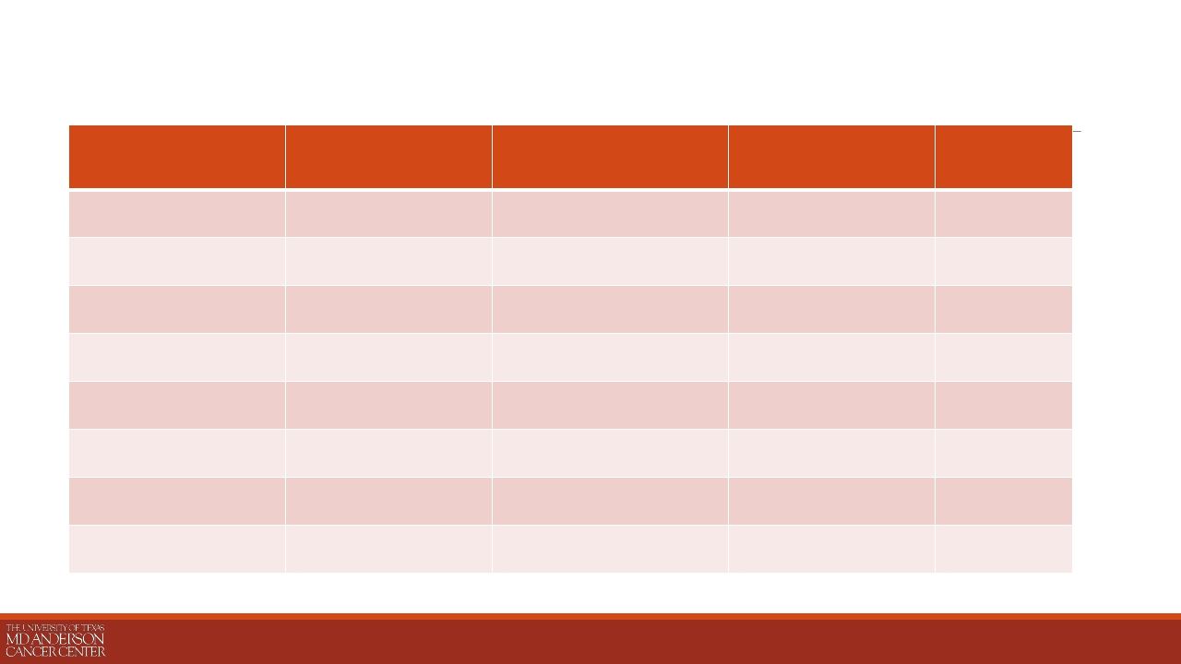
Age, MSI, BRAF, and Methylation (CIMP) are
Associated with Right-sided Primaries
Right-Sided
Left-Sided
n=63 (32%)
n=135 (68%)
Odds Ratio
P-value
Median age
Male sex
White race
MSI-High
PIK3CA mutant
BRAF mutant
NRAS mutant
CIMP High
62 (30-81)
37/63 (58.7%)
55/63 (87.3%)
5/31 (16.1%)
7/51 (13.7%)
22/61 (36.1%)
7/50 (14.0%)
24/63 (38.1%)
56 (24-76)
84/135 (62.2%)
103/135 (76.3%)
2/71 (2.8%)
19/112 (17.0%)
12/116 (10.3%)
14/107 (13.1%)
28/135 (20.7%)
1.05 (1.02-1.08)
6.63 (1.21-36.3)
5.45 (2.47-12.0)
2.35 (1.22-4.54)
0.001
0.64
0.09
0.026
0.65
0.00003
1.00
0.015
PRESENTED BY: MICHAEL S. LEE, MD

