Slide 1
This House believes that: Metronomic chemotherapy has an emerging role for early and advanced breast cancer treatment
Elisabetta Munzone
Discussion Leader.
Vito Lorusso
Direttore UOC di Oncologia Medica
Istituto Oncologico
Bari, Italy

Slide 2
Conclusions
Metronomic chemotherapy is an alternative treatment, especially for palliative indications and for the elderly and/or frail patients that otherwise would not be candidates for MTD chemotherapy
Increased attention to patients' quality of life favors the use of active oral treatments.
Metronomic combinations in early stages key for future trials

Slide 3
Conclusions
Metronomic chemotherapy is an alternative treatment, only? for palliative indications and for the elderly and/or frail patients that otherwise would not be candidates for MTD chemotherapy
Increased attention to patients' quality of life favors the use of active oral treatments.
Metronomic combinations in early stages key for future trials

Slide 4
Is metronomic chemotherapy active?
Cyclophosphamide given as last treatment to PS III or elderly/frail patients in which any chemotherapy is contraindicated?
Is this “placebo like” treatment to be considered as metronomic chemotherapy?
If doctors do not trust in metronomic chemotherapy is mainly due to the fact that most of them have used it only in these cases, when BSC was the real indication.

Slide 5
Metronomic chemotherapy has its dignity!
It is a real alternative to MTD chemotherapy when:
  Patients unfit for MTD Chemotherapy
  PS 1-2 patients cannot tolerate MTD chemo for other reasons
  A fully oral home treatment is the best choice for QOL
  The patient and the doctor agree to start a treatment that is practically devoid of toxicity

Slide 6
Breast cancer

Slide 7
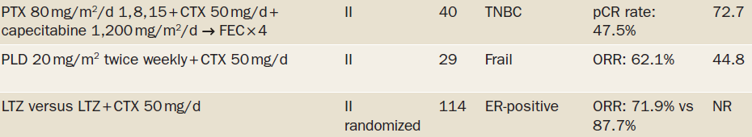
Trials with metronomic chemotherapy in the neoadjuvant setting
Elderly women (age > 70 years) or women between 65 and 70 years, unfit for chemotherapy
Nat Rev Clin Oncol 2015; 12: 631-44

Slide 8
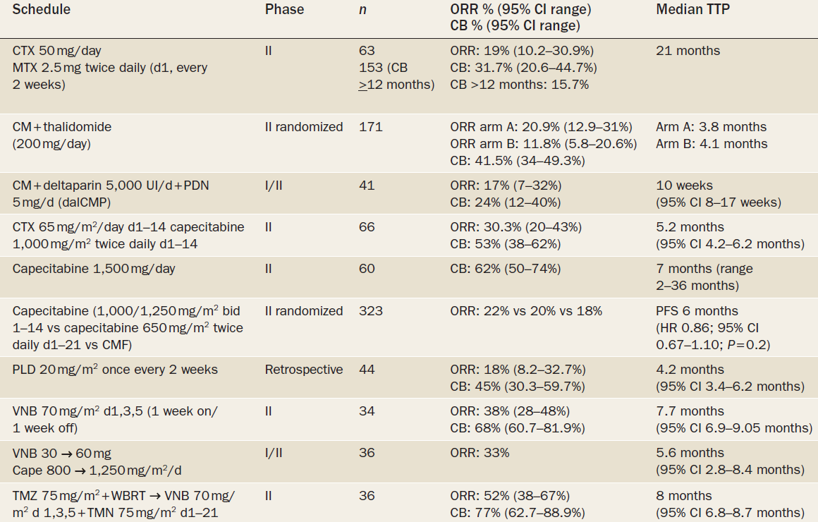

Trials with metronomic chemotherapy in metastatic breast cancer

Slide 9
Metronomic therapy is indicated in breast cancer patients unfit for MTD chemotherapy in neadjuvant setting as well as in advanced stages
Not for terminal illness!
Take Home message

Slide 10
Manteinance therapy in Breast Cancer

Slide 11
IBCSG Trial 22-00 (CM Maintenance)
Hormone receptor negative (< 10% positive cells by IHC) by locally-determined ER and PgR
1086 patients enrolled Jan 2001 - Dec 2012
RANDOMI
ZE
*
SURGERY
Induction Chemotherapy
CM Maintenance Chemotherapy (CMM)
Stratify
Institution
Menopausal status
Induction regimen
4-6 mos.
12 mos.
Induction Chemotherapy
Observation (OBS)
4-6 mos.
*Any time from start of induction to within 8 weeks after first day of last course of induction
1081 patients in ITT population; Median follow-up 6.9 years

Slide 12
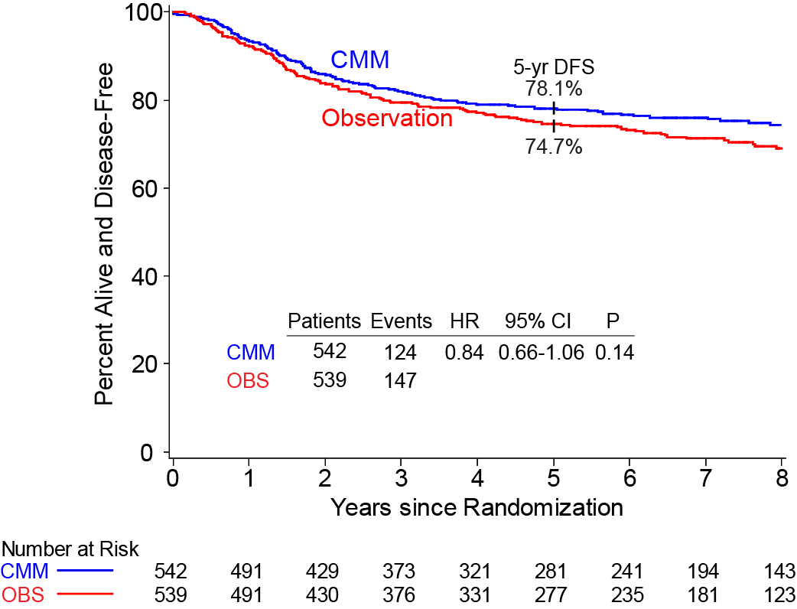
Disease-Free Survival
CMM after adjuvant CT reduced the relative
risk of recurrence by 20%, and reduced the absolute risk of recurrence by 4.1%

Slide 13
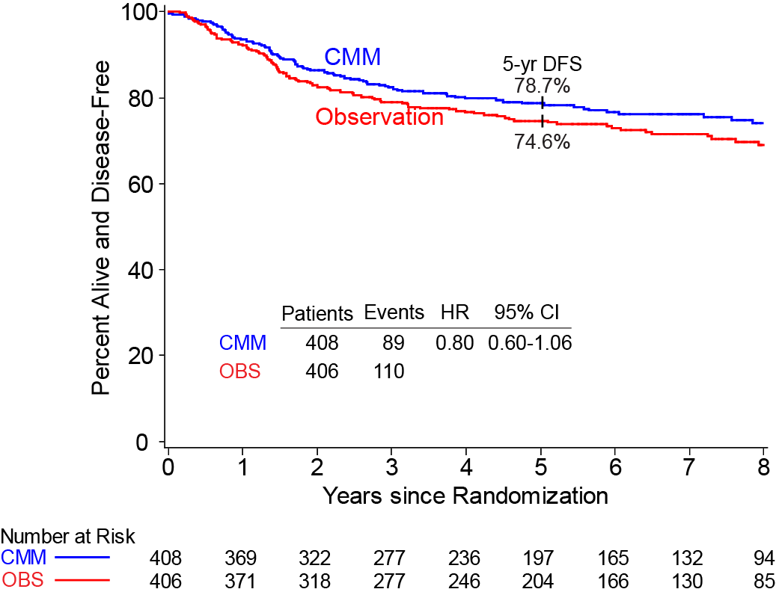
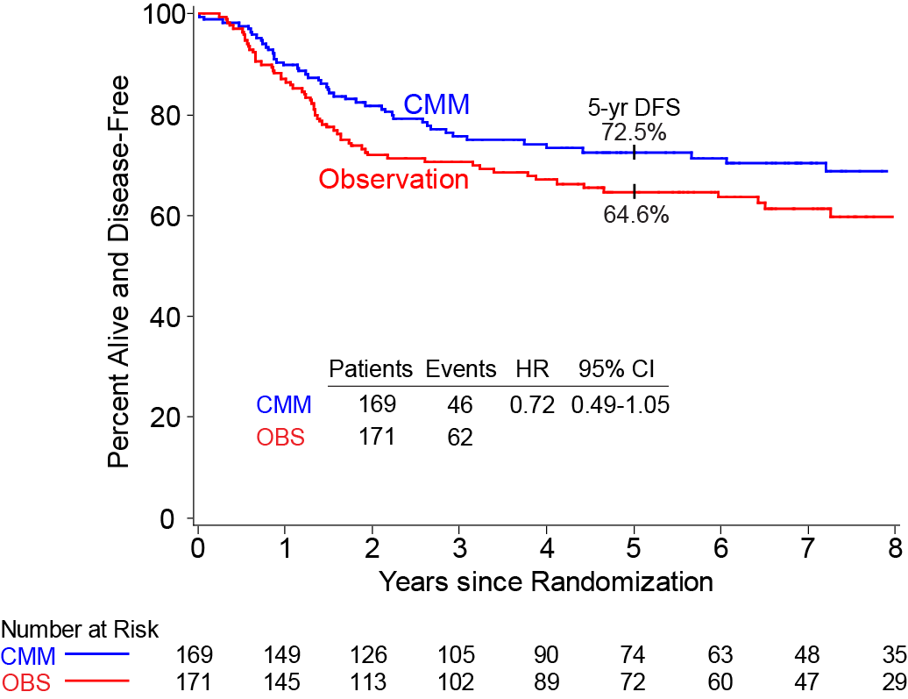
Disease-Free Survival
Triple Negative
Node Positive and Triple Negative
Patients with triple negative and node positive disease experienced the largest benefit: a 7.9% reduction in their absolute risk of recurrence.

Slide 14
Metronomic therapy is effective in manteinance chemotherapy in adjuvant setting
In particular, it is true fro TNBC
Take Home message

Slide 15
Other neoplasms

Slide 16
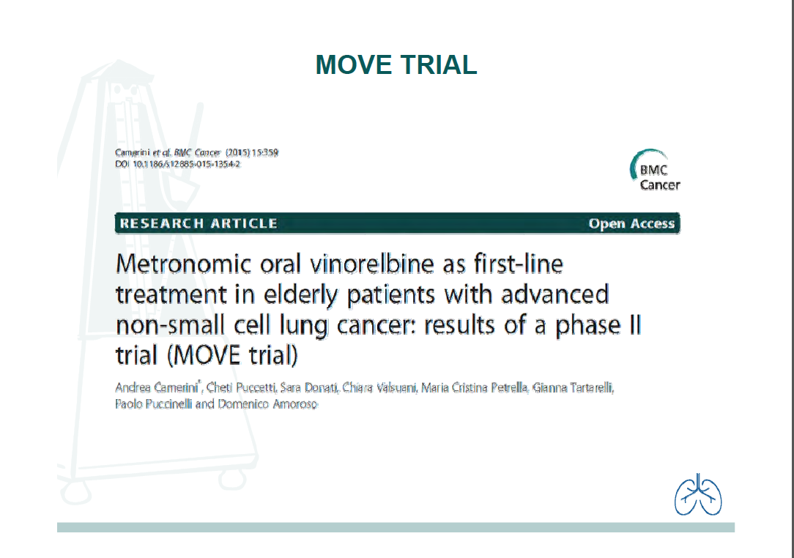

Slide 17
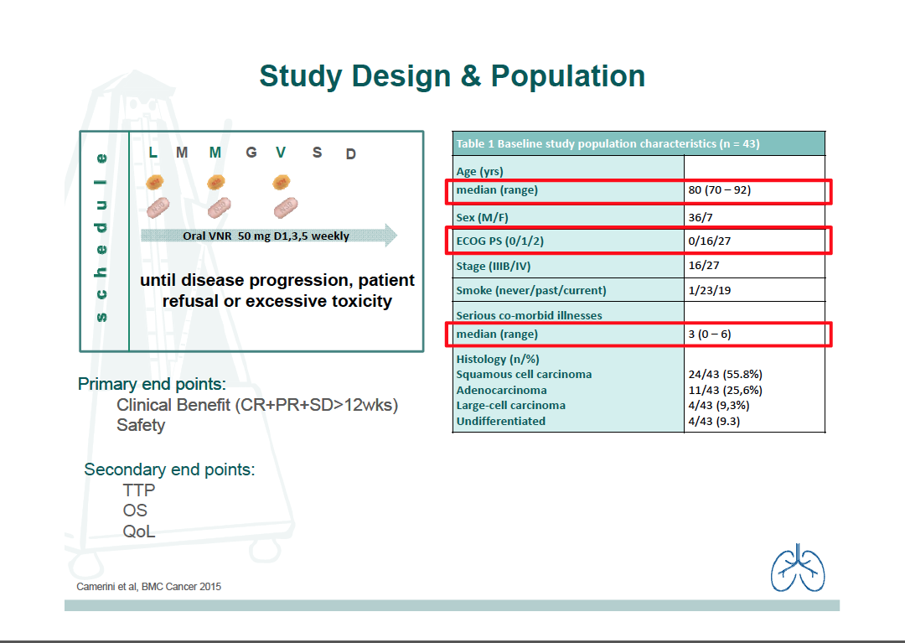

Slide 18
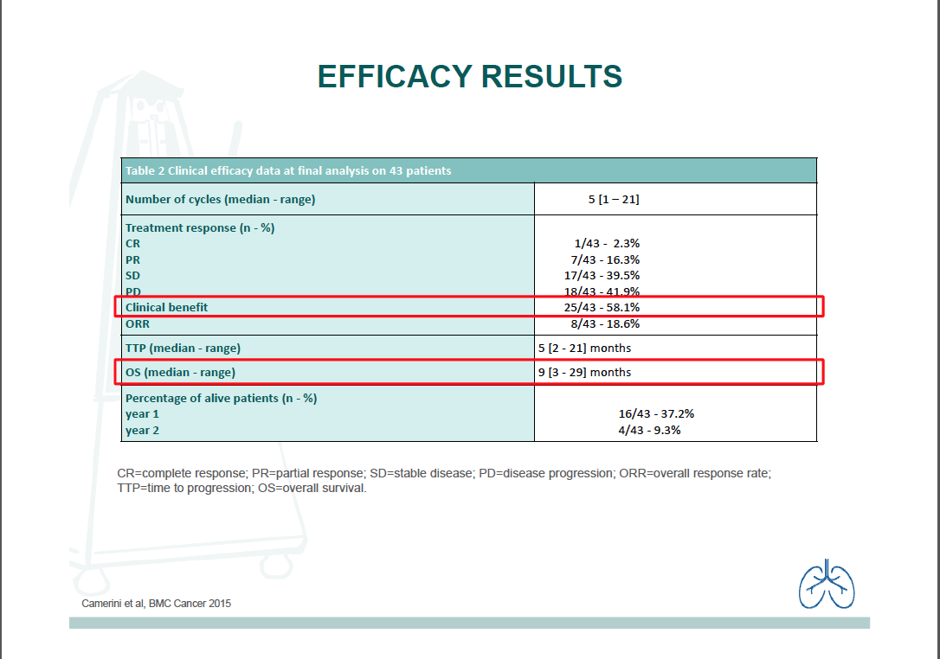

Slide 19
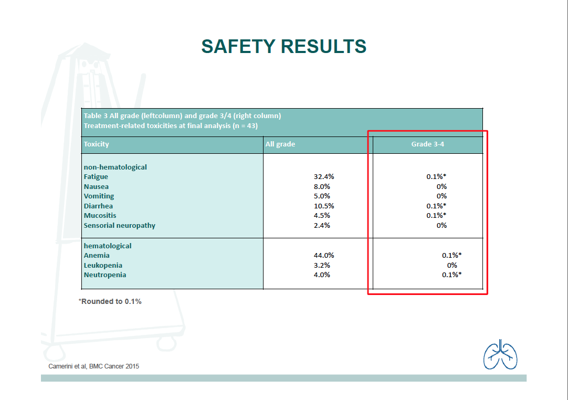

Slide 20
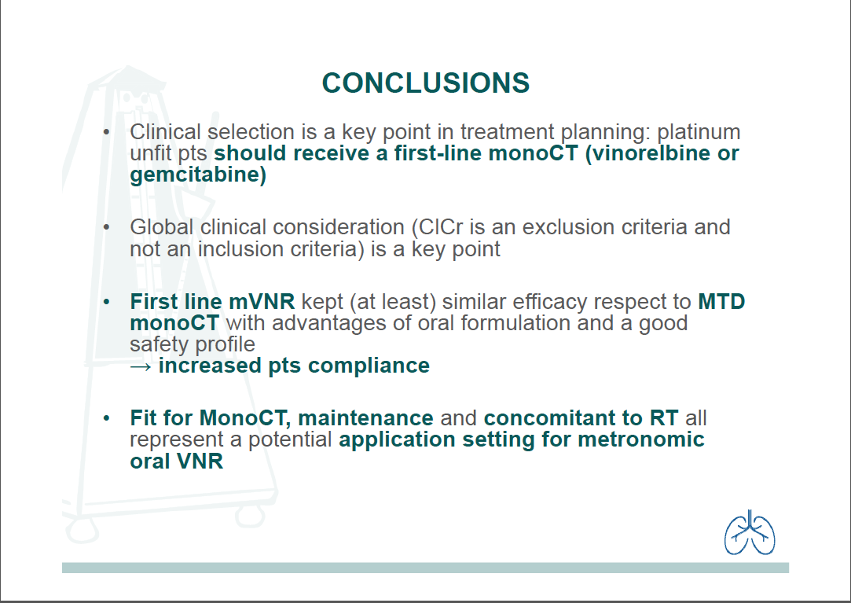

Slide 21
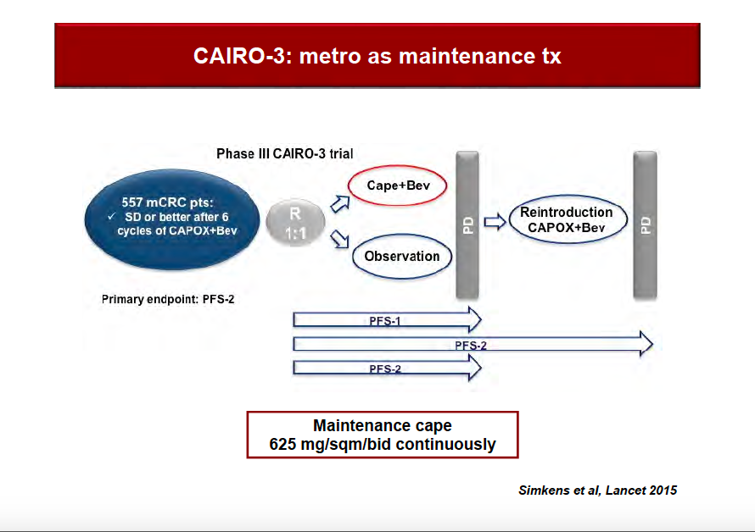

Slide 22
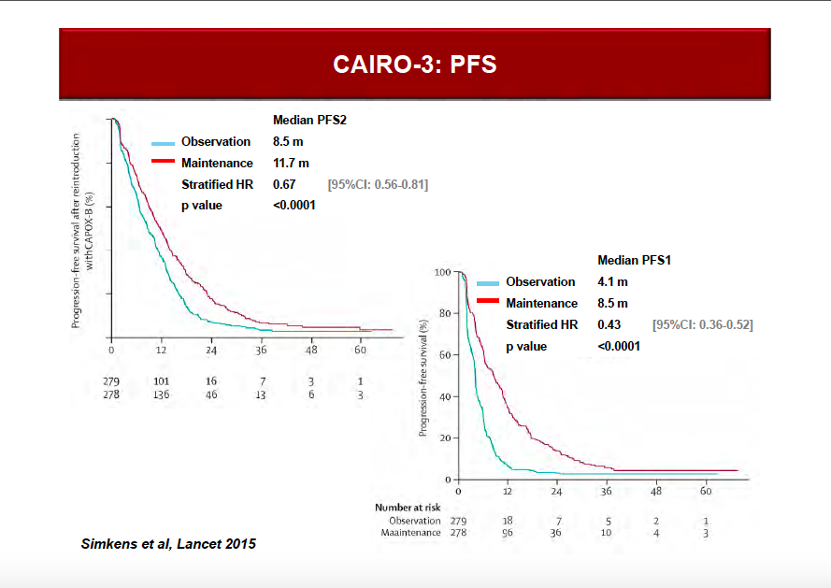

Slide 23
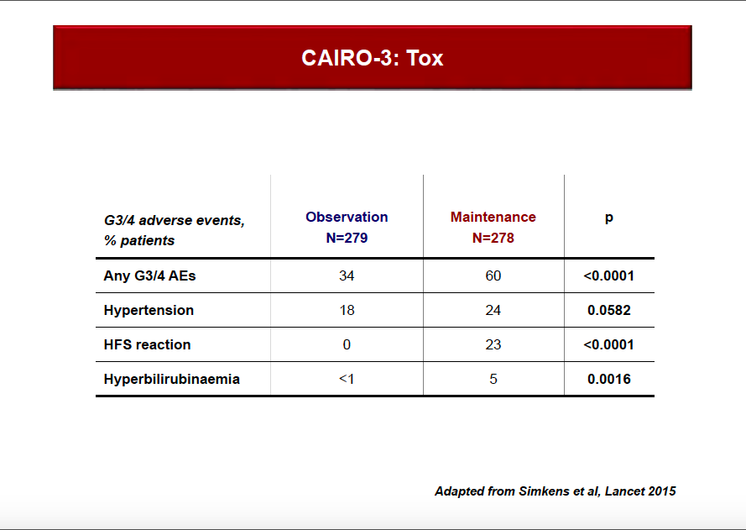

Slide 24
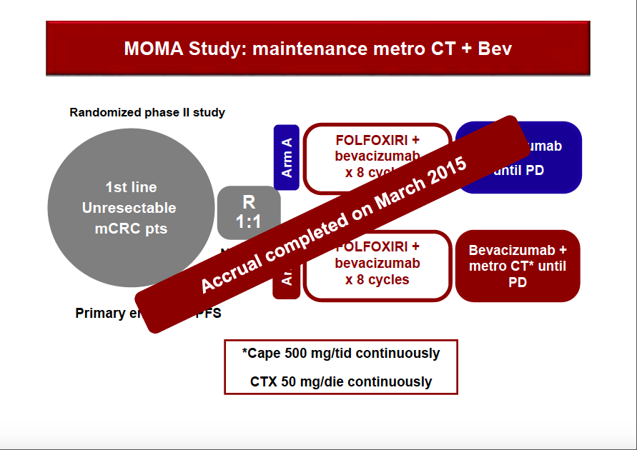

Slide 25

My personal point of view
Metronomic chemotherapy has demonstrated activity in BC
It can obtain disease control for a significant proportion of patients with MBC
I usually prescribe metronomic CM or metronomic Vinorelbine plus capecitabine not only in elderly/frail patients, but also in “fit” patients who desire low-toxic treatments or in those who are still in good PS but have already rundown MTD chemotherapy in previous lines.
We have also concluded a trial with HEX with exciting preliminary results.
Notes:
25

Slide 26
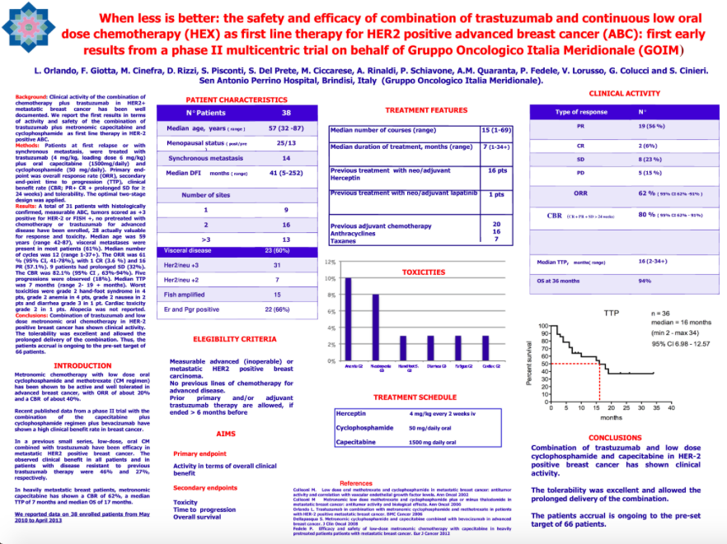

Slide 27
Conclusions
Metronomic chemotherapy is an alternative treatment:
For palliative indications and for the elderly and/or frail patients that otherwise would not be candidates for MTD chemotherapy
For fit patients who need/wish less toxic chemotherapy
In breast cancer as well as in other neoplasms in all cases when the aim is to preserve quality of life
Never to be cosidered as “placebo like” treatment for terminal illness

