Slide 1

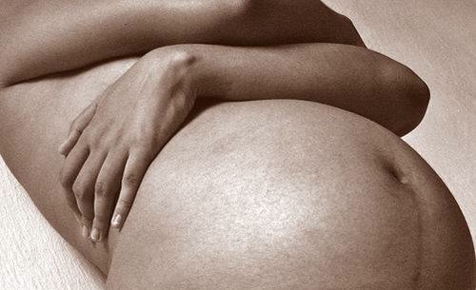

Fertilità e gravidanza dopo cancro della mammella: una realtà?
dott. ssa Federica Tomao, MD, PhD
“University of Rome Sapienza”
Notes:
fertilità e gravidanza

Slide 2
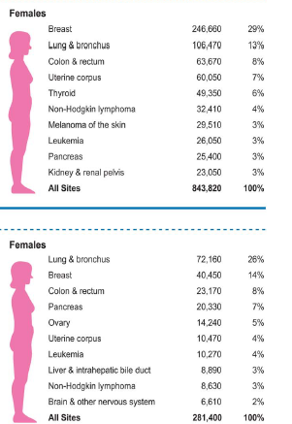


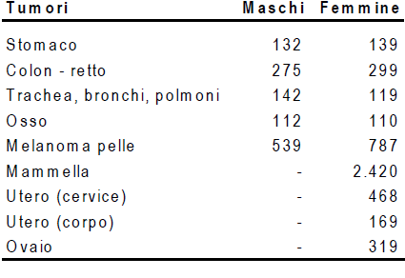

BREAST CANCER INCIDENCE IN FERTILITY AGE
Estimated new cases
Estimated deaths
Ca statistics 2016
ISTAT 2014
Notes:
BC represents one of the most frequent neoplasia among female population worldwide

Slide 3

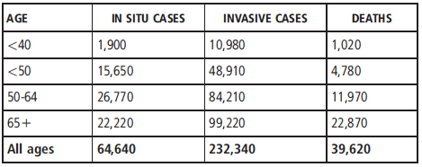

Breast Ca statistics 2013
«Elderly Primigravidas»
Women start to find a pregnancy at an ever increasing age
OVER 40
ISTAT 2014
Only 10% (out of of 502.596) babies are born from women younger than 25 years
Notes:
Since the number of elderly primigravidas rised in the last decades, such as only 11% of babies are born from women younger than 25 years, this topic is abstolutely actual

Slide 4

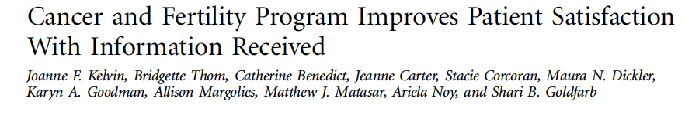
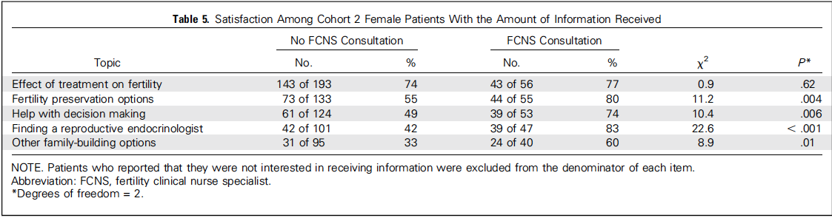
Interest about fertility preservation
…couselling is mandatory

Slide 5

Roadmap
Pregnancy after breast cancer
Chemotherapy induced premature ovarian failure
Pathophysiology
Diagnosis and symptoms
Fertility preservation options
Prevention of chemotherapy induced infertility
Cryopreservation
Notes:
Secondary we will discuss about fertility preservation in BC patients

Slide 6
Pregnancy rate after cancer
30-50% of patients want a pregnancy
Only 4-7% have a pregnancy
Litton JK; Curr Treat Options Oncol 2012
Notes:
And even if 30-50% of women want a pregnancy but only 4-7 % have it

Slide 7

Pregnancy rate after cancer: not all alike
Analysis adjusted for education level,
previous pregnancy
age
Stensheim et al; Int J Cancer 2011
Notes:
Moreover, we well know that not all tumors have the same impact on fertility depending on different treatments.
And breast cancer presented one of the lower pregnancy rate.

Slide 8

RATETOOL survey
- 180 Italian oncologists involved in breast cancer treatment
- web-based questionnaire
- homogeneous geographical sampling
Ratetool, 2012
Notes:
In this italian survey involving 180 oncologists

Slide 9
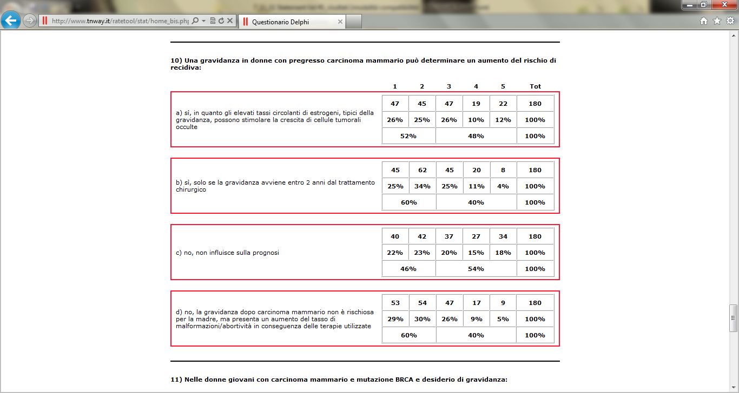
RATETOOL survey
180 Italian oncologists involved in breast cancer treatment
web-based questionnaire
homogeneous geographical sampling
1+2=Disagree
3+4+5=Agree
Ratetool, 2012
Notes:
It was shown that most the physician think that pregnancy after breast cancer could consist in a worse prognosis in term of recurrence rate

Slide 10
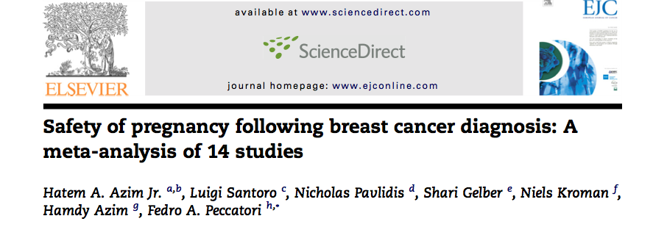
Safety: meta-analysis
-14 studies
7 case control studies
4 population based studies
3 hospital based studies
-1244 cases e 18145 controls
-Follow-up 5-30 years
Azim HA et al 2011
Notes:
However, in this metanalysis on 14 studies

Slide 11
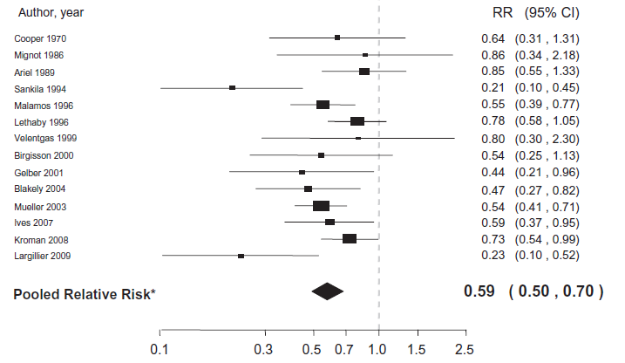
Safety: meta-analysis
All studies, 41% risk reduction
Azim HA et al 2011
Notes:
Pregnancy after BC seems to have even a protective effect on risk of death consissting of 41% of risk reduction

Slide 12
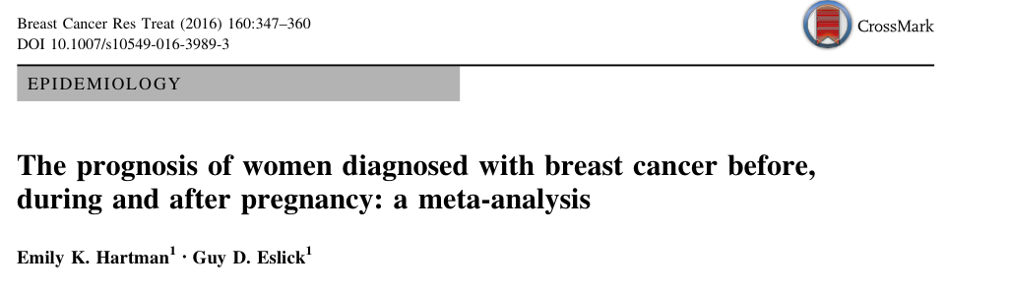
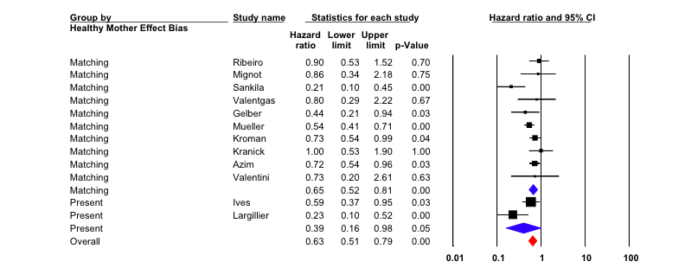
Women who became pregnant after a diagnosis of breast cancer had a significantly reduced risk of death compared to those who did not become pregnant, pHR 0.63 (95 % CI 0.51–0.79) p = 0.02.
Hartman EK et al 2016

Slide 13
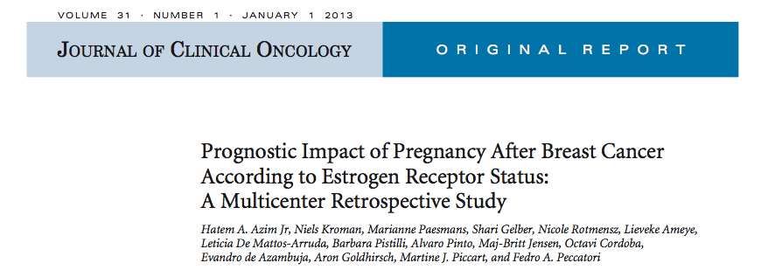
Safety: multicenter study in ER+/ER-
Retrospective, multicenter cohort study (7 Institutions)
333 cases with pregnancy after breast cancer
874 non pregnant controls matched for ER, stage, adjuvant treatment, age, year at diagnosis (+ healthy mother effect)
Primary endpoint: DFS ER+ pts.
Secondary endpoints: DFS in ER- pts., OS
Subgroup analysis: DFS according to timing of pregnancy
DFS according to breastfeeding
Azim HA et al 2013
Notes:
And what about Estrogen receptors?
In this study among 333 cases

Slide 14
Safety: multicenter study in ER+/ER-
Institution/Group | Pregnant cases, n | Matched controls, n
Number | 333 | 874
Median age (range) | 31 (21-44) | 34 (22-48)
Tumor size > 2cm * | 135 (40.5%) | 359 (41%)
Nodal status Negative Positive | 188 (57%) 144 (43%) | 498 (57%) 376 (43%)
Histological grade 1 2 3 unknown | 37 (11%) 96 (29%) 114 (34%) 84 (26%) | 103 (12%) 253 (29%) 346 (39%) 172 (20%)
ER status Negative Positive | 139 (42%) 194 (58%) | 382 (44%) 492 (56%)
Adjuvant chemotherapy received | 264 (79%) | 714 (82%)
Median duration of hormonal therapy in months (range) | 60 (6-69) | 60 (7-96)
Median time to conception: 2.4 ys Median follow-up from conception: 4.7 ys
Azim HA et al 2013
Notes:
With a median age of 31 years and the same distribution of main prognostic factors

Slide 15
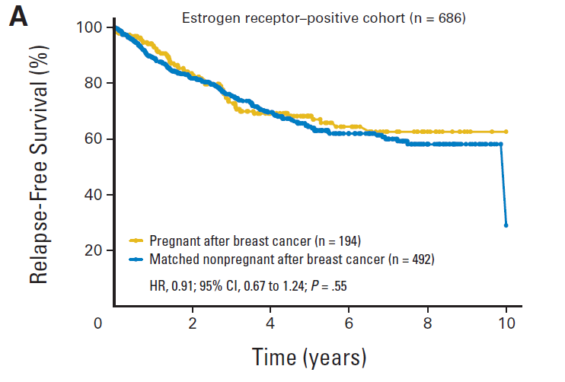
Safety: DFS in ER+
HR 0.91 (95%CI 0.67-1.24)
Azim HA et al 2013
Notes:
DFS was similar in patients having a pregnancy after tumor and others both in ER+ disease

Slide 16
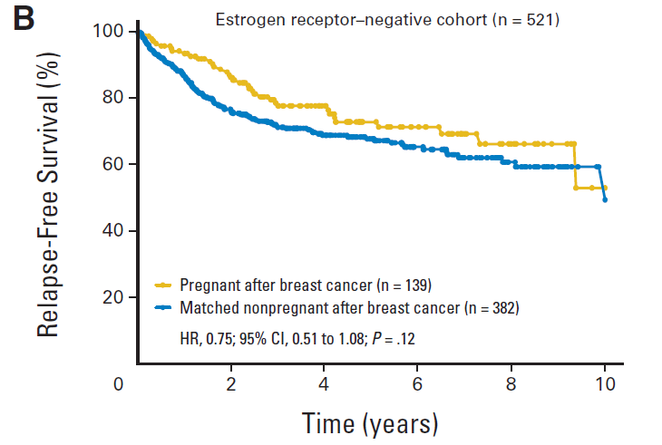
Safety: DFS in ER-
HR 0.75 (95%CI 0.51-1.08)
Azim HA et al 2013
Notes:
And in ER-disease

Slide 17
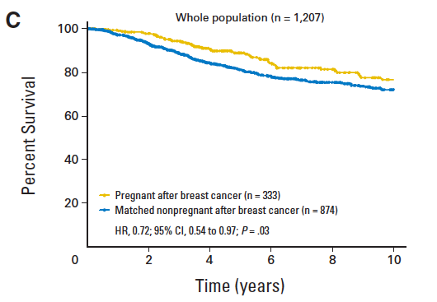
Safety: OS all patients
HR 0.72 (95%CI 0.54-0.97)
Azim HA et al 2013
Notes:
With an OS higher in patients who had pregnancy

Slide 18
Roadmap
Pregnancy after breast cancer
Chemotherapy induced premature ovarian failure
Pathophysiology
Diagnosis and symptoms
Fertility preservation options
Prevention of chemotherapy induced infertility
Cryopreservation
Notes:
Secondary we will discuss about fertility preservation in BC patients

Slide 19


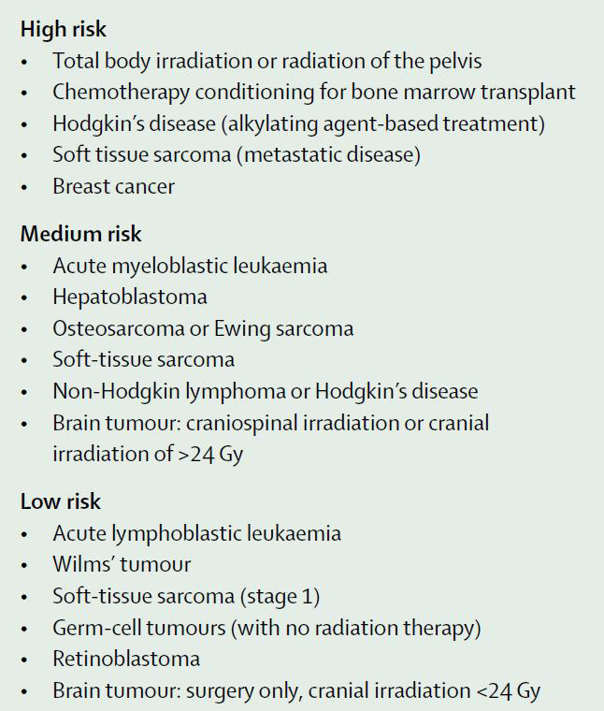
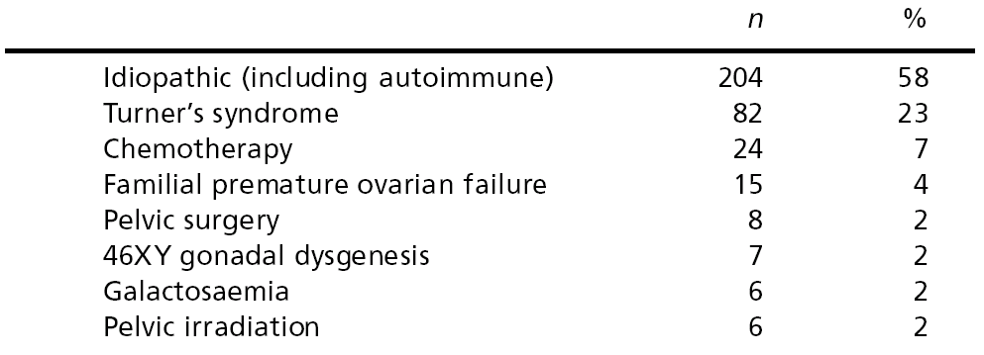


PREMATURE OVARIAN FAILURE (POF)
1-4% of female population
(250.000 and 1 million, USA 2010)
Ovarian insufficiency risk
assessment
17.000 patients have a CT
induced POF
On 352 WOMEN
Gerard S Conway, 2000
Michel De Vos, et al. Lancet 2010
Notes:
About 1-4 % of female population has POF and 17.000 of cases are chemotherapy induced

Slide 20
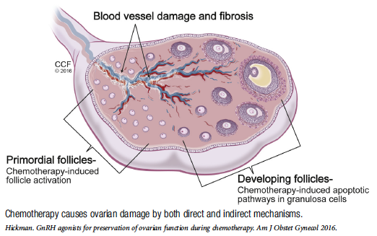
Chemotherapy-ovarian damage

Slide 21

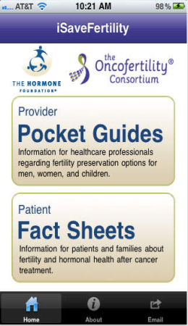
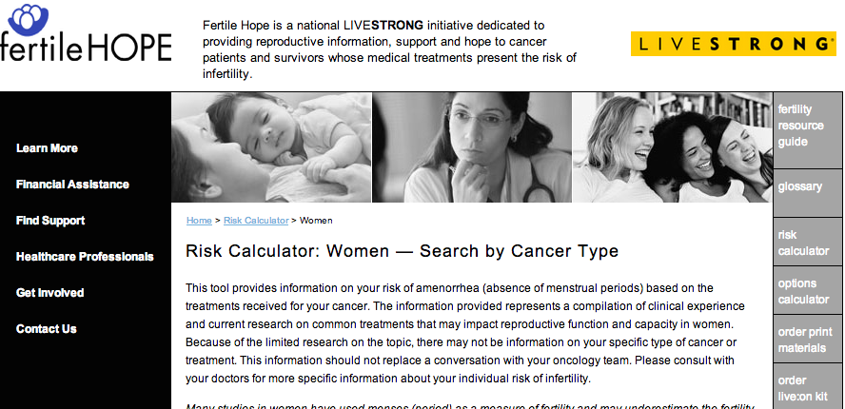
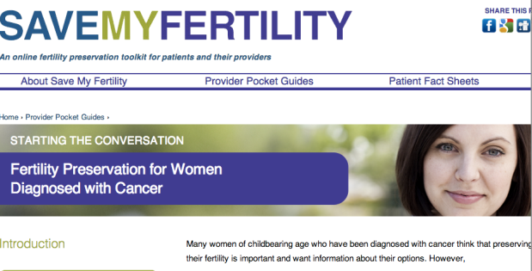

Chemotherapy damage
PRIMARY DISEASE
Age at diagnosis (oocyte quantity and quality)
Age at pregnancy (treatment duration)
DRUG FAMILY & DOSES
Meirow D. et al., NEJM 2008
Wallace WH et al., Clin Obstet Gynecol 2010
Notes:
And it depends on the primary disease, on age and drug family and doses.

Slide 22

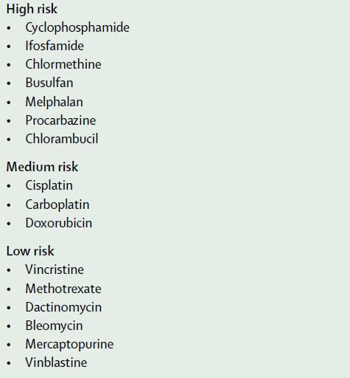
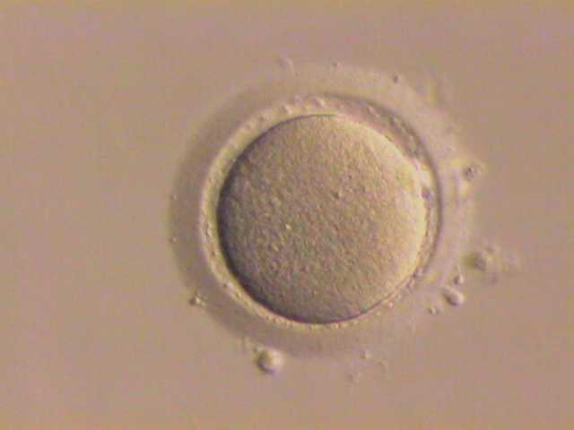
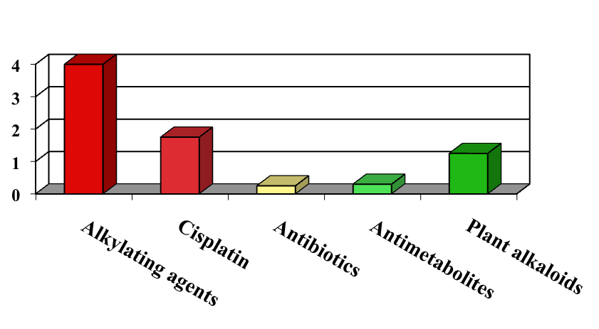
Drug Family
Estimated risk of gonadal Dysfunction with cytotoxic drugs
Meirow Mol Cell Endocrinol 2000
168 patients treated with combined shedules: POF 34%
Odds Ratio: 1
Michel De Vos, et al. Lancet 2010
Notes:
Drugs most frequently used for breast cancer are heavily gonadotoxic

Slide 23
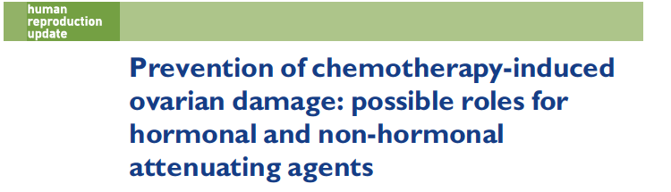
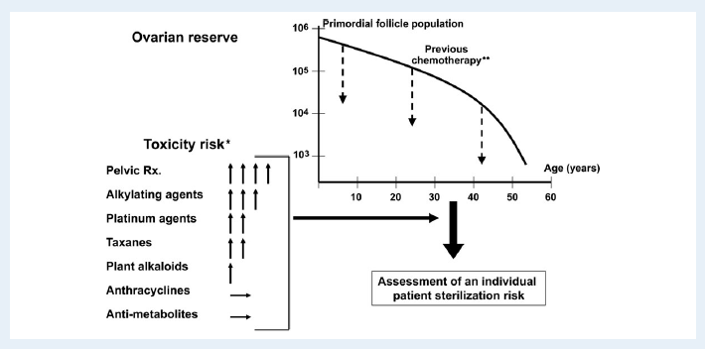
Roness H, et al. Hum Reprod Up 2014

Slide 24
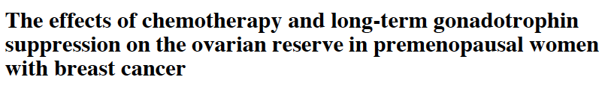
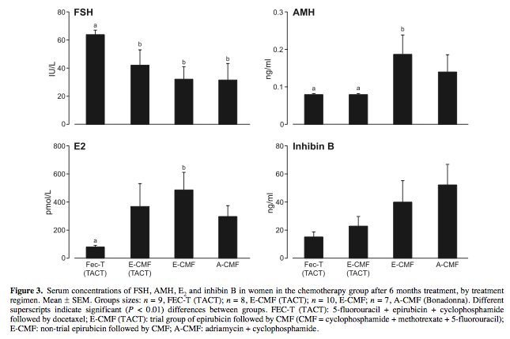
Regimens containg Taxanes showed higher gonadotoxicity
Anderson RA, et al. Hum Reprod 2006

Slide 25
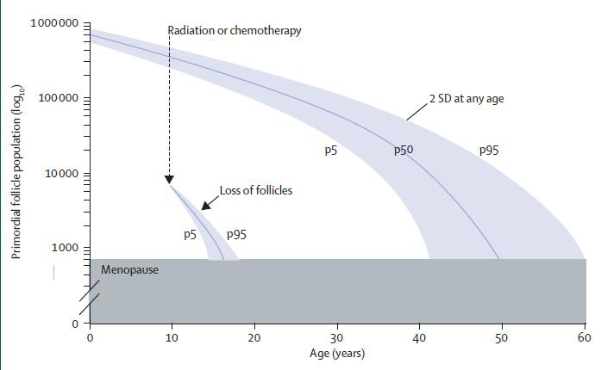
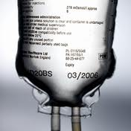

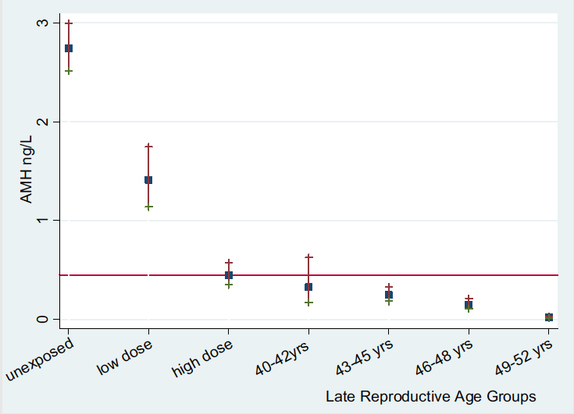

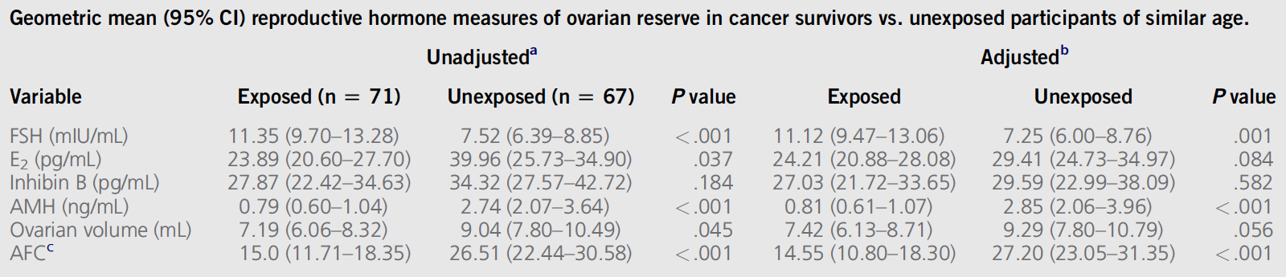
AGE: THE ONLY DIFFERENCE!!!
1858 pts
Decline of ovarian follicular reserve
p5=5th percentile. p50=median. p95=95th percentile
Michel De Vos, et al. Lancet 2010
Median reproductive hormones at same age
Gracia CR et al, Fertil Steril 2012
Notes:
And of follicular reserve

Slide 26
Chemotherapy-ovarian damage (symptoms)
-main aspects-
Ovarian damage following chemotherapy can present with a
variety of symptoms that reflect varying degrees of damage, culminating
in premature ovarian failure (POF).
POF is associated with a wide array of effects including vasomotor symptoms (hot flushes and night sweats), genitourinary symptoms (vaginitis, dyspareunia, dysuria) and osteoporosis, which can lead to skeletal fractures (Ganz and Greendale, 2001).
Ovarian failure after adjuvant chemotherapy has been shown to be associated with rapid bone loss in women with early stage breast cancer (Shapiro et al., 2001).
The management of these symptoms is particularly difficult (especially in patients with breast cancer) owing to concerns about HRT (Rostom, 2001; Beral, 2003).

Slide 27

Ovarian Reserve Testing
The diminished reserve may manifest immediately after
treatment with persistent amenorrhea or have a delayed clinical presentation with infertility or POF long term.
Biophysical | Biochemical
Ultrasound: 2D or 3D Ovarian volume Antral follicle count (AFC) Ovarian stromal blood flow Uterine dimensions | Basal (early follicular) levels: FSH, LH, E₂ Inhibins and activins Anti-Müllerian hormone (AMH)
Follicle density | Ovarian stimulation tests: GnRH agonist stimulation test (G-test) Clomiphene citrate challenge test (CCCT) FSH (EFORT)
Singh KL et al., Hum Reprod Up 2005

Slide 28
Roadmap
Pregnancy after breast cancer
Chemotherapy induced premature ovarian failure
Pathophysiology
Diagnosis and symptoms
Fertility preservation options
Prevention of chemotherapy induced infertility
Cryopreservation
Notes:
Secondary we will discuss about fertility preservation in BC patients

Slide 29
FERTILITY PRESERVATION OPTIONS IN FEMALES
INTERVENTION
DEFINITION
COMMENT
CONSIDERATIONS
Embryo cryopreservation (S) | Harvesting eggs, in vitro fertilization, and freezing of embryos for later implantation | The most estabilished tecnique for fertility preservation in women | 10-14 days of ovarian stimulation Requires donor sperm or partner Outpatient surgical procedure $ 8,000 per cycle, $ 350 per year storage fees
Oocyte cryopreservation (I) | Harvesting and freezing of unfertilized eggs | Small case series and case reports | 10-14 days of ovarian stimulation Outpatient surgical procedure $ 8,000 per cycle, $ 350 per year storage fees
Ovarian cryopreservation and transplantation (I) | Freezing of ovarian tissue and reimplantation after cancer tretment | Case reports; as of 2005, two live births reported. | Not suitable when risk of ovarian involvement is high Same day outpatient surgical procedure
Ovarian Suppression with gonadotropin releasing hormone (GnRH) analogs or antagonists (I) | Use of Hormonal Therapies to protect ovarian tissue during chemotherapy | Small randomized studies and case series. Larger randomized trials in progress. | Medication given before and during treatment with chemotherapy Approximately $ 500/mo
Abbreviations: S, standard; I, investigational
Lee et al JCO 2006
Notes:
These are all the strategies available for fertility preservations in BC and embryo cryopreservation is still the unique standard procedure with a success rate of about 40%

Slide 30
Treatment strategy for women of reproductive age with a cancer diagnosis
(update 2016)
Embryo
Cryopreservation:
- Non-experimental
-Solely for fertility
maintenance
- Requires male
partner or sperm
donor for embryo
creation
- Realistic outcome
to be discussed if
poor ovarian reserve
- Hormone-sensitive
malignancies- add AI
- Treatment urgency
may preclude use
Oocyte
Cryopreservation:
- Non-experimental
- Solely for fertility maintenance
- For those without a
partner or who prefer
to not have embryos
created
- Realistic outcome
to be discussed if
poor ovarian reserve
- Number of oocytes
required for
cryopreservation to
obtain a pregnancy
- Hormone-sensitive
malignancies-add AI
- Treatment urgenc
Ovarian Tissue
Cryopreservation:
- Experimental
- Can be used for
fertility or
maintenance of
gonadal function
alone
- Good for those with
hormone-sensitive
cancers, treatment
urgency, prepubertal
girls, or those who
cannot afford the
cost associated with
embryo or oocyte
cryopreservation
- Reimplanted tissue
may delay
GnRH
Agonist:
- Experimental
- Can use with other
cryopreservation
strategies
- Confers a
protective effect for
premature ovarian
failure
- Can be used for
fertility or
maintenance of
gonadal function
alone
- Post-treatment
pregnancies
reported
Ovarian
Transposition:
- Non-experimental
- For planned pelvic
radiation therapy
- Can use with other
cryopreservation
strategies
- If gonadotoxic
treatment planned,
must chose
alternative/additional
regimen
Hickman LC et al., Exp Rev, 2016

Slide 31
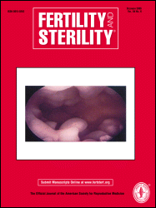
90% vitality and fertilization after thawing
30% probability of a baby
Jain JK et al 2009
Notes:
31
And even if as previously reported, the preseration of embryos semms to be more effective in case of absence of a partner oocyte storage could be a valid choice with a 30% of success rate

Slide 32
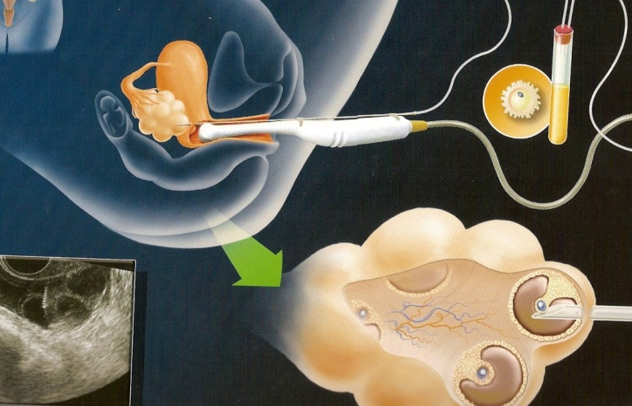
Consider egg/embryo freezing before chemo
            Gonadotrophin administration
            Oocytes pick up
            Oocytes freezing
            IVF/ICSI and embryo freezing
Notes:
32
It needs the use of Gonadotropin administration ad oocyte pick-up

Slide 33
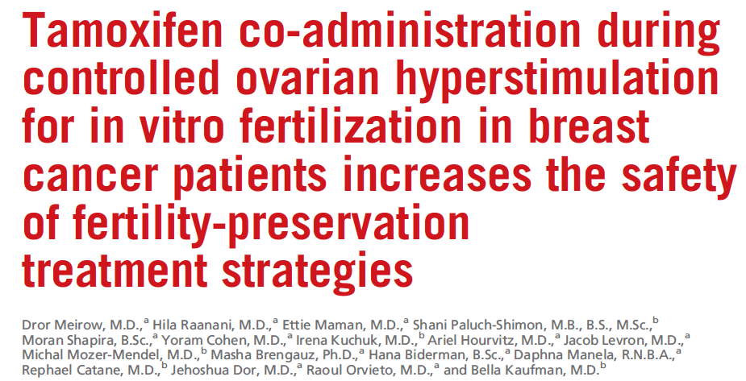
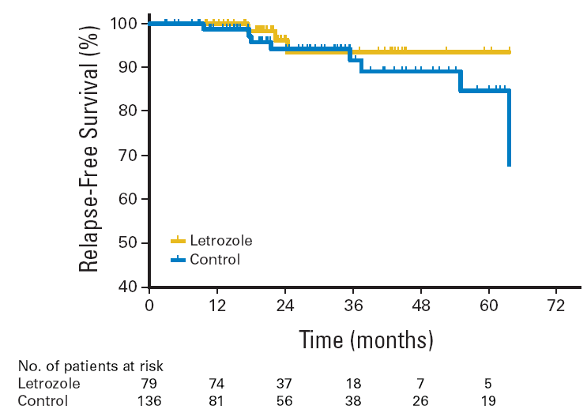
Controlled ovarian stimulation in breast cancer
…with letrozole
…with tamoxifen
10 embryo implanted, 5 deliveries
79 pts
Mean age: 36.1 + 3.8
N-: 62%
ER+: 81%
HER-2+: 26%
No substantially increased recurrence risk
70 patients, 76 cycles
48 cycles with TAM, 28 cycles without TAM
Median age 33.6 y (range: 24-43), 58%=ER+
No difference in outcome for the 4 groups, with 4.3%
late mortality
Fertility preservation with COH and TAM
is safe (and effective!)
Azim AA et al, JCO 2008
Meirow D et al Fertil Steril 2014
Notes:
33

Slide 34
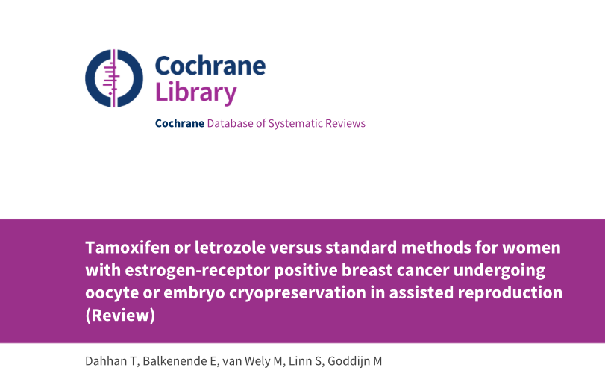
COS schedules with the additional use of tamoxifen or letrozole are commonly chosen as an alternative regimen in young women with
ER positive breast cancer who undergo COS for oocyte or embryo cryopreservation. No randomised controlled trials support the idea
that these alternative COS schedules are superior to standard COS.
Dahhan T et al 2013

Slide 35
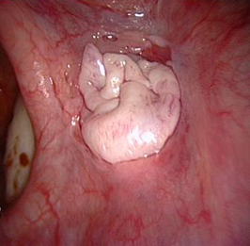
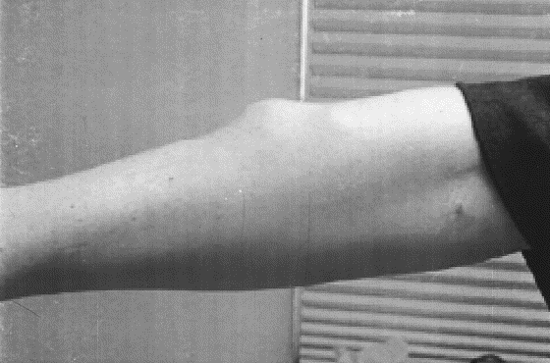
Ovarian tissue crypreservation
Tissue samples obtained through laparoscopy
Cryopreservation
Unfreezing (only primordial follicles survive)
Autotransplantation
- Orthotopic (on the ovaries or near them)
- Heterotopic (outside the pelvis)

Slide 36
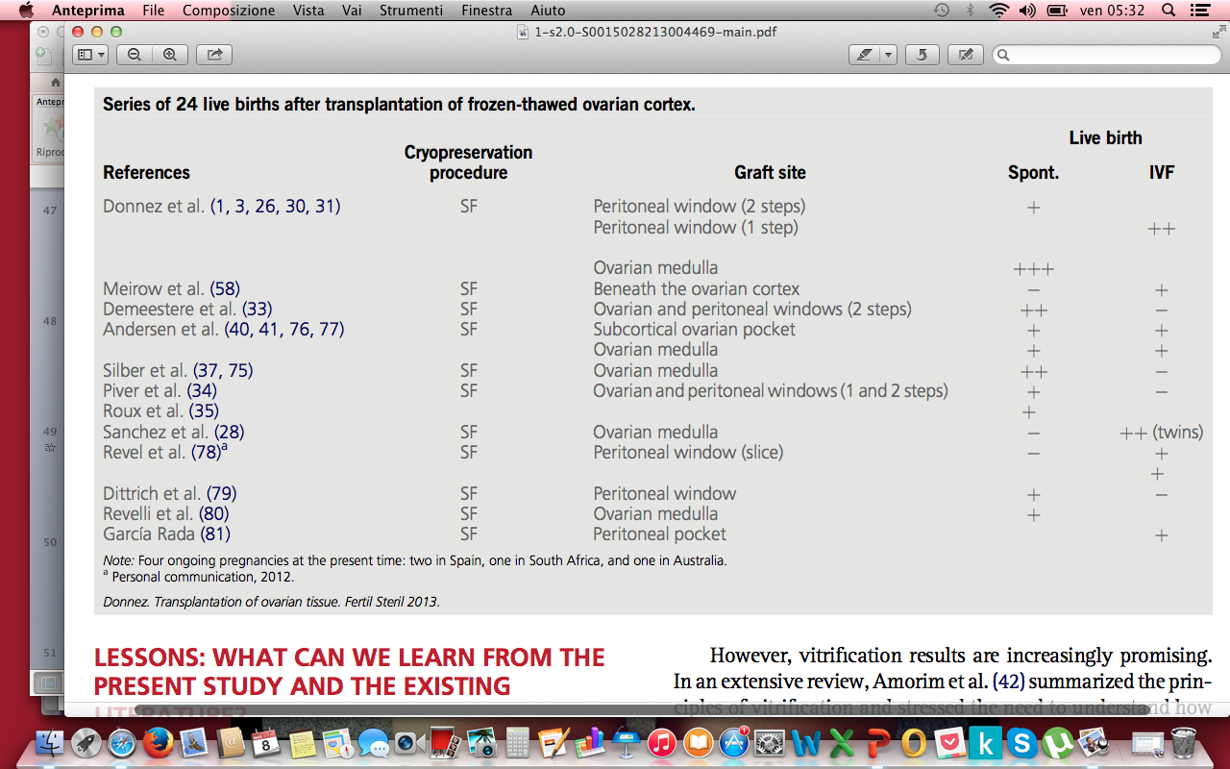
OVARIAN TISSUE CRYOPRESERVATION
Among the 60 patients, eleven conceived and six of those had already delivered twelve healthy babies
Donnez J et al Fertil Steril 2013
+
Four patients delivered healthy babies
+
Dittrich R et al 2013
11/40 pregnancies (28%) 9/40 deliveries (23%) 10/11 (91%) spontaneous conceptions
+
Van der Ven H et al 2016
16 pregnancies (10 after IVF, 6 spontaneous) 10 live births
Meirow D et al, Fertil Steril, 2016
Notes:
Totally 40

Slide 37
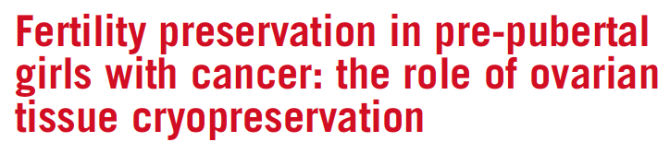
The Edinburgh OTC selection criteria
The majority of women show restoration of ovarian activity by four months after transplantation, with live birth in about 25%
Age younger than 35 y
No previous chemotherapy or radiotherapy if aged or older at diagnosis, but mild, non-gonadotoxic chemotherapy acceptable if younger than 15 y
A realistic chance of surviving for 5 y
A high risk of premature ovarian insufficiency (>50%)
Informed consent (from parents and, where possible, patient)
Negative serology results for HIV, syphilis, and hepatitis B
Not pregnant and no existing children
Note: OTC . ovarian tissue cryopreservation
Hamish WB. et al 2016
Notes:
i criteri di edinburgo nascono dalla necessità di selezionare accuratamente le pazienti

Slide 38
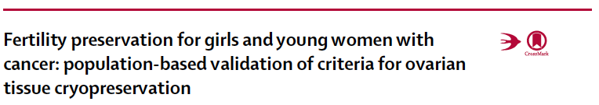
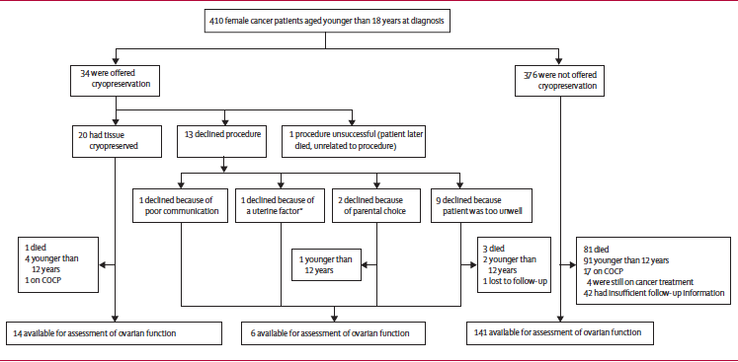
34 pts (8%) met the Edinburgh selection; 13 pts declined the procedure and 21 consented; the procedure was completed successfully in 20 patients.
Wallace WHB et al., Lancet Oncol, 2014

Slide 39

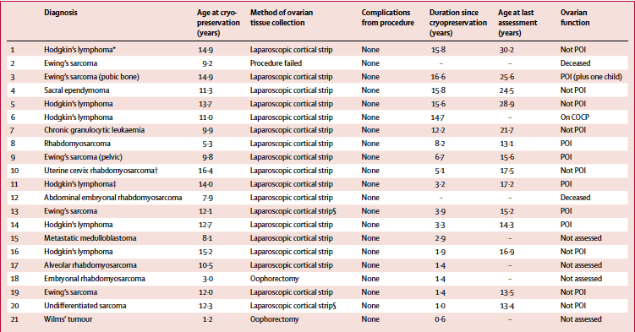
The cumulative probability of developing premature ovarian insufficiency after treatment was completed was significantly higher for patients who met the criteria for ovarian tissue cryopreservation (p<0·0001)
Wallace WHB et al 2014

Slide 40
Ovarian tissue cryopreservation
First author, year | N° | Assessment | Menstrual status or age | Characteristics (study group) | Characteristics (pts with ov metastasis) | Oncological therapy: Study group | Ov metastasis
Histology or PCR (OTC pts)
Azem et al. (2010) | 13 | Histology/Histochemistry Fresh ovarian tissue | Premenopausal | OTC pts | - | No CT or RT | 0%
Rosendahl et al. (2011) | 51 | Histology/immunohistochemistry Cryopreserved and thawed ovarian tissue | Premenopausal | OTC pts Median tumour size 18 mm (5–75) N1: 44% | - | NR | 0%
Sanchez-Serrano et al. (2009) | 69 | Histology/immunohistochemistry Fresh ovarian tissue n = 63; Cryopreserved and thawed tissue n = 6 | Premenopausal | OTC pts Excl: BRCA1/2 or HER2neu mutation, ER+: 76.2%; PR+:69.7% N0: 49.2%; N1: 50.8% | - | 17% received CT before OTC | 0%
Xenotransplantation
Rosendahl et al. (2011) | 9 | Xenotransplantation of cryopreserved and thawed ovarian cortex into immunodeficient nude mice. Histology 4 weeks after xenotransplantation | Premenopausal | OTC pts | - | NR | 0%
Clinical studies
Lecca et al. (1980) | 15 | Histology after therapeutic oophorectomy | Premenopausal | NR | NR | Radical mastectomy RT, CT, HT | 46.7%
Lee et al. (2010) | 406 | Clinical follow-up (mean 74 ± 48.19 months) | ≤35 | Patients with IDC (Otherwise NR for subgroup) | NR | NR for subgroup | IDC: 0–0.2%
Autopsy
Bumpers et al. (1993) | 15 | Autopsy; evaluation of medical records | <50 | Died of disseminated ILC | NR | NR | 46.7% (7/15)
Kyono et al. (2010) | 648 | Autopsy | <41 | NR | NR | NR | 24.2%
Bastings L, Hum Reprod Up 2014

Slide 41
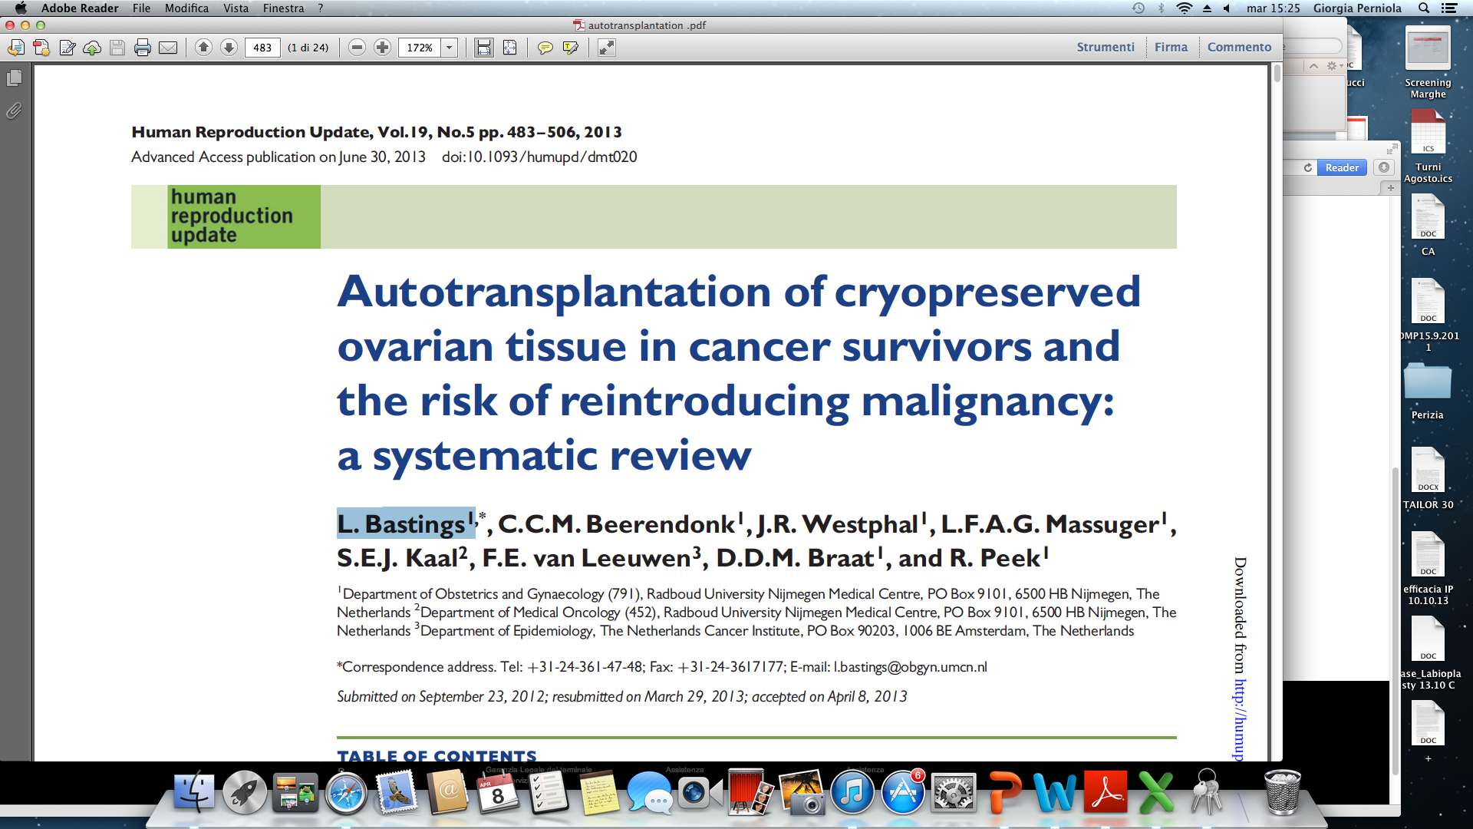
1 local recurrence
In some cases metastatic lesions on ovarian tissue transplanted were found
  In studies with bigger series it was safe
  In autopsies metastatic tumors were found mainly in advanced breast cancer
  Not available data on BRCA mutations
Current knowledge regarding the safety of autotransplantation in BC survivors should be discussed.
Bastings L, Hum Reprod Up 2014
Notes:
Two clinical studies indicated ovarian metastases in breast cancer
patients, although the study with the largest population reported a
very low percentage. However, results from autopsy studies suggested
that ovarian metastases are fairly common in advanced breast cancer.
As no explicit information on BRCA testing was reported in the clinical
and autopsy studies, it remains unclear whether BRCA patients were
part of the studies.

Slide 42
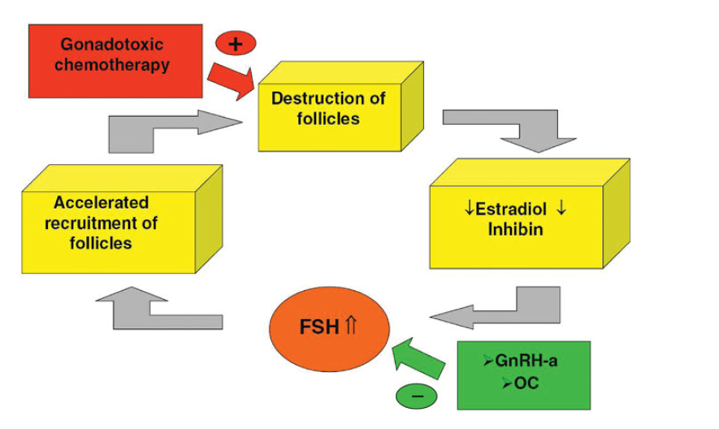
Rationale for using GnRH-a
Possible mechanisms of action
interruption of FSH
a decrease in utero-ovarian perfusion,
the activation of GnRH receptors on the oocytes,
the up-regulation of intragonadal–antiapoptotic molecules
the protection of undifferentiated germ-line stem cells
Del Mastro L et al Canc Tr Rev 2014
Notes:
The chemotherapy-induced gonadotoxicity consist on the cytotoxic effect with destruction of follicles determining lower estrogen levels resulting in an accelerated recruitment of follicles , due to FSH stimulation, thus inducing dramatic destruction of ovarian reserve.

Slide 43

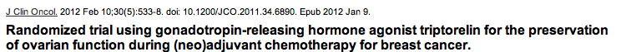
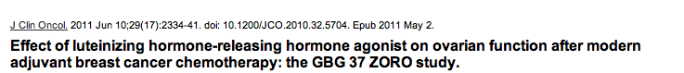
GNRH-A…… CONTRO
Munster PN JCO 2012
BIAS
Age of patients
Inappropriate evaluation of ovarian reserve
The definition of “resumed menses” is different from that reported from the rest of international literature
After chemotherapy amenorrhea rates are different from others riported by international literature
Gerber B 2011
Notes:
GNRHa coul stop this accelerated follicular recruitment, however, data about its efficacy are controversial. Two rtecent stuidies reported no benefits

Slide 44

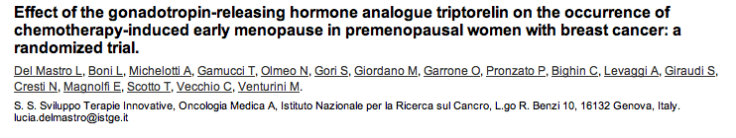
GNRH-A…… PRO
Randomized phase III trial
281 pts
Stage I-III
Rate of POF
25.9% in the chemotherapy-alone group
8.9% in the chemotherapy plus triptorelin group
(absolute difference of −17% (95% CI, −26% to −7.9%; P.001).
Del Mastro L et al JAMA 2011

Slide 45
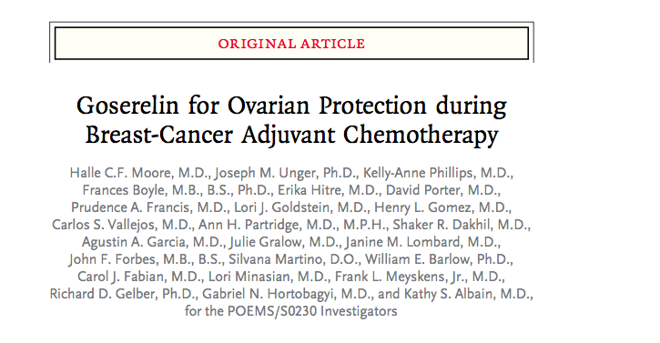
GNRH-A…… PRO
The administration of goserelin with chemotherapy appeared to protect against ovarian failure, reducing the risk of early menopause and improving prospects for fertility.
Moore HCF et al NEJM 2015

Slide 46

Pregnancy outcomes
Moore HCF et al NEJM 2015

Slide 47

Survival
Moore HCF et al NEJM 2015
Notes:
Moreover Moore et al suggested also an effect on survival determined by the use of goserelin during chemotherapy

Slide 48


Pooled analysis of randomized studies shows that the temporary ovarian suppression induced by GnRHa significantly reduces the risk of chemotherapy-induced POF in young cancer patients.
Notes:
Even if this metaìanalysis published by del Mastro Shows that temporary ovarian suppression reduces the risk of chemotherapy-induced POF

Slide 49




The undefined role of GnRHa
Concurrent administration of GnRH agonists during chemotherapy treatment of breast cancer in premenopausal women appears to protect against chemotherapy-related POF in the first year after treatment, but appears to have no effect on resumed menses or spontaneous pregnancy rates.
No significant difference in pregnancy rates was seen
Notes:
However, in clinical practice, the use of these agents remain undefined.

Slide 50

Gonadotropin-Releasing Hormone Agonists for Ovarian
Function Preservation in Premenopausal Women
Undergoing Chemotherapy for Early-Stage Breast Cancer
A Systematic Review and Meta-analysis
1047 randomized patients from 7 studies
Higher number of pregnancies (OR, 1.85; 95% CI, 1.02-3.36; P = .04)
Munhoz RR et al., JAMA 2016

Slide 51



Discuss temporary interruption of endocrine treatment
A single-arm, phase II trial evaluating the pregnancy outcomes and safety of interrupting endocrine therapy for young women with endocrine responsive breast cancer who desire pregnancy.
Pregnancy Outcome and Safety of Interrupting Therapy for women with endocrine responsIVE breast cancer (POSITIVE).
Study chair: Olivia Pagani (IBCSG/IOSI)
IBCSG

Slide 52
POSITIVE study: eligibility criteria and schema
ER+ early breast cancer
<43 years at enrolment
Completing 18-30 months of ET
(SERMs alone, LH-RH analogue + SERM or AIs)
Pregnancy desire
Treatment interruption
3 months’ wash out
2 years’ break to allow:
conception, delivery ± breast feeding or pregnancy failure
Resume ET to 5-10 years according to individual risk, institutional policy and patient’s preference
IBCSG

Slide 53
POSITIVE study: endpoints
Primary:
  Breast cancer free interval (BCFI) defined as the time from enrollment in the phase II trial to BC relapse. BC relapse will be the primary measure of safety being evaluated
Secondary:
  Pregnancy outcome (i.e. full term pregnancy, abortion, miscarriage, ectopic, stillbirth rates, caesarean section)
  Offspring outcome (i.e. preterm birth, low birth weight, births defects rates)
IBCSG

Slide 54
POSITIVE study: correlative studies
IBCSG

Slide 55
Take Home message…
Pregnancy after breast cancer is feasible and scientific evidence showed a protective role
Fertility preservation during chemotherapy is possible
The most effective tests for ovarian reserve are: the antral follicle count (AFC), the measurment of ovarian volume and levels of Inhibin, E2 and AMH
Standard strategies are: embrio and oocytes cryopreservation
The use of GnRHa seems to be effective to avoid chemotherapy induced menopause
Ovarian tissue cryopreservation is an experimental procedure
Couselling about this topic is mandatory

Slide 56


Pictures from “The scar project”

