Slide 1

THBT neoadjuvant endocrine therapy is to be used in post-menopausal breast cancer woman
Antonino Grassadonia
Università «G. D’Annunzio» – Chieti-Pescara

Slide 2
Neoadjuvant Systemic Therapy of Primary BC
For all patients with locally advanced breast cancer
Not operable. Surgical approach is unlikely to be
successful in removing all existing disease
Operable, but require a mastectomy rather than
breast-conserving surgery to achieve ideal surgical
margins

Slide 3
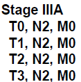
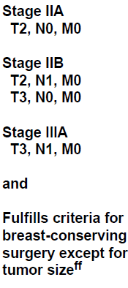
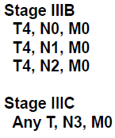

Slide 4
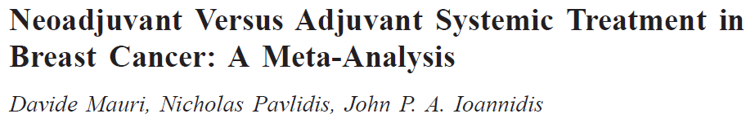
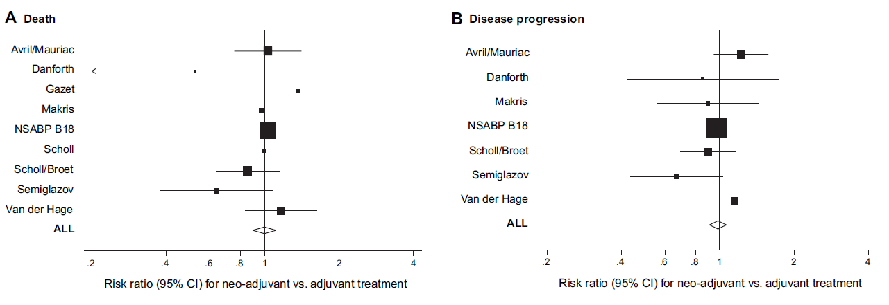
J Natl Cancer Inst 2005;97:188–94
Neoadjuvant vs adjuvant systemic therapy: similar long-term outcomes
At the current time, no randomized studies have been performed to demonstrate
the equivalence of neoadjuvant endocrine therapy with adjuvant endocrine therapy
Candidate Selections as in Adjuvant Therapy - Avoid Over-treatment

Slide 5
What is the best neoadjunt therapy for HR+/HER2- breast cancer ?
Issues to be considered:
Magnitude of benefit from the addition of chemotherapy to endocrine
therapy in the adjuvant setting
- Neoadjuvant Chemo vs endocrine therapy: OR and BCS rates
- Rates of pCR obtained by chemotherapy
- Prognostic implications of pCR
If the choice is endocrine therapy: Which agent? How long?
Data from clinical studies on:
- AI vs tamoxifen
- Optimal duration

Slide 6
The Oxford meta-analysis
The Early Breast Cancer Trials Collaborative Group (EBCTCG), with its Data Management and Analysis Center in Oxford, England, has conducted meta-analyses of a variety of therapies, producing information that is not available from individual trials. This process has become known as the Oxford Overview.
Trials of chemotherapy vs no adjuvant chemotherapy
Trials of Tamoxifen vs no adjuvant therapy

Slide 7
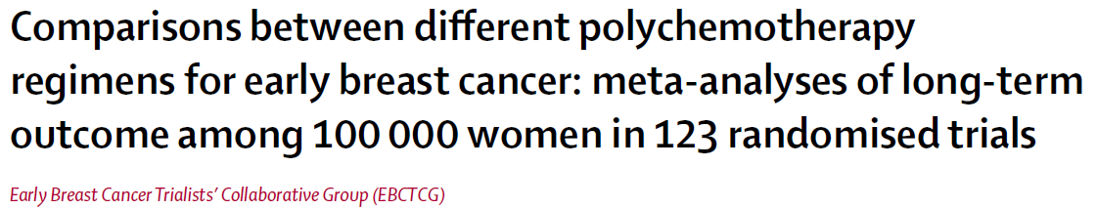
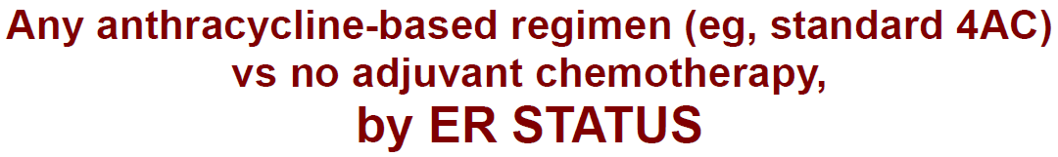
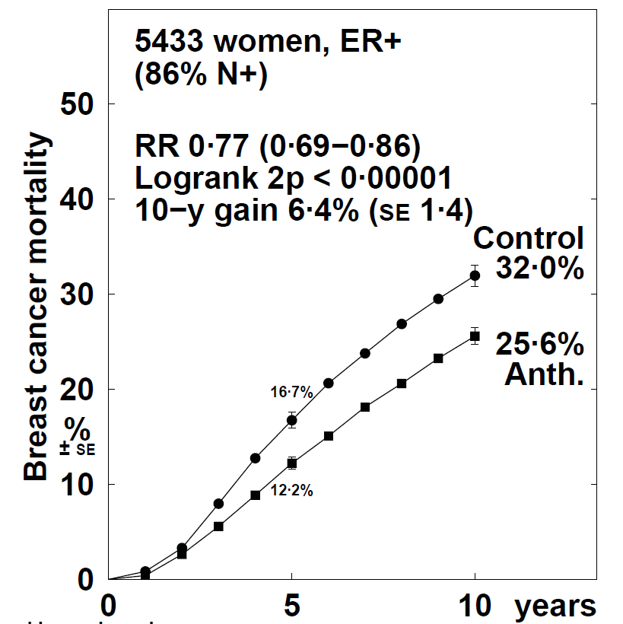
Lancet 2012; 379:432-44

Slide 8
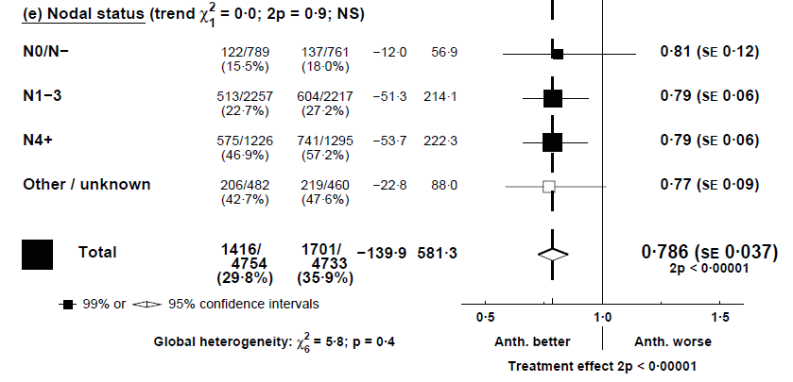
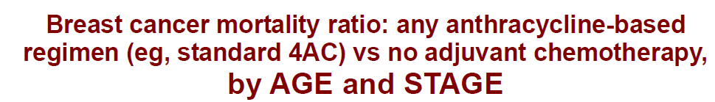
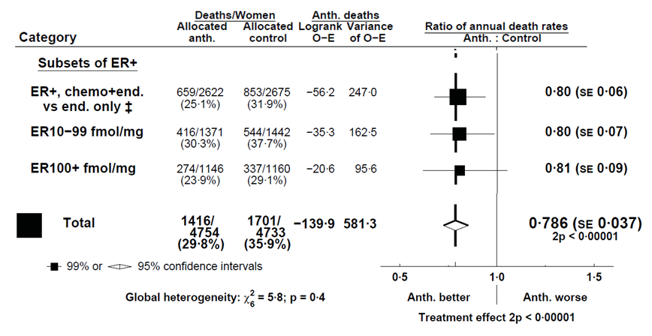
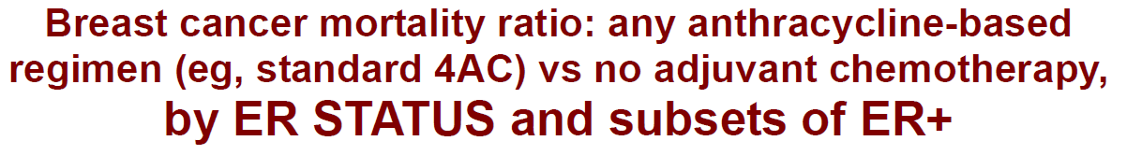
Lancet 2012; 379:432-44

Slide 9
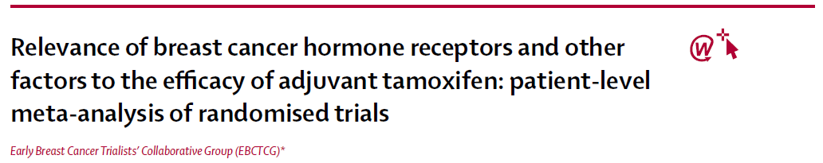
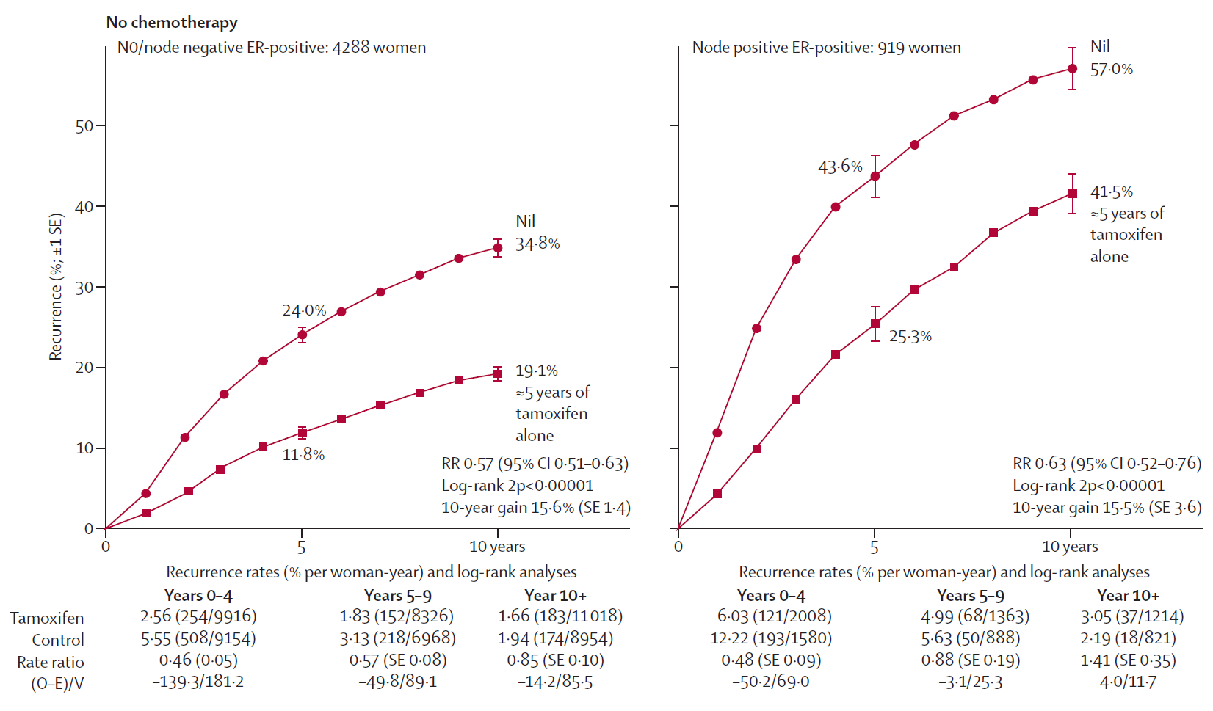
Lancet 2011; 378:771-84

Slide 10
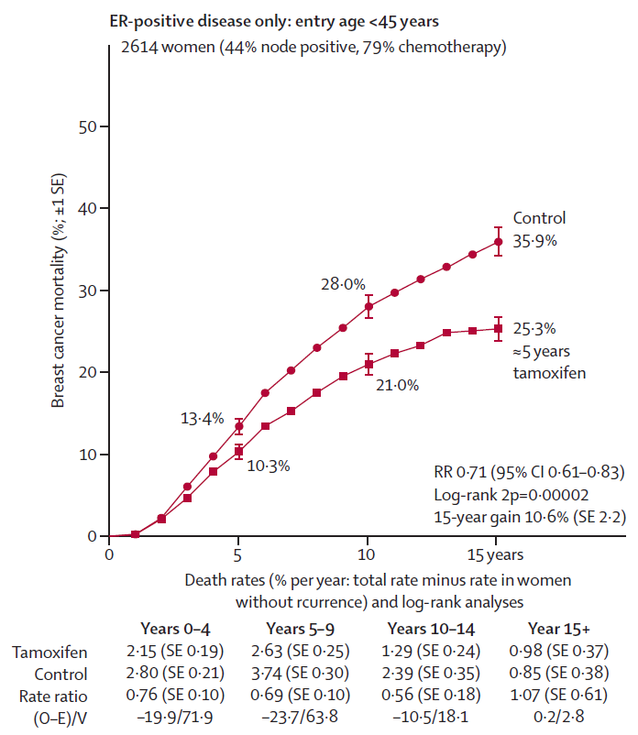
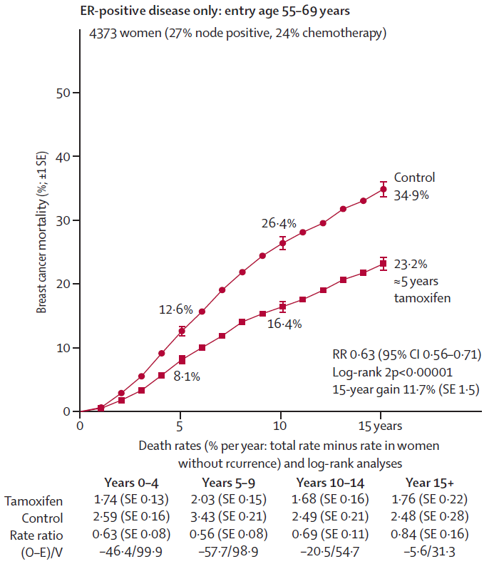
Lancet 2011; 378:771-84

Slide 11
Oxford meta-analysis:
postmenopausal women with HR+ disease
Polychemotherapy vs nil OS benefit 3–4%
Tamoxifen vs nil OS benefit 10%

Slide 12
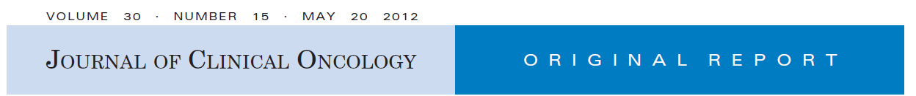
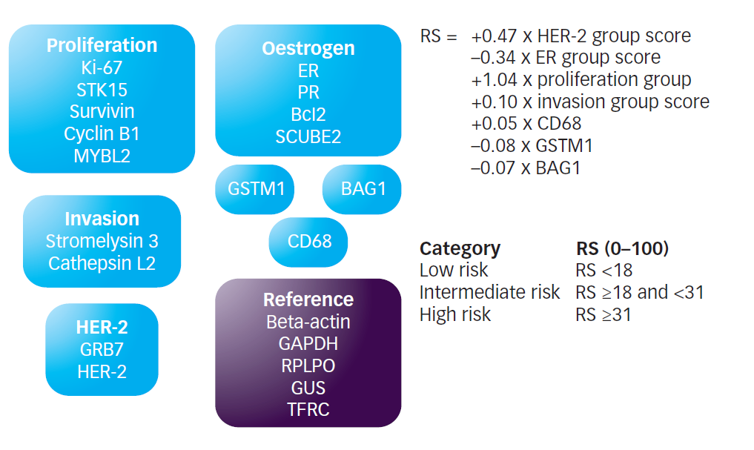
VOLUME 26 - NUMBER 5 - FEB 10 2008
Development of the 21-Gene Assay and Its Application in Clinical Practice and Clinical Trials
RS = Recurrence Score

Slide 13
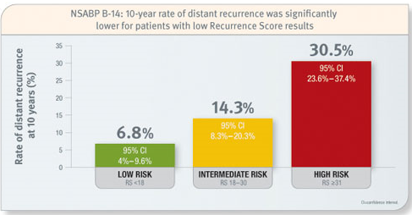
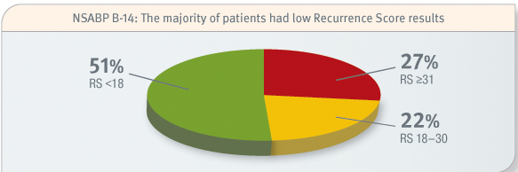
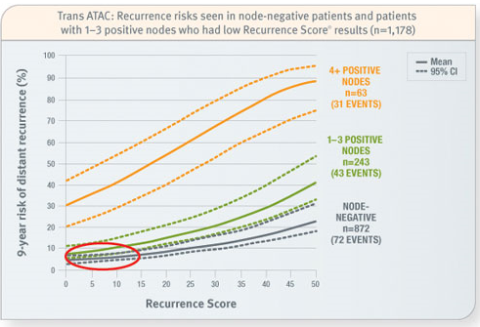
Oncotype Dx score and risk of distant recurrence

Slide 14
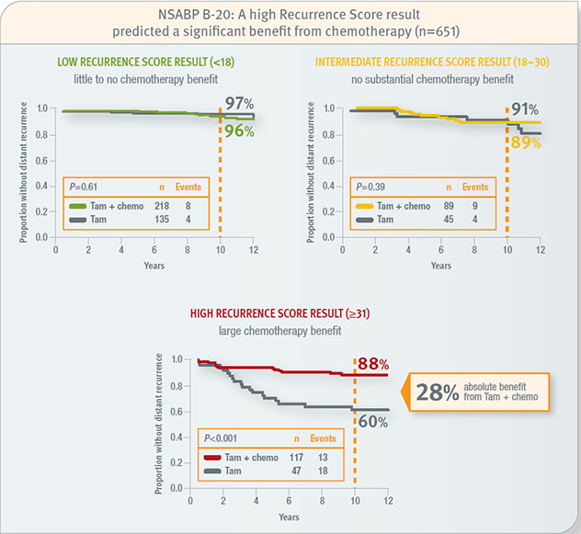
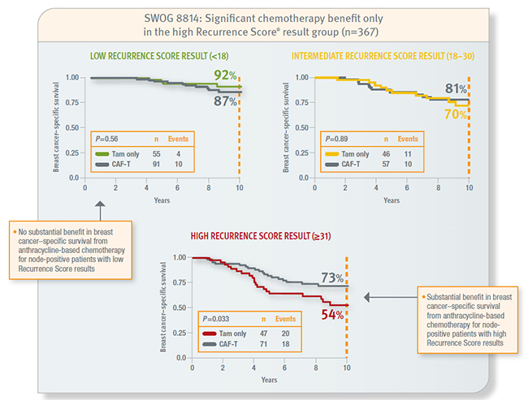
Oncotype Dx score and benefit from chemotherapy
pN0
pN1
Chemotherapy benefit only in high recurrence score group

Slide 15
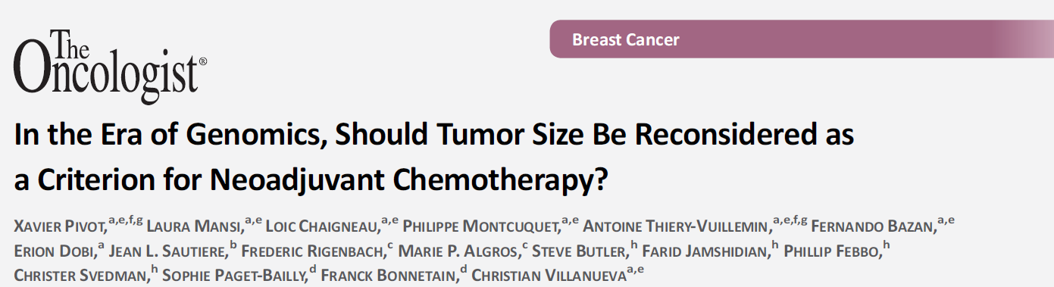


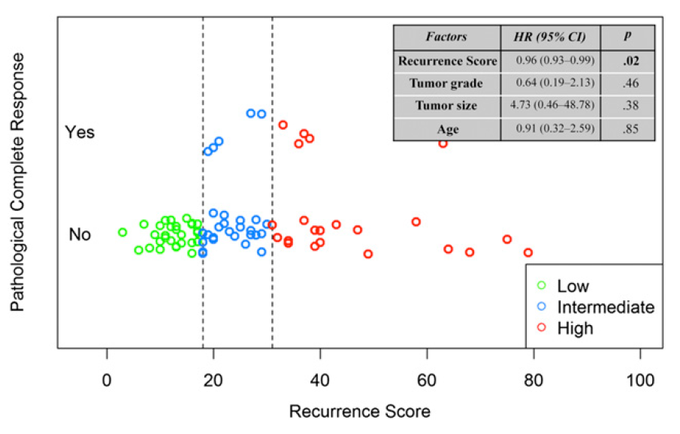
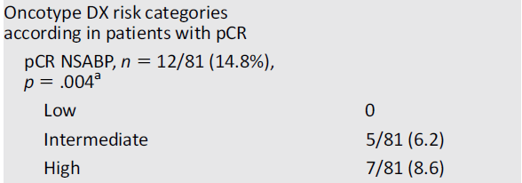
Retrospective study (81 patients).
Recurrence score assessed in pretreatment biopsies.

Slide 16
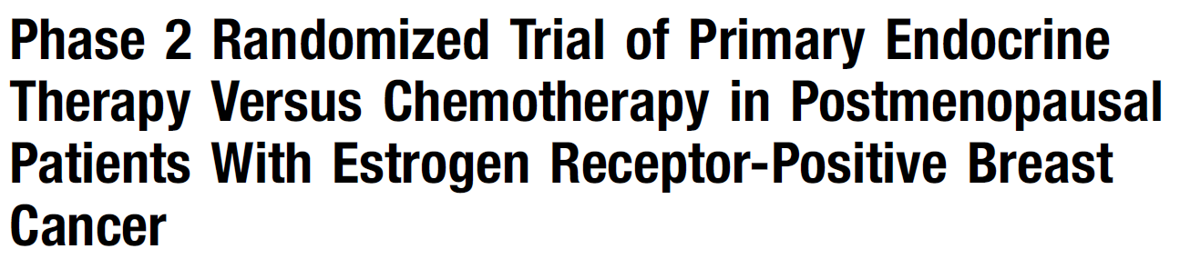


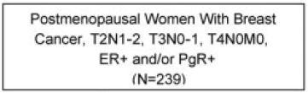
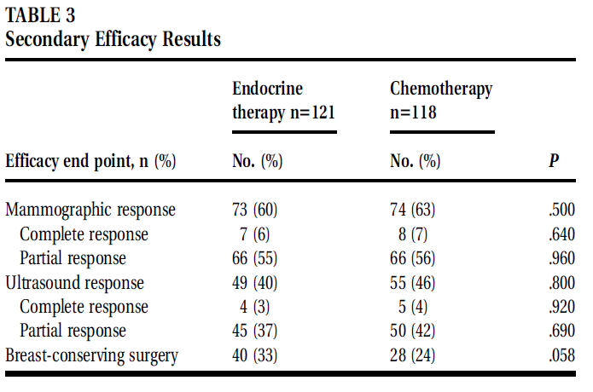
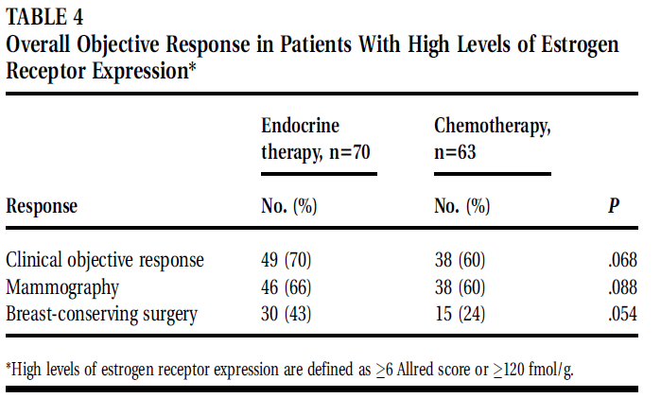
239 patients:
121 HT (61 ANA; 60 EXE) for 3 months
118 4 Anthracyclin → 12 PTX w
OR: HT 61% (4 pCR)
Chemo 63% (7 pCR)
p > 0.5

Slide 17
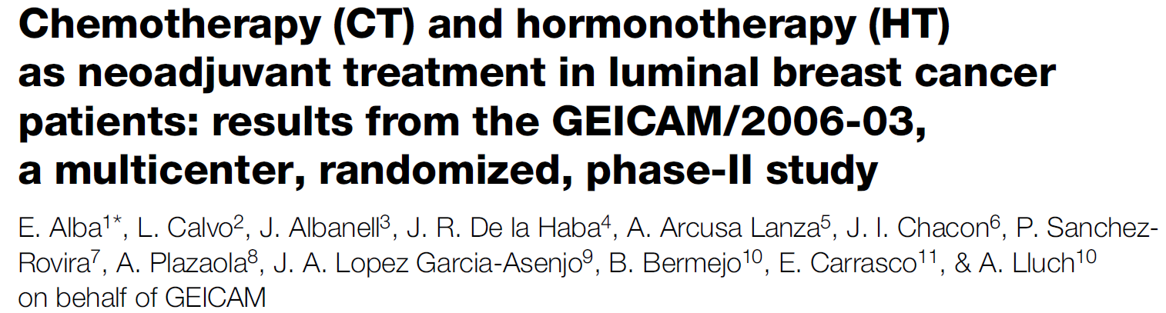
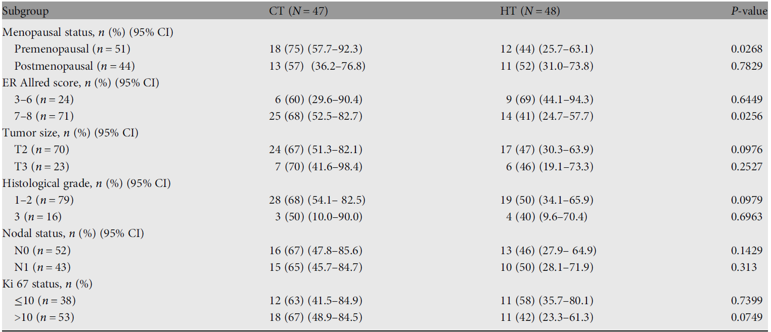
97 patients: 47 exemestane for 6 months
48 4 EC → 4 DTX
OR: exemestane 48% (no pCR)
chemo 66% (1 pCR)
p = 0.075

Slide 18
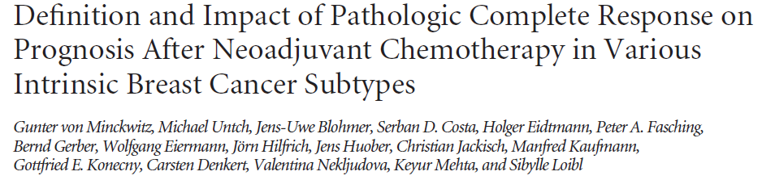
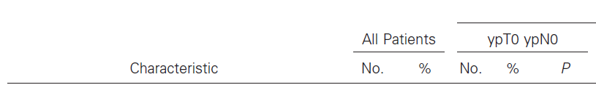
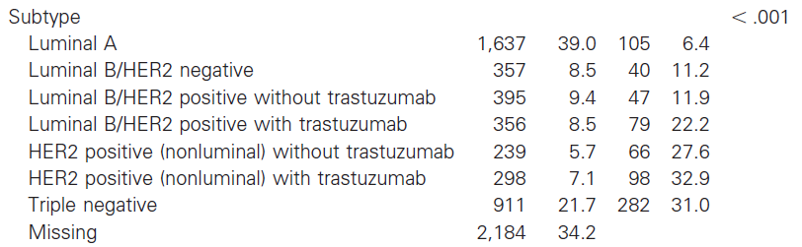

Slide 19
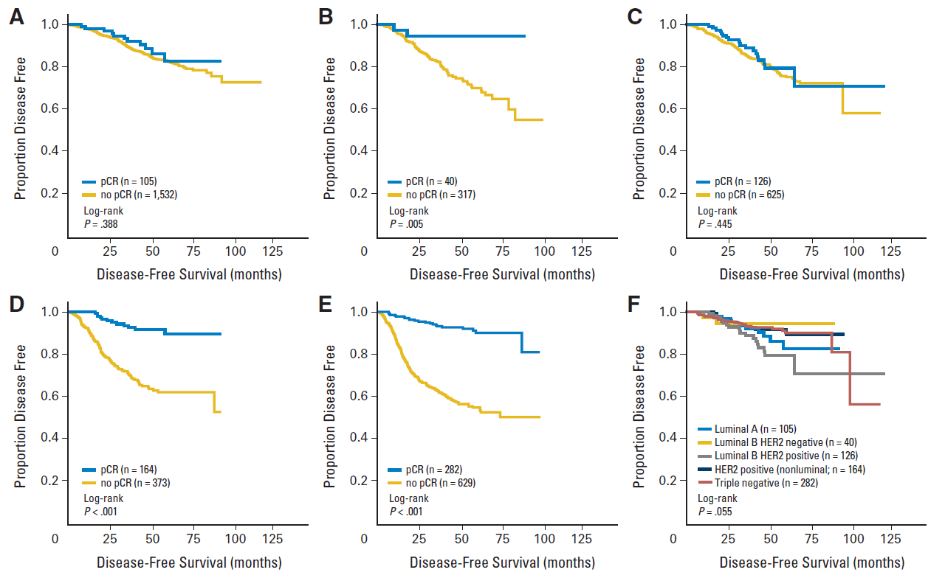
luminal A
luminal B/HER2-
luminal B/HER2+
HER2-positive
Triple negative
DFS in patients with pCR

Slide 20
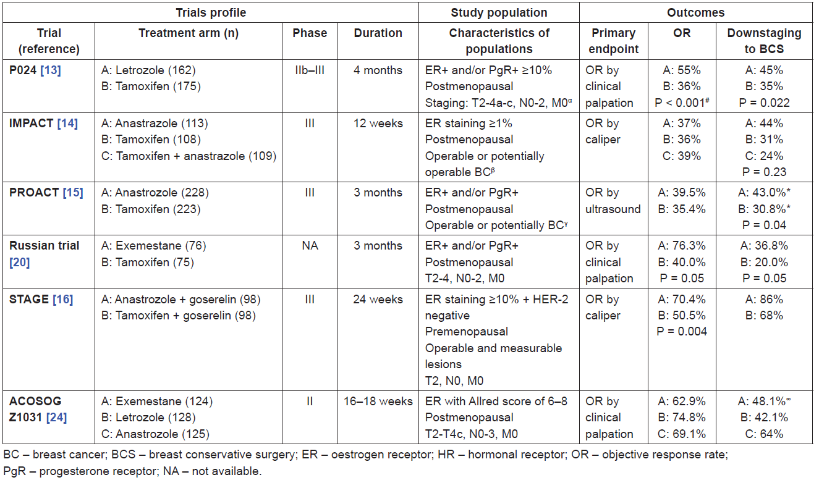
Randomised clinical trials comparing different endocrine agents in the neoadjuvant setting
AI better than TAM

Slide 21
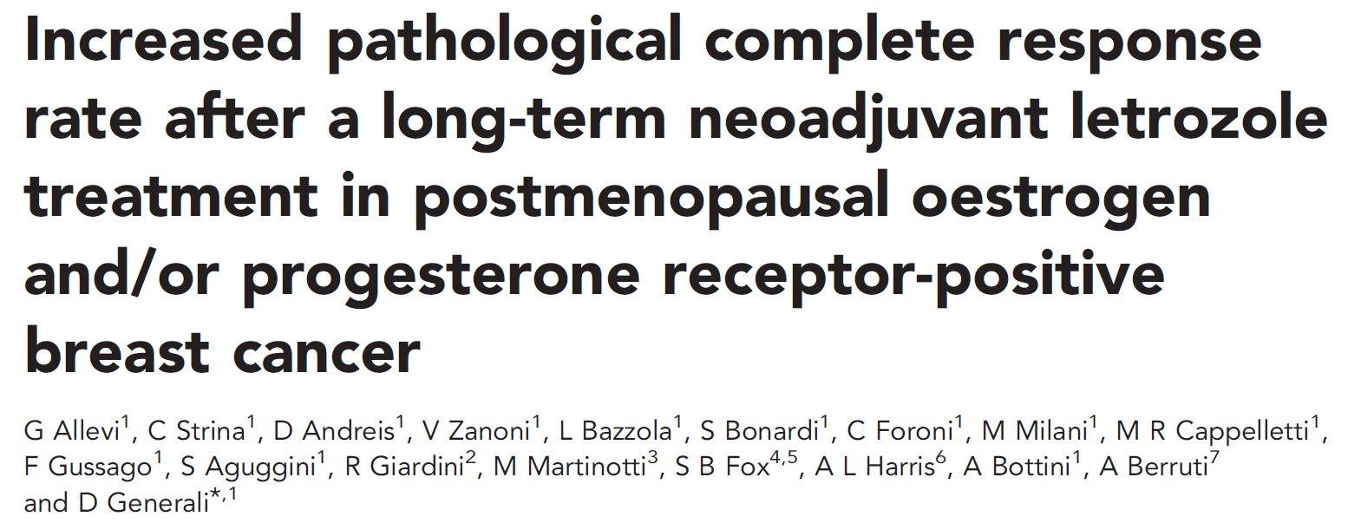

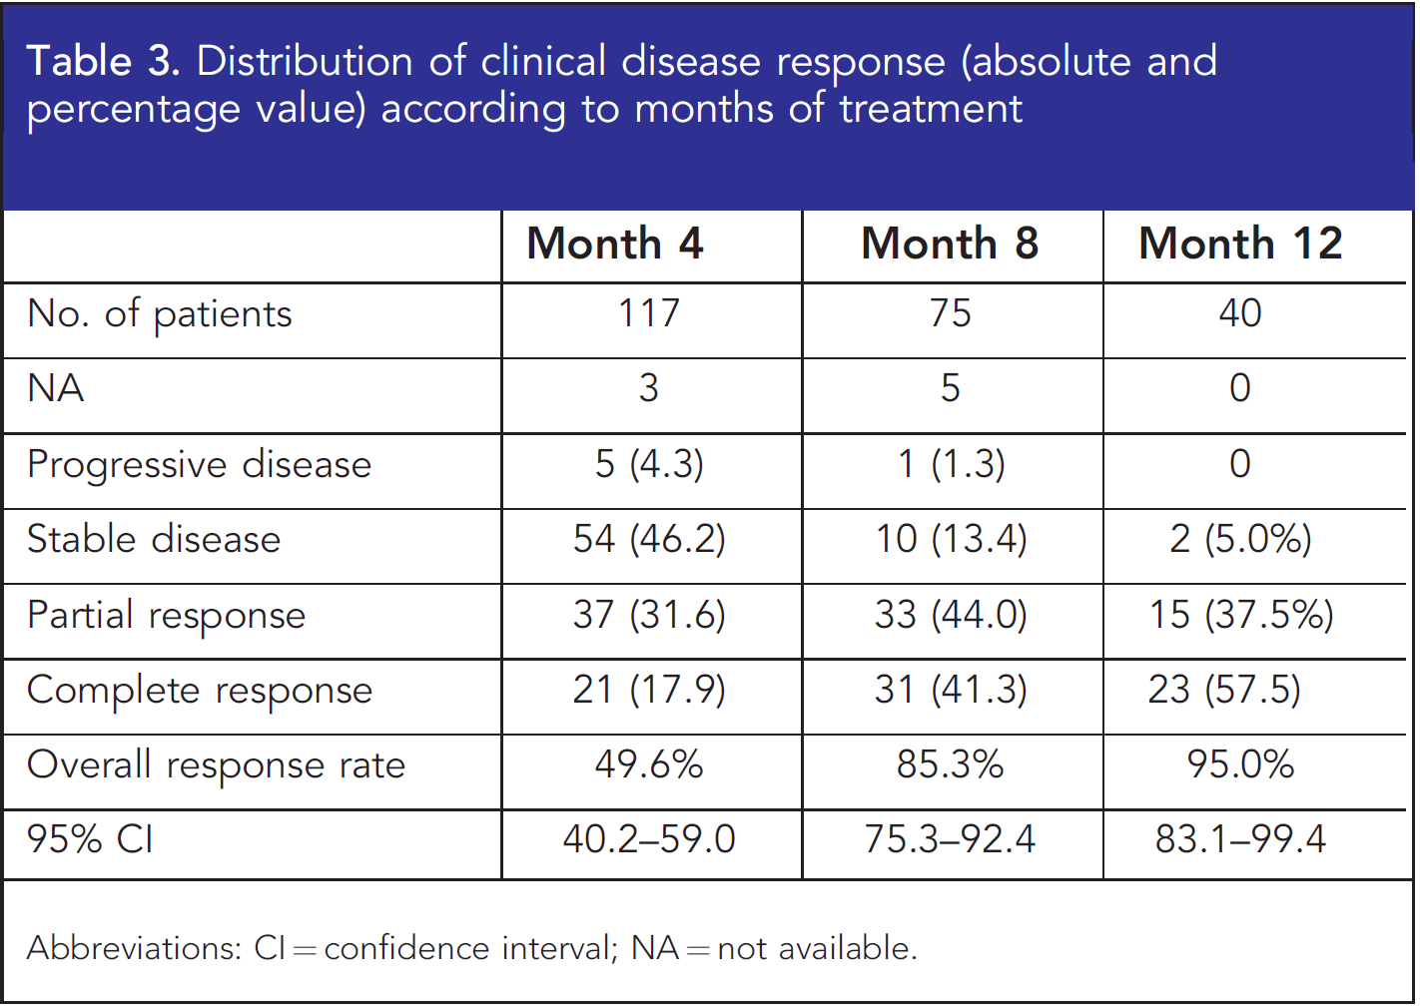

Slide 22
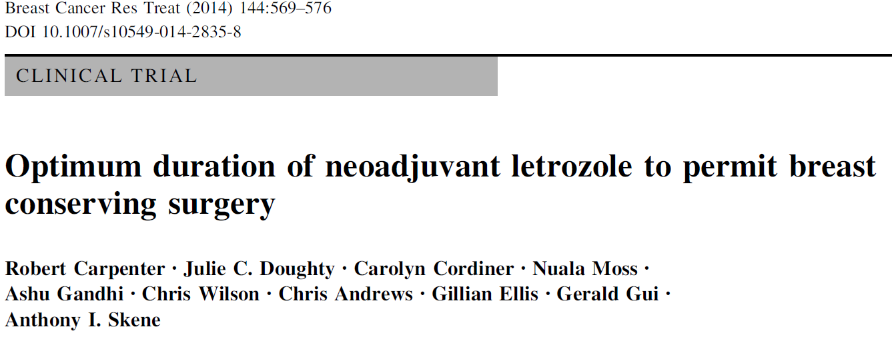
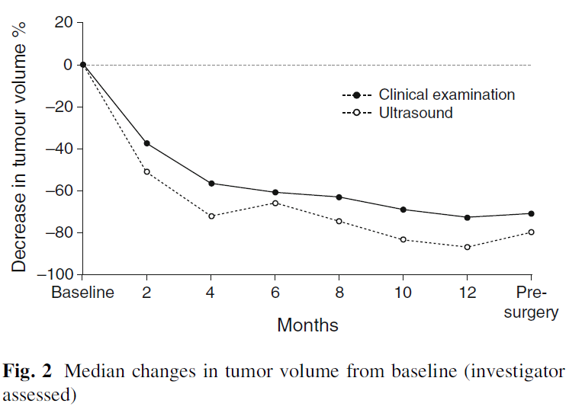
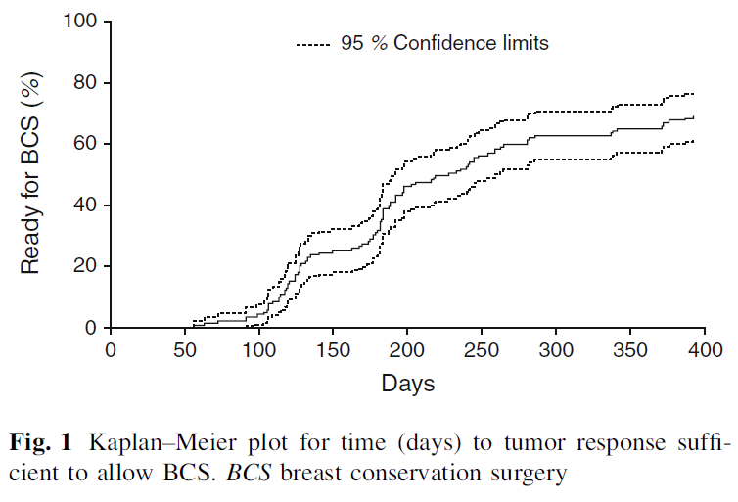
139 patients treated with
letrozolo until eligible for BCS
Extended letrozole more than 4 months (7.5 months) is optimal to achieve maximum reduction in tumor volume sufficient for BCS
Optimal duration 4-8 months

Slide 23
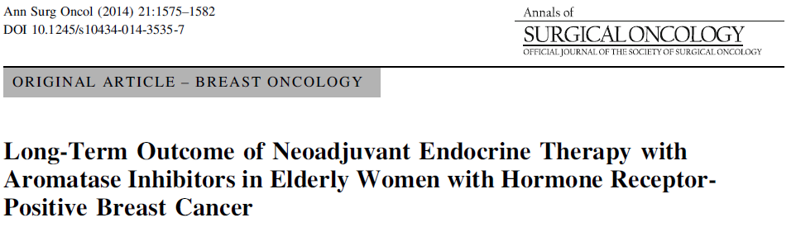
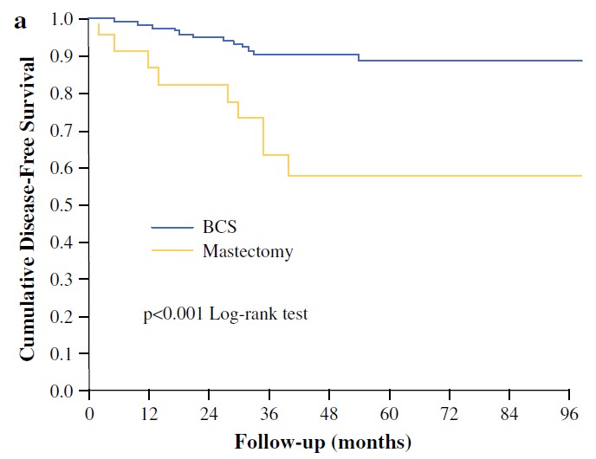
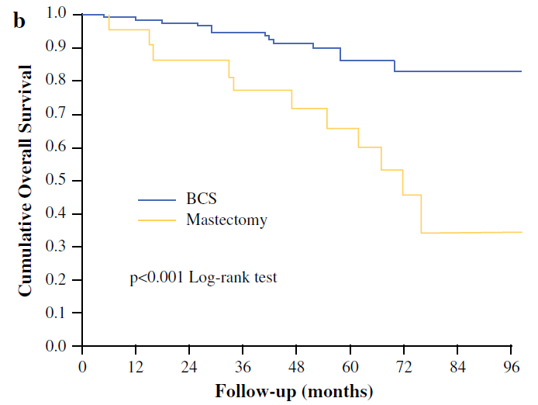
144 postmenopausal patients inoperable with BCS
Median duration of NET: 6 months (85% pts >5 months)
OR: 85%
BCS: 84%
pCR: 2 patients

Slide 24
What is the best neoadjunt therapy for HR+/HER2- breast cancer ?
Issues to be considered:
Marginal benefit from the addition of chemotherapy to endocrine
therapy in the adjuvant setting
- Neoadjuvant Chemo vs endocrine therapy: Comparable OR and BCS rates
- Low rates of pCR obtained by chemotherapy
- No prognostic implications of residual disease (no pCR)
If the choice is endocrine therapy: Which agent? How long?
Data from clinical studies :
- AI better than tamoxifen
- Optimal duration: 4-8 months

Slide 25
CONCLUSION
Neoadjuvant endocrine therapy in post-menopausal women with operable locally advanced breast cancer HR+/HER2- is…..
…recommended in
Luminal A, stage cT2-3, cN0
Comparable to chemotherapy for:
Cancer downstaging: OR and BCS
Long-term outcomes: DFS and OS
2 …to be considered in
Luminal A, stage cT2-3, cN1 (minimal N involvement)
Limited data
3 …NOT recommended in
Luminal B, any stage
Chemotherapy better than ET

Slide 26
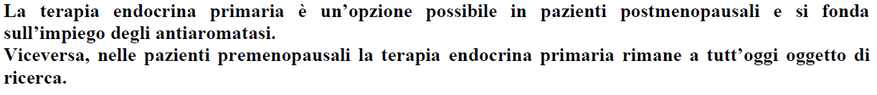
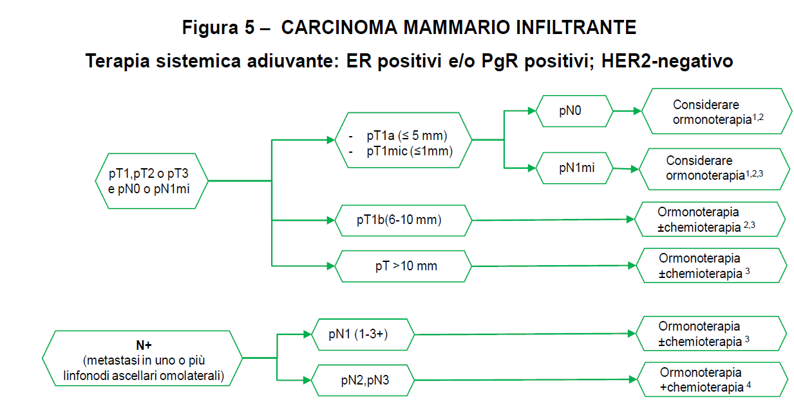

Slide 27
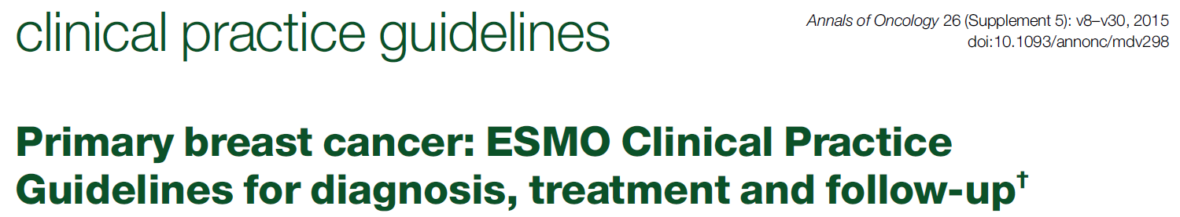
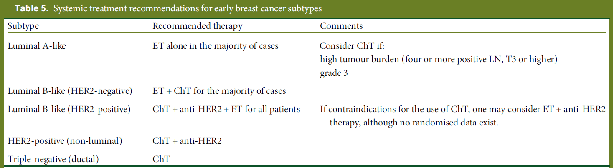
ER-positive, HER2-negative carcinomas, especially of the lobular subtype, are generally less responsive to primary chemotherapy than ER-negative and HER2-positive tumours, and may benefit more from primary ET.
In accordance with the 2013 and 2015 St Gallen guidelines

Slide 28

